Slide 1
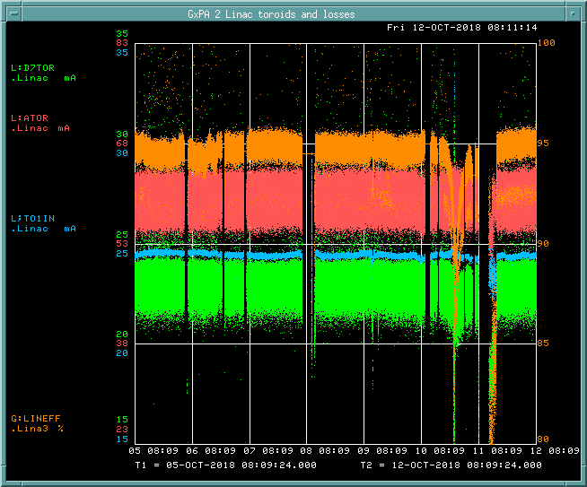
PREACC/LINAC Weekly Performance (October 05 – October 12, 2018)
ATOR: 60mA
TO1IN: 24.3 mA
D7TOR:22.8 mA
LINAC efficiency:
94%

Slide 2
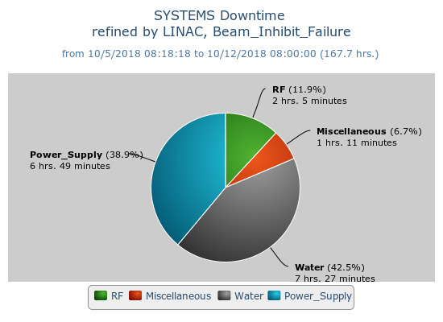
Beam inhibit downtime PREACC: (0 min)
LINAC: (17 hr 33 min)
Issues
LRF5 CPS (10/06) → Replaced it on 10/08
KRFV water regulation loop. (10/06) → Replaced a turbine on 10/08
HE Q64 regulation (10/11) → Replaced the pulser twice.
Request
Safety want to access to Linac by the end of this month.

