Slide 1
650 MHz Cryomodule Design and Transportation
Vincent Roger
9th November 2018

Slide 2
Layout
Design strategy
Description of the cryomodule
Transportation analysis
Assembly process
Instrumentation
Conclusion

Slide 3
1. Design strategy
To decrease the design effort and the cost of the project, our idea was to design all the cryomodules with the same design concept: the strong-back, and then to have one configuration for the single spoke cryomodules, and one for the elliptical cryomodules.
SSR1 & SSR2 Cryomodules
LB650 & HB650 Cryomodules
  Similar cavity design
  Similar tuner
  Same coupler
  Similar configuration:
  SSR1: C-S-C-C-S-C-C-S-C-C-S-C SSR2: S-C-C-S-C-C-S-C
  Similar solenoid
  Similar BPM
  Similar current leads
  Same cryogenic layout
  Similar cavity design
  Similar tuner
  Same coupler
  Similar configuration
    LB650: C-C-C
    HB650: C-C-C-C-C-C
  Same cryogenic layout

Slide 4
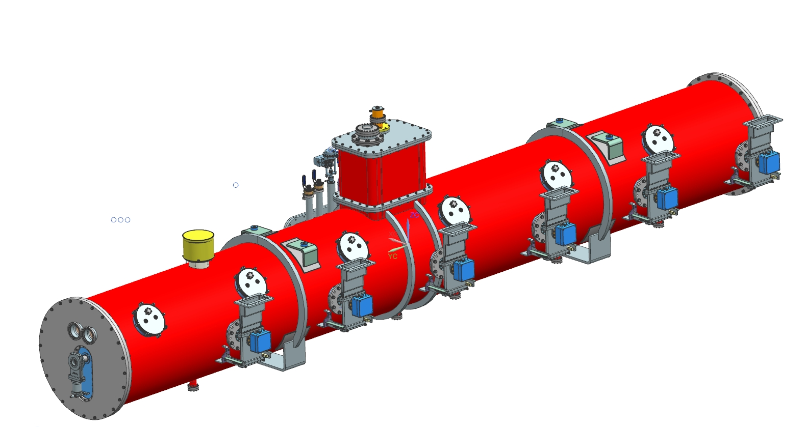
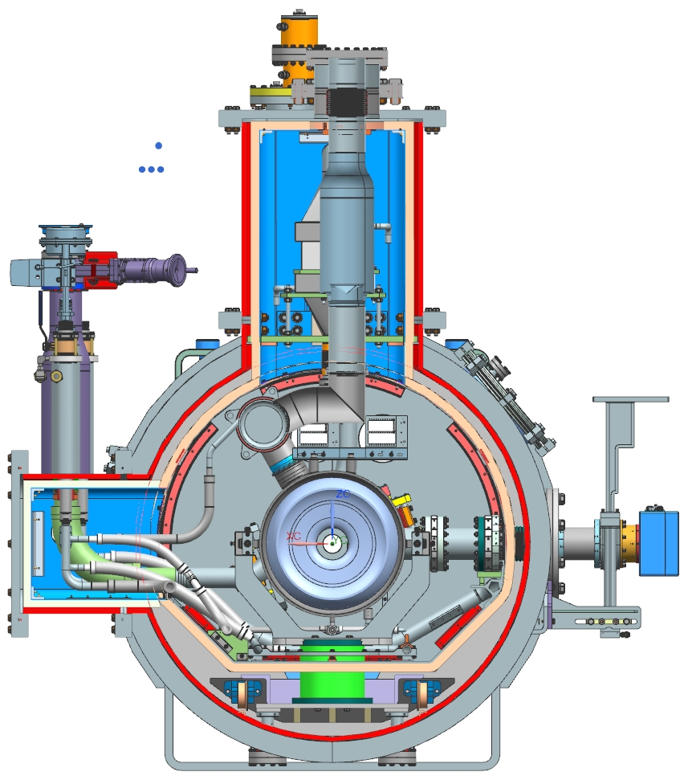
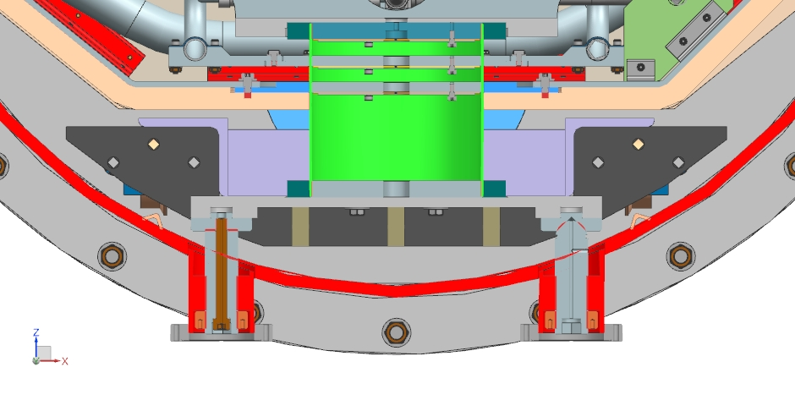
1. Design strategy
All cryomodules are based on a strong-back at room temperature. The strong-back is connected and secured with screws to the vacuum vessel (12 posts for the HB650 Cryomodule).

Slide 5
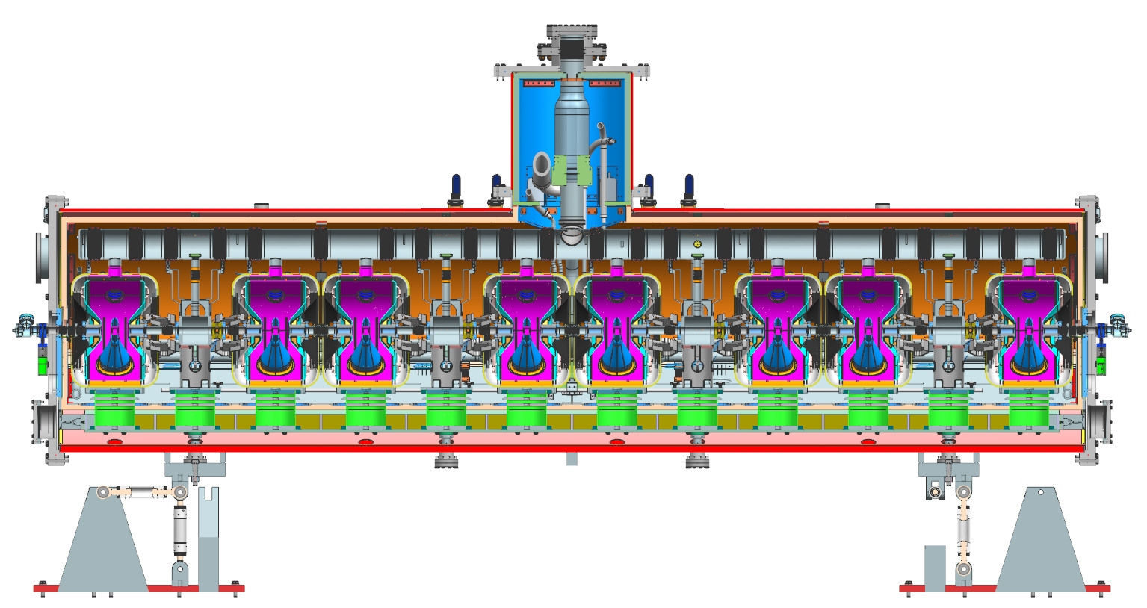
1. Design strategy
1.1 SSR configuration
SSR configuration - One support post per cavity and per solenoid

Slide 6
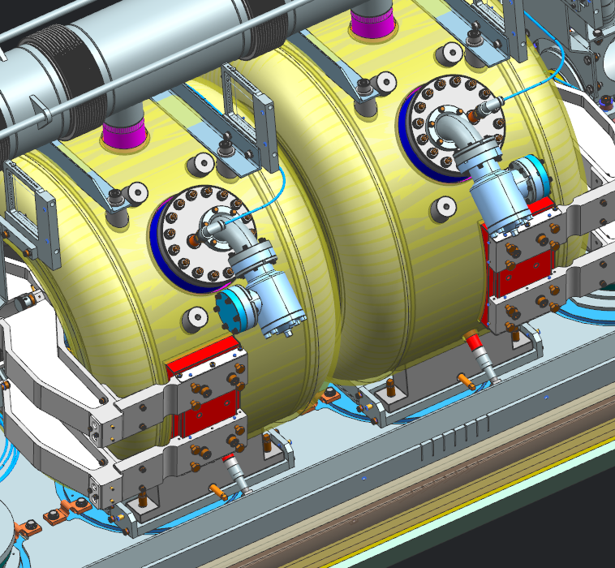
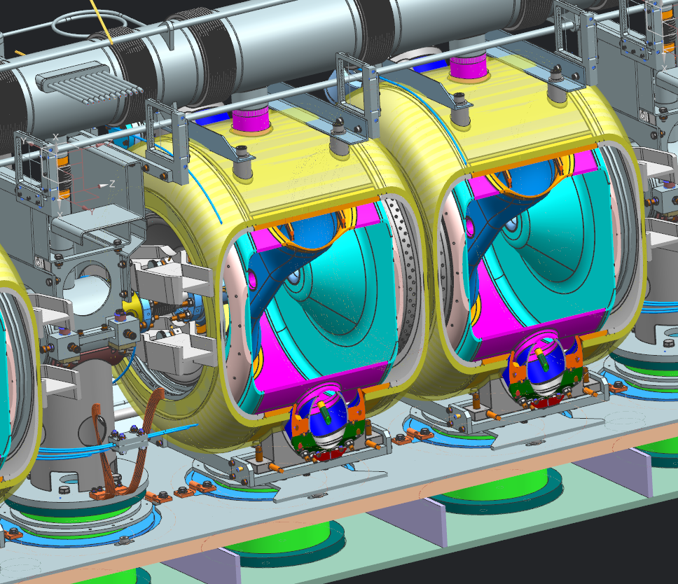
1. Design strategy
1.1 SSR configuration
With several sets of screws, we control the location of each cavity. Then each cavity are secured with nuts.

Slide 7
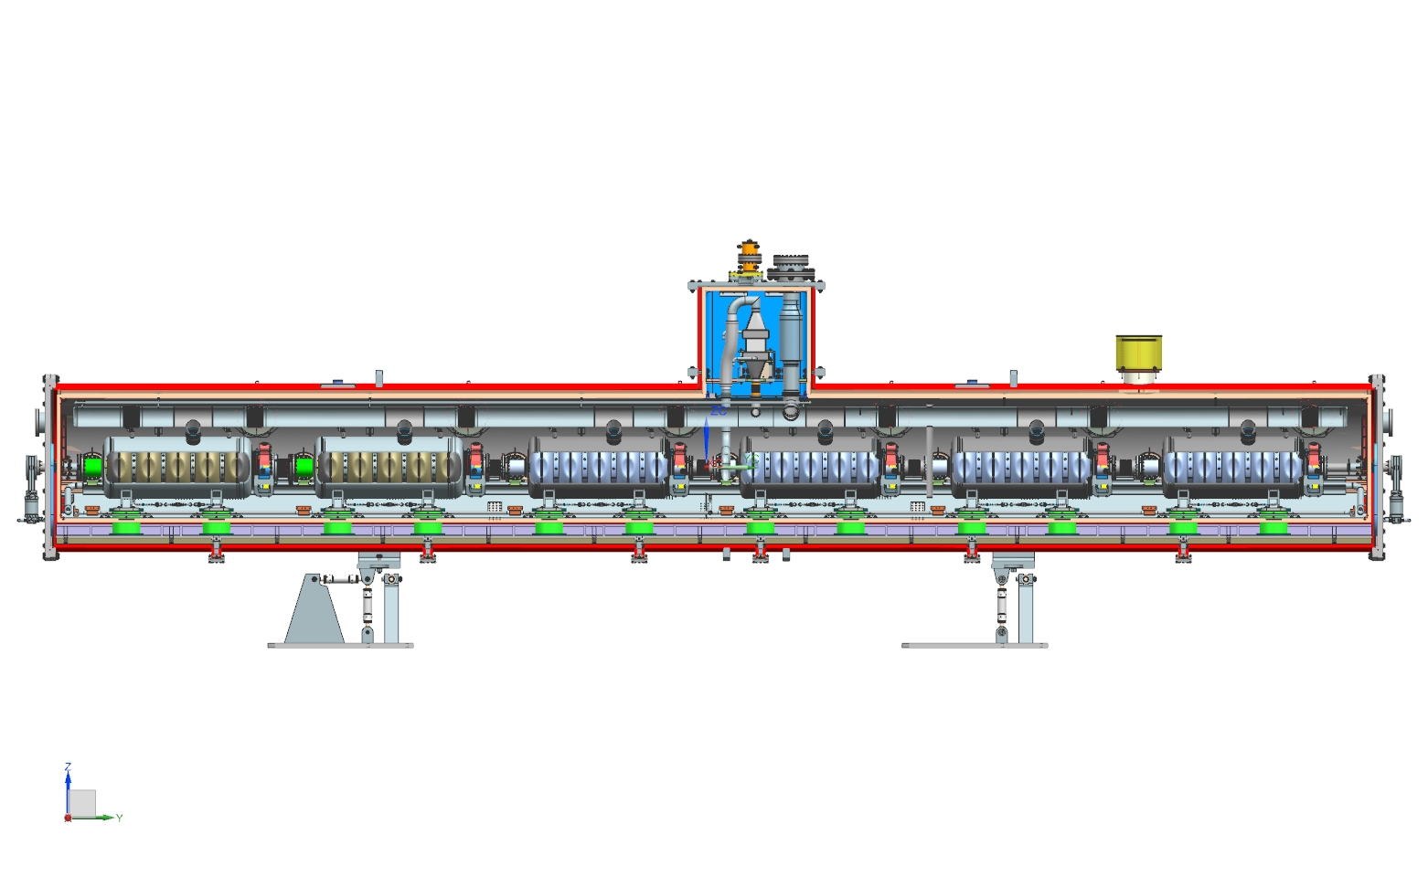
1. Design strategy
1.2 650 configuration
650 configuration - Two support posts per cavity

Slide 8
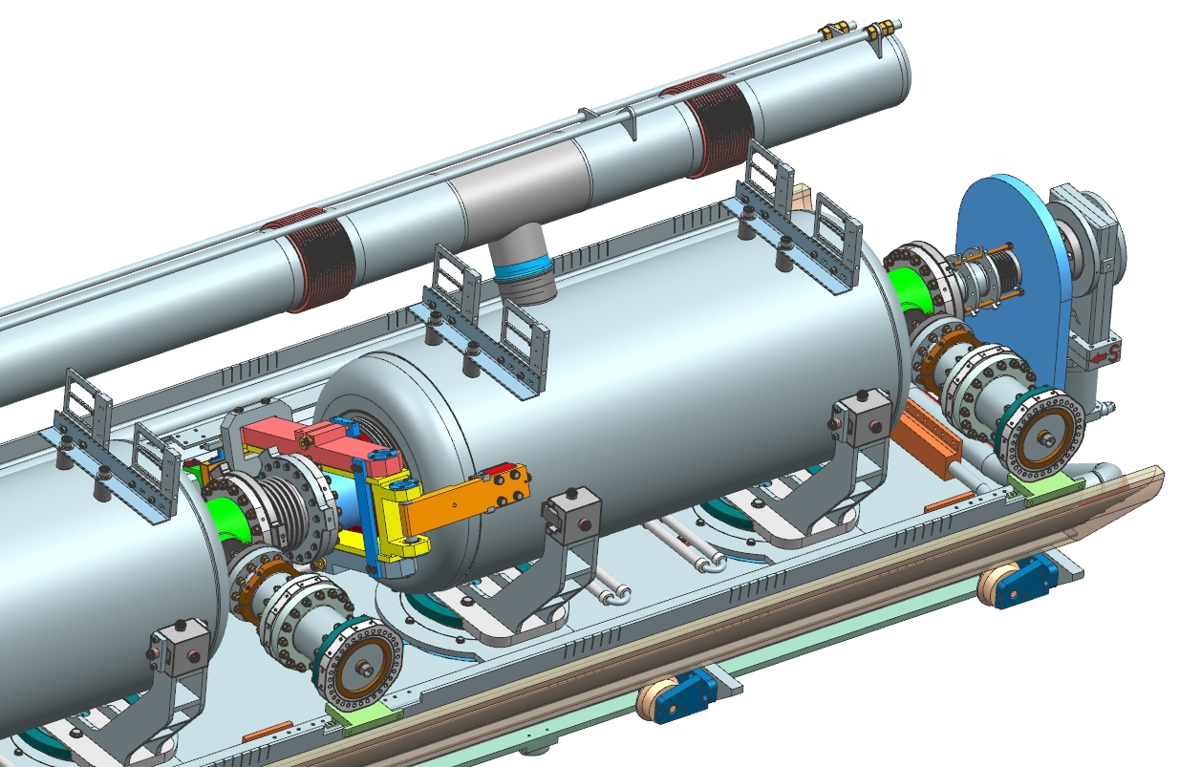
1. Design strategy
1.2 650 configuration
4 Lugs are welded on each cavity as LCLS II cavities. But, there is no invar rod inside the coldmass, the alignment is exclusively done using the C clamps. With several sets of screws and springs, we control the location of each cavity.

Slide 9
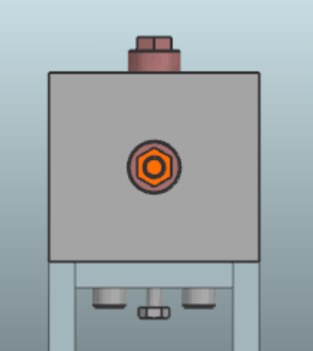
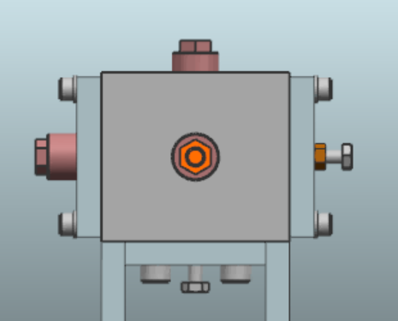
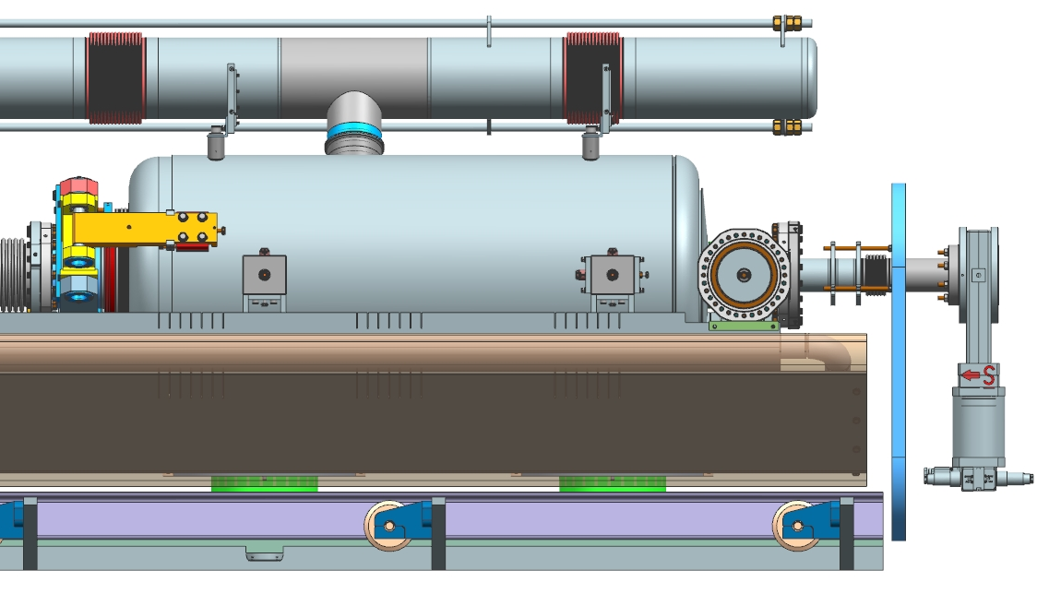
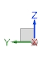
1. Design strategy
1.2 650 configuration

Slide 10
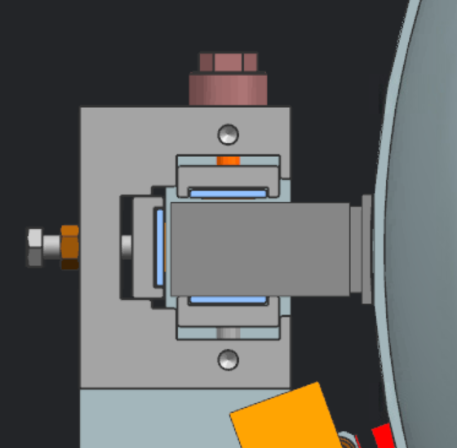
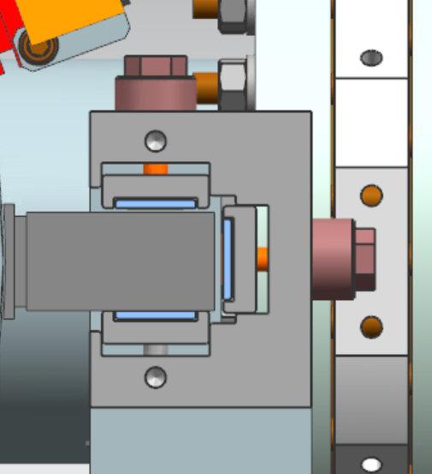
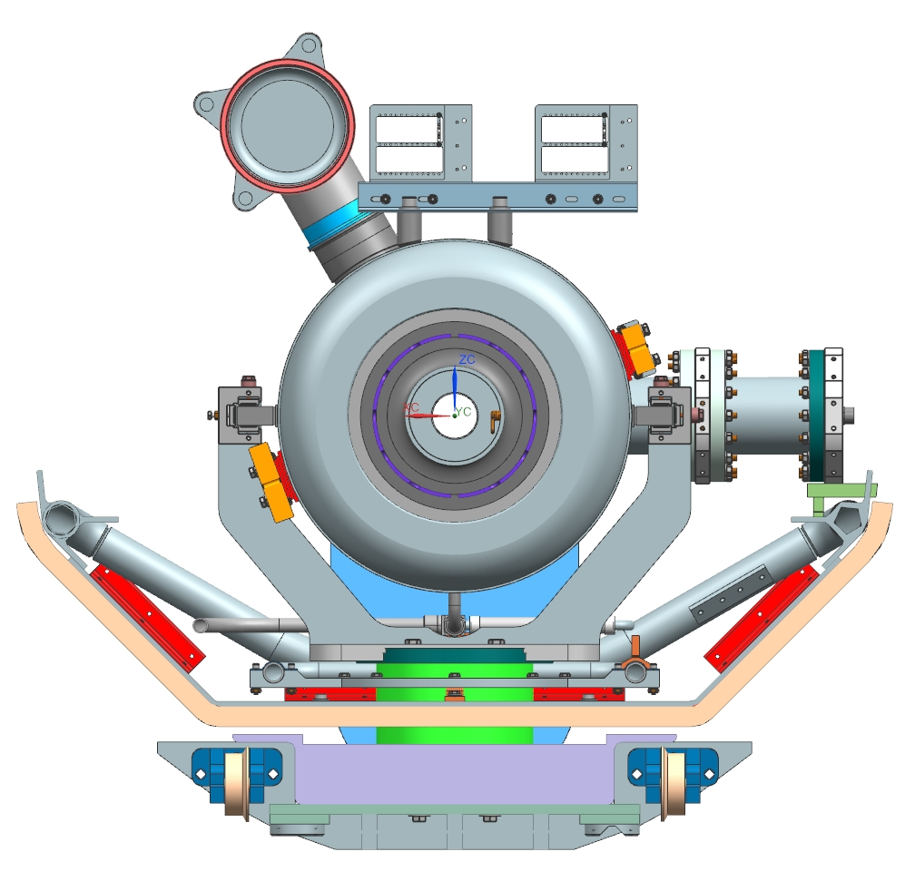
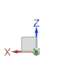
1. Design strategy
1.2 650 configuration

Slide 11
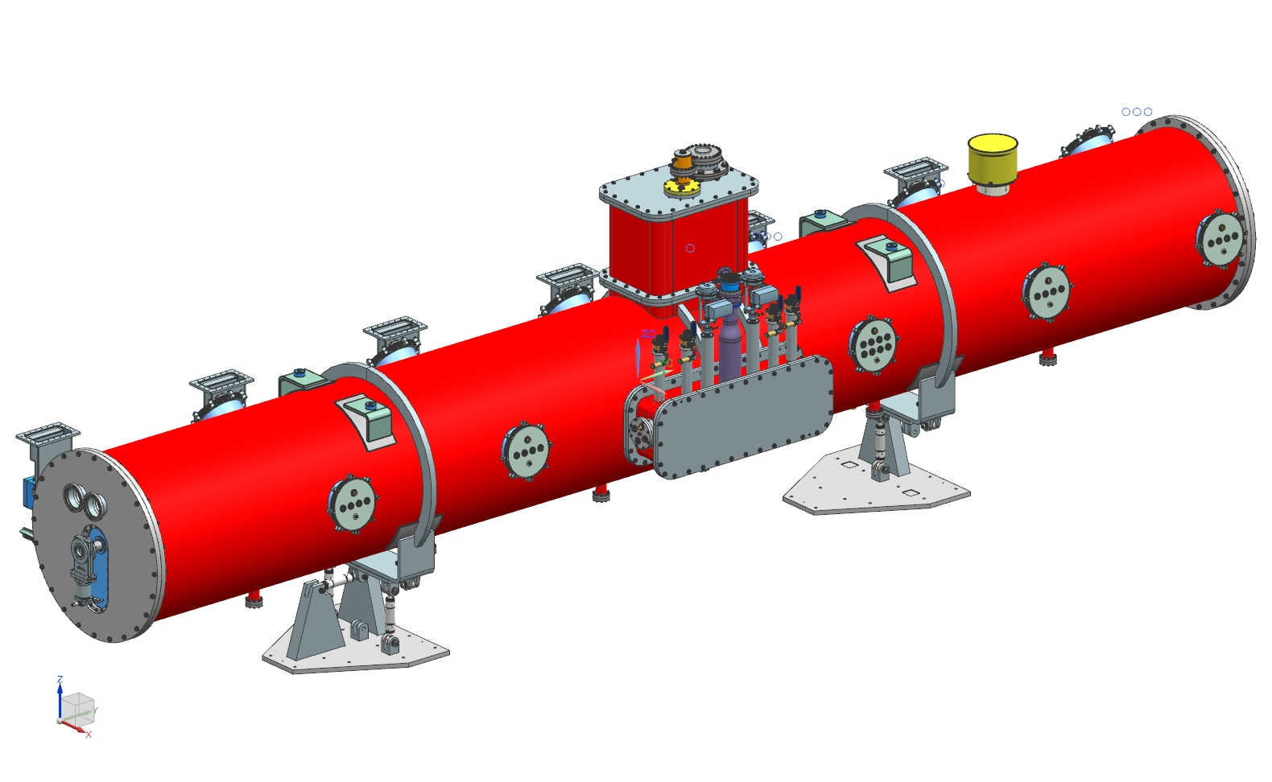
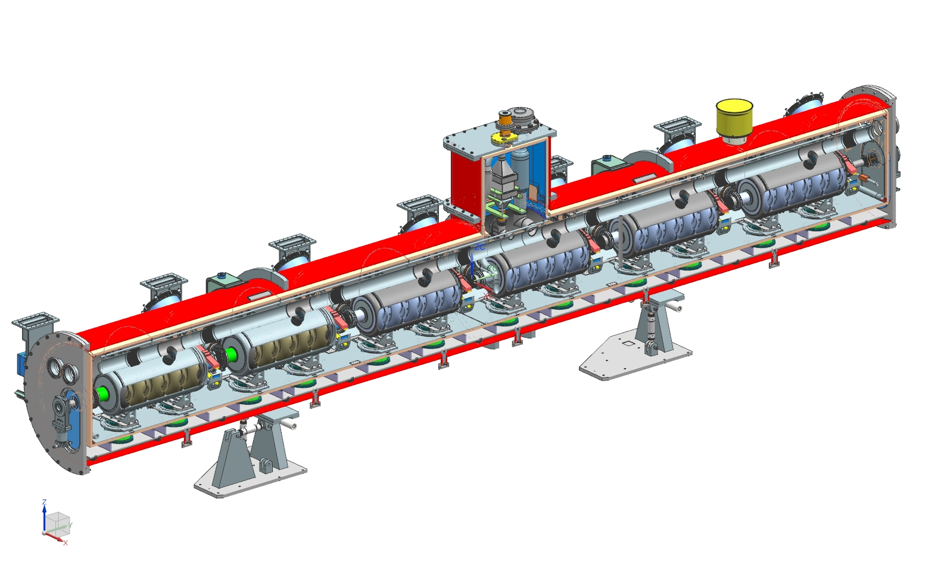
2. Description of the HB650 cryomodule
Vacuum vessel : 9.7 m long
Thermal shield at 35-50 K
5 K line used as thermal intercept & to cool down the cold-mass
5 Bayonets, 2 cryogenic valves & an heat exchanger
6 Cavities, tuners & couplers
A cold magnetic shield around each cavity, and warm magnetic shield on the inner surface of the vacuum vessel (still under discussion)

Slide 12
2. Description of the cryomodule
2.1 Cryomodule requirements
Max Cryomodule height: 2.35 m
Max allowed heat load to 35-50 K: 160 W
Max allowed heat load to 5 K: 61 W
Max allowed heat load to 2 K: 175 W
Transverse cavity alignment error < 0.5 mm
Angular cavity alignment error < 1 mrad
Max variation of pressure in the 2-phase helium pipe: 0.1 mbar
2.35 m

Slide 13
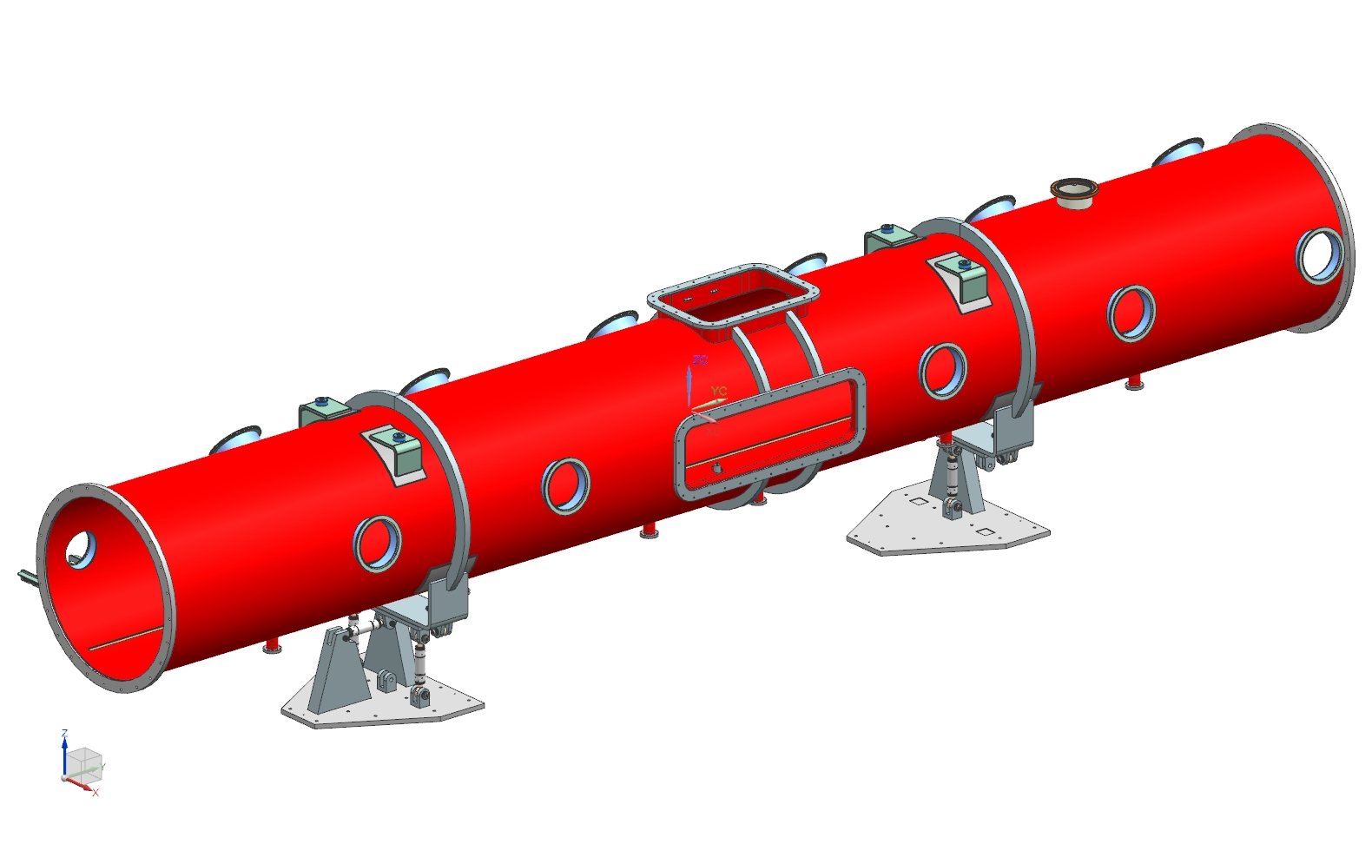
2. Description of the cryomodule
2.2 Vacuum vessel
Some analytical calculations have been done to size this vessel. This design has been updated recently based on S. Cheban transport analysis.
Relief analysis has been done.
FEA need to be done in order to be sure about the locations of the supports post and the lifting lugs.
The vacuum vessel is composed of 11 tuner ports which are used also for the instrumentation.

Slide 14
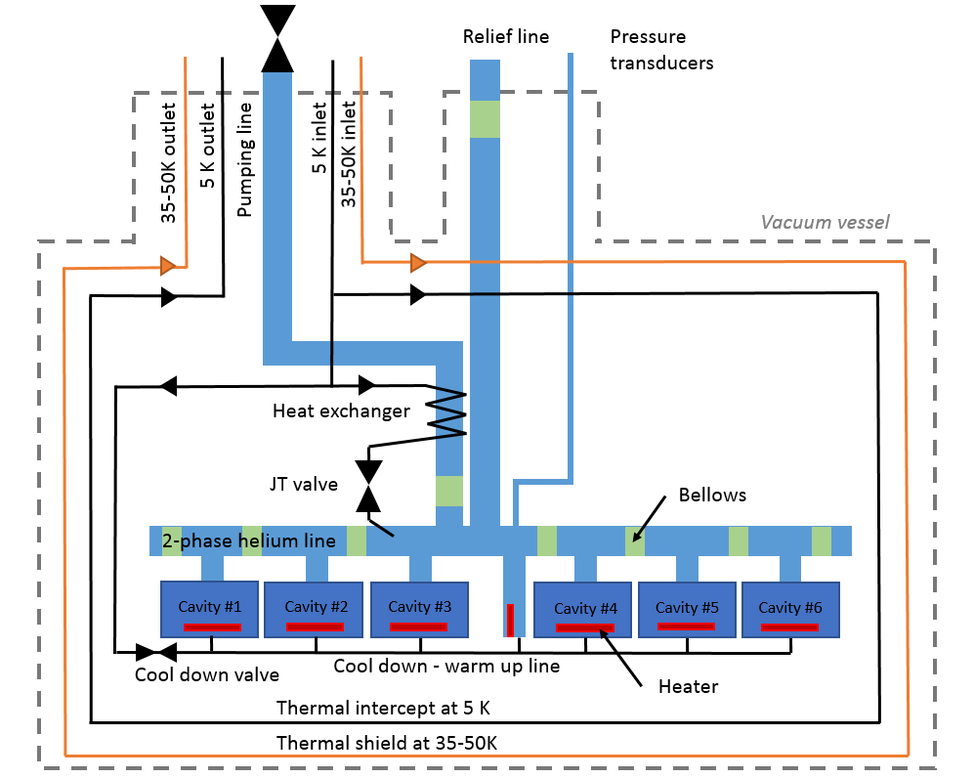
2. Description of the cryomodule
2.3 Layout of the cryomodule
All PIP II cryomodules need to be compatible with a fast cool down:
• Above 20 K/hour through the Q-disease regime 90 - 175 K.
• Above 120 K/hour through the superconducting transition at 9.2 K

Slide 15
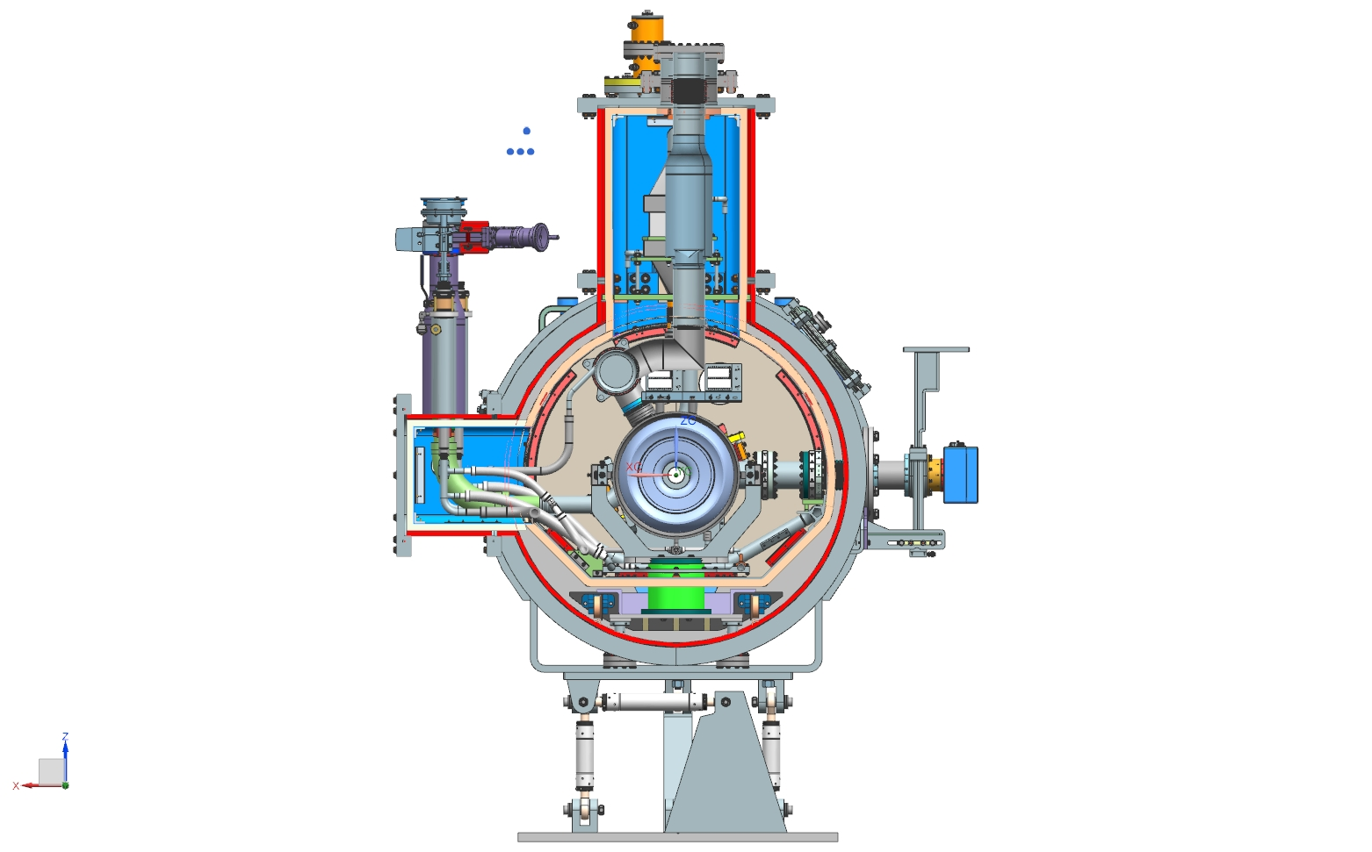
2. Description of the cryomodule
2.4 Cryogenic lines
Pipe A - 2 K supply
MAWP: 20 bar
Pipe G - 2phase He pipe & Relief line
MAWP: 2.05 bar warm, 4.1 bar cold
Pipe E & F - 35-50 K line
MAWP: 20 bar
Pipe B - Pumping line
MAWP: 2.05 bar warm, 4.1 bar cold
Pipe H - Cool down /
warm up line
MAWP: 20 bar
Pipe C & D - 5 K line
MAWP: 20 bar

Slide 16
2. Description of the cryomodule
2.5 Pipe sizing
Calculations have been done in order to demonstrate that all the pipes of HB650 cryomodule have been designed per venting requirements.
 | Needed diameter for the chimney of the dressed cavity | Needed diameter for the 2-phase helium pipe | Needed diameter for the relief line
Loss of insulating vacuum | 28.8 mm | 74.7 mm | 75.2 mm
Cavity vacuum loss | 40 mm | 97.8 mm | 97.8 mm
Considered diameter | 93.5 mm | 146.8 mm | 108.2 mm
The two-phase helium pipe has been oversized in order to increase the gas volume and therefore the pressure stability.

Slide 17
3. Transportation analysis
With courtesy of S. Cheban
A preliminary transportation analysis has been performed including static structural and modal analysis. The vacuum vessel, strong-back, G10 support posts, cavity support posts, string assembly, two phase helium pipe and thermal shield have been modeled.

Slide 18
3. Transportation analysis
With courtesy of S. Cheban
3.1 Structural analysis
In order to compare the spaceframe design to the strong-back design, similar boundary conditions have been applied.
Axial 5g
Transvers 1.5g
Vertical 3g

Slide 19
3. Transportation analysis
With courtesy of S. Cheban
3.1 Structural analysis - Vertical 3G
Displacement: Max 3.4 mm
Stress:

Slide 20
3. Transportation analysis
With courtesy of S. Cheban
3.2 Modal analysis
Mode 1
Mode 2
Mode 3

Slide 21
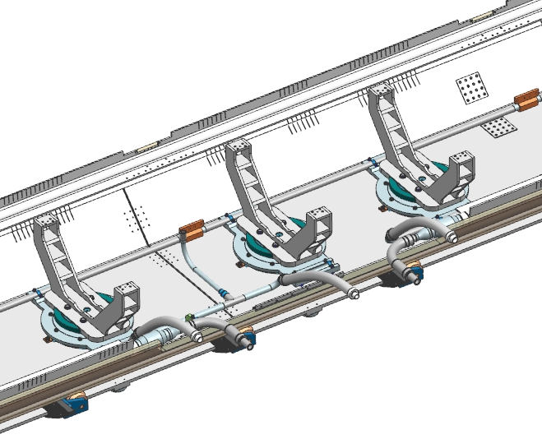
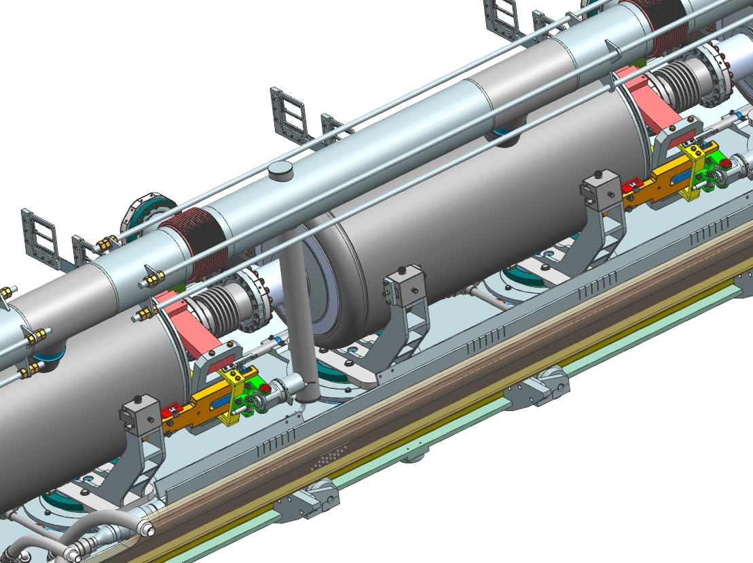
3. Transportation analysis
3.3 Design update for transport considerations
The vacuum vessel (rails and stiffening rings)
The strong-back (with wheels, and stiffer design)
Update of the 5 K line, directly connected to the thermal intercept of the support posts & update of the assembly process.
Update of the helium level container.
Beam pipe end modifications using one bellows

Slide 22
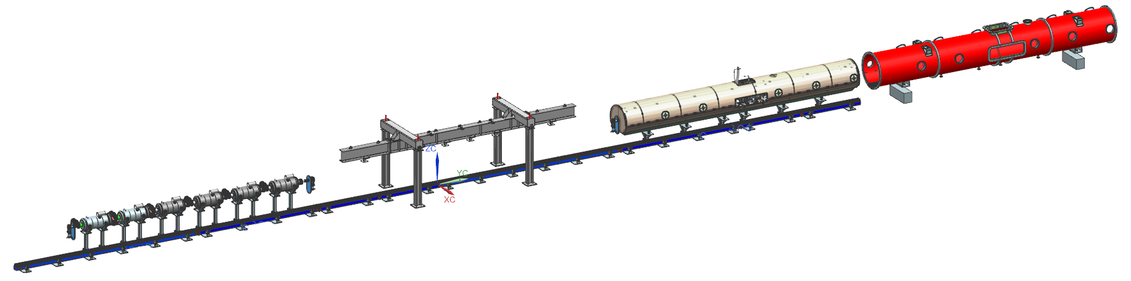
4. Assembly process & alignment strategy
Workstation 1: Assembly of the cavity string in the clean room
Workstation 2: Lifting of the string assembly
Welding of the cool-down / warm up line
Moving down the string assembly on the strong-back assembly
Workstation 3: Assembly of the cold-mass
Workstation 4: Insertion of the cold-mass in the vacuum vessel
Completion of the cryomodule

Slide 23
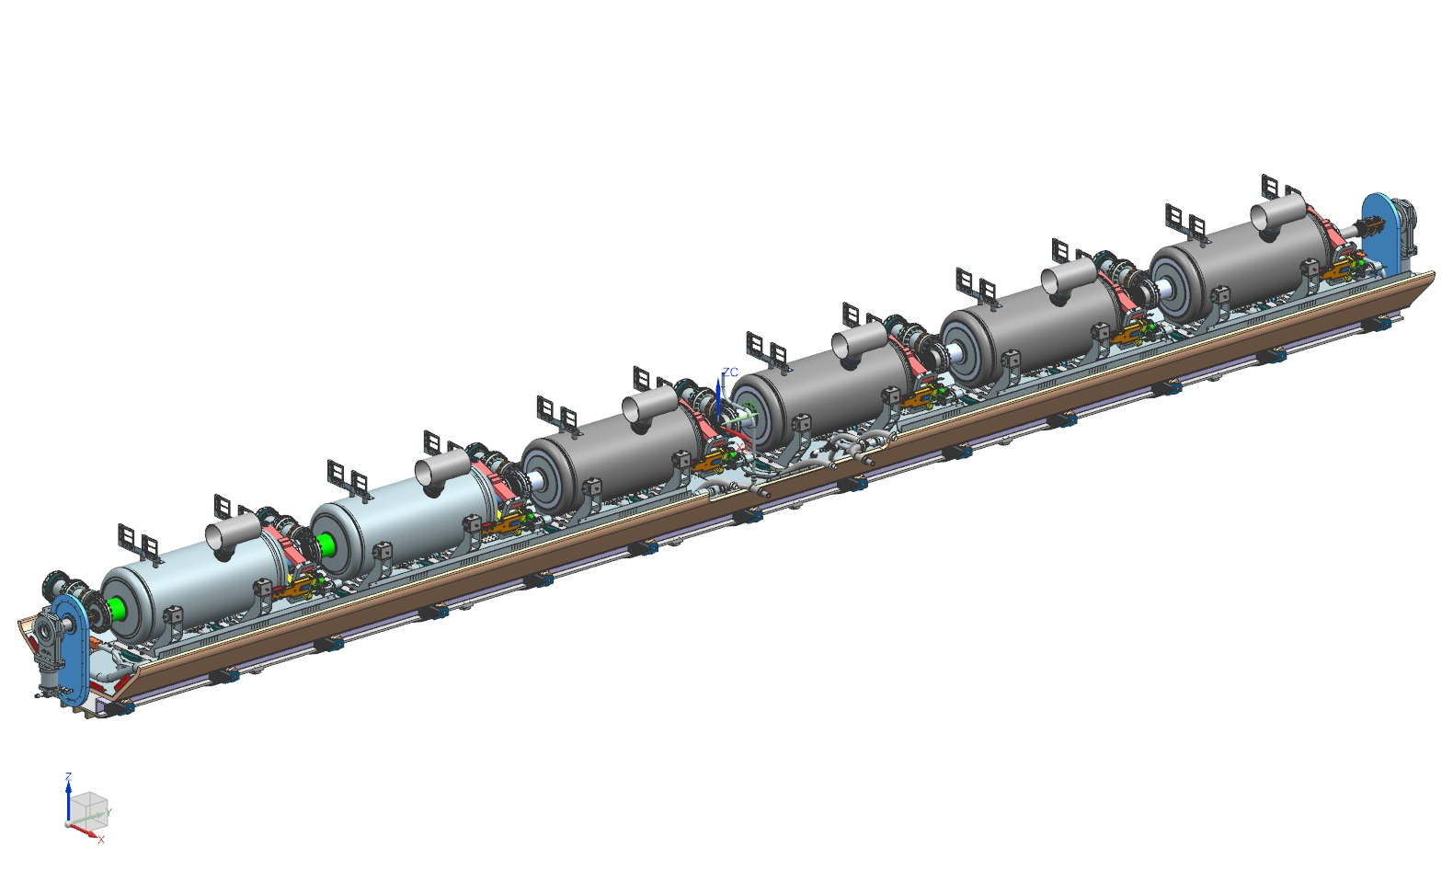
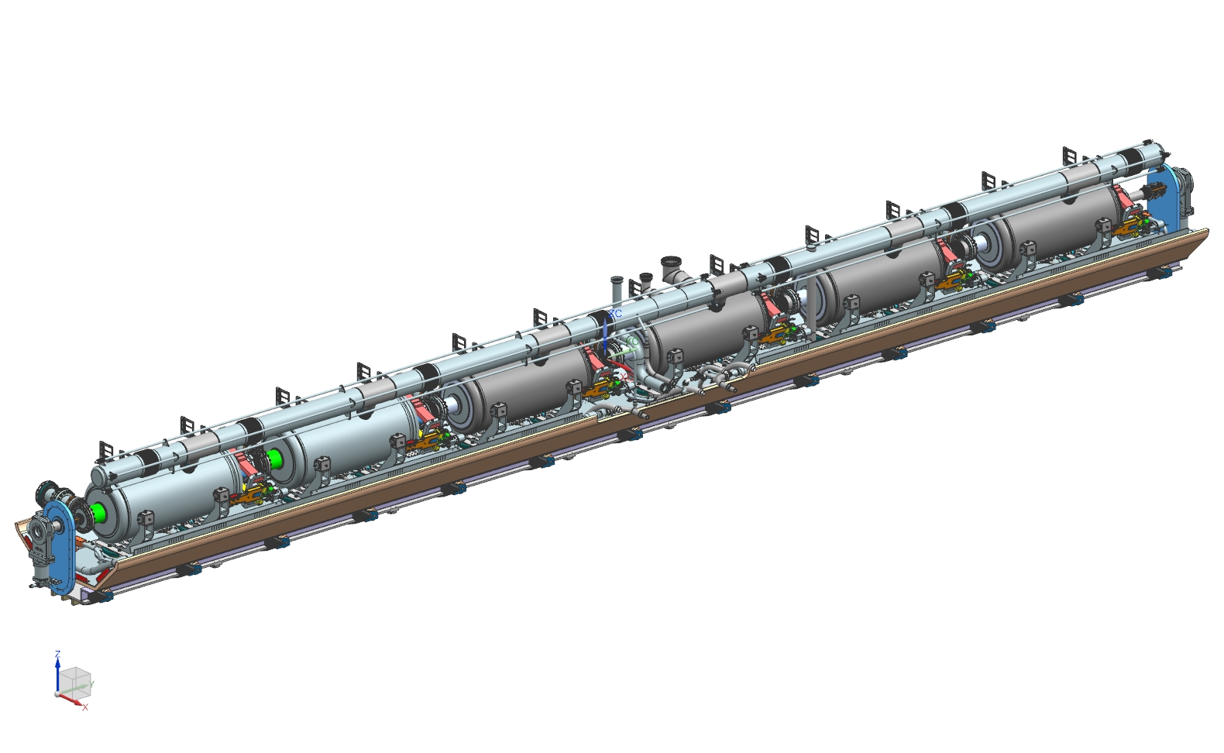
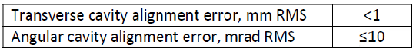
4. Assembly process & alignment strategy
1. Cavities will be measured in order to record their geometrical, electric and magnetic axis wrt fiducials placed on their top.
2. During the assembly of the beam line, inclinometers and then laser tracker will be used to align each cavities and avoid stress on the bellows.
3. Once the beam line moved down on the strong-back, another alignment of the cavities will be done taking into account the shift due to the thermal contraction during the cool-down. After welding the two-phase helium pipe, 4 fiducials will be set up on each cavity and the final alignment will be done.

Slide 24
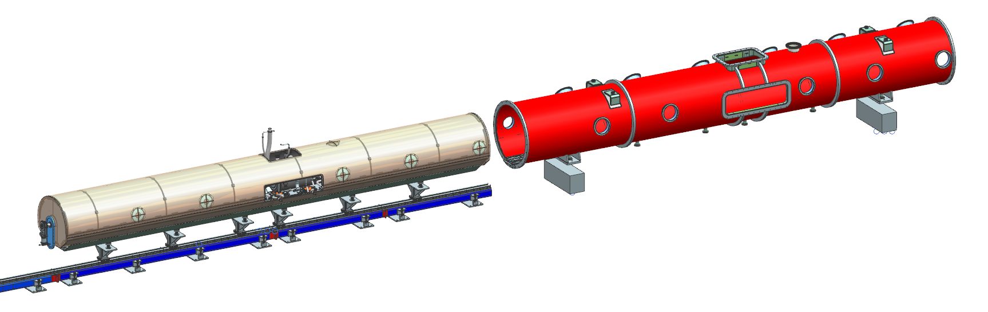
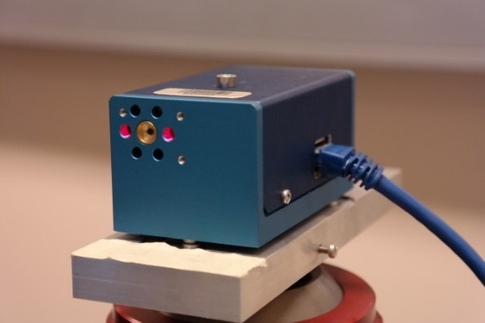
4. Assembly process & alignment strategy
The key of the strong-back strategy is to support the strong-back in the same way on the insertion tooling and inside the vacuum vessel.
4. The coldmass will be inserted in the vacuum vessel slightly below the nominal position. Wheels located below the strong-back and rails on the vacuum vessel will be used. Then the coldmass will be lift up using several set of screws.
5. After the insertion, the alignment of all the cavities will be checked using HBCAM.
6. Finally the alignment will be transferred to the vacuum vessel.
7. View ports will allow to control the location of the cavities during transport, and cool down.

Slide 25
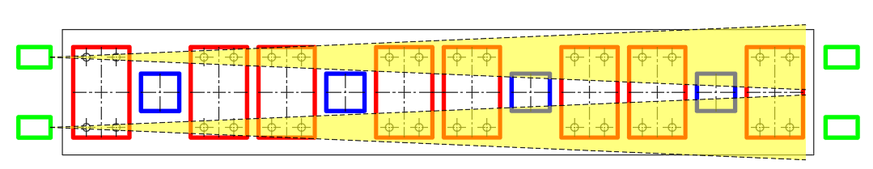
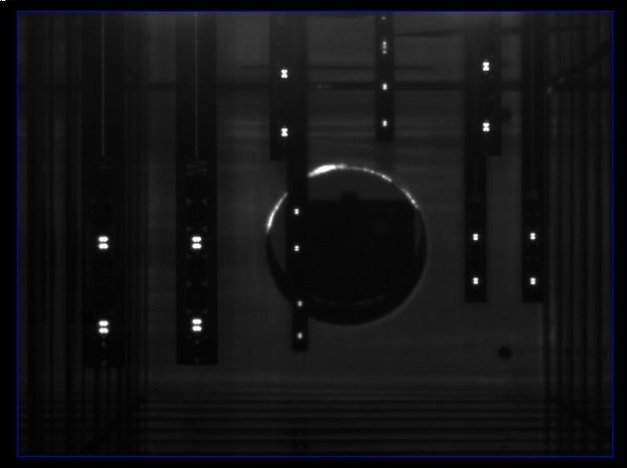
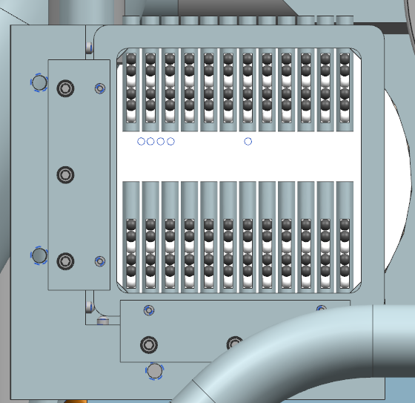
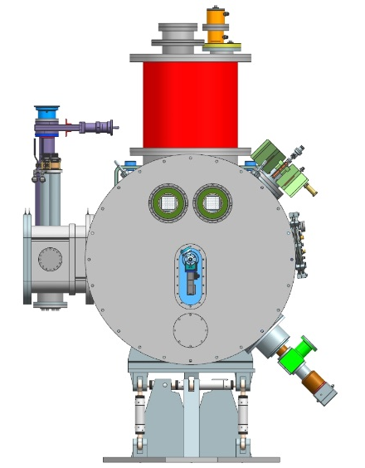
4. Assembly process & alignment strategy
SSR1 Cryomodule
HBCAMs on the cryomodule flange
Two BCAMs per side to monitor the relative position of the components in the cryomodule
An addition couple of BCAMs reading external, fixed targets would enable absolute position measurements

Slide 26
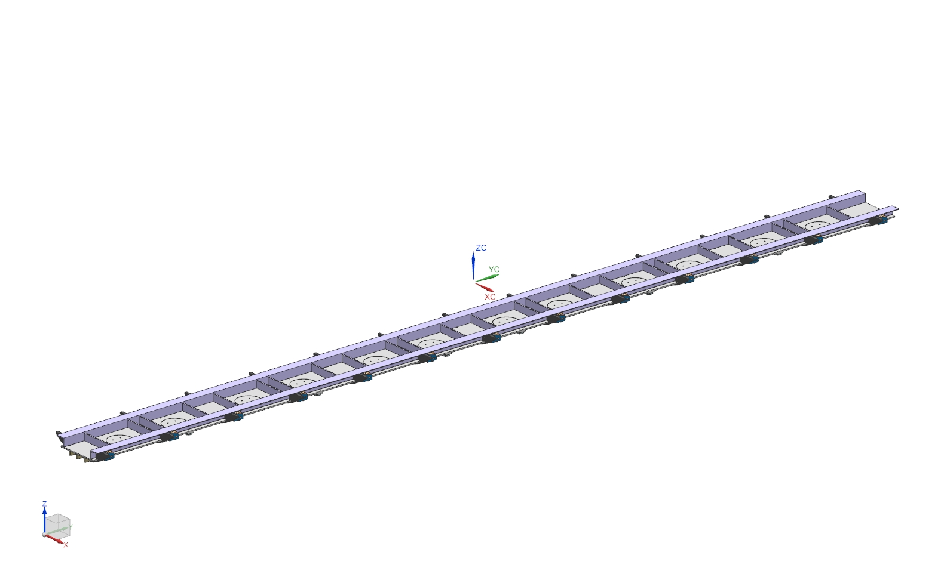
4. Assembly process
All the cryogenic lines have been pre-designed based on an assembly process, but the design stage is not over yet. Simulations, and several parts need to be designed including the beam line.

Slide 27
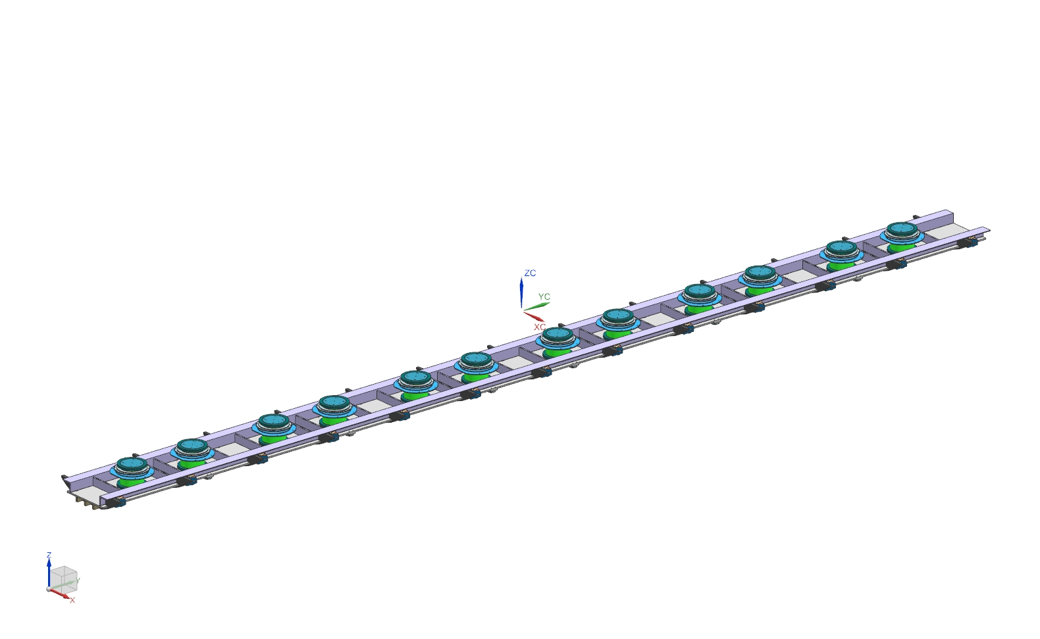
4. Assembly process

Slide 28
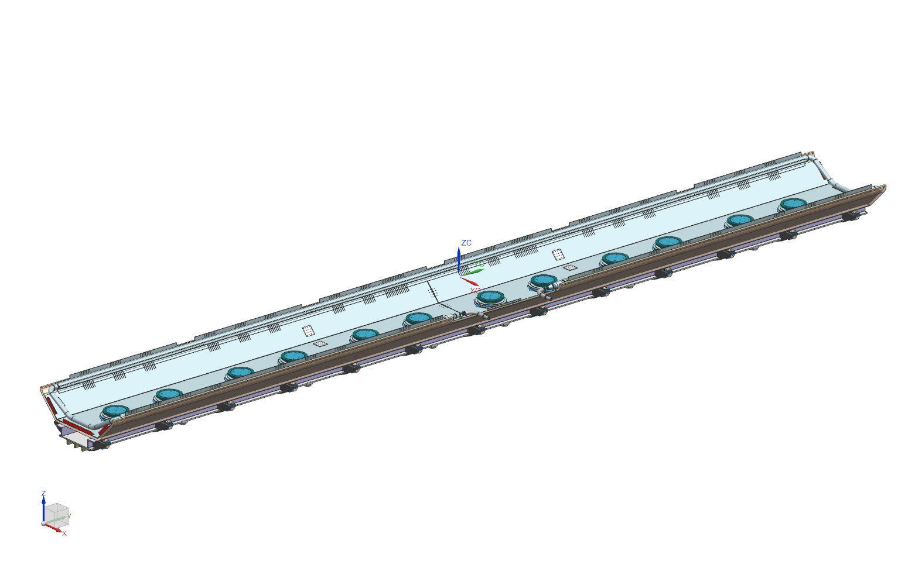
4. Assembly process
35-50 K line will be leak tested and pressure tested by the manufacturer.

Slide 29
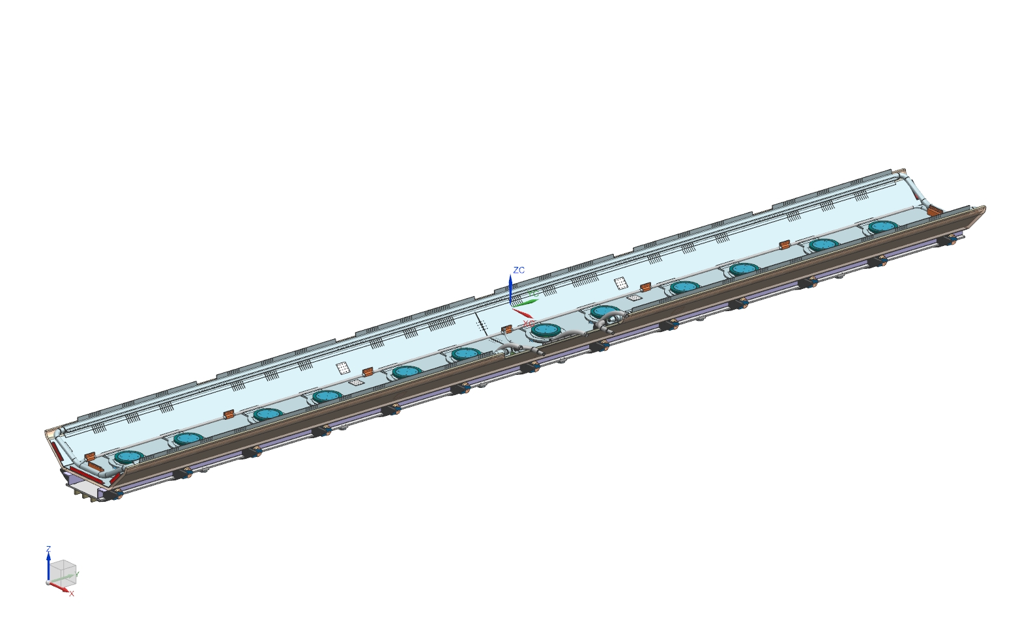
4. Assembly process

Slide 30
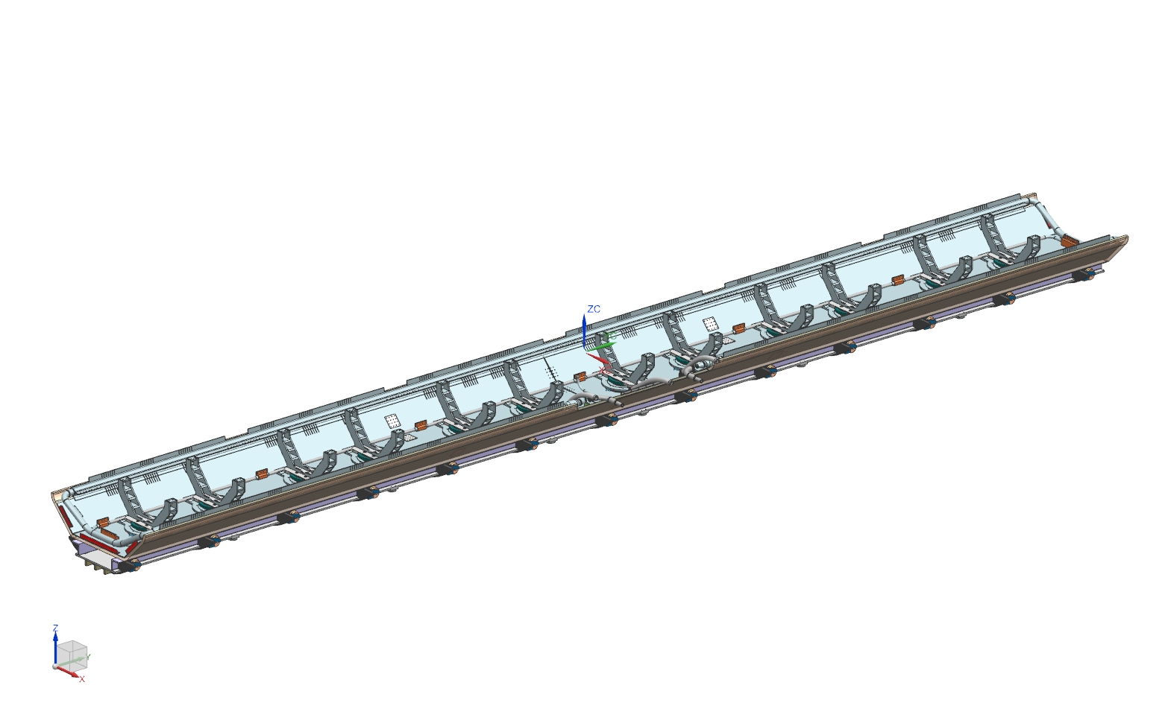
4. Assembly process
This full assembly could be provided from a company using the same strategy as LCLS II.

Slide 31
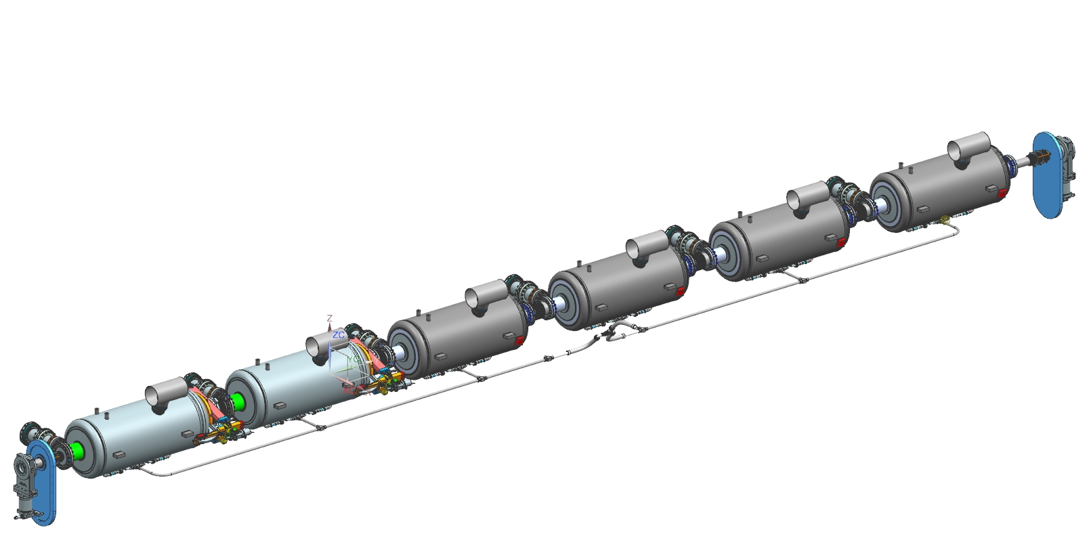
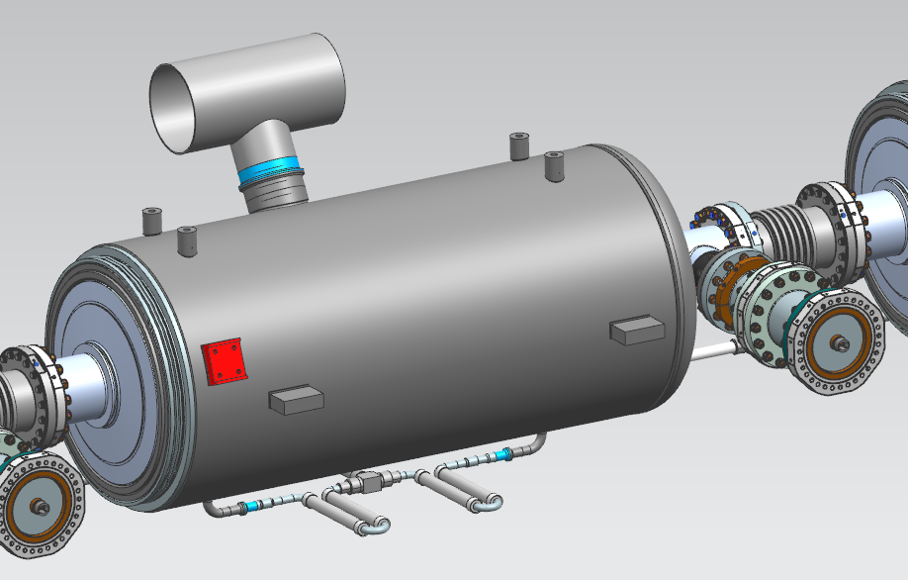
4. Assembly process
Under the lifting tooling:
The tuner will be set up on each cavity.
A magnetic shield around each cavity will be set up.
The cool down line will be welded to the cavities
MLI will be set on each cavity and on the cryogenic lines.
Design pressure of the cool down line : 20 barg.
Design pressure of the weld making the connection with the dressed cavities: 2.05 barg at warm, 4.1 barg at cold .

Slide 32
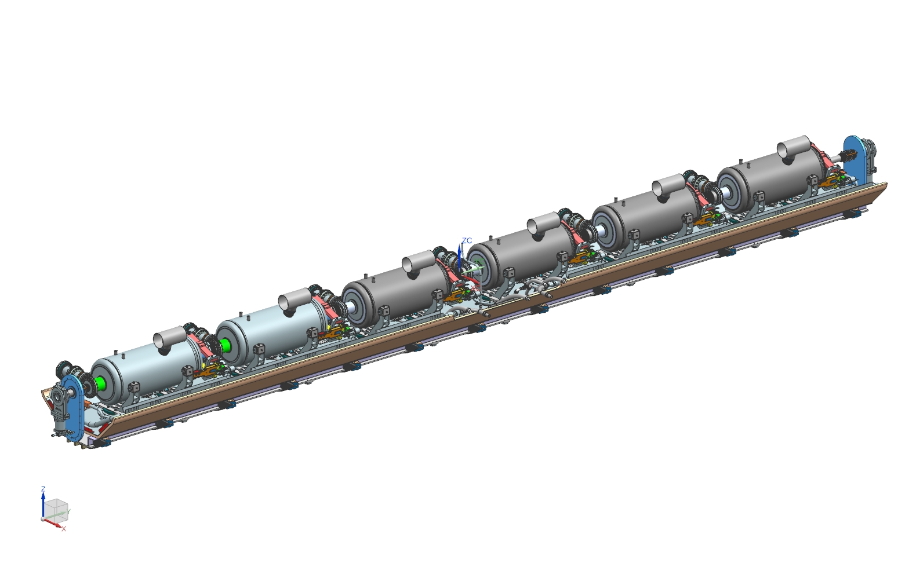
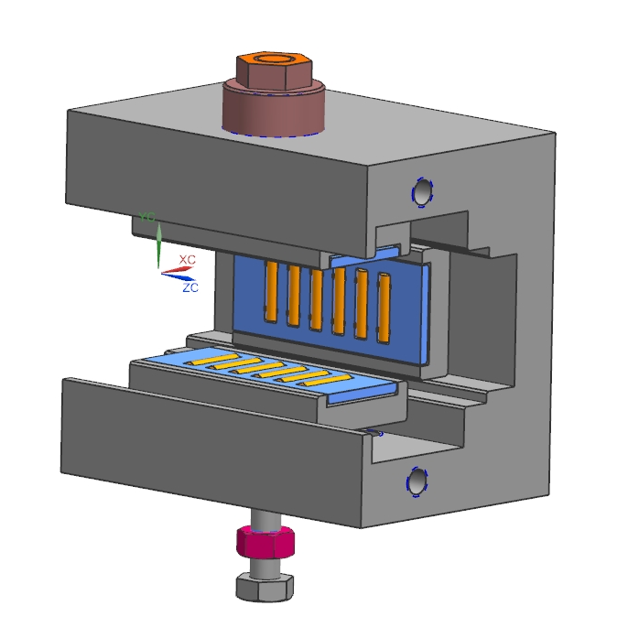
4. Assembly process
Alignment of the cavities.
Similar fixtures as LCLS II to align the cavities.

Slide 33
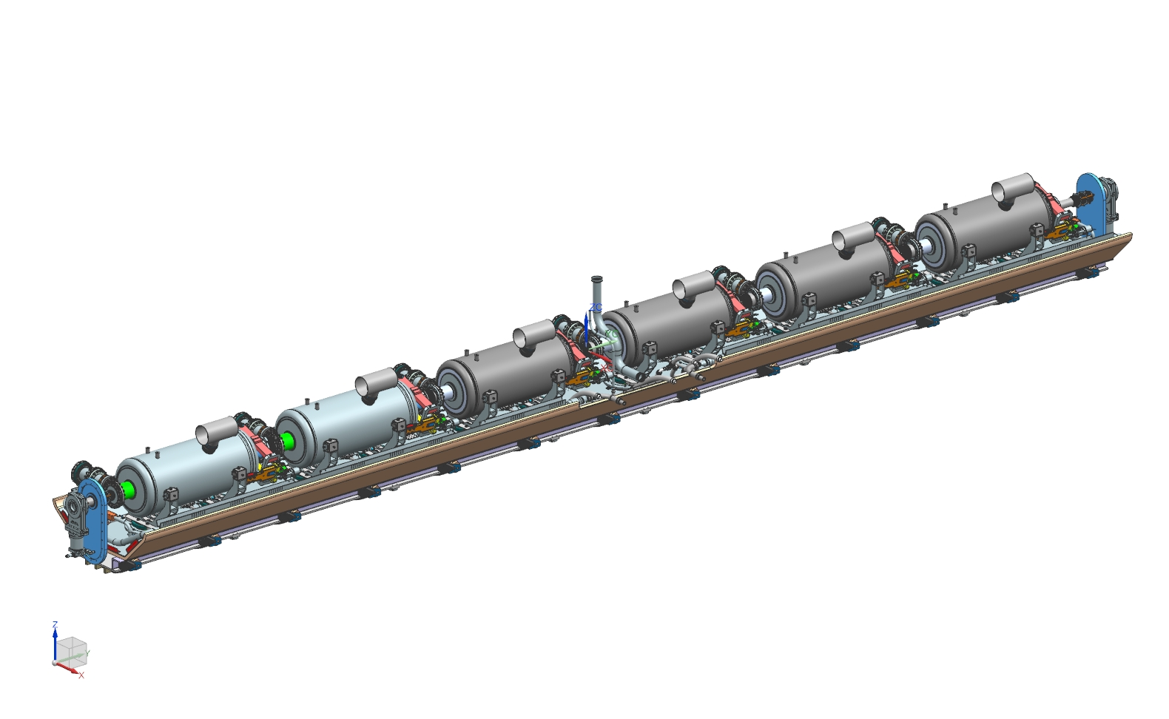
4. Assembly process
Set up of the pumping line, and the 2 K lines connected to the heat exchanger.

Slide 34
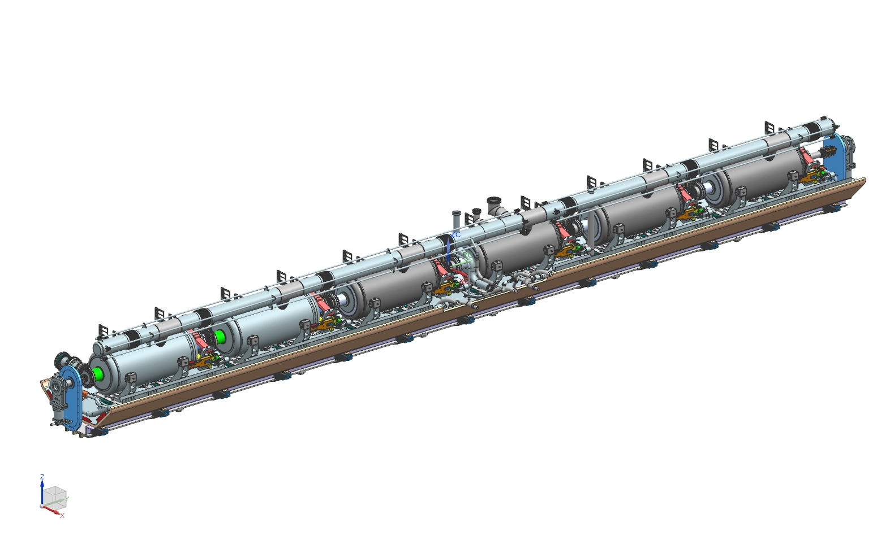
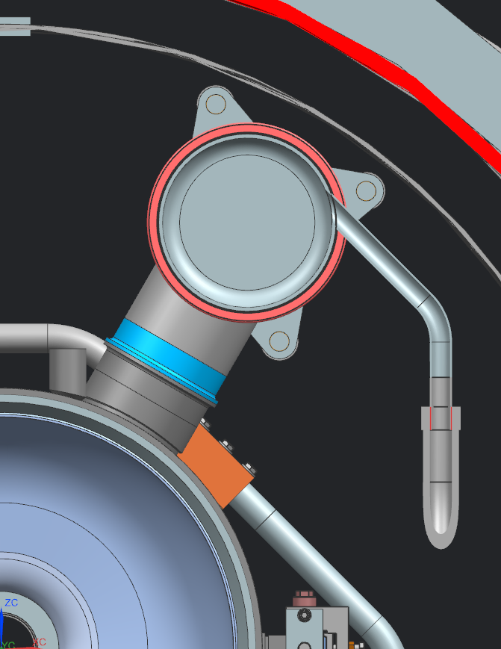
4. Assembly process
Weldment of the two phase helium pipe and leak tests.
Final alignment, and transfer to the cavities fiducial.
Inlet of the helium in the 2 phase helium pipe

Slide 35
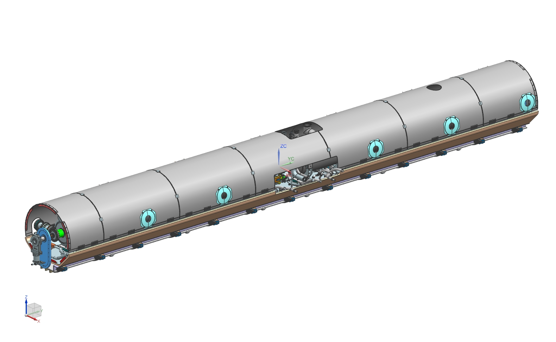
4. Assembly process

Slide 36
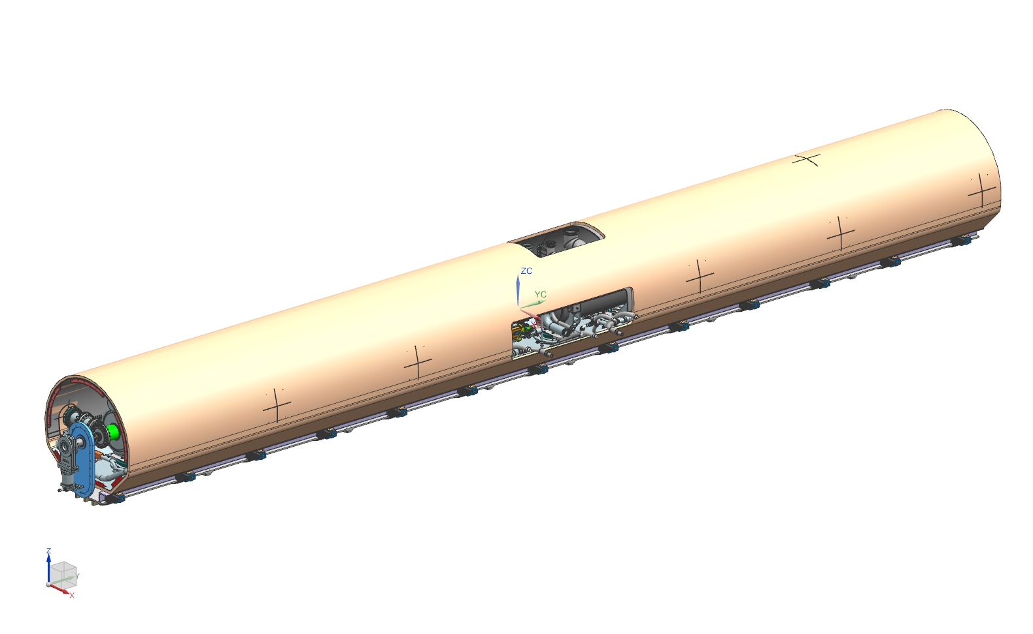
4. Assembly process

Slide 37
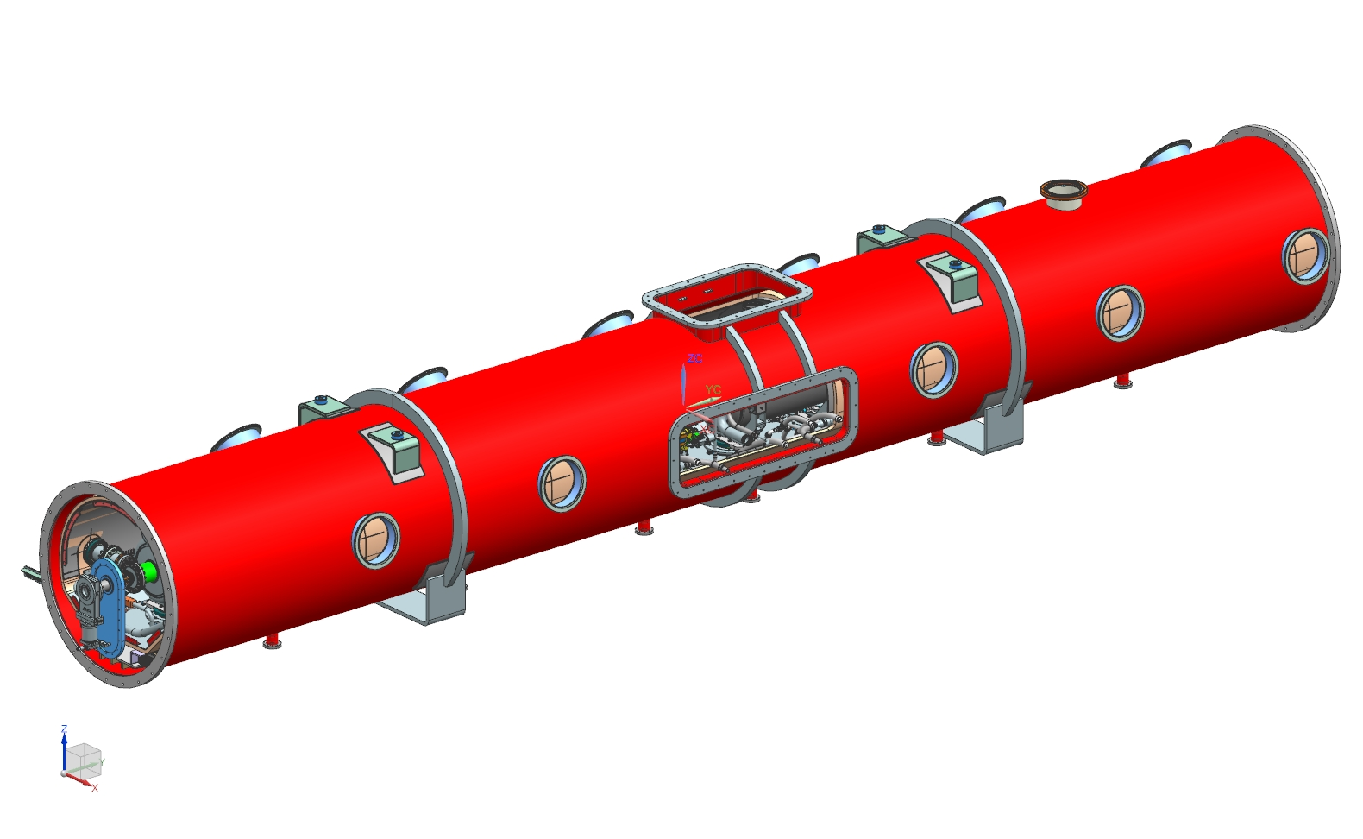
4. Assembly process

Slide 38
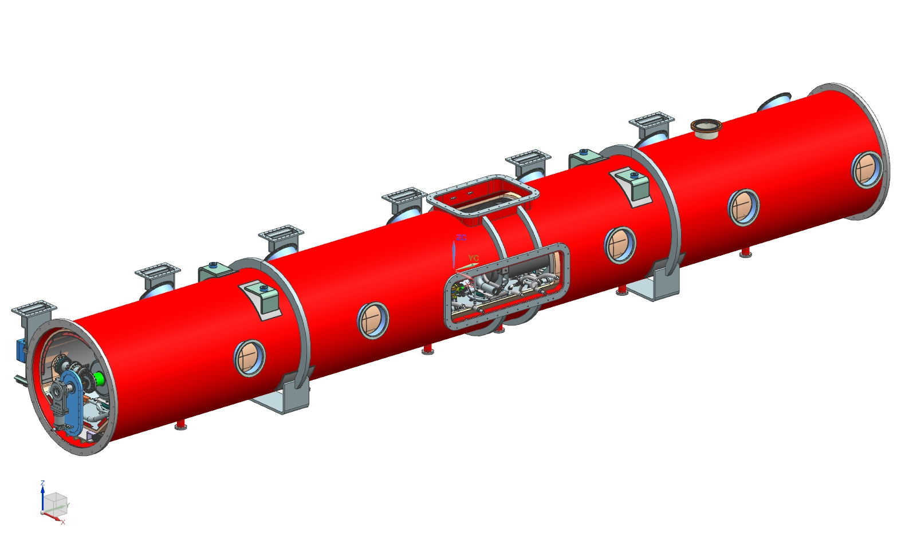
4. Assembly process

Slide 39
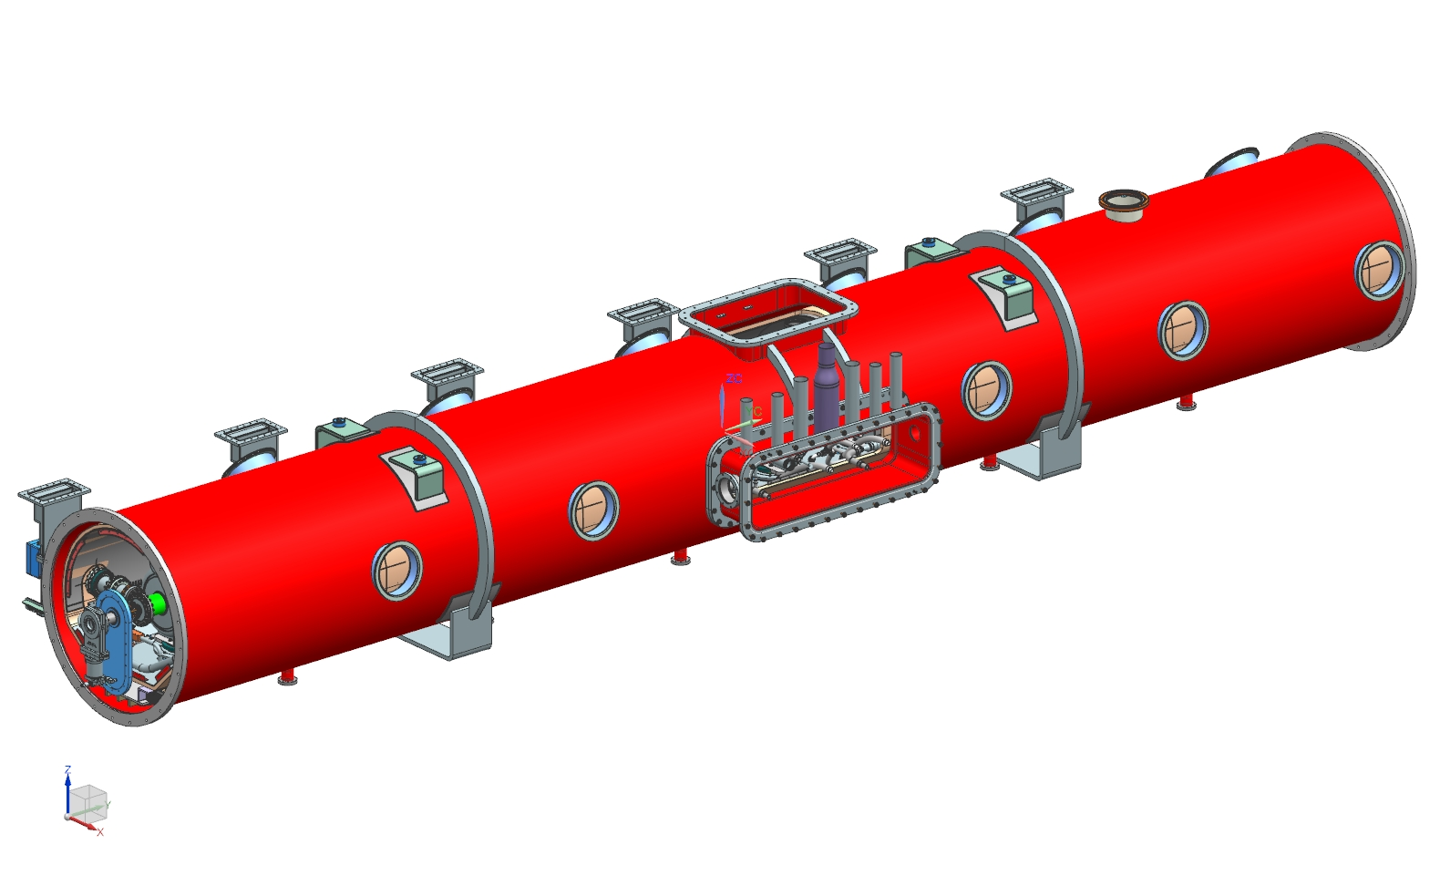
4. Assembly process

Slide 40

4. Assembly process
Final pressure test of the 35-50 K line.

Slide 41

4. Assembly process

Slide 42

4. Assembly process

Slide 43

4. Assembly process

Slide 44

4. Assembly process
Radiographic tests of the weld between the CD line & the CD valve.
Final pressure test of the 5 K line.
Leak test 2 K line and pumping line.
The CD and JT valves have a similar design as LCLS II project to avoid thermal acoustic oscillations

Slide 45

4. Assembly process

Slide 46

4. Assembly process

Slide 47

4. Assembly process

Slide 48

4. Assembly process
Final pressure test of the 2 K line, the pumping line and the dressed cavities.

Slide 49

4. Assembly process

Slide 50

4. Assembly process

Slide 51

4. Assembly process

Slide 52

4. Assembly process

Slide 53

4. Assembly process
Leak test of the vacuum vessel.

Slide 54

4. Assembly process

Slide 55

5. Instrumentation
In the interface document all the external interfaces of HB650 Cryomodule have been mapped out, how it interfaces with the connected systems of PIP-II and the PIP-II Injector Test (formerly known as PXIE).
The instrumentation will be very similar to what has been done on SSR1 cryomodule.
Having two ports for each tuner it is possible to split the instrumentation in order to have more room to do these connections. Moreover these two ports could be used to secure the beam line during the transport if needed.
On the top of the cryomodule, two pressure transducers will read the pressure inside the two-phase helium pipe.

Slide 56
6. Conclusion
Our design strategy was so far to use the feedback of SSR1 cryomodule to design the 650 cryomodules.
Many documents have been written to validate the design of SSR1 cryomodule. We have several documents for HB650 cryomodules, but they will need to be updated.
However, the 650 configuration is different from SSR configuration: how the cavities are hold and aligned, the length and weight of the cryomodules. Specific analysis will need to be done.
Due to the fact that the production cryomodules will be assembled in UK, Sergey Cheban started to perform transport analysis to evaluate the transportation of this cryomodule.

