Slide 1
Warm particle-free sections
L. Prost
during the Visit by Dr. Nick Gazis, ESS, and Prof. Gary Solbrekken, University of Missouri
Discussions with PIP-II Team
9 November 2018

Slide 2
Background
Front-end of PIP-II is being built (a.k.a. PIP2IT)
Warm front-end + 2 cryomodules + (warm) HEBT
‘Test bed’ for PIP-II
Standard high vacuum practices in the warm sections but not ultra-high/particle-free requirements
Vacuum & cleanliness requirements for the warm sections immediately preceding or following a cryomodule are not very clear
“as clean as possible” !?
What actually matters ?

Slide 3
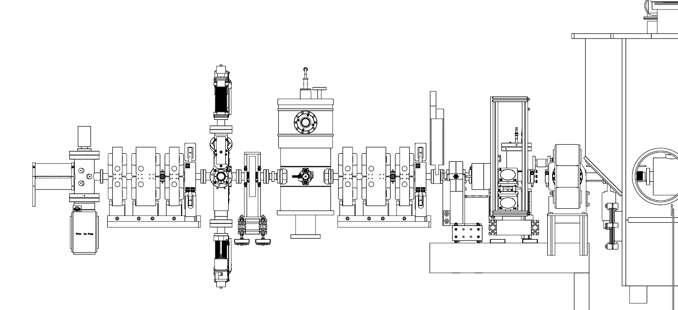
“Particle-free” section at PIP2IT (MEBT ⇨ HWR)
Fast Acting Valve
Laser wire
DPI
~2.5 m
About 3 m longer at PIP-II
Vacuum failure protection + radiation shielding wall

Slide 4
Questions related to ESS design
Plan and rationale for:
The length of the particle-free region before/between/after cryomodules
Warmup cycles (of the cryomodules) vs. performance
Policy on insertion devices in these sections

