Slide 1
Fluid Systems Design and Quality Assurance Management in Accelerator Applications
Maurice Ball
ESS Collaboration Meeting
8 November 2018

Slide 2
Charge
Design and Quality Assurance Management in Accelerator Applications
This topic will include discussions about water quality management such as copper oxide production and control requirements and impact on accelerator operations reliability. This topic will also cover aspects of LCW system design and its impact on project management, including construction, scheduling, and layout of such systems.

Slide 3
Outline
Overview of LCW and RAW Systems
Challenges of piping system Design, Installation, Commissioning, Operations
Radioactive Water (RAW)
Copper Oxide Particulate

Slide 4
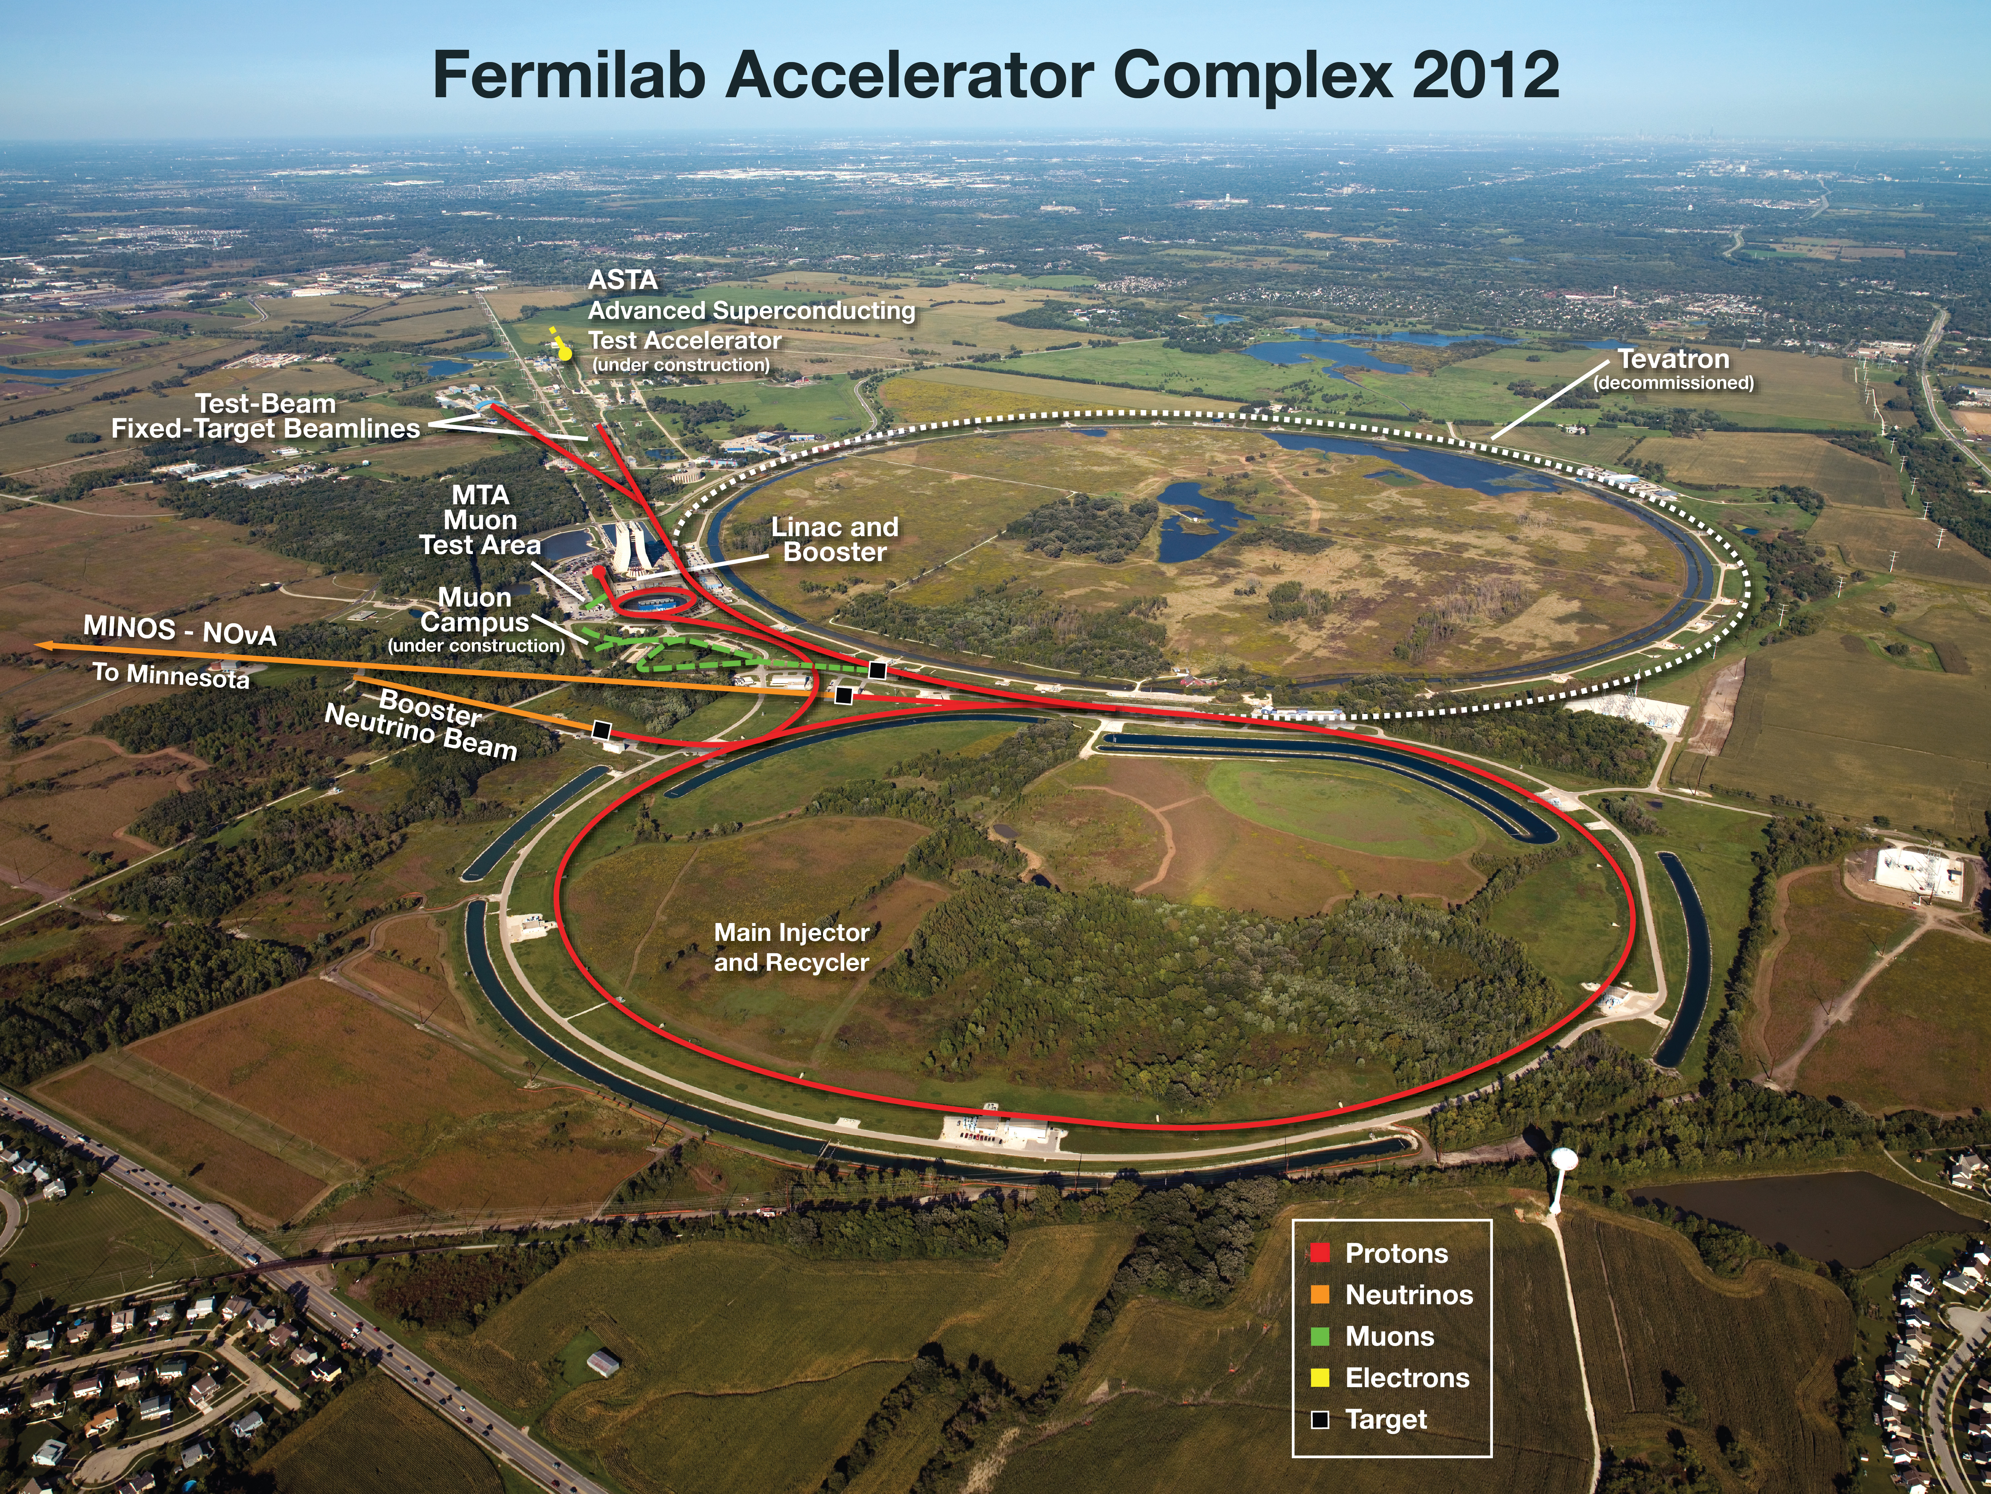

Slide 5
Overview
Typically Category D or Normal Fluid Systems under the ASME B31.3 Piping System code
Over 50+ LCW and RAW Systems
  Differential pressures ranging from 10 PSID to 300 PSID.
  System flows ranging from 5 GPM to 8000 GPM.
  Temperatures range from 80 F to 100 F
  Conductivities range 1 MOhm-cm to 18 MOhm-cm
Over 100 compressed air systems
  Instrument and shop air applications
  Moisture down to -40F
  Pressures cycle between 80 PSIG and 130 PSIG
Other fluid systems (Fluorinert, compressed gases)

Slide 6
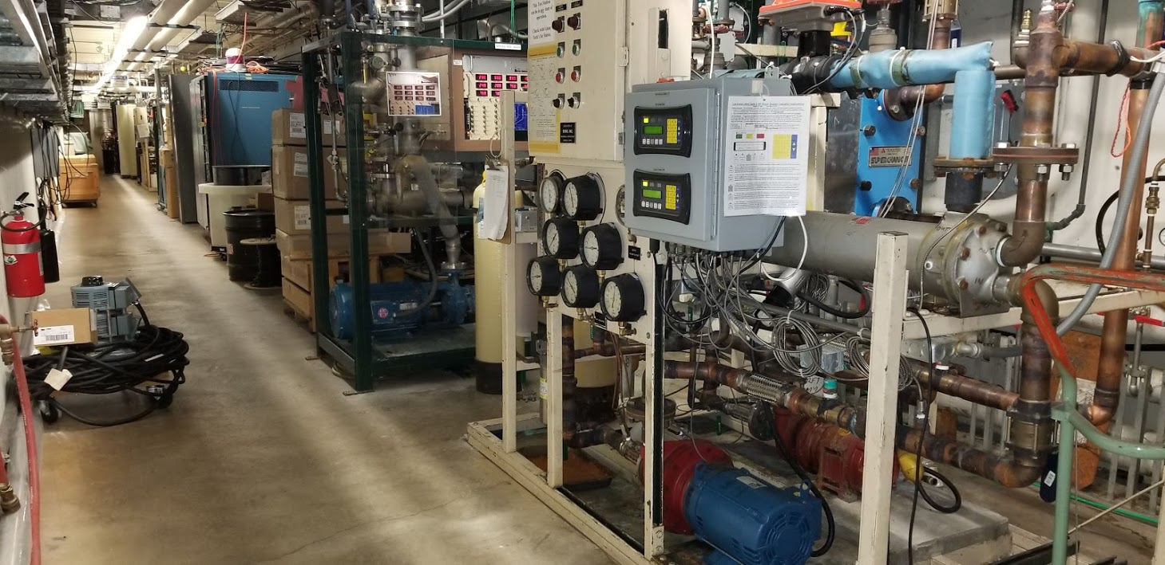
Small Systems (Skids) – Proton Source/LINAC

Slide 7
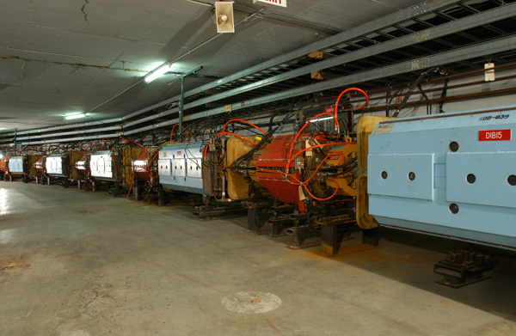
Medium to Large Systems – Muon Campus Delivery Ring

Slide 8
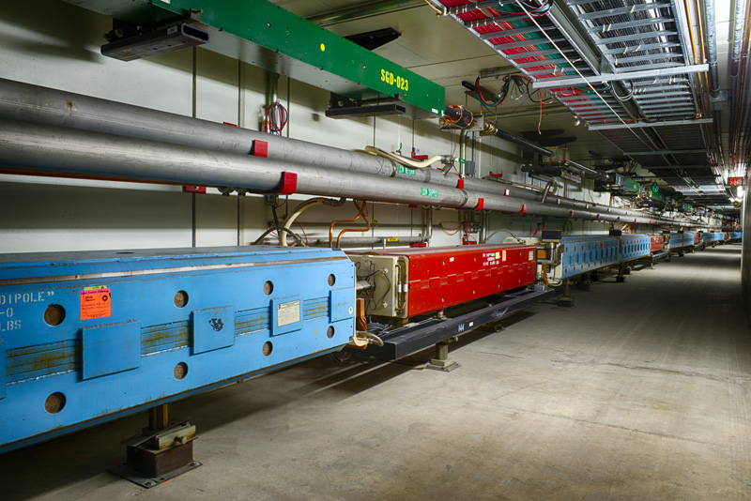
Systems of a Very Large Scale – Main Injector

Slide 9
Challenges

Slide 10
Engineering Design Process – Fermilab Engineering Manual
Requirements and Specifications
Engineering Risk Assessment
Requirements and Specifications Review
System Design
Engineering Design Review
Procurement and Implementation
Testing and Validation
Release to Operations
Final Documentation

Slide 11
Issues We Have Experienced – Design of LCW Systems
Accelerator component fluid system engineers must be included in the design process of the accelerator components.
Getting up to date component information and drawings
Correct heat loads at actual operating conditions
Determining Resistivity ranges
Types/kinds of controls desired (i.e. temperature, pressure, dissolved oxygen, resistivity
Obtaining actual operating parameters/expectations.
Result: Incorrect or improperly sized equipment, schedule/milestone delays

Slide 12
Issues We Have Experienced – Installation of LCW Systems
Timing issues, scheduling
Coordinating the timing of installation of components (i.e. power, interlocks, controls, piping
Coordinating with safety, radiation, manpower, and contractor requirements.
Communication with the stakeholders: landlords, safety, project engineers, and integration groups
Walkthroughs, toolbox meetings
Microbiologically Induced Corrosion (MIC)
Hydrostatic pressure testing very time consuming, especially for big systems. Testing in sections leads to a more thorough and streamlined process.
Result: schedule/milestone delays

Slide 13
Issues We Have Experienced – Commissioning of LCW Systems
Timing issues, difficulty with start-up, trouble-shooting, and corrections, system balancing
Coordinating the timing of installation of components (i.e. power, interlocks, controls, piping
Coordinating with safety, radiation, manpower, and contractor requirements.
Pressure to get the accelerator machine operational
Effective communication, particularly at startup
Allowing time for verifying valves, system balancing
Result; component damage and safety problems

Slide 14
Issues We Have Experienced – Operation of LCW Systems
Poor communication of failing equipment
Addressing issues immediately
Communicating the gradual decline or concerns.
Mismatch between stakeholder/user expectation and how the system was designed.
Viewing fluid system like a public utility instead of a critical process.
Systems tapped in without consequences.
Negotiating priority. Allowing time for trip/alarm limits validated
Result: Interruptions to operations, decreased system reliability

Slide 15
Radioactive Water (RAW) Systems

Slide 16
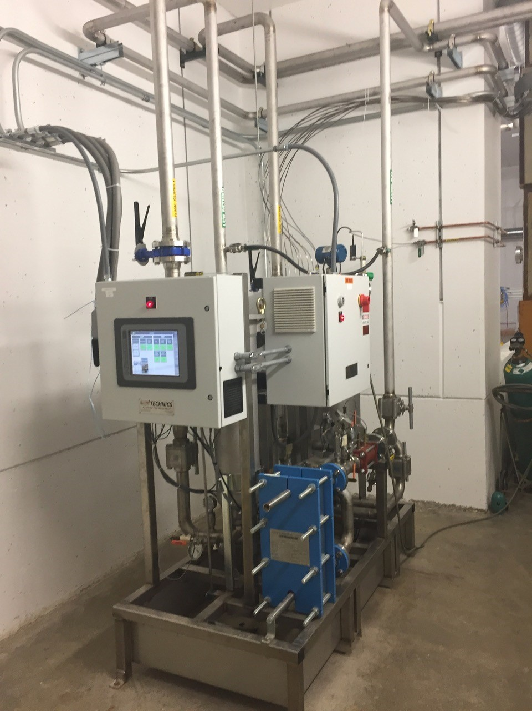
Radioactive Water (RAW) Systems
Isolated water systems
Normal Fluid Systems under the ASME B31.3 Piping System code
Specifically designed to cool highly radioactive devices or accelerator equipment.
Heat exchange with regular LCW or chill water systems
Sometimes with an intermediate system in between
Protects from cross contamination from radioactive water.

Slide 17
Overview
Introduction to NuMI RAW systems
    Target Hall RAW room
    Target Hall DI room
    Absorber Hall RAW room (Not discussed here)
Auxiliary fluid systems for RAW systems
    Target RAW exchange system
    TGT, H1, and H2 Argon purge systems
    H1 and H2 spray nozzle high pressure Argon system
    Absorber RAW exchange system (Not discussed here)
  Future system: H₂ sampling system for H1 and TGT RAW system

Slide 18
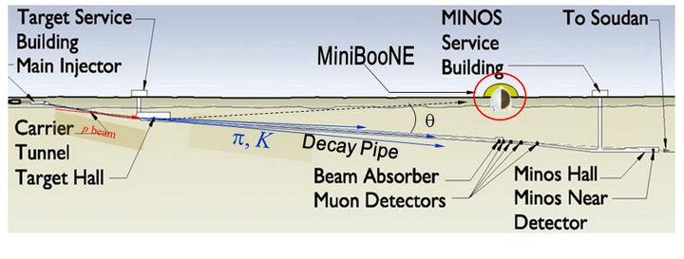
Overview
Target, Horn 1, Horn 2, and Decay Pipe US RAW systems
Decay Pipe DS and Absorber RAW systems

Slide 19
Overview of RAW systems
Target, Horn 1, Horn 2, and Decay Pipe RAW cooling systems are closed loop systems.
They provide cooling water to the above components. The water is maintained at a resistivity of 6-8 MOhm-cm.
There are full-flow filtration and De-Ionization (DI) loops on all of the systems.
There is a flow, pressure, level, temperature, resistivity, and exhaust gas flow (not on Decay pipe RAW) instrumentation package on all the systems.
There are other auxiliary fluid systems that support the RAW system:
  The Argon purge systems to displace the produced H₂ gas.
  The RAW exchange system to maintain a low concentration of tritium in the RAW systems during operations.

Slide 20
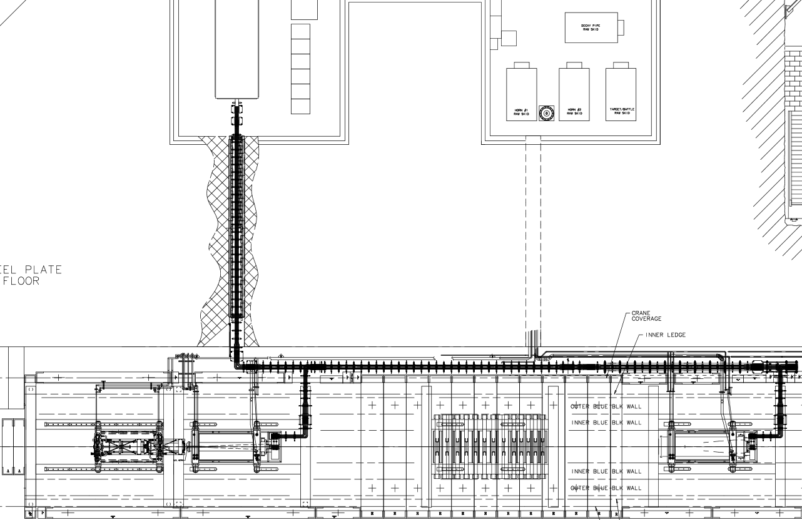
Overview: Plan view of Target Hall
Decay Pipe US RAW System
Horn 1 RAW System
RAW Room
Target RAW System
Target Hall
(Chase)
Horn 1
Horn 1 RAW System
Target
Horn 2
RAW room-Target Hall penetration (~28’ long)
Beam

Slide 21
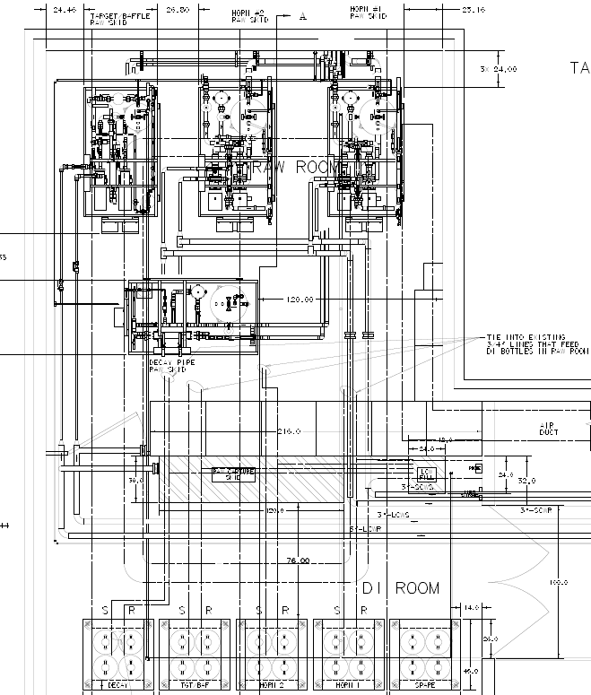
Overview: RAW and DI Rooms
Target RAW System
Horn 2 RAW System
Horn 1 RAW System
Penetration to Target Hall
Decay Pipe US RAW System
RAW system DI bottle casks
2013 upgrade

Slide 22
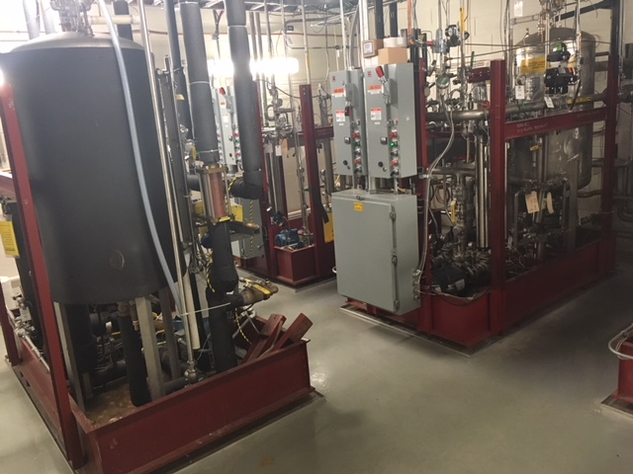
Overview: RAW room
Horn 2 RAW System
Target RAW System
Decay Pipe US RAW System
Horn 1 RAW System

Slide 23
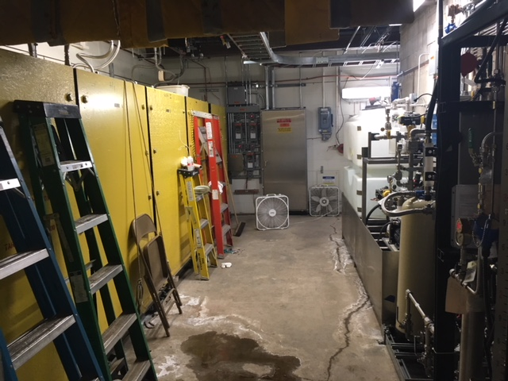
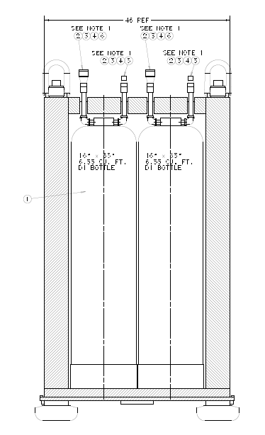
Overview: DI Room
RAW room behind this wall
Exchange system (Fill, make-up, drain RAW systems)
2013 upgrade
DI bottle casks for RAW Systems (6” thick walls)

Slide 24
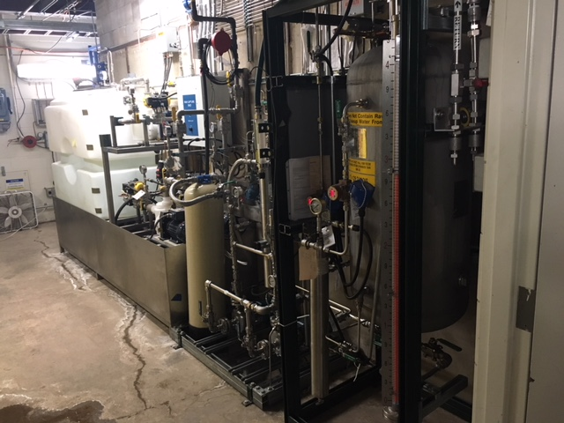
Target RAW Exchange system
Stores RAW water from systems in this tank
Fill and make-up operation: Fills( entire system vol) and makes-up RAW systems with fresh DI water

Slide 25
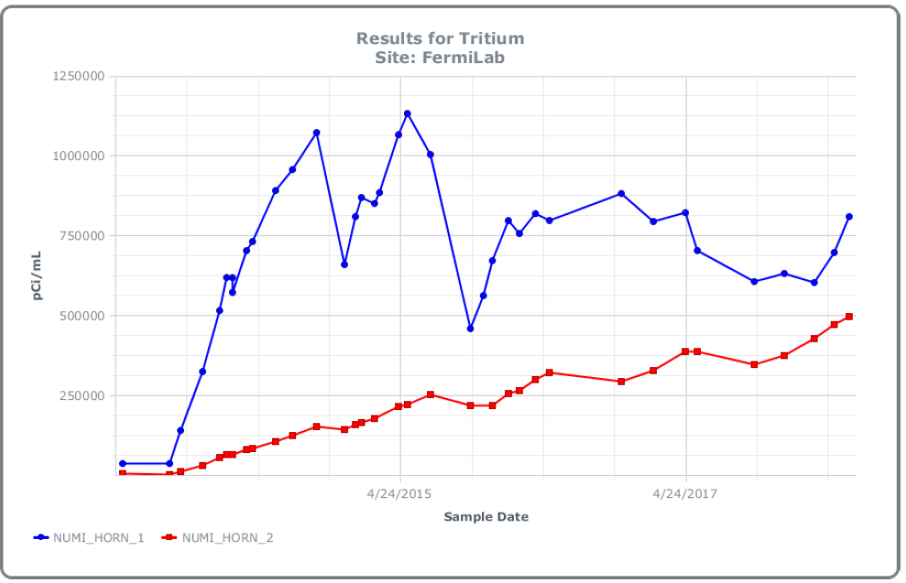
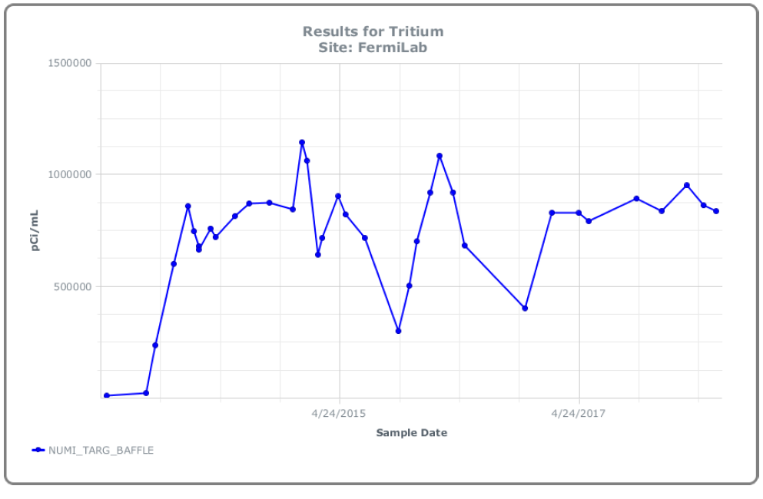
Target RAW Exchange system
During operations, try to maintain tritium concentration to values <=1E06 pCi/ml. This is not a hard limit.
This is done by draining some water from the RAW systems and adding fresh DI water on a weekly basis.
1 Million pCi/ml
1 Million pCi/ml
Source: Abhishek Deshpande, Tony Busch, and Matt Quinn

Slide 26
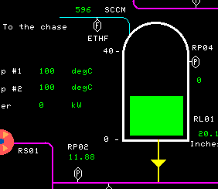
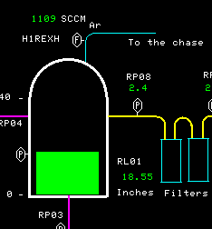
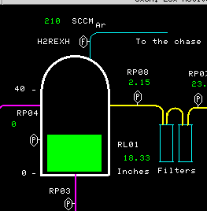
TGT, H1, and H2 Ar purge systems
RAW system expansion tanks have low pressure Argon gas flowing into them.
This is to displace the H₂ produced during beam operations. Outlets of the tanks open Target Hall Chase.
Above measurements are made during downtime (Sept. 25 2018) conditions with newly installed gas mass flow meters.
598 Sccm_{Ar}
502 Sccm_{Ar}
120 Sccm_{Ar}
Target RAW
Horn 1 RAW
Horn 2 RAW

Slide 27
Horn 1 and Horn 2 Spray Nozzle Ar purge systems
Argon is also induced through the Horn 1 and Horn 2 inner conductor water spray nozzles.
This Argon shows up on the exhausts of the H1 and H2 expansion tanks:
502 Sccm_{Ar}
120 Sccm_{Ar}
~1109 Sccm_{Ar}
~210 Sccm_{Ar}
Horn 1
Horn 2
80 Sccm_{Ar}
(Spray Line)
530 Sccm_{Ar}
(Spray Line)

Slide 28
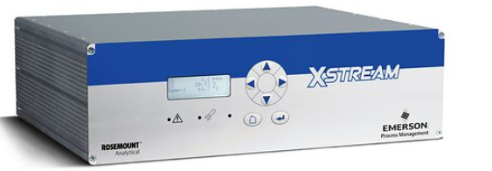
New instrumentation
A gas analyzer to measure H₂, O₂, and water vapor concentrations inside the head space of the RAW system expansion tanks will be purchased.
The sampling line infrastructure has been installed and tested during Shutdown 2018.

Slide 29
Operational experience
DI bottles used to be in the RAW room. They have been upgraded, put into casks, and moved to the DI room in 2013. Less radiation in the RAW room. Prolongs the life of the bottles.
DI bottles have pre and post filters. Increases life of the bottle.
DI bottles not used continuously, 3-way valve loop maintains system resistivity between 6-8 MOhm-Cm. This also increases the life of the bottle.
Filter cartridges are changed every 4 months of beam-time. This too prolongs the life of the DI bottle.
Conventional off-the shelf process instrumentation fails due to radiation in the RAW room. Rad-hard instrumentation or instrumentation with remote signal conditioning capabilities is selected. A radiation map of the RAW room is created by placing dose monitors in various locations. This map is used to install instrumentation that is not rad-hardned.
Copper oxide is an issue with systems with copper piping: Decay Pipe RAW system. There are 3 full-flow filtration loops with 5 micron absolute filter cartridges. They are replaced every 4 months of beam-time.
In the copper systems, water is replaced every 2 years.
Argon purge on all the system expansion tanks prevents carbonic-acid and nitric acid formation.

Slide 30
Copper Oxide

Slide 31
History of the Copper Oxide Problem in Muon Campus (formerly Pbar)
  Oxygen introduced into the LCW system during maintenance activities combined with copper in solution to form copper oxide
  Copper oxide accumulates in the system and plugs narrow flow paths in water cooled devices
  Water cooled devices overheats.
  Shutdown accelerator operations, requiring intrusive back flushing procedures

Slide 32
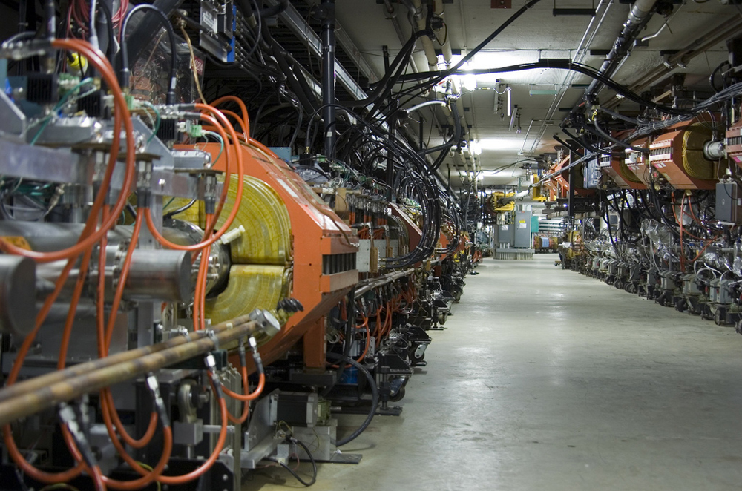
Copper Oxide

Slide 33
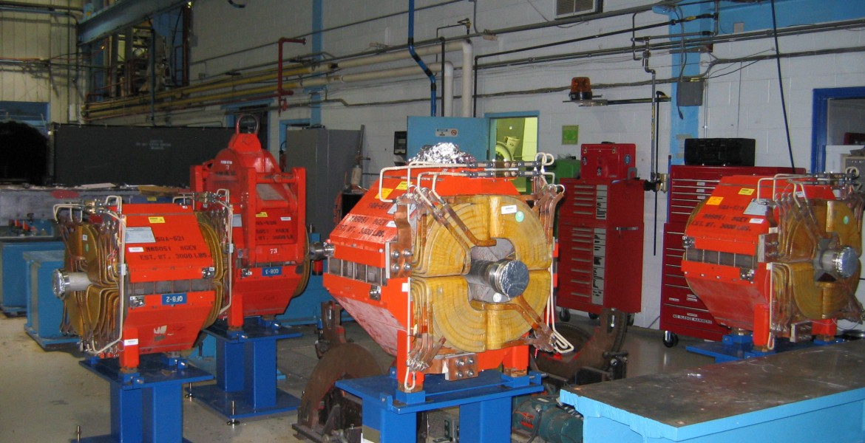

Slide 34
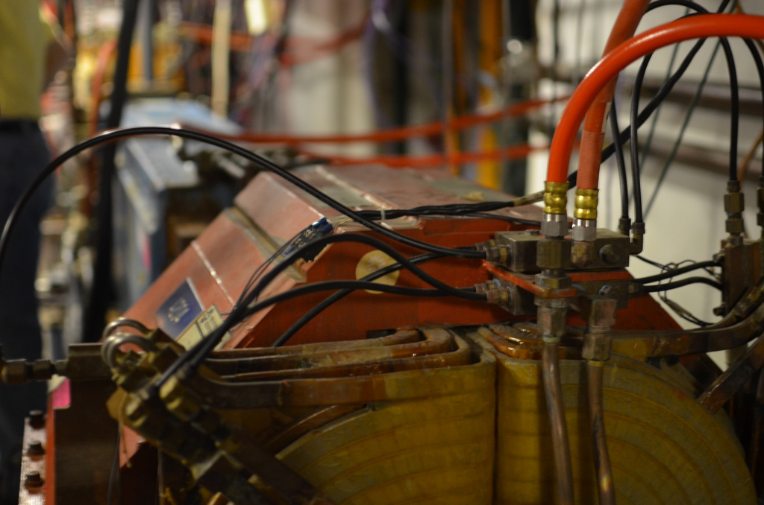

Slide 35
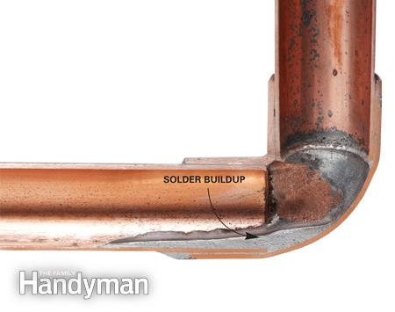
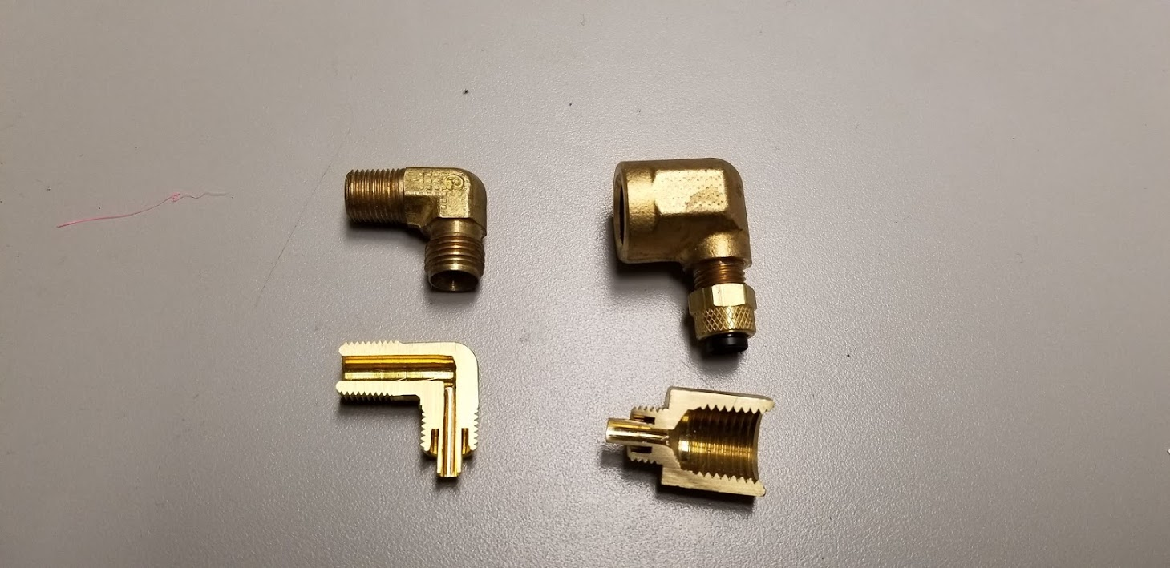

Slide 36
Copper Oxide - Resolution
  Monitor, trending of oxygen and particulate levels via DO and TDS sensors
  Remove the oxygen, Prevent new oxygen from entering
  Remove copper oxide particulate, via full flow filtration

Slide 37
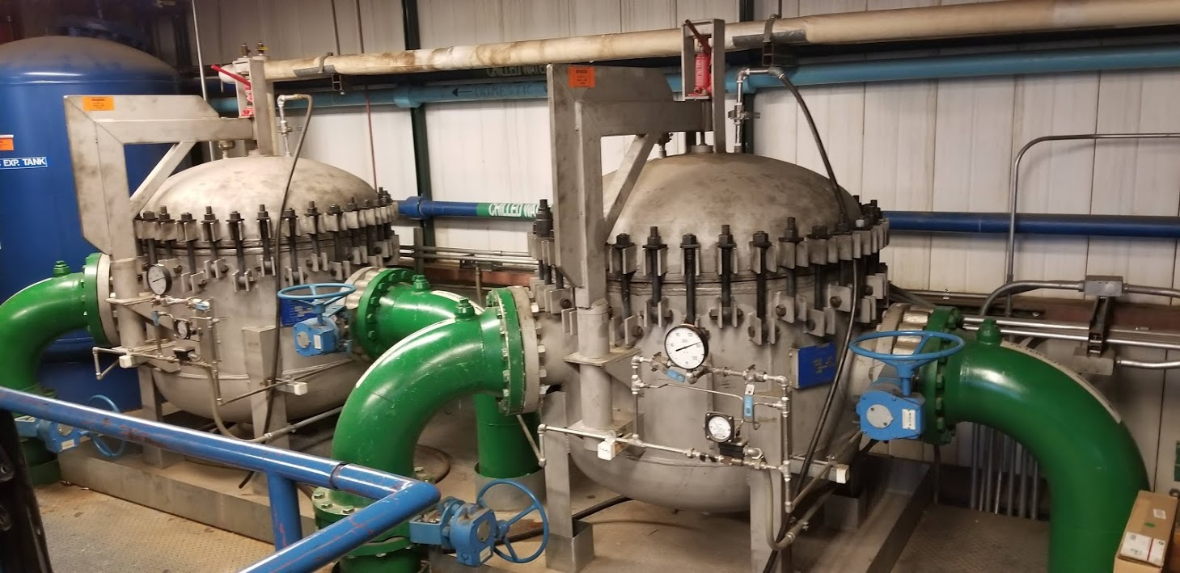
Copper Oxide – Action Plan/Implementation
  Full-Flow Filtration (PIC)
  Maintenance Program

Slide 38
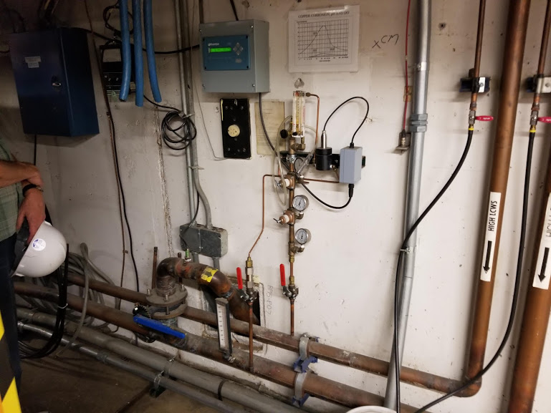
Copper Oxide – Action Plan/Implementation
  Dissolved Oxygen/TDS Sensors (PIC)
  High maintenance
  Constant calibration

Slide 39
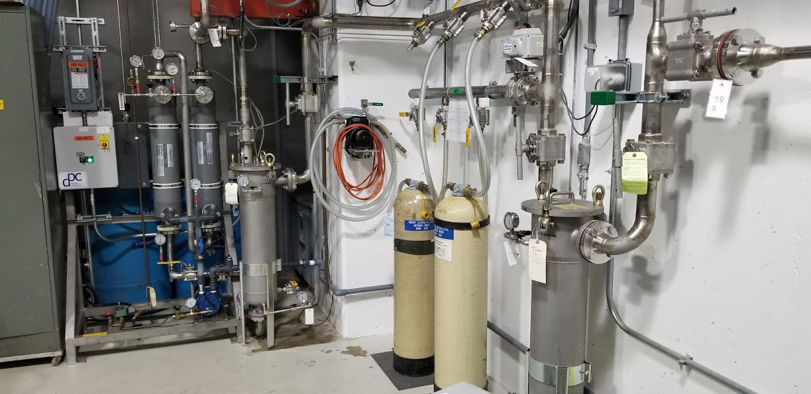
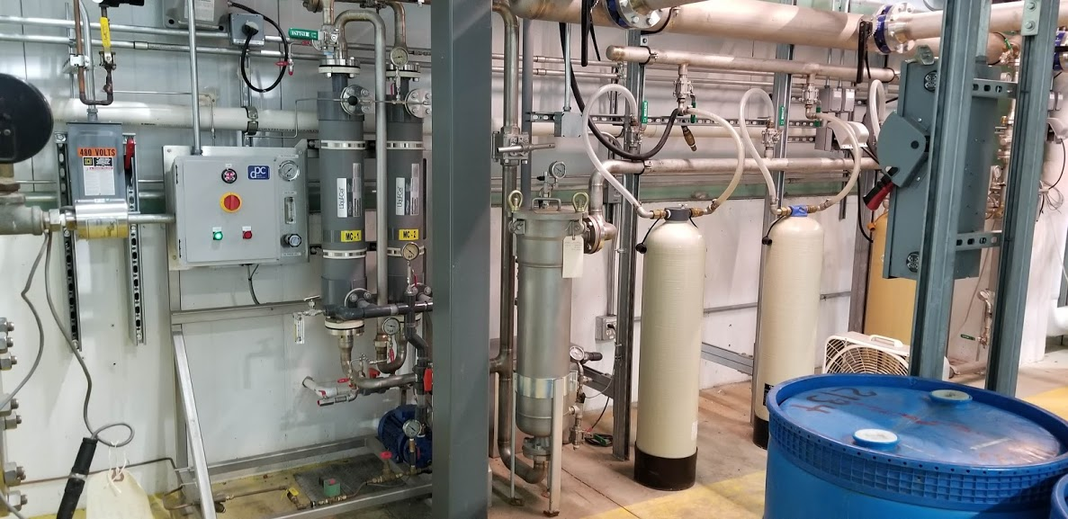
Copper Oxide – Action Plan/Implementation
  Oxygen Removal Skid – Liqui-Cel Technology
  Uses Nitrogen gas to pull a vacuum through a cel membrane

Slide 40
Summary
Fluid Systems require careful consideration, care, and respect.
Not just plumbing - “Its not just water”
Fluid systems are critical process systems.
Serious consideration must be taken regarding
  Design
  Installation
  Commissioning
  Operation
Other issues That Require Engineering Input/Consideration
  Radioactive Water (RAW) Systems
  Copper Oxide Mitigation

Slide 41
References/Acknowledgements
The Chemistry Of Copper In Water And Related Studies Planned At The Advanced Photon Source - R. Dortwegt , Advanced Photon Source, Argonne National Laboratory, Argonne, IL 60439 E.V. Maughan, College of Knowledge; Duisburg, Germany D-47198
Experience With Copper Oxide Production In Antiproton Source Components At Fermi National Accelerator Laboratory- Christine R. Ader (FNAL), Elvin R. Harms, Jr. (FNAL), James P. Morgan (FNAL), Fermi National Accelerator Laboratory
Abhishek Deshpande, Fluids Machine Engineer, Beamlines and Muon Campus, AD/Mechanical Support Department, Fermi National Accelerator Laboratory
David Hixson, Fluids Machine Engineer, Proton Source and Main Injector/Recycler Machine, AD/Mechanical Support Department, Fermi National Accelerator Laboratory
Karl Williams, Deputy Head, Project Engineering Group, AD/Mechanical Support Department, Fermi National Accelerator Laboratory
Jerzy Czajkowski, Fluids Machine Engineer, Fermilab Accelerator Science and Technology (FAST) Facility, AD/Mechanical Support Department, Fermi National Accelerator Laboratory

Slide 42
Questions?

