Slide 1
Near Detector Hall Options –
June 2018 Update
T. Hamernik
15 June 2018
DUNE DocDB 3866

Slide 2
June 2018 Update
Various ND hall configurations (Options A – D) were proposed by DUNE and studied by CF in mid-2017. The CF cost impacts were presented in June 2017.
Late 2017/early 2018 discussions suggested the collaboration was going to request a 50% lengthening of the detector hall (Option B).
Team targeted May 2018 as goal for finalizing the hall configuration. Goal was to determine size and configuration of cavern and shaft locations to allow ND geotechnical exploration to begin in September 2018
The collaboration confirmed their requested hall dimensions in June 2018. Despite earlier indications, requested changes are similar in impact to Option C (100% lengthening of the detector hall).

Slide 3
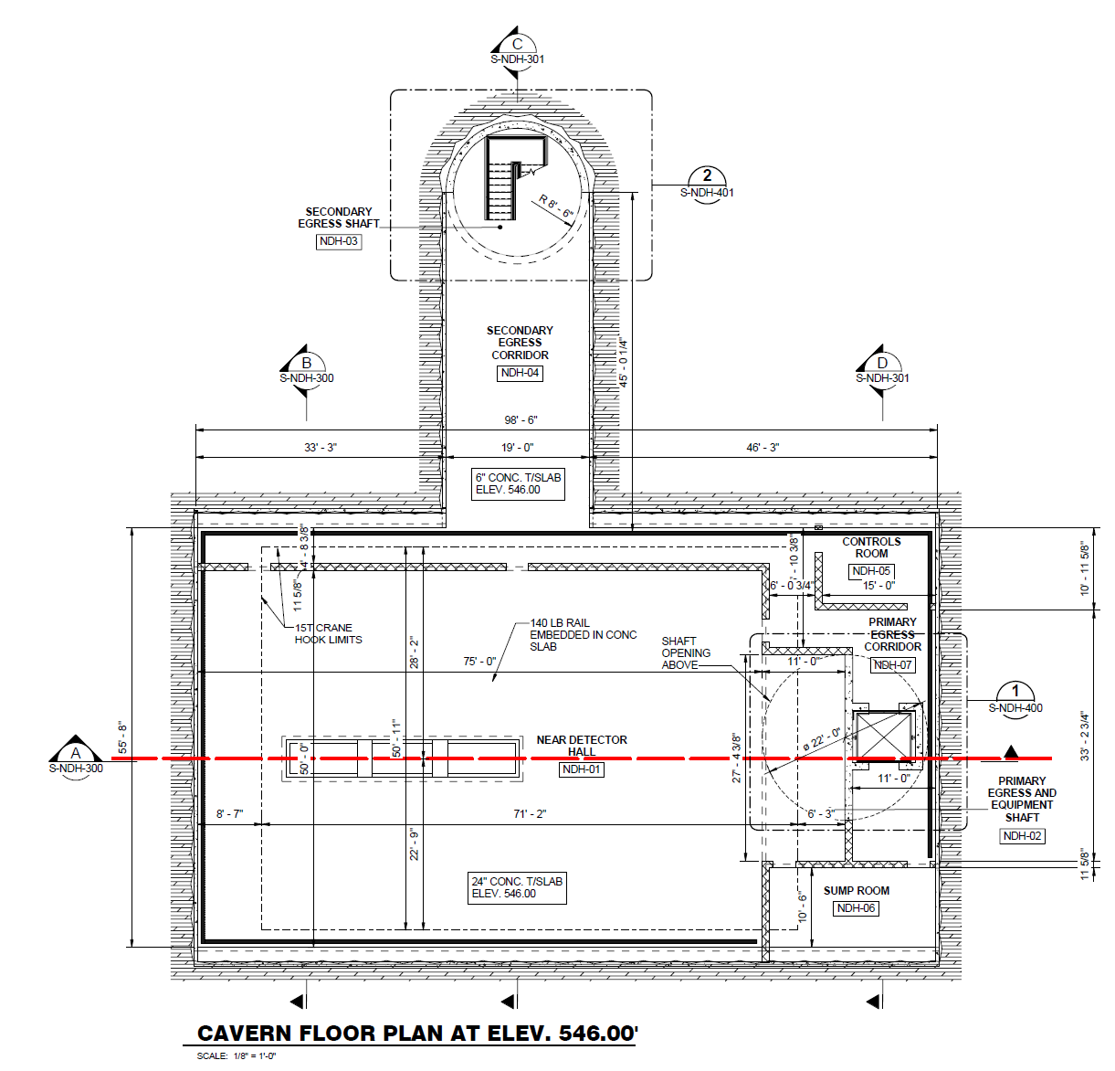
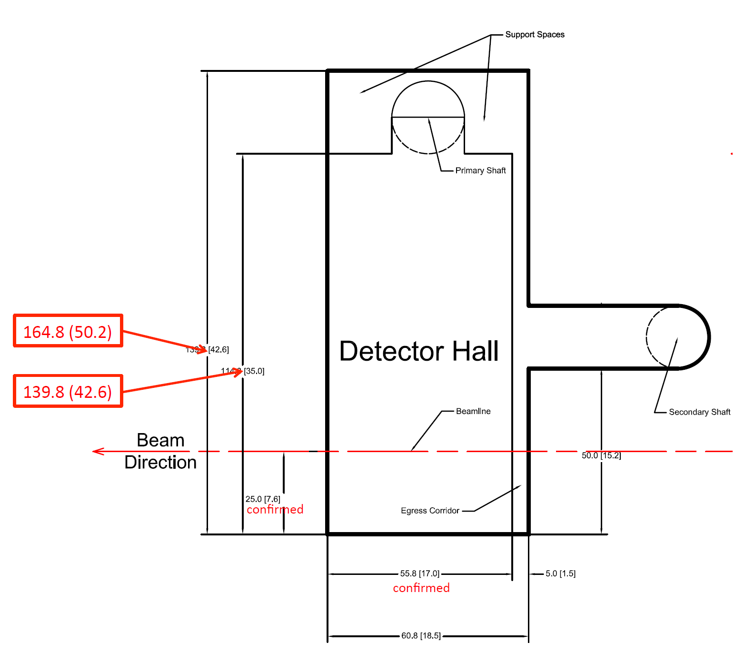
June 2018 Update
Reference ND Detector Cavern Concept:
100ft x 56ft Cavern with
75ft x 50ft Detector Hall
June 2018 ND Collaboration Proposal:
165ft x 61ft Cavern with
140ft x 56ft Detector Hall

Slide 4
June 2018 Update – CF Cost Impacts – With Contingency (TPC)
Notes:
Design and estimate are at the conceptual level.
All costs are FY2015 Direct and based on 2016 AECOM Estimate, DUNE DocDB 1622-v3
No changes to service building or shafts are thought to be necessary and have not been evaluated
Assumes maximum egress distances can be met using current egress corridor concept

Slide 5
June 2018 Update – CF Cost Impacts – With Contingency (TPC)
* June 2018 Proposal adds approximately $10M (TPC)
Notes:
Design and estimate are at the conceptual level.
All costs are FY2015 Direct and based on 2016 AECOM Estimate, DUNE DocDB 1622-v3
No changes to service building or shafts are thought to be necessary and have not been evaluated
Assumes maximum egress distances can be met using current egress corridor concept
*

Slide 6
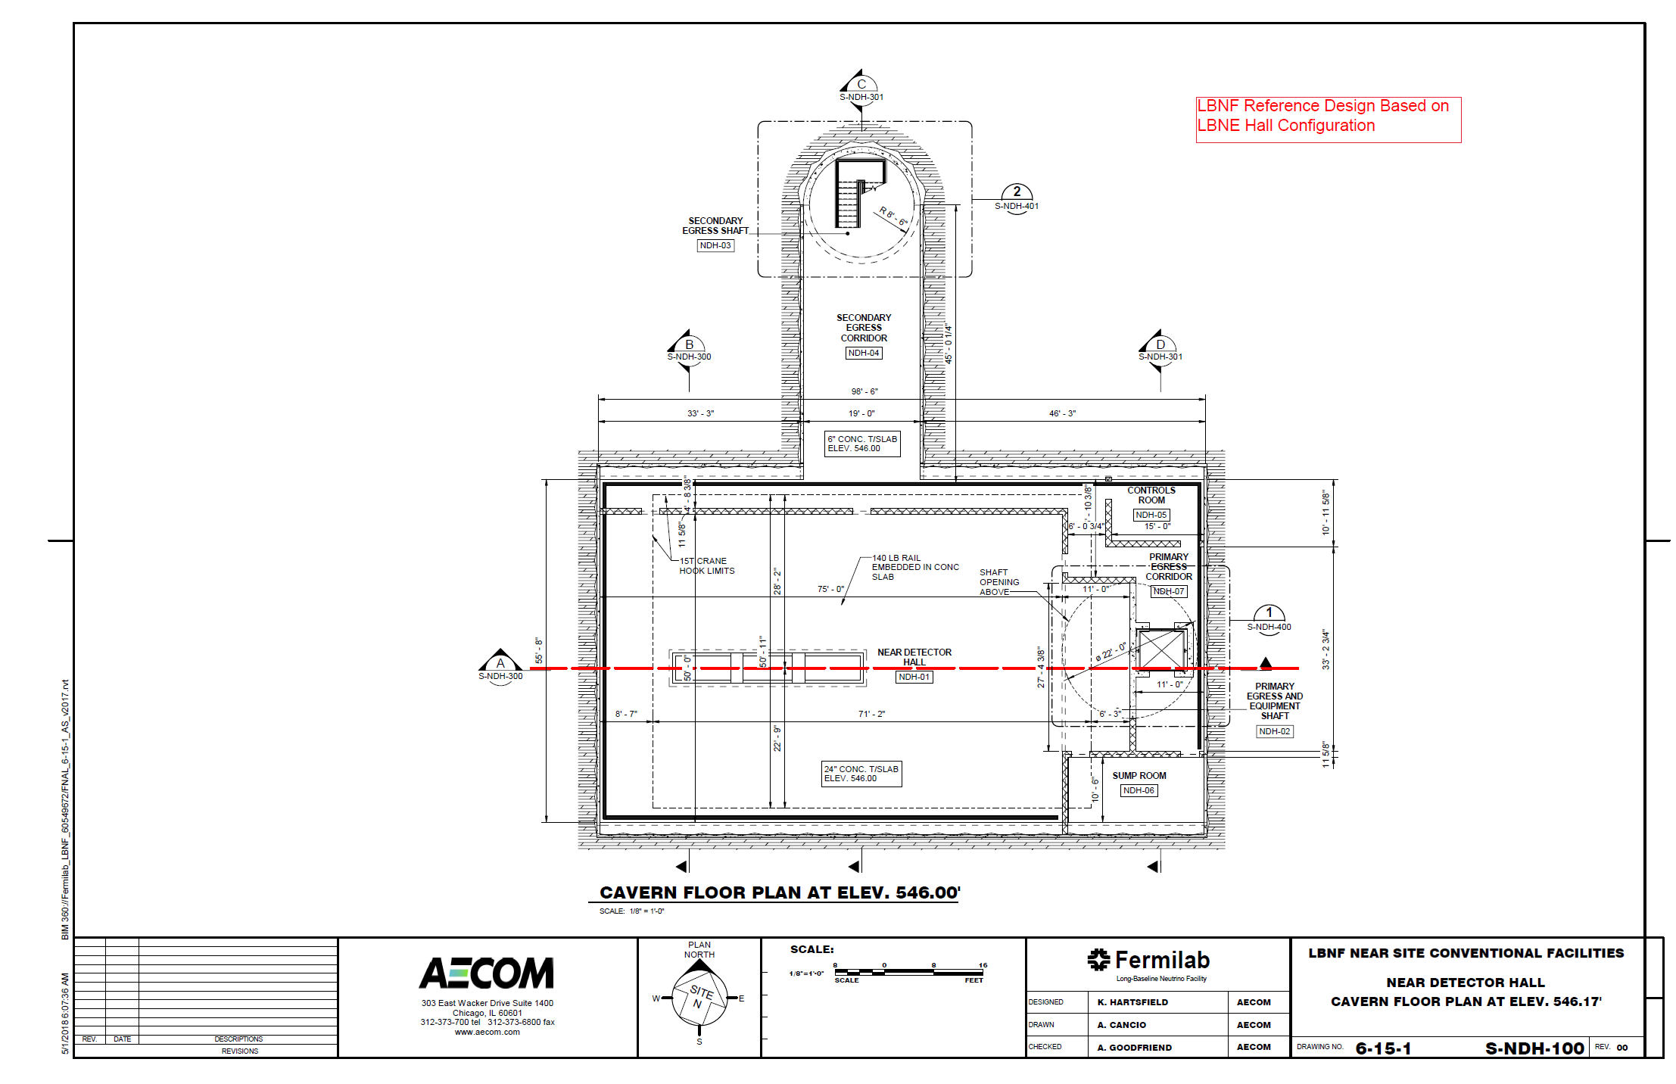
June 2018 Update – Reference Design

Slide 7
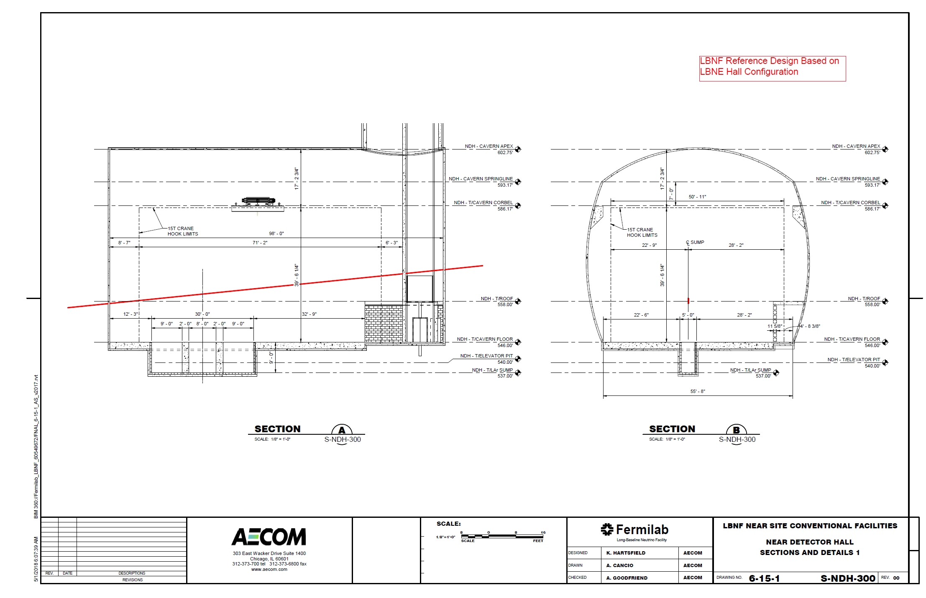
June 2018 Update – Reference Design

Slide 8
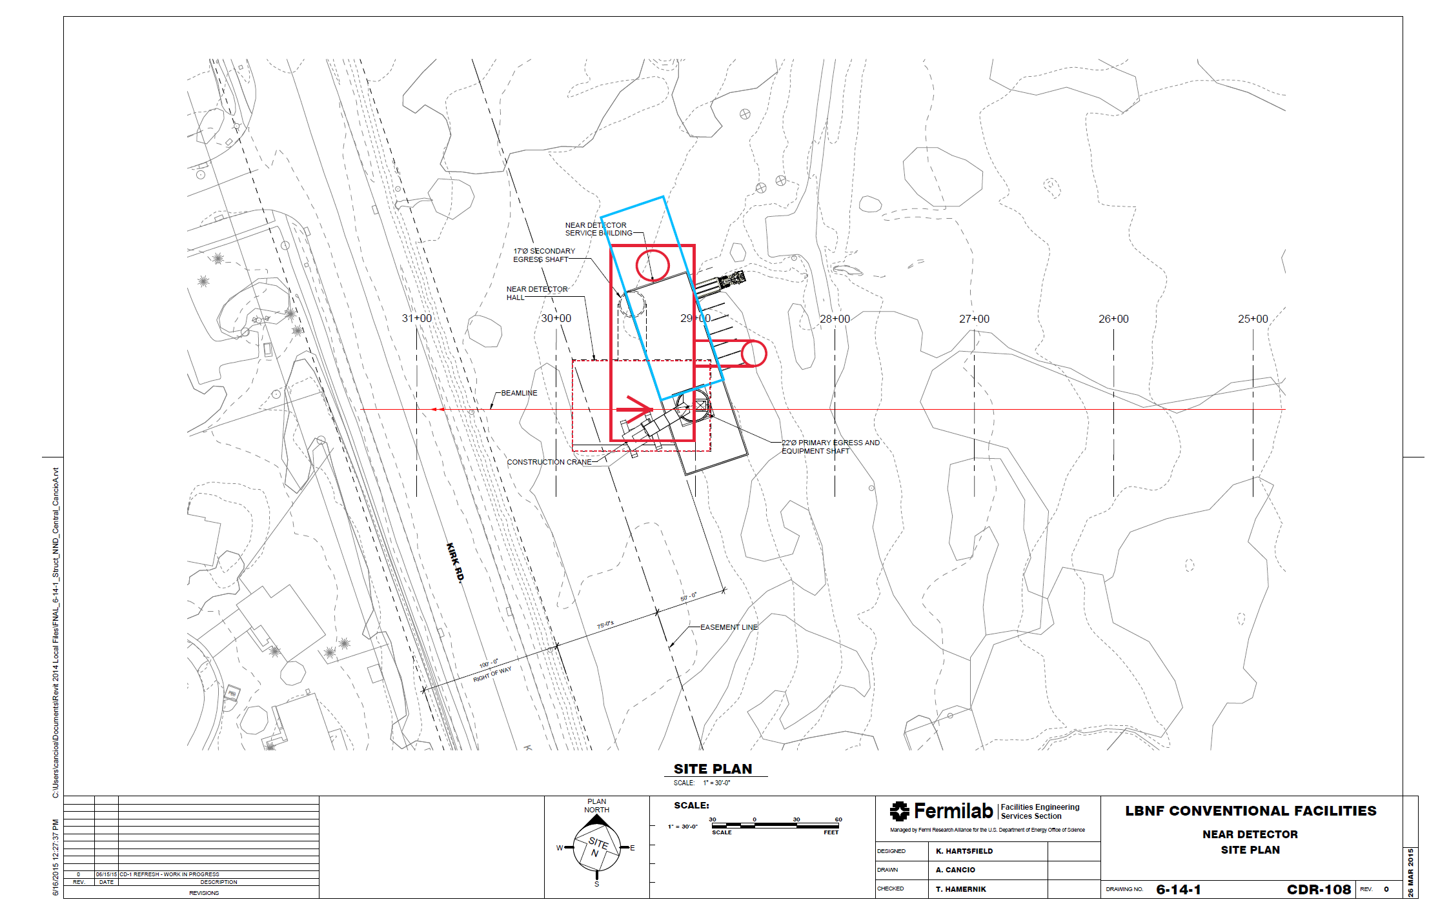
June 2018 – New Orientation / Cavern Slightly Upstream of Reference Position

Slide 9
Backup Slides

Slide 10
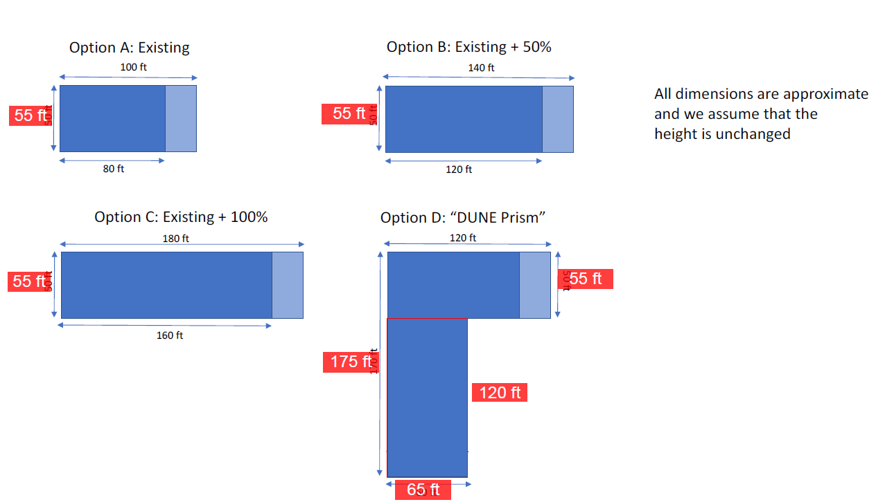
Request to Evaluate Near Detector Hall Options
DUNE has requested CF’s support in evaluating the CF cost impacts of several Near Detector Hall options.
Dimensions in reflect current plan include a 50ft wide detector hall and an additional 5ft for an egress corridor
Options received from Mark Thomson, 26 May 2017

Slide 11
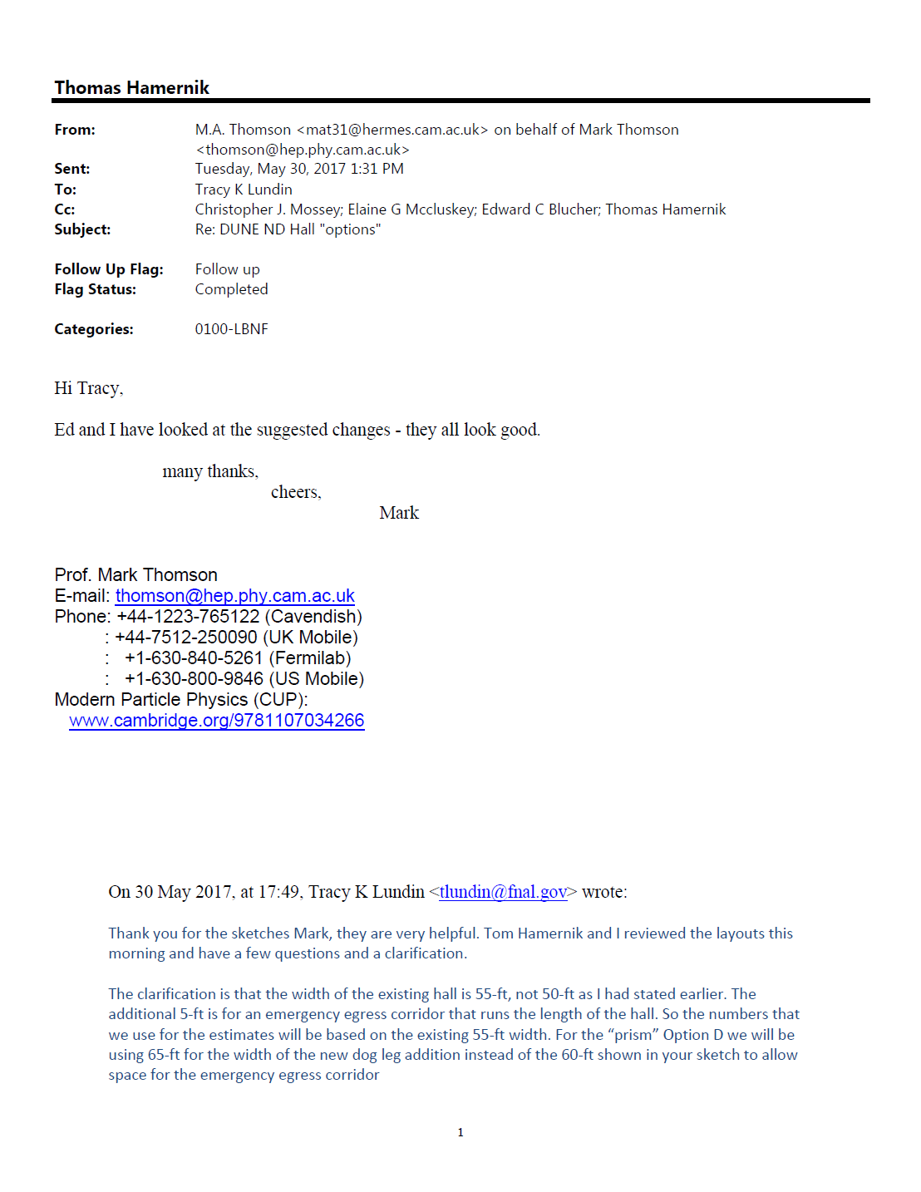
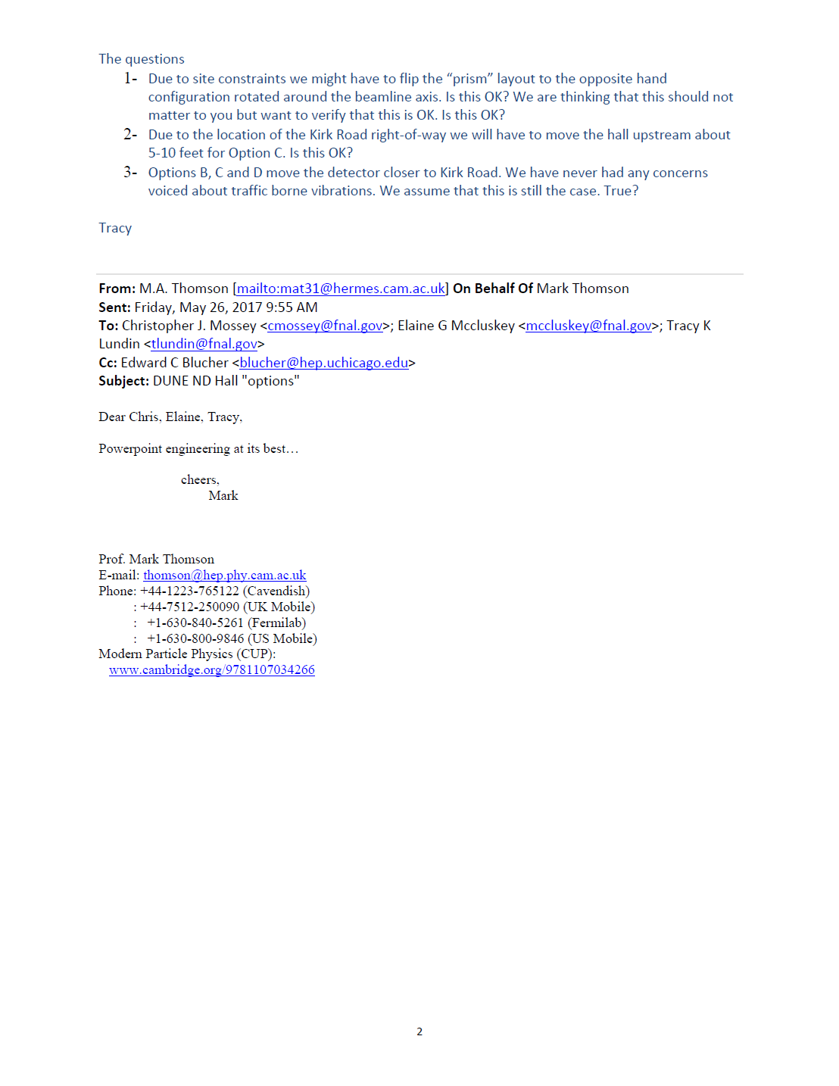
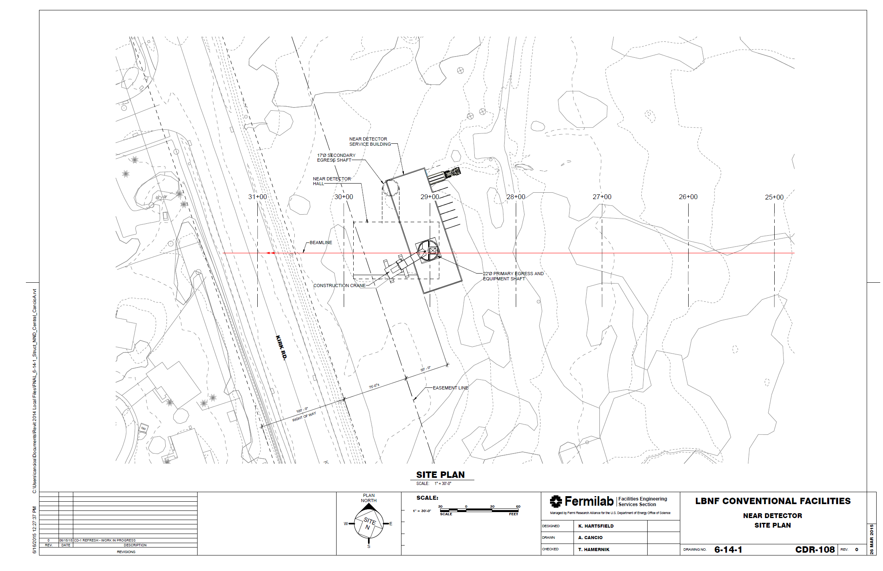
Changes Proposed by CF to Minimize Impact of Site Constraints Deemed Acceptable

Slide 12
Cost Impact Approach
For Options A, B, & C, costs were generally scaled by the ratio of the length of the proposed cavern to the length of the reference design.
A similar approach was used for Option D except that some quantities were scaled by both length and width or by functions of length and width (such as cross-sectional area) to reflect the wider, longer dogleg cavern.
New quantities were calculated for several line items.
Estimated impacts were applied to several line items when scaling was considered inappropriate.
A second 15-ton crane was added to Option D for the dog-leg cavern.
A “Shallow Rock Cover and Geometrical Complications Factor” was applied to the Option D excavation impact to produce an adjusted Option D cost delta to reflect likely complications resulting from the wider hall’s reduced span-to-rock overburden ratio.

Slide 13
CF Cost Impacts – Direct Cost Compare to Reference Design
Option B is 15% Higher / Option C is 29% Higher / Option D is 74% Higher
Notes:
Design and estimate are at the conceptual level.
All costs are FY2015 Direct and based on 2016 AECOM Estimate, DUNE DocDB 1622-v3
No changes to service building or shafts are thought to be necessary and have not been evaluated
Assumes maximum egress distances can be met using current egress corridor concept

Slide 14
CF Cost Impacts – With Escalation and EDIA (BCWS)
Option B adds $3.8M / Option C adds $7.6M / Option D adds $19.2M
Notes:
Design and estimate are at the conceptual level.
All costs are FY2015 Direct and based on 2016 AECOM Estimate, DUNE DocDB 1622-v3
No changes to service building or shafts are thought to be necessary and have not been evaluated
Assumes maximum egress distances can be met using current egress corridor concept

Slide 15
CF Cost Impacts – With Contingency (TPC)
Option B adds $4.9M TPC / Option C adds $9.7M / Option D adds $24.5M TPC
Notes:
Design and estimate are at the conceptual level.
All costs are FY2015 Direct and based on 2016 AECOM Estimate, DUNE DocDB 1622-v3
No changes to service building or shafts are thought to be necessary and have not been evaluated
Assumes maximum egress distances can be met using current egress corridor concept

Slide 16
Other Considerations
The ND is not currently on the critical path and schedule impacts have not been considered (yet).

Slide 17
Back-up Slides

Slide 18
Overview
“Current” NSCF Near Detector design is conceptual and more than a year old
Last related CF activity was preparation for the July 2015 DOE CD-1 Refresh Review / NSCF activities have been minimal since
The Near Detector was rapidly evolving at that time with significant power requirement increases anticipated
There were ongoing discussions about the available distance between the Absorber and Near Detector facilities related to muon range out and the potential for a longer target chase (realized) and longer decay pipe (since abandoned)

Slide 19
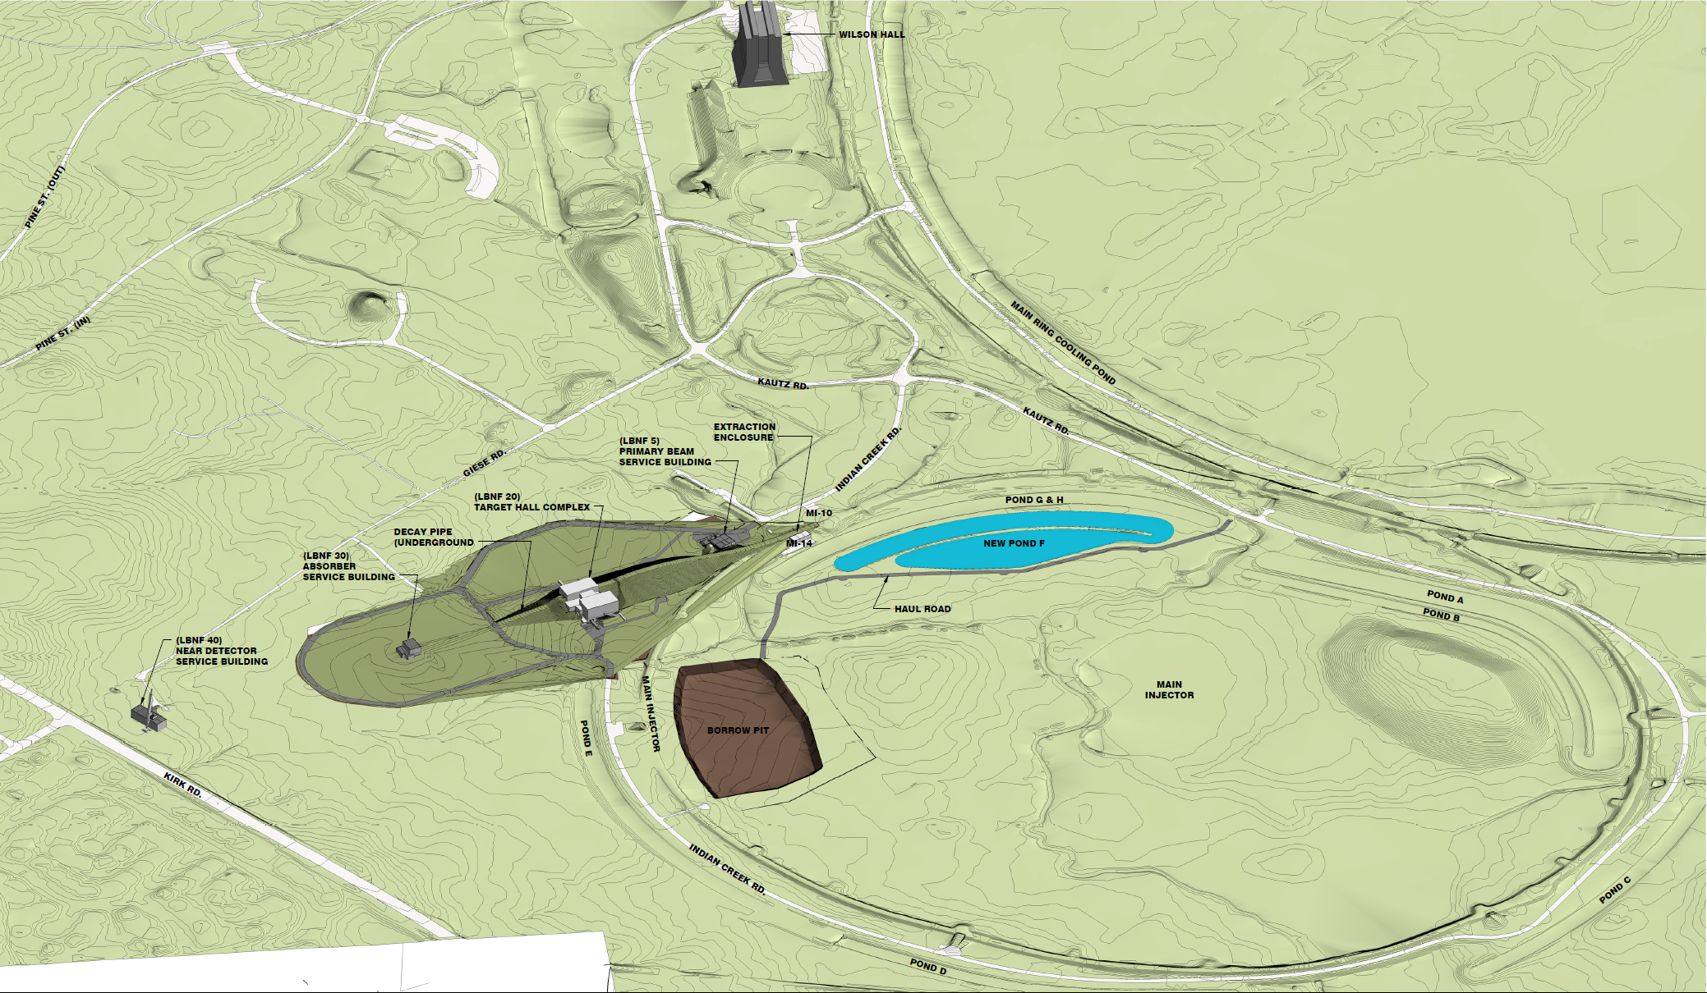
Near Site Overview
TRUE NORTH

Slide 20
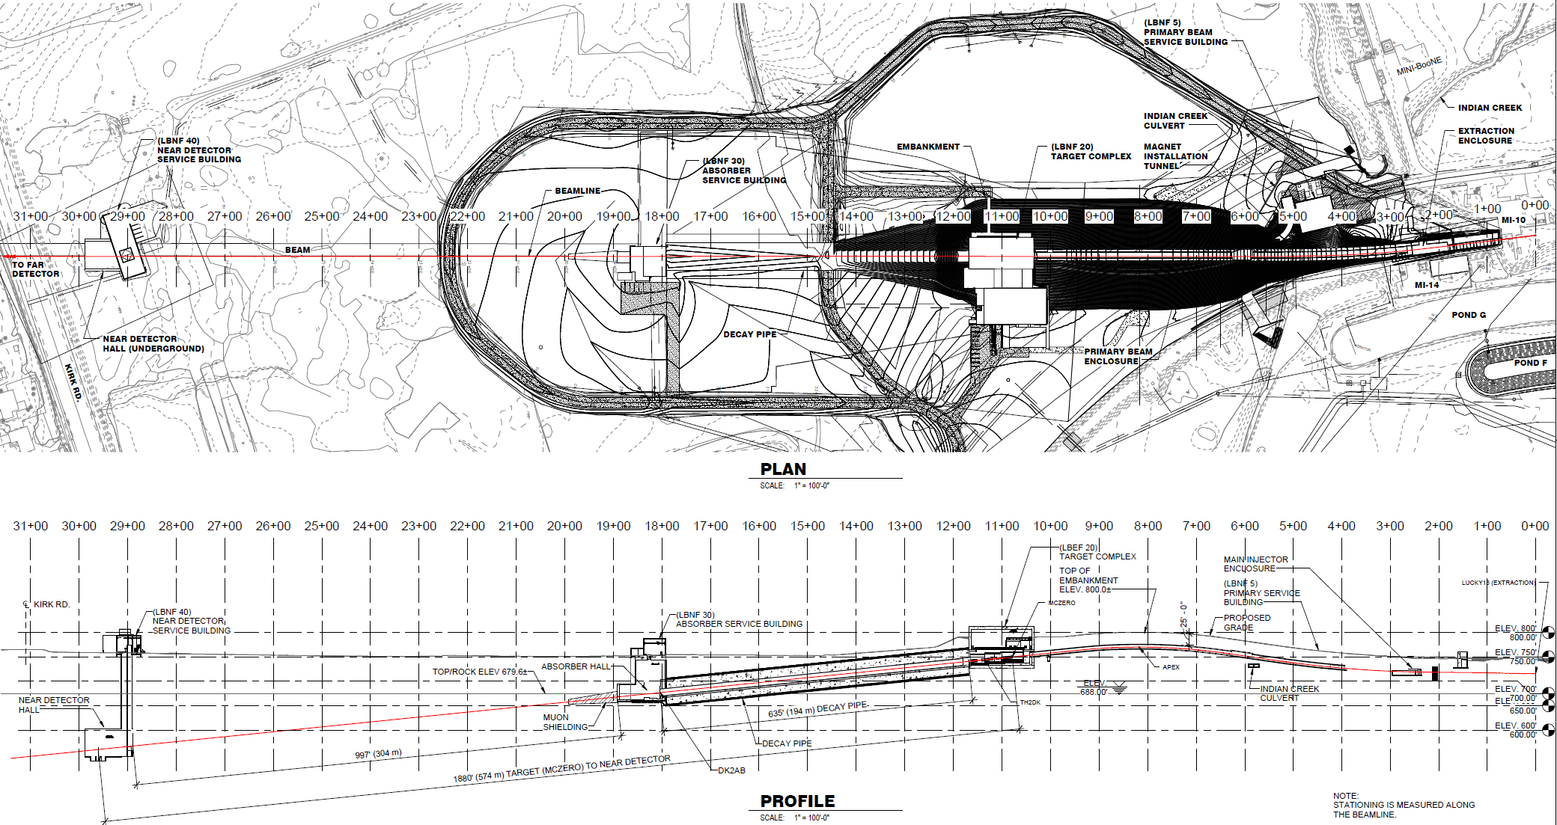
Plan and Profile

Slide 21
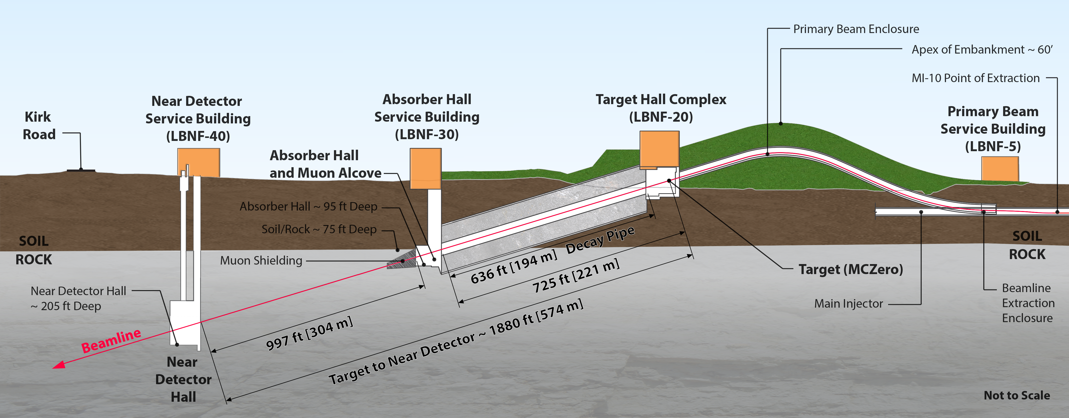
Near Site Profile
*
* Dimension given is distance from target to assumed ND center (not upstream end of ND Hall as depicted by dimension line)
LBNE DocDB 11180

Slide 22
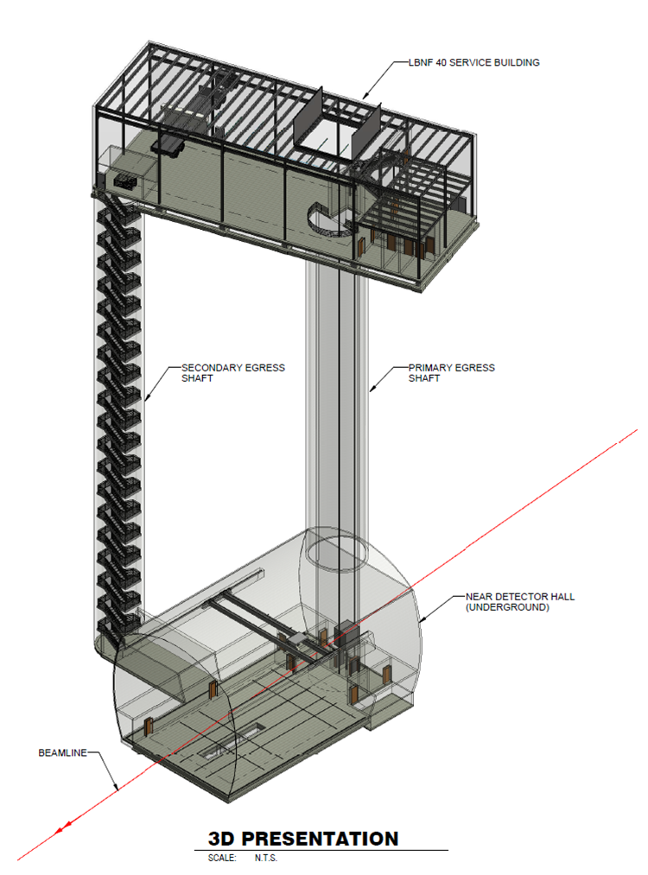
Near Detector Conventional Facilities Overview
Scope includes:
  Service building
  Primary and secondary shafts
  Underground detector hall
  Supporting site infrastructure (not shown)
Detector Hall:
  Excavated in rock a depth of over 200 feet below ground surface

Slide 23
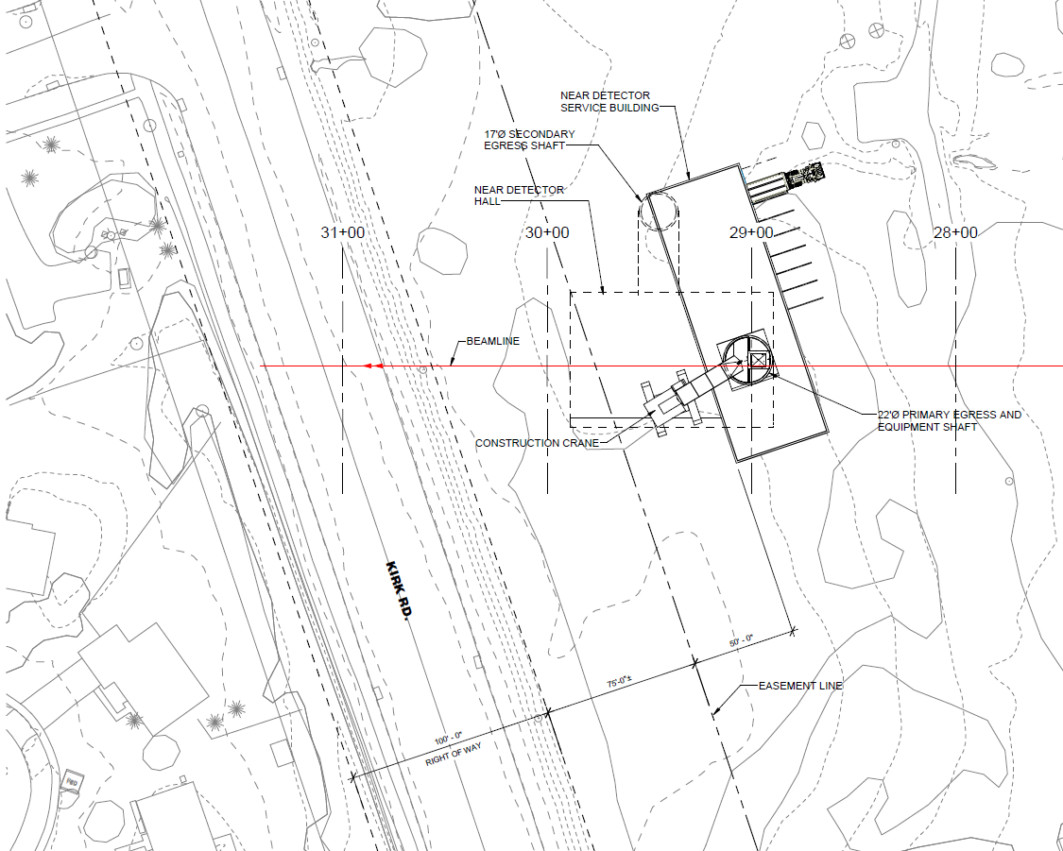
Service Building – Siting Considerations
Goal is to locate as far downstream as property allows
No permanent surface features within 75-ft utility easement but can build underground
50-ft clearance for access around structure perimeter
Hardstand and parking areas
Equipment yard for electrical and mechanical equipment
Can be oriented parallel to Kirk Road

Slide 24
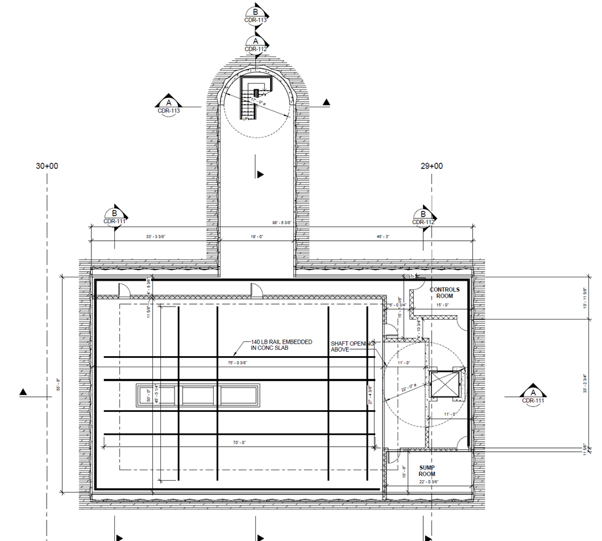
Detector Hall
Approximately 56-ft wide x 100-ft long wide by
Provides 50-ft wide x 75-ft long detector area with ~37-ft hook height

Slide 25
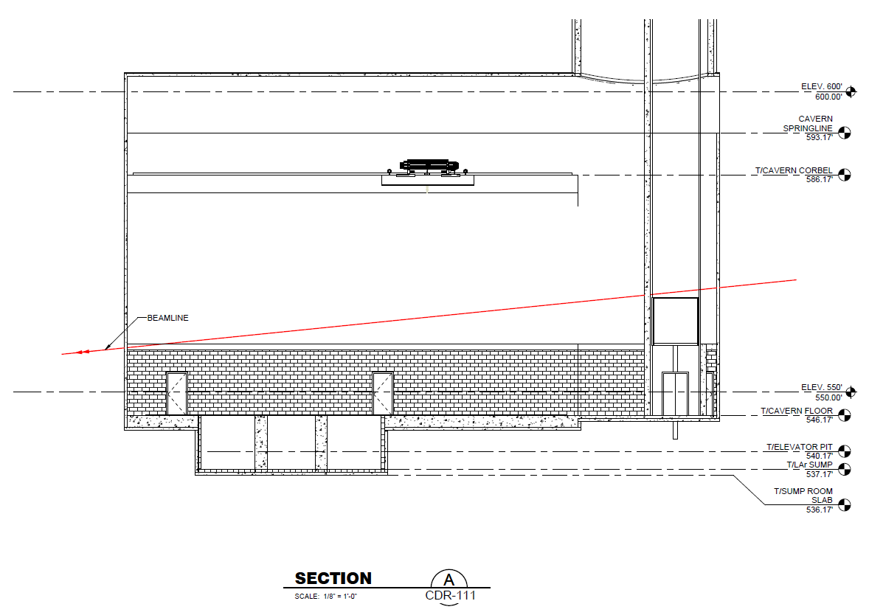
Detector Hall – Profile
Cavern floor elevation set so that beam is 4.4m above center of LAr sump
4.4 m

Slide 26
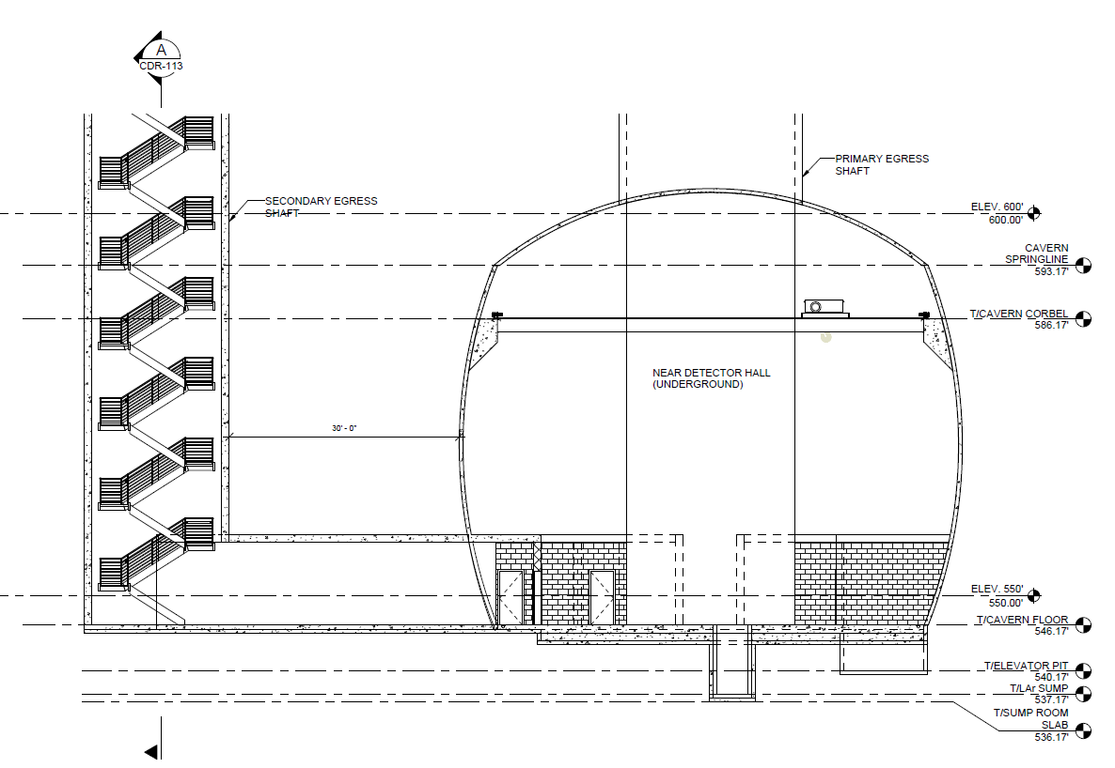
Detector Hall Section

Slide 27

Service Building – Siting Considerations
Current location of Hall:
  Maximizes rock cover over hall (good)
  Maximizes muon range-out distance (good)
  Creates opportunity to expand hall upstream (but not without complications)
*
* Dimension given is distance from target to assumed ND center (not upstream end of ND Hall as depicted by dimension line)

