Slide 1
PIP-II Update
In partnership with:
India/DAE
Italy/INFN
UK/STFC
France/CEA/Irfu, CNRS/IN2P3
Lia Merminga
DUNE Collaboration Call
19 October 2018

Slide 2
Outline
PIP-II Mission and Scope
Progress Update
PIP-II Principles of International Partnerships
Summary

Slide 3


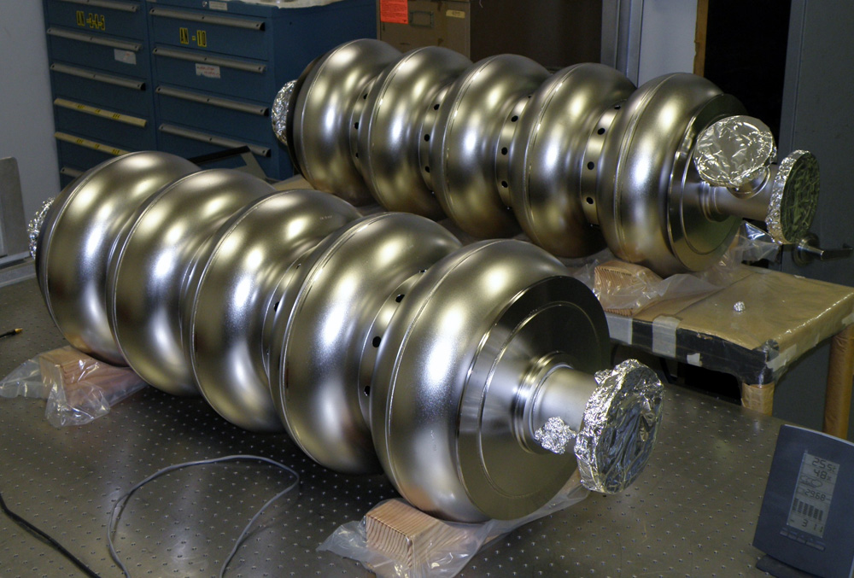





PIP-II: convergence of three compelling factors
Mission Need
Particle Physics is Global
Fermilab leadership in SRF technology

Slide 4
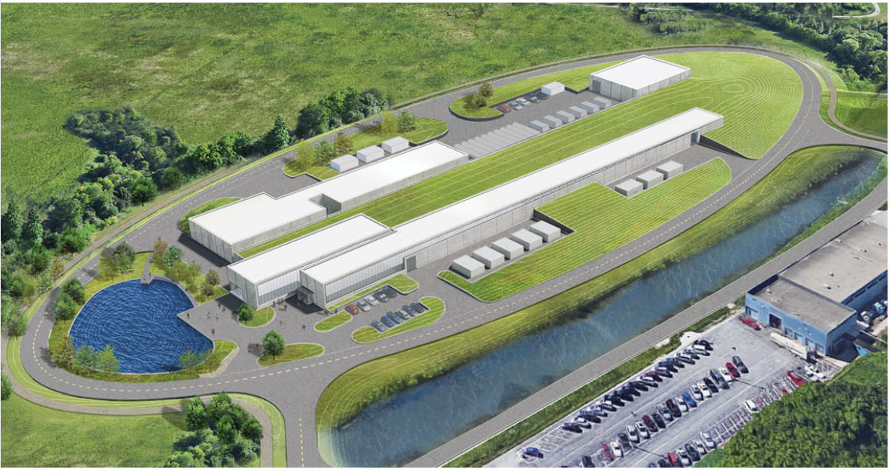
PIP-II Mission
Mission
PIP-II will enable the world’s most intense beam of neutrinos to the international LBNF/DUNE project, and a broad physics research program, powering new discoveries for decades to come.
PIP-II linac will provide:
Beam Power
Meeting the needs for the start of DUNE (1.2 MW proton beam)
Flexibility
Upgradeable to multi-MW capability for LBNF/DUNE
Compatible with CW-operations which greatly increases the linac output
Customized beams for specific science needs
High-power beam to multiple users simultaneously
Reliability
Fully modernizing the front-end of the Fermilab accelerator complex
Building the world’s most powerful neutrino beam cost-effectively

Slide 5
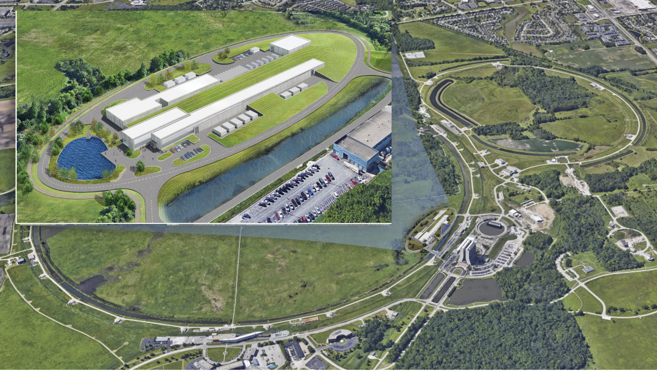
PIP-II Site

Slide 6
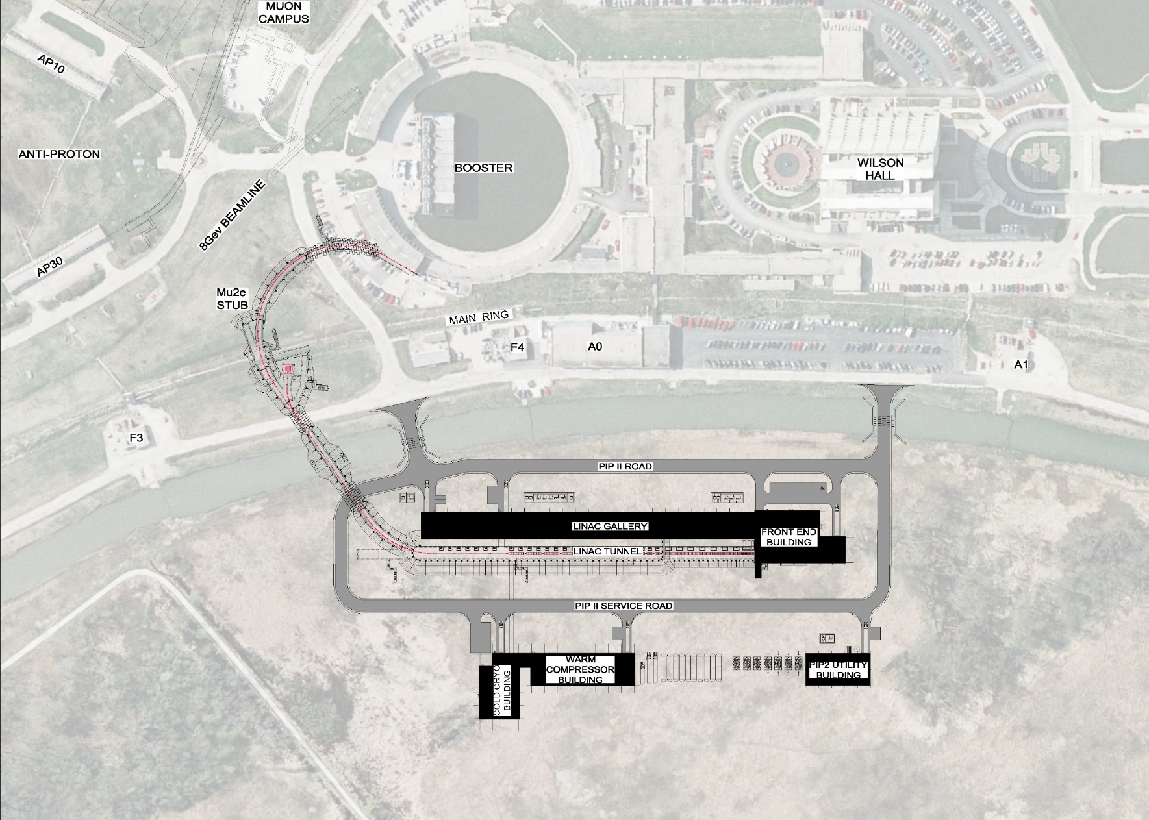
PIP-II Scope
Rings Upgrades
BTL
Linac
Conventional Facilities

Slide 7
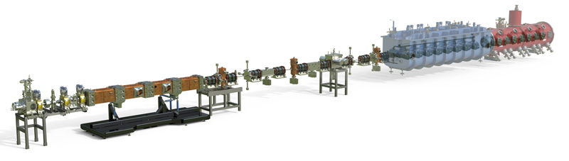
PIP-II Injector Test Facility (PIP2IT)
The PIP-II 800 MeV Linac Technologies
Room Temperature
Technology
Superconducting
Radio Frequency Technology
PIP-II Injector Test Facility retires a significant number of technical risks – complete in FY21

Slide 8
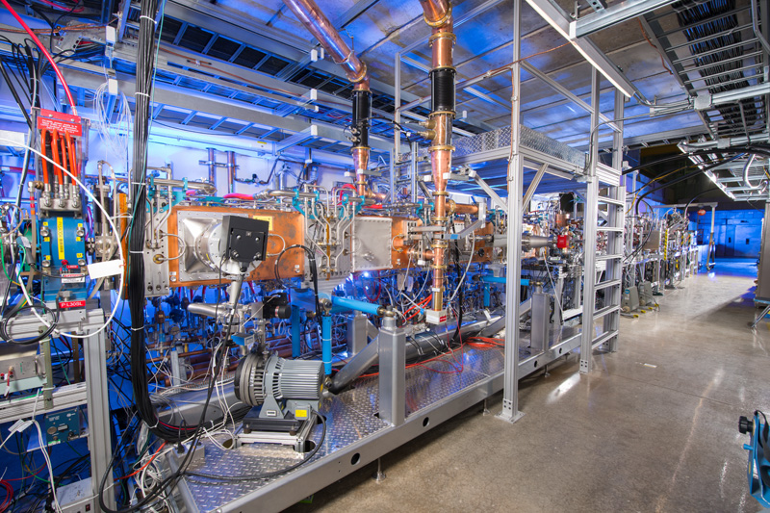
PIP-II Injector Test Facility (PIP2IT)

Slide 9
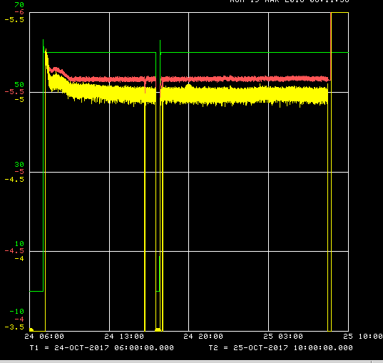
Beam through full length MEBT
Demonstrated transporting the beam at “CDR parameters” through the final-length PIP2IT MEBT for 24 hours
  5 mA ×0.55 ms×20 Hz×2.1 MeV
Long run demonstration at CDR parameters (24-25 Oct-17)
Ran by Operators from the Main Control Room
“Booster injection” chopper waveform
2 interruptions (1 hour total)
  Beam availability ~96%
RFQ
DCCT
Dump
J.-P. Carneiro
B. Hanna
V.L.S. Sista
A. Saini
A. Shemyakin
24 hours
0.5 mA/div for currents

Slide 10
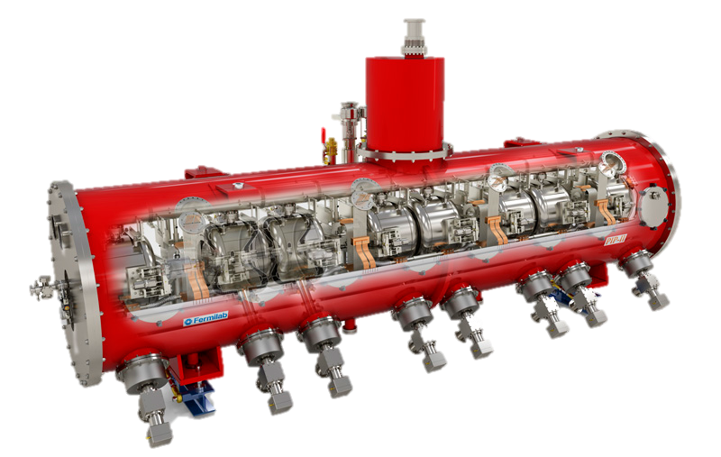
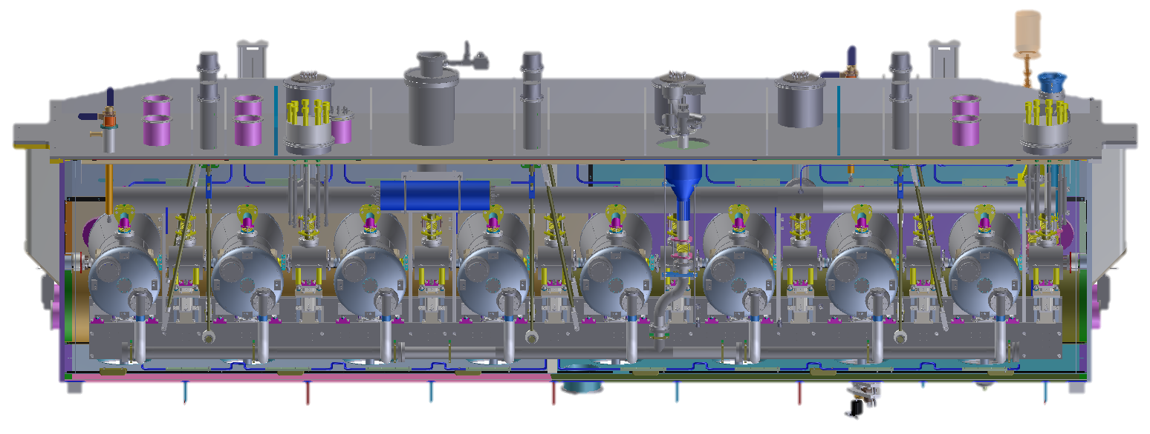
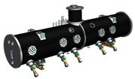
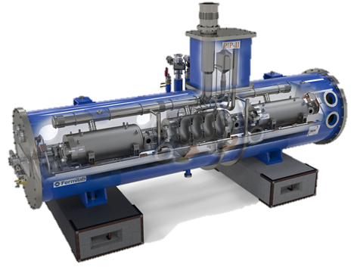
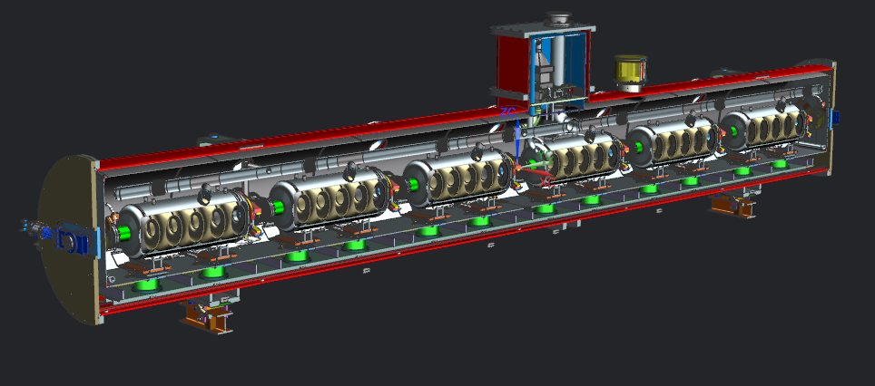
PIP-II SRF Linac & Areas of International Interest
HWR X 1
SSR1 X 2
SSR2 X 7
LB650 X 11
HB650 X 4
PIP-II is the first accelerator project in the U.S. with substantial international contributions

Slide 11
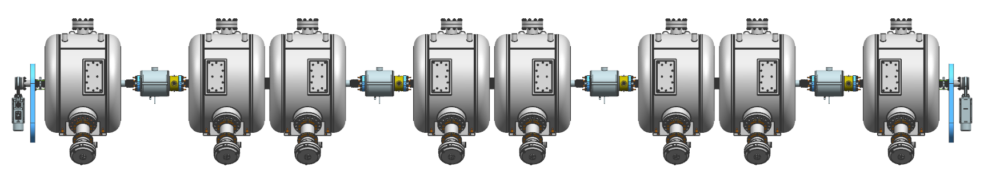
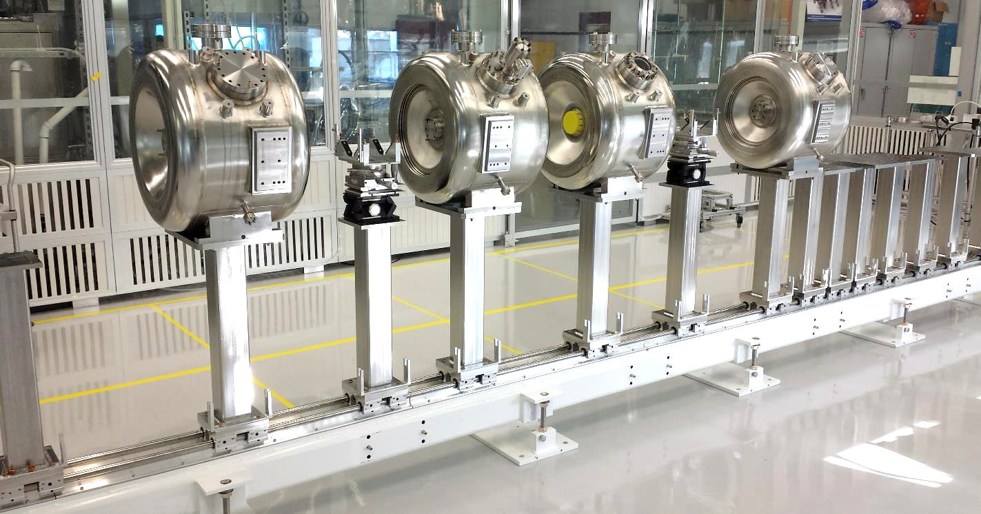
SSR1 – String Assembly
BPM
Solenoid
SSR1
Type A
SSR1 Type B
SSR1
Type A
SSR1 Type B
SSR1
Type A
SSR1 Type B
SSR1
Type A
SSR1 Type B
Gate Valve
Coupler
(vacuum-end)
Gate Valve
LAB2 has demonstrated successful operations of a horizontal high pressure rinsing and clean room assembly.
Mock-up assembly completed, procedure developed.

Slide 12
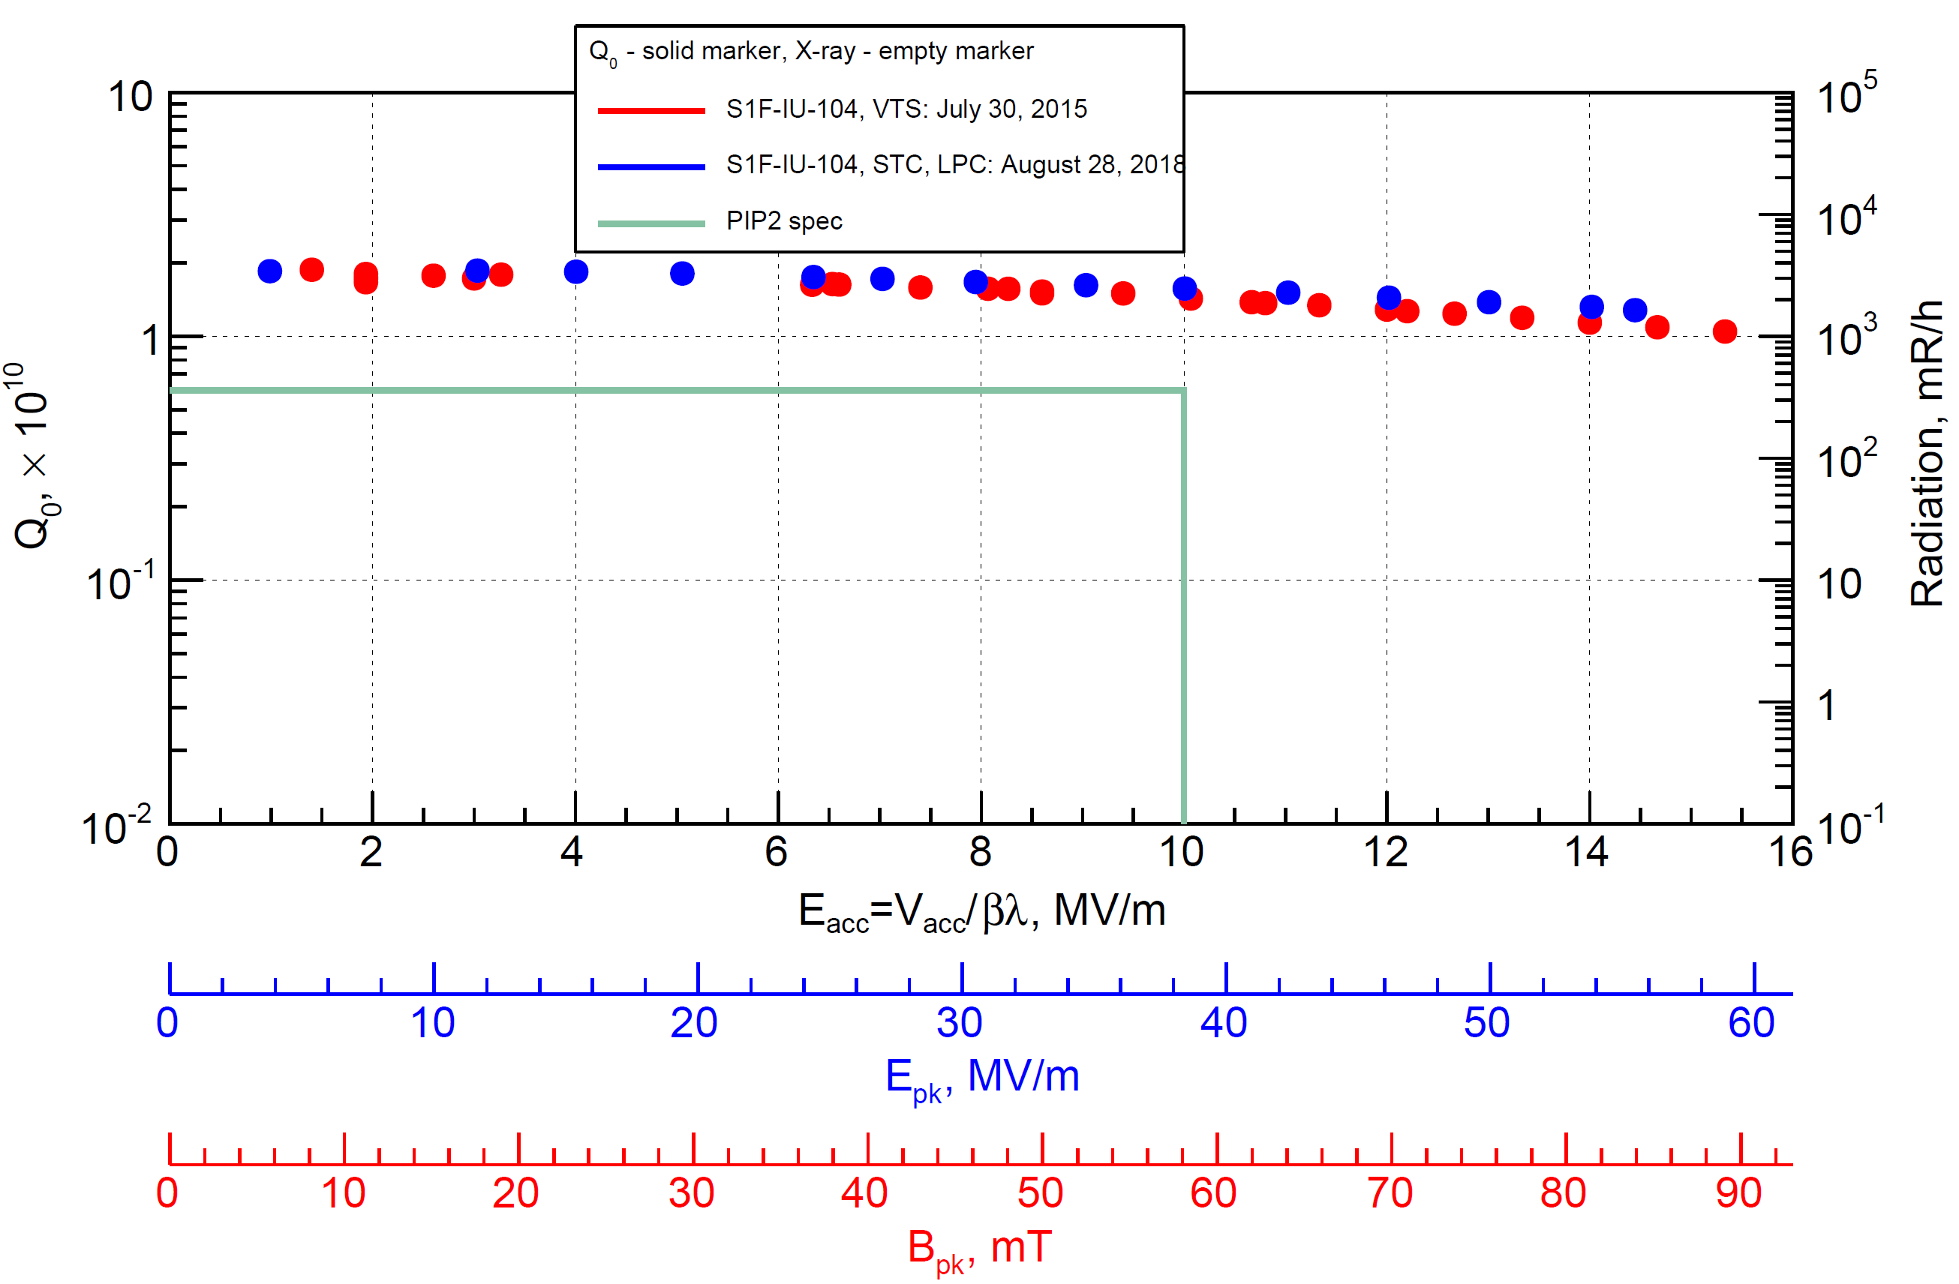

SSR1 – Indian Cavity Performance
STC test with low power coupler
Data by A. Sukhanov
High Q at high gradient and field emission free
BARC cavity has the best cavity Q performance up to date

Slide 13
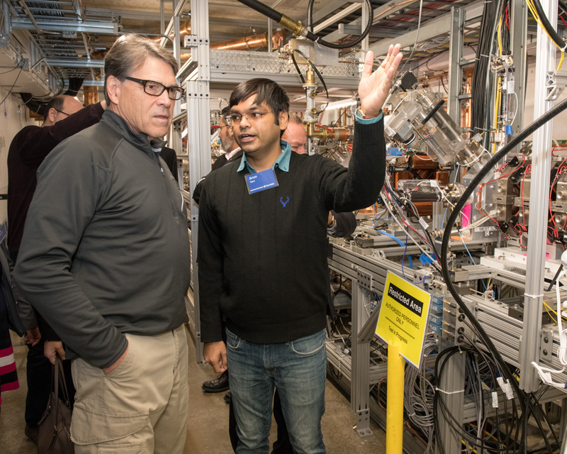
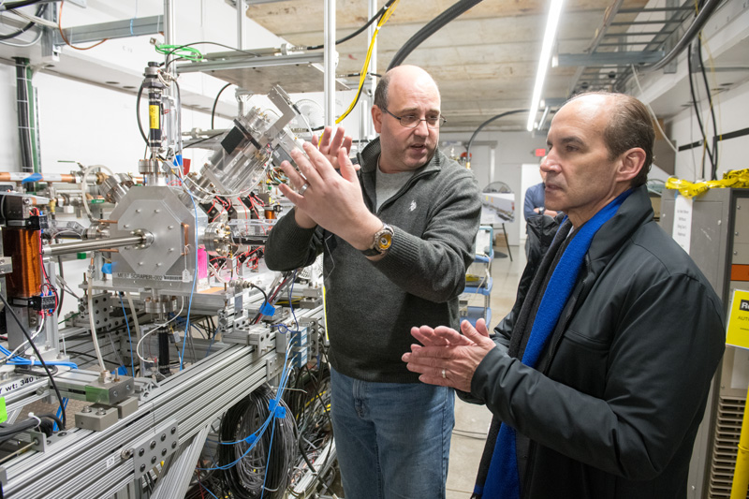
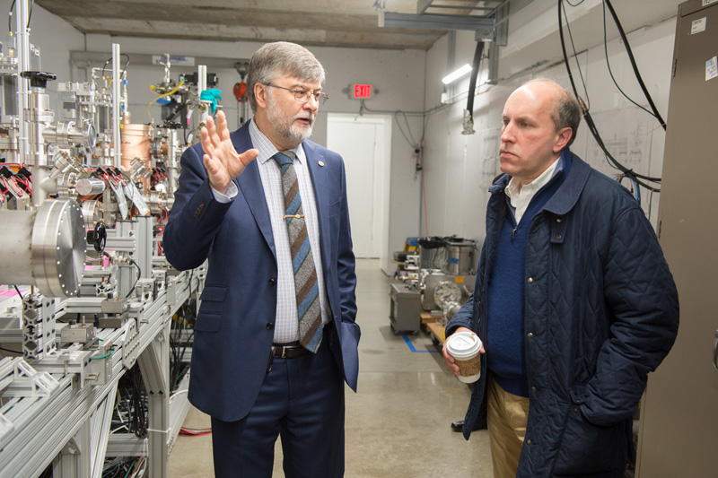
PIP-II achieves major milestone: CD-1 approval
Enthusiasm and strong support from FNAL, OHEP, Office of Science, DOE, Congress
New organization and strong team with focus on execution
Ground breaking – March 2019
Aiming to baseline in Q3FY19
In process of defining IKC from international partners
Strong FY18 & FY19 funding
Construction start
DOE Secretary of Energy Rick Perry
DOE Under Secretary of Energy Mark Menezes
DOE Under Secretary for Science Paul Dabbar
Notes:
Energy Systems Acquisition Advisory Board

Slide 14
PIP-II Schedule Summary Overview
DRAFT
CD-1
Approval
HWR Fab/Assembly
SSR1 1st Cryomodule Fab/Assembly
PIP2IT Program
Cryoplant Final Design & Fabrication
Cryoplant Building Construction
SSR1 Production
SSR2 Engineering/Design Verification
SSR2 Production
LB650 Engineering/Design Verification
LB650 Production
HB650 Engineering/Design Verification
HB650 Production
Installation & Commissioning
CD-2
CD-3a
Remaining Conventional Facilities Construction
CD-3
CD-4
FY17
FY18
FY19
FY20
FY21
FY22
FY23
FY24
FY25
FY26
FY27
FY28
FY29
FY 30
PDR Complete
Beneficial Occupancy of the Linac Tunnel
DOE Activity
Retirement of several high technical risks
Production
Receipt of largest single in-kind contribution
Engineering/Development
DOE and/or International Partners

Slide 15
PIP-II International Partnership Principles
  All partners are treated equally
  Pursue partnerships where broader interests are aligned, specifically technology (SRF) and science (DUNE)
  Partner scope, delivery timeframe, milestones and management processes are described in joint Project Planning Documents, under development
  Develop redundant core capabilities and knowledge between each partner and Fermilab
  The International Neutrino Council (INC), chaired by Jim Siegrist, comprises partner agencies’ directors, provides oversight, escalation mechanism, issues resolution at partner-wide level
  Present state: Fermilab is still in negotiation with PIP-II partners for IKC

Slide 16
Summary
PIP-II is the first accelerator project in the US built with substantial international participation
PIP-II is the “heart and soul” of Fermilab, and critical to the success of DUNE
PIP-II technical design is mature and being validated
  Warm Front End is operational
Received CD-1 approval in July 2018, aiming to baseline in 2019
  In process of defining scope for international partners
There is an international and in-house momentum building up.
International partnerships are essential
for the success of the PIP-II project.

Slide 17
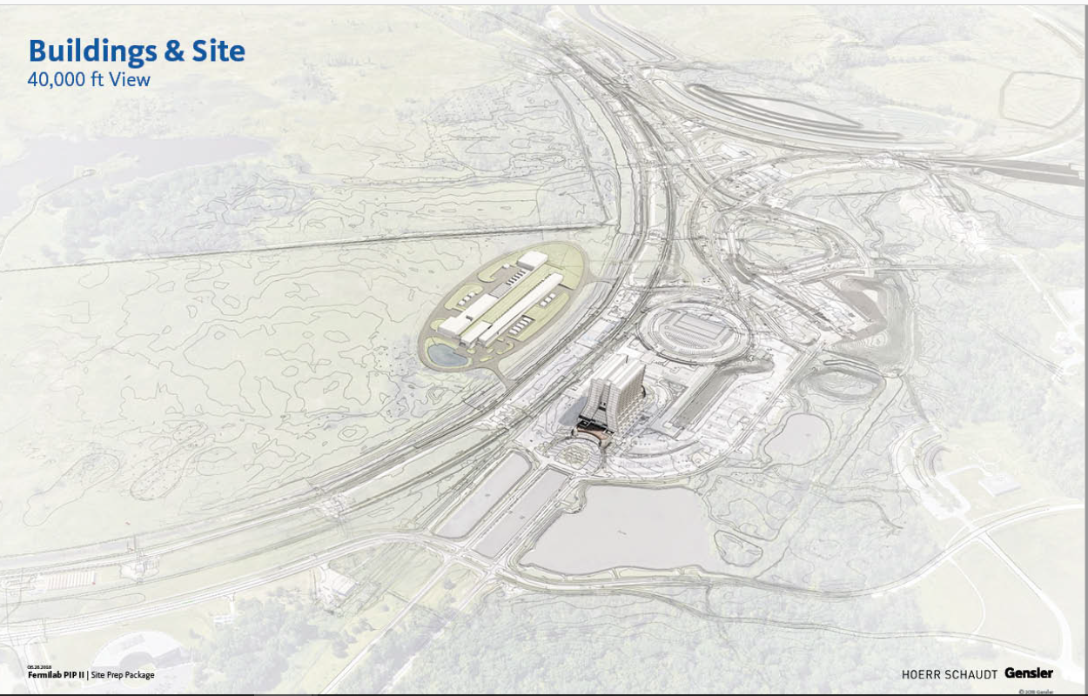
International partnerships are essential
for the success of the PIP-II project.
Thank you for your support of PIP-II!

Slide 18
U.S.-India S&T Agreement
India/DAE (started 2009)
Expertise, experience, capabilities
    Substantial engineering/manufacturing experience
    Superconducting correction magnets for LHC
    Construction and operation of 2 GeV synchrotron light source at RRCAT
Implementing Agreement
Project Annex
R&D Addendum
PPDs
Construction Addendum
Contributions to PIP-II
  R&D Phase: Substantial contributions over many systems including:
    SRF accelerating cavities
    RF amplifiers
    Magnets (conventional and superconducting)
  Construction phase:
    2 kW cryoplant in procurement phase
    Many systems covering all areas under development

Slide 19
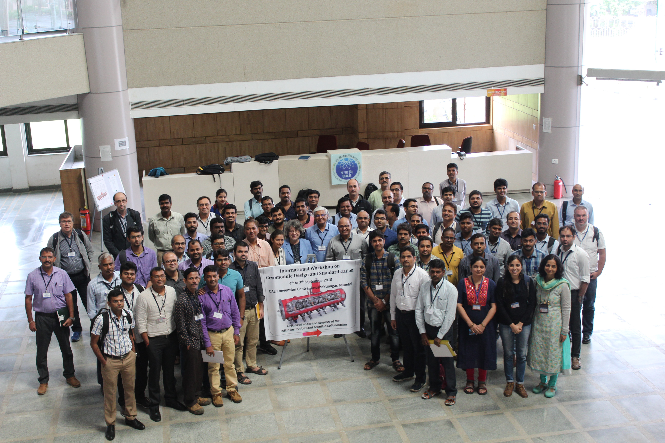
International Workshop on Cryomodule Design and Standardization – BARC, Mumbai 4-7 Sept 2018

Slide 20
UK/UKRI (started 2017)
U.S.-UK S&T Agreement
Expertise, experience, capabilities
  Substantial engineering and manufacturing experience
  Construction and operation of domestic synchrotron light and neutron sources
  SC cavity processing and testing for ESS
Implementing Agreement
Project Annex
PPDs
Contributions to PIP-II
  R&D Phase:
    Participation in the assembly of the HB650 pCM at Fermilab
  Construction phase:
    Proposal submitted to UK government for contribution of three (of six required) HB650 cavities & cryomodules

Slide 21
Italy/INFN (started 2016)
U.S.-Italy S&T Agreement
Expertise, experience, capabilities
  Internationally recognized leader in superconducting RF technologies
  SC cavity and CM fabrication for XFEL
  SC cavity fabrication for ESS
Implementing Agreement
Project Annex
PPDs
Contributions to PIP-II
  R&D Phase:
    LB650 dressed cavities (2)
  Construction phase:
    50-100% of required LB650 cavities (~20-40 cavities)

Slide 22
France/CEA/IN2P3 (started 2017)
U.S.-France S&T Agreement
Expertise, experience, capabilities
  Internationally recognized leader in large-scale cryomodule assembly
  CM assembly for European XFEL and ESS
  SSR2 cavities and couplers for ESS
Agency level Agreements
SOIs
Project Annex
PPDs
PPDs
Contributions to PIP-II
  R&D Phase:
    LB650 CM assembly plan
    Assistance on SSR2 cavity and coupler designs
  Construction phase:
    Assembly of all required LB650 cryomodules (12)
    ≥50% of required SSR2 cavities

Slide 23
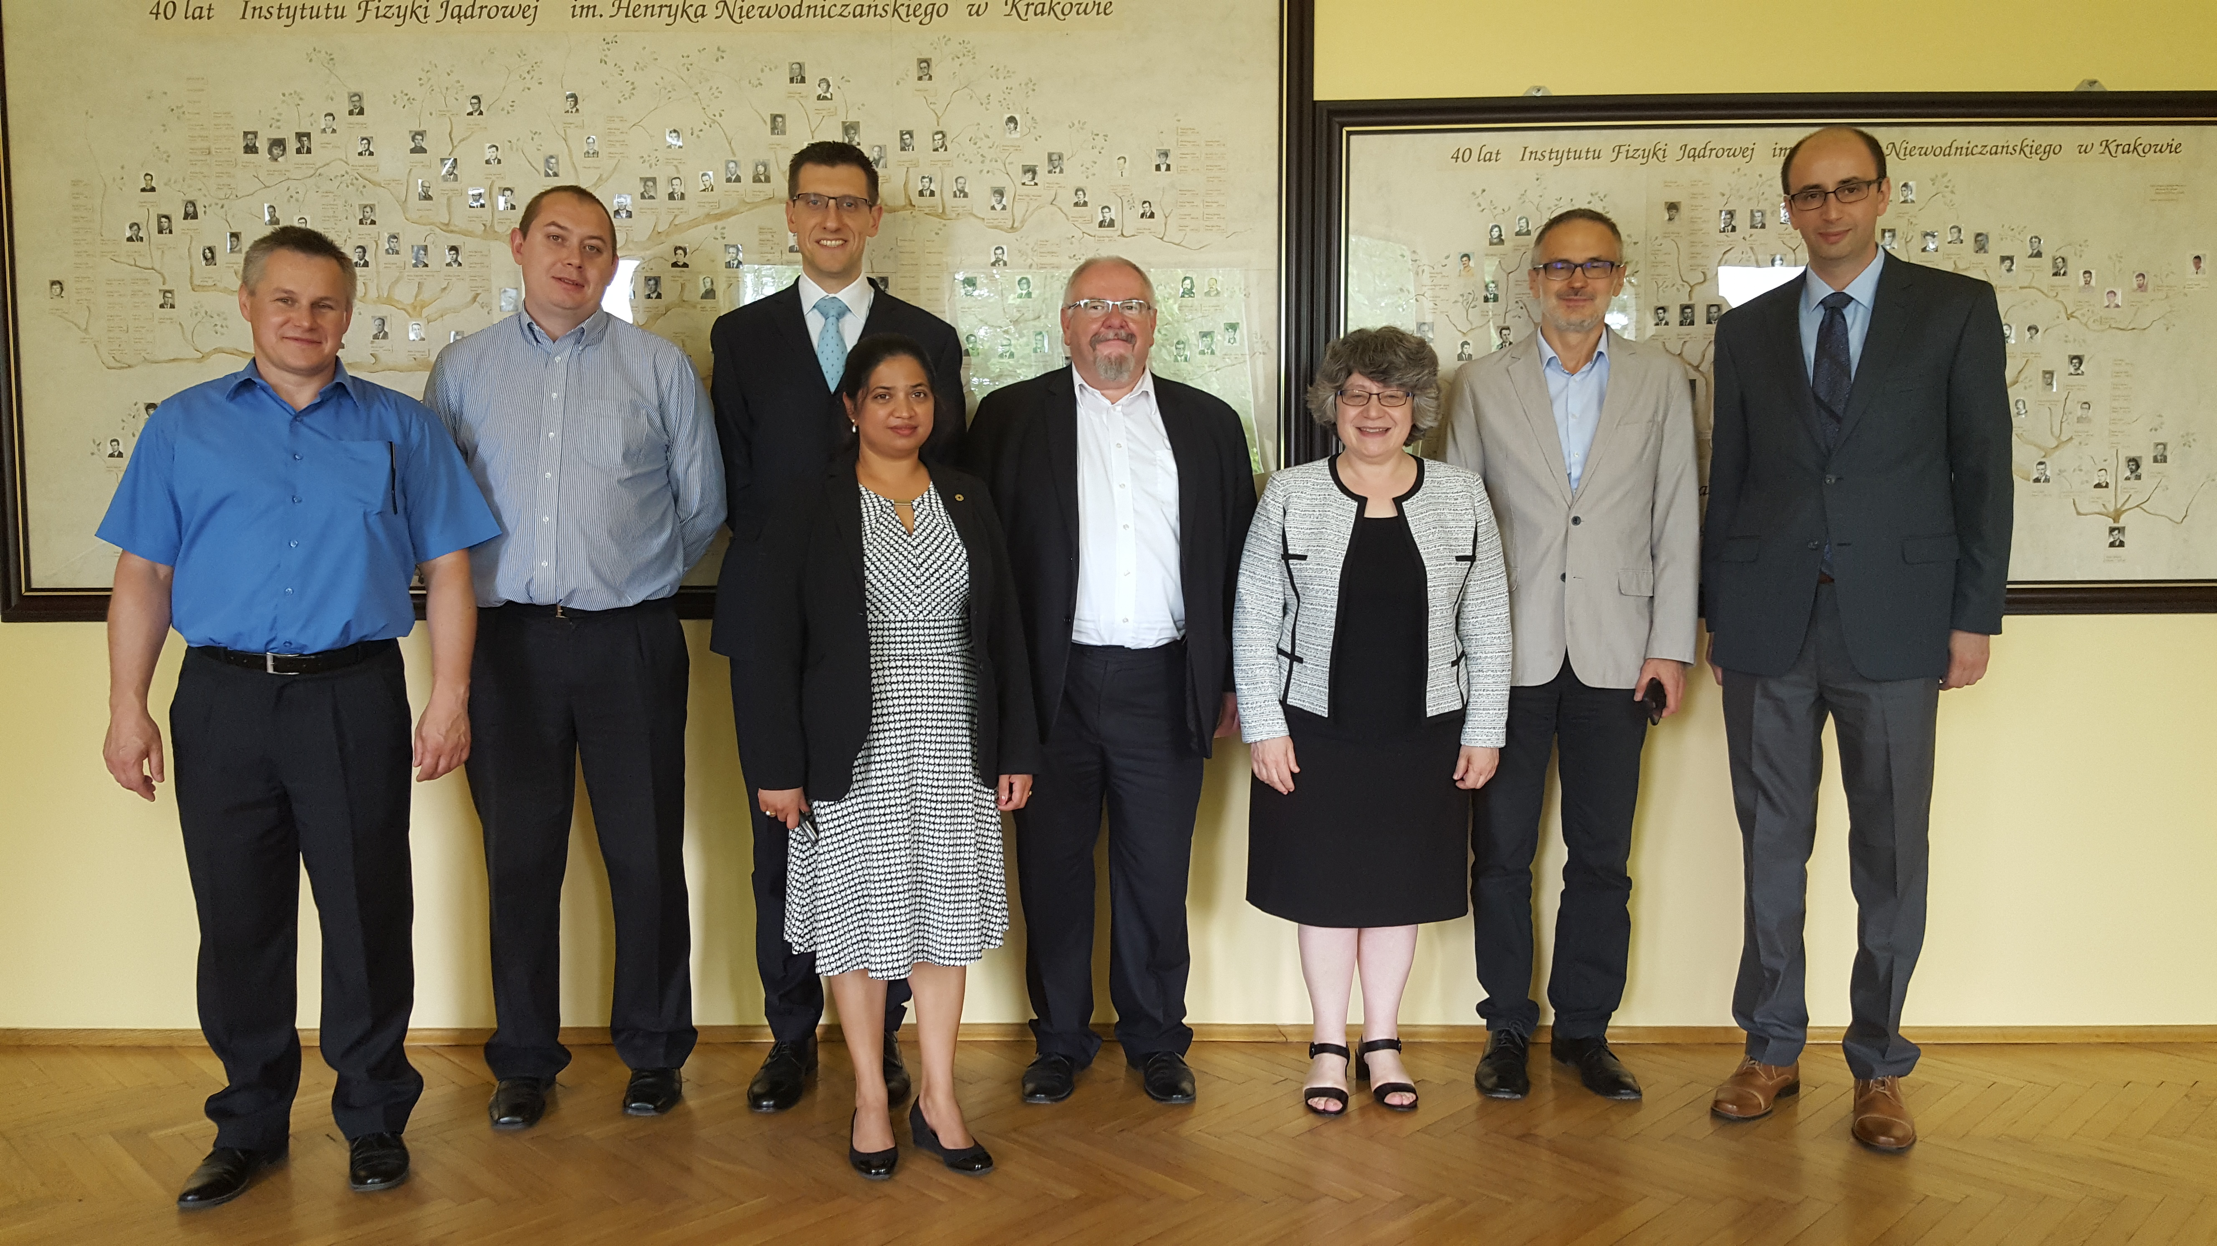
Partnerships in Early Stages
Poland
Visited the Institute of Nuclear Physics Polish Academy of Sciences, Krakow – May 2018
Wrocław University delegation visited FNAL 17-22 Sept 2018
Members of IFJ PAN to visit Fermilab 13-16 Nov 2018
  CDS
  QA/QC
Canada
SRF deflecting resonator

