Slide 1
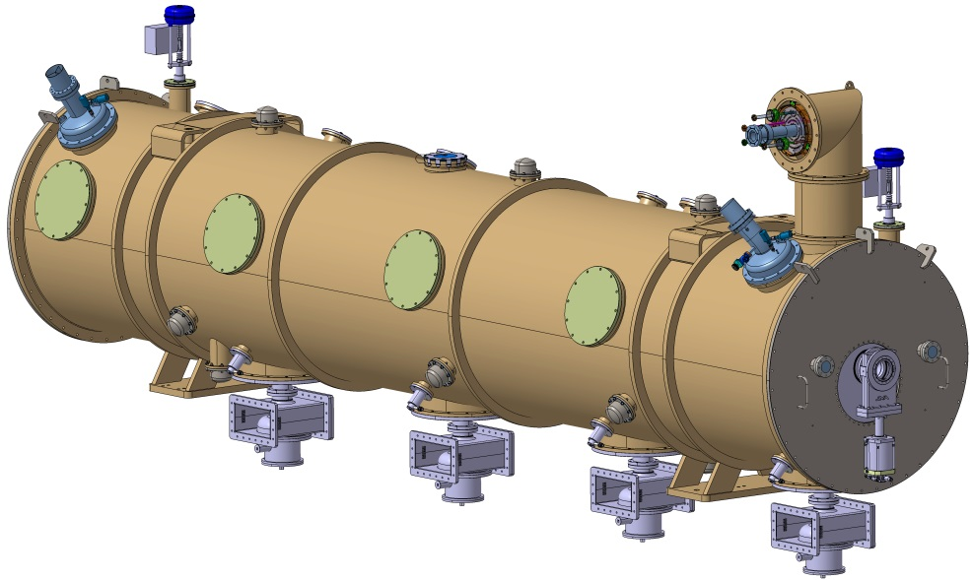
ESS elliptical cryomodule
ESS CRYOMODULE FOR ELLIPTICAL CAVITIES
FIRST TRANSPORTATION AND ALIGNMENT RESULTS
PIP-II 650MHz Cryomodule design advisory meeting
FERMILAB, October 23, 2018
Unité mixte de recherche CNRS-IN2P3
Université Paris-Sud 11
91406 Orsay cedex
Tél. : +33 1 69 15 73 40
Fax : +33 1 69 15 64 70
http://ipnweb.in2p3.fr

Slide 2
ESS elliptical cryomodule
SUMMARY
Overview
Alignment
Transportation

Slide 3
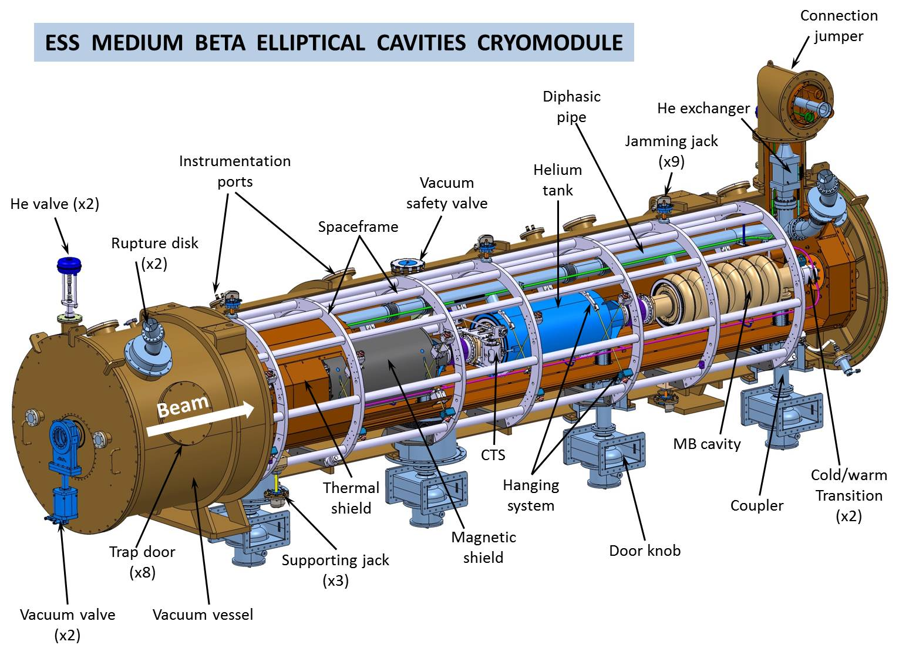
ESS elliptical cryomodule
First medium beta prototype assembled. Tests are ongoing.
High beta prototype and series to follow

Slide 4
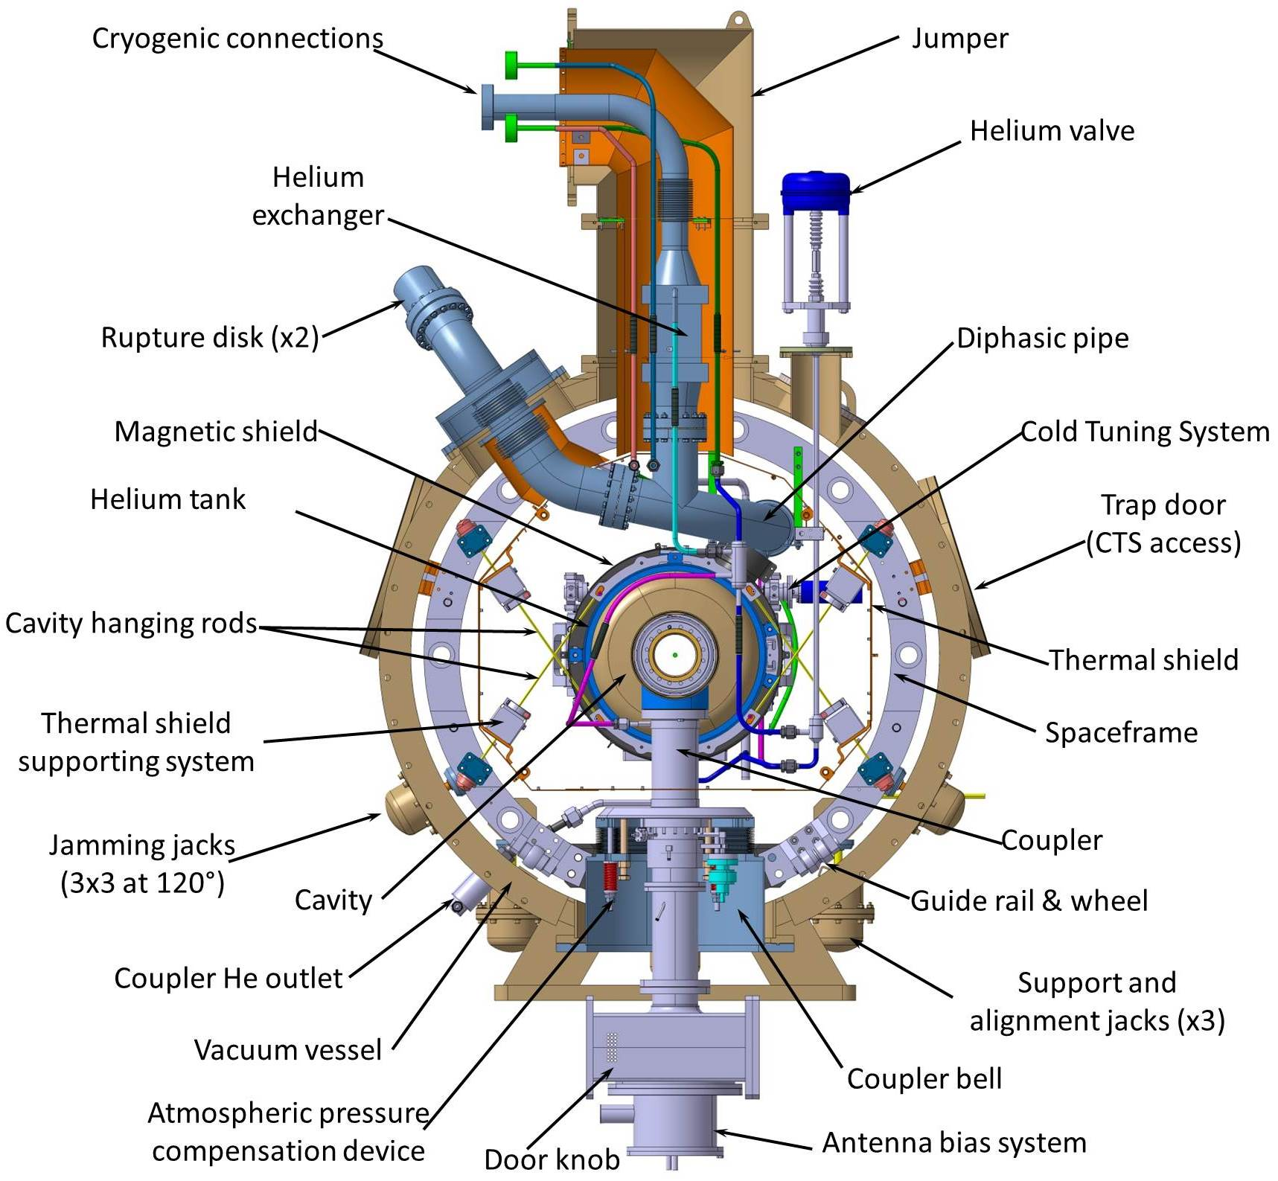
ESS elliptical cryomodule

Slide 5
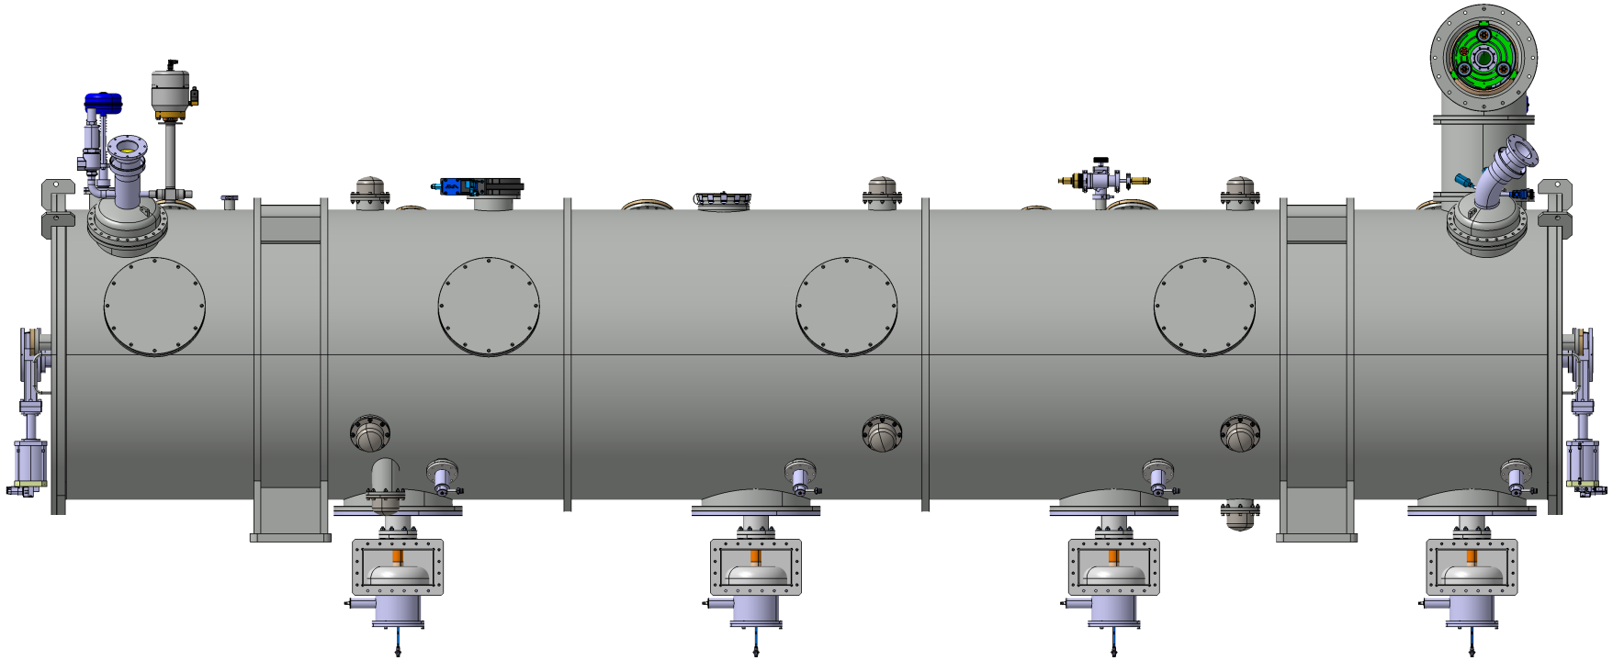
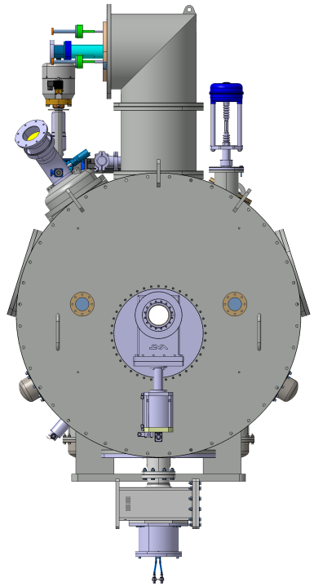
Main characteristics
Weight: 6 tons
1245
2969,5
2745
Ø1216
1500
1500
1500
1500
506,3
GROUND
4300
1156,3
6587,6 (valve flange to valve flange)

Slide 6
ESS elliptical cryomodule
ALIGNMENT
PROCESS
&
FIRST RESULTS FOR THE MEDIUM BETA CRYOMODULE
(For the results and some pictures, courtesy of Michel FONTAINE, CEA Saclay)
Measurements are performed by laser tracker

Slide 7
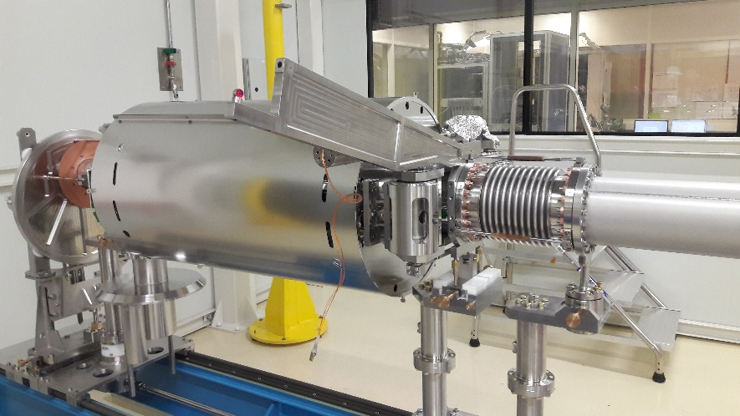
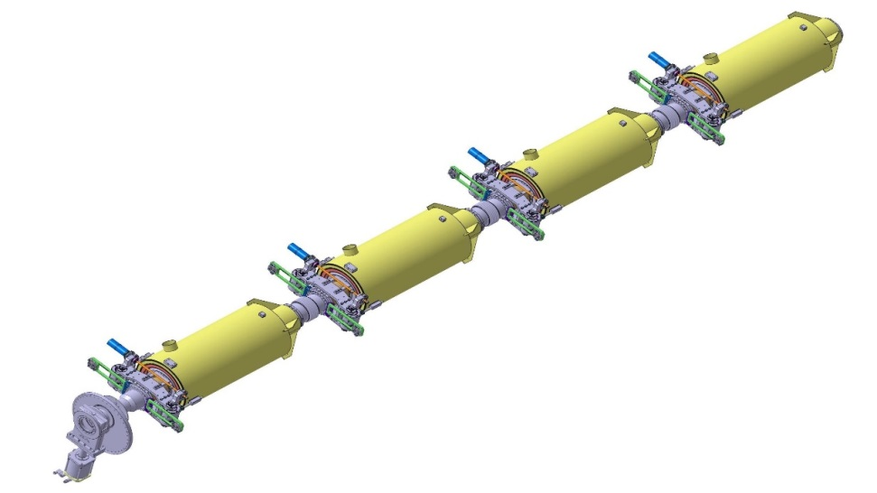
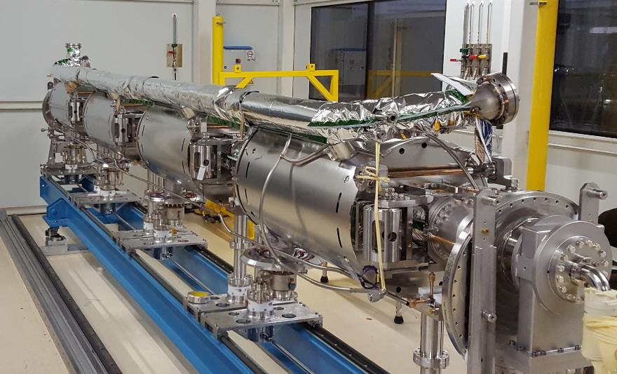
alignment of the cavity string on its support
Z
Z
Z
X
X
Y
Z
Y
X
Y
X
Y
Remote fiducials on one beam flange and on the RF coupler flange.
These points are accessible and measurable at each step of the assembly (cavity string alone, inside the spaceframe, inside the vacuum vessel).
The complete cavity string is supported and aligned by means of a set of adjustable posts fixed on a girder.
This tooling is used until the hanging inside the spaceframe.

Slide 8
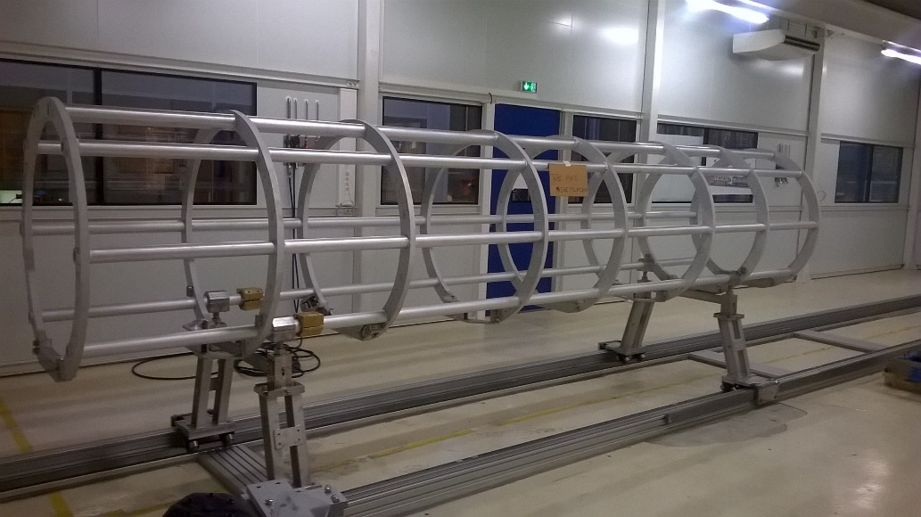
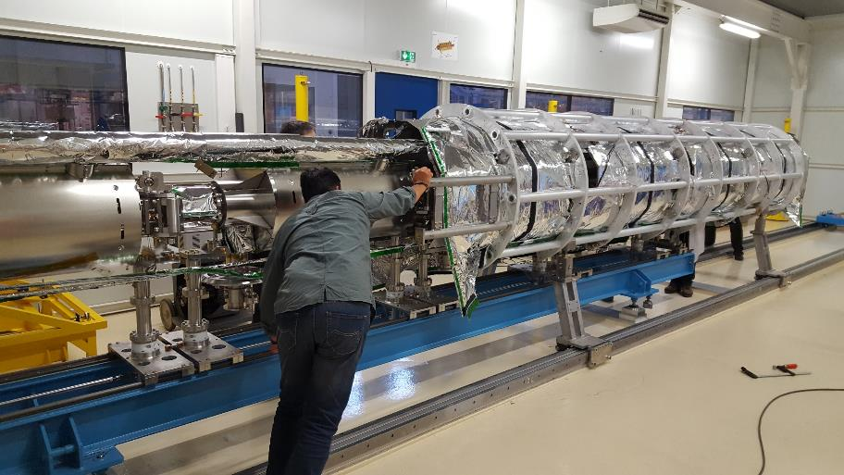
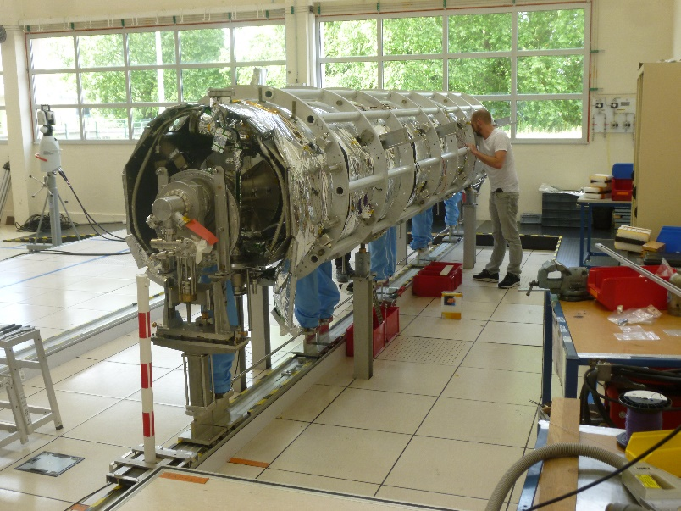
InserTion of the cavity string inside the spaceframe
Z
The spaceframe axis is defined by the center of the first and last rings.
The resting points are the same than inside the vacuum vessel.
The sag is measured before and after hanging of the cavity string.
X
Y
Remote positions of the fiducials are kept for the cavity string.
Rolling of the spaceframe (equipped with thermal shield) around the cavity string

Slide 9
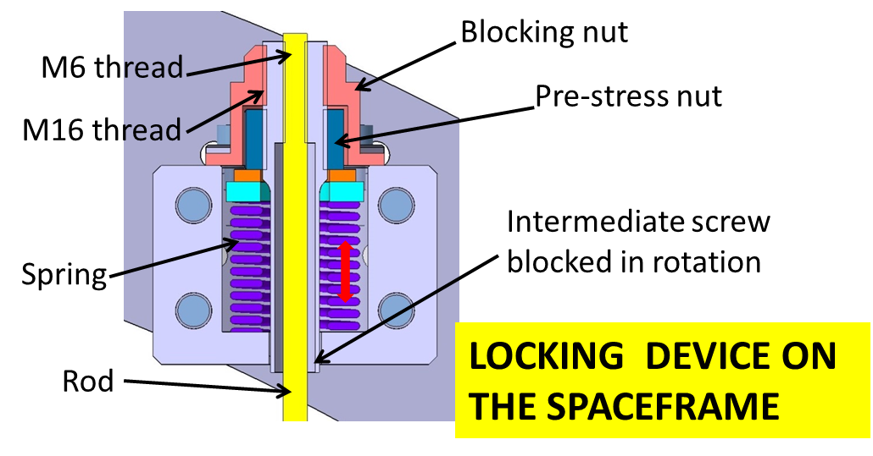
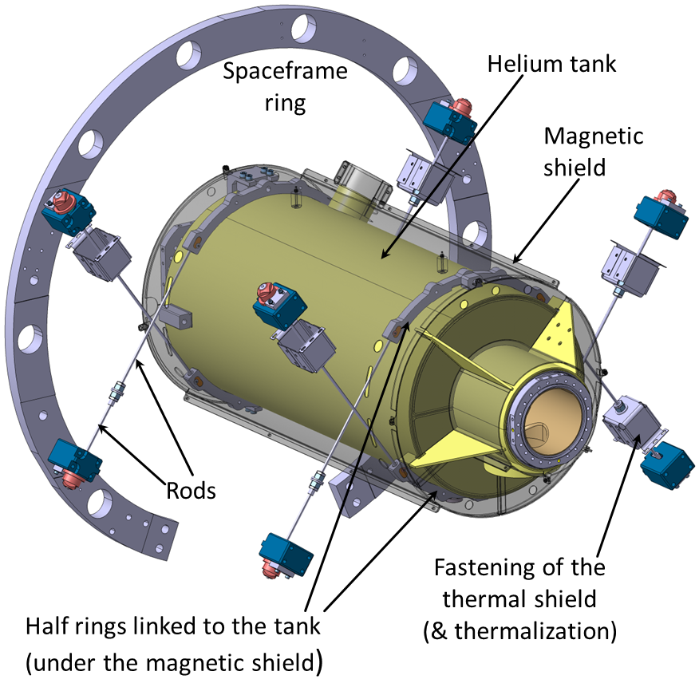
hanging of the cavity string inside the spaceframe
Rod length 490mm, diameter 6mm, material TA6V
Heavy load spring D16x32 H38mm, stiffness 518N/mm
Stroke under 3000N pre-stress: 5,8mm. Applied by M16 pre-stress nut with a symmetrical process
Locking of the rods after pre-stress by the blocking nut
All the hanging and pre-stress process is performed while the cavity string is still maintained on its supporting system (see previous slide)

Slide 10
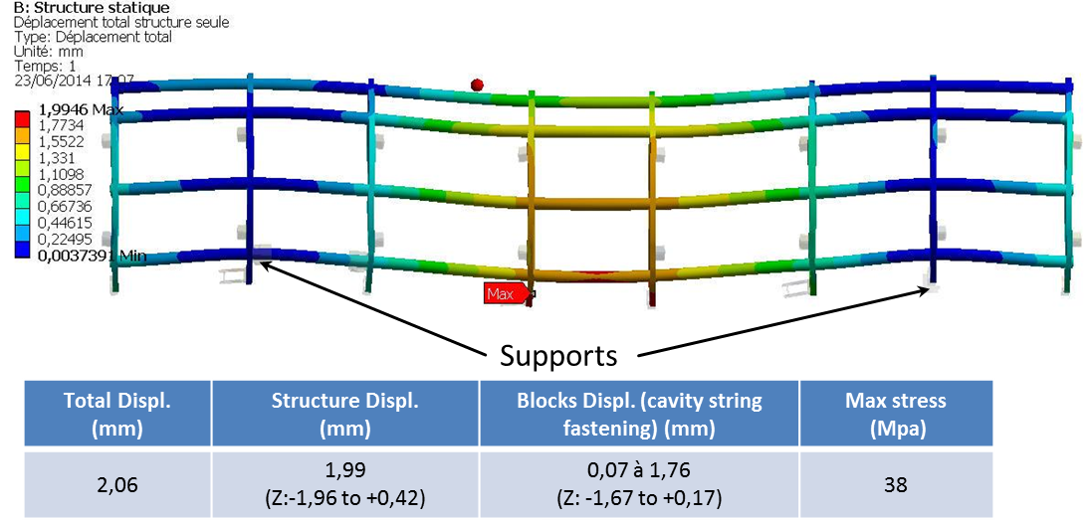
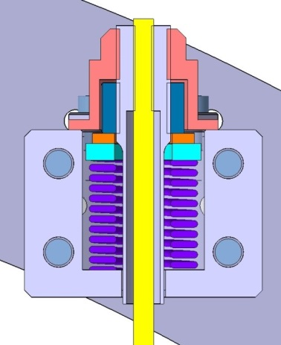
removing of the cavity string supporting system
The full weight of the cavity string is applied
The spaceframe sag increases (in addition to the initial sag)
Removing of the cavity string supporting system
Di-symmetrical effects of the pre-stress induce transverse and vertical displacements
(It cannot be totally symmetric)
Need to correct the position of each cavity by action on the blocking nuts, flange by flange.

Slide 11
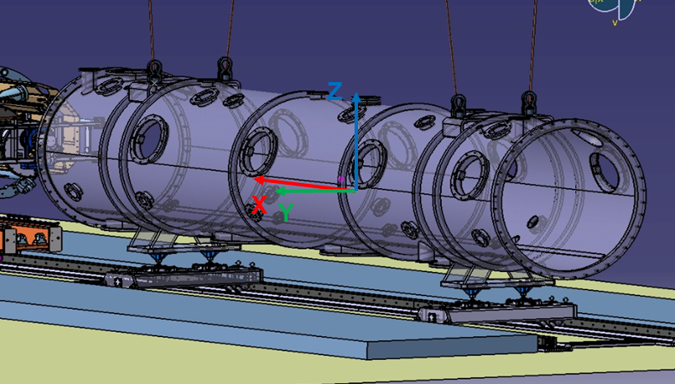
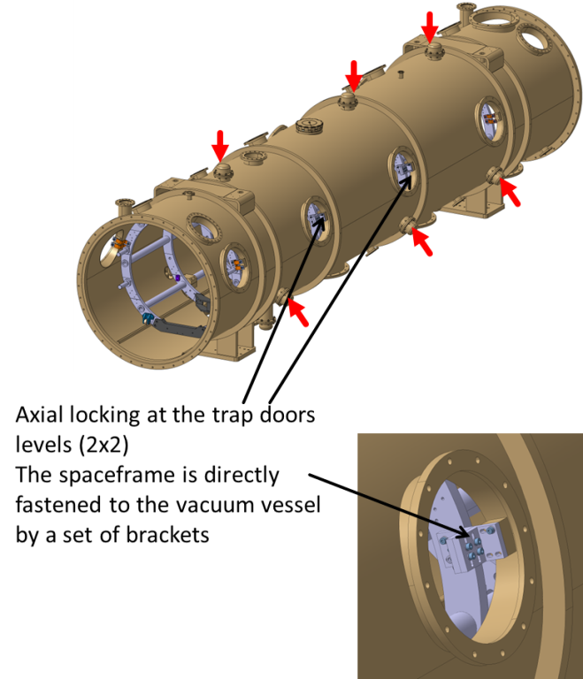
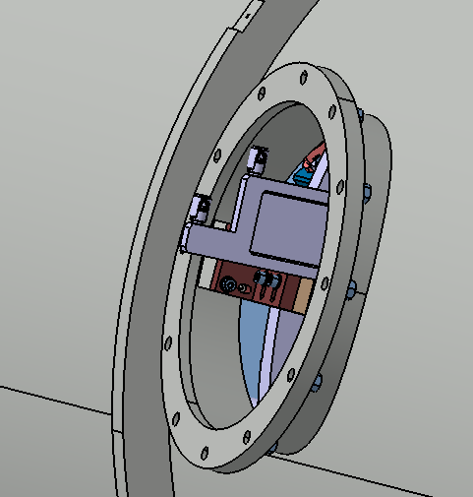
Insertion inside the vacuum vessel
The spaceframe (equipped with the cavity string) is at rest inside the vacuum vessel on the same supporting points than outside. Therefore, the displacements are not changed.
The position is adjusted by 3 mechanical jacks to align the beam and vacuum vessel axis.
The vacuum vessel axis (and therefore the beam axis) is defined by the center of the two extremity flanges
Fiducials are accessible via CTS trap doors and RF couplers ports (same configuration than previous phases)
After positioning, the assembly is blocked inside the vacuum vessel by means of jacks and brackets.

Slide 12
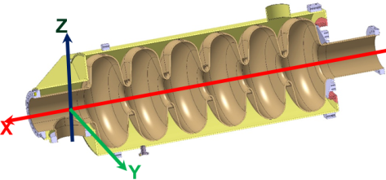
Alignment results for the first ESS prototype
FROM THE EQUIPPED CAVITY STRING TO ITS COMPLETE MOUNTING INSIDE THE SPACEFRAME
Step 1 | Adjustment of the cavities string on their support posts
Step 2 | Tight rods with thermal shield temporary supporting system
Step 3 | Tight rods after removing of the thermal shield temporary supporting system
Step 4 | Removing of the support posts
Step 4 fit | New definition of the reference to mitigate the defaults (the spaceframe has no need of coaxiality with the cavity string and the vacuum vessel)
Tolerance requirement for the beam axis: +/-1mm

Slide 13
Alignment results for the first ESS prototype
FIRST CONCLUSIONS AFTER THE ALIGNMENT OF THE MEdIUM BETA PROTOTYPE
The corrections needed are important to comply with the requested tolerance for the beam axis position. This is mainly due to the displacement after the 3000N pre-stress and the removing of the cavity string supporting system. The identified causes are listed hereafter:
Low stiffness of the cavity string supporting system
Pre-stress not symmetrical and not carried out simultaneously (by rods at a same level)
Stress due to the thermal shield and its temporary blocking on the spaceframe (can be fixed by change of the tooling)
Stress due to external forces: mainly diphasic pipe, bellows, pressure effects…
Sag of the spaceframe (but can be anticipated on the cavity string alone)
Stiffness of the spaceframe supporting system?
Process and parts of the design to be improved

Slide 14
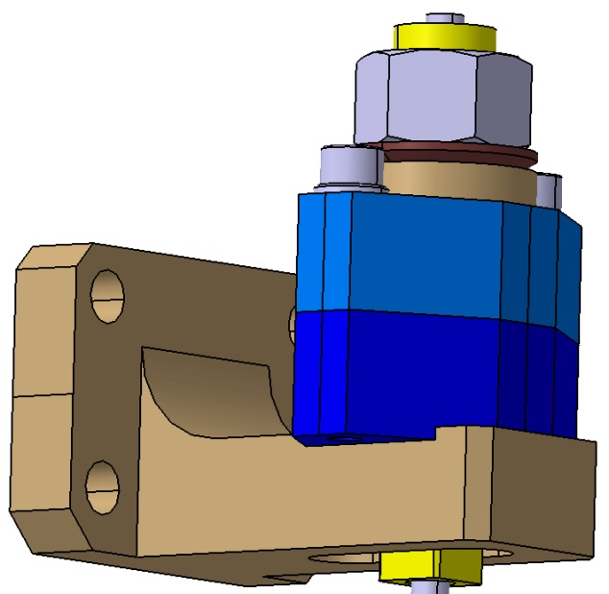
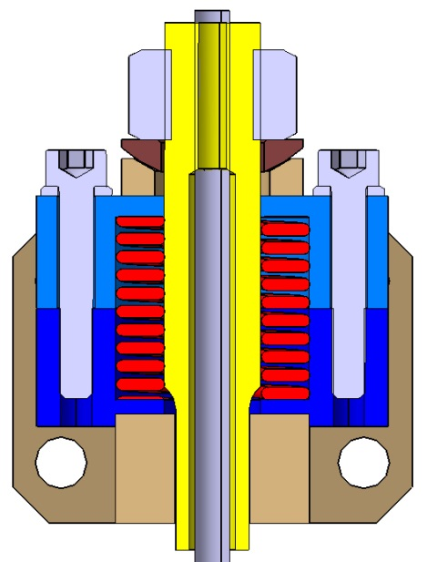
Alignment process improvements to come
Process analysis on a reduced mock up (2 cavities) at the end of the year. More time will be spent to understand the facts.
New device for the 3000N pre-stress implementation and the blocking of the rods. The aim is to lock the position before applying the pre-stress.
1-Blocking of the rod
Fastening on the spaceframe
2-Loosening of the screws to apply the pre-stress
Spring loaded inside a 2 shells box
Rod

Slide 15
Alignment comments & advises
First importance of the tooling. Do not neglect it and take it into account during the cryomodule design:
High stiffness or the cavity string supporting system
Stiffness of the spaceframe supporting system
Devices easy to mount and to remove
Be careful of the stress induced by the diphasic pipe (stiffness as low as possible, need of a cardan system), the inter cavity bellows and the pressure effects of the vacuum.
Keep the same references at each step of the assembly. Use remote fiducials for that.
Laser tracker apparatus mandatory for such dimensions. Easy to collect data.
Possibility to adjust the position after each step
Good locking of each component after alignment, especially for transportation.
What about a longer cryomodule (6 cavities), its length and weight?
Are the same principles still available (spaceframe resting on 3 points for instance)?

Slide 16
ESS elliptical cryomodule
TRANSPORTATION

Slide 17
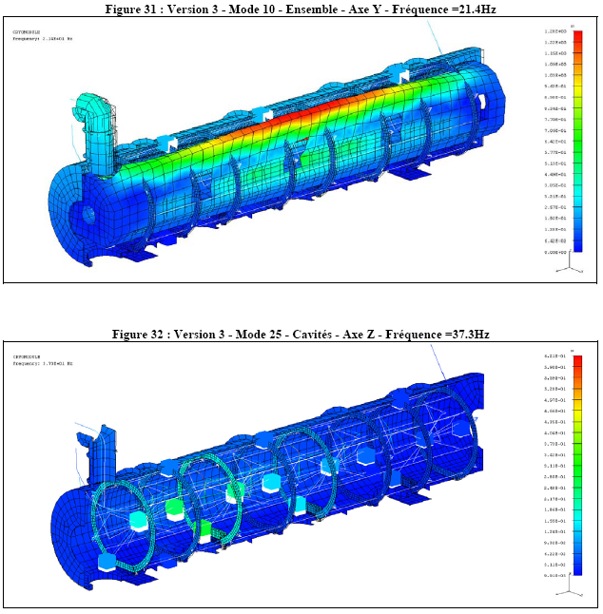
transportation
Modal analysis
Main modes | Frequency (Hz) | % load X | % Load Y | % Load Z
7 | 19,5 |  | 21,5
10 | 21,4 |  | 42
25 | 37,3 |  |  | 24,4
29 | 41,2 |  |  | 5,8
36 | 45 | 11,8
These values are high enough to avoid any activation during transportation
(>16Hz)

Slide 18
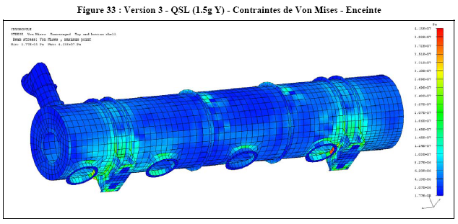
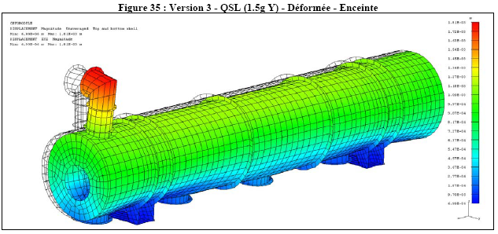
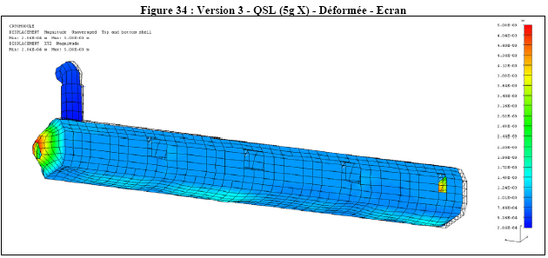
transportation
"Static" acceleration
Accelerations :
Axial (X): 5g
Transverse (Y): 1,5g
Vertical (Z): 3g
Von-Mises stress
 | X (axial) (Mpa) | Y (trans) (Mpa) | X (vert) (Mpa) | R_{p02} at 300K (Mpa)
Vacuum vessel | 44,9 | 41,3 | 45,7 | 210 (SS)
Thermal shield | 43,6 | 12,3 | 30,2 | 240 (Alu)
Space-frame | 35,8 | 24,9 | 48,6 | 240 (Alu)
Cryo. lines | 33,3 | 6,8 | 20,8 | 210 (SS)
Support. rods | 138 | 157 | 238 | 825 (TA6V)

Slide 19
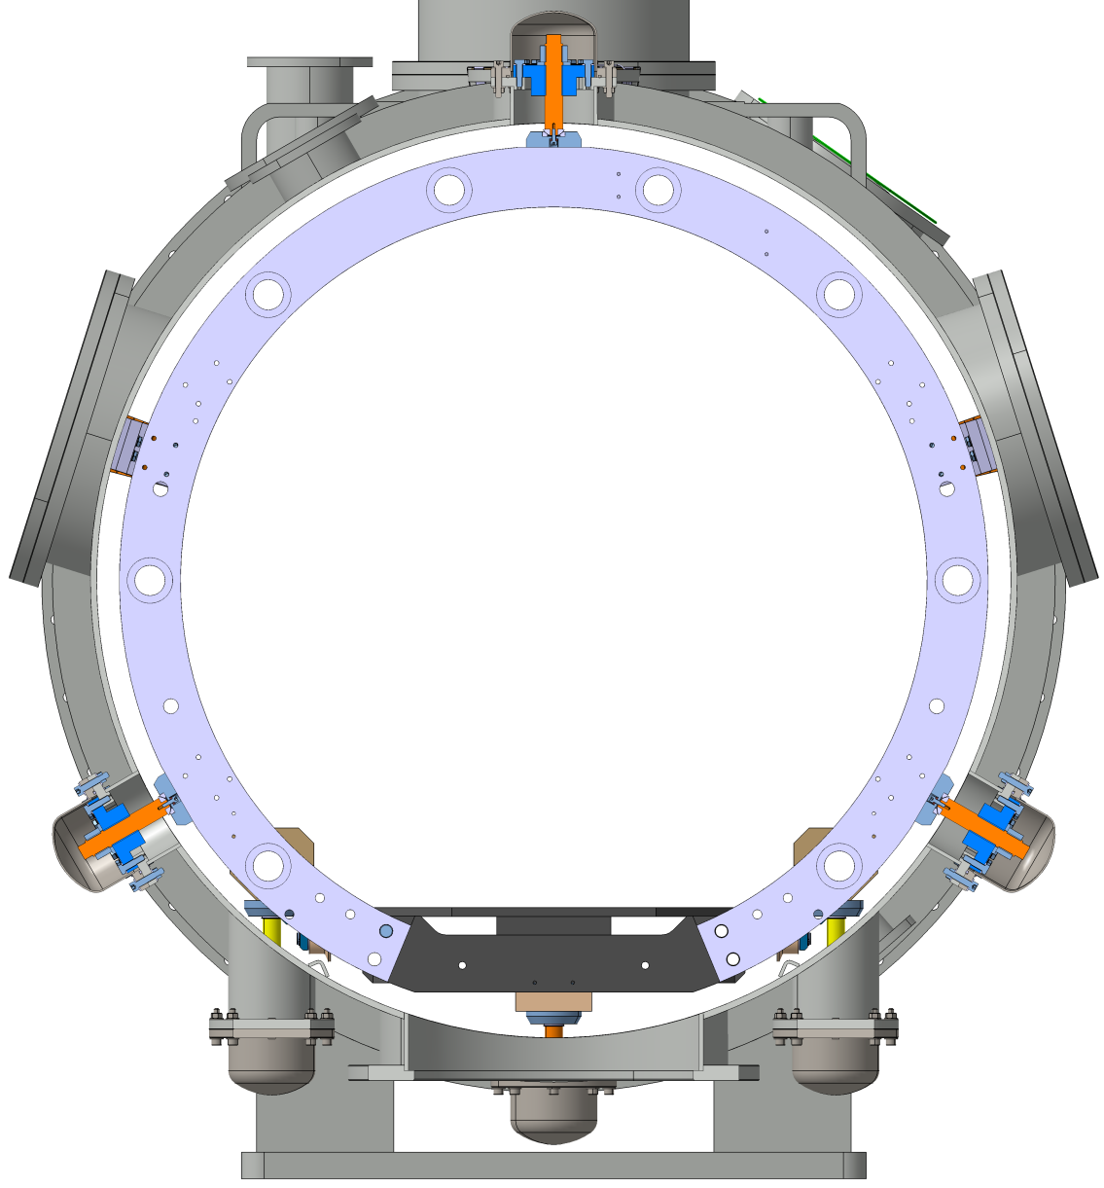
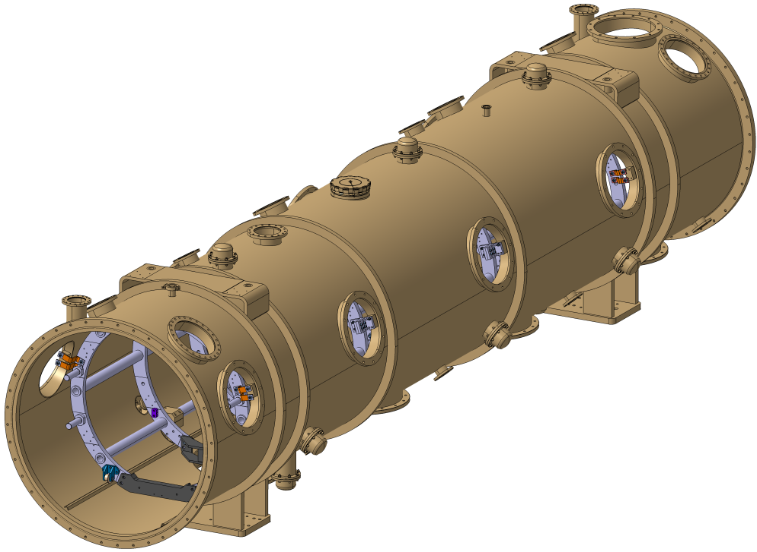
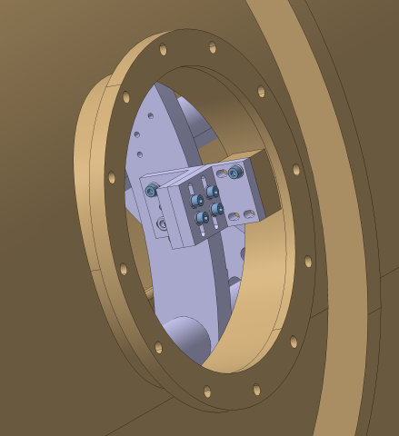
Spaceframe locking
Permanent configuration
in operation
Transverse blocking:
3 jacks at 120°
On 3 sections
Axial locking at the trap doors levels (2x2 in central positions)
The spaceframe is directly fastened to the vacuum vessel by a set of brackets
(Positioning: 3 vertical jacks)

Slide 20
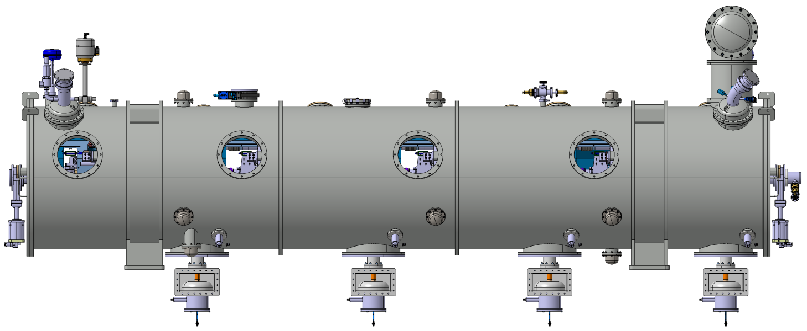
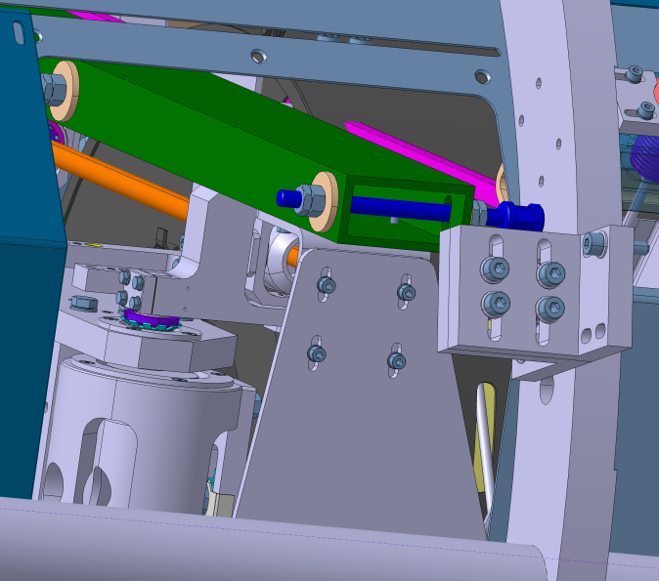
Transportation additional links
Fastening of the jumper cryogenic pipes
To be removed:
Door knobs
Actuators
Others
Fastening of each cavity
Fastening of the spaceframe on the vacuum vessel (2 more levels)
Specified accelerations during
transportation (CEA) :
Axial (X): 2,5g
Transverse (Y): 2,5g
Vertical (Z): 2,5g
Fastening of the thermal shield
(2x4 positions)

Slide 21
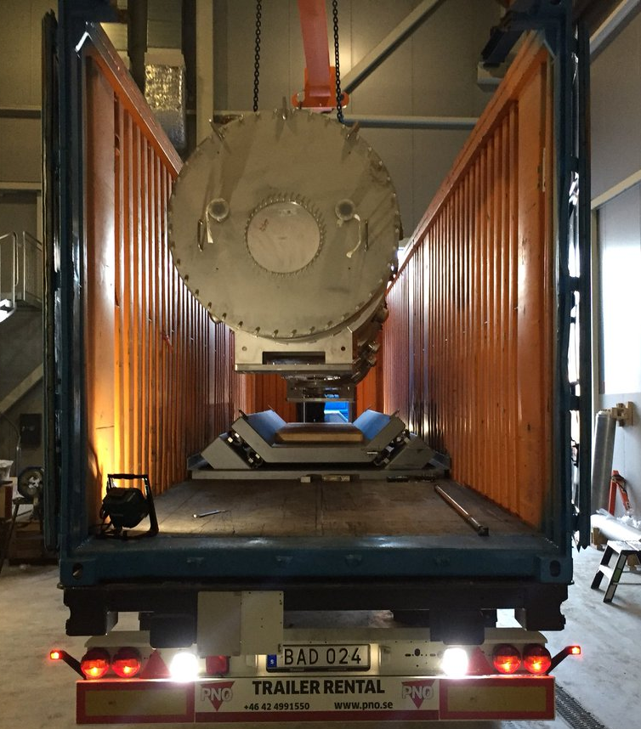
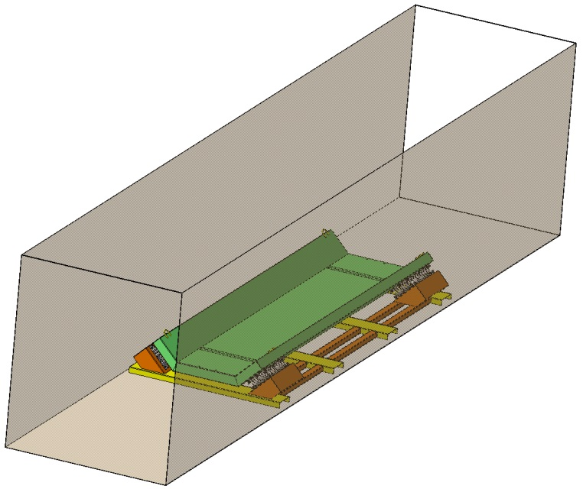
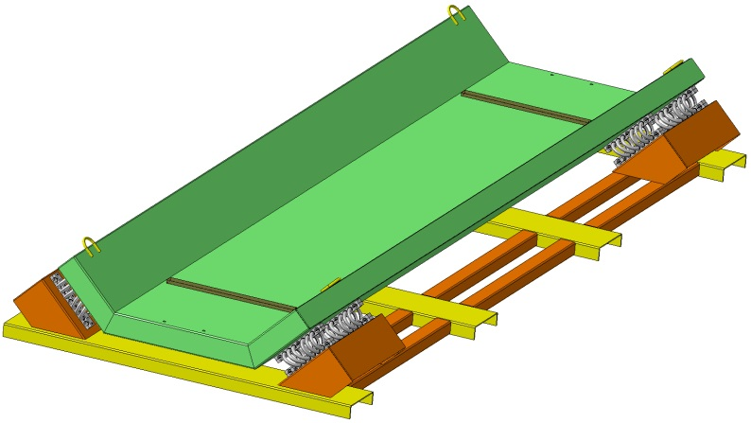
Transportation tooling
First transportation test by truck from Saclay (Paris) to Lund (Sweden) with a vacuum vessel alone (round trip)
Floating tray on springs to mitigate impacts
The aim was the validation of the procedures and the mechanical interfaces with the container box, the handling trolley and the test stand at ESS Lund.
The only data was collected by shock loggers on the return trip:
5,6g on the container
0,65g on the damped frame

Slide 22
Transportation comments & advices
Temporary blocking of the components as much as possible (mandatory for cavities, thermal shield and spaceframe). Take it into account during the cryomodule design: trap doors, temporary devices, easy access…
Modal and acceleration analysis as soon as possible during the design (avoid further changes).
Removing of the maximum of external components: door knobs, actuators…
ESS team is in charge of these transportation matters. The first cryomodule is foreseen to be sent in Sweden at the end of the year.

Slide 23
ESS elliptical cryomodule
Thank you for your attention

