Slide 1
PIP-II Project Manager’s Report
Marc Kaducak
Project Management Group
17 Oct 2018

Slide 2
Outline
Staffing/Organization
Funding, financials
International Updates
Technical Updates
CD-2/3a Preparations
Assumptions and Interface Documents

Slide 3
Staffing
Project Controls Manager position still open.
  Thanks to OPSS for continued support.
Procurement Manager and Administrator – interviewing
  Current procurements supported by central procurement group
Risk Manager
  Developed plan for carrying PIP-II risk management forward with Lucas Taylor, who will be leading the effort. Jim Morgan, John Anderson, Mohammed Elrafih contributing.
Eduard Pozdeyev is joining FNAL as PIP-II Project Scientist

Slide 4
Funding Profile and Milestones
Milestone | Planned | Actual or Forecast
CD-0 | Q1 FY2016 | November 12, 2015 (A)
CD-1 | FY2017 | July 23, 2018 (A)
CD-2/3a | FY2019 | Q3FY2019
CD-3 | FY2020 | Q4FY2020
CD-4 | FY2026 | Q3FY2027
FY19 Budget Notes:
PIP-II P6 not quite ready as a tool for budget planning. First priority is FY19 rollup.
BPS request ~85 FTE. Divisions returned ~92 FTE. Both numbers are more than we can afford. CD-1 profile allowed ~75 FTE for FY19.

Slide 5
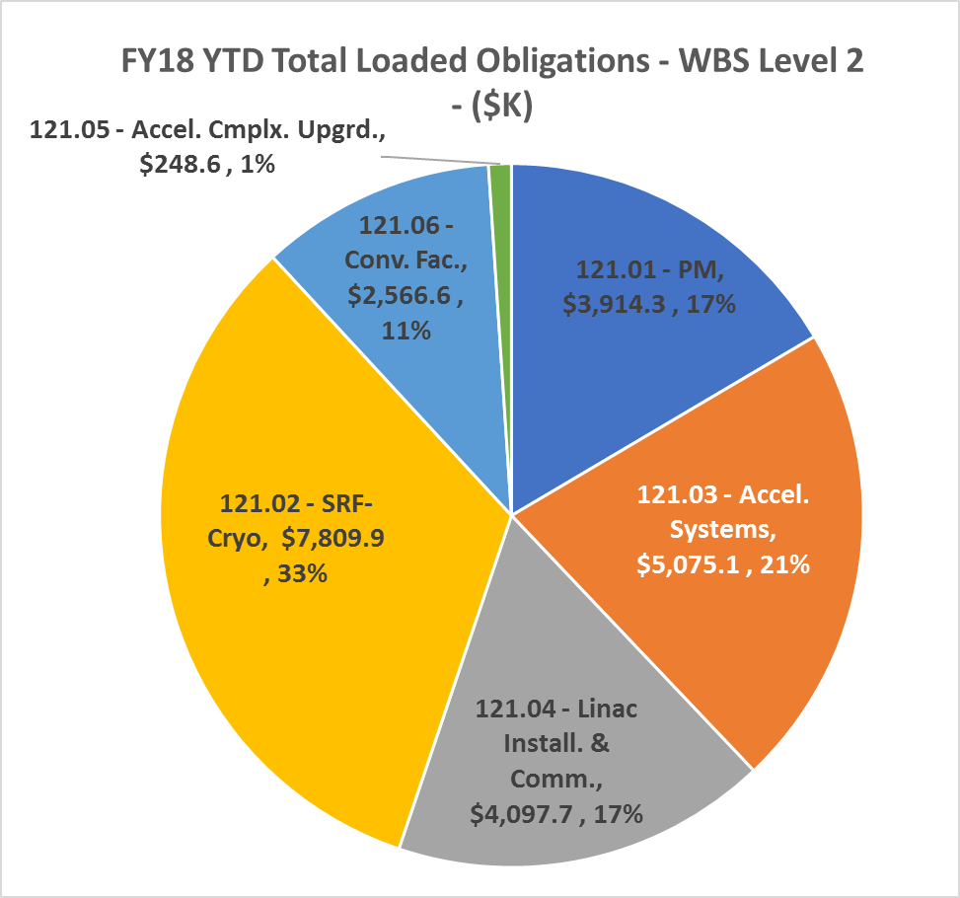
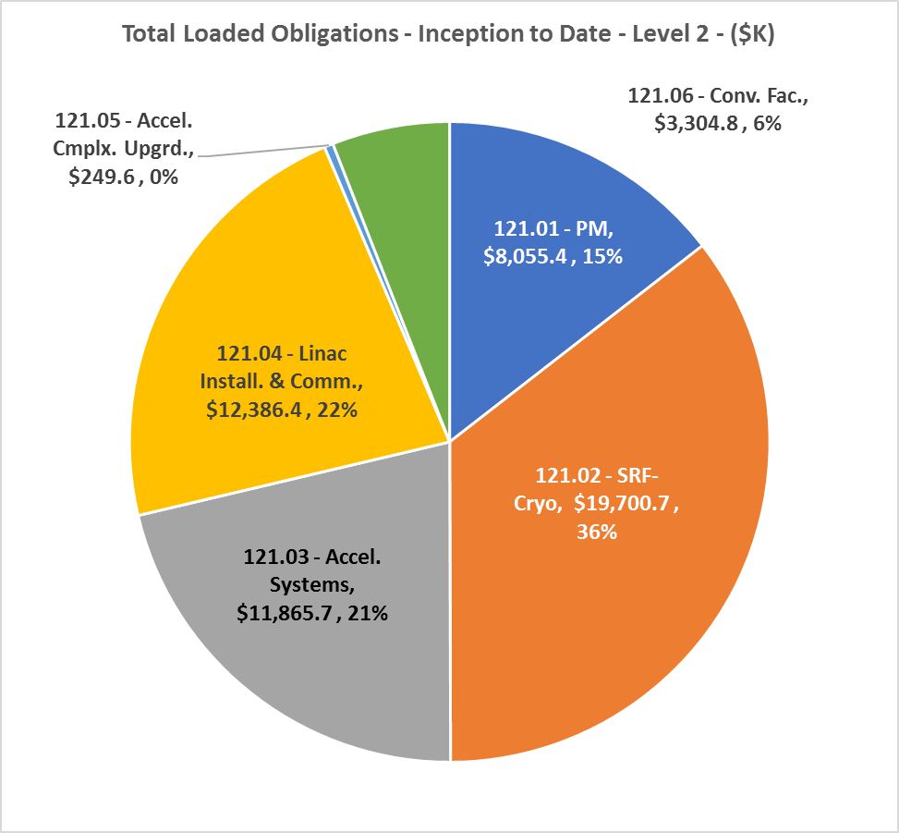
FY18 Financials – End of Year
FY18 | Inception to Date

Slide 6
Updates - International Partnerships, In-kind Contributions
Four long term and one short term DAE visitors arrived at Fermilab
Progress on Export Control: Received guidance from Steve Clagett and Chantal Lakatos of the U.S. Department of Commerce’s Bureau of Industry and Security (BIS), on preparing an application to request a license for accelerator components. In process.
Constructive DOE GC visit: toured PIP2IT, clarified PPDs, SOIs
Two Italian prototype LB650 cavities to arrive ~ June/July 2019 [3-4 months late]
UK visitors – funding starts to flow April 2019
Cryoplant bids were opened last Friday

Slide 7
ESH&Q Update
DOE released the PIP-II EA for public comments from Oct 15 – Nov 15
  Still on track for a FONSI determination by the end of CY18
  http://pip2.fnal.gov/env-assessment
PIP-II Safety by Design Implementation guidance document ready for project review
Updating the PIP-II PHAR for the upcoming IPR
Working with the ESH&Q Section Construction Oversight and Safety Group to Develop the PIP-II Construction Safety and Health Plan
ESH&Q Radiation Physics Science Department provided comments on the PIP2IT Shielding Assessment
  Updates for the final PIP2IT shielding assessment to support 25 MeV operations are in progress
ESH&Q Radiation Physics Science Department is analyzing the planned cryogenic penetration into the Linac enclosure in support of constructing the Cryogenic Building in 2019
  Anticipate results next month
  Analysis is required before going out for bids on the Cryogenic Building
First draft of QA plan under internal review
QA Audit at MSU/FRIB next week

Slide 8
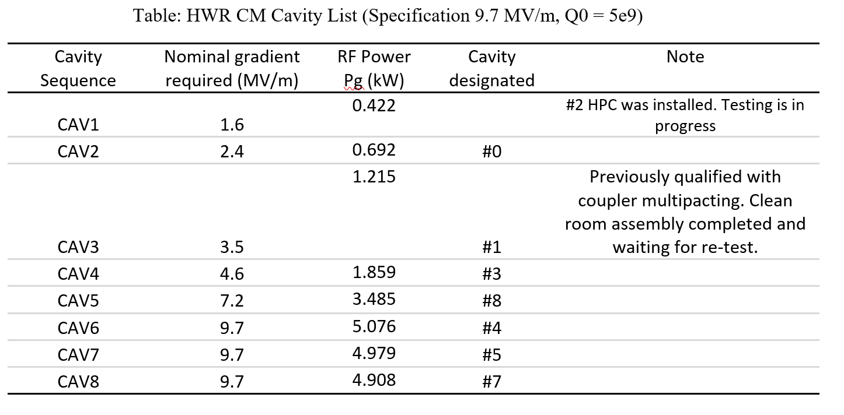
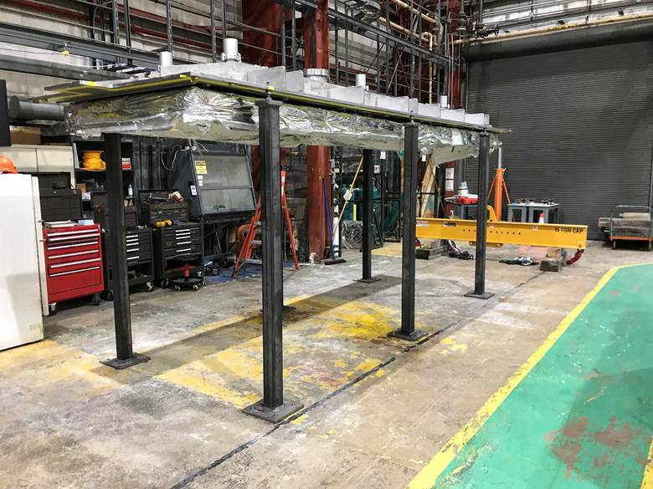
WBS 121.2 SRF Updates – HWR Cryomodule
HWR Cavities (9.7 MV/m, Q0 = 5e9)
  Received authorization to proceed with Critical Lift, cryomodule lid now lifted and installed on assembly stands (see photo).
  Cleaning and assembly procedures for solenoids/BPM verified, cleaning and assembly of remaining solenoids to proceed next.
  Remaining Work Control Documents for cryomodule assembly are being completed.

Slide 9
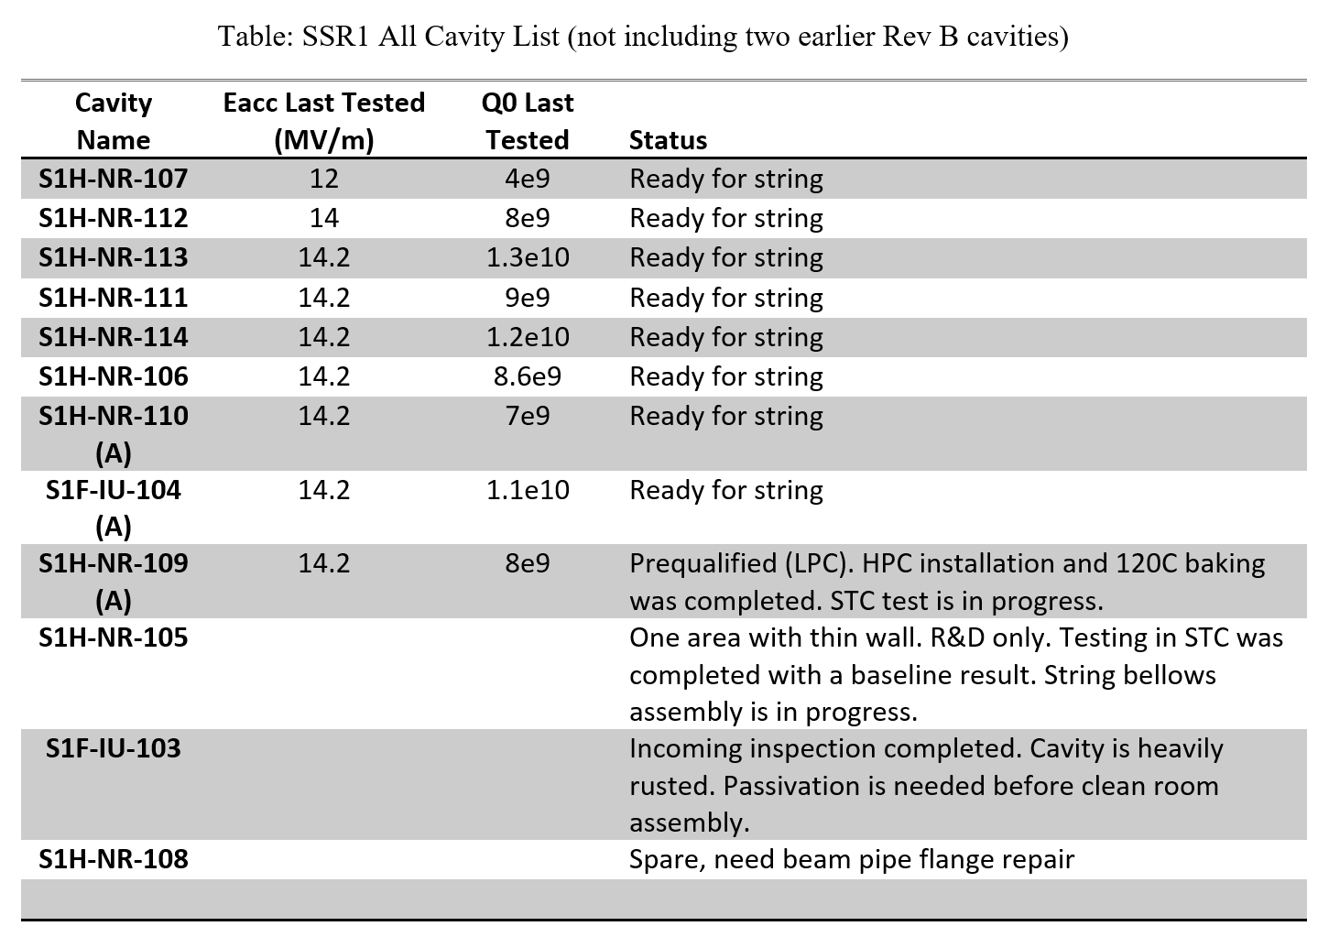
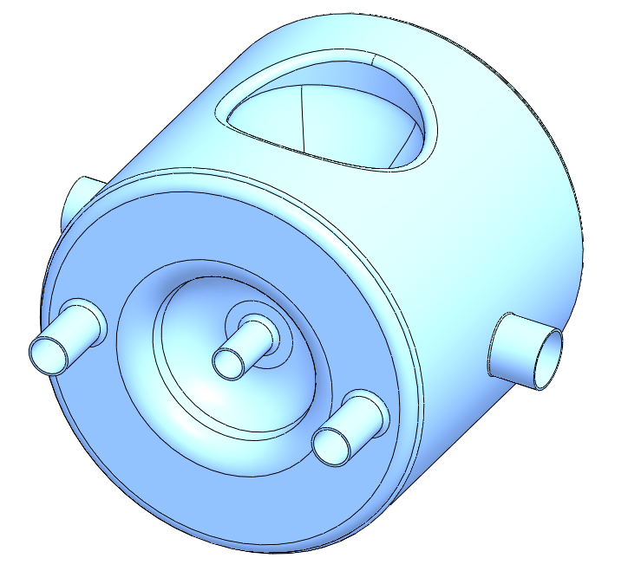
WBS 121.2 SRF Updates – SSR Cryomodules
SSR1 Cavities (Specification 10 MV/m, Q0 = 6e9)
SSR1: 8 cavities ready for string assembly. String assembly preparation is in progress
SSR2: RF model finalized. Two water rinsing ports were added and could potentially be used as Electropolishing ports as well. Multipacting analysis is in progress.
SSR2 RF model

Slide 10
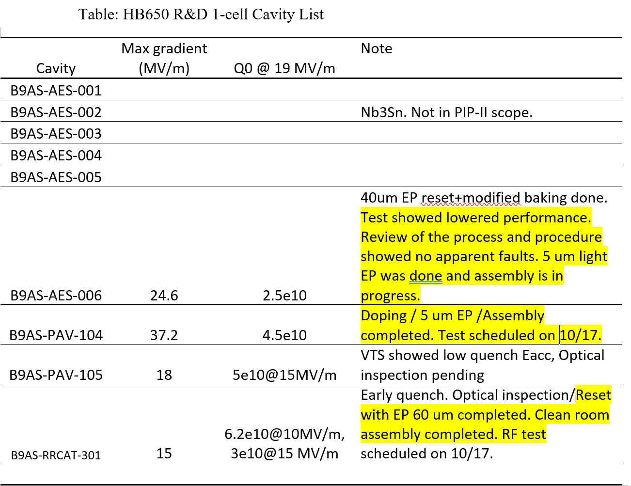
WBS 121.2 SRF Updates – 650 Cryomodules
HB650 Cavities (Specification 19 MV/m, 3.0e10)
HB650 R&D: Doping was completed for 1-cell cavity B9AS-PAV-104. Test is scheduled.
Coupler: Low loss coupler cleaned and particulates test showed coupler is compatible with assembly procedure.
Safety bracket for helium vessel bellows design is in progress.

Slide 11
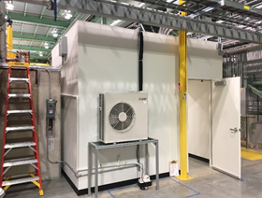
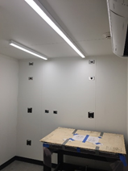
Updates - WBS 121.4 Linac Installation and Commissioning (1 of 2)
Test Infrastructure
Progress continues with PIP2IT
CTL preparation work - estimate installation inside the cave begins in ~ 3 weeks
Preliminary ODH analysis for PIP2IT has been completed
Interlocks for PIP2IT south entrance gate have been completed
Laser hut construction is 95% complete
Building Infrastructure
  Issued Room Data Sheet to POCs for distribution to the L3s. Regular meetings being conducted to discuss and track progress.
  Goal is to have requirements defined for CF Site Prep this month.

Slide 12
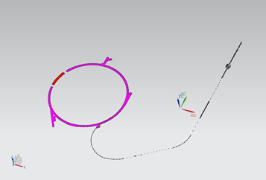
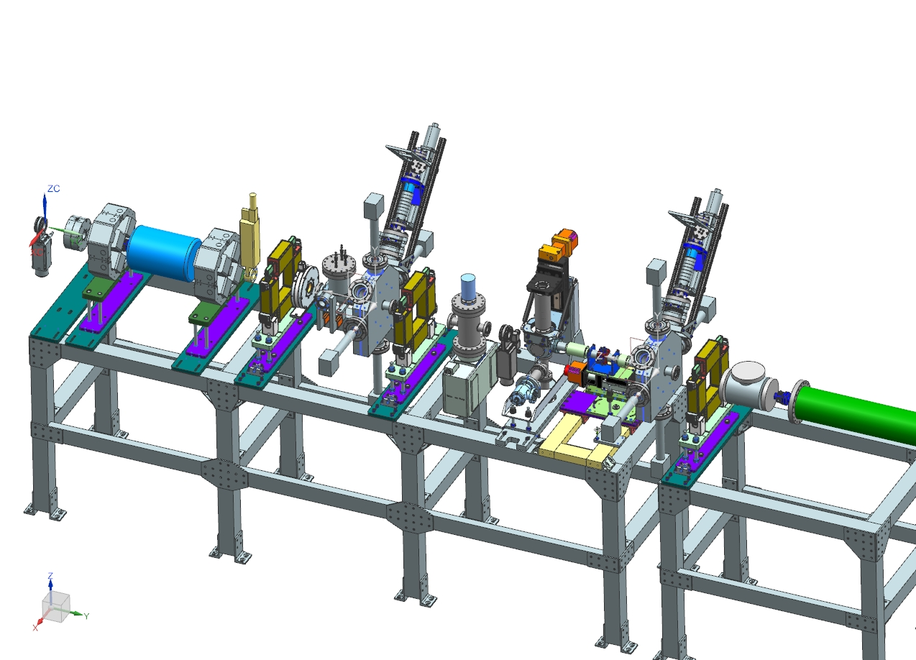
Updates - WBS 121.4 Linac Installation and Commissioning (2 of 2)
Installation
  An initial test of the linac CAD export to Conventional Facilities was successfully conducted.
  Steve Dixon will send it on to the A&E for their feedback.
Commissioning
  Started developing the preliminary Beam Commissioning Plan
WFE
  Developing the design of HEBT section of PIP2IT in order to support HWR/SSR1 beam commissioning

Slide 13
Conventional Facilities
Site Prep Design
  60% Cost/Schedule Update
    Initial review indicated a ~13% increase over conceptual estimate;
    Design team review indicated the significant drivers:
      Additional costs for “looped” utilities (longer runs);
      Additional AZero pond work;
      Less road work;
      Less electrical feeder cost;
      Additional landscaping work (more than doubled);
      Additional hauling costs for filling site;
      Less natural gas supply (removed from scope);
      Minor math errors;
      Impact of economic conditions;
    Design Change Focus:
      Revised landscaping plan (utilize simpler scheme, simpler materials, relocate on site materials);
      Revise AZero pond design based on meeting with stakeholders;
    Updated Estimate Goal: Within ~5% of Conceptual Estimate

Slide 14
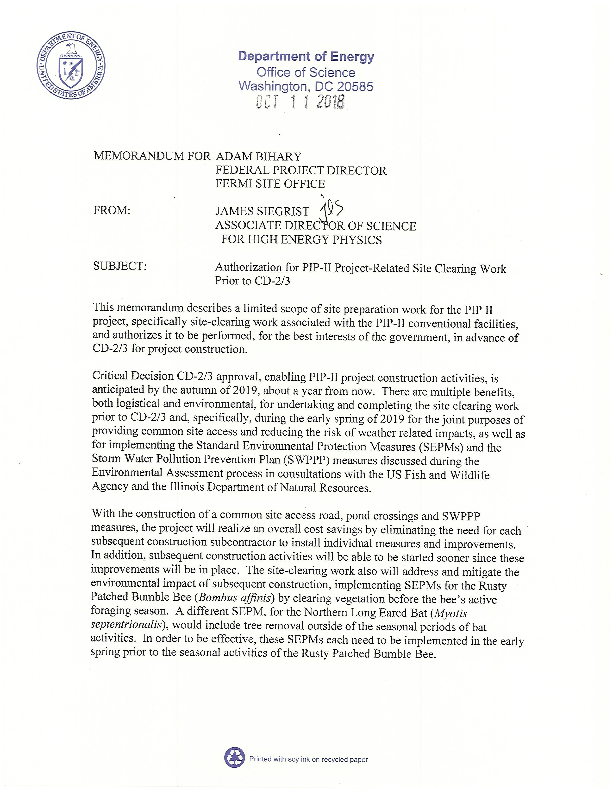
Conventional Facilities
Site Prep Design
  90% Design Documents anticipated on 19OCT18
  Estimate will be updated based on the revised drawings
  Design Completion scheduled for December 2018.
  Site Clearing work is planned to have purchase order in place for March 2019 groundbreaking.
  Authorization for Site Clearing received on 11OCT18 (thank you!)
  Coordinating work with the FY19 Utility Corridor GPP project (more thanks)

Slide 15
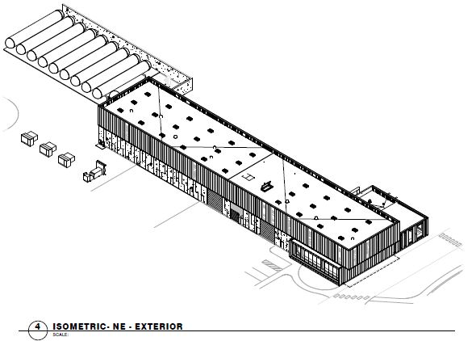
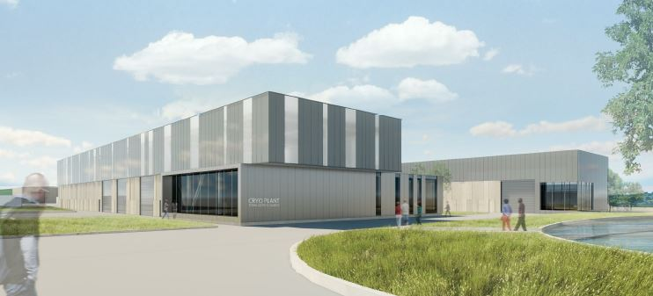
Conventional Facilities
Cryo Plant Building Technical Requirements
  Documents received 28SEP18.
  Review in progress
A/E Re-compete
  Source Evaluation Board review complete;
  Internal Procurement recommendation review in process;
  On track for December award;

Slide 16
Systems Engineering Update
Technology Roadmap– work started;
Preliminary Design Deliverables Document – under review with L2Ms;
L3 ICDs and FRs are complete – verification is in progress;
Preliminary Design Report – issued first consolidated draft;
SEMP and DRP review – received comments and recommendations from MSU/FRIB; expecting comments from Fermilab, JLab and ORNL

Slide 17
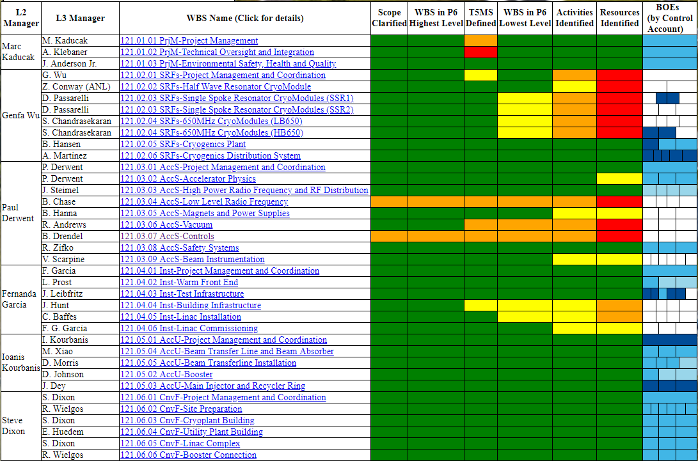


RLS Development Status (https://pip-ii-evms-tracking.fnal.gov/)

Slide 18
EVMS Milestones
Updated BOE template, instructions - done
Scope frozen for all systems – 27-Oct-2018
All resource loading, estimate uncertainty information available from CAMs – 15-Nov-2018
All data entered into P6 – 30-Nov-2018
P6 data validated – 07-Dec-2018
Align P6 plan to funding profile – 15-Jan-2019
Initiate EVMS – 01-Feb-2019

Slide 19
Upcoming Events
650 MHz Cryomodule Design Advisory Meeting - 23 Oct 2018
P2SPAC - Tue 30 Oct 2018
ESS Mechanical Engineering Section Leader visit 5-6 Nov 2018
DOE IPR - 4-6 Dec 2018
PIP-II Groundbreaking – March 2019
P2MAC - 25-27 March 2019

Slide 20
Assumptions and Fermilab Interface Documents
Assumptions Document (DocDB#144)
  https://pip2-docdb.fnal.gov/cgi-bin/private/ShowDocument?docid=144
Interface Document (DocDB#528)
  https://pip2-docdb.fnal.gov/cgi-bin/private/ShowDocument?docid=528
Current versions of these documents date to CD-1. Need to update for CD-2, requiring discussions with lab leadership, APS-TD, AD, FESS.
The following slides list some selected assumptions and lab interfaces that could require revisiting.

Slide 21
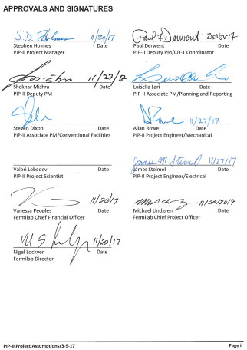
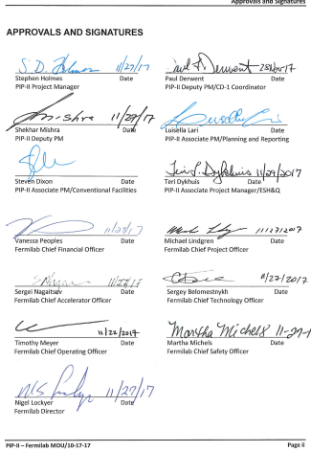
Approvals

Slide 22
Transition to Operations
For all PIP-II systems the scope includes research & development, design, fabrication, inspection and acceptance, installation, and commissioning activities. Commissioning is assumed complete upon meeting the project KPPs. Demolition and decommissioning is not included in the project
Operating funds will be available to support maintenance and operations of PIP2IT systems once commissioning of each system is completed.
Operating funds will be available to support maintenance and operations of the 800-MeV linac, Booster, Recycler, and Main Injector once Key Performance Parameters (KPPs) associated with each of these systems is achieved.
Installation and commissioning of new systems required for injection of 800-MeV protons into the Booster will be scheduled coincident with the interruption to accelerator operations in the Main Injector complex required for integration of the long baseline neutrino facility (LBNF).
PIP-II will be operational by the end of the LBNF shutdown.
The 800-MeV linac and transfer line can be installed and commissioned without interruption to accelerator operations.
The accelerator shutdown required to connect the beam transfer line into the 8-GeV Booster will be coincident with the accelerator shutdown for LBNF connection into the Main Injector.
PIP-II will transition to operations as work is completed on the Project. A transition to operations plan that will capture the cost and labor necessary for operations will be developed before CD-2.

Slide 23
Spares
The PIP-II project will fabricate an adequate complement of spare components to achieve all threshold KPPs and supporting objective KPPs. Such spares will be included in the Project cost.
In consultation with Accelerator Division, the Project will identify and fabricate an initial complement of spare components adequate to sustain operations. Such spares will be fabricated by the Project and then will be transferred to, and reimbursed from, the Fermilab special process spares account prior to CD-4.

Slide 24
Conventional Facilities
The enclosure for the superconducting linac will have sufficient length to accommodate two HB650 cryomodules beyond those nominally required for 800 MeV beam.
1,400 gallons per minute of industrial cooling water (ICW) will be available for PIP-II process loads. This flow will be available in all operating conditions. The connection location from the existing site-wide ICW will be in the vicinity of AZero;
The PIP-II ICW return discharge will be routed to the existing AZero cooling pond. It is assumed that the existing system to pump the ICW to the Casey’s Pond system is adequate for this flow.
250 tons of chilled water will be available from the Central Utility Building (CUB) for use by PIP-II. The connection point for the chilled water will be in the vicinity of CUB;
PIP-II will require six (6) 13.8 electrical feeders, fed from the Master Substation (MSS);
Existing feeder 46A, fed from the Kautz Road Substation, will be used for backup of critical PIP-II systems;
PIP-II will install new electrical breakers at MSS;
Existing electrical ductbanks will be utilized for PIP-II feeders from MSS to manhole P-71 in the main ring;
New PIP-II electrical ductbanks will be extended from the existing electrical system at manhole P-71;
The Accelerator Division will assume responsibility for the maintenance of PIP-II systems/buildings/structures at the time of Beneficial Occupancy.

Slide 25
Booster Tower SE
The primary interface between the PIP-II conventional facilities and the existing accelerator complex is located at the connection of the PIP-II Beam Transfer Line into the Booster. To accommodate this connection, the Booster Tower Southeast (FIMS No. 208) will be demolished as part of the PIP-II work scope. Listed below are the specific items and responsibilities of this work:
  Fermilab will relocate the existing occupants and functions currently housed in the building;
  Fermilab will mitigate lead, asbestos and activated components within the building;
  Fermilab will terminate existing utilities (electrical, industrial cooling water, domestic water, sanitary sewer, natural gas, data/communication) to a point outside the building demolition limits;
  Fermilab will prepare and submit paperwork and notification of demolition in accordance with
  current procedures;
  Fermilab demolition preparation will be completed by October 2023;
  PIP-II will demolish the Booster Tower Southeast building;
  At the conclusion of the PIP-II work an earthen shielding berm will be installed above the
  existing Booster enclosure and new PIP-II enclosures;
  PIP-II will replace the existing exit stair from the Booster enclosure;
  PIP-II will install a weathertight entrance to the east Booster Gallery.
  PIP-II will maintain access to the electrical substation located southeast of the Booster Tower Southeast;

Slide 26
Project vs. Overhead
Fermilab ES&H support is off-project and is included in the overhead rate.
Procurement support is off-project and is included in the overhead rate, with the exception of complex procurements.
The PIP-II Project will rely on the Finance Section for the procurement of materials and services for the Project. More specifically:
  The Finance Section will assign a dedicated point of contact for all PIP-II procurements with his/her effort funded as an indirect expense to the Project.
  The Finance Section will assign dedicated Procurement Manager support to the PIP-II Project as required to manage complex procurements, by the time of CD-2. The Procurement Support will report his/her effort directly to the appropriate PIP-II Project task code.

Slide 27
Facility Availability
The Technical Division will provide access to superconducting radio frequency (SRF) test and production facilities during the PIP-II R&D and construction phases as necessary to maintain the project schedule. Such facilities include:
  SRF Processing facilities at ANL and Fermilab
  Test stands, including VTS, HTS, STC, and MTS
  Cryogenic support for the above listed Test Stands
  QC facilities, including Nb qualification, cavity inspection, and cavity tuning
  Fabrication Facilities, including the Cryomodule Assembly Facility (MP-9 and ICB) and Lab 2
The Accelerator Division will provide access to superconducting radio frequency (SRF) test facilities during the PIP-II R&D and construction phases as necessary to maintain the project schedule. Such facilities include:
  CMTF, including PIP2IT
Maintenance and operations support of the above facilities is provided through operating funds. The Project will pay for project-specific enhancements and utilization of the facilities, and for cryogens.

Slide 28
PIP-II Organization
The Accelerator Division will host the PIP-II Project Office and provide the required administrative support. Administrative support will be funded as indirect expenses to the Project.
The Fermilab Divisions/Sections will provide the line management of personnel supporting the Project.
The Accelerator and Technical Divisions will each designate a primary point of contact, from within their management, to provide coordination of activities between the Division and the Project.
It is expected that the Divisions/Sections will solicit input from the Project on the performance of Fermilab staff assigned to the PIP-II Project as part of the annual performance appraisal process.
The Fermilab Divisions/Sections will support activities related to engineering, documentation, ESH, and QA via their normal process.
The Fermilab ESH&Q Section will provide ESH&Q support at the Project level. ESH&Q support will be funded as indirect expenses to the Project.
The Fermilab Finance Section will provide procurement support for the Project. Such support will be funded as indirect expenses against the Project with the exception of the Procurement Manager, described in the next section.

Slide 29
Summary
CD-2/3a preparations continue to be the highest priority:
  Good RLS progress but behind with respect to CD-2 goals
  Assumptions for partner deliverables are nearly final for purposes of RLS
  CD-3a schedule driven by cryoplant procurement
  Next major effort is resource loading remainder of RLS, and updating BOEs.
Funded at $35M (CD-1 profile), but this is tight w.r.t. our goals
Good progress on HWR, SSR1, PIP2IT
EA on track for anticipated FONSI this year.
A/E procurement on track for award in December. Site clearing still planned for March 2019.
Need to revisit assumptions and interface documents

