Slide 1
Status of the SP-PD at the CE Test Stand (ICEBERG)
David Warner
Colorado State University
October 18, 2018

Slide 2
SP-PD Goals for ICEBERG Tests
Primary goals of testing:
Tests of single-sided ARAPUCA and single-sided X-ARAPUCA (with filter-plate rear reflectors) with TPC track information-- Similar to ProtoDUNE
Comparison of SSP and mu2e electronics
Mu2e DAQ interface available for second run (Winter 2019)
Interference testing between CE and PD electronics
Comparison of active ganging circuit prototypes
Available in second test run
DAQ/TPC interface
DUNE FD PD cabling scheme

Slide 3
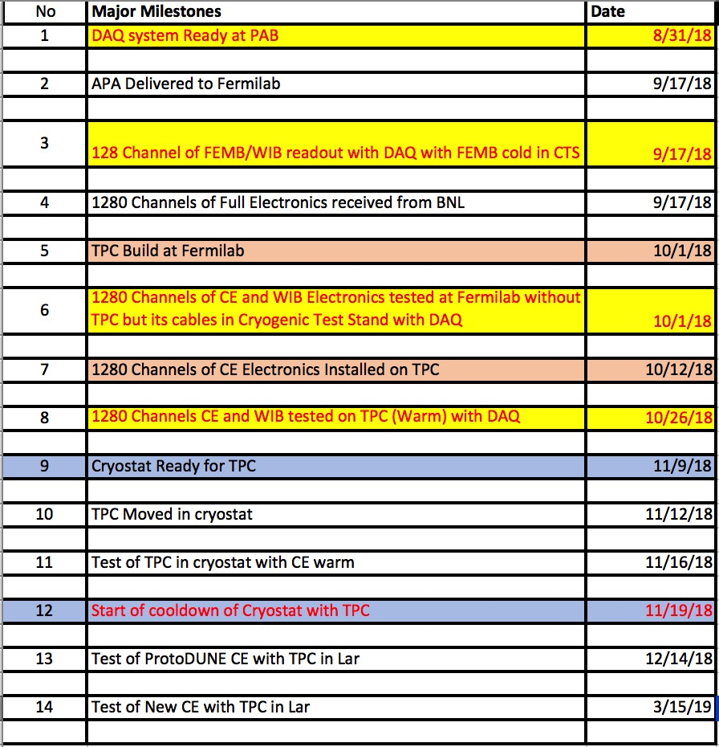
Schedule (as of October 16)
PDs needed for installation ~ 11/7/18
Initial Cool-down begins.
First Test Run ~ 12/14 – 12/24(?)
Second Test Run ~March 2019

Slide 4
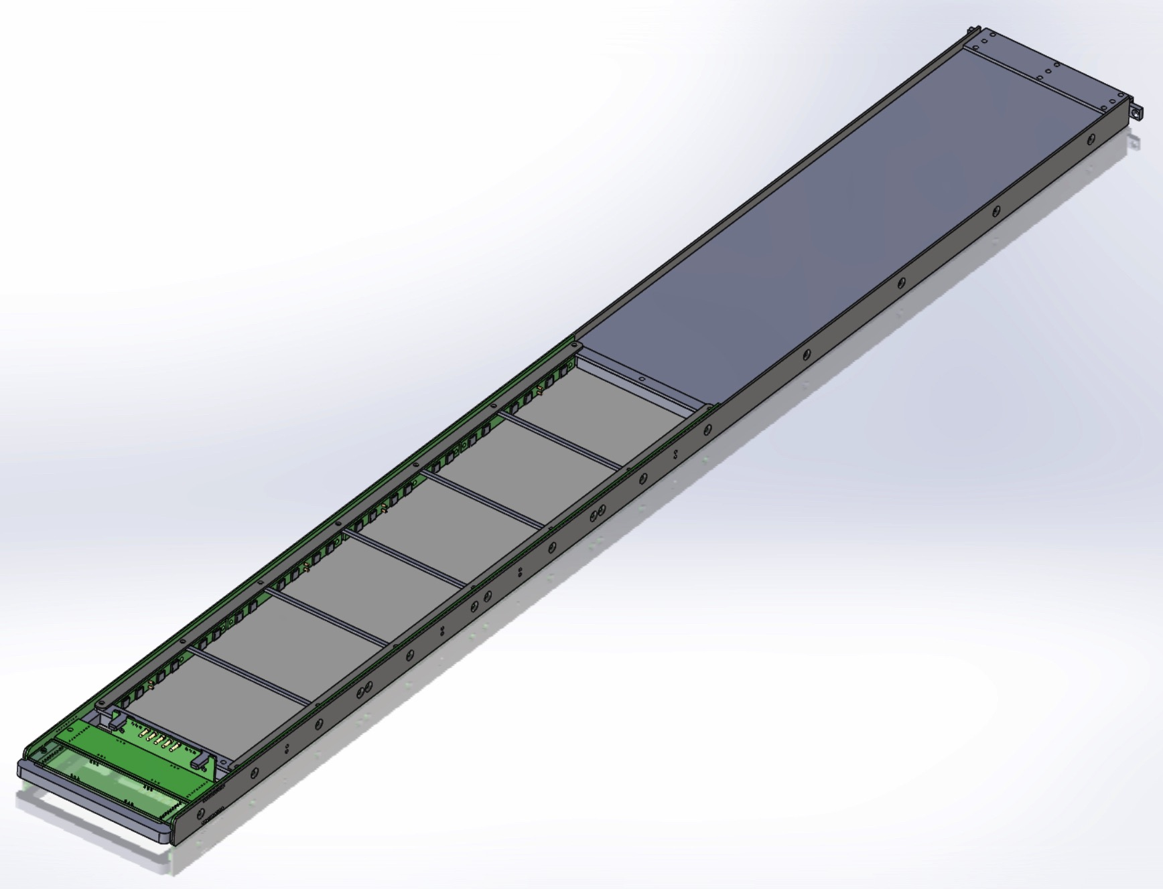
PD Mechanical Design Status-Done!
Single-sided ARAPUCA Module

Slide 5
PD Status: Test 1 Modules
Required: 96 MPPCs OK (In hand)
Required: 16 MPPC mount boards OK (In hand)
Active Ganging Boards (2 req’d) OK (In fab.)
Required: 12 coated filter plates, 6 Vikuiti sheets
Filter plates OK
Vikuiti On order
Coating Real-time update
WLS Plates (X-ARAPUCA) OK (In hand)
APA Connectors/cables OK (Installed)
Connectors (Module mount) 2 on hand OK (In hand)
Mechanical Design& Fabrication OK (In fab)

Slide 6
Readout Electronics
Primary readout in test 1 will require an SSP modified for MPPCs (50V) and ideally for RJ-45 connectors)
Still working to identify exact SSP to be used
Secondary readout will be provided by the mu2e electronics system.
System is making good progress-- still on track for December use.
Working to understand data analysis/DAQ integration plan.

Slide 7
SP-SP ICEBERG group
Operations group (FNAL)
Design Lead: Warner
Operational lead(s): Escobar, ???
Electronics group
FE electronics: Fitzpatrick, Mousseau, Spitz, Djurcic
Active ganging: Cancelo, Molina
Cabling: Warner, ???
DAQ/Data readout: ???
Run coordination/analysis/planning: ???

