Slide 1
Tritium: BNB Canopy and Berm Stabilization update
Cons Gattuso
October 19 2018

Slide 2
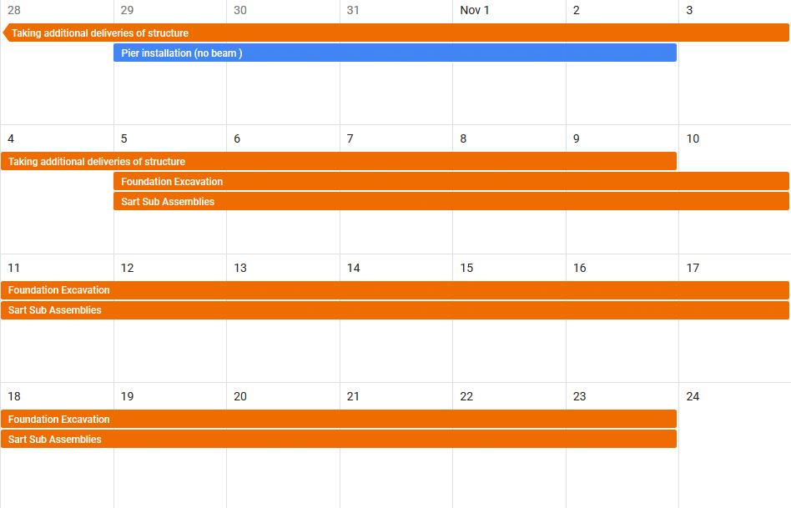
Monday Tuesday Wednesday Thursday Friday
Preliminary Schedule
Draft

Slide 3
We will still maintain access to MI12 building from the south end
Staging Area
Lab access
Construction area
Construction
Attire Required
Hard Hat
High Vis vest/jacket
Safety Shoes
Ect.
Details on Job HA

Slide 4
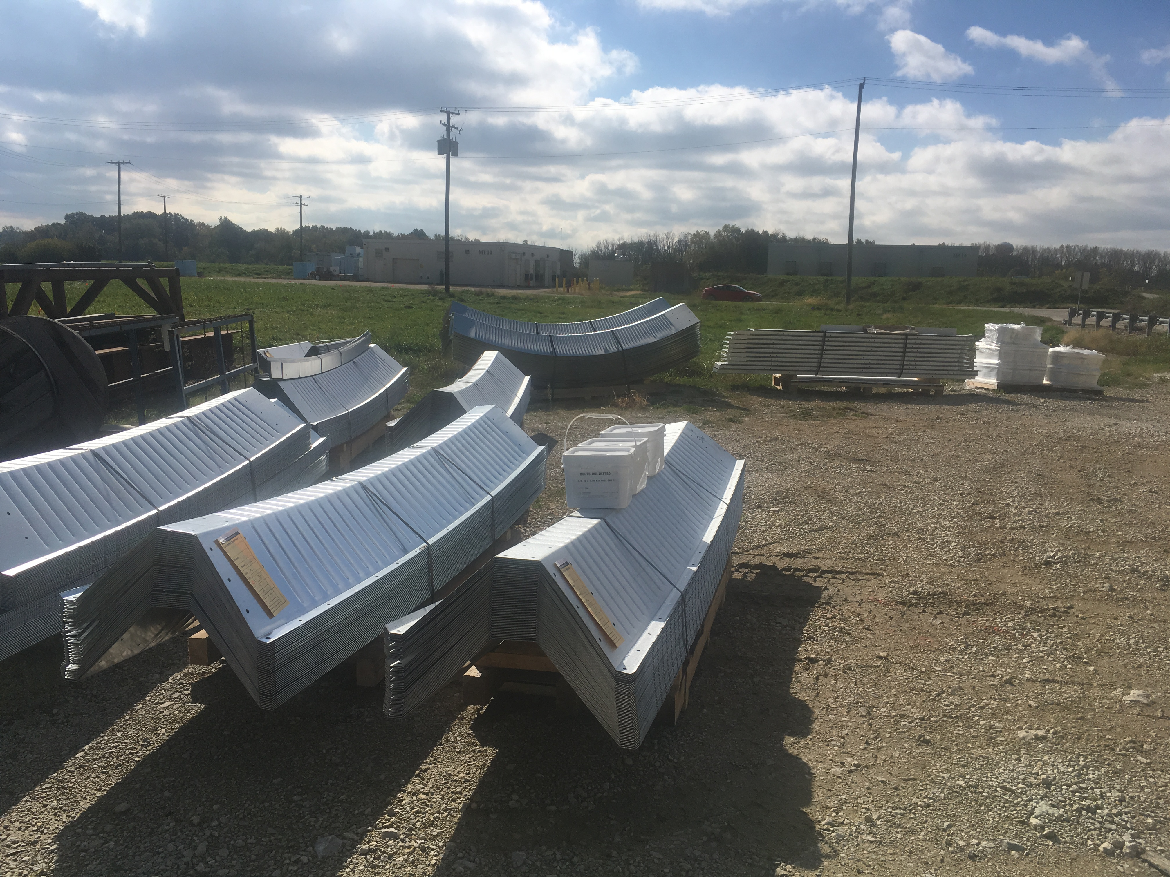
1 of 7 shipments
of canopy segments
Stairs to be removed

