Slide 1
Analysis of a small racetrack model
for cable studies
3rd US MDP Collaboration Meeting
Vadim Kashikhin
January 17, 2019
Fermi National Accelerator Laboratory

Slide 2
Goals
To develop a possible test vehicle for the cable/coil/magnet related studies:
high-J_{c} and high-C_{p} cables;
improved cable insulation;
new impregnation materials;
new quench protection methods.
Should preferably have features of a real magnet:
coil with a relatively large number of turns to simulate a single block of a potential 16+ T dipole;
straight-section and ends.
Should be cost-effective and allow a quick turn-around.

Slide 3
General constraints
Pole width: 20 mm. Smaller is better – makes coils more compact, but too small would be difficult for winding.
Maximum current <30 kA (at 1.9K).
Preferably use a cable that has already been well characterized by the past experiments to weed out the cable-related factors (i.e. degradation due to cabling, expansion during the reaction, etc.) and that has a potential to be used in future magnets.
Cable parameters | Unit | Value
Strand diameter | mm | 0.700
Cu/non-Cu ratio | - | 1.13
Non-Cu J_{c} (12 T, 4.2K) | A/mm² | 3000
Number of strands | - | 40
Bare cable dimensions | mm | 1.319 x 15.100
Insulation thickness | mm | 0.125

Slide 4
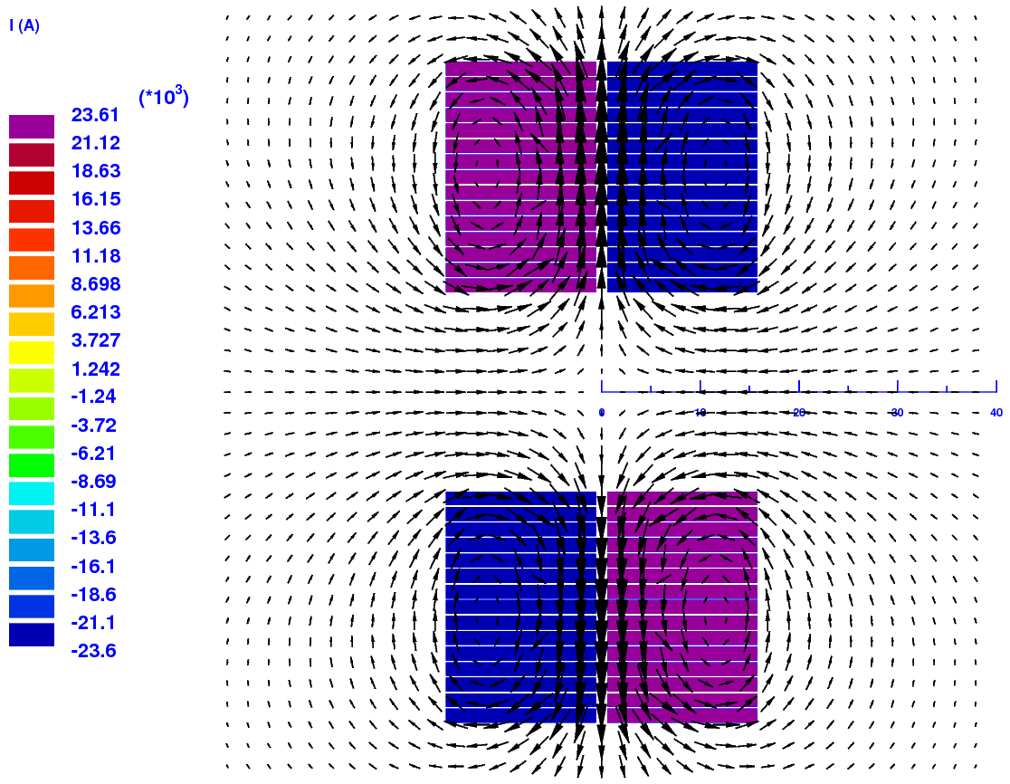
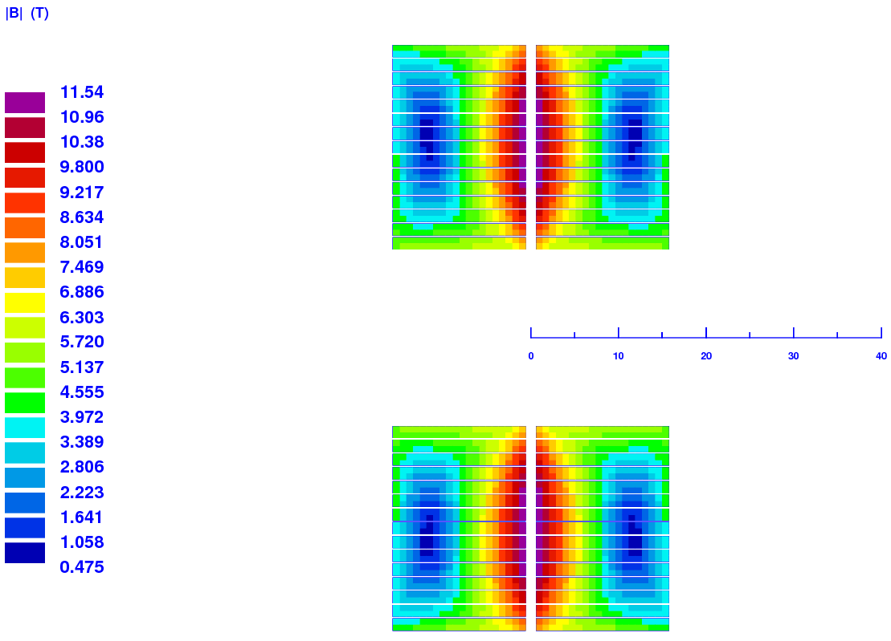
Common-coil design
Parameter | Unit | Value
Number of turns/layer | - | 15 | 30
B_{peak_SSL} @ 4.2K/1.9K | T | 11.55/12.47 | 12.37/13.35
I_{SSL} @ 4.2K/1.9K | kA | 23.61/25.49 | 20.14/21.75
Inductance | mH/m | 0.121 | 0.325
Stored energy @ I_{SSL} | kJ/m | 33.6/39.2 | 65.9/76.9

Slide 5
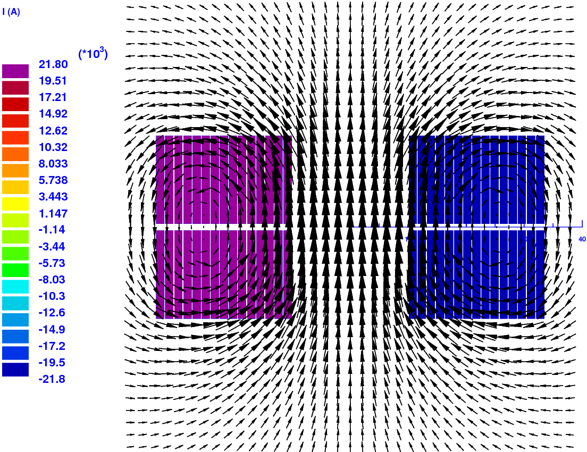
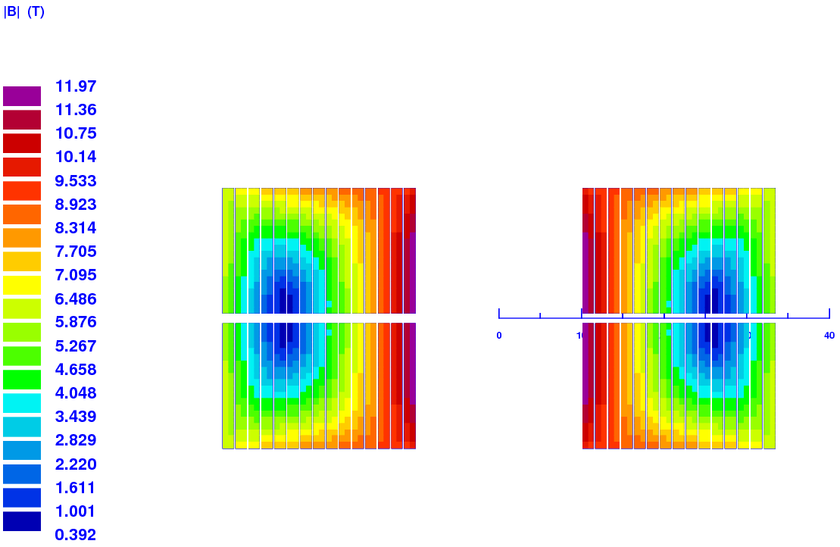
Block-type design
Parameter | Unit | Value
Number of turns/layer | - | 15 | 30
B_{peak_SSL} @ 4.2K/1.9K | T | 11.97/12.92 | 13.38/14.47
I_{SSL} @ 4.2K/1.9K | kA | 21.81/23.53 | 16.35/17.67
Inductance | mH/m | 0.462 | 1.893
Stored energy @ I_{SSL} | kJ/m | 109.8/127.8 | 252.9/295.5

Slide 6
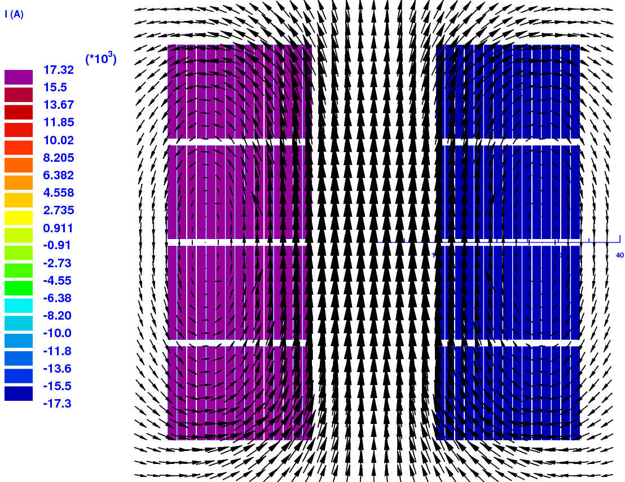
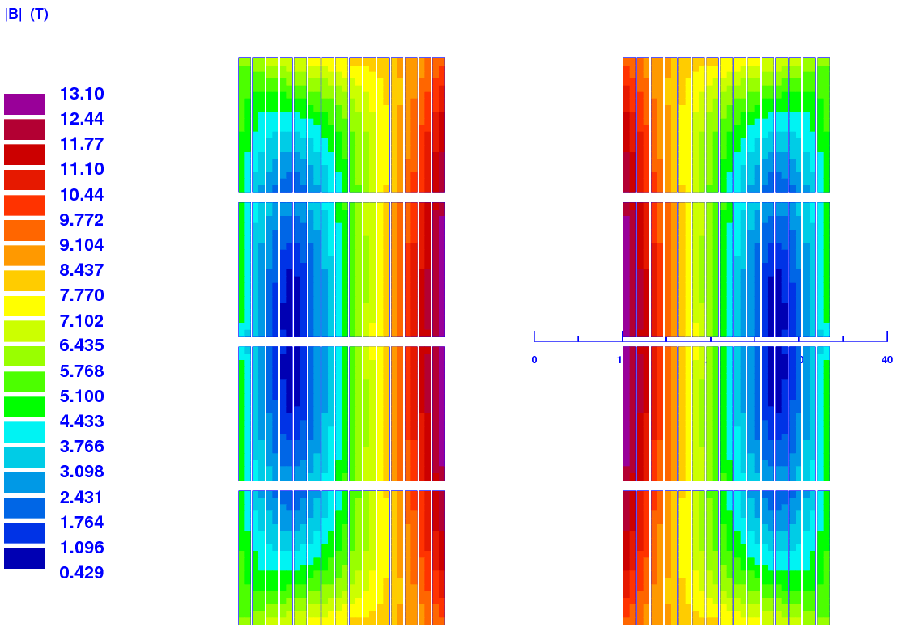
Double block-type design
Parameter | Unit | Value
Number of turns/layer | - | 15 | 30
B_{peak_SSL} @ 4.2K/1.9K | T | 13.11/14.16 | 14.77/16.00
I_{SSL} @ 4.2K/1.9K | kA | 17.32/18.72 | 12.00/13.00
Inductance | mH/m | 1.318 | 5.892
Stored energy @ I_{SSL} | kJ/m | 197.8/230.9 | 424.5/498.0

Slide 7
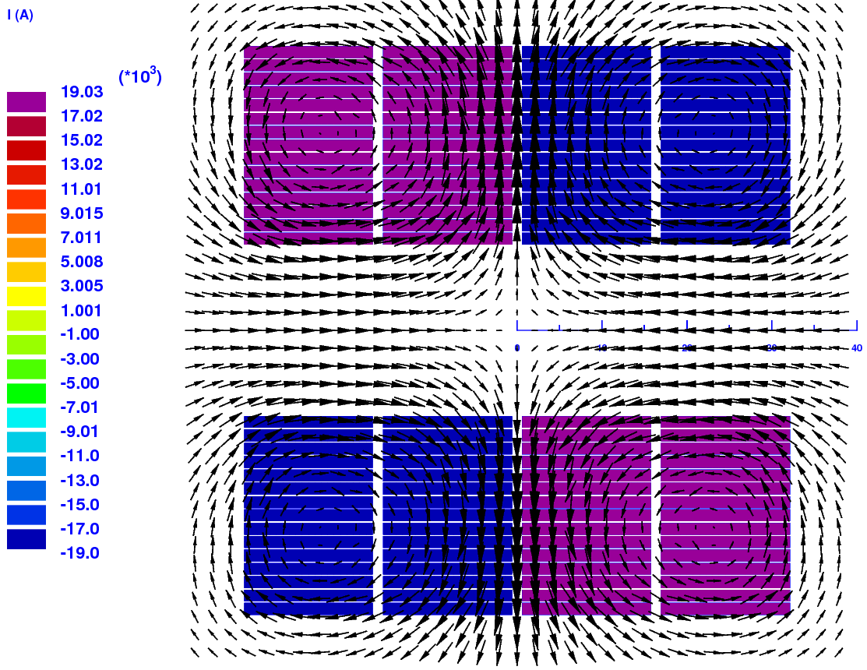
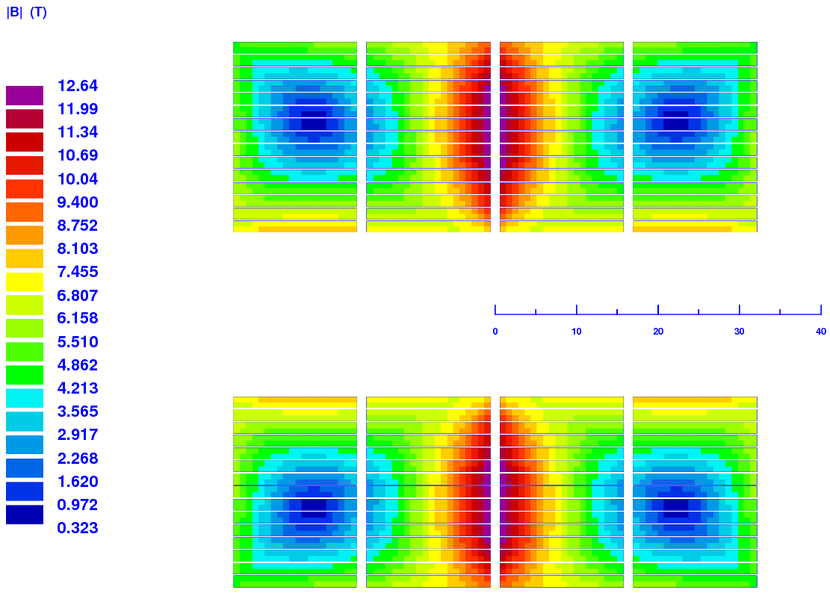
Inverted double block-type design (i.e. common-coil)
Parameter | Unit | Value
Number of turns/layer | - | 15 | 30
B_{peak_SSL} @ 4.2K/1.9K | T | 12.64/13.65 | 13.90/15.03
I_{SSL} @ 4.2K/1.9K | kA | 19.03/20.56 | 14.65/15.85
Inductance | mH/m | 0.529 | 1.680
Stored energy @ I_{SSL} | kJ/m | 95.7/111.7 | 180.3/210.9

Slide 8
Assumptions for the structural analysis
Block-type design with 30 turns per layer.
Forces at the maximum current (at 1.9K).
Uniform coil block with orthotropic (elastic) material properties from 10-stack measurements. Isotropic material properties everywhere else.
A free sliding contact between the coil and the pole and between the coil and the structure.
Material | Parameter (4.2K) | Unit | Azim. | Radial | Axial | Reference
Coil | Young’s modulus | GPa | 37 | 46 | 46 | Bossert 2014
 | Shear modulus | GPa | 15 | 15 | 15 | Estimated
 | Poisson’s ratio | - | 0.37 | 0.37 | 0.20 | Bossert 2014
 | CTE(4K-293K) | mm/m | 3.2 | 3.1 | 2.7 | Swenson 1997
SS316 | Young’s modulus | GPa | 208 |  |  | Ekin 2006
 | Poisson’s ratio | - | 0.28
 | CTE(4K-293K) | mm/m | 3.0
Aluminum 6061-T6 | Young’s modulus | GPa | 78 |  |  | Ekin 2006
 | Poisson’s ratio | - | 0.327
 | CTE(4K-293K) | mm/m | 4.14

Slide 9
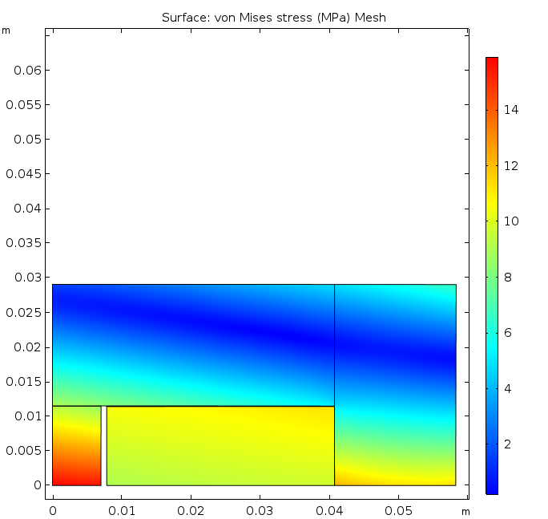
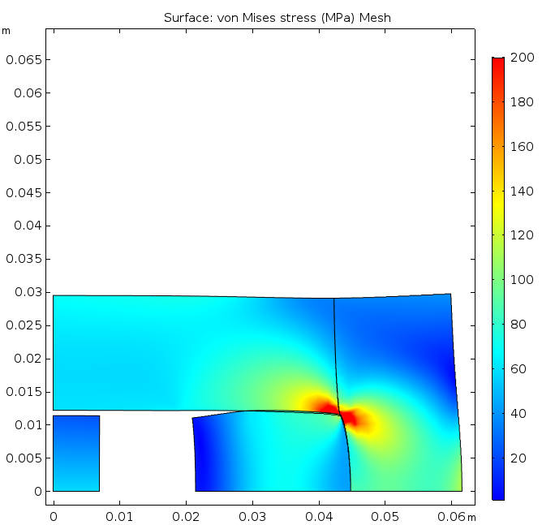
SS structure, zero interference everywhere
After cool-down At the maximum current
Displacements are scaled up by a factor of 100 here and in the following plots
11 μm gap
8 μm gap
143 μm gap
σ_{max} = 132 MPa
Small gap due to differential thermal contraction
Large pole gap, stress concentration in the corner

Slide 10
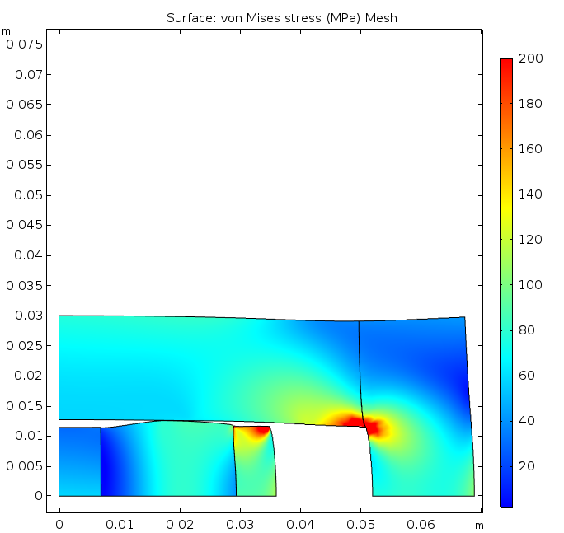
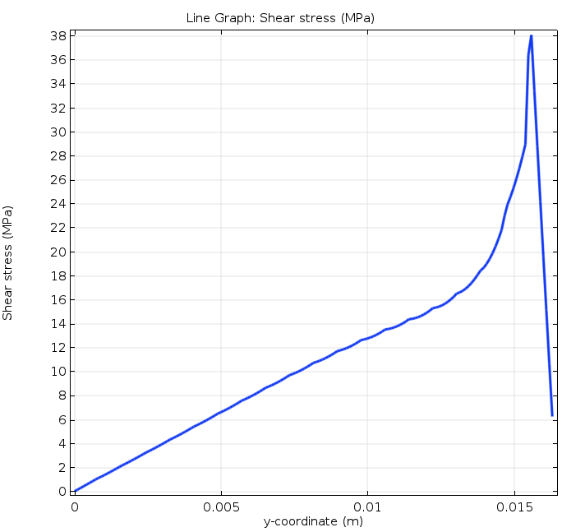
SS structure and glued pad, horizontal interference
At the maximum current Coil-pad shear stress
σ_{max} = 114 MPa
160 μm
interference
The peak coil stress is reduced by 26 MPa.
However, there is a substantial shear stress
at the coil-pad interface.

Slide 11
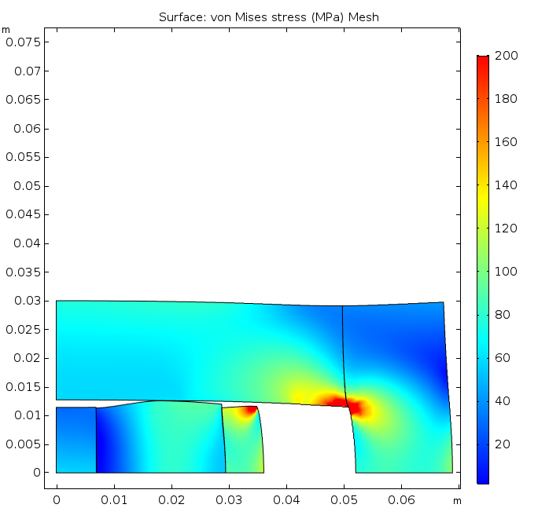
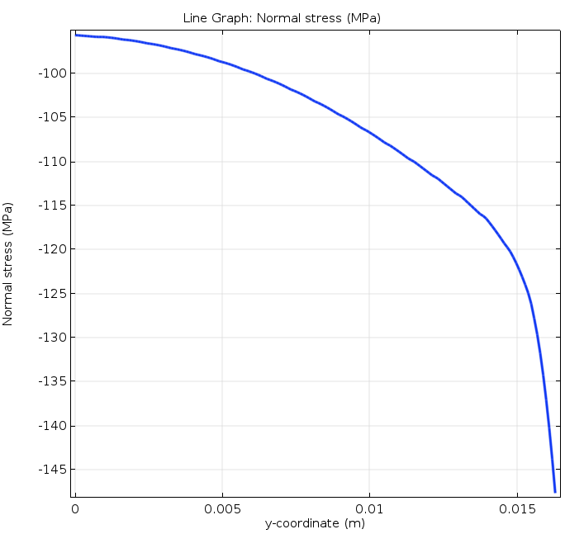
SS structure and sliding pad, horizontal interference
At the maximum current Coil-pad normal stress
σ_{max} = 91 MPa
160 μm
interference
The shear stress at the coil-pad interface is 0.
However, the normal stress is over 100 MPa.
Zero friction is not realistic.
The peak coil stress is further reduced by 23 MPa.

Slide 12
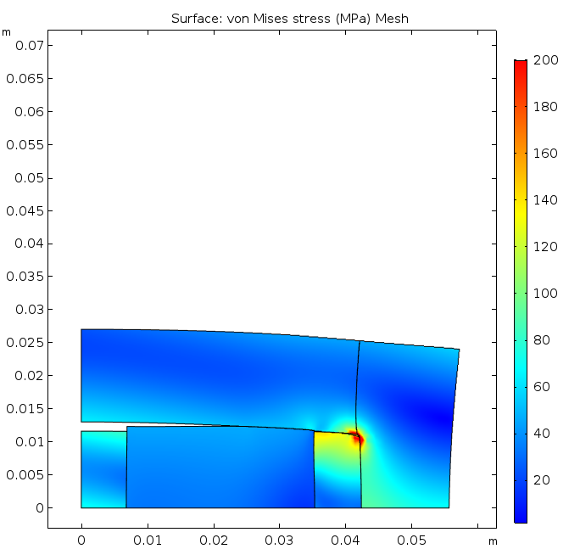
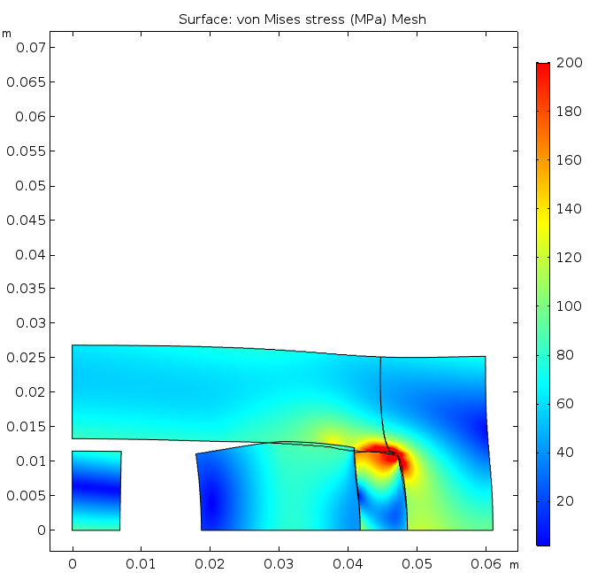
Aluminum structure and SS sliding pad, zero interference
After cool-down At the maximum current
20 μm gap
118 μm gap
σ_{max} = 46 MPa
σ_{max} = 91 MPa
Virtually no gaps after cool-down with zero
initial prestress.
A large structure deformation under the
Lorentz forces.

Slide 13
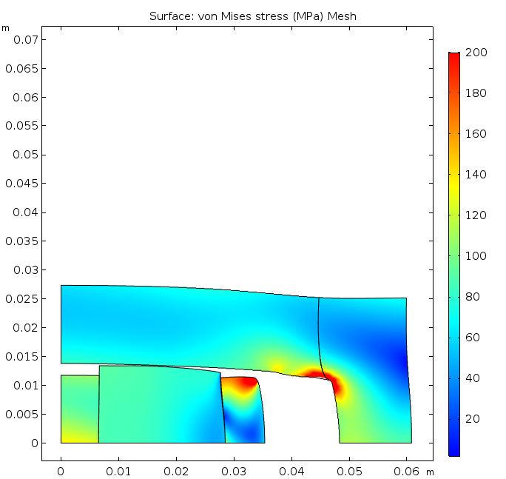
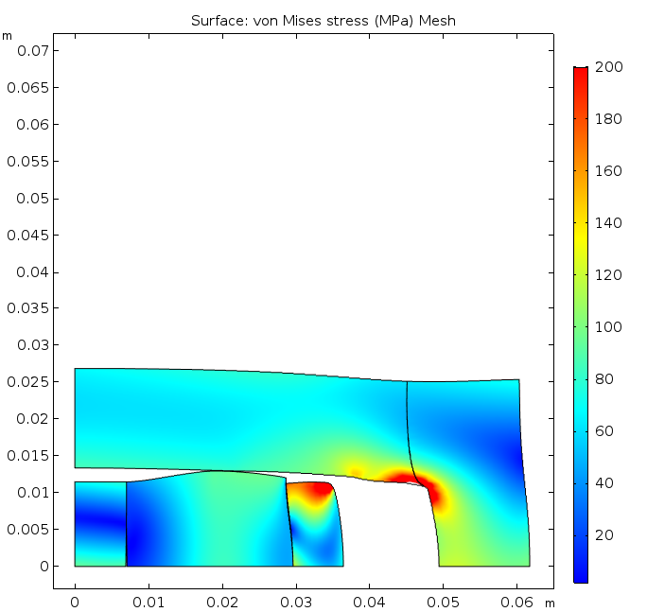
Aluminum structure and SS sliding pad, horizontal interference
After cool-down At the maximum current
18 μm gap
130 μm
interference
130 μm
interference
σ_{max} = 91 MPa
σ_{max} = 96 MPa
The required interference is reduced vs. the stainless steel structure. The peak coil stress is (slightly) higher. Also, there is a substantial vertical gap due to the structure deformation.

Slide 14
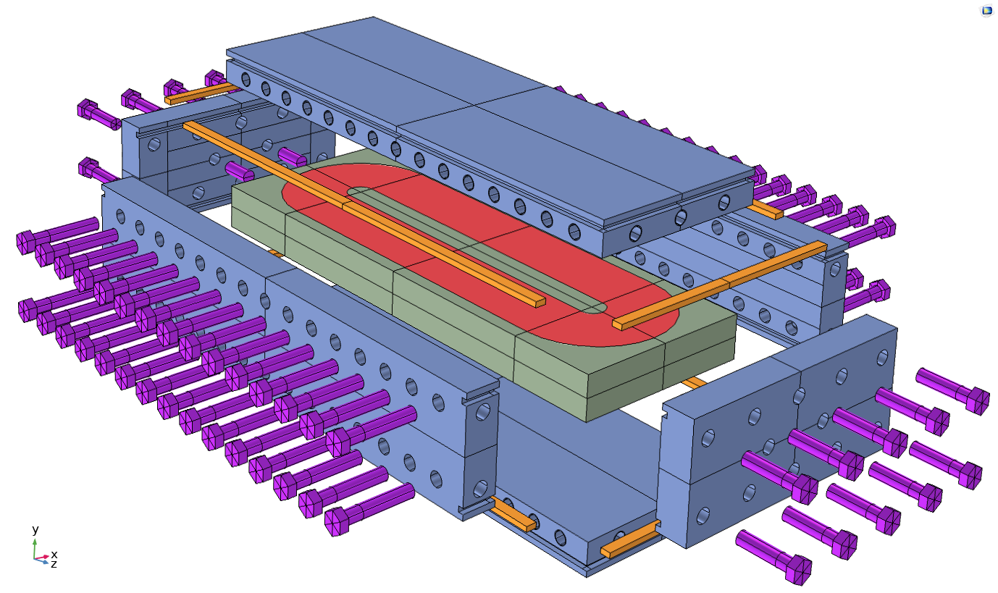
Assembly - bolted structure

Slide 15
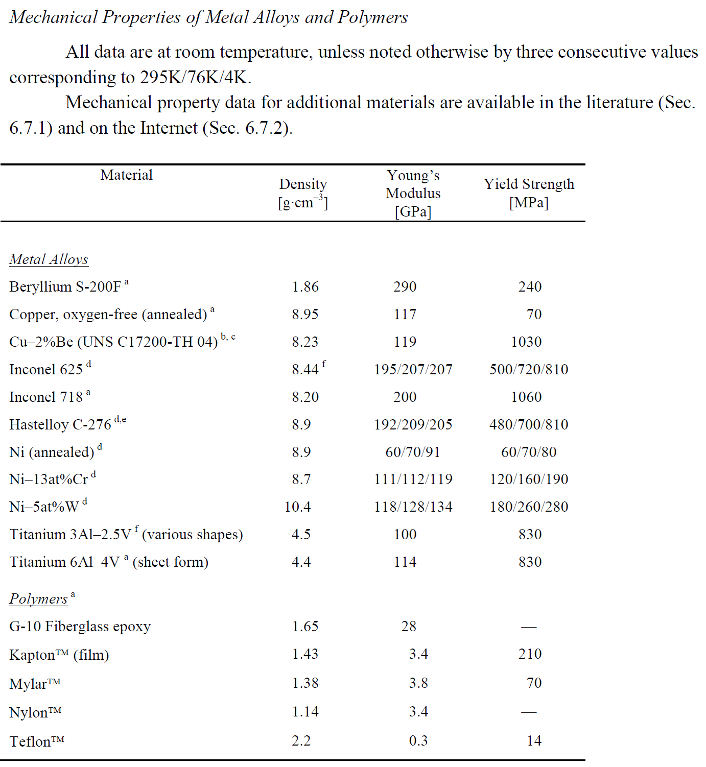
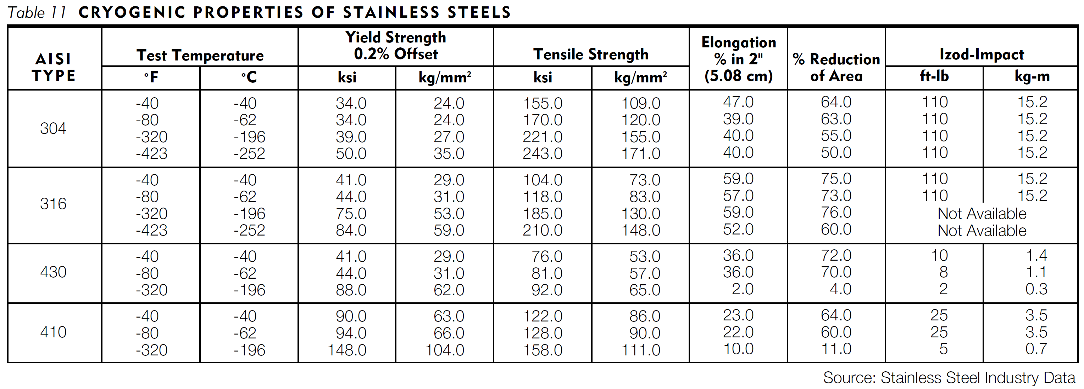
Bolt selection
The total azimuthal reaction force is 1.73 MN/m per one coil (including the prestress, thermal contraction and Lorentz forces.
If the bolts are 25 mm apart, the total force per one bolt is 43.1 kN.
If the bolt diameter is 3/8”, the peak bolt stress is 605 MPa.
Possible bolt materials:
Inconel 718 σ_{bolt}/σ_{y.s.} = 605/1060 = 0.57
Titanium 3Al-2.5V σ_{bolt}/σ_{y.s.} = 605/830 = 0.73
If the bolts are made from SS316, σ_{y.s.} = 84 ksi = 386 MPa.
The minimum bolt cross-section area is F_{bolt}/ (2/3▪σ_{y.s.}) = 112 mm²
The bolt diameter should be 11.94 mm → ½”

Slide 16
Summary
Magnetic analyses of the common-coil and block type racetrack models have been performed. The block type design was selected for the structural studies as the more promising in terms of the field and force distribution.
The structural analysis showed that the stresses and displacements can be well controlled in the stainless steel structure combined with the stainless steel pole and the protective pad.
An aluminum structure is a less favorable alternative. It allows to reduce the amount of interference (and prestress at RT), but has a larger deformation under the Lorentz forces and consequently higher peak stresses in the coil as well as a larger vertical gap.
The preloads and the interface behaviors should be tailored to the specific test goals.

