Slide 1
Integration of Custom Elements into STEAM
B. Auchmann CERN/PSI, L. Bortot CERN, L. Brouwer LBNL, M. Maciejewski CERN, Mathijs Mentink CERN, M. Prioli INFN, E. Ravaioli CERN, A. Verweij CERN
US-MDP Annual Meeting, January 17, 2019, FNAL.

Slide 2
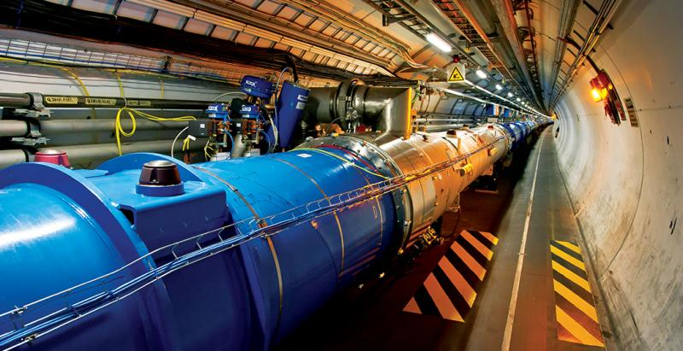
Motivation
154 magnets in series, 7 MJ/magnet, 1.1 GJ/circuit
Simulation of Transient Effects in Accelerator Magnets

Slide 3
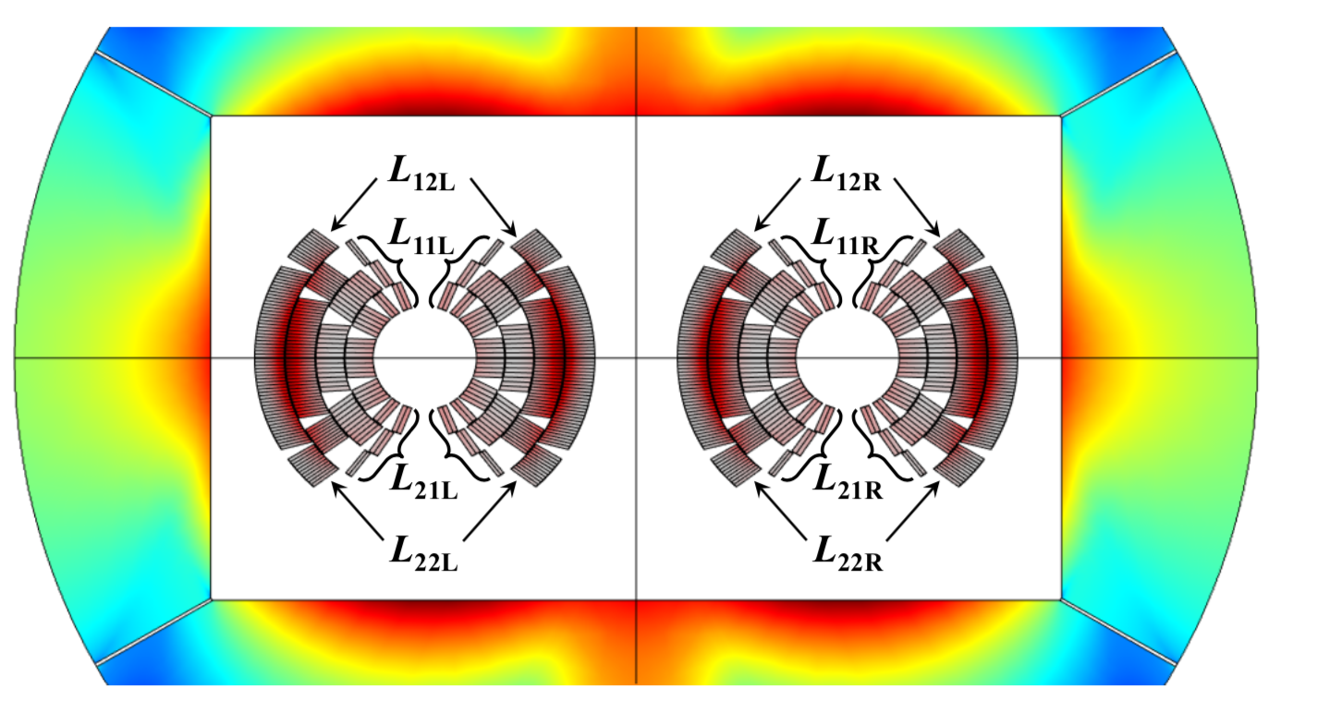
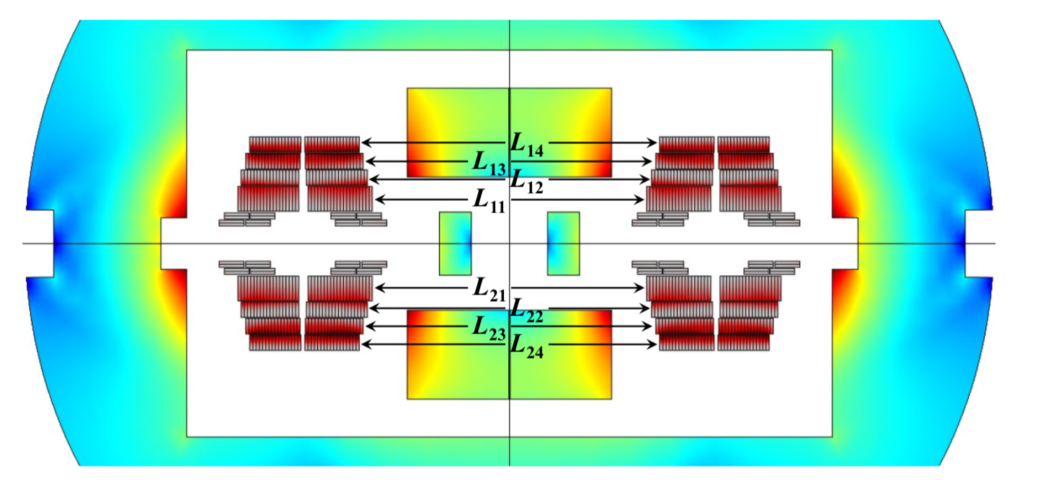
Example: CLIQ on the EuroCirCol Magnets
Automatically generated COMSOL electro-thermal models with CLIQ.
M. Prioli et al., The CLIQ Quench Protection System Applied to the 16-T FCC-hh Dipole Magnets, submitted for publication, 2019.

Slide 4
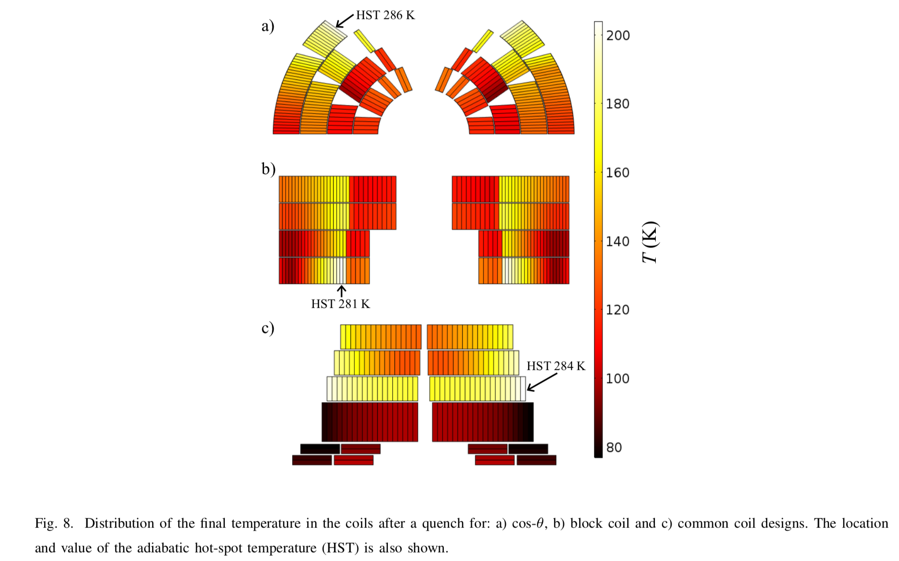
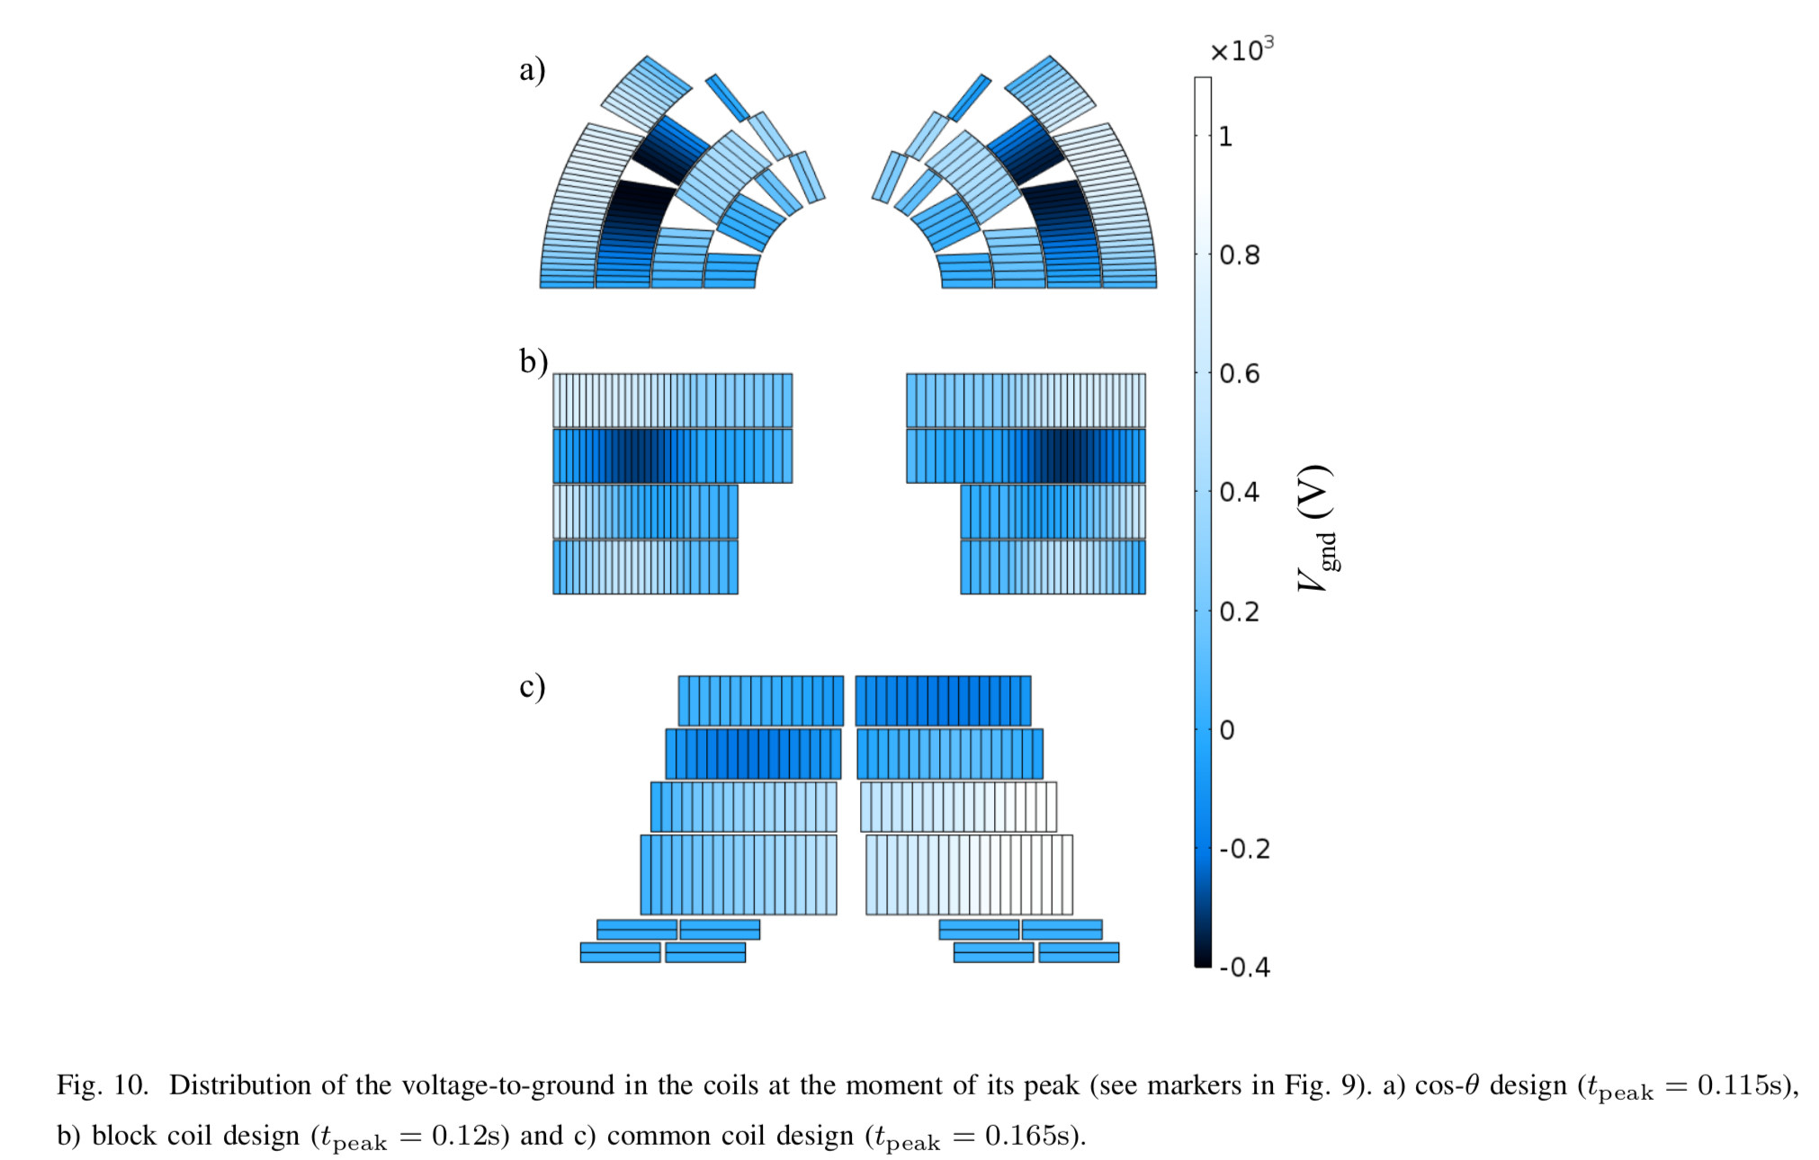
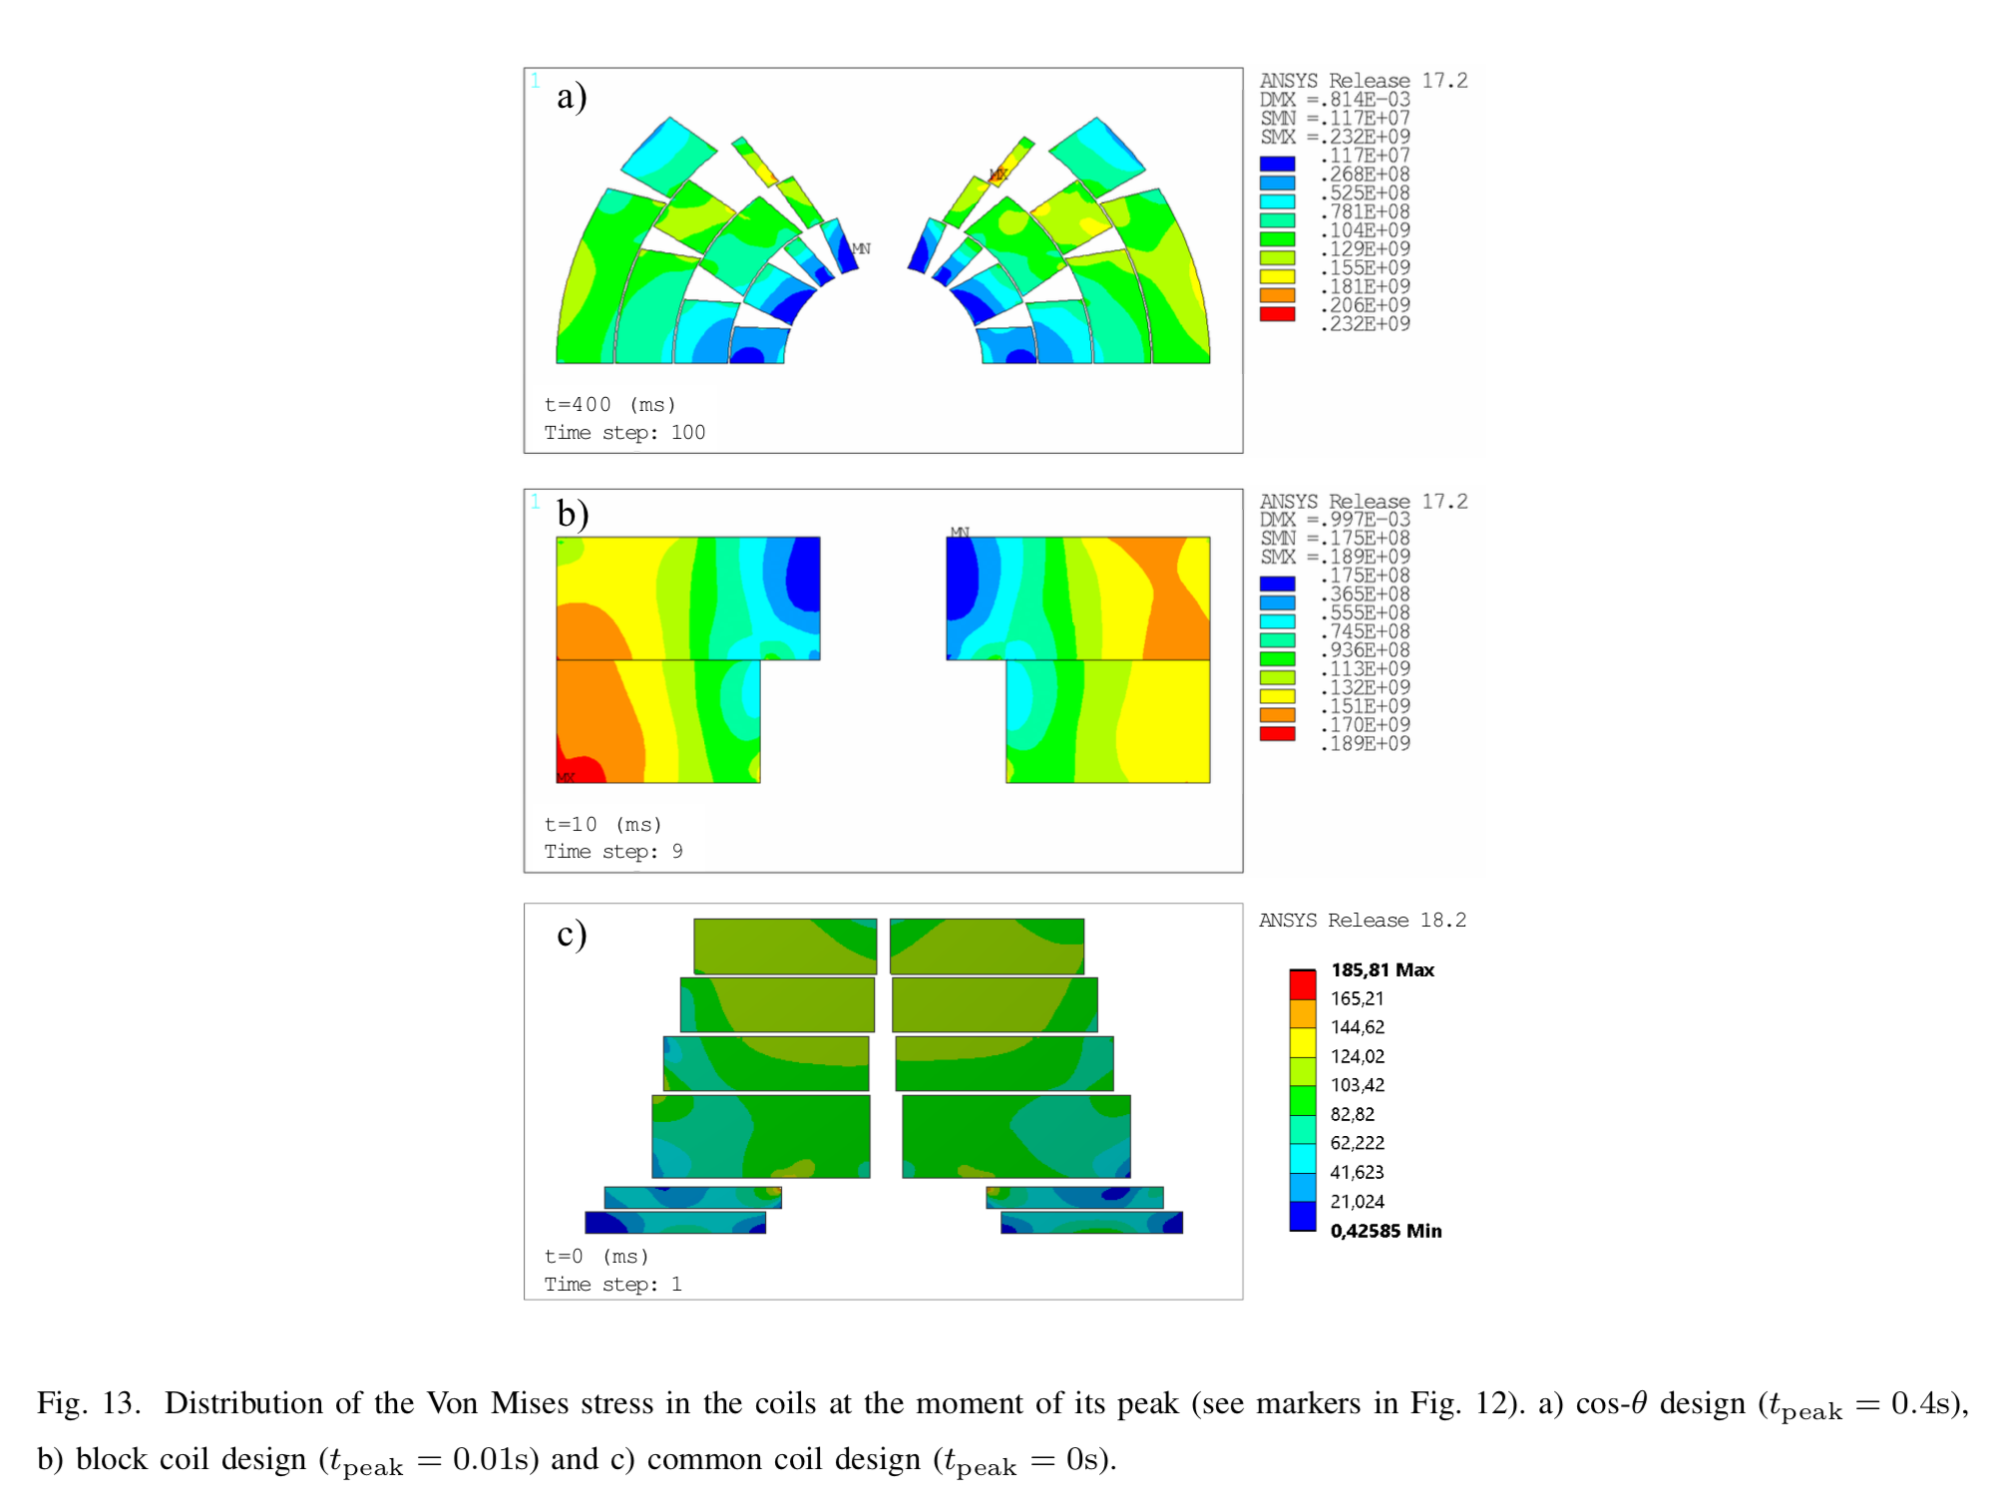
Example FCC electro-thermo-mechanics
M. Prioli et al., The CLIQ Quench Protection System Applied to the 16-T FCC-hh Dipole Magnets, submitted for publication, 2019.

Slide 5
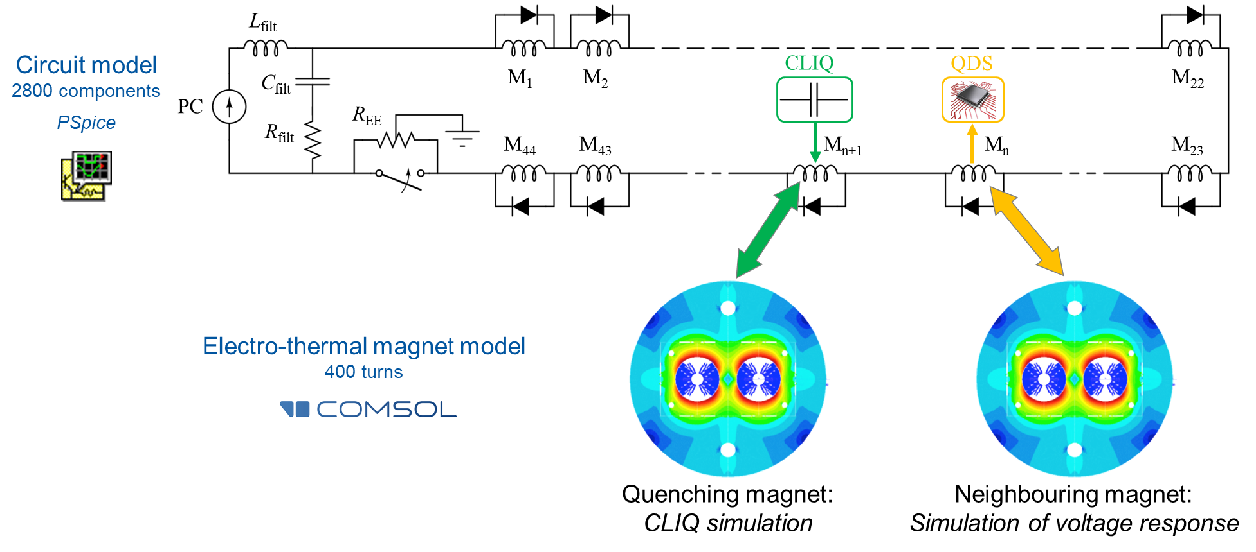
Example: FCC Circuit QDS Sensitivity
Courtesy M. Prioli
SING circuit-model generator API, SIGMA magnet-model generator API, cosimulation.

Slide 6
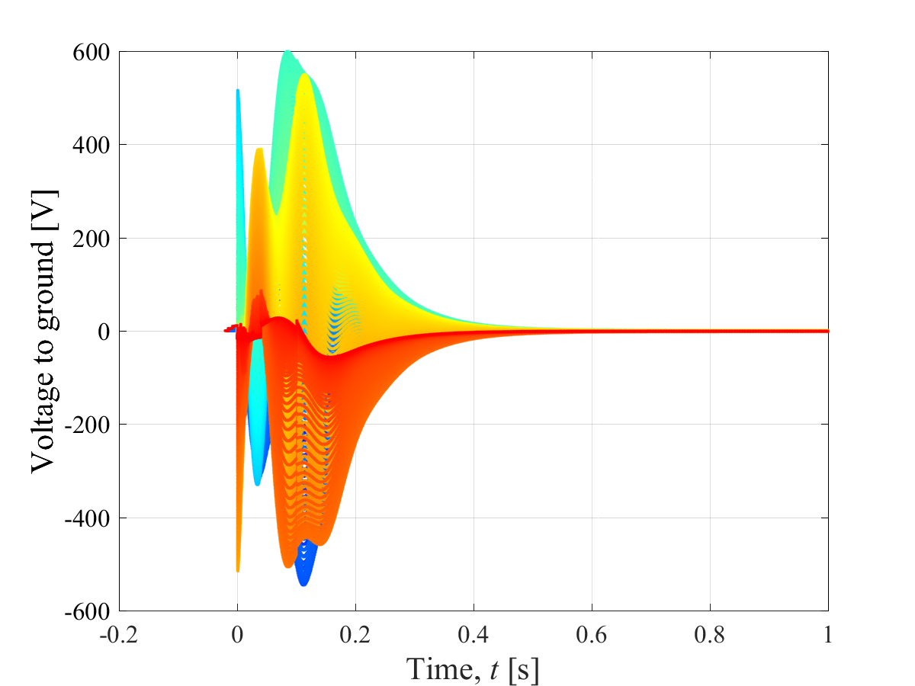
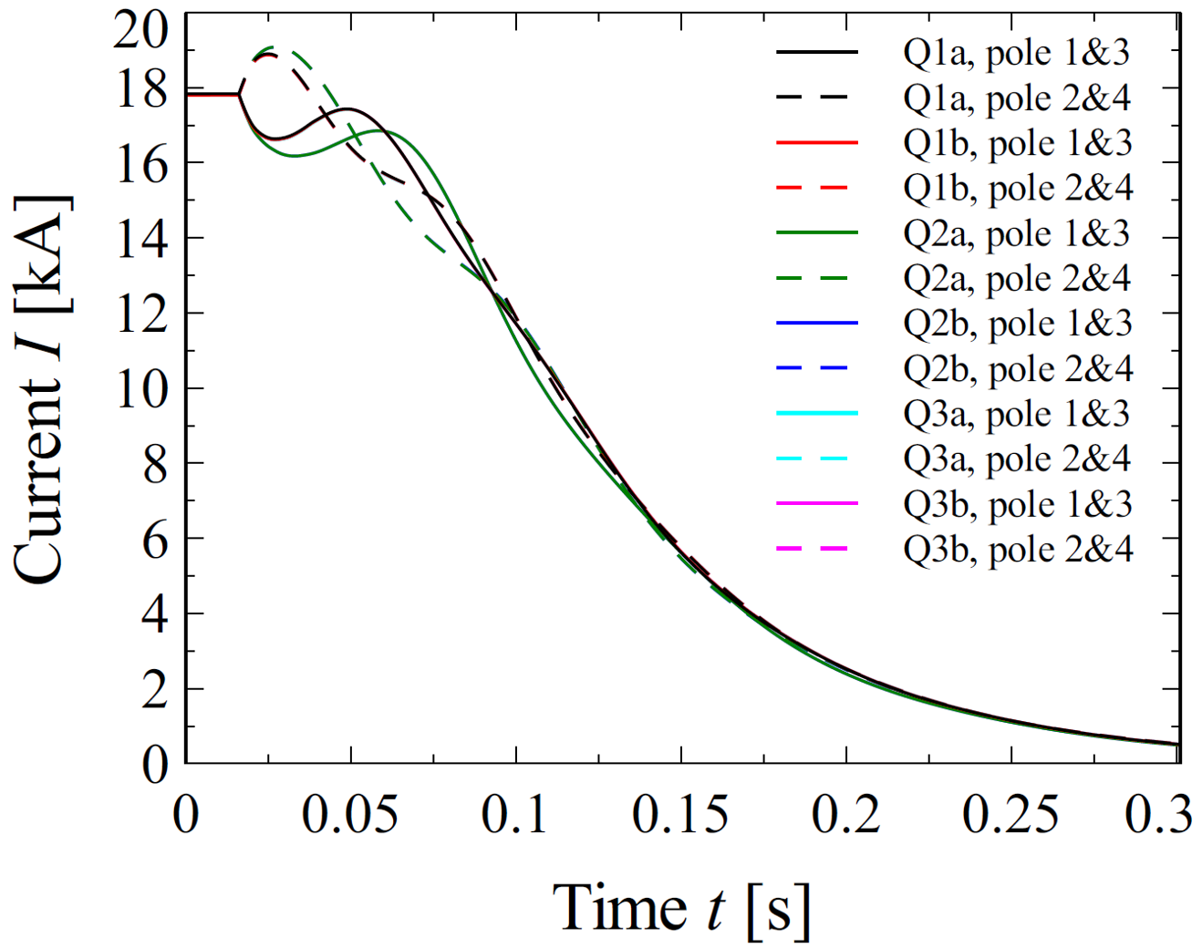
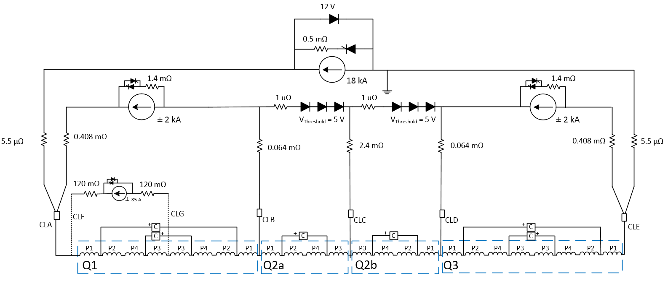
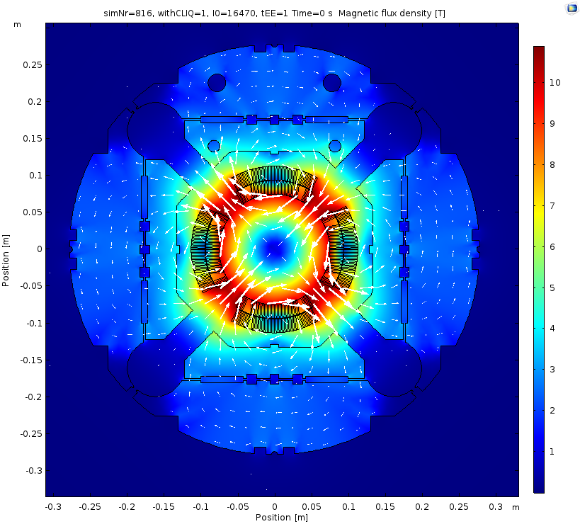
Examples PSpice + COMSOL / LEDET
SIGMA magnet-model generator API + cosimulation API

Slide 7
Example: Tiina Salmi’s FCC MQ
Slide from T. Salmi presentation at EuroCirCol 2018 annual meeting.
First use of SIGMA by external user (Tiina Salmi, TUT, Finland) successful. Working simulations of FCC main quad within one week.

Slide 8
Example: Ad-hoc Modeling Apps
Pre-configured workflows via Frontends (Mathematica, Matlab, Jupyter) or COMSOL.
Versioned apps replace a great deal of specialist simulation and documentation work.

Slide 9
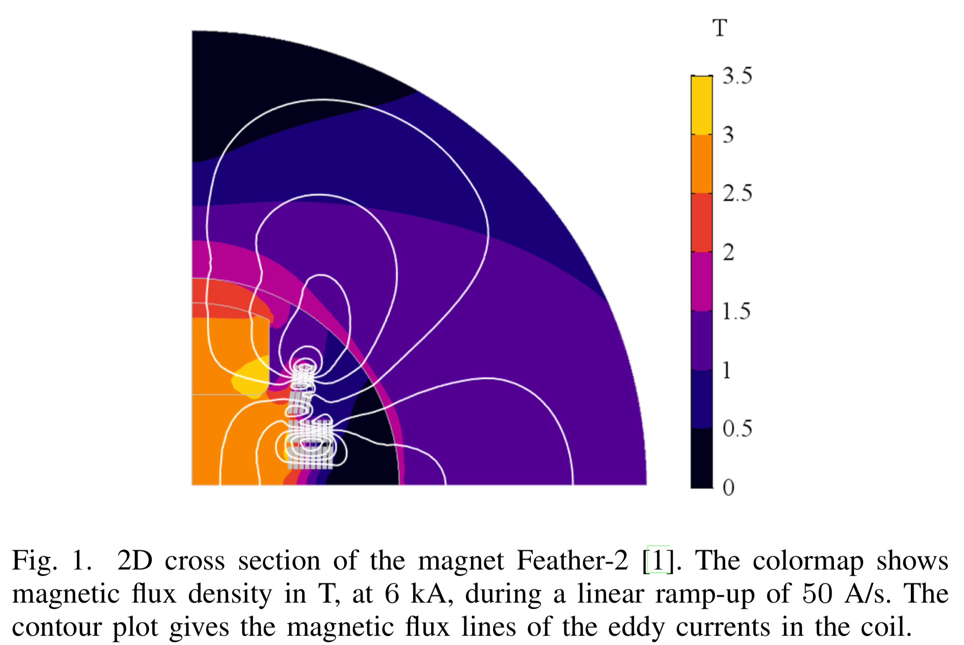
Example: Lorenzo Bortot HTS Protection PhD
L. Bortot abstract submitted to COMPUMAG 2019 conference.

Slide 10
Meta-Method APIs (Java, MpCCI)
Cosimulation
Tool Adapters (Java)
COMSOL, PSpice, LTSpice, QLASA, LEDET, ANSYS , PSIM
.
Model-Generator APIs (Java)
SIGMA: COMSOL, ANSYS, LEDET, QLASA, GetDP
SING: PSPice, LTSPice
Tools (COMSOL, QLASA, PSpice, LEDET, Cryosoft, LTSpice, PSIM, ANSYS, Opera, ROXIE, viewers, etc.)
Frontend (Jupyter, Mathematica, Matlab, Python, Java, etc.)
ROXIE parser

Slide 11
UDE Integration
The tool is the UDE-enhanced custom-compiled version of ANSYS – distributed and supported by Lucas&Co @ LBNL.
STEAM integration is done via:
A tool adapter for cosimulation and other (future) meta-methods – Exists!
A plugin to the SIGMA magnet-model generator, translating the SIGMA data containers into ANSYS APDL input (rather than COMSOL mph).
Estimated work-load: 1-week joint expert time (Lucas + STEAMer).
UDEs become directly usable to the growing STEAM community: CERN, INFN, CEA, CIEMAT.
Meta-Method APIs
Tool Adapters
.
Model-Generator APIs
Tools
Frontend

Slide 12
Conclusion
The STEAM platform is driven by accelerator-specific needs.
We harness the power of co-simulation with waveform relaxation to provide a new level of flexibility in tackling complex interdependent problems.
We build upon the feature sets and future innovation of commercial products as well as on well-proven community tools.
We emphasize sustainable development, growing and improving over time (e.g. 80% code coverage with automated unit tests, platform-independent build system, etc.).
The framework is used in the analysis of LHC operation data, the design of the HL-LHC upgrade, and the Future Circular Collider study at most European labs.
APDL files based on LBNL’s ANSYS UDEs can be generated through the model-generator API, thus making them available to a growing community of STEAM users, and integrating them into co-simulation scenarios.

