Slide 1
Update on Nb₃Sn Composite R&D
January 17th 2019
3rd MDP Collaboration Meeting
Steven Krave
US Magnet Development Program
Fermi National Accelerator Laboratory

Slide 2
Outline
Composite Studies within MDP
Probing Interface Behavior With Short Beam Shear Testing
Results
Energy Release
Acoustic Data
High Viscosity Resin
Why and How
Preliminary results
Next Step: Thermoplastic Resins

Slide 3
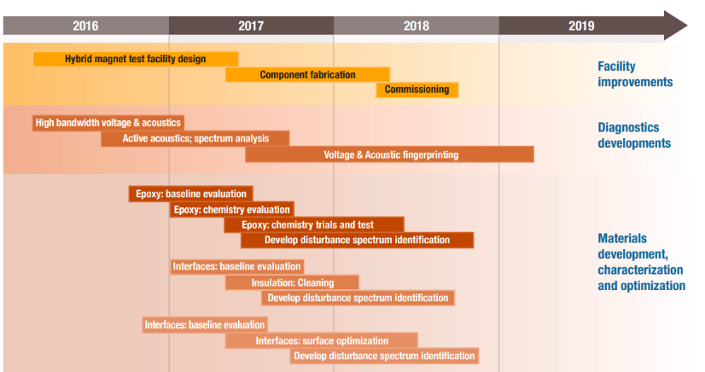
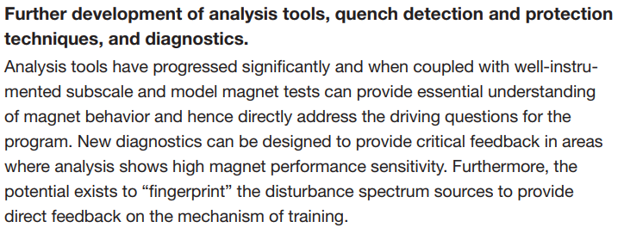

Slide 4
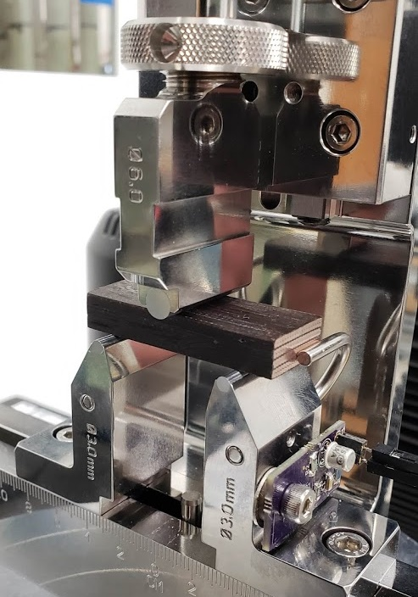
Why Short Beam Shear Testing
An appropriate test to quantify any changes in mechanical performance
Compressive behavior is dominated by cable properties
Tensile just wont work
Shear
Binder is likely to affect interface behavior, therefore shear properties
Generally shear samples are complicated geometry that can not be realized with cable
Short Beam strength uses a symmetric beam with a span to thickness ration of ~4.
This is do-able

Slide 5
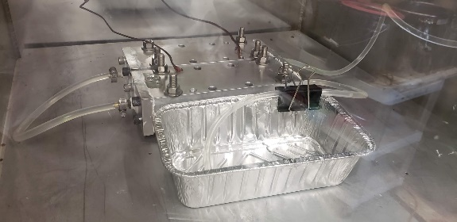
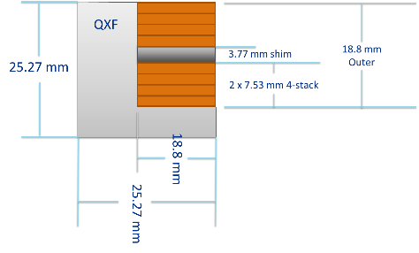
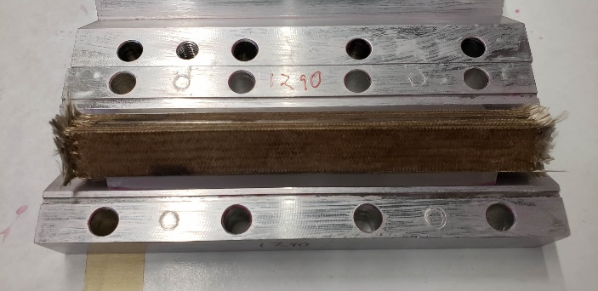
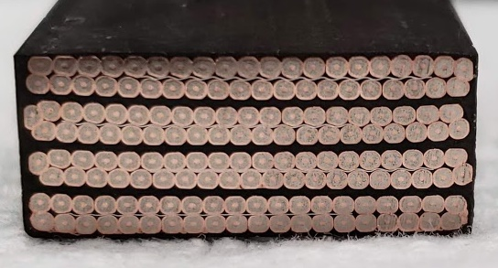
Sample Preparation
Samples were:
Cut and Fused
Insulated (by leftover sleeve removed previously)
Cured to nominal size
Reacted
Impregnated
Sectioned

Slide 6
Test Data
Samples all behaved in a similar fashion.
Minimum of ~7 Mpa short beam stress
Audible cracking present during testing

Slide 7
Short Beam Strength per ASTM D2344
QXF Cable with replaced braided on 933 sized S-glass insulation after curing and reaction in argon at room temperature.
Short Beam Strength (Mpa) | A1 | A2 | A3 | B1 | B2 | B3
1202 | 10.172 | 11.0995 | 9.1679 | 8.9705 | 9.4933 | 9.2027
1290 | 9.662 | 9.0029 | 8.1725 | 8.8717 | 9.1438 | 8.6172
 | Average | σ | CV
1202 | 9.68 MPa | 0.811 MPa | 8.37%
1290 | 8.91 MPa | 0.502 MPa | 5.18%

Slide 8
Comparison between S and E-glass
E-glass has a lower softening temperature than S glass and appears to be degraded further during the reaction process. A comparison between 0.003” E and S-glass tape is in progress with Shear and compressive tests
Tests are ongoing
High sample rate acoustic data is being recorded
Higher load data rate will be used for future tests (100 Hz - 1kHz)

Slide 9
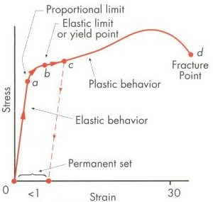
Energy.
During testing, a force is applied over a displacement.
Work is done
In the elastic regime, this energy is stored as strain energy and is recoverable.
In the plastic regime work is done to deform the sample.
A small(negligible?) amount is stored in structure defects
A majority is dissipated as heat
Cable stacks do not behave in an ideal plastic fashion.

Slide 10
Interface Failure During Testing
Cable stacks fail gradually in reasonably large fast changes in energy
These changes have measurable magnitude over adjacent data points
This can be calculated by assuming a plastic like behavior with constant modulus, leading to an offset value of initial location
∝ Energy Release

Slide 11
What is the scale of energy release?
Assuming that K ≈ constant and some basic spring stuff:
F=kx
x=F/k
E=1/2*k*x^2
E=1/2*k*F^2/k^2
=1/(2k)*F^2
$∆E=\frac{1}{2k}\left(F_{1}^{2}−F_{2}^{2}\right)$
In the highlighted event, the energy release is around 79 mJ
Interface area ~48mm * .25mm * 19mm > ~0.3 mJ/mm^3, 192 J/kg
~20 K local temperature rise in “G10” from ~4 to 24 K
dN of ~250N
K=12.5MN/m

Slide 12
How about more events?
Several events between 1 and 10 mJ
Acoustic data from earlier shows that many of the evets that span
The sample below shows at least 13 events above 2mJ
This is mostly failure along a single interface 48mm long

Slide 13
And we can do more stuff!
Should be able to correlate acoustic emissions with the above changes in load.
Might be able to characterize energy levels of acoustic events through
Other magical signal processing? Working to Meet MDP goal of fingerprinting quench Mechanisms

Slide 14
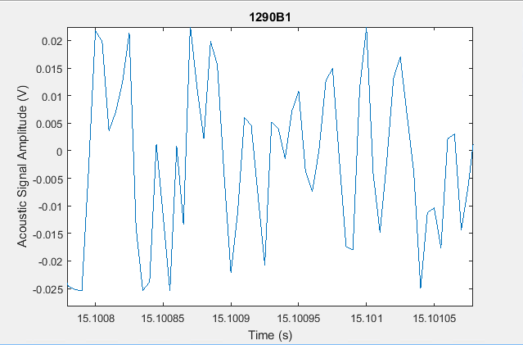
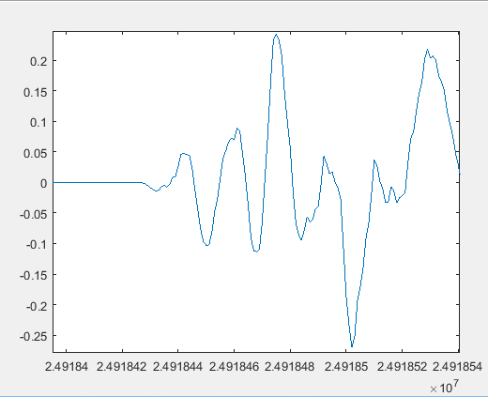
Improving Aquisition
Original Sample data 12 Mpts, 8 bit 200 khz by basic DSO
New DAQ hardware on hand, some data available, but not yet examined
12 bit, 80MS/s 256Mpt buffer
200 kHz is probably not enough…
But 20 MHz is sufficiently overkill

Slide 15
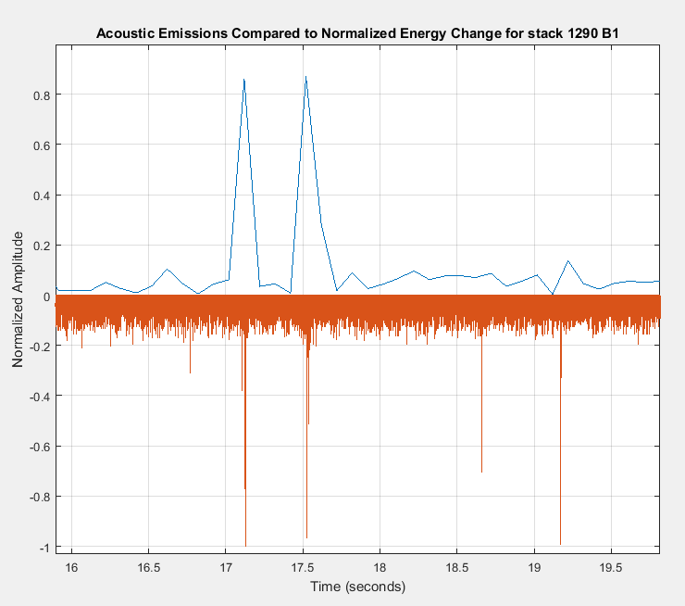
Look, they do line up!
Acoustic events do line up with energy change events
Manually aligned to 1 event between datasets as the Instron does not provide a sync signal
All other events followed
Events have substantial acoustic power
Most easily seen force events saturate the acoustic DAQ
Small events in the noise of the force signal still have substantial acoustic signals
Huge dynamic range!
Note example shown has substantial noise, noise floor reduced by 10 dB with better shielding on cable (Aluminum foil)
Intuitively, noise is the result of an energy release.
Build a quiet magnet, reach short sample limit.
Load
Acoustic Amplitude

Slide 16
High Viscosity Impregnation: Enabling Filled and Thermoplastic Resins
Tailoring matrix mechanical properties can be used to engineer coil properties substantially
Probably the most important ones for magnets
Strength
CTE
Modulus
Ductility
Homogeneity
Other properties that are good
Thermal Conductivity
Specific Heat
Radiation resistance
Cost
Things that we care about for fabrication, but not that much for coil performance
Viscosity
Processing Temperature/melt temperature/Tg
Processing Time

Slide 17
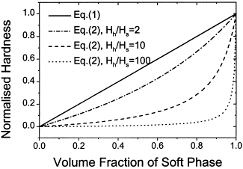
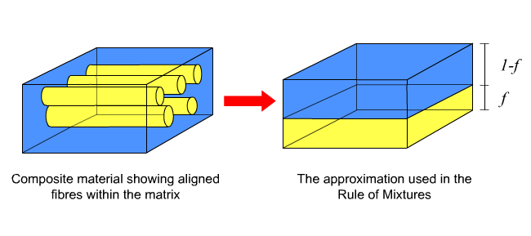
Rules of Mixtures: Guidelines to Engineering Composites.
2 forms:
Parallel, isostrain, Voight model (|| fiber)
Series, isostress, Reuss model (ꓕ Fiber)
In the upper bound (parallel) condition, the hard material dominates
In the lower bound (series) condition the soft material dominates
This becomes evident as the modulus ratio of the mixtures becomes larger
For S-glass to epoxy the ratio is ~30
H. Kim On the rule of mixtures for the hardness of particle reinforced composites

Slide 18
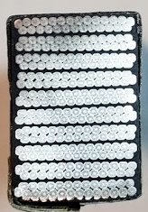
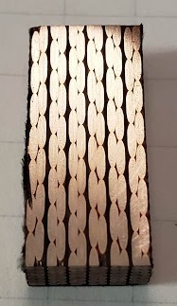
Cable Directions
3 cable coordinate systems show preferences to different models
Longitudinal: Clearly columns of conductor and columns of insulation.
Radial: Clearly columns of conductor and columns of insulation. Somewhat less then longitudinal.
Azimuthal: Clearly conductor and insulation in series.

Slide 19
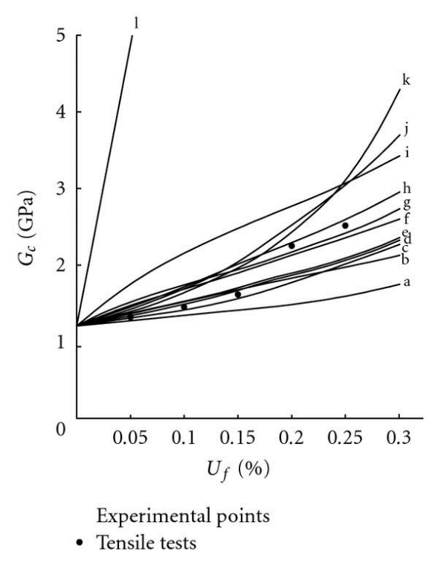
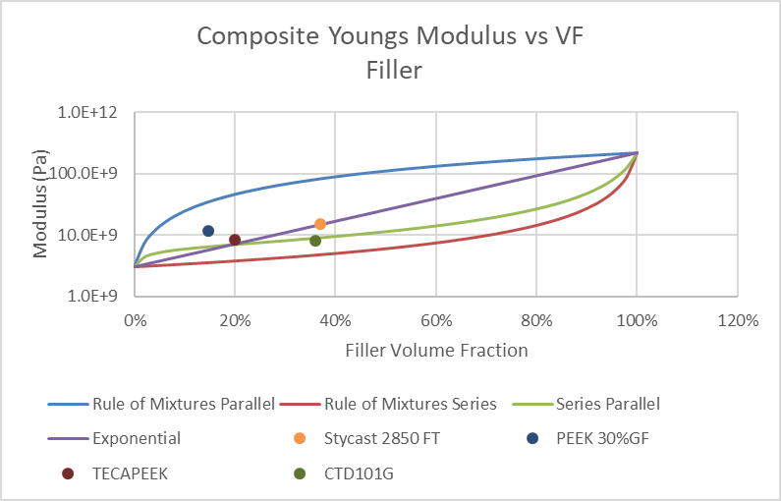
Plots of Calculated Modulus vs loadings for different rules for mixtures
Semi-log Y
From G. Bourkas Estimation of Elastic Moduli of Particulate Composites by New Models and Comparison with Moduli Measured by Tension, Dynamic, and Ultrasonic Tests

Slide 20
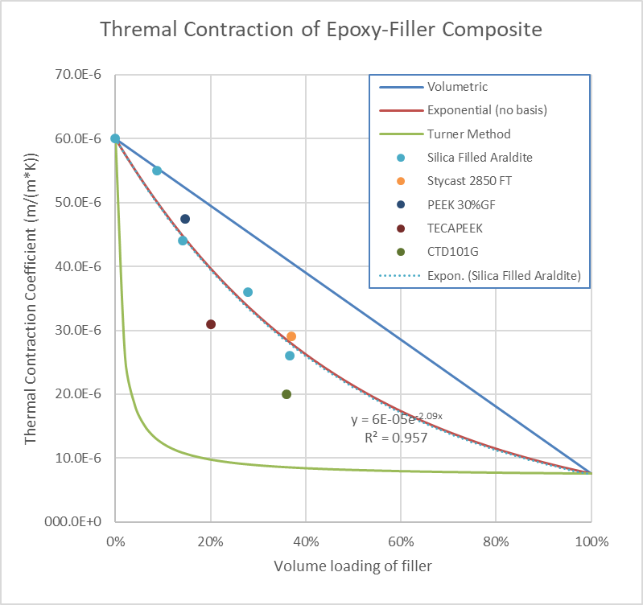
On Thermal Contraction
Thermal contraction of a mixture can be estimated in several fashions, none of which gives a good estimation of the bulk material behavior. The popular ones are below:
Volumetric: overall thermal contraction is equal to the cube root of change in volume of the constituents. This is the upper bound for CTE.
Turner: stress normalization in the composite: CTE depends on bulk modulus of materials. This is the lower bound for CTE.
Exponential: I think I made this up, but it works well for modulus and is almost perfect for CTE on particulate fillers with real data.
Note: High aspect ratio fillers have substantially larger impact on CTE, but may be anisotropic e.g. PEEK 30%GF is 11^10^-6 at 15% VF
?
?
?
Aluminum: 23 ^10^-6
Stainless: 17.3^10^-6
Steel: 12 ^10^-6
Titanium: 9.5 ^10^-6

Slide 21
So Why do We Care?
Fibers in a composite contribute strength along the length of the fiber. They do very little perpendicular to the fiber direction.
Small contribution to rigidity, strength, thermal conductivity, and thermal contraction
If we look at how we apply insulation to cable and load a coil pack composite, primary loading, is perpendicular to the cable face, and therefore perpendicular to the fiber.
Even so there are radial and axial components, but by the rule of mixtures, the cable dominates cable pack behavior in radial and longitudinal mechanical behavior and cable is rigid, low expansion, and well enough behaved.
Since the insulation is just a space filler, it might as well do something useful
But filled resins are too thick for traditional potting

Slide 22
Vacuum-Pressure Resin Infusion Molding (VPRIM)
I made that up…
Use all of the best parts of the best processes to do the otherwise impossible.
A combination of:
Vacuum Assisted Resin Transfer Molding (VARTM)
Vacuum Pressure Impregnation (VPI)
Resin Infusion Molding (RIM)
An Integrated design and fabrication process to tackle extreme resins.
Resin accommodation from cable to coil to tooling

Slide 23
An Experiment: Can this work?
Pot a sample with highly filled, highly viscous resin.
Managed to mix up ~40% alumina by volume
70% by mass (most filled stuff runs up to ~30% by mass)
Thick as nutella (maybe ~100,000 cP)
Thinned substantially with heat, could probably get to ~50-55% by volume and be workable

Slide 24
Coil and Tooling
Flow media is integrated into coil impregnation tooling.
Do not count on the coil to partake in resin distribution
In the case below, the flow media is stainless wire mesh. This could be varied to enable better surface finish or higher flow (or both)
Use a release layer between
Teflon or Teflon coated glass for Epoxies
Metals for more exotic things

Slide 25
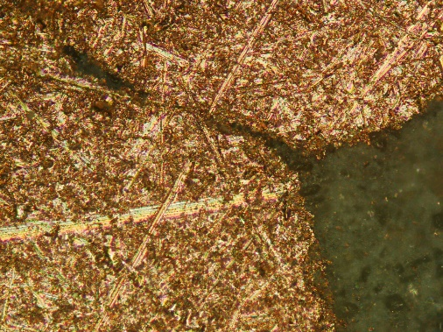
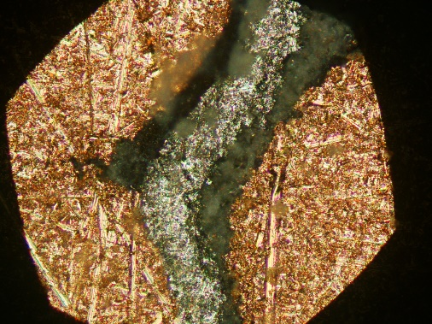
How does it Fill?
Generally pretty good!
Filled resin between turns, between core and conductor and throughout the cross section
Some tiny voids ( < core thickness) inside of conductor, but this should be curable with a little better setup
In general the impregnation quality was excellent for using the 10-stack setup.

Slide 26
Testing: Short Beam Shear
Samples were tested about per ASTM D2344 after curing
The first sample used the short CTD cycle (1.5 hr at 135°C)
The second used an additional 16 hours at 125°C
Side filler was left on for simplicity
Small fraction of total cross section for shear, mesh geometry does not support shear
Note: Samples used Copper Cable

Slide 27
Comparison of results
Notes: Different cables have different sample geometries, different preparations, different insulations, different reaction processes and may not be directly comparable but the data aligns with experience gained from handling
11 Tesla is cured, reacted, impregnated Nb₃Sn with E-Glass and 101k
QXF is cured, reacted impregnated Nb₃Sn with S-Glass and 101K
New samples are Copper with wrapped string and filled 101K. No reaction

Slide 28
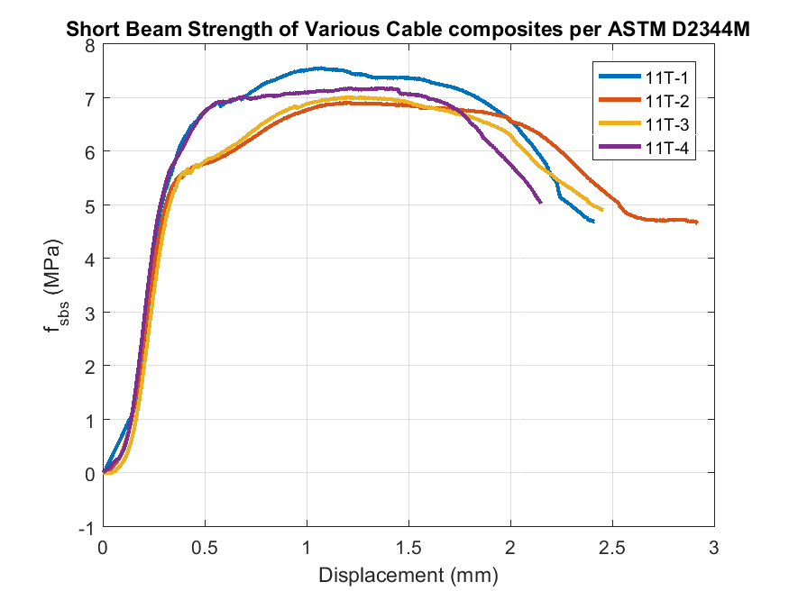
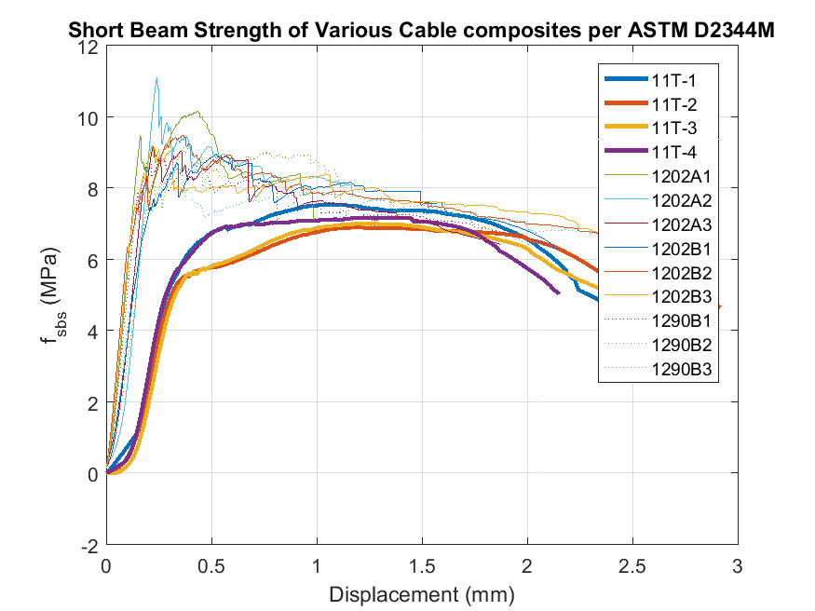
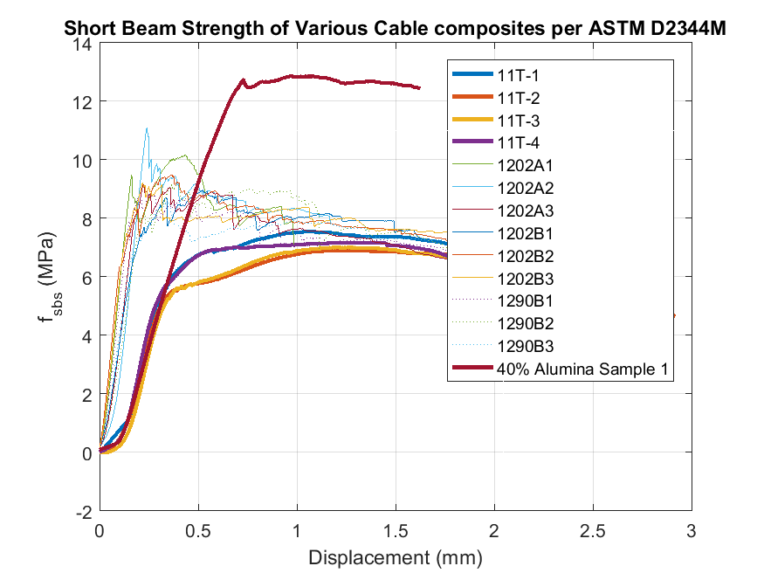
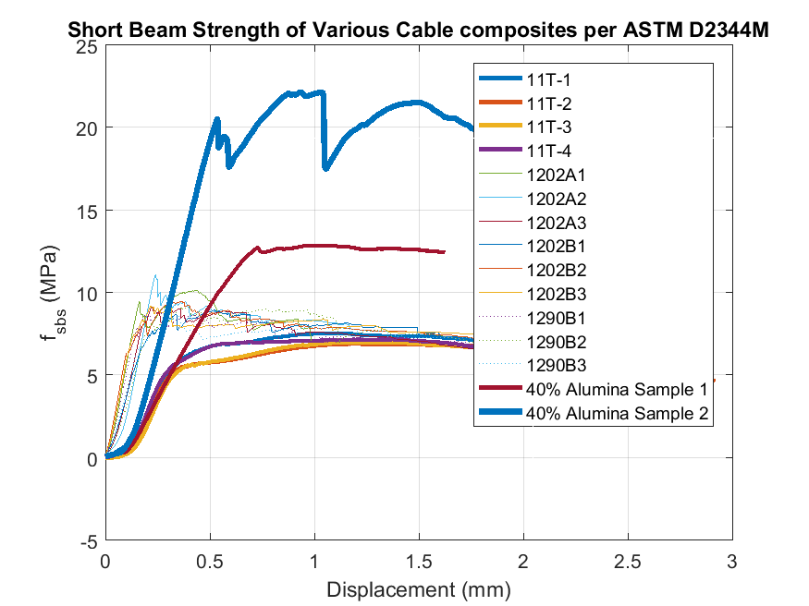
11 Tesla measures ~7 MPa
QXF measures ~9 MPa
Filled #1 measures 12 MPa
Filled #2 measures 22 Mpa
Some behavior may be contributed to cleaner interface from lack of reaction
This is only a qualitative comparison and maybe not a fair one at that, but it is an excellent indication that we have something to look into

Slide 29
Aside from Highly Filled Resins
Thermoplastic resins seem very promising
Infinite pot-life
Available with extreme mechanical properties
PEEK, Thermoplastic Polyimide, ULTEM
Are generally tougher than their thermoset counterparts
Potentially very good for reducing training
Nontoxic
Radiation Resistant
Fast (no cure required)
Cheap(*)

Slide 30
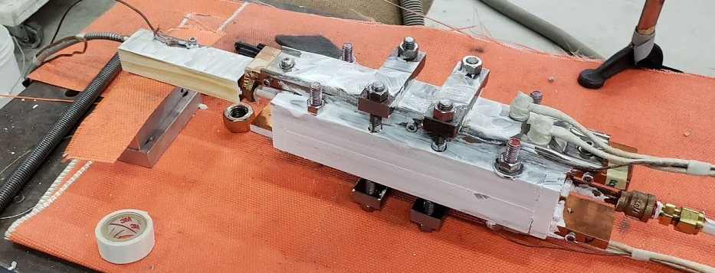
Attempting to pot some samples
Apply high viscosity techniques and high temperature tooling
Pot coil
Hopefully

Slide 31
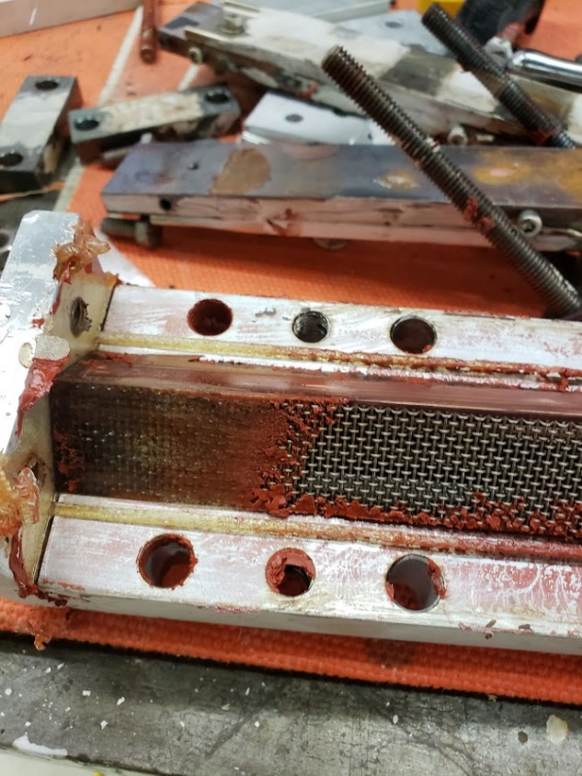
1st Attempts with Ultem 1000 PEI resin
Several Learning Experiences:
Short sections of cooler pipe need to be insulated
Hot injection screw needs good lubricant
Galled and destroyed on 2nd attempt
High temperature RTV near its limit is near its limit. Don’t ask anything demanding of it.
RTV melted and resin leaked out
Aside from the parts that didn’t work, the resin flowed really well with minimal pressure.

Slide 32
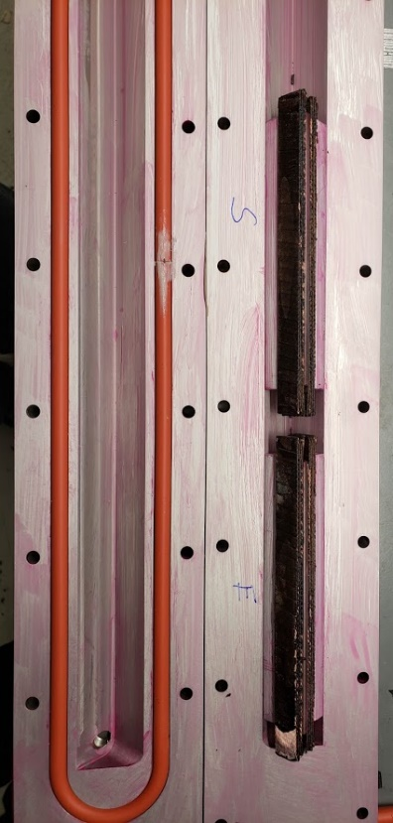
Moving forward with Thermoplastics
A new piston based injector will be fabricated
New stainless tooling with fiberglass gaskets is in hand
No more Sealants
It can run through reaction with appropriate mold release
PEEK neat and 30% glass filled resin samples will be delivered by early next month
Filled resin CTE nearly matches titanium
Low to no thermal stresses on cooldown?
Begin (resume) Cryogenic testing
With advanced diagnostics

Slide 33
In Summary
Since last year, we have:
Begun collecting acoustic data
Explored some modified insulation systems
Shown the feasibility of using difficult to process resins for superconducting magnets
4-stacks:
4-stack shear testing is a fast way to get potentially relevant information
Data from testing provides some new insights into energy release and potential acoustic signatures
Engineered resin systems for engineered material properties
We can estimate coil pack azimuthal modulus based on fiber or filler volume fraction.
We can calculate expected thermal expansion coefficient for filled resin systems with low aspect ratio fillers.
Both of the above can be tailored build a substantially more isotropic coil cross section.
We can actually work with the extreme viscosities that result from formulating the systems above. These techniques can be applied to other systems as well.

Slide 34
Backup Slides

Slide 35
Background
CTD has re-formulated their CTD1202 a couple of times, originally from a 3 part system to a 2 part system, both of which are claimed to be the same formulation. There has then been a change in suppliers leading to poor adhesion and curing performance reported by users on the floor.
A new version of the system named CTD1290 apparently increases the ratio of hardener in the system to improve curing.
A method to verify that system performance was not degraded was desired.

Slide 36
Binder Conclusions
Both binder systems behave similarly for shear testing.
Slightly lower strength for the new 1290
But only 1 donor sample of impregnated, slight voids noted in 1290 stack.
Better statistics would be better…
I would have no problem using the new system in place of the old system.

Slide 37
Cable insulation properties in the azimuthal direction
In modeling a cable pack composite, insulation between turns is often modeled as G10.
G10 is a composite and rather orthotropic
In the coil azimuthal direction, where we apply prestress, modulus isn’t even typically reported
We can estimate
Rule of mixtures for thermal contraction>use same relation for stiffness – Not so good approximation probably but maybe not so bad…
$\frac{1.2e−5 K^{−1}}{7.0e−5 K^{−1}}∗24GPa=4GPA$
For a cable stack with bad assumption of 1.57mm mid-thickness Nb3Sn at 130 GPa and .250mm G-10 the composite is roughly 13GPa
By Equivalent springs normalized to 1.82mm length:
$E_{eq}=\frac{1}{.\frac{\frac{.25}{1.82}}{4∗{10}^{9}}+\frac{\frac{1.57}{1.82}}{{130∗10}^{9}}}=24$ GPa
One could assume completely rigid conductor and still be below 30GPa
Parameter | Value
Specific gravity/density | 1.850 g/cm³ (0.0668 lb/cu in)
Water absorption | −0.125 in < 0.10%
Temperature index | 140 °C (284 °F)
Thermal conductivity, through-plane | 0.29 W/(m·K),^{[1]} 0.343 W/(m·K)^{[2]}
Thermal conductivity, in-plane | 0.81 W/(m·K),^{[1]} 1.059 W/(m·K)^{[2]}
Rockwell hardness | 110 M scale
Bond strength | > 1,000 kg (2,200 lb)
Flexural strength (A; 0.125 in) - LW | > 415 MPa (60,200 psi)
Flexural strength (A; 0.125 in) - CW | > 345 MPa (50,000 psi)
Dielectric breakdown (A) | > 50 kV
Dielectric breakdown (D48/50) | > 50 kV
Dielectric strength | 20 MV/m
Relative permittivity (A) | 4.4
Relative permittivity (D24/23) | 4.4
Dissipation factor (A) | 0.017
Dissipation factor (D24/23) | 0.018
Dielectric constant permittivity | 4.70 max., 4.35 @ 500 MHz, 4.34 @ 1 GHz
Glass transition temperature | Can vary, but is over 120 °C
Young's modulus - LW | 3.5×10⁶ psi (24 GPa)
Young's modulus - CW | 3.0×10⁶ psi (21 GPa)
Coefficient of thermal expansion - x-axis | 1.4×10⁻⁵ K⁻¹
Coefficient of thermal expansion - y-axis | 1.2×10⁻⁵ K⁻¹
Coefficient of thermal expansion - z-axis | 7.0×10⁻⁵ K⁻¹
Poisson's ratio - LW | 0.136
Poisson's ratio - CW | 0.118
LW sound speed | 3602 m/s
SW sound speed | 3369 m/s
LW acoustic impedance | 6.64 MRayl
From https://laminatedplastics.com/fiberglasslaminates.pdf
From Wikipedia

Slide 38
Lets just double check
Estimate 50% VF Glass modulus, and assume glass is infinite!
50% resin at 3GPa
Calculated form chart to the right
Pretty good for unfilled.
PEEK is ~3.9 Gpa Unfilled
Can be 27 GPA filled
ULTEM is 3.58 Gpa Unfilled
Polyimide us 2.5GPa Unfilled
Stycast is 15GPa
For 50/50 in series 3/.5=6GPa
Not unreasonable…
Using calculation from before, stack modulus is...
34 Gpa
Stycast would result in 63 Gpa
CF Filled PEEK or high alumina content could be up to 80MPa
From: Yin, Epoxies for Nb3Sn superconducting accelerator magnets -an update

Slide 39
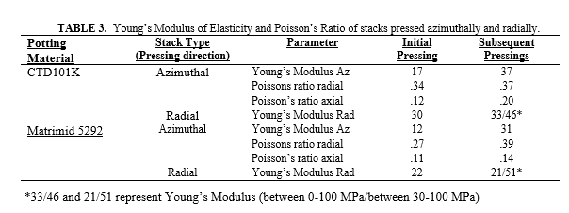
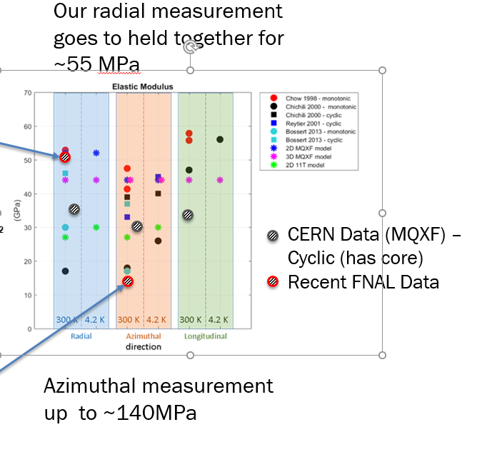
From earlier ten stack measurements:
CF FILLED PEEK/50% Al2O3
Unfilled Stycast
101K Traditional
Reuss rule of mixtures for azimuthal modulus is an excellent predictor of composite modulus compared to historical data
ROM values for different materials shown in red bubble to the left

Slide 40
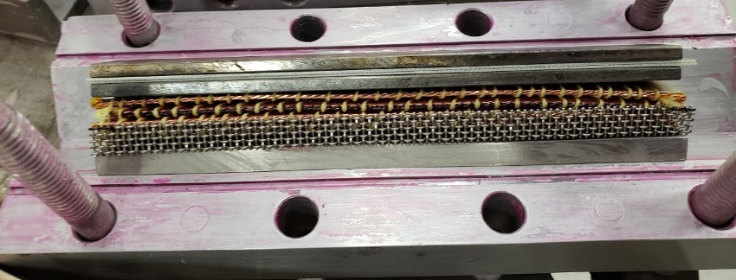
Sample Prep
We don’t care about the glass insulation anyway, we can do better using filled resin everywhere that matters Azimuthally without sacrificing too much radially or longitudinally
Get rid of it.
We still need space between turns
Use a spacer, like thread or string
When wrapped around cable, it provides a natural flow path for matrix resins orders of magnitude larger than the fiberglass it replaces
At the strand level: Transposition allows flow channels at the lowest level
Flow media is integrated into coil impregnation tooling.
Do not count on the coil to partake in resin distribution
In the case below, the flow media is stainless wire mesh. This could be varied to enable better surface finish or higher flow (or both)
Use a release layer between
Teflon or Teflon coated glass for Epoxies
Metals for more exotic things
Note: If you rely on perfect filling of epoxy in a coil, it is not going to happen. It is going to fail.
Copper cable wrapped in Kevlar string

Slide 41
Filling
Fill tooling under pressure with air evacuated: vacuum-pressure
Minimize tube lengths: Very important
3’ of tube was too much without a pump (15 psi), it was rough feeding the pump through 6” of tube
Once you hit the pump, it’s good though
~20 psi from pump,~15 from vacuum

Slide 42
It went in and came out
It took a little while, I worried that the pump tube might burst.
Filling with Resin
Curing in the oven

Slide 43
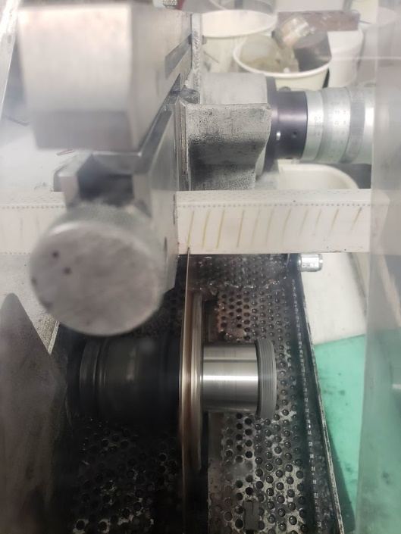
Sample Demolding
Sample filled well
Note there is less than 0.001” of space between cable spacer and tooling that filled well with filled resin > Should be able to fill spaces of this size with filler. Smaller might just be neat resin.
Demolding and sectioning

Slide 44
Future Plans
Make some more samples
Measure modulus in azimuthal Direction
Begin Thermal Shock tests of materials
All materials in hand, including thermoplastic compatible molds
Characterize resin viscosity vs loading for 0.25mm chopped S Glass (Ø 9µm) and Al2O3
We have a viscometer in MDTL
Characterize thermal contraction vs loading for 0.25mm chopped S Glass and Al2O3
Find reaction compatible thread, yarn, quartz, basalt, S-Glass, etc for cable stack
In the meantime, insulate cable after reaction
Insulation is essentially non-structural spacer.
Use the best stuff and pot a subscale magnet

