Slide 1
Superconducting Magnet R&D for Accelerator Science at KEK Cryogenics Science Center
Toru Ogitsu
Head Cryogenics Science Center, KEK

Slide 2
Item
HL-LHC and FCC
  D1
  Nb₃Sn conductor R&D
J-PARC
  COMET
  g-2/EDM
  MLF second target
High Radiation SC Magnet R&D
HTS Magnet R&D

Slide 3
Item
HL-LHC and FCC
  D1
  Nb₃Sn conductor R&D
J-PARC
  COMET
  g-2/EDM
  MLF second target
High Radiation SC Magnet R&D
HTS Magnet R&D

Slide 4
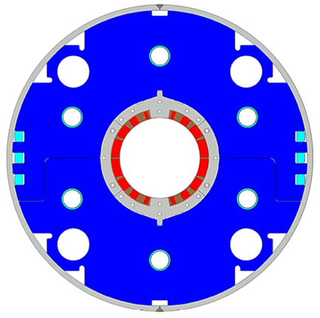
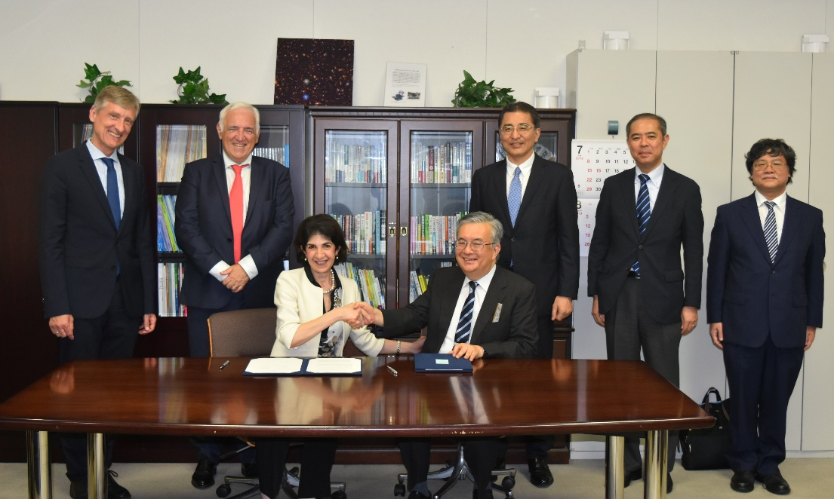
Japanese Contribution to HL-LHC: D1 magnets
Beam separation dipole (D1) by KEK
  Design study of D1 for HL-LHC within the framework of the CERN-KEK collaboration since 2011.
  150 mm single aperture, 35 Tm (5.6 T x 6.3 m), Nb-Ti technology.
  Development 2-m long model magnets (3 units) at KEK
Deliverables for HL-LHC
  1 full-scale prototype cold mass (MBXFP)
  6 series cold masses (MBXF1-6)
MOU’s were signed on July 6, 2018 at MEXT, Tokyo
↓
Budget partially approved

Slide 5
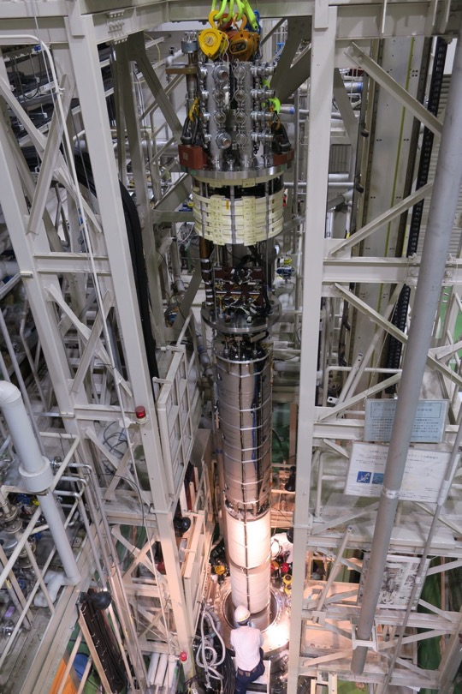
Test Results
Training Performance
  Almost satisfactory for 2nd Model
Quench Protection
  Satisfactory with renewed QPH design
  Irradiation effect being checked
Field Quality
  Large b3 due to structure deformation?

Slide 6
Item
HL-LHC and FCC
  D1
  Nb₃Sn conductor R&D
J-PARC
  COMET
  g-2/EDM
  MLF second target
High Radiation SC Magnet R&D
HTS Magnet R&D

Slide 7
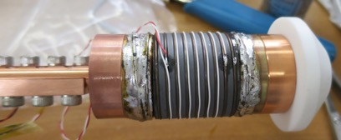

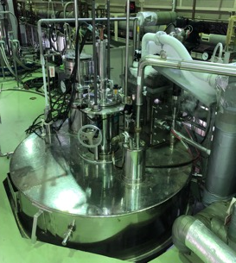
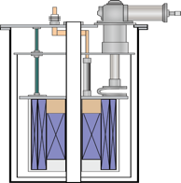
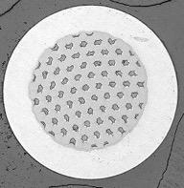
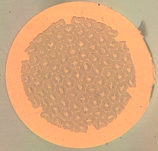
High Jc Nb₃Sn conductors in Japan for FCC
Design and Characterization
KEK
CERN
• In-depth characterization
HT, J_{c}, composition, d_{eff} ...
• Program coordination
• Defining specification
• Conceptual design
• Evaluation of J_{c}, B_{c2}
Tokai University
Tohoku University
• Optimization of HT condition
• Microstructure observation
• Compositional analysis
• High field magnet facility
• Evaluation of d_{eff}
Specification,
design
R&D billets
Fabrication
Kobe Steel / JASTEC
28 T HM
Furukawa Electric
15 T VSM

Slide 8

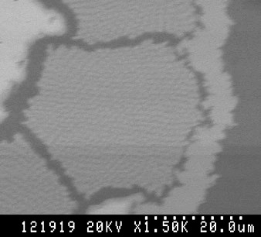
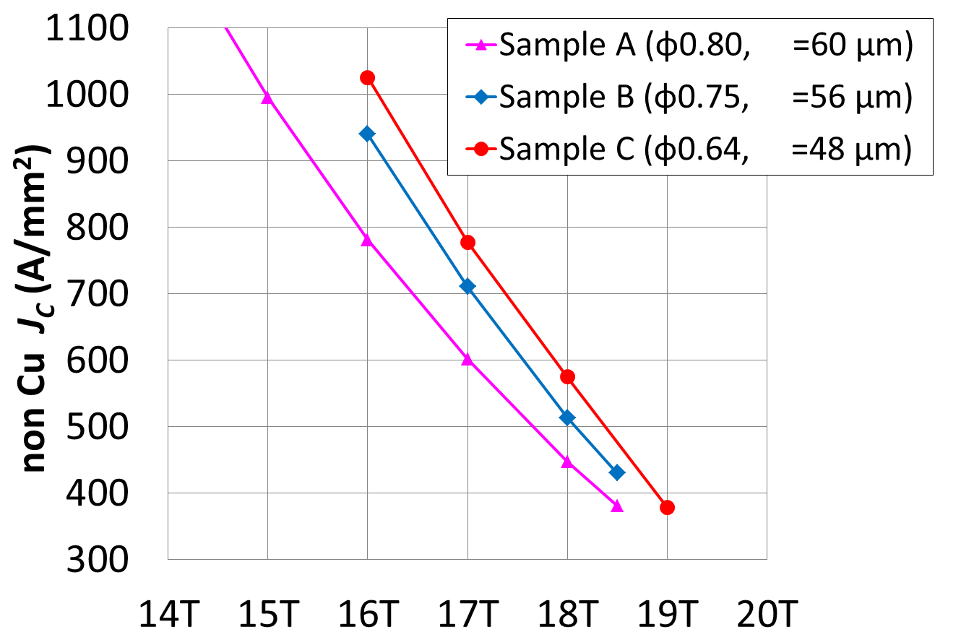
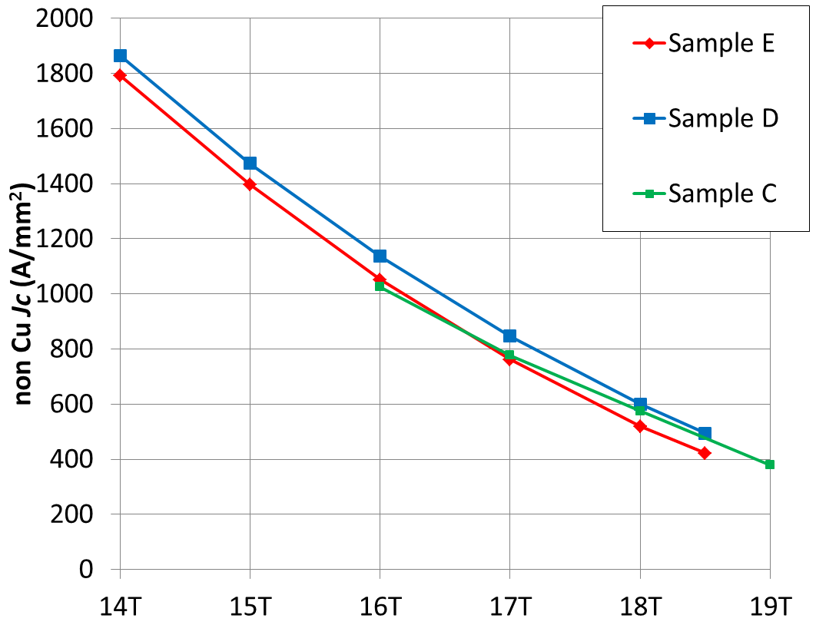
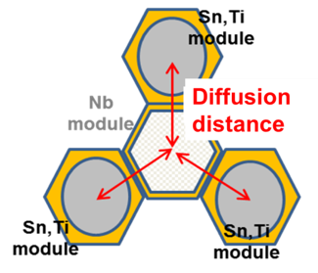
Current Achievement
Sn
Nb
KSL/JASTEC
  DT method
  non-Cu J_{c} of 1137 A/mm² at 4.2 K and 16 T
  Diffusion length optimization
  Ternary additive optimization
Furukawa electric
  Nb tube method
  Workability issue was significantly improved
  J_{c} will be evaluated soon.
Nb
Nb
Ti content: C > D > E

Slide 9
Item
HL-LHC and FCC
  D1
  Nb₃Sn conductor R&D
J-PARC
  COMET
  g-2/EDM
  MLF second target
High Radiation SC Magnet R&D
HTS Magnet R&D

Slide 10
Superconducting Magnet R&D at J-PARC Cryogenics Section
J-PARC Cryogenics Section: KEK Cryogenics Science Center & KEK IPNS Cryogenics Group
J-PARC Facility is jointly operated by KEK and JAEA
Bird bye view 2009
g-2/EDM

Slide 11
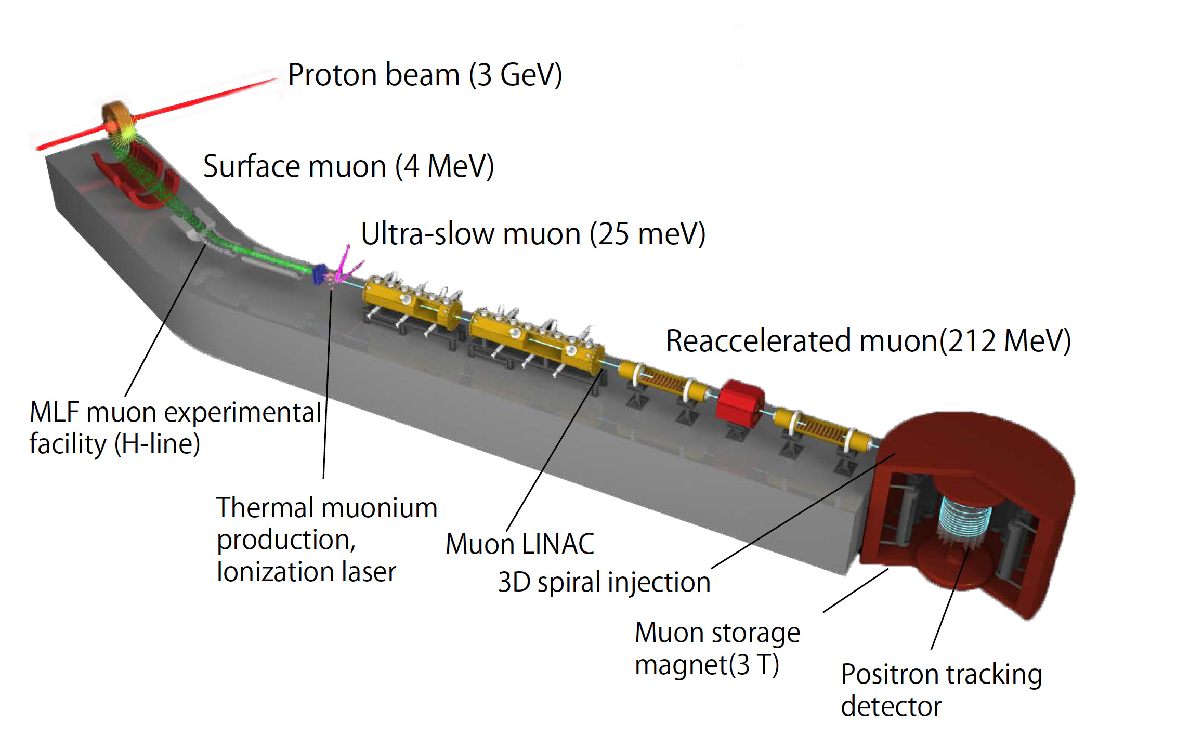
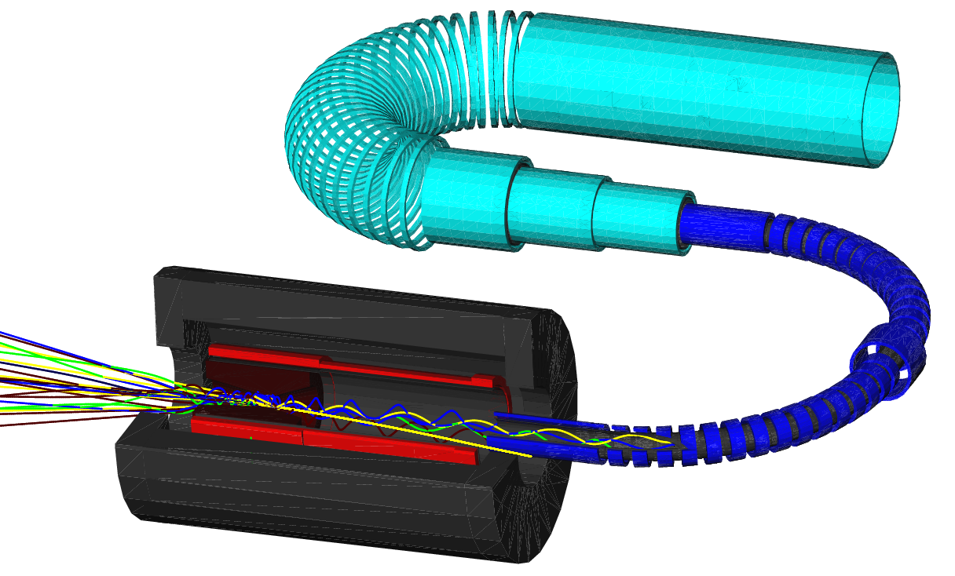
Superconducting Magnet R&D at J-PARC Cryogenics Section
J-PARC Cryogenics Section: KEK Cryogenics Science Center & KEK IPNS Cryogenics Group
J-PARC Facility is jointly operated by KEK and JAEA
Bird bye view 2009
g-2/EDM
MLF Second Target
COMET

Slide 12
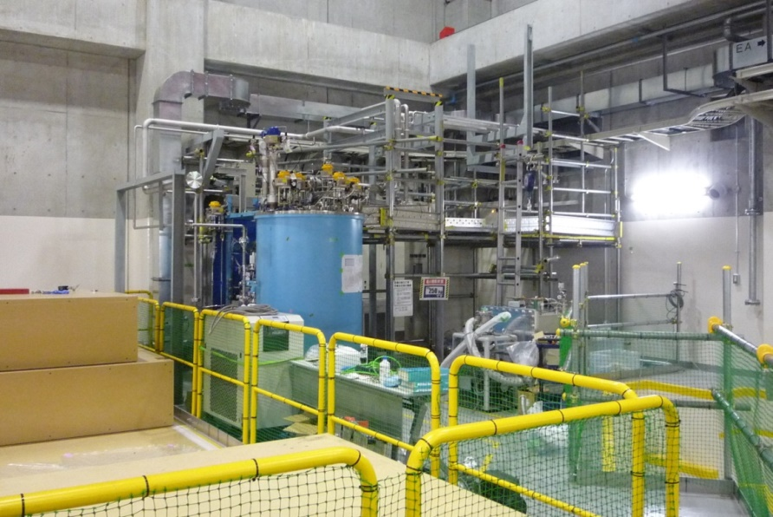
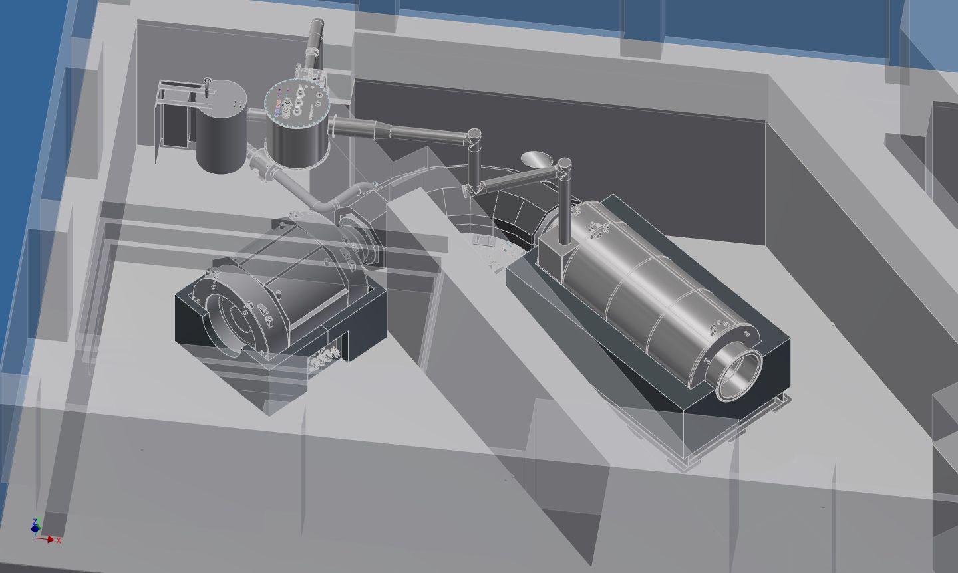
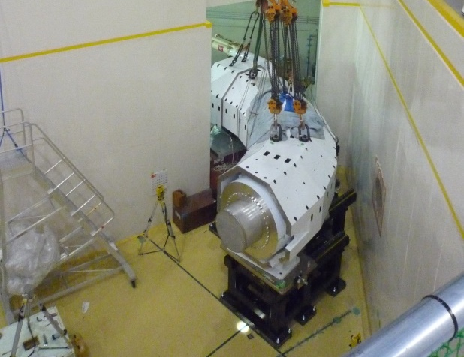
COMET Magnet System (Phase-I)
TransferTube
to MTS
ColdBox
CurrentLeadBox
TransferTube
to PCS
Transfer Tube Assembly
Muon
Transport
Solenoid
Pion Capture
Solenoid
Capture Solenoid Winding
Detector
Solenoid
US-JP Collaboration for Aluminum Stabilized Pion Capture Solenoid
Transport Solenoid Installation

Slide 13
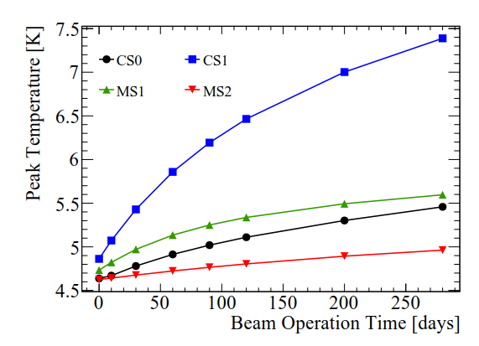
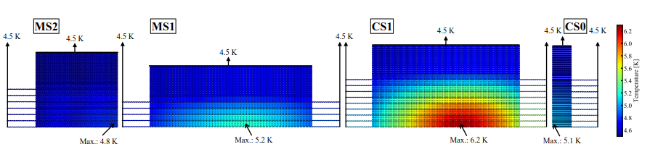
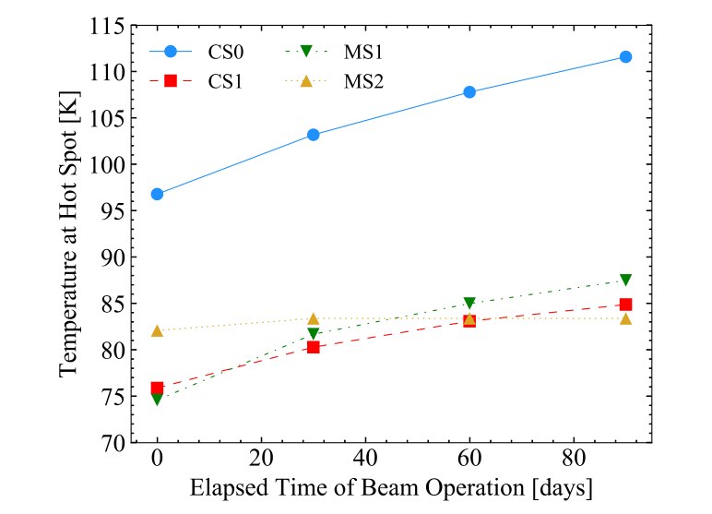
Neutron Irradiation Effects
Pion Capture Solenoid: heat up by irradiation
(max. 35mW/kg @ 56kW)
Temperature rise with thermal conductivity degradation by irradiation
Irradiation damage in Aluminum: recovered 100% by thermal cycling to room temperature.
(~85% for Copper)
Tcs
RRR of stabilizer will decrease by irradiation.
May affect to quench protection
Temperature at quench is estimated with MIITs
  adiabatic condition
Y. Yang et al., IEEE Trans. App. Supercond., 28(3), 4001405 (2018).

Slide 14
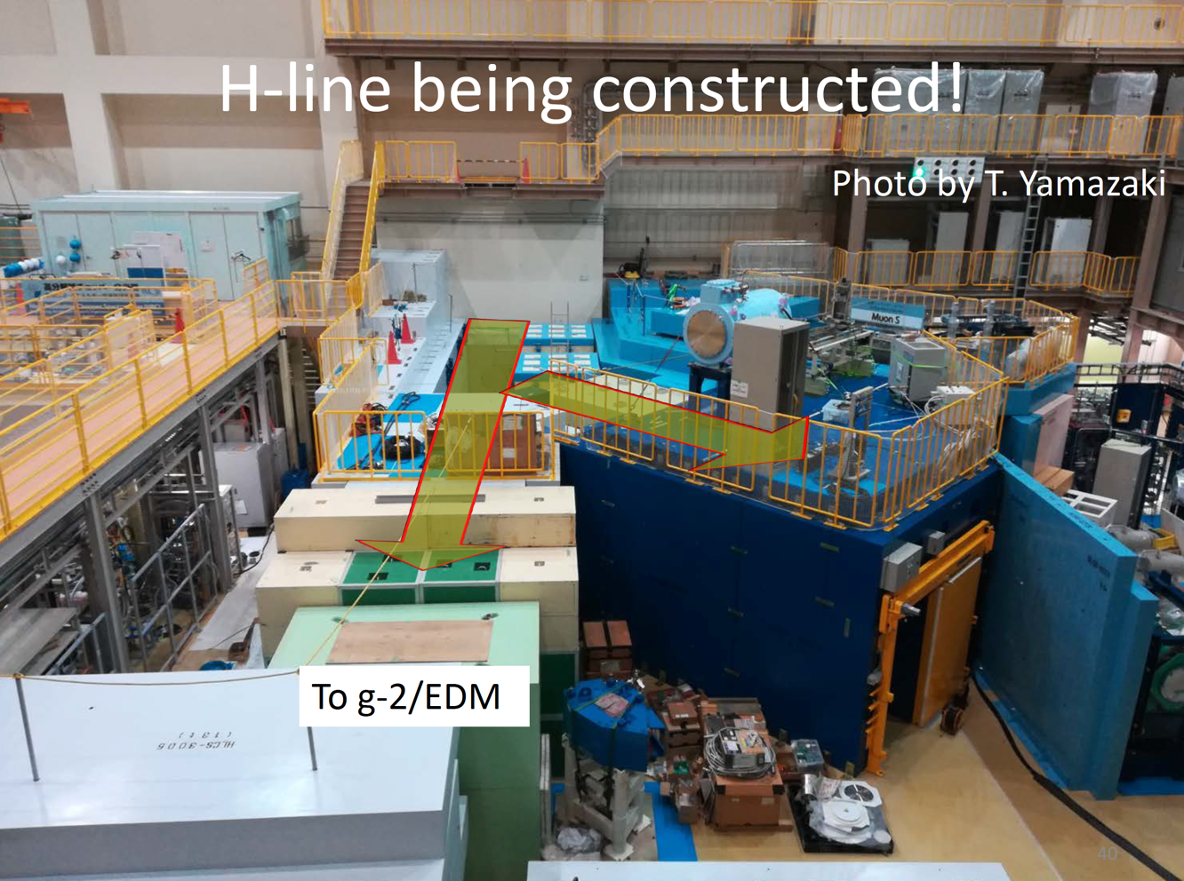
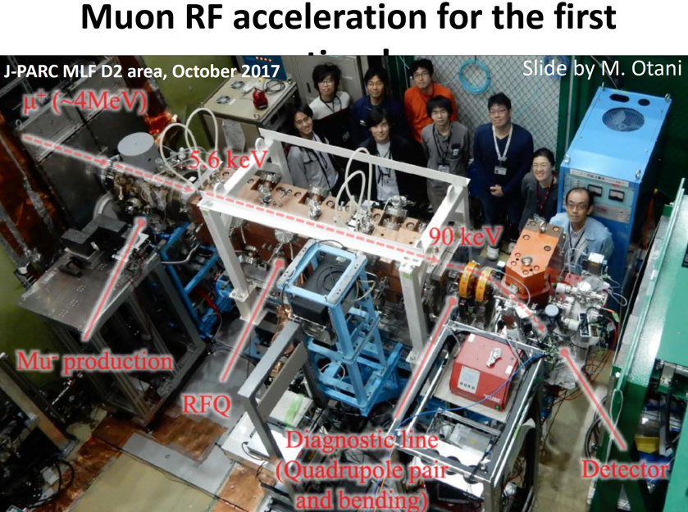
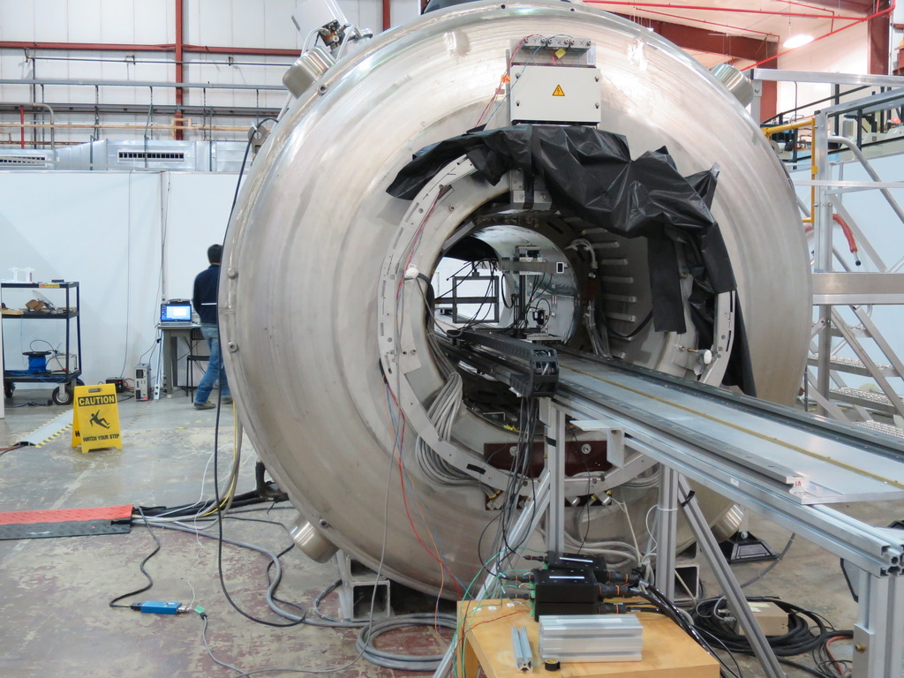
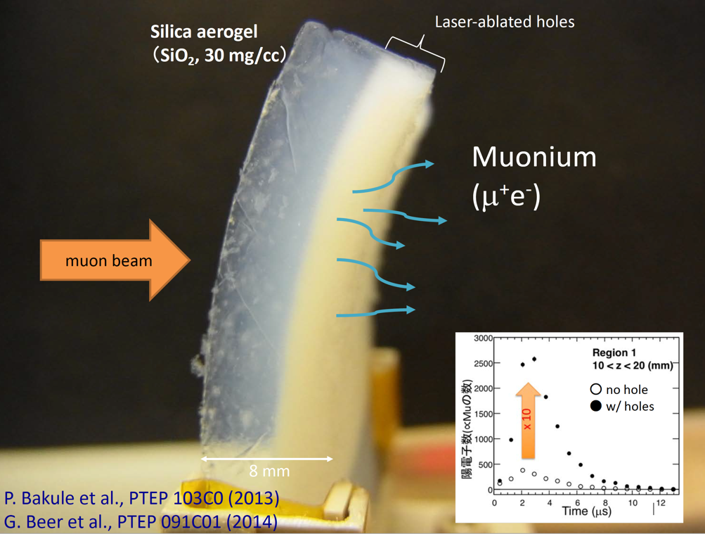
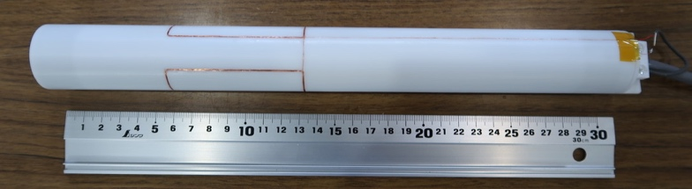
J-PARC g-2/EDM status
*H-line being constructed !
Oct. 2017
First Muon Acceleration
NMR probe system R&D
Stage 2 is approved from IPNS in Nov. 2018
SiC Aerogel Target

Slide 15
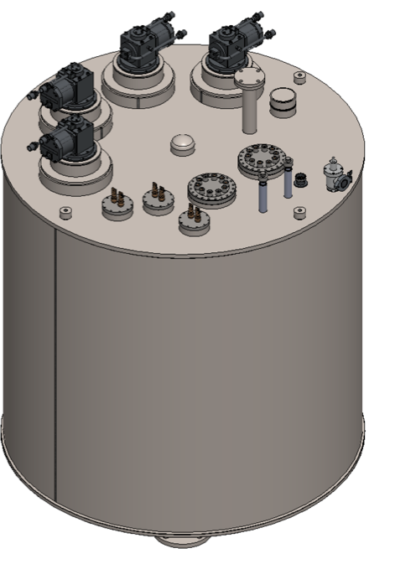
Magnet Design
Superconducting coils : NbTi
  Main solenoid
    Persistent current operation
  Weak focusing coil
    Power supply operation
  Shim coils
    Power supply operation
Field tuning system using iron pieces
Design work in collaboration with Japanese Company
Cold box
2900 mm
Muon storage orbit
Dia. : 666 mm
Iron yoke
  Adjust field shape
Cooled by liquid Helium
  Cryocoolers to recondense LHe
Separated cold box from magnet cryostat
  Isolate vibration of cryocooler
US-JP Collaboration for Field Measurements
Main solenoid
  Current : 419 A
    Cond. size : 2.2 x 1.5 mm
    RRR : 4
  Stored Energy : 14.78 MJ
  Inductance : 168 H
  Max. B on Cond. : 4.9 T
Storage region :
  radius : 33.3±1.5 cm
  height : ±5 cm
Field strength : 3T
Uniformity : 0.1 ppm (Azimuthal integral)
Weak focus field: -5e-4 T/m of Br at max.

Slide 16
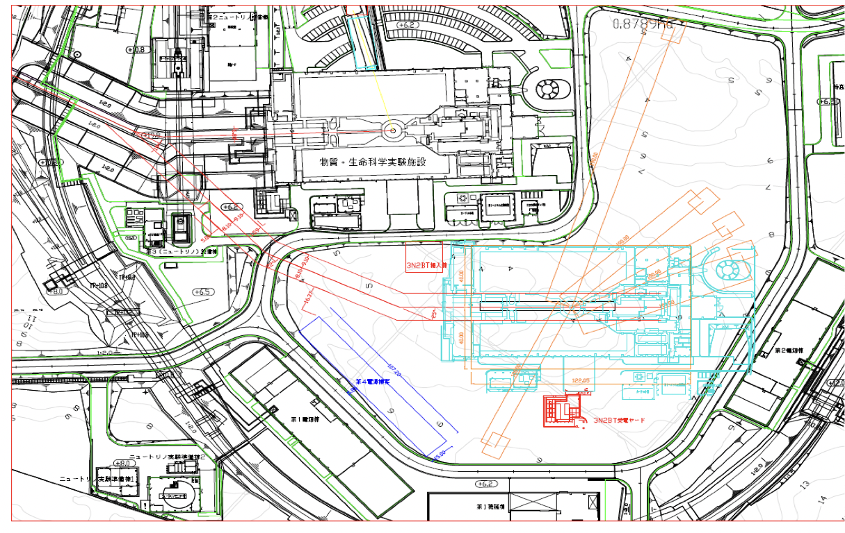
HTS Solenoid for MLF 2nd Target
Muon Capture Solenoid
(Axial field ~1.5T)
directly attached to neutron target
Advantages of mineral-insulated HTS magnet
High temperature margin
(Operation in temperature range of high thermal conductivity of metal)
High radiation tolerance of ceramics insulator
Suppression of refrigerant activation by conduction cooling system
Aluminum stabilized ReBCO conductor

Slide 17
Item
HL-LHC and FCC
  D1
  Nb₃Sn conductor R&D
J-PARC
  COMET
  g-2/EDM
  MLF second target
High Radiation SC Magnet R&D
HTS Magnet R&D

Slide 18
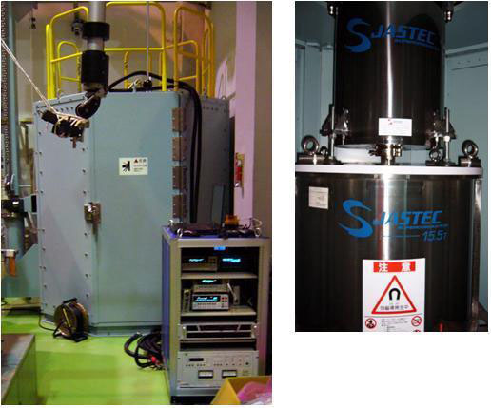
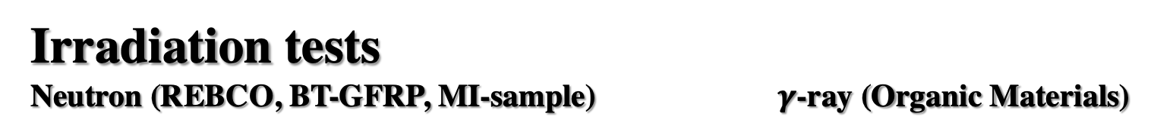
R&D for Radiation Resistant SC Magnet
Irradiation tests
Neutron (REBCO, BT-GFRP, MI-sample) $γ$-ray (Organic Materials)
LBNL Samples
VTI
15.5 T Magnet
Jan9-Mar.22
8.5MGy
Jan9-Jun
~20MGy
In JFY 2019
Up to 80MGy
is approved
(CTD101K, mix61, ATLAS ECT)
Superconducting Properties Evaluation System
@IMR-Oarai Hot Lab.
US-JP Collaboration

Slide 19
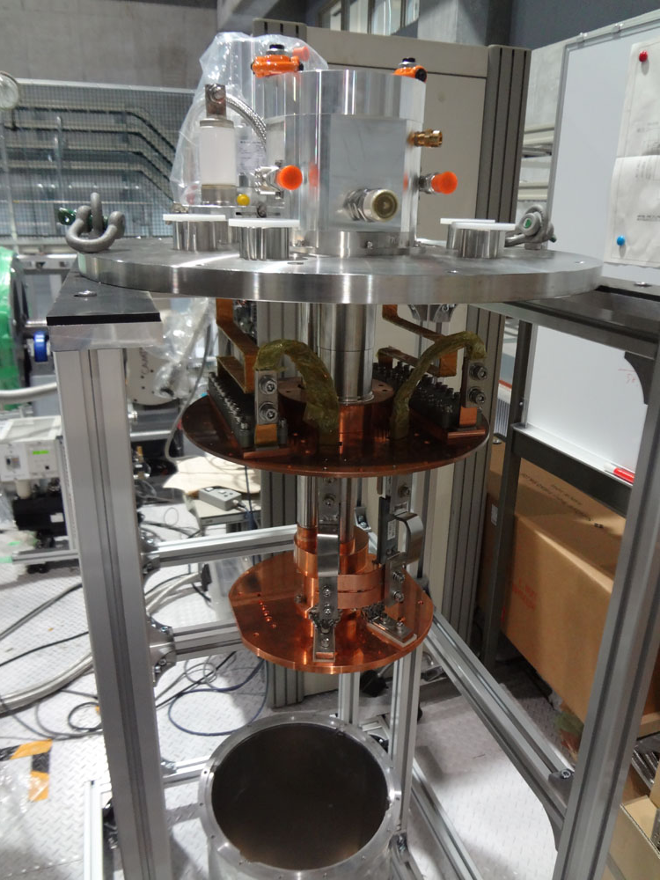
R&D for Radiation Resistant SC Magnet
Design study of muon source
Demonstration of RR cooling system
Customized pulse tube cryocooler

Slide 21
Item
HL-LHC and FCC
  D1
  Nb₃Sn conductor R&D
J-PARC
  COMET
  g-2/EDM
  MLF second target
High Radiation SC Magnet R&D
HTS Magnet R&D

Slide 22
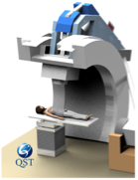
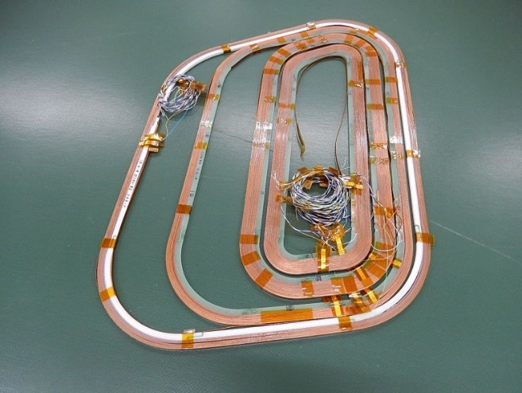
HTS Accelerator Magnet R&D with Kyoto University, NIRS and Toshiba
Compact Gantry
for Carbon Ion
Cancer Therapy
HTS combined function coil
HTS cosθ coil
Basic R&D for Medical Accelerator
Medium Field Magnet
↓
Expanding to High Field Magnet
for
High Energy Accelerator Application

Slide 23
HTS Accelerator Magnet R&D (JSPS)
Possibility for High Field High Rad. Application
In collaboration with LBNL (and BNL)
Wind Subscale coil with mineral insulation
Test with 10 T backup field
2019-2021

Slide 24
Summary
KEK Cryogenics Center Magnet R&D
HL-LHC and FCC
  D1: On going 2nd model completed
  Nb₃Sn conductor R&D: JASTEC achieved 1137A/mm²@16T4.2K
J-PARC
  COMET: Construction on going
  g-2/EDM: High accuracy field measurement collaboration (FNAL, ANL)
  MLF second target: Possibility for HTS explored
High Radiation SC Magnet R&D
  D1, COMET, MLF second target, CERN, LBNL, etc..
HTS Magnet R&D
  Many collaborations.

Slide 25
Field integral (I=12.047kA)
(): OPERA
n | RE (-1750 ~ -525) |  | SS (-525 ~ 525) |  | LE (525 ~ 1750) |  | Total (-1750~1750)
 | bn | an | bn | an | bn | an | bn | an
1 | 1925 (1871) | 0.61 (0.00) | 6259 (6267) | -0.20 (0.03) | 1816 (1862) | -6.01 (-2.73) | 10000 (10000) | -5.60 (-2.69)
2 | 1.18 (0.00) | -1.05 (-0.01) | -2.52 (-0.01) | 0.16 (0.01) | 1.03 (-0.03) | -3.66 (-0.08) | -0.31 (-0.04) | -4.55 (-0.08)
3 | -14.11 (-12.27) | -0.45 (0.00) | 24.81 (13.76) | 0.15 (0.11) | -9.74 (-9.61) | 7.30 (5.73) | 0.95 (-8.12) | 7.01 (5.84)
4 | 0.02 (0.00) | -0.30 (0.00) | -0.40 (0.01) | 0.16 (0.00) | -0.63 (-0.11) | -0.01 (0.05) | -1.00 (-0.11) | -0.14 (0.05)
5 | -0.40 (-0.90) | -0.02 (0.00) | 1.09 (0.26) | -0.14 (-0.10) | 2.62 (1.03) | -0.66 (-0.59) | 3.30 (0.39) | -0.82 (-0.69)
6 | 0.22 (0.00) | -0.02 (0.00) | 0.13 (0.00) | 0.09 (0.00) | 0.06 (-0.10) | -0.12 (0.04) | 0.41 (-0.10) | -0.05 (0.04)
7 | -1.25 (-1.05) | -0.04 (0.00) | -0.50 (-0.06) | 0.02 (0.07) | -0.39 (-0.26) | 0.42 (0.41) | -2.14 (-1.37) | 0.40 (0.48)
8 | 0.29 (0.00) | 0.05 (0.00) | -0.15 (0.00) | 0.07 (0.00) | 0.26 (-0.07) | 0.02 (0.06) | 0.40 (-0.07) | 0.14 (0.05)
9 | -0.98 (-0.99) | -0.06 (0.00) | 0.28 (0.07) | -0.05 (-0.03) | -0.50 (-0.64) | -0.04 (-0.08) | -1.19 (-1.56) | -0.15 (-0.12)
10 | 0.14 (0.00) | 0.01 (0.00) | -0.05 (0.00) | 0.01 (0.00) | 0.13 (-0.05) | 0.01 (0.04) | 0.21 (-0.05) | 0.03 (0.04)
11 | -0.37 | 0.01 | 0.06 | 0.02 | -0.29 | 0.03 | -0.60 | 0.06
Unallowed multipole components small enough.
Issue: large b₃ of 18 unit at Straight Section.

