Slide 1
Ongoing Collaborations: Status and Next Steps, Areas to Pursue
S. Gourlay, LBNL
US Magnet Development Program
MDP Collaboration Meeting, FNAL, January 2019

Slide 2
MDP International Relations and Collaborations
MDP, by definition, is collaborative
MDP provides the strategic framework for high field magnet and conductor R&D in the US (particularly for OHEP)
Leveraging through well-organized collaborations is a key component for achieving the MDP goals

Slide 3
Tracking has been Expanded
“Next Steps” from last year
Augment/modify the list
Associate a “value” to each activity
Start and End dates?
Include MDP-internal collaborative activities
Include relevant activities outside OHEP? E.g. Fusion?
✔
✔
✔
✔

Slide 4
The Number of Collaborations has Grown Substantialy Since the Last Meeting
International (9)
CERN, EuroCirCol, PSI, KEK
Other OHEP-funded programs (4)
Ohio State, U. Houston, Penn State
Industry (12) – Includes procurements
Internal to MDP (8) – explicit identification. (Metric of how well the Program is integrated)
Other (Pending or non-HEP funded) (4)
Organized into 5 categories

Slide 5
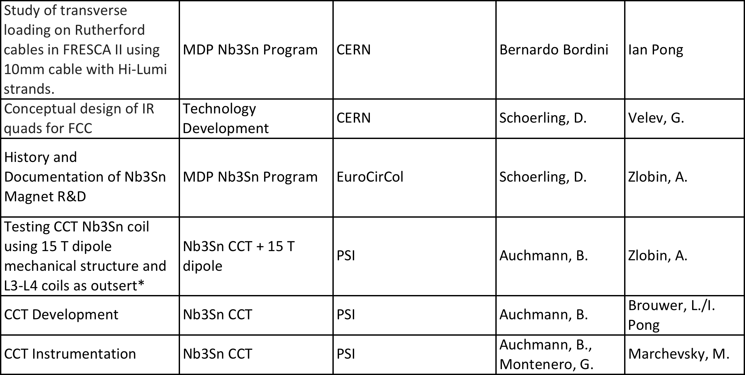
2019 International Collaborations

Slide 6
2019 International Collaborations (cont’d)

Slide 7
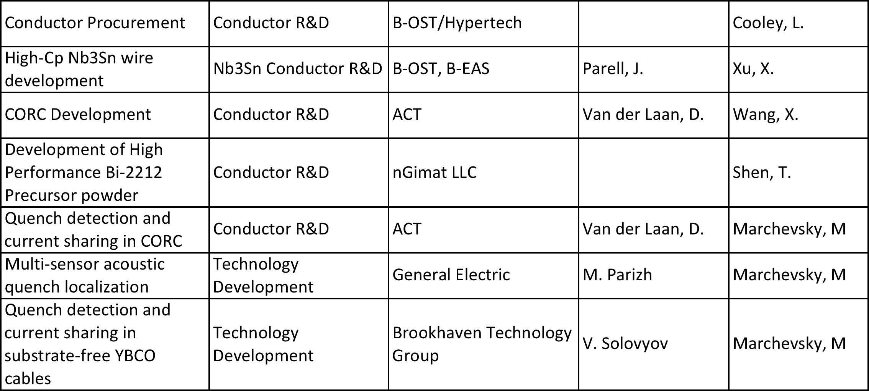
2019 Industry Collaborations

Slide 8
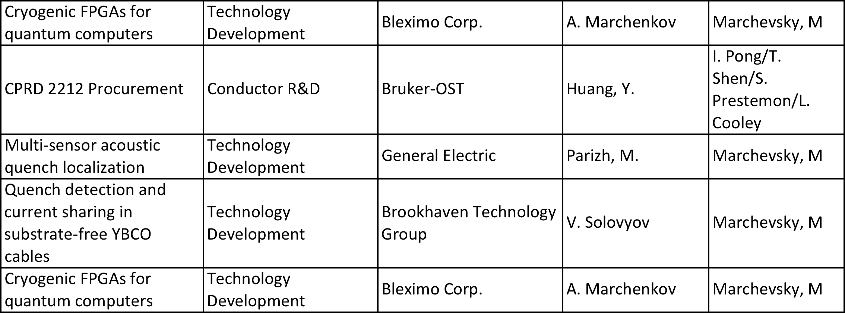
2019 Industry Collaborations (cont’d)

Slide 9
Other HEP Funded

Slide 10
Other non-HEP Funded and Pending

Slide 11
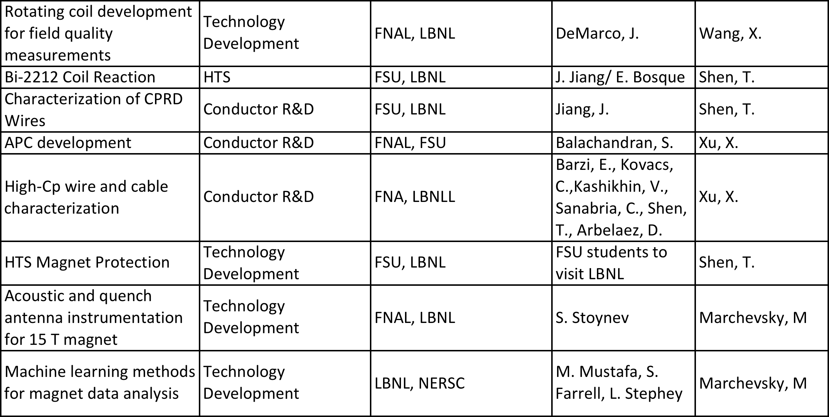
Internal

Slide 12
SBIR/STTR are a Significant Resource
2017 Phase I - $1.4M
2017 Phase II - $5M
2018 Phase I - $1.8M
2018 Phase II - $4M
HEP is the major contributor
but FES and NP are in the game

Slide 13
2017 SBIR/STTR
Phase I
Phase II

Slide 14
2018 SBIR/STTR
Phase I
Phase II

Slide 15
MDP Reach has Significantly Expanded Over the Last Year
Both internal and external collaborations growing
Endothermic nature of internal collaborations will always require participants to actively engage
Cross-cutting opportunities in FES, NP
SBIR/STTR program is a significant resource that needs active community engagement in order to maximize gains

