Slide 1
15 T: Diagnostics and Magnet Test Plan
MDP collaboration meeting
January 16, 2019
Stoyan Stoynev
US Magnet Development Program
Fermi National Accelerator Laboratory

Slide 2
Collaboration efforts
All diagnostics discussed among FNAL-LBNL collaborators
Instrumentation contributions from both FNAL and LBNL
Based on 11 T and CCT experience
The magnet testing will be at VMTF (FNAL)

Slide 3
Instrumentation - overview
VMTF Facility limits
102 channels
for characterization
64 channels
2x2 independent units
(16 input channels)
13 channels (+ reserve)
LBNL (~6 channels)
From LBNL (~4-6 channels)
5 channels
Voltage taps – for quench detection and characterization;
splice resistance measurements
Strain gauges on coils, poles, bullets/rods and shell – strain monitoring during cool down, warm up and quenches to build the full stress picture vs conditions
Protection heaters – for quench protection of the superconducting magnet
In addition to heaters the magnet is protected by an energy extraction system
Quench antenna – for independent quench characterization
Acoustic sensors - for independent quench characterization
Temperature sensors – outside magnet/coil temperature
In collaboration between FNAL and LBNL

Slide 4
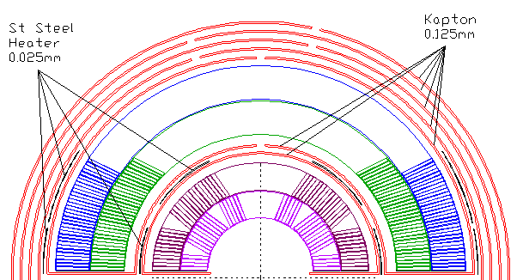
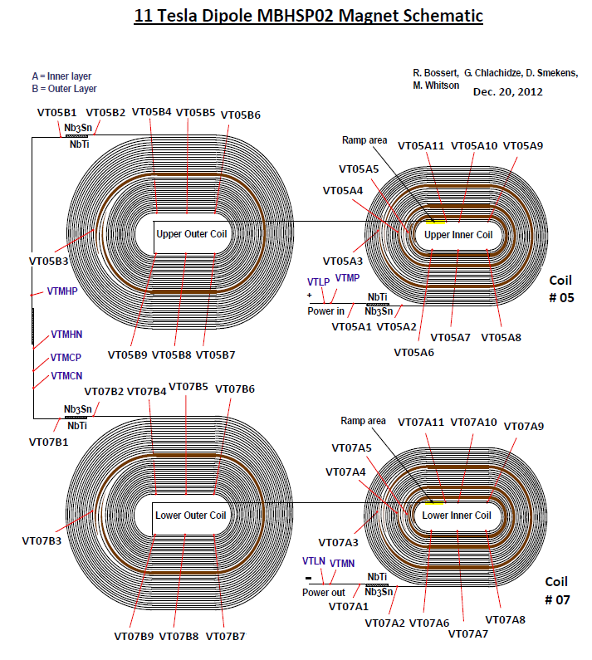
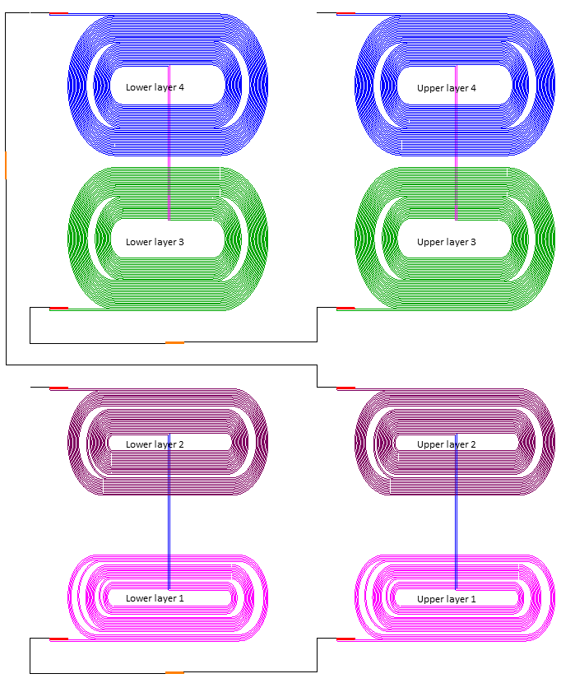
Voltage taps and heaters for 15 T coils
heaters
Layers 1 and 2 resemble the structure of a two-layer magnet
Instrumented in a similar to past magnets way
Voltage tabs at the inner- and outer-most surfaces of the structure
Heaters at the outer-most surface
Layer 4 resembles the outer layer of a two-layer magnet (or layer 2 in our case)
Layer 3 is different from past
Limited number of voltage taps instrumented
insulation
15 T
{
Layers: 4 3 2 1
Very similar
11 T
4
3
2
1
15 T
similar

Slide 5
Voltage tap schematics
Coil instrumentation (seen from “above”)
D7
D1
D2
B1
B2
B8
D4
B5
Layer 2
D3
Layer 4
B3
D6
D5
B4
B7
B6
C3
C7
A5
A9
A8
A3
C4
C6
Layer 1
Layer 3
A4
A7
C5
A6
A1
A2
C1
C2
Innermost layers are slightly more instrumented, in particular around the pole where
most of quenches are expected.
Not shown: NbTi-NbTi splices (between coils and coil-to-leads)
All of them will have voltage taps as well

Slide 6
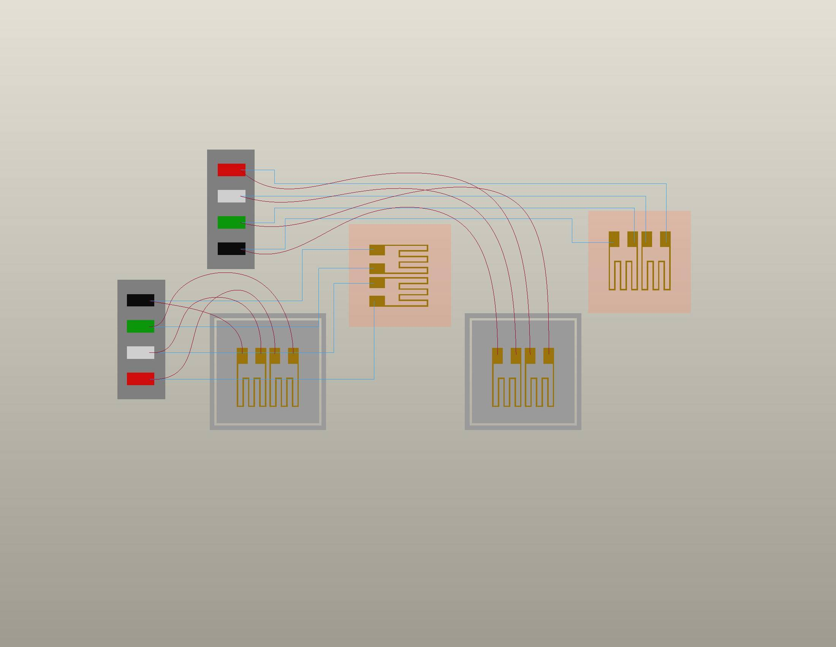
Strain gauges – half bridges where possible
ACTIVE GAGE
Bonded in Axial Direction
ACTIVE GAGE
Bonded in Transverse Direction
P+ (red)
S- (wht)
S+ (grn)
P- (blk)
We are using the
typical LBNL SG
configuration where
possible
(coil and bullet gauges
are exceptions)
TEMP-COMPENSATING GAGES
“Floating”
LBNL COIL INSTRUMENTATION
from LBNL 23N928 SPEC DWG

Slide 7
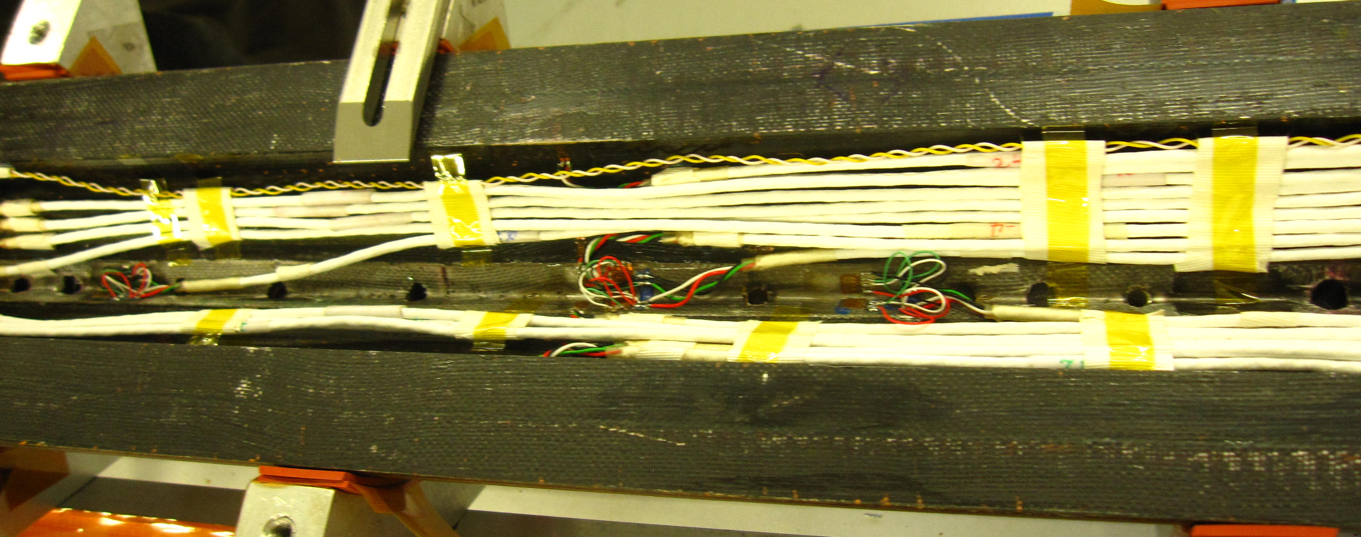
Layer 1 pole and coil strain gauges – positions and type
Schematics
There are 4 SG per coil pole ( ) –
half of them axial, half - azimuthal.
8 pole SG (“half bridge”) in total.
There are 2 more single gauge
(“quarter bridge”) azimuthal gauges per pole for assembly purposes (~same positions as
“half bridges”).
At several inches from the pole block separation
There are 8 SG per coil ( ) – all azimuthal.
So 16 active coil SG.
Those are “standard” positions for the
measurements but now we read both
azimuthal/axial directions

Slide 8
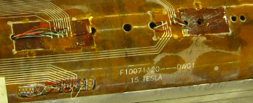
Layers 3-4 pole strain gauges – positions and type
L3
4 SG
Locations were discussed
with LBNL.
L4
2 SG
Used for wiring
Each groove hosts one azimuthal and one axial gauge.
12 L3 and L4 pole SG (“half bridge”)
16 skin SG (“half bridge”) and 18 bullet SG (including TC) will also be instrumented.

Slide 9
Wiring – “traces”
Traces: 25 μm SS on 1 mil Kapton; etched
Incorporate heaters and wiring for VT and SG
Minimal distance of 2 mm between
VT strips and 5 mm from heaters
All wiring for coils 2, 3 and 4 goes
through the traces on layer 2 and 4
Wiring for layer 1 is “old-fashioned”
heaters
insulation
Layers: 4 3 2 1
Traces in layer 2 and 4 carry the coil voltage/strain gauge signals and make the heaters
Developed together with LBNL

Slide 10
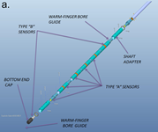
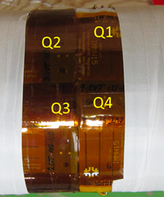
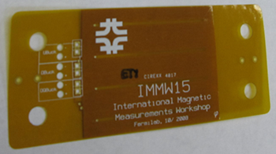
Quench antenna
Sketch of the
assembled quench
antenna
and photo of the
antenna sections
Two types of quench antenna
“Conventional” (used in HD magnets)
It will be supplied by LBNL
It will be inserted in the warm bore (warm finger)
“Trace” (flexible; first successful test in a MQXF magnet)
80 mm long coils on a trace
To be attached to the cold side of the warm finger
Non-continuous coverage
Seven wire wound sections separated by 14 cm (23 mm OD)
Traces will cover both sides of a coil, ends + the straight section (close to the trasition region) for both innermost coils : 3 x 4 = 12 channels
“Trace” QA tested
in MQXFS1
~ 3’’
Warm finger radial dimensions: 1.25” (31.75 mm) OD Tube x .035” wall or ~ 1.18” (~ 29.97 mm) ID.

Slide 11
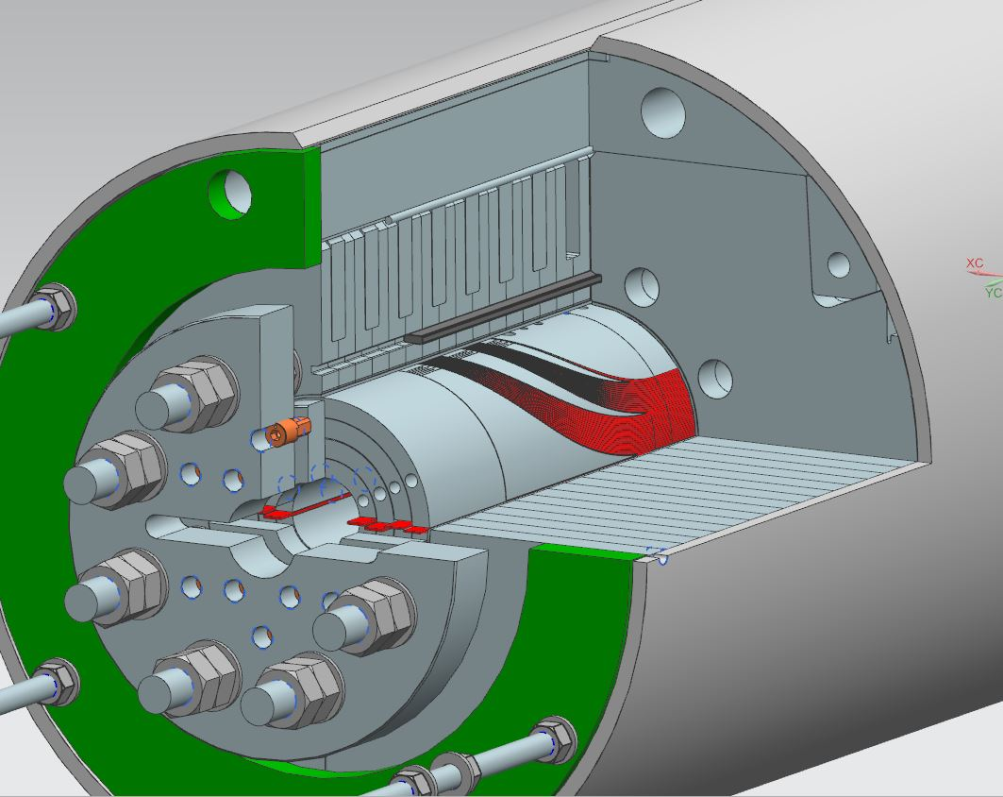
Acoustics
Sensors and
adjacent electronics
New improved electronics and sensor options allow
to use the technology in difficult locations
1 MHz aquisition rate for the DAQ
Locations – on the end parts (pusher plate) and skin
Likely four sensors on the end parts (reading only two)
Three or six sensors on the skin (reading only three),
close to the magnet center axially and
separated by 120º azimuthally
Installation will be after magnet assembly
Location of sensors on
the pusher plate (the other
displaced 180º azimuthally)
All supplied by LBNL

Slide 12
Magnet Test Plan Overview
At 300 K
Electrical Checkout, including RRR measurements before cool down
Hi-pot schedule: Coil to ground (with heaters grounded or floating) at 1000 V, protection heater to ground (with coils grounded or floating) at 1000 V
Magnetic measurements
At 4.5 K
Electrical checkout and quench detection checkout, Hi-pot
Manual trip at 1000 A
Protection heater provoked quenches at Imax ≤ 5 kA
At 1.9 K
Magnetic measurements up to 5000 A (before training)
Quench training at 20 A/s, or at mixed ramp rates (start at 50 A/s and then continue at 20 A/s)
Quench ramp rate dependence study (10-400 A/s)
Voltage Spike Analysis for training and ramp rate quenches
Magnetic measurements
Quench temperature dependence study at 20 A/s
At 4.5 K (after 1.9 K)
Check quench plateau at 20A/s, or at mixed ramp rates (start at 50 A/s and then continue at 20 A/s)
Magnet inductance measurement at 50 A/s and 300 A/s
Splice resistance measurements
RRR measurements (cold at warm up)
At 300 K
RRR measurements after warm up

Slide 13
Magnetic measurements
Z-scan, 300 K (10 A)
Z-scan at 5000 A (~half of expected current)
(after quench training)
Z-scan at injection current (FCC)
Z-scan at ¾ current reached
Z-scan at Imax – 500 A
“Stair steps” measurements (500-1000 A steps)
“Loops” measurements (20/40/80 A/s)
Accelerator profile (FCC/LHC/...) measurements
The full plan will be finalized in the Test Readiness Review before magnet testing

Slide 14
Summary
Instrumentation plan developed with LBNL
Based on previous experience and succesful tests
All steps in the plan being completed
Non-invasive techniques massively applied
Magnet test plan draft based on previous experience
To be finalized during the forthcoming Readiness Review

Slide 15
Back up

Slide 16
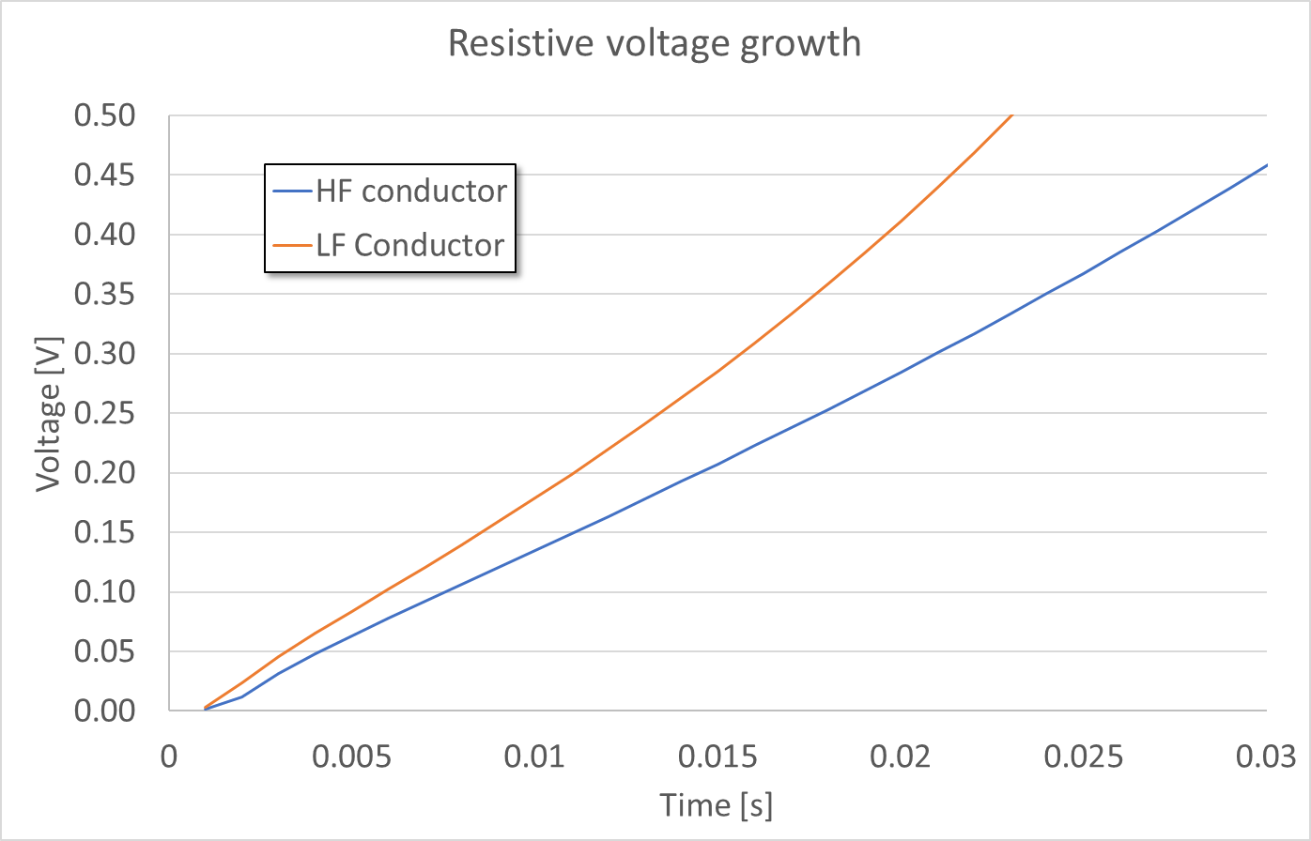
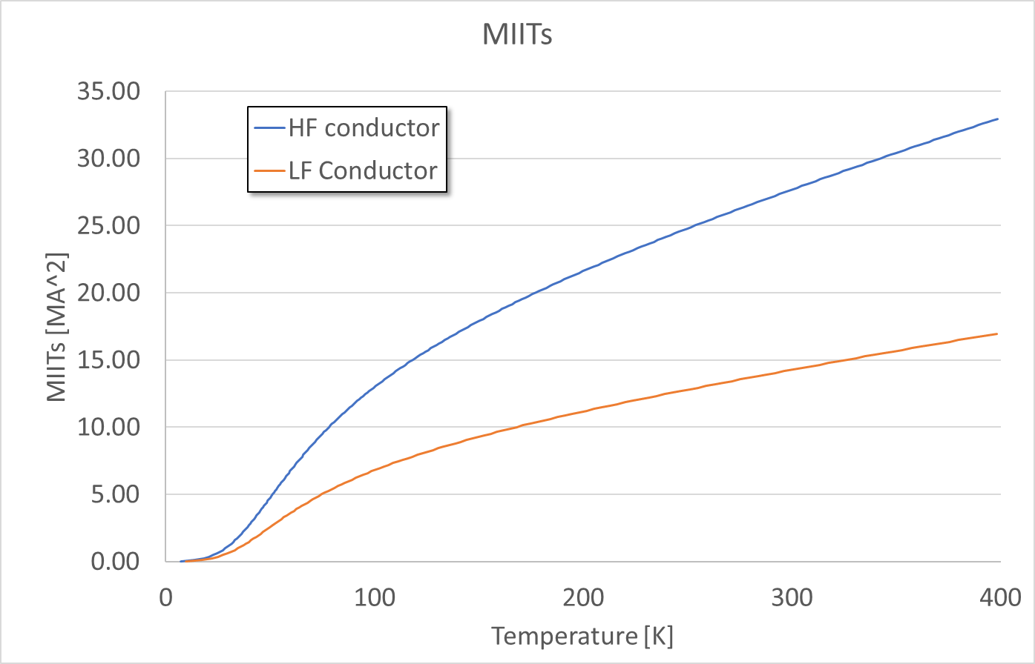
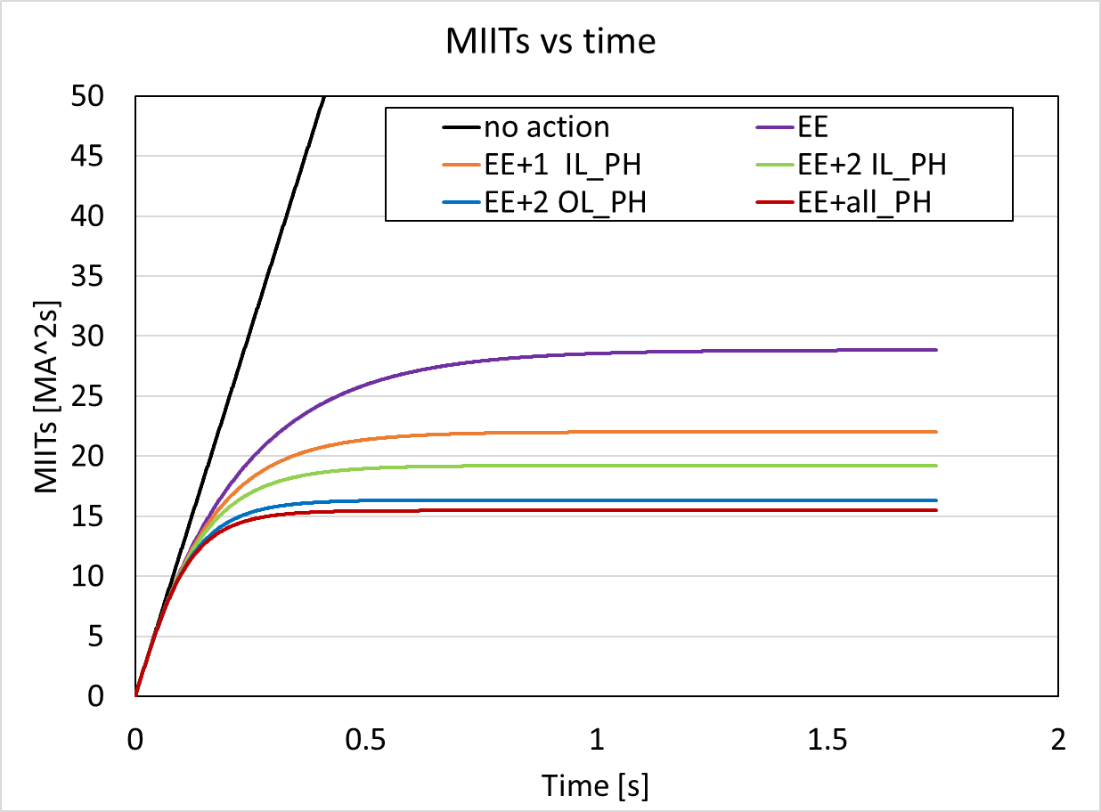
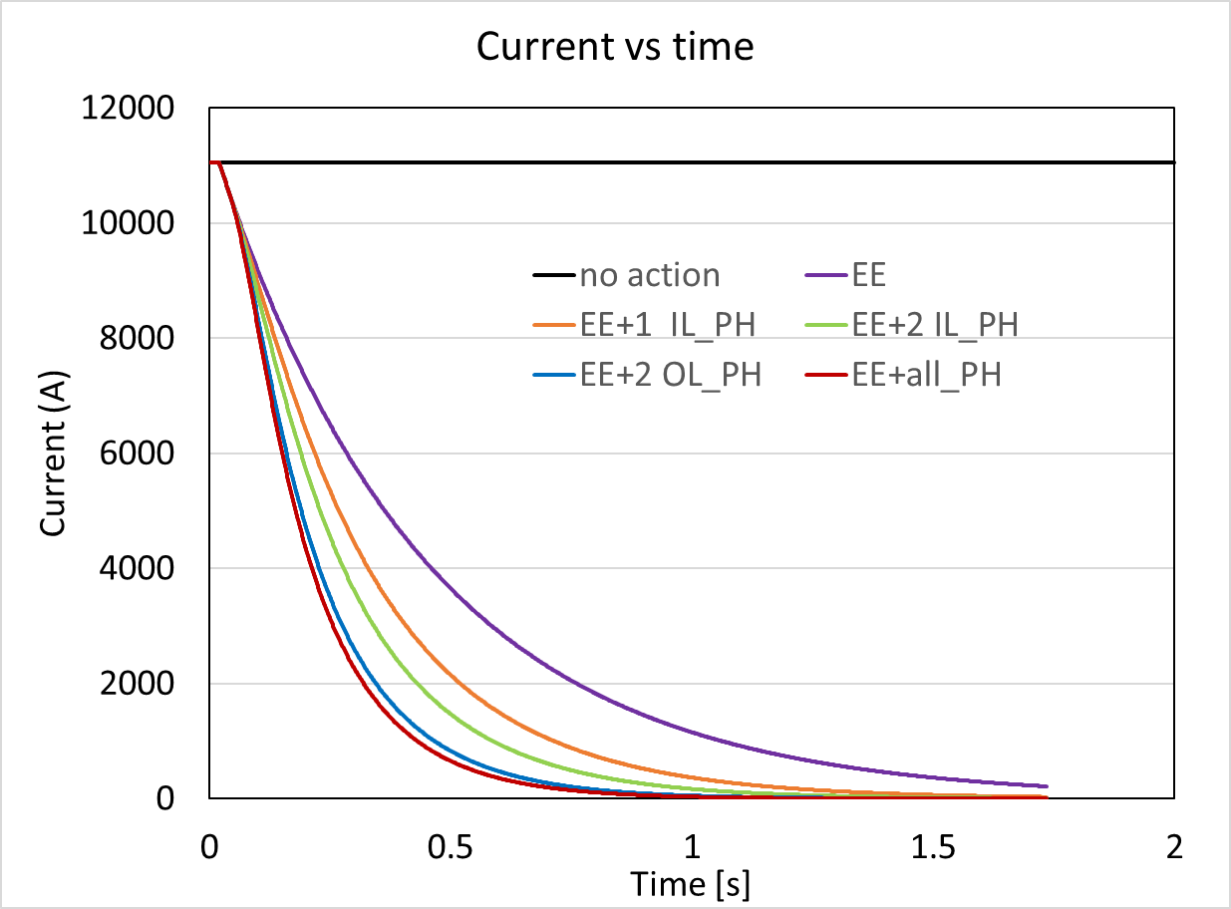
Magnet safety
MIITs budget:
conservative
estimates for various
failure scenarios
Vittorio M.
and Stoyan S.

Slide 17
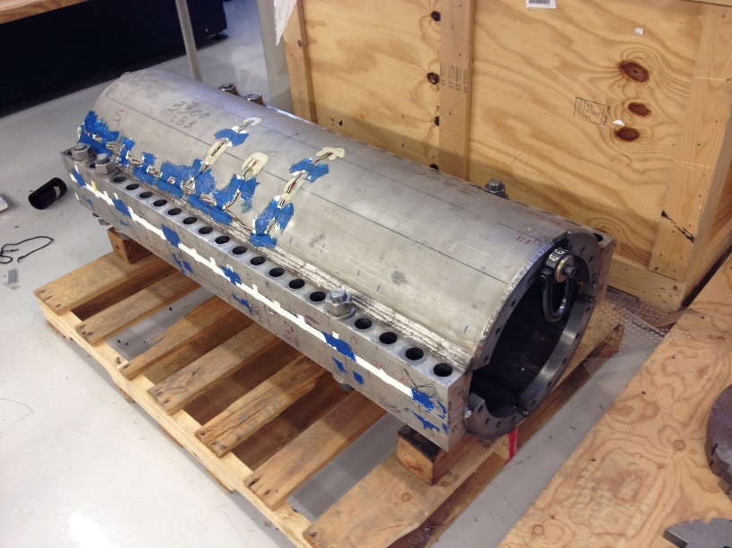
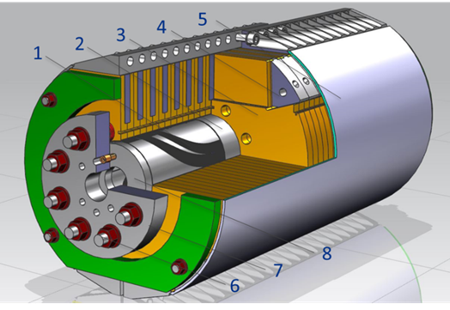
Skin and bullet strain gauges
Example from 11 T models
Instrumented
skin gages
Two positions (~ 70 cm apart longitudinally) around the magnet center to be instrumented
- At 75º and 45º
- Azimuthal and axial gages
- Two opposite sides of the magnet circumference
16 skin SG (“half bridge”).
Bullet
with
SG
15 T model
There are 8 bullet holes on the LE and 10 bullet holes on the RE
- A bullet is instrumented with 2 SG
- One TC on each side of the magnet
- Only part to be instrumented
18 bullet SG (including TC).
bullet
Those are all “standard” positions

Slide 18
Protection heaters
Protection heaters cover layer 2 and 4
25 μm SS in four strips over the
lenght of the coil
23/32 mm widths at layer 2
25 mm widths at layer 4
The low field region is supplied with higher
power density at same current (smaller width)
In 11 T we had 21.5 vs 26 mm heater widths
(low/high field regions)
They cover 60-80% of the layer coil surface
Together with the dump resistor heaters are enough to protect the magnet
heaters
insulation
Layers: 4 3 2 1

Slide 19
DAQ channels
Voltage Taps: 50 coil channels to use
Splices will take about 10 more channels
102 channels available (the “spare” ones can be used for other type of data –
a back up option)
Strain gauges – all 64 channels to use
All gauges as discussed except: 10 skin SG (“half bridge”) instead of 16
One half of the skin will be fully read, and the other will have a single station (azimuthal, longitudinal readings) read out – 10 channels in total
Protection heaters: 12 channels to use
Includes the additional (non-trace) heaters – see later
There are still four spare channels
Quench antenna – 12 dedicated channels to use
There are 13 available
Several additional independent channels will be read by the independent LBNL DAQ
(high rate)
Acoustics – between 4 and 6 channels
The whole measurement system will be provided by LBNL
High read-out rate (1 MHz)

Slide 20
Documentation
Magnet description
The draft of the document is prepared and resides
in the usual test folder (in Run Support area:
S:\Run Support\VMTF\LIST_of_MAGNETS\15Tdemonstrator)
It contains the usual information for this type of document
Check-out forms
Being generated during the coil instrumentation process
Once the magnet is assembled “official” forms for the magnet are to be generated (consistent between IB3 and IB1 as for each magnet tested so far)
All reside in the Run Support area
Presentations
This and previous presentations serve as status updates
Information of various types was/is provided
Drawings
Traces were fabricated based on drawings available in Teamcenter
(F10071120 and F10071151)

Slide 21
Risks and mitigation
Magnet protection in case of heater failure
We are to install four more heaters (8 strips, similar to 11 T)
in layer 4 over the traces (Kapton insulation)
Existing heaters need 8 channels and we have 16 (enough)
Voltage tap failures
Two quench antenna and acoustics (all non-invasive techniques) will help with reducing the risk of quench localization failures, especially in the innermost layer
Temperature sensor failure
We typically need two properly positioned sensors for safe cool-down
and we’ll have five
There are more back up readings from facility measurements
(not as acurate for the magnet)

