Slide 1

Mechanical Design in the CCT Program
January 16th 2018
3rd MDP Collaboration Meeting: FNAL
Lucas Brouwer
US Magnet Development Program
Lawrence Berkeley National Laboratory

Slide 2
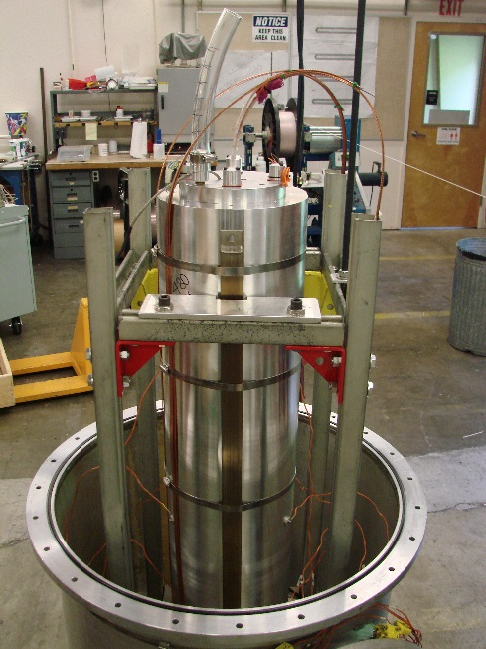
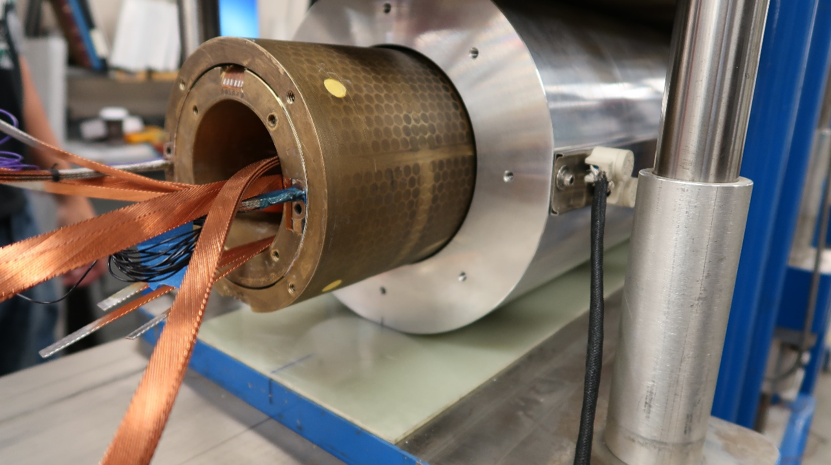
Outline
This Year
At last MDP meeting
Next Year
CCT4
CCT5
Modeling Capabilities
FEA on clusters
multi-physics/quench
de-bonding elements
addressing with bend+shim and mix61 epoxy
CCT Subscale
Concern about:
layer-layer interface
epoxy cracking
cable-channel
probing cable-channel interaction as a source of training

Slide 3
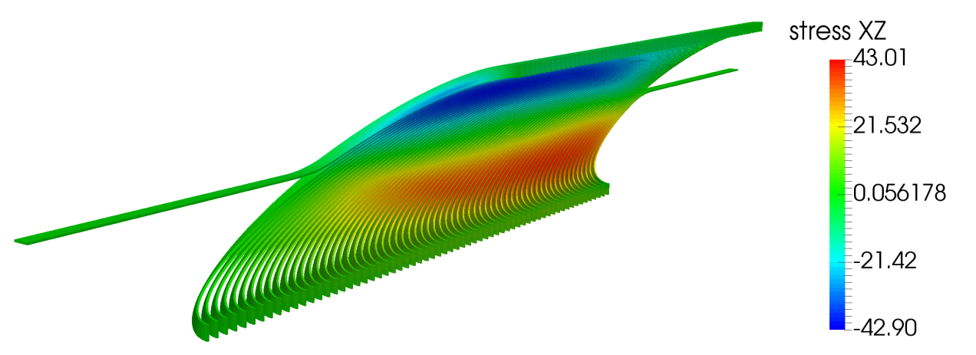
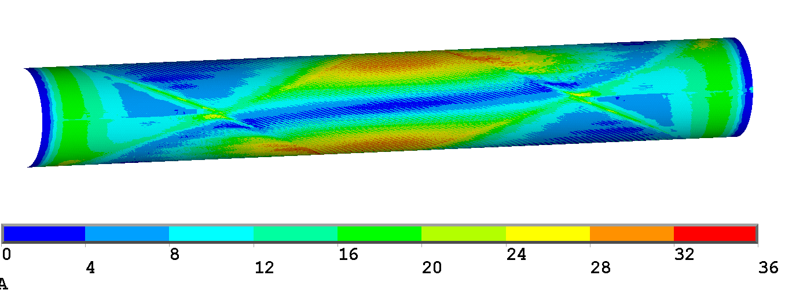
Layer-layer interface and cable-groove interface are potential trouble areas identified at last MDP meeting
At last MDP meeting
large conductor-channel shear at +- 45 deg
CCT4
large shear between layers at pole of bonded model
Concern about:
layer-layer interface
epoxy cracking
cond-groove interface

Slide 4
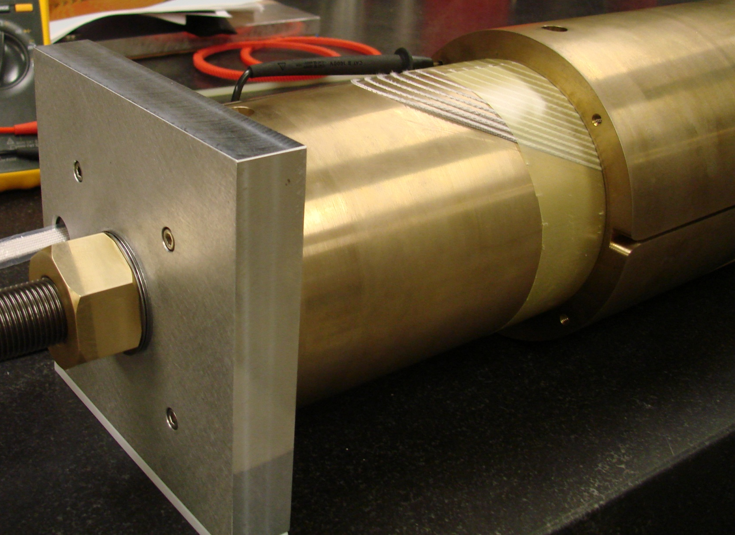
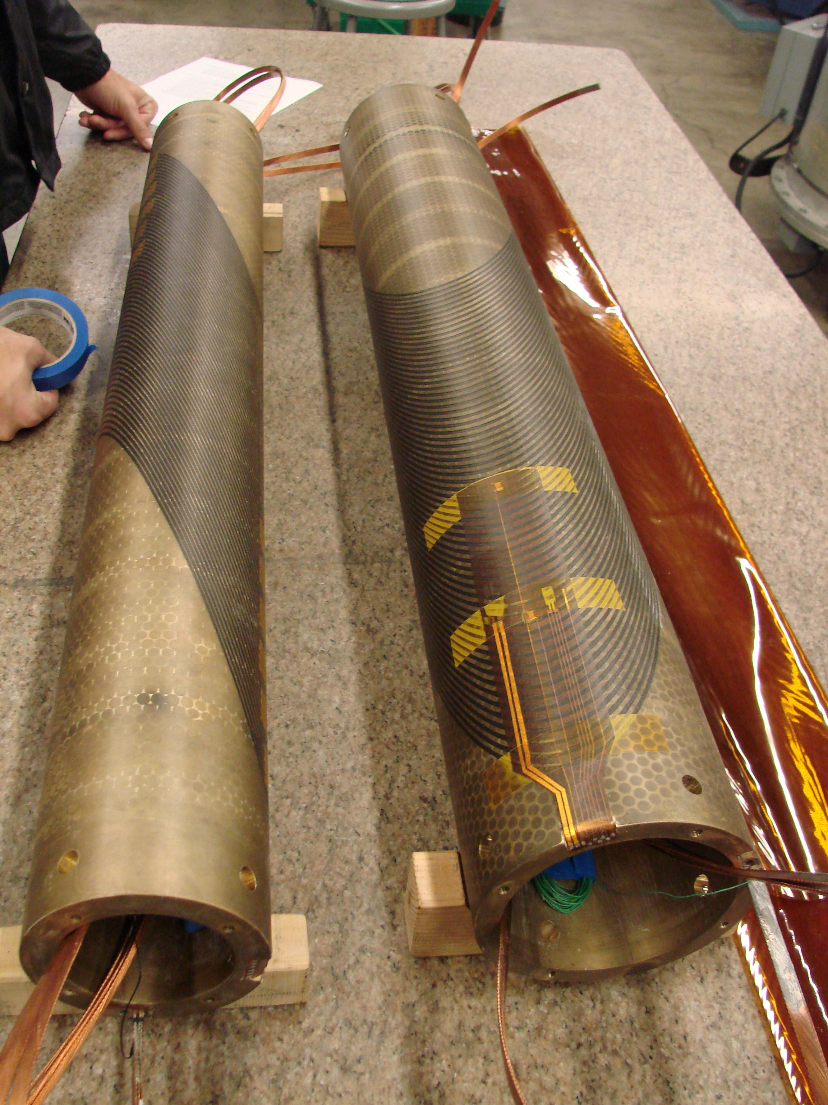
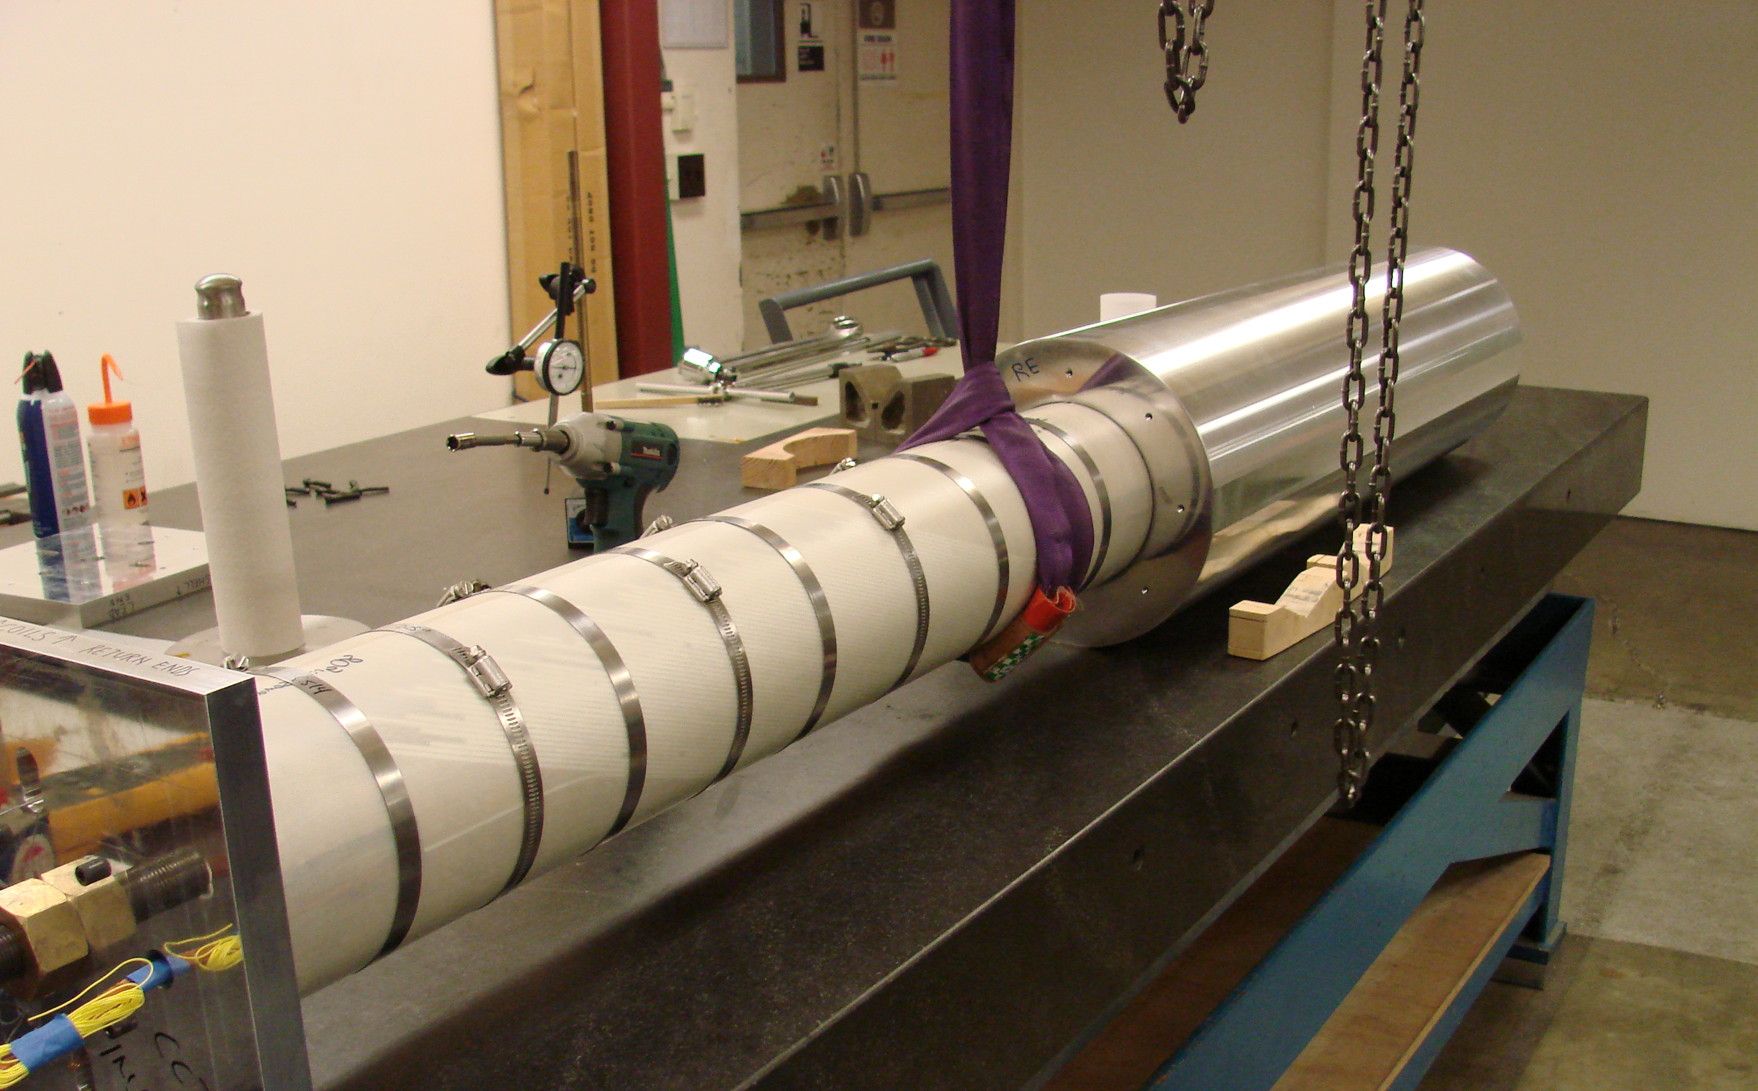
Individual layer impregnation was used on CCT5 to address layer-layer interface
Old Method: CCT3, CCT4
New for CCT5
Step 1. Assemble Layers
Layer 2
Individually impregnated layers using vacuum bag technology
Layer 1
G10 slip plane
Step 2. Layers 1+2 into shell
Step 3. all impregnated together
with the shell used as tooling

Slide 5
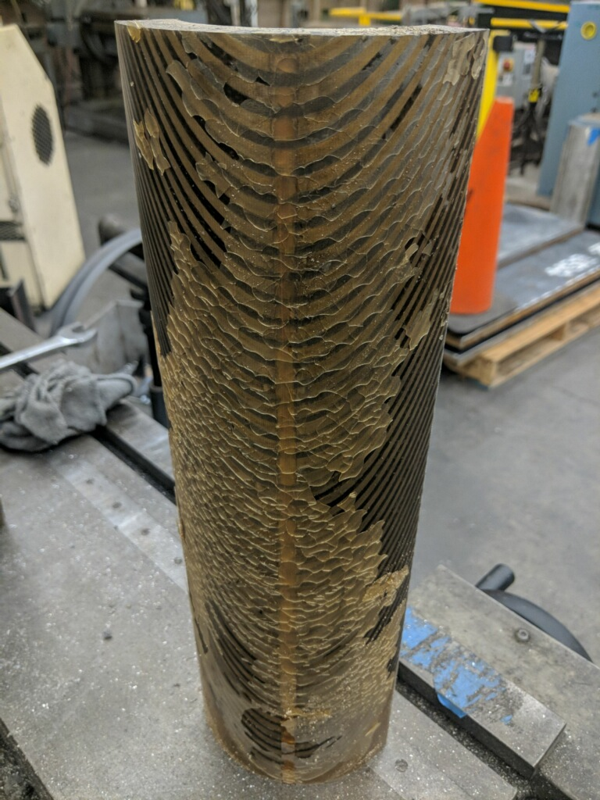
CCT3 layer-layer interface showed significant epoxy delamination
Old Method: CCT3, CCT4
New for CCT5
CCT3 layer-layer interface after test
Individually impregnated layers using vacuum bag technology
fix for this

Slide 6
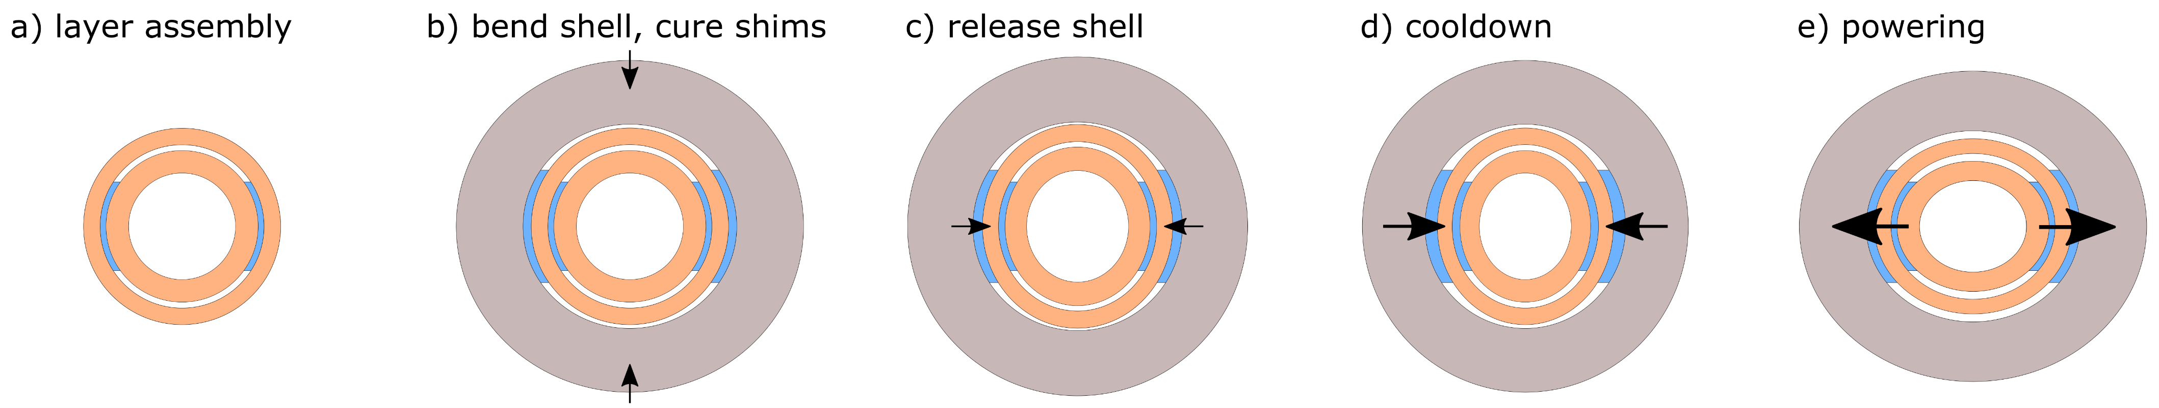
Individually impregnated layers of CCT5 were assembled using inflatable epoxy shims
Designed to address many of the assembly challenges for CCT magnets
avoids large friction interfaces between layers during assembly
accounts for deviations along length from reaction (warpage)
well defined contact between layers with no epoxy bonding which can delaminate
applies pre-bending against the Lorentz forces (balances deviation from round)
has the potential to be reversible (replacement of individual layers)
6

Slide 7
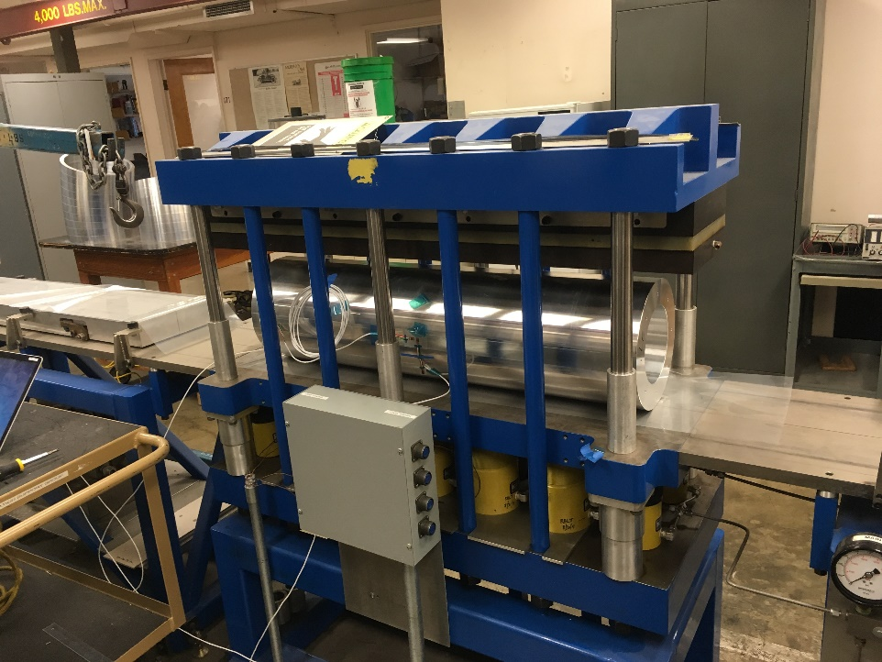
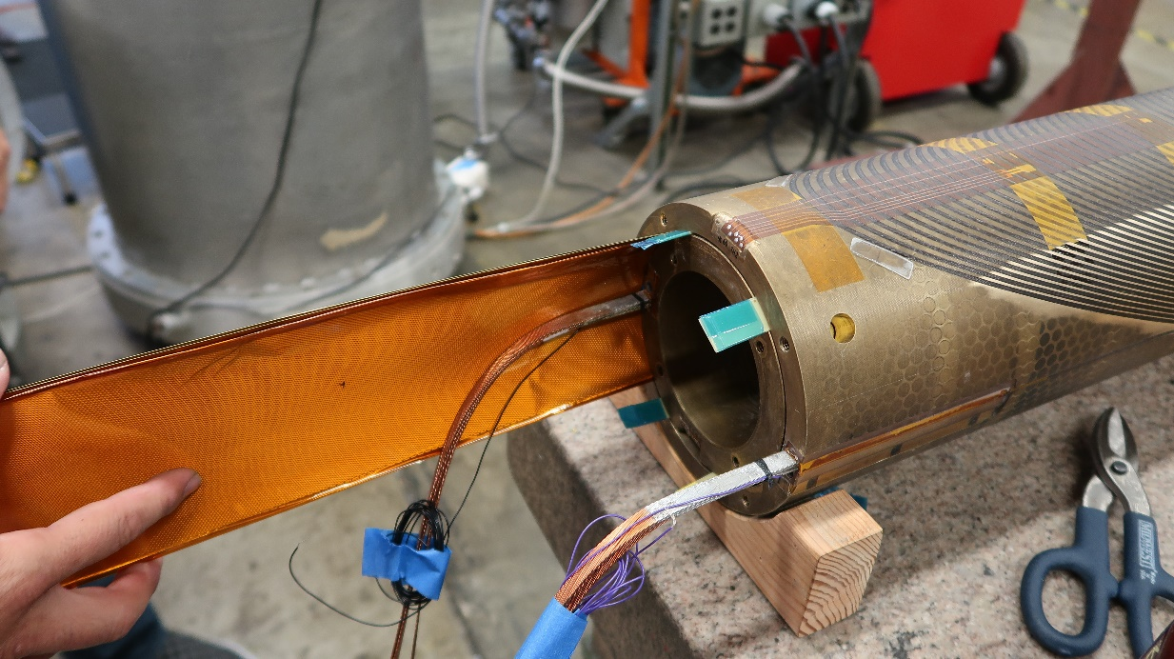
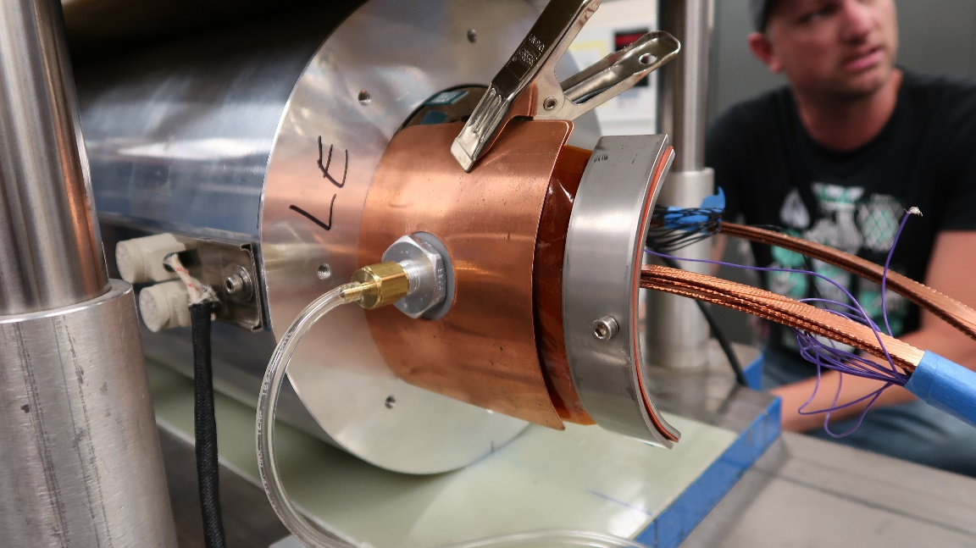
Shell pre-bending used for the assembly of CCT5
Layer 1 and 2 assembled with no bending
Shell bent, layers inserted while press holds shell bend, shims inflated, cured, and press released
7

Slide 8
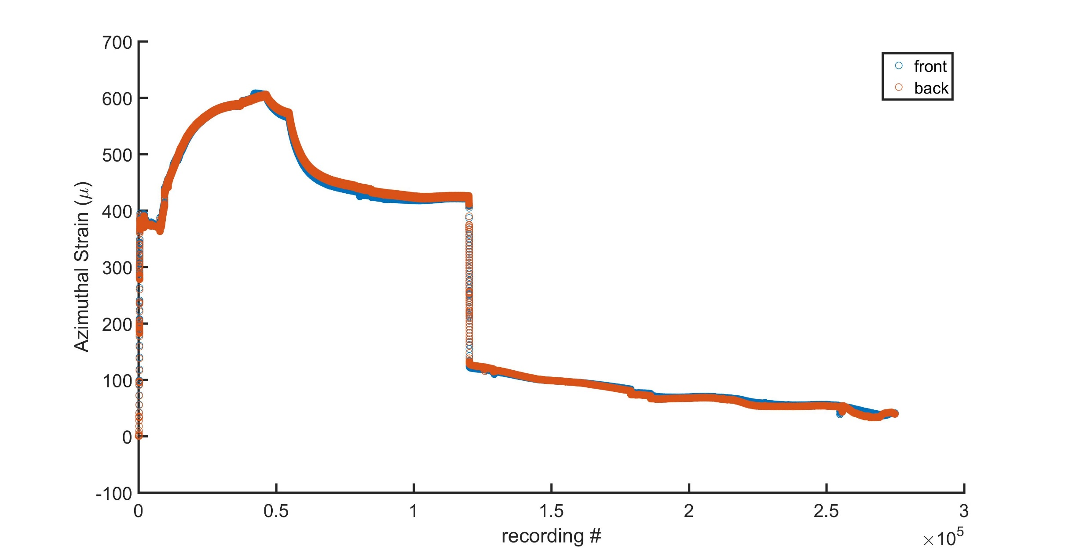
Shell strain gauge readings are aligned with ANSYS predictions during assembly
bend
inflate/cure
release bend
But, creep observed under load at room temperature!
several days
8

Slide 9
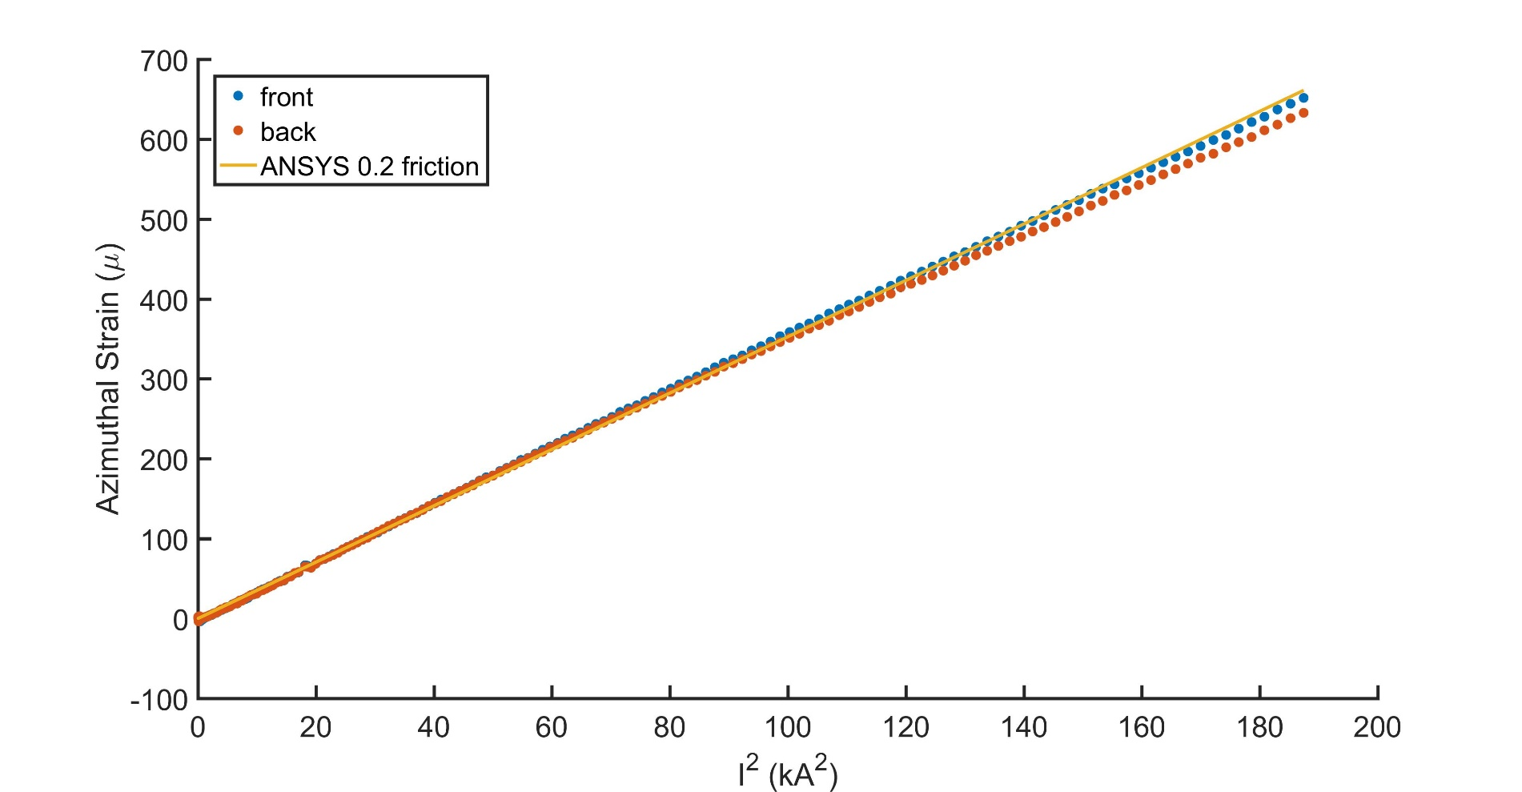
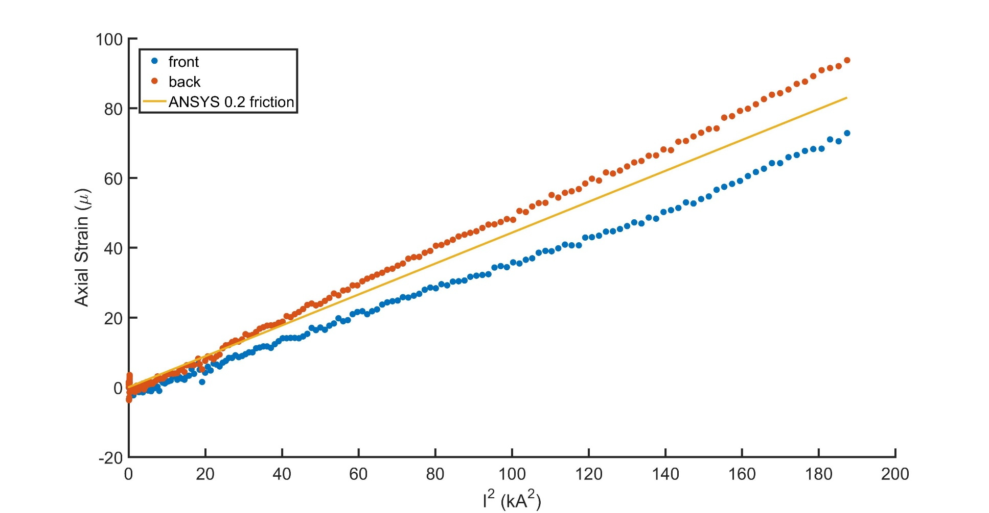
Cold powering strain gauge data points to CCT5 bend+shim behaving as modeled
700
Azimuthal strain (on shell)
comparison with ANSYS
no creep observed cold
very little offset observed between ramps
results consistent before and after the thermal cycle
100
Axial strain (on shell)
comparison with ANSYS
9

Slide 10
Future Work
This Year
At last MDP meeting
Next Year
CCT4
CCT5
Modeling Capabilities
FEA on clusters
multi-physics/quench
de-bonding elements
addressing with bend+shim and mix61 epoxy
CCT Subscale
Concern about:
layer-layer interface
epoxy cracking
cable-channel
probing cable-channel interaction as a source of training

Slide 11
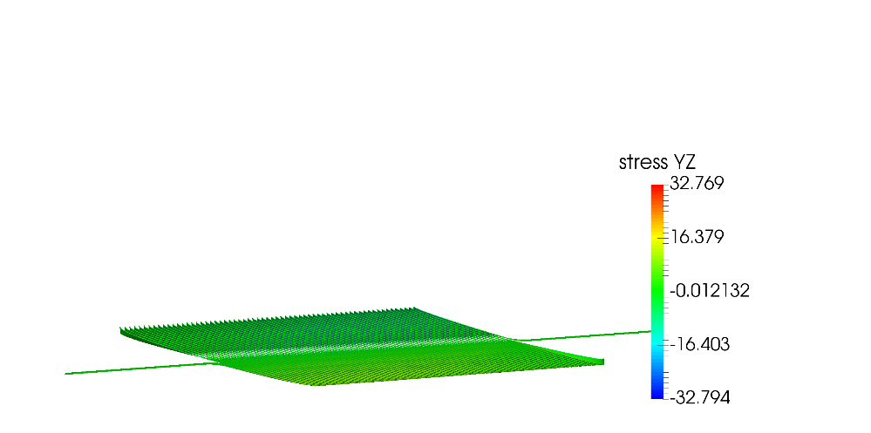
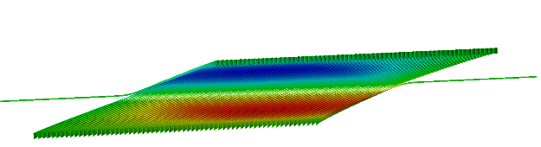
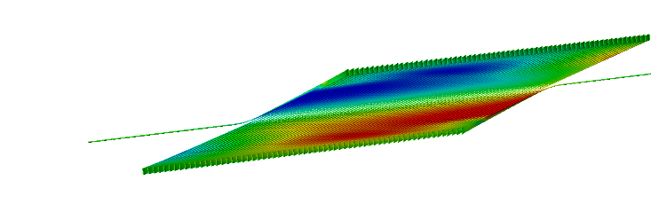
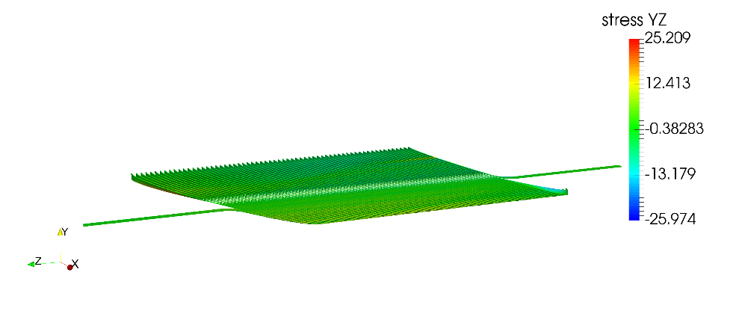
Bend and shim only addresses layer-layer interfaces, it does not dramatically impact cable–groove interface
CCT4: Lay1 radial-binormal
CCT5: Lay1 radial-binormal
+32 MPa
+25 MPa
-32 MPa
-25 MPa
With layer-layer interfaces and epoxy changed, channel behavior is one remaining explanation for CCT4/CCT5 training
11

Slide 12
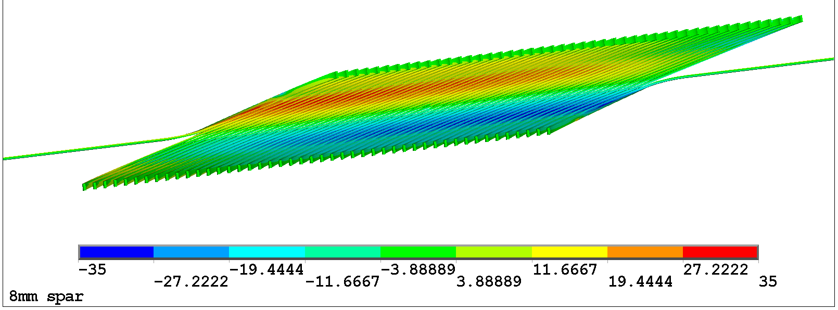
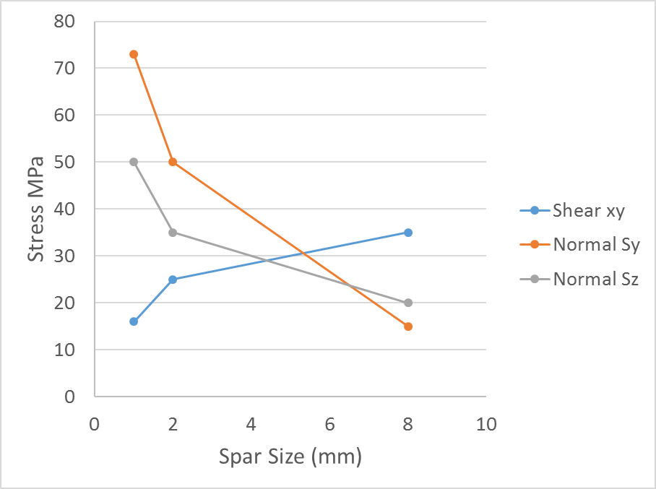
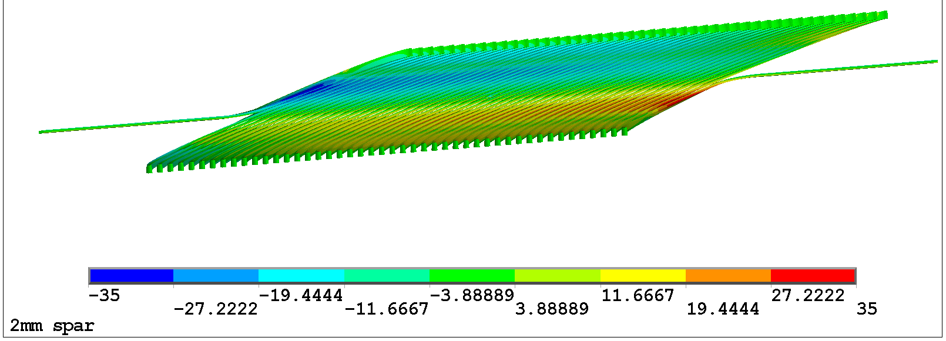
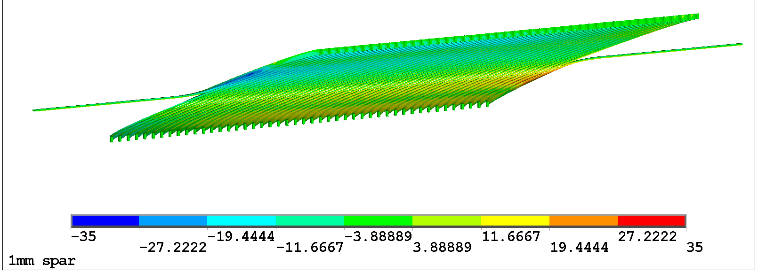
The subscale program can study the tradeoff between conductor normal and shear stress
Sxy (radial-azimuthal)
Thin spars
Low shear
High normal
Thick spars
High shear
Low normal
CCT5 Sxy training from 12-16 kA
12

Slide 13
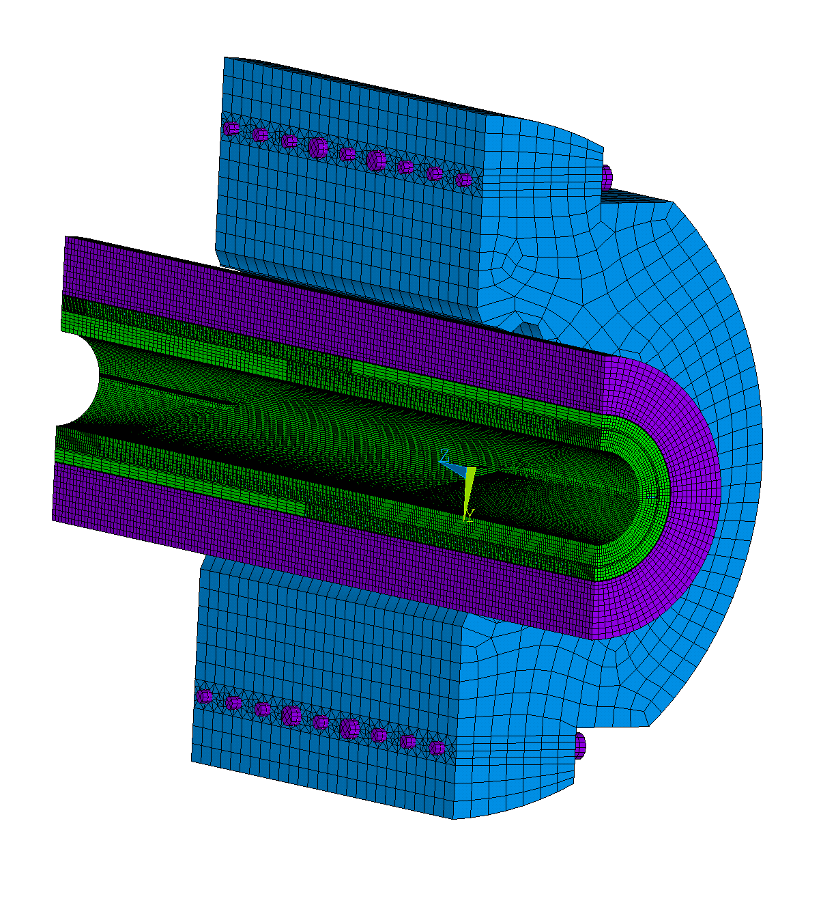
3D FEA on clusters enables efficient mechanical solutions of full geometry
Example: CCT4 full mechanical model
Speed up for CCT4 3D Mechanical Model
Solid186, 7M DOFs
3 load steps: assembly, cooldown, Lorentz forces
PCG (iterative) solver
Use of Lawrencium cluster: overnight -> less than a hour
13

Slide 14
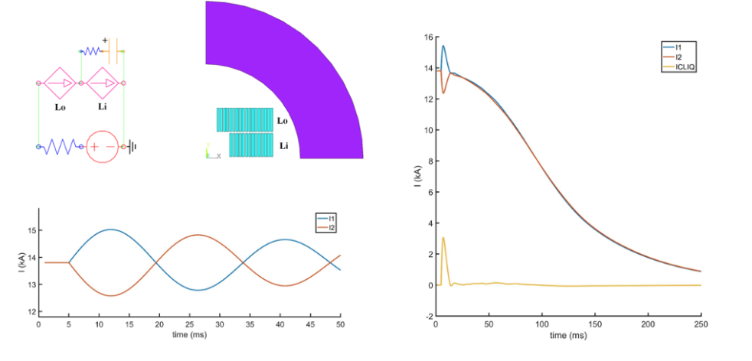
Desired modeling capabilities for design of a hybrid, multi-layer CCT
Current Capabilities
In Development
3D FEA on clusters allows for full geometry with reasonable run times (optimization)
2D multi-physics simulation with ANSYS user elements can simulate CLIQ and other highly coupled quench scenarios
debonding contact elements for cable-groove interface (cohesive zone) – already used in HiLumi for pole unloading in cos(t)
extension of some multi-physics tools (user elements) to 3D to better represent the CCT and short magnets
Ex: CLIQ with user elements
14

Slide 15
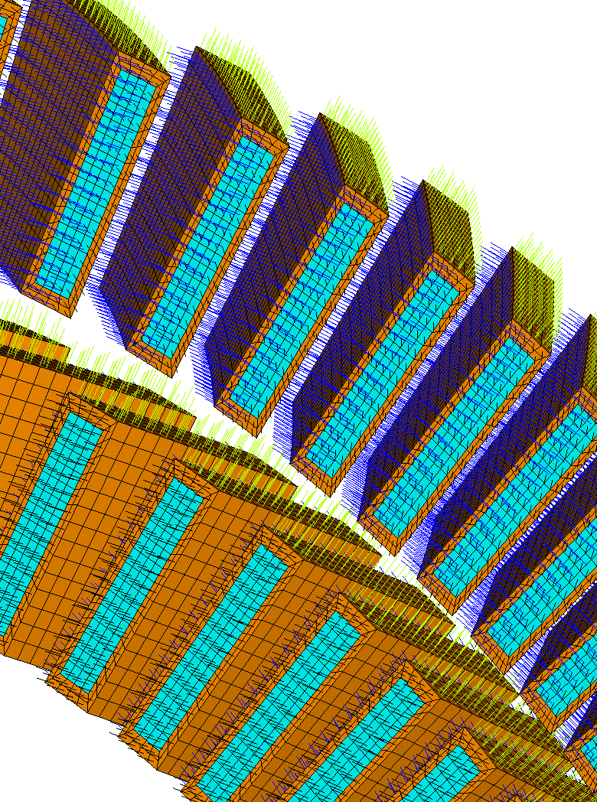
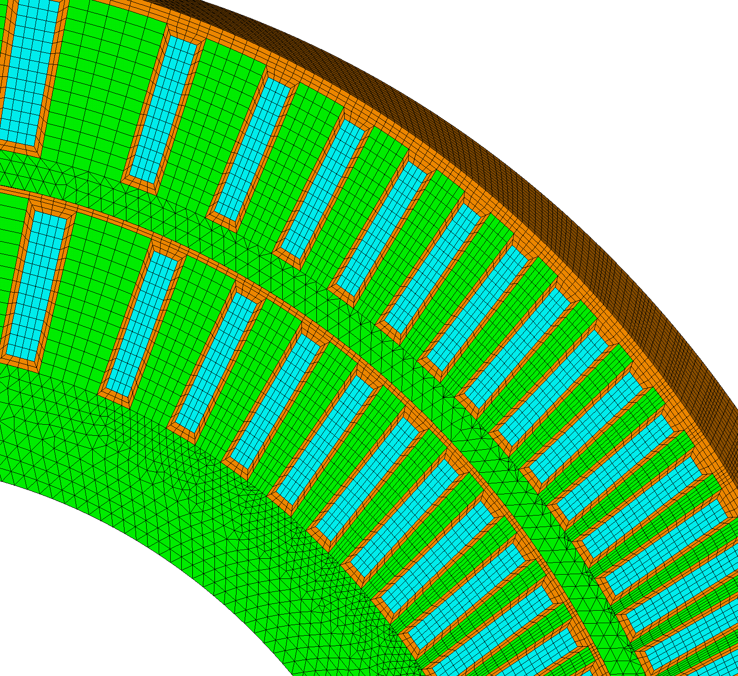
Mechanical Behavior of Interfaces is Important for the CCT
Epoxy interfaces are a possible source of quenches
between cable and channel
between layers
element coordinate system alignment allows for anisotropic conductor and epoxy (warp,fill,normal) properties
layer of epoxy around conductor (brown)
and b/w layers
15

Slide 16
Summary
This Year
At last MDP meeting
Next Year
CCT4
CCT5
Modeling Capabilities
FEA on clusters
multi-physics/quench
de-bonding elements
addressing with bend+shim and mix61 epoxy
CCT Subscale
Concern about:
layer-layer interface
epoxy cracking
cable-channel
probing cable-channel interaction as a source of training

Slide 17
Extra Slides

Slide 18
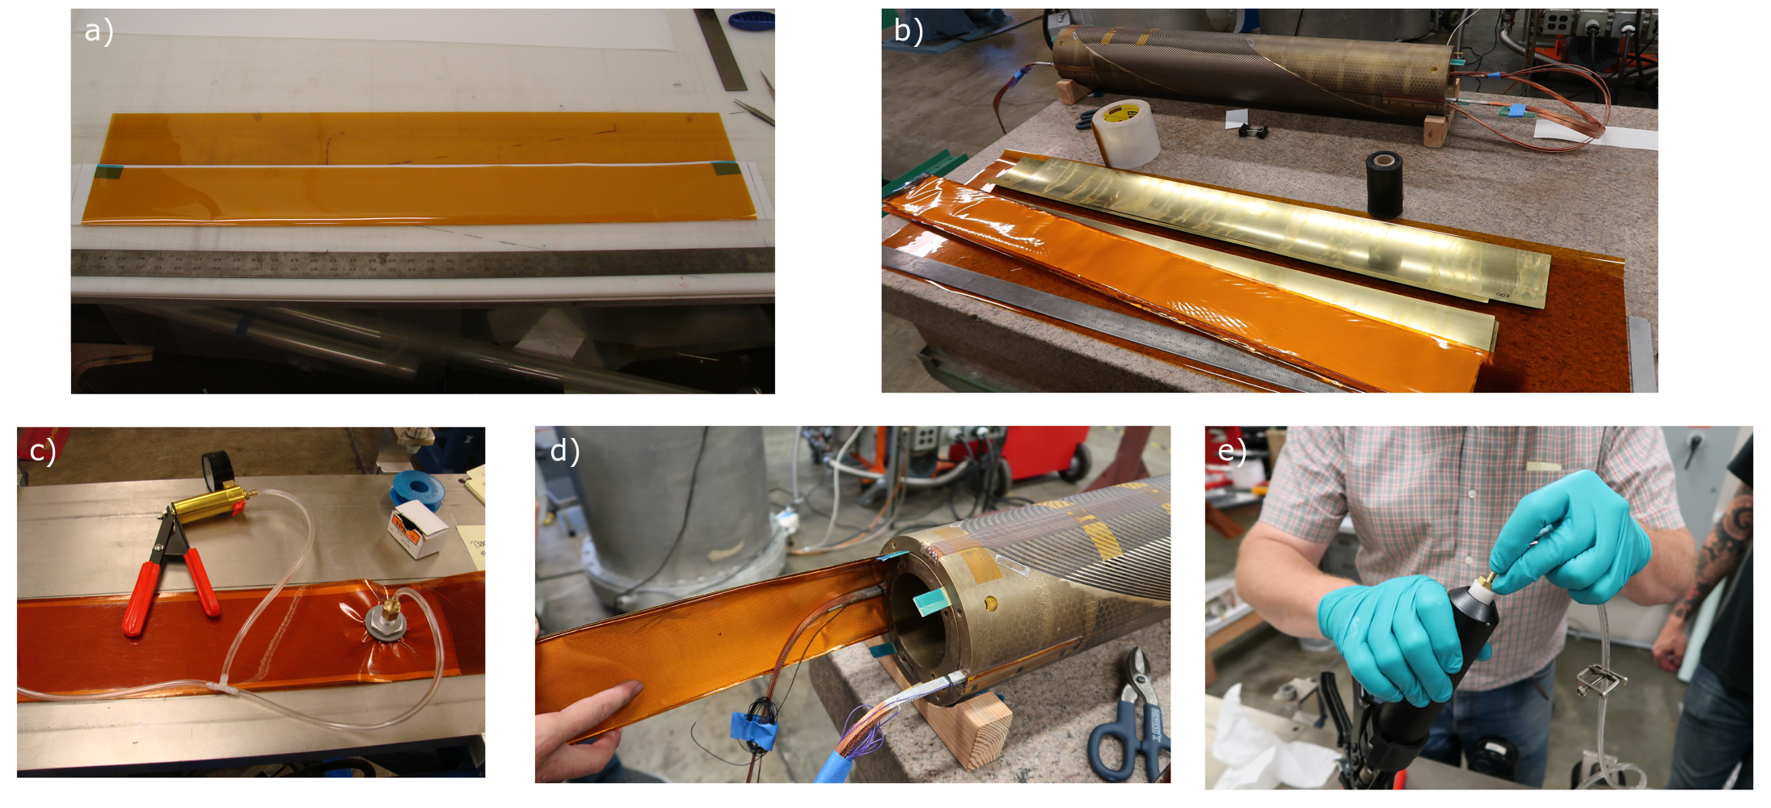
Inflatable shims are created from sealed kapton sheet
18

Slide 19
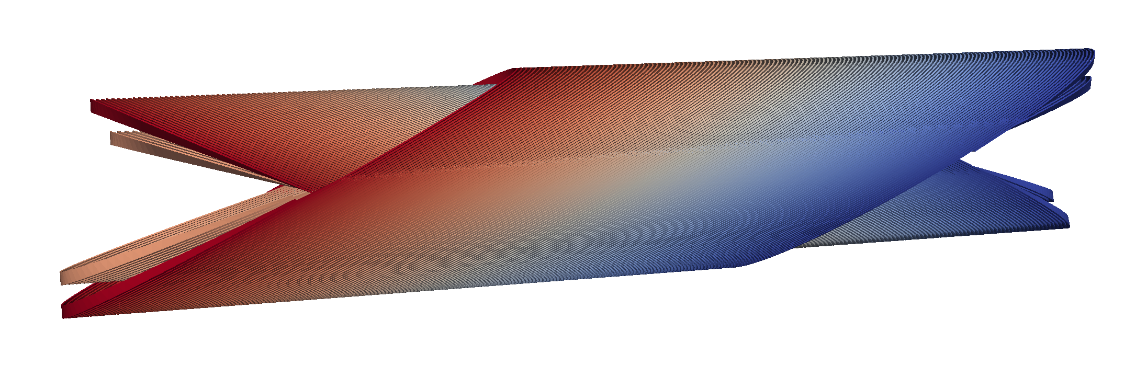
Towards the design of a four layer CCT for insert testing
2 m
125 mm clear bore
200 mm straight section
steps toward first design (in progress – tradeoffs being studied)
choice of strand/cable
choice of spar thickness and external structure
best protection scheme: CLIQ, dump, etc.
19

