Slide 1
Probing current distribution in CORC with Hall arrays
MDP 2019 Collaboration Meeting, Jan. 16 2019
M. Marchevsky, E. Hershkovitz, S. Prestemon (LBNL)
J. Weiss and D. van der Laan (ACT)

Slide 2
Outline
Current sharing and quench detection: two immediate problems to address for use of CORC in HEP and fusion applications
Hall array instrumentation for evaluating current sharing, measuring quench propagation velocity and detecting a quench
Experimental results
Conclusions

Slide 3
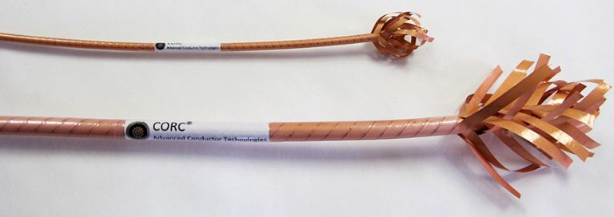
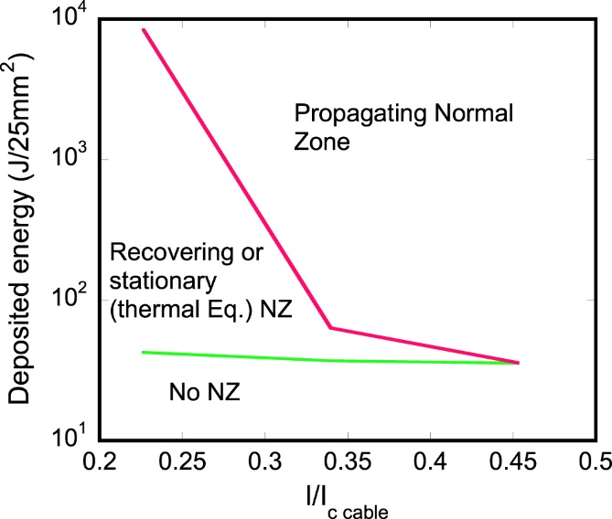
Recent progress and challenges in developing CORC ® conductors for accelerator applications ®
Understanding stability limits and developing adequate quench detection/protection techniques is crucial for accelerator magnet applications of CORC ®
Recovering and stationary normal zones have been experimentally demonstrated. Also significant inhomogeneity in current distribution between tapes was observed starting at I/I_{c}~0.3 (77 K, self-field)
CORC® wires reach record in-field current densities beyond 400 A/mm² at 20 T
The first CORC® Canted Cosine Theta dipole was demonstrated at LBNL (1.1 T at 4.2 K)
Wang et al., A viable dipole magnet concept with REBCO CORC® wires and further development needs for high-field magnet applications, Supercond. Sci. Technol. https://doi.org/10.1088/1361-6668/aaad8f
M. Majoros et al., “Stability and normal zone propagation in
YBCO CORC® cables “, Supercond. Sci. Technol. 29 (2016) 044006, doi:10.1088/0953-2048/29/4/044006

Slide 4
Measuring current sharing and quench propagation with a Hall sensor
Normally, current sharing can be studied by measuring voltage drop across individual tapes in the cable. Alternatively one can measure magnetic field re-distribution.
Single tape case:
B_{x}
B_{x}
Re-distribution of current flow away from its solenoidal path can be detected by appearance of the transverse field component in the vicinity of a normal zone boundary
B_{s}
B_{s}
B_{x}
B_{x}
z
z
Z-axis Hall sensor
Z-axis Hall sensor
As real CORC® conductor has equal number of tapes wound clockwise and counter-clockwise, the solenoidal component is largely compensated. But whenever current distribution between tapes becomes non-uniform (or just some of them quench), the “leaking” transverse field emerges, similar to the single tape scenario.

Slide 5
Hall sensor array design
Commercial GaAs ion-implanted Hall sensors: work well down to cryogenic temperatures (sensitivity actually increases with cooling)
6V dc / ~ 300 mA at 77 K (60 mW per probe)
Sensitivity is ~1.2 mV/mT
A simple 2-layred PCB board designed to integrate sensors in an array
Yokogawa WE700 DAQ with 32 simultaneous 16-bit channels with hardware-selectable range down to 10 mV and speed up to 100 kHz used for data acquisition

Slide 6
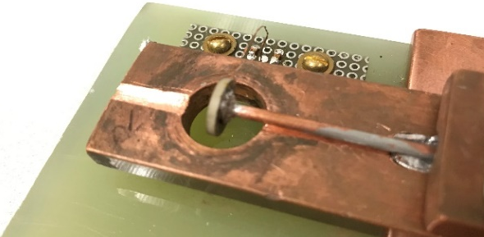
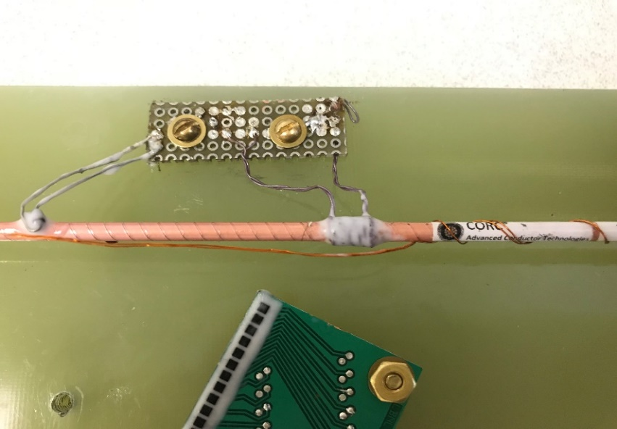
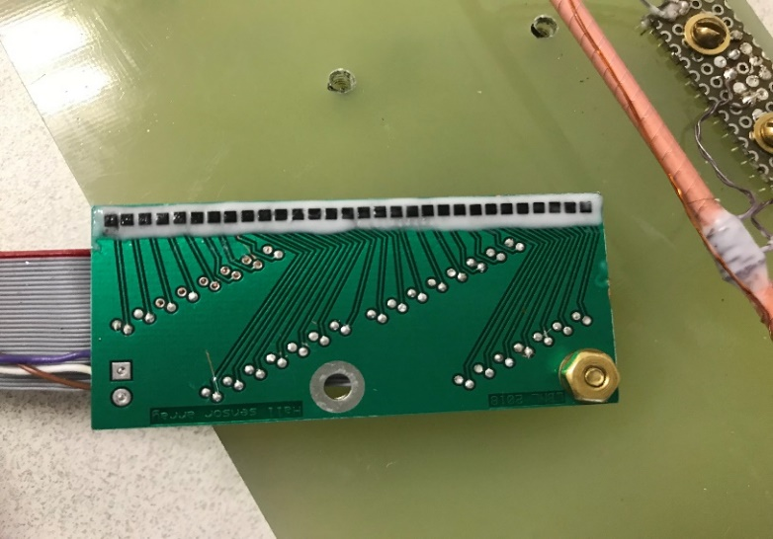
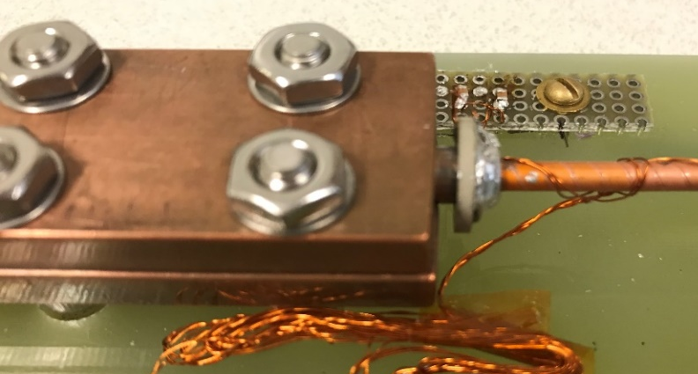
Experimental arrangement
16-tape CORC® wire; 20 cm long section with 15 cm long terminals
Piezo-transducer (small)
Piezo-transducer
(large)
Hall sensor array
Spot heater
Wire-wound heater
Linear period is 1.9 mm

Slide 7
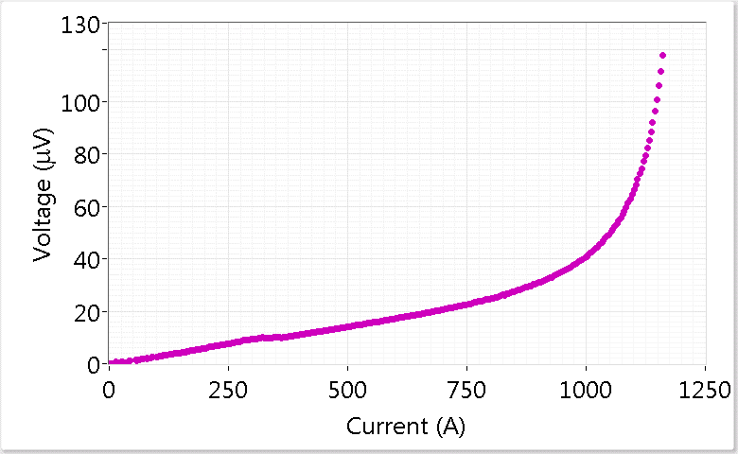
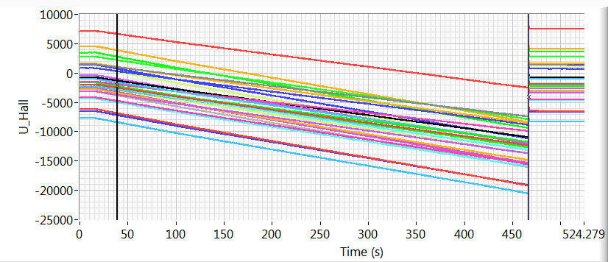
I-V characteristic and raw Hall signals
IV curve
Liquid nitrogen bath conditions
Signals are acquired at 1 kHz; then low-pass filtered at 100 Hz.
(Full scale = 32768 units = 50 mV)
120 μV criterion
Linear current ramp to 1150 A.
As Hall array is not perfectly aligned with respect to the wire, signals corresponding to B_{x} are still present.
Straight line subtraction from each signal
Remove offsets
Post-processing:

Slide 8
Current re-distribution towards the transition
Ramp at 5 A/s to 1115 A
(80 μV criterion)
Ramp at 4 A/s to 1159 A
(120 μV criterion)
#9
#10
Inhomogeneous
current distribution at quench
30
Field “leakage”
30
Sensor #
Sensor #
0
0
Voltage
Current
~450 A
50
Time (s)
312
50
Time (s)
417.6

Slide 9
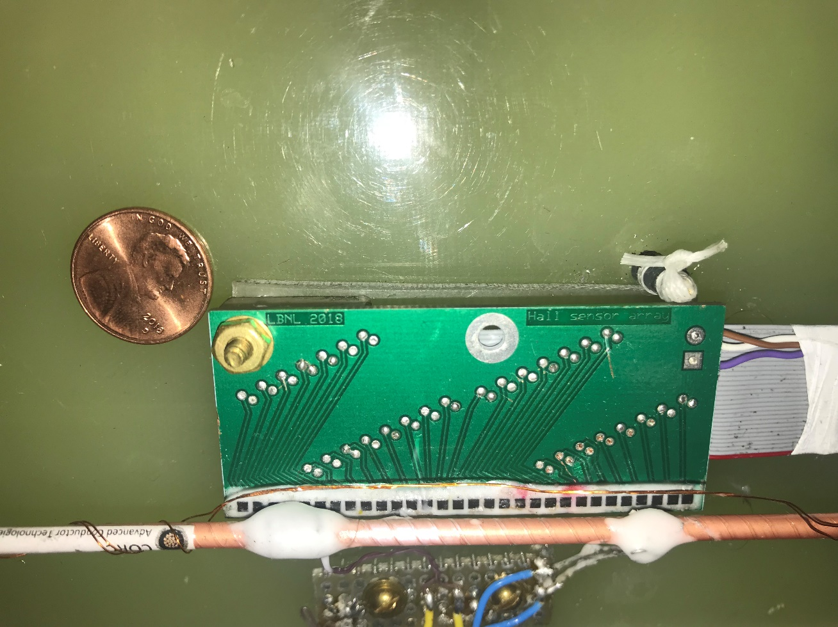
Heater-initiated quench (I)
#13
850 A
Wire heater (~ 4 Ohm, bifilar chromel wire)
is at sensor #4 location
30
6.9 cm/s
0
Sensor #
30
Heater location
Sensor #
0
Heater
voltage
~3.6 s
Voltage
102
Time (s)
113.6

Slide 10
Heater-initiated quench (II)
#9
617 A
#12
585 A
30
30
2 cm/s
1.6 cm/s
Sensor #
Heater location
Sensor #
Heater location
0
0
Heater
voltage
Heater
voltage
~3.4 s
~4 s
Voltage
8
Time (s)
16.5
56
Time (s)
62.4

Slide 11
Heater-initiated quench (III)
#14
400 A
#15
300 A
30
30
0.66 cm/s
∼ 0 cm/s
Non-propagating quench
Sensor #
Sensor #
0
0
Heater
voltage
~6.1 s
Heater
voltage
~10 s
Voltage
Voltage
55
Time (s)
66.5
90
Time (s)
105.1

Slide 12
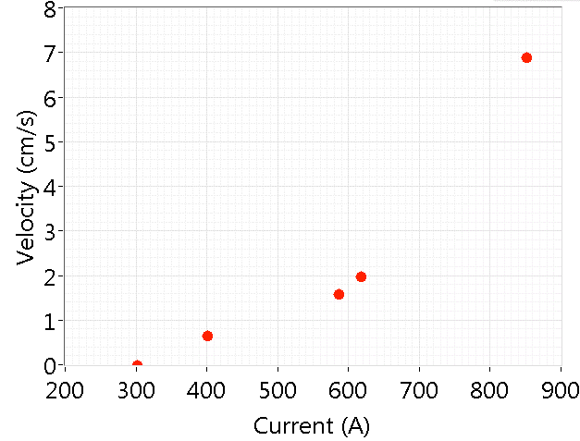
Quench propagation velocity summary
QPV appears to be somewhat higher than in bare HTS tape at similar conditions. Potentially, current sharing and reduced cooling capacity within the CORC® wire play a role here; we will investigate it further.

Slide 13
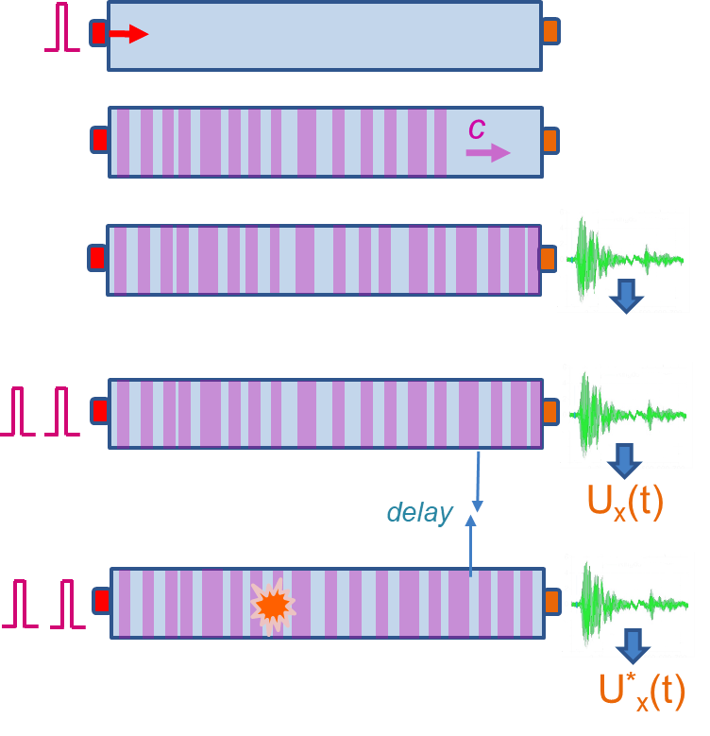
Active acoustic quench detection
Sound velocity: $v=\sqrt{\frac{E}{ρ}}$ , where Young’s modulus E exhibits the strongest temperature dependence: $E\left(T\right)=E_{0}−s/\left[e^{t/T}−1\right]$ (s, t – adjustable parameters).
In metals the relative change $1−E\left(T+ΔT\right)/E(T)$ is roughly $1∗{10}^{−4}K^{−1}$ at 77 K
A body is pulsed by a sender transducer and “ring-down” transient waveform reverberates across the sample multiple times
Transient oscillation is acquired by a receiver transducer; and stored as “reference” U_{Ref} (t). Its shape is uniquely defined by the body geometry, density and elastic modulus E(T)
Transient acquisitions are repeated periodically; every new transient U_{x}(t) is compared to U_{Ref}(t) using cross-correlation; the relative time shift Δt yielding maximal cross-correlation is measured.
When a hot spot develops, E(T) decreases locally, This proportionally increases Δt.
ReBCO tape experiment
ΔT~1.6 K
Δt_{rel}~3.5 ns
ΔU_{max} ~ 7.6 mV (68 μV/cm)

Slide 14
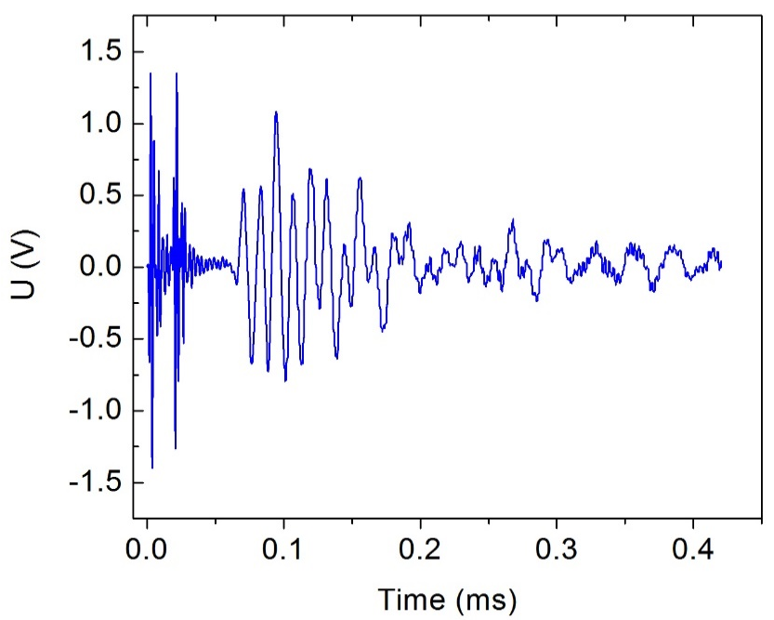
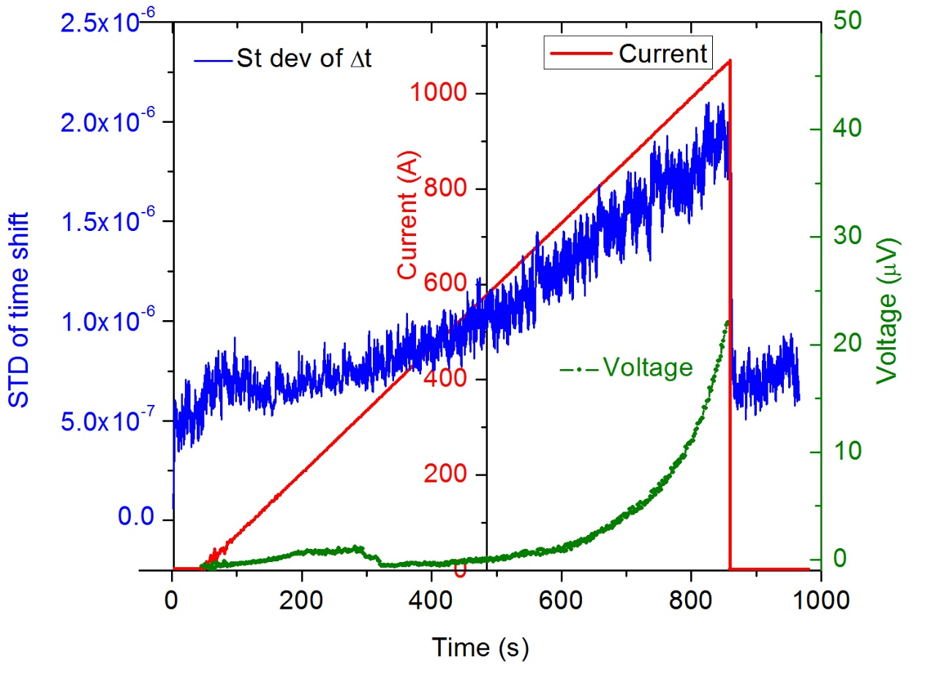
Acoustic detection results
It turned out, that strong fluctuations of time shift are observed when CORC® wire is immersed in liquid nitrogen. This peculiar behavior is likely due to the intrinsic “multipath” configuration for the acoustic wave in CORC. Any minor change of a mechanical interface between neighboring tapes leads to a significant variation of the transient and corresponding fluctuation of measured time shift Δt.
Reference waveform
Nevertheless, if standard deviation of Δt is plotted versus the applied current, a dependence closely resembling the I-V curve is recovered.

Slide 15
Conclusions
We have developed non-invasive magnetic and acoustic instrumentation to probe current sharing and quenching in CORC® conductors
Significant current flow inhomogeneity was detected in CORC® wire at current levels above ~ 0.3 I/I_{c}
Quench propagation velocity was measured as function of applied current at 77K; presence of non-propagating hot spots was confirmed for quenches initiated by an external heat pulse at I< 0.2 I_{c}
Active acoustic technique was proven to sense low-level heat dissipation in CORC® wires, and will be further developed in collaboration with ACT

Slide 16
Future plans
We plan to develop flexible-board Hall arrays to perform de-convolution of current distribution in the CORC
We are thinking of ways of implementing Hall probes in CORC terminals for quench detection purposes
Hall arrays can be useful as a standard addition to LTS magnet instrumentation for measuring various aspects of remnant magnetization, creep, etc…

