Slide 1



Prediction of the J_{C}(B) Behavior of
Bi-2212 Wires at High Field
Authors:
Michael D. Brown, J. Jiang, C. Tarantini, D. Abraimov, G. Bradford, J. Jarozynski,
E.E. Hellstrom, D.C. Larbalestier

Slide 2
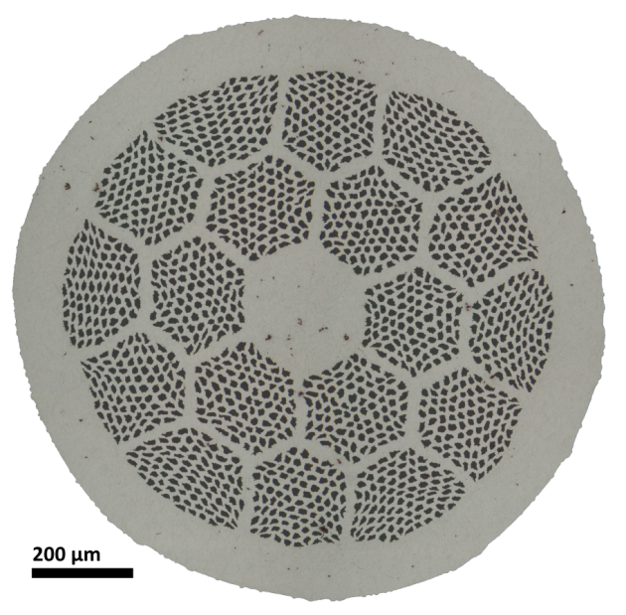
Bi-2212 is important for high field magnet applications
Bi-2212 is the only HTS taking the form of common LTS conductors:
  Round wire
  Multifilament
  Macroscopically isotropic
  Twisted
  Can be Rutherford cabled
…but unlike it’s LTS counterparts
  H_{irr} >> 24 T
  Low magnetization
High field magnet applications:
  General purpose high field research magnets
  Nuclear Magnetic Resonance (NMR)
  Next generation of particle accelerators
Relevant US-MDP Goals:
Investigation of the fundamental limits of superconducting materials for use in future high field HTS accelerators

Slide 3
What is causing such large J_{C} variations over the last decade?
Why?
We’ve had 9 years of development by DOE-HEP
  a variety of wires with a wide range of J_{C}(B)
  We believe J_{C} (B) differences are due to connectivity
Bi-2212 is now ready for applications in the 20 T – 30 T range.
  We need up-to-date info on J_{C}(B) for Bi-2212
How?
Taking J_{C}(B) measurements up to 31 T
  fitting to functional forms
VSM measurements ranging from 4.2 to 20 K.
  To probe vortex pinning differences between wire types
Notes:
…

Slide 4
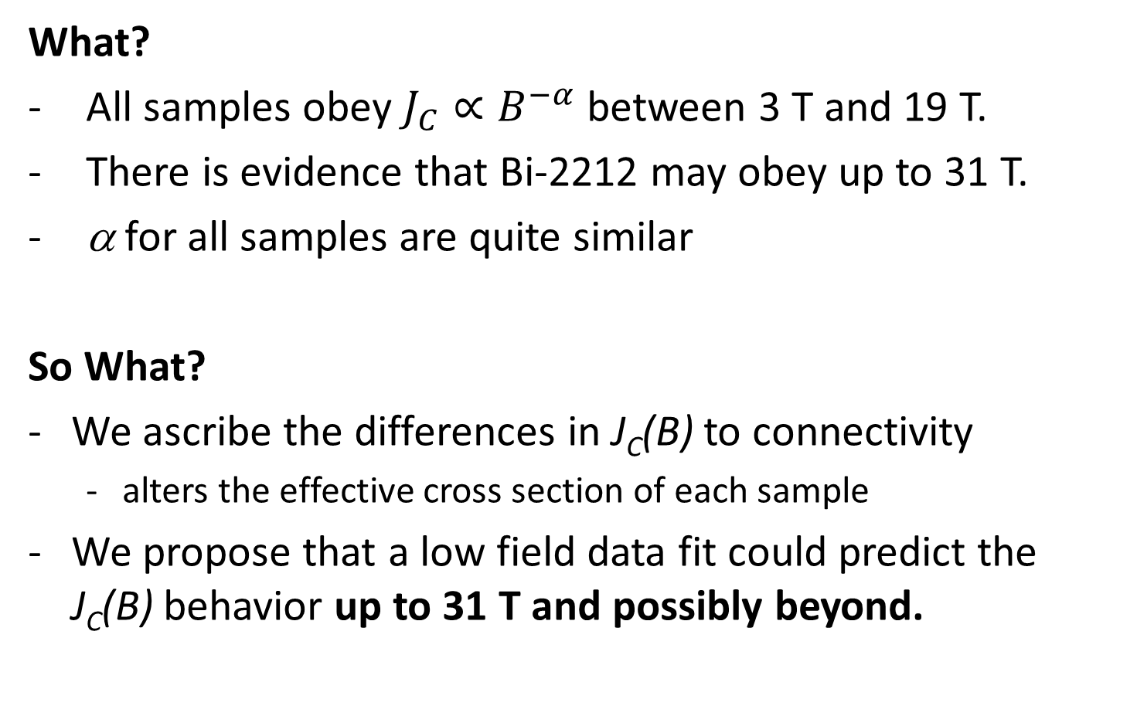
The intrinsic properties of
Bi-2212 remains unchanged.
What?
  All samples obey $J_{C}∝B^{−α}$ between 3 T and 19 T.
  There is evidence that Bi-2212 may obey up to 31 T.
  α for all samples are quite similar
So What?
We ascribe the differences in J_{C}(B) to connectivity
  alters the effective cross section of each sample
We propose that a low field data fit could predict the J_{C}(B) behavior up to 31 T and possibly beyond.
Notes:
First, a bit of motivation for this work.

Slide 5
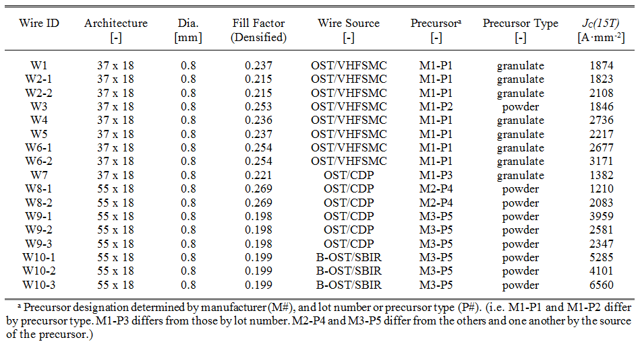
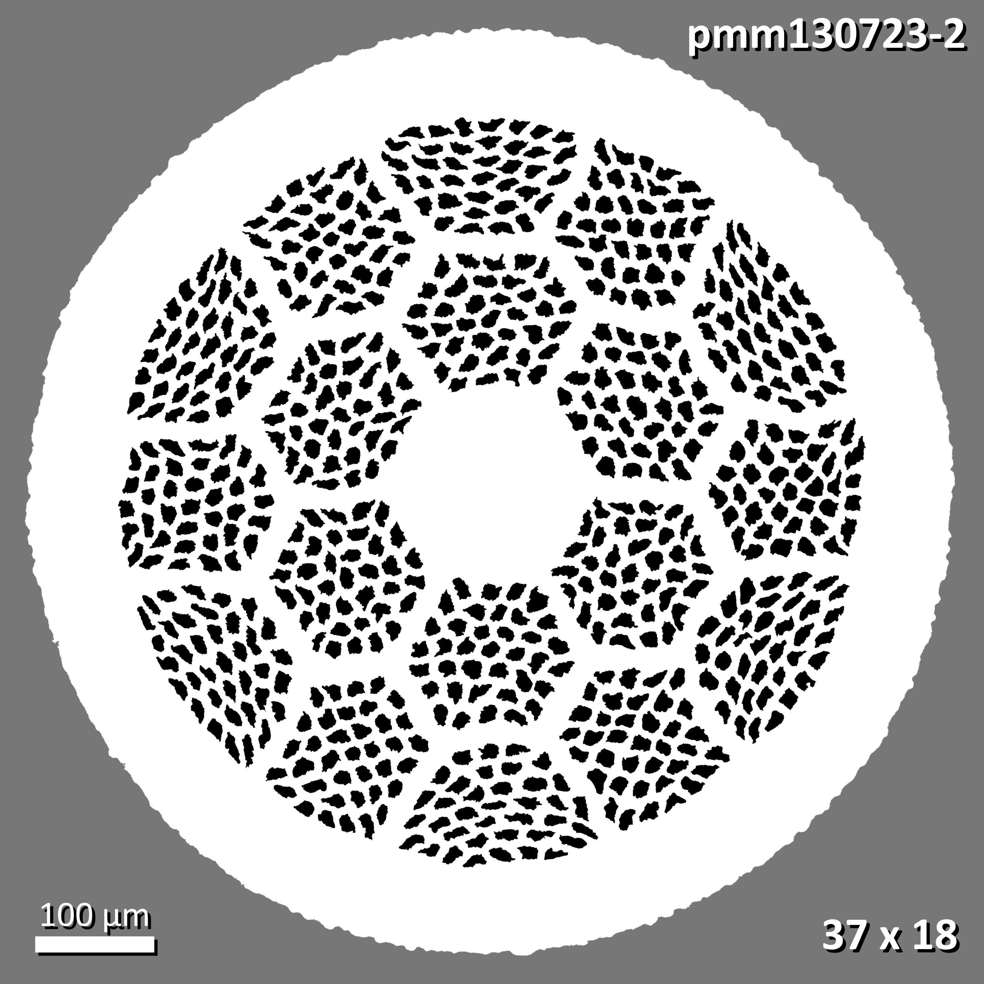
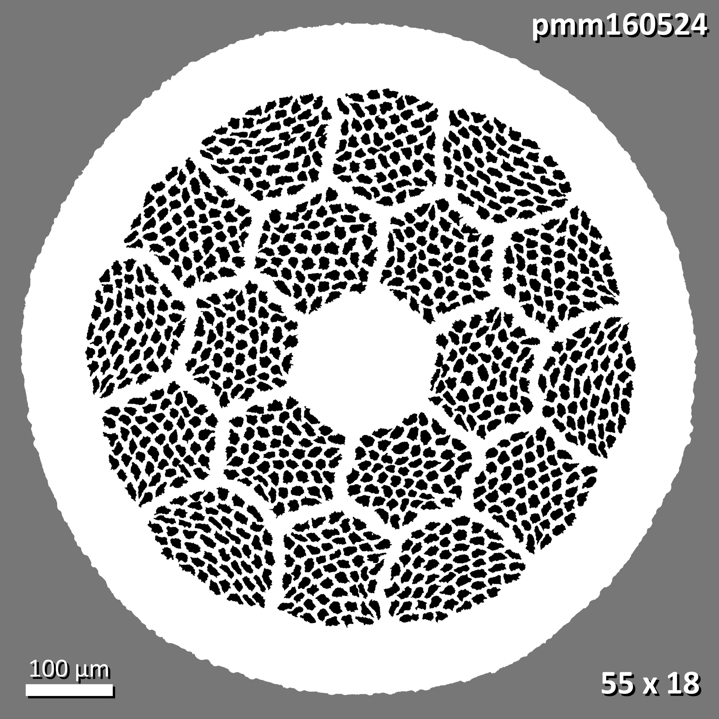
5x variation of J_{C}(15 T) in wires produced over the last decade.
Sample Set
17 samples from OST/B-OST
10 wire types with 2 architectures
5 powder types from 3 manufacturers
Precursor
521 composition
(Bi_{2.17}Sr_{1.94}Ca_{0.90}Cu_{1.98}O_{X})
powder & granulate
Nexans, MetaMateria, and nGimat included
Representative architectures for
37 x 18 and 55 x 18
Large variation in J_{C} (15 T)
(over a factor of 5)!!!

Slide 6
J_{C}(B) behavior same for all up to ~19 T
J_{C}(B) behavior for all
Bi-2212 samples up to
31 T
  Normalized to 15 T
Power law fit from 3 T to 15 T shown for W-8
  Follows sample behavior
  up to J_{C}(31 T)
Downward scatter seen above 19 T
  Heating artifact due to the slight diamagnetism of He
    [1] E. J. McNiff et. al. (1988)
    [2] H. W. Weijers et. al. (2010)
  Occurs when:
  B_{Z} ∙ dB/dz < -21 T²/cm
Normalized (@15 T) Critical Current vs. Field
heating reduces I_{C}
y = 2.11x^{-0.277}
W8-2 fit
3 T to 15 T
no bubble
bubble
Notes:
Add heating

Slide 7
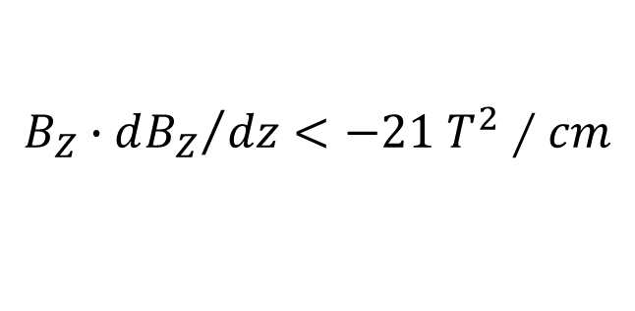
He bubble can cause sample heating and reduces critical current
31 T resistive magnet
50 mm bore
240 mm height
Helium is expelled from the region where
causing gaseous He to grow into the sample space.
$$B_{Z}∙{dB_{Z}}/{dz}<−21 T^{2}∕cm$$
[3] H. Bai, et. al. (2015)
H. Bai et. al. show that the bubble can encroach down to z = ~ -30

Slide 8
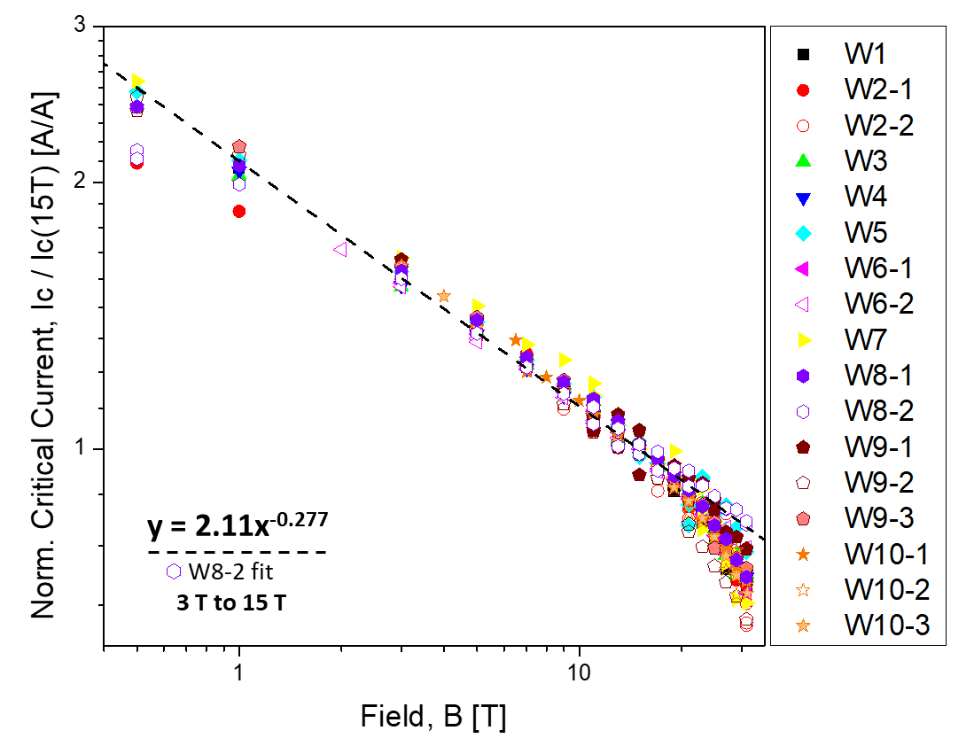
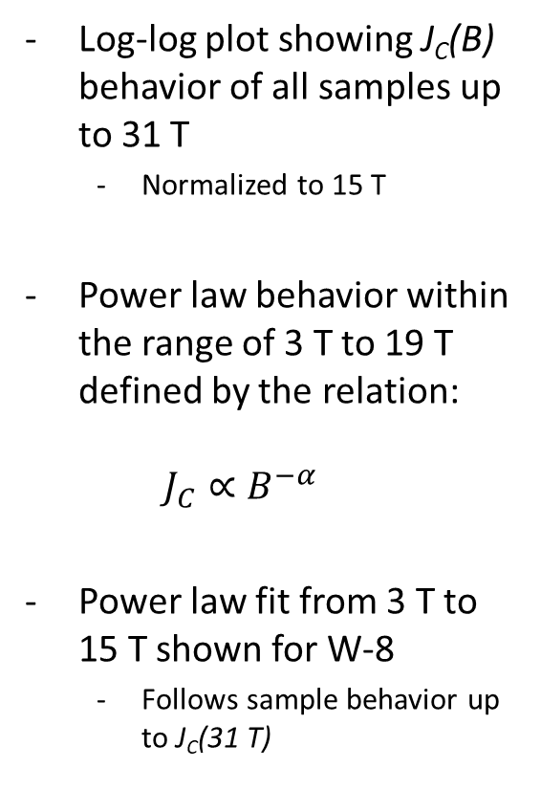
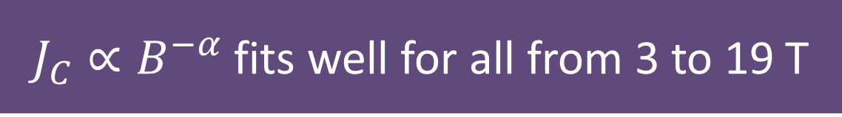
$J_{C}∝B^{−α}$ fits well for all from 3 to 19 T
Log-log plot showing J_{C}(B) behavior of all samples up to 31 T
  Normalized to 15 T
Power law behavior within the range of 3 T to 19 T defined by the relation:
$J_{C}∝B^{−α}$
Power law fit from 3 T to 15 T shown for W-8
  Follows sample behavior up to J_{C}(31 T)
Normalized (@15 T) Critical Current vs. Field
3 T to 19 T

Slide 9
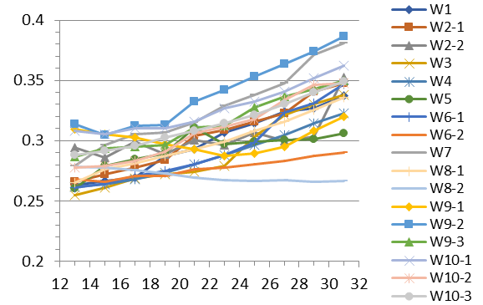

For $J_{C}∝B^{−α}$, α values are quite similar
α values were found for ranges 3 T to 15 T, 17 T,… 31 T
  approaching the helium bubble region and beyond
The average value for α in the 3 T to 15 T range is 0.282
  α varies by 0.044
α
no bubble
bubble
Field Fit Range Upper Limit [T]
For comparison, YBCO sees large variation in its pinning behavior due to dopant, heat treatment, manufacturer, conductor anisotropy…
  α in YBCO: ~0.5 to ~0.9 (range of ~0.4) ^{[4][5]}
The ranges for 2212 and YBCO differ by an order of magnitude.

Slide 10
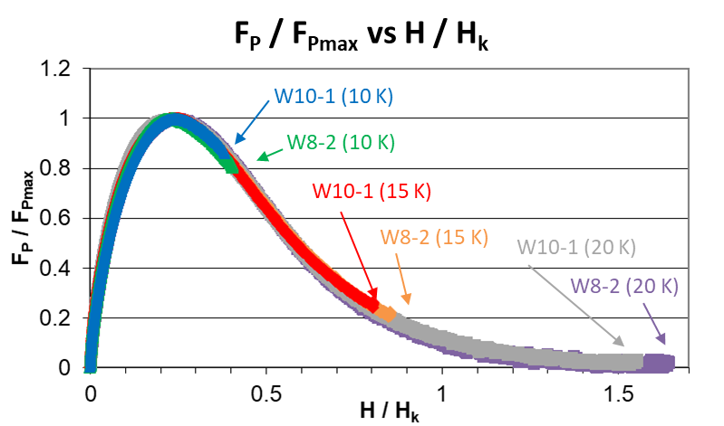
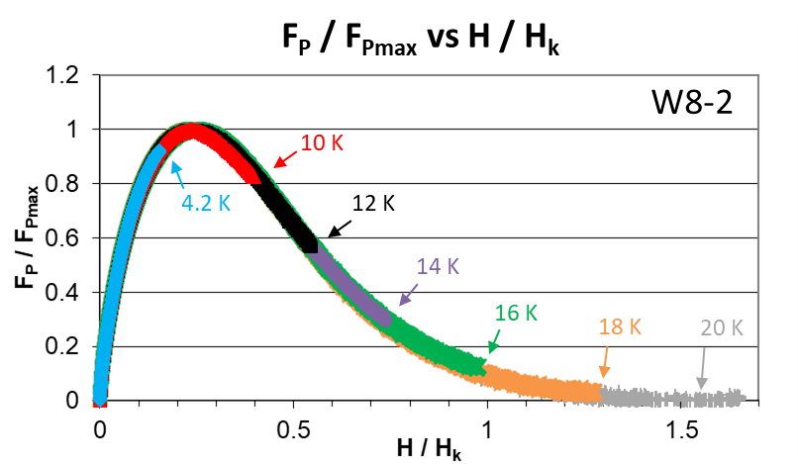
Magnetization: pinning does not vary with powder or temperature
Magnetization from -2 T to 14 T
Comparison of two of the newer powder wires was made at 10, 15, and 20 K
  W8-2 (MetaMateria, M2-P4)
  W10-3 (nGimat, M3-P5)
Pinning force curves were produced on the wire containing MetaMateria powder at 4.2, 10, 12, 14, 16, 18 and 20 K.
We do not see a significant variation in vortex pinning…
  between two newest powders
  between temps from 4.2 to 20 K
Transport up to 15 T from 4.2 to 40 K to come at LTSW (A. Francis)

Slide 11
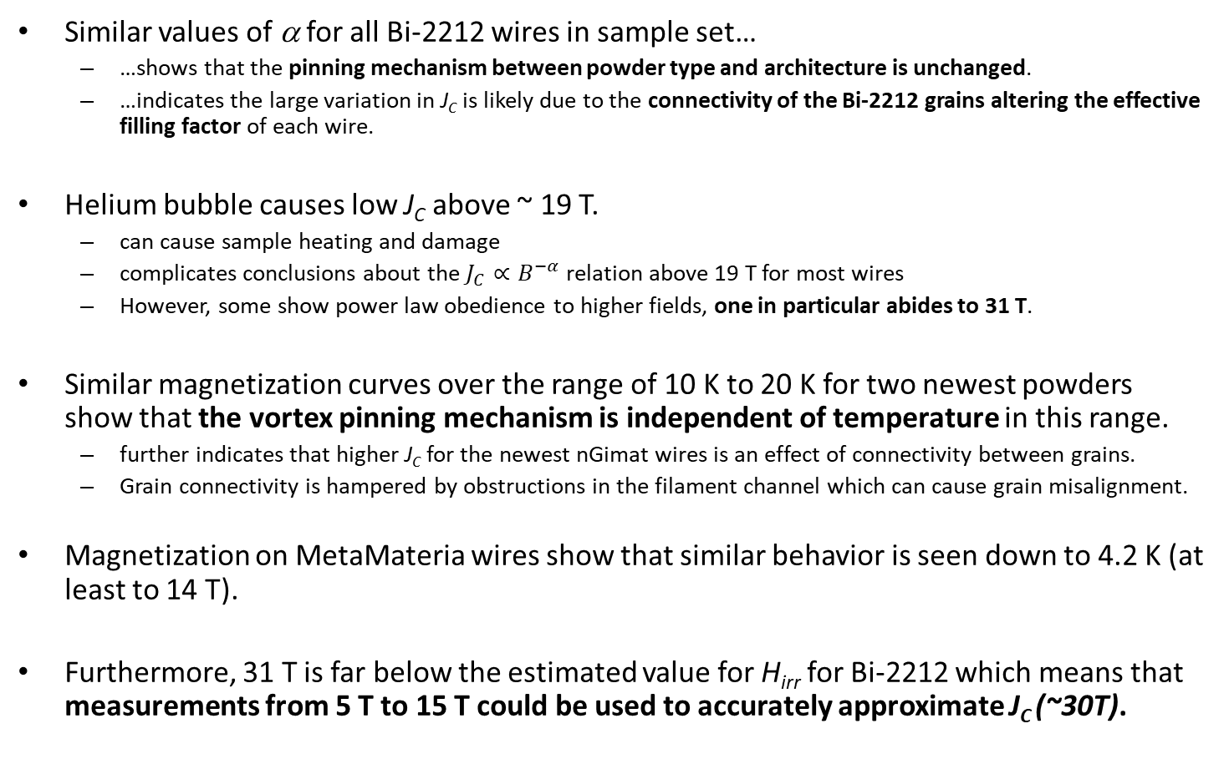
Discussion and Conclusions
Similar values of α for all Bi-2212 wires in sample set…
  …shows that the pinning mechanism between powder type and architecture is unchanged.
  …indicates the large variation in J_{C} is likely due to the connectivity of the Bi-2212 grains altering the effective filling factor of each wire.
Helium bubble causes low J_{C} above ~ 19 T.
  can cause sample heating and damage
  complicates conclusions about the $J_{C}∝B^{−α}$ relation above 19 T for most wires
  However, some show power law obedience to higher fields, one in particular abides to 31 T.
Similar magnetization curves over the range of 10 K to 20 K for two newest powders show that the vortex pinning mechanism is independent of temperature in this range.
  further indicates that higher J_{C} for the newest nGimat wires is an effect of connectivity between grains.
  Grain connectivity is hampered by obstructions in the filament channel which can cause grain misalignment.
Magnetization on MetaMateria wires show that similar behavior is seen down to 4.2 K (at least to 14 T).
Furthermore, 31 T is far below the estimated value for H_{irr} for Bi-2212 which means that measurements from 5 T to 15 T could be used to accurately approximate J_{C} (~30T).

Slide 12
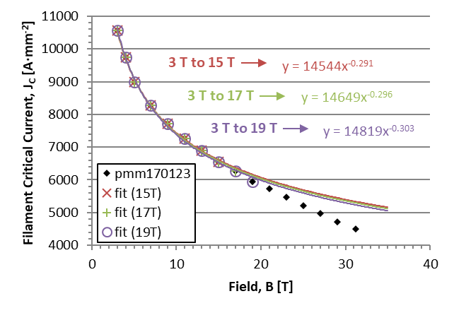
Extrapolation for newest nGimat wires
J_{C} (30 T) for 3T to 15T
  = 5406 A∙mm⁻²
J_{C} (30 T) for 3T to 17T
  = 5353 A∙mm⁻²
J_{C} (30 T) for 3T to 19T
  = 5288 A∙mm⁻²
J_{C} (30 T) > 5200 A∙mm⁻²

Slide 13
References
[1] E. J. McNiff, B. L. Brandt, S. Foner, L. G. Rubin, and R. J. Weggel, “Temperature anomalies observed in liquid ⁴He columns in magnetic fields with field–field‐gradient products >21 T²/cm,” Review of Scientific Instruments, vol. 59, no. 11, pp. 2474–2476, Nov. 1988.
[2] H. W. Weijers et al., “High Field Magnets With HTS Conductors,” IEEE Transactions on Applied Superconductivity, vol. 20, no. 3, pp. 576–582, Jun. 2010.
[3] H. Bai et al., “Impact of Trapped Helium Gas Bubble in Liquid Helium on the Cooling in High Magnetic Field,” IEEE Transactions on Applied Superconductivity, vol. 25, no. 3, pp. 1–4, Jun. 2015.
[4] V. Braccini et al., “Properties of recent IBAD–MOCVD coated conductors relevant to their high field, low temperature magnet use,” Supercond. Sci. Technol., vol. 24, no. 3, p. 035001, 2011.
[5] D. Abraimov et. al., ASC 2014 slides

Slide 14



Acknowledgements
This work was supported by a grant from the US Department of Energy, Office of High Energy Physics (DE-SC0010421), from the NHMFL, which is supported by the NSF under NSF/DMR-1644779, and by the State of Florida.
Technical support from Y. Oz & V. Griffin

Slide 15
Extra slides

Slide 16
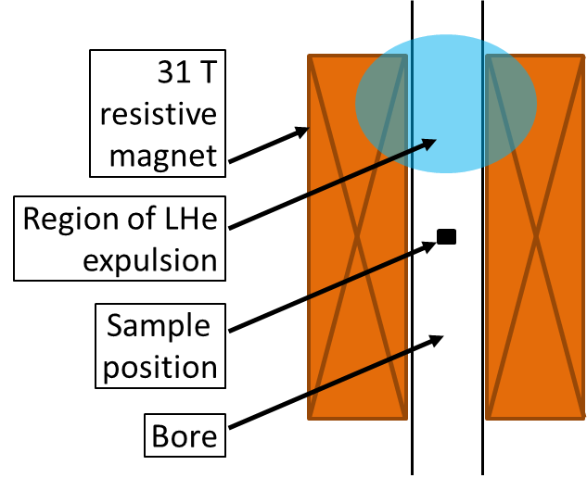

He bubble effect
$B_{Z}∙{dB_{Z}}/{dz}<−21 T^{2}∕cm$
31 T
resistive
magnet
Region of LHe
expulsion
Sample
position
Bore

