Slide 1

Connectivity of Bi-2212 and Ba-122 FBS, and route to increasing J_{c}
Fumitake Kametani,
A. Oloye, Y. Oz, M. Matras, J. Jiang, E. Hellstrom, D. Larbalestier
Applied Superconductivity Center,
National High Magnetic Field Laboratory,
And Mechanical Engineering, College of Engineering,
Florida State University

Slide 2
Connectivity issues in Bi-2212

Slide 3
J_{c} of Bi-2212 round wires is getting higher and higher in recent years
By. J. Jiang
Record J_{c} of ~7,000 A/mm² at 15 T was achieved by using the new nGimat powder

Slide 4
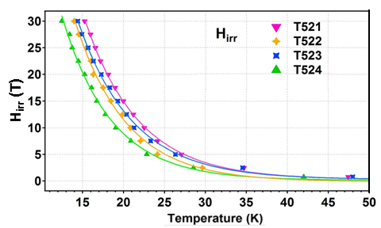
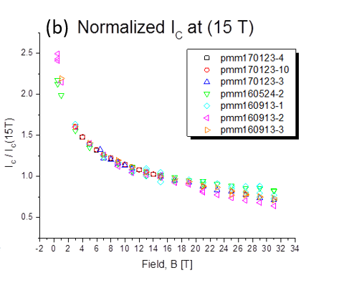
High J_{c} is not driven by intragrain flux pinning
H_{irr} defined by flux pinning depends on the powder composition
The nGimat powder (MetaMateria powder as well) uses the same composition of 521 like Nexans
Flux pinning in the wires is almost the same regardless to J_{c}
M. Brown
See the later talk by M. Brown

Slide 5
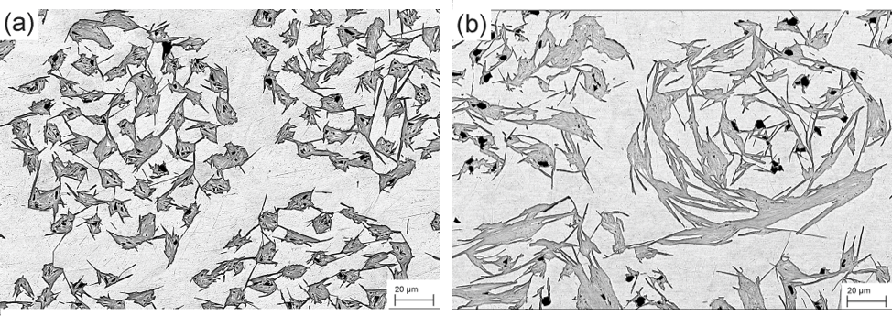
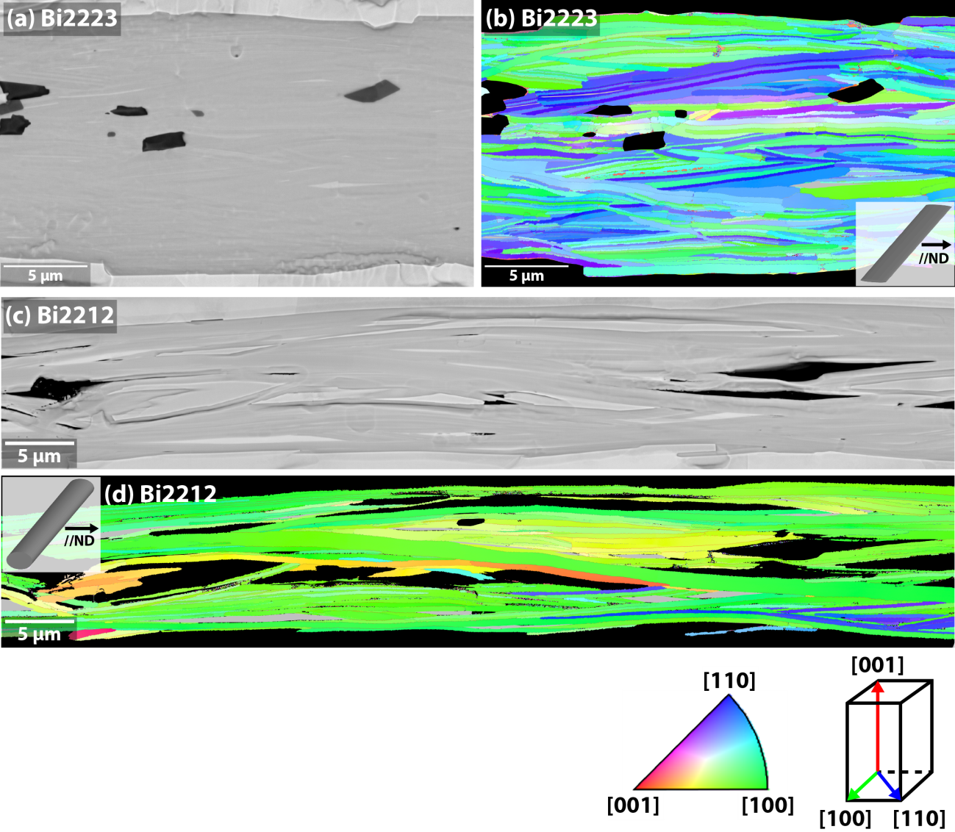
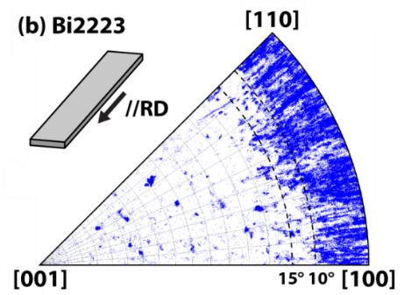
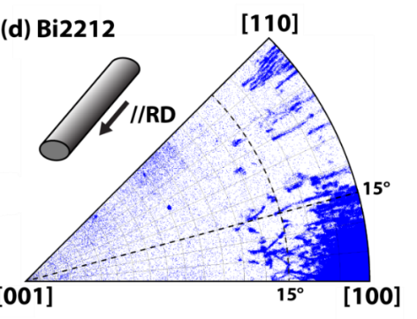
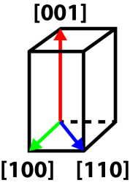
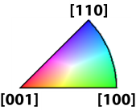
High J_{c} is driven by good intergrain connectivity
The key microstructure is the quasi-biaxial texture of Bi-2212 grains

Slide 6
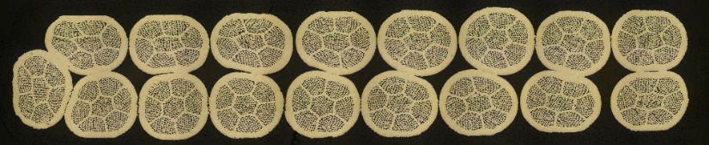
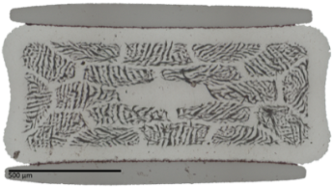
Cabling, tight winding and/or different HT for large masses can change the filament structure
T_{max} = 885.5 °C and J_{E}(4.2K,5T) = 1900A/mm²
T_{max} = 894 °C and J_{E}(4.2K,5T) = 936 A/mm²

Slide 7
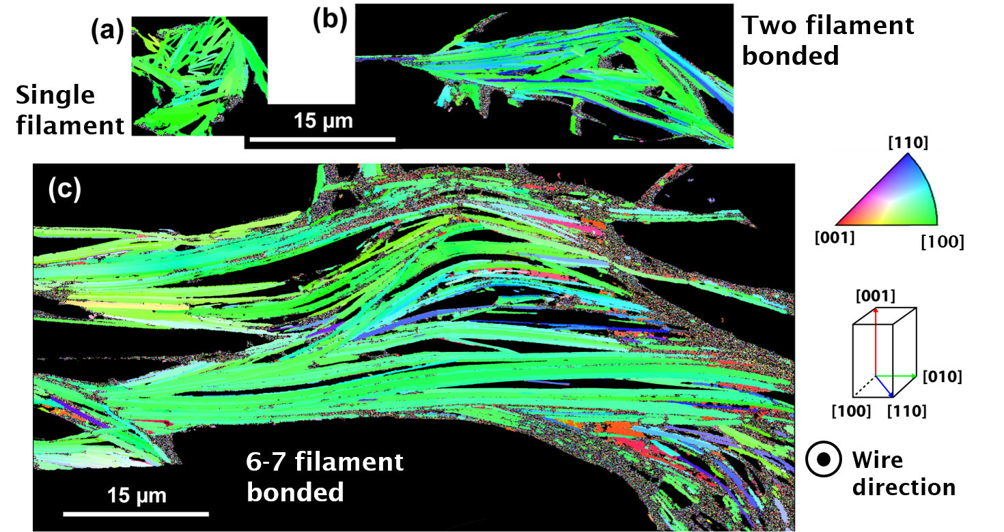
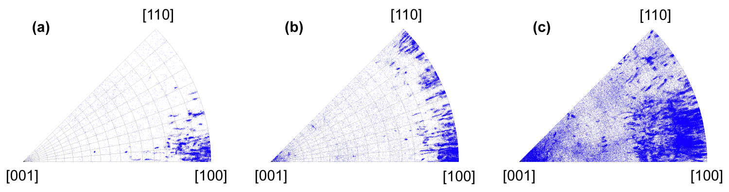
Too much filament bonding can negatively impact the grain texture

Slide 8
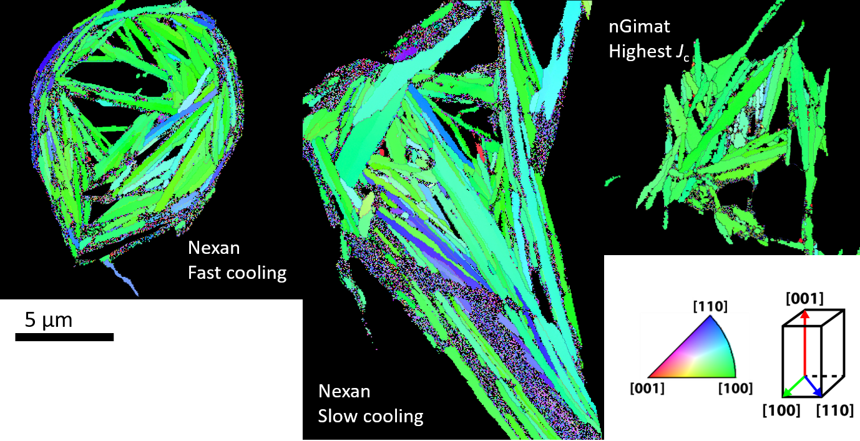
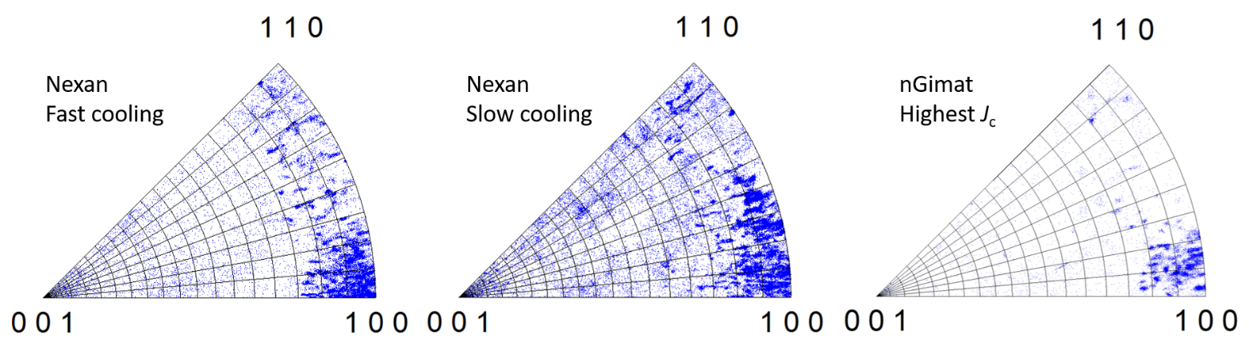
Different powders and HT parameters change the grain texture too

Slide 9
Challenge and opportunity of Bi-2212 conductors for larger scales
If large coil HT must be different, why does this cause J_{c} to be lower than our best present? Could we fix them?
  T_{max}, t_{melt}, and cooling rate affect the high J_{c} grain texture
  Plastic deformation during cabling and winding changes the filament spacing that can cause more filament bonding
  We may need to re-optimize the filament spacing so as to maintain the discrete filament structure
How good should the biaxial texture should be? How can it be reproducible and predictable?

Slide 10
Connectivity issues in Ba-122 FBS

Slide 11
Opportunity and potential of Ba-122 FBS
Material | Raw material cost per liter | P factor | Conductor cost per liter | T_{c} | H_{c2} (4.2 K) | Intragrain J_{c} (20 T, 4.2 K) | Intergrain J_{c} (20 T, 4.2 K) | Conductor J_{E} (20 T, 4.2 K)
Nb-Ti | $600-700 | 3 | ~$2,000 | 9.2 | 11 T | n/a | 0 A/mm² | 0 A/mm²
Nb₃Sn* | $2,000-2,500 | 6~7 | ~$15,000 | 18 | 26 T | n/a | ~400 A/mm² | ~280 A/mm²
Bi-2212* | ~$10,000 | ~10 | ~$100,000 | 85 | ~100 T | n/a | ~6,000 A/mm² | ~1,200 A/mm²
REBCO* | n/a | >10-20 | ~$100,000 | 92 | >120 T | ~20,000 A/mm² | ~20,000 A/mm² | ~420 A/mm²
Co-122 | < $400 ^{i)} | ~10 ^{ii)} | < $4,000 | 22 | ~70 T | ~4,000 A/mm² | ~2 A/mm² | n/a
K-122 | < $400 ^{i)} | ~10 ^{ii)} | < $4,000 | 39 | ~90 T | ~6,000 A/mm² | ~100-1000 A/mm² | n/a
L. Cooley, Cost analysis
Production factor (P factor) = (Final product cost)/(Raw materials cost)
* Properties of production grade conductors
^{i)} Raw material cost estimated by the purchase price as lab supplies
^{ii)} Assumes the P factor of Bi-2212 RWs
The cost of Fe-based superconductor (Ba/Sr)Fe₂As₂ (122) can be at least 70-80% lower than Nb₃Sn
122 FBS appears a good alternative HTS if intergrain J_{c} is high enough

Slide 12
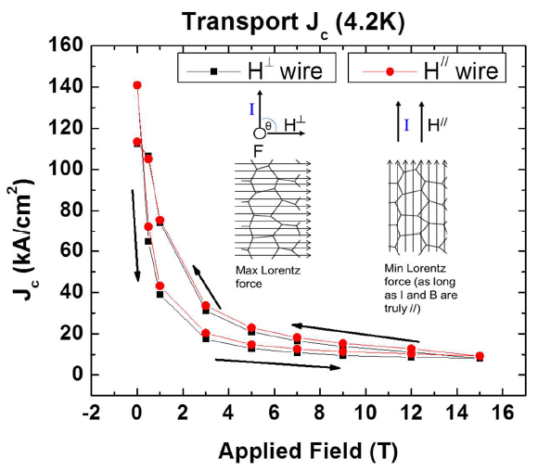
Strongly and weakly coupled GBs coexist in K-Ba122 bulks
Time dependence of trapped field at 5 K
J. Weiss et al., SUST, doi:10.1088/0953-2048/28/11/112001
J. Weiss, FSU, PhD Thesis
The trapped magnetic field does decay very slowly
  Indicates that the GBs in high J_{c} K-122 are strongly coupled
But J_{c} with increasing/decreasing magnetic field shows the hysteresis behavior
  Indicates that the GBs in high J_{c} K-122 are still weakly linked

Slide 13
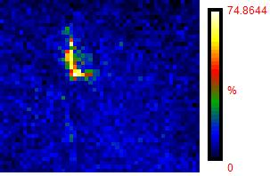
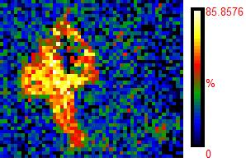
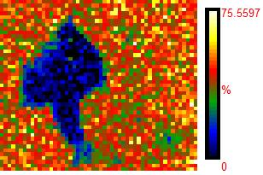
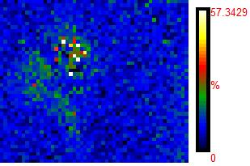
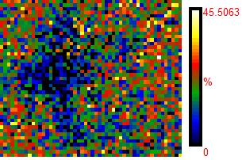
Oxygen contamination exists at almost all GB junctions
K Rel. comp.
O Rel. comp.
Fe Rel. comp.
Ba Rel. comp.
As Rel. comp.
Oxygen contamination always accompanies with Ba segregation
Local composition at the GBs is not Ba-122

Slide 14
Can reduction of oxygen level improve the connectivity?
O₂: 100 ppm -> 0.005 ppm, H₂O: 10 ppm -> 0.05 ppm
Now we can see the effects of milling time, HT temperature and time on the GB cleanliness
Raw materials (K, Ba, Fe, As)
High energy ball milling (1 h)
HT: 550-600 °C under 9.6 MPa for 20 hrs
Packed and densified
Packed and densified
2nd high energy ball milling (1-50 hrs)
2nd HT: 550-600 °C under 193 MPa (0.5-10 hrs)

Slide 15
No trace of oxygen any more, but still significant K segregation at the GBs
Oxygen is below the detectable level – We could successfully reduce the oxygen and water in the system
Sharp increase of K on the dark contrasts of GBs
Clean synthesis reveals the new chemistry issues at the GBs

Slide 16
The thicker the segregation band at the GBs, the larger kink on the transport resistance curves
(Ba_{0.6}K_{0.4})Fe₂As₂
50 h 2nd milling, 0.5 h 600 °C HT
(Ba_{0.6}K_{0.4})Fe₂As₂
1 h 2nd milling, 10 h 550 °C HT
The broad tails of RT curves are caused by the weakly connected GBs
The thicker K segregation more strongly compromises the GB connectivity

Slide 17
Summary
J_{c} of both Bi-2212 and Ba-122 FBS is driven by intergrain connectivity controlled by the grain boundaries
  We need full controls of nanostructure at the grain boundaries
Jc of Bi-2212 RW short samples is very high now with the good quasi-biaxial grain texture
  Next challenge is to develop the methodology to predict and reproduce the high J_{c} biaxial texture in large cables and coils
  Maintaining the filament structure by optimizing the s/d ratio and HT parameters may be the key
Grain boundary blocking effects must be resolved to make Ba122 FBS as a practical conductor
  Now with the new glove box, we almost eliminate the oxygen and water contamination in the material
  The new chemistry issue at the GBs is the local chemical variation of K
  We are now re-optimizing the milling and HT parameters for the cleaner Ba-122

Slide 18
Non-stoichiometry ‘trace’ depends on the milling and HT
(Ba_{0.6}K_{0.4})Fe₂As₂
50 h 2nd milling, 0.5 h 600 °C HT
(Ba_{0.6}K_{0.4})Fe₂As₂
1 h 2nd milling, 10 h 550 °C HT
Fe-As
Fe-As
K-Ba122
K-Ba122
Longer milling and shorter HT time resulted in thick dark contrasts at the GBs
Shorter milling and longer HT time reduced the thickness of non-stoichiometry ‘band’ at the GBs

Slide 19
Magnetization J_{c} doesn’t show the highly compromised GBs
50 h 2nd milling, 0.5 h 600 °C HT
1 h 2nd milling, 10 h 550 °C HT
50 h 2nd milling, 0.5 h 600 °C HT
1 h 2nd milling, 10 h 550 °C HT
The intragrain H_{c2} more dominantly determine the magnetization J_{c}
The extrinsic current blocking factor is still dominant but may not be easily recognized

