Slide 1

Comparison of Different Hamamatsu MPPC Parts
PHOTOSENSOR WG MEETING
Kurt Francis
10/23/2018

Slide 2
Hole Wire Bond MPPCs
Most of the Hamamatsu MPPCs we have used are of the same silicon design (S13360) :
  Vbr > 50V
  But Standard wire bond MPPC don’t pack together well (dead space where bonds are)
  Quartz window (cryomppc’s) have packaging that has even more dead space
  Through silicon via (TSV) MPPCs pack together well but are expensive to produce
Hole Wire Bond MPPCs (S14160) have same packing characteristics as TSV but use a wirebond through a hole in the middle in place of TSV
  Cheaper to produce than TSV parts
  Also, different silicon structure with lower Vbr ~ 37V
  Higher capacitance
  Higher gain
  Less temperature dependence

Slide 3
Some Specifications from Data Sheets
6 mm x 6mm Hamamatsu MPPCs |  |  |  |  |  |  |  | terminal
 |  |  |  | dark count |  |  | dark | capacitance
type | pixels | PDE (%) | gain | typical | max |  | current | pF | Vbr | deltaTvop
S13360 | 14336 | 40 | 1.70E+06 | 2 Mcps | 6 Mcps |  |  | 1300 | 53+/-5V | 54mV/C
S14160 | 14331 | 50 | 2.50E+06 |  |  |  | 2.5uA | 2000 | 37 V | 34mV/C

Slide 4
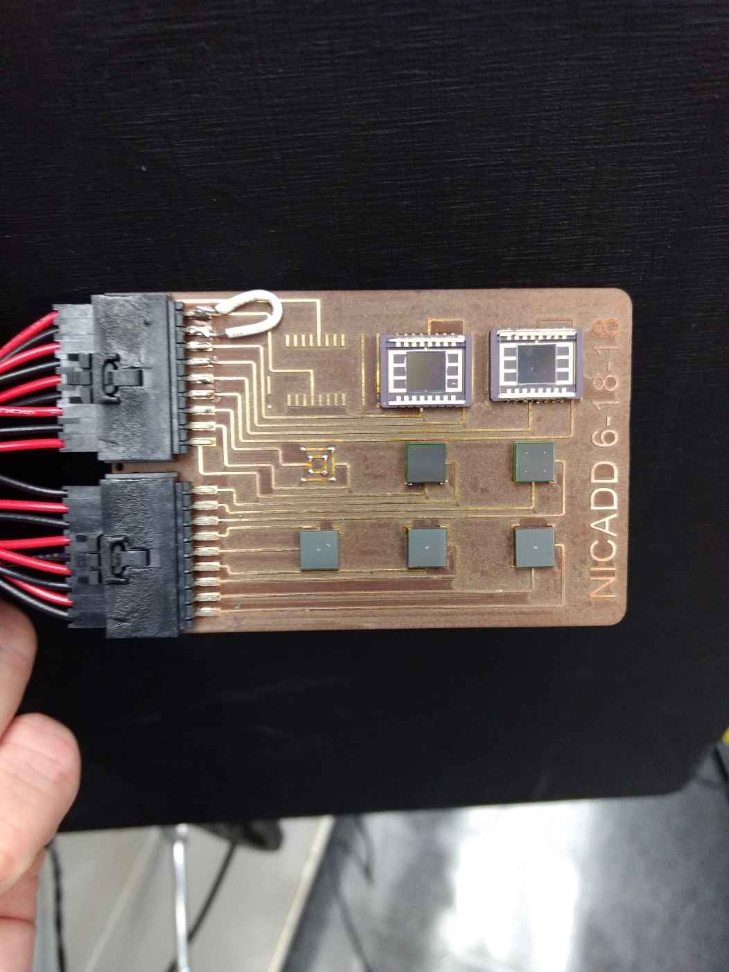
To Study differences we created a circuit board with at least two of each type
Allows data to be taken at the same time and under the same conditions for a better comparison
Connects to SSP through LEMO-2 and Gor cables
Also connects to Keithley 6485 pico-ammeter (for IV studies)

Slide 5
Properties we Studied
Current-Voltage Characteristics with Keithley picoAmmeter
  Current vs Voltage response (IV curves)
  Breakdown Voltage (Vb) warm and cold from IV and gain
  Quenching resistance warm and cold by studying the forward bias response
Pulse Measurements with SSP
  Pulse height/amplitude and integral of pulse in sample window
  Pulse shape
  Dark Count Rate
  Afterpulsing
  Crosstalk

Slide 6
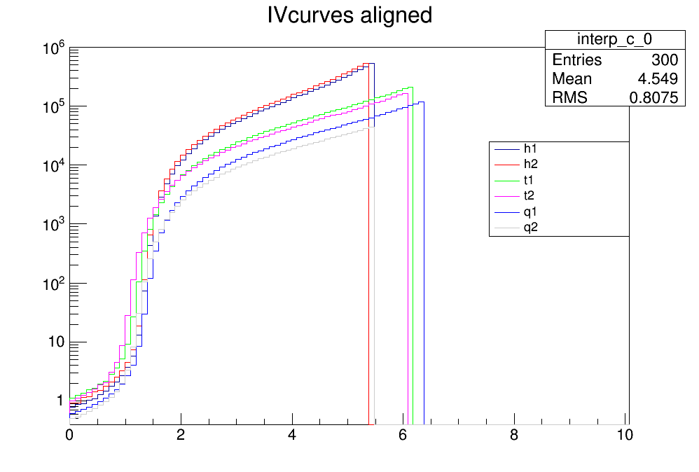
IV CURVES
Vbreak down
 | warm IV | cold gain | cold IV | delta
h1 | 38.3 | 31.3 | 31.6 | 6.7
h2 | 38.2 | 31.4 | 31.5 | 6.7
t1 | 51.9 | 42 | 42.1 | 9.8
t2 | 51.9 | 42.1 | 42.1 | 9.8
q1 | 51.9 | 41.9 | 42.1 | 9.8
q2 | 52.8 | 42.8 | 42.8 | 10
Vover + 1

Slide 7
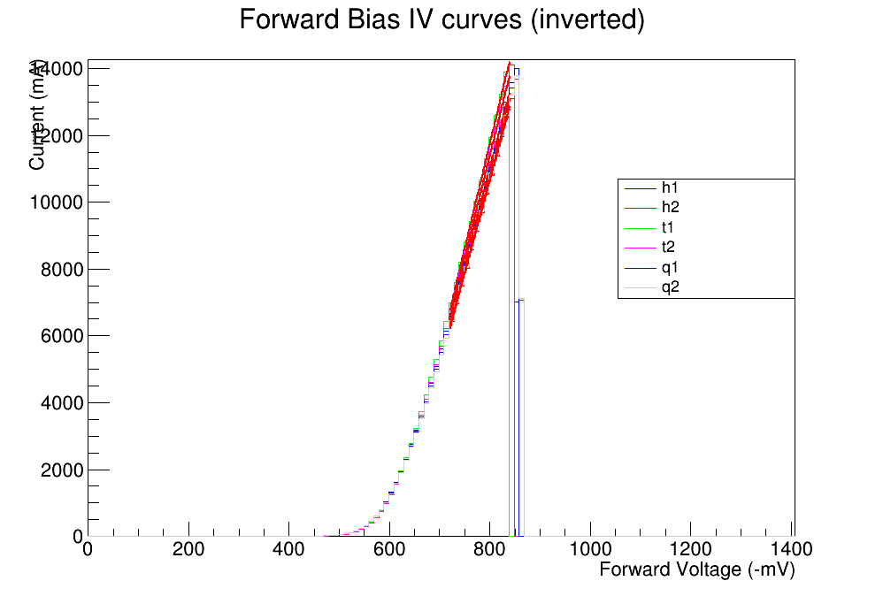
WARM
Current (uA)

Slide 8
 |  |  | slope | Rt (Ohm) | pixels | Rq (Ohm) | Rq (kOhm)
holewirebond |  | H1 | 29.1 | 34.36426 | 14331 | 492474 | 492
holewirebond |  | H2 | 28.7 | 34.84321 | 14331 | 499338 | 499
TSV |  | T1 | 31.8 | 31.44654 | 14336 | 450818 | 451
TSV |  | T2 | 31.1 | 32.15434 | 14336 | 460965 | 461
Quartz window |  | Q1 | 27.5 | 36.36364 | 14336 | 521309 | 521
Quartz window |  | Q2 | 28.5 | 35.08772 | 14336 | 503018 | 503
From Ardavan:
・S13360-6050CS/VE: 350 kohm
・S14160-6050HS: 450 kohm

Slide 9
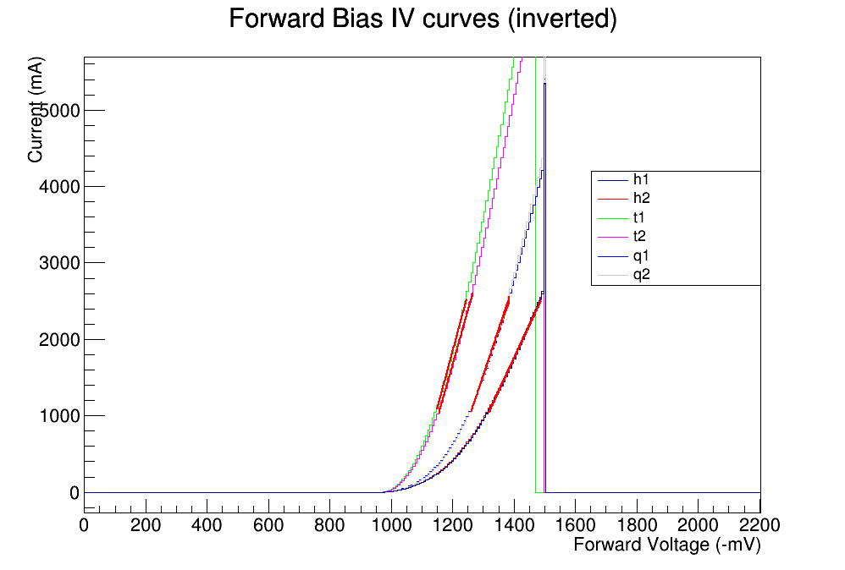
COLD
Current (uA)
COLD |  |  | Rq (kOhm)
holewirebond |  | H1 | 1620
holewirebond |  | H2 | 1672
TSV |  | T1 | 943
TSV |  | T2 | 994
Quartz window |  | Q1 | 1221
Quartz window |  | Q2 | 1174

Slide 10
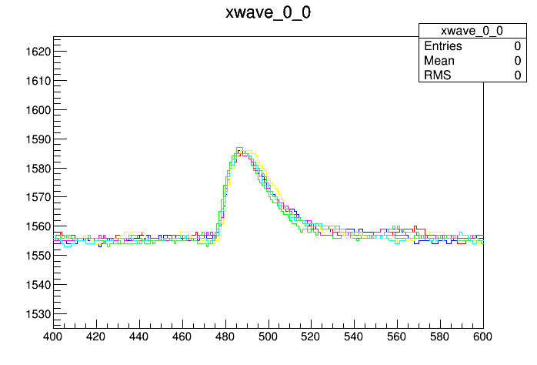
Pulse Measurements
For HWB parts used Vover=2.5 -> PED=45%
For TSV parts used Vover = 3 -> PED=40%
For each run find pedestal/baseline by looking at first 100 samples of first 500 events
For amplitude plot – find ADC value of highest ADC in sample window of 450 to 650 , synchronized with LED light pulse
For Integral plot – Add ADC – pedestal of samples 450 to 650

Slide 11
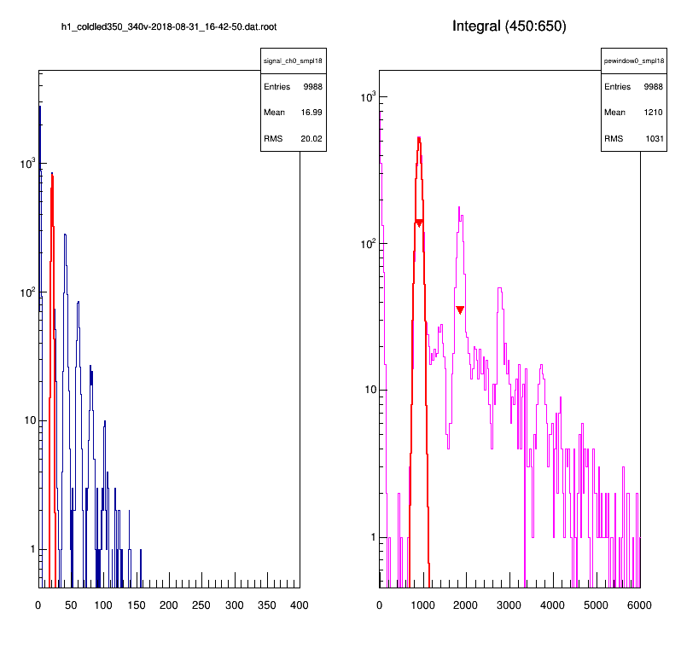
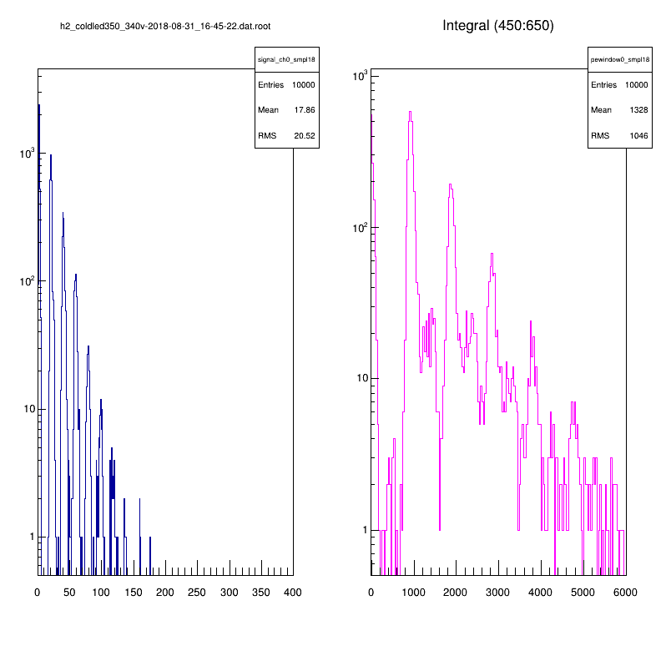
Example Pulse amplitude and Pulse Integral Plots
HWB#1
Integral
Of Pulse
HWB#2
Integral
Of Pulse
Pulse
Amplitude
Pulse
Amplitude

Slide 12
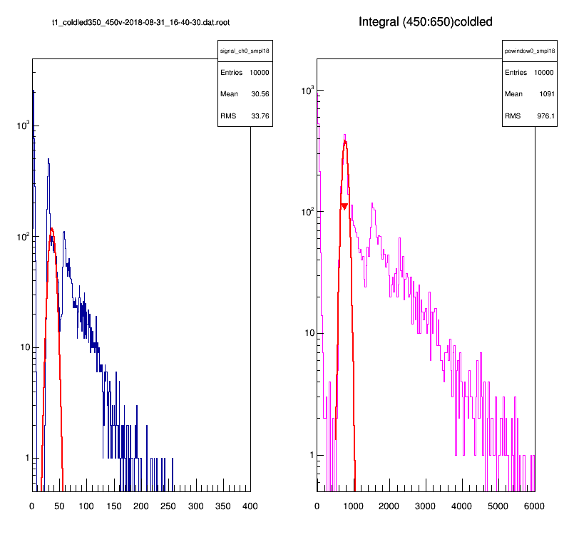
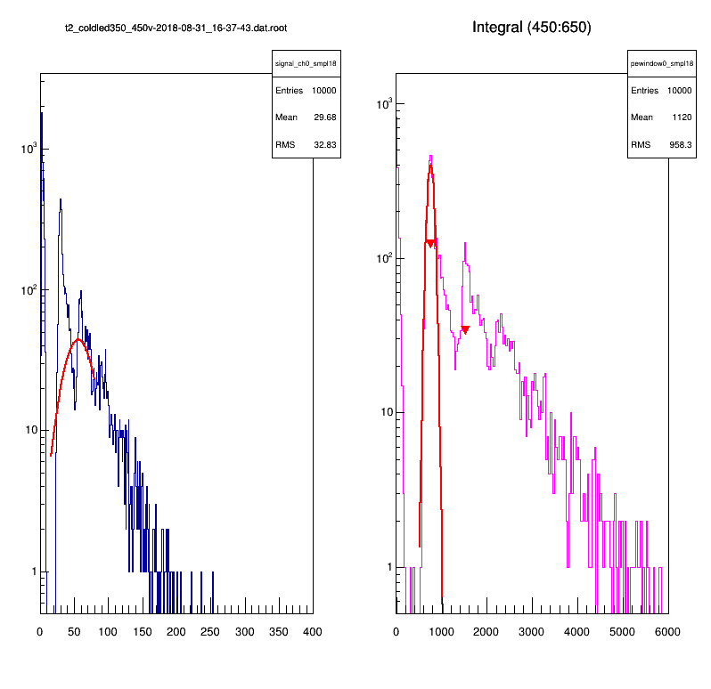
Example Pulse amplitude and Pulse Integral Plots
TSV#1
Vovr = 2.9V
TSV#2
Integral
Of Pulse
Integral
Of Pulse
Pulse
Amplitude
Pulse
Amplitude

Slide 13
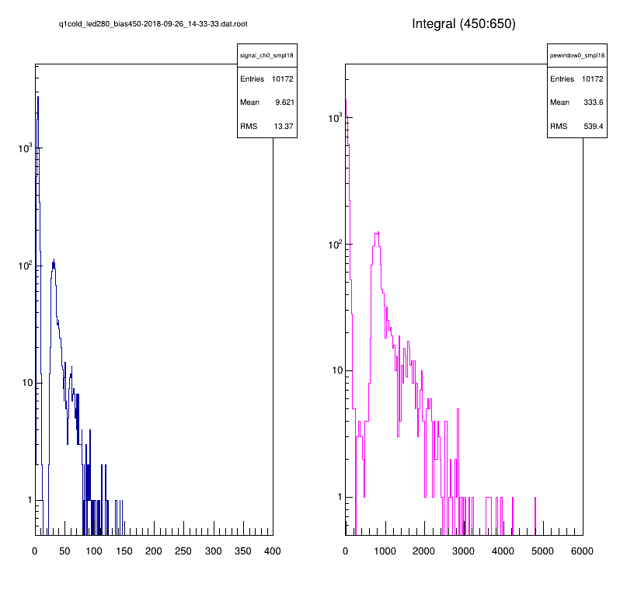
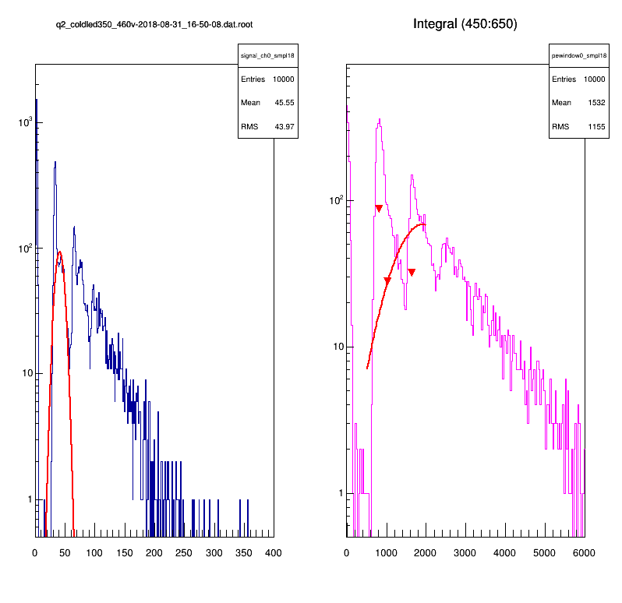
CRYO#1
(dimmerLED)
CRYO#2
Integral
Of Pulse
Integral
Of Pulse
Pulse
Amplitude
Pulse
Amplitude
11

Slide 14
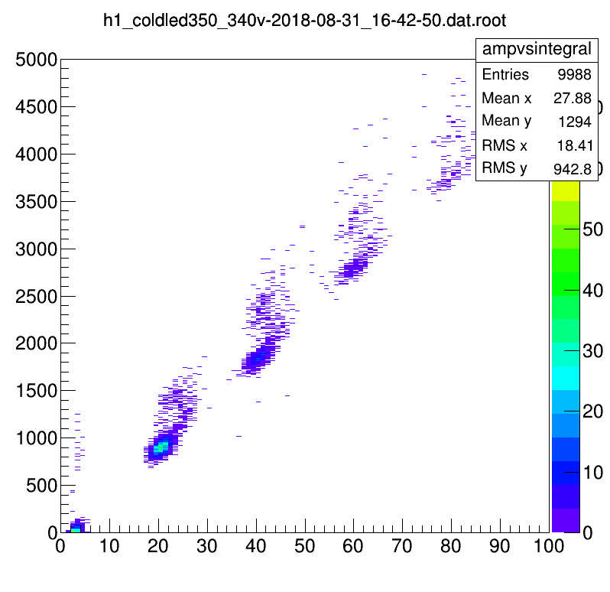
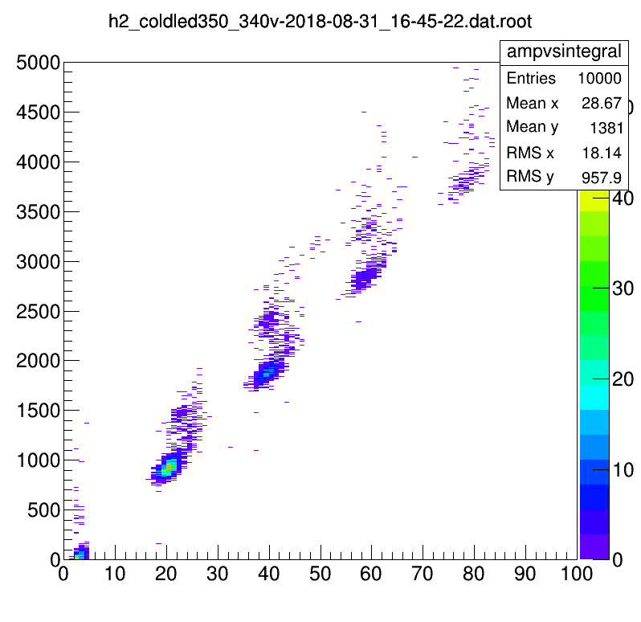
AMPLITUDE vs INTEGRAL
HWB#1
HWB#2
Amplitude (ADC)
Amplitude (ADC)

Slide 15
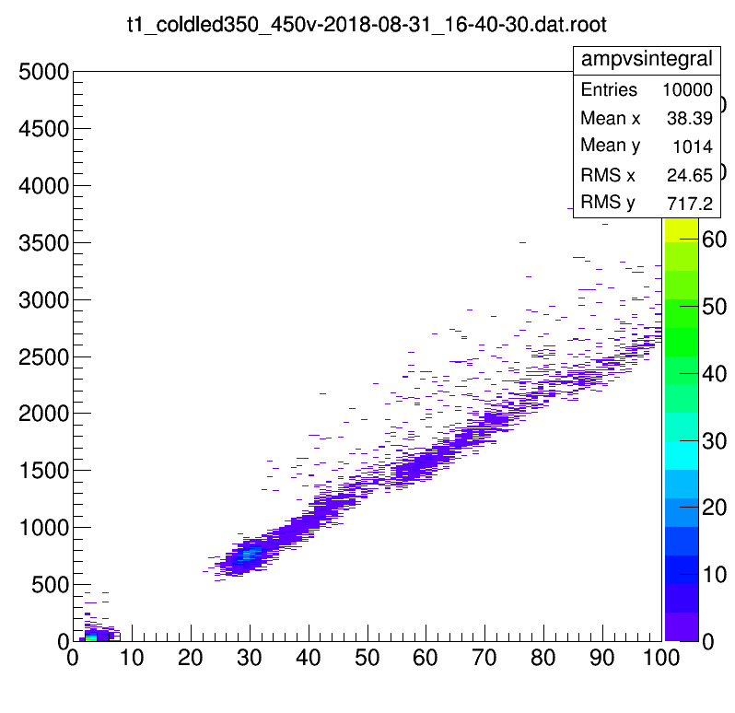

AMPLITUDE vs INTEGRAL
TSV#1
TSV#2
Amplitude (ADC)
Amplitude (ADC)

Slide 16
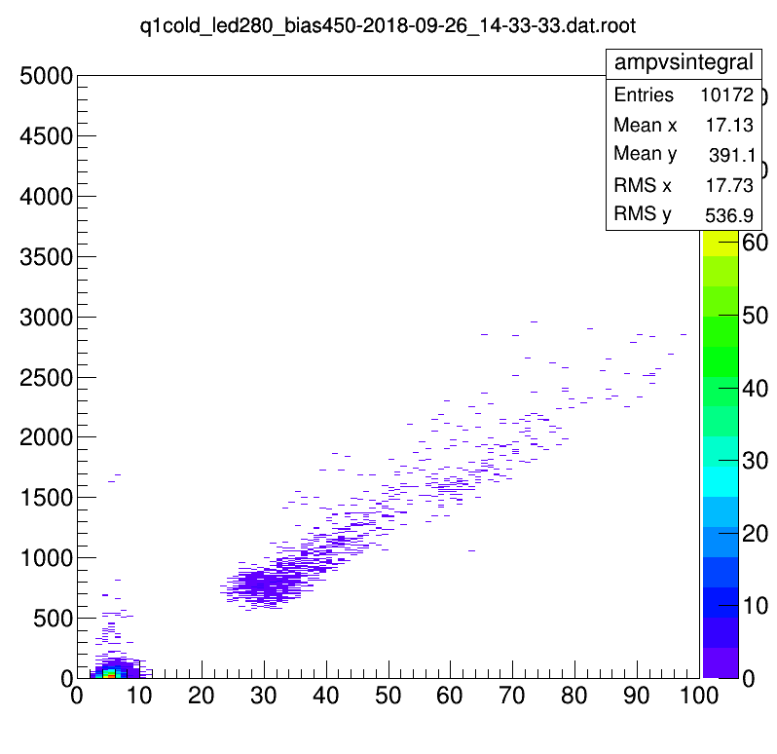
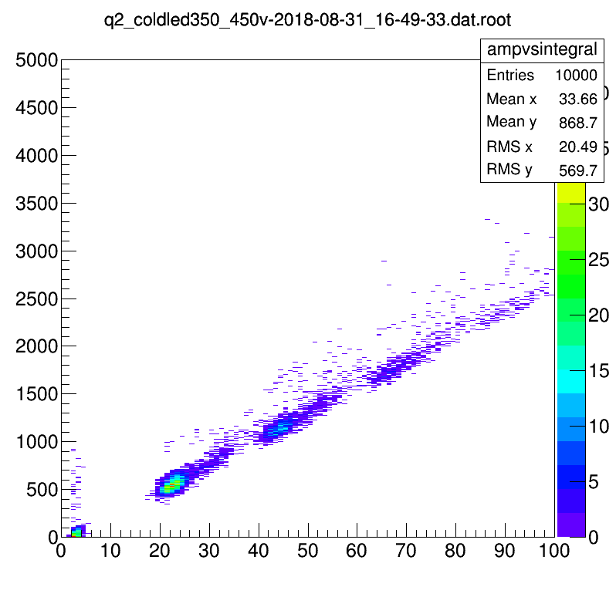
AMPLITUDE vs INTEGRAL
Quartz / Cryo #2
Quartz / Cryo #1
Amplitude (ADC)
Amplitude

Slide 17
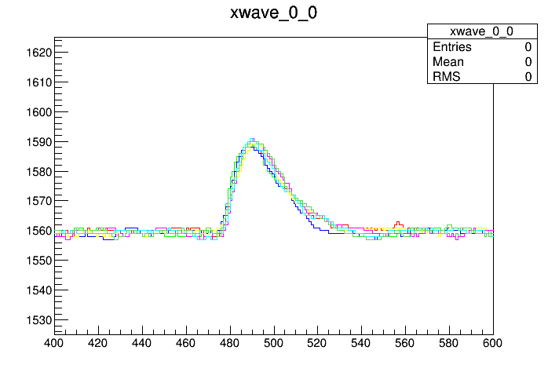
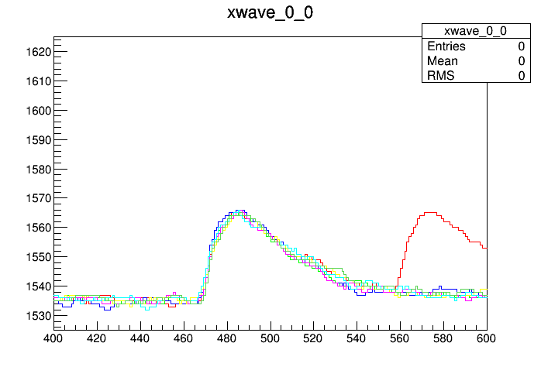
TSV
QUARTZ/CRYO
HOLE WIRE BOND
RED BOX
GOOD, “NORMAL”, 1PE PULSE

Slide 18
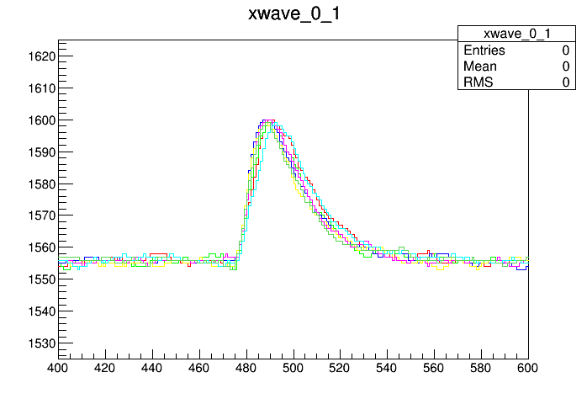
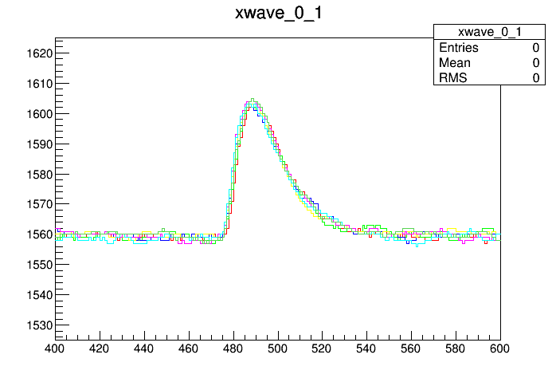
TSV
QUARTZ/CRYO
GREEN BOX
GOOD LOOKING PULSE, BUT >1PE PULSE
And < 2PE

Slide 19
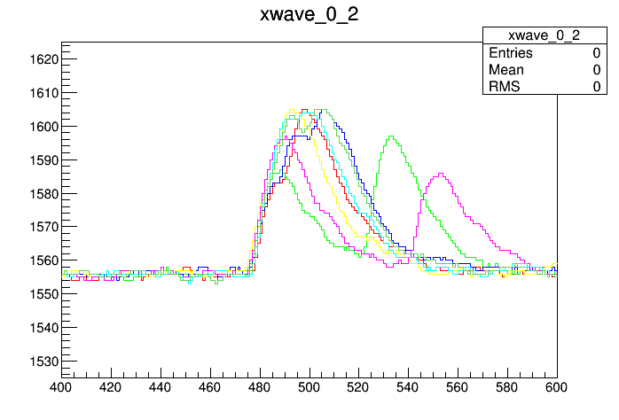
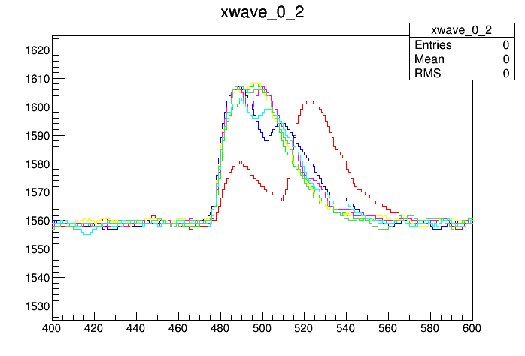
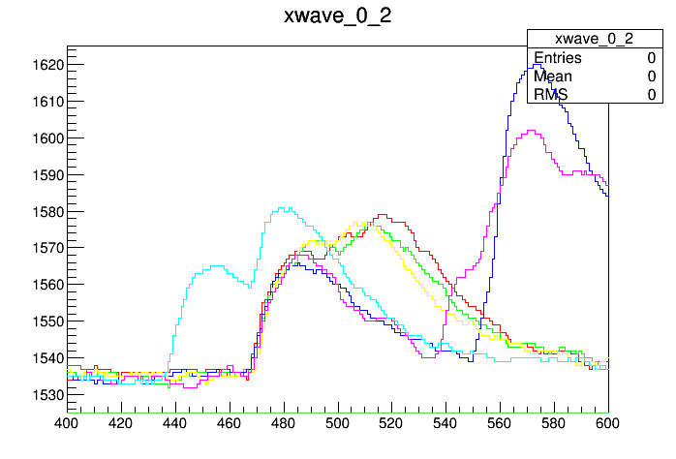
QUARTZ/CRYO
HOLE WIRE BOND
PURPLE BOX:
DELAYED CROSSTALK?

Slide 20
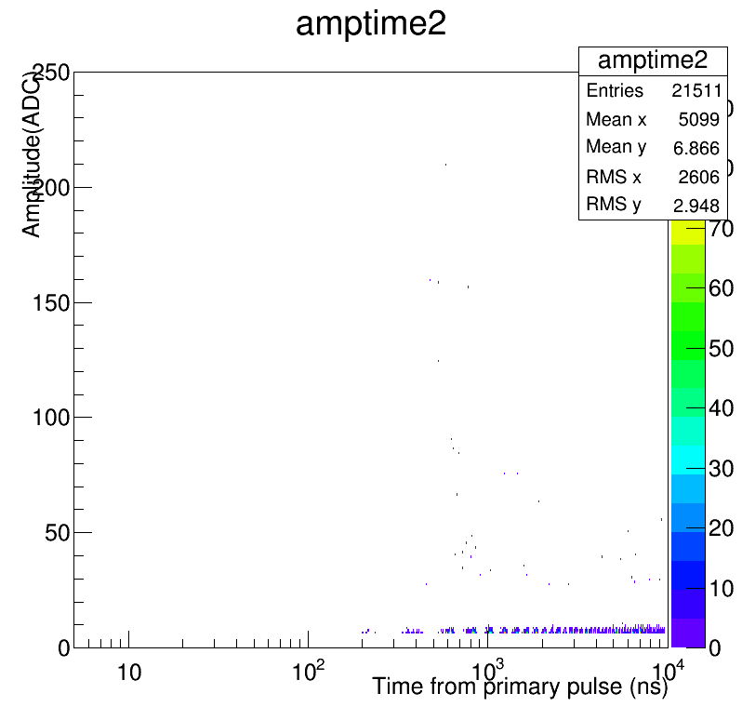
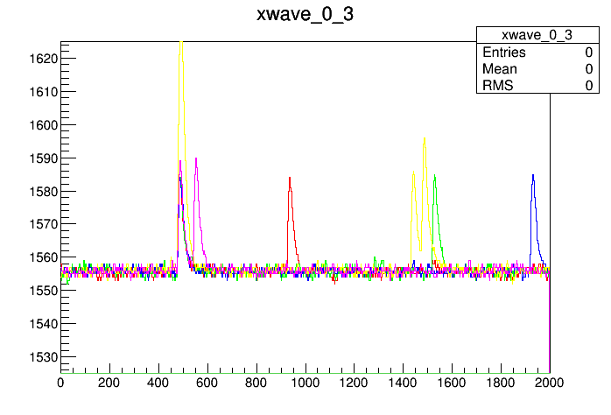
TSV
TSV
AFTERPULSES or DELAYED CROSSTALK

Slide 21
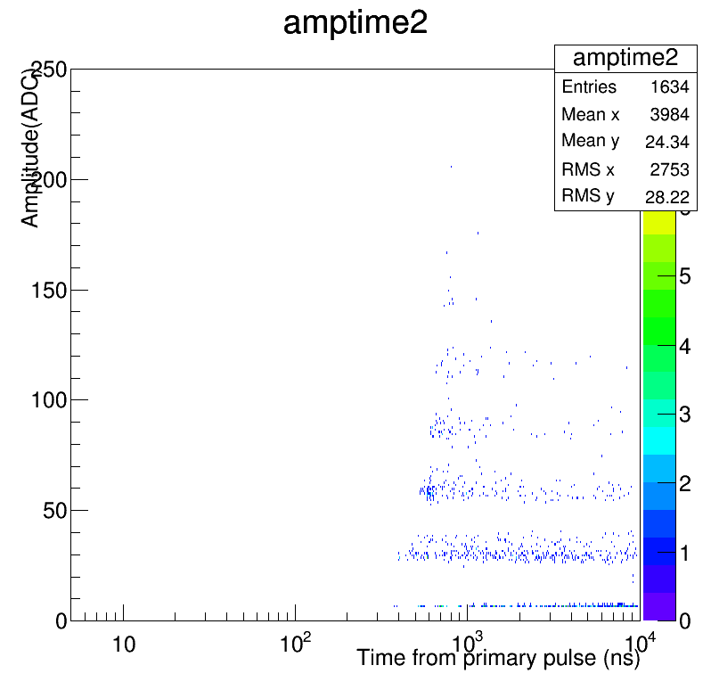
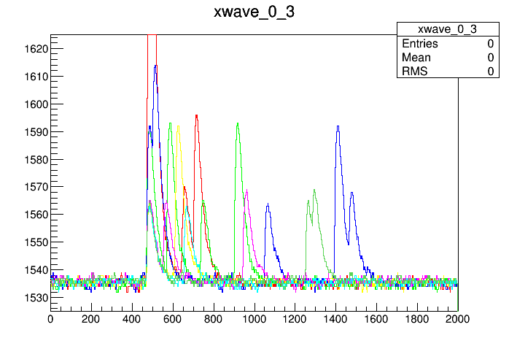
HOLE WIRE BOND
AFTERPULSES or DELAYED CROSSTALK

Slide 22
Dark Count Rate
SSP |  |  |  | hwb1 | hwb2
setting | Vop | Vbr | Vovr | dcr(Hz) | dcr(Hz) |  | PDE
165 | 33 | 31.5 | 1.5 | 1 | 1
170 | 34 | 31.5 | 2.5 | 12.9 | 9.2 |  | 45%
175 | 35 | 31.5 | 3.5 | 18.2 | 15.1
180 | 36 | 31.5 | 4.5 | 47.9 | 34.5
SSP |  |  |  | tsv1 | tsv2 | cryo1
setting | Vop | Vbr | Vovr | dcr(Hz) | dcr(Hz) | dcr(Hz) | PDE
220 | 44 | 42 | 2 | 3 | 1.2 | 3
225 | 45 | 42 | 3 | 7.3 | 8.9 | 4.7
230 | 46 | 42 | 4 | 19.5 | 9.5 | 6.5 | 46%
235 | 47 | 42 | 5 | 16.5 | 10.4 | 6.7
240 | 48 | 42 | 6 | 20.3 | 13.2 | 9
SSP |  |  |  | cry02
setting | Vop | Vbr | Vovr | dcr(Hz)
220 | 44 | 42.8 | 1.2 | 0.1
225 | 45 | 42.8 | 2.2 | 2.3
230 | 46 | 42.8 | 3.2 | 6.4 |  |  | 43%
235 | 47 | 42.8 | 4.2 | 7.1
240 | 48 | 42.8 | 5.2 | 9.2

Slide 23
Summary
All three types survive and function an LN2 temperatures – so far no sign of damage/cracking
The HWB type shows less temperature dependence
The HWB have higher gain and higher noise
The Quenching resistance gets greater at LN2 temperatures
  Though Rq of the three types is close at room temp 350 Ohm to 450 Ohm,
  at LN2 Temp. Rq(hwb)->1.6Mohm, Rq(tsv)->950kOhm, Rq(cryo)->1.2Mohm

Slide 24
Summary
TSV and Quartz/Cryo devices have a spectrum of pulses heights between integral PE peaks, seen in both Amplitude and Integral plots
HWB has clearly separated PE Peaks in both Pulse Amplitude and Integral plots
HWB appears to high afterpulsing or delayed crosstalk
HWB devices have a higher Dark Count Rate compared to the other two types at similar overvoltage but at equivalent PDE the DCR is comparable
All three types have high crosstalk at LN2 temperatures
  (For the HWB type the crosstalk is delayed)

Slide 25
backup

Slide 26
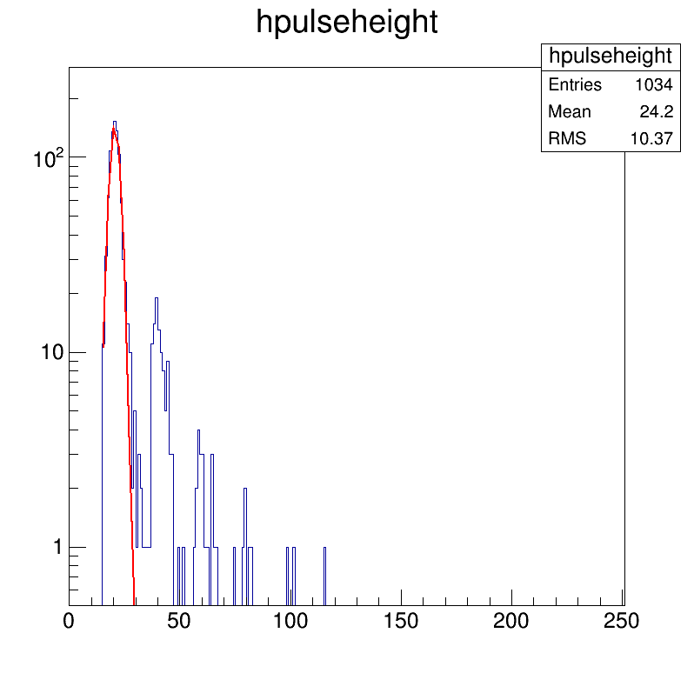
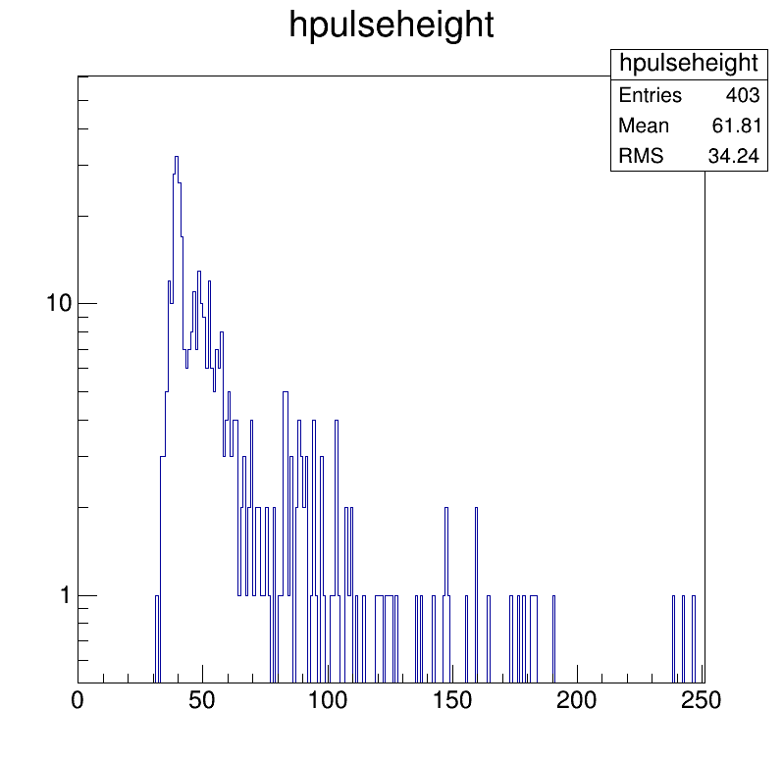
LN2 Dark Count Rate Detail and Crosstalk
DARK COUNTS AMPLITUDE
DARK COUNTS AMPLITUDE
Hole Wire Bond#1
DCR=20.5 Hz
Crosstalk=14%
TSV#1
DCR=10 Hz
Crosstalk=30%

Slide 27
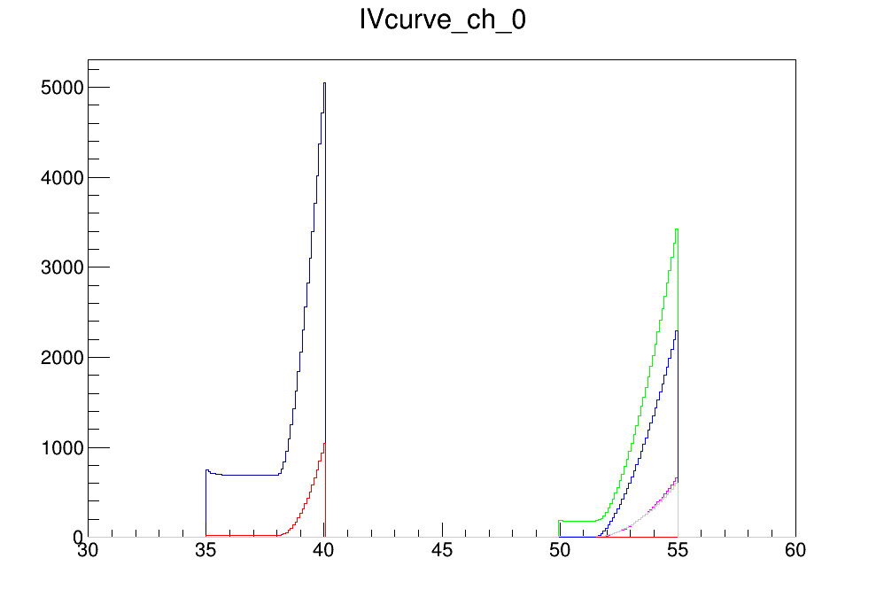
Compare With and Without Light

