Slide 1
Printed Circuit Board Design Updates
Andrew Laundrie and Xu Zhai
UW Physical Sciences Laboratory
March 27, 2019

Slide 2
Design Updates ̶ Overview
Foot Boards and Side Boards
Dimensions stretched to fit larger frame tubes
Multi-layer boards are required in some locations
Head Boards
Increased spacing between wire traces
Improved interface for electrical testing
Hardware Improvements
Custom Mill-Max sockets and pins
Stronger threaded inserts in boards

Slide 3
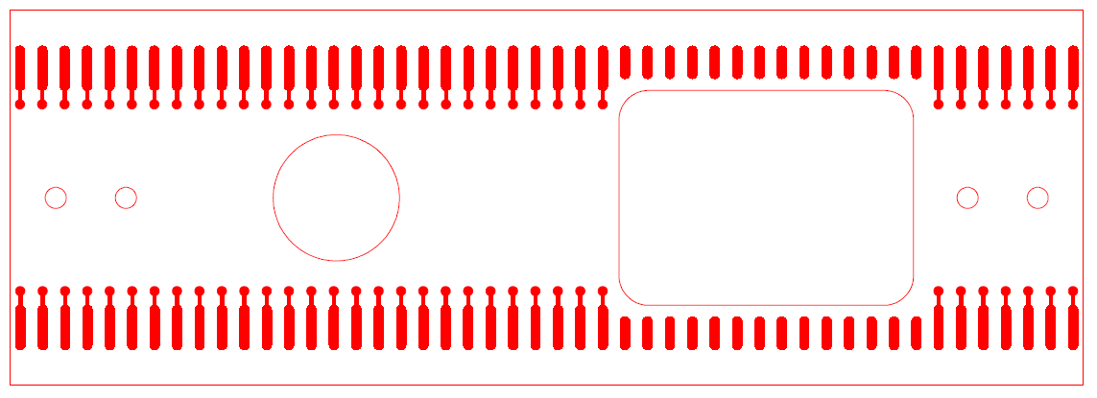
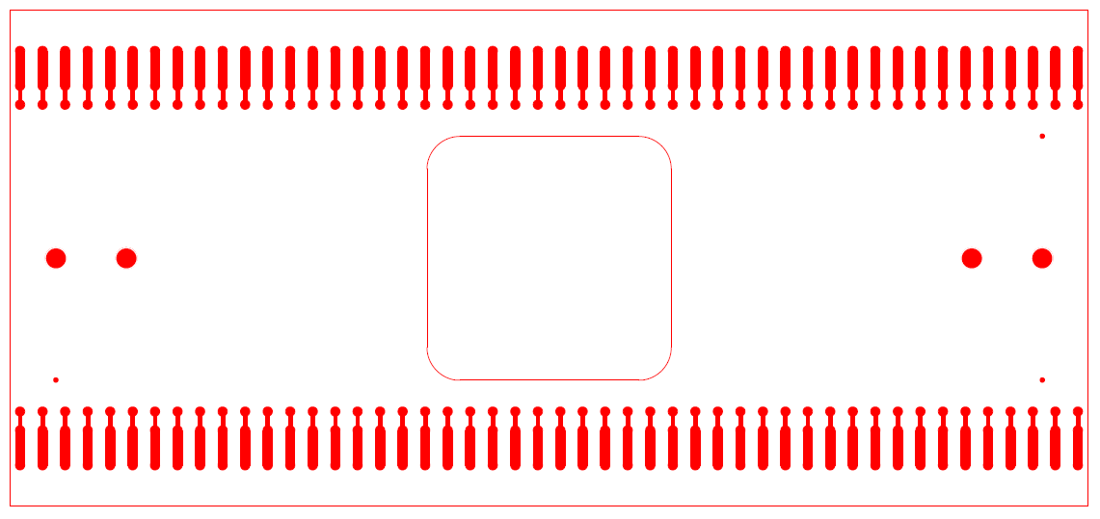
X-Layer Foot Boards
Old
New

Slide 4
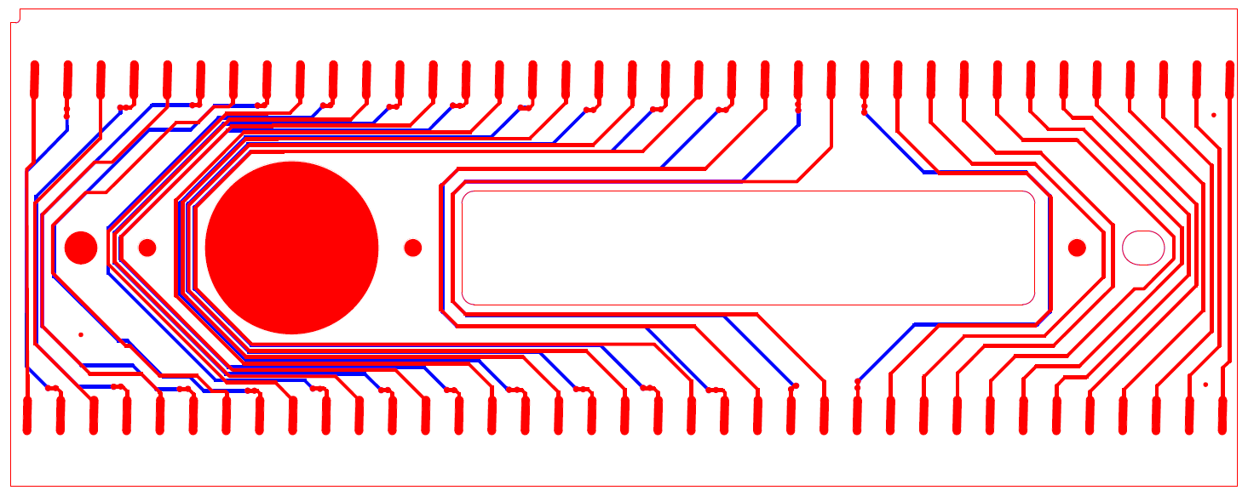
V-Layer Side Boards

Slide 5
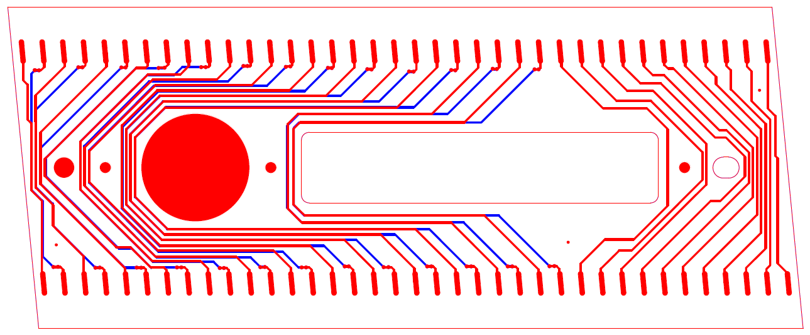
U-Layer Side Boards

Slide 6
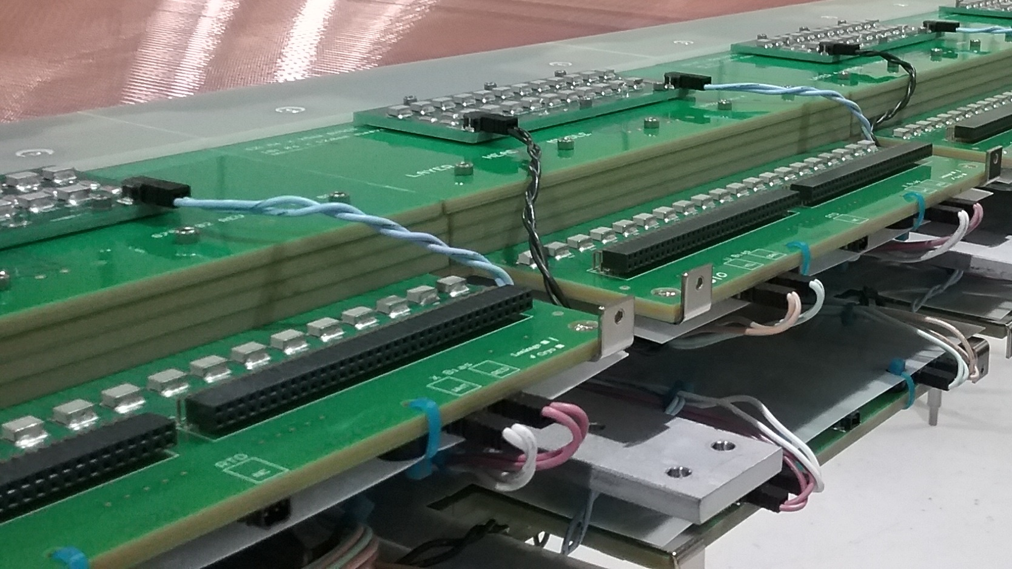
Head Board Structure

Slide 7
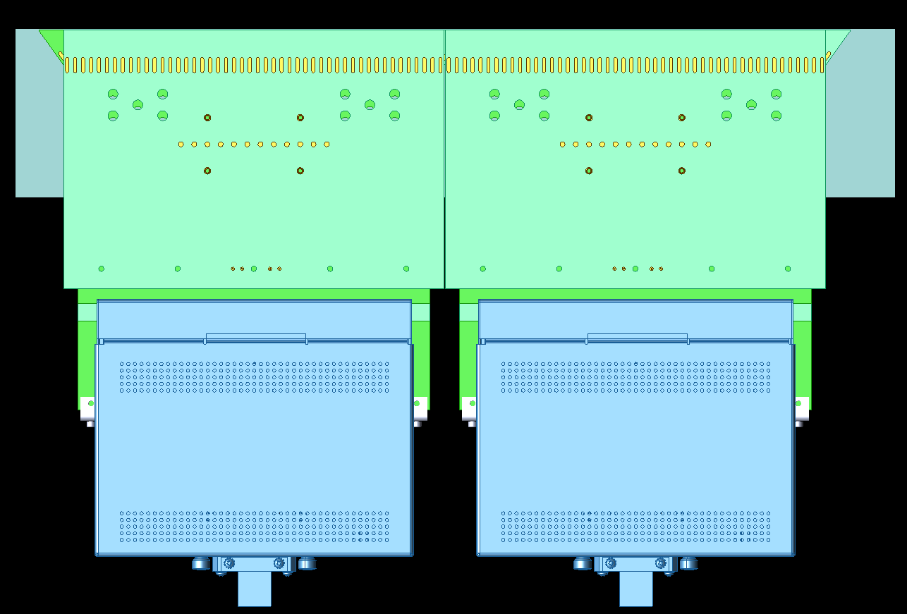
Slots Between CR Boards

Slide 8
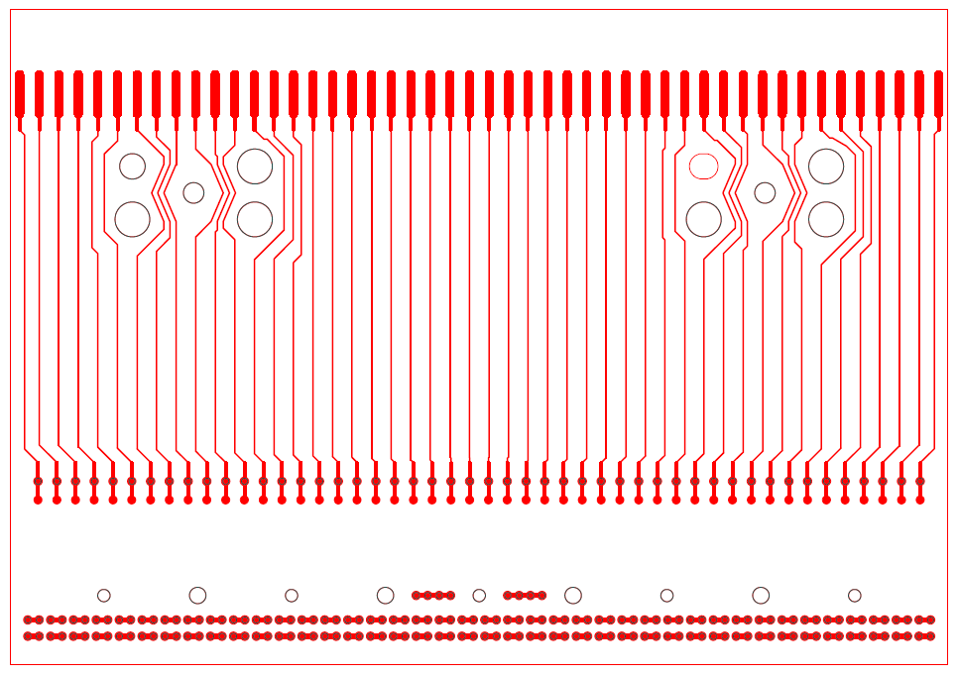
X-layer Head Board: ProtoDUNE
Solder Pads (48)
X Plane Sockets and Test Pads (48)
VSS pass-throughs
V
U
V and U signals pass through connected socket pairs

Slide 9
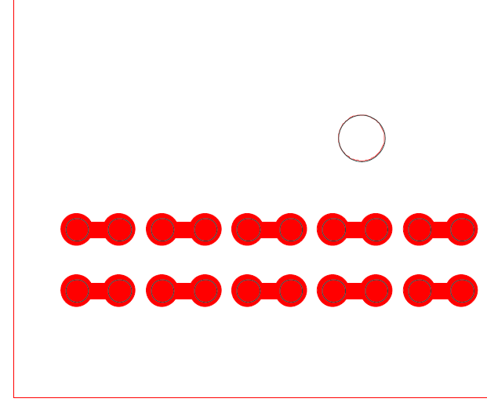
X-layer Head Board: ProtoDUNE
Spacing of 0.5 mm between channels limits the safe voltage that can be applied between adjacent wires (~100 V)
Increased spacing is desired to support voltage differences as high as 400 V

Slide 10
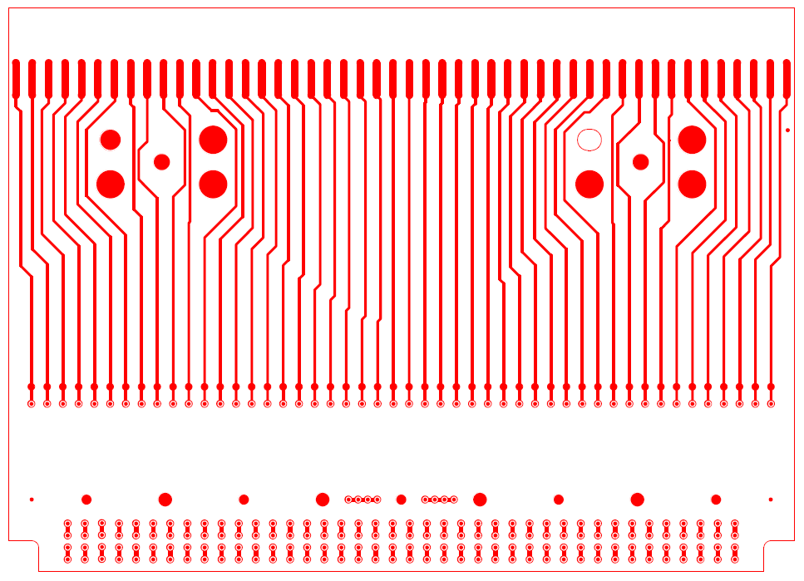
X-layer Head Board: DUNE

Slide 11
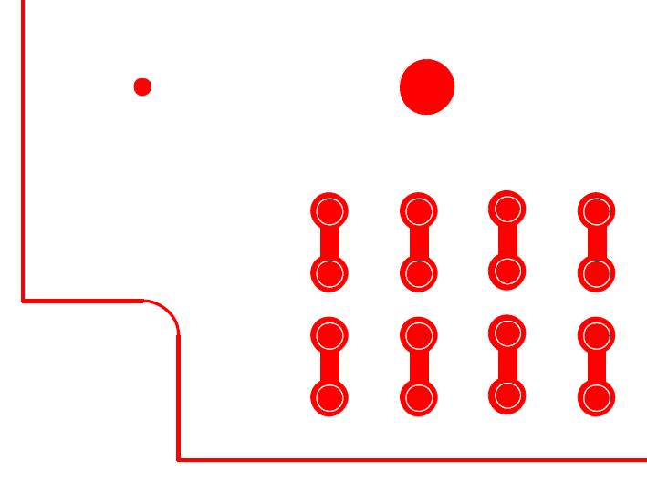
X-layer Head Board: DUNE
Spacing between U and V wire channels has increased to 2.5 mm
Board edge was moved 4.0 mm to accommodate increased channel spacing
Fiducials were added to all boards to support inspection by automatic vision systems
Fiducial reference point
V
U

Slide 12
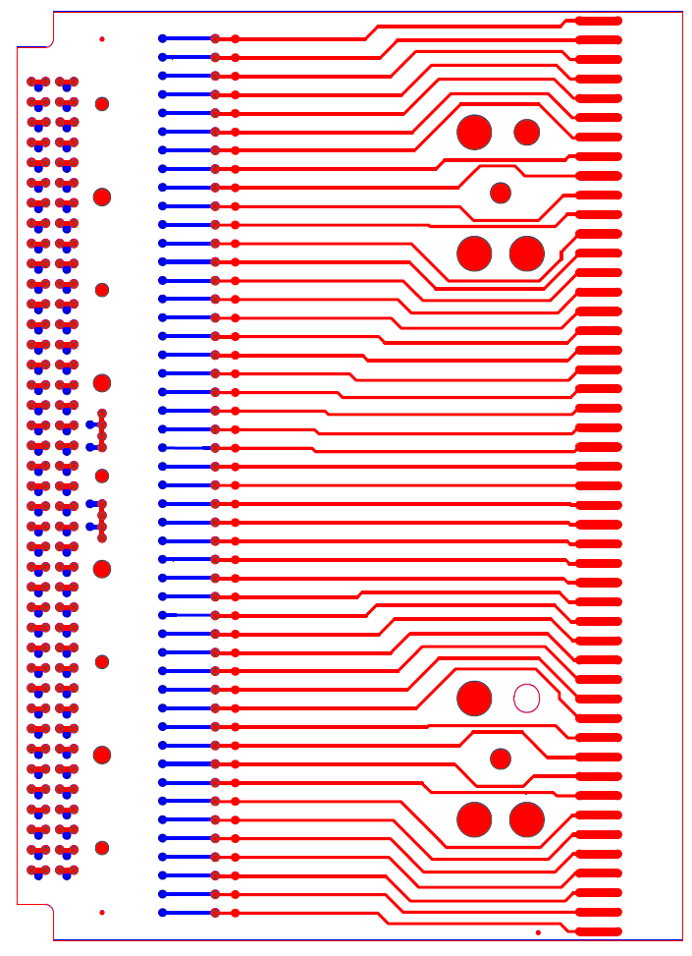
X-layer Head Board: DUNE
Landing pads were added to the bottom side of X head boards (blue traces)
Pads allow the attachment of test headers in place of CR boards
Headers use spring-loaded contact pins

Slide 13
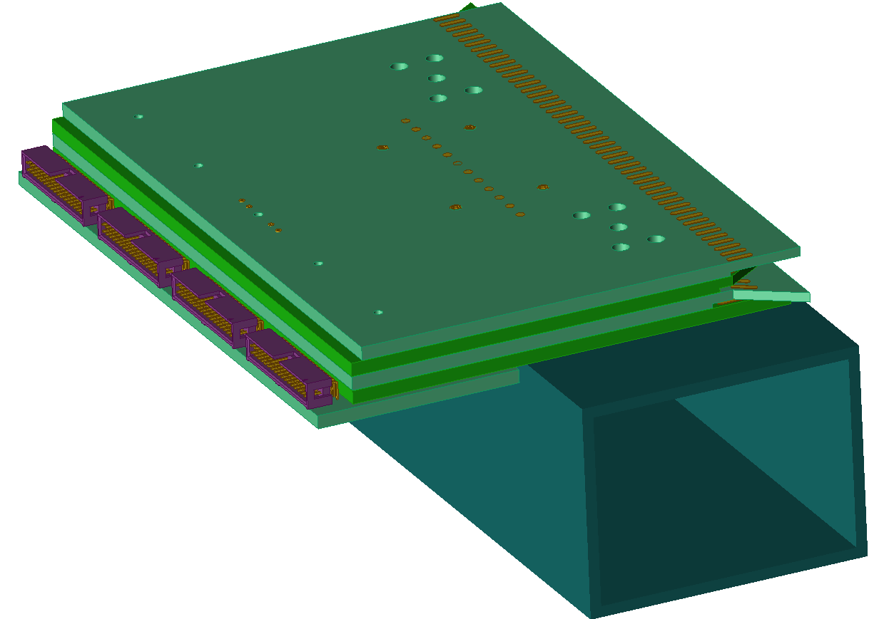
Test Header Concept
Four connectors provide access to all channels on the X, U, and V head boards

Slide 14
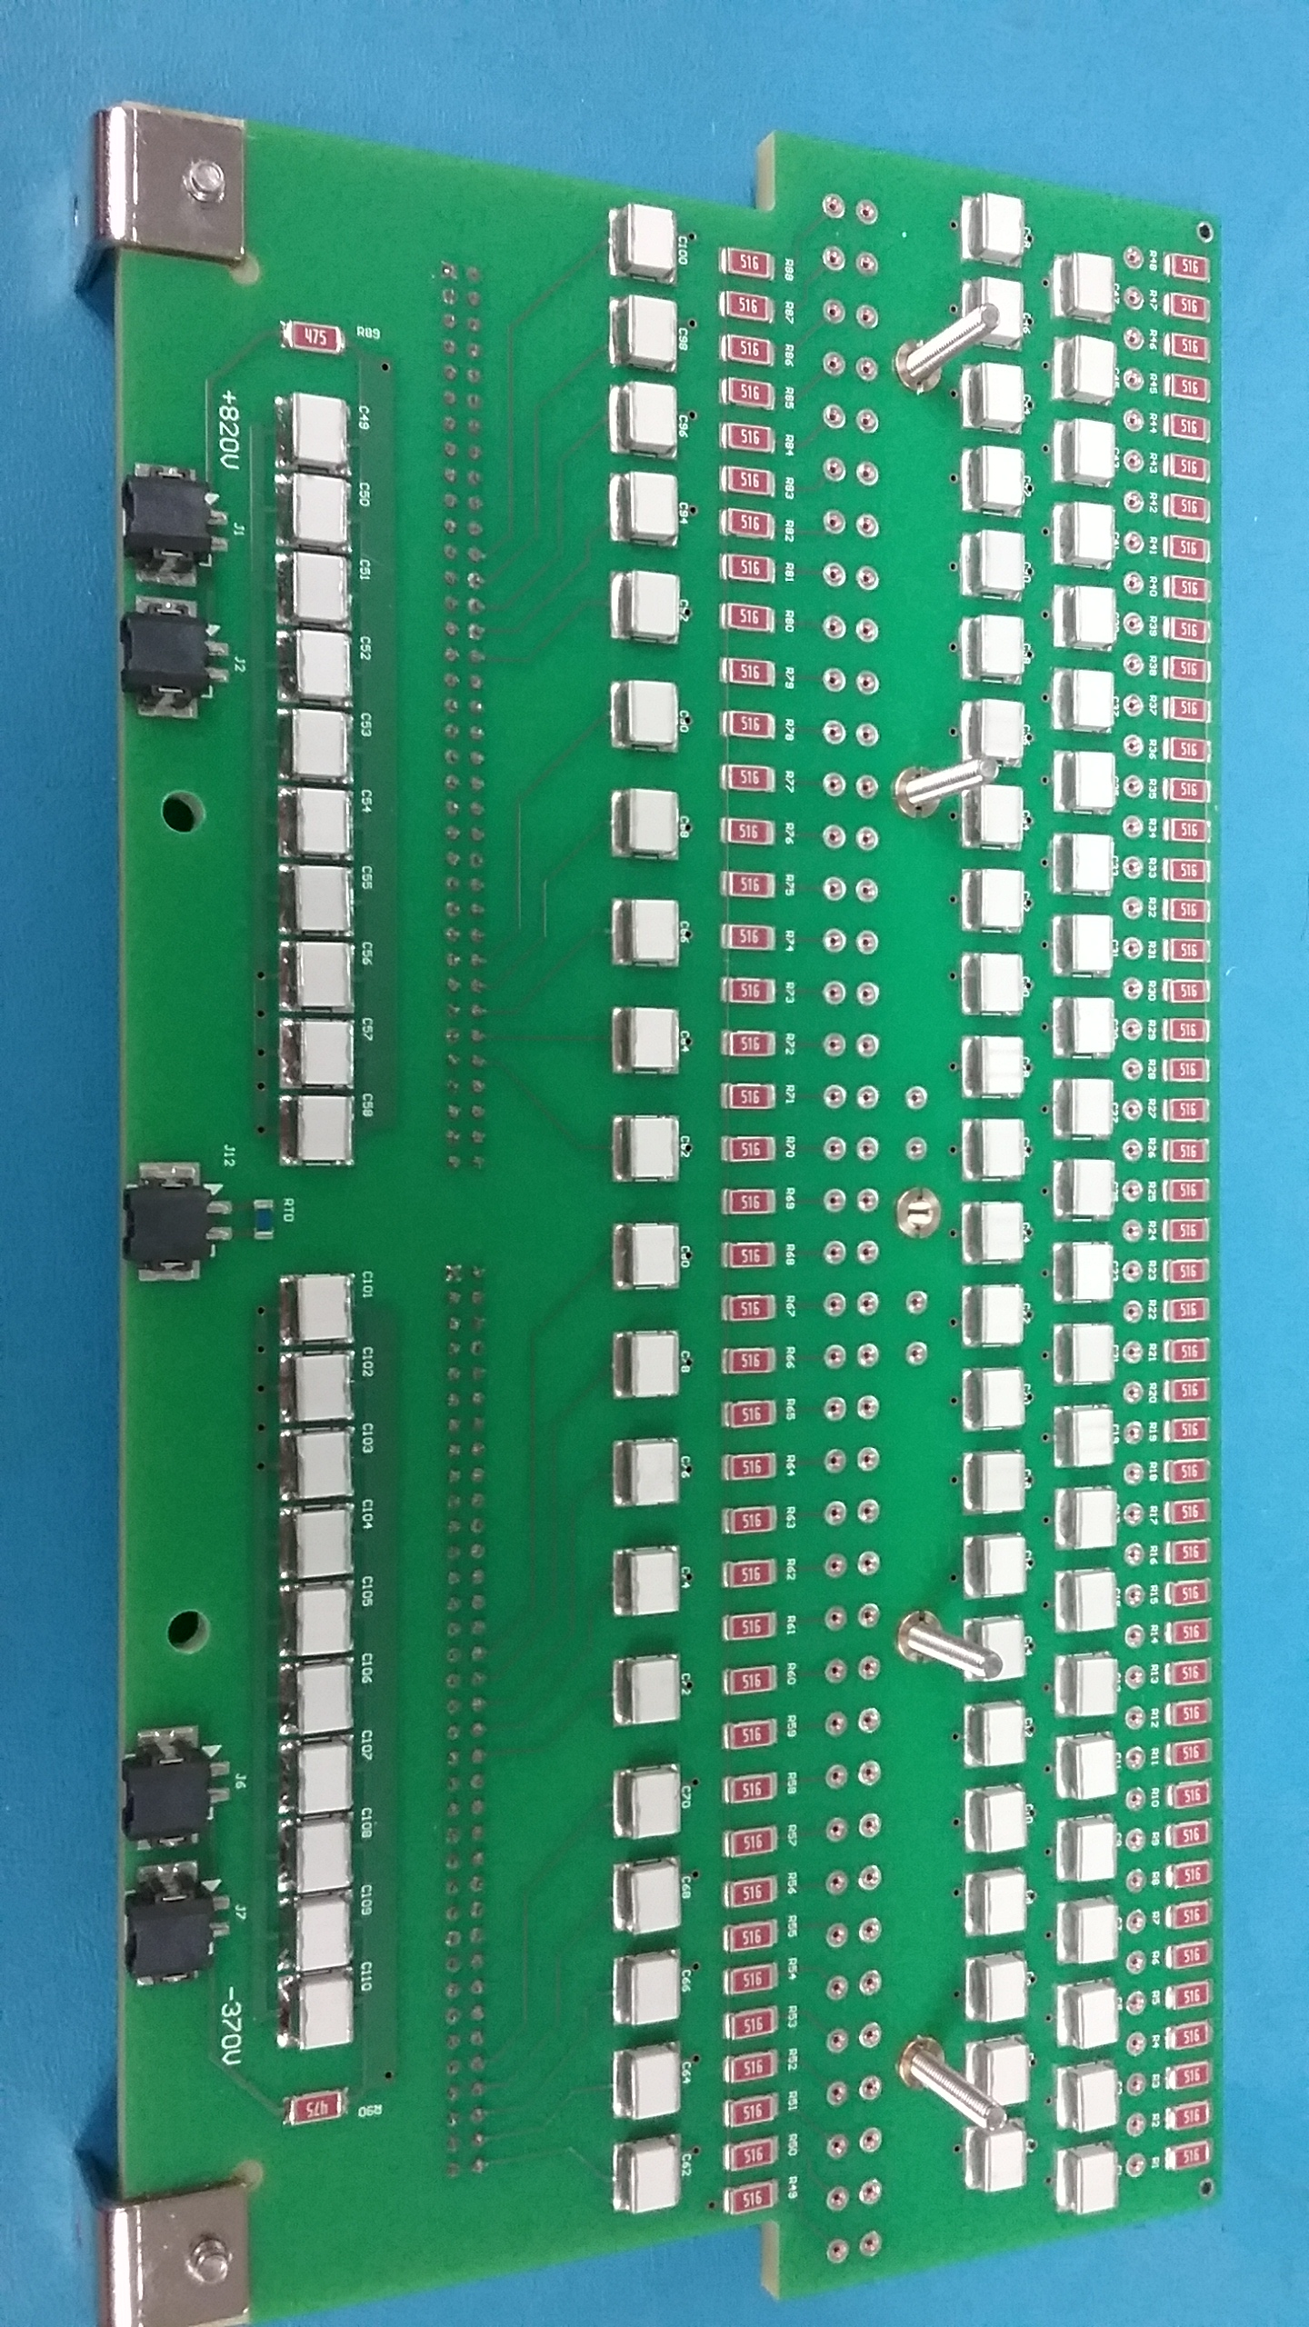
CR Board (ProtoDUNE)

Slide 15
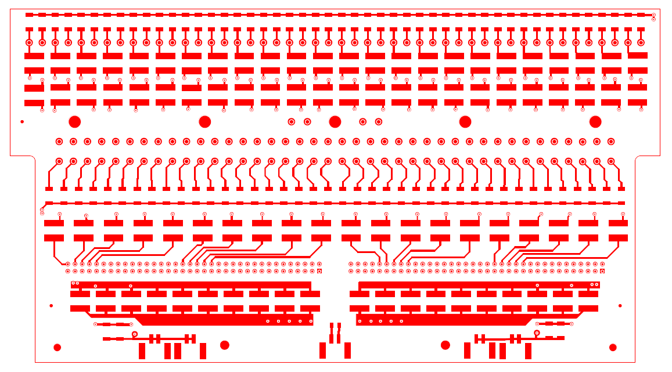
New CR Board
Minor changes only

Slide 16
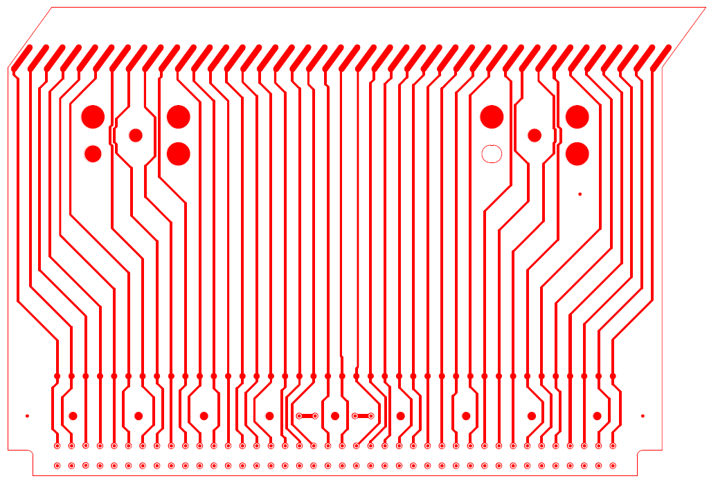
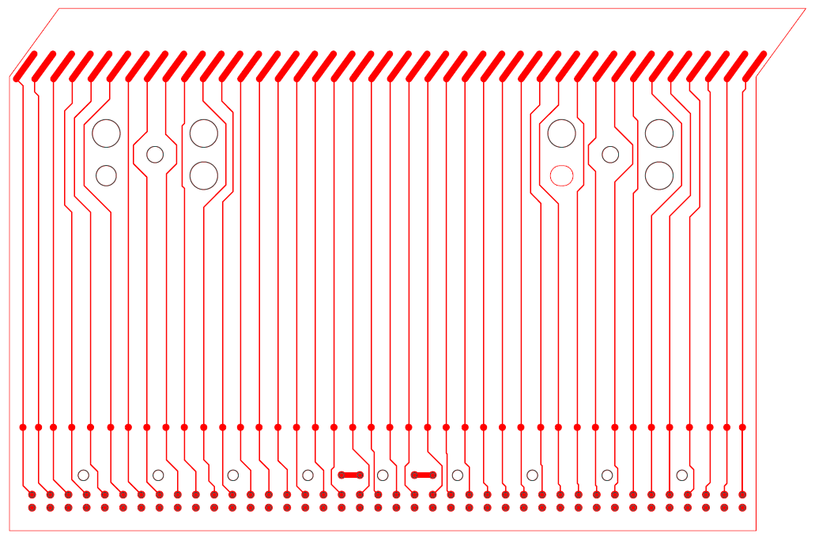
V-layer Head Boards (new / old)

Slide 17
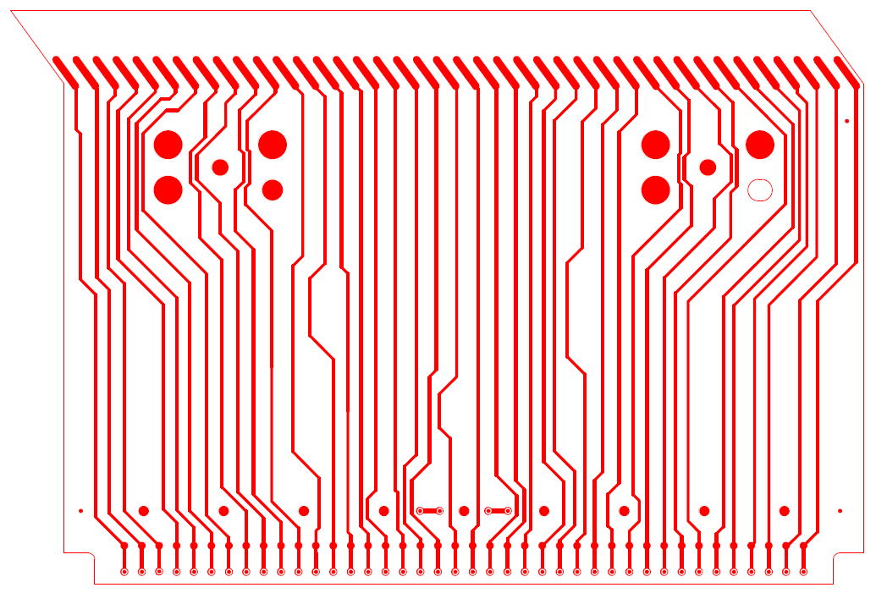
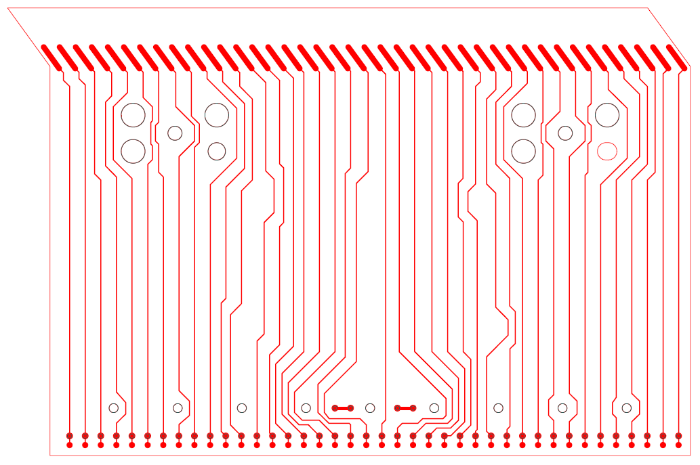
U Layer Head Boards (new / old)

Slide 18
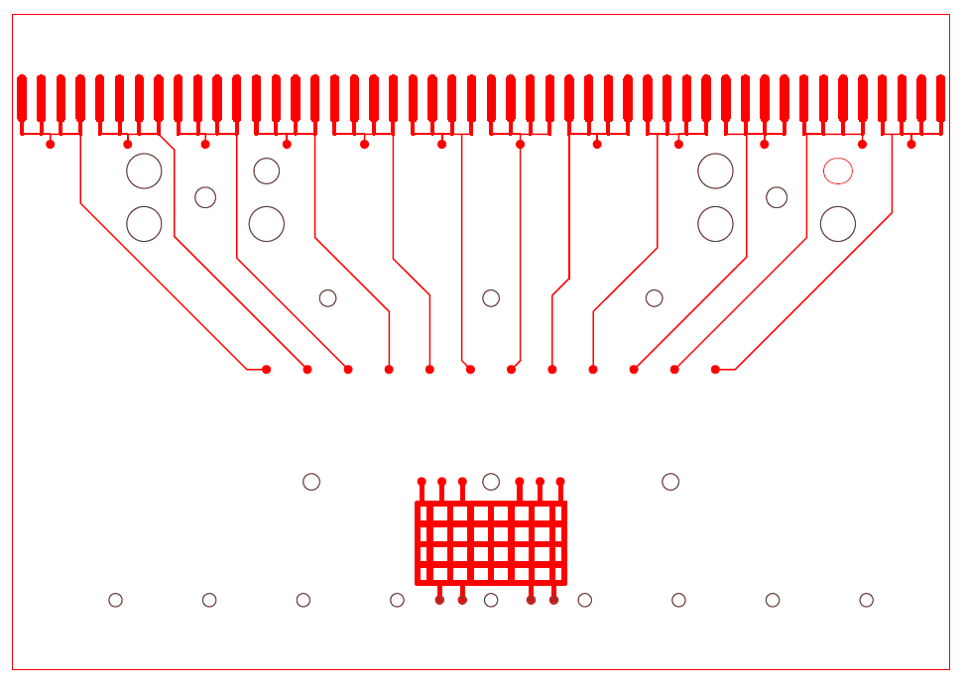
G Layer Head Board: ProtoDUNE
Solder Pads (48)
Landing pads for G bias (12 + 6)

Slide 19
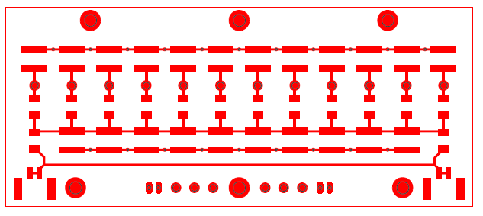
G Bias Board: ProtoDUNE

Slide 20
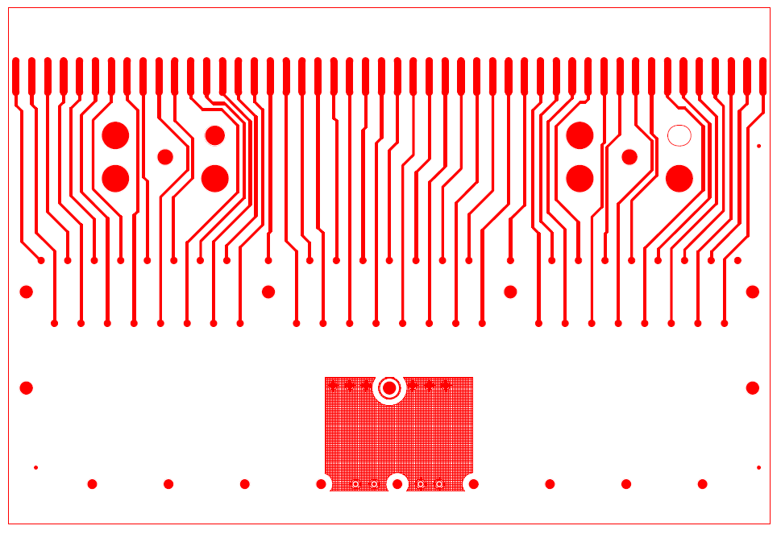
G Layer Head Board: DUNE
Solder Pads (48)
Landing pads for G bias (48 + 6)

Slide 21
G Bias Board: DUNE

Slide 22
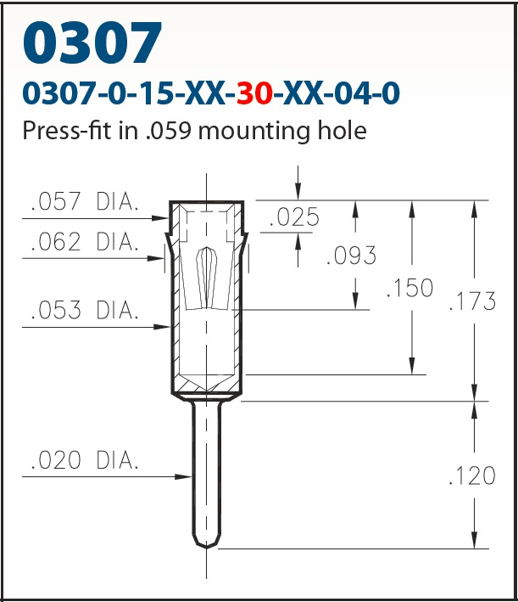
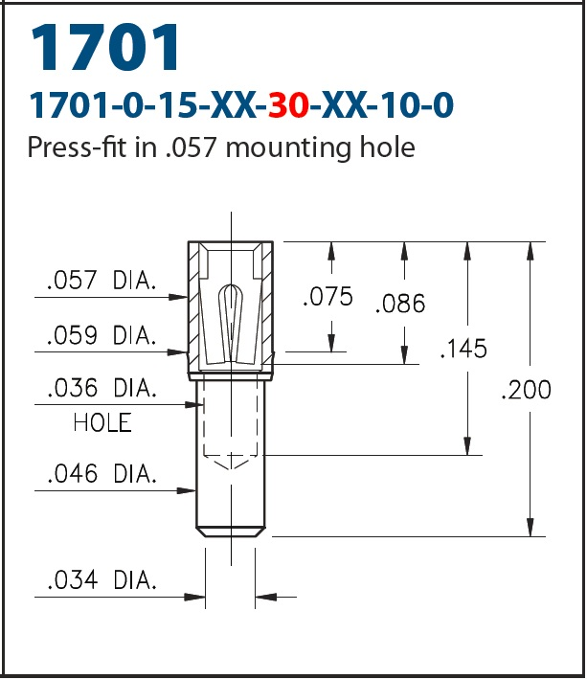
ProtoDUNE Sockets and Pins
Standard catalog items had
some performance issues

Slide 23
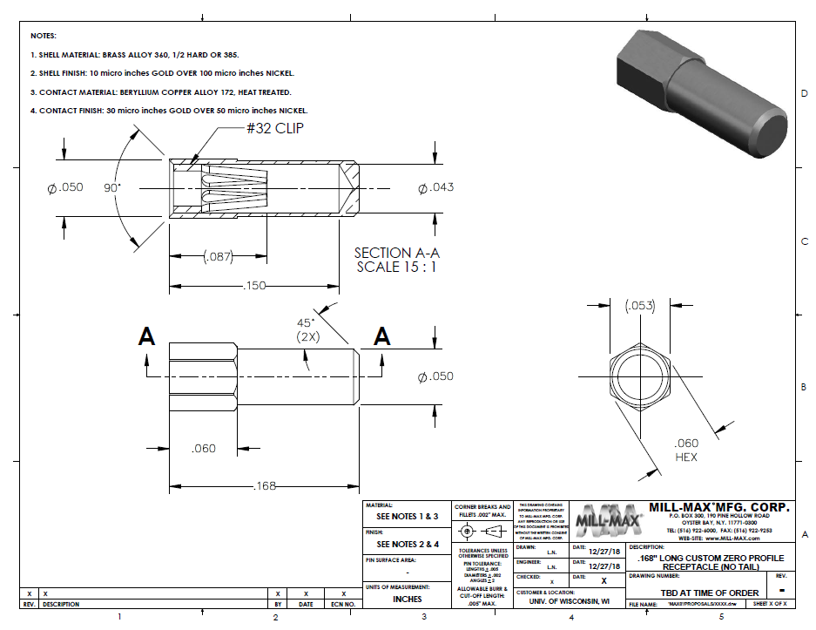
DUNE Sockets

Slide 24
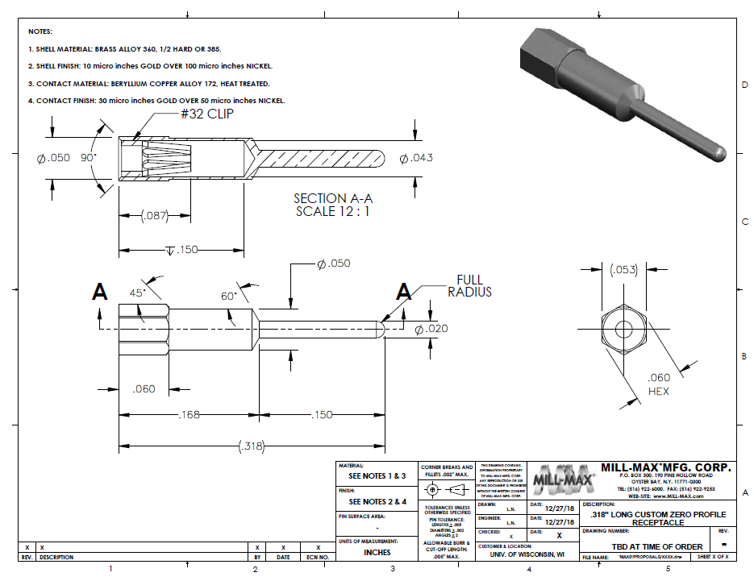
DUNE Pins

Slide 25
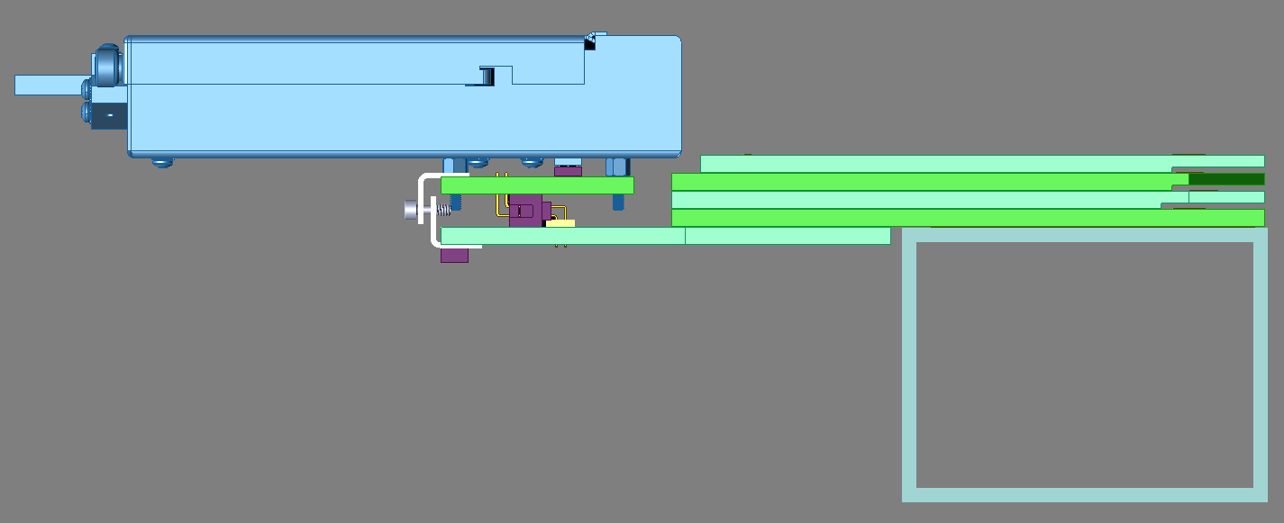
CE Assembly Installation
Captive screws in ProtoDUNE were meant to pull connectors together in a controlled fashion, but they posed a risk of being dropped into the cryostat during CE installation or removal

Slide 26
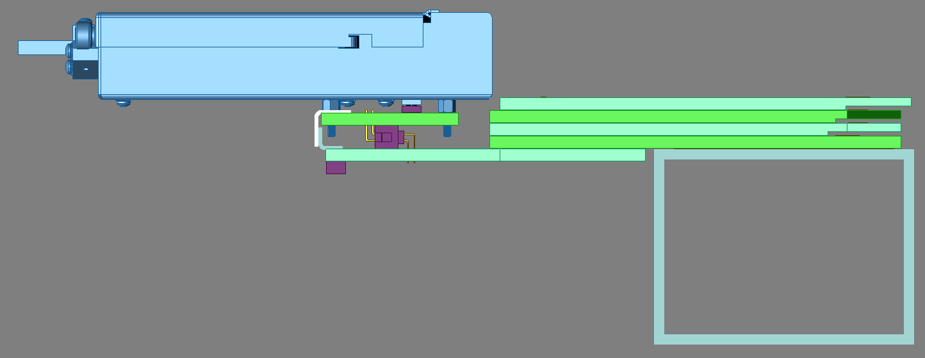
CE Assembly Installation
Captive screws were eliminated by changing the angle brackets on CR boards
Threaded tools are inserted and rotated to pull connectors together, then removed

Slide 27
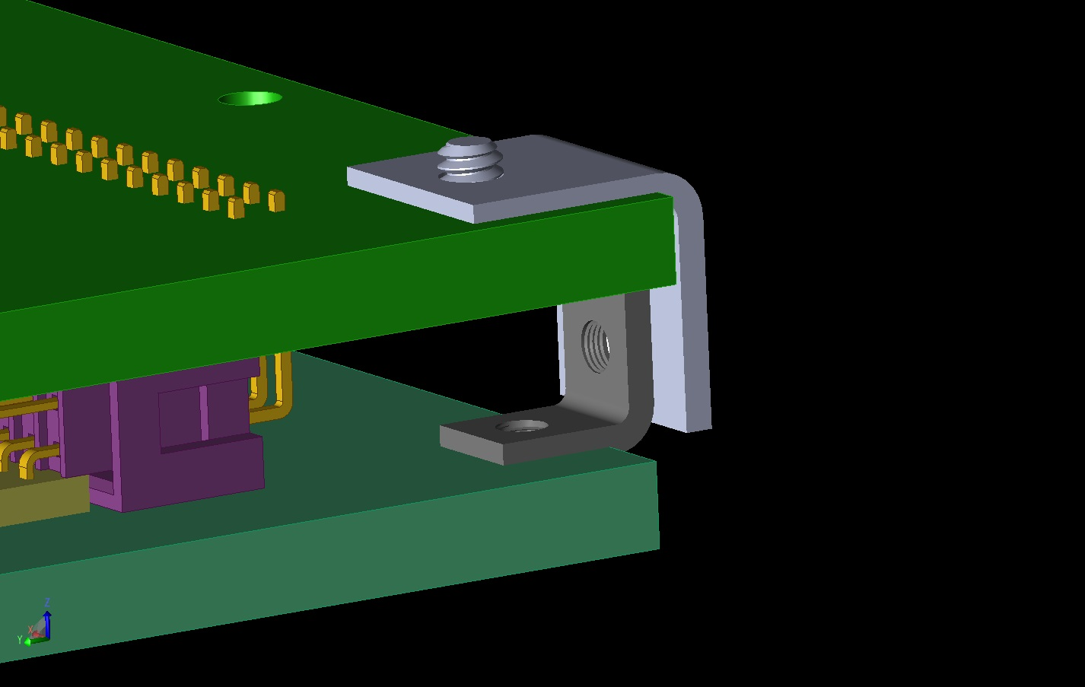
CE Assembly Installation

Slide 28
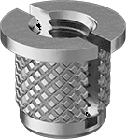
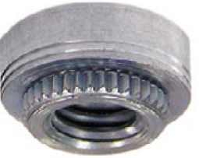
Hardware Improvements
Expanding threaded inserts have been replaced by broaching fasteners to prevent breaking and reduce metal debris

Slide 29
Process Improvements
Improved tools and methods are being evaluated for PCBs
Instrumented tips on soldering irons for process control
Vapor-phase reflow soldering for CR and G Bias boards
Improved board-washing equipment
Automated test systems for CR boards and G-Bias boards

Slide 30
Quality Assurance and Control
All ProtoDUNE boards were inspected when received
Complex mechanical features were frequently out of spec
Continued inspection of most boards is probably needed
Manual board inspection was time-consuming
Vision systems are being evaluated for board inspection

Slide 31
Backup Slides

Slide 32
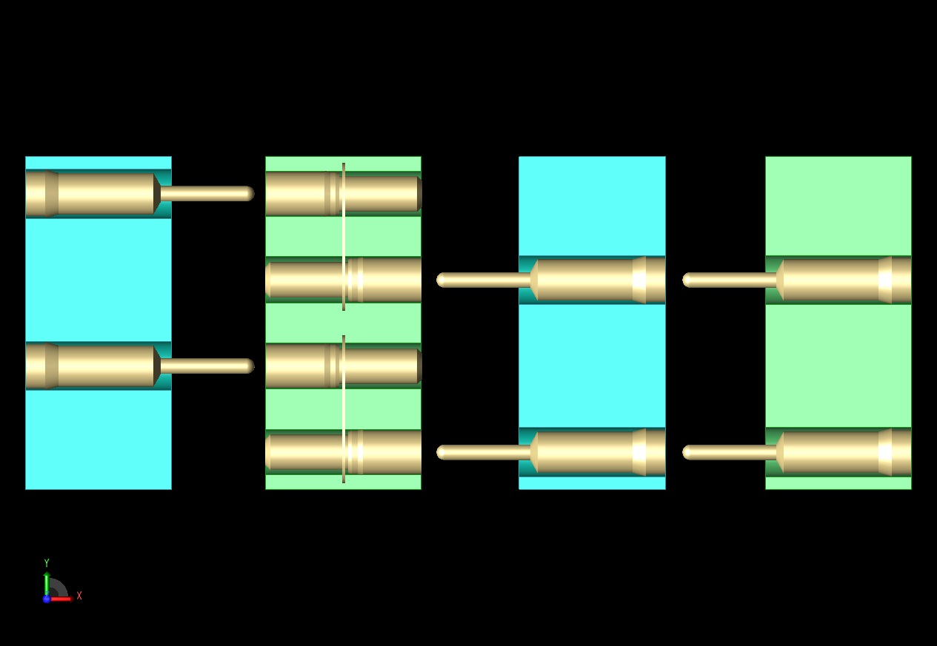
Mill-Max Pins and Sockets
Pins are fragile and not repairable once bent.
Their exposure is minimized during APA assembly.
.
CR
X
V
U

Slide 33
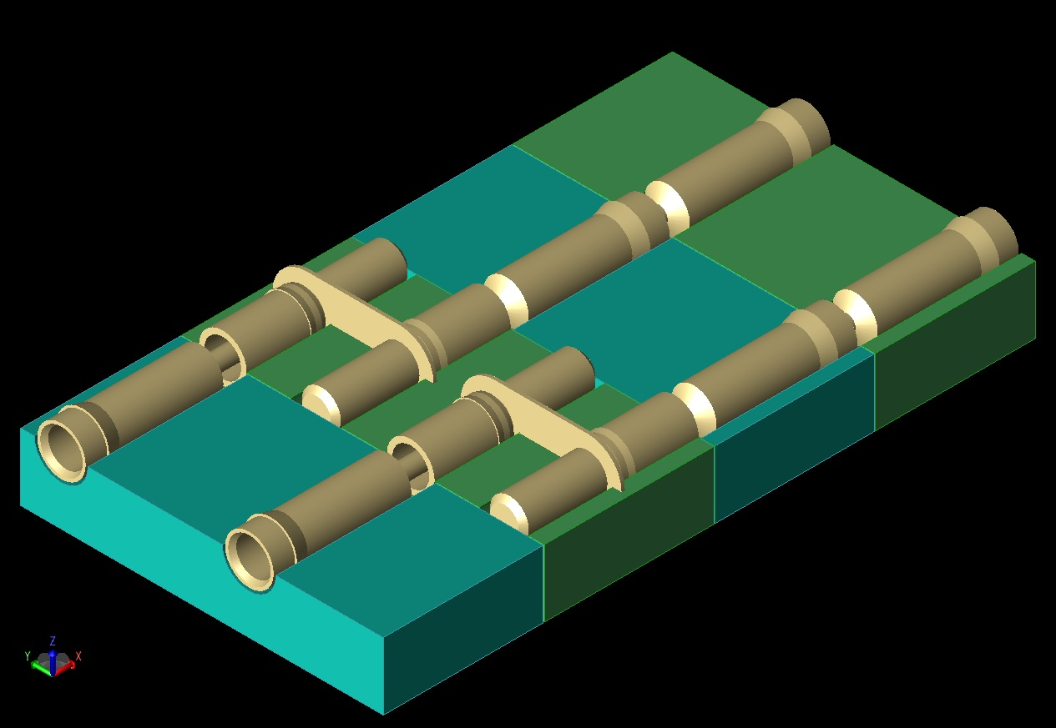
In ProtoDUNE the separation between exposed metal through-hole pads is about 0.5 mm.

