Slide 1
Engineering Analysis
Dan Wenman
DUNE PDR: APA Review
March 27, 2019

Slide 2
Contents
Charge question
Introduction
Nomenclature
Design codes
APA frame analysis
  Loading and Load Cases
  FEA Model
  Analysis of Welded connections
  Analysis of Bolted connections
  Frame results warm/1g $ 4g
  APA slot investigation
  Cool down
APA yoke
APA structural tee
APA link

Slide 3
Charge question
Are engineering analyses sufficient to ensure the design is safe during all phases, and have applicable design codes and standards been satisfied?
Note: The DUNE APA Structural Analysis can be found on EDMS at:
https://edms.cern.ch/document/2100877/1

Slide 4
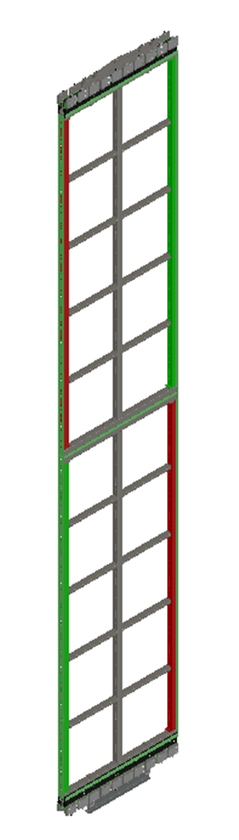
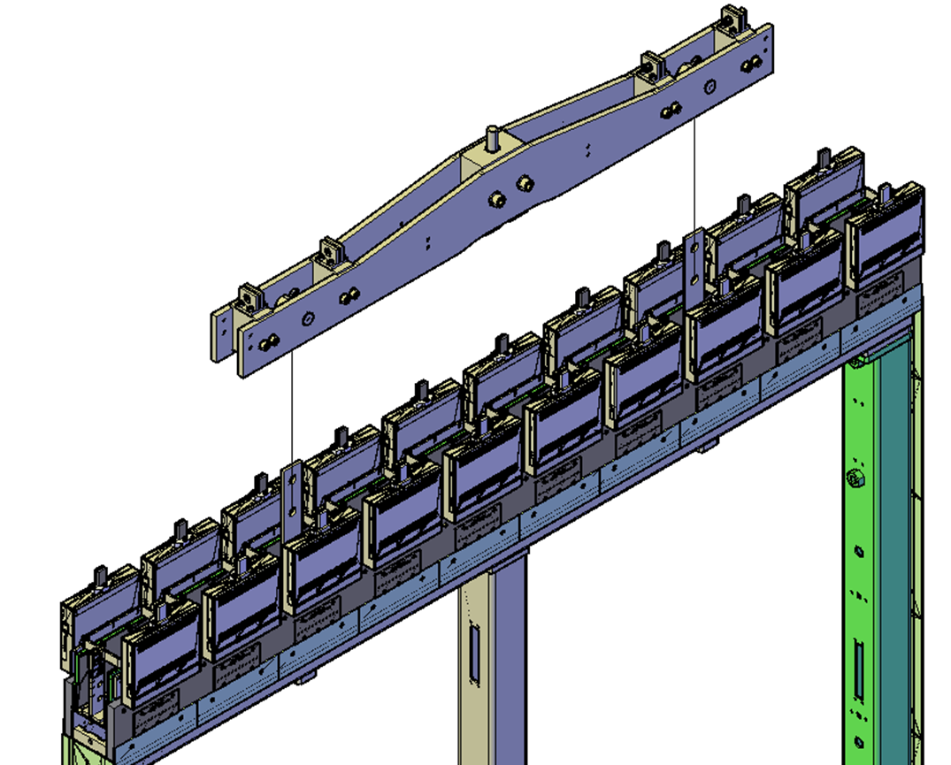
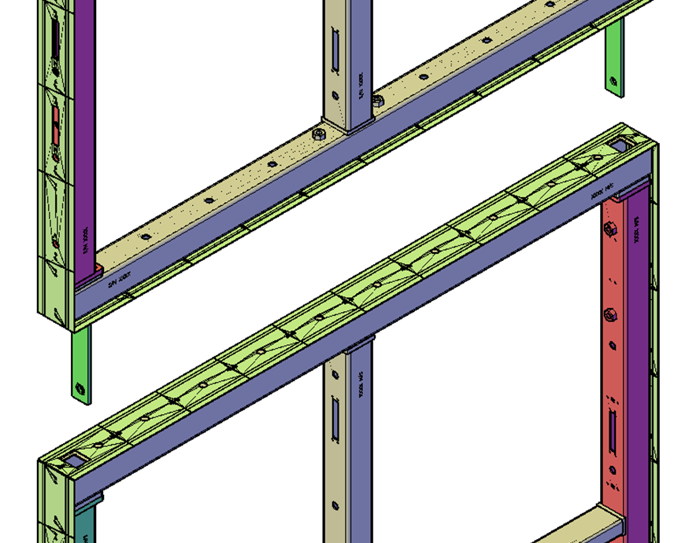
Introduction
yoke
The analysis of the APA Frame, Yoke, Structural Tee, and link for all significant load cases will be presented.
The load factors and resistance factors used for Load Factor Resistance Design (LFRD) method will be identified.
The APA structural members, welded connections and bolted connections will be checked.
Structural tees
Links
Integrated APA with yoke structural tees and links

Slide 5
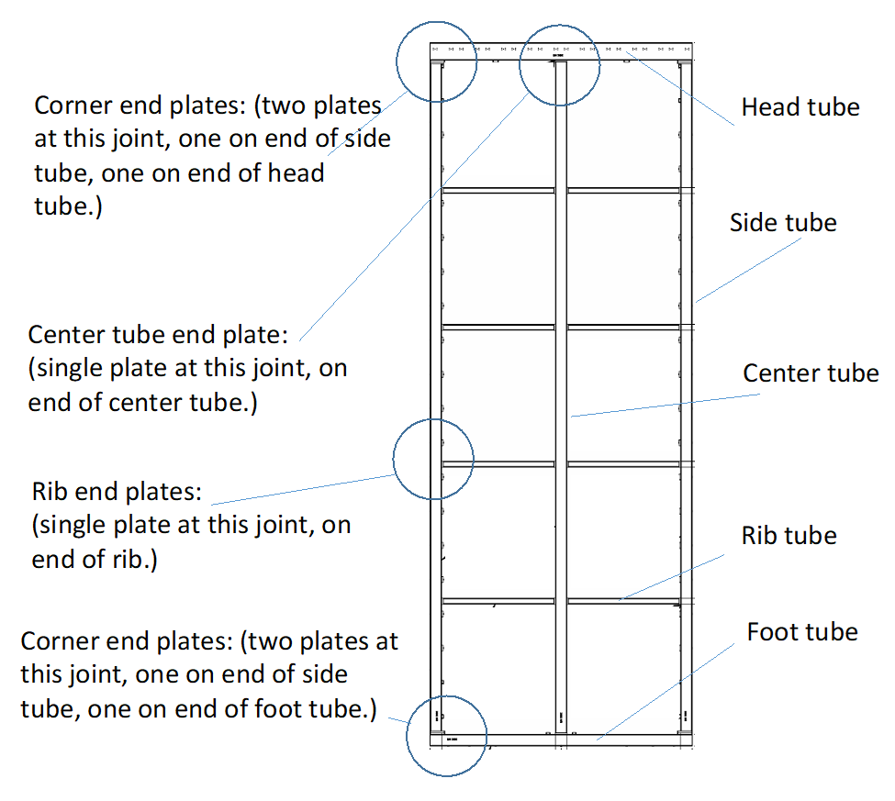
Nomenclature

Slide 6
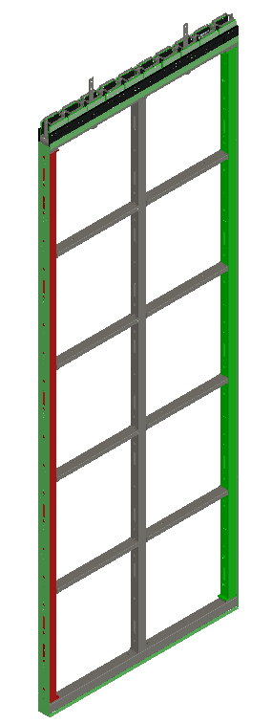
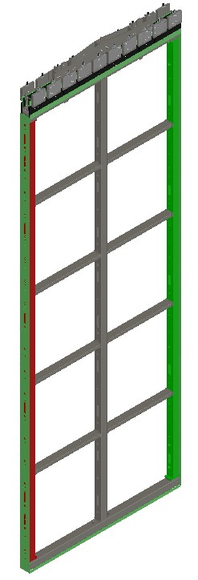
Nomenclature
Factory APA
Integrated APA (PDs not shown)
APA Pair (PDs not shown)

Slide 7
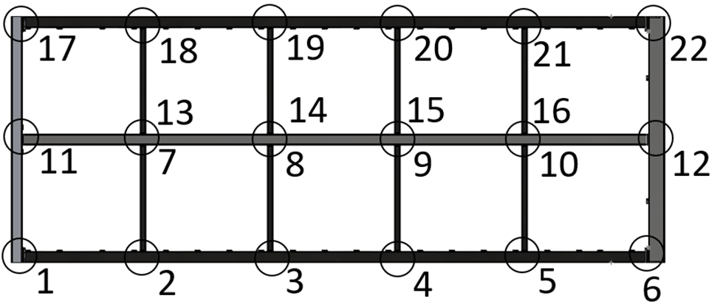
Nomenclature
PD slot (near head tube)
Labels used for frame joints
High slot tube
Low slot tube
PD slot

Slide 8
Design codes
AISC’s Specification for Structural Steel Buildings (AISC document 360-10)
Design Guide 27: Structural Stainless Steel
Load and Resistance Factor Design (LRFD) method for Stainless steel structures
  Load Factor = 1.4
  Member Resistance factor = 0.9
  Weld nominal strength factor for shear = 0.6
  Weld shear resistance factor = 0.55
  Bolt resistance factor = .75
JRC Science for Policy Report “Prospect for New Guidance in Design of FRP” as a guide for designing fiber reinforced plastics (FRP) structures
  Safety factor of 3.75 for all effects of temperature, humidity, creep and material variation.

Slide 9
APA Frame Analysis - Loading
The loading on the frame is defined in the order that the loads are applied to the frame as a frame makes its journey from the factory to final installation. Plans for the ITF are not so well understood, but worse case supporting and loading is anticipated. For example it is assumed that the APA will be handled with the edge lift kit and in the transport frame.
  APA factory
  ITF
  Transport and rigging (dynamic)
  Installation process
  Installed state and cool down

Slide 10
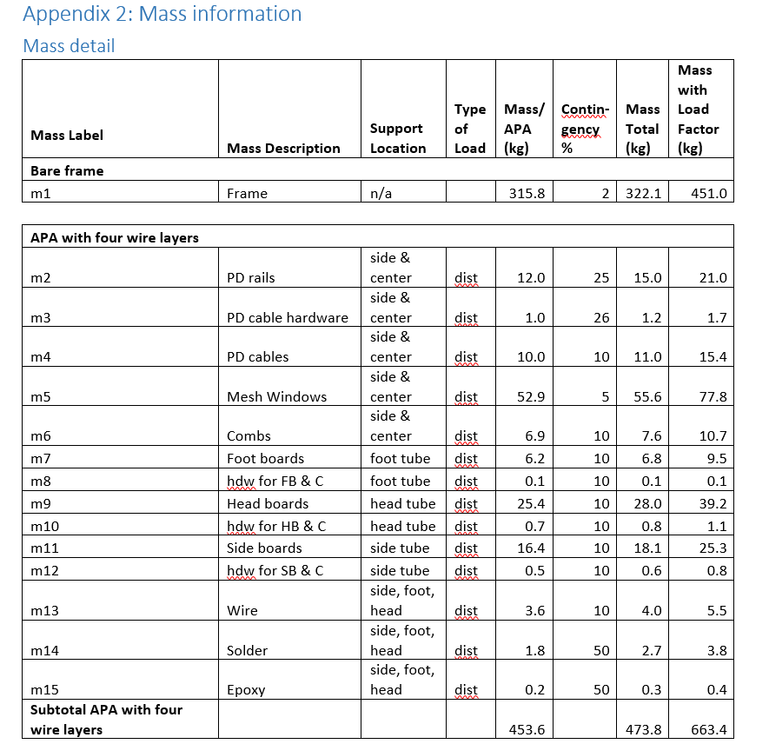
APA Frame Analysis - Loading
Masses and mass contingency

Slide 11
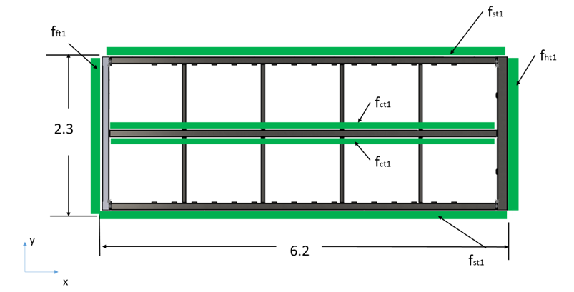
APA Frame Analysis - Loading
Application of distributed masses carried by the frame
As the APA is manufactured components are mounted to the frame. The masses of these components are assigned to the frame members as a distributed mass.
The FEA model applies gravity in the appropriate direction to convert the distributed load applied in the appropriate direction
APA with four wire loads
Integrated APA
The APA protection

Slide 12
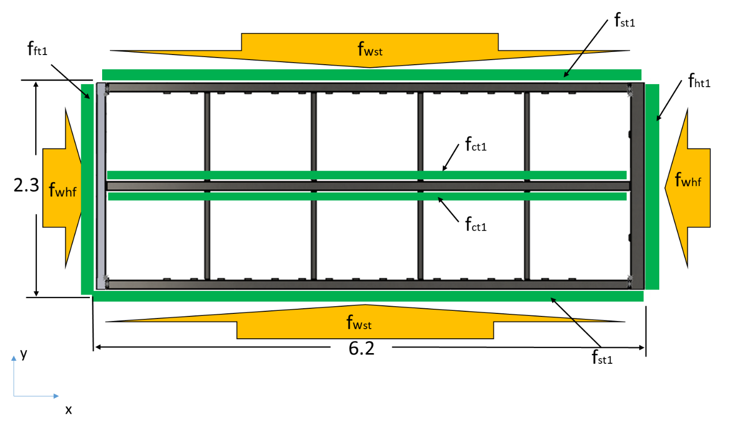
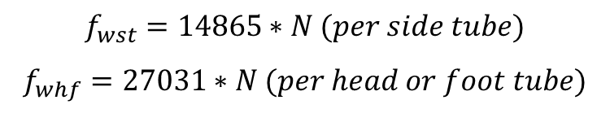
APA Frame Analysis - Loading
Wire load carried by the frame
$$f_{wst}=14865∗N (per side tube)$$
$$f_{whf}=27031∗N (per head or foot tube)$$

Slide 13
Load cases
APA factory
  1 Bare frame
  2-4 APA in the winding machine
ITF (Fully integrated APA with protection)
  5 & 6 In the process cart on edge and flat
  7 lifted by the edge lift kit
  8 Lying flat in the transport frame
Transport and rigging
  9-11 Fully integrated top APA with protection and yoke in the transport frame at 0, 45 and 90 degrees)
  12-13 Fully integrated bottom APA with protection and FC support in the transport frame at 0 and 45 degrees)

Slide 14
Load cases
Installation process
  13-14 Fully integrated bottom APA with protection supported by M20’s and by head end
  15 Fully integrated top APA with protection and bottom end supported by the structural tees
Installed state and cool down
  17 Fully integrated bottom APA with head end down supporting the FC
  18 Fully integrated top APA with bottom APA, FC, CE and CE cables
  19 APA pair with maximum spatial temperature gradient
  20 Transient thermal case on fully integrated APA pair

Slide 15
FEA model
A 3D representative model was built and Finite Element Analysis (FEA) was used to evaluate the frame.
Primary software was SolidWorks Simulation. (Independent verification was done in ANSYS).
Quadratic tetrahedral elements were used.
Stresses in frame members were calculated by FEA
Stresses in and near welds were calculated by FEA and used as reference
Forces and moments on the joints were calculated for use in code calculations.

Slide 16
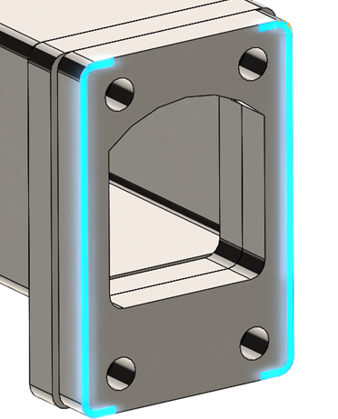
Analysis of welded connections
The weld joints are identified and reported by their joint location.
There are four different types of welds
  Pad to head or foot tube
  Endcap to side tube
  Endcap to center tube
  Endcap to ribs
Forces and moments on each joint were pulled from the FEA
The weld stresses were calculated for each weld joint per the AISC -306-10 code.
The resistance factor of .55 from Design Guide 27: Structural Stainless Steel was used.
View of pad to head tube weld. Head tube not shown.

Slide 17
Analysis of welded connections
The contribution of stresses from each of the 3 forces and 3 moments applied to the weld to determined the contribution to stress from each.
The stresses from each force and moment are summed directly or vectorially (as appropriate) to arrive at the maximum value of force per unit length applied to the weld (N/m).
The welds are also modeled in 3D FEA and the stresses evaluated. Linear FEA has difficulties capturing relavent stresses in areas of singularities and stress concentrations. Appendix 7 in the report explains the treatment of these very localized stresses

Slide 18
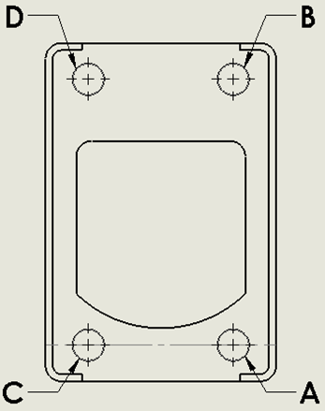

Analysis of bolted connections
Individual bolts were labeled using the joint and bolt locations with respect to the Coordinate system
Forces and moments on each joint were pulled from the FEA
The tensile and shear forces were calculated for each bolt for each load case
The Available strength of the M10 and M12 bolts was determined based on bolt size and materials (A2 Class 70 304 SS bolts and 0.75 resistance factor)
Note: It was not necessary to evaluate combined stresses because both the shear and tensile strengths where never over 30% of the available strengths

Slide 19
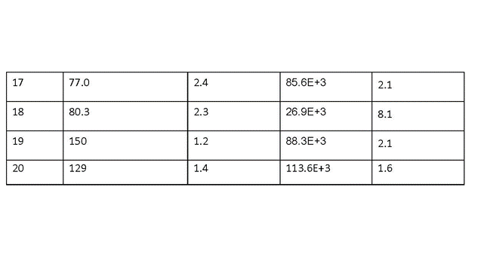
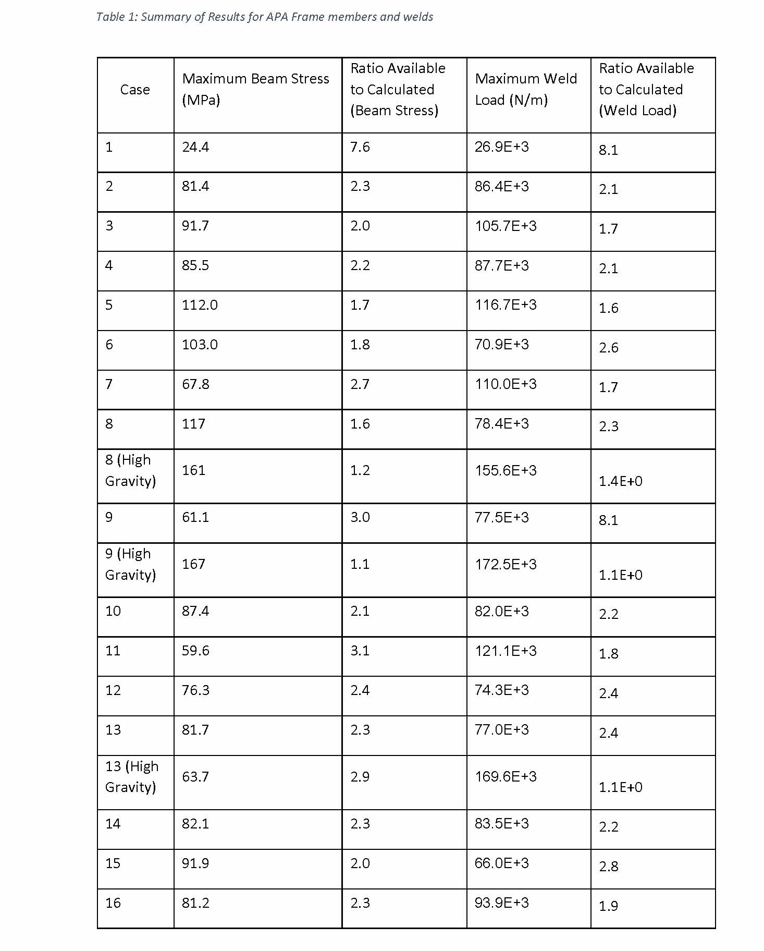
Frame Member and weld Results –
Maximum stress for each case

Slide 20
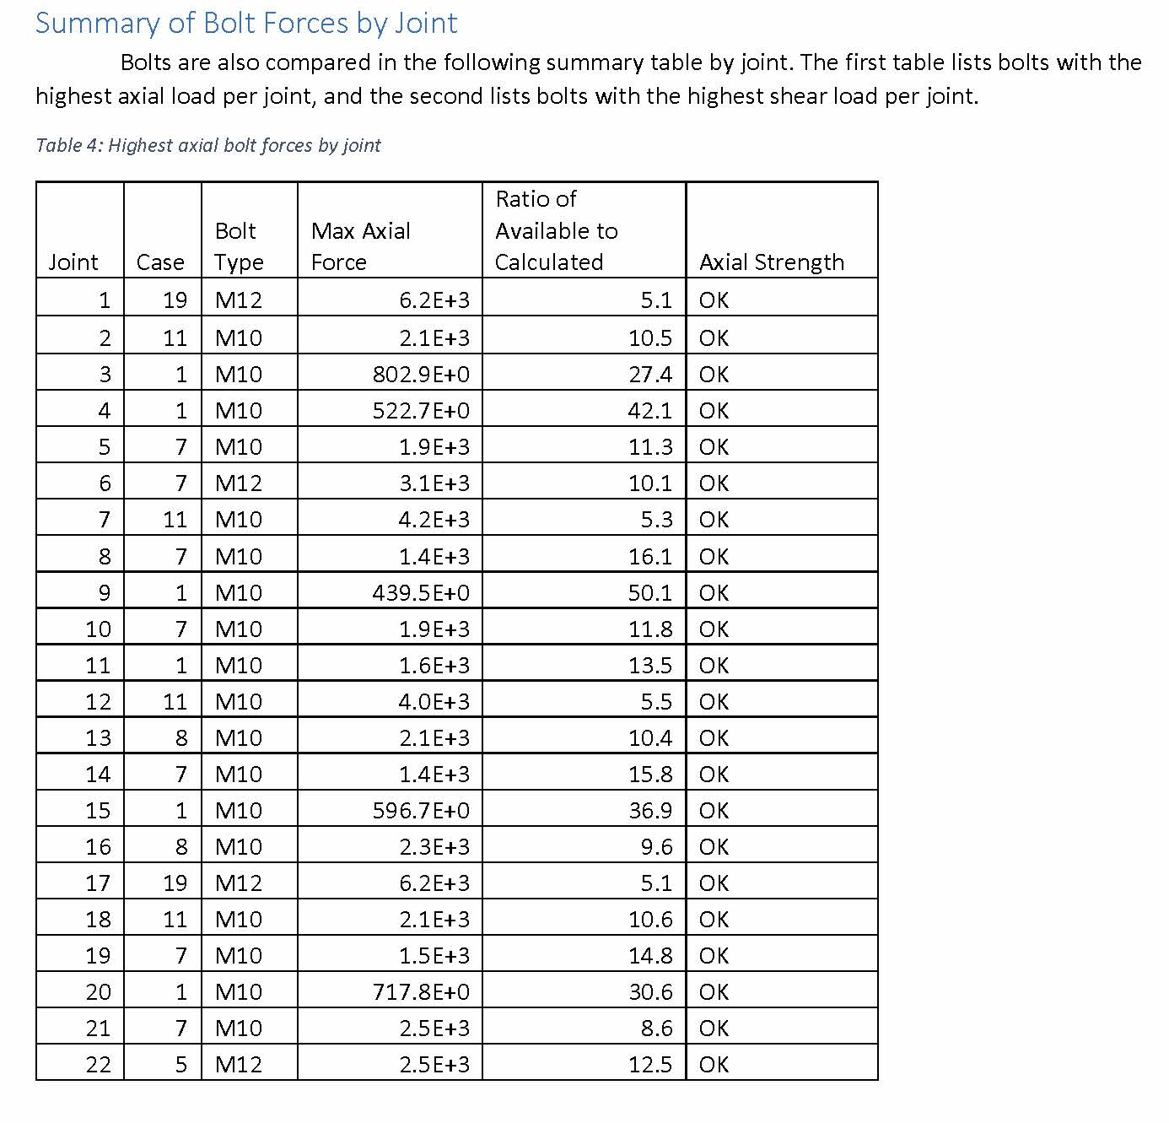
Maximum Axial Bolt Forces by Joint -1 g (N)

Slide 21
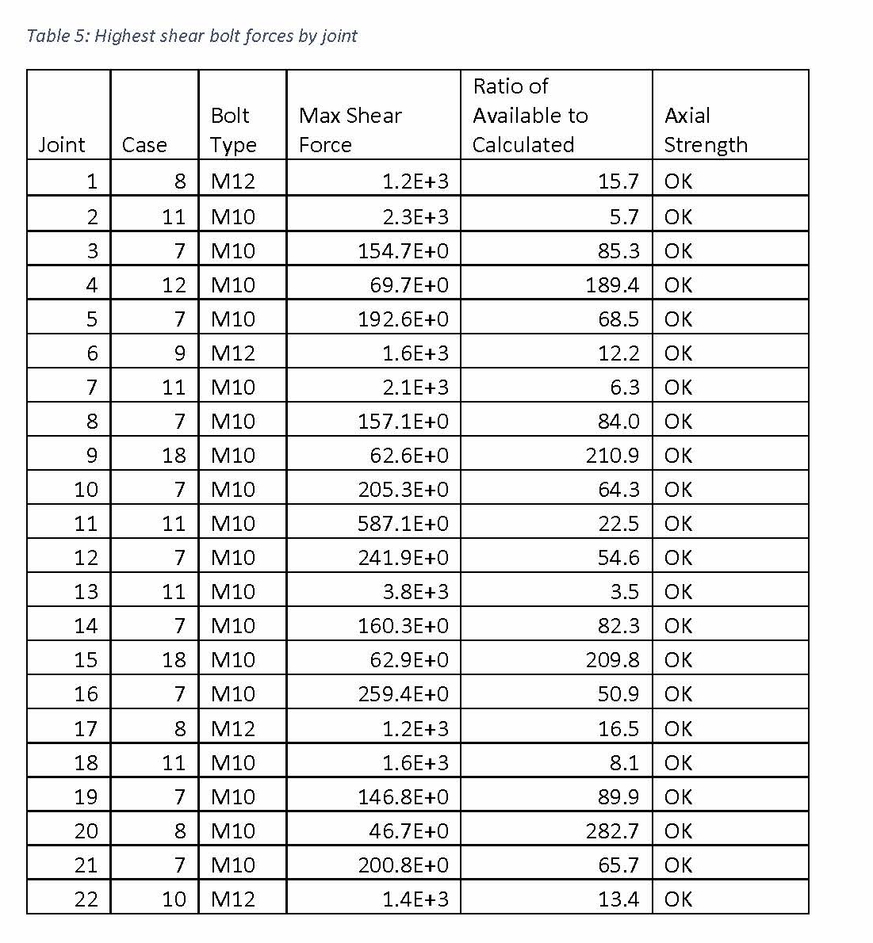
Maximum Shear Bolt Forces by Joint -1g

Slide 22
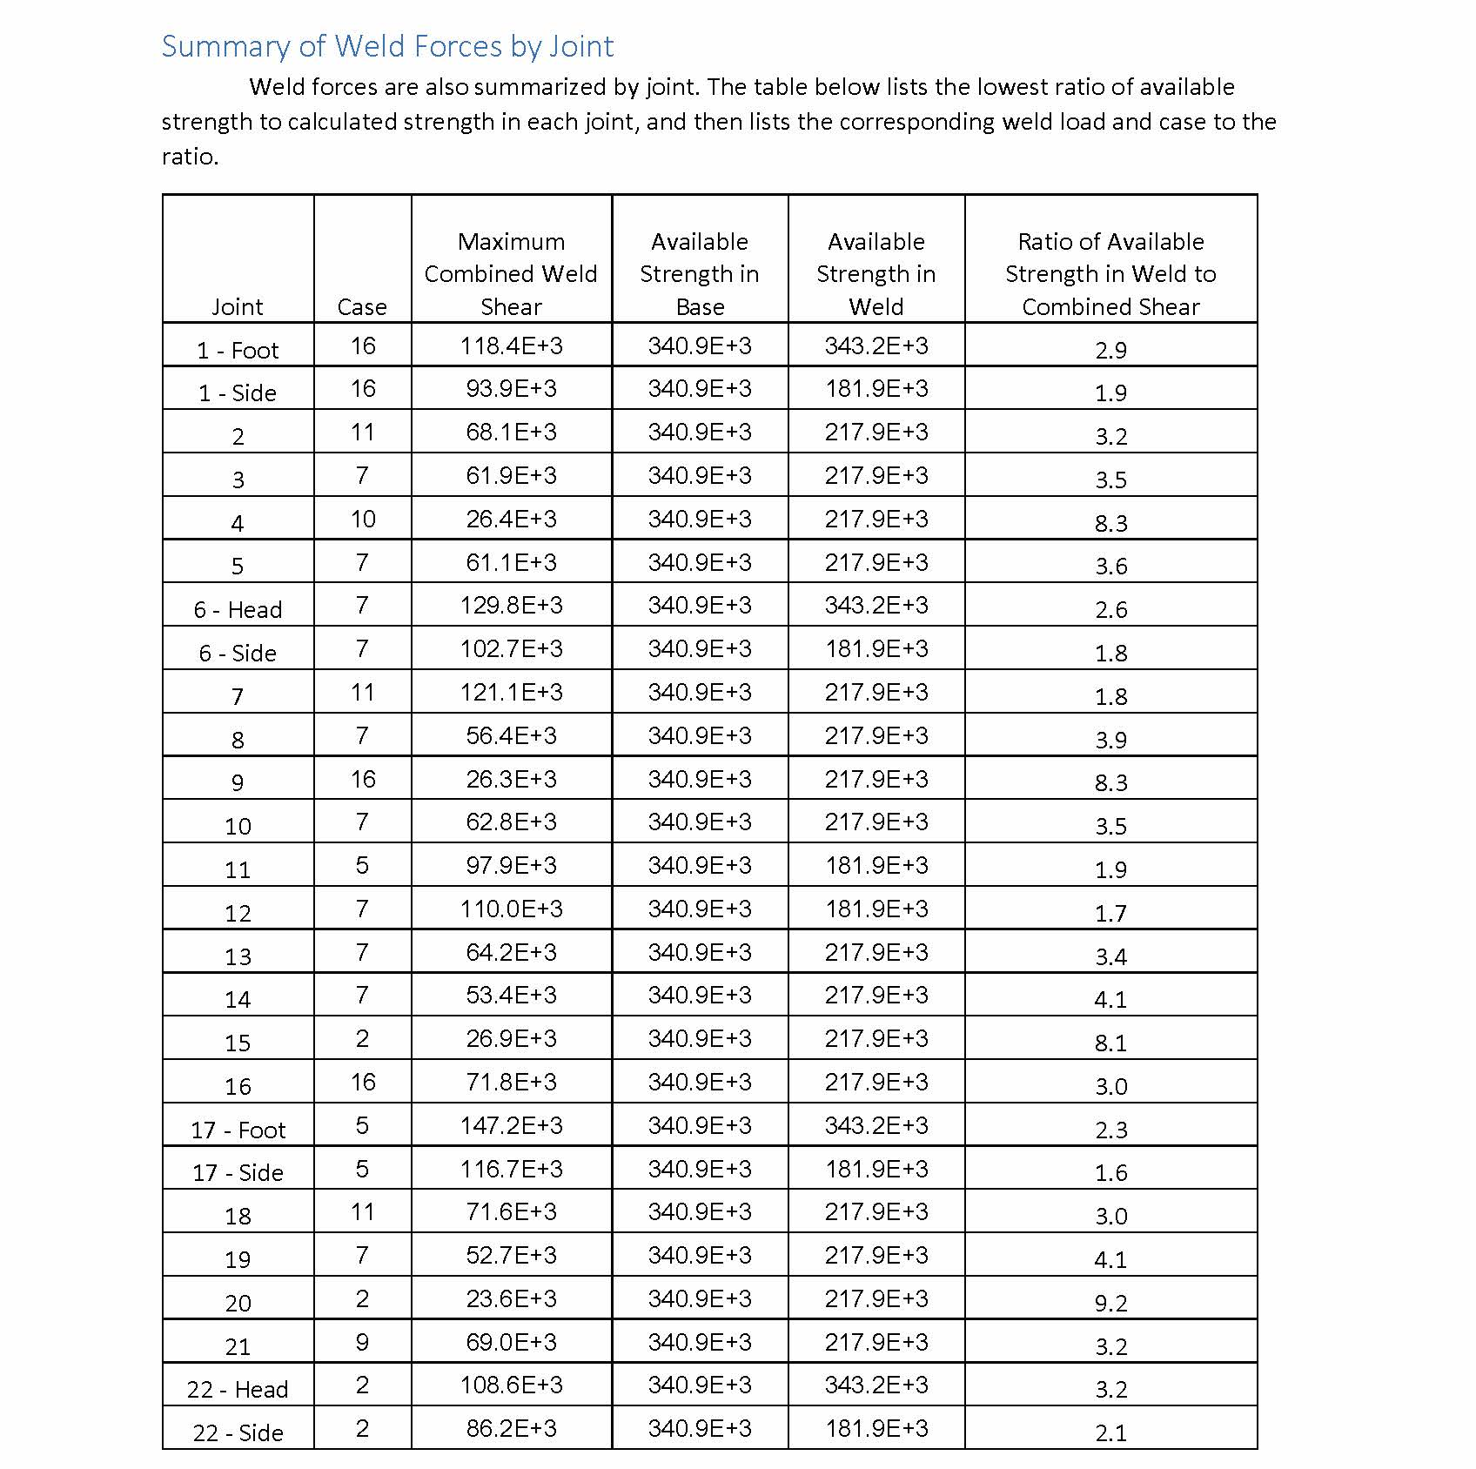
Maximum Weld Forces by Joint – 1g

Slide 23
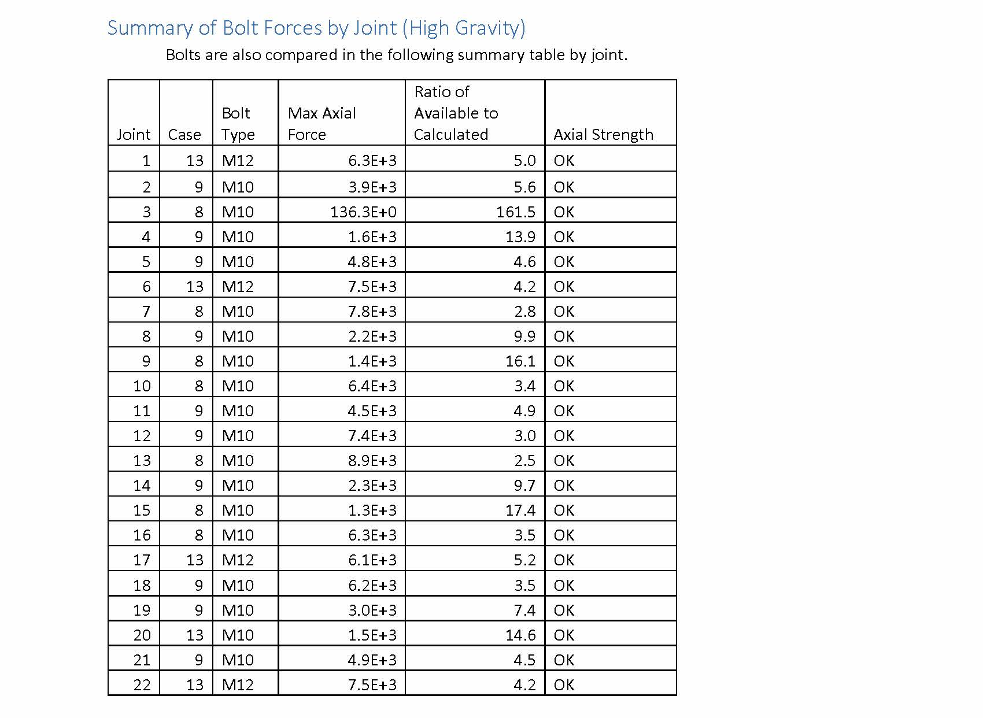
Maximum Axial Bolt Forces by Joint - 4g

Slide 24
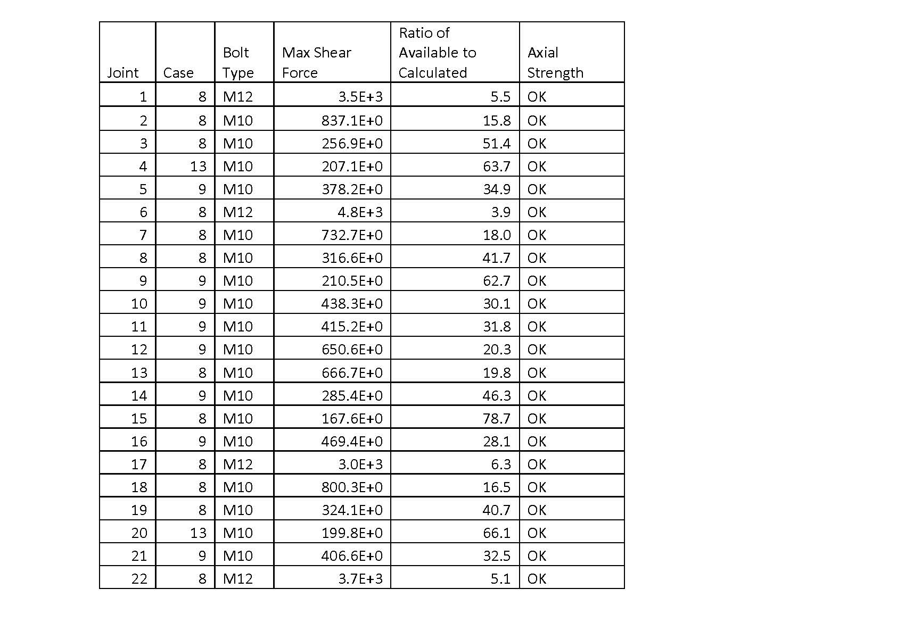
Maximum Shear Bolt Forces by Joint – 4g

Slide 25
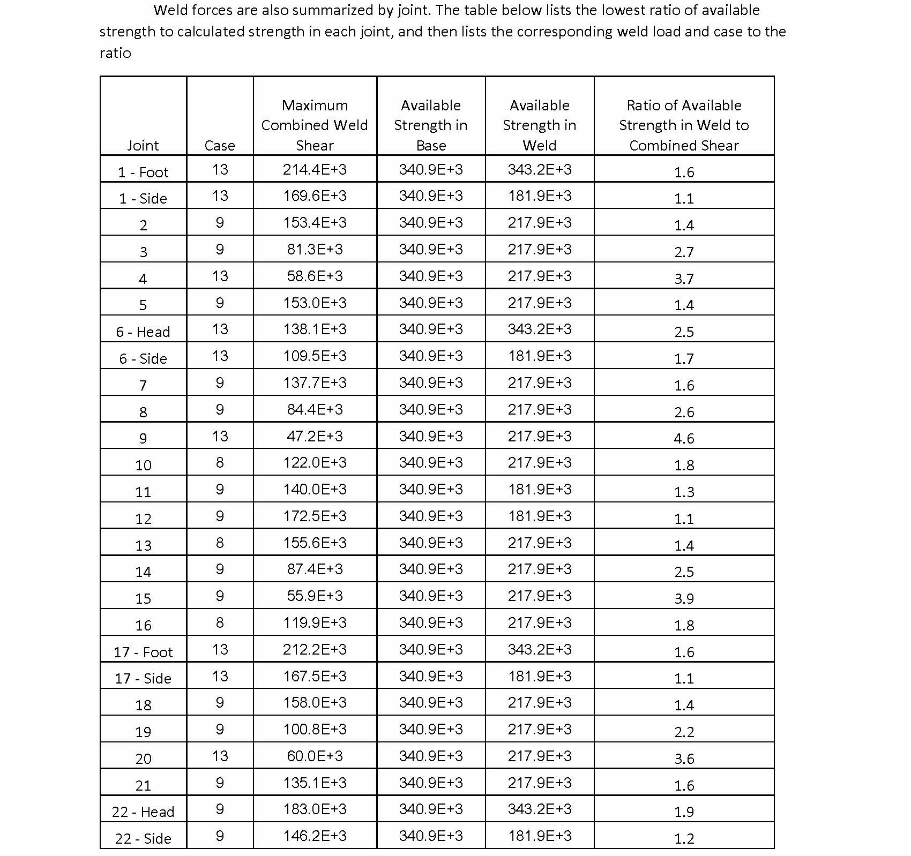
Weld Forces per Joint – 4g

Slide 26
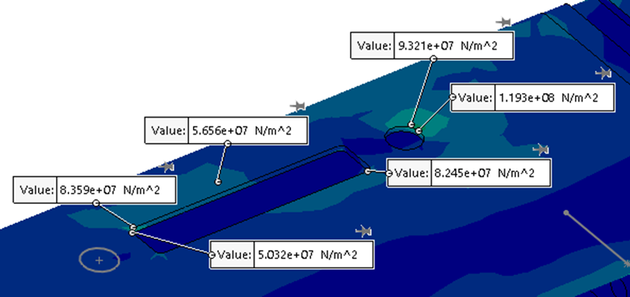
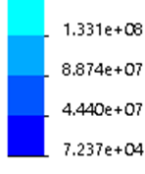
APA Slot investigation
In order to keep analysis times reasonable, the PD slots were removed from the frame.
Load case 9 with the 4g load was rerun with slots and stresses and forces checked.
Maximum stress at the edge is 119MPa.
Slots or no slots did not significantly affect Forces and Moments at the joints.

Slide 27
Cool down
When an APA is quickly cooled, the wires will cool and contract faster than the frame. This will lead to an increase in tension in the wires and subsequent loading on the frame. In this case, 9N tension is applied to the frame. A limit of 9N tension equates to a delta T between the wires and the frame of 75 degrees C and ensures that the wire bonds are not overly stressed.
For this analysis it is assumed that the wire immediately follows the gaseous Argon temperature and the frame temperature. The rate that gaseous environment can cool down without exceeding the allowable temperature must be determined.

Slide 28
Assumptions:
Temperature-dependent thermal properties for GAr and SST 304.
Cooling via free convection with film coefficients calculated using standard formulas.
  Temperature dependent properties for GAr.
  Frame temperature fixed at 300 K (conservative since film coefficients for a given delta-T increase with decreasing frame surface temperature).
No cooling where boards mounted to head, foot, and side tubes. Cooling with 1/3 of calculated film coefficient on cross tube surfaces where comb bases are mounted.
All surfaces designed to be in contact thermally bonded.

Slide 29
Results
Note: Because the film coefficients were calculated for a fixed temperature difference of 75 degrees, max frame temperature is generally understated so the temperature difference between wires and frame is expected to be larger than what is calculated. However, given that the calculated maximum frame temperature does not at any time cross the uppermost curve, denoting a 75 degree temperature difference, it is assured that the actual temperature difference will not exceed 75 degrees since this would require film coefficients which are smaller than those calculated for that temperature difference.
Therefore, this analysis shows that the temperature difference cannot exceed 75 degrees if cooldown is at or slower than 10800s (3 hours).

Slide 30
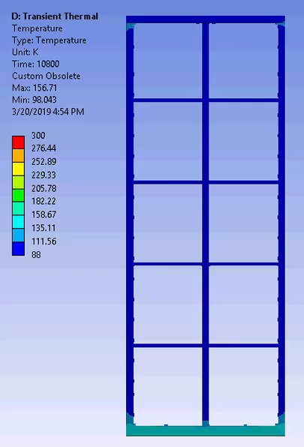
Results

Slide 31
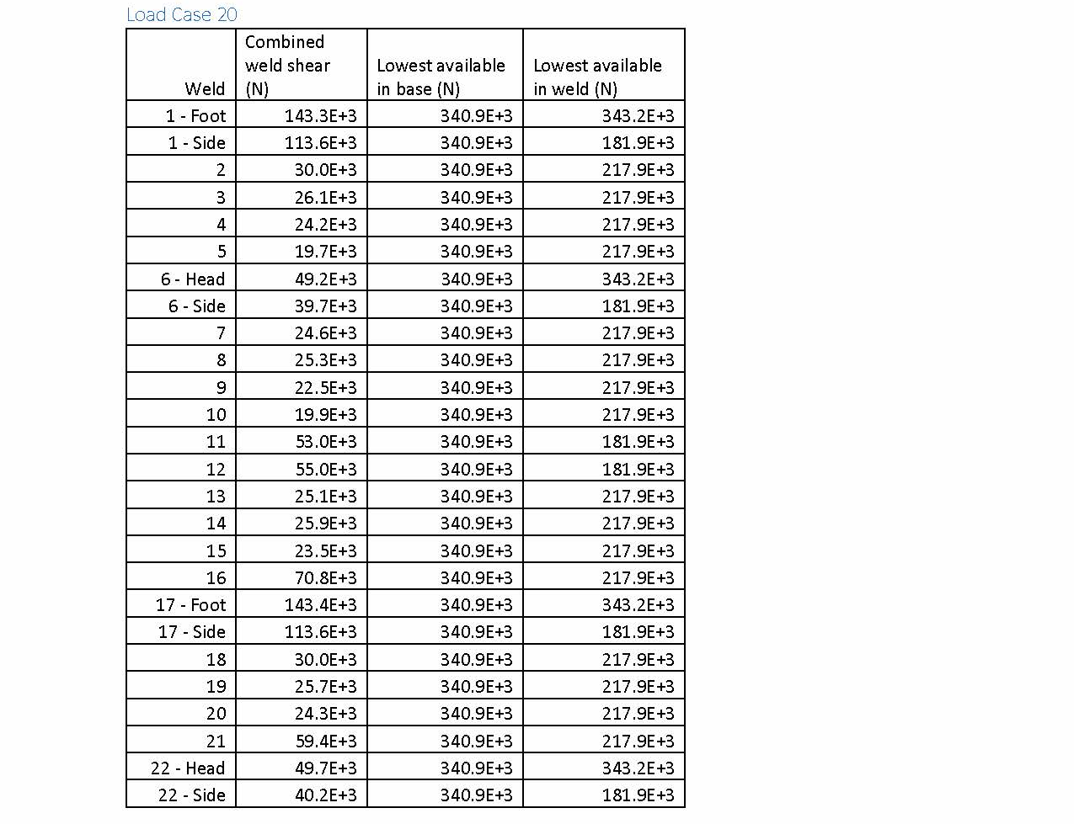
Weld Forces in Case 20 – High Tension

Slide 32
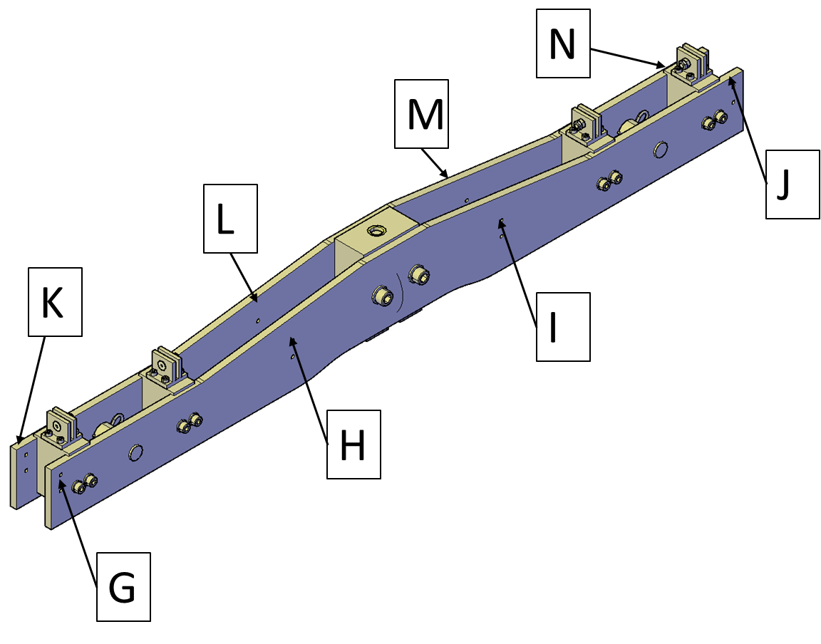
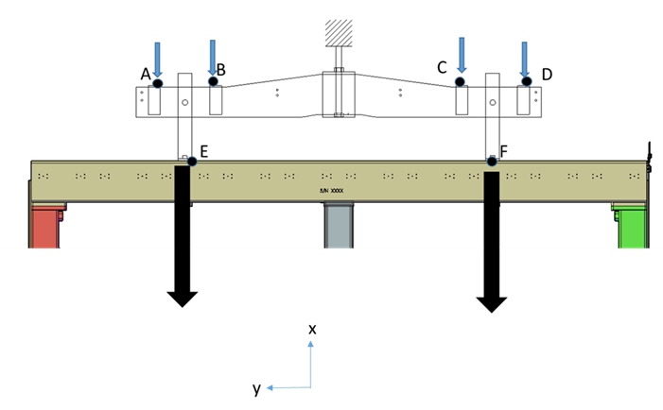
APA yoke – Installation case
Unbalance cable load on APA
Inputs:
FA=FB=FC=FD==4.6 kg
FE=FF=960 kg

Slide 33
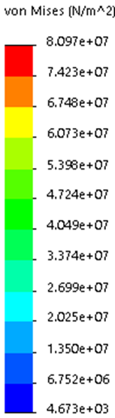
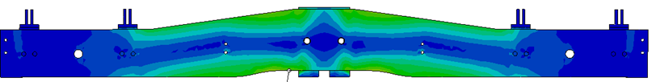
APA yoke – Installation case
Unbalance cable load on APA
Results: Peak stress =81 MPa

Slide 34
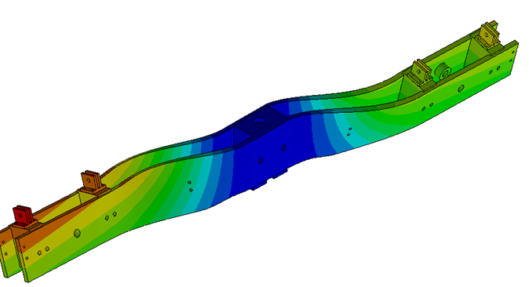
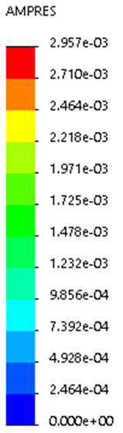
APA yoke – Installation case
Unbalance cable load on APA
Results: 1st buckling load factor = 37.2

Slide 35

APA yoke – Installed APA
TOP CE cable tray transferred to DSS
Inputs:
FA=FB=FC=FD==50.3 kg
FE=FF=1052 kg

Slide 36
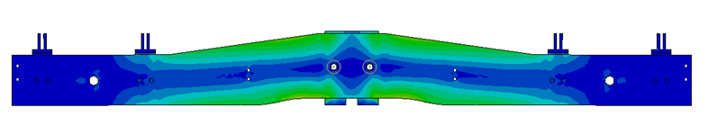
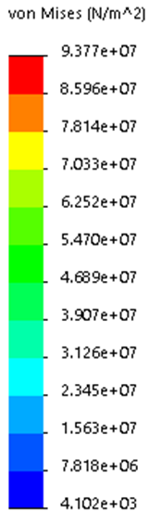
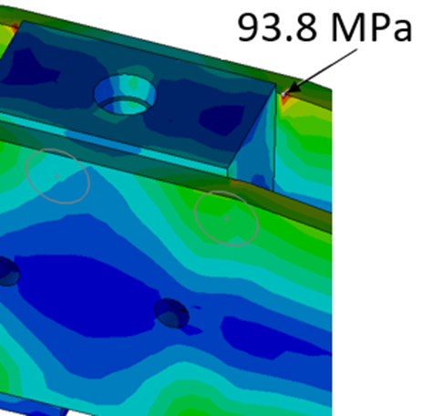
APA yoke – Installed APA
TOP CE cable tray transferred to DSS
Results: 93.8 MPa

Slide 37
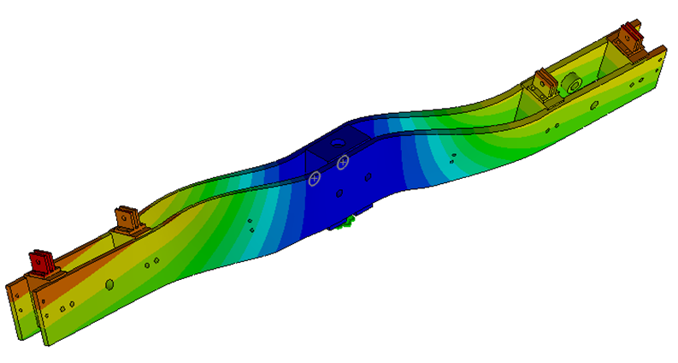
APA yoke – Installed APA
TOP CE cable tray transferred to DSS
Results: 1st buckling load factor = 33.0

Slide 38
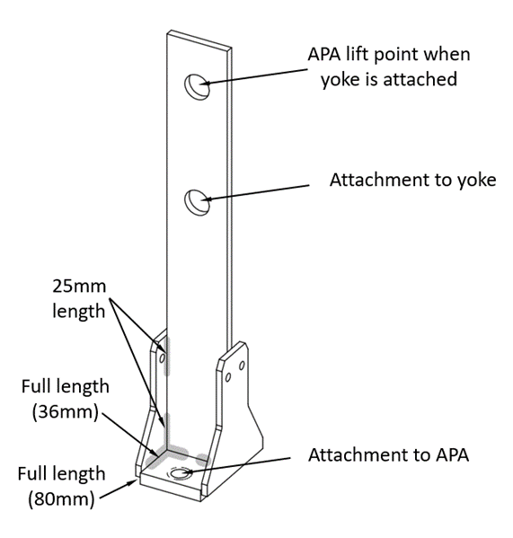
APA structural tee
11260N
Dimensions per drawing:
Loads: See figure.
Required Strength = 11260N
810N
10450N
Loads on the structural tee

Slide 39
APA structural tee
Required Strength = 11260N
Vertical pinned link
Tensile rupture on net section
  Available = 74600N
Tensile yielding on gross section
  Available = 60100N
Tensile yielding on net section
  Available = 38850N
Shear rupture on effective area
  Available = 80820N
Bearing stress between pin and hole
  Available = 35940N

Slide 40
APA structural tee
Welds
Available strength = 350N/mm
Unit load on vertical link to gusset welds = 52N/mm
Unit load on gussets to base plate welds = 34N/mm

Slide 41
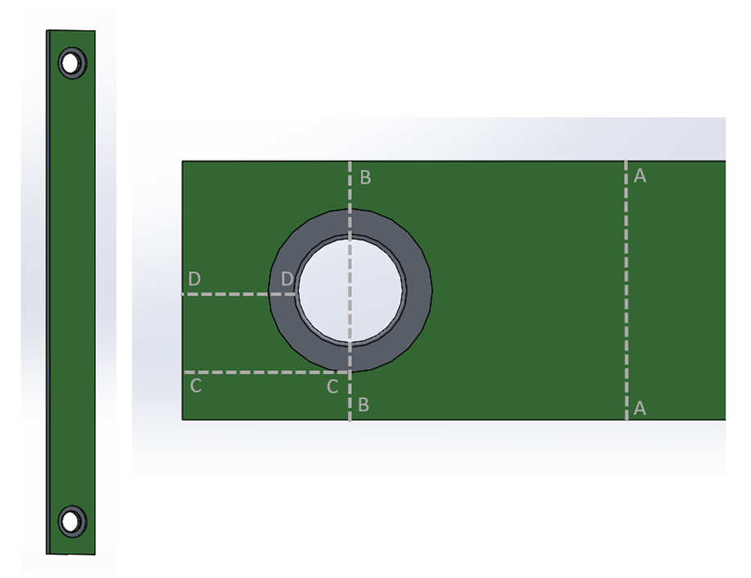
APA to APA link
Dimensions per drawing:
Load: 4436N
4436N
4436N
Loads on the APA to APA link

Slide 42
APA to APA link
Results:
Required Safety factor for FRP 3.75
Tensile rupture on net area (line B-B)
SF = 10.7
Tensile rupture on gross area (line A-A)
SF = 17.9
Shear rupture on effective area
SF = 9.6
Bearing stress between pin and hole
SF = 7.2

Slide 43
APA to APA link
Assumptions:
Evaluation of stresses in the link due to the foot tube in the bottom APA cooling faster than the foot tube in the top.
Temperature assumptions:
Thermal special gradient at 17K/m
Head end of the bottom APA in LAr and foot tube at 88K
Top APA at temperature 9 m above the LAr = 241K

Slide 44
APA to APA link
The difference is shrinkage between the top and bottom = 4.6mm
The deflection at the midpoint of one link is 1.15mm.
The force to deflect the link 1.15 mm is 4N..
4N is insignificant compared to the 4436N supported by the link.

Slide 45
Conclusion
FEA model and results have been verified in an independent analysis using ANSYS vs SolidWorks for the Case 17.
The available strength of the APA structural members, weld joints, and bolted joints exceed the required strength:
  For all cases under normal loading and room temperatures
  For shipping and handling cases when a 4g acceleration is applied.
  When subjected to a 17k/m spatial gradient or a linear cool down from room temperature to LAr temperature in 3 hours.
The available strength of the yoke exceeds the required strength.
The available strength of the structural tee base material and welds exceeds the required strength.
The “ASD” safety factor of the link exceeds the minimum required.

Slide 46
Back ups

Slide 47
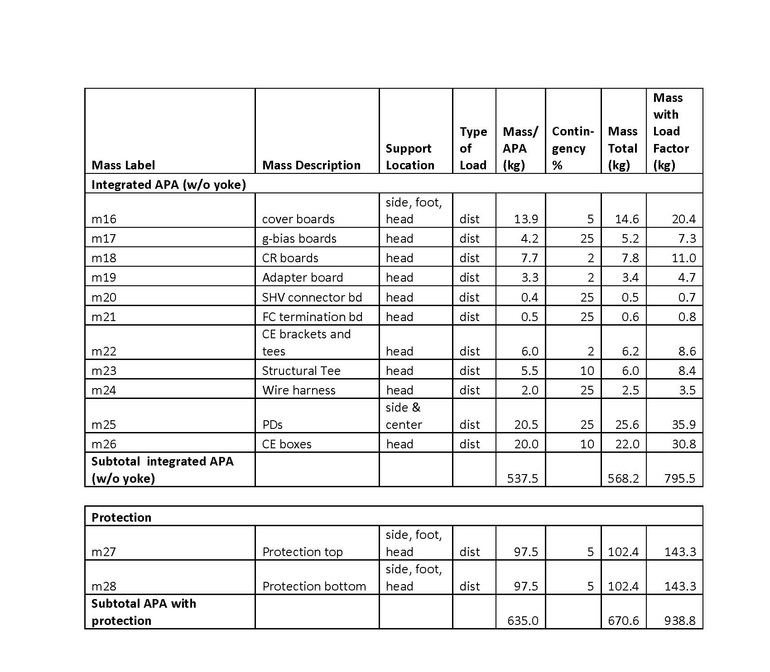
Weight of an APA

Slide 48
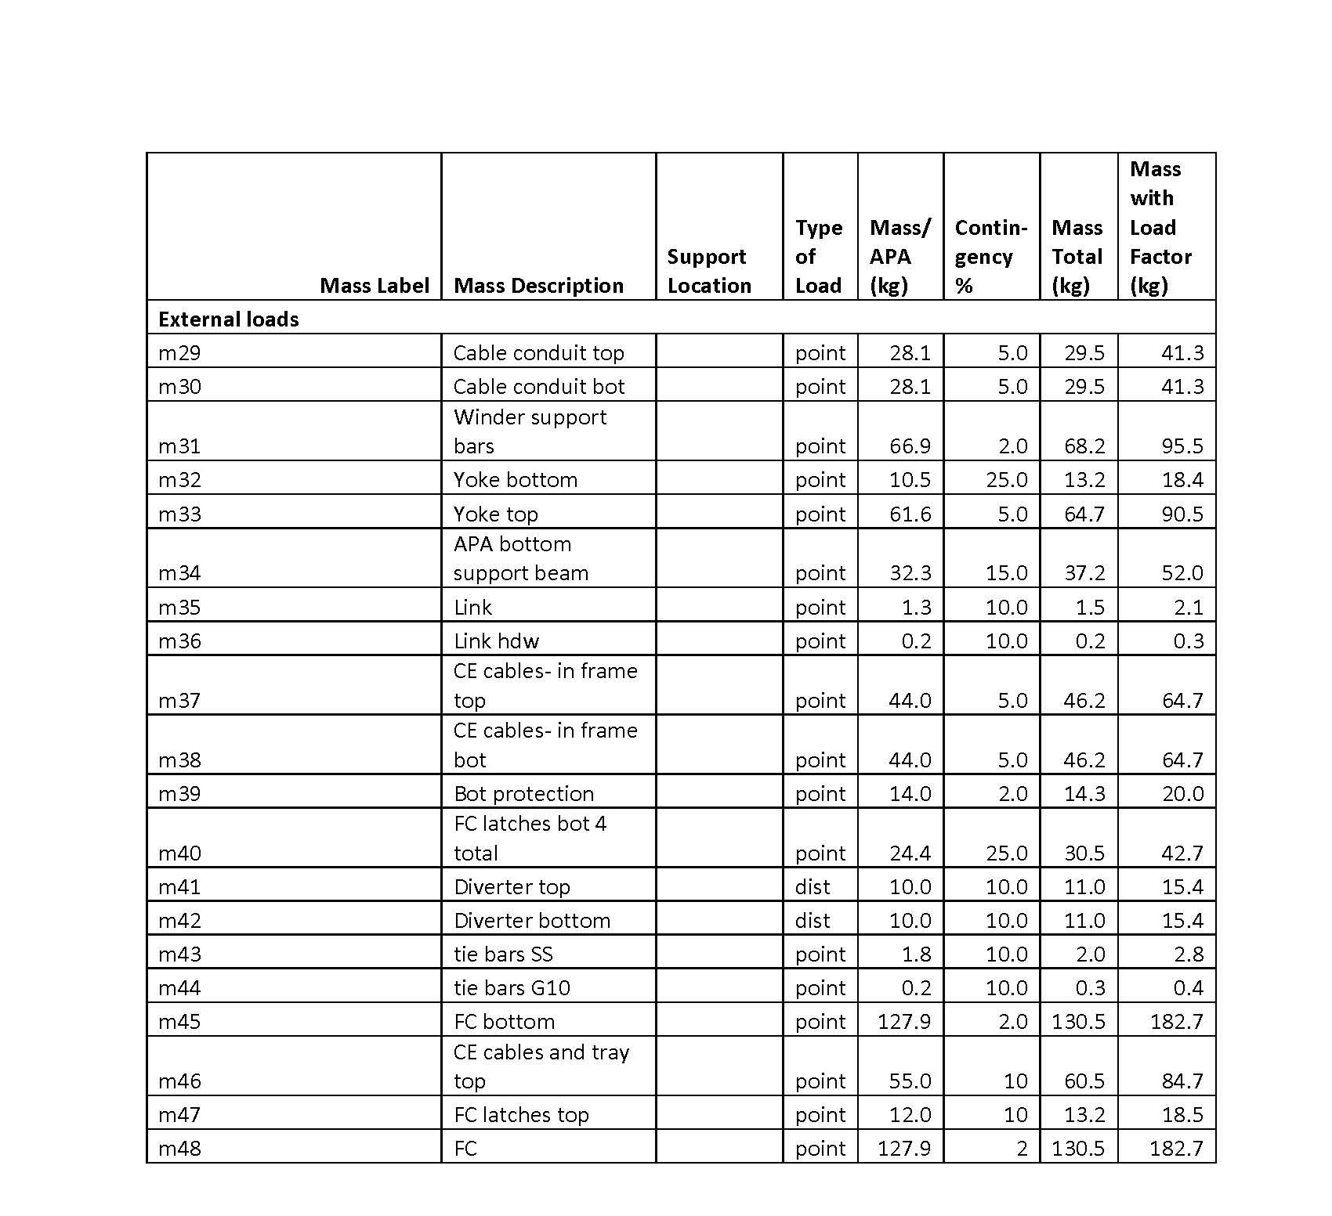
Weight of an APA

