Slide 1
DUNE APA Prototyping
R. Paulos
DUNE APA PDR
27 March 2019

Slide 2
First, a little history
There have been many prototyping efforts of APAs over the past seven years or so –
2012: a 40 percent scale APA was built based on the continuously wound concept of Bo Yu.
2013: first full scale frame was built, this frame was 7m x 2.5m and was a weldment
2015: four small APAs were built for use in the 35T cryostat at FNAL
2015/16: the first 6m x 2.3m frame was built in the “bolted joint” style
2017/18: six APAs were built in the US and UK for use in ProtoDUNE
2018: a small (~ 1m) APA was built for use in CE testing (ICEBERG)
2018/19: one additional ProtoDUNE style APA built in the UK
2 27 March 2019 Robert J. Paulos

Slide 3
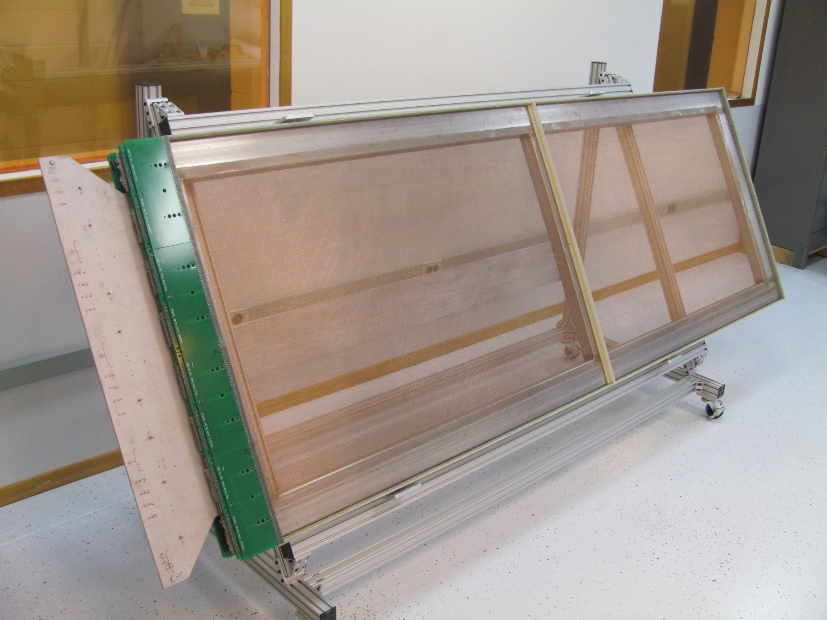
40 percent scale APA
built at PSL. The concept originated with Bo Yu. It was a continuously wound
concept – winding was done essentially by hand. The U and V plane wire angle was 45 degrees at that time.

Slide 4
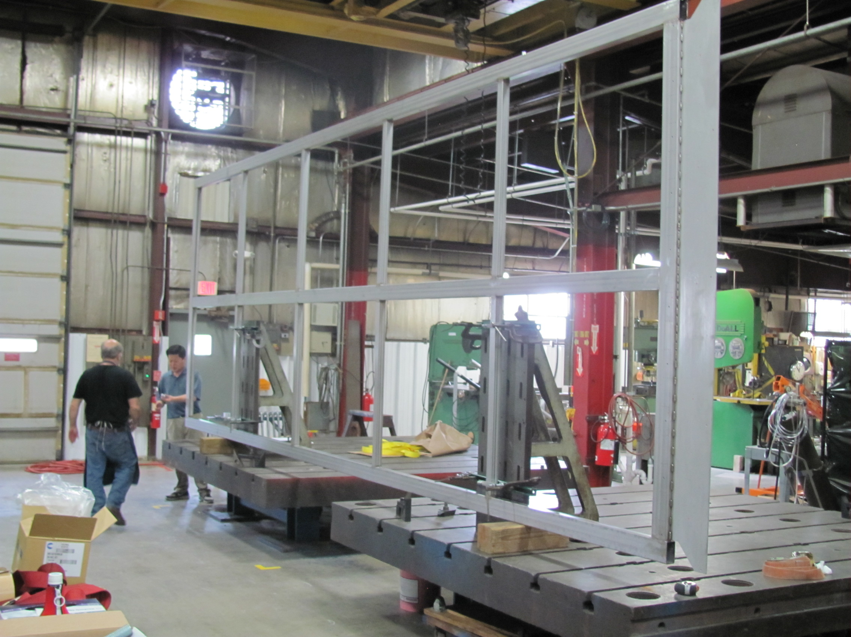
A 7m x 2.5m frame was built in 2013. This frame was a monolithic weldment. It was time consuming to build and flatness was difficult to achieve. Note the fin at the head.

Slide 5
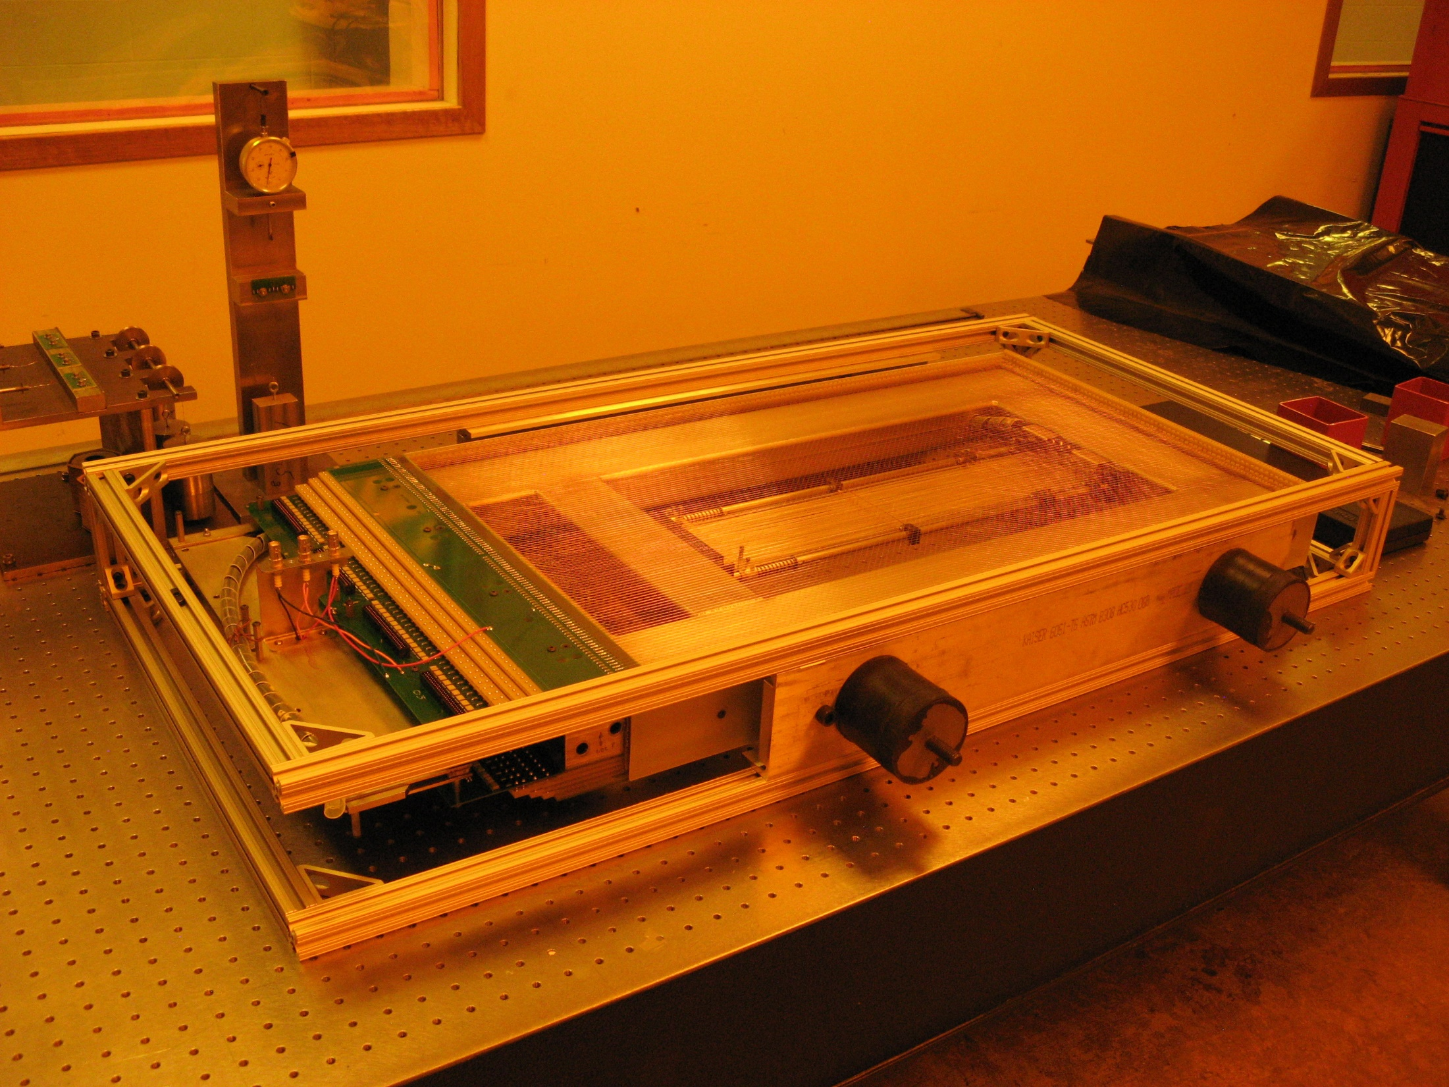
35T APA fully assembled and ready to ship.

Slide 6
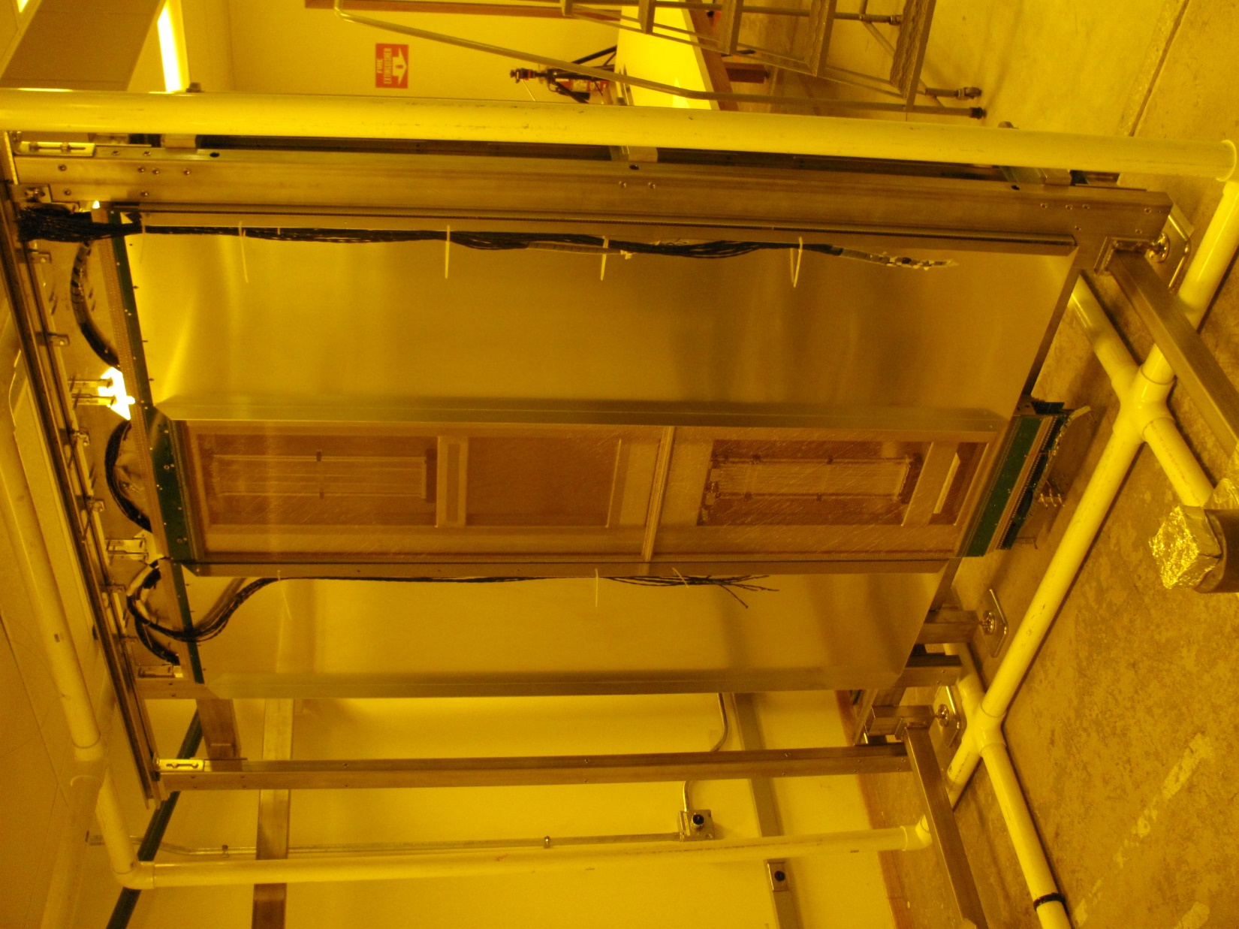
Two 35T APAs during the TPC trial assembly at PSL.

Slide 7
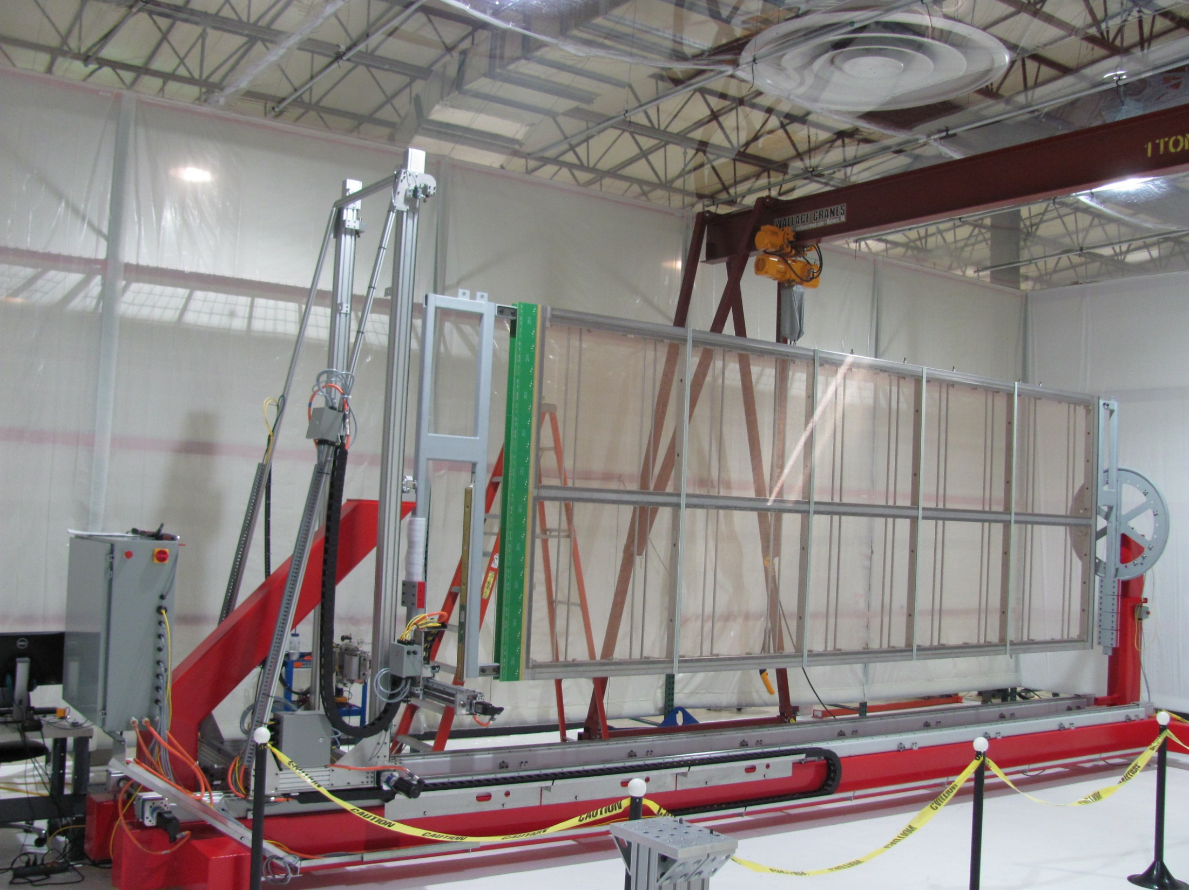
Full scale ProtoDUNE APA in the winder. The fundamental difference between these APAs and those planned for the far detector is the thickness of the frame material and the addition of conduits for routing CE cables.

Slide 8
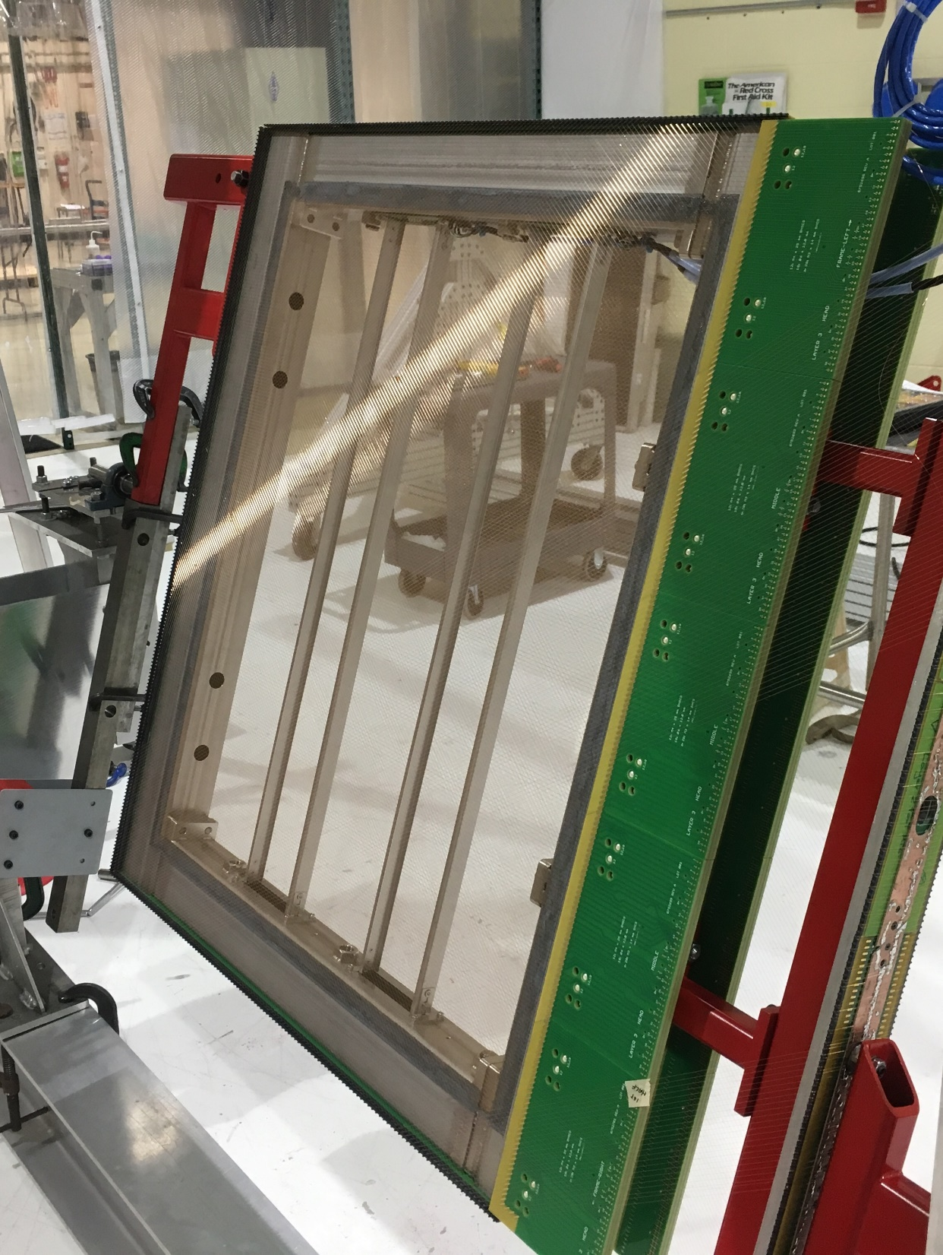
CE test APA (ICEBERG) built during summer of 2018. This APA is about 1.1 m on a side but otherwise shares many of the same characteristics as ProtoDUNE

Slide 9
Next prototyping steps
Frames for Ash River
Pre-production board sets
Pre-production prototypes in the US and the UK
Additional tests at CERN in ProtoDUNE cryostat
9 27 March 2019 Robert J. Paulos

Slide 10
Frames for Ash River
Building two frames at PSL (parts are in fabrication now)
These frames are of the new 4 inch tube design
Will include the new “conduit” feature for routing CE cables
Will include a yoke and tees for supporting two APAs – this is a new design but similar to the ProtoDUNE
Will include link hardware that connects the upper and lower APA
10 27 March 2019 Robert J. Paulos

Slide 11
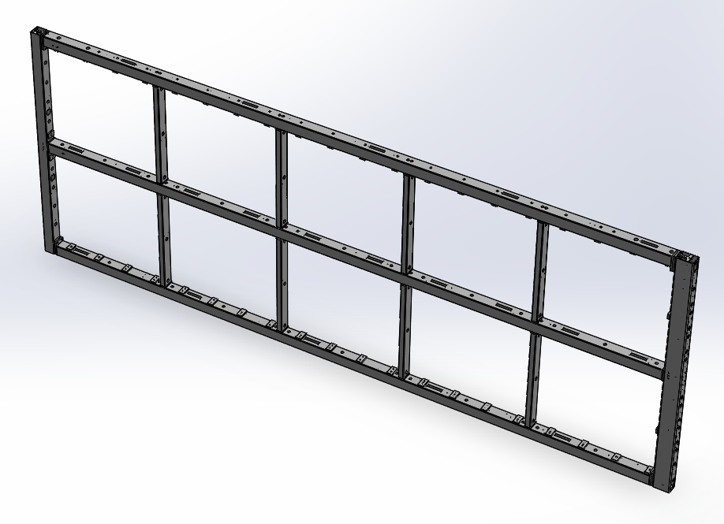
APA Stainless Steel Frame
High slot side
Foot end
Low
slot side
Head end
11 27 March 2019 Robert J. Paulos

Slide 12
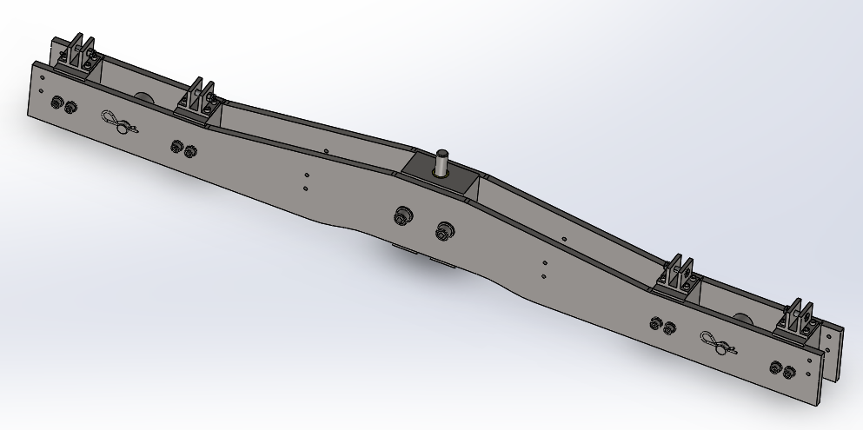
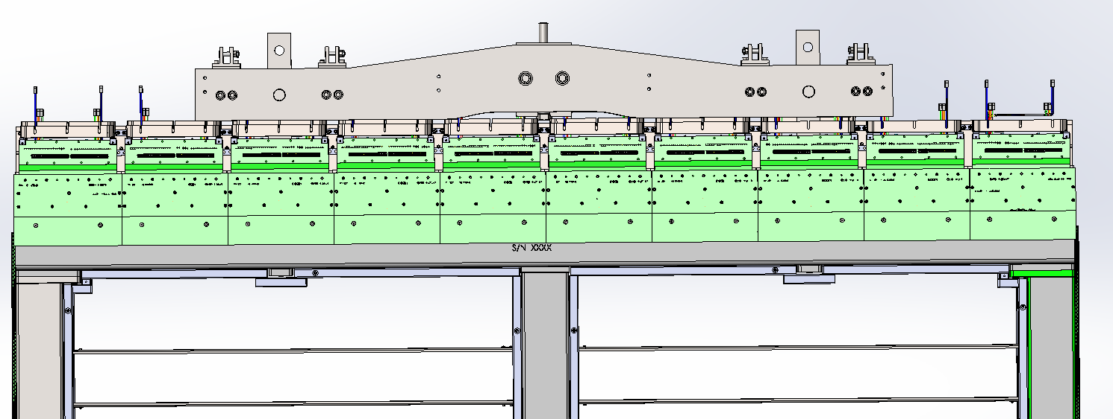
Upper Yoke
This part connects the upper APA to the detector support structure.
It supports the weight of both the upper and lower APAs.
It will be installed on the APA underground - just before the APA is rotated to a vertical position.
12 27 March 2019 Robert J. Paulos

Slide 13
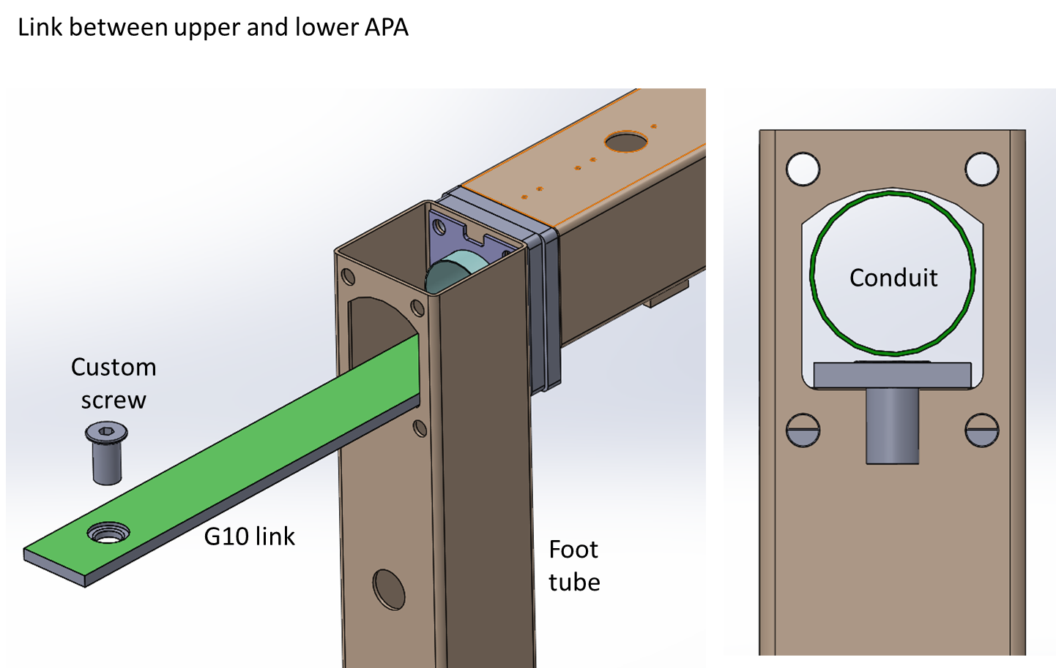
Changes from ProtoDUNE to DUNE
The link is new to DUNE because there was no lower APA in ProtoDUNE. The link fits along the inner surface inside the side tube. The screws screw in to heavy plates welded to the outside of the side tube.
Plate
The link has been planned in G10 – and calculations show good safety margin. However, we are going to consider making it stainless steel for increased strength, with G10 linings to insulate it from the frame.
13 27 March 2019 Robert J. Paulos

Slide 14
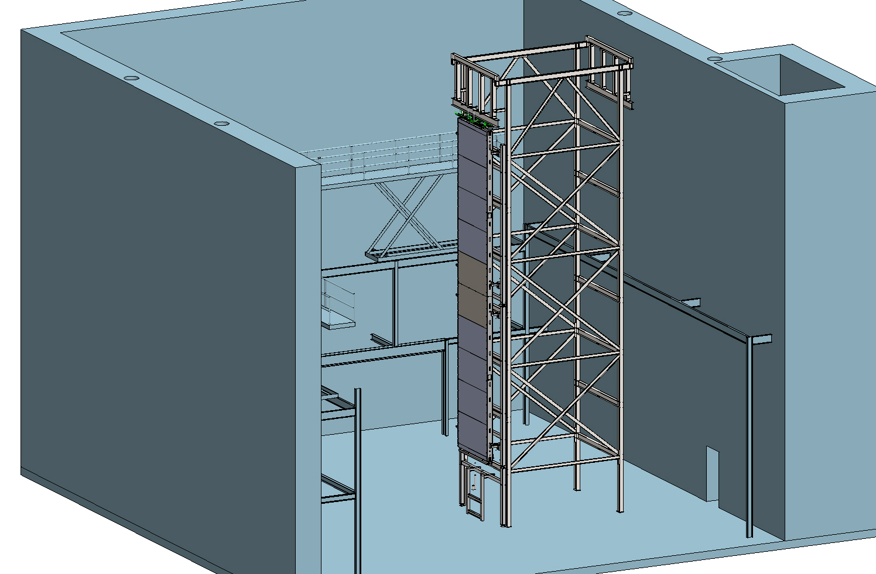
Ash River test setup
Two frames will be shipped to Ash River end of April for use in testing APA installation procedures underground
14 27 March 2019 Robert J. Paulos

Slide 15
Board prototypes
Building three sets of PC boards (board orders underway)
As has already been described there is a complicated set of boards and features that are not traditional (thickness, milled edge, etc.)
We will use this prototyping run to identify new vendors
This was a challenge during ProtoDUNE, only one vendor had both reasonable cost and delivery (Imagineering).
Finding even one additional vendor will be important for production work
Two sets of these boards will be used in the fabrication of pre-production prototype APAs assuming they meet specifications
The third set will be used for test purposes
New custom pins and sockets will also be prototyped and evaluated
15 27 March 2019 Robert J. Paulos

Slide 16
Pre-production prototype APAs
In the US we plan to build two pre-production prototypes starting in fall 2019
This is an opportunity to exercise improvements to processes and design that have been planned since ProtoDUNE and to also bring new consortium members into the manufacturing process before full production occurs
These prototypes will be shipped to CERN for use in the next generation ProtoDUNE test (the exact nature of the configuration to be tested is under discussion)
16 27 March 2019 Robert J. Paulos

Slide 17
UK Prototypes
The plan is to build two (possibly four) APAs starting summer of 2020 that will then be shipped via the new custom shipping container to CERN
Once at CERN the quality steps worked out during the ProtoDUNE program will be executed (inspection, survey, wire tension tests)
Next, the APAs will have CE installed for testing in the CERN vertical cold box
One or more of these APAs will stay for the next generation ProtoDUNE test
Remaining APAs will be shipped to the US for use in the far detector
17 27 March 2019 Robert J. Paulos

Slide 18
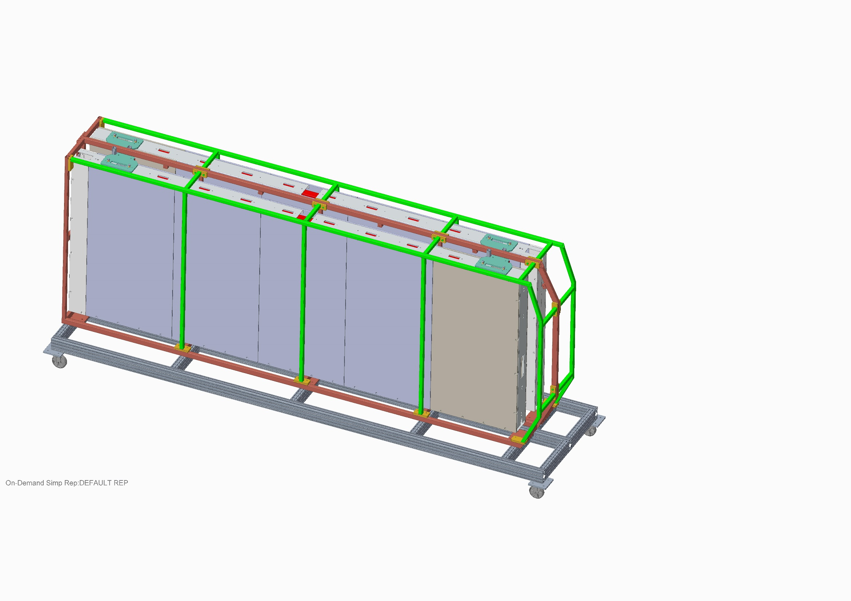
The two-APA shipping container.
(from Peter Sutcliffe – Liverpool)

