Slide 1
APA Manufacturing Procedures
APA 60% Review
27th March 2019

Slide 2
Overview
APA manufacturing procedures
Procurement
Safety
Questions

Slide 3
Step 1 - Preparation for winding
This is covered by Document #:8752 Doc
  The document was produced by PSL for ProtoDUNE APA’s.
Purpose
  Describes the process of preparing the APA frame for winding of the 1st wire plane of the APA, including installation of mesh, comb supports, X-combs and attachment of X wire and foot boards.

Slide 4
For comb attachment to comb bases:
Materials / Equipment / Tools Needed
  x comb (p/n 8752772), 40 pieces
  comb base strip (p/n 8752803), 8 pieces
  comb base prep jig (p/n 8752860), 1 or more as available
  2216 Scotch-Weld gray epoxy in Duo-Pak cartridge
  Duo-Pak dispenser and mixing tip
  10 ml plastic syringe
  pink dispensing tip
  lint-free wipes
  ethanol in dispenser bottle

Slide 5
For comb attachment to comb bases:
Procedure – Preparation of Adhesive
Insert into the gray Duopak dispenser, label-side up (larger diameter barrel to the left), the cartridge containing Scotch-Weld 2216 gray epoxy, then close the hinge lock and slide he actuator into the cartridge until it stops.
Remove the cap from the Duopak cartridge and place the nozzle against a paper wipe. Slowly operate the trigger of the dispenser until both components (gray and white paste) can be seen emerging from the tips of the cartridge. Remove the ejected material with the paper wipe.
Attach a new mixing tip to the Duopak and operate the dispenser trigger to fill the mixing tip.
Remove a new 10 ml plastic syringe from its packaging and remove its piston from the barrel. Insert the Duopak mixing tip into the syringe barrel and dispense about 2 ml of epoxy along the side of the barrel, near the tip.
Start the syringe piston into the barrel and invert the syringe so the tip is up; wait a few minutes for the epoxy to flow back toward the plunger
Depress the plunger to expel most of the air above the epoxy through the syringe tip.
Install the 20 gauge pink dispensing tip onto the syringe tip.

Slide 6
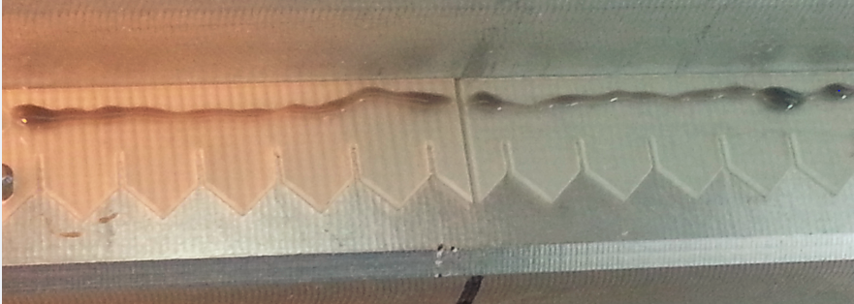
For comb attachment to comb bases:
Procedure
Place the comb base prep jig on the table with its comb location pins pointing upwards.
Use a lint-free wipe moistened with ethanol to clean both sides of five pieces of x comb.
Position the five x comb pieces end to end along the comb base prep jig, placing the holes in the comb pieces over the location pins on the jig so that the comb teeth evenly span the length of the jig and all point the same direction, across the table.
Combs placed into comb-base jig. Locating pins are seen holding comb in place.
Use the syringe to deposit a thin line (≤ 1/2 mm width) of epoxy through the dispensing tip onto the five combs in the gluing jig, about 2mm above the flat edge of the combs. Allow a gap of 1-2mm on either side of comb location holes and at the ends of the comb pieces. Take care not to apply epoxy to the pins themselves, nor to the holes in the combs. Remove excess or misplaced epoxy from the comb or jog with a lint-free wipe; if necessary, temporarily remove the affected comb from the gluing jig to clean it with an ethanol-moistened wipe.
A thin line of properly dispensed 2216 G epoxy is seen near the flat edge of the comb.
Rotate the comb base prep jig and the five attached combs 90° so that the prep jig handles point upwards.

Slide 7
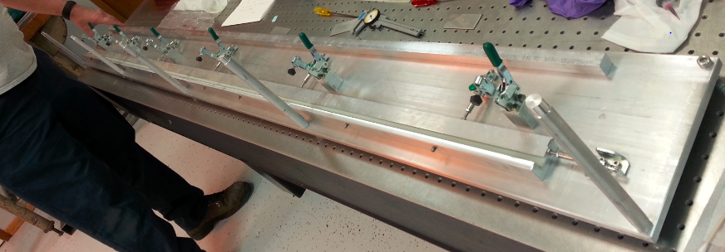
For comb attachment to comb bases:
Procedure
Use a lint-free wipe moistened with ethanol to clean all surfaces of a 2.3m piece of comb base. Allow surfaces to air dry a few minutes.
Place the cleaned piece of comb base into the jig, so that one end rests against the stop pin. Slide the comb base forward so that one long edge contacts the glued surface of the x combs. Place the top bar onto the comb base, then close all the jig clamps, starting with the clamp on the end opposite the stop pin, to bring the comb base and x combs into close contact.
A thin line of properly dispensed 2216 G epoxy is seen near the flat edge of the comb.
Allow the epoxy to cure for at least 8 hours. The stated “Time to Handling Strength” for Scotch-Weld 2216 Gray is 8-12 hours, and time to full cure is 7 days at 24°C.
Loosen the clamps and remove the x comb / comb base assembly from the jig. (Evenly tighten the setscrews to break loose the comb base from the jig if necessary, then retract them into the jig.) Inspect the epoxied assembly and put it aside for later attachment to the APA frame.
Inspect the gluing jig and scrape off any epoxy remnants.
Repeat steps 9.1.1 through 9.1.18 enough times to prepare eight comb bases with x combs to populate both sides of the APA.

Slide 8
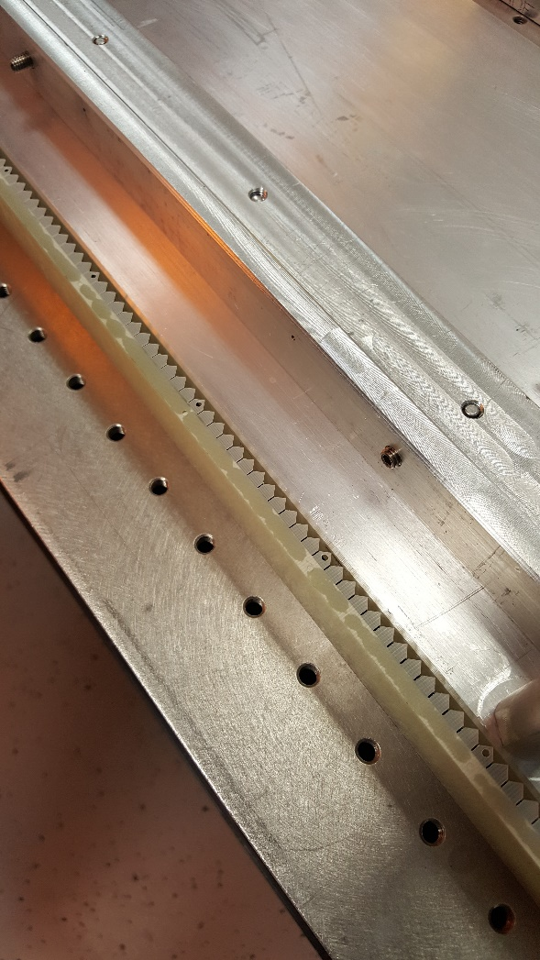
For comb attachment to comb bases:

Slide 9
For Installation of Mesh on APA Frame:
Materials / Equipment / Tools Needed (New to DUNE APA’s)
  Process cart
  Mesh panel Head End LH(p/n 294-10560) – 2 pieces
  Mesh panel Head End RH(p/n 294-10561) – 2 pieces
  Mesh panel Foot End RH(p/n 294-10562) – 2 pieces
  Mesh panel Foot End LH(p/n 294-10563) – 2 pieces
  Mesh panel Centre (p/n 294-10564) – 12 pieces
  Mesh panel bracket (p/n 294-10559) – 120 pieces
  M4 SHCS silver plated

Slide 10
For Installation of Mesh on APA Frame:
Procedure (New to DUNE APA’s)
APA frame vertical in process cart
Two people handle mesh panel and offer up to correct aperture (corner head, corner foot or middle) on APA frame.
Insert M4 screws (6 off) through mesh panel to retainer clip and mounting bracket on frame.
Repeat for all lower level mesh panels side A and B. (5 off each side)
Rotate APA through 180 degrees in process cart.
Repeat mesh panel installation process as described above for remaining 5 off panels each side
Mesh panel installation takes place after comb base installation.

Slide 11
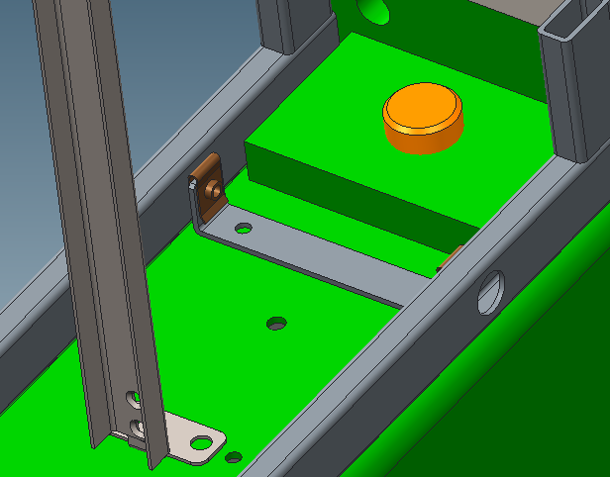
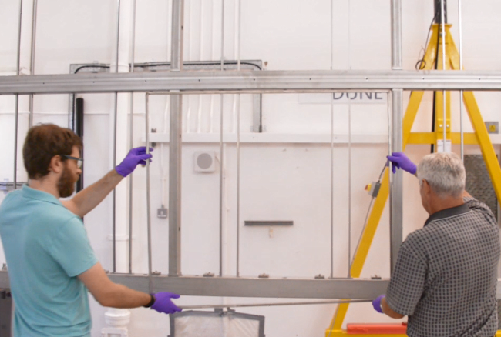
Fixing brackets (6 per frame) require two M4 tapped holes each in the APA frame.
M4 ‘U’ Nut to allow float.
Mesh frame profile 10 x 20 x 1.5
Clearance for M4 cap head screw

Slide 12
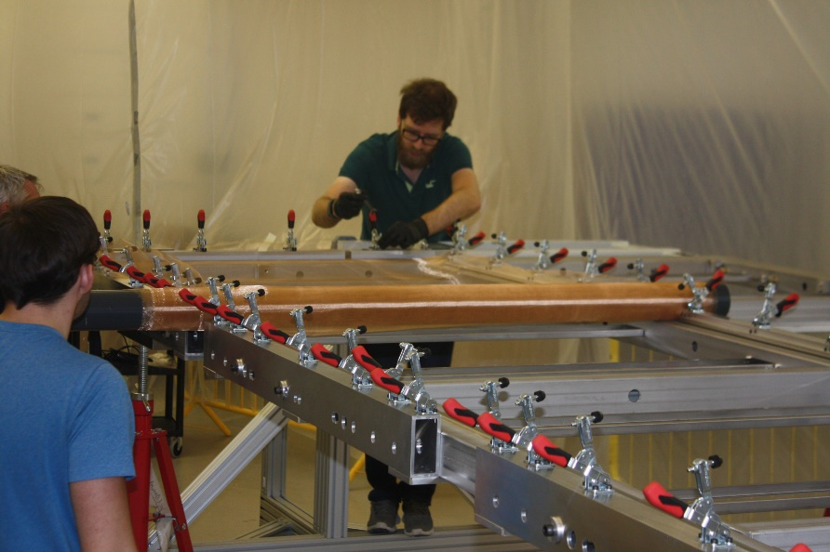
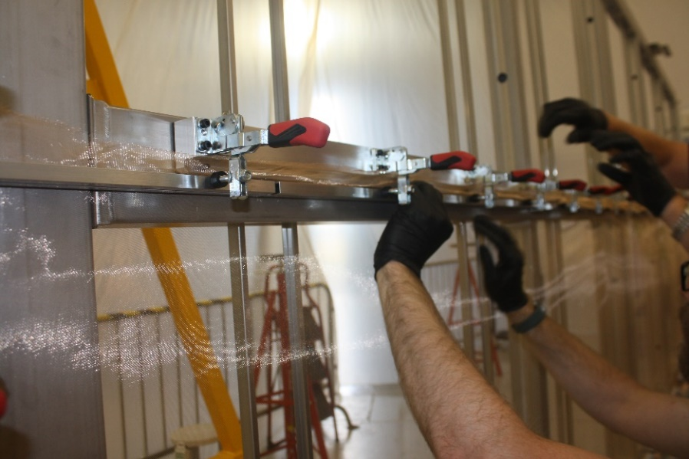
Mesh Installation - Superceded Procedure
Preparation of mesh
Preparation of APA frame in window
Mount Jigs to APA
Roll out mesh & stretch to clamp areas and clamp mesh in place with clamp bars
Evaluate parallel relationship to frame
Adjust clamp bars to ensure uniform tension and check for ripples (work the mesh)
Fix masking tape around the frame
Apply Scotch-Weld 2216 to mesh/APA frame
Allow to cure - 8hrs
Remove masking tape, jigs
Trim mesh with knife being careful to leave no spikes
Repeat for other 3 mesh strips
Detailed Procedure in 8752 Doc

Slide 13
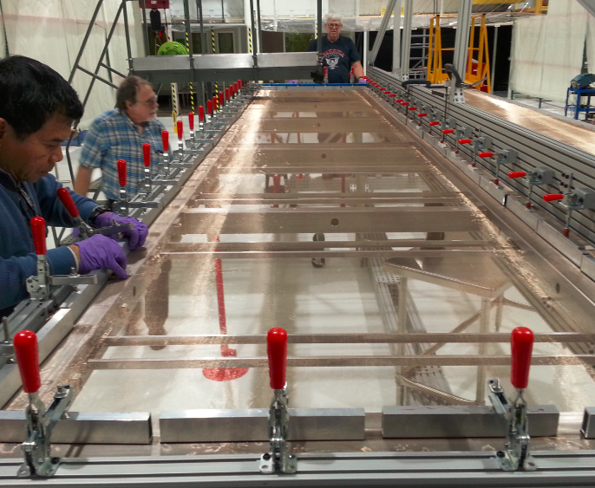
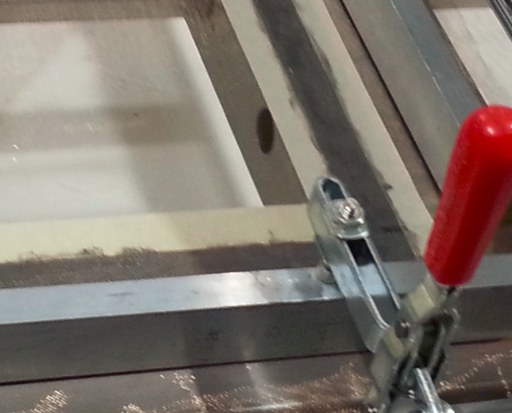
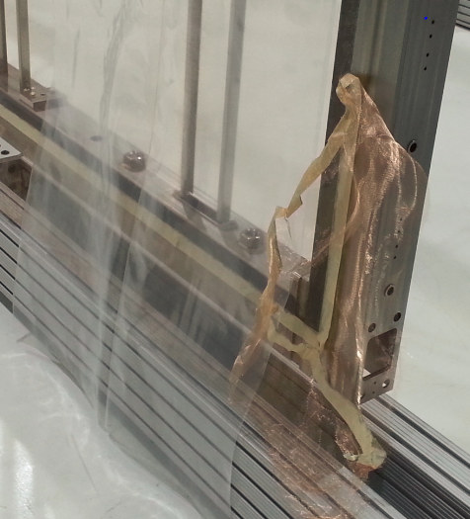
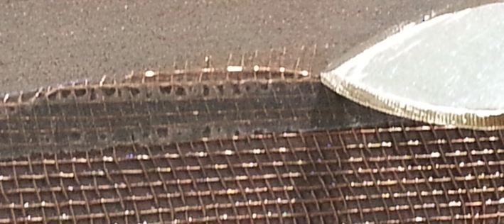
Mesh Installation - Superceded Procedure
Double frame of masking tape with 2216 Gray epoxy painted in the border.
Metal hold down bar with Destaco clamp.
Border of 2216 G epoxy has been applied to the entire perimeter of the mesh-frame interface.
Unraveling trimmed mesh that must be re-trimmed and/or vacuumed.
Trimming the mesh

Slide 14
For Installation of Comb bases:
Materials / Equipment / Tools Needed
  comb base installation jig (p/n 8752892)
  comb base adapter set (2-3 pieces)
  mesh protector
  masking tape, 25 mm (1”) wide
  2216 Scotch-Weld gray epoxy in Duo-Pak cartridge
  Duo-Pak dispenser and mixing tip
  disposable mixing cup, 30 ml (2 pieces)
  electronic decigram balance
  flux brush, modified (2 pieces)
  x head boards (p/n 8752694) (20 pieces)
  x foot end board assembly (p/n 8752795) (1 piece)
  standard x foot board assembly (p/n 8752796) (4 pieces)
  x-winding fixture boards (5 pieces)
  M4 x 10mm silver-plated BHSCS (40 pieces)
  M4 x 25mm silver-plated BHSCS (40 pieces)
  6mm OD x 2.5m length screw sleeve (p/n 8752747) (40 pieces)
  M4 x 20mm silver-plated FHSCS (10 pieces)
  2.5mm hex driver
  torque limiting driver with 2.5mm hex bit

Slide 15
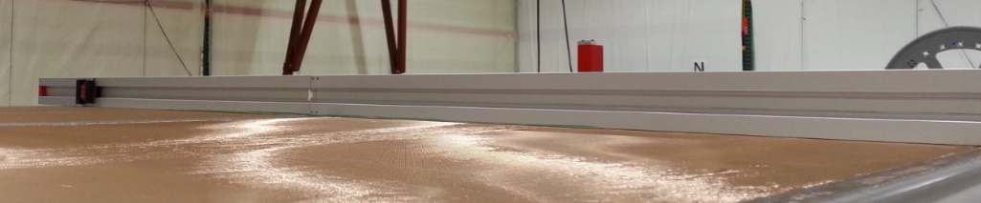
Installation of Comb bases:
Procedure – Comb base jig
Use the process cart frame rotation controls to place the APA in horizontal position with side A facing upwards.
Support the APA frame with a pair of jackstands placed about halfway between the head and foot beams along the outer edges of the side beams. The aluminum jack caps should contact the side beams outside the mesh area. Alternate raising each jackstand in turn until both side beams are straight and level between the head and foot beams.
Thread an M10 setscrew with a nut and washer about 15 mm into each of the two side beam two rivet nuts closest to one of the APA ribs where a comb base has not yet been installed. Repeat this on the opposite side beam directly across from the first location. Leave a gap of about 15mm between the washers and the frame.
Place a 2.3m straightedge over the crossbeam (pair of ribs) that you bracketed with the setscrews in the previous step. Determine if any gaps appear between the frame and the bottom of the straightedge along its length. Use additional jackstands beneath and / or lead weights atop the long beams (center or side) to flatten out any high or low spots. It is very important that the installation area of the frame is flat before installing the comb base!
Straightedge in place for measurement purposes.
With an operator on either end, pick up a mesh protector and lift it, with its 2cm side first and flat side down, over the APA from the head end. Place it just footward of the selected crossbeam, so that a small gap is visible between its headmost edge and the weldments at each end of the crossbeam. Put a piece of masking tape over each end of the protector to hold it in place against the side beams, taking care not to cover with tape the M4 tapped hole halfway down the side beams.
Have at hand one of the x-comb / comb base assemblies prepared in 9.1, a Duo-Pak cartridge of Scotch-Weld 2216 Gray epoxy at least half full, and the corresponding dispensing applicator with a fresh mixing tip.
Place two small work tables near the head end of the APA in the process cart. The tables should be aligned parallel to the long axis of the APA, with their centers about 2m apart, with room to walk between the ends of the tables and the process cart

Slide 16
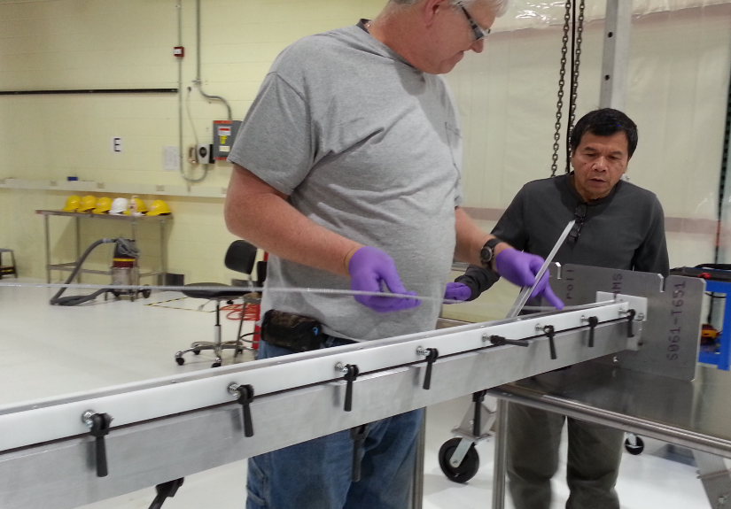
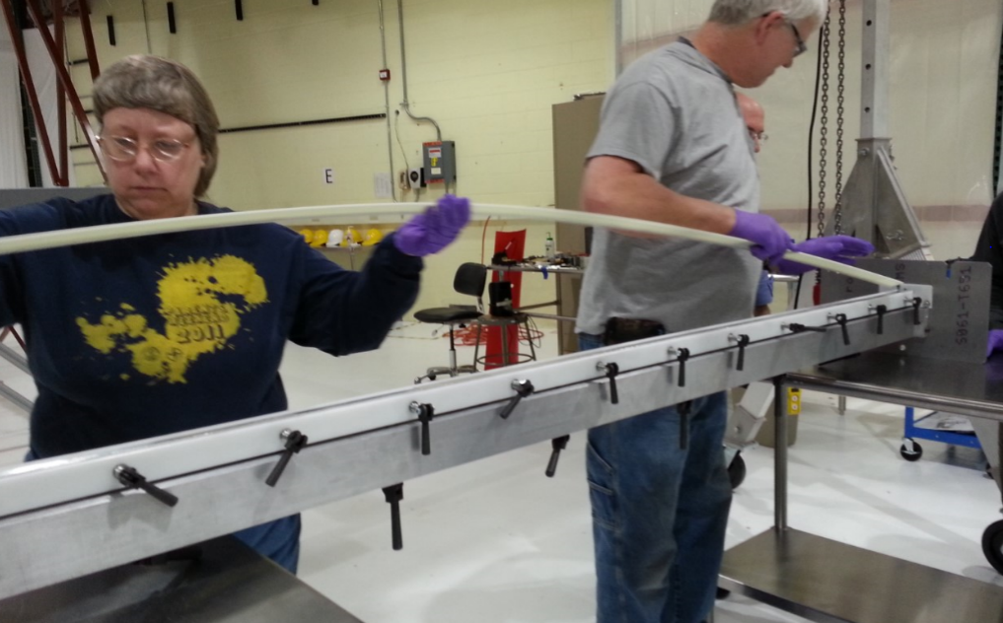
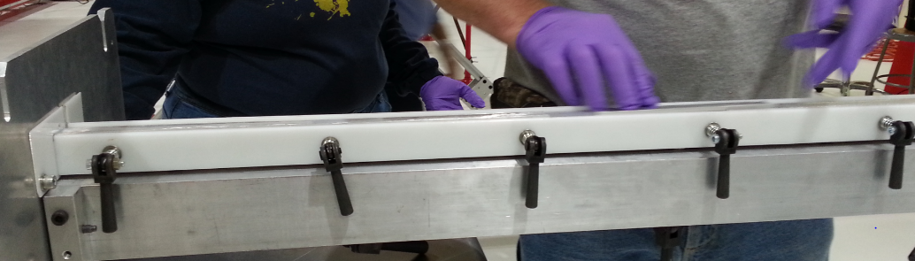
Installation of Comb bases:
Procedure – Comb base jig
With an operator on either end of a comb base installation jig, place the jig onto the tables so that one of its end plates rests on each table, with the bolt slots in the end plates down, and the “Head” arrows on the plates showing the same orientation as the head of the APA has from its foot. Ready the comb install jig to load a piece of comb base by turning all six of the upper row of cam bolt handles curved side down, then tighten them to fully compress their springs. (You will have to lift the two end cam bolt handles to clear the end plates as you tighten them.) Loosen by two rotations both of the thumbscrews on the end plate nearer the right side of the APA
With an operator on either end, pick up the attachment jig from the table, rotate it 180° (on its long axis) and set it back down with the bolt slots on the end plates now facing upwards. Open fully (turn counterclockwise) all 12 of the smaller cam clamps that will secure the comb base in the jig.
Place into the jig all pieces of a comb base adapter set. The adapter should be positioned with its ridged edge facing up and pushed towards the cam bolt side of the jig.
Place the x comb /comb base assembly into the jig with the x comb teeth facing downwards along the opposite side of the jig from the cam bolts and the non-comb side of the comb base against the ridge of the comb base adapter. Press down on the comb base to hold it while tightening all 12 of the cam clamps. Important: Turn each of the cam bolt handles so that none of them extend above the inverted comb base assembly. Clean the exposed surface of the comb base assembly with a lint-free wipe moistened with ethanol
All CAM bolt handles turned Down and the exposed surface being cleaned with an ethanol wipe.

Slide 17
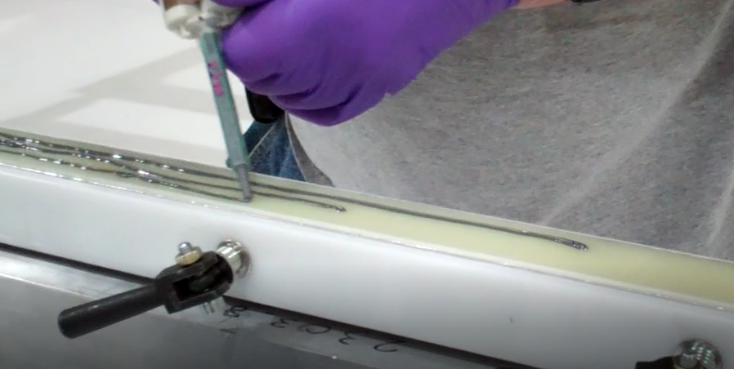
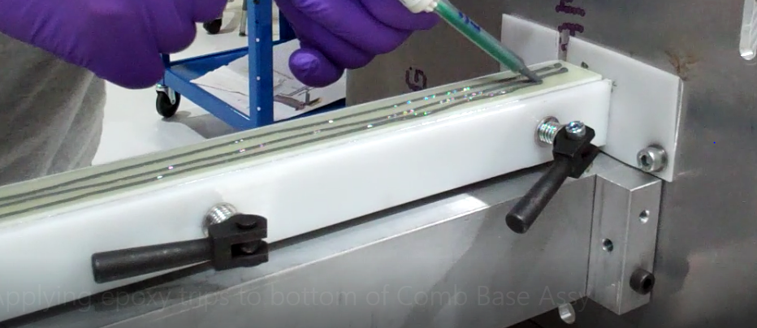
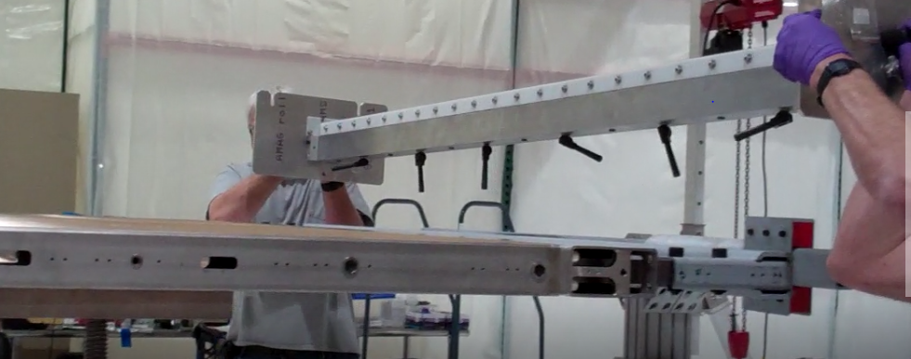
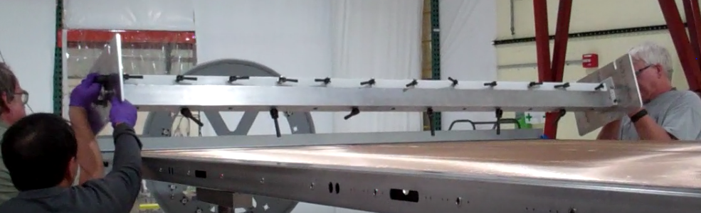
Installation of Comb bases:
Procedure – Comb base jig
Record the Scotch-Weld 2216 Gray epoxy parts A & B batch numbers on the APA Traveler.
If it’s been more than an hour since its last use, install a fresh mixing tip on the Scotch-Weld 2216 Gray Duo-Pak dispensing tool. Record the epoxy mix start date / time on the traveler. The pot life (working time) for Scotch-Weld 2216 Gray is about 90 minutes at 24°C.
Place into the jig all pieces of a comb base adapter set. The adapter should be positioned with its ridged edge facing up and pushed towards the cam bolt side of the jig.
Position the end of the mixing tip to one end of the inverted comb base in the installation jig, about midway across its width. Apply a bead of epoxy ~2mm in diameter, while walking along the comb base from one end to the other. Add a 2nd bead of the same size, roughly parallel to the first, along one edge of the comb base, then add another along the other edge. Try to avoid getting epoxy on either edge of the comb base (particularly onto the x comb) nor on any part of the attachment jig.
Applying (3) stripes of 2216 Gray Epoxy along the cleaned bottom of the Comb Base Assembly while loaded in the installation jig.
With an operator on either end of the Installation jig bearing the epoxied comb base, lift the jig in its current inverted position and carry it over the head end of the horizontal APA frame, making sure that the x-comb, in this inverted position, is on the side of the comb base closer to the foot end of the APA. Bring the jig over the APA cross beam (pair of ribs) near which the four M10 setscrews, nuts and washers were placed in 9.4.3, and the mesh protector in 9.4.5.
Lifting the Installation jig over the Head End and positioning near the Mesh Protector along the APA cross beam.

Slide 18
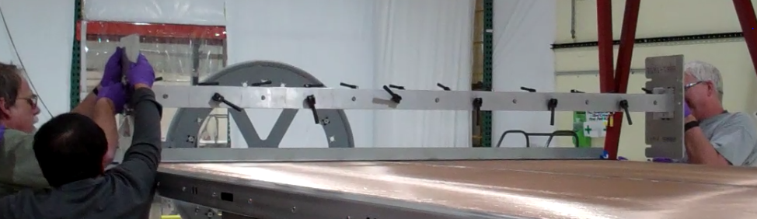
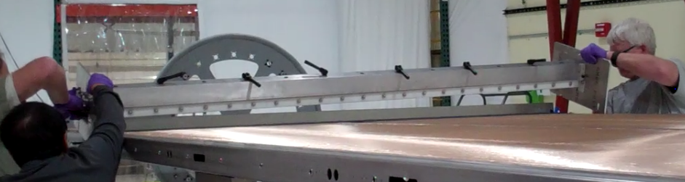
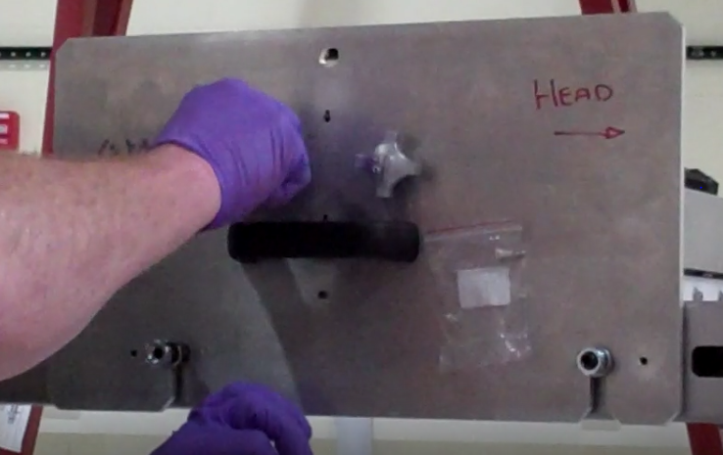
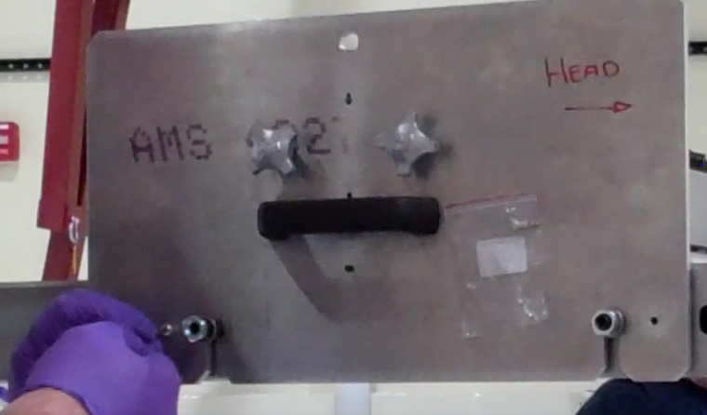
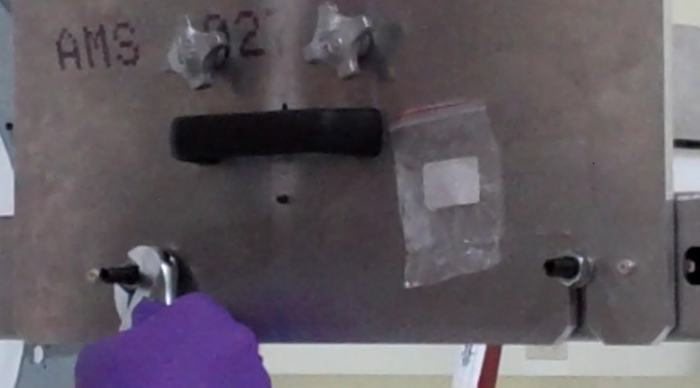
Installation of Comb bases:
Procedure – Comb base jig
Rotate the jig with the comb base 180° on its long axis, each operator turning the jig so that the epoxied bottom of the comb base first faces the APA’s foot end, then down toward the frame. Carefully position the jig so that the end plates fit over the side beams, and the slots in the end plates fit over the two M10 setscrews on either side. Tighten the nuts on the setscrews against the washers over the end plate slots until the washers just contact the plates. On the right side of the APA, tighten the two thumbscrews until they are snug against the end plate.
First a 90° turn toward the Foot End, then a second 90° turn in the same direction so the epoxy stripes are facing the crossbeam.
The operator on each side of the APA should fit M4 shoulder screws into the pair of location holes along the front and back edges of each end plate. You may need to lift the bottom edge of the end plates slightly to start each screw into its hole. Use a 2.5mm hex driver to seat both screws firmly against the end plates. Once the M4 shoulder bolts are installed, the M10 nuts should be tightened against the washers with a 17mm box end wrench.
Lift the cam bolt levers along the top of the comb base attachment jig, and turn them counterclockwise until slack, permitting spring force to press the epoxied comb base onto the APA crossbeam. Use a small flashlight to check for gaps along the assembly. Use extra force as needed to ensure the epoxy is touching the entire surface along the crossbeam. You will need to use the prone platform to reach the two center clamps. Record the current (comb base placement) time and date on the APA Traveler.

Slide 19
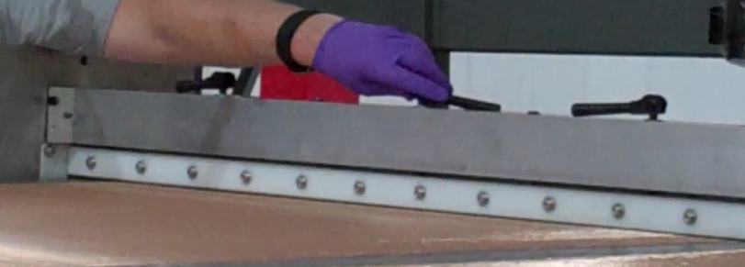
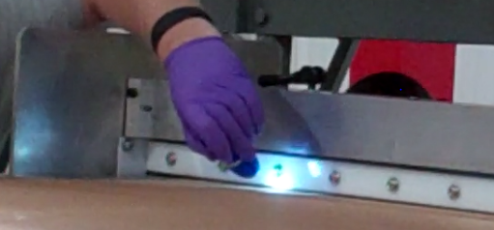
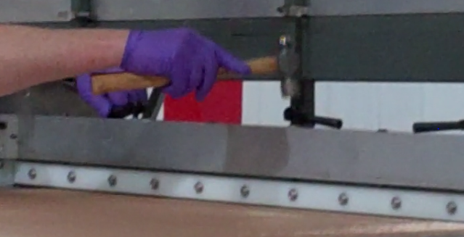
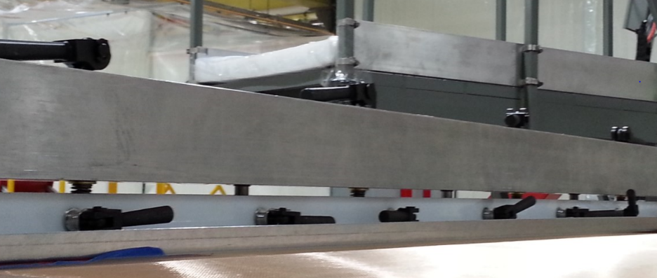
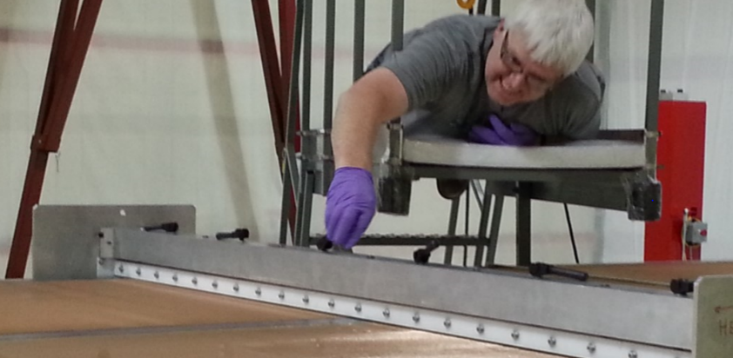
Installation of Comb bases:
Procedure – Comb base jig
Turn CAM bolts counterclockwise, check for areas not seated w/ flashlight and use additional force to seat the CAM bolts.
Allow the comb base epoxy to cure for at least 8 hours. (If there are not yet four comb bases installed on this side of the APA, and another comb base install jig is available, you can repeat steps 9.4.3 through 9.4.18 while the epoxy is curing on the first comb base.)
Record the comb base install jig removal date / time on the Traveler. Release the 12 cam bolt clamps (the lower line of clamps with handles toward the foot of the APA) that hold the jig to the comb base. You will need to use the prone platform to reach the clamps near the center of the APA. Once this is complete, tighten all six of the cam bolts on the top row of clamps to re-compress the springs.
View of the bottom row of CAM Bolts on the Mesh Protector plate. Tightening the Top CAM bolts while on the prone platform

Slide 20
Installation of Comb bases:
Procedure – Comb base jig
Operators working on opposite sides of the attachment jig should remove with 2.5mm hex drivers the pair of M4 shoulder bolts that located the jig’s end plates to the APA’s side beams, then loosen and back off the nuts and washers along the M10 setscrews.
With an operator on each end, lift off the comb base install jig and walk it off over the head end of the APA, and return it to the pair of work tables from which it was removed in step 9.4.15. Remove the four M10 setscrews, nuts & washers from the APA’s rivet nuts near both ends of the newly attached comb base.
Inspect the surfaces of the comb base attachment jig and remove any epoxy remnants.
Repeat steps 9.4.3 through .23 to install the three remaining comb bases on this side of the APA frame.
Use the process cart’s frame rotation controls to rotate the frame so that side B faces upwards and the four installed comb mounts are on the bottom side.
Repeat step 9.4.2 through .24 to install on side B the four remaining comb mounts and five remaining x head boards directly across the head beam from the first five. Note on Process Traveler that ten wire boards have been installed.
Advantages of using mesh panels
Fixing directly to APA frame…no mesh interface
Better access releasing cam bolt levers
Eliminates risk of puncturing mesh

Slide 21
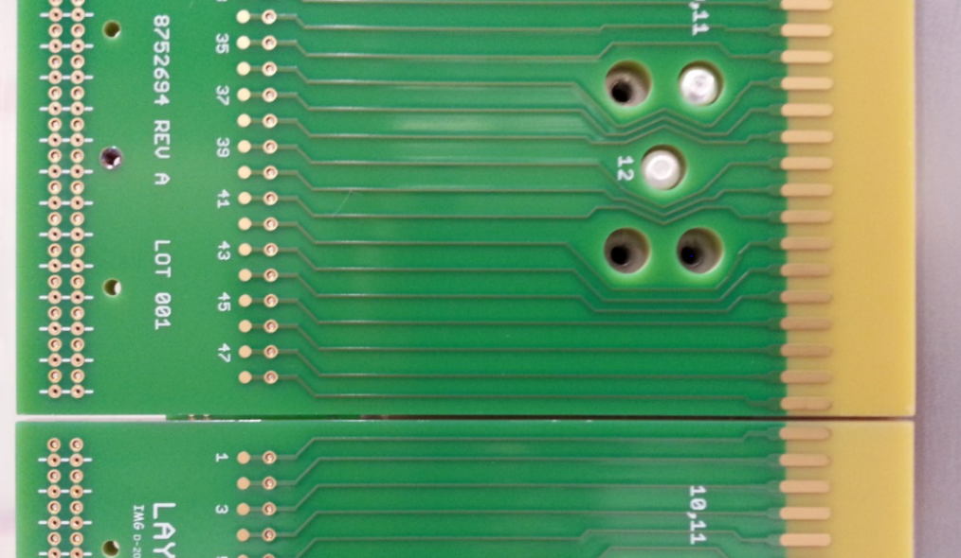
Installation of x head and foot boards & winding fixture boards:
Procedure
Use the process cart controls to rotate the APA frame into edgewise vertical (or other angled) position so that you have a clear, straight-on view of the APA’s head beam on the side where the head interface frame has an opening. Adjust the APA angle and/or your elevation as needed during the next three steps to maintain that perspective.
2) X – Head Boards attached to the X-end of the APA. Solder pads are facing the Foot End of the APA, and there is a small gap seen between the boards when positioned correctly on the APA. Each pattern of screw holes should have (2) screws attached for this level.
Place an x head board (P/N 8752694) onto the APA frame’s head beam in the position closest to side opening of the head interface frame; the board’s solder pads should be towards the foot end of the APA. Start a M4 x 10mm silver-plated SBHCS into the center hole of the five hole pattern closer to the side beam, and a M4 x 25mm silver-plated SBHCS into the center hole of the five-hole pattern further from the side beam. Tighten these screws with a 2.5mm hex driver until snug, then back them off slightly. Place 2.5mm length screw sleeve spacers (P/N 8752747) over two M4 x 10mm silver-plated SBHCS and start the screws into the board’s two location holes (in each of the board’s two five-hole patterns, these are the holes at 10:00 o’clock position from the perspective of a viewer at the head end – they will be the only counter-bored holes among the outer holes in the patterns), and tighten them until snug, with a 2.5mm hex driver. Note that these screw heads, when properly seated, will be below the surface of the board, but because the screw sleeves tend to seat prematurely against the board’s counter-bore, you will probably need to wiggle the board with one hand while turning the hex driver with the other until the screw sleeves slip into proper position. After the screw tightens against the properly-positioned screw sleeve, loosen it a fraction of a turn. Once all four screws are installed, wiggle the board to make sure that it is free to move in all directions, then push it gently but firmly toward the foot end of the APA and hold it there while tightening, first, the two location screws, then, the two hold-down screws at the centers of the five-hole patterns.

Slide 22
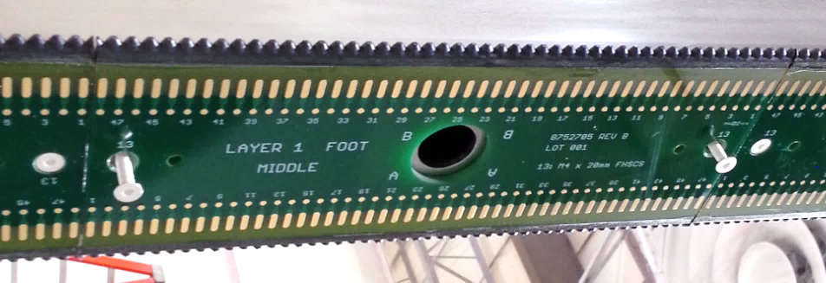
Installation of x head and foot boards & winding fixture boards:
Procedure
Repeat previous step with the next X head board along the head beam, with the difference that both of the two hold-down screws installed in the center holes of the five-hole patterns should be M4 x 25mm SBHCS; repeat this until five X head boards have been installed on this side of the APA.
Use a 2.5mm hex bit in a torque driver set to 1.4 Nm (12 lb-in) to tighten each of the 4 screws in turn on all 5 (or 10) boards (on each board, first tighten the pair in the location holes with the screw sleeves, then the pair at the centers of the five-hole patterns), until the driver signals that the set torque is met.
Middle X – Foot Board Assembly attached w/ (2) M4 x 20mm FHSCS
Before mounting the X foot board assemblies, ensure each hole that will accept an attachment screw has received a Kapton spacer placed onto the backside of each board.
On the outer corner of the foot beam not covered by the foot end interface frame, position an X foot end board assembly (P/N 8752795) against the foot beam and carefully start a M4 x 20mm FHSCS into both of its countersunk screw holes with a 2.5mm hex driver. Tighten screws until just snug.
Repeat previous step with a Middle X foot board assembly (P/N 8752796) adjacent to the -795; do this four times across the half of the foot beam not covered by the interface frame.

Slide 23
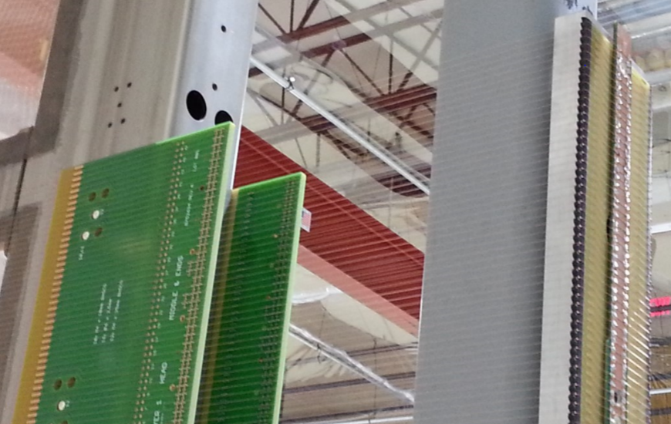
Installation of x head and foot boards & winding fixture boards:
Procedure
Use a 2.5mm hex bit in a torque driver set to 1.4 Nm (12 lb·in) to tighten both of the screws in turn on all five boards, until the driver signals that the set torque is met. Note on Process Traveler that five X foot board assemblies have been installed.
Attach five X winding fixture boards to the head interface frame’s fixture plate using two black oxide steel M4x10mm FHSCS in each. Use similar hardware to install TSBs (temporary soldering boards) along the center line of the row of X winding fixture boards.
Winding Fixture boards are shown here with X-wire already wound and tacked down with solder joints. The fixture boards seen here are attached from the corner edge and extend only a small bit further than the center beam.
Use the process cart frame rotation controls to place the APA in edgewise vertical position. The APA frame is now ready for X-plane winding, once moved to the winder.

Slide 24
Step 2 – Installation of first (X) wire plane
This is covered by Document #:8752 Doc
  The document was produced by PSL for ProtoDUNE APA’s.
Purpose
  Describes the process of installing the first (X) wire plane of the APA, including winding, tension checking, wire termination (soldering and epoxying, removal of excess wire), and electrical tests, and preparation for the 2nd (V) wire plane.

Slide 25
Step 2 – Installation of first (X) wire plane
Covered in this procedure is the following:-
  Materials / Equipment / Tools Needed
    For winding the 1st & 2nd half x wire plane
    For soldering the 1st & 2nd half x wire plane
    For epoxying the x-plane wires and installing the v wire and v foot boards
    For attachment of the v wire combs
    For installation of the v side boards and v winding fixture boards

Slide 26
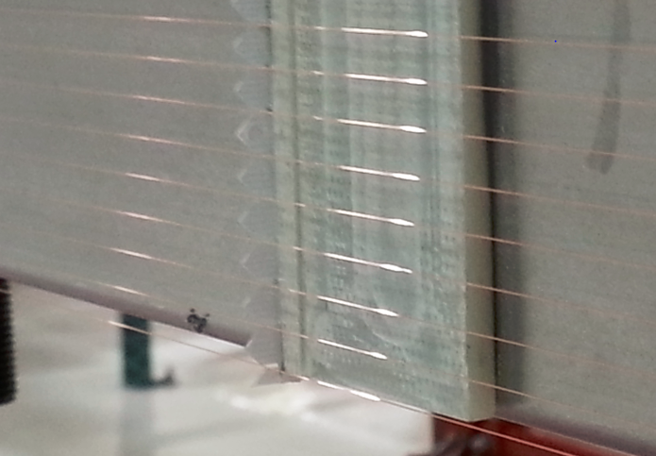
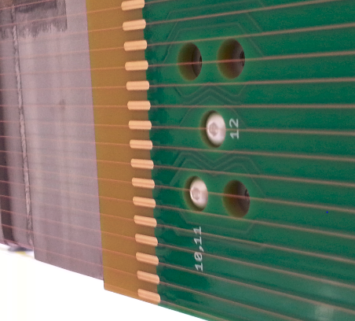
Step 2 – Installation of first (X) wire plane
Procedure
For winding the 1st & 2nd half x wire plane
  Doc 8752 describes in detail steps required to move the APA frame from the process cart into the winding machine.
  Verify that the winder controls are set for winding the x plane, that the wire tension head is operational and that a full bobbin (containing about ½ kg of wire) is loaded into the tension head. Record the wire lot number, spool ID #, and bobbin net weight on the APA process traveler.
  Turn off the tension head, pull out a length of wire and solder it with the Metcal solder station to the temporary solder board (TSB) on the x-winding fixture board adjacent to the first wire pitch. Take the slack out of the wire and turn the tension head back on. Record the winding start date / time in the appropriate place on the traveler.
  Start the winder and allow it to wind two complete turns. Pause the winder and verify that the wound wires are properly laid into the proper slots of the x-combs, x-foot board, and x-winding fixture board. Adjust the position of the winding fixture on the head interface frame as necessary to center the wires over the head board solder pads.
Wires routed through a comb base of the X-plane and wound wires laying across one of the X-Head board solder pad areas.

Slide 27
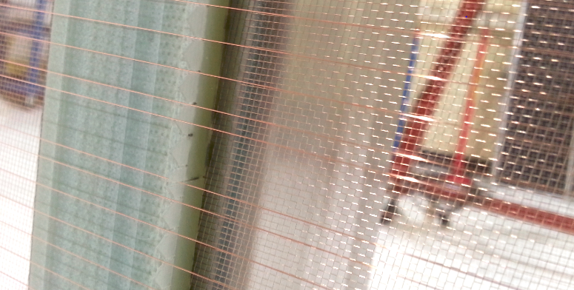
Step 2 – Installation of first (X) wire plane
Procedure
For winding the 1st & 2nd half x plane
  Resume winding and wind another 8 turns; pause the winder and inspect the wire lay. Solder the first 10 turns to the TSB, alternating edges of the TSB for each wire to avoid re-melting the previous wire’s solder joint.
  Continue winding 48 wire groups and soldering them to the TSB until half of the APA’s X-plane (including all five head boards on either side of the APA’s lower half) has been wound and all wires soldered to the TSB. Verify wire tension delivery every 48 wires and adjust the tensioning head as needed
  Turn off the tensioning head, use small diagonal cutting pliers to cut the spool wire near the last TSB joint, and secure the free end of the wire to the spool. Record the finish date / time for winding the first half X-plane on the traveler.
  Dismount wire tensioning head from winder and mount tensometer (tension measurement) head in its place on the “front” side of the winder, that is, the side that permits adjustment of the Z dimension perpendicular to the wire plane; this is required for focusing the tensometer.
  Inspect the newly wound wires on the front side of the APA, paying particularly close attention to where the wires cross the four X-comb strips, to ensure that each wire passes through a unique comb slot with no doubled wires nor missed slots.
Two adjacent wires are mis-routed: (1) is in-between two comb pieces and the (2nd) adjacent wire is on the top edge of the comb-peak, not routing down into the groove slot. These can both be moved and seated properly by hand.

Slide 28
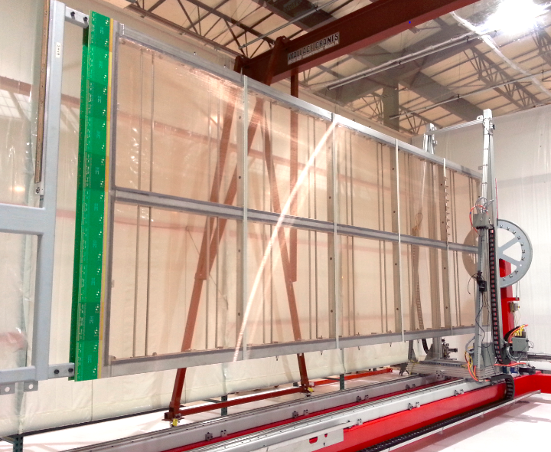
Step 2 – Installation of first (X) wire plane
Procedure
For winding the 1st & 2nd half x plane
  Carry out tension measurments using tensometer in zone 5 to check wire tensions. This procedure described in detail in Doc 8752
  Start the tensometer operation to measure and record the resonant frequency of the footmost wire segment of each newly wound wire on side A of the APA. The measurement software will use this frequency and the expected length of the wire segment to calculate the wire segment tension, which is assumed to be essentially the same as in the other segments of the wire, and will produce a report showing any wires whose tensions are out of tolerance.
Remove the capo from side A, leaving the M10 studs and spacers in place. Move the winder gantry to its headmost position to permit rotation of the APA frame. Use the winder’s frame rotation control to rotate the APA 180°, then return the winder gantry to measurement zone 5. Reattach the capo to the corresponding position on side B, just headward of the footmost comb.
Use the winder in manual mode to replace any out of tolerance wires soldering each in turn to the TSB.
Certify on the APA traveler that the tensions of all of the wires on this half of the x-plane are within tolerance; attach a copy of the initial tension report for the A & B sides, as well as a list of any replaced wires and their tensions.
Comb-CAPO placement at measurement zone 5 near the first cross beam up from the foot end of the APA.

Slide 29
Step 2 – Installation of first (X) wire plane
Procedure
For soldering the 1st & 2nd half x plane
  This procedure described in detail in Doc 8752….36 steps
    Preparation for soldering….. positioning APA, fixing masking tape, setting up Metcal soldering station, positioning access platform.
    Solder each wire to both of the foot board solder pads it crosses.
    Inspect all of the solder joints to ensure that the wires are properly bonded with solder to every solder pad.
    Rework any solder joints that were initially unsatisfactory.
    Cutting use an Xacto knife with a half-round blade to cut through the wire just inside (ie, toward the center of the foot board from) each solder pad, taking care as you do so not to drag the knife between pads! The strips of masking tape should hold the short pieces of wire as you make your 2nd cut.
    Strip off and discard the masking tape applied in step 9.2.2, along with the attached pieces of cutoff wire.
    Electrical Tests Use a digital multimeter ‘Keithley picoammeter’ and details of continuity / isolation tests set to continuity test mode and equipped with 3.5m test leads to check the continuity of each of the x heads on both sides of the APA
    APA’s 1-6 soldering took place in the Process Cart……APA #7 All soldering was carried out in the winder.

Slide 30
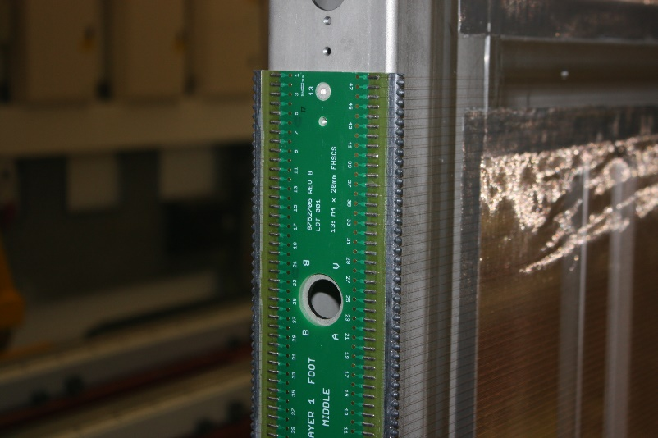
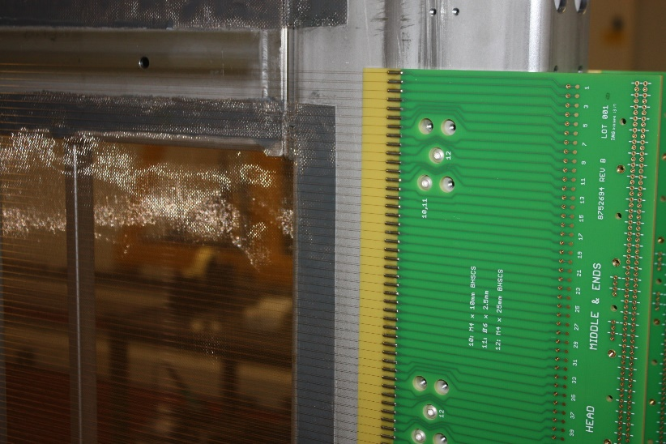
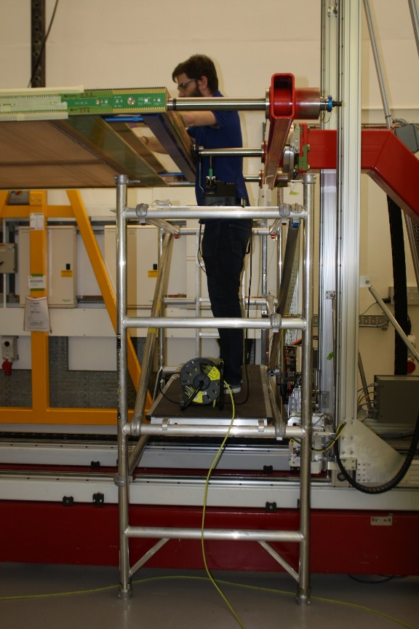
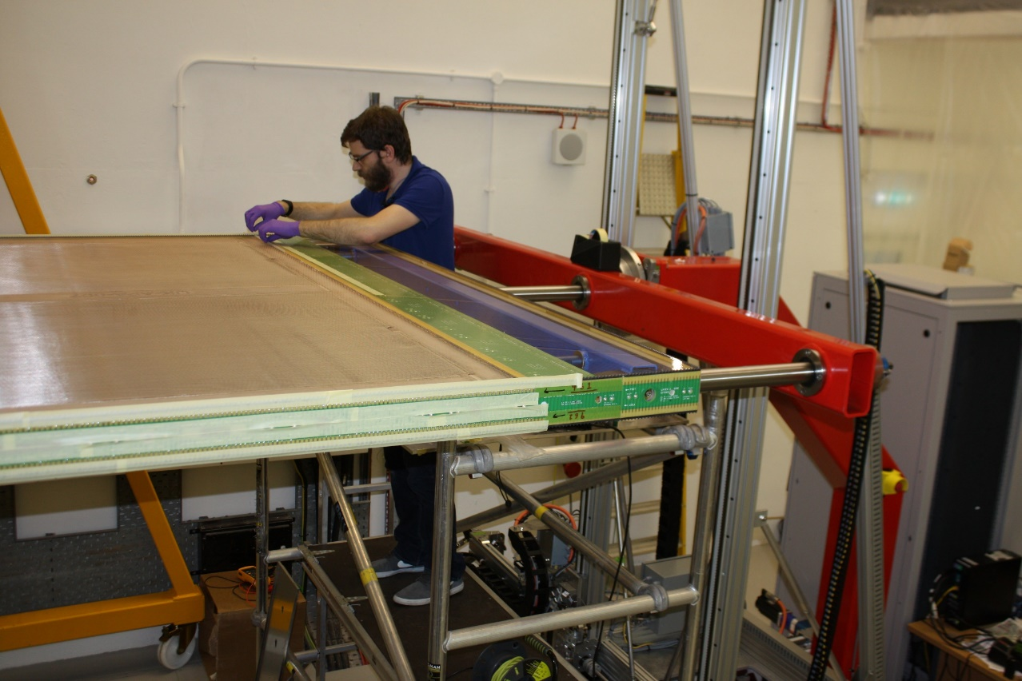
Foot End Board Soldered
Head End Board Soldered
Soldering carried out in winder - APA#7
Head End Access Platform

Slide 31
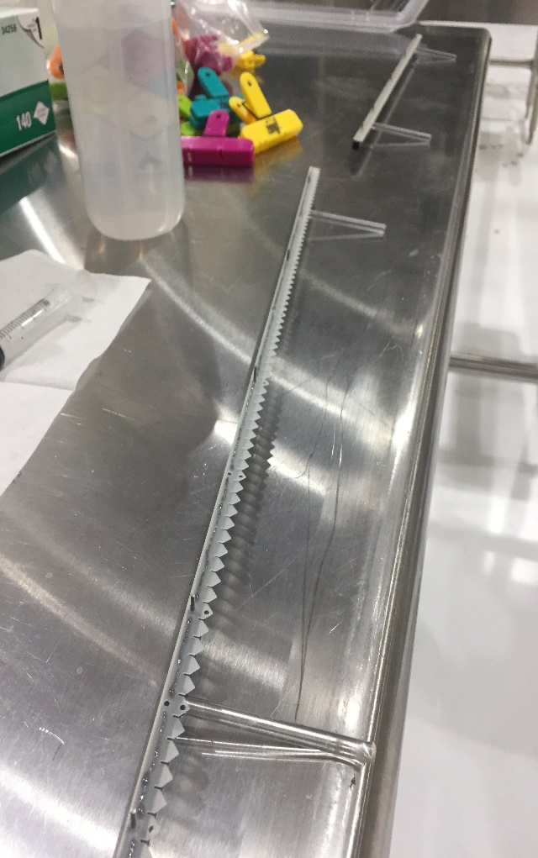
Step 2 – Installation of first (X) wire plane
Procedure
For attachment of the v wire combs
  This procedure described in detail in Doc 8752….27 steps
    Preparation - Translucent Scotch –Weld 2216 - 2 part adhesive,
    Place (± 0.1g) part A & B into mixing cup using a syringe and mix epoxy thoroughly.
    Transfer to 10ml syringe ready for application to the combs through a small tip.
    Place a comb attachment bar with its location pins facing upwards on a long edge of the table.
    Position the five v comb pieces end to end along the comb attachment bar
Location Pegs
Comb Attachment Bar

Slide 32
Step 2 – Installation of first (X) wire plane
Procedure
For attachment of the v wire combs
    Epoxy Application - Use the syringe to deposit a thin line (≤ 1/2 mm width) of epoxy through the dispensing tip onto the five combs on the attachment bar, about 2mm above the flat edge of the combs. Allow a gap of 2-3mm on either side of the jig’s location pins and at the ends of the comb pieces. Take care not to apply epoxy to the pins themselves, nor to the holes in the combs
    Fitting Combs - Lift the attachment bar bearing the epoxied v combs
    Position it behind (ie, nearer the APA’s foot end from) the line of x combs so that the location pins point toward the APA’s head end, the v comb teeth point upwards, and the ends of the v combs line up with those of the x combs. Gently lower the bar onto the x heads in this position behind the x combs.
    Carefully slide the bar forward (ie, toward the APA’s head end) so that its pins engage the holes in the x combs along the entire length of the bar.
    Place a line of ten (?) spring clamps over the comb attachment bar to hold the bar against the x combs during epoxy cure.

Slide 33
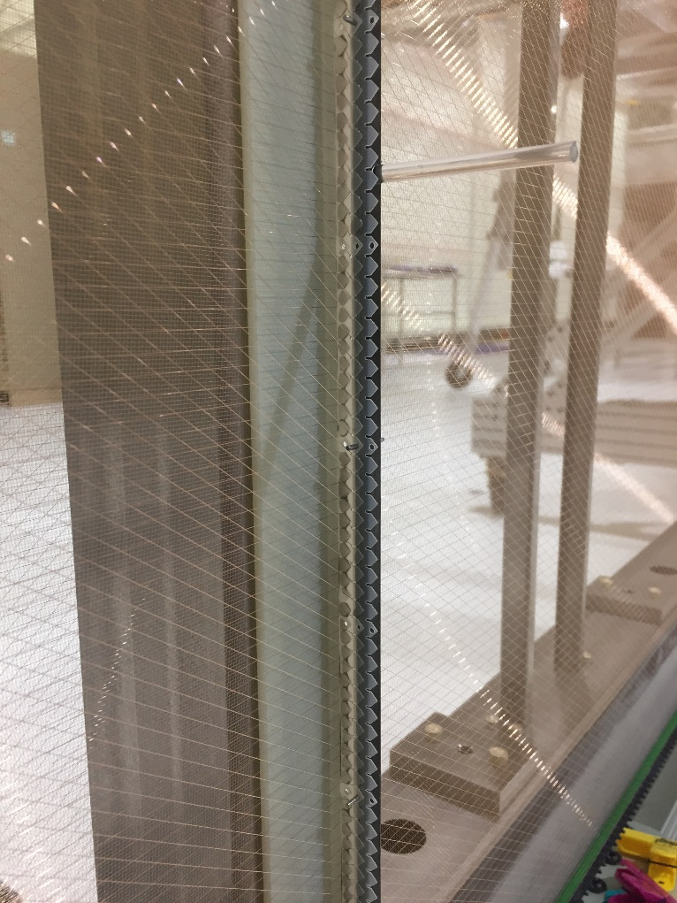
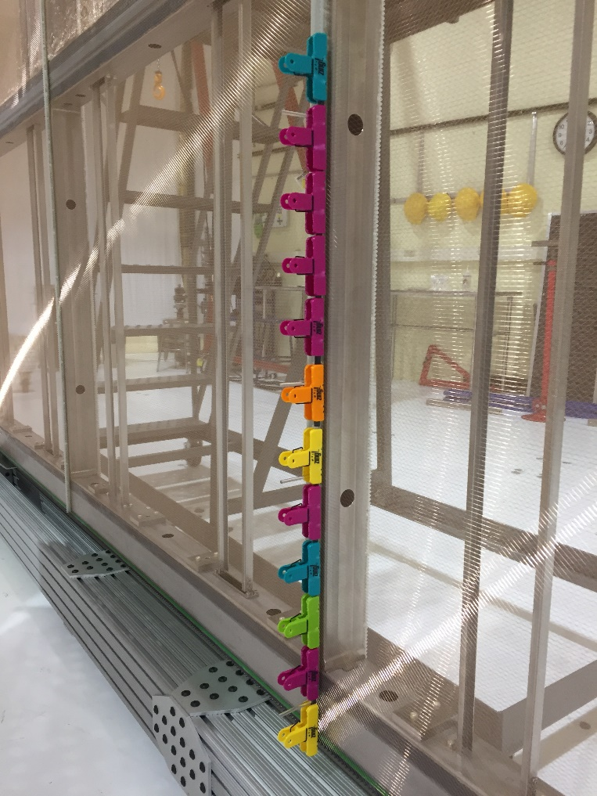
Attachment of the V wire combs
Location Pegs
‘V’ Combs fitted to the ‘X’ combs
‘V’ Combs clamped in position for adhesive cure time

Slide 34
Other Procedures
Installation of first (Y) wire plane is covered in a separate procedure but is very much like the procedures for the (X) wire
Installation of (U) wire plane use same procedure as (V) wire plane
Installation of (G) wire plane use same procedure as (X) wire plane
Step 0 (8752Doc001) covers in great detail the procedure for assembling the APA frame – as carried out at PSL
Traveler – document holds reference information, including tension test results, dates of operations, adhesive batch numbers, cure times

Slide 35
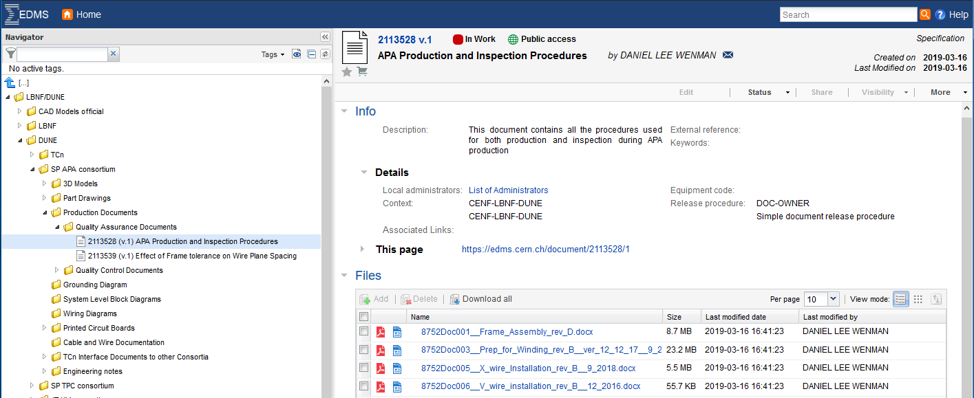
Procedure Documents uploaded on EDMS
Thanks to PSL for producing these procedures – without which we would have struggled in the UK

Slide 36
Procurement

Slide 37
Ensuring the reliable supply of raw materials and parts for each factory is critical to keeping APA production on schedule through the years of construction.
Supplier institutions will be responsible for sourcing, inspection, cleaning, testing, quality assurance, and delivery of hardware to each factory.

Slide 38
Frame Construction
Considering two approaches
  Outsource to an industrial supplier – (Most likely case for UK)
  Procure all major machined and welded components and then assemble and surveyed in house – (PSL)
  Same material supplier may be used for both US & UK
Mesh supply and construction
  Significant advantages in moving to smaller self-supporting window screen panels, saves assembly time and improves overall APA quality
  Supplier has been sourced in UK
  This construction method used on APA#7
Wire Procurement
  Propose to use existing US supplier to provide wire spools that are used on the winder head with no additional handling or re-spooling required.
Comb Procurement
  Each institution will either work with our existing comb supplier or find other suppliers who can meet our requirements.

Slide 39
Board Procurement – wire wrapping
  One or more consortium institutions will take responsibility for the supply of wire-wrapping boards both in the US & UK.
  276 boards per APA, for 150 APA’s we will need 41,400 boards.
  Institutions responsible for boards will spend time working with vendors to reduce risk and ensure quality.
Capacitor resistor boards (CR)
  Unique given their thickness, HV components and leakage current requirements.
  Reliable supplier of bare boards identified in US.
  Assembly and testing was carried out at PSL for ProtoDUNE.
  Need to identify other suppliers or institutions to perform assembly and testing of the 3000 plus boards required.
Winders and tooling
  PSL and Daresbury will work together to supply tooling and winding machines for additional production lines at new locations and for additional lines in-house.

Slide 40
Safety

Slide 41
Safety Requirements for DUNE winding Machine
Need to operate the winding machine in a safe manner to be compliant with Machinery Safety Guides and EU legislation – Machinery Directive 2006/42/EC
Method statement identifying modes of operation
  this in draft form with inputs fro PSL
Risk assessment
  Drafted needs updating once safety system is in place
Develop a safe design & any safe guarding requirements
  Ongoing as electrical & mechanical design develop
Develop a safe control system with built in emergency stops capability.
  New Allen-Bradley control system ordered – upgrade to current controller

Slide 42
Winding machine modes of operation
Mode | Safety Control System Requirements | Emergency stop | Safety Systems
Home | Returns winding head to reference position, operated by GUI/ control console |  | De-Activate any barriers, light curtains
Run | Operates winding machine through PLC programme & GUI/ control console | At control console and other nominated positions Line wire emergency stop | Activate any barriers, light curtains
Inspection | Reduces to safe limiting speed of winding, operated by GUI/ control console | Line wire emergency stop | De-Activate any barriers, light curtains Limited access to personnel carrying out the task | Inspection & tension testing
Commissioning / Manual | Operated manually from drive system controls and PLC and / control console | Line wire emergency stop | De-Activate any barriers, light curtains Limited access to personnel carrying out the task
Light Curtain

Slide 43
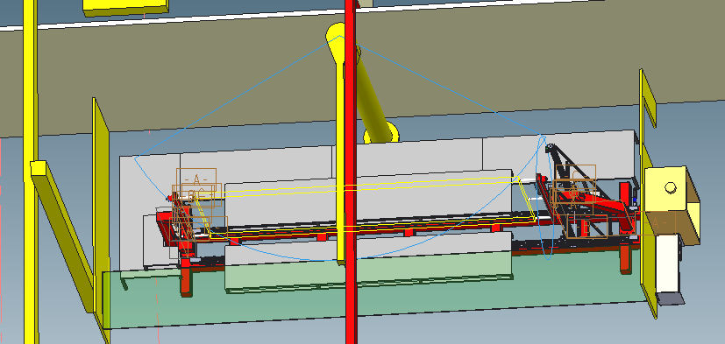
Access to rear of winder via interlocked door
Light Curtain

Slide 44
Questions

