Slide 1
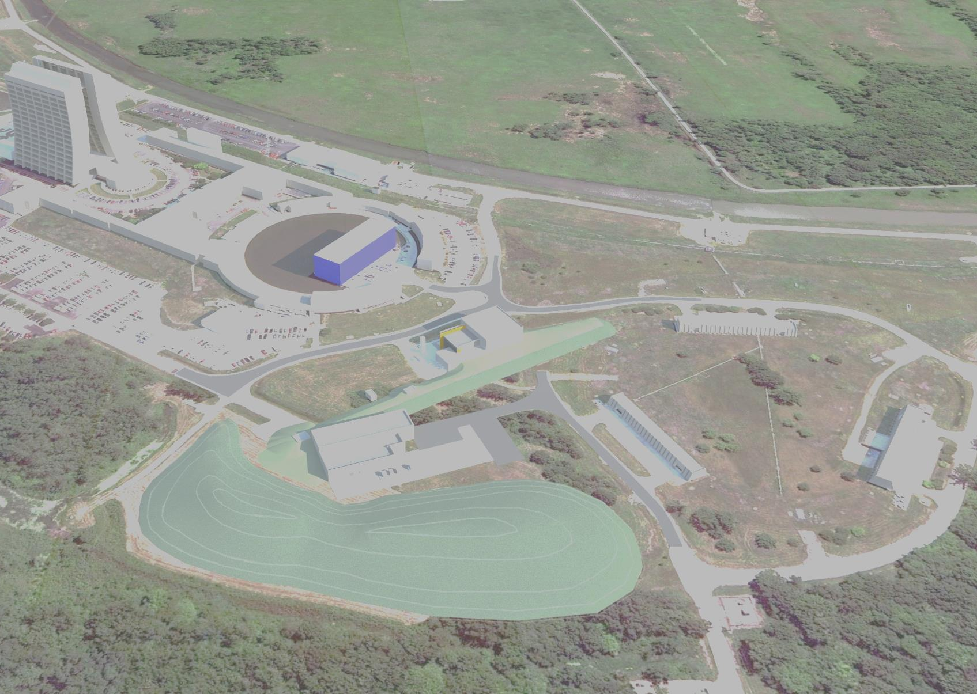
Muon Campus
Beamline Overview
October 17, 2018
Jim Morgan

Slide 2
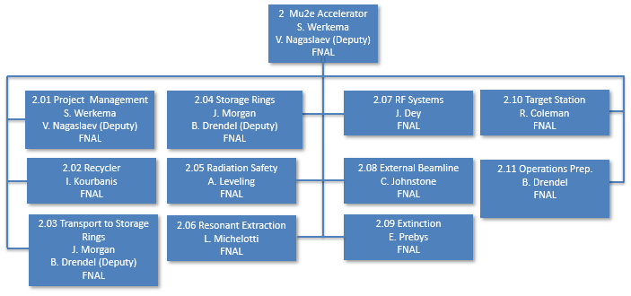
Back in 2011…
Collider Run II ended in September, 2011
Mu2e was working towards their CD-1 Review
  Bunch formation in Accumulator, partial turn in Recycler, estimated costs are growing
g-2 experiment had been discussed since at least 2008 and was now preparing for CD-0 Review
  Experimental building near AP-0 after single turn through Debuncher

Slide 3
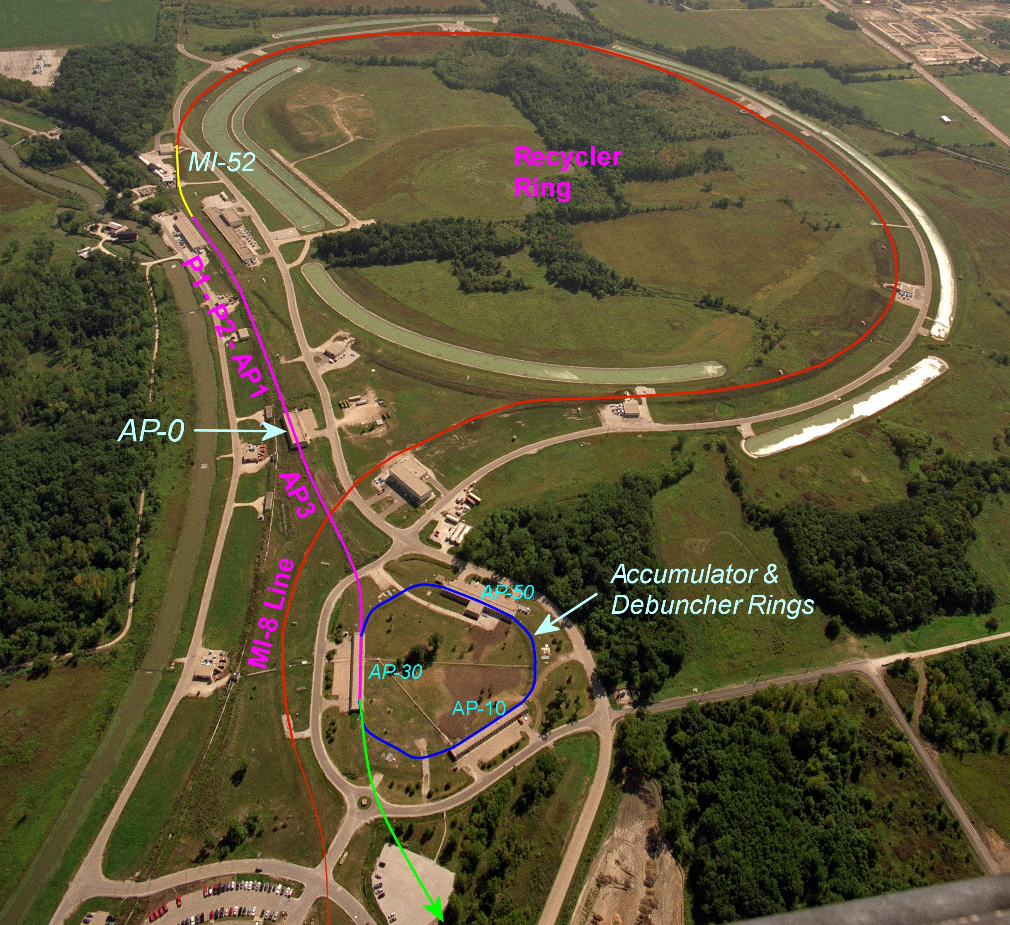
The Mu2e plan – Circa fall 2011
8 GeV kinetic energy beam from Booster takes a long path through mostly existing beam lines to the Mu2e production target.
Booster → MI-8 line
Partial turn in Recycler
Extracted at MI-52 from Recycler to the P1 beam line*
P1 → P2 → AP1 → AP3 → Accumulator Ring
Multiple proton batches stacked in Accumulator
h=4 RF bunch formation in Accumulator
One bunch at a time extracted to the Debuncher
Resonantly extracted to the Mu2e external beamline *
  * New beamlines
Mu2e external beamline
Steve Werkema presentation

Slide 4
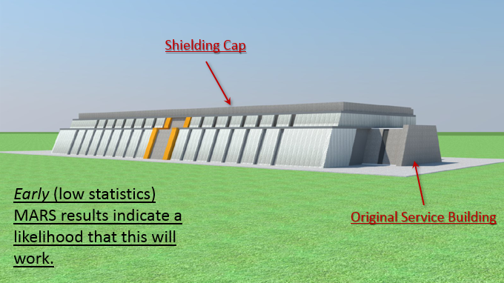
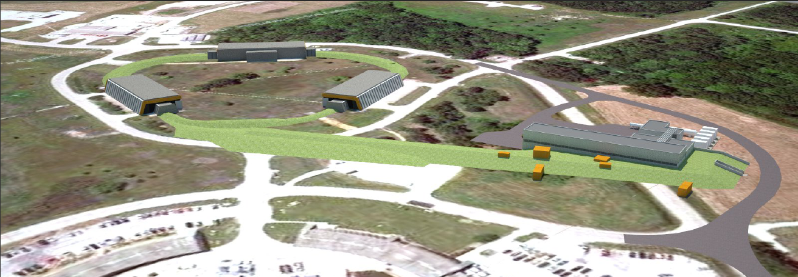
The Mu2e plan – Circa fall 2011
Enhanced shielding
Steve Werkema presentation
Transport to Mu2e target
Mu2e Experimental Hall

Slide 5
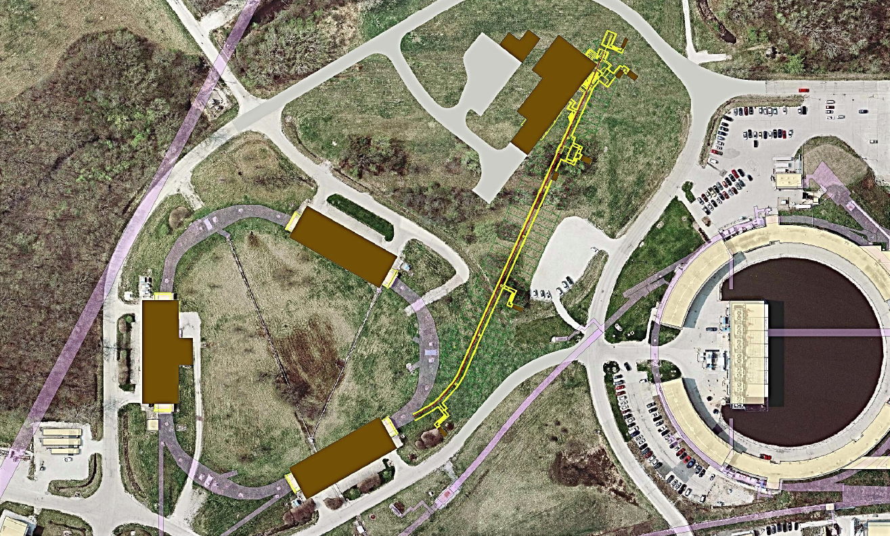
The Mu2e plan – Circa fall 2011
Final Focus
Vertical Bend
Extinction Collimation
Extinction AC Dipole
H-Bend, Δp collimation
Steve Werkema presentation

Slide 6

Wacky alternatives were considered…
Beam from Booster is injected directly into the Accumulator
MI-8 line → AP-B Line
B/A Line → Accumulator
Beam circulates in opposite direction, A/D line would need to be reoriented
Beam extracted to Mu2e from Debuncher at AP50
Could provide larger aperture, eliminate need for long beam line and new kickers, operational simplicity, improved up-time
Main drawback is the cost of the new beam line (partly mitigated by eliminating Recycler → Accumulator costs) and program interruption
New Beamline

Slide 7
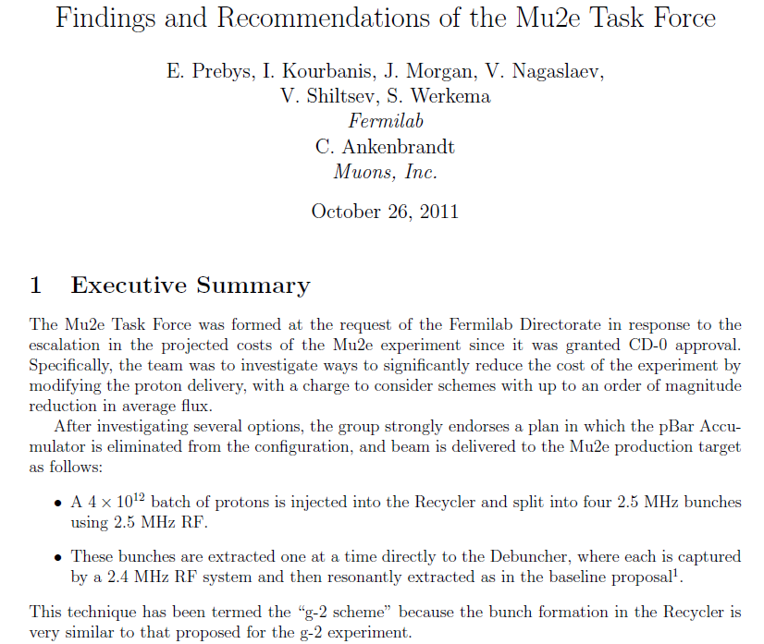
And Mu2e was about to drop the Accumulator

Slide 8
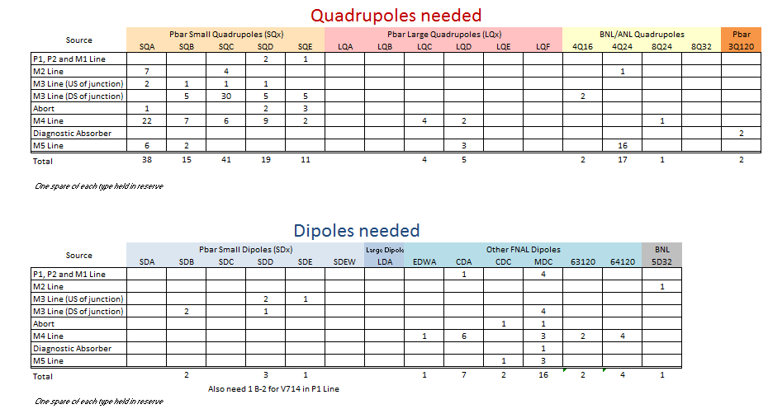
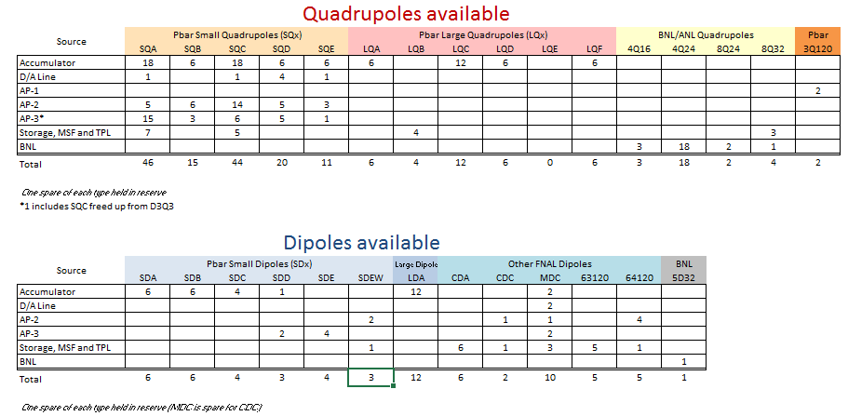
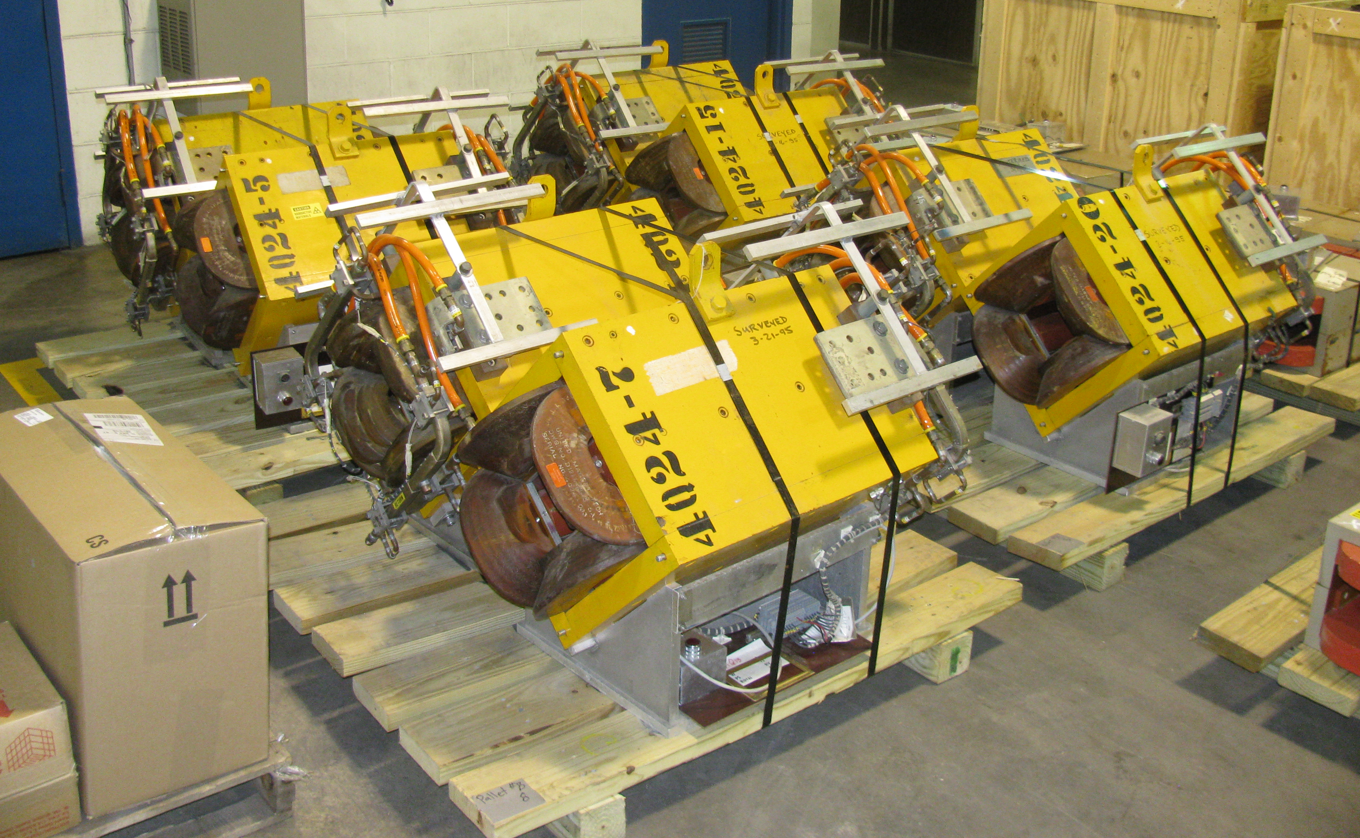
Accumulator magnets became available
Beamline dipoles and quadrupoles – 85% Pbar, 10% BNL, 5% New

Slide 9
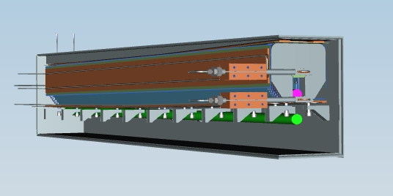
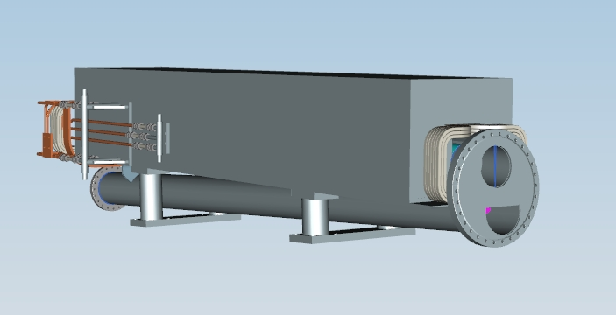
New Magnet types were needed
B2 and CDA dipoles - Refurbished by Technical Division and installed this summer (BT AIP)
BNL magnets (4Q16, 4Q24, 8Q24 and 5D32) – Inspected and one of each type had magnetic field measurements
MLG Lambertsons (new type) – Construction in progress
MCDA Septum Dipoles/C-Magnets (new type) - All parts received, construction about to start
Pulsed Septum (new type, DR AIP) - Design complete, parts procurement to begin soon
MDC dipoles (existing type) – Drawing updated and tooling located, production to begin later this winter
MCDA (Injection and Extraction)
Pulsed Septum (Injection and Abort)

Slide 10
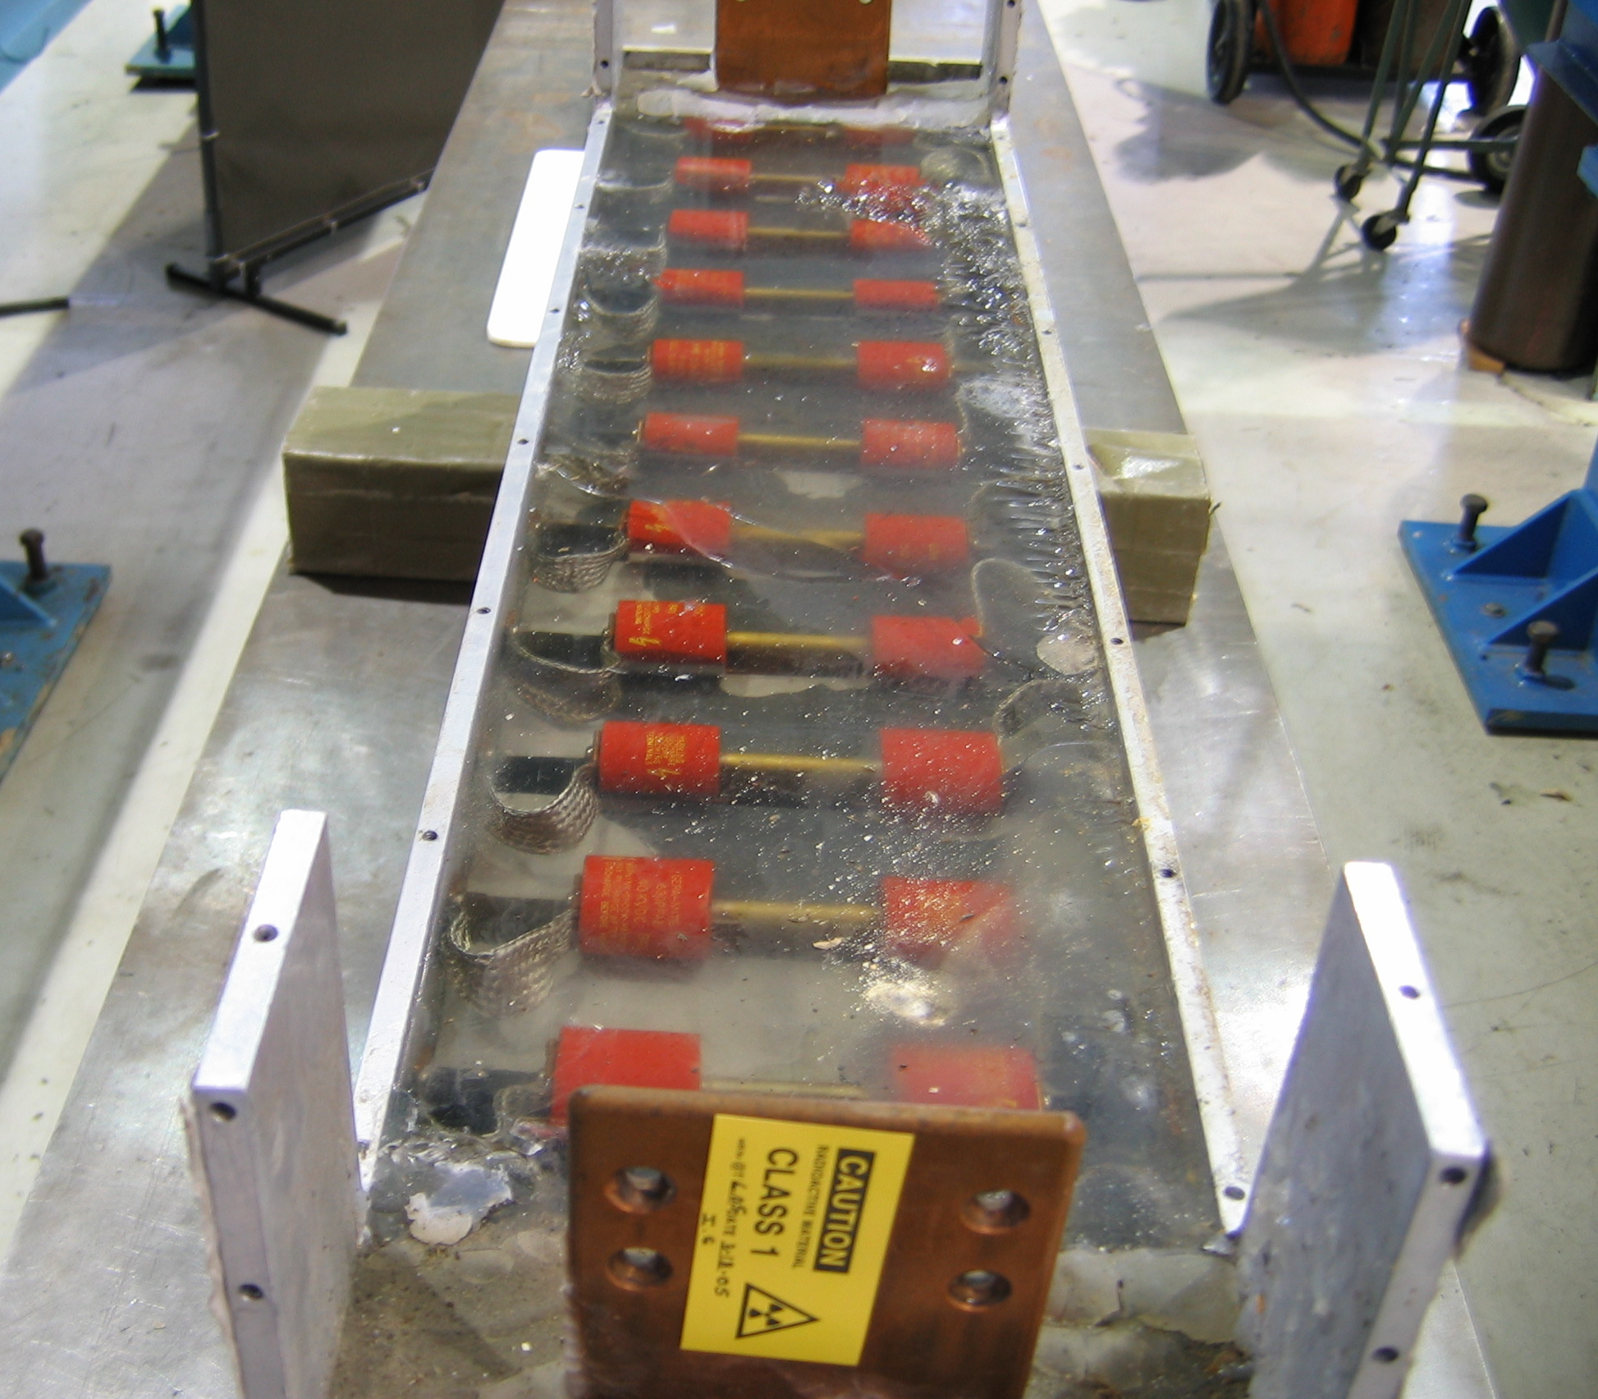
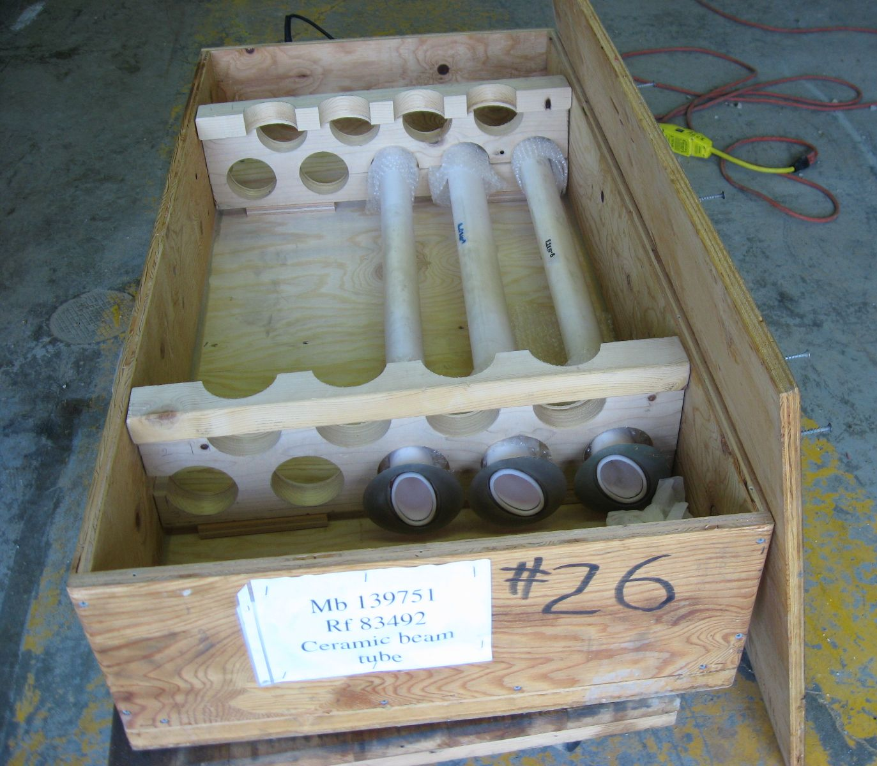
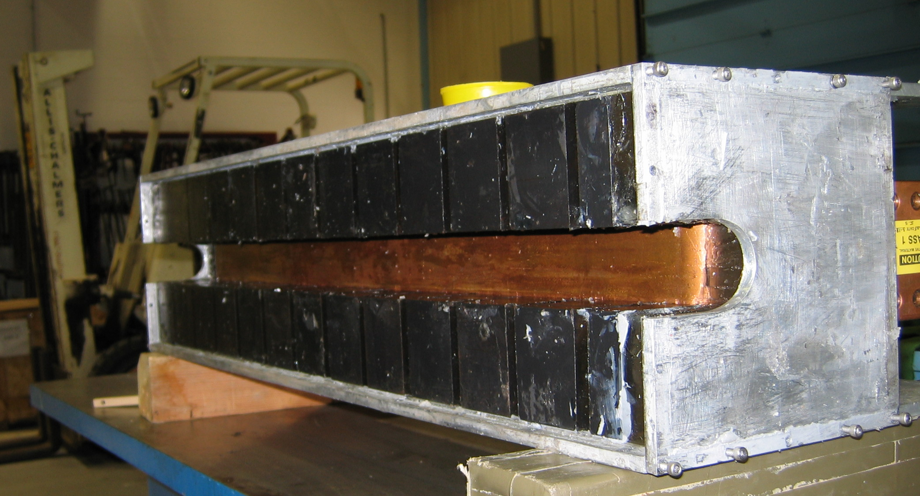
Needed to reuse Kickers to meet schedule
Four new kicker systems required for g-2 operation
  RR Extraction Kicker (RR AIP)
  DR Injection Kicker (DR AIP)
  DR Extraction Kicker (g-2)
  DR Abort Kicker (DR AIP)
RR kicker done first, all others on the same time scale
DR Extraction Kicker very close to the Critical Path for the g-2 experiment
All kicker systems need to be completed before muon-only beam can be delivered to Storage Ring

Slide 11
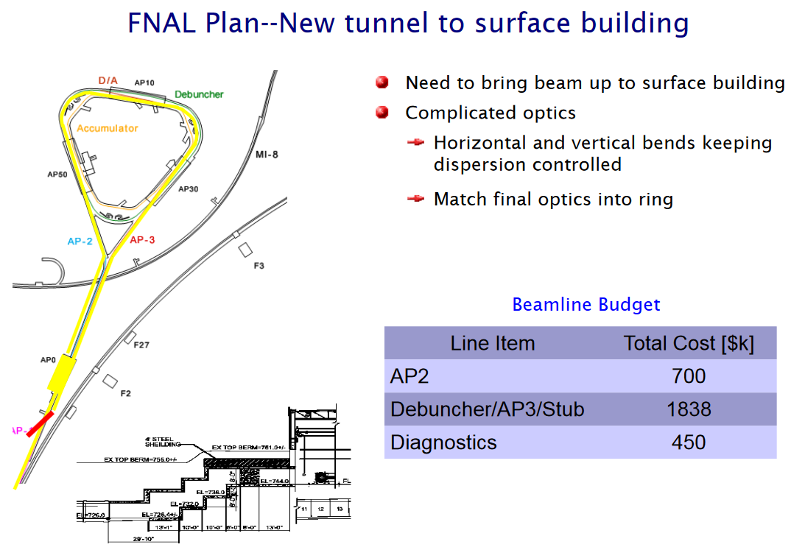
The g-2 plan – Circa fall 2011
Chris Polly presentation

Slide 12
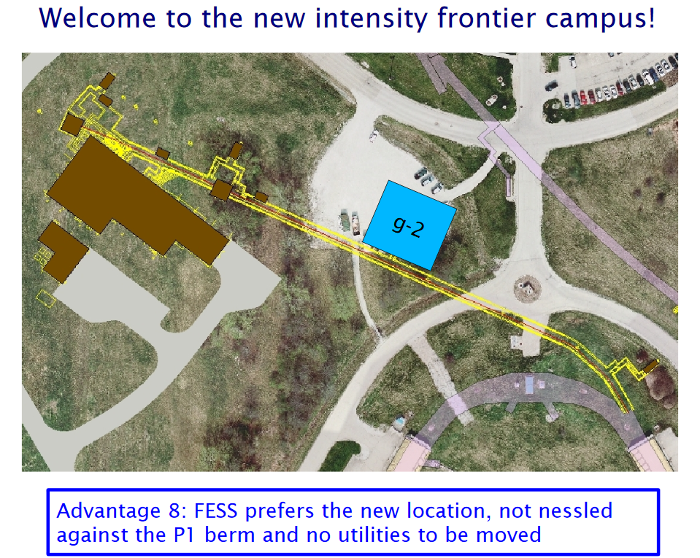
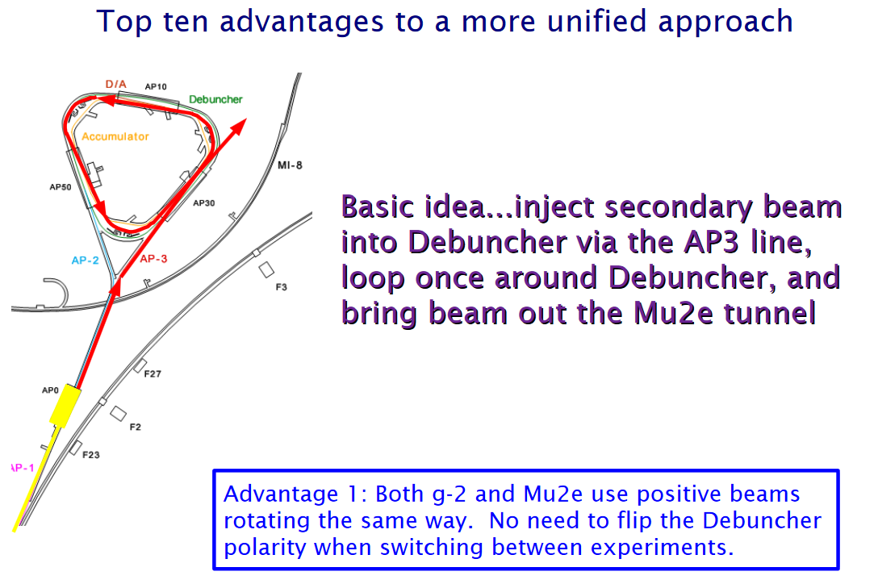
Chris Polly already had a vision of a Muon Campus
Note that there was no proton removal strategy and g-2 building location was highly constrained
Chris Polly presentation

Slide 13
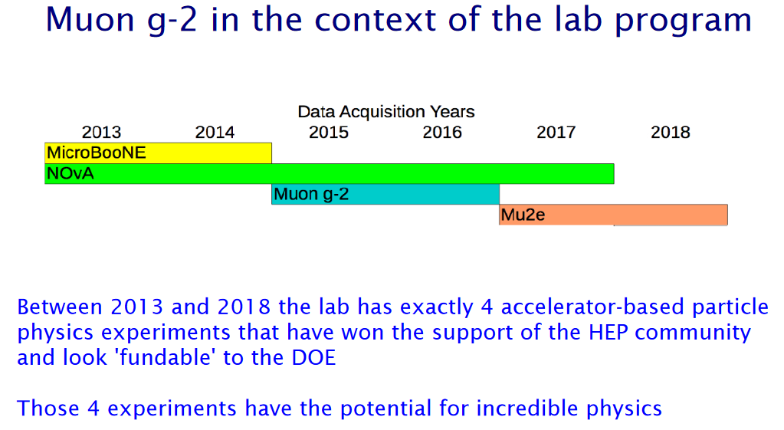
However, the schedule was optimistic
Actually began commissioning g-2 in Spring 2017
Chris Polly presentation

Slide 14
2012-2015 The Muon Campus takes shape
g-2 receives CD-0 (Mission Need) in fall 2012
Mu2e receives CD-1 approval in July 2012 (CD-0 was November 2009)
Most of the major design features of the Delivery Ring and beamlines are in place by the end of 2012
  New beamline tunnel construction schedule requires early decisions on M4/M5 Line geometry
Spring 2013 MC-1 construction begins
Tunnel construction starts in Fall 2014
Mu2e Building construction begins in Fall 2015

Slide 15
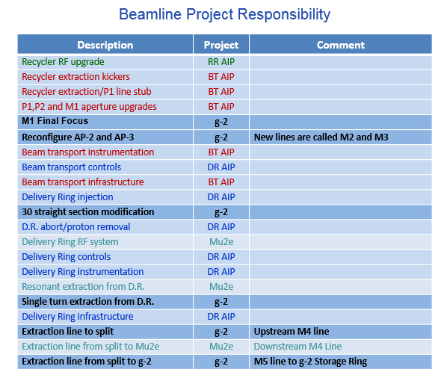
Lots of AIPs to interface with g-2 and Mu2e projects

Slide 16
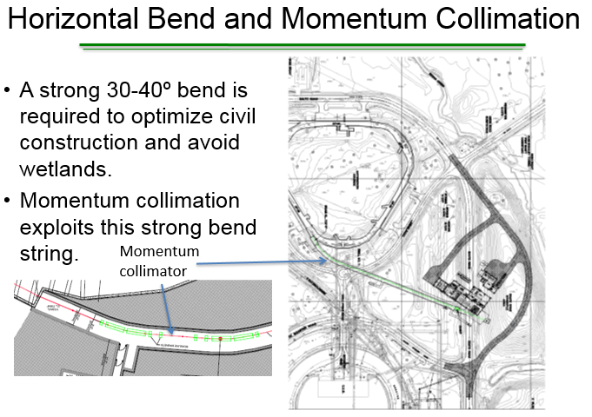
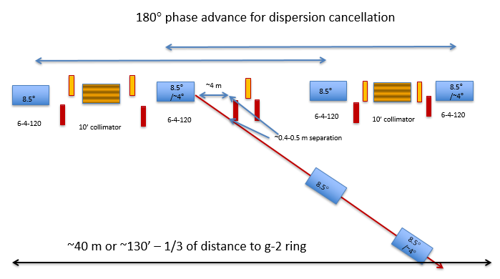
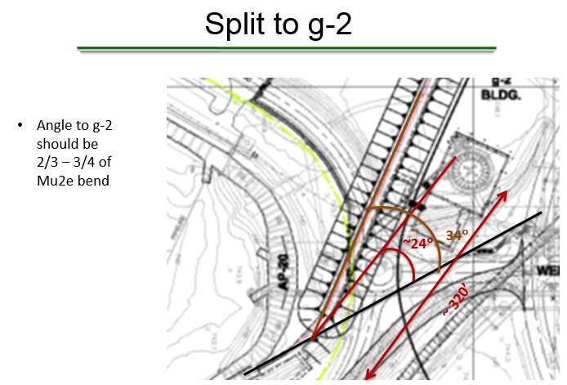
2012- Locating the MC-1 Building
At Mu2e CD-1 Review, M4 design is still underway
Beamline to g-2 is now part of planning process
  Initial design was horizontal split in middle of Left Bend
Carol Johnstone presentation

Slide 17
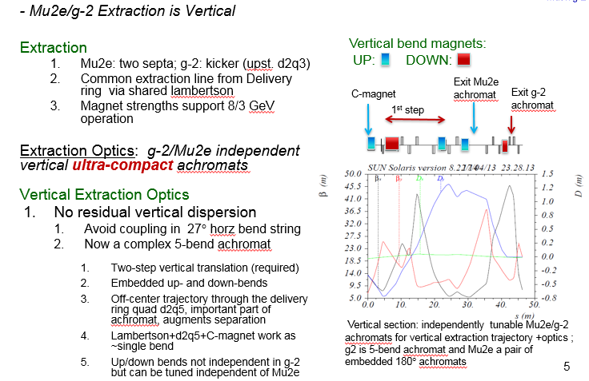
2013 g-2 IDR, vertical split from M4
Carol Johnstone presentation

Slide 18
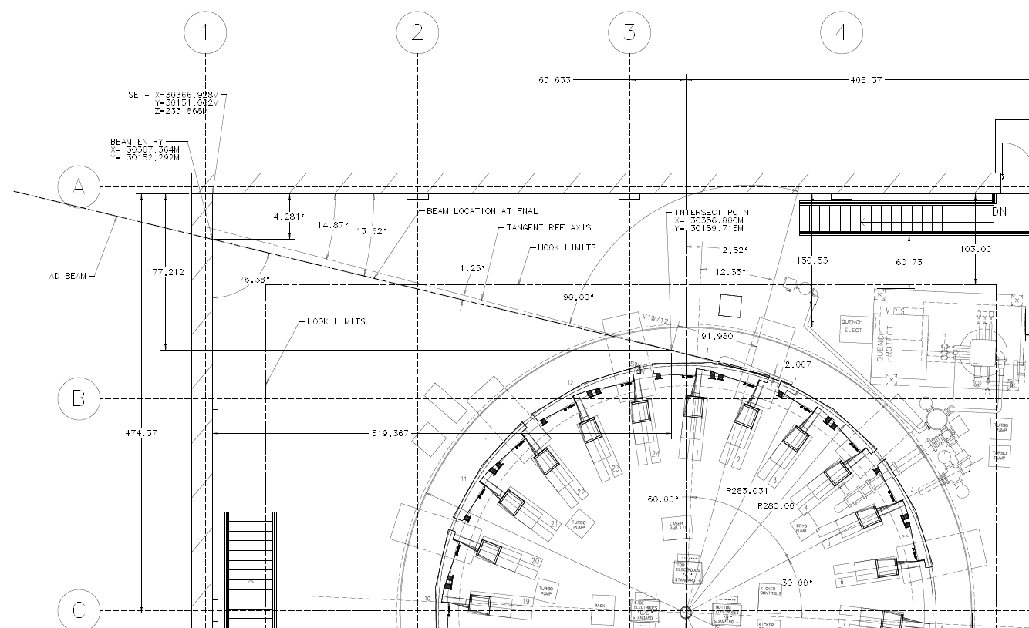
2012- Locating the MC-1 Building

Slide 19
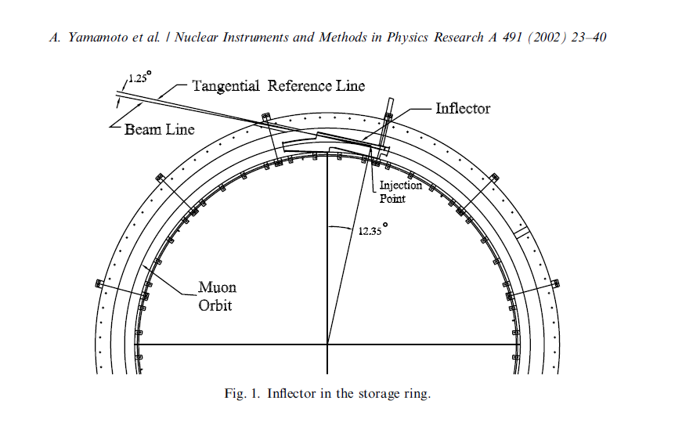
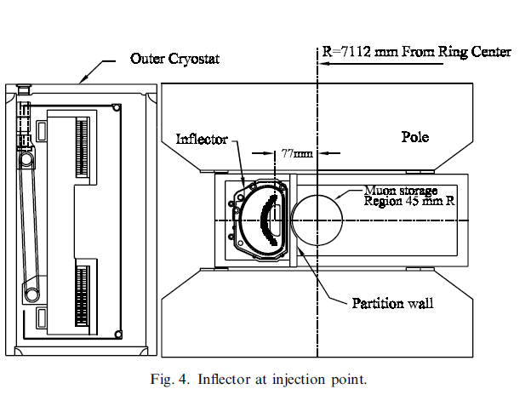
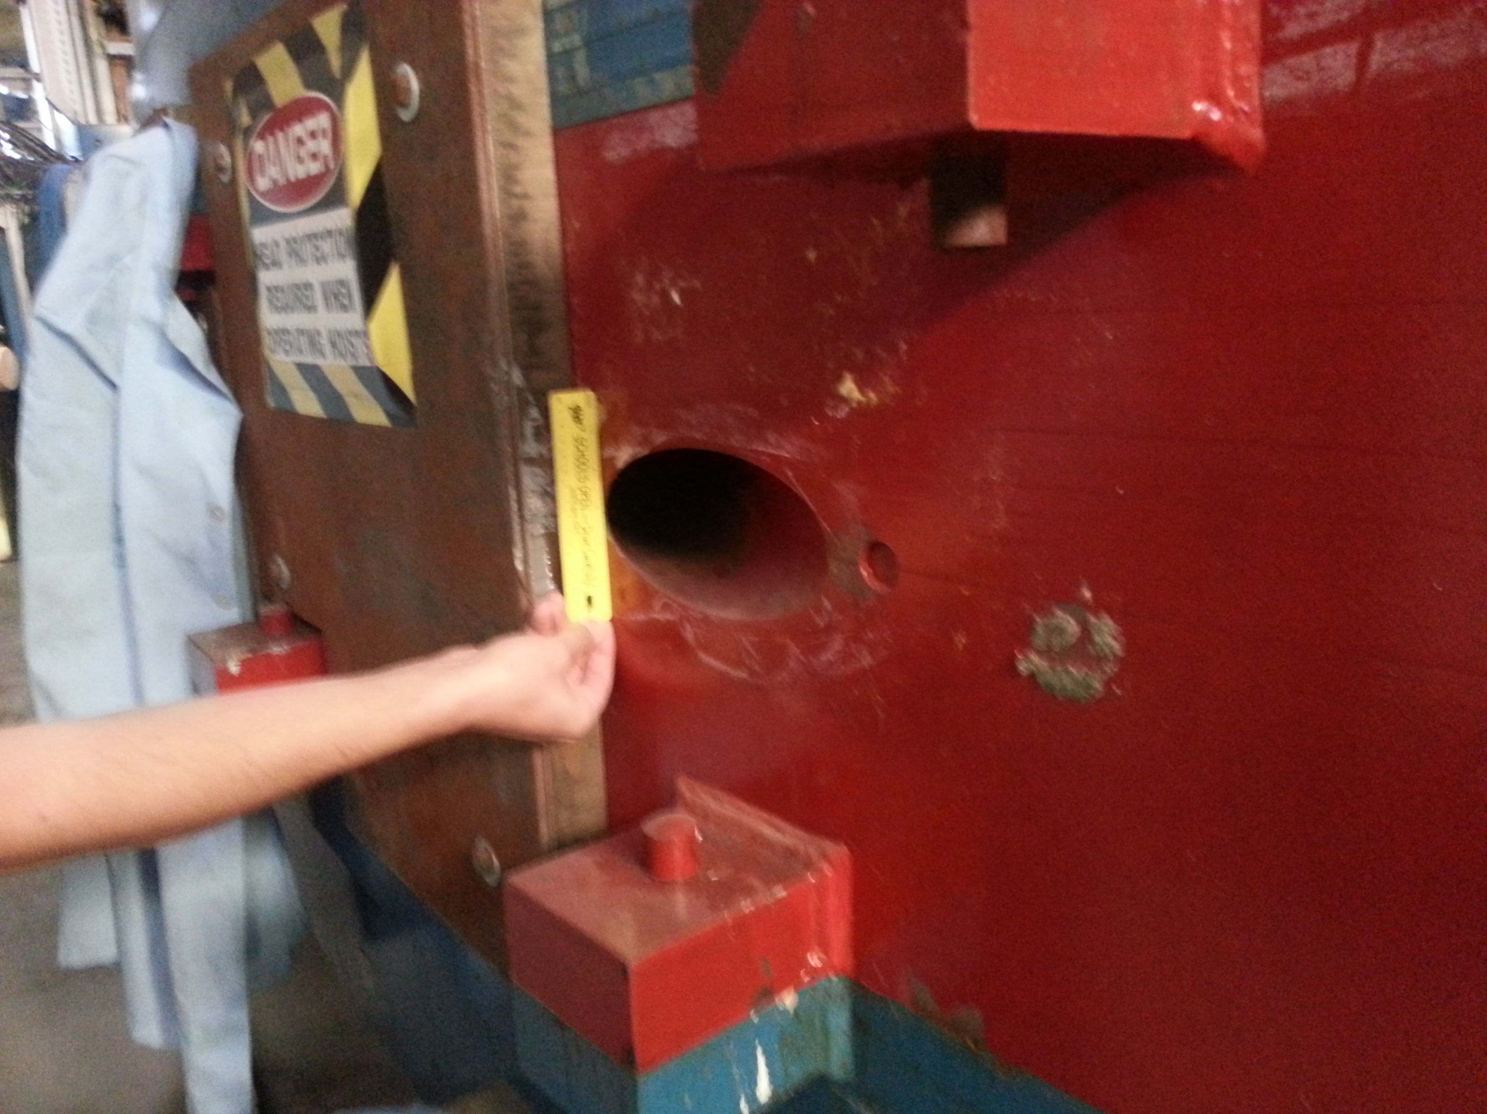
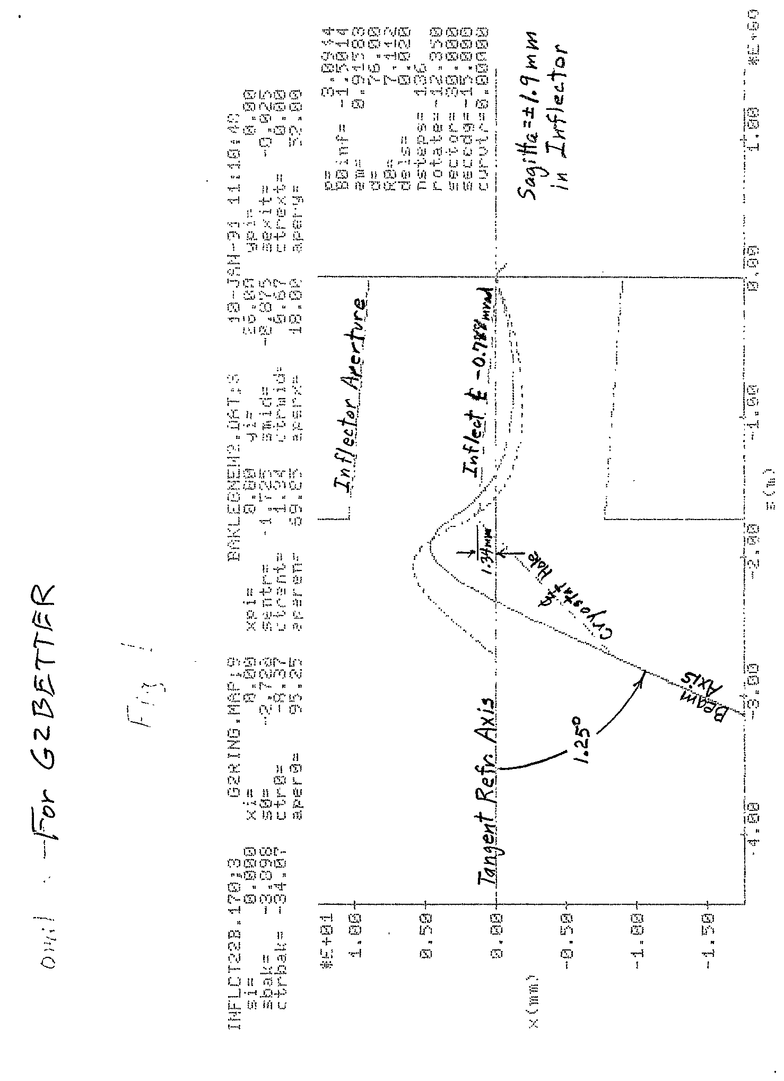
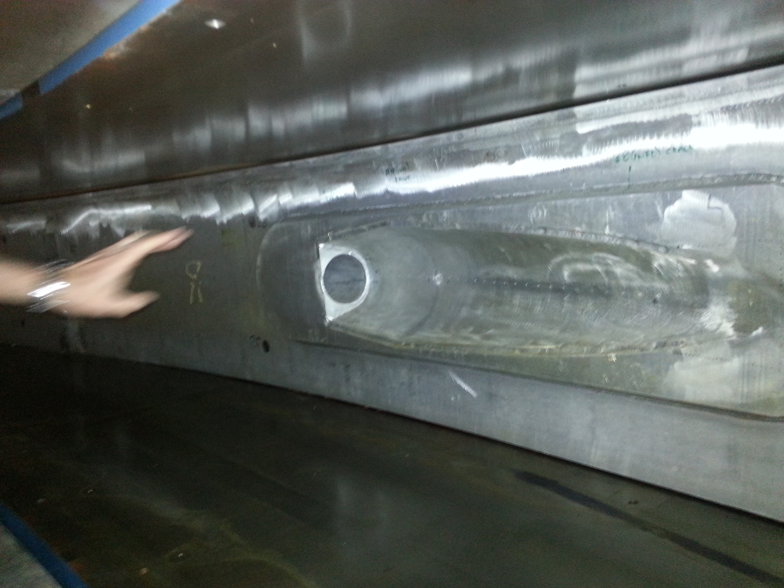
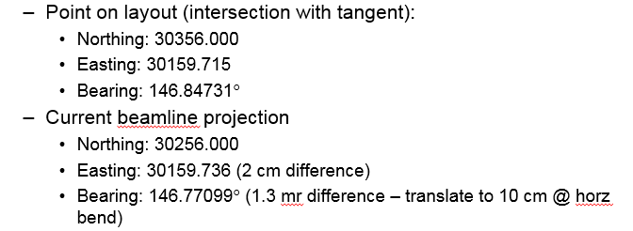
2012- Locating the MC-1 Building

Slide 20
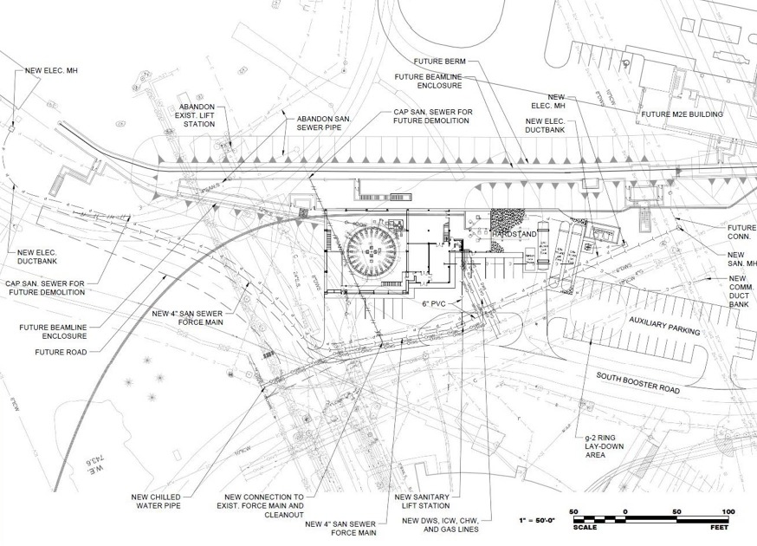
2012- Locating the MC-1 Building

Slide 21
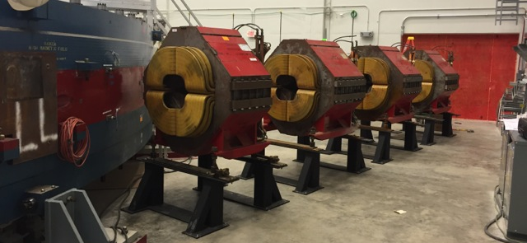
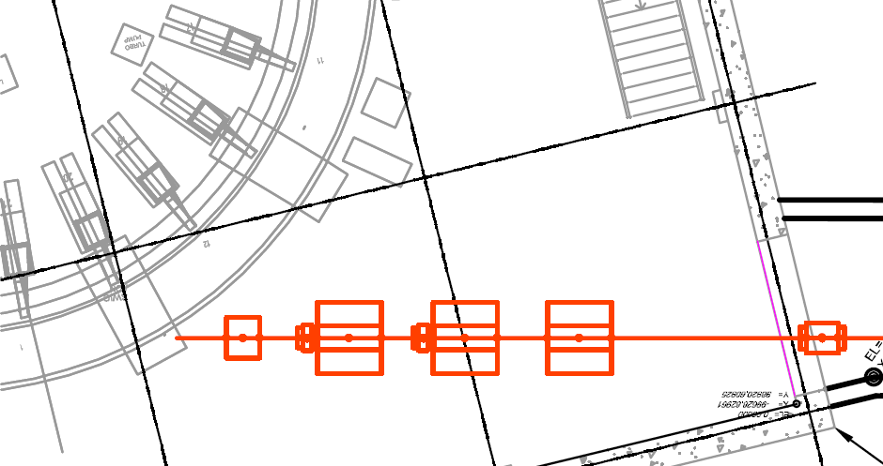
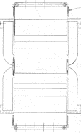
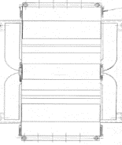
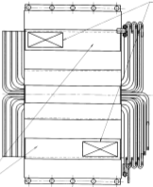
M4/M5 Line - Magnets in MC-1 Building
tunnel BO
Feb 2016
Q021
PWC025
& IC025
HT024
VT023
PWC021
Cerenkov
Q025
Q024
Q023
Q022
room for t₀ detector, etc
Installed 4 quads in MC-1 and working towards powering them for ring shimming
  Won’t precisely align or install vacuum components until rest of M5 line installed

Slide 22
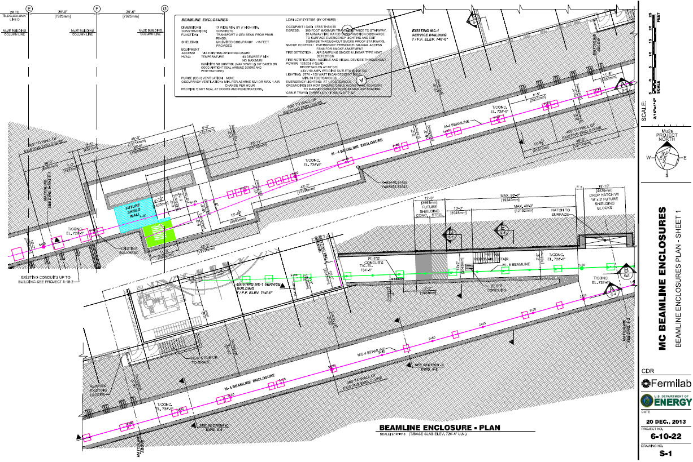
December 2013 – New tunnel design

Slide 23
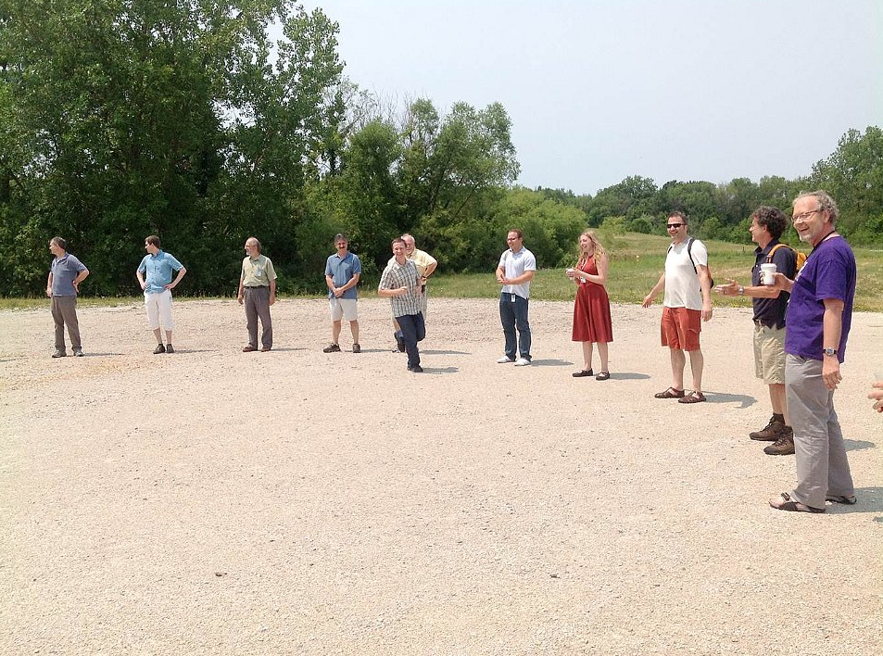
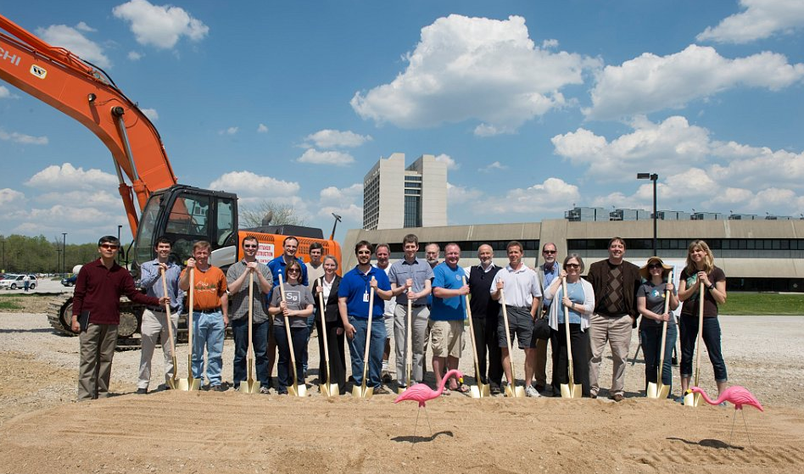
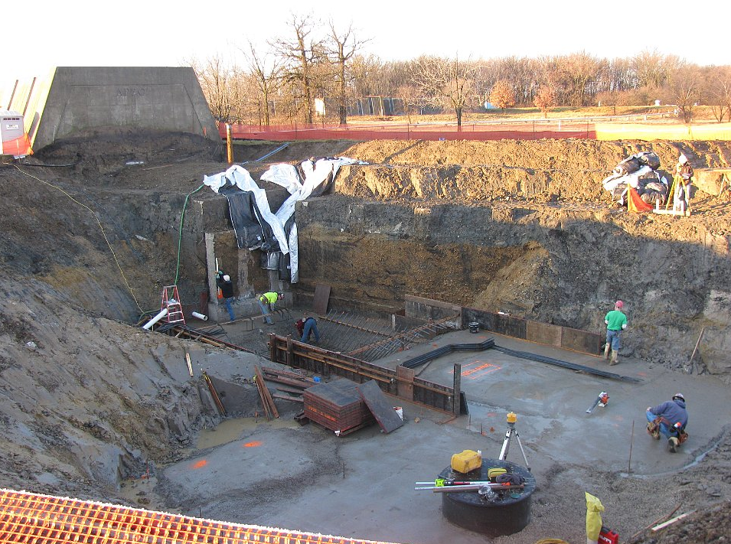
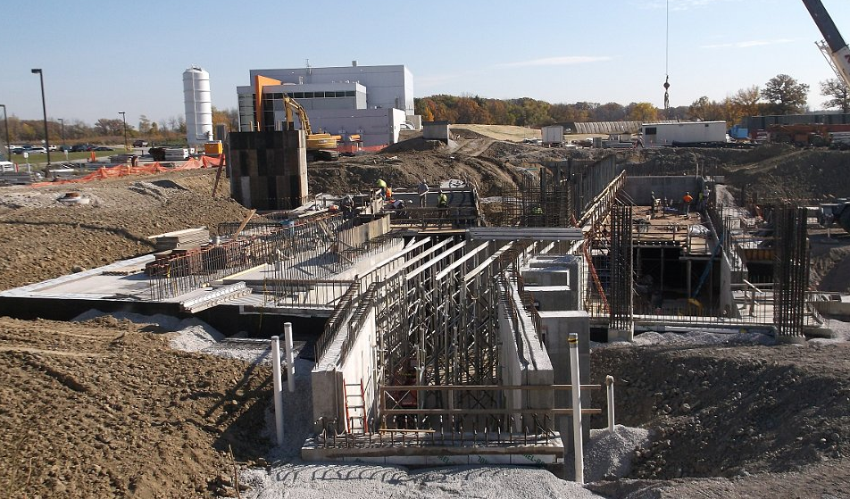
2012-2015 The Muon Campus takes shape
g-2 Collaborators making “ring”
May 2013, MC-1 Groundbreaking
Winter 2014-15, tunnel construction
October 2015, Mu2e construction

Slide 24
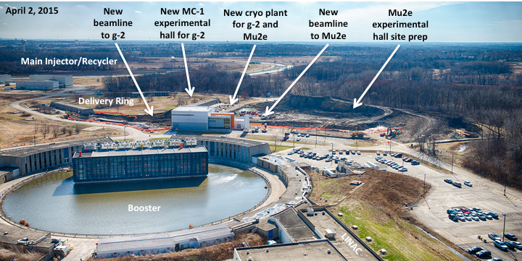
2015 The Muon Campus takes shape

Slide 25
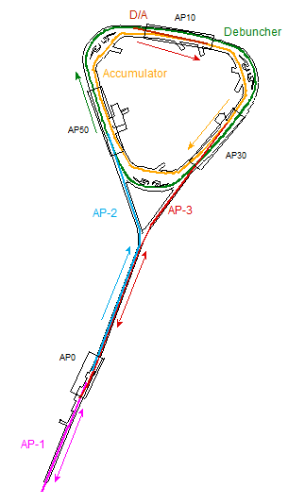
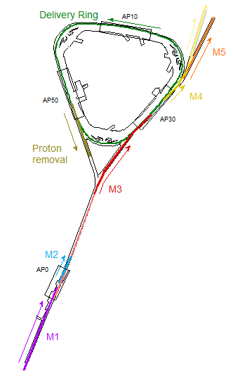
Repurposing Pbar
Target Station
Target Station
Antiproton
production
Muon Campus
(g-2 operation)

Slide 26
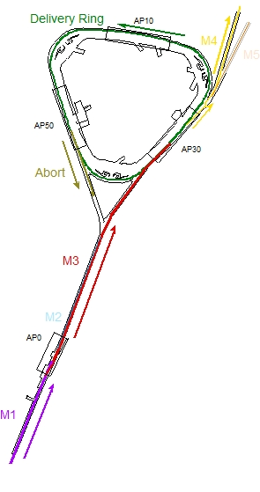
Beamline Design – Dual modes
g-2 versus Mu2e operation
  3.1 GeV/c Pion decay channel, beta functions need to be as small as possible to maximize muon capture
40 pi-mm-mr transverse acceptance, +/- 2% dp/p momentum acceptance
Beam does a few turns in Delivery Ring to separate and eliminate protons
Single turn extraction into M4 and M5
8.89 GeV/c proton beam bypasses Target Station and is transported in M3
Beam intensity is much higher that Pbar was or g-2 will be
Protons are resonantly extracted from the Delivery Ring
Extracted beam is transported down M4 to the Mu2e Target
g-2 operation
Mu2e operation

Slide 27
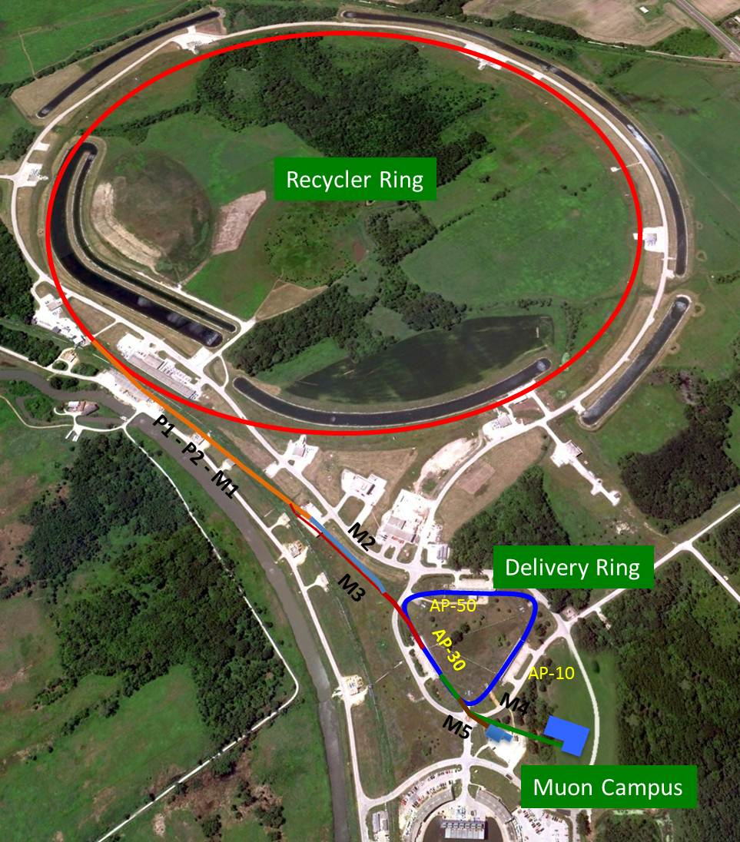
Beamline Overview
Target
Station
The Muon Campus beamlines

Slide 28
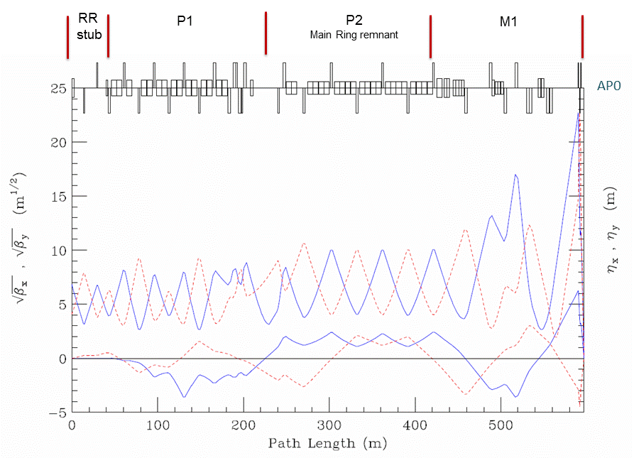
RR to Target optics and aperture improvements
Final Focus
SQx triplet
F-17 C-Magnets
Replace with CDA
HV102 dipoles
Replace with MDC’s
V714 C-magnet
Replace with B2
HV100 dipoles
Replace with MDC’s
MI-52 Lam. / V701 C-magnets
Eliminated by new RR to P1 Line
Tev. F0 Lambertsons
Remove

Slide 29
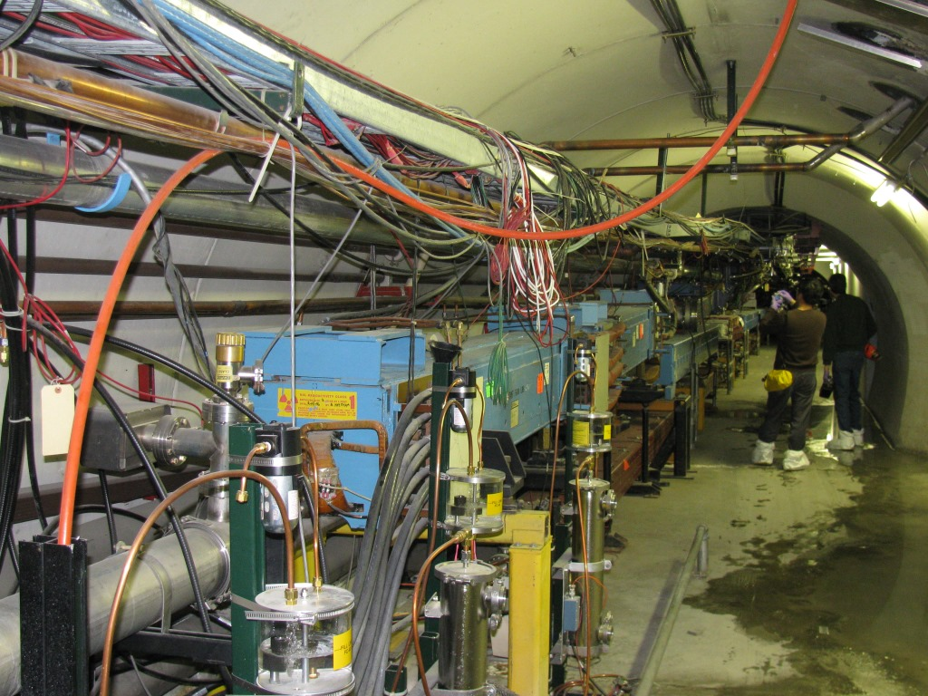
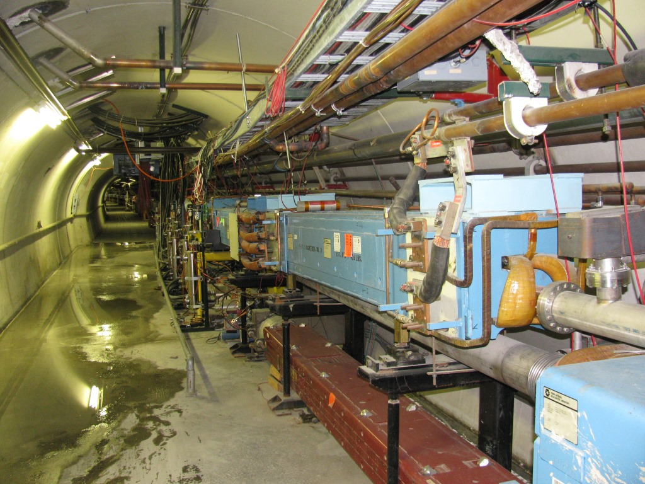
F-17 before C-Magnet and EPB dipole removal
Tevatron Enclosure – upstream AP-1 at F-17/18

Slide 30




F-17 ─ Old magnets removed, new M1 dipoles installed
Aperture comparison –
old versus new

Slide 31



M1 Final Focus
Old AP-1
New M1

Slide 32



M1 Final Focus
Final Focus – replace PQ9B quadrupole with triplet
Quadrupole triplet
PA6A&B
PA7A&B
PQ8A&B and PQ9A removed and replaced with a quadrupole triplet
Beta function at the target needs to be 7 cm!
Large beta functions are required in downstream M1 Line, particularly in triplet
V. Tishchenko

Slide 33


M2 Line optics
  Peak beta functions occur in four quadrupole “triplet” immediately after Target Vault
After triplet, beta functions vary between 2 and 25 m
540°of phase advance required to cancel horizontal dispersion from PMAG
M2 matches into M3 lattice
Existing AP-2 and AP-3 quadrupoles, trims and magnet supports can be used to construct most of M2 line (dipoles mostly come from AP-3 and the Accumulator)
M2 Merge must not compromise ability for M3 to efficiently transport 8.89 GeV/c protons
5D32
M2
M3
Target Vault

Slide 34



M3 Line optics
  Match from M2, transition to FODO lattice with 90°cells
After triplet, beta functions vary between 2 and 25 m
540°of phase advance required to cancel horizontal dispersion from PMAG
Two dipole 18.5°achromatic bend made of two Accumulator SDB dipoles
  Another FODO section with 72°cells spans section between “Right Bend” and Delivery Ring match
M3 Line changes elevation in two steps to Delivery Ring level, on either side of a horizontal bend
Two dipole 5°achromatic bend made of two MDC dipoles to align M3 with Delivery Ring
5D32
Rings Enclosure
D30 straight
M3
Target Vault

Slide 35


M3 Line 8 GeV optics
  Original Pbar AP-3 Line target bypass bend geometry remains in place
Pbar AP-3 to AP-1 optics match always had issues
Beamlines AIP had budget for optics analysis and addition of quads, trims and power supplies
Did not have solution that cancelled dispersion in both planes when money had to be spent
  Vladimir assisted and came up with the present configuration
  M3 numbering downstream of M2 merge was already in place, thus Q704A,B&C, Q705A&B
8 GeV protons from RR via M1/M3 are only about 60% efficient to the Delivery Ring
Rings Enclosure
D30 straight
M3
Target Vault

Slide 36

M3 Line 8 GeV optics
Old EB6/H928 is renamed H700
(EB6 in Vladimir’s OPTIM model)
Old EQ28/Q928 is renamed Q702
(Q902 in Vladimir’s OPTIM model)
Old EB5/H926 is renamed H702
(EB5 in Vladimir’s OPTIM model)
Old EQ26/Q926 is renamed Q703
(Q902 in Vladimir’s OPTIM model)
VT107A
HT107A
H700
VT107B
VT700
HT107B
Q108A-C
Old EQ27/Q927 is relocated upstream and becomes new Q701
(Q901 in Vladimir’s OPTIM model)
H702
H703
Old EB6, EQ28, EB5, EQ26 and EB4 remain where they are and become H700, Q702, H702, Q703 and H703
(new naming convention)
Old EB4/H925 is renamed H703
(EB4 in Vladimir’s OPTIM model)

Slide 37

M3 Line 8 GeV optics
Hanging magnets to improve
head clearance
VT703
Q906/Q704C
Q904/Q704A
Q905/Q704B
Hatch
HT704C
SEM703
Q907/Q705A
Existing EQ24
Q908/Q705B
AP-3
Vault
M3

Slide 38


Delivery Ring 30 straight section
Extraction kickers
Injection kickers
Horizontal bend (5°)
Vertical bend
Extraction Lambertson
and C-magnet
Injection Septum
and C-magnet
Vertical bends

Slide 39

Beamline Design – D30 reconfiguration
Overview of what needs to be reconfigured
Obsoleted AP3 Line
Obsoleted Accumulator
Remove the AP3 Line.
Store magnets in the tunnel for reuse.
Current Debuncher - Future Delivery Ring

Slide 40

Beamline Design – D30 reconfiguration
After reconfiguration
New M4 Beamline
New Extraction Devices
New Injection Devices
Delivery Ring
New M3 Beamline

Slide 41



D30 Straight Section Reconfiguration
Delivery Ring
injection of beam from target
extraction towards g-2 ring
5/8/14 start of decommissioning
3/23/15
Remove existing magnets (complete)
Reconfigure cables, cooling water, electrical bus, lighting (40% complete)
Install injection (M3) and extraction (M4) lines
Reinstall Delivery Ring magnets

Slide 42


Injection Region
Q302 extended star
chamber and g-2 beam
Bend angles of Septum, LQ and C-Magnet
Injection region

Slide 43



Delivery Ring Extraction
Design is driven by need for Lambertson to support Mu2e resonantly extracted beam
g-2 will extract beam with a pair of horizontal kickers
Lambertson has design bend angle of 38 mr, requiring 1.13 T-m of integrated field @8.89 GeV/c
8 inch aperture quadrupole required due to beam being offset in both planes
Large horizontal bump required for g-2 to achieve 40 pi acceptance
“C”-Magnet has design bend angle of 56.3 mr, requiring 1.68 T-m of integrated field @ 8.89 GeV/c
Extraction devices will have radiation shielding for Mu2e operation

Slide 44

Proton removal in the Delivery Ring

Slide 45



M4 Line optics design
Carol Johnstone began the original M4 design in 2010, tunnel defined by 2013
Modular design (Carol’s terminology)
  Extraction
  Horizontal Bend /Momentum Collimation
  A/C dipole optics
  Collimation section
  Vertical bend to experiment
  Final Focus (within vertical descent)
Original horizontal bend was similar to the AP-2 Left Bend (36.53°)
From Mu2e CD-1 Director’s Review, May 2011
M4 Line design, September 2013

Slide 46


M4 Line design now
Mu2e Target
Common Section:
Shared with g-2. Extraction is vertically up.
Vertical Split between g-2 & mu2e is at 908.
Vertical dispersion due the ECMAG is locally corrected.
Horizontal Bend Section:
Left bend section uses 4 SDFW and 2 SDF dipoles to bend beam 41° to the mu2e target.
Extinction Section:
Out-of-time to in-time particle ratio < 10⁻¹⁰
At AC dipole location:
  Large β_{x} to maximize the kickers effect .
  Small β_{y} allow small kicker vertical gap.
At collimator: 90° of phase between up & down stream collimator & kicker. Small β_{x} at downstream collimator.
Final Focus Section:
Brings beam to required spot size at target. (2x2 mm²)
2 Vertical dipoles bend the beam down to the target (2x1.375°)
FF magnets are installed on a 1.375° vertical slope.
protons
Bend
Common
Extinction
Final Focus
Courtesy Eliana Gianfelice-Wendt

Slide 47


The g-2 and Mu2e Common Section
g-2 Beamline
Mu2e Beamline
Vertical Split
Extracted beam from Delivery Ring (DR)
ECMAG
Q901
ECMAG
Q902
Q903
Q904
Q905
Q906
V906
Q907
V907
Q908
Q909

Slide 48

The V907 issue for Mu2e versus g-2 operation

Slide 49


The Horizontal Left Bend Section
g-2 beamline
H918
H917
H916
H911
H912
Mu2e Beamline
H910
Protons
Left bend section use 4 SDFW and 2 SDF dipoles to
Bend beam 41° to the mu2e target.

Slide 50

The Extinction & Diagnostic Absorber Section
Diagnostic Absorber – 170W
capacity for
beam commissioning
Q936
Post Extinction Collimator
Shield Wall
AC Dipole
Displaces out of time particles
HDA1 – Horizontal bend to
Diagnostic Absorber Line
Q931
Q929
Pre Extinction Collimator
Q920

Slide 51


M4 Diagnostic Absorber Line
The M4 beamline requires a diagnostic absorber for commissioning the beamline and commissioning resonant extraction during mu2e
The absorber has a 170 W capacity derived from 2 modes of commissioning:
  Mode 1 - Low intensity commissioning kicked beam (does not matter if people are present downstream). This is roughly 5E10 protons/pulse every 10 sec or so.
  Mode 2- Resonant Beam commissioning. Takes 4 pulses at 1E12 per pulse or 4E12 total protons/pulse every 30sec or so.
  Beam Power Calculations for the 2 Modes:
Beam is bent horizontally outward to the diagnostic beamline by an
MDC dipole at 5 °(85mrad).
There are 2 quads (QDA01 & QDA02) in the beamline to control optics in the line. (optics not critical but diagnostic capability depends on the ability to change phase and observe phase space evolution)

Slide 52


Diagnostic Absorber
The M4 Diagnostic Absorber is a series of 6’x6’x5’ long stacked steel plates using 108 steel plates.
It is surrounded by 1’ of concrete on the top & bottom and 3’ in the back.
The absorber has 1’x1’x3’ albedo trap angled at 5° to match the beamline.
The absorber is passive with no water cooling.
The steel for the absorber has been and cut , prepared, assembled and will be installed in the tunnel walls surrounded by concreate. The for installation has been transferred for Mu2e project to the tunnel GPP.
The absorber was designed on by the External beamline WBS but cost transferred to the tunnel GPP for installation because it is part of the tunnel wall.
Diagnostic Absorber before concrete pour
Tunnel View of Diagnostic Absorber after surrounded in concrete

Slide 53




The Final Focus Section
Transport
Solenoid -TS
Detector
Solenoid -PS
HT940
VT940
VT942
V943
HT943
V936
Q937
Q938
Q939
Q940
Q941
Q942
Q943
Production
Solenoid -PS

Slide 54



M4&M5 Lines
Mu2e
Bldg
Booster
MC-1
Bldg
M5 Line
Delivery Ring
M4 Line
M4/M5 split

Slide 55


Shared M4 and M5 Line optics
Elevation change to Storage Ring elevation in three steps
  ELAM/Q205/C-Magnet to V901 (32”)
  V905 to V907 (16”)
  V907 to V003 (69.5”)
“Switch” Magnet at V907 reverses polarity for g-2 vs. Mu2e operation
Immediate transition into 27.1°Left Bend to establish proper horizontal trajectory to Ring
Shield wall incorporated into M5 tunnel
Final Focus section to provide optical matching to Storage Ring
M5 trajectory entering Storage Ring must compensate for horizontal steering caused by fringe fields
M4
M5

Slide 56



M5 Final Focus into g-2 Storage Ring
Design accommodates optics for cases with and without focusing from the Inflector, provided by Ring Team
Also provides tuning flexibility for optics between the two cases
Four repurposed Pbar LQ magnets are used to provide adequate aperture
Inflector with uniform field
Inflector with WG field map
Storage Ring is on left side of plots

Slide 57




The g-2 Storage Ring
10 cm beam access port
1.45 Tesla field

Slide 58




Beam trajectory into the g-2 Storage Ring
Beam passes through fringe fields in the backleg steel (weak) and main dipole field (strong) near the poles
Beam passes through a bore in the cryostat between the yoke and Inflector
Ring field also acts like “D” quad
The Inflector produces a uniform 1.45 T magnetic field to cancel main dipole field

Slide 59

The Inflector

Slide 60
Injection into g-2 Storage Ring
Tilt inflector 1.8 mrad to better match trajectory
Beam exits centered in inflector tangent to and displaced 77mm from ring central orbit
Projected center of bore to
properly aligned Inflector
shifted by approximately 8 mm
Center of bore
Dave Rubin

Slide 61

Matched beam versus Inflector aperture
Good transmission or matched optics…you can’t have both

Slide 62

Magnet can be powered during access

Slide 63
Possible future presentations
Delivery Ring Injection and upstream optics issues
Delivery Ring Extraction, the Abort and g-2 Proton Removal
Issues complicating rapid switch between g-2 and Mu2e
The Delivery Ring’s role for g-2 versus Mu2e (?)
The Ionization Cooling Wedges (Diktys?)
Injecting beam into the g-2 Storage Ring (Nathan?)

