Slide 1
The Fermilab High Power Targetry R&D Program
Patrick Hurh
Introduction for I. Szlufarska, UW
29 Nov 2018

Slide 2

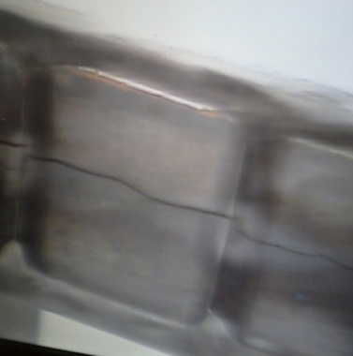
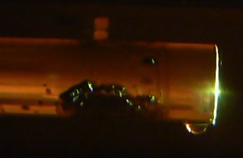
High Power Targetry Challenges
Recently major accelerator facilities have been limited in beam power not by their accelerators, but by their target facilities (SNS, NuMI/MINOS)
Plans for future high power, high intensity target facilities will present even greater challenges
To maximize the benefit of high power accelerators (physics/$), these challenges must be addressed in time to provide critical input to multi-MW target facility design

Slide 3
Recognition of HPT Challenges
“Sustained, focused research into target technology in the context of a broad international collaboration of interested laboratories will be essential.”
-Snowmass 2013 Report, Section 6.4.3 High Power Targets
“High power targets, as noted at Snowmass, will address critical needs and should be included in GARD.”
-2014 Report of the Particle Physics Project Prioritization Panel
“Fund generic high-power component R&D at a level necessary to carry out needed thermal shock studies and ionizing radiation damage studies on candidate materials that are not covered by project-directed research."
-Recommendation 1 from Accelerator R&D Sub-panel 2015 Report

Slide 4
Fermilab HPT R&D Program
      Objectives
          To enable the design, construction, and operation of multi-MW target facilities through development of the required simulation/modeling methods and through measurement of required irradiated material behavior data;
          To develop advanced targetry technologies using these methods and data;
          And to point the way to new radiation and thermal shock compatible materials and technologies.
      Outcomes
      Reduce the cost and enhance the effectiveness of existing and future facilities by:
          Lowering operation costs;
          Increasing operating time;
          And optimizing useful secondary particle production.
        Beneficiaries
          Specifically planned to benefit HEP projects such as LBNF and other multi-MW or high intensity beamlines
          But also generally benefits all HPT facilities such as spallation neutron sources and rare isotope beam facilities

Slide 5
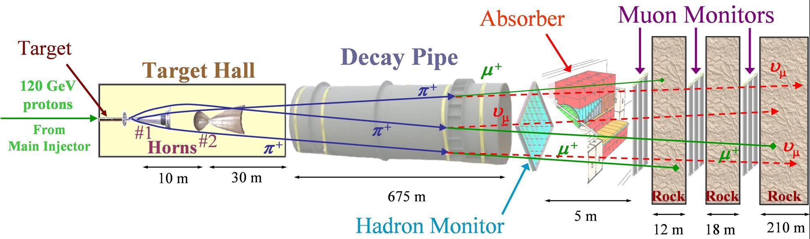
The NuMI Beam “Neutrinos at the Main Injector”
Absorbs ~ 40 % of beam power
Allows high-energy muons to penetrate
2 m diameter
Roughly decay length for 10 GeV π⁺
He-filled
2 interaction length, C target
Produces π⁺, K⁺ mesons
400 kW design average power
700 kW upgrade for NOvA
σ ∼ 1 mm
Pulsed focusing horns
Toroidal magnetic field
Parabolic inner conductor profile
Focuses meson momentum band
Measure hadron & muon fluxes
Arrays measure distributions
Notes:
Go light on horn description, other details

Slide 6
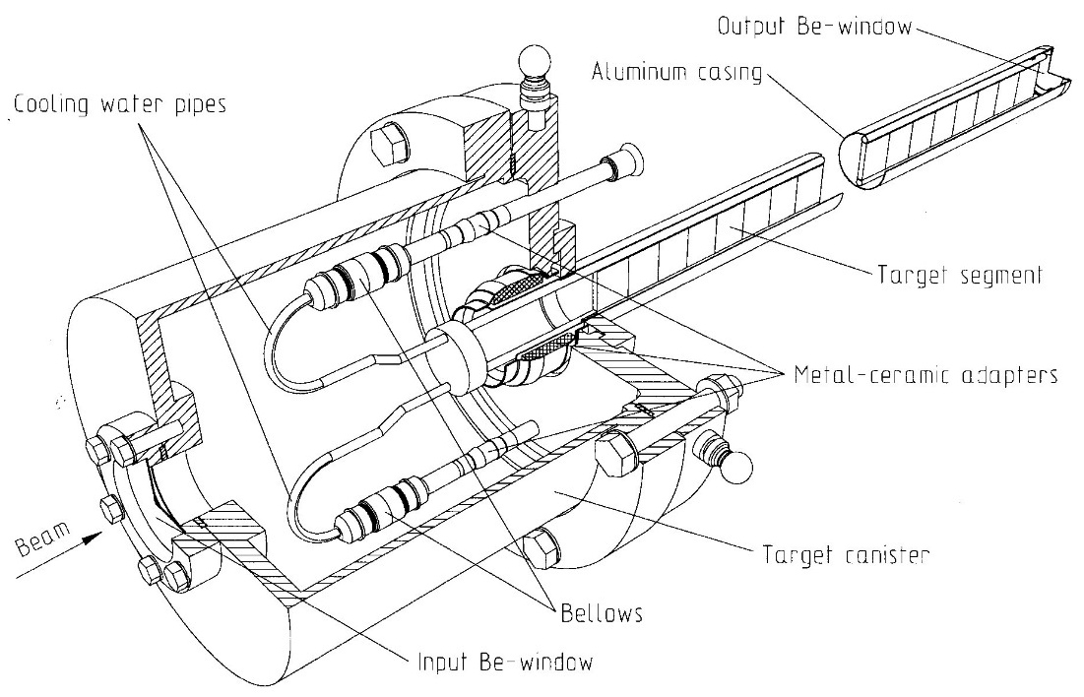
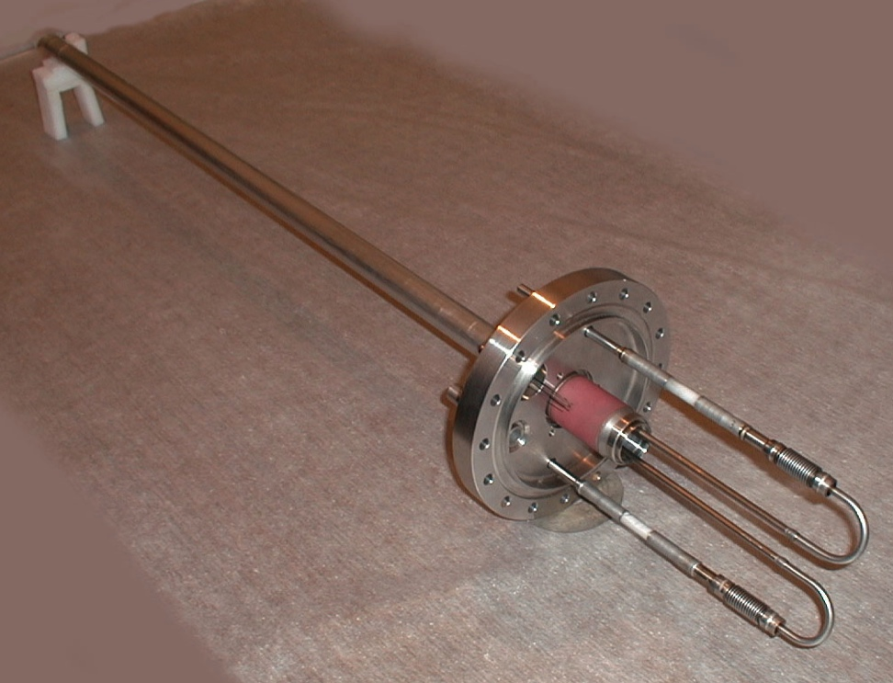
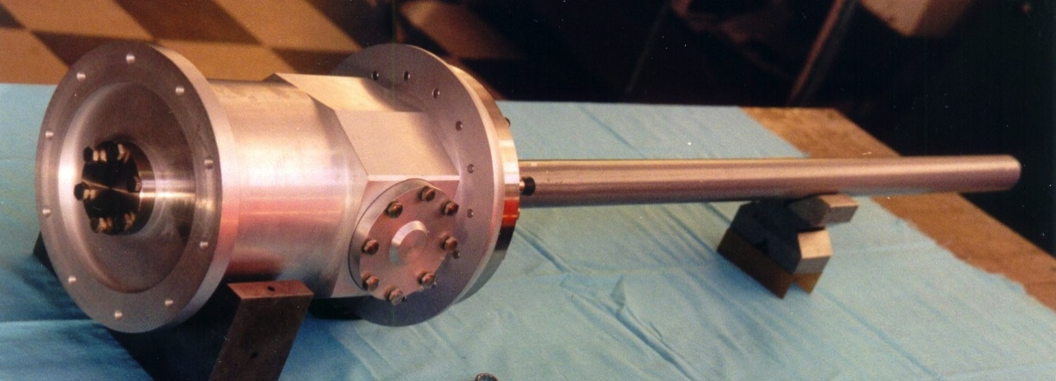
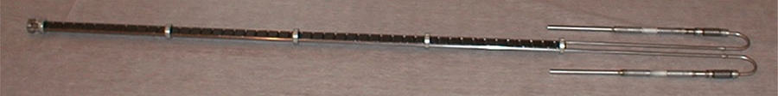
The MINOS Target
~ 4 kW beam power
deposited in target
Encased in
vacuum / helium can
with beryllium windows
Water cooled
graphite core

Slide 7
NOvA Target
Graphite fins: 50 x 24 mm; 7.4mm wide
Helium atmosphere
Beryllium windows
Water cooled aluminum pressing plates
fins not brazed to cooling (cf. NT-series)
Water cooled outer vessel
IHEP Protvino (Russia) did initial design
STFC-RAL / FNAL did final design and construction

Slide 8
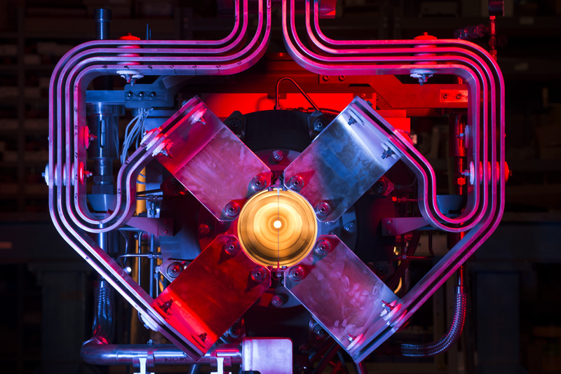

Slide 9
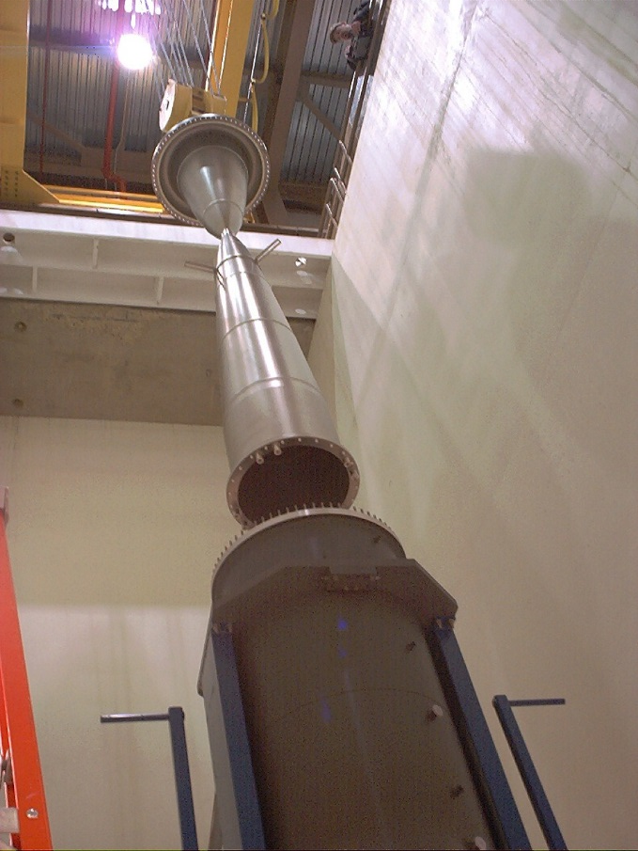
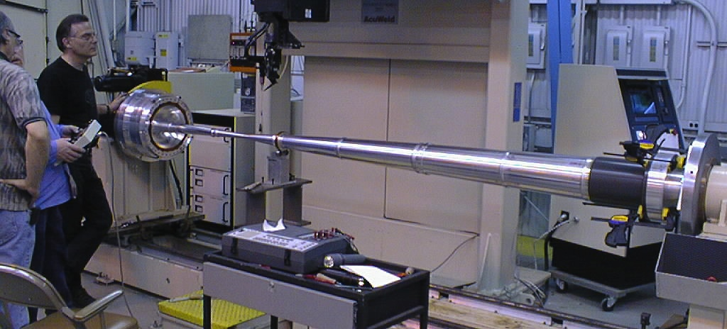
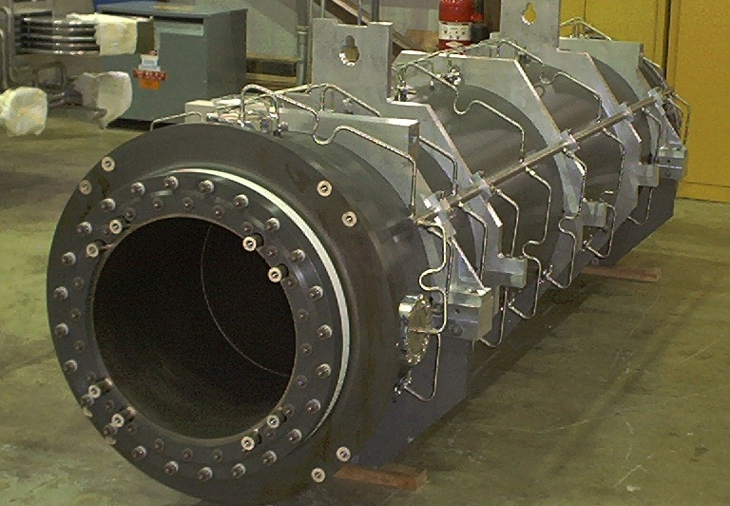
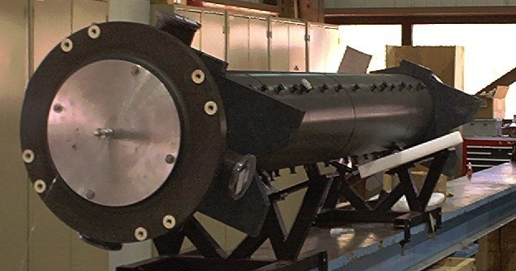
Horn Fabrication

Slide 10
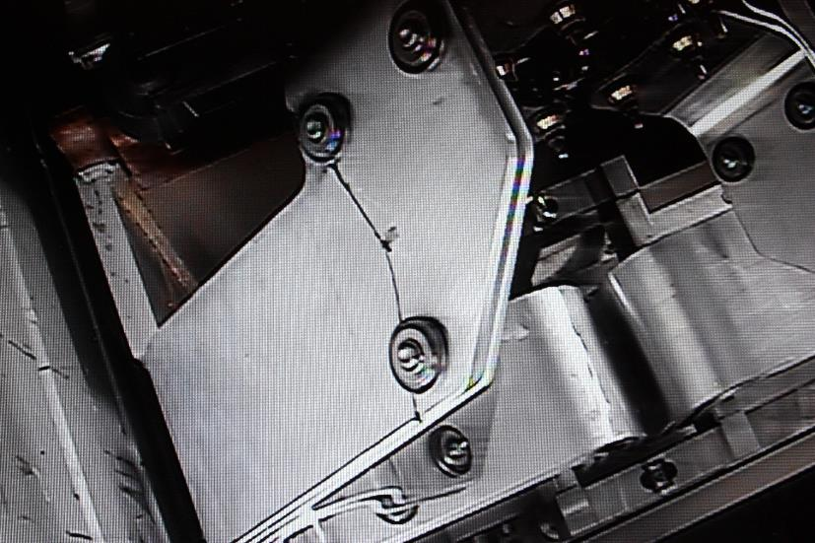
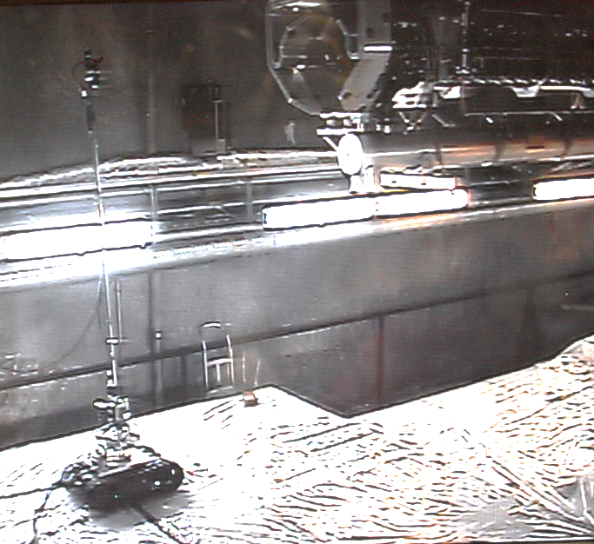
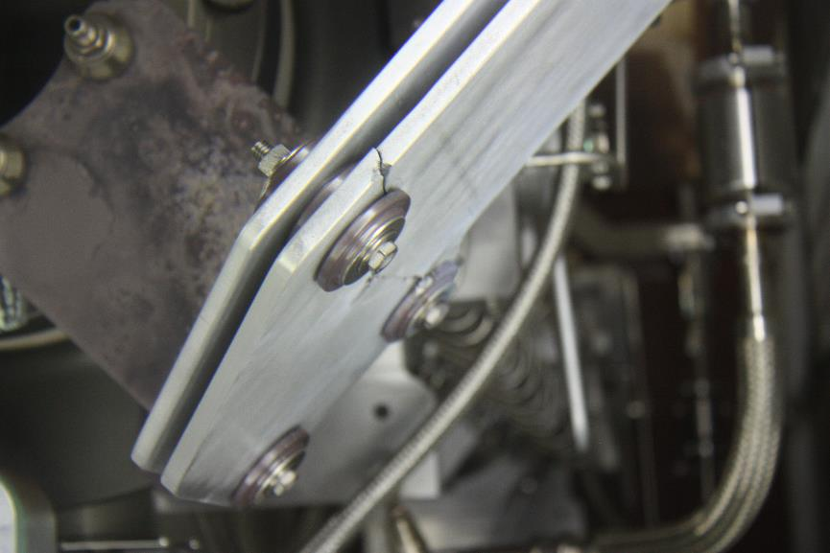
Challenging Environments
Replaced NuMI Horn summer 2015 due to failed stripline
  First 700 kW capable horn, in service since Sept. 2013, accumulated ~ 27 million pulses
Failure was due to fatigue, likely enhance by vibrations

Slide 11
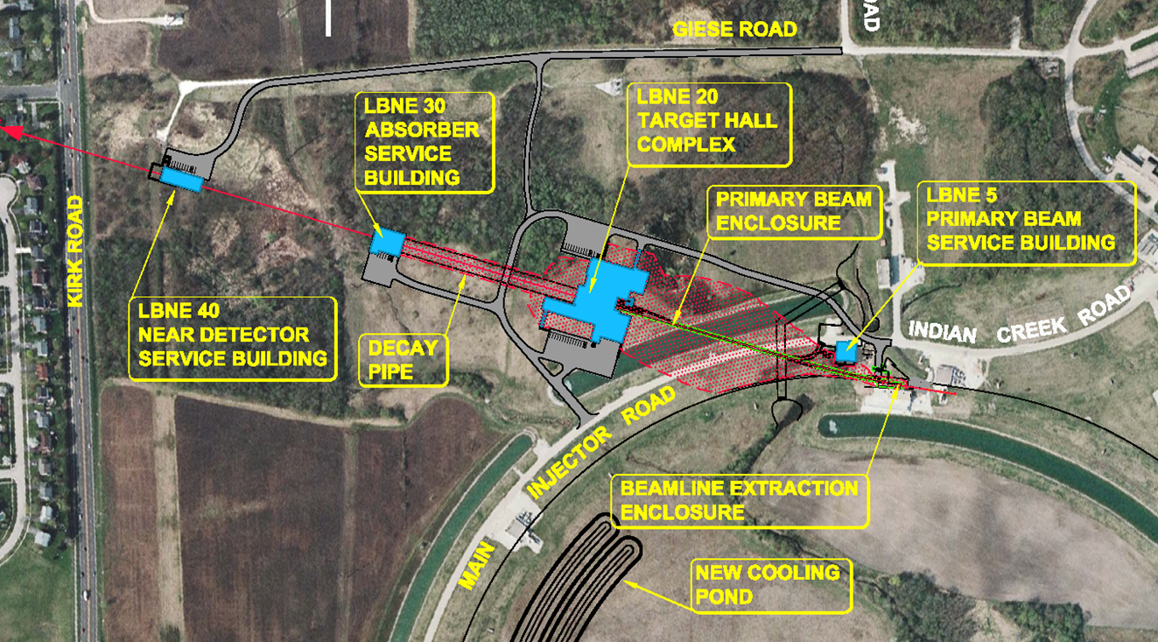
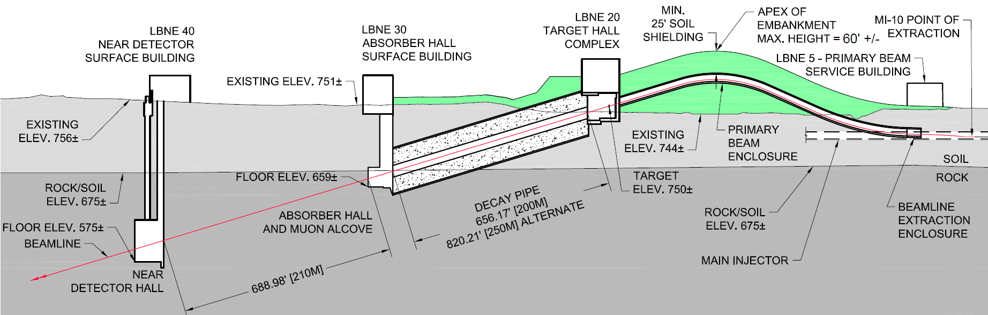
DUNE: Deep Underground Neutrino Experiment
LBNF: Long-Baseline Neutrino Facility

Slide 12
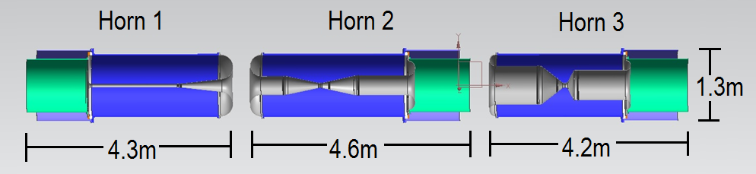
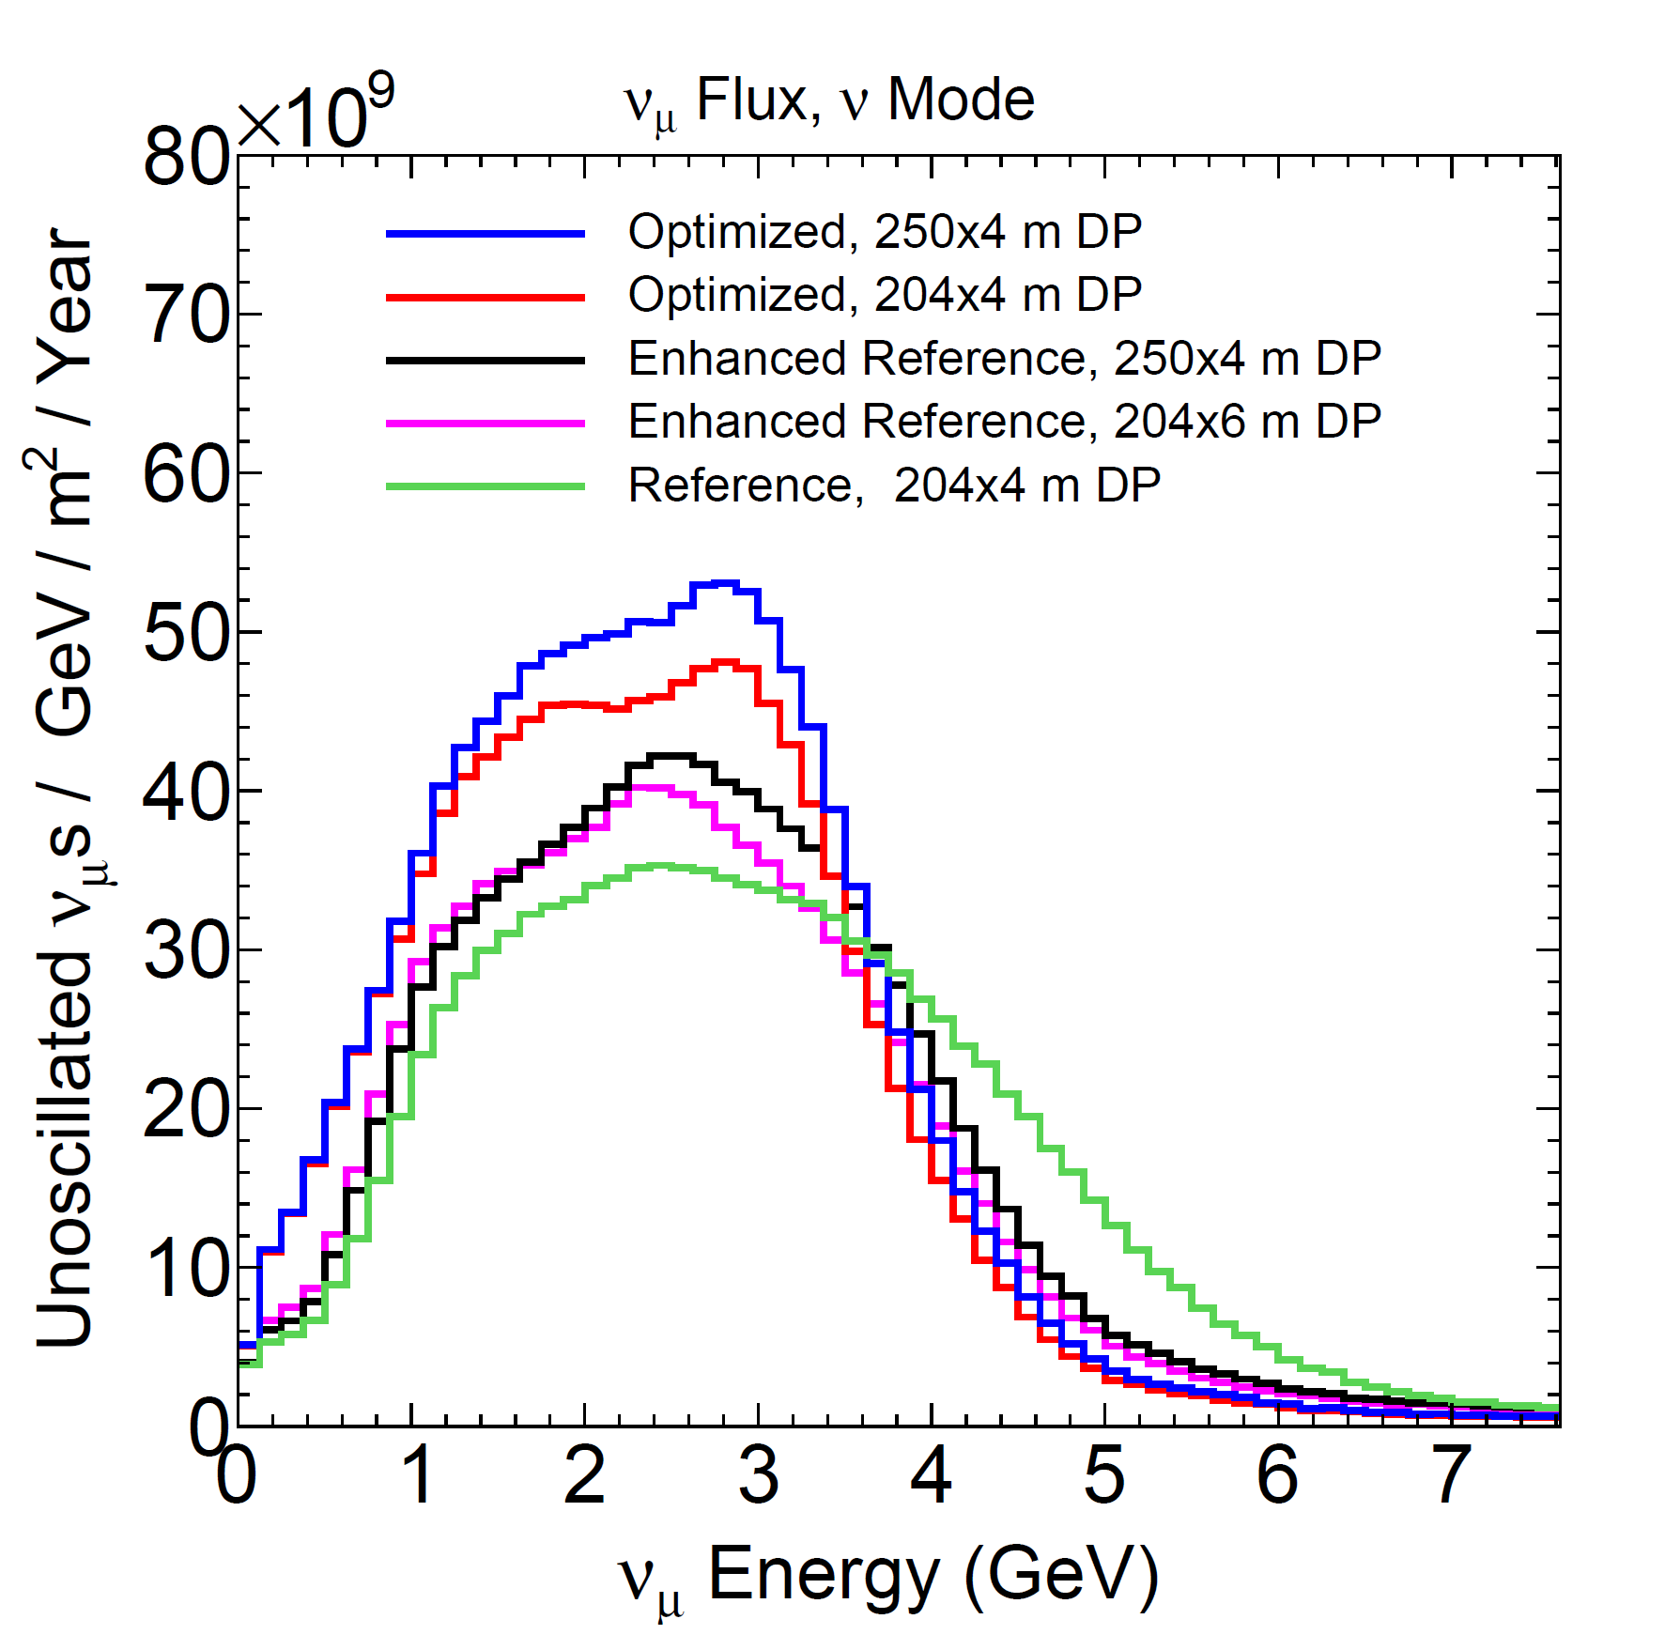
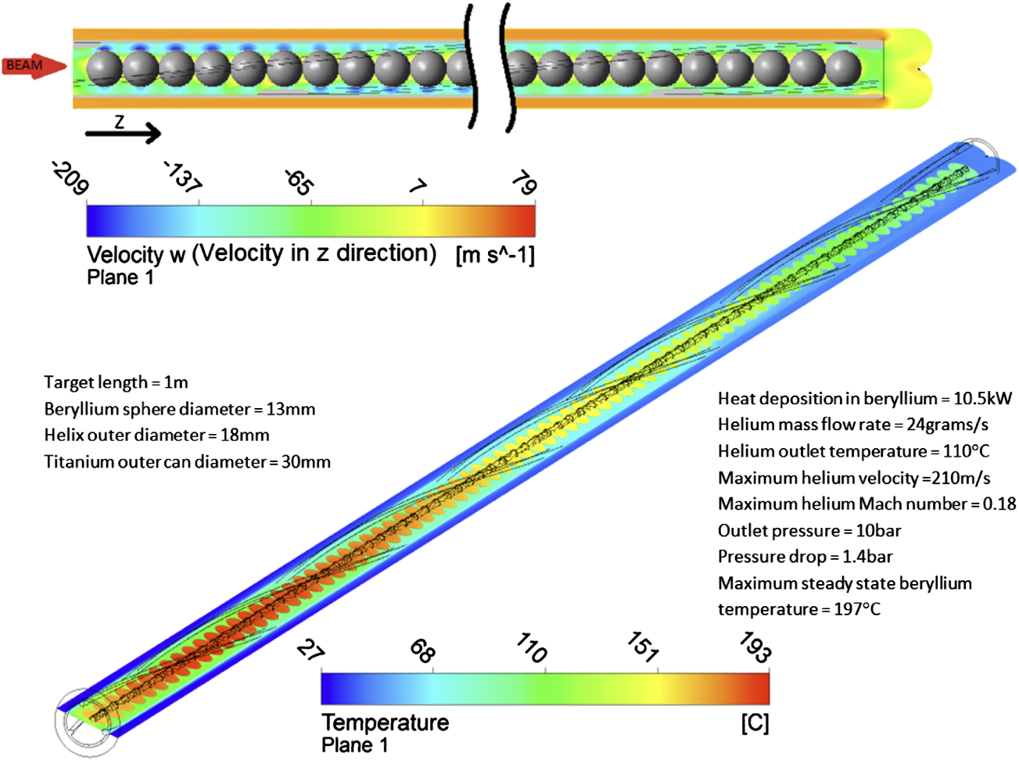
DUNE Considering optimized focusing systems
Automated optimizations yielding 2m target and 3 large horns
Optimized target & horns push the envelope of technology, particularly with a 1.2 MW beam (upgradeable to 2.4 MW)
80 GeV protons
NuMI-like

Slide 13
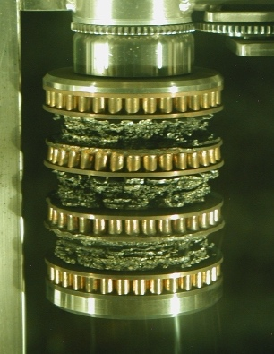
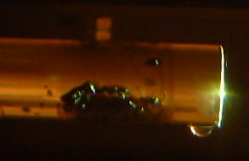
High Power Targetry Challenges
Recently major accelerator facilities have been limited in beam power not by their accelerators, but by their target facilities (SNS, NuMI/MINOS)
Plans for future high power, high intensity target facilities will present even greater challenges
To maximize the benefit of high power accelerators (physics/$), these challenges must be addressed in time to provide critical input to multi-MW target facility design

Slide 14
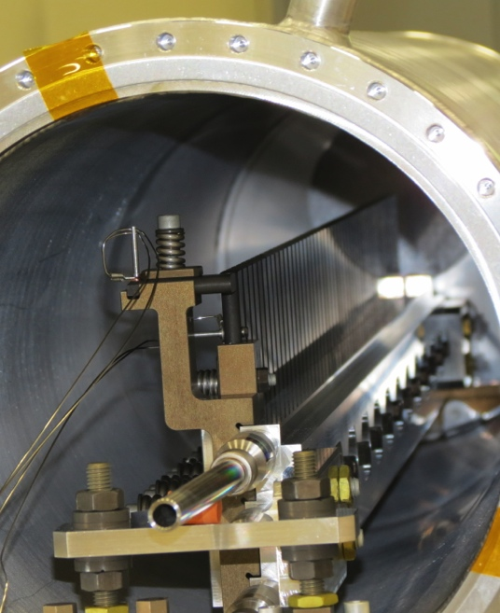
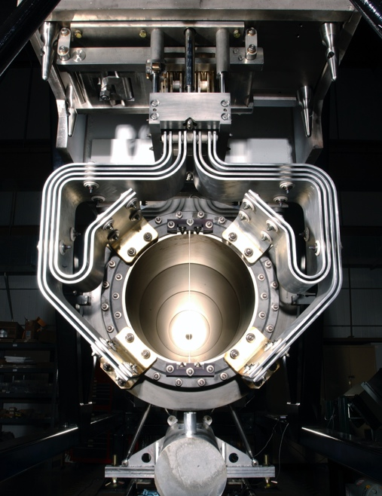
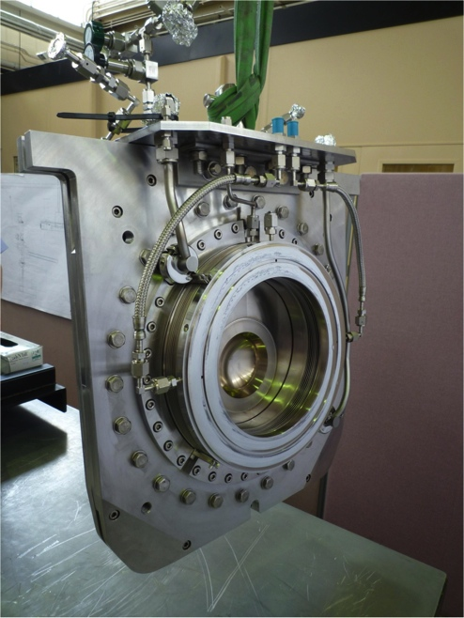
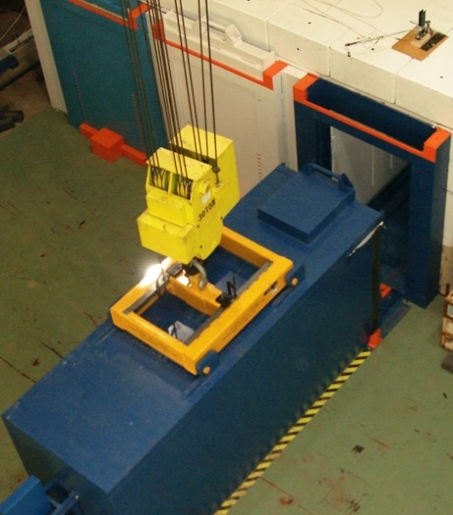
High Power Targetry Scope
R&D Needed to Support:
Target
  Solid, Liquid, Rotating, Rastered
Other production devices:
  Collection optics (horns, solenoids)
  Monitors & Instrumentation
  Beam windows
  Absorbers
Collimators (e.g. 100 TeV pp collimators)
Facility Requirements:
  Remote Handling
  Shielding & Radiation Transport
  Air Handling
  Cooling System
Notes:
Add tie in with 100 TeV pp collider collimator

Slide 15
High Power/Intensity Targetry Challenges
Material Behavior
  Thermal “shock” response
  Radiation damage
  Highly non-linear thermo-mechanical simulation
Targetry Technologies (System Behavior)
  Remote handling
  Target system simulation (optimize for physics & longevity)
  Rapid heat removal
  Radiation protection
  Radiation accelerated corrosion
  Manufacturing technologies
Subjects of the RaDIATE Collaboration
Proton Accelerators for Science and Innovation Workshop 2012 identified radiation damage as the most cross-cutting challenge facing HPT facilities
P5 2014 Recommendation for GARD
Prioritized first by 2017 HPT R&D Roadmap Workshop

Slide 16
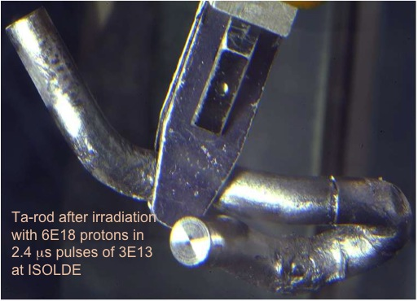
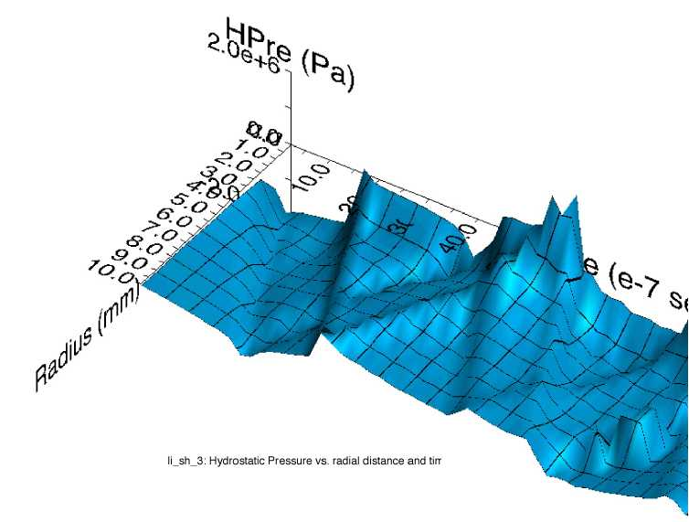
Thermal Shock (stress waves)
Ta-rod after irradiation with 6E18 protons in 2.4 μs pulses of 3E13 at ISOLDE (photo courtesy of J. Lettry)
Simulation of stress wave propagation in Li lens (pbar source, Fermilab)
Fast expansion of material surrounded by cooler material creates a sudden local area of compressive stress
Stress waves (not shock waves) move through the target
Plastic deformation, cracking, and fatigue can occur
Notes:
Ta-rod after irradiation with 6E18 protons in
2.4 μs pulses of 3E13 at ISOLDE

Slide 17

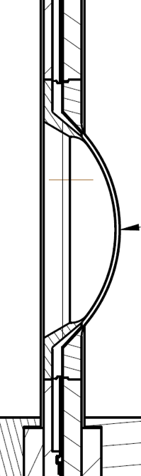
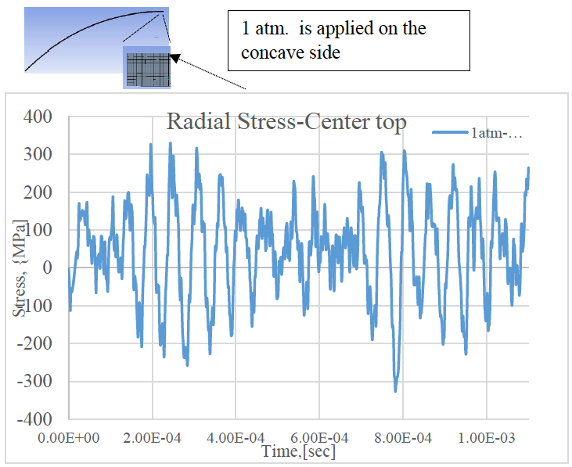
Stress wave example: T2K window
Preliminary
Material response dependent upon:
  Specific heat (temperature jump)
  Coefficient of thermal expansion (induced strain)
  Modulus of elasticity (associated stress)
  Flow stress behavior (plastic deformation)
  Strength limits (yield, fatigue, fracture toughness)
S. Bidhar, FNAL
Heavy dependence upon material properties, but:
Material properties dependent upon Radiation Damage…
Notes:
Note that magnitude of stresses is not the issue, but the number of stress cycles from just one pulse. High Cycle Fatigue!

Slide 18
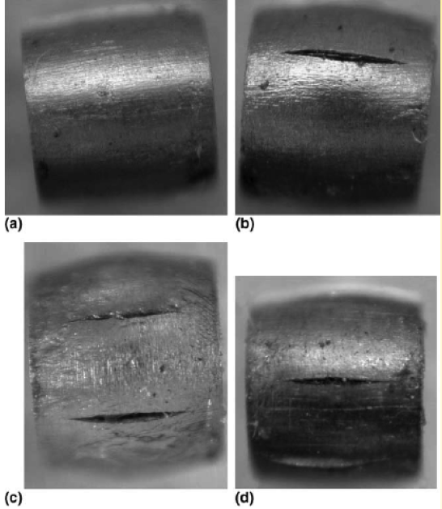
Radiation Damage Effects
Displacements in crystal lattice
(expressed as Displacements Per Atom, DPA)
  Embrittlement
  Creep
  Swelling
  Fracture toughness reduction
  Thermal/electrical conductivity reduction
  Coefficient of thermal expansion
  Modulus of Elasticity
  Fatigue response
  Accelerated corrosion
  Transmutation products
    H, He gas production can cause void formation and embrittlement
    (expressed as atomic parts per million per DPA, appm/DPA)
Very dependent upon material condition and irradiation conditions (e.g. temp, dose rate)
0 DPA
3.2 DPA
14.9 DPA
23.3 DPA
S. A. Malloy, et al., Journal of Nuclear Material, 2005. (LANSCE irradiations)
Notes:
One notes that all the properties that are important for thermo-mechanical health of the target are affected by radiation damage. The dependence on irradiation temperature is due to annealing (or healing) the crystal structure is faster at higher temperatures.

Slide 19
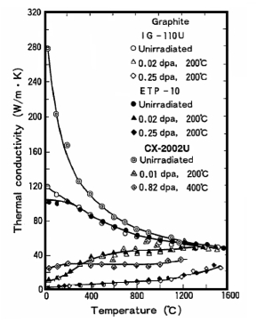
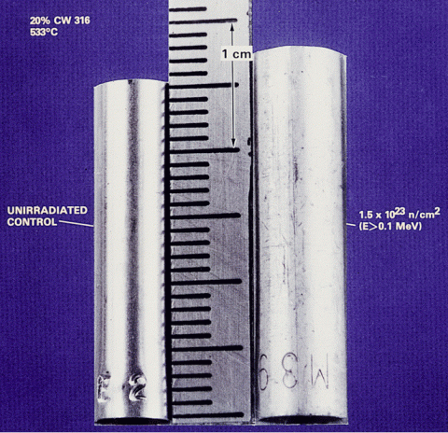
Radiation damage effects can be significant
D.L. Porter and F. A. Garner, J. Nuclear Materials, 159, p. 114 (1988)
Factor of 10 reduction in conductivity at 0.02 DPA
Void swelling in 316 Stainless steel tube (on right) exposed to reactor dose of 1.5E23 n/cm²
N. Maruyama and M. Harayama, “Neutron irradiation effect on … graphite materials,” Journal of Nuclear Materials, 195, 44-50 (1992)

Slide 20





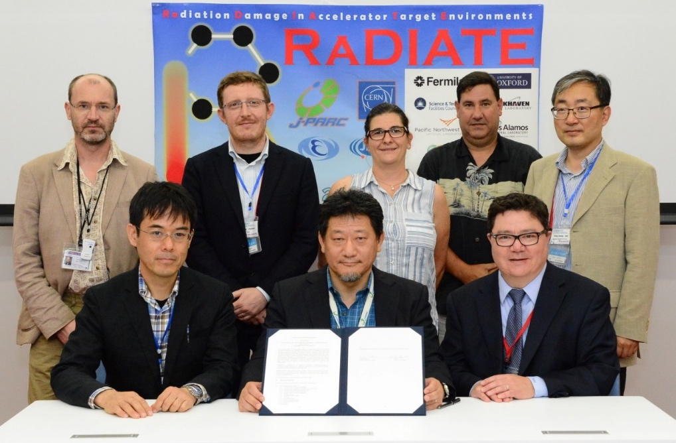
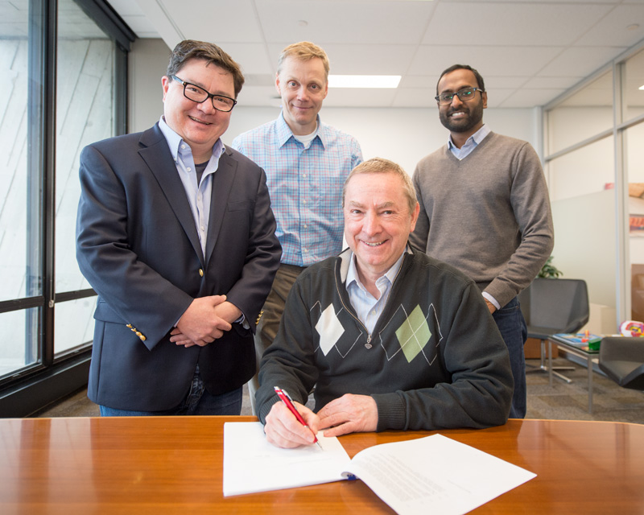
R a D I A T E Collaboration
Radiation Damage In Accelerator Target Environments
To generate new and useful materials data for application within the accelerator and fission/fusion communities;
To recruit and develop new scientific and engineering experts who can cross the boundaries between these communities;
To initiate and coordinate a continuing synergy between research in these communities, benefitting both proton accelerator applications in science and industry and carbon-free energy technologies
In 2017, MoU revision has counted J-PARC (KEK+JAEA) & CERN as official participants
http://radiate.fnal.gov
CERN
PNNL
STFC
FRIB
ESS
J-PARC
FNAL
@J-PARC, Sep.20, 2017
@FNAL, Dec.11, 2017

Slide 21
Overview of Strategy for HPT Material R&D
        Near Term (2010-2019)
        Determine material behavior of currently identified targetry materials (Be, graphite, Ti alloys) via “conventional” methods (HE p irradiations, thermal shock tests, autopsy)
        Develop and validate FE material models of currently identified targetry materials
        Explore new, more effective Methods of Irradiated Material Characterization (MIMiC)
        Explore ab initio and molecular dynamics to model irradiated material behavior
        Identify promising novel materials for use in targetry environments
        Mid Term (2020-2024)
        Develop MIMiC ideas into valid experimental techniques
        Continue with material studies stemming from near-term results with a focus on reducing costs and risks associated with high-energy proton irradiations
        Far Term (2025-2040)
        Utilize the developed MIMiC techniques, ab initio/MD modeling, and previous experimental results to develop and select promising candidate targetry materials
        Qualify the most promising candidate targetry materials for next generation HPT facilities with a combination of high-energy proton and MIMiC techniques

Slide 22
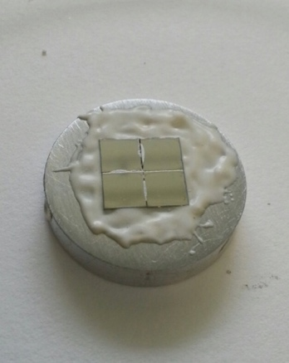
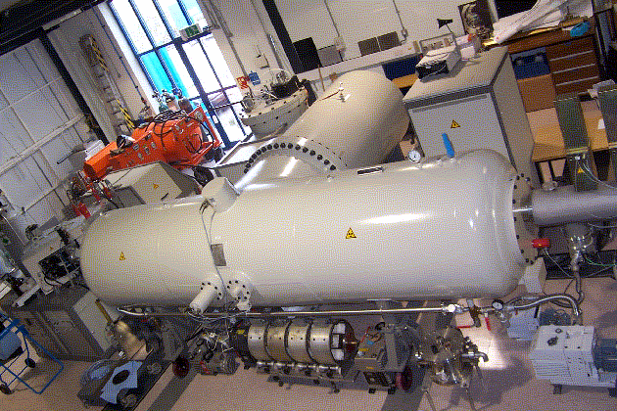
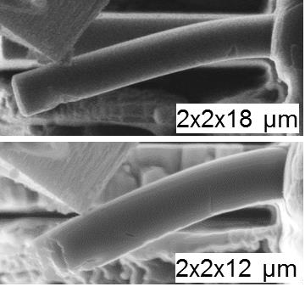
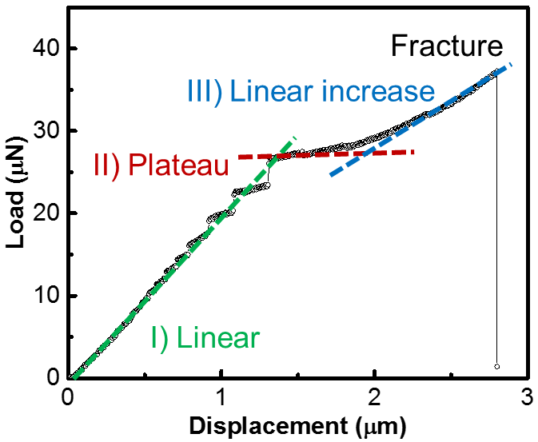
MIMiC – Replicating proton beam interaction damage with little or no residual activity (1)
        The current routes for high-energy proton irradiations are expensive, long in duration, and lack control of testing conditions and schedule.
        Low-energy ion irradiations are attractive because they allow study of the evolution of the micro-structure during irradiation without activating the specimens, are relatively low cost, and can achieve high dose in very short durations.
        Micro-mechanics and meso-scale testing are potential enabling technologies to overcome some of the limitations of low-energy irradiations as well as to drastically reduce specimen size requirements (which also reduces activity of specimens).
        Ion irradiations and micro-mechanics have been used in the RaDIATE studies on beryllium.

Slide 23
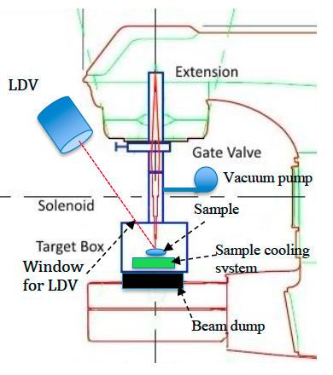
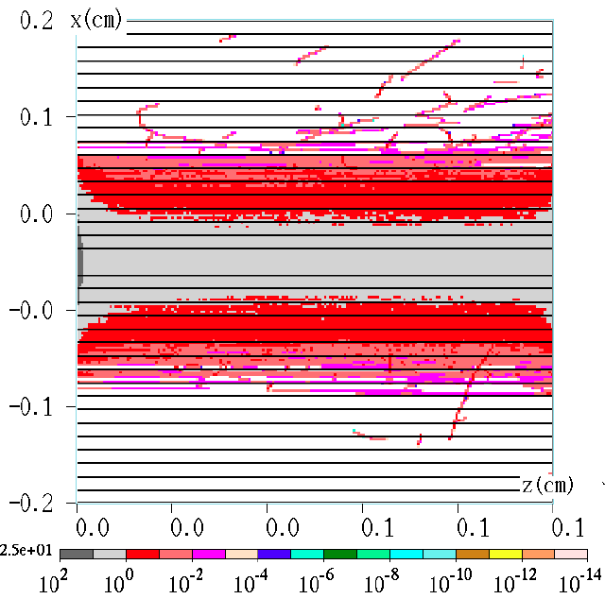
MIMiC – Replicating proton beam interaction damage with little or no residual activity (2)
Likewise, proton beam thermal shock studies are expensive, long in duration, not suitable for high-cycle fatigue studies and dependent upon the host accelerator facility operations schedule.
        Thermal shock testing using electron beams, lasers, or other techniques could reduce the cost and length of R&D cycles compared to proton beam-line tests.
        Electron beam induced thermal fatigue could allow the unique combination of proton beam-like thermal shock cycling at relatively high frequency while simultaneously creating radiation damage.
        LDRD proposal for a prototype testing station has been submitted (S. Bidhar et al.) capable of up to 0.5 DPA per week in beryllium (see right).

Slide 24
Overview of Strategy for HPT Material R&D
        Near Term (2010-2019)
        Determine material behavior of currently identified targetry materials (Be, graphite, Ti alloys) via “conventional” methods (HE p irradiations, thermal shock tests, autopsy)
        Develop and validate FE material models of currently identified targetry materials
        Explore new, more effective, methods of irradiated material characterization (MIMiC)
        Explore ab initio and molecular dynamics to model irradiated material behavior
        Identify promising novel materials for use in targetry environments
        Mid Term (2020-2024)
        Develop MIMiC ideas into valid experimental techniques
        Continue with material studies stemming from near-term results with a focus on reducing costs and risks associated with high-energy proton irradiations
        Far Term (2025-2040)
        Utilize the developed MIMiC techniques, ab initio/MD modeling, and previous experimental results to develop and select promising candidate targetry materials
        Qualify the most promising candidate targetry materials for next generation HPT facilities with a combination of high-energy proton and MIMiC techniques

Slide 25
Targetry Materials Science and Technology Lab Initiative
Target Systems Department is proposing an initiative to build the infrastructure required to support the ambitious materials R&D program. Current objectives:
Evaluate radiation damage effects and thermal shock behavior in HPT materials
Accelerate and reduce costs of the iterative irradiated materials characterization by developing lower cost/duration MIMiC
Enable simulation of HPT materials by developing and validating elevated temperature and high strain-rate material strength and damage models.
Develop materials science and engineering expertise in target and nuclear materials by collaborating with University students and research groups.
Explore synergies for applications of research across the DOE complex (HEP, NP, Fusion, NE) and global partners.
These objectives will be achieved by building the laboratory infrastructure:
Materials science lab capable of activated specimen research
Thermal test stand to evaluate high heat-flux cooling concepts
Robotics lab to innovate remote handling methods
Lab-space to support MIMiC development, potentially including irradiations
High-strain rate, dynamic stress wave test machine (split-Hopkinson bar)

Slide 26
Summary of Major HPT Accomplishments & Impacts (HEP)
RaDIATE collaboration grew from 5 institutions (2013) to 14 institutions (2017) on the MOU and 70 participants
Completed comprehensive literature study on Reactor Radiation Damage in Tungsten, Graphite and Beryllium within context of HPT irradiation environment
First Round of Proton Beam Studies on Graphite (completed 2018)
  Degradation of mechanical/thermal properties and swelling can be partially negated by irradiating at high temperature
  Identified most radiation damage resistant graphite grade
  NSLS-II studies confirmed lattice swelling in HE proton irradiated graphite is similar to reactor irradiated graphite
First Round of Proton and Ion Beam Studies on Beryllium (completed 2018)
  Significant hardening at low dose can be partially overcome by higher irradiation temperature
  Both Li and He production and subsequent diffusion effects may limit high temperature operation
Very relevant to HEP (NOvA, LBNF, Mu2e) and also NP and BES (FRIB, SNS-TS2)
Informed design of LBNF target cooling system and choice of graphite grade
Allows confidence to use reactor data for lattice swelling of graphite in High Energy (HE) proton regime
Will inform design of Be beam windows for LBNF (desired operating temperature)

Slide 27
Summary of Major HPT Accomplishments & Impacts (con’t)
In-beam Thermal Shock Test on Beryllium at CERN’s HiRadMat (completed in 2018)
  Validated empirically developed Johnson-Cook strength model used to predict deformation at high temperature and strain rates
  Demonstrated potential use of glassy carbon beam windows at very high beam intensities
RaDIATE organized proton irradiation at BNL’s Isotope Production (BLIP) facility (completed in 2018)
  100’s of specimens supported by 8 RaDIATE institutions subjected to 4.5x10²¹ 181 MeV protons
  Post-Irradiation Examinations (PIE) underway now
  Includes fatigue testing of irradiated Ti alloys utilizing FNAL custom designed and built testing machine
In-beam Thermal Shock Test on previously irradiated material at CERN’s HiRadMat
  Brought together radiation damage and thermal shock for the first time in a controlled experimental setting
  Experiment ran successfully last month. PIE phase next.
Allows prediction of stress and deformation of Be beam windows or targets (alternate target material for LBNF)
Benefits many facilities including LBNF, T2K, BDF at CERN, FRIB, and even LHC-HiLumi (collimators)
Radiation damage effects on high cycle fatigue are relatively unknown. Immediately benefits LBNF, T2K, FRIB
Benefits facilities that use Be or Ti beam windows or graphite targets (LBNF, T2K, FRIB, and more)

Slide 28
Meetings, Conferences, Workshops and Publications
4 in-person annual RaDIATE collaboration meetings
  FNAL, Oxford, PNNL, J-PARC
50 RaDIATE video conference meetings
FNAL hosted HPT R&D Roadmap Workshop
Many invited/contributed oral presentations & session chair roles at conferences & workshops such as:
  High Power Targetry Workshops
  ANS Nuclear Applications of Accelerators
  International Workshop on Spallation Materials and Technology
  IPAC & NAPAC
  Particle Accelerators for Science and Innovation Workshops
  International Congress on Fracture
  International Workshop on Beryllium Technology
List of Publications (7)
  In Back-up Slides
  Phys Rev Acc-Beams
  Journal of Nuclear Materials
  Nuclear Materials and Energy

Slide 29
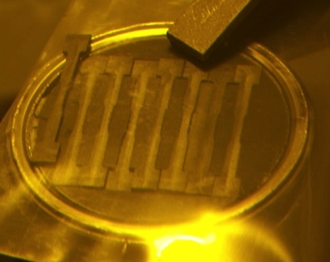
Graphite Results –Tensile Properties Partially Recover When Annealed
Irradiation Temperature ~150 ˚C
Simos et al

Slide 30
Graphite Results – Tensile Properties Summary Plot
POCO ZXF-5Q exhibited smallest change
IG-430 exhibited largest change
Increase in E lowers IG-430 thermal shock resistance
Simos et al

Slide 31
Graphite Results – X-ray diffraction
Simos et al
XRD on BLIP irradiated POCO graphite indicates agreement with c-axis lattice growth results from neutron irradiation
W. Bollmann. “Electron-microscopic observations on radiation damage in graphite” Phil. Mag., 5(54):621-624, June 1960.

Slide 32
Neutron irradiated graphite dimensional changes
B.J. Marsden, “Irradiation Damage in Graphite due to fast neutrons in fission and fusion systems,” IAEA-TECDOC-1154, 2000
Big change in c-axis growth ~250 ˚C

Slide 33
Graphite Results – X-ray diffraction of NuMI graphite fin shows lattice growth and amorphitization at beam center
Simos et al

Slide 34
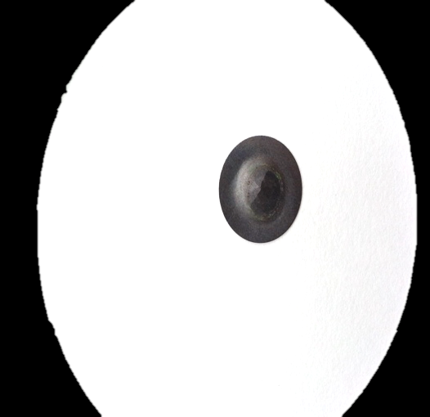
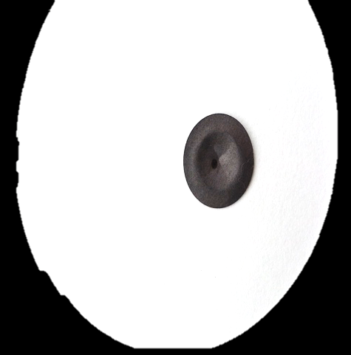
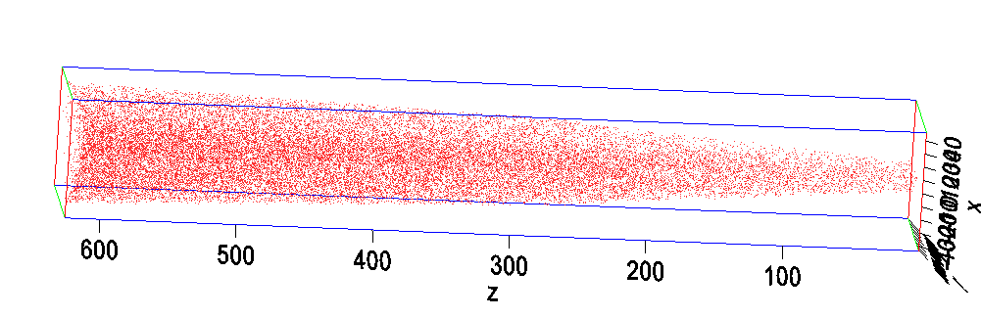
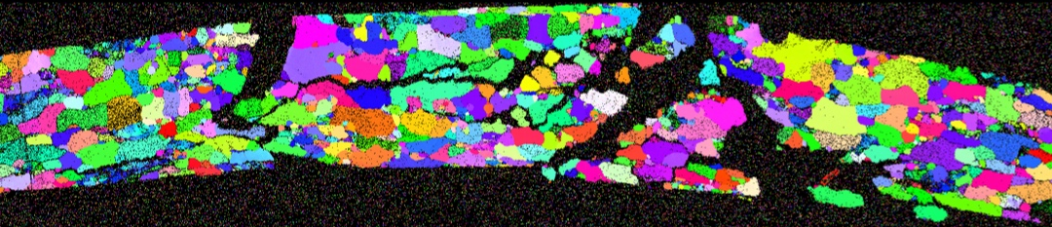
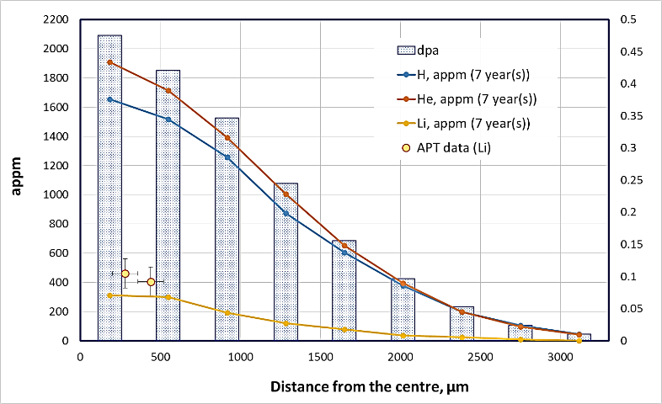
Be Results - Beryllium beam window from NuMI (1.6E21 POT)
NuMI Be window (Kuksenko, Oxford)
  Nanohardness shows significant hardening
  Atomic Probe Tomography shows Li production matches MARS [6] predictions and remains homogeneously distributed at ~50 ˚C

Slide 35
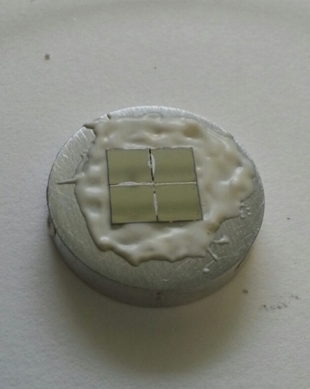
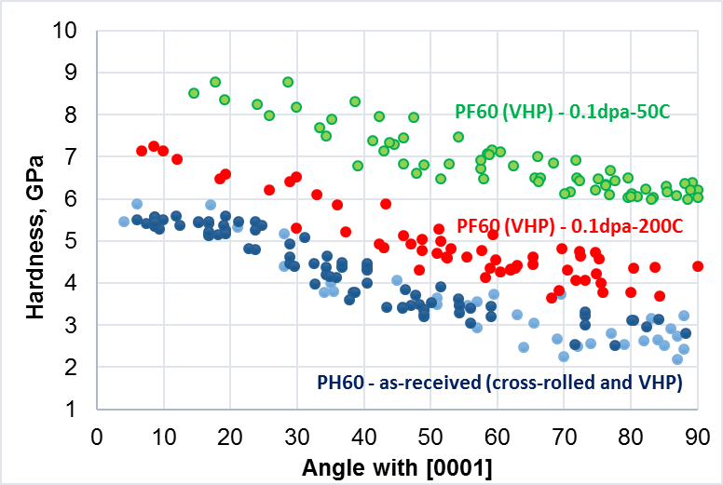
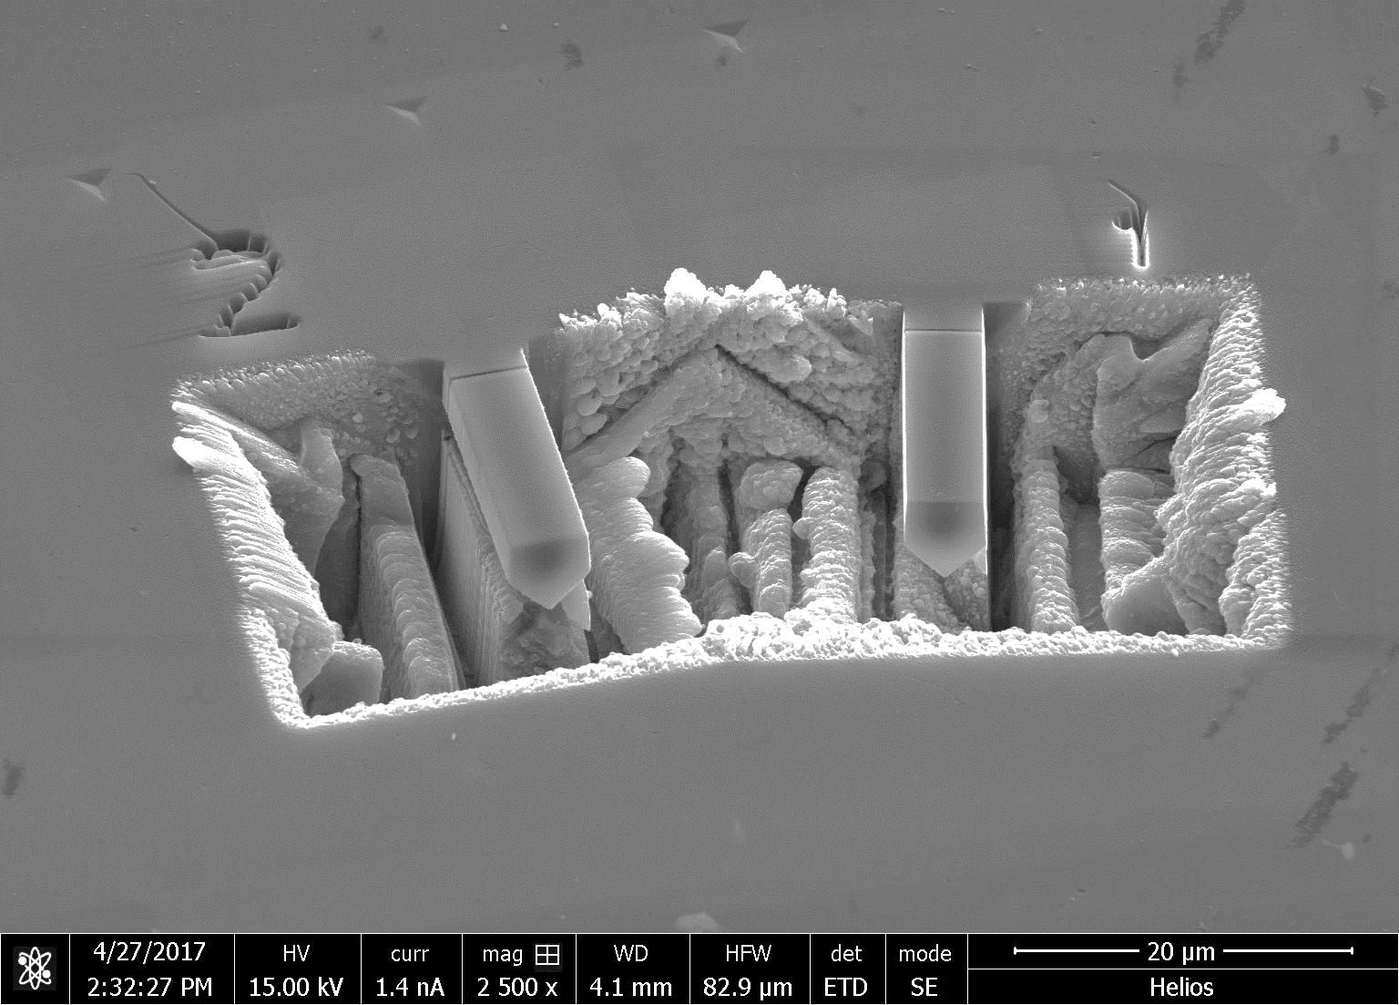



Ion implantation of Beryllium indicates reduced hardening at higher irradiation temperature
He implantation study at Surrey/Oxford
  Maximum beam energy: 2 MeV => 7.5µm implantation depth (SRIM)
  Dose: up to 0.1 dpa currently
  Temperature: 50ºC and 200ºC
  Nano-indentation indicates significant hardening dominated by 2000 appm He production (DPA is lower order effect)
  Less hardening at higher temperature
  Micro-cantilever work shows increase of fracture strength and decrease of work to fracture with severe drop for 50C implantation

Slide 36







High Energy Proton Irradiation Completed
    181 MeV p irradiation @ BNL’s BLIP facility
  Includes graphite at various temp (up to ~1,000 ˚C)
  Also Beryllium, Ti alloys, Si, TZM, Al, & Ir
  Over 200 specimens from 6 RaDIATE collaborators
  Participants: BNL, PNNL, FRIB, ESS, CERN,
  J-PARC, STFC, Oxford, FNAL
Completed irradiation on March 9, 2018
  4.5E21 accumulated protons on target
  1.52 peak DPA on Ti alloy achieved
  2nd shipment of activated samples to PNNL completed
  Be, Graphite, and Ti alloy samples will be included in thermal shock in-beam experiment at CERN
Microstructural analysis specimens
Fatigue specimens
Tensile specimens
70mm

Slide 37





Post-Irradiation-Examinations (PIE) beginning
3.4mm
Preliminary results indicate hardening of Ti alloys at relatively low dose
Fatigue samples will be shipped to FNAL to conduct testing with unique machine compatible with testing highly active samples (25 Hz)
Will be the first time radiation effects on high cycle fatigue are tested on Titanium alloys
In collaboration with Oxford and STFC, meso-scale ultrasonic fatigue testing will also be employed (20 kHz)

Slide 38





BeGrid1 (HRMT24) – experimental set-up
Experiment successfully completed in September 2015
Consisted of four specimen arrays of thin Beryllium discs and slugs
  Various commercial grades (S200F, S200FH, PF60, S65F) and thicknesses
  Real time measurements of temperature, strain and displacement
  PIE of thin disc specimen at the University of Oxford (2016-2017)

Slide 39




BeGrid1 (HRMT24) – online results
Real-time thermomechanical measurements
Instrumented Be slugs in downstream containment boxes
LDV for radial displacement measurements
Strain and temperature gages
Distinctive strain response for the three different Be grades
Residual plastic strain observed upon cool-down
Array 3 – 24 bunches, 3.2e12 POT
Array 4 – 216 bunches, 2.8e13 POT

Slide 40




BeGrid1 (HRMT24) – Post Irradiation Examination Results
Thin disc specimen PIE performed at University of Oxford
Optical microscopy and profilometry to measure out-of-plane plastic deformations
S-65F grade specimens
All Be grades showed less plastic deformation than predicted by available literature strength models
S200FH showed least plastic deformation, in agreement with empirical strength model
Observed plastic strain ratcheting in Array 3
Glassy carbon windows survived without signs of degradation
V. Kuksenko (University of Oxford)

Slide 41




BeGrid1 (HRMT24) – data analysis
Beryllium S-200FH Johnson-Cook strength model
Strength model parameters empirically determined at Southwest Research Institute (SwRI)
High strain rate and elevated temperature testing with Split-Hopkinson pressure bar
$$σ_{Y}=\left[A+B(ε_{eff}^{p})^{n}\right]\left[1+Cln{\dot{ε}}^{∗}\right]\left[1−T_{H}^{m}\right]$$
Yield stress (σ_{y}) dependent on strain rate and temperature
Model parameters A, B, C, m, n empirically determined
Be JC damage model postponed due to limited funding
S-200FH 0.75 mm thick specimen
Good agreement
S. Bidhar (FNAL)
HRMT24 completed successfully and safely with valuable PIE results and validation of advanced strength model

Slide 42
Preparations for HiRadMat Experiment
Finished final design
Rapidly fabricating and assembling parts
Working with CERN to create work-dose-plan and procedures
PNNL preparing activated specimens for shipment to CERN

Slide 43


BeGrid2 (HRMT43) – Pictures

Slide 44


BeGrid2 (HRMT43) – Pictures

Slide 45


BeGrid2 (HRMT43) – Pictures

Slide 46


BeGrid2 (HRMT43) – Pictures

Slide 47

BeGrid2 (HRMT43) – Pictures

Slide 48

BeGrid2 (HRMT43) – Pictures

Slide 49

BeGrid2 (HRMT43) – Pictures

Slide 50


BeGrid2 (HRMT43) – Pictures

Slide 51
HPT R&D Summary
R&D for High Power Targetry is benefiting future accelerator target facilities such as LBNF-DUNE and T2K (US-Japan)
  Material choice
  Optimal operating temperature for annealing radiation damage
  Developing/validating material models and simulation techniques
Current HPT R&D Projects include bringing together, for the first time, radiation damage and thermal shock in the RaDIATE HiRadMat Experiment, BeGrid2
Many challenges remain to achieve stable and reliable multi-MW accelerator target facilities in the future
The HPT R&D core team is capable, but small. Additional investment is needed in order to:
  Increase research scope
  Further develop University partnerships
  Develop more efficient irradiation and examination methods
  Add needed capabilities
    Advanced Robotics Lab for Remote Handling
    Post-Irradiation Examination Lab for Active Materials

Slide 52


• Beam Intercepting Devices Studies and Radiation Damage Effects
• Studies for multipurpose applications of dumps & targets
• Neutrino Beam Target & Windows
• Neutron Spallation Target Facilities
• Nuclear/Rare Process Physics Facilities
• High Power Target Radiation Damage Studies
• Post Irradiation Experiments Testing & Techniques
• Monte Carlo Codes for Radiation Damage Estimation
• Radiation damage modelling (atomistic to micro-scale)
• Novel Materials for Targetry Application
• Low Energy Ion Beam Facilities & Tests
• High Energy Proton Irradiation Experiment Status & Plans
• Thermal Shock Studies and Techniques

Slide 53
List of potential projects (in no particular order)
He bubble formation and void swelling in HCP materials
  Beryllium
  Glassy carbon (not HCP)
  Graphite (complex microstructure with pores and cracks)
  Ti alloys (complex 2 phase microstructure)
Hydrogen trapping in graphite
  Have assumed hydrogen leaves graphite through pores
  What about trapping? If so, what affect would it have on material behavior?
Crystal lattice swelling in graphite
  Light Source XRD shows swelling in NuMI minos target
  Assumed interstitial defects between basal planes?
  What is relationship to temperature?
Lithium production, migration and effects in beryllium
  Significant Li produced by transmutation
  Does Li move to GB?
  Relationship to temperature?
  What will low melting temp Li do to grain boundary strength?

Slide 54
Role of dose rate in displacement damage
  Dose rates are very high during very short pulses
  Empirical studies have shown that damage effects are less
  What is cause?
  What is effect of large temperature cycling from beam pulse?
How to move from MARS/FLUKA output to atomic scale modeling?
  Is it possible to take energy deposition and/or DPA results from MC codes as input to ab initio and MD computations?
  Is there any way to link the calculations together to gain efficiency/accuracy?

Slide 55
RaDIATE
Questions?
10 keV protons into Beryllium (simulated with SRIM 2008 and artistically rendered with Graphic Converter by P. Hurh)
Radiation Damage In Accelerator Target Environments

Slide 56
Back-Up Slides Follow

Slide 57



Radiation Damage Disorders Microstructure
Microstructural response:
creation of transmutation products;
atomic displacements (cascades)
  average number of stable interstitial/vacancy pairs created = DPA (Displacements Per Atom)
From D. Filges, F. Goldenbaum, in:, Handb. Spallation Res., Wiley-VCH Verlag GmbH & Co. KGaA, 2010, pp. 1–61.
Slide prepared by V. Kuksenko (Oxford)

Slide 58

HPT R&D Roadmap Workshop held at Fermilab to develop best R&D routes for next generation targetry facilities
HPT R&D Roadmap workshop held in late May 2017 to come to consensus among the HPT community on best path forward
Next generation target facility requirements were collected
Most promising R&D cycles were identified
Enabling R&D activities identified
Workshop report available on web-site
Final Roadmap report to be completed soon
http://indico.fnal.gov/e/HPT_Roadmap_Workshop_2017
Workshop Charge: Identify the required and most beneficial High Power Targetry (HPT) R&D routes and associated key milestones, considering the needs, objectives, and timeline of the HEP experimental program as recommended in the 2014 P5 report.

Slide 59
Exploration of Radiation Damage Effects to High Doses Likely Requires High and Low Energy Irradiation Studies
High energy, high fluence, large volume proton irradiations are expensive and time consuming
  Long irradiation beam times (months)
  Difficulties of Post-Irradiation Examination (PIE) of highly activated samples
Low energy, small volume ion irradiations are inexpensive and can achieve several DPA in an hour
  Low to zero activation (PIE in “normal” lab areas)
  Greatly accelerated damage rates (several DPA in hours)
However Low energy ion irradiations have drawbacks:
  Very shallow penetration (0.5-100 microns)
  Little gas production (transmutation) in samples
Promising Solutions:
  Micro-mechanics (coupled with advanced microscopy techniques) may enable evaluation of critical properties
  Simultaneous implantation of He and H ions (triple-beam irradiation)
But still need HE proton irradiations to correlate and validate techniques

Slide 60



Micro-mechanics can provide mechanical properties at the micro-scale
Chris Hardie, University of Oxford
Useful where only small samples are available (implanted layer)
Need for a sample design that can be machined in surface of bulk samples
Geometry that can be manufactured quickly and reproducibly
Fe 6%Cr
Stress (Pa)
0.3mm
Beam Thickness 2um
, D.Armstrong. University of Oxford
Strain

Slide 61






New directions and techniques
  High frequency meso-scale fatigue testing (20 kHz, 100 um foil) (Wilkenson/Gong, Oxford)
Other planned work
  Graphite
    2017-18 Low E ion irradiation studies (Notre Dame/Michigan/BNL?)
    2017 – Micro-mechanics (Liu @ Oxford)
    2018? - NOvA TA-01 target autopsy/PIE (PNNL)
  Beryllium
    2016-17 – Irradiation of Be fins in NOvA TA-02 target with PIE in 2018-19?
  Titanium 6Al-4V
    2018 - Macro-fatigue testing of BLIP specimens 2018 - Meso-fatigue testing of BLIP specimens (20 kHz) (Oxford, Culham)
  Micro-mechanics on graphite (Liu, Oxford)

Slide 62
Reactor materials studies are limited in relevance to Targetry
p
100+ MeV
n
1-14 MeV
Irradiation Source | DPA rate (DPA/s) | He gas production (appm/DPA) | Irradiation Temp (˚C)
Mixed spectrum fission reactor | 3 x 10⁻⁷ | 1 x 10⁻¹ | 200-600
Fusion reactor | 1 x 10⁻⁶ | 1 x 10¹ | 400-1000
High energy proton beam | 6 x 10⁻³ | 1 x 10³ | 100-800
Effects from low energy neutron irradiations do not equal effects from high energy proton irradiations. Table compares typical irradiation parameters.
Cannot directly utilize data from nuclear materials studies!
Notes:
Add note that use of data from nuclear materials research is limited and should not be depended upon.

Slide 63
Material Behavior Activities Overview
Strength & Damage Model Testing
LE Ion Irradiations
HE Proton Irradiations
Micro-mechanics Validation
$$
Thermal Shock Tests
High Activity PIE
$$
¢¢
LE Ion Irradiations
LE to HE Correlation
Simulation Techniques Development
Low Activity PIE
¢¢
Enabling Data & Tools Available
Notes:
Points to make:
LE to HE Correlation and Micro-mechanics validation are necessary to enable affordable LE Ion Irradiations and PIE.
Thermal Shock tests and Simulation development is needed to make use of radiation damage results

Slide 64
NT-02 Target Examination
Operation between 2006 to 2009, and again in 2011
Subjected to 120 GeV protons
  Integrated POT ~ 6.1 x 10²⁰
  Gaussian beam spot size (1σ): 1.1 mm
  Peak fluence: 2.5 x 10²² p/cm²
  Estimated DPA ~ 0.63
Peak temperature ~ 330°C
  Heat to 330 C in 10 µs, cool to 60 C before next pulse (1.85 s cycle time)
Neutrino yield declined 10-15% during life, possibly due to radiation damage
  - Yield reduction not observed in other NT targets
  - NT-02 lifetime significantly longer than any other NT targets (2x or more)
Slides courtesy of K. Ammigan, Fermilab

Slide 65
NT-02 Target
Proton beam
Upstream end
Downstream end
Graphite fin core
47 fins – 6.4 mm x 15 mm x 20 mm segments
Graphite fins soldered to water cooling tubes attached on top/bottom of fins
Target autopsy
Performed in hot cell at FNAL
Cracks observed along centerline
Some fins broken in halves
Cracks along centerline
Autopsy work by V. Sidorov, Fermilab
Slides courtesy of K. Ammigan, Fermilab

Slide 66






Why use micro-mechanical testing?
Useful where only small samples are available
  Cost
  Processing
Need for a sample design that can be machined in surface of bulk samples
Suitable for measuring individual microstructural features
Samples that can be manufactured quickly and reproducibly
3μm
1um
4μm
3μm
10μm
3μm
Slides courtesy of DEJ Armstrong, Oxford

Slide 67





Microcantilever Manufacture
2μm
10μm
Slides courtesy of DJ Armstrong, Oxford

Slide 68
Current State of the Art
Slides courtesy of DJ Armstrong, Oxford

Slide 69

Fracture at 600ºC
1µm
Slides courtesy of DJ Armstrong, Oxford

