Slide 1
Progress on recommendations from previous meeting
M. Rominsky
Annual Test Beam Committee Meeting
12 November 2018

Slide 2
Responses to Recommendations
Continue to prepare and plan for a spike in requests at the FTBF during the next long CERN shutdown. The period during 2019/2020 will be crucial for the LHC HL-LHC upgrades, and a time where the CERN facility will be unavailable.
Continue to track the number of papers, conference talk, conference proceedings and internal notes generated based on data taken at the FTBF, to accurately account for the impact of the FTBF
Work with ATLAS and CMS to ensure that the requests for beam from those experiments are prioritized by the experiments.
  Thank you for the comments, we’ll continue to talk to groups and coordinate to prioritize activities

Slide 3
Response to Recommendations
Develop a clear accounting for the actual fraction of protons that are sent to the facility compared to the total available to the physics program. Ensure that this fraction is used to describe the impact of the FTBF on the physics program (the “proton tax”) rather than the maximum 10%
  We are working the accelerator division to calculate this. At the moment, we don’t have a concise accounting. Last year we worked with AD and our users to make sure we were out of the timeline whenever we weren’t running. This year, we’re supporting the NOvA test beam, and next year T1039 will run.

Slide 4
Response to Recommendations
Work with the experiments to develop a contingency plan if the amount of beam time is reduced
  We currently have weeks open this year and we’re limiting people to 12 hours per day unless they can prove they have the need or shifters to staff it. We would slot groups in that need time in these spaces.

Slide 5
Response to Recommendations
Write the standard paragraph to be included in papers and conference proceedings and hand it to the experiments when they arrive on site.
  This year, the Fermilab Technical Publications group has developed a paragraph and an easy to understand website on how to give credit to any Fermilab facility (including Test Beam) and provides instructions on getting a Fermilab technical publications number. We’ve passed this information along to users and will continue to remind them throughout the year.
  http://techpubs.fnal.gov/

Slide 6
Questions? Comments?

Slide 7
Annual FTBF Report for 2018
M. Rominsky
Annual Test Beam Committee Meeting
12 November 2018

Slide 8
FY18 Annual Report
General statistics
Specific users
Facility projects

Slide 9
Running Conditions
This year, the AD did well with minimal downtime to users
  2 day downtime for Septa issue
  5 day downtime for a magnet change out
There were a few < 1 day downtimes for general maintenance, and these would often coincide with our changeover days.
We supported 20 experiments plus the EDIT school.
Smoother installations
  Maintained a spreadsheet of users coming – helped with training prep.
  Had space setup for staging. Users took extensive advantage of that.

Slide 10
Summary of Users - Research groups
This year, a majority of users were from LHC and other collider groups
Experiment | Beam weeks
Collider (LHC) | 37
Collider (Non LHC) | 8
General R&D | 7
Outreach/Facility | 2
Neutrino | 14
Total | 68

Slide 11
Summary of Users – People
A variety of professional classes came to the test beam
  These numbers do not include EDIT
Professional group | Number
Undergraduate students | 19
Graduate students | 60
Postdoc | 43
Scientist/Faculty | 89
Engineer/Technician | 5
EDIT Students | 48
Total | 264

Slide 12
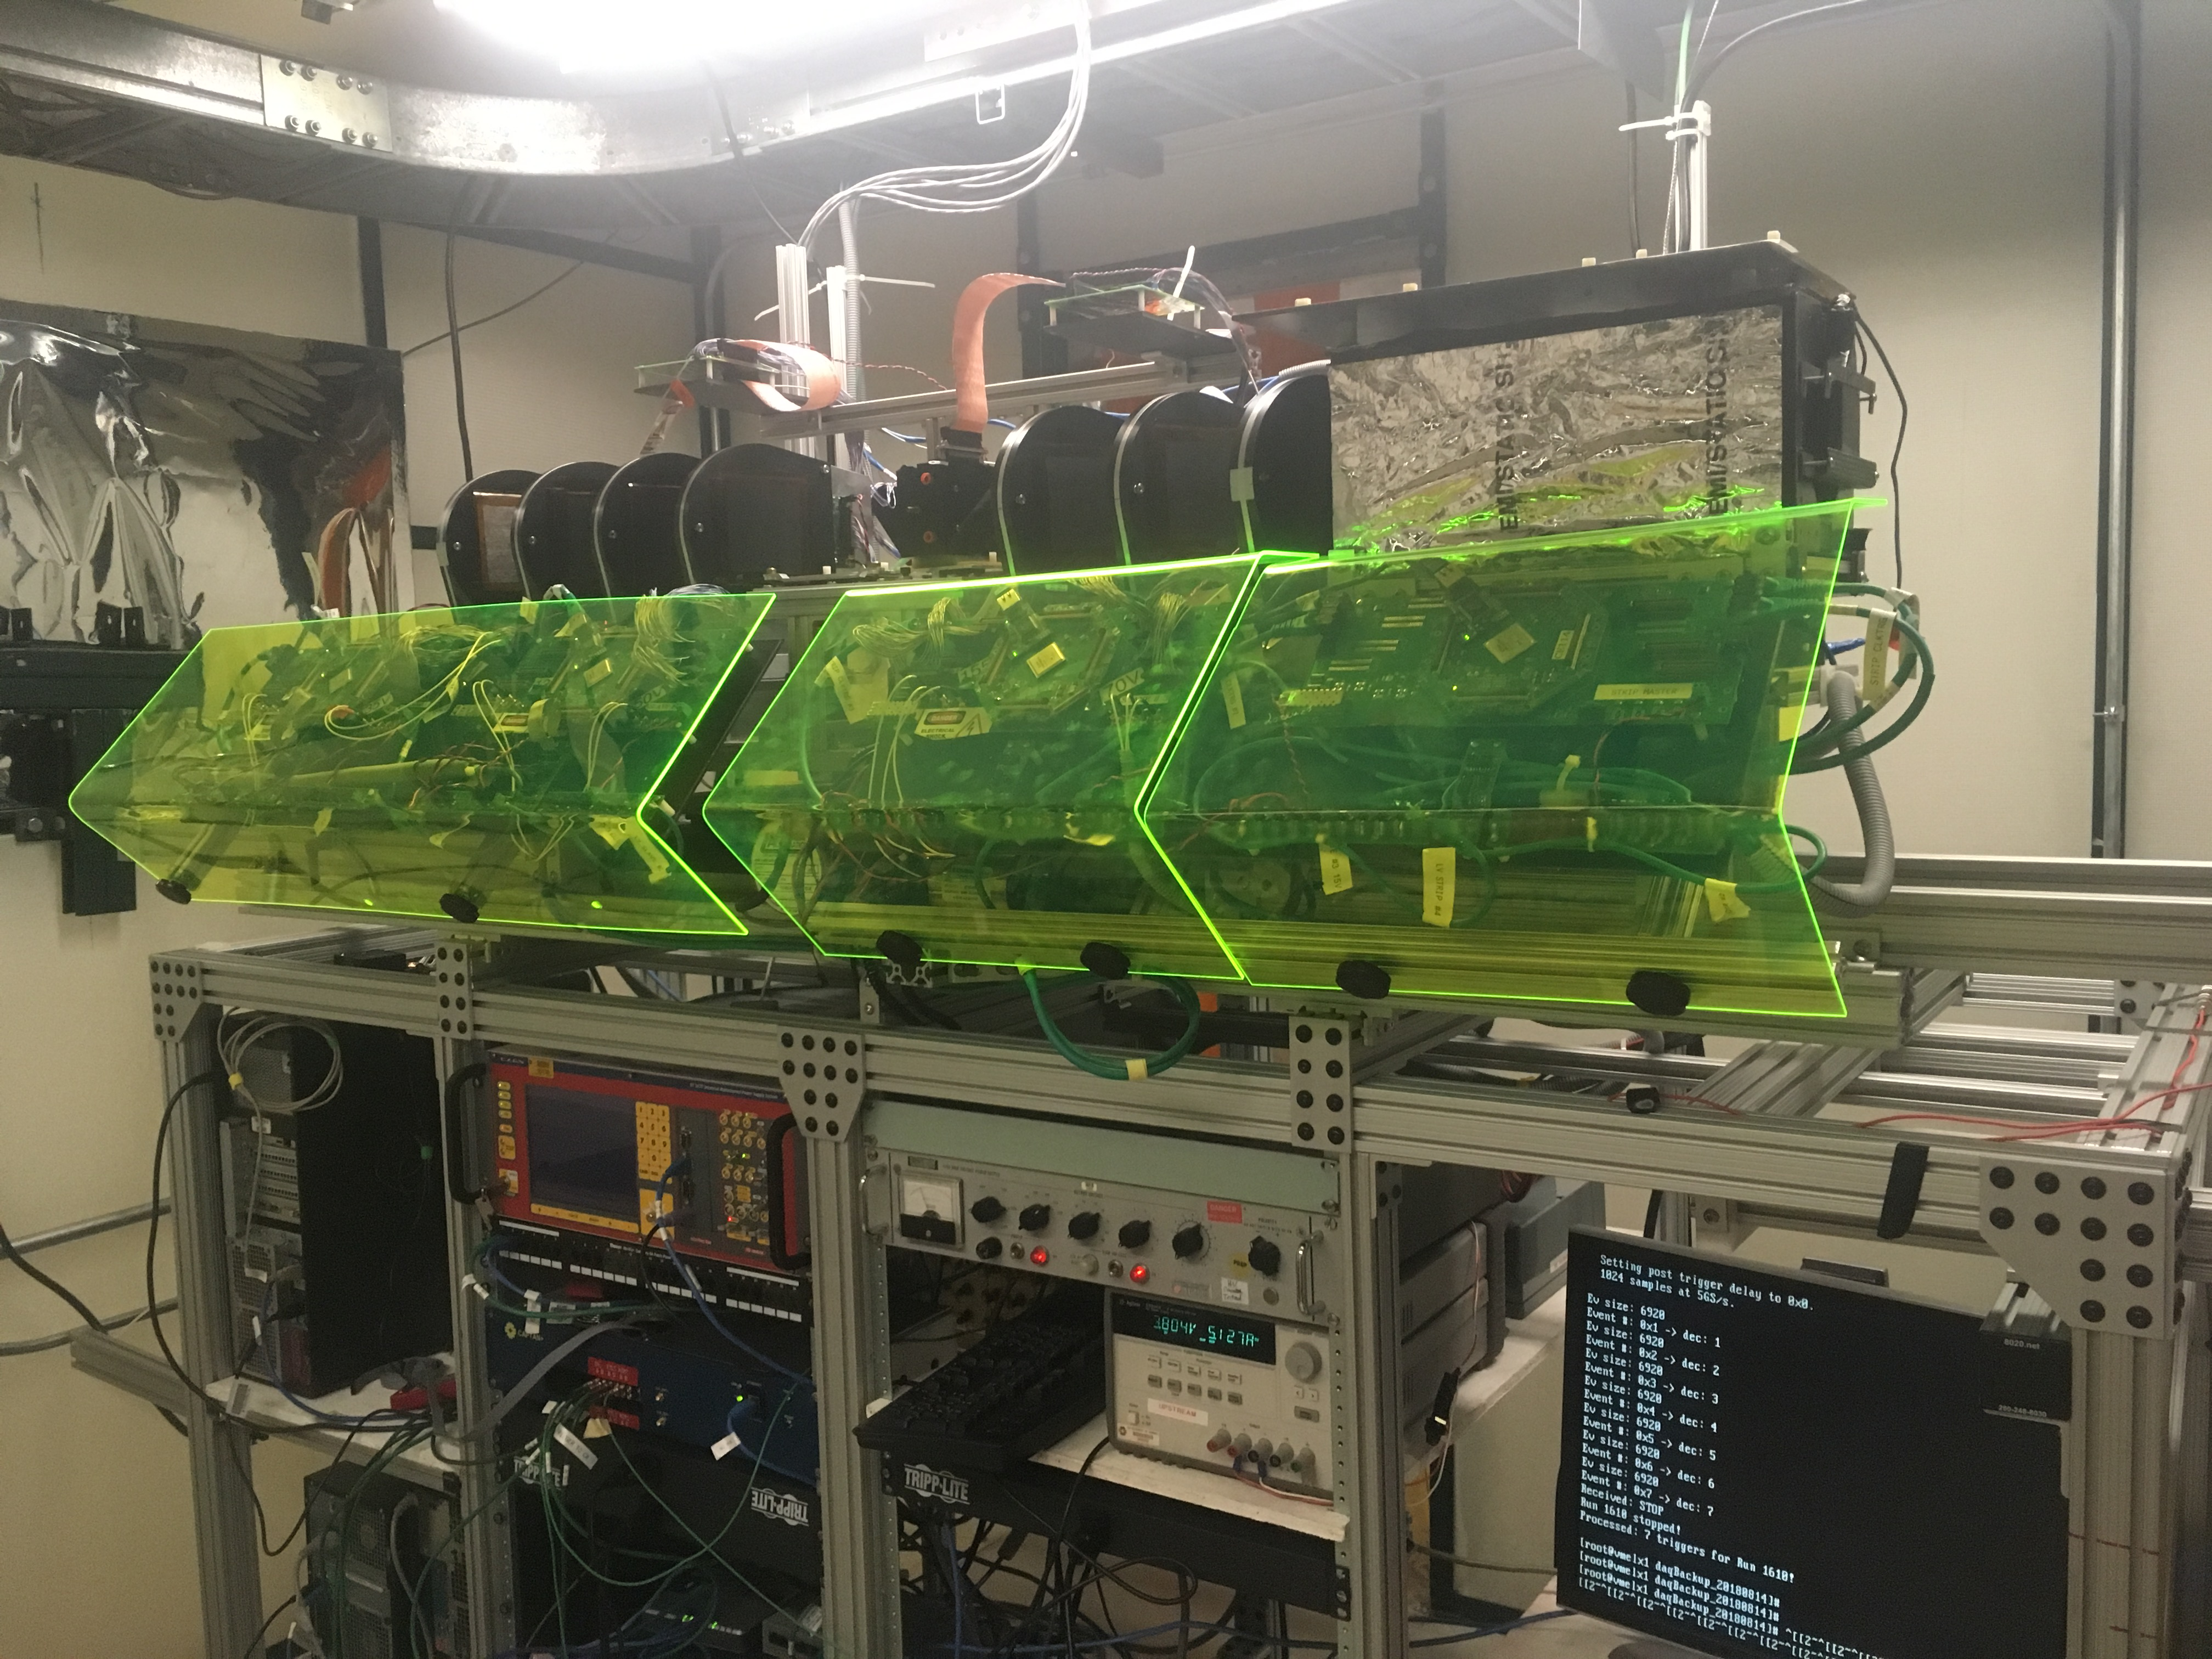
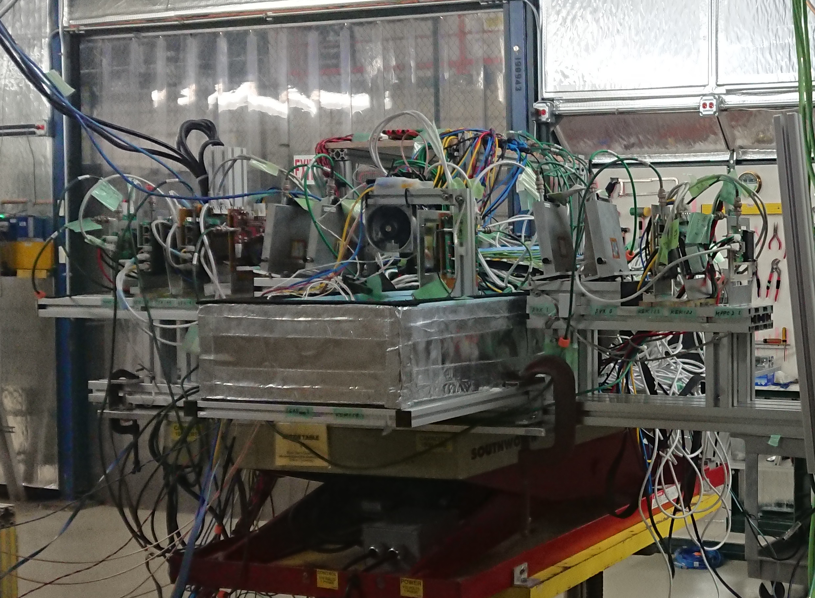
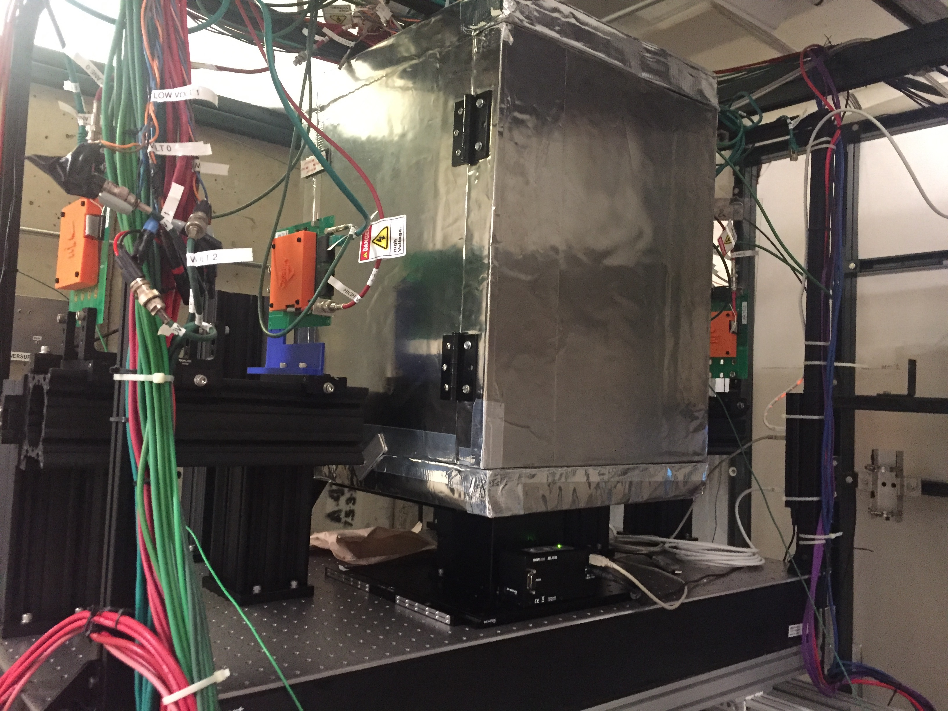
LHC: CMS and ATLAS
Both experiments did a variety of sensor and ROC tests using telescopes
CMS
ATLAS Telescopes

Slide 13
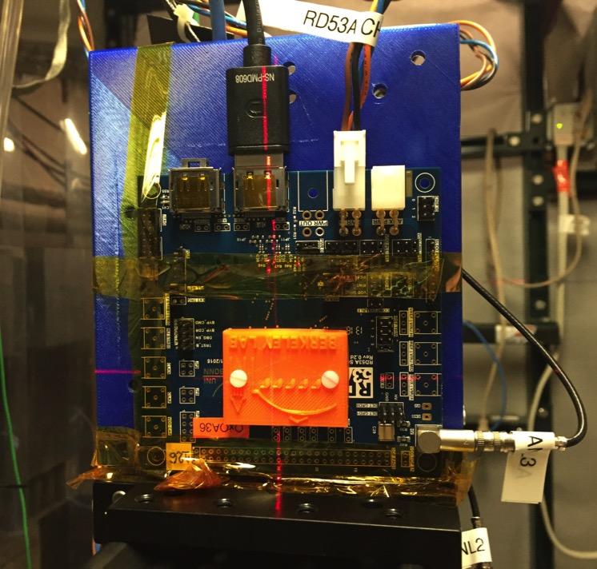
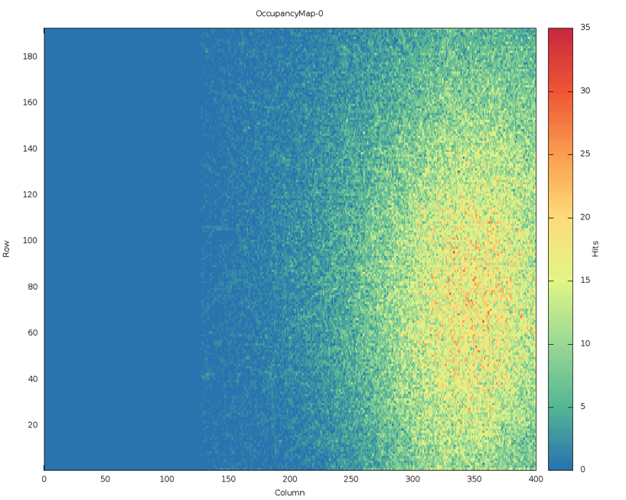
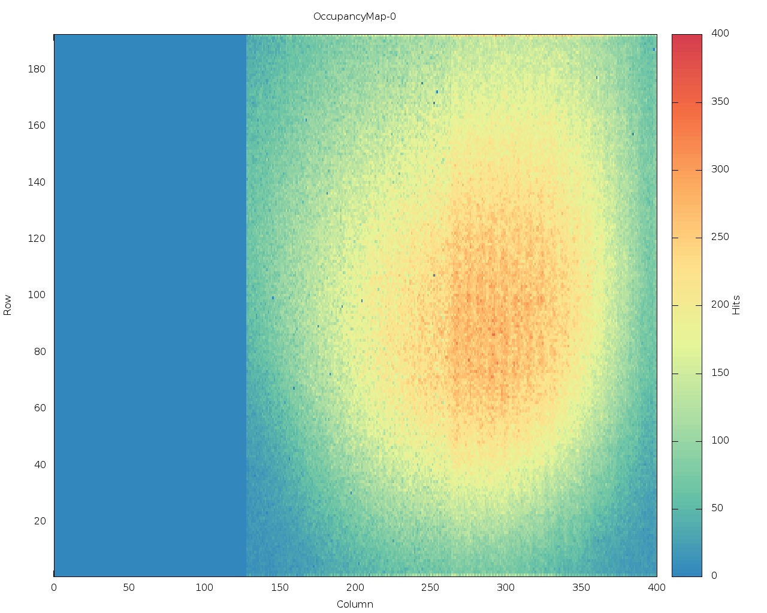
Sensor Testing
A large variety of sensors, both irradiated and not, were tested in these telescopes
  3D sensors (T992)
Readout chips
  RD53a (both CMS and ATLAS)
LGAD detectors also tested
Beam spot for RD53a chips: ATLAS (Left), CMS (Right)

Slide 14
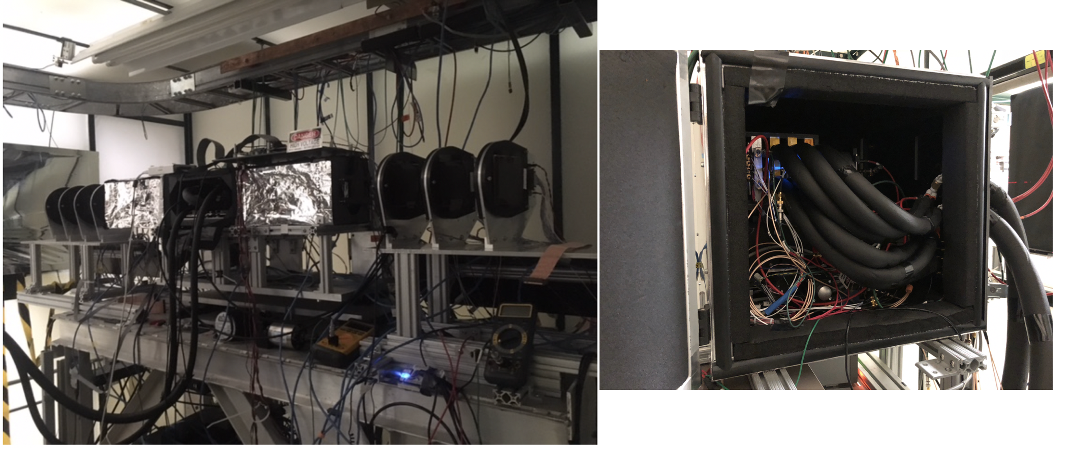
CMS Timing
High priority for the US CMS group
Looking for radiation hard solutions with timing resolutions between 30-40 ps.
Endcap and barrel detectors technologies tested
  Endcap: LGAD
  Barrel: SiPM-LYSO

Slide 15
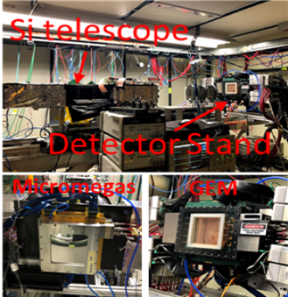
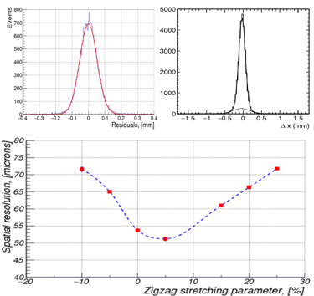
EIC R&D Groups
ZigZag readout for GEMs and Micromega detectors
  Testing different type of zigzags
  Resolutions between 50 and 90 microns

Slide 16
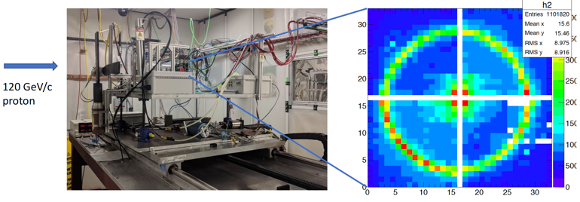
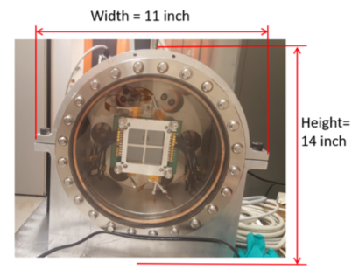
EIC R&D groups
EIC PID groups (Argonne, Hawaii, Georgia)
  Using LAPPD Style MCP-PMTs
  Looking at imaging detectors (RICHs, DIRCs)

Slide 17
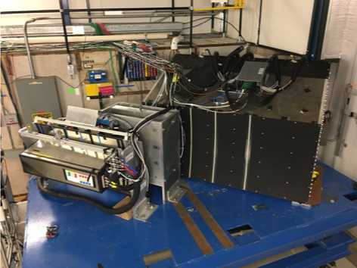
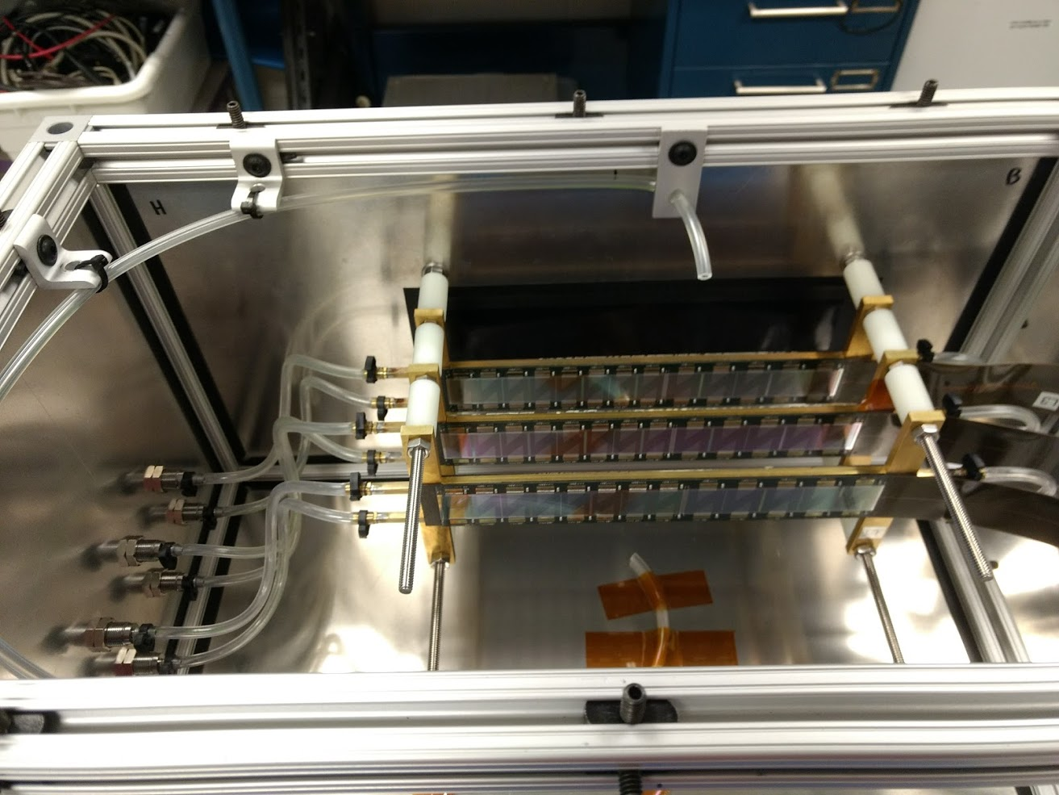
sPHENIX Groups
Calorimeter, Silicon Strip, MAPS vertex Detector tests
  Part of the goal was integrated tests of these detectors and DAQ system

Slide 18
EMPHATIC
Testing emulsion detectors to be used for hadron identification.
  Goal is to measure pion, proton, and kaon production cross sections
  Big neutrino experiment background, goal is to help reduce that
  Funded via US-Japan funding stream
  Multi-year testing

Slide 19
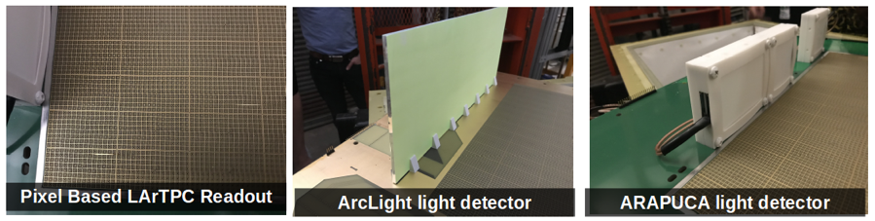
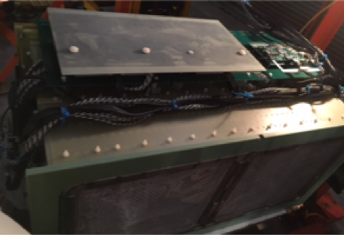
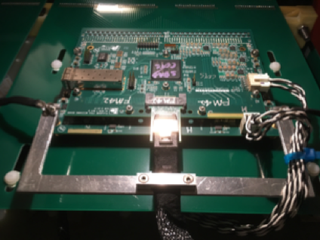
PixLAr and SBND Cold electronics
PixLAr testing pixel planes instead of wires for LAriAT
SBND
  Testing TPC readout, DAQ, online monitoring, etc

Slide 20
Facility projects
Students worked over the summer on the DAQ
  Wrote a Cherenkov module
  Separate group worked on documentation and tutorials
Students worked on Cherenkov slow controls.
  Removed unnecessary cabling
  Researched and suggested a new controls system
Hired another Applications Physicist
  Welcome to Evan!
NOvA Prep work most of the summer in MCenter
  Constructing a second Tertiary beamline
  General help with facility

Slide 21
FY19 Plans and Beam Request
M. Rominsky
Annual Test Beam Committee Meeting
12 November 2018

Slide 22
FY19 Users
Nominally 36 weeks running
Scheduling: MTest
  14 weeks with 2 or more users (split at 12 hours)
  16 weeks with one user (12 hours)
  6 (ish) weeks with no users (includes over the holidays)
Scheduling: MCenter
  Commissioning, Installation of NOvA Test Beam until January
  NOvA Physics: January – July
Of the currently scheduled groups:
  1 is from LHCb – first time at our test beam
  About 2/3 are from CMS/ATLAS
  Mu2e, EIC R&D also returning

Slide 23
FY19 Current Status of Projects
OTSDAQ has modules written for all our detectors, so we’ll continue to debug and bring this up to speed.
  Tutorials written over the summer by students
We have hired Evan Niner to help out with coordination and running of the test beam. He joined us 2 weeks ago and has jumped in already with both feet.
  Set up a Slack channel
We have a working method for allowing access to machines on our network from offsite
  Refined over the summer by students.
Continuing to refine our space for users to stage
  Also, allows us to focus on safety. We can see/help people as they are working.

Slide 24
FY19 Focus - Documentation
Setup our own instance of DocDB
  Transfer all old documentation
  Write new documentation for current projects
  Include safety information, yearly statistics.
Finish the FTBF paper
  Reaching out for more help: Evan and Jason have agreed to write portions.
Each week: remind users about our elog, slack channel, weekly status emails, other ways to communicate with us.
  Helps to make runs go more smoothly
  Keeps lab management aware of what is happening and the importance of the work.

Slide 25
FY19 Focus: Controls system
Much of our infrastructure is on separate systems
  Cherenkov pressures
  Gas shed (gas levels, safety systems)
  HV and LV
Not easy to monitor
  Alarms need to be updated
System needs to be easy to work on by facility staff.

Slide 26
FY19 Focus: DAQ and Beamline
DAQ is there, needs to be exercised
  Stability studies
  Add a few other instruments
Documentation
  Instructions on running the DAQ
  Instructions on installing new detectors
Will test out the DAQ by carrying out various beam studies.
  In January we have a few weeks downtime.

Slide 27
Questions?
Comments?

