Slide 1
Mu2e Resonant Extraction in Operations
V. Nagaslaev
Muon Department
November 1, 2018

Slide 2
Why Slow Extraction for Mu2e?
Detectors will not be able to digest all intensity in one pulse
Instead - 25,000 μ-pulses from one 1e12p bunch during 43ms (spill)
Timing between μ-pulses is 1.7μs – ideal for Mu2e

Slide 3
Beam Intensity diagram in RR and DR

Slide 4
Mu2e Slow Extraction in the Delivery Ring
Parameter | Value | Units
MI Cycle time | 1.4 | sec
Number of spills per MI cycle | 8
Duration of each spill | 43 | msec
Number of protons per micro-pulse | 3.9x10⁷ | protons
Maximum DR Beam Intensity | 1.0×10¹² | protons
Reset Time Gap between spills | 5 | msec
Operation point (Qx/Qy) | 9.650/9.735
Extraction efficiency | >98 | %
Spill uniformity | <50 | %
Notes:
At the pulse-pulse level, the intensity variations should not exceed 50% of average.

Slide 5
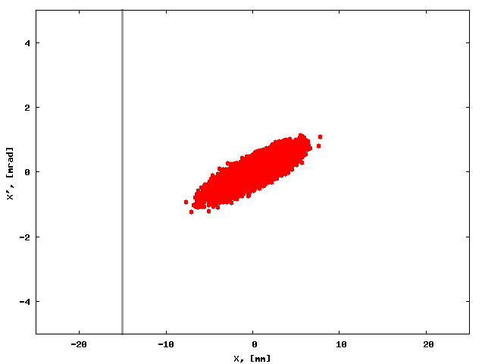
Motion in ideal linear machine
Non-perturbed machine
Horizontal tune

Slide 6
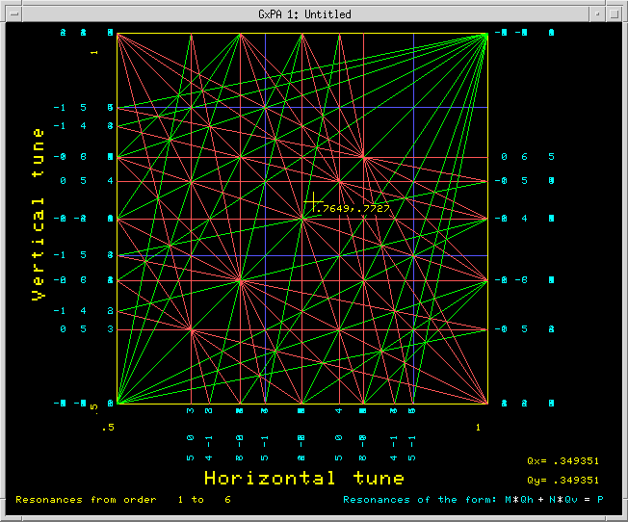
Nonlinear fields
Magnets are not ideal
Dedicated multipoles:
Chromaticity sextupoles in DR
Correction sextupoles in ACC
Multipole magnets in ACC
Skew sextupoles in ACC
Dynamic aperture
Resonances
Machine operating point (tunes)
Debuncher tune diagram (P195)

Slide 7
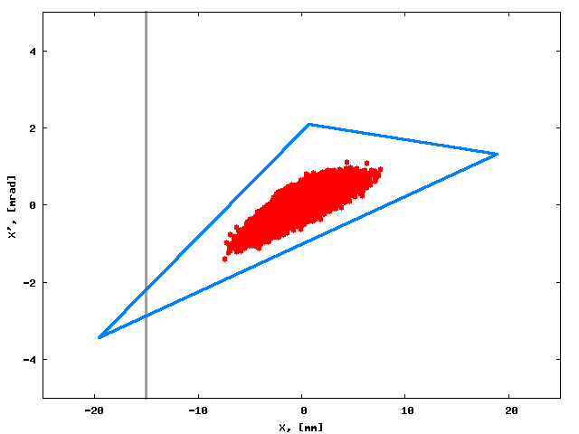
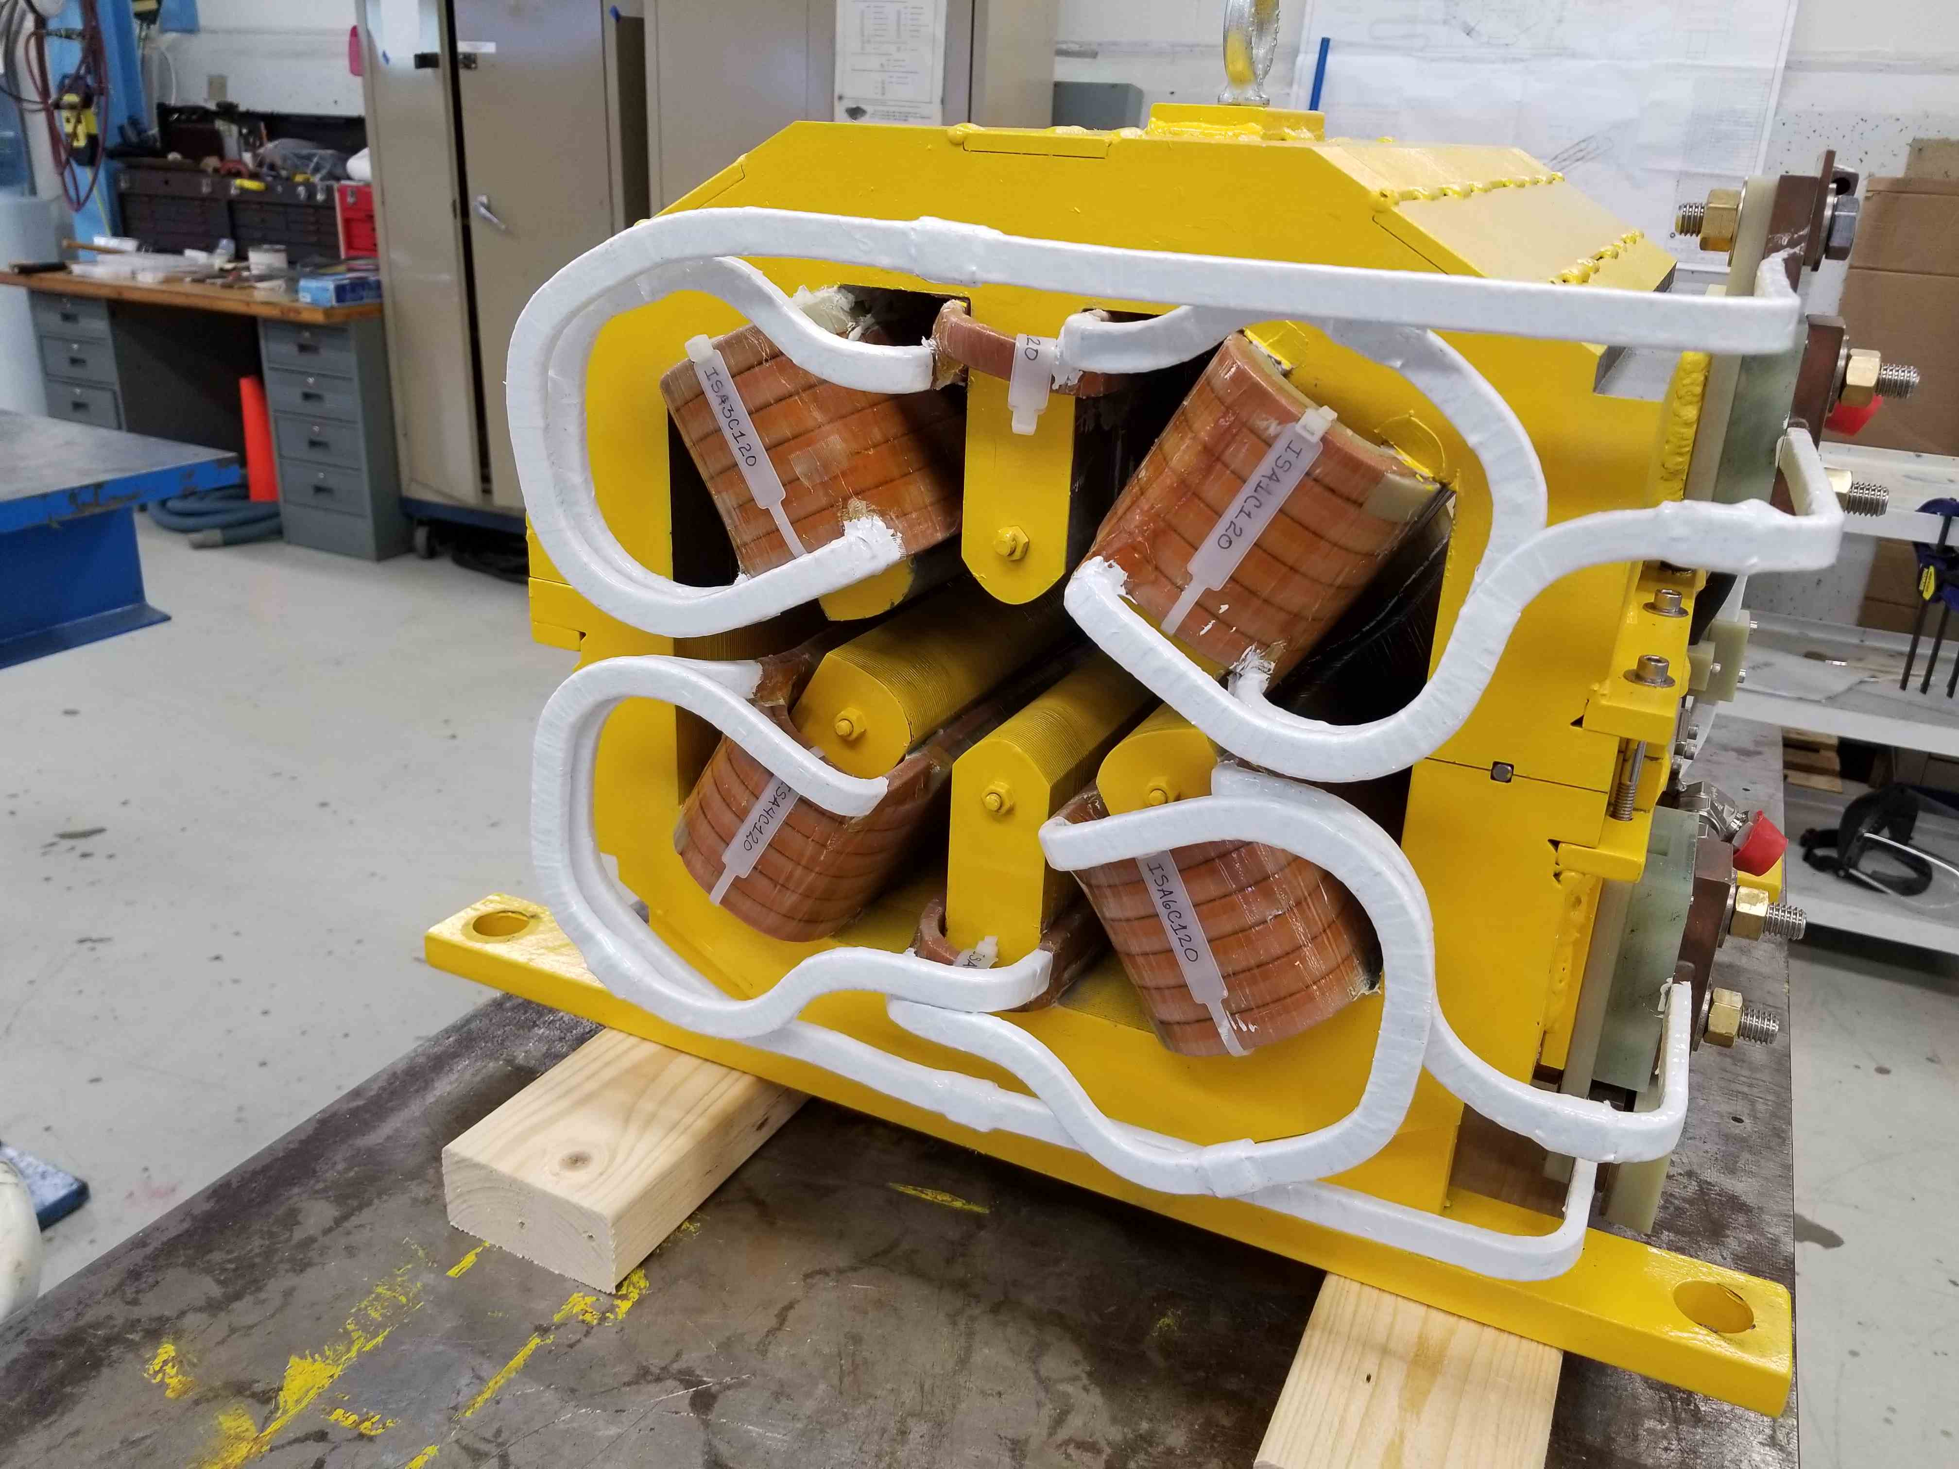
Sextupole field
What happens near sextupole resonance
Horizontal tune
1st ISA magnet
Notes:
Addition of Sextupole field
Ellipse shape changes
Most importantly: dynamic aperture: unstable region
Size of stable region can be controlled
Delta and G factors
ISA sextupole: started receiving

Slide 8
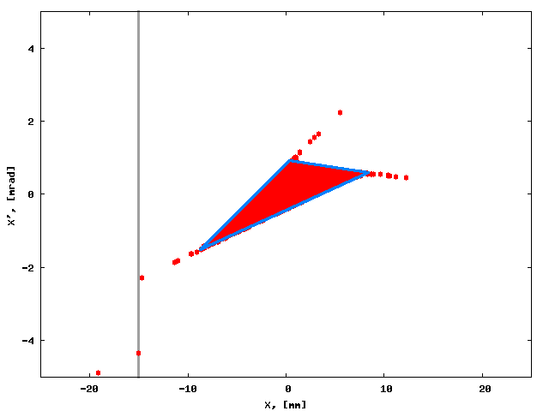
Beam Phase Space Formation in the Ring
Moving machine to the resonance: extraction starts
Notes:
When squeezed, part of the beam becomes unstable
Drifts along branches
Intercepted and kicked
Different from one turn kick!

Slide 9
Circulating and Extracted Beam at Upstream End of ESS1
Cathode
Beam center
Clearing Electrode
E
-100 kV
60 mm
Foil Plane
S.Werkema
Notes:
Beam shape deceiving
Circulating part and unstable parts
Kick in ES field

Slide 10
Beam Phase Space Formation in the Ring
Notes:
The initial part of the squeeze is skipped

Slide 11
Simple cartoon of extraction
A
Stop-band
Q=2/3
Q_{h}
Beam
Notes:
Beam tune
Stop band opening
Dynamic aperture
Continuous extraction

Slide 12
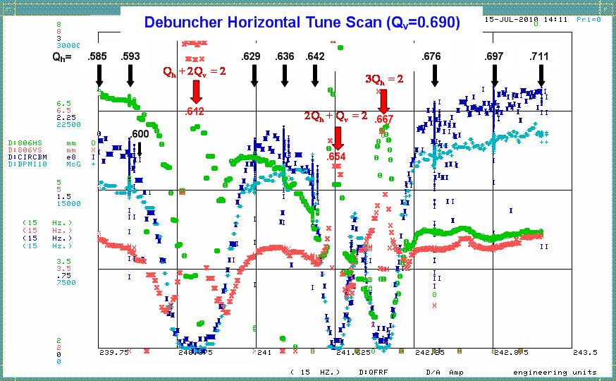
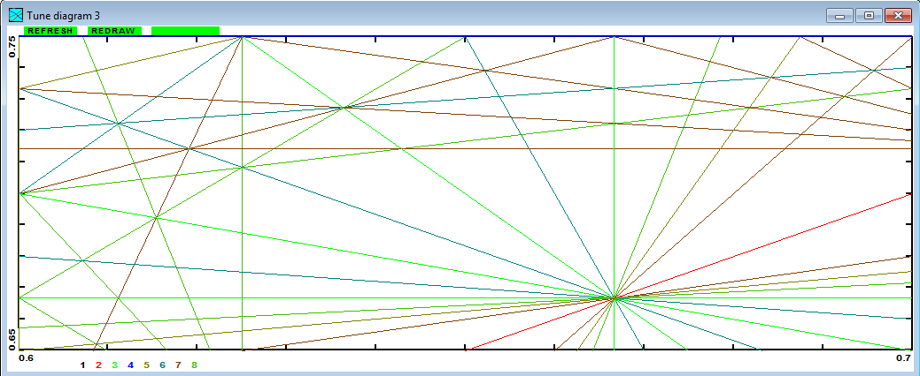
Traveling in tune space
Tune scan in Debuncher, July 2010 - B.Drendel
Mu2e, SX
BD, 2010
Tune diagram, up to 8th order
Notes:
Search for non-linear resonances
Only 3rd order can be seen
3rd order is not harmful – will clean it up AND move away from coupling
5th order is touched, not seen (0.600) AND we are far away from it
4th order interesting, but not touched
Mu2e path is in safe place, but could be issues with 4th order!

Slide 13
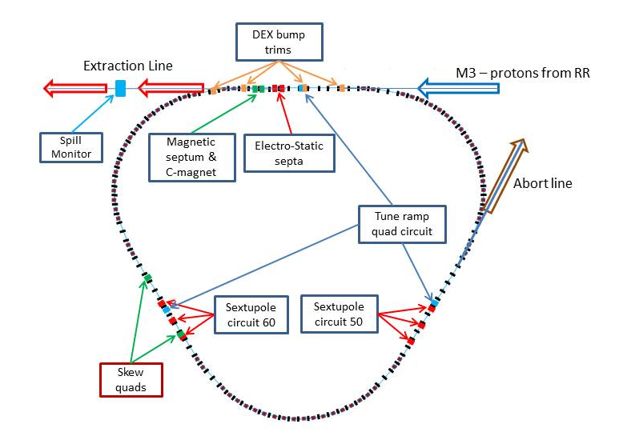
Mu2e Resonant Extraction – General Map
SS20-30
Tune ramp quads (3)
Sextupoles (2x3)
ES septa (2)
DEX bump trims (4)
RFKO kicker (1)
Spill Monitor (1+1+1)
Spill Regulation (NS)
Skew quads (2)
RFKO kicker
SS10-60
SS40-50
Notes:
SX elements
Most (except of SRS and SQ) are shown in photos here

Slide 14
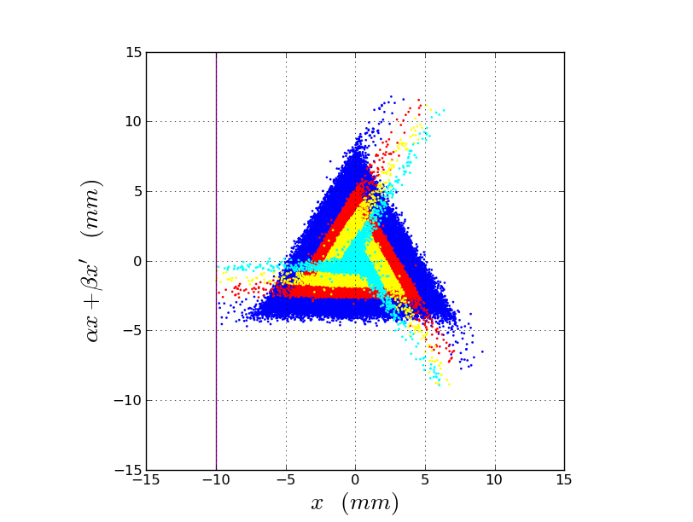
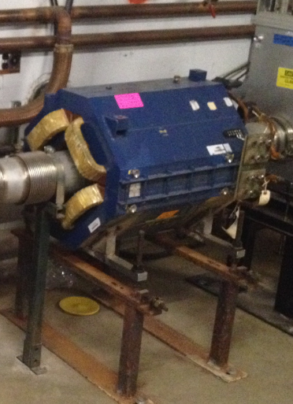
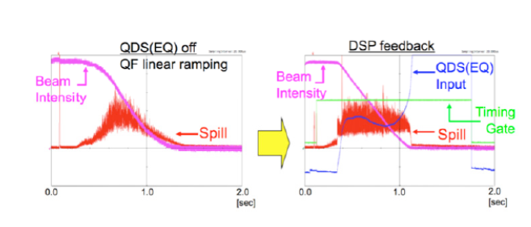
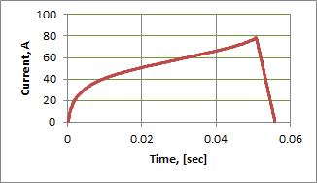
Driving the H-tune to the resonance
ΔQ~G
Beam squeeze by the tune ramp
CQA magnet for tune ramping (3)
Spill Ramp (FF regulation -JPARC)
Spill Ramp (FF regulation – Synergia)
Notes:
Tune change proportional to the gradient
If the gradient is ramped linearly – non linear spill
Will learn out the correct curve
Variations: slow and fast
Will try to regulate variations as much as possible with quads, same SRS
Limitations of FB regulation with quads

Slide 15
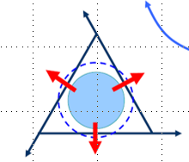
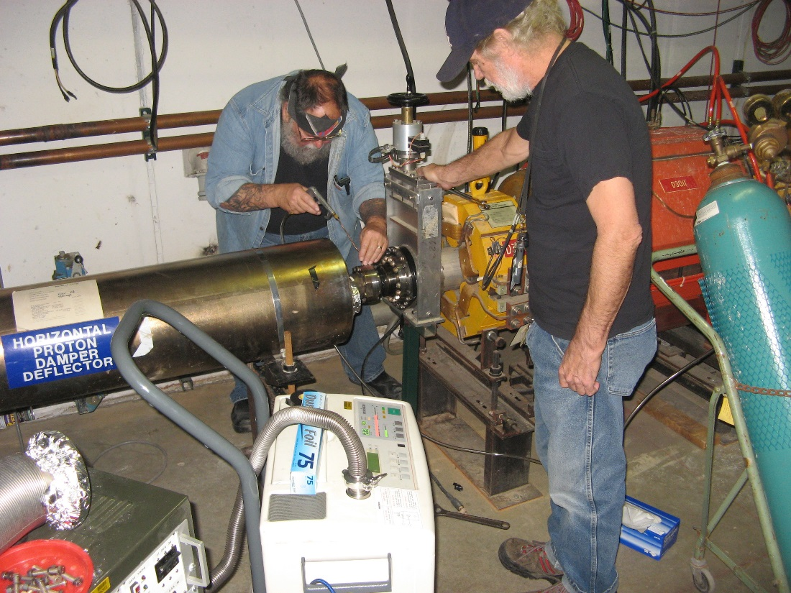
Spill Regulation with RF Knock-Out (BL)
Transverse RFKO- fast betatron beam heating
Will be used for the regulation of fast spill ripples.
Very effective in medical applications
It’s cheap (reusing hardware)
Needs special waveform: FM and AM
Did studies for the EGR (emit. growth rate)
Potential problem: can only heat the beam, can not inverse heating
Notes:
Principle of RFKO regulation
Why RFKO
Modulation
What we learned so far
Potential problem

Slide 16
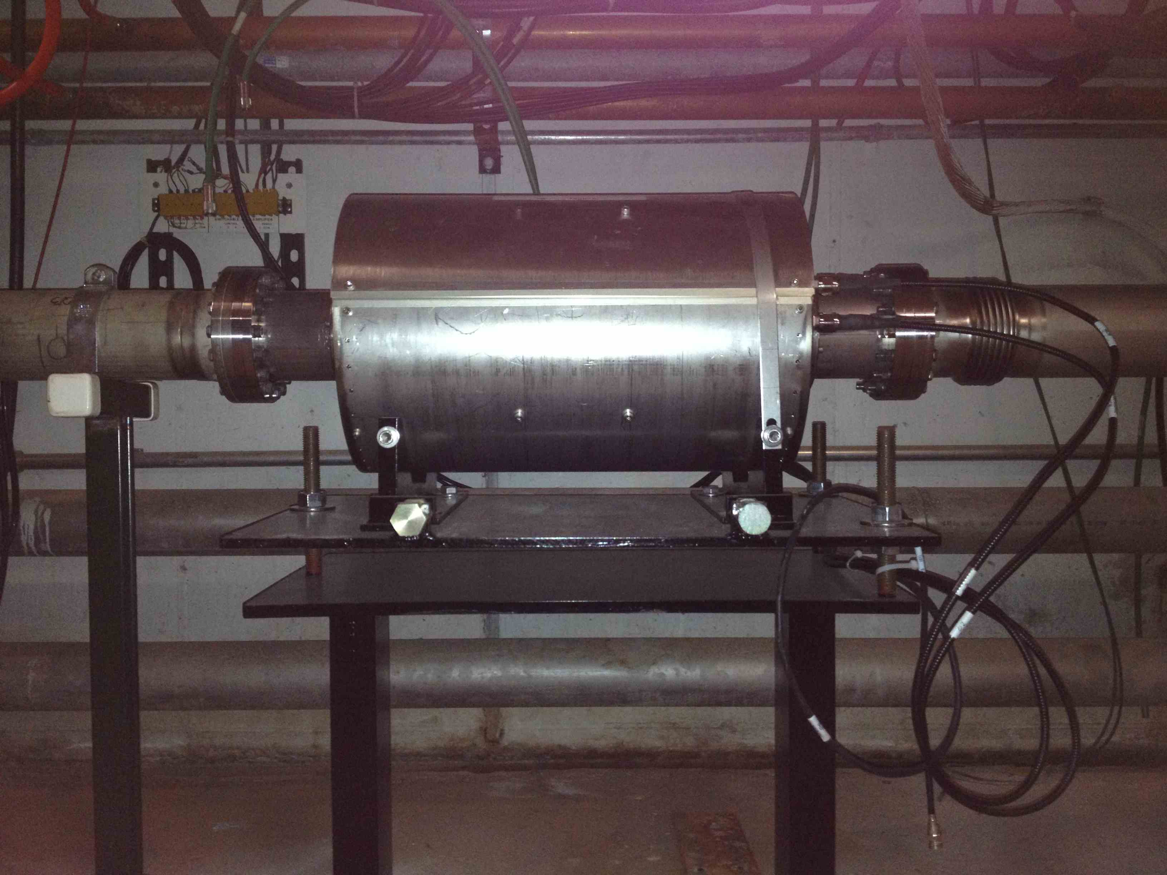
Spill Monitoring
Wall Current Monitor at SS-50
Also:
DCCT
Extinction Monitor (Main)
Extinction Monitor (U)
Notes:
Spill Monitoring
First device – WCM, will be available immediately
Is it used in g-2?
Others

Slide 17
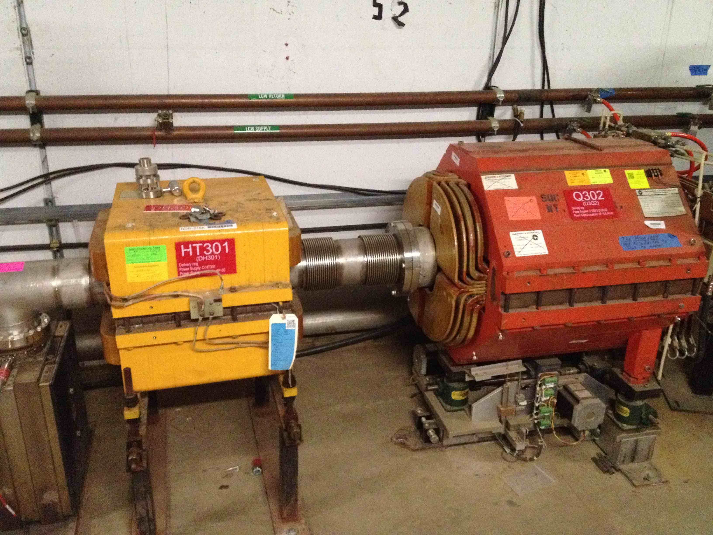
Orbit control at extraction
ESS
H305
H301
H206
H209
NDB trim magnets:
H206
H301
H305 moved from 302
H209 new
Notes:
Horizontal extraction orbit is controlled by 4 fast dipole correctors, NDB type.
1 moved, 1 new; all moved to optimal placements as much as practically convenient
Shown is H301

Slide 18
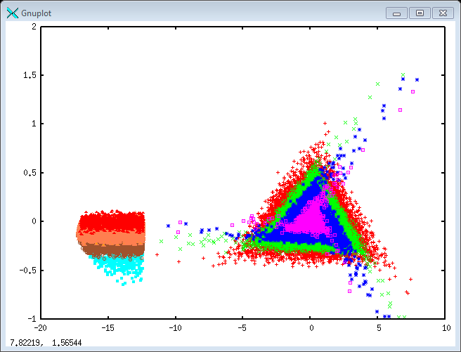
Why dynamic orbit bump
Max deflection angle is 0.4mR
Notes:
Most important – dynamic bump
Phase diagram: angle at septum is changing during the spill
Max angle 0.4mR

Slide 19
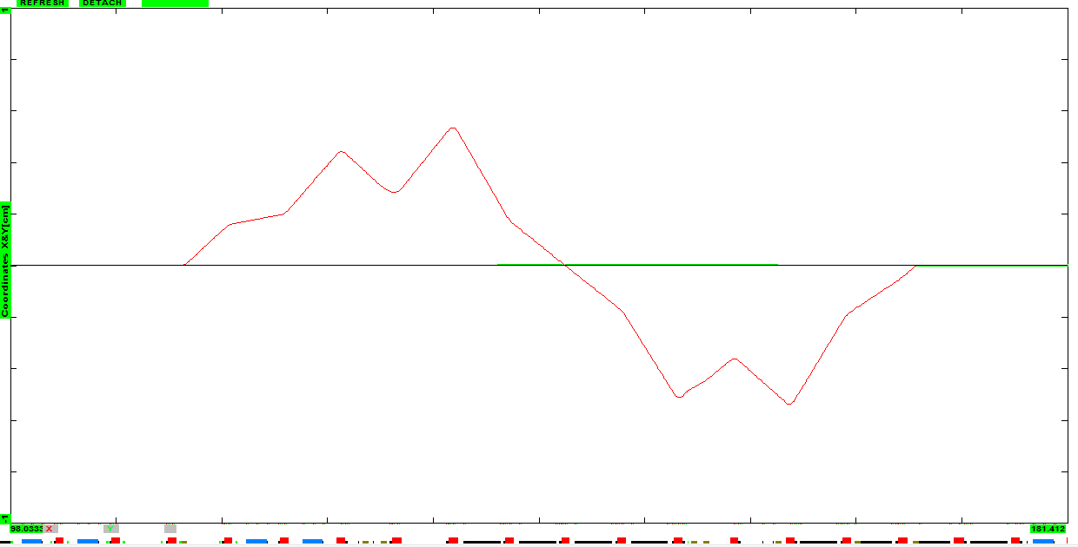
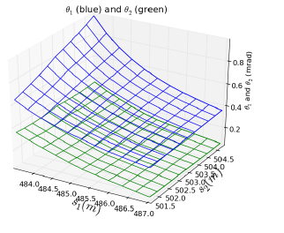
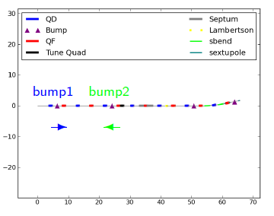
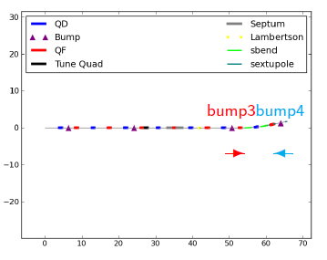
Dynamic orbit bump
ΔI_{max}=7A
Q203 X=0; X’=4mR
Q205 X=5.3mm X’=0
Q301 X=-5mm X’=0
Q303 X=-5.3mm X’=0
Notes:
Initial bump design made in OptiM
Fine adjustment by variation analysis in Synergia
Large deviations
Static counter bump

Slide 20
Extra Slides

Slide 21
SX operation sequence
Inject beam into the resonance
Sextupoles always ON
ESS and LAM/CMAG always ON
DEX correctors: at nominal
Tune ramping quads at zero
Note: SX is sensitive to injection errors
Squeeze (43ms):
Ramp up tune quads and DEX bump
Reset (5ms):
Reset back tune quads and DEX bumps
Abort any beam left-over

Slide 22
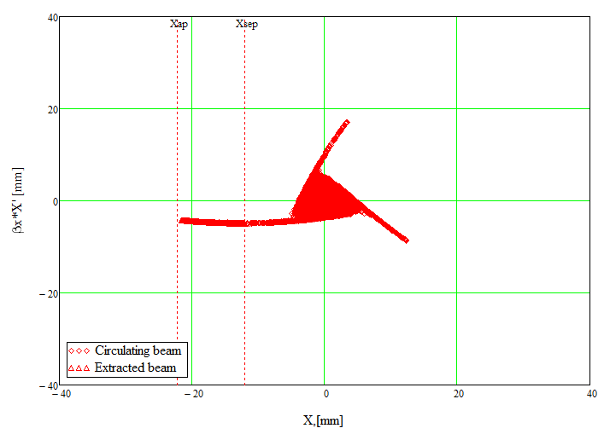
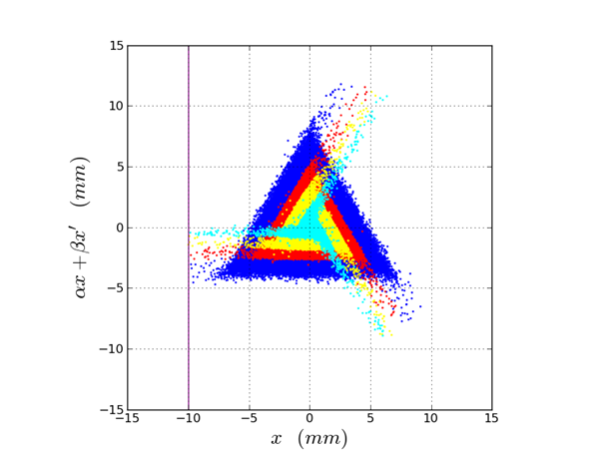
What’s important for SX
Monitoring losses: local & distributed
Septum alignment
Dynamic bump
Chromaticity control
Separatrix alignment – orbit studies
Maximum aperture
Minimum emittance
Coupling!
Optics
Etc.

Slide 23
Important diagnostic
Fast tune tracking
BPM: COD and TBT at 2.36MHz
Loss Monitoring
Emittance monitoring
Beam profile

Slide 24
BPM orbits
Closed Orbits:
Bumped orbits change, non-linear corrections
Cusped at sextupoles
Need for lattice studies
Turn by Turn Orbits:
With sufficient bumping, follow the triangle shape in phase space
Information about the resonance strength and phase
Helpful to tune the sextupole circuits
Notes:
The initial part of the squeeze is skipped

Slide 25
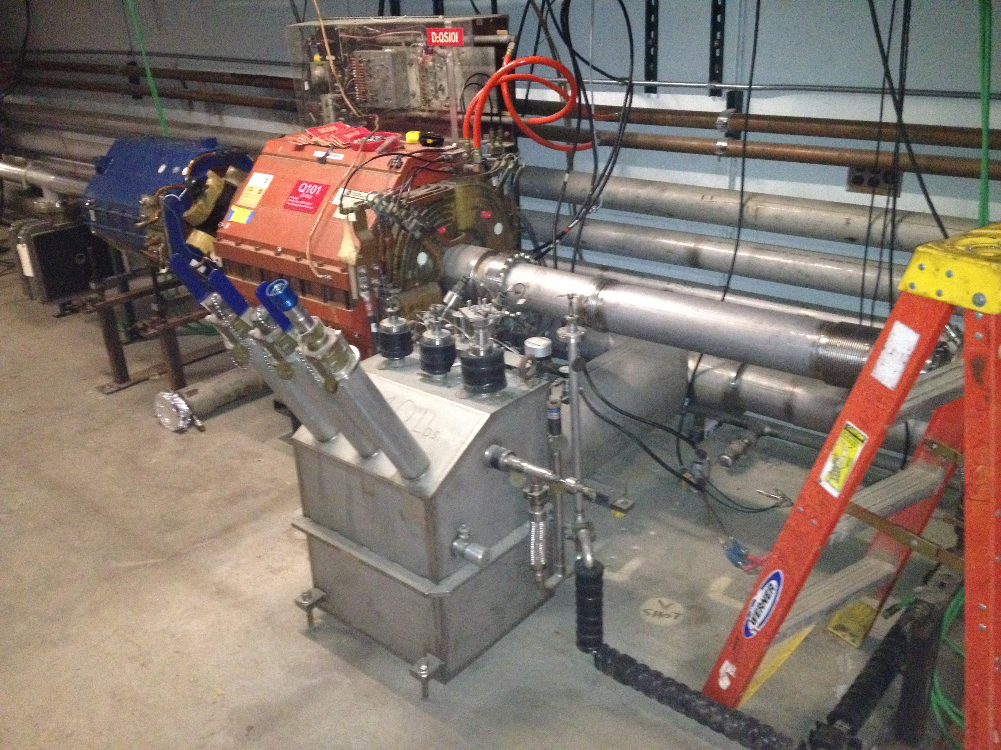
Hardware - magnets
Tune ramping quads – installed in 30, 10, 50
Need new PS (still unknown)
Harmonic sextupoles
Not installed
2 families in 60 and 50
Issue in 50
Issue in 10
Need new PS (still unknown)
Skew quads
In place (60)
PS are there
Need to re-cable
DEX bump magnets
In place
Need new PS (coming)

Slide 26
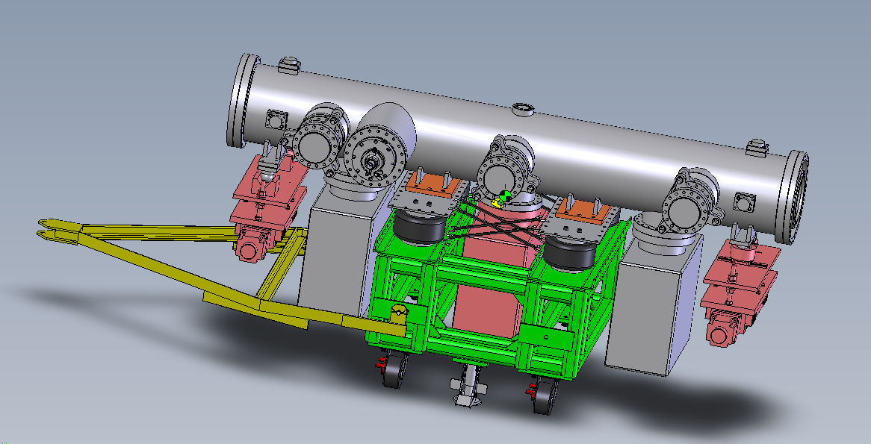
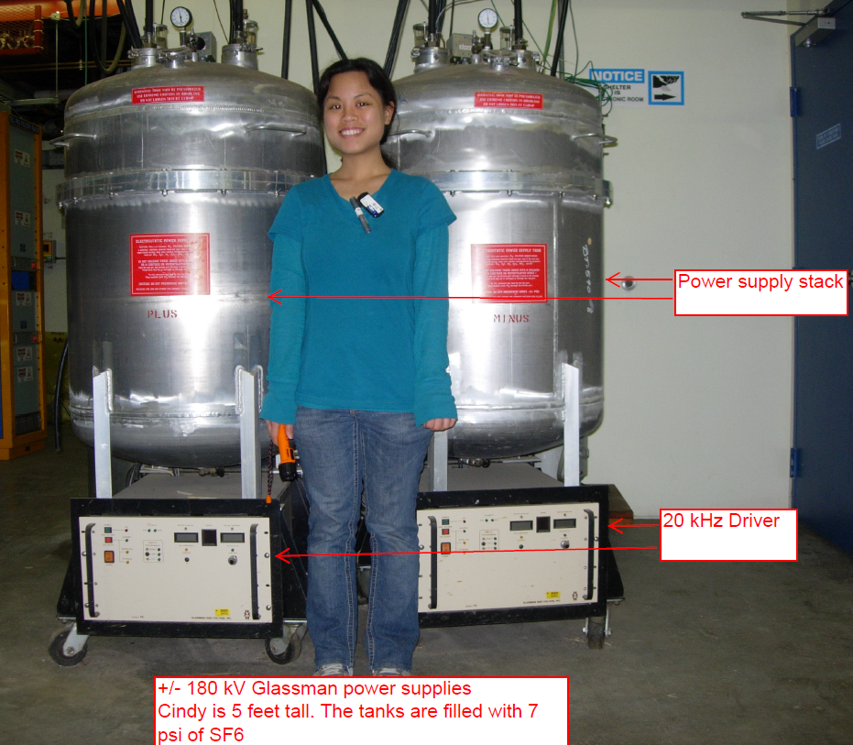
Hardware - other
ESS installation
At Q203 (left & right)
Will be the latest
Quick access & maintenance
Vacuum
ESS HV PS
In AP30
Will start moving soon
ESS Fluorinert skid
In AP30
Pending Construction funds
Spill Regulation System
In AP30

Slide 27
List of studies BEFORE ESS installation
Improving beam lifetime
RF studies
Beam transport, matching beam lines
Injection errors
Establish tune tracking
Tune ripples
Chromaticity
Ramping quads *
Sextupole resonance:
Sextupole phase tuning; orbit distortions;
Aperture studies and improvements
Loss monitor commissioning and studies *
Optics measurements/Lattice improvements
DEX bump studies: bumps, ramp, leaks
X-Y coupling, skew quads
Emittance monitoring
Beam profile monitoring?
Machine protection modes

