Slide 1
Computing All-Hands Meeting
Liz Sexton-Kennedy
November 5, 2018

Slide 2
Top 5 takeaways from director’s Oct. 15 all-hands meeting
LBNF far site and US-DUNE far detector must be baselined (receive CD-2) approval) in 2019.
Full pre-excavation construction work expected to begin in December in South Dakota.
Outstanding technical performance by ProtoDUNE at CERN, which recorded its first charged particle tracks and has met all technical specifications. Congratulations to the collaboration.
PIP-II has achieved CD-1 and must be baselined (receive CD-2 approval) in 2019.
The project continues to receive broad support and maintain excellent technical progress.
Strong engagement with international partners continues.

Slide 3
Top 5 takeaways from director’s Oct. 15 all-hands meeting
LCLS-II cryomodule (CM) transportation issues are being addressed by a multi-lab team.
A solution is close and plan is to begin transporting CMs to SLAC in November.
CM assembly is on schedule, with all CMs exceeding specifications.
Mu2e transport solenoid first production module coil successfully tested.
Continue to address challenges with Detector and Production solenoidal coil winding that is impacting schedule.
LHC CMS HL-LHC detector upgrade project advancing toward CD-1 next spring and superconducting quadrupole magnet fabrication progressing to CD-2.

Slide 4
New Employees Since Jan. 2018 (Welcome!)
CCD Sudha Balakrishnan Joshua Kenward
OCIO Jo Fazio Gabriela Garcia
SCD Sophie Berkman
Jose Berlioz
Allison Hall
Matti Kortelainen
Lorena Lobato Pardavila
Marianette Wospakrik

Slide 5
Foreign Visits
In the event that any non-U.S. citizen will be visiting the lab, you must contact Fermilab’s Foreign Visits and Assignments Specialist Melissa Ormond, mormond@fnal.gov, prior to their arrival. Approval is required for all such visits.

Slide 6
Diversity and Inclusion Employee Survey
WDRS will be conducting a survey to identify our strengths and opportunities for improvement on different dimensions of diversity and inclusion including development opportunities, mentoring, engagement, leadership commitment, respect and recognition.
Employees’ perceptions will help us determine what actions we need to take to move diversity and inclusion forward at the lab.
The survey will take place this coming winter. Watch for more information!

Slide 7
ITNA & Training Completion
ESH&Q required training for all 3 groups = 99.6%
ITNA completion = 98.8%
Keep up the good work!!
Liz Sexton-Kennedy | Computing All Hands

Slide 8
ESH&Q Notable Items
Multiple FESHM chapter updates
Three minor injuries and zero OSHA recordables since Jan. 1
New avenue for reporting near misses on ESH&Q website
Go to ESH&Q internal site under ESH&Q resources:
New Work Planning and Control tool being developed for labwide use

Slide 9
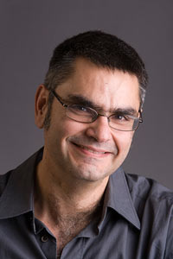
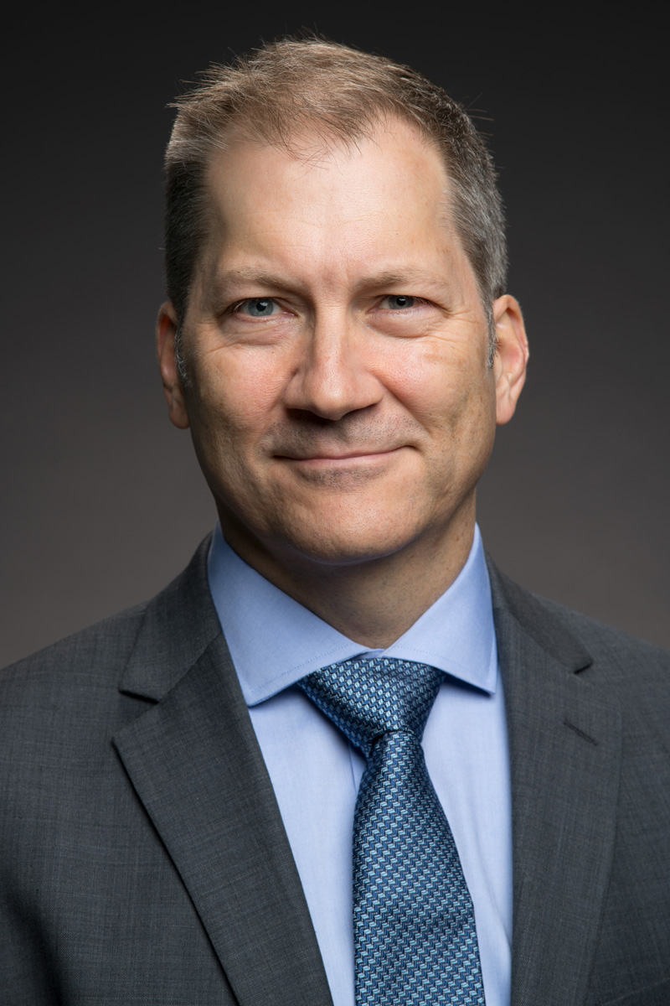
Leadership changes on Oct. 1, 2018
Quantum Science initiative has been established and reports to Joe Lykken, Chief Research Officer. Panagiotis Spentzouris, previously the head of the Scientific Computing Division, leads the effort.
Jim Amundson, previously the head of Fermilab’s Scientific Software Infrastructure Department, has been named head of the Scientific Computing Division.

Slide 10
Scientific Computing Division
James Amundson
Computing All Hands
2018-11-05

Slide 11
This talk
Perspectives
On where we came from and where we are going with computing
On where we are going with our experiments
Division Status

Slide 12
Introductions
Hello.
Why are we here?
Notes:
I am here to enable the rest of you to continue your best work. Why are you here? To further the mission of the lab.

Slide 13
Fermilab
https://www.fnal.gov

Slide 14
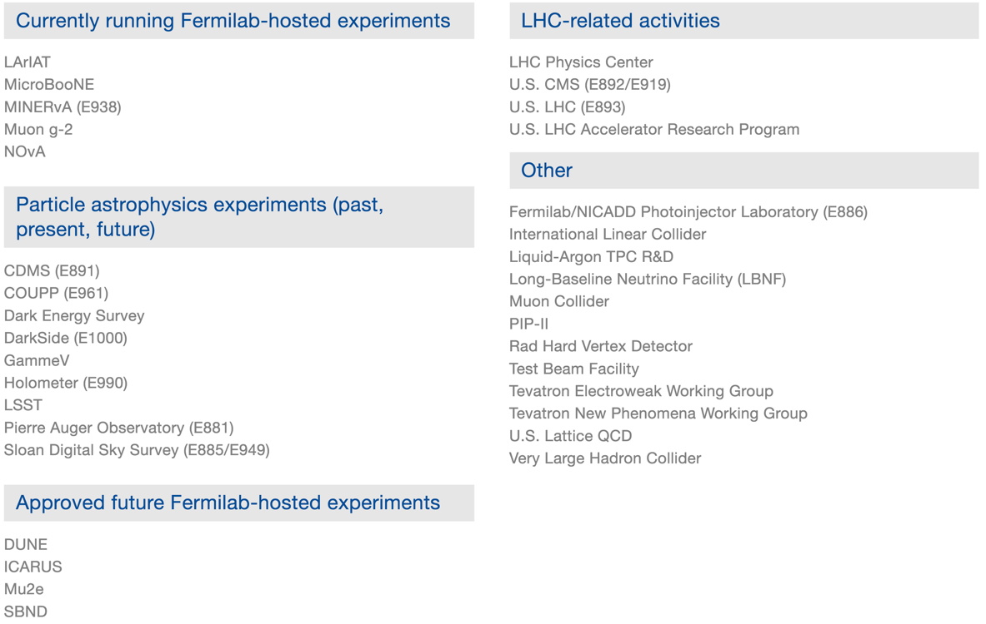
Fermilab Experiments and Projects
http://news.fnal.gov/fermilab-at-work/experiments-and-projects/

Slide 15
SCD’s contribution to the lab mission
What do we have to do with these experiments (and projects)?
Everything!
We help take the data
We store the data
We help process the data
We help analyze the data
Computing professionals, staff, engineers and scientists all contribute
Your work is crucial to every aspect of the U.S. particle physics programs – without computing there would be no modern particle physics
I could not be happier to be here to help

Slide 16
Where are we going?
Big changes are coming in computing
But… big changes have happened before
Let’s see how we got here…

Slide 17
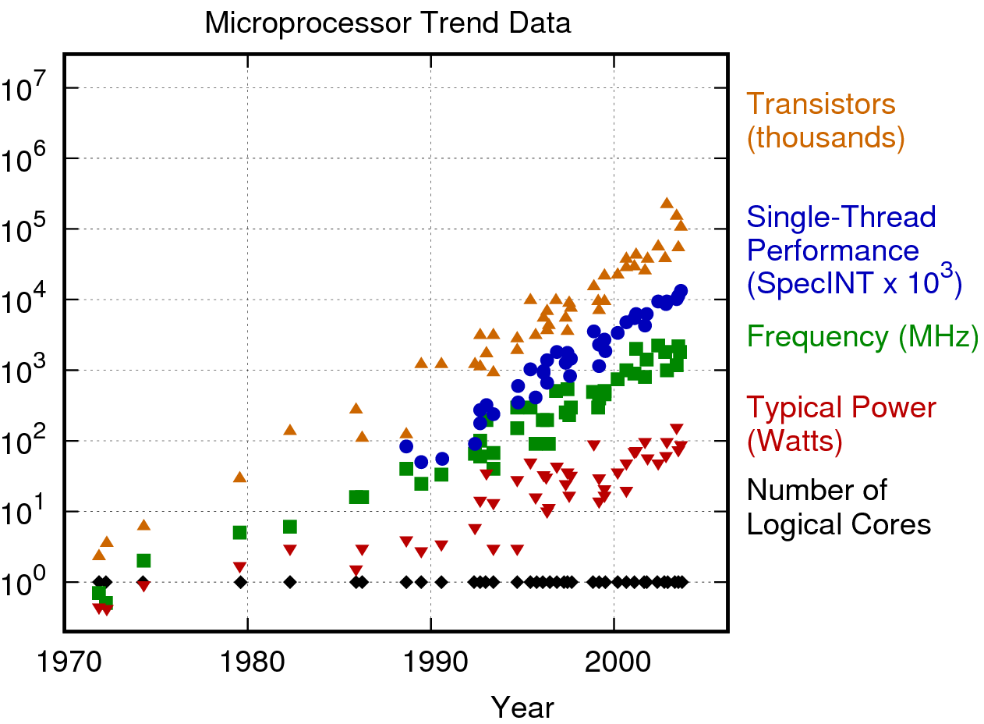
“Moore’s Law” – the good old days
https://www.karlrupp.net/2018/02/42-years-of-microprocessor-trend-data/

Slide 18
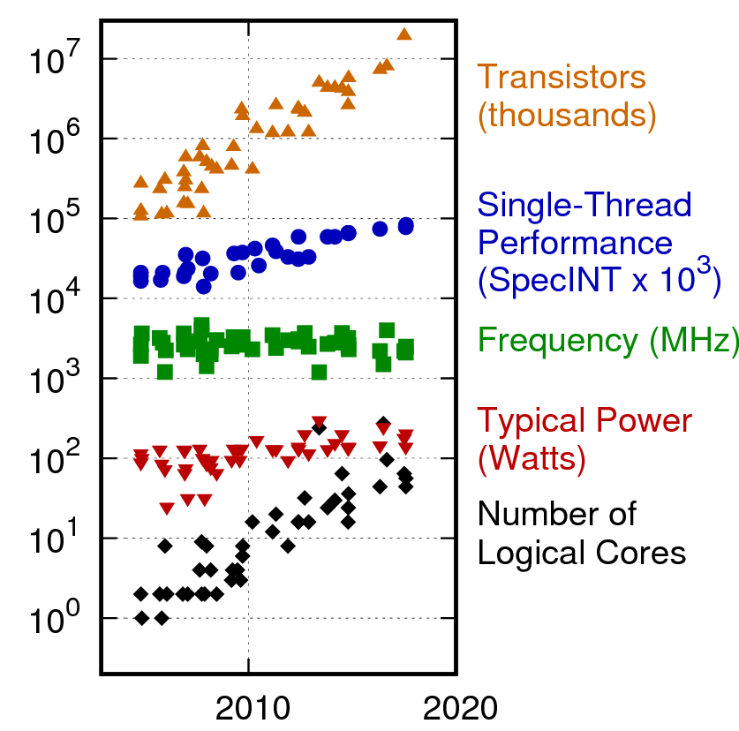
“Moore’s Law” – recent times
Trends have changed

Slide 19
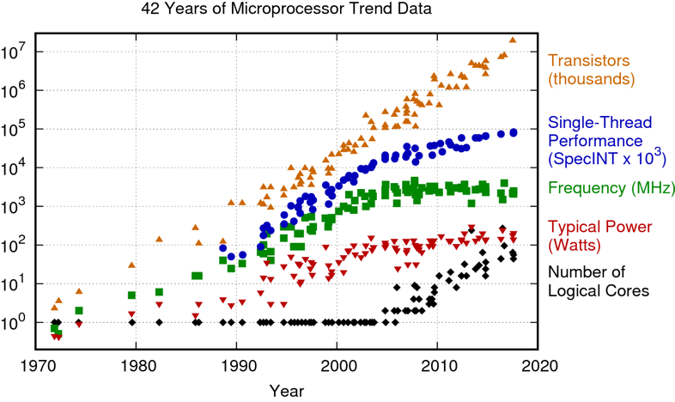
Ancient (personal) history
Second computer
Apple IIe
1 MHz 6502
48kB RAM
First paid programming job
Computer dating app for student council
Pure assembly
First (1/2) computer
Sinclair ZX80
3 MHz Z80
1kB RAM
(including VRAM!)

Slide 20
Physics history
DEC VAX
with the VMS operating system was the most popular HEP computing platform in the 80’s
Fortran was the language of Physics
1985-1993
University of Minnesota
BS Physics
University of Chicago
PhD Particle Theory

Slide 21
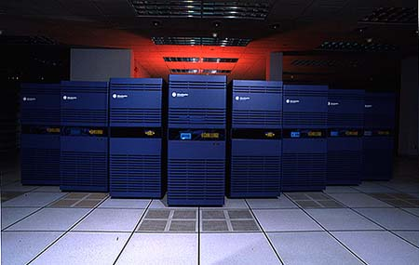
Physics history
The 90’s saw a transition to Unix-based computers and C++
Many people were skeptical that physicists could ever move from VMS to Unix and from Fortran to C++
Nonetheless, proprietary Unix workstations and large shared-memory machines came to dominate HEP
1993-1998
University of Wisconsin
Particle Theory Postdoc
Michigan State University
Particle Theory Postdoc

Slide 22
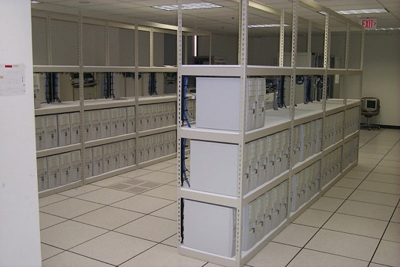
Current era
Since the early 2000’s, HEP has been dominated by large clusters of x86-based Linux machines
Many people were skeptical that physicists could work without large shared-memory machines
Fermilab Computing
1998-2001
SoftRelTools for CDF and D0
CMS Grid Computing
2001-2018
Accelerator Simulation
Synergia
HPC
SSI Department

Slide 23
Computing is changing
Architectures are changing
Driven by solid state physics of CPUs
Multi-core
Limited power/core
Limited memory/core
Memory bandwidth increasingly limiting
High Performance Computing (HPC, aka Supercomputers) are becoming increasingly important for HEP
2000s: HPC meant Linux boxes + low-latency networking
No advantage for experimental HEP
Now: HPC means power efficiency
Rapidly becoming important for HEP, everyone else
New technologies will change our workflows
Containers are one example

Slide 24
Exascale computing is coming
President Obama, July 29, 2015:
EXECUTIVE ORDER
CREATING A NATIONAL STRATEGIC COMPUTING INITIATIVE
By the authority vested in me as President by the Constitution and the laws of the United States of America, and to maximize benefits of high-performance computing (HPC) research, development, and deployment, it is hereby ordered as follows:
…
Sec. 2. Objectives. Executive departments, agencies, and offices (agencies) participating in the NSCI shall pursue five strategic objectives:
Accelerating delivery of a capable exascale computing system that integrates hardware and software capability to deliver approximately 100 times the performance of current 10 petaflop systems across a range of applications representing government needs.
…

Slide 25
Exascale
http://science.energy.gov/ascr/research/scidac/exascale-challenges/
Power. Power, power, power.
Naively scaling current supercomputers to exascale would require a dedicated nuclear power plant to operate.
ALCF’s Mira: 4 MW, 0.01 exaflop
“The target is 20-40 MW in 2020 for 1 exaflop”
Exascale computing is the leading edge of advances of computing architecture
The same changes are happening outside of HPC, just not as quickly
Optimizing for Exascale is really optimizing for the future
Storage of large-scale physics data sets will remain our job
Future U.S. computing resources will be dominated by the Exascale machines

Slide 26
This talk
Perspectives
On where we came from and where we are going with computing
On where we are going with our experiments
Division Status

Slide 27
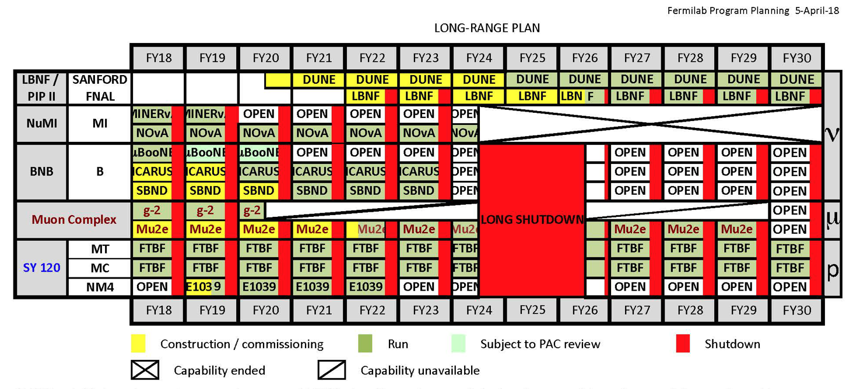
Experiments and collaborations
Fermilab accelerator-based experiments
New now: g-2
New soon: ICARUS, SBND, Mu2e

Slide 28
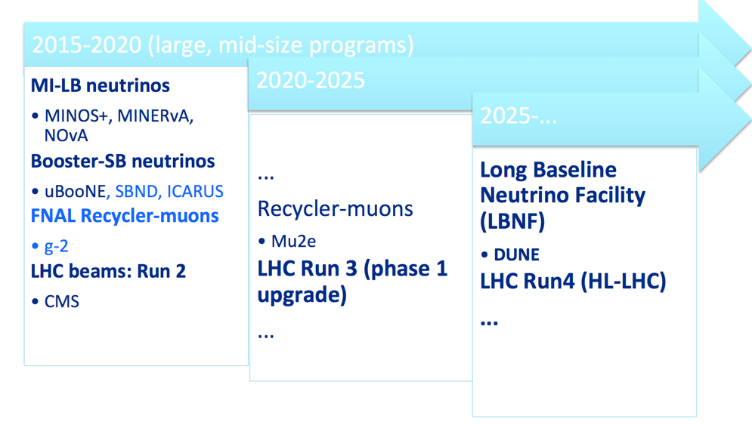
International collaborations are the future
Our future is dominated by international collaborations (HL-LHC and LBNF/DUNE)

Slide 29
Outlook for the future
Computing is changing
New architectures, HPC, Exascale
More threads
Memory access will be more expensive
New technologies
Containers
Experimental collaborations are becoming more international
Need to seek collaborative computing solutions

Slide 30
This talk
Perspectives
On where we came from and where we are going with computing
On where we are going with our experiments
Division Status

Slide 31
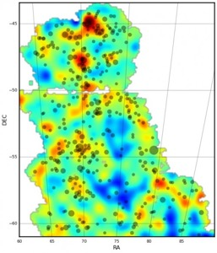
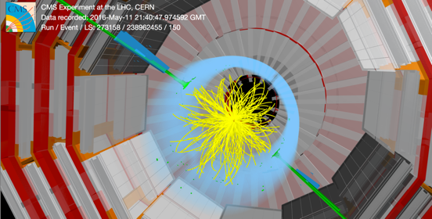
Scientific Programs Quadrant
SCD scientific staff lead research on supported experiments
SCD encourages research and mentors postdocs and young scientists
Intensity Frontier
Neutrinos: DUNE, NOvA, MINERvA, MicroBoone, ICARUS, SBND and LArIAT
Muons: Mu2e and g-2
Cosmic Frontier
DES, DESI and LSST
Energy Frontier: CMS
Particle & Accelerator Theory
Intensity Frontier
Cosmic
Frontier
Energy Frontier
Notes:
we "encourage research" we also "mentor postdocs and young scientists"

Slide 32
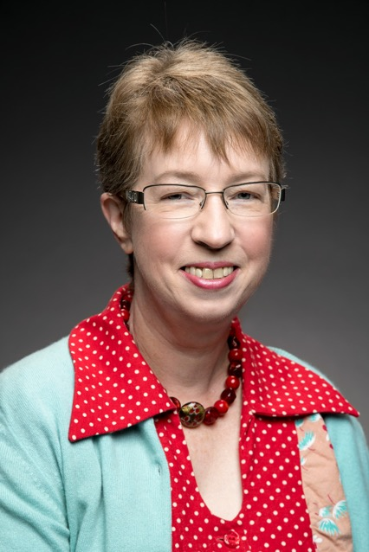
American Physical Society Fellow
Congratulations to senior scientist Elizabeth Buckley-Geer
Her 2018 APS fellow award recognizes the level of scientific achievement to which all SCD scientists aspire.
APS Citation
For the creation and leadership of the Dark Energy Survey Strong Lensing Group, including discovery and confirmation of numerous strong lenses and multiply lensed quasars and their application to new measurements of cosmic dark matter and dark energy.
Nominated by the Division of Astrophysics

Slide 33
SSA: Scientific Computing Applications (new name) [Daniel Elvira]
New group: Neutrino Simulations led by Laura Fields
New group: Machine Intelligence and Reconstruction led by Rob Kutschke
Completed Geant4/Genie Interface (neutrino simulations have access to Geant hadronic models)
GeantV (next generation detector simulation) vectorization complete; CMS using alpha release; Beta soon
Geant4 support for experiments + model variation, profiling, uncertainties
New version and improvement to Genie (neutrino simulation)
Phase 1 Integration of LArSoft and Geant4 nearly complete
Automated LArTPC data reconstruction fully vetted (for uBooNE)
Cosmology/Astro workflow pipeline (WLPIPE) enables LSST & DES analyses (paper published)
Paper in ArXiv on Deep Learning and Lensing of Cosmic Microwave Background
Three Accelerator modeling posters at IPAC; paper published on instability development with space charge (relevant for DUNE)
Commissioned and put into general use the setup for rapid evaluation of photon detectors in LAr using the Material Test Station
Notes:
GeantV vectorization: new architectures

Slide 34
SSA: Scientific Software Infrastructure [Chris Jones] (new head)
CMS Software:
Integrating GPU algorithms in data processing framework
MC simulation jobs now efficient to very large number of cores (ran millions core hours)
LArSoft and art development teams merged into SciSoft team (led by Kyle Knoepfel and Erica Snider)
Multithreading in art for parallel processing of events
Improved LSST observing schedule simulation with realism
Significant speed improvements to DES Year3 cluster cosmology with C++ modeling pipeline
C++ library using HDF5 for tabular data for analysis (NOvA using)
Root performance improvements to Trees and Histograms
Led organization of Fermilab’s participation in Grace Hopper Celebration of Women in Computing conference
Fermilab Computational Science Internship Program Established
Notes:
GPUs and multithreading: new architectures

Slide 35
SSA: Real-Time Systems Engineering [Liz Buckley-Geer]
Notes:
protoDune and Dune: international collaborations

Slide 36
SciDAC Projects [Jim Kowalkowski, Giuseppe Cerati, JFA]
Notes:
HPC everywhere

Slide 37
SCF: Data Movement and Storage [Gene Oleynik]
DMS put into production two 100PB IBM tape libraries, 92 LTO8 tape drives
A big effort with help from many groups, Thanks to all! RFP, procurement, demolition of 2 Oracle libraries, facilities, electrical, fire-suppression, fiber-channel and networking infrastructure, mover computer procurement and installation
Enstore development to support TS4500 library and LTO8 drives
Dealing with LTO8 media unavailability due to corporate patent infringement cases.
All experiments are converted over to LTO media.
Upgraded dCache from 2.6 to 4.2 with Fermilab developed components:
dCache-View admin interface enhancements, xrootd 3rd party copy.
Resilient Manager provided an effective stop-gap solution for user code distribution
Networking Research team has joined the department. Welcome!
mdtmFTP version 1.0.2 released, 590+ downloads, SC’18 demo
BigData Express under evaluation at multiple sites, SC’18 demo, INDIS’18 paper
Amidst all of this the operations team kept data storage operating well!
Notes:
Heard about tapes at most recent Director’s All Hands

Slide 38
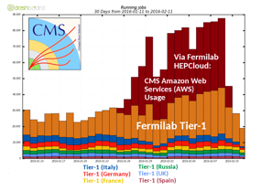
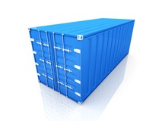
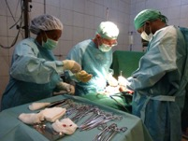
SCF: Experiment Computing Facilities [Glenn Cooper]
Working with experiments to prepare for DAQ computing: ICARUS, Mu2e, SBND, DUNE
HEPCloud: Going into production early 2019
Containers
In use for batch jobs (FermiGrid, CMS Tier 1)
Testing infrastructure to build, test, store containers
Testing tools for container orchestration/management
“Normal operations”
DOE granted ATO
Notes:
New experiments, HPC, Containers, good picture

Slide 39
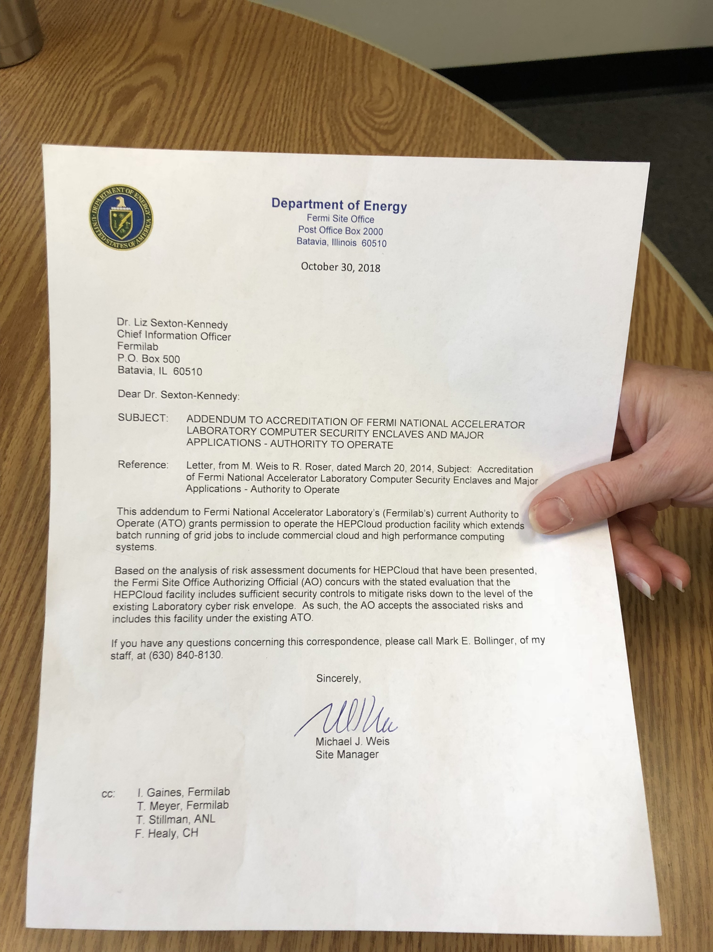
HEPCloud granted authorization to operate by DOE
Liz has the ATO
in hand
Literally

Slide 40
SCF: High-Performance Computing [Jim Simone]
LQCD facility delivers world-class computing to USQCD scientific projects.
Integrated FLOPS delivered at or above DOE Project’s benchmark pace.
Fermilab consistently leads in ratings on USQCD customer satisfaction survey.
Kudos to Alex Kulyavtsev, Ken Schumacher, Amitoj Singh, Alexei Strelchenko, and Rick Van Conant.
Fermilab institutional HPC cluster
Funded by USQCD national Project and Fermilab SCD.
Amitoj leads co-design effort with LQCD and experiment stakeholders.
IC will extend LQCD computing and deliver HPC computing to experiments.
IC will provide upgrade path from aging Wilson cluster.
Exascale Computing Program (ECP)
Alexei S. research on LQCD algorithms suitable for exascale computing.
Phys. Rev. D 97, 114513 (2018), and Comp. Phys. Comm. 233, 29-40 (2018).
Notes:
HPC efforts at Fermilab, especially Exascale

Slide 41
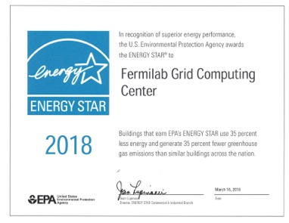
SCF: Data Center Operations [Adam Walters]
One scheduled outage of FCC2 July 20 to retire an ‘End of Life’ UPS
Assisted with the delivery and installation of the IBM TS4500 Libraries
Retirement and disposal of two SL8500 Libraries
Successfully mitigated: ✓4 water leaks; ✓3 cooling events; ✓3 Un-scheduled UPS/ATS/Generator events; ✓1 Un-scheduled Lab power outage; ✓6 Scheduled Lab power outages
Green Strategies In Computing - Docdb 6540
Notes:
These are the facilities that make all our work possible

Slide 42
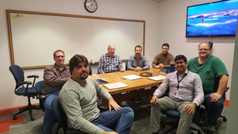
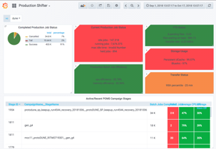
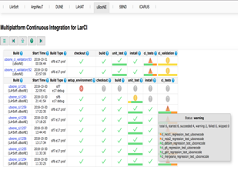
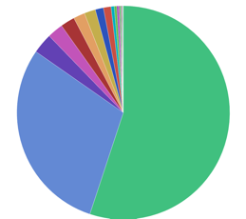
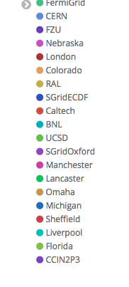
SCS: Scientific Distributed Computing Solutions [Tanya Levshina]
FIFE Support Team: handled 710 tickets opened by FIFE experiments and CMS LPC users since April. On-boarded several new experiments.
Frontier Experiments RegistRY: account registry and quota management. Integrated with SNOW and numerous services. In production since September 15th!
Landscape: Shifter dashboards, protoDUNE monitoring of data movement at CERN and Fermilab.
Continuous Integration provides a comprehensive framework to test and validate their offline production and analysis code on the supported platforms. Is used by 9 FIFE experiments and 4 SCS projects.
Successful protoDUNE production campaigns ran on FermiGrid, OSG, CERN and European GRID using FIFE tools.
Notes:
protoDune: international collaboration

Slide 43
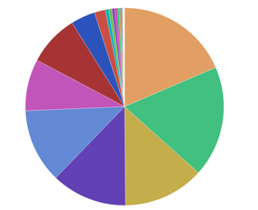
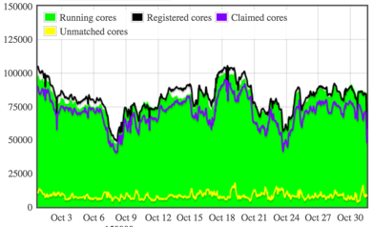
SCS: Scientific Distributed Computing Solutions [Tanya Levshina]
DOE granted ATO
JobSub handled 50M jobs (500 unique users) during last 6 months. Provides reliable and scalable solution for all FIFE experiments. Working on HEPCloud integration and Rapid User Code distribution.
HEPCloud Program: Applied to DOE for ATO. Successful CMS and NOvA runs at NERSC. Testing AWS and GCE. Continuing Decision Engine development and testing. Working with FIFE on-boarding documents.
GlideInWMS: wide user community that includes CMS, HEPCloud, FIFE, OSG, LIGO and GLOW. Production factory supports 72 groups from 14 frontends. The project had 7 releases since April. Implemented singularity support, improved the efficiency in the resources provisioned, modernized the code in preparation for Python3. Continued strong collaboration with HTCondor team.
Notes:
Hepcloud: we already heard about

Slide 44
SCS: Scientific Data Processing Solutions [Brian Yanny]
Beginning the migration of CMS data management to Rucio - the emerging community project for data management and distribution
ProtoDUNE data taking is cataloging and transferring multiple petabytes of raw data from CERN to Fermilab
Deployed a prototype Rucio instance for DUNE and started using it to distribute ProtoDUNE data
The IFBeam database has integrated collecting ProtoDUNE beam instrumentation data from CERN
Major new release of the Production Operations Management System for Intensity Frontier workflow management
Striped Data Analysis Platform demonstrated to CMS, DES, others. 120TB cluster has been built for CMS Panda dataset.
Job Traceability trainings and security drills at the USCMS VO with T2 and T3 Site administrators.
Implemented a database for tracking collaboration membership and affiliations for DUNE
Notes:
Call out Rucio as common solution

Slide 45
In summary
Your work is crucial to every aspect of the U.S. particle physics program
Many important things are going on in the division
Changes are on the horizon
New computing architectures
New technologies
International collaboration will be the new default mode of operation

Slide 46
CCD + OCIO All-Hands
Jon Bakken
November 5, 2018

Slide 47
Nigel’s Top 5
What does Nigel’s Top 5 have to do with CCD & OCIO?
Priority: PIP-II & LBNF/US-DUNE must be baselined 2019
LBNF: South Dakota construction start Nov…thank you for focus on getting pre-excavation package completed
DUNE: great success with protoDUNE…congratulations
LCLS-II…thank you for focus on transporting cryomodules
Mu2e…thank you for focus on production solenoid coil
LHC Upgrades…..thank you for focus on pulling timing project together with other major upgrades including magnets
Quantum science…thanks for teleporting..congrats on awards
IOTA….. Congratulations first beam (electrons) in IOTA.
Everyone should know that it has everything to do with us!
We are either directly working on these projects, like SURF networking, or are providing support allowing our colleagues to accomplish these tasks.
I encourage everyone to read the web pages about these projects to understand more of lab’s goals, & therefore, also its needs.

Slide 48
Four Observations
Making lists always means something is left off. Everything we do is important & we value everyone’s work. My apologies if your work isn’t mentioned.
Remember, Safety & Security are always on every list. These items are integral to everything we do. Stop & think! Ask for help if unsure.
We work in teams in which we need everyone’s talents:
Multiple technical teams, testers, project management, communications, enterprise architecture, service management – all are required for a successful project.
Last year’s effort reporting indicated we spent 80% of our time on operational activities & 20% on projects.
Operations is critical to keeping lab functioning - we must maintain an efficient, well-functioning & secure infrastructure for the lab
Many thanks!

Slide 49
ISO20k Recertification Audit – Nov. 5-8
Computing is executing at a higher level now than it was before we adopted the ITIL framework.
Framework provides an accepted set of standards
Incidents, Change, Request, Problem, & more
Documentation is also a key part of framework
Resolving incidents means providing a technical solution & documenting it. A record that only says “fixed” is not very useful. We all need to do better here.
Why do we certify?
An external review demonstrates we are following consistent industry standard IT practices.
Demonstrates to lab & DOE that we are efficient, effective & good stewards of the lab funds we manage.

Slide 50
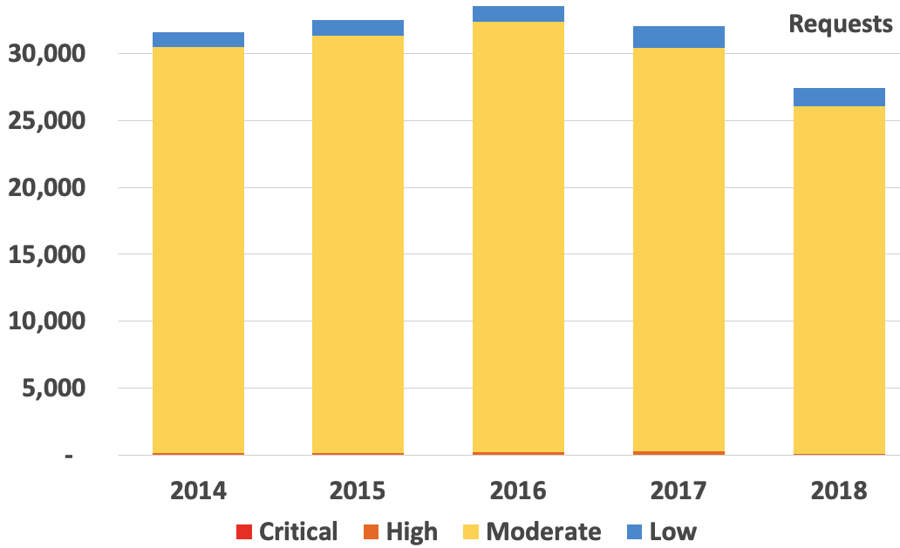
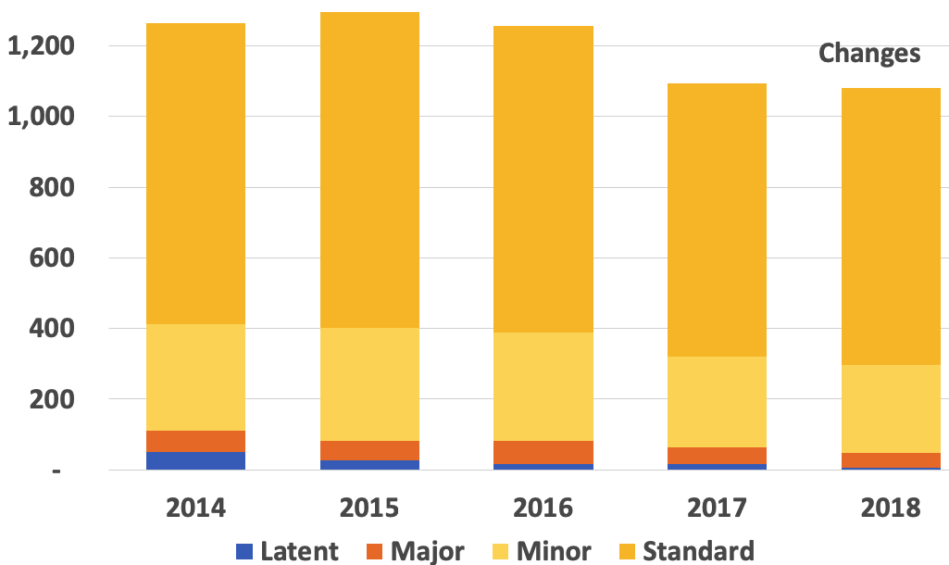
Some stats…
Requests
Work load is roughly the same for the past 5 years
(not completed)
Changes
(not completed)

Slide 51
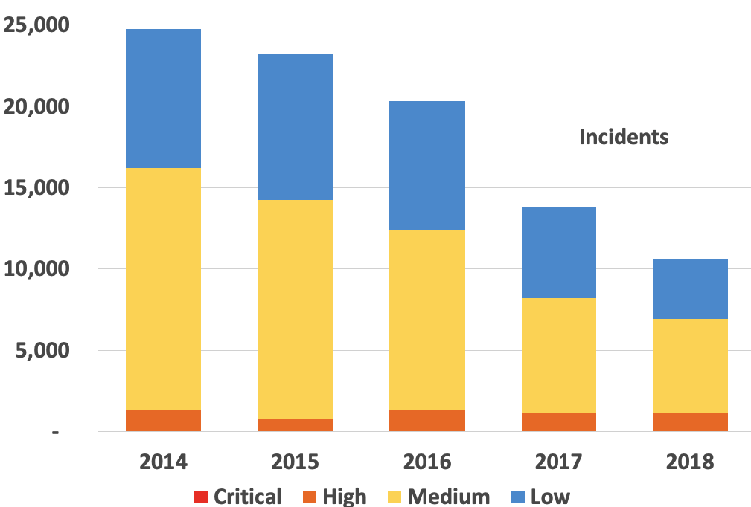
Some stats to back up claim
Incidents going steadily down implies quality is steadily going up.
(not completed)

Slide 52
Planning & Enterprise Architecture
I often hear, “I know what Computing has done – that is communicated well, but I don’t have any idea about what Computing is working on right now.”
The answer I give to this question is that we work through Strategic Plans, developed in collaboration with the lab & yearly Tactical Plans that indicate how we plan to achieve strategic goals.
There are two meetings I recommend you attend, or listen via Zoom
Community Collaboration Discussion Meeting (CCDM) occurs every other Thursday at 10 AM in FCC1W
Discussion about initiatives that introduce significant changes on our systems & our application’s architectural environment.
OPS & Project Status meetings at 1PM Mondays
Allows everyone to hear all weekly updates.

Slide 53
Project Management
Lattice QCD Program – a long & very successful program at the lab.
DOE review in May
Very successful, no formal recommendations
Two suggestions for the project to consider & two for the collaboration
FY18 user survey results
Overall Satisfaction: 97% – System Reliability: 95%
User Support: 97% – Responsiveness of Staff: 98%
What’s next?
Working to build first institutional cluster at Fermilab that will be used jointly by USQCD Collaboration, CMS, and Fermilab Neutrino Experiments.

Slide 54
Supplier Management
Successful negotiations with numerous vendors
Ask for help if you need any contract or license assistance
Example: eliminated thousands of Oracle database licenses no longer needed after Run2
Centrally managed lab licenses are carefully controlled & monitored
Over the past 4 years we have been able to move existing unused licenses to new requesters
Have not had to pay any true-up costs to Oracle & Microsoft
D/S approaching us & asking for help managing their unique licenses
With our managed service contractor NTT, developed detailed Runbook that lists the work we expect NTT to perform
Working to reduce our printer fleet through right-sizing to minimize cost in terms of resources & future Managed Print contracts.
What’s next?
Right sizing our license count before renewal of upcoming 3-5-yr EA agreements with Adobe & Microsoft (Can not true down)

Slide 55
Cybersecurity
Major emphasis on phishing awareness – a huge threat to lab – Think before you click! Ask for help if unsure.
We’ve had three successful audits this year:
DOE Office of Science, Office of Inspector General, Crowe Horwath
We’ve extended coverage of our default-deny firewall that has had minimal disruptions to lab’s science program
We’ve added extra functionality to email & web security to meet requirements of DHS BOD 18-01
Requires https & stricter allowable methods (TLS)
Enhanced NCIS’s ability to find more devices on network
3,000 new devices were detected after this change was made.
What’s next?
Planning started to require MFA for VPN access (rollout Jan. 2019)
Planning to migrate existing MFA infrastructure to use Yubikeys
New models are fully NIST certified
Eliminates RSA exemption to DOE policy

Slide 56
Replacement of 5ESS, aka VoIP Project
Our phone service uses a 1980’s AT&T 5ESS switch.
In 2012, AT&T said they will discontinue service to 5ESS by 2020
In 2020, our AT&T 5ESS lease contract ends
Should we need to continue with AT&T 5ESS past Dec 2020, our phone system costs will increase from $750K/year to $9.75M/year (10/2017 quote)
Project has 3 major components:
Enhance Offsite Service – 2 independent paths, completion ~Dec 2018
Construction – Wilson Hall, Aspen East, Eola Road, completion ~Dec 2018
Equipment – 5 major analog gateways across site, completion ~June 2020
Allows lab to use existing handsets & convert to VoIP as required
IARC, FCC, WH5E, WH13, & WH Creative Services have been fully converted to VoIP, Directorate in progress
Annual cost avoidance of ~$92K

Slide 57
Site Access & Badging Project, with ESH&Q & WDRS
Project started with a PEMP Notable Outcome – Objective 8.3.1
Evaluate the lab’s badging & site access policies to ensure that all personnel accessing site have sponsorship & risk-based processes are in place to monitor activities
A common misconception is this project is creating new rules & limiting access to lab. NOT true.
Plan was developed & go-ahead was given to implement a single portal to manage physical & remote access requests for employees, users, authorized guests, & contractors
Modern system will streamline processes & deliver an integrated approach for inviting, processing, & starting onboarding
Effort required in WorkDay, ServiceNow, & a new DataService app
Initial “back-office” tasks are being finished.
Expected completion is mid 2020, depending on funding.

Slide 58
Work Planning & Controls Project, with ESH
WPC project will streamline business processes for work planning & drive what needs to be completed for a set of work, based on established criteria & controls
Consolidates different applications & forms used by D/S
Provides automated workflows
Will eliminate many paper forms
Will eliminate redundant applications
Release 1 DONE. Ongoing with other releases.
Demos provided to D/S – have shown interest in adding their unique processes to WPC

Slide 59
TeamCenter Upgrade
Our platoon of experts completed upgrade of all TeamCenter modules to V11
Very long project that faced many obstacles. Finished Oct. 28, 2018
Upgrade included:
TeamCenter modules – Associated CAD programs
Structure manager – Lifecycle viewer
Dispatcher – Workflows
This was a lab-wide effort – received significant help from AD, APS-TD, & PPD

Slide 60
Finance Team
FY18 fiscal year ended at end of September.
Our Finance team “closed the books” for all computing budgets.
Balanced Research B&R within $25K for research
We have a new lab-wide budgeting system (BPS).
Plan was for those individuals who entered data into old Budget-input system to enter FY19 data into BPS.
Our Finance team shouldered this entire responsibility & loaded budget for FY19 into BPS
Our Finance team also is keeping our old Budget-input system up to date until reporting is available from BPS.
What’s next?
Heavily involved with BPS User Acceptance Testing for budget execution module
Assisting with rollout of BPS tool to computing dept heads

Slide 61
Networking
Zoom – it’s a resounding success at the lab!
19 Zoom Rooms installed. 31 more rooms in progress or in planning
Migrated core services onto new F5 load balancers, retiring old system
New system is more resilient, able to survive a failures in any 2 of 3 locations (FCC2, FCC3, GCC), has higher capacity to handle services, & lowers overall maintenance costs
Recent major networking upgrades include
1) increased offsite internet connectivity to 3x 100Gb/s
2) increased site-VPN user capacity by 10x
3) increased site-interconnect infrastructure to support more 100Gb/s & 10Gb/s connectivity
4) continued consolidation of legacy switching infrastructure
What’s next?
Increase Guest Wireless bandwidth to 10Gb/s & move service behind site-firewall

Slide 62
Applications & Databases
With FESS, deployed Release 2 (of 5 planned) of Self-Service Property
Modernized property system & included listing of custodian’s property
Includes ability to electronically transfer assets, update locations & update asset owners
With Finance, implemented OBIEE for ProCard reporting
Replacement for Discoverer
With Finance, deployed Release 2 (of 4 planned) of BPS
Provides lab-wide budgeting capabilities
Modernizes our budgeting system
FermiDash core upgraded to new look & feel using SQL Reporting Services
Changes were well received by MSO & DOE Site Office
What’s next?
Direct payment to employees for reimbursements – eliminates paper checks
Implement Procurement Cloud Service in eBS to automate processes in Procurement, Accounting & Receiving

Slide 63
ServiceNow Program
FERRY is an SCD application that provides a central attribute repository for scientific applications, for example, disk quota or data set access rights
ServiceNow team provided underpinning integration infrastructure
From my perspective, the most important non-SCD component of this work was creation of an Activity-based Catalog Workflow Engine (AWE) in ServiceNow.
This provides a configurable workflow engine for any catalog item
Discussions started to get AWE noted as a ‘record of invention’
Kingston upgrade – Well coordinated & had minimal service disruption
Telephone Repair process was implemented to replace paper based process. Allows end users to better track progress of their repair.

Slide 64
ServiceNow Program, continued
What’s next?
Automated method to regularly exercise all defined on-call paging
Grants – infrastructure to create, manage, & revoke grants to access web sites, service & captive accounts, system exemptions, etc.
Node Registration – new process for central management of devices on our networks

Slide 65
Web Program
With Office of Communication, we have modernized many public websites & made them more effective at delivering lab’s message to the public.
Including our own History and Archives site
We have also migrated many websites under our Central Web umbrella, where security & access is strictly controlled.
Enterprise Search has been deployed, allowing searches of DocDB content
Deployed a modern Library catalog SharePoint application, replacing an unsupportable legacy system
What’s next?
Upgrade to SharePoint 2019 to provide greater flexibility & features for managing content as well as better integration with Office365.

Slide 66
INSPIRE, TechPubs, Records
Achieved PEMP Notable outcome on publicly available accepted manuscripts.
DOE Goal set at 85%, measured after 1 year after publishing
2017 = 93.1% 2016 = 95.6% On track for 2018
Note – we achieve these goals by leveraging our INSPIRE work
Database of 8k+ offsite records loaded from legacy FileMaker system
Required all entries to be examined to ensure record owner is a current employee & Division/Section-Department names standardized.
What’s next?
INSPIRE: Continue author disambiguation program, leveraging the global ORCID initiative
Records: Large-scale destruction of expired records stored offsite, possibly 25% of our holdings

