Slide 1
Near Detector Integration
F. Feyzi
15 November 2018

Slide 2
Agenda
Update on LAr dimensions- M. J. Kim
Update on integration and construction concept- F. Feyzi
For next meeting:
D0 movement mechanism- A. Stefanik

Slide 3
Near Detector Integration
Slides shown at ND general meeting
F. Feyzi
14 November 2018

Slide 4
Topics
Engineering meetings, communication methods, repositories
LAr basic geometry, orientation
Multipurpose detector basic geometry, orientation
Hall layout
Detector layout
Present issues
A concept

Slide 5
Integration Meetings
Started engineering and integration meetings
Every two weeks, meetings on Indico: https://indico.fnal.gov/category/902/
Other meeting may be called if necessary
Bob Flight principal developer of engineering drawings and models
Min Jeong Kim principal interface for the LAr engineering
Engineering representation needs to grow (magnet, HPTPC, ECal, other?)
Indico is the repository at this time
EDMS is being developed as a repository for Far Detector, can also be used for Near Detector

Slide 6
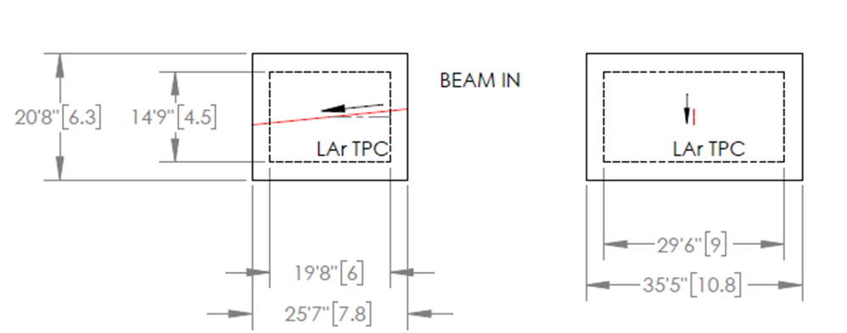
LAr Layout and Dimensions (as of 18 October)

Slide 7
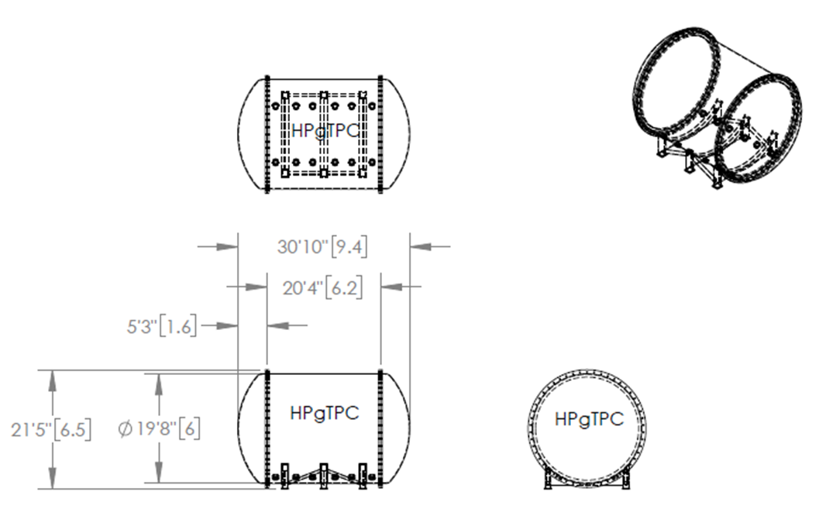
HP Vessel Layout and Dimensions

Slide 8
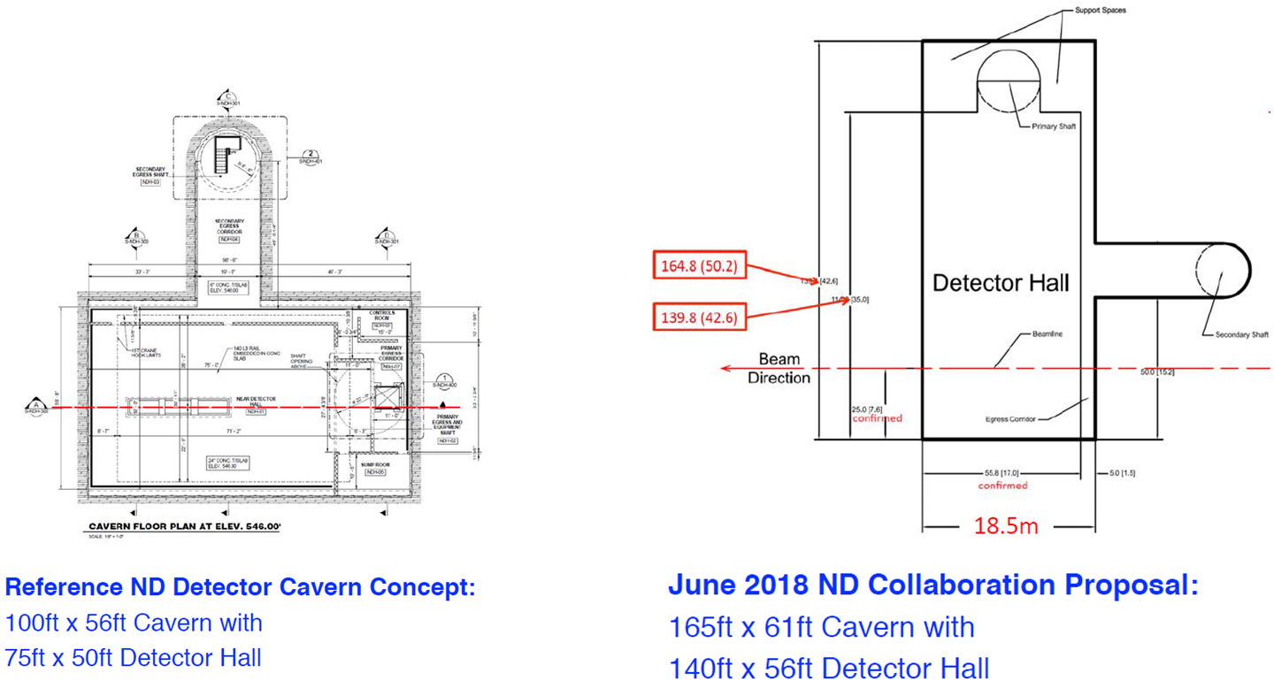
Hall Layout and Dimensions

Slide 9
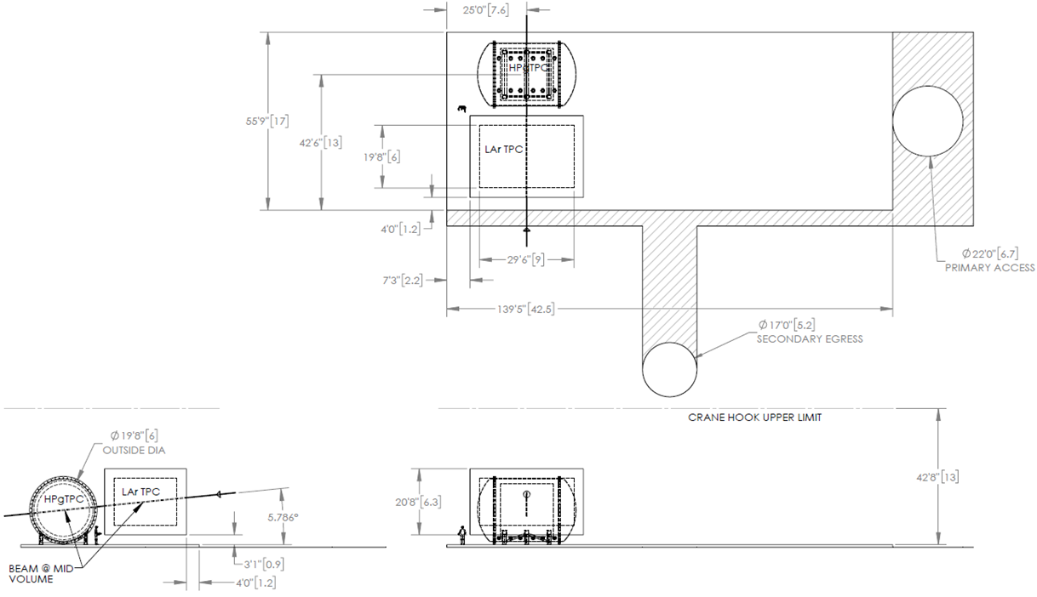
Detectors in Proposed Hall
Approximately 27.5 m of movement possible with this layout
Space for magnet?
Only ½ available
R. Flight

Slide 10
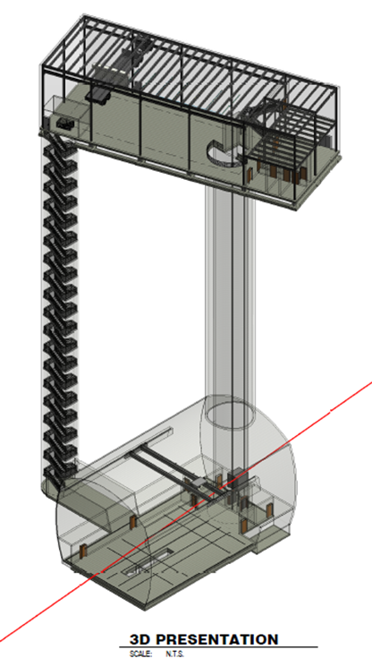
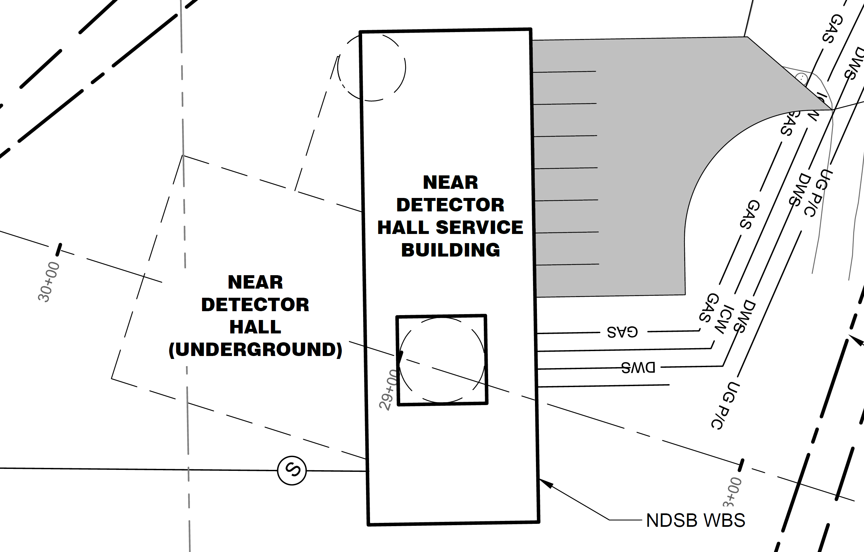
Near Site Conventional Facilities
https://docscert.dunescience.org/cgi-bin/cert/ShowDocument?docid=6527

Slide 11
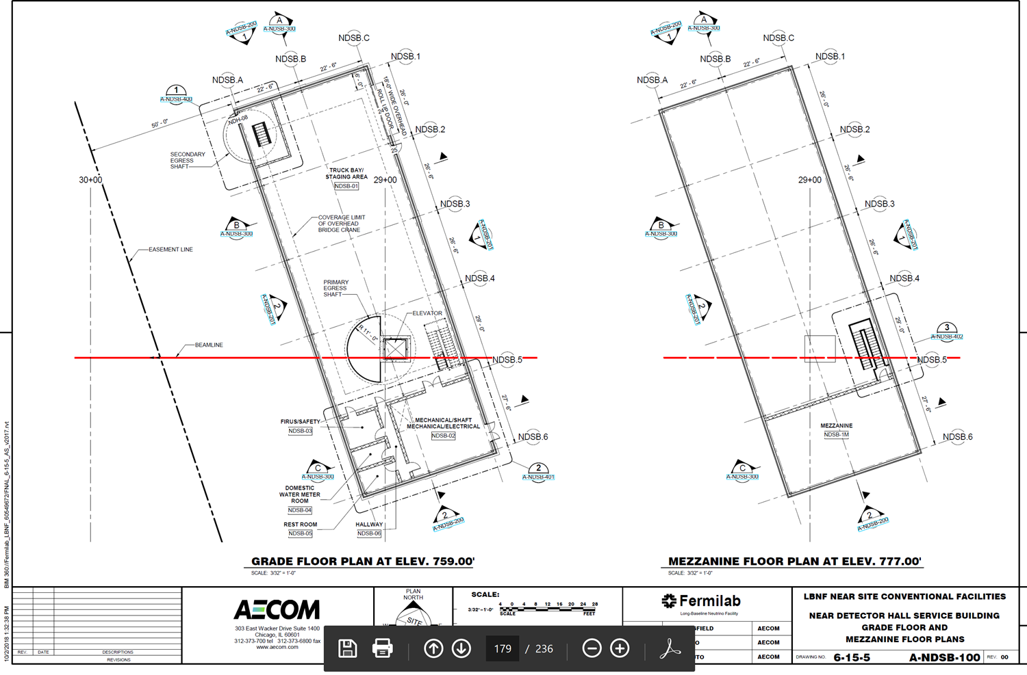
Service Building Layout

Slide 12
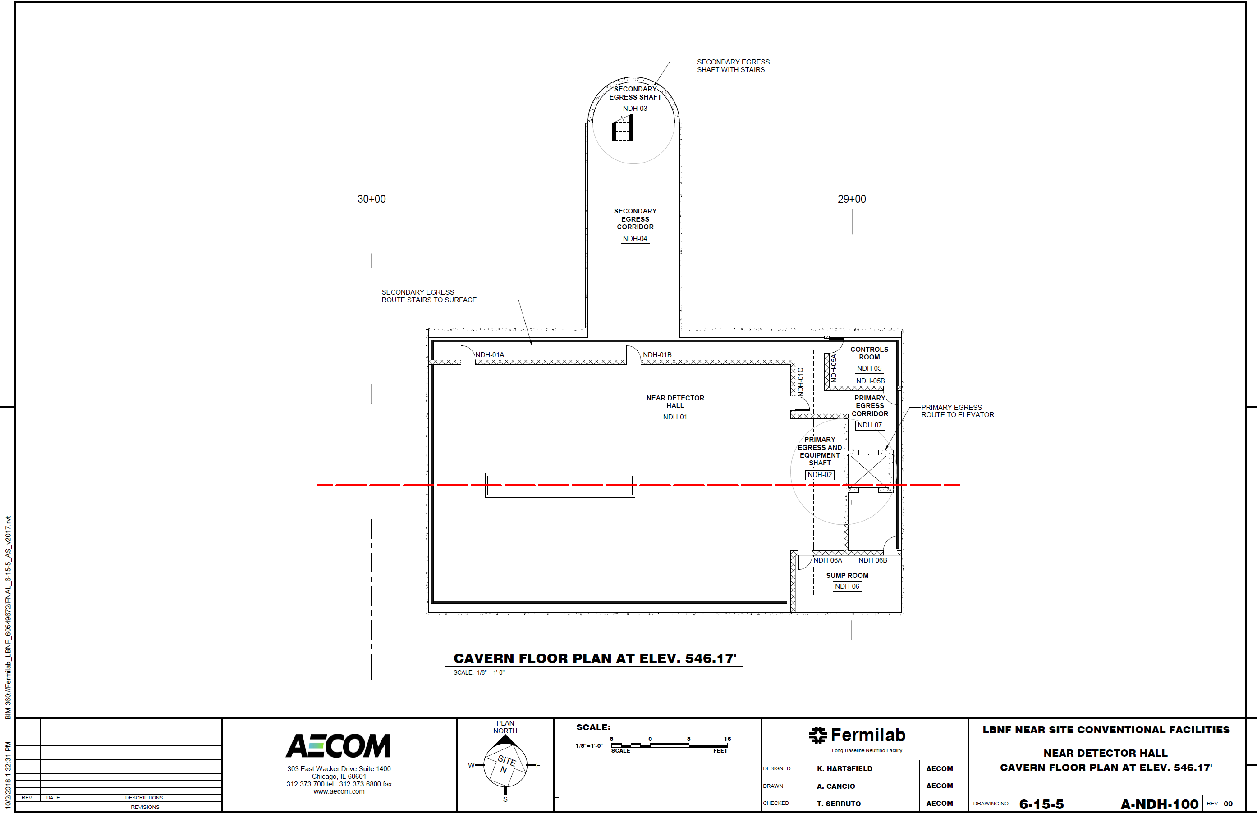
Cavern Floor Plan

Slide 13
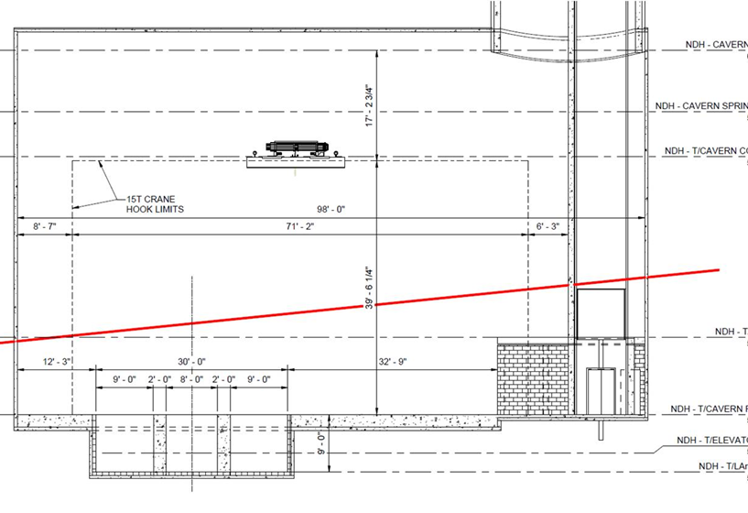
Cavern Cross Section

Slide 14
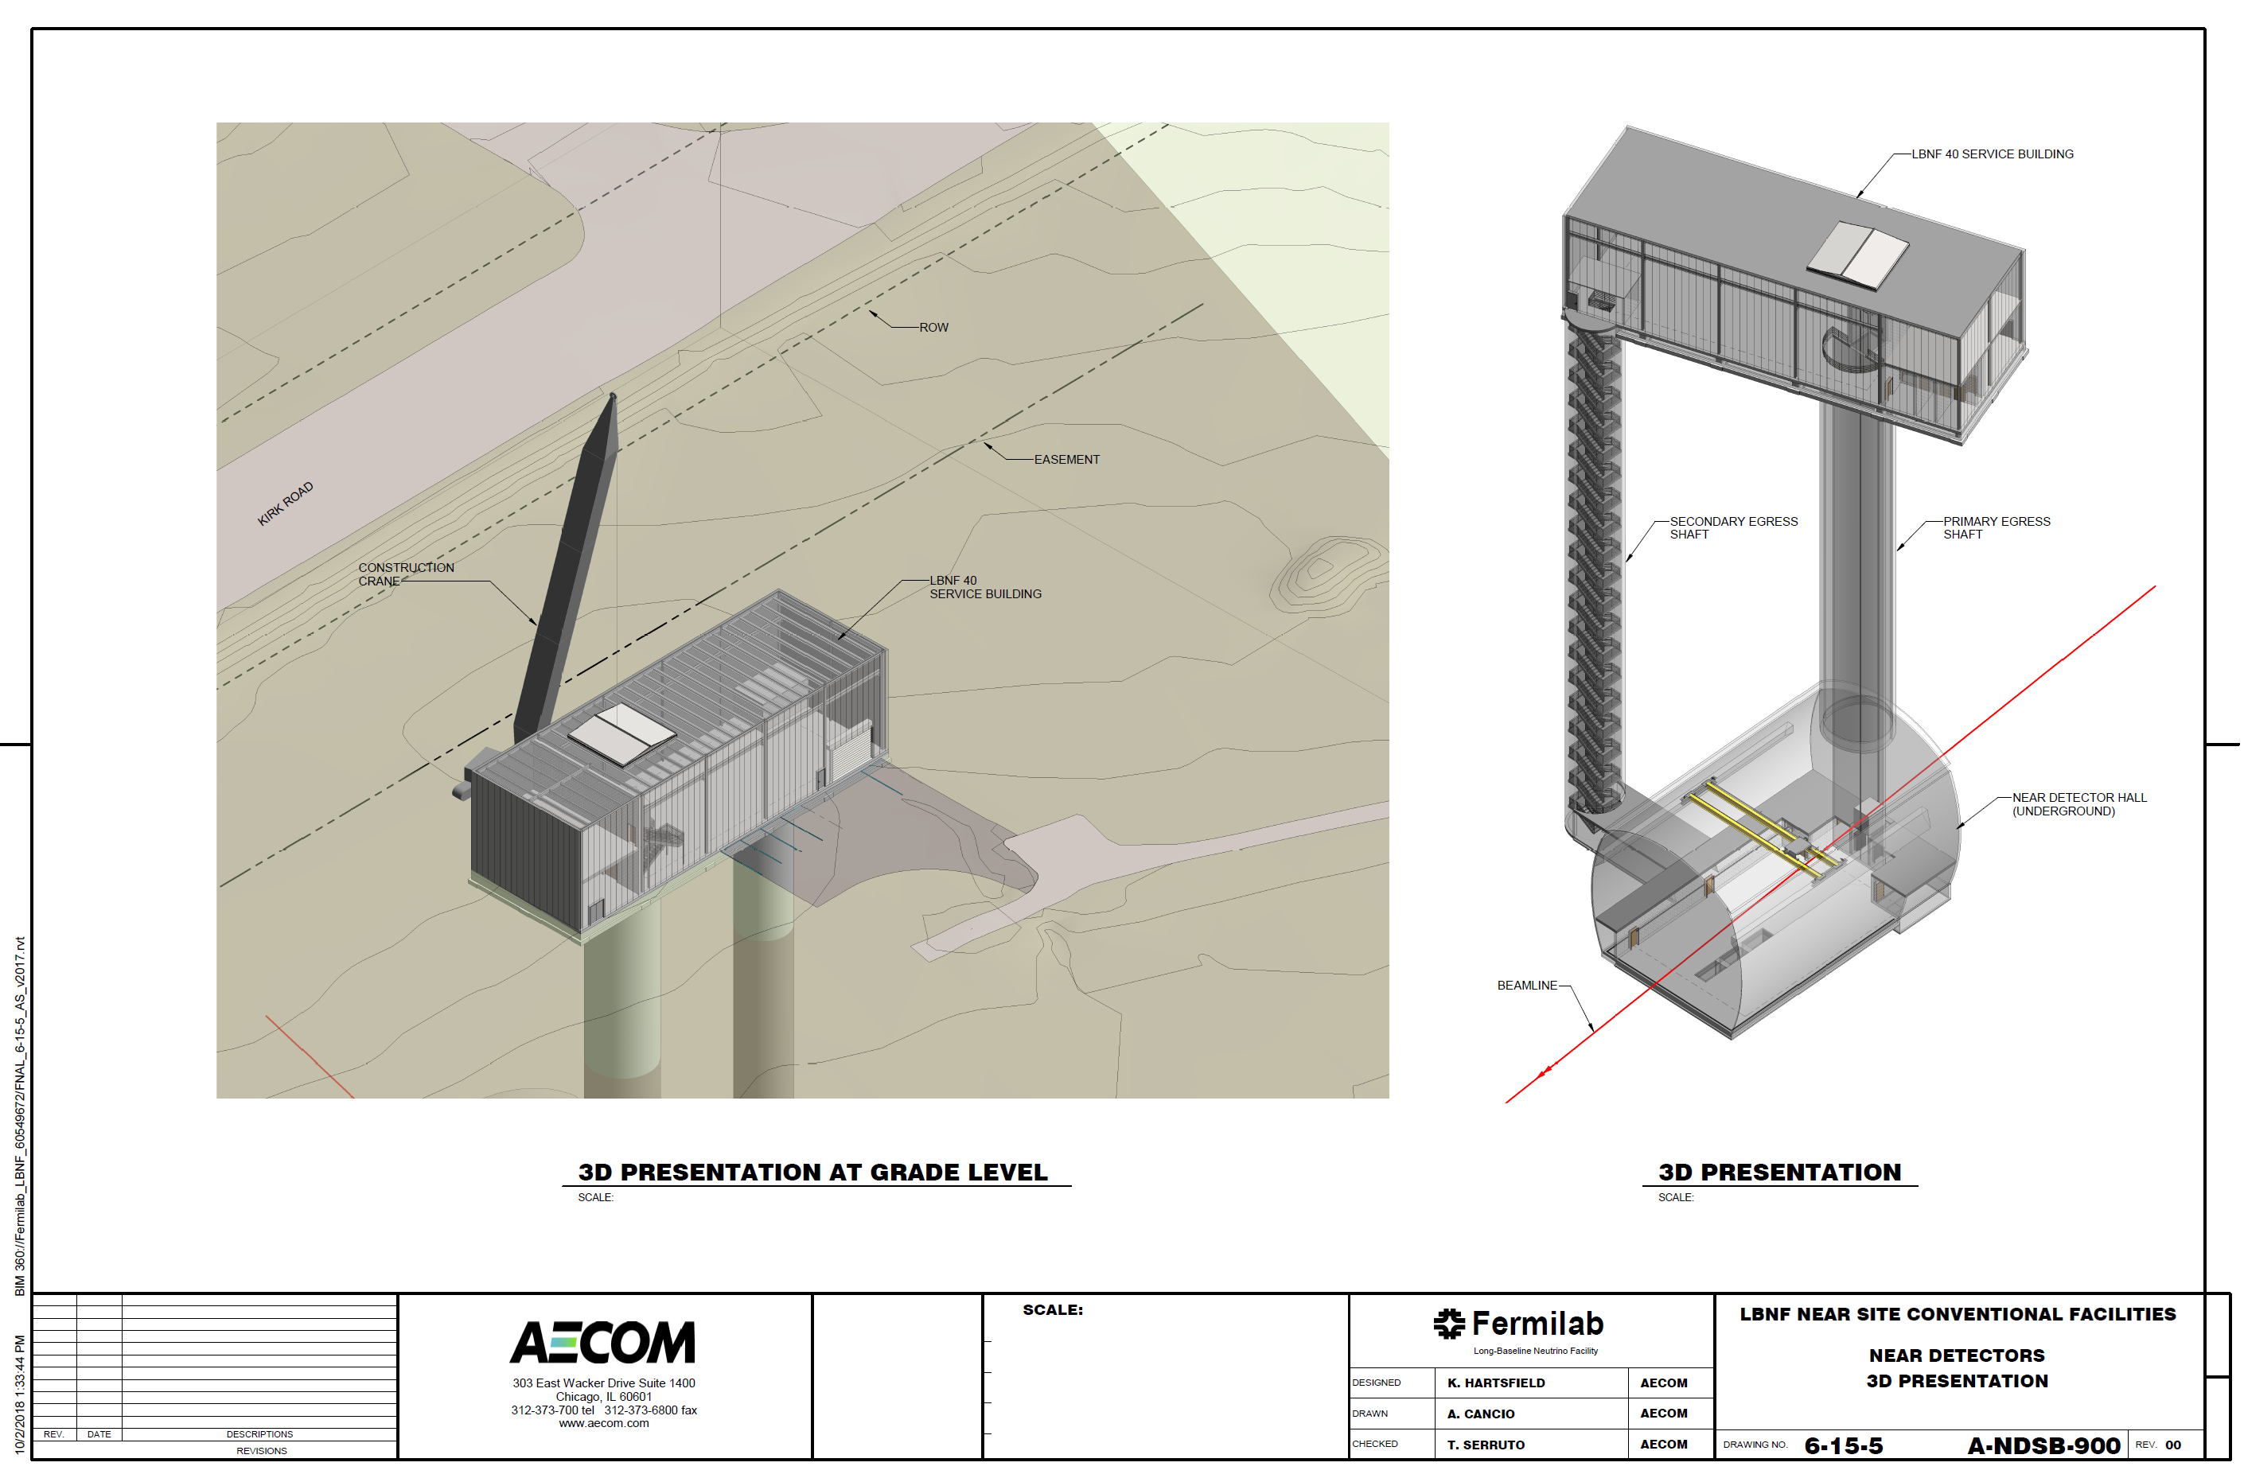
Detector Component Lowering Concept

Slide 15
Issues
Magnet goes around pressure vessel: How big is it? How and where is it constructed? Is there a return yoke?
HPGTPC cylindrical inside the vessel: What is the diameter, where and how is it installed? Penetrations?
Pressure vessel: Needs to be code stamped, can it be constructed on site? Underground?
ECal: Where is it, inside, outside, or both? Penetrations and services?
LAr detector services and cryogenics: Where do they go?
Both LAr detector and multi-purpose detector move together? On same platform or separate platforms? Speed, precision, frequency?
Addition of 3DST: May become a third element?
Depth of cavern floor?
Need to reengage CF, but we need to advance much more before we do.

Slide 16
A Concept
Increase shaft diameter to accommodate lowering of pressure vessel and magnet coils, separately
Build two transport frames in cavern
Construct magnet coils remotely and transport to near site surface building
Lower magnet coils and assemble on transport frame 1
Construct pressure vessel remotely and transport to surface building
Construct TPC and ECal in surface building and install in pressure vessel
Lower full pressure vessel into cavern
Insert pressure vessel in magnet, install ECal and yoke
Construct LAr cryostat in cavern on transport frame 2
Construct LAr modules remotely, lower and install in cryostat

