Slide 1
Near Detector Integration
F. Feyzi
29 November 2018

Slide 2
Agenda
No-crane and lower height construction ideas- R. Flight
Detector movement: frequency, speed, precision – M. Wilking
D0 movement mechanism - A. Stefanik

Slide 3
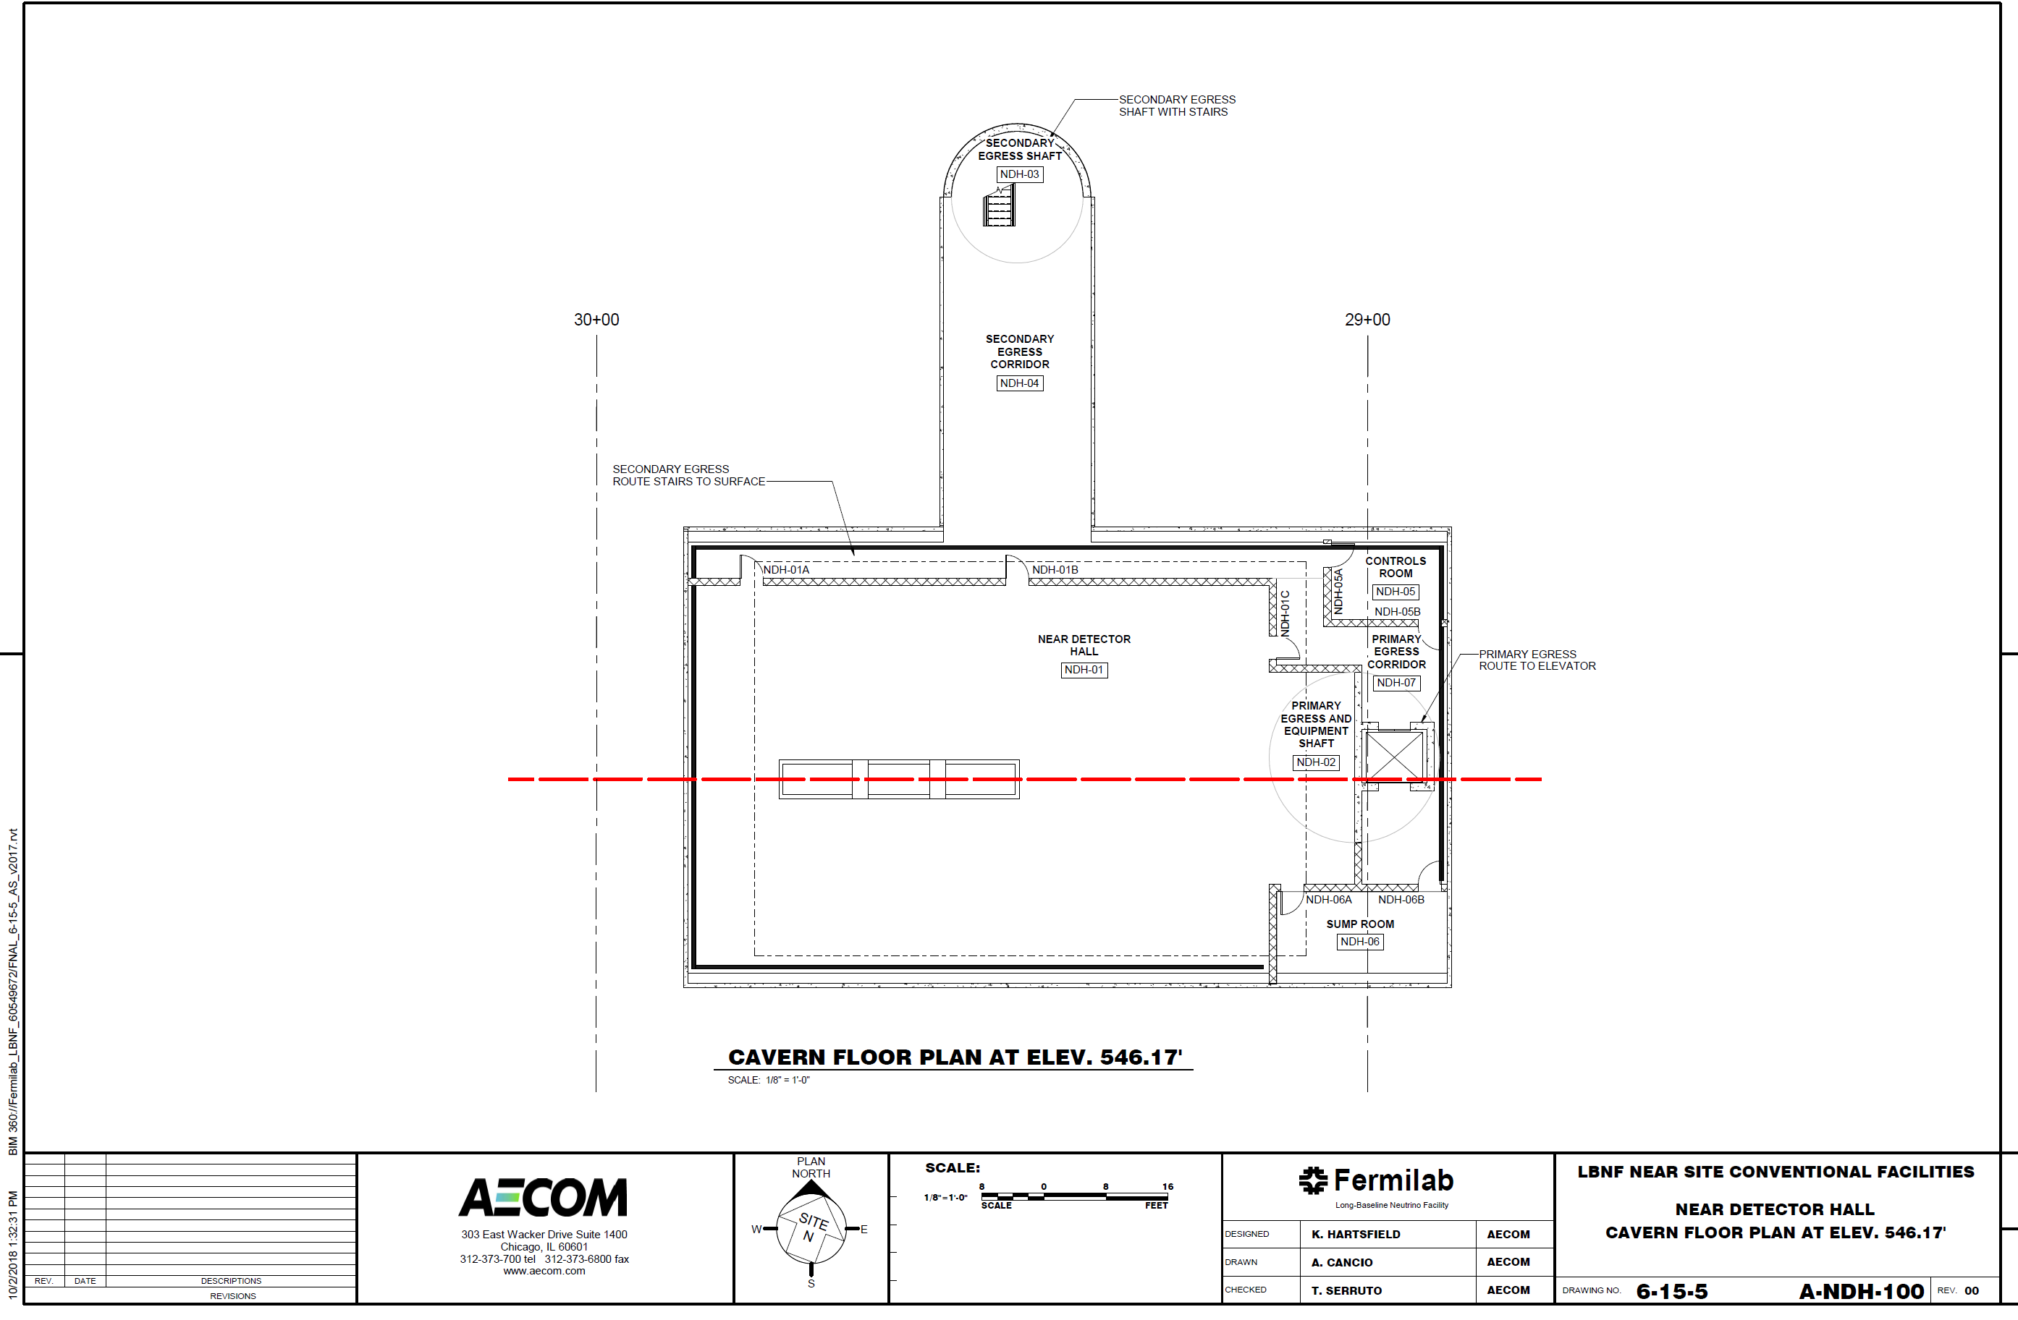
Cavern Floor Plan

Slide 4
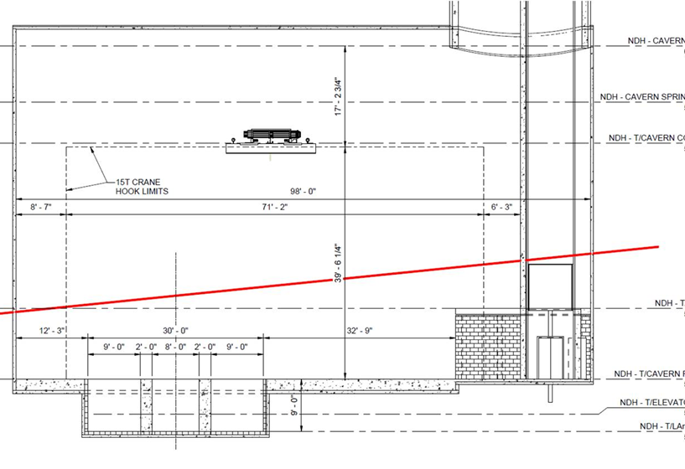
Cavern Cross Section

Slide 6
Next Meeting
Pressure vessel optimization-S. Carcel

