Slide 1
LBNF/DUNE – Near Detector Description of the hydraulic cylinder push-pull system to move the D-Zero Detector.
As told by John Najdzion to scribe Andy Stefanik on Nov 28, 2018.

Slide 2
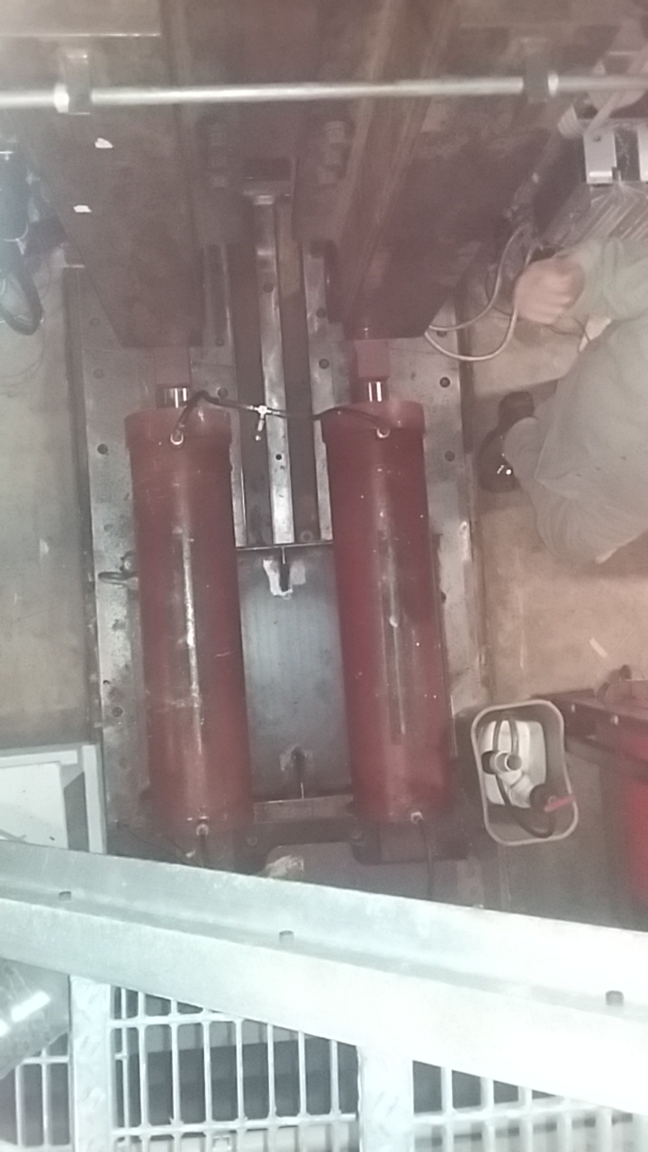
Looking down at the hydraulic cylinders
The pull bar is missing from this image; it is shown on the next slide.
RAIL
D
E
T
E
C
T
O
R
P
L
A
T
F
O
R
M
HYDRAULIC CYLINDER
TRUCK
PULL BAR RUNS THROUGH HERE
HYDRAULIC CYLINDER
RAIL

Slide 3
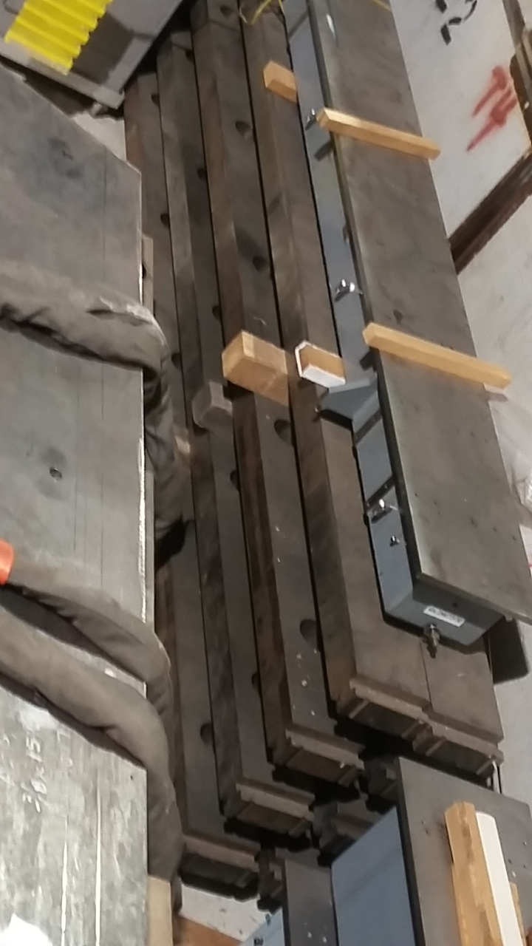
The pull bar
48’ (14.6 m) long. Pin hole spacing is about 34” (864 mm). Hydraulic cylinder stroke is 36” (914 mm). “Pull bars are always anchored to the floor bracket in the direction of the move – these bars are tension members.”

Slide 4
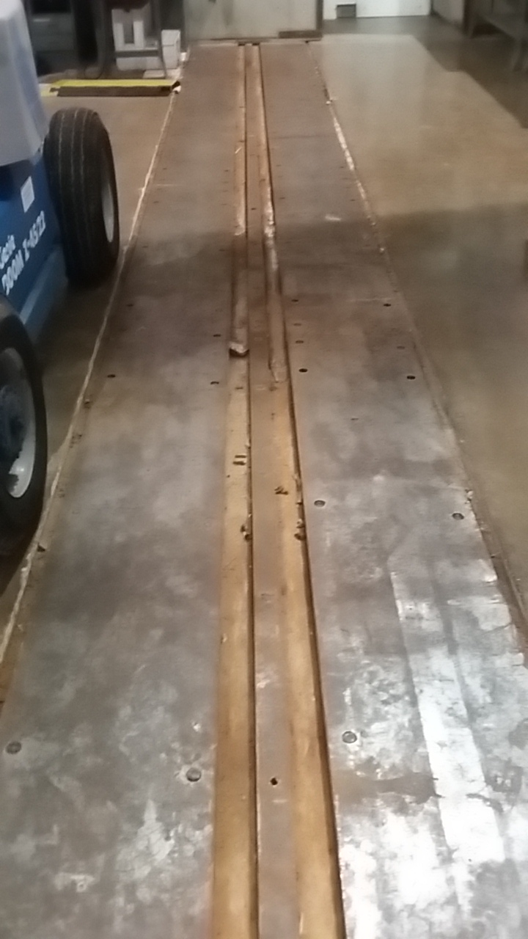
The rails
The rails are embedded in the concrete floor.

Slide 5
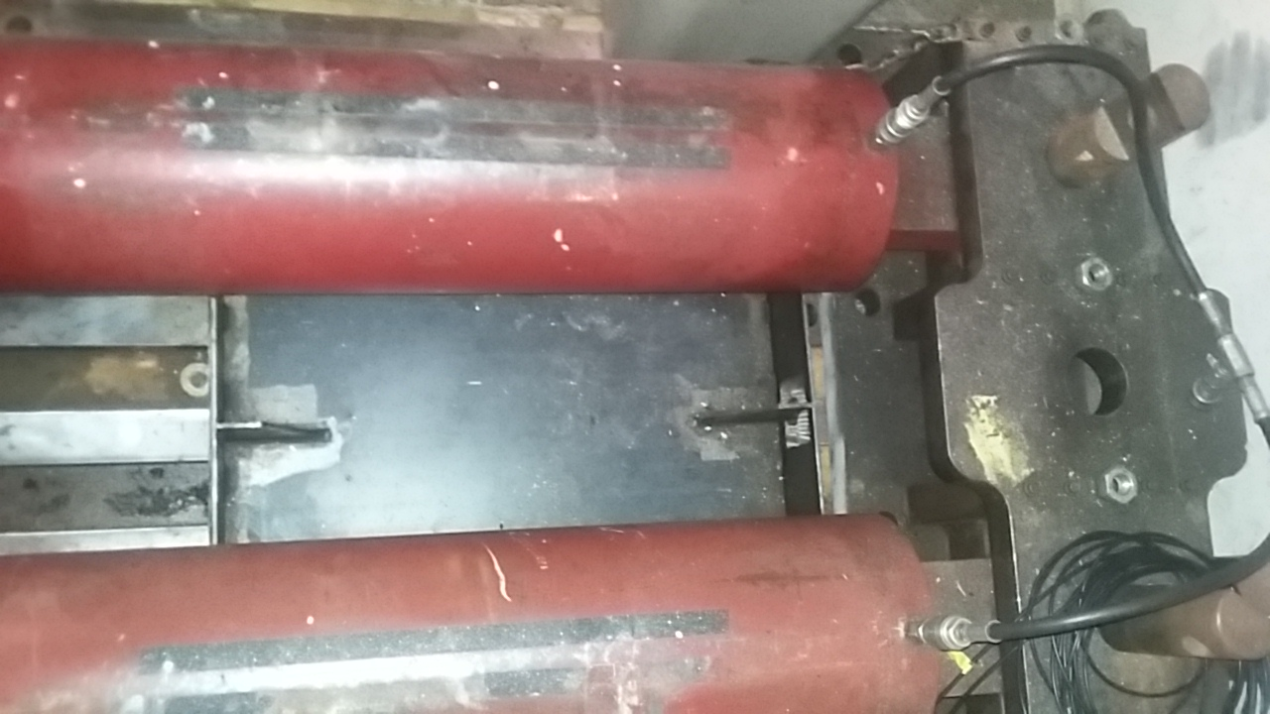
The truck
One end of the two cylinders is pinned to the truck.
PIN
PIN

Slide 6
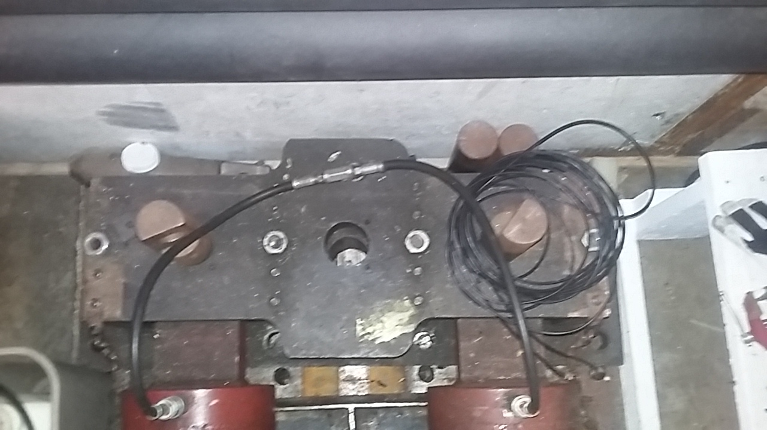
Looking down at the truck
* Pin used to connect the other ends of the cylinders to the Detector platform.
** Pin used to pin the truck to the bar.
The truck runs on the rails.
*
*
**
PIN
PIN

Slide 7
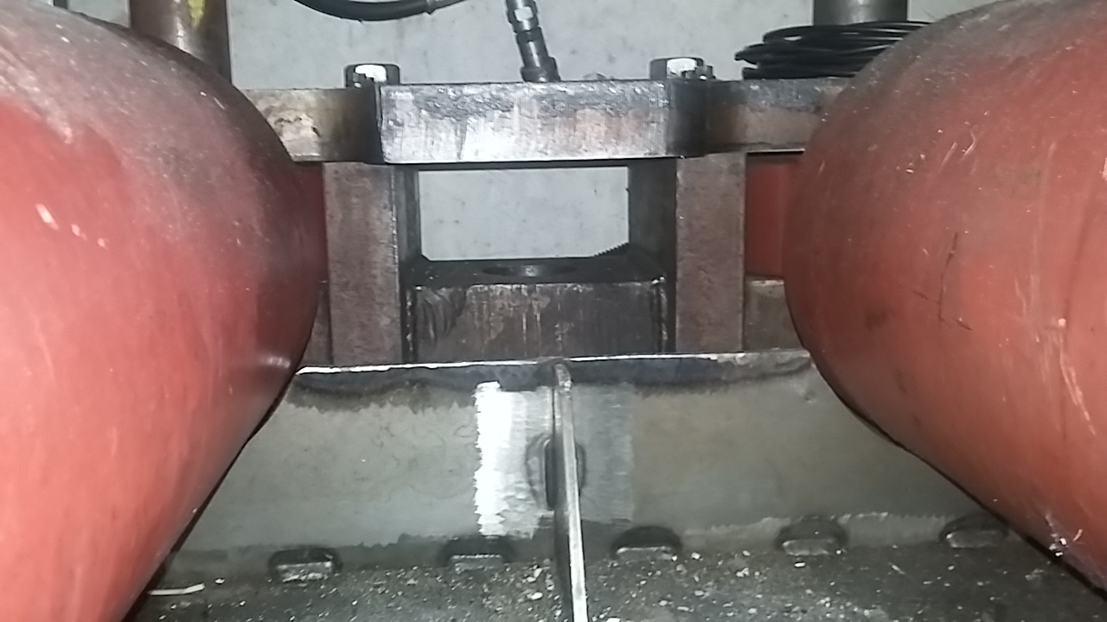
Opening in the truck for the bar to pass through

Slide 8
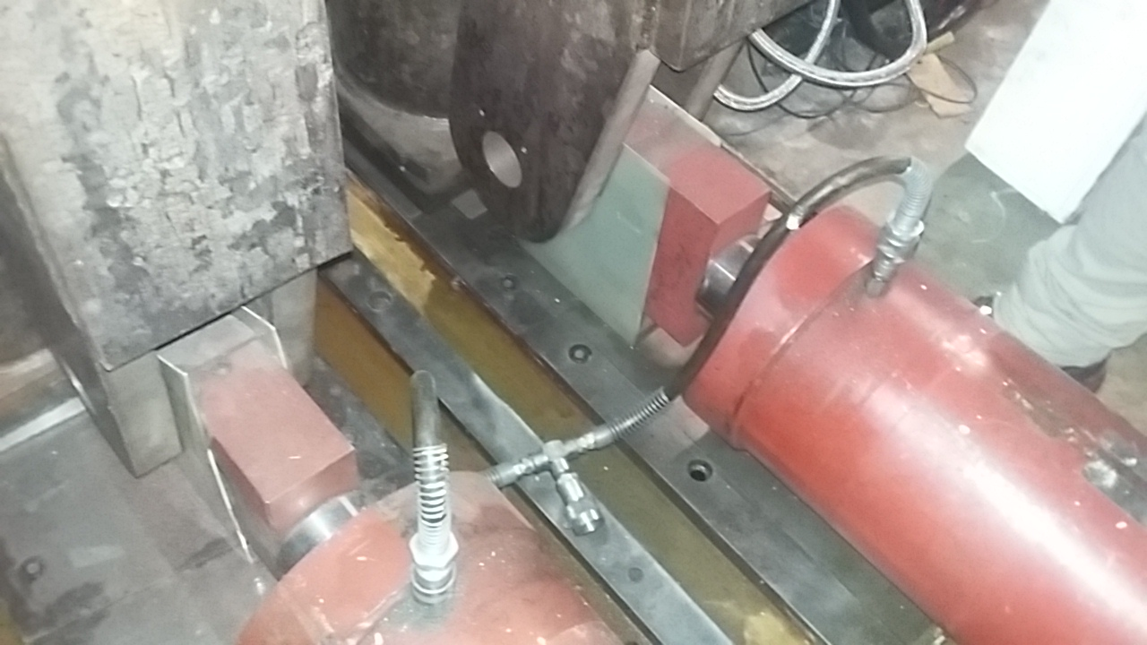
The other end of the two cylinders is pinned to the Detector platform
These ends of the cylinders are disconnected and electrically isolated from the platform for Detector operation. * View direction for the next slide.
G10
*

Slide 9
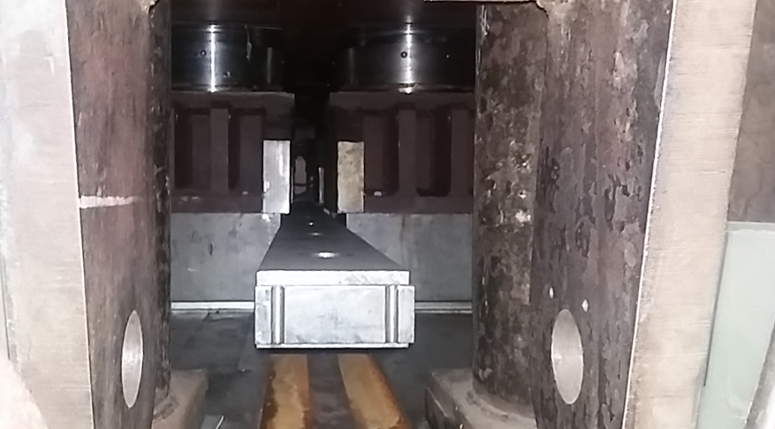
Looking at the end of the bar that runs through the Detector platform
We are standing at the two cylinders and looking under the Detector platform. The bar is not connected to the Detector platform.

Slide 10
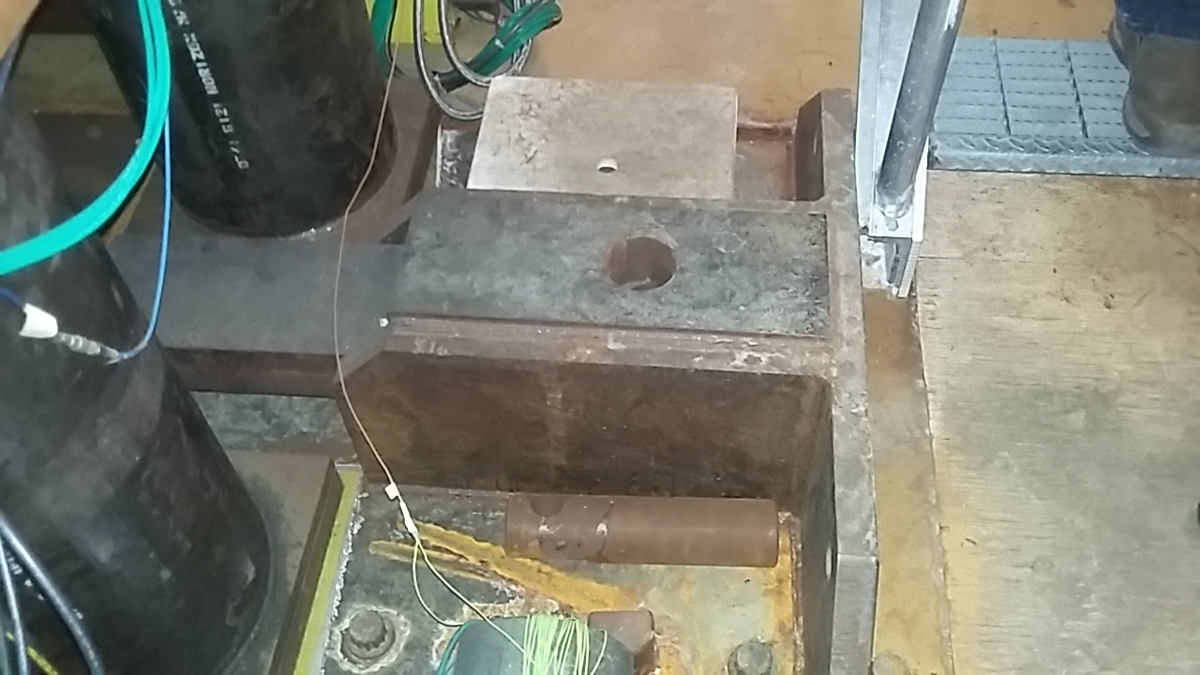
Pull bar anchor in the Collision Hall (West)

Slide 11
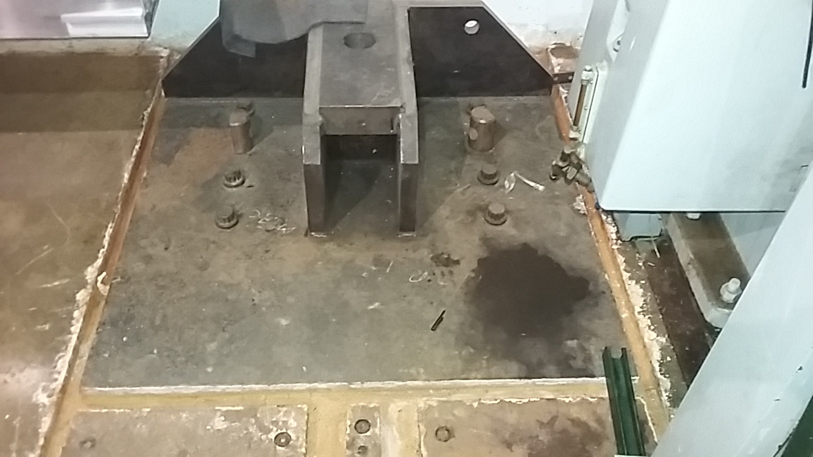
Pull bar anchor in the Assembly Hall (East)

Slide 12
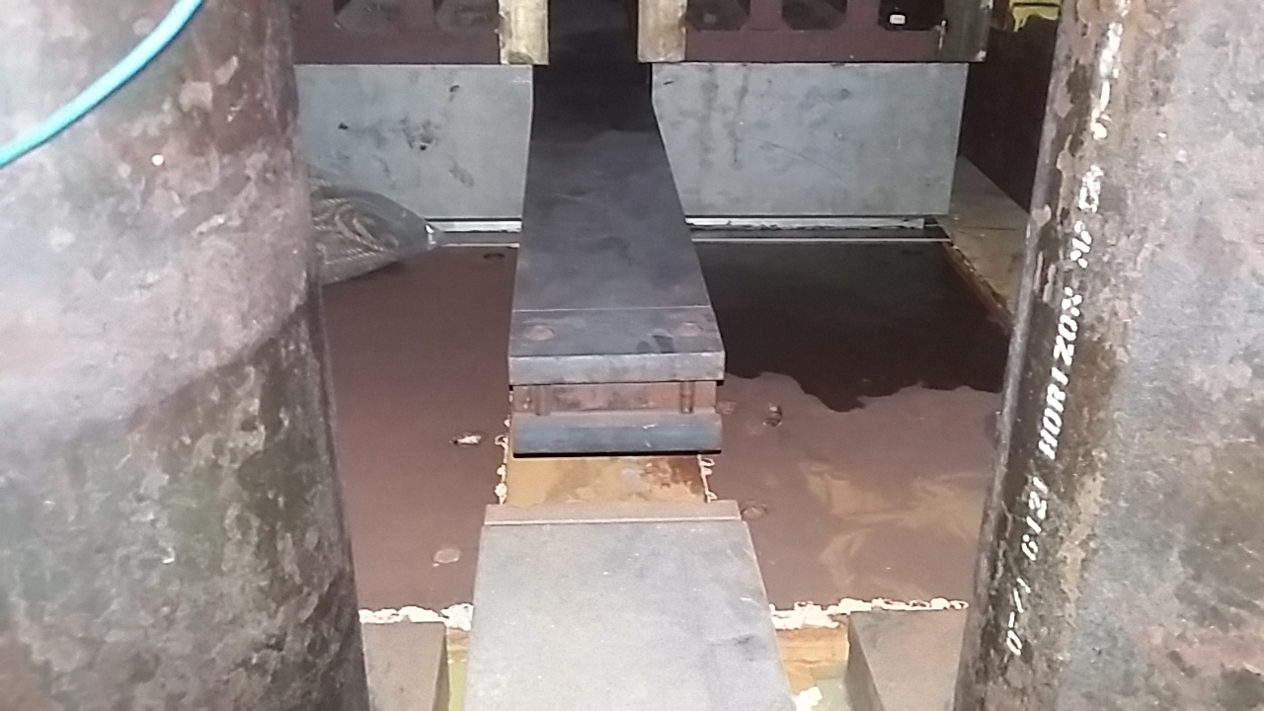
Bolted pull bar connecting links

Slide 13
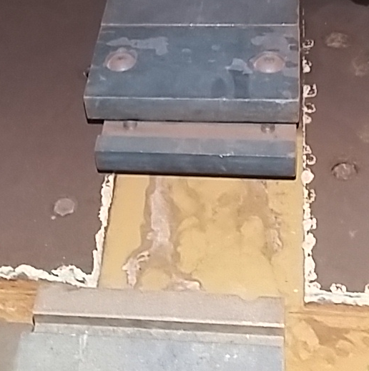
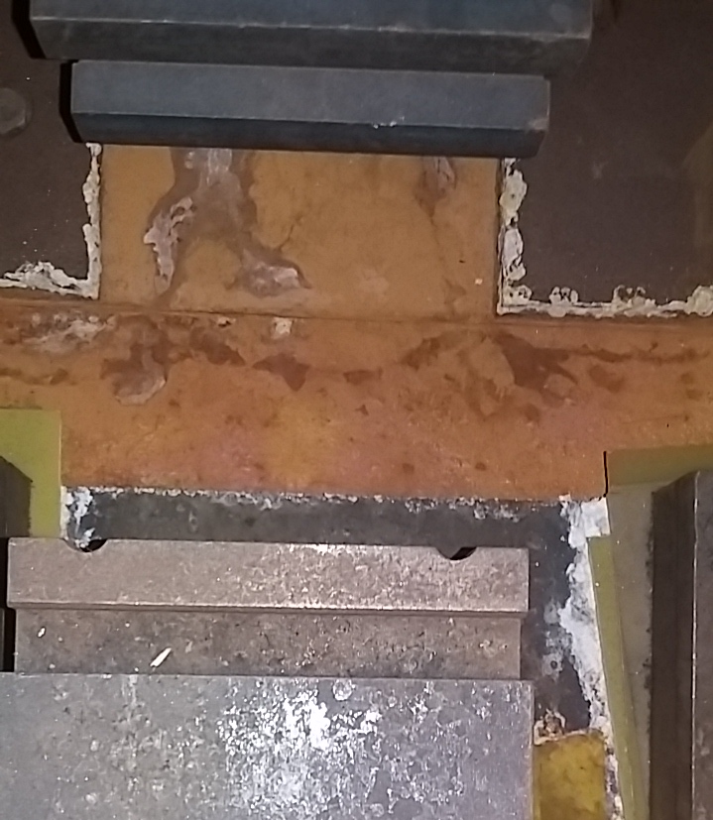
Bolted pull bar connecting links

Slide 14
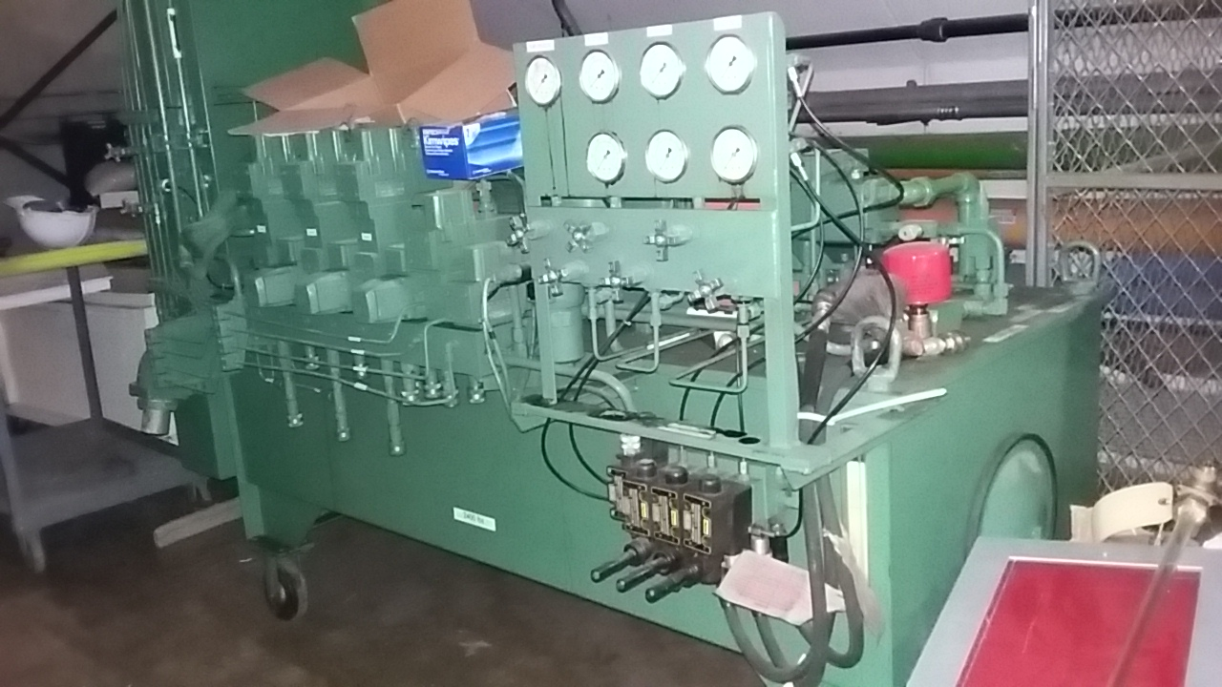
Hydraulic system
Two pairs of hydraulic cylinders are used to push-pull the Detector.
The cylinders in each pair are piped together so they act as a single unit.
There is a separate hydraulic circuit for each cylinder pair. There is one control valve in each circuit.
The Detector platform sits on four rails with Hilman rollers and no guides. The hydraulic cylinders run on the two center rails.
Detector platform skew while moving is controlled by adjusting hydraulic pressure to each pair of cylinders.
The hydraulic unit:

Slide 15
Operation to move the Detector out of the Collision Hall (West to East)
Clean the rails. Use Scotch-Brite pads and a powered floor buffer on the accessible areas of the rails. Clean the rails under the cylinders by hand with Scotch-Brite pads.
Oil the rails with WD-40.
Anchor the pull bar to the floor bracket in the direction of the move.
“The pull bars should be supported with cribbing at the connecting links in order to prevent bending of these links”.
Use the crane to insert a pull bar through the truck and connect it to the pull bar under the Detector platform.
Extend each pair of hydraulic cylinders about 34” until the pin hole in the truck aligns with the pin hole in the bar. Insert the pin to tie the truck to the bar.
Flip the hydraulics and retract the hydraulic cylinders. This will pull the Detector towards the pinned truck.
Remove the truck pin.

Slide 16
Operation to move the Detector out of the Collision Hall (West to East)
Continued…
Flip the hydraulics and repeat the 3 previous steps until the Detector has moved 12’ (3.66 m) from the Collision Hall wall. At this point, move the hydraulic cylinders from the East side of the Detector to the West side. On this side of the Detector the hydraulic cylinders will push the Detector rather than pull it.
The hydraulic cylinders are moved to the West (push) side of the Detector after moving 12’ (3.66 m) for two reasons.
The Detector must be pushed very close to the wall in the Assembly Hall. Having the hydraulic cylinders on the East (pull) side of the Detector would result in wasted space between the Detector and the Assembly Hall wall.
The hydraulic cylinders push faster than they pull under load.
The one-way move distance is about 42.5 ft (13 m). (Best estimate at this point.)
The way-way move takes two 10 -12 hour shifts.
Quotes are taken from the written reference D0 DETECTOR LIFT AND MOVE PROCEDURE prepared by H. J. Stredde, August 16, 1991.

Slide 17
Backup Slides

