Slide 1
PIP-II WBS 121.05.05 ACCU – Main Injector and Recycler Ring
Accelerator Upgrade
Joseph E. Dey
PIP-II IPR
4-6 December 2018

Slide 2
Outline
Scope/Deliverables
Requirements
Interfaces
Preliminary Design, Maturity
Technical Progress to Date
ESH&Q
Risks and Mitigations
Summary

Slide 3
About Me:
Joseph E. Dey : Senior RF Design Engineer
  NOvA - Main Injector RF Cavities L3 Manager
  Mu2e - Delivery Ring RF L3 Manager
  Recycler RF AIP L2 Manager
  Accelerator Division RF Department

Slide 4
Scope and Deliverables
Charge #2
WBS Dictionary Definition: pip2-docdb #599
  Labor, materials, travel and costs associated with the management, design, procurement, fabrication, and installation of the upgrades to the Recycler and Main Injector to handle increased intensity and shorter cycle times.
WBS 121.05.05.02 – MIRR-Main Injector
  Deliver 20 upgraded MI RF stations along with their corresponding modulators and solid state drivers.
WBS 121.05.05.03 – MIRR-Recycler Ring
  Remove the Recycler 53 MHz RF stations and replace them with new ones.

Slide 5
WBS L3 System Requirements
Charge #2
Recycler Requirements
  Slip Stack at 20 Hz
    Slip stacking cavities with higher voltage.
  Support Main Injector operations from 60-120 GeV.
    Slip stacking cavities should be able to work CW.
Main Injector requirements
  Have enough RF power to accelerate up to 7.5E13ppp with a 1.2 sec cycle time.
    Increase the RF power in all 20 MI RF stations.

Slide 6
121.05.05 L3 System Requirements
Charge #1
Necessary to achieve 1 Objective Key Performance Parameters (3).
# | Description of Scope | Threshold KPP | Objective KPP
1 | SRF Linac Beam Energy | 600 MeV | 800 MeV
2 | Linac Beam | Beam delivered to the Beamline Dump | 5.4E12 particles per pulse (H-) at 20 Hz beam delivered to the Beamline Dump
3 | Booster/Recycler/Main Injector upgrades | Booster injection region, Recycler RF upgrades, and Main Injector RF upgrades, hardware installed and tested without beam in respective machines. | Linac beam injected and circulated in the Booster
4 | Cryogenic Infrastructure | Cryogenic plant and associated distribution system are installed and capable to support cavities operation at 2 K | Cryogenic system installed and is capable to support Linac operation in the CW mode

Slide 7
Interfaces
Charge #2
121.05.02 Interface Control document (Team Center 7704)

Slide 8
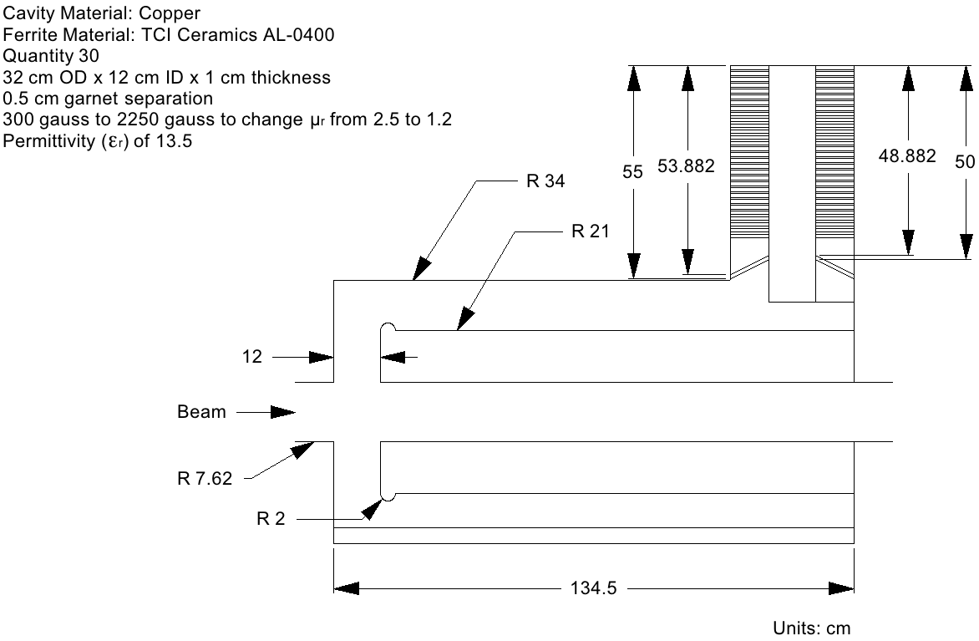
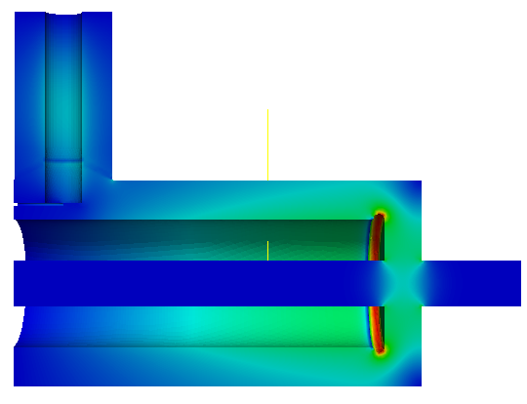
Conceptual Design and Design Maturity
Charge #2
Conceptual Design of
Recycler 53 MHz Cavity
maxEs=7.4MV/m
@ μr=2.5 and μr=1.2
with 20mm gap rounding
Second Harmonic Cavity Design for Project X Main Injector
IPAC 2012, New Orleans, Louisiana
Liling Xiao, Cho-Kuen Ng, SLAC
J. Dey, I. Kourbanis, FNAL
The Plans are to Verify the Design of the
Cavity and the Design of the Tuner

Slide 9
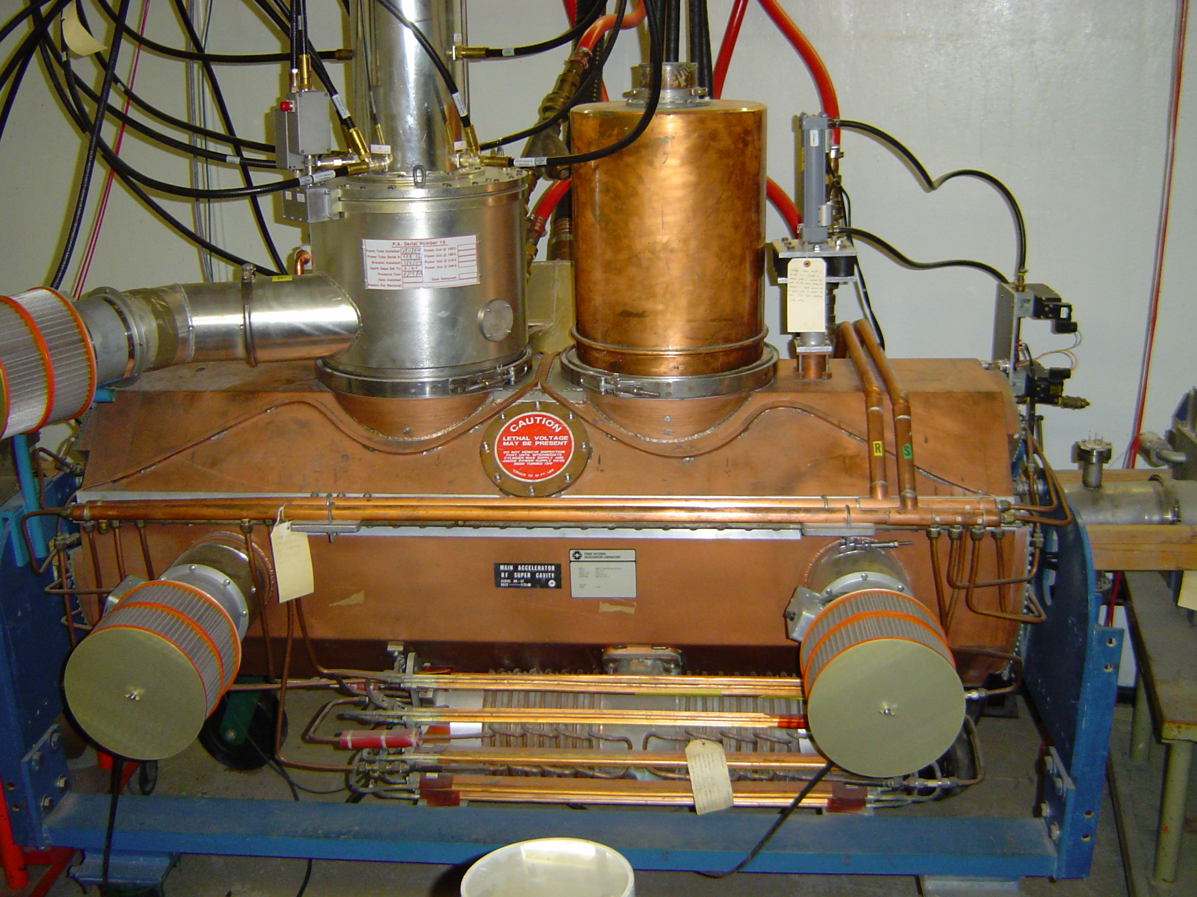
Conceptual Design and Design Maturity
Charge #2
Conceptual Design of
MI-RF Power Upgrade
Two Power Amplifier
The Plans are to Verify the Simulations of the
Cavity and the Drive the Cavity with
Two Power Amplifiers on the Test Stand

Slide 10
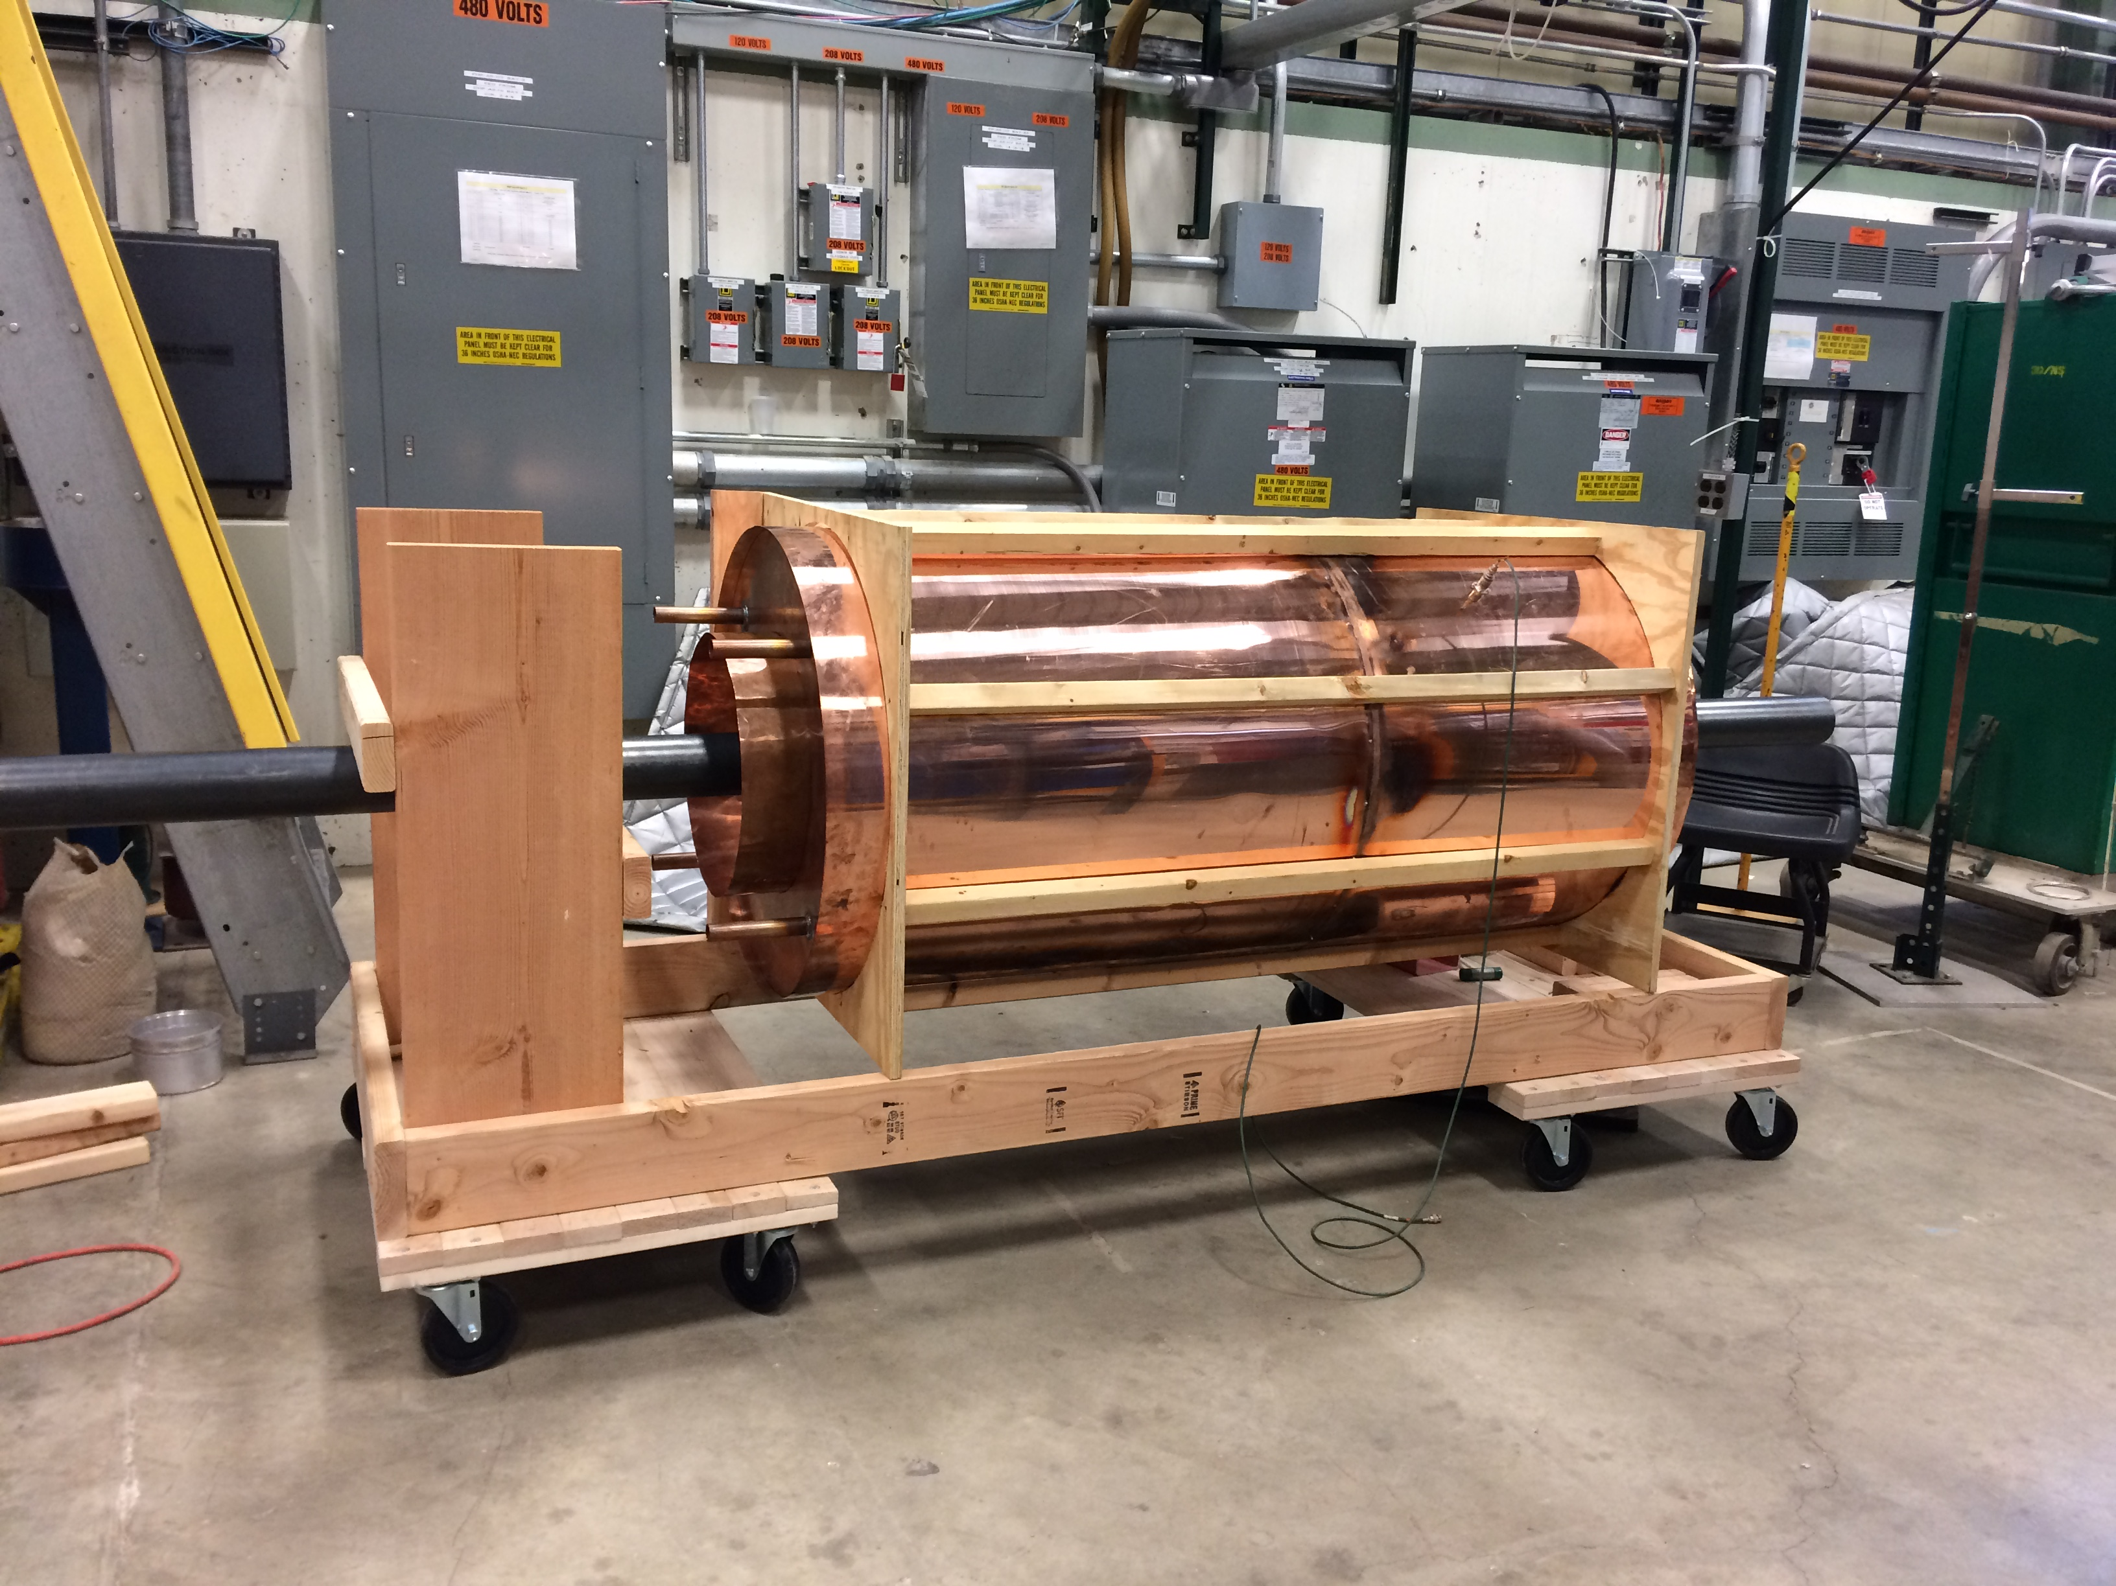
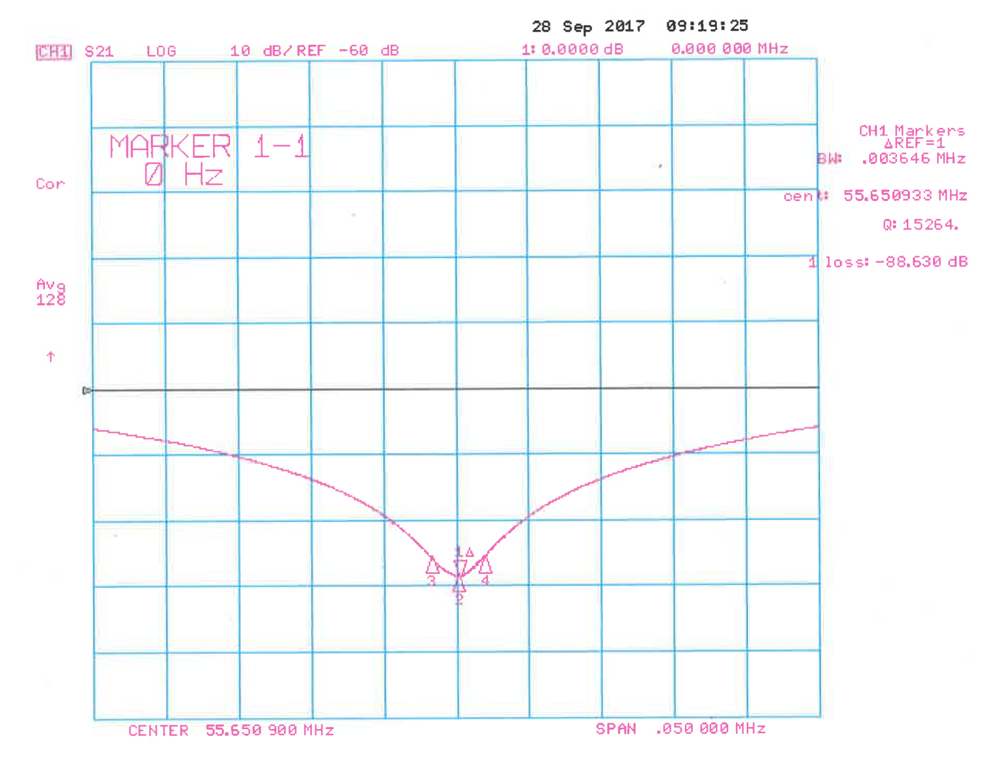
Progress to date - Recycler
Charge #1
Mock-up of Recycler Ring Cavity
Shunt Impedance
Mathematica Transmission Line Model: 700.2 kΩ
CST Microwave Studio Model: 705.8 kΩ
Stretched Wire Method on Mock Cavity: 717.5 kΩ
Stretched Wire Method

Slide 11
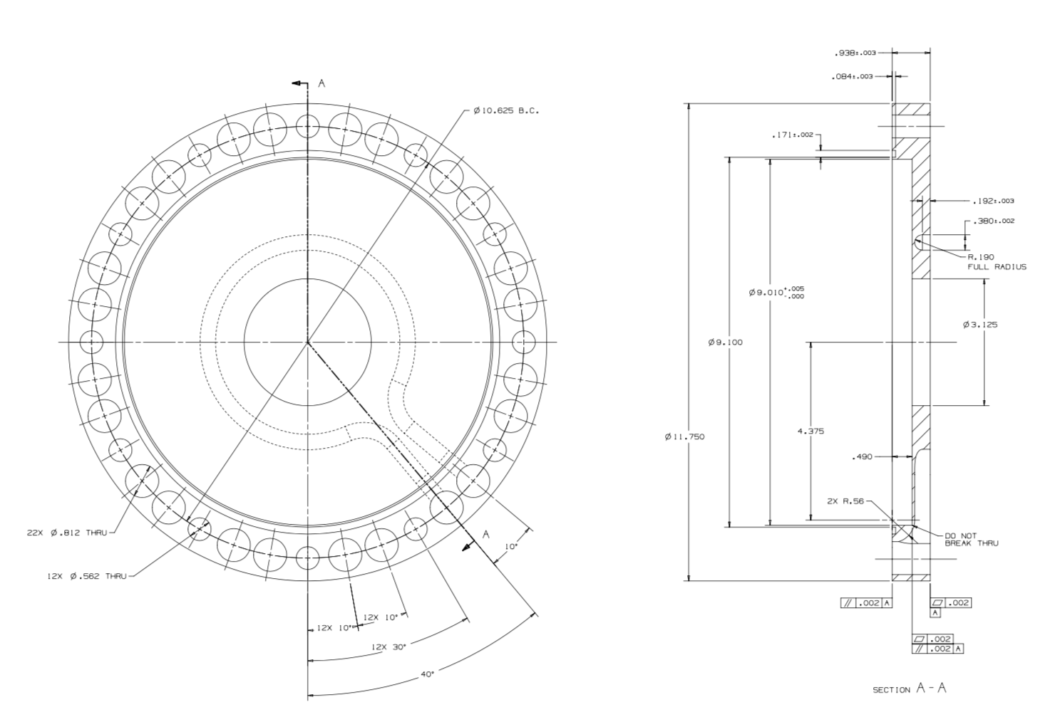
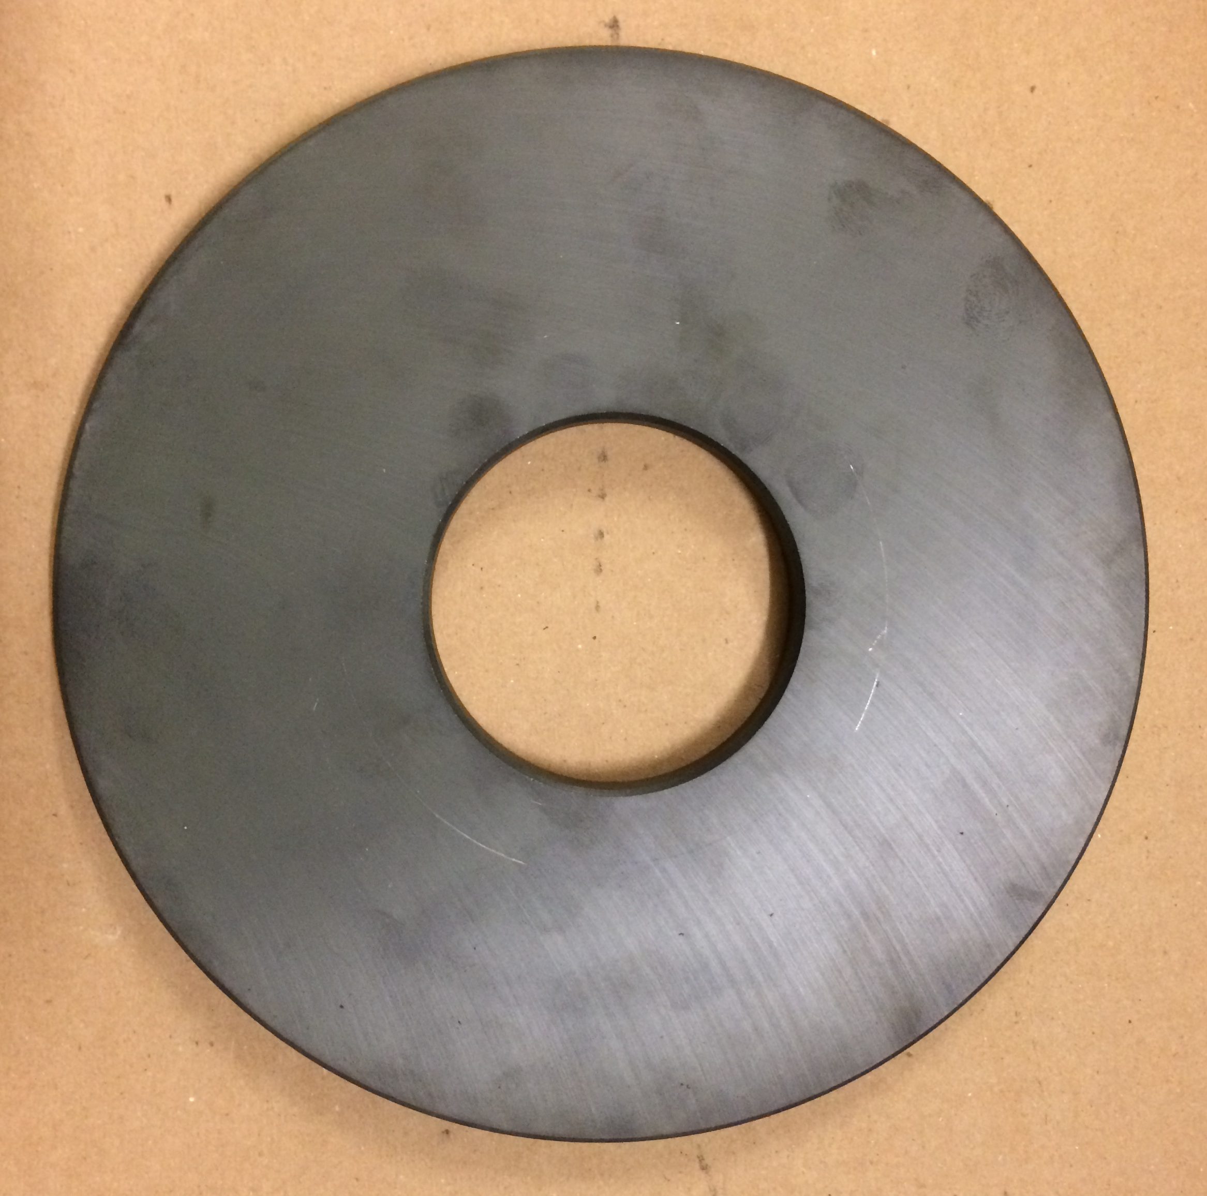
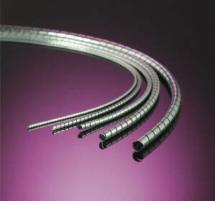
Progress to date - Recycler
Charge #1
Copper Garnet Cooling Plate for Tuner
Al Doped Yttrium Iron Garnet (YIG) AL-400
OD = 9 in, ID = 3 in
Thickness = 0.5 in
Spira-Shield EMI Gasket

Slide 12
Next Steps - Recycler
Charge #1
FY19 – Second Quarter:
  Test Perpendicularly Biased YIG Tuner on Test Cavity
FY19 – Third Quarter:
  Work on Design and Drawings of New Cavity
FY19 – Fourth Quarter:
  Preliminary Design Review – June 6, 2019
  Review of Design and Drawings for New Cavity

Slide 13
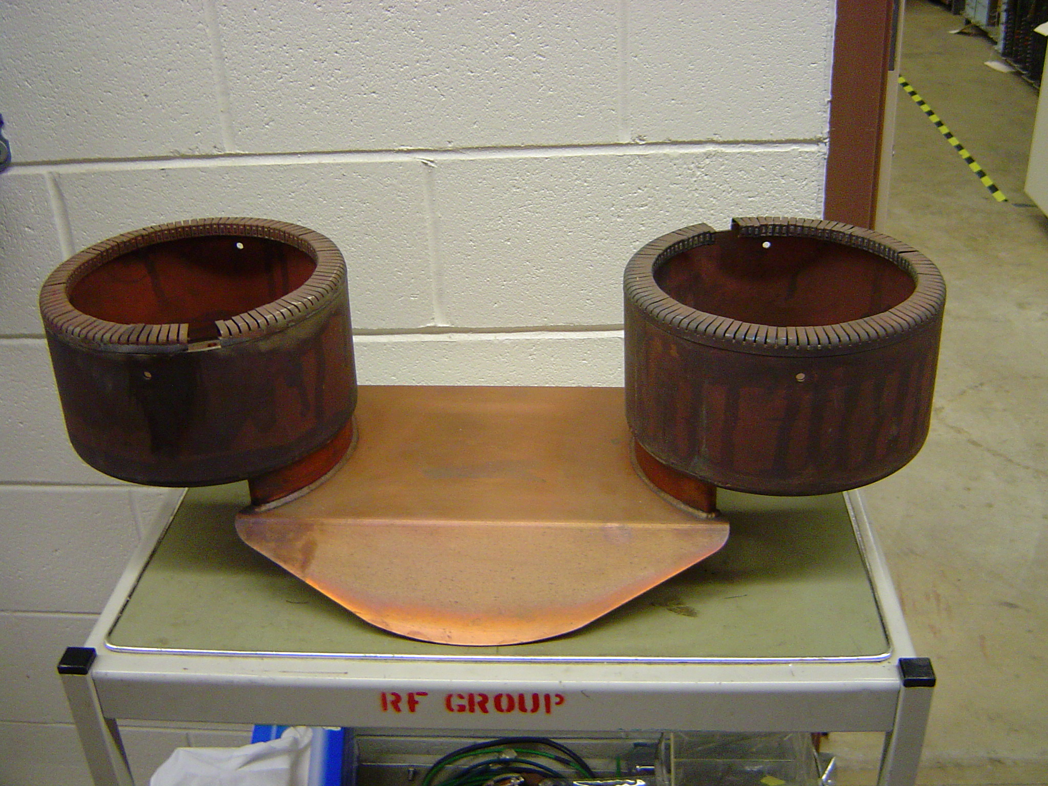
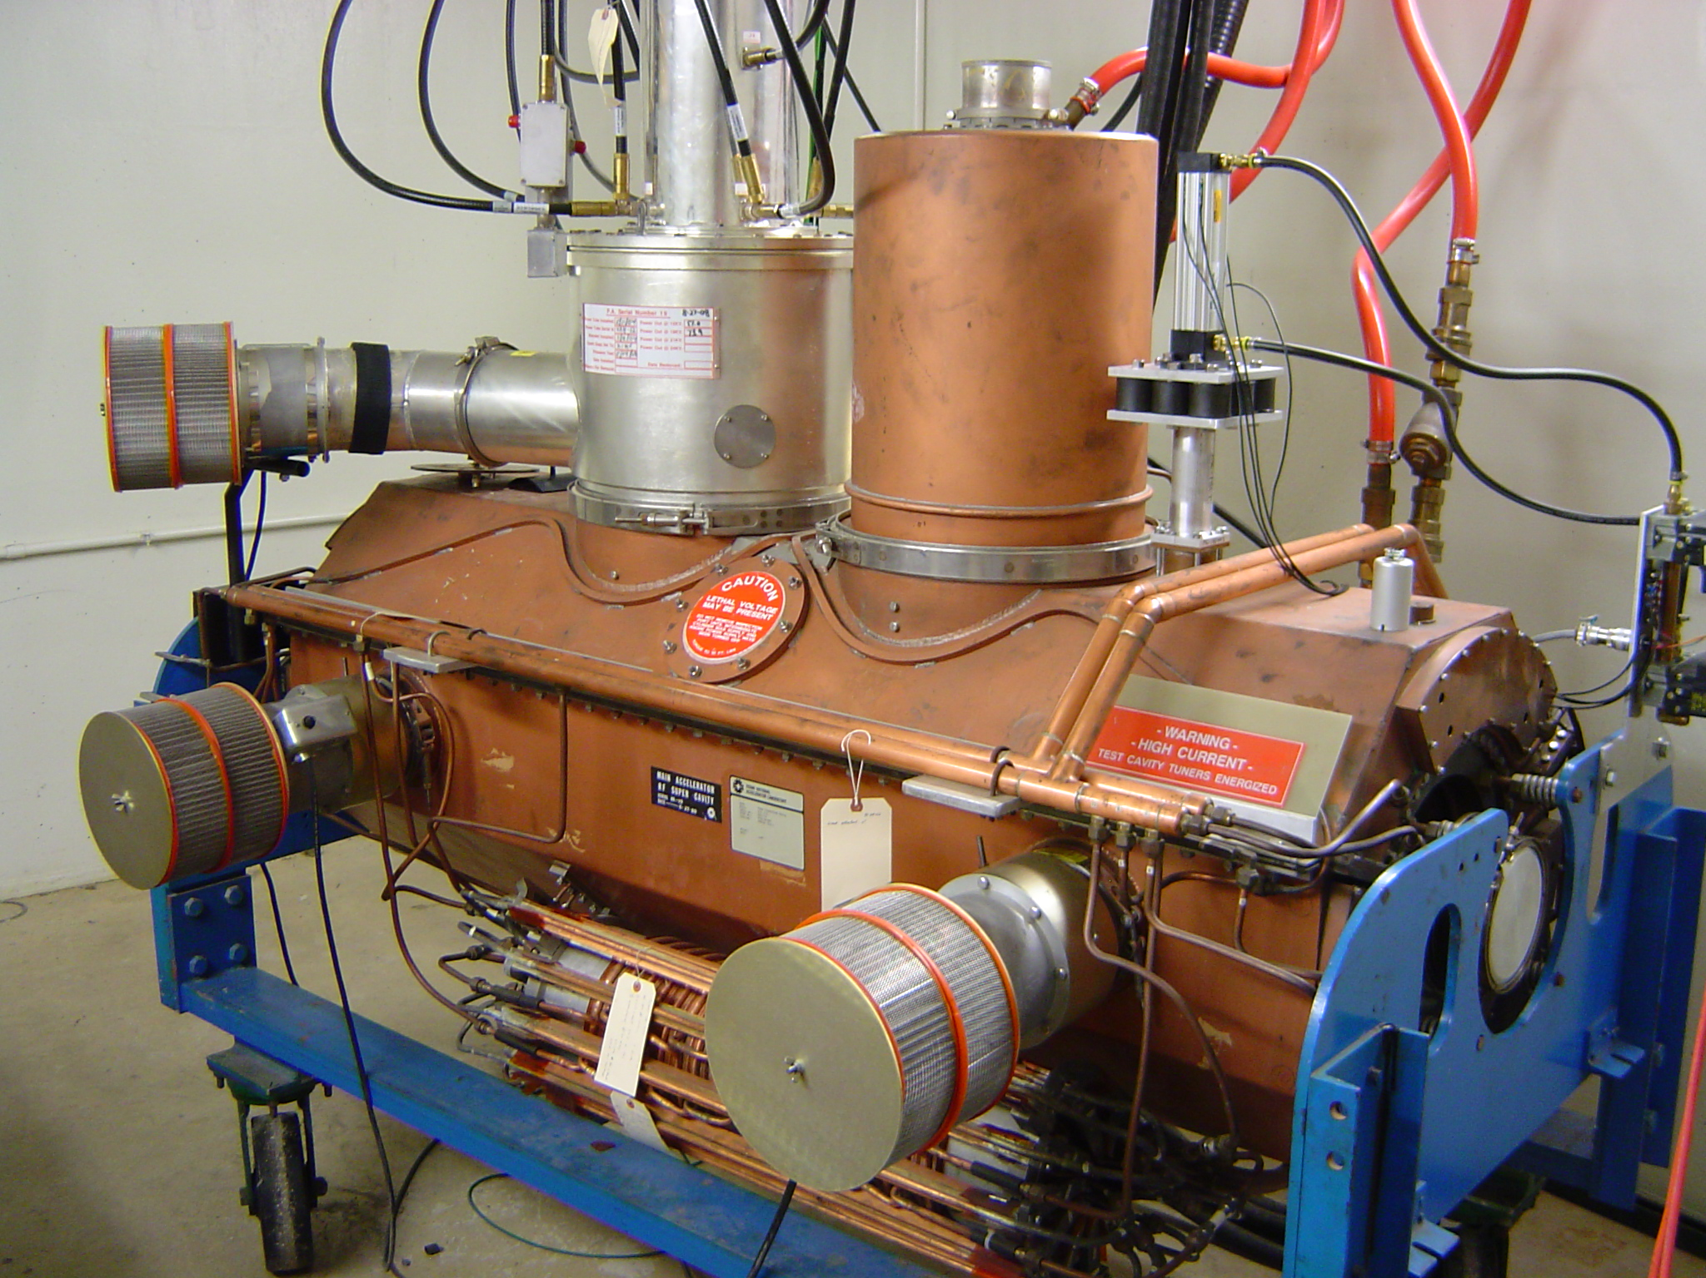
Progress to date – Main Injector
Charge #1
MI-RF Power Upgrade
Two Power Amplifier
Two PA Coupling Loop
Main Injector Test Stand
Low-level Test with MI Test Stand Cavity Modified
with Two Power Amplifiers.

Slide 14
Progress to date – Main Injector
Charge #1
Two PA Main Injector Cavity HFSS Simulation by Ding Sun
Simulation paper can be found in pip2-docdb: PIP-II-doc-2302

Slide 15
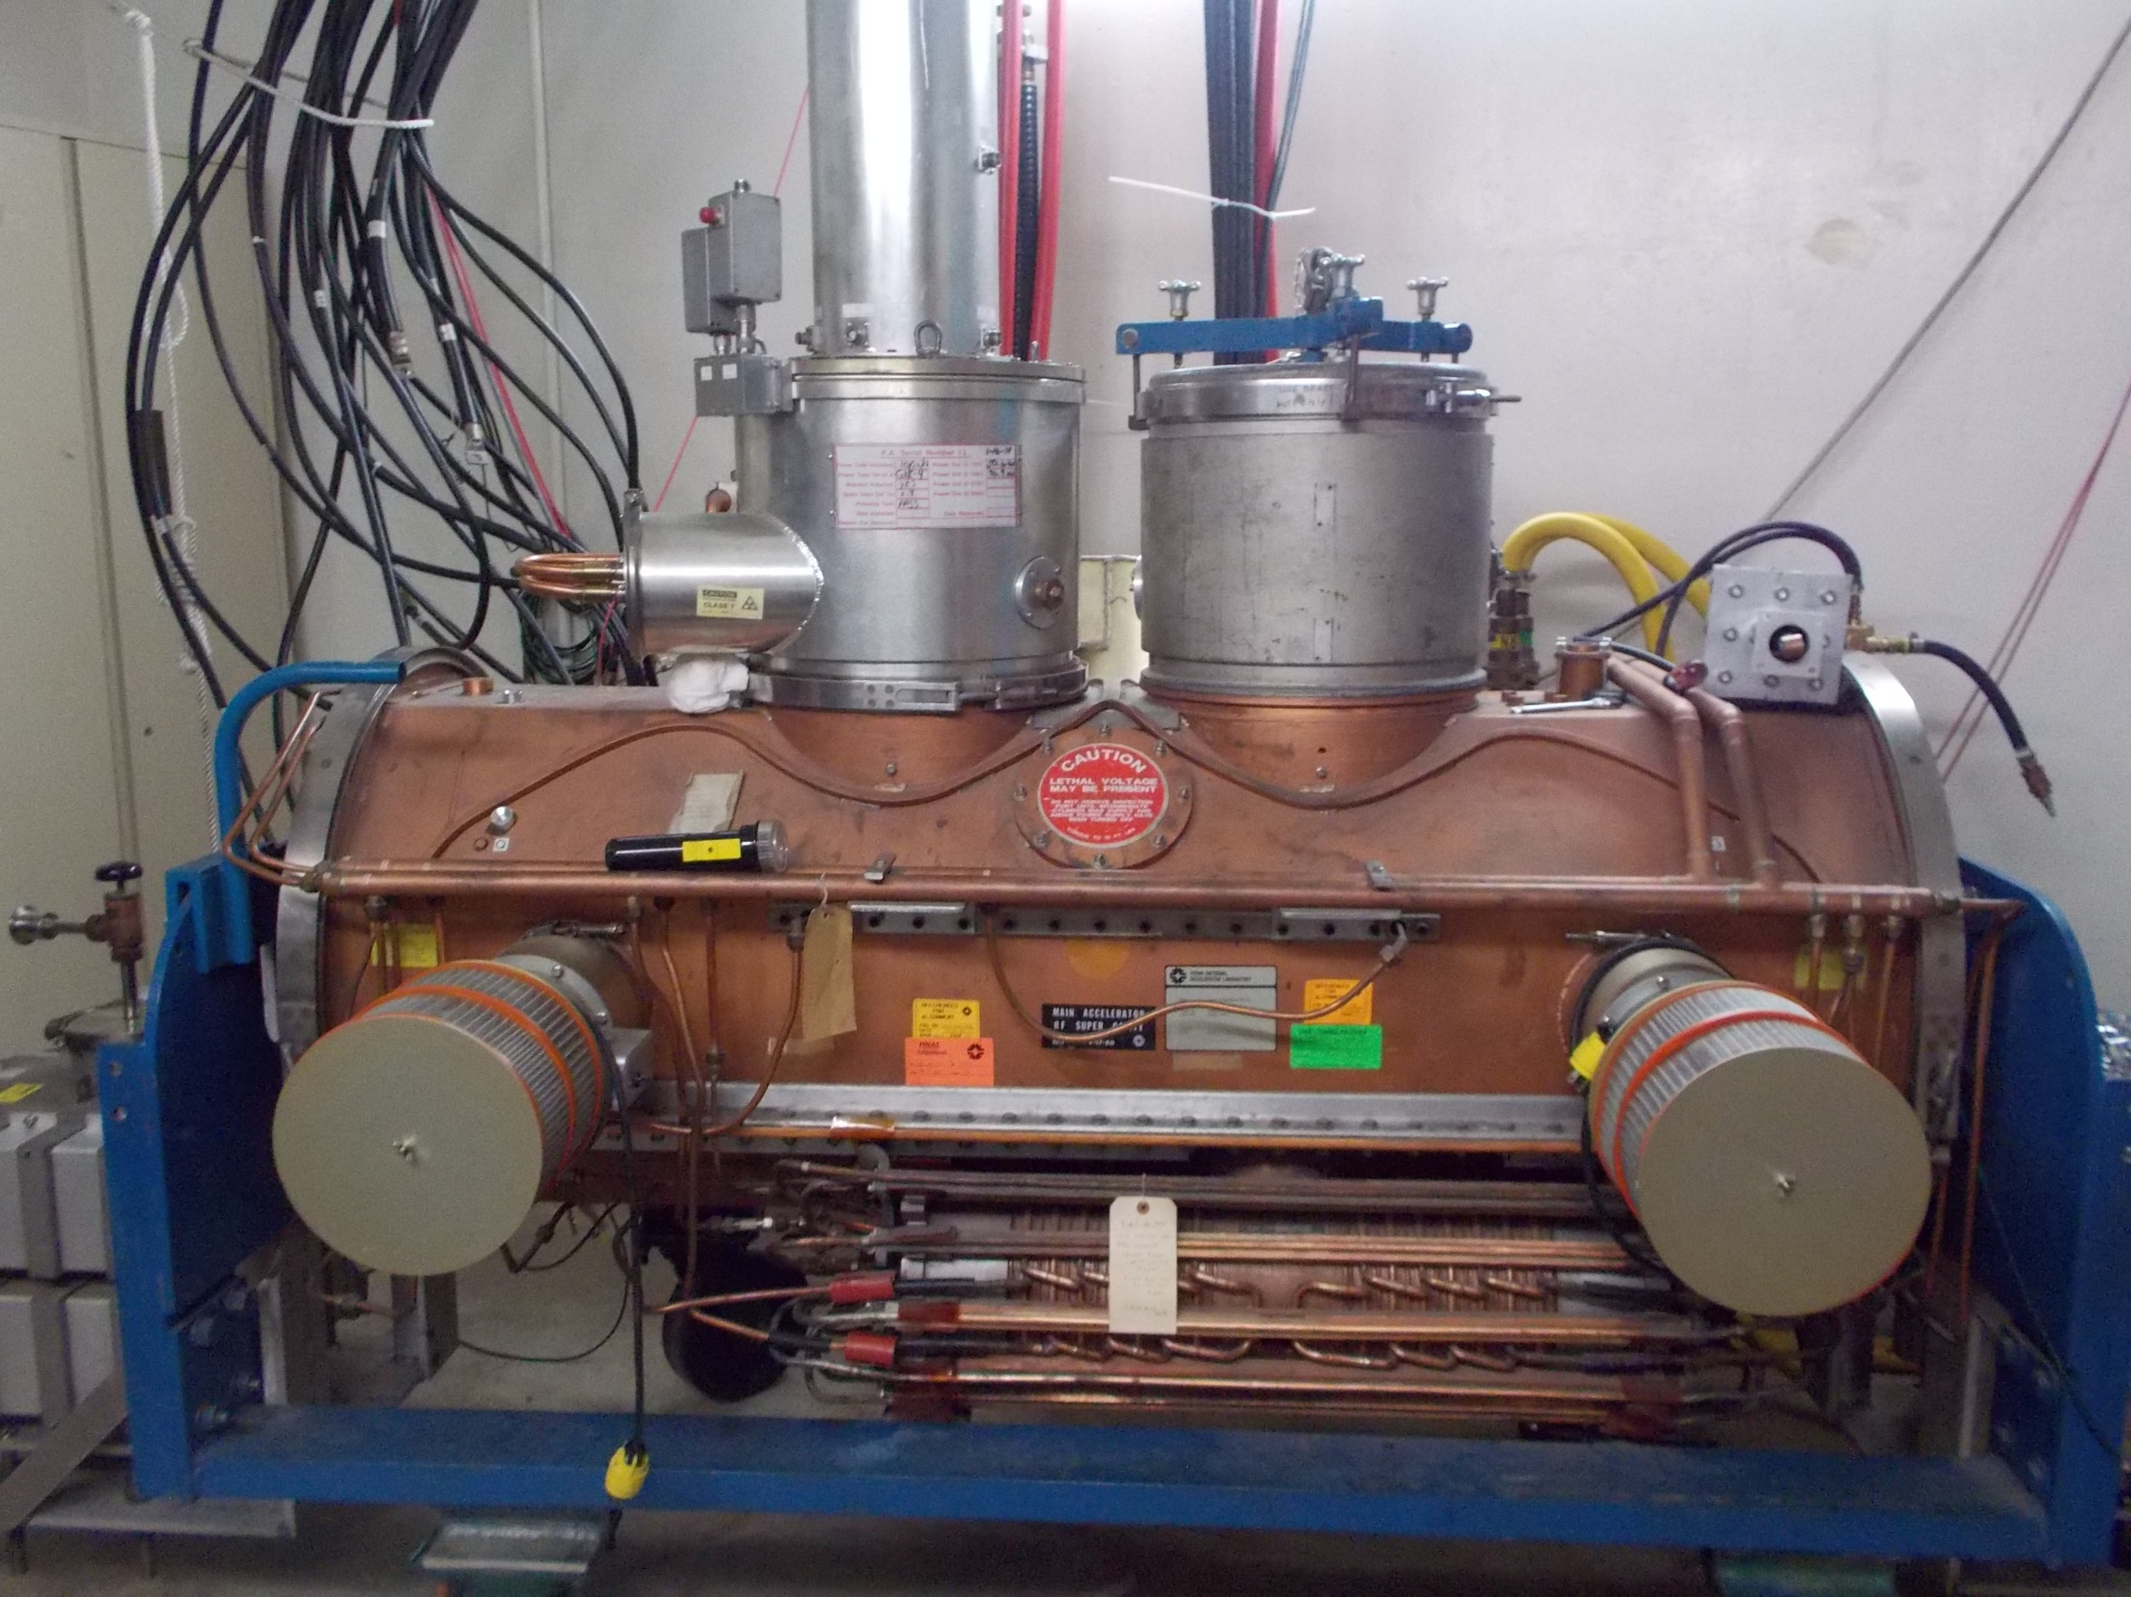
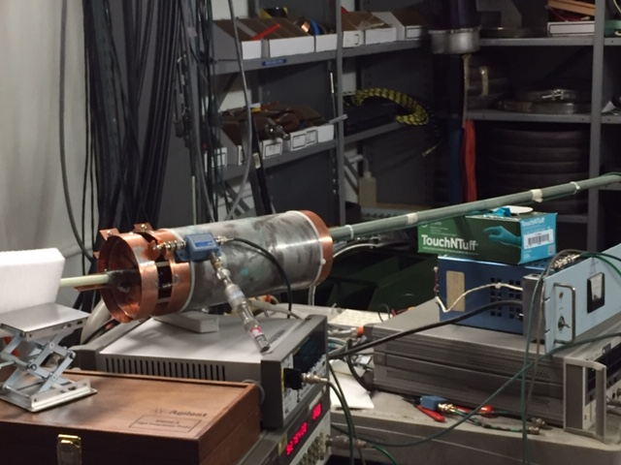
Progress to date – Main Injector
Charge #1
MI Test Cavity with Dummy Power Amplifier
Diode Test Fixture for Measuring Cavity Step-up Ratio.

Slide 16
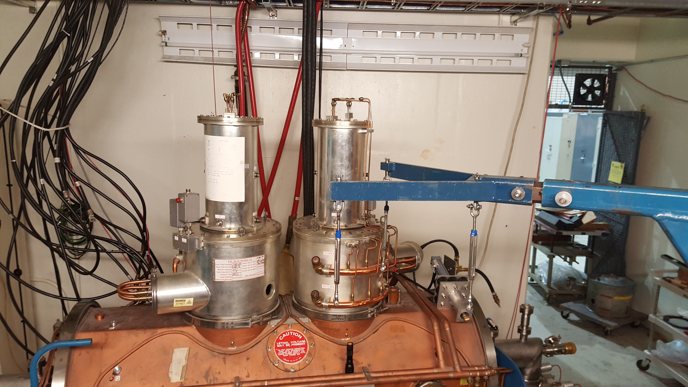
Progress to date – Main Injector
Charge #1
MI Test Cavity with Two Power Amplifiers

Slide 17
Progress to date – Main Injector
Charge #1
 | Simulation Q 52.808 MHz | Measured Q 52.808 MHz
Single PA Standard Configuration | 4510 | 3475
Dual PA Configuration | 4489 | 3176

Slide 18
Next Steps – Main Injector
Charge #1
FY19 – Second Quarter:
  Operate MI Two PA Cavity in Test Cave at MI-60
  Preliminary Design Review – First Week of February 2019
FY19 – Third Quarter:
  Prepare for Replacing Existing MI RF Station with MI Two PA Cavity.
FY19 – Fourth Quarter:
  During Summer Shutdown, Replace Existing MI Cavity with Two PA Cavity and Make System Operational with Beam.

Slide 19
ESH
Charge #6
ESH is integrated into all phases of the Project
  Design, Procurement, Construction, Installation
ESH requirements are clearly defined within the Project
  FESHM, FRCM
Design & installation review process includes an ESH component
Utilize Fermilab’s work planning requirements & processes
  Hazard analysis
  Daily work planning meeting

Slide 20
Quality Management
Charge #6
Quality Control:
  Recycler: Manufactured Copper Cooling Plates will be sent to Applied Physics and Superconducting Technology Division (APSTD) to check if manufactured part matches drawing prints.
  Main Injector: Diode Test Fixture for measuring cavity step-up ratio was tested on the bench for accuracy before it was used on the actual Main Injector cavity.
Quality Assurance:
  Recycler: Accelerator Mechanical Support has made numerous visits to vendor manufacturing Copper Cooling Plates to insure that they understand what they are manufacturing.
  Main Injector: HFSS simulations of MI Two PA Cavity step-up ratio were done to compare against actual measurements of step-up ratio on the real MI Cavity.
Lessons Learned:
  Quality Control Recycler: Wrote a requisition for 3000 ft ($4.46 per foot) of Spira-shield EMI gasket and was informed by Purchasing that Spira Manufacturing would not accept the labs terms for a Purchase Order and that I would have to order a product from a different vendor or do a ProCard (credit card) order for $2,500 and only a 130 feet of product. A substitute manufacturer of this quality of product is not known and the price for only 130 feet was too exorbitant, so I pursued looking for a distributor for Spira Manufacturing. The first vendor also did not accept the labs Purchase Orders, but the second was a Department of Defense supplier and we were able to complete the transaction for 3000 feet of Spira-shield. In doing this, we were able uphold the high quality of using a Spira-shield product and not accept a lower quality substitute.

Slide 21
Risk Management
Charge #2,7
MR RF System upgrade
The default 2PA Upgrade of the Main Injector RF cavities will not work.

Slide 22
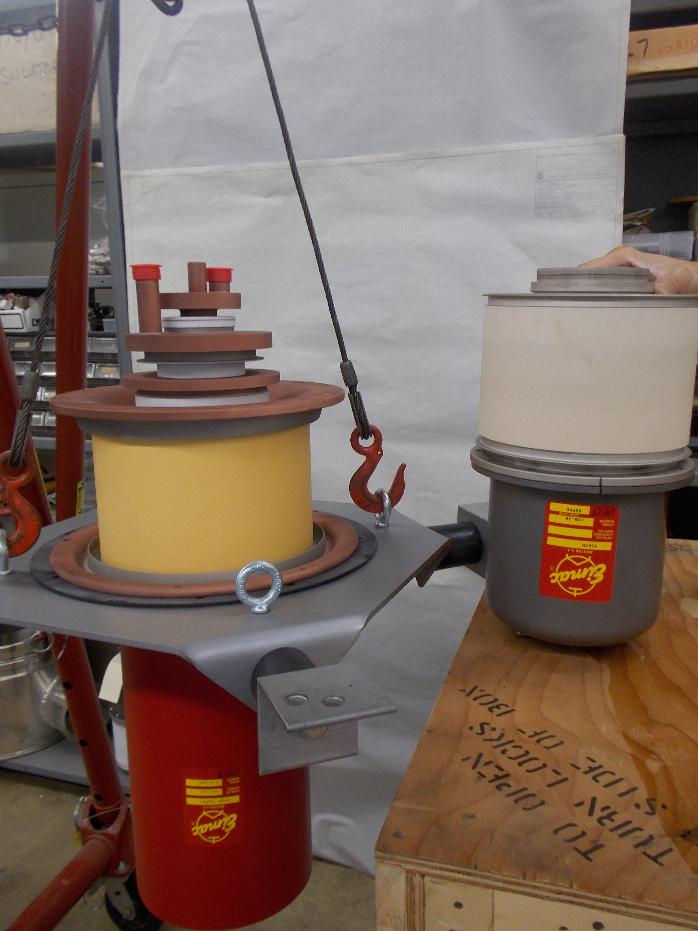
Risk Management
Charge #2,7
We are actively pursuing the Two PA Amplifier solution and hope to retire the Single Tube Solution in the Second Quarter of FY19. This will be done by proving that a Two PA Cavity can operate on the test stand.
4CW250,000B (Single Tube Solution) next to
presently used Y567B on right.

Slide 23
Summary
Requirements are well defined
We have designs that will meet our requirements and we are making good progress towards preliminary design reviews.
We are on schedule to retire our major risk.
ESH and QA plans are in place.
We are on track for CD-2/3a and look forward to your feedback.
Thank you for your attention.

Slide 24
END

