Slide 1
Conventional Facilities Overview (WBS 121.06)
Breakout Session
Steve Dixon
PIP-II IPR
4-6 December 2018

Slide 2
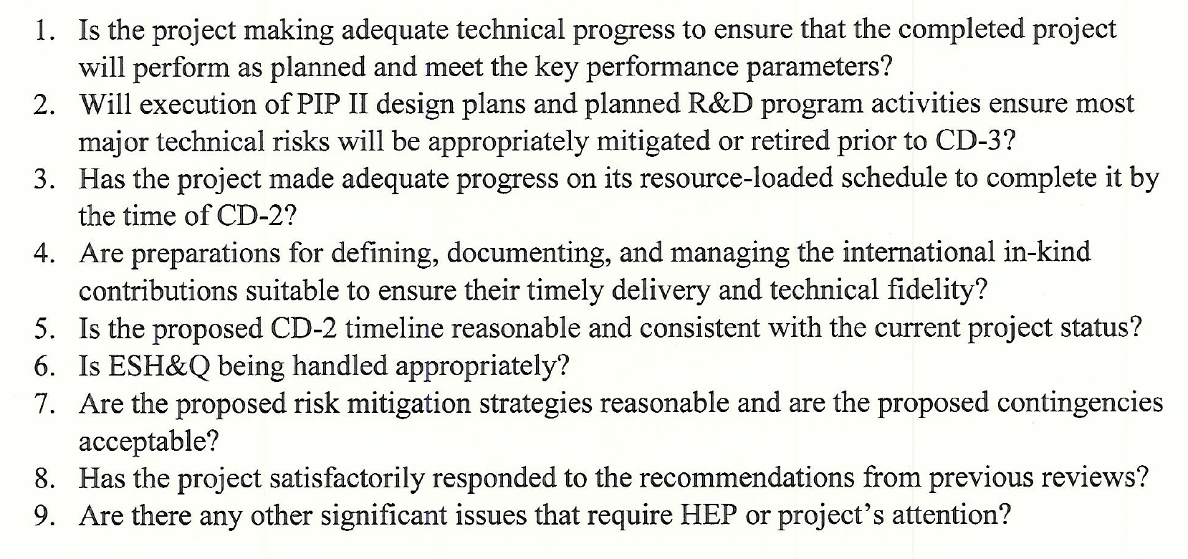
Charge Questions Addressed

Slide 3
Outline
Technical Progress
Interfaces
Risks and Mitigations
ESH&Q
Previous Review Recommendations
Summary

Slide 4
About Me:
PIP-II Level 2 Manager for Conventional Facilities
Relevant Experience
Licensed Architect;
Project Management Professional (PMP);
LEED Accredited Professional;
26+ years at Fermilab;
NOvA Project L2 Manager for Site and Buildings;
2014 CD-4
2015 U.S. DOE Secretary’s Award for Excellence
General Plant Project Manager for 15+ years
Short Baseline Neutrino (SBN) Near Detector Building;
Short Baseline Neutrino (SBN) Far Detector Building;
Experimental Operations Center;

Slide 5
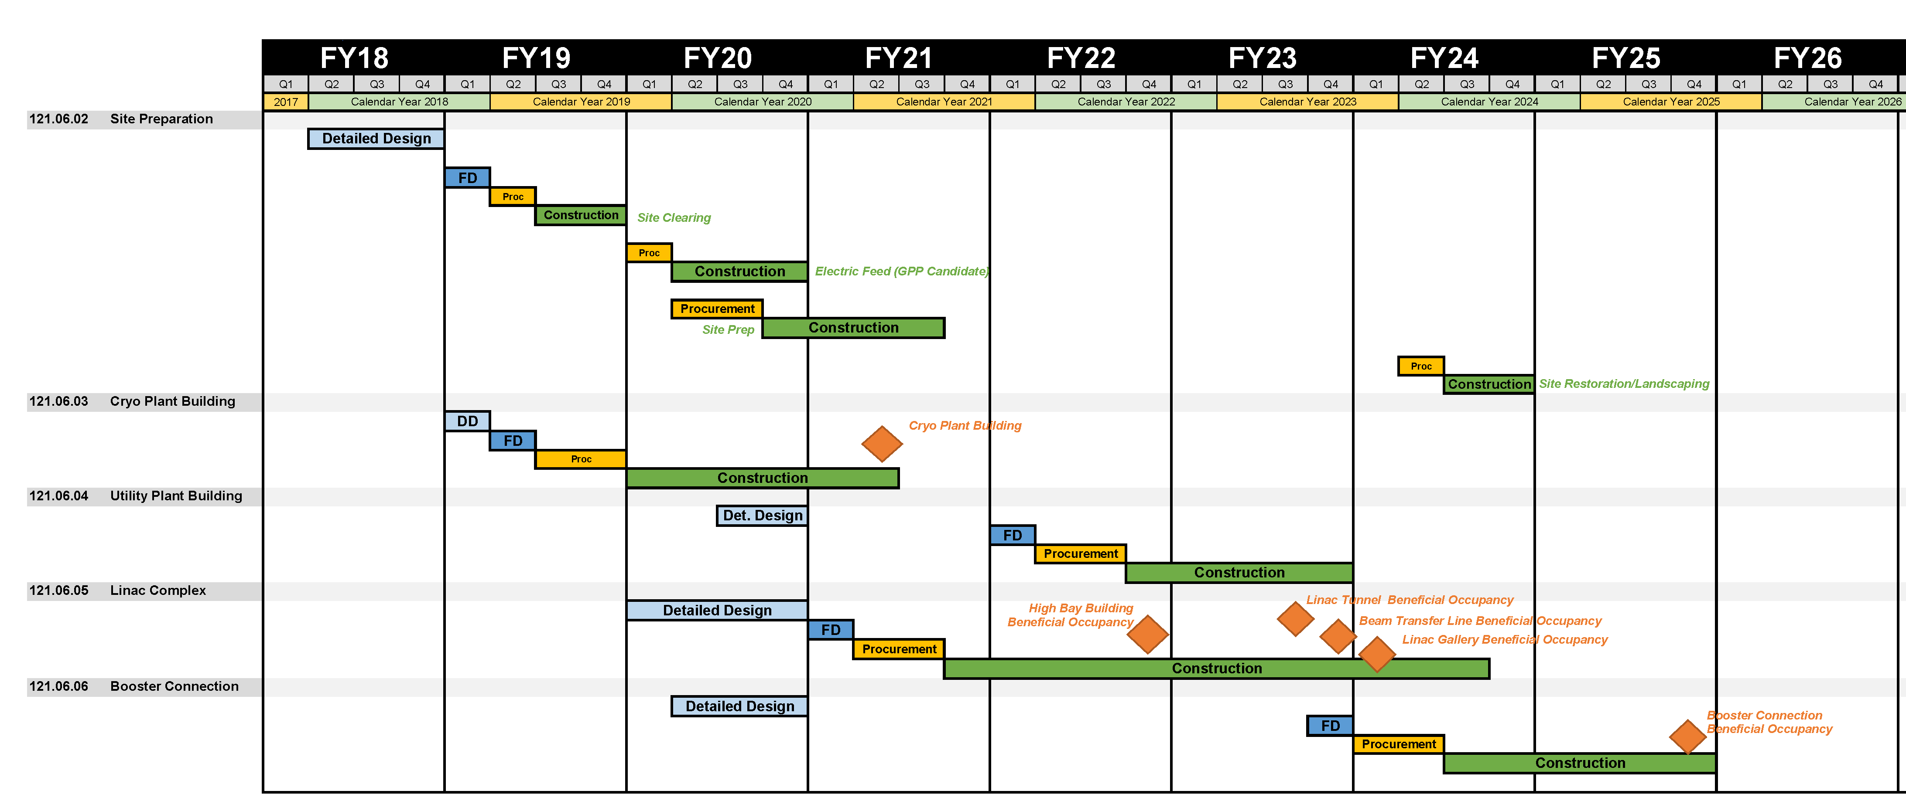
CF Schedule Overview

Slide 6
Progress to Date Since CD-1
Charge #1, 2
General Progress Milestones
January 2018 - Value Engineering Workshop with the CF team [1]
April 2018 – Received updated cost/schedule estimate [2]
June 2018
Completed Geotechnical Engineering Investigation [3]
Chartered and held the first meeting of the PIP-II Architectural Advisory Board [4]
July 2018
Received favorable wetland determination for the US ACOE [5]
Developed preliminary shielding strategy for Cryogenics Plant Building with 121.03 (Accelerator Systems)
November 2018 – Preliminary Design Report
December 2018 – Completed the A/E recompete process
[1] See PIP-II-doc-1377
[2] See PIP-II-doc-333
[3] See PIP-II-doc-1533
[4] See PIP-II-doc-1308 and PIP-II-doc-1548
[5] See PIP-II-doc-1630

Slide 7
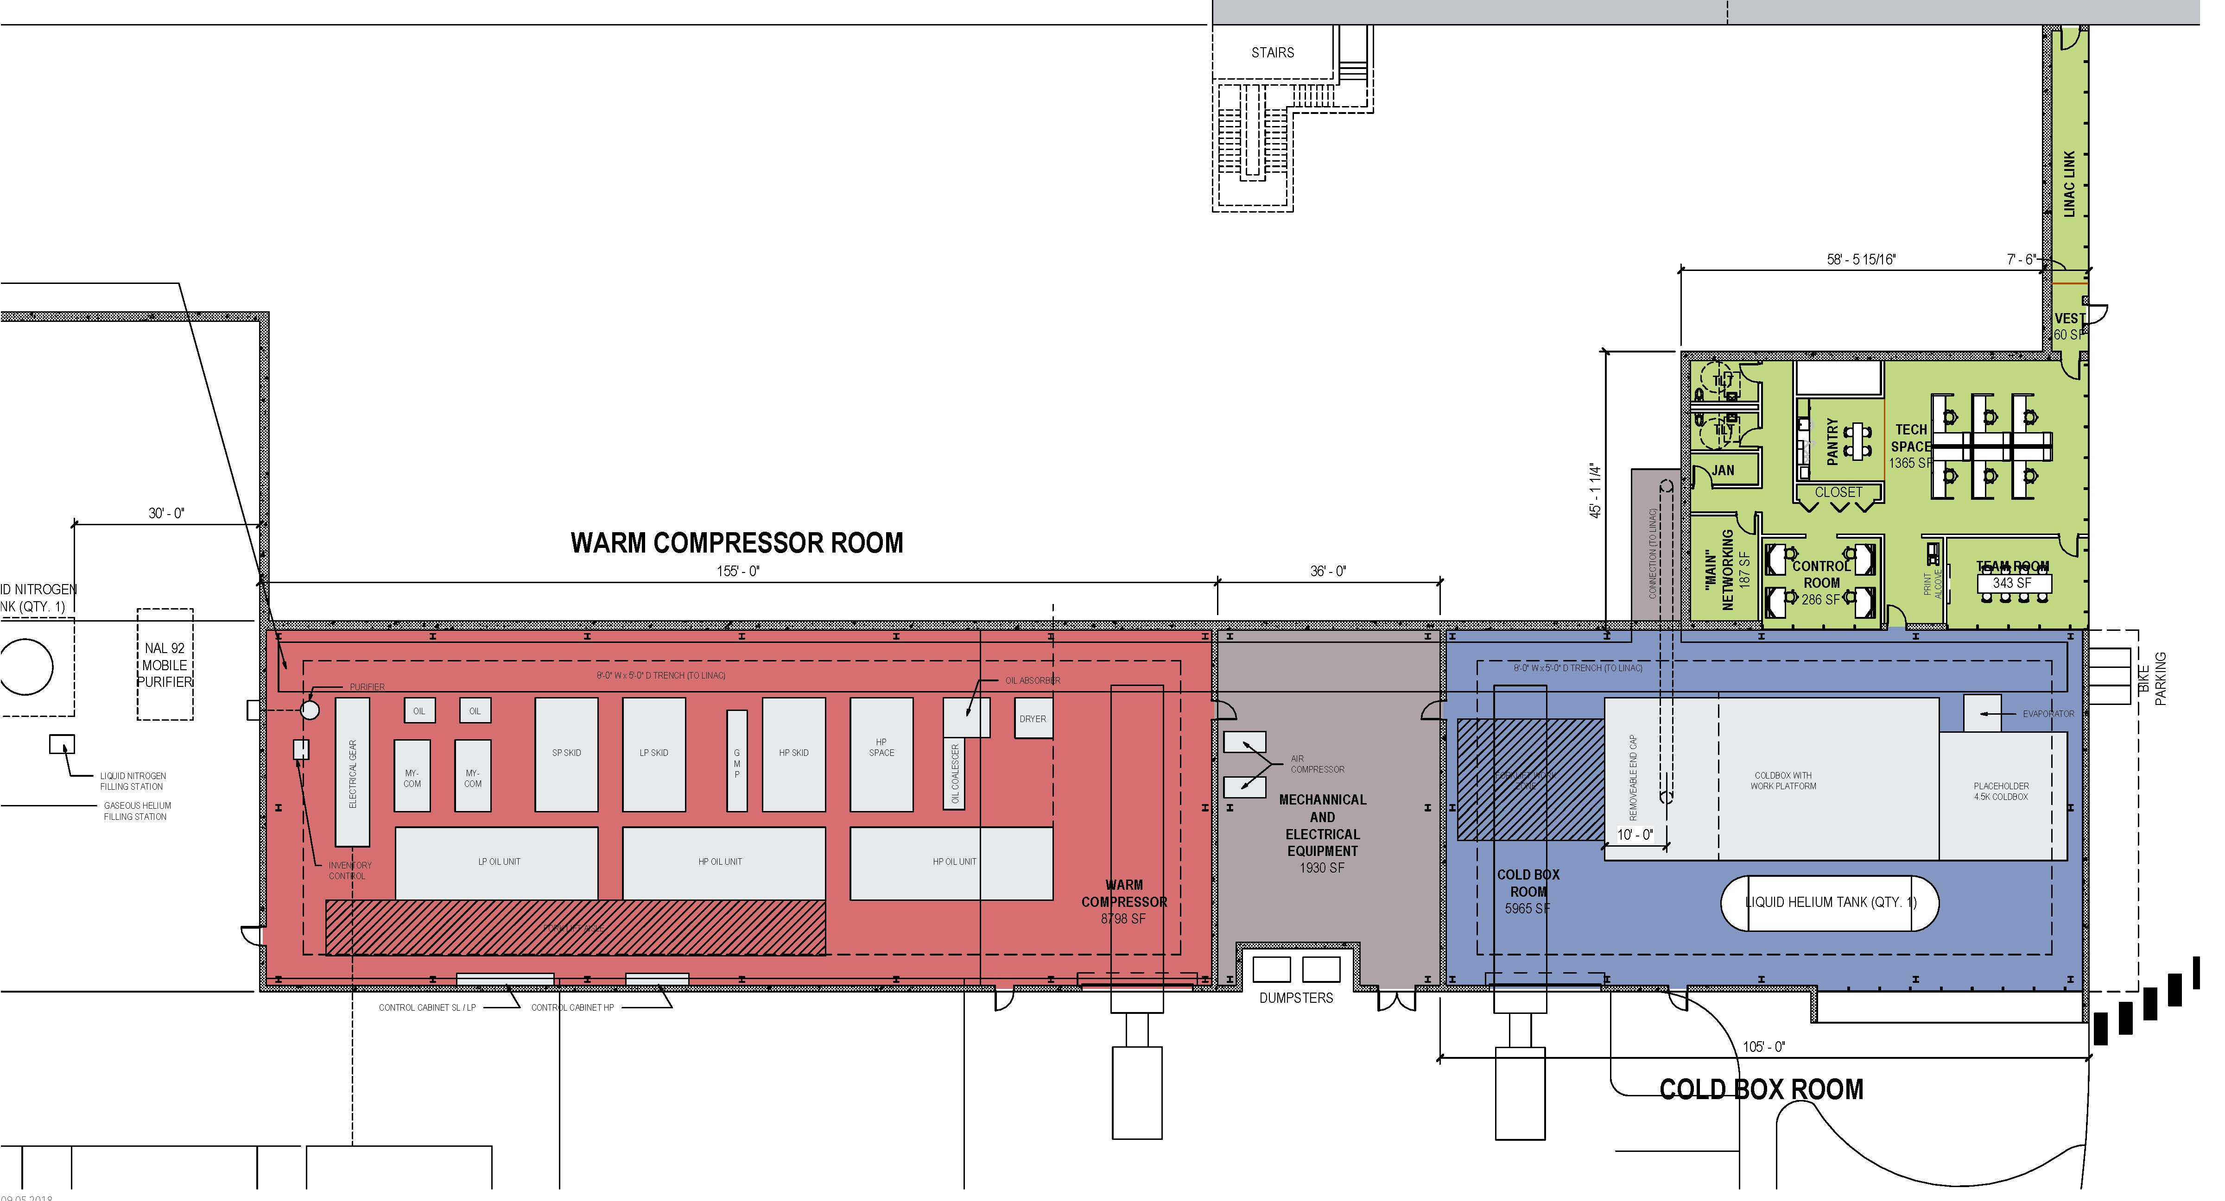
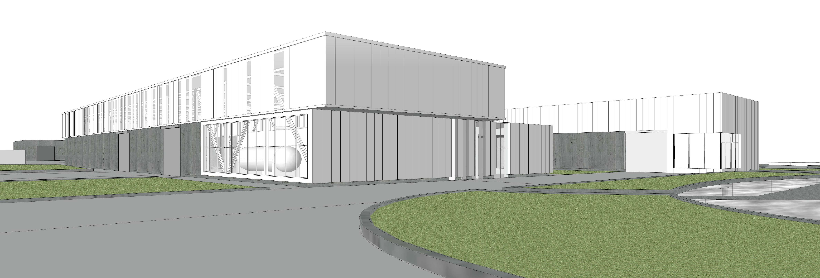
Technical Progress – In Progress
Charge #1
Site Preparation (WBS 121.06.02)
Site Clearing package[1] (Authorization to Proceed Approved)
Site Work package[2]
Electrical Feeder package[2]
Site Restoration/Landscaping package[2]
Cryogenics Plant Building (WBS 121.06.03)
Technical Requirements Complete [3]
Completed Water Quality Testing [4]
View Looking Southwest
[1] See TeamCenter ED0008374
[2] See TeamCenter ED0008459
[3] See TeamCenter ED0008373
[4] See PIP-II-doc-155
Cryogenic Plant Building Plan

Slide 8
Technical Progress – Planned
Charge #1
Utility Plant Building (WBS 121.06.04)
Linac Complex (WBS 121.06.05)
Combined into one WBS
High Bay Building
Linac Tunnel
Linac Gallery
Beam Transfer Line
Booster Connection (WBS 121.06.06)
Discussion of interface point between Linac Complex and Booster Connection based on accelerator shutdowns
Notes:
Design maturity is based on AK’s formula

Slide 9
Interfaces
Charge #2,7
Project Interfaces (Managed through PIP-II processes) [1]
ED0007698 – Interface Control Document
WBS 121.02 - SRF & Cryo Systems
WBS 121.02.05 – Cryo Plant (B. Hansen)
WBS 121.02.06 – Cryogenic Distribution (A. Dalesandro)
Fermilab Interfaces
Infrastructure Connections (Managed through FESS processes)
General Plant Projects (Managed through FESS processes)
International Interface (Managed through WBS 121.02)
Cryogenic plant is Indian partner deliverable
As a reminder, Subproject Requirement Changes is the highest Conventional Facilities risk
FESS is the Facilities Engineering Services Section
[1] See PIP-II Systems Engineering Management Plan at PIP-II-doc-1539

Slide 10
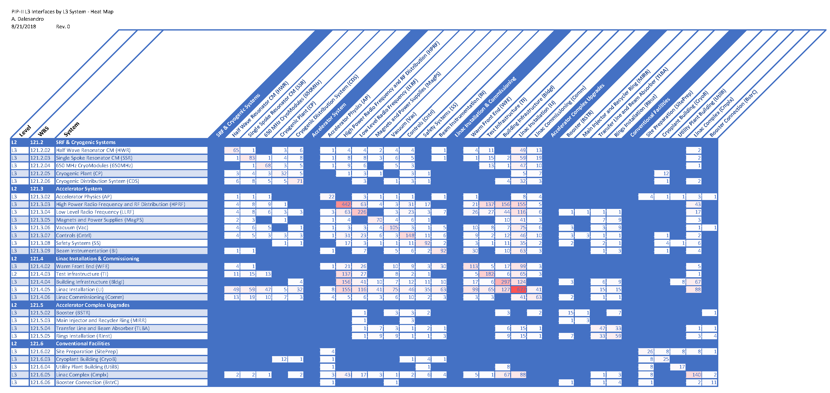
Interfaces
43: High Power RF
88: Linac Installation
67: Building Infrastructure

Slide 11
Risk Management
Charge #2,7
Conventional Facilities Risks
0 High Risks
15 Medium Risks
31 Low Risks
Top 3 Risks
RT-121-06-001 – Subproject Requirement Changes
RT-121-06-002 – Accelerator Shutdown Schedule
RT-121-06-003 – Construction Bids Exceed Estimates
Link to Risk Register: https://fermipoint.fnal.gov/organization/ocoo/ippm/Lists/Risk%20Register/all-risks.aspx

Slide 12
Environment Safety and Health (ES&H)
Charge #6
Consider and plan for ES&H issues throughout the project life cycle
Conceptual Design Phase
ES&H input includes review of the design, input from Tritium Task Force and Life Safety Analysis [1]
Design Phase
ES&H is considered in A/E selection process;
ES&H is included in design reviews;
Implement Safety by Design process;
Incorporate Hazard Analysis Report hazards in the design process [2]
Procurement/Construction Phase
Include safety performance as part of the subcontractor selection process;
Detail the responsibilities for team members including the Construction Subcontractor and Fermilab Construction Coordinator;
Independent oversight by ESH&Q Section
[1] Life Safety Analysis can be found at PIP-II-doc-120
[2] Hazard Analysis Report can be found at PIP-II-doc-140

Slide 13
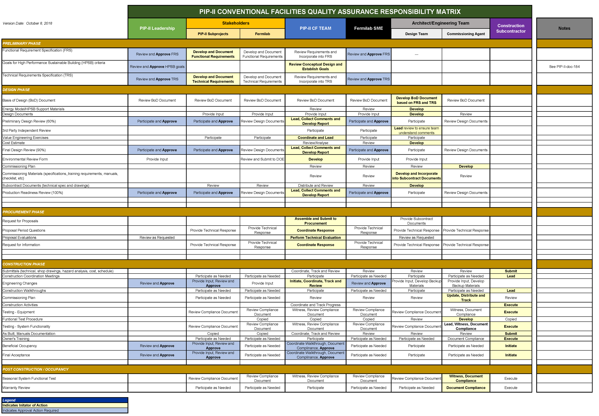
Quality Management
Charge #6
Process to date include:
Requirement and Specification Review (PIP-II process) [1]
Comment and Compliance Review (FESS/E process)
QAQC Process Report (A/E process)
[1] PIP-II Quality Assurance Plan is at PIP-II-doc-142
See PIP-II-doc-2291 for Quality Assurance Responsibility Matrix

Slide 14
Response to Recommendations
Charge # 8
Director’s CD-1 Review (October 2017) [1]
2 Recommendations, both closed
DOE CD-1 Review (December 2017) [2]
3 Recommendations, all closed
P2MAC Review (March 2018) [3]
3 Recommendations, all closed
Link to iTrack database: https://www.esh.fnal.gov/pls/cert/iTrackRPT.html
[1] Review ID 47866
[2] Review ID 48107
[3] Review ID 48469

Slide 15
Summary
Focus of Technical Progress has been the Site Preparation and Cryogenics Plant Building (CD-3A request) to be ready to receive the cyrogenic equipment.
The Site Preparation work is 90% complete and on track for completion in January 2019;
Project Management functions (ES&H, Quality, Interfaces and Risk) processes are in place and functioning;
Previous review recommendations have been incorporated
Thanks for your time.

Slide 16
END

