Slide 1
121.04.05 Linac Installation (LI)
SC2: Accelerator Complex Upgrades, Linac Install. and Comm.
Curt Baffes
PIP-II IPR
4-6 December 2018

Slide 2
Outline
Scope/Deliverables
Requirements
Interfaces
Preliminary Design, Maturity
Technical Progress to Date
ESH&Q
Risks and Mitigations
Summary

Slide 3
About Me:
PIP-II Roles
  L3 Manager for Linac Installation
  Installation lead for PIP2IT
Other Fermilab experience
  Participated in build-out of FAST, PIP2IT, and CMTS1 machines
  Led design and installation of FAST 50 and 300MeV beamlines
  Led installation of 1.3GHz CC1 and CM2 cryomodules at FAST
  Led installation of first LCLS-II cryomodule in CMTS1 test stand

Slide 4
Scope and Deliverables
Charge #2
WBS Dictionary: PIP-II doc DB #599
121.04.05 Inst – Linac Installation (LI) | Planning and execution of the installation of the PIP-II linac, from the Warm Front End through the HB650 upgrade section. This includes planning, design of support structures for cryomodules and warm units, disassembly of PIP2IT, logistics and transportation support for PIP2IT and installation-ready cryomodules, subsystem integration of warm units, installation of all linac systems (in the highbay, tunnel and gallery), and checkout of the linac to bring installed systems to a state of readiness for beam commissioning.

Slide 5
Scope and Deliverables
Key Design Scope
  Cryomodule Stands
  Cryomodule Tunnel Transport System
  Warm Unit Structures
  Top-level Technical CAD Model Integration and Maintenance
  Alignment Network
Key Installation Work Scope
  Disassembly and storage of PIP2IT
  Storage and monitoring of accepted cryomodules
  Integration of Warm Unit packages
  Installation of Linac through HB650 upgrade section
    Work kicks into high gear at Beneficial Occupancy of the highbay
    Install linac interleaved with incremental commissioning campaigns
    Achieve Key Performance Parameter 4: Linac at 2K, full-power RF
    Final handoff to commissioning WBS element is at readiness for beam commissioning to the straight-ahead dump

Slide 6
WBS L3 System Requirements
Charge #2
FRS – ED0007996 / PIP-II Doc DB 2495
  PIP-II 3D CAD model
    Features required for simplified/envelope representations
    Full assembly-tree traceability required
  Cryomodule Stands
    Positive restraint in 6 degrees of freedom required
    Coarse and fine adjustment required to 50µm level
    Detailed Technical Requirements Spec. released: ED0007997
  Cryomodule Tunnel Transport System
    Transport a cryomodule from the major access at the highbay to its slot in the string
    Features to enable handoff to stand required

Slide 7
WBS L3 System Requirements
FRS – ED0007996 / PIP-II Doc DB 2495
  Linac Warm Section Structures
    Accommodation of magnet, vacuum, instrumentation required
    Coarse and fine adjustment required
  Accelerator Alignment Network
    Allows alignment of PIP-II relative to global complex coordinates
  Linac Installation and Checkout
    Scope requirements, e.g. disassembly of PIP2IT
    Technical requirements, e.g. “Particle Free” vacuum practices near SRF cavities
    Logistic requirements, e.g. compatibility with incremental commissioning
  Storage of Accepted Cryomodules
    Beamline vacuum monitoring required

Slide 8
Interfaces
Charge #2
Linac Installation has physical or logistical interfaces with almost every system
  Enumerated in the Interface Control Document (ED0007507 / Doc DB 2495)
  Owner/Supplier/Integrator scope is defined in PIP-II’s interface control process
    Linac Installation is the “Integrator” of many interfaces owned by other elements
Character of key interfaces
  Physical interfaces (e.g. for cryomodule stands)
  Handling interfaces (e.g. not-to-exceed volumes)
  Logistical interfaces (e.g. interleaving of installation with commissioning plan)
Current focus
  Interface control drawings for driving envelopes (e.g. F10106150)
    Especially cryomodules and RF amplifiers
  Interface control drawings for stand/structure design scope (e.g. F10107984)

Slide 9
Cryomodule Stand Interface Control Drawing
Detail definition at module/stand interface plane

Slide 10
Preliminary Design and Design Maturity
Charge #2
Focus areas for mechanical design scope
Cryomodule Stands
  prototype needed for PIP2IT in April 2019
  Preliminary Design Review (PDR) held Nov 2018
3D CAD model
  Skeleton and assembly structure defined
  Lattice import tools developed
  Configuration studies underway
Cryomodule Tunnel Transport System, Warm Unit Structures
  Focusing on requirement and interface definition

Slide 11
Preliminary Design and Design Maturity
Focus areas for process design scope
Interface definition
  Particular focus on volume envelopes, documented in drawings and captured in the 3D model
Installation equipment list – ED0007992
  “shopping list” for installation tools and equipment
Installation plan document – ED0007915
  Organization and communication
  Defines high-level installation flow and strategy
Installation sequence being developed in concert with commissioning plan and Resource Loaded Schedule
  Breaks in installation major access for Phase 1 and Phase 2 beam commissioning
SC2-Garcia

Slide 12
Design Maturity – PIP2IT Installation Lessons
Maintenance of complete volume envelopes in the CAD model is critical, especially for “non-mechanical” systems
Make sure the subsystems folks can populate the cable database, properly and consistently
Re-verify hardware documentation at the moment of delivery (Engineering Process Data Management Sheet (EPDM), survey referencing, drawings, procedures are all complete and stored in the appropriate database)
Re-verify system pressure specifications prior to fluids connection and keep track of discrepancies
Confirm that machine protection features are fully implemented and tested at the subsystem level prior to responsible engineers handing off to operations

Slide 13
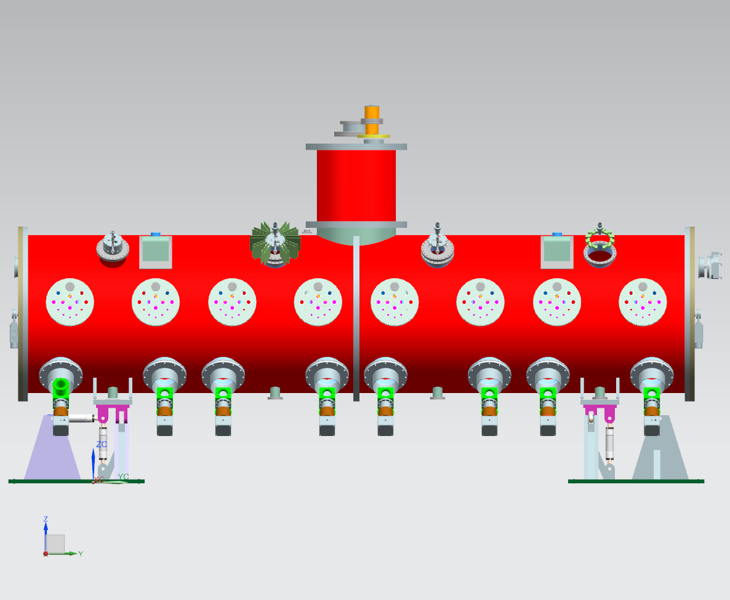
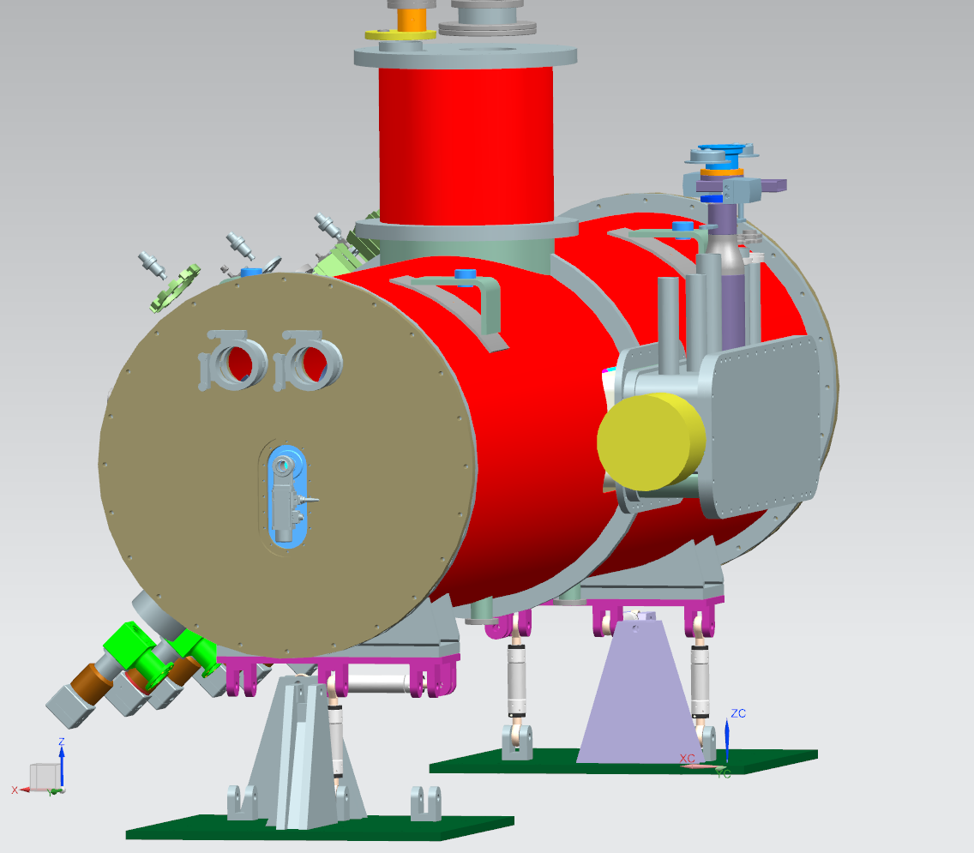
Progress since CD1 – Cryomodule Stands
Charge #1
Preliminary design complete, initiating prototype fab
Modular kinematic system supports all PIP-II cryomodule types
Allows smooth longitudinal stroke to facilitate tight-space vacuum connection

Slide 14
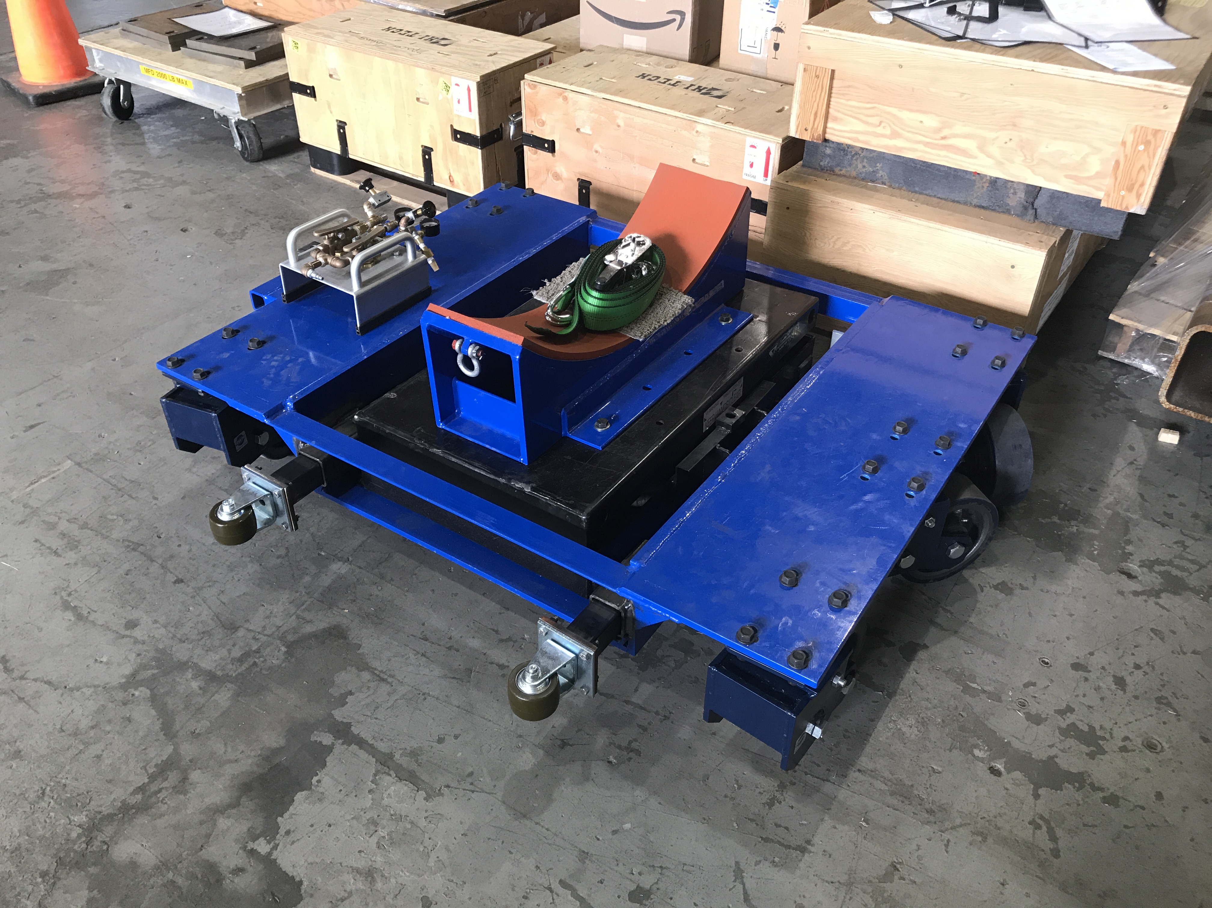
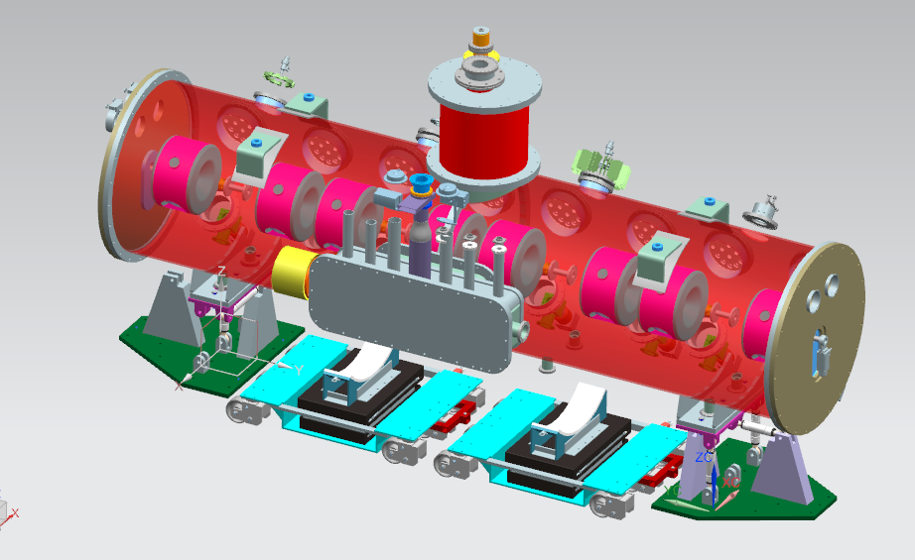
Concepts for cryomodule mover
Conceptual design beginning
We hope to borrow heavily from the LCLS-II design
  Very similar cryomodule interfaces
  A few improvements have been recommended by the SLAC team
LCLS-II design
Courtesy R. Coy, SLAC
LCLS-II concept is workable
Stand locations clear, outboard of dollies

Slide 15
Progress since CD1 – 3D CAD Model
Data integration example
Existing machine
Position data
Point cloud, .xls format
Metric
FSCS-Z
PIP-II Lattice
Fermilab - AP
Optim/MAD
Metric (m)
CSYS: FSCS-Z
Alignment Database
Fermilab – Alignment
(database)
(multiple units supported)
FSCS-Z, FSCS-h
Lattice file
.csv format
Metric
FSCS-Z
QA data
Format
Survey feet
FSCS-h or FSCS-Z
T-to-A output
Parasolid .x_t
metric
A0YN-Z
A-to-C output
Format
Int inches
A0YN-Z
Technical Model
Fermilab - LI
Siemens NX
Metric (mm)
CSYS: A0YN-Z
Architectural Model
Revit
International inches
CSYS: A0YN-Z
Civil Model
Rhino?
Survey Ft.
CSYS: FSCS-h
International units:
No unit
correction needed
Survey ft to
international ft
correction needed
A-to-T output
3D .dxf
International inches, converted to mm at import
A0YN-Z
C-to-A output
Format
units
CSYS-Z

Slide 16
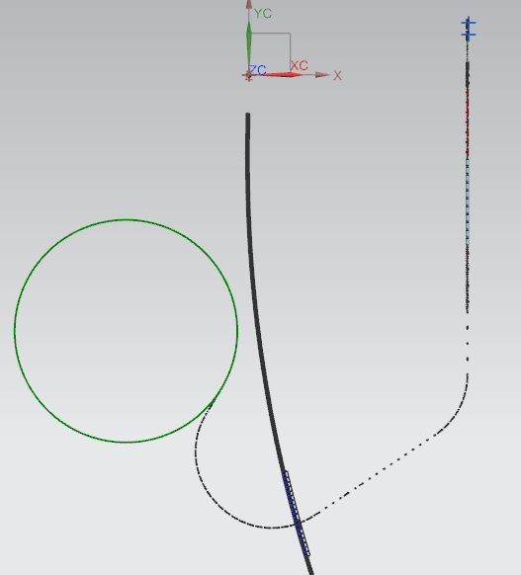
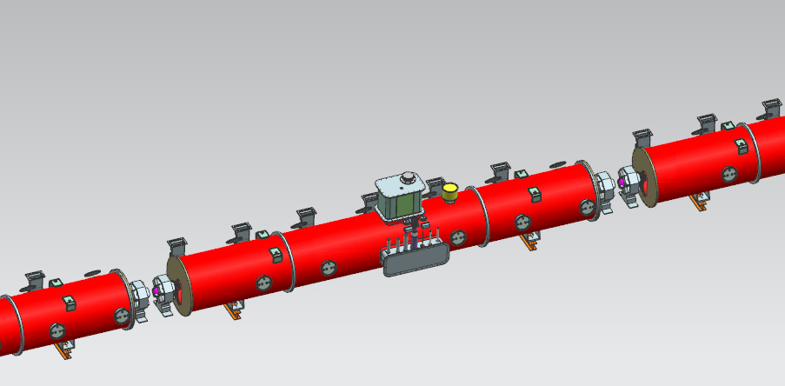
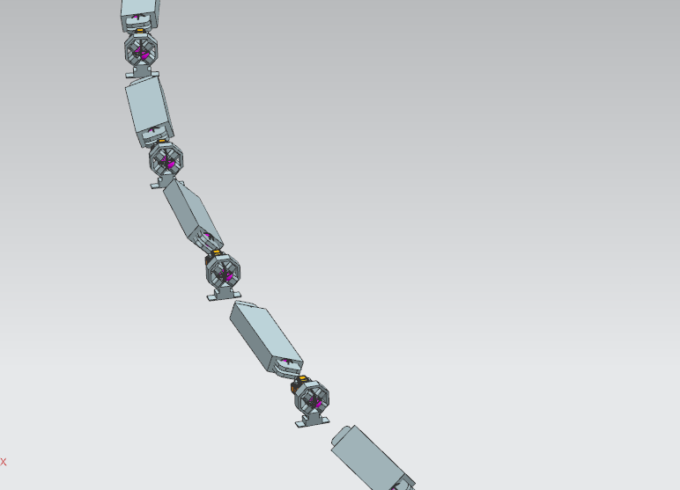
Accelerator Lattice in CAD – F10101501
Model populated by
lattice-to-CAD import script

Slide 17
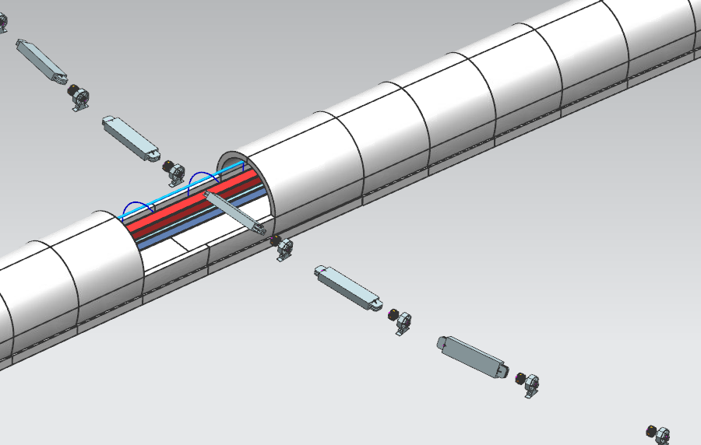
Accelerator Lattice in CAD – Main Ring Crossing

Slide 18
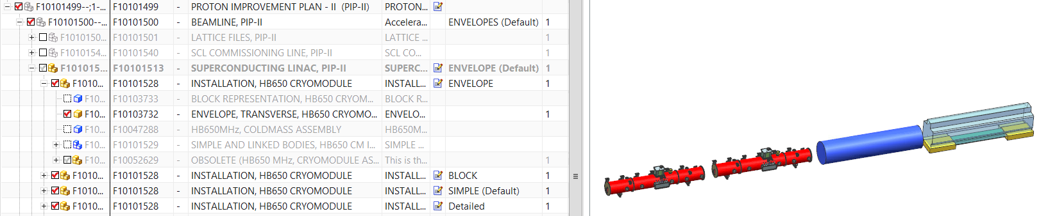
Model Simplification
Example:
Representations of the HB650 Cryomodule string in the PIP-II NX CAD Model
Envelope
Simple
Block
We use an “installation model” approach to capture detailed and simplified component geometry in the assembly tree
Allows flexibility in display options without breaking strict assembly-tree traceability
Detailed
light

Slide 19
ESH
Charge #6
Project team is committed to construct PIP-II in a safe, environmentally respectful, and cost efficient manner that meets our stakeholder’s needs
Safety is an essential element in all work we do
  Project Integrated Safety Management Plan (docdb #141)
  Laboratory and DOE standards and practices
    Fermi Radiological Control Manual
    Fermi ES&H Manual
  Apply ”Lessons Learned” from internal and external project work
    Nearly every identified risk/hazard is in play during installation
    LOTO schemes to be given explicit consideration
    Cable management and documentation is a high priority
  Partner deliverables are required to meet Laboratory Safety Standards

Slide 20
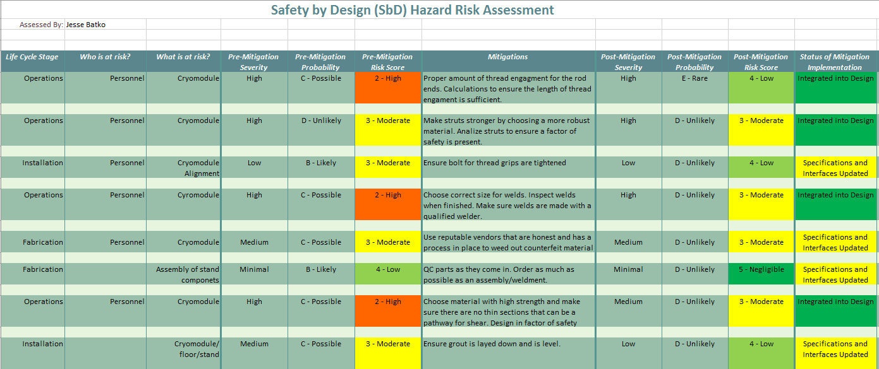
ESH – “Safety by Design” Approach
Have exercised “Safety by Design” approach in cryomodule stand design
The process is highly complimentary to Failure Modes and Effects Analysis (FMEA)

Slide 21
Quality Management
Charge #6
Quality Assurance and Control
  Project Quality Assurance Plan (docdb #142)
  We will communicate and work with vendors and collaborators
Focus areas for Linac Installation
  Process documentation
    Will develop travelers to document installation and test processes
    Leverage FNAL Traveler Support Group
  Hardware Acceptance – Installation Readiness Review
    Described in the PIP-II Design Review Plan, ED0008163
    A gate to ensure that deliverable documentation is complete
      E.g. QC and test documentation
      E.g. drawings
      E.g. travelers and installation and procedures
    Opportunity to capture punch-list action items for deliverables

Slide 22
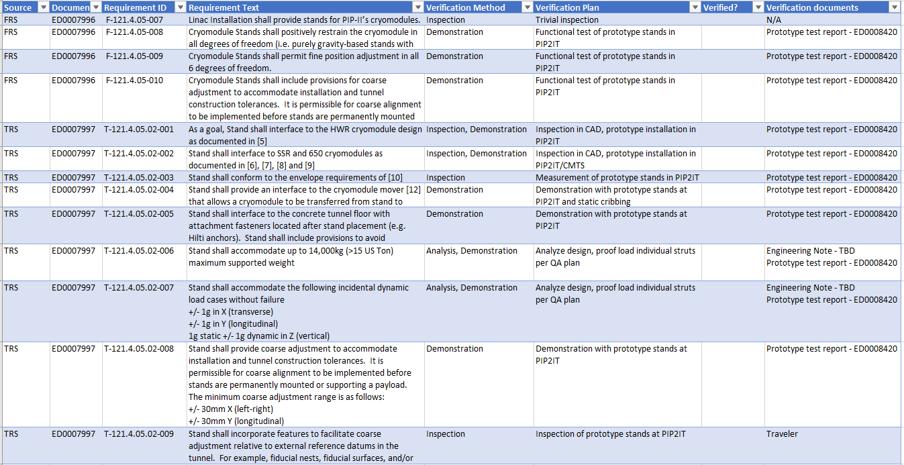
Quality Management – Quality Plan
QC plan created for cryomodule stands: ED0008417
  Component level QC – e.g. strut proof loading
  Assembly level QC – e.g. part count
  Requirement verification tracked by matrix

Slide 23
Risk Management
Charge #2,7
High Rank Risks– none held by Linac Installation
Medium Rank Risks
  RT-121-04-006 Late subsystem delivery makes installation less efficient
    Maintain and enforce transportation envelopes
    Modular designs wherever possible
  RT-121-04-012 Subsystem or component problem discovered after installation
    Mitigated by full-system tests at PIP2IT/CMTF
    Communication and team continuity between PIP2IT and PIP-II
Low Rank Risks
  RT-121-04-021 Critical component damaged during installation or checkout
    Mitigated by full-system tests at PIP2IT/CMTF
    High bar for hardware and machine safety during installation and checkout
Some relevant risks are held by other WBS elements
  E.g. Procurement, Union, Time & Material, Contract Issues
    Managed and mitigated at project level, but relevant to installation

Slide 24
Summary
Installation concepts are evolving in parallel with facility and system design, commissioning planning, and Resource Loaded Schedule development
3D CAD modeling efforts and mechanical design tasks have been initiated and are proceeding well
The team’s past (and future) efforts at PIP2IT provide guidance and training for the installation of PIP-II
We look forward to your feedback, thank you for your attention

Slide 25
END

