Slide 1
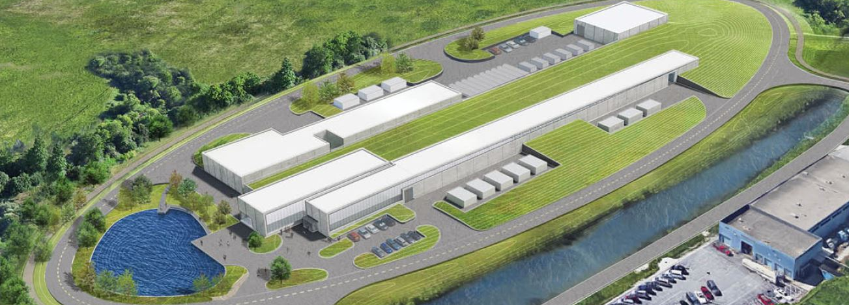
SRF and Cryogenics (121.02)
Genfa Wu
PIP-II Independent Project Review
4-6 December 2018

Slide 2
Outline
Introduction
Cryomodule Development Plan and Schedule
In-kind Contribution and Partner Lab Management
Technical Risks and Challenges
Lessons Learned
Summary

Slide 3
Scope and Deliverables
Charge #1
SRF
Cryomodule | Number (Prototype + installed) | Cavity Number | Magnet Number | Testing | Note
HWR | 1 | 8 | 8 | Tested at FNAL | ANL Led Design
SSR1 | 1+2 | 8 | 4 | Tested at FNAL | FNAL Led Design
SSR2 | 1+7 | 5 | 3 | Tested at FNAL | Integrated Design
LB650 | 1+11 | 3 | 0 | Partial Test at Partner lab, Full Test at FNAL | Integrated Design
HB650 | 1+4 | 6 | 0 | Test at FNAL | Integrated Design
Total | 4+25 | 116 | 37
Shipping from overseas
CRYO
Cryoplant 2.2 kW 2K capacity
Cryogenic distribution to support 2K CW operation and appropriate cool down of Linac

Slide 4
Outline
Introduction
Cryomodule Development Plan and Schedule
In-kind Contribution and Partner Lab Management
Technical Risks and Challenges
Lessons Learned
Summary

Slide 5
Cryomodule Development Path
HWR
(in progress)
Built in US
Built in US
SSR1-1,2
SSR1-0 (prototype)
In progress
SSR2-0 (prototype)
SSR2-1…7
Built in US
Built in US
Built in US
Built in US and Overseas
HB650-1…4
HB650-0 (prototype)
LB650-0 (prototype)
LB650-1…11
Built in US
Built Overseas
Built Overseas

Slide 6
Cryomodule Schedule
Charge #5
27 November 2018 – Critical path on SSR2
Fiscal year
SSR1
SSR1
Prototype
Design Optimization
Production
SSR2
SSR2
Prototype
Design Optimization
Production
LB650
LB650
Prototype
Design Optimization
Production
HB650
HB650
Prototype
Design Optimization
Production
Legend
Start Cavities Cold Tests
Start String Assembly
Start CM RF Testing

Slide 7
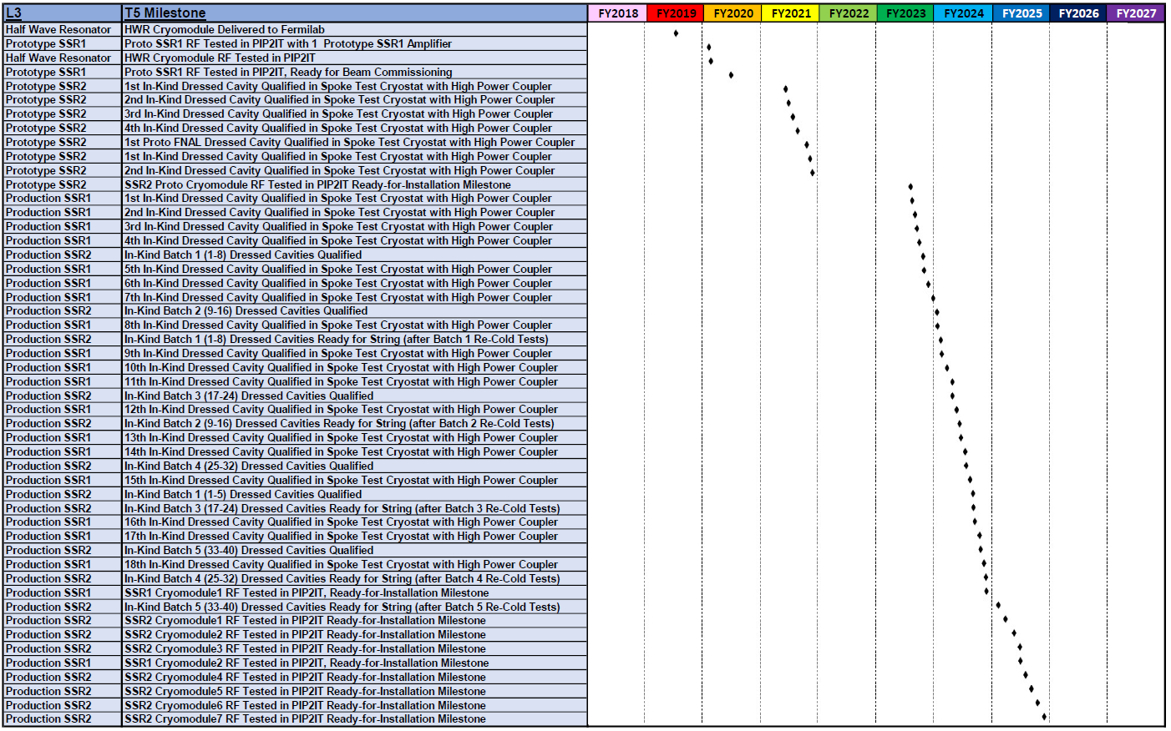
T5 Milestones – Half Wave Resonators and Single Spoke Resonators
SSR2 Prototype
Charge #5
SSR2 Production
SSR1 Production
SSR1 Prototype

Slide 8
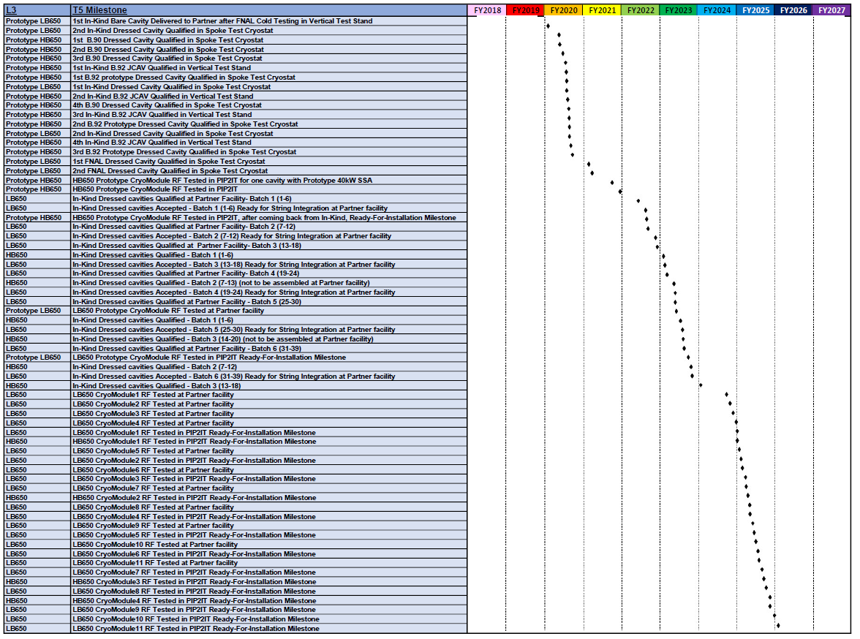
T5 Milestones – 650 MHz Cryomodules
Charge #5
LB650 Prototype
LB650 Production
HB650 Prototype
HB650 Production

Slide 9
T5 Milestones – Cryogenic Systems
Charge #5
Last SSR2 cryomodule and LB650 Cryomodule ready for installation

Slide 10
Outline
Introduction
Cryomodule Development Plan and Schedule
In-kind Contribution and Partner Lab Management
Technical Risks and Challenges
Lessons Learned
Summary

Slide 11
In-kind Contribution
Item | US DOE | In-kind | Note
HWR Cryomodule | ANL builds cryomodule, FNAL tests.
SSR1 Cryomodules | FNAL builds and tests all Cryomodules | Some prototype cavities, all production cavities, tuners and solenoids
SSR2 Cryomodules | FNAL builds and tests all Cryomodules | Some prototype cavities, all production cavities, tuners and solenoids
LB650 Cryomodules | FNAL tests all cryomodules | Prototype and production cryomodules including all sub components | Cavities from different partner lab
HB650 Cryomodules | FNAL builds prototype cryomodule and transportation tests FNAL builds one production cryomodule. FNAL tests all cryomodules | Production cryomodules including all subcomponents Transportation design and procurement | Couplers from different partner lab
Cryoplant | FNAL installation and commissioning | Cryoplant Procurement
Cryogenic Distribution | FNAL design, procurement, installation and commissioning
Cryomodule Repair after Delivery is Fermilab Responsibility

Slide 12
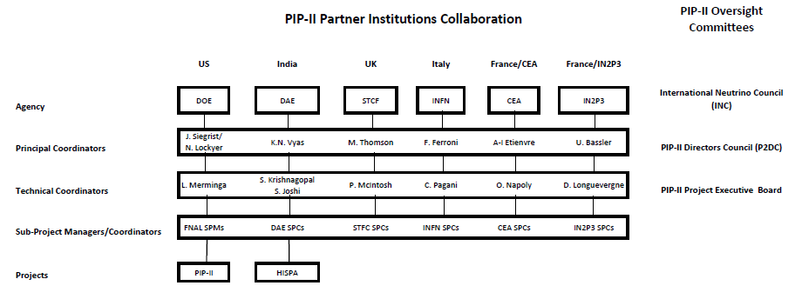
Partner Lab Management
Partner scope, delivery timeframe, milestones and management processes are described in joint Project Planning Documents, under development

Slide 13
Partner Lab Management – SPC List (1)
India Institute and Fermilab Collaboration (IIFC)
Sub-Project | Indian-DAE Sub-Project Coordinator | US-Fermilab Sub-Project Coordinator
SSR1 Cavity Design | P. N. Prakash, IUAC | Leonardo Ristori
SSR2 Cavity Design | Srinavas Krishnagopal, BARC | Leonardo Ristori
SSR1 + SSR2 Cavity Manufacture | Vinay Mishra, BARC | Leonardo Ristori
SSR Cryomodule | Vinay Mishra, BARC | Donato Passarelli
LB650 Dressed Cavity | Sumit Som, VECC | Saravan Chandrasekaran
HB650 Dressed Cavity | Avinash Puntambekar, RRCAT | Saravan Chandrasekaran
LB650 & HB650 Cryomodules | Prashant Khare, RRCAT | Saravan Chandrasekaran
RF Couplers | Rajesh Kumar, BARC | Nikolay Solyak
Cryogenic Systems | Anindya Chakravarty, BARC | Ben Hansen
SRF Infrastructure | Satish Joshi, RRCAT | Allan Rowe
Vertical Test Stand | S. Raghavendra, RRCAT | Alex Melnychuk
Horizontal Test Stand | Pradeep Kush, RRCAT | Joe Ozelis

Slide 14
Partner Lab Management – SPC List (2)
Italy INFN
Sub-Project | ITALY-INFN Sub-Project Coordinator | US-Fermilab Sub-Project Coordinator
LB650 Cavity Design | Carlo Pagani | Martina Martinello
LB650 Dressed Cavity Fabrication | Carlo Pagani | Martina Martinello
LB650 Dressed Cavity Testing | Carlo Pagani | Martina Martinello
UK UKRI
Sub-Project | UK-UKRI Sub-Project Coordinator | US-Fermilab Sub-Project Coordinator
HB650 Cavity | Alan Wheelhouse | Martina Martinello
HB650 Cryomodule Assembly | Phil Atkinson | Tug Arkan
HB650 Transportation | Alan Wheelhouse | Tug Arkan

Slide 15
Partner Lab Management – SPC List (3)
France CEA
Sub-Project | France-CEA Sub-Project Coordinator | US-Fermilab Sub-Project Coordinator
LB650 Cryomodule Design | Nicolas Barzin | Vincent Roger
LB650 Cryomodule Assembly | Catherine Madec | Tug Arkan
LB650 Cryomodule Testing | Catherine Madec | Tug Arkan
LB650 Transportation | Catherine Madec | Tug Arkan
650 MHz Coupler | TBD | Nikolay Solyak
France IN2P3
Sub-Project | France-IN2P3 Sub-Project Coordinator | US-Fermilab Sub-Project Coordinator
SSR2 Jacketed Cavity and Tuner | David Longuevergne | Donato Passarelli
SSR2 Coupler | David Longuevergne | Donato Passarelli

Slide 16
Partner Lab Management and Standardization
Working towards: Common Design Software
UG NX and Siemens Teamcenter
Working towards: Common Traveler Data Sets
Working towards: Standard Units
Standard Non-Conformance-Report and its Work Flow
Hold Point Data Reviews
Common Acceptance Criteria
Partner Lab’s QA plan Approved by Both Partners and Fermilab

Slide 17
Outline
Introduction
Cryomodule Development Plan and Schedule
In-kind Contribution and Partner Lab Management
Technical Risks and Challenges
Lessons Learned
Summary

Slide 18
WBS 121.02 Risk Management
Charge #2,7
SRF and Cryogenics Risks
High Risks: 7
Medium Risks: 17
Low Risks: 12
High Risks
RI-ID | Title
RT-121-02-001 | 650 Cryomodule is damaged during transportation
RT-121-02-003 | Underestimated resources for design optimization of SSR1 CM (1)
RT-121-02-003-B | Underestimated resources for design optimization of HB650 CM (1)
RT-121-02-003-C | Underestimated resources for design optimization of SSR2 CM (1)
RT-121-02-004 | SRF pre-production input couplers are unreliable
RT-121-02-005 | 650 MHz IOT Amplifiers fail
RT-121-02-006 | Cryomodule production rate at Fermilab is too slow
Most high risks retired by CD-3 except -001, -006

Slide 19
WBS 121.02 Risk Management
Charge #2,7
Medium Risks
RI-ID | Title
RT-121-02-007 | SSR1 Cryomodule design modifications identified late in design cycle
RT-121-02-008 | HWR Cryomodule does not meet technical performance requirements
RT-121-02-009 | SSR1 CM (2) Performance at PIP2IT CMTS does not meet technical requirements
RT-121-02-010 | LB650 CMs (1-11) performance at CMTS does not meet technical requirements
RT-121-02-011 | SSR2 Production CMs (2-7) do not meet technical performance requirements at PIP2IT
RT-121-02-012 | HB650 production CMs (2-4) do not meet technical performance requirements at CMTS
RT-121-02-016 | Cavity yield is lower than expected to support production
RT-121-02-013 | Delay in access to SRF testing and fabrication infrastructure
RT-121-02-014 | Insufficient quality of installed cavities
RT-121-02-015 | Insufficient cavity production delivery rate (US/International)
RT-121-02-017 | Niobium quality control is inadequate
RT-121-02-018 | HB650 Cryomodule assembly and integration
RT-121-02-019 | Failure of SRF cavity processing equipment
RT-121-02-020 | Cryoplant delivery is delayed
RT-121-02-021 | SRF Test Infrastructure Cryogenic Plant Failure
RT-121-02-027 | CDS components delayed delivery

Slide 20
2K Heat Load Specification
 | HWR | SSR1 | SSR2 | LB650 | HB650
Cavity length | 0.207 | 0.205 | 0.438 | 0.705 | 1.0438
R/Q | 272 | 242 | 297 | 341 | 610
G | 48 | 84 | 115 | 193 | 260
Nominal Gradient | 9.7 | 8.6 | 11.4 | 15.6 | 18.7
Nominal Q0 | 5.0E+09 | 8.3E+09 | 1.0E+10 | 2.2E+10 | 3.0E+10
Cavity number | 8 | 16 | 35 | 33 | 24
Cryomodule number | 1 | 2 | 7 | 11 | 4
1 Cav Nominal Dynamic Heat Load | 3.0 | 1.6 | 8.4 | 15.9 | 20.8
Current Leads Dynamic Heat Load |  | 2.0 | 1.5
Total Nominal Dynamic Heat Load | 23.7 | 28.9 | 304.3 | 525.6 | 499.7
Total Expected Dynamic Heat Load
Static Heat Load per CM Type | 30 | 45 | 120.4 | 63.8 | 30
Total PIP-II Static HeatLoad |  |  |  |  | 289.2
Total PIP-II Dynamic HeatLoad |  |  |  |  | 1382.2
Total PIP-II Cryogenic Heat Load (2K) |  |  |  |  | 1672
ED0008200 PIP-II Cryogenic Heat Load
Nominal values based on CDR and latest analysis
Heat Load does not including uncertainty and margin

Slide 21
2K Heat Load R&D Goal
 | HWR | SSR1 | SSR2 | LB650 | HB650
Cavity length | 0.207 | 0.205 | 0.438 | 0.705 | 1.0438
R/Q | 272 | 242 | 297 | 341 | 610
G | 48 | 84 | 115 | 193 | 260
Nominal Gradient | 9.7 | 8.6 | 11.4 | 15.6 | 18.7
Nominal Q0 | 5.0E+09 | 1.0E+10 | 1.5E+10 | 3.0E+10 | 4.0E+10
Cavity number | 8 | 16 | 35 | 33 | 24
Cryomodule number | 1 | 2 | 7 | 11 | 4
1 Cav Nominal Dynamic Heat Load | 3.0 | 1.3 | 5.6 | 11.9 | 15.6
Current Leads Dynamic Heat Load |  | 2.0 | 1.5
Total Nominal Dynamic Heat Load | 23.7 | 20.5 | 195.9 | 394.2 | 374.7
Total Expected Dynamic Heat Load
Static Heat Load per CM Type | 30 | 45 | 120.4 | 63.8 | 30
Total PIP-II Static HeatLoad |  |  |  |  | 289.2
Total PIP-II Dynamic HeatLoad |  |  |  |  | 1009.1
Total PIP-II Cryogenic Heat Load (2K) |  |  |  |  | 1298
ED0008200 PIP-II Cryogenic Heat Load
R&D Supported both by FNAL and partner labs

Slide 22
High Q R&D – 650 MHz 1-cell Results
1.5K
EP + 120C baking only.
N-doping soon
2K
M. Martinello
VTS test results from B9AS-PAV-104 and B9AS-AES-106 after 75C/120C baking and 40µm EP reset, respectively.
Lower and upper set of curves represent 2 K and 1.5 K measurement, respectively.
B9AS-PAV-105 after EP and B9AS-AES-006 after BCP are illustrated for comparison.
High Q cavity procedure is being optimized

Slide 23
High Q R&D – SSR
ESS Double Spoke Cavities
SSR2 Spec = 8e9 @ 11 MV/m
Results from ESS spoke cavity are encouraging
D. Longuevergne

Slide 24
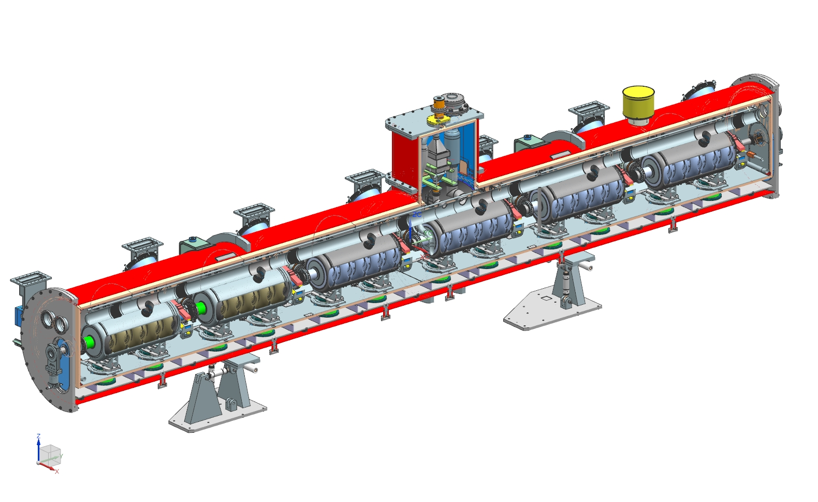
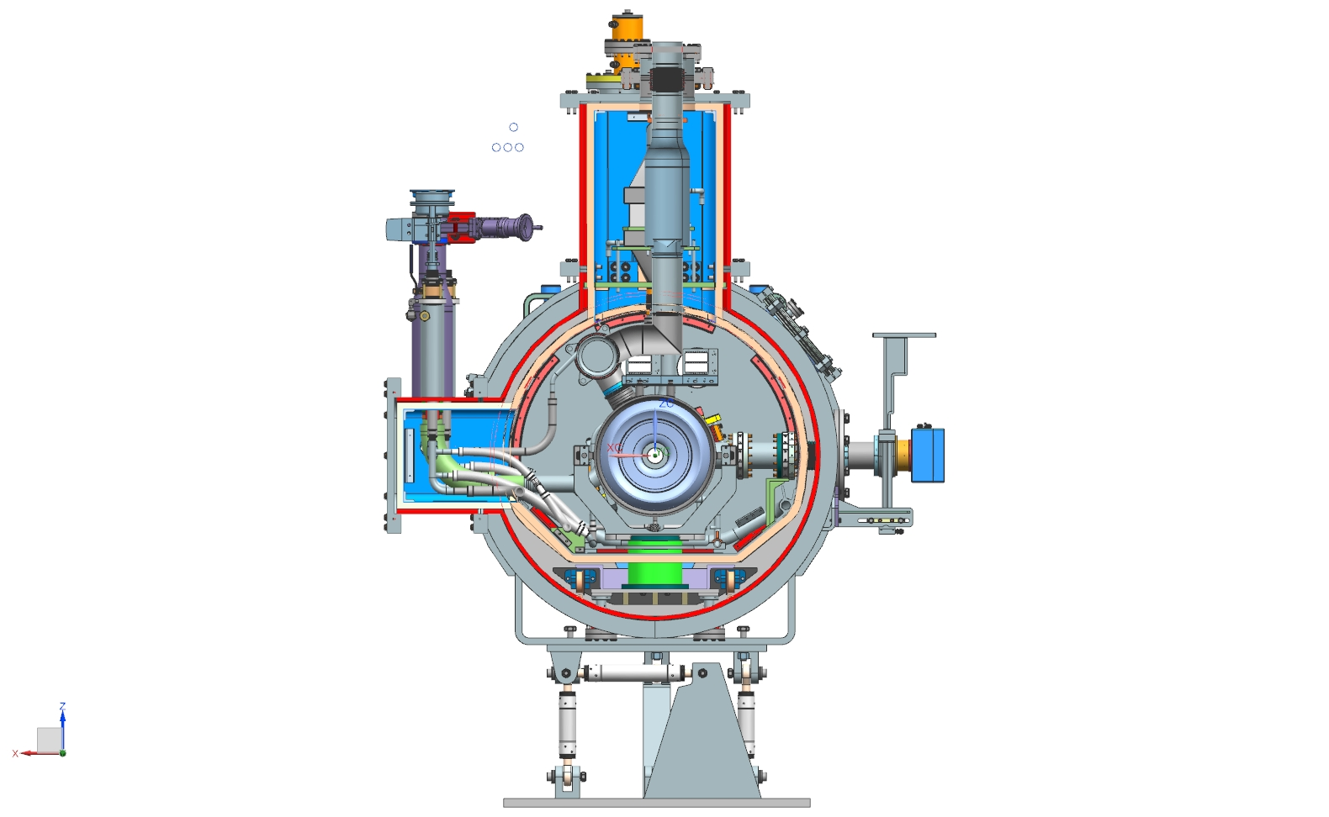
HB650 Cryomodule Design Features to Support High Q
Cryogenic System Supports Fast Cool Down
Cryomodule Thermal Design to Minimize Thermoelectric Current
Magnetic Shield to Minimize Ambient Earth Magnetic Field
Global and local magnetic shield design
Better Instrumentation for High Q operation
SC3-Chandrasekaran
2018-12-04

Slide 25
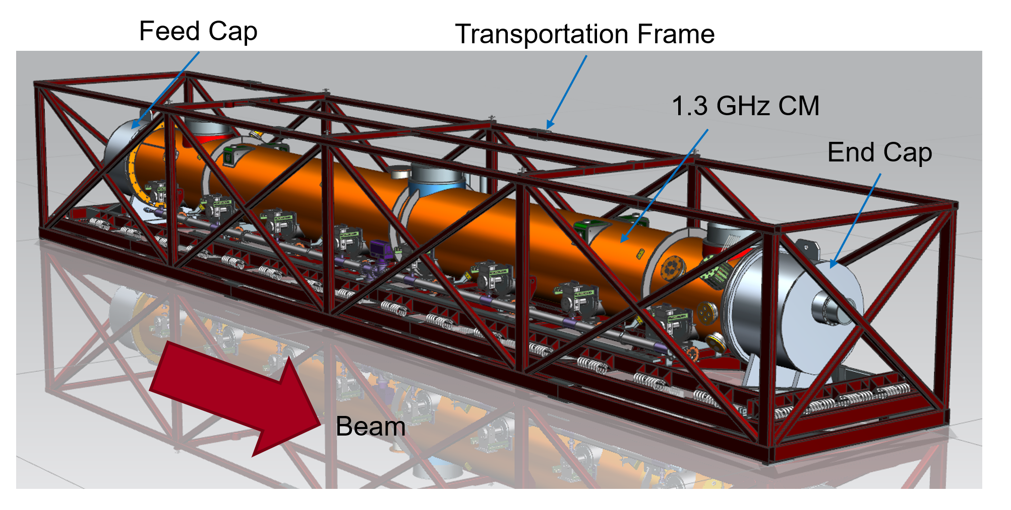
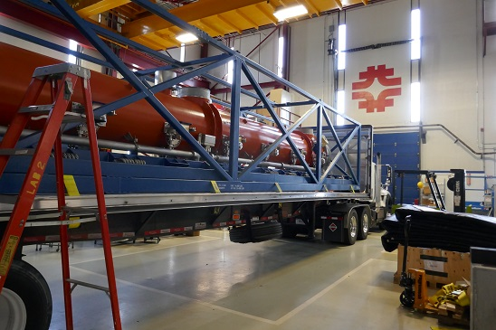
Transportation Challenge in LCLS-II
LCLS-II Cryomodule – inner coupler bellows failures at cavities 4 and 5 in F1.3-06 (later in cavity 1 in F1.3-05)

Slide 26
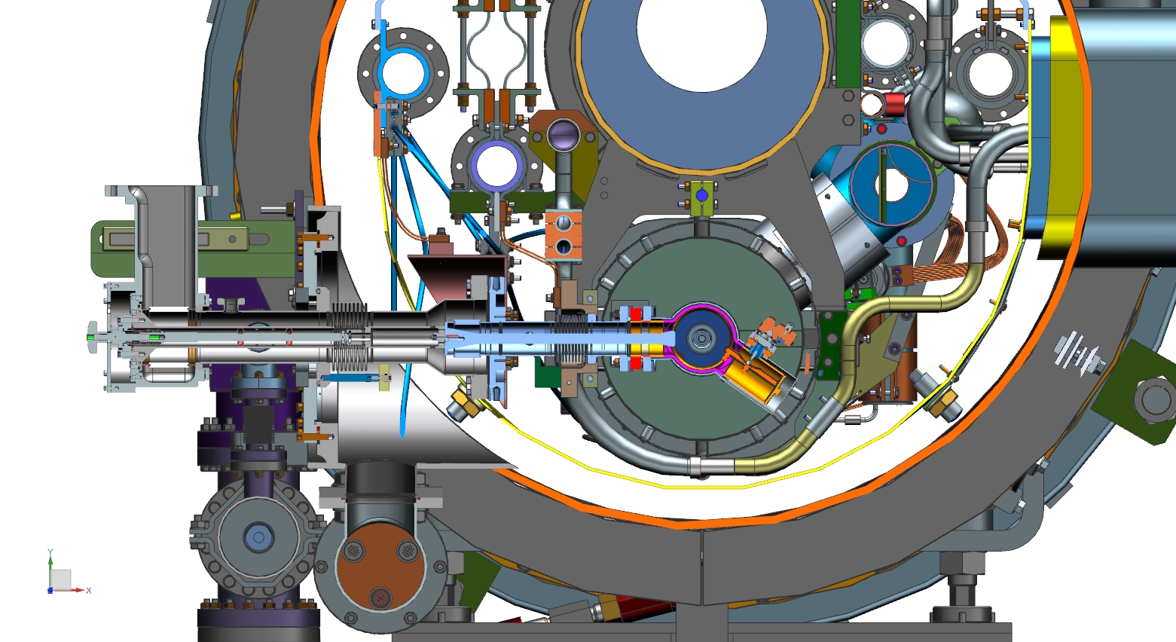
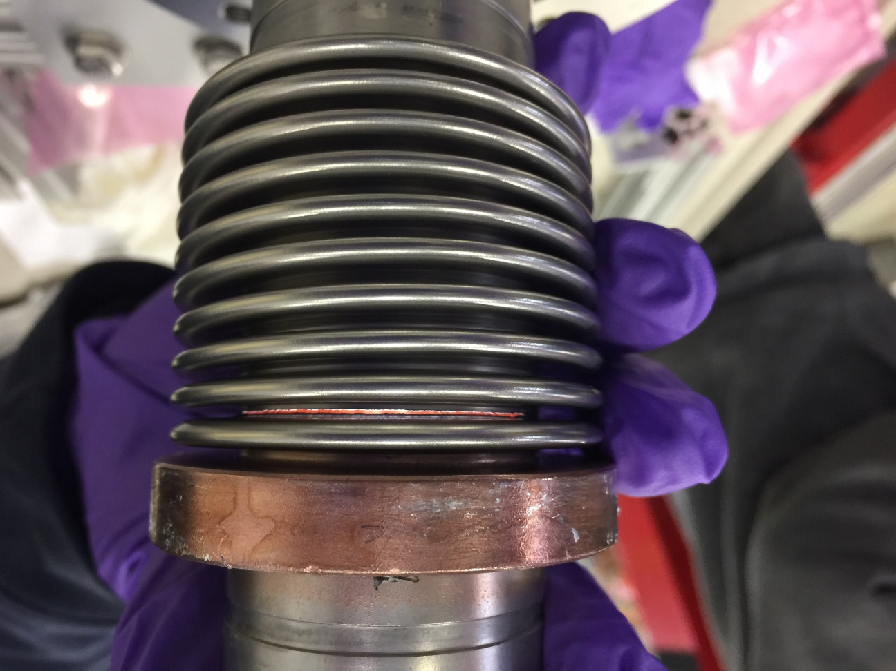
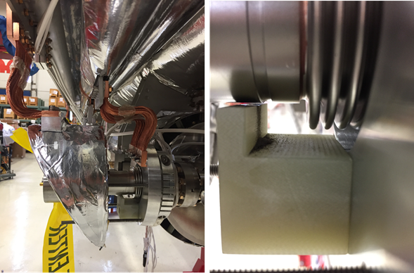
LCLS-II Cryomodule – inner coupler bellows failures at cavities 4 and 5 in F1.3-06 (later in cavity 1 in F1.3-05)

Slide 27
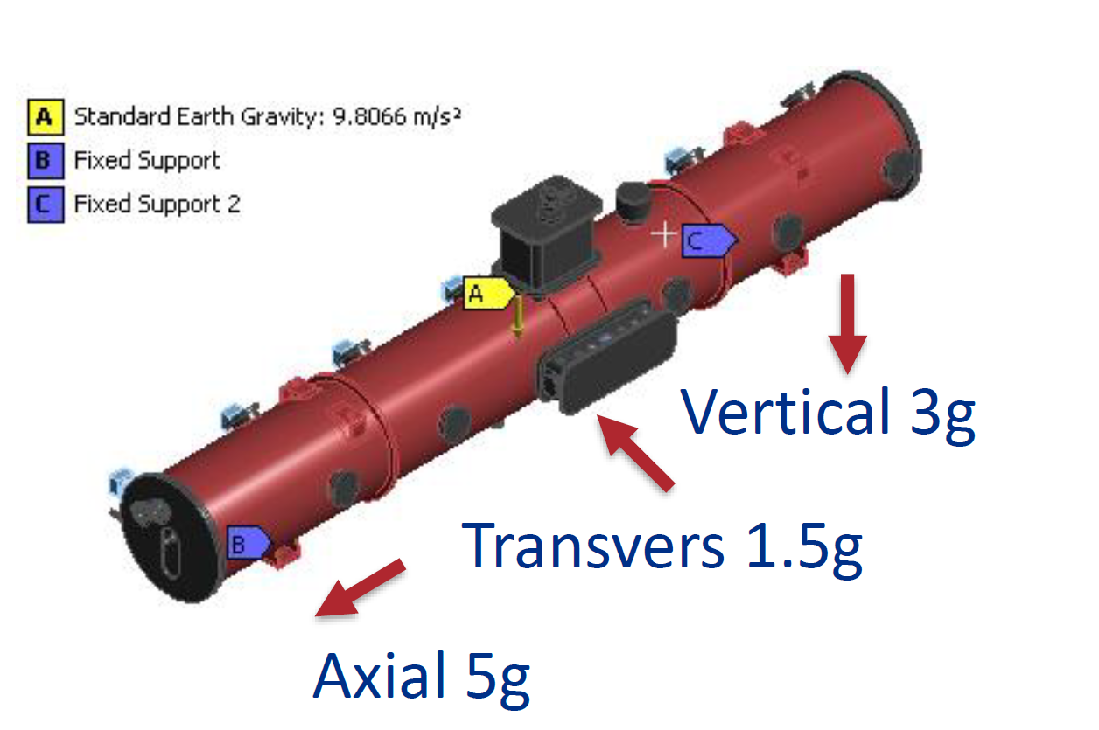
Transportation is Part of the Cryomodule Prototyping
Transportation is Part of the Cryomodule Prototyping
Transportation Studies (three trips)
HB650 Prototype Cryomodule
Fully Tested
FNAL to Europe, fully instrumented
Test Optional
Europe to FNAL, fully instrumented
Verification Test
LB650 Prototype Cryomodule
Partially Tested
Europe to FNAL, fully instrumented
Verification Test
SC3-Chandrasekaran

Slide 28
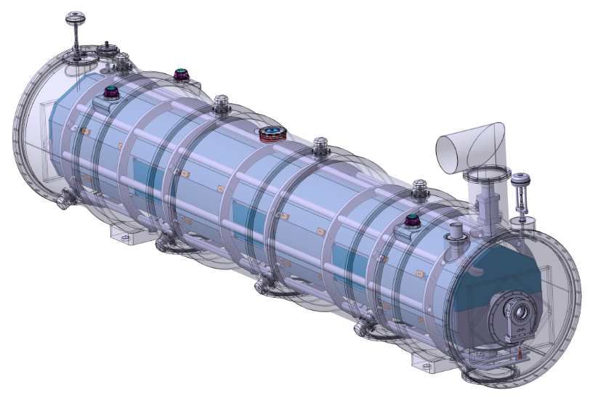
650 MHz Cryomodule Transportation
Conducted transportation analysis of two leading CM design concepts: strong-back (SSR1) and spaceframe (ESS, SNS)
Held 650 MHz cryomodule design advisory meeting
Hasan Padamsee, Robert Laxdal, Michael Kelly, Thomas Peterson,, Ed Daly, Mark Wiseman, Joel Fuerst
Preliminary analysis showed no technical preference in terms of shipping and alignment
Final decision considered: Technical evaluation; Schedule & Cost impact; CEA & other partners considerations;
A preliminary design choice was made in November to adopt strong back design
RLS includes shipping proto HB650 from US to Europe and back
Spaceframe Design
CEBAF, SNS, ESS
Bottom Support (strong back)
FRIB, PIP-II
28
2018-12-04

Slide 29
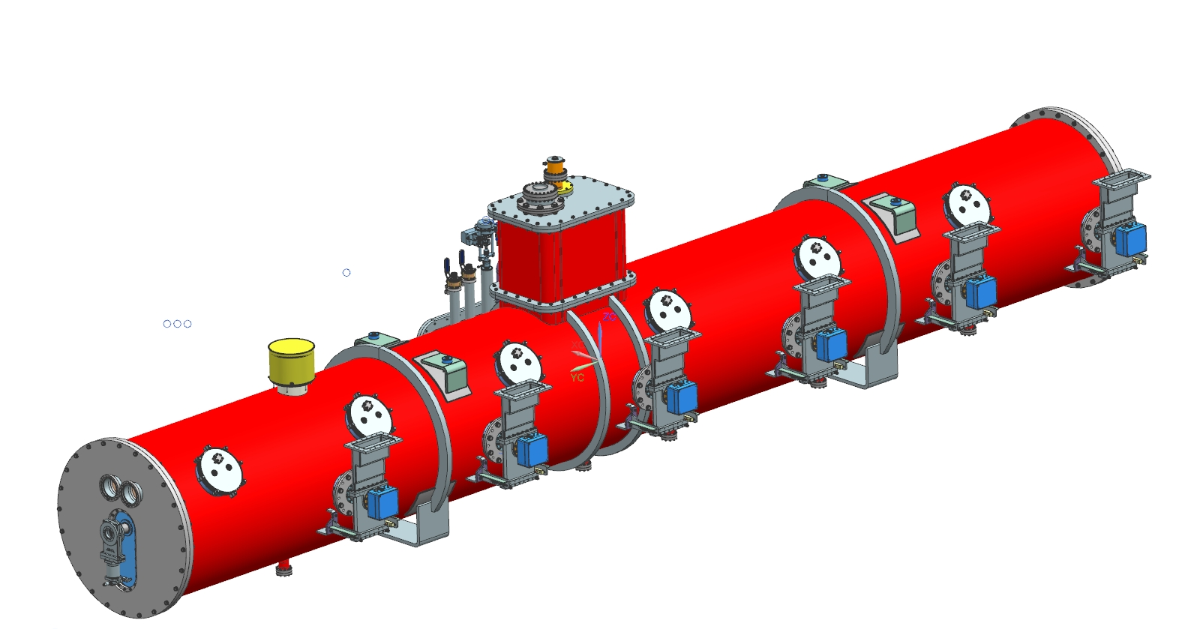
Transportation Strategy and Specification (Draft)
To be removed during transportation:
Warm Couplers and Door knobs
Actuators
Pressure Gauges and Transducers
Others
Specified accelerations during
Transportation on Cryomodule:
Axial: 2.5g
Transverse: 1.5g
Vertical: 2.5g
To be constrained:
Heat exchanger
Gate valves
Fully instrumented with accelerometers, etc.

Slide 30
Partner Lab Risk Management
Charge #2,7
System/Component | India/DAE | Italy/INFN | UK/UKRI | France/CEA/IN2P3 | Fermilab Backup
Cavities
SSR1 - jacketed | ✓ |  |  |  | ✓
SSR2 -jacketed | ✓ |  |  | ✓ | ✓
LB650 – Jacketed | ✓ | ✓ |  |  | ✓
HB650 – jacketed | ✓ |  | ✓ |  | ✓
Cryomodules
SSR2 | ✓ |  |  |  | ✓
LB650 |  |  |  | ✓ | ✓
HB650 | ✓ |  | ✓ |  | ✓
SSR2 Cold Magnets | ✓ |  |  |  | ✓
Cryoplant | ✓
Partner Labs have their own risk management

Slide 31
Partner Lab Risk Management
Charge #2,7
Joint Cryomodule Design Team with Experienced Staff
Fermilab Staff Participates Partner Lab Activities
Redundancy Capability Explored
Support Activities including Quality Assurance are Built into Resource Loaded Schedule
Partner Labs Participates Monthly Status Reporting
International Risk Mitigation is being Developed
Fermilab has staff and infrastructure to support at risk components
Notes:
Allan drafted a document, posted.

Slide 32
Outline
Introduction
Cryomodule Development Plan and Schedule
In-kind Contribution and Partner Lab Management
Technical Risks and Challenges
Lessons Learned
Summary

Slide 33
Lessons Learned
Lessons Learned from other Projects
Transportation by design
Comprehensive fastener torque specification
Microphonics Early Studies
Cryomodule Test with Sufficient Duration
Lessons Learned within PIP-II
Realtime Traveler
Spoke cavity S104 near-miss of uncontrolled pump down

Slide 34
Summary
Cryomodule Development Plan Allows Sufficient Prototyping to Feedback to Production.
In-kind Contribution has Redundancy of Capabilities.
Technical Risks and Challenges are mostly Understood
Lessons Learned from other Projects will be Positive for PIP-II Cryomodules.

Slide 35
END

