Slide 1
121.02.03 SRF - Single Spoke Resonator Cryomodules
SRF and Cryogenics Breakout Session
Donato Passarelli
PIP-II IPR
4-6 December 2018

Slide 2
Outline
Scope/Deliverables
  Including In-Kind Contributions from partners
Requirements
Interfaces
Preliminary Design, Maturity
Technical Progress to Date
ESH&Q
Risks and Mitigations
Summary

Slide 3
About Me:
Donato Passarelli
  L3 Manager for SSR cavities and cryomodules
  Group Leader, Mechanical Engineering in APS-TD
  Working in the SRF field (SSR at FNAL) since 2010
  PhD in Mechanical Engineering on SSR1 cavities and tuner

Slide 4

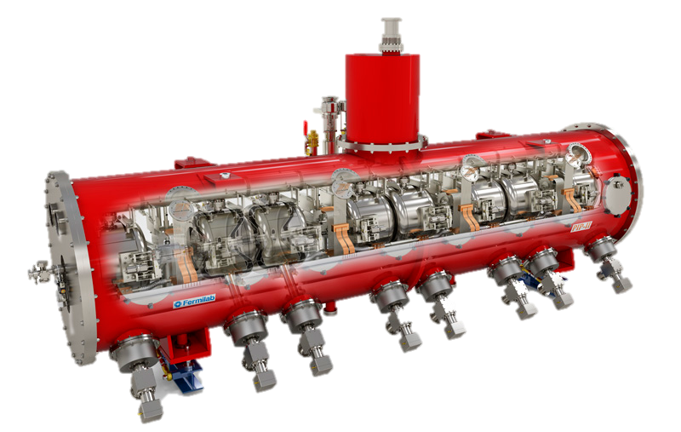
121.02.03 SSR Scope and Deliverables
Charge #2
Design, procurement, fabrications and testing of the Single Spoke Resonator (SSR1, SSR2) cavities and cryomodules
 | SSR1 | SSR2
# CMs | 1+2 | 1+7
Cavities per CM | 8 | 5
Solenoids per CM | 4 | 3
CM configuration c: cavities; s: solenoids | 4x (csc) | sccsccsc
CM length (m) | 5.2 | 6.5
SSR1 cryomodule
Final scope will be delivery of tested CMs for installation into PIP-II tunnel

Slide 5


121.02.03 SSR Scope and Deliverables
Charge #2
SSR1, SSR2 International Partners:
India
France

Slide 6
121.02.03 SSR Scope and Deliverables
Charge #2
Item | Quantities installed | DOE | Partners R&D & Construction
SSR1 proto CM | 1
Cryomodule | 1 | 1
Jacketed Cavities | 8 | 8 | 2
Couplers | 8 | 11
Tuners | 8 | 10 | 2
SC Solenoids | 4 | 5
Cold BPMs | 4 | 5
SSR1 CM1-2 | 2
Cryomodule | 2 | 2
Jacketed Cavities | 16 | 18 | 18
Couplers | 16 | 18
Tuners | 16 | 16 | 16
SC Solenoids | 8 |  | 10
Cold BPMs | 8 | 10
Item | Quantities installed | DOE | Partners R&D & Construction
SSR2 proto CM | 1
Cryomodule | 1 | 1
Jacketed Cavities | 5 | 2 | 6
Couplers | 5 | 2 | 7
Tuners | 5 | 1 | 6
SC Solenoids | 3 |  | 4
Cold BPMs | 3 | 4
SSR2 CM1-7 | 7
Cryomodule | 7 | 6 | 1
Jacketed Cavities | 35 |  | 40 + 5
Couplers | 35 |  | 40 + 5
Tuners | 35 |  | 37 + 5
SC Solenoids | 21 |  | 23
Cold BPMs | 21 | 23
CM assembly and final qualification testing at Fermilab

Slide 7
121.02.03.02 SSR1 Scope and Deliverables
Charge #2
SSR1 Prototype CM
  FNAL scope:
    Qualification of 8 jacketed cavities with coupler and tuner
    Complete procurement, QA/QC and integration of all cryomodule components
    RF testing and verification of cryomodule performance at PIP2IT
  Partners deliverables:
    2 jacketed cavities, 2 tuners
  FNAL deliverables:
    delivery of tested and qualified proto SSR1 CM at PIP2IT
SSR1 Production CMs (1, 2)
  FNAL scope:
    Finalization of design and procedures using lessons learned from proto CM
    Testing and qualification of 16 fully integrated cavities
    Procurement, QA/QC, assembly and integration of the full cryomodules
    RF testing and verification of cryomodule performance at PIP2IT
  Partners deliverables:
    18 Jacketed cavities, 16 tuners, 10 SC solenoids
  FNAL deliverables:
    delivery of 2 tested and qualified CMs for installation at PIP-II tunnel

Slide 8
121.02.03.02 SSR2 Scope and Deliverables
Charge #2
SSR2 Prototype CM
  FNAL scope:
    Design/support partners to design cavities and cryomodule components
    Fabrication of prototype cavities, tuners, couplers
    Testing and qualification of fully integrated cavities
    Procurement, QA/QC, assembly and integration of all cryomodule components
    RF testing and verification of cryomodule performance at PIP2IT
  Partners deliverables:
    6 jacketed cavities, 6 tuners, 7 couplers, 4 SC solenoids
  FNAL deliverables:
    tested and qualified proto SSR1 CM at PIP2IT
SSR2 Production CMs (1…7)
  FNAL scope:
    Finalization of design and procedures using lessons learned from proto CM
    Testing and qualification of fully integrated cavities
    Procurement (1…6), QA/QC, assembly and integration of the full cryomodules
    RF testing and verification of cryomodule performance at PIP2IT
  Partners deliverables:
    45 jacketed cavities, 45 couplers, 42 tuners, 23 SC solenoids, all CM components for the 7th CM
  FNAL deliverables:
    7 tested and qualified CMs for installation at PIP-II tunnel

Slide 9
121.02.03 System Requirements
Charge #2
Functional Requirement Specification (FRS) are defined and traceable in Teamcenter:
SSR1 cryomodule: TC# ED0001316
SSR2 cryomodule: TC# ED0001829
Main Cryomodule Parameters | Units | SSR1 | SSR2
Energy for section | MeV | 10.3 to 35 | 35 to 185
Cavities (solenoids) per cryomodule |  | 8 (4) | 5 (3)
Cryomodule flange-to-flange length | m | ≤ 5.4 | ≤ 6.5
2 K heat load | W | < 50 | < 75
5 K heat load | W | < 80 | < 80
30 – 50 K heat load | W | < 255 | < 250
Environmental magnetic field | mG | ≤ 15 | ≤ 15
Transverse cavity (solenoids) alignment error, RMS | mm | ≤ 1 (0.5) | ≤ 0.5 (0.5)
Angular cavity (solenoids) alignment error, RMS | mrad | ≤ 5 (0.5) | ≤ 5 (0.5)
Table of main cryomodules requirements

Slide 10
121.02.03 System Requirements
Charge #2
SSR1 cavities
SSR2 cavities
Main Cavities Parameters | Units | SSR1 | SSR2
Frequency | MHz | 325 | 325
β_{g} (β_{opt}) |  | 0.186 (0.222) | 0.398 (0.475)
Aperture diameter (Effective length) | mm | 30 (205) | 40 (438)
Operating energy gain per cavity | MV | 2.05 | 5
Unloaded cavity quality factor (Q₀) at 2K |  | 0.6×10¹⁰ | 0.8×10¹⁰
Cavity operating temperature | K | 2.0 | 2.0
MAWP at room temperature (at 2K) | bar | > 2.05 (4.1) | > 2.05 (4.1)
Sensitivity to LHe pressure fluctuations | Hz/mbar | < 25 | < 25
Lorentz Force Detuning coefficient | Hz/(MV/m)² | < 5 | < 2.8
Coupler testing power (in full reflection) | kW | 10 | 20

Slide 11
121.02.03 Interfaces
Charge #2
L2 Sys | L3 WBS | L3 System Name | L3 Sys | ICD TC ID
SRFCryo | 121.2.03 | Single Spoke Resonator Cryomodule (SSR) | SSR | ED0007565
121.02.03
SSR
121.03.03
High Power RF
121.03.06
Vacuum
121.03.04
Low Level RF
121.03.07
Controls
121.03.02
Accelerator Physics
121.02.05
Cryo Plant
121.06.05
Linac Complex
121.04.03
Test Infrastructure
121.02.06
Cryo Distribution Systems
121.03.09
Beam Instr.
121.03.05
Magnet PS
Interfaces are identified and revision controlled documents exist in Teamcenter

Slide 12
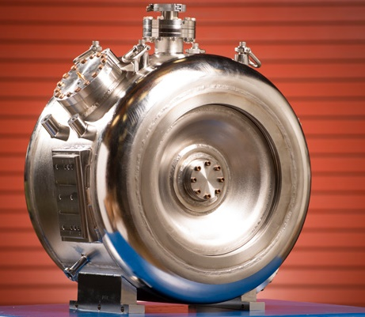
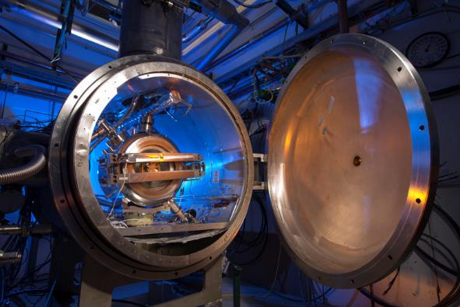
SSR1 cavities
Charge #2
8 fully integrated cavities were tested and qualified
  S104, S106, S109, S110, S111, S112, S113, S114
    S107 is conditionally qualified and it will serve as spare one

Slide 13
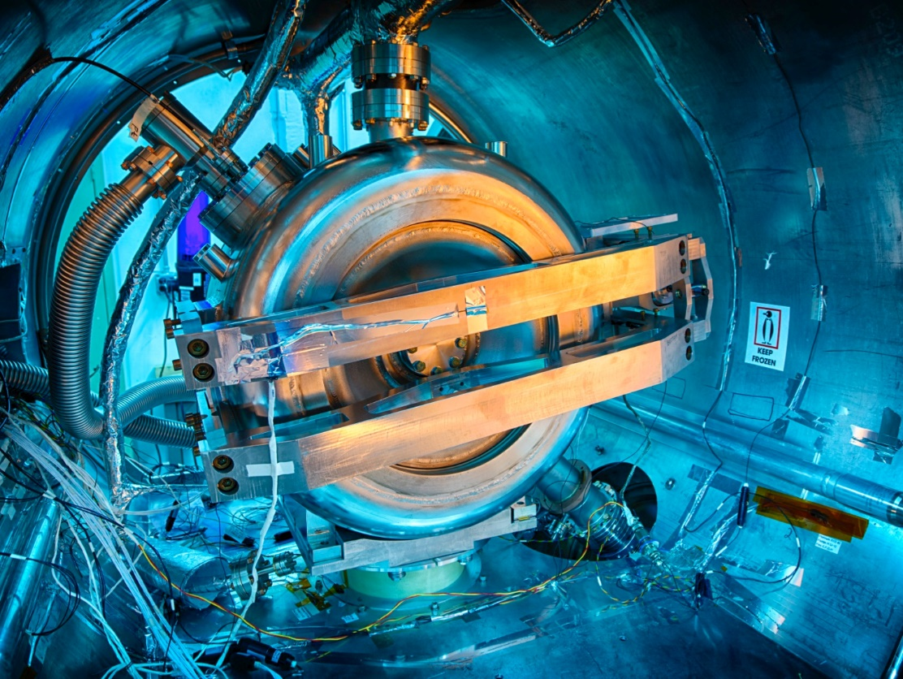
SSR1 cavities performance
Charge #2
Cavity ID # | Type | Date of test, yyyy-mm-dd | Q0, x10e8 @10 MV/m | Eacc max, MV/m | Rad. onset field, MV/m | Rad, mR/h @10 MV/m | Rad, mR/h @Eacc max
S1F-IU-104 | A | 2018-10-07 | 110 | 14.4 | 13 | 0 | 45
S1H-NR-106 | B | 2018-08-19 | 80 | 14.4 | 12.7 | 0 | 153
S1H-NR-109 | A | 2018-10-21 | 64 | 11.7 | 9.3 | 27 | 170
S1H-NR-110 | A | 2018-09-29 | 133 | 14.4 | 11 | 0 | 666
S1H-NR-111 | A | 2018-06-13 | 90 | 14.4 | n/a | 0 | 0
S1H-NR-112 | B | 2018-04-10 | 83 | 14.4 | n/a | 0 | 0
S1H-NR-113 | B | 2018-05-17 | 122 | 14.4 | n/a | 0 | 0
S1H-NR-114 | B | 2018-09-09 | 121 | 14.4 | 14.4 | 0 | 9
df/dp for all cavities with tuner engaged:
  4 ≤ df/dp ≤ 10 Hz/Torr
LFD coefficient for all cavities with tuner engaged:
  4 ≤ LFD coeff. ≤ 7 Hz/(MV·m)²
All 8 cavities were found within the frequency target range at 2k

Slide 14
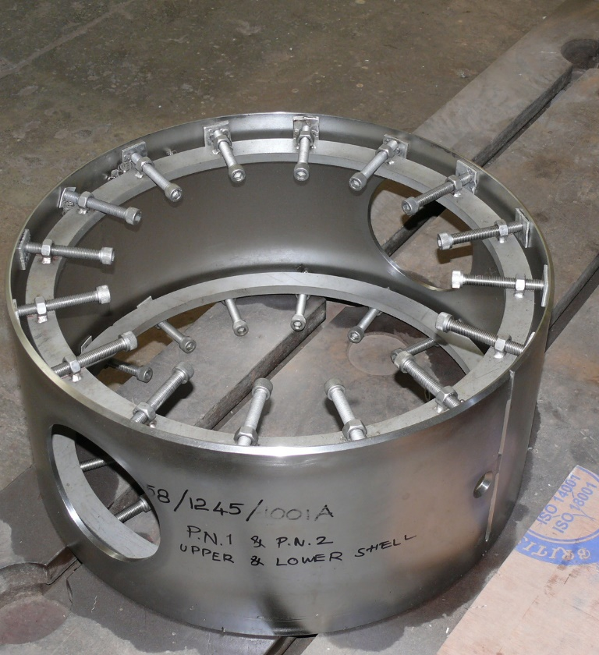
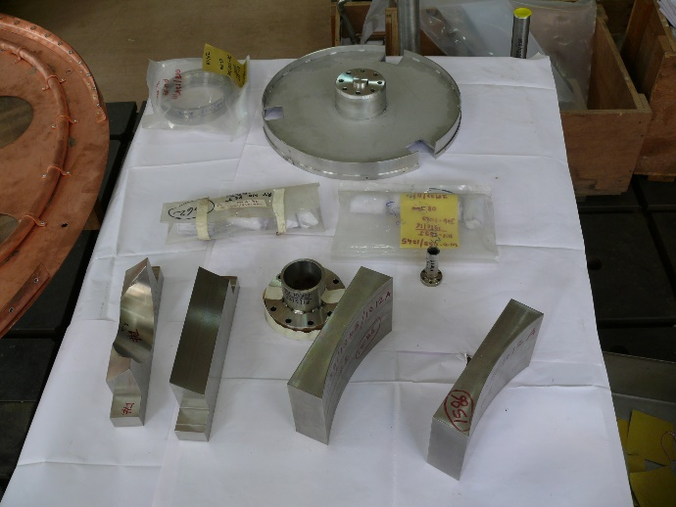
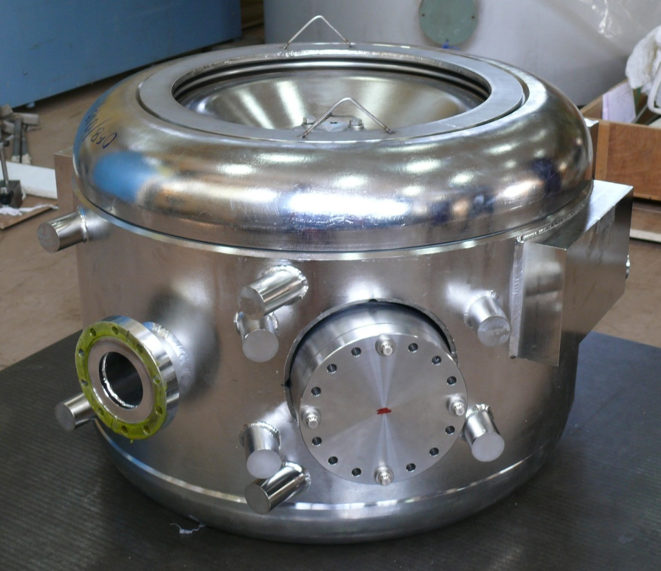
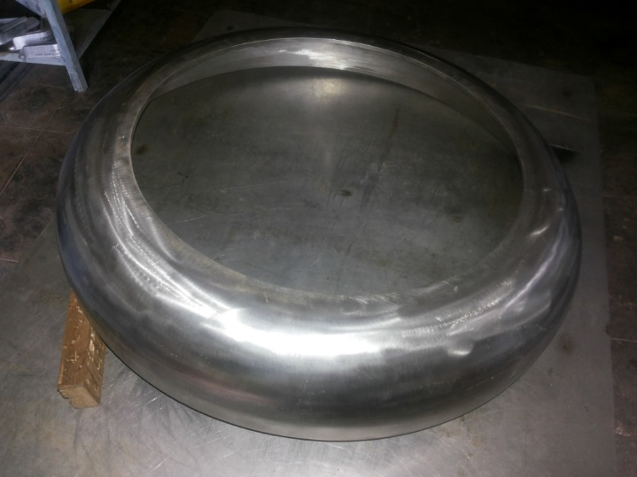
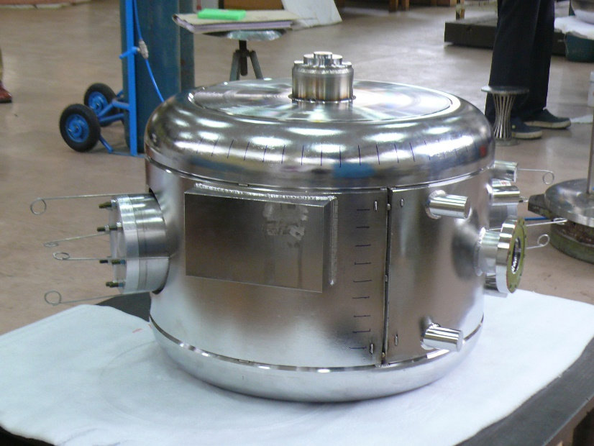
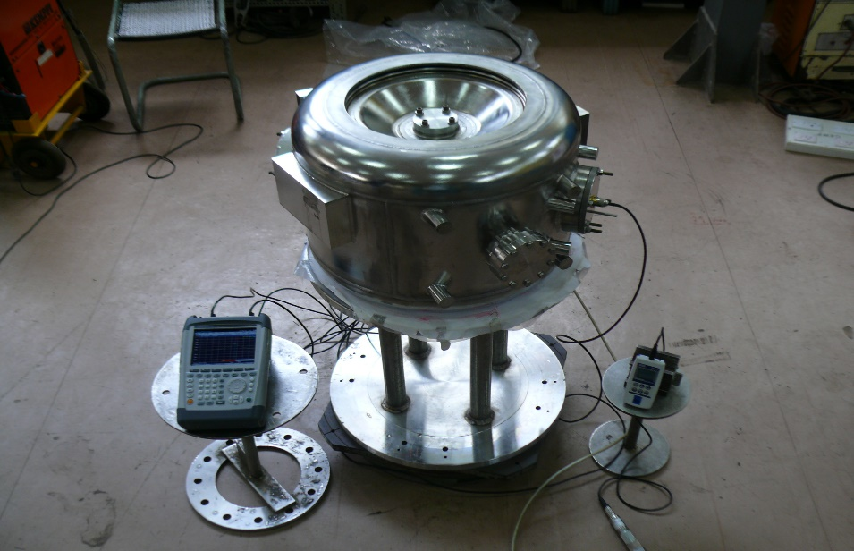
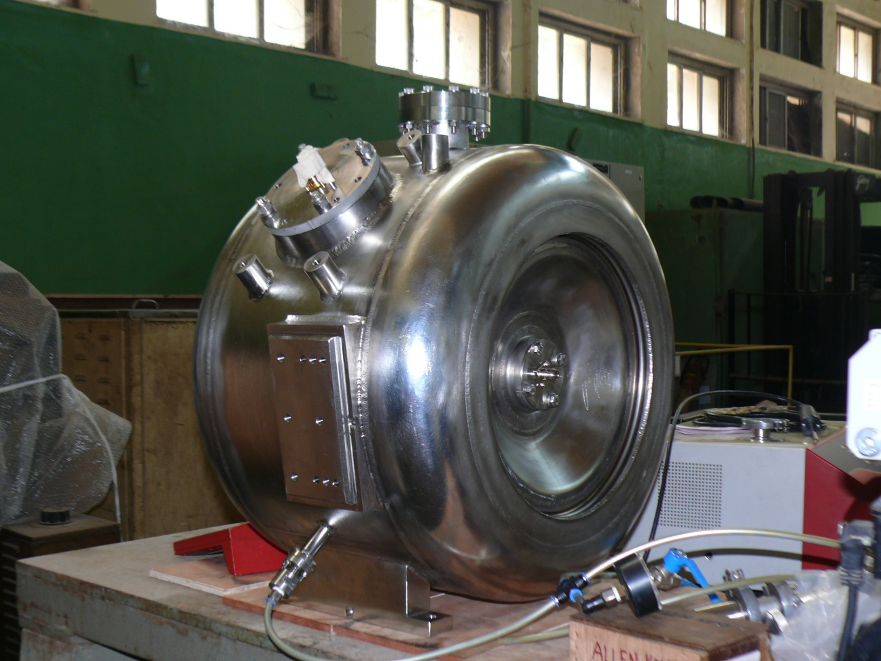
SSR1 cavities S103 and S104 from partners
Charge #2
Components
Shell before Weldment
Dome Head
Dry fitting before weldment
Pressure Gauge
VNA
Tack Welded
RF Frequency & Pressure Testing
Components for He Jacketing for two cavities S103 and S104 were manufactured in house at BARC, Mumbai
He Jacketing followed by RF measurement and Pressure testing were done on the Dressed cavity prior to shipping to FNAL
Dressed Cavity

Slide 15
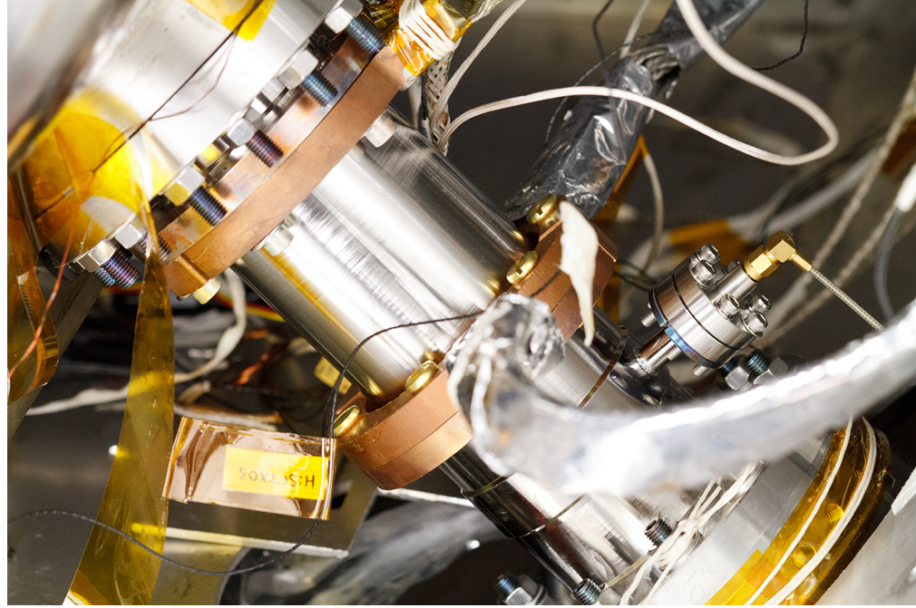
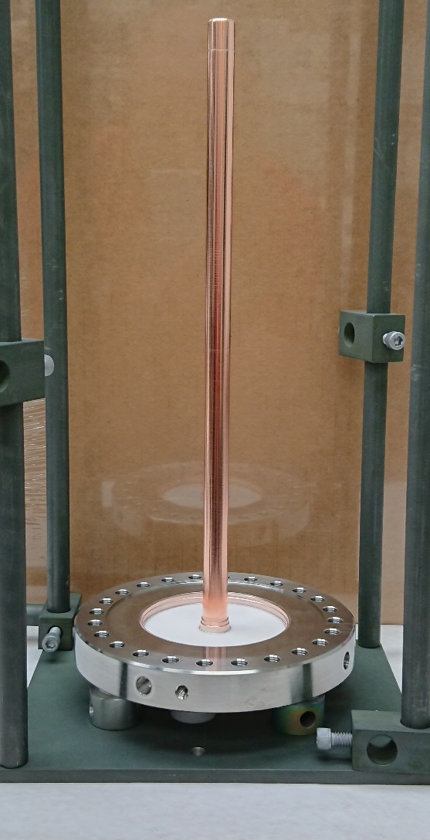
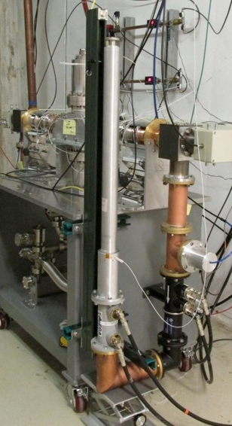
SSR1 couplers
Charge #2
8 vacuum end couplers were successfully:
  QC inspected
  qualified at room temperature on the RF test stand (10 kW full reflection)
  cleaned and particle-free installed on cavities
  qualified during integrated cavity tests in the Spoke Test Cryostat

Slide 16
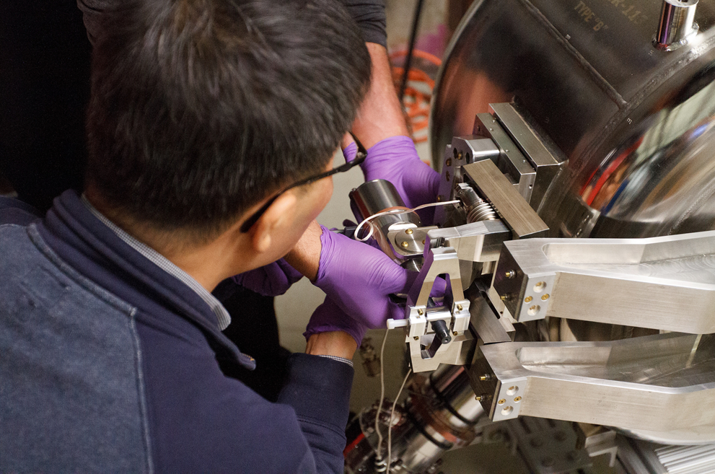
SSR1 Tuner and resonance control
Charge #2
Prototype SSR1 tuner
Design completed and one unit was prototyped
Successfully tested at 293K and cold temperature
Production SSR1 tuner
Design completed
1 out of 10 units was received and used for resonance control of SSR1 cavities
Active components for 1st cryomodule ( 9 electromechanical and 18 piezo actuators) were tested at cold temperature
SSR1 cavity in the Spoke Test Cryostat (STC)
Resonance control studies
  Requirements: microphonics <20 Hz
  Good progress during cold tests at STC. ResControl algorithms, developed for ILC/ProjectX and LCLS II, successfully applied and requirements are nearly achieved.

Slide 17
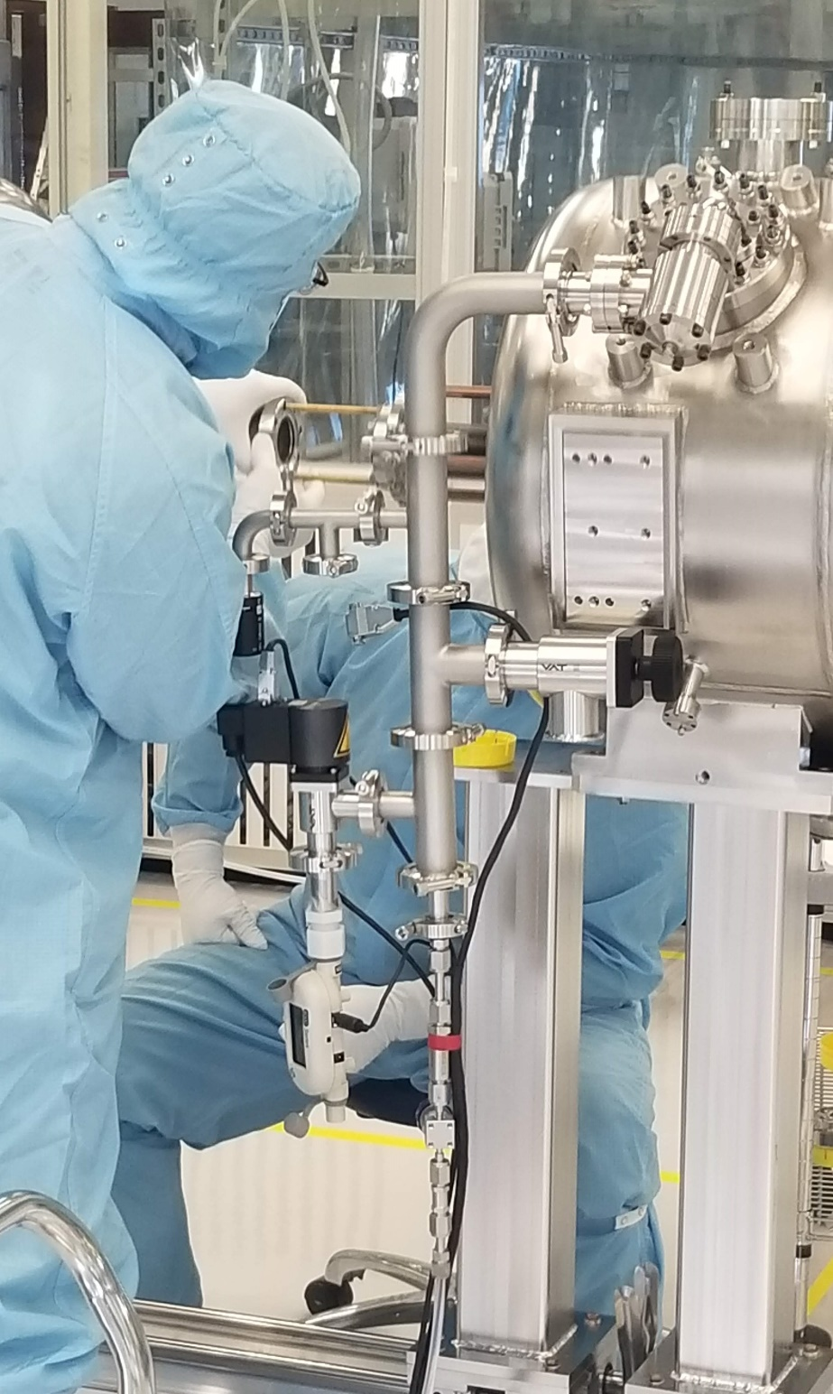
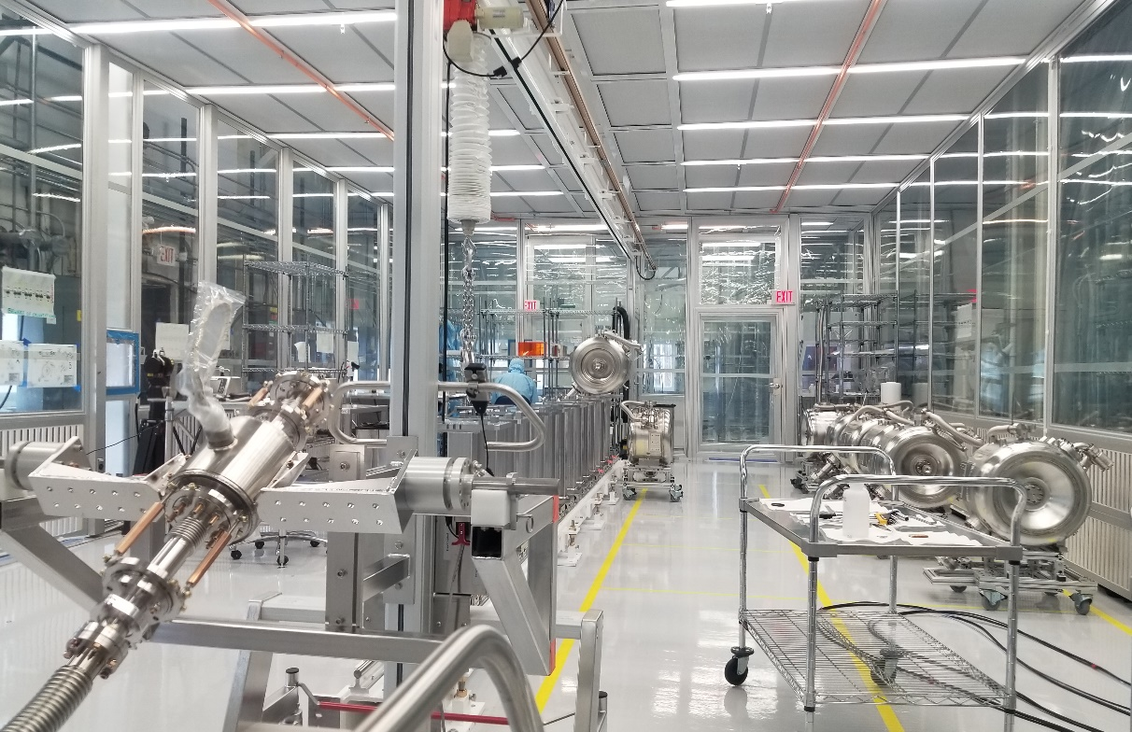
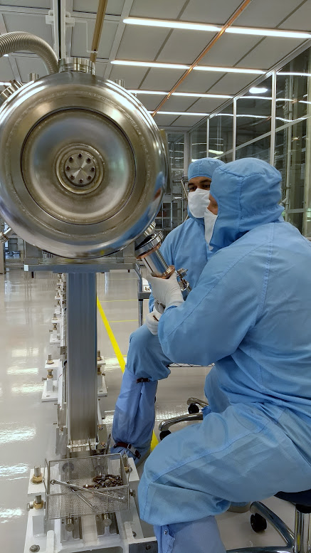
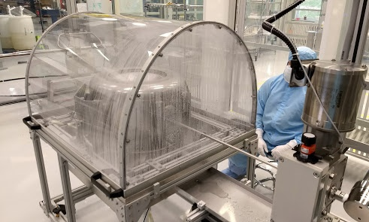
Lab 2 cleanroom
Charge #2
Lab 2 cleanroom is a qualified facility for SRF activities: SSR1 string assembly

Slide 18
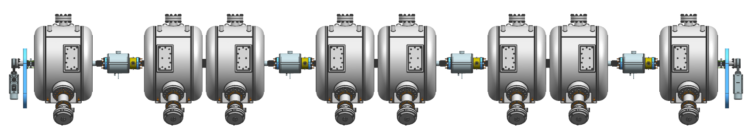
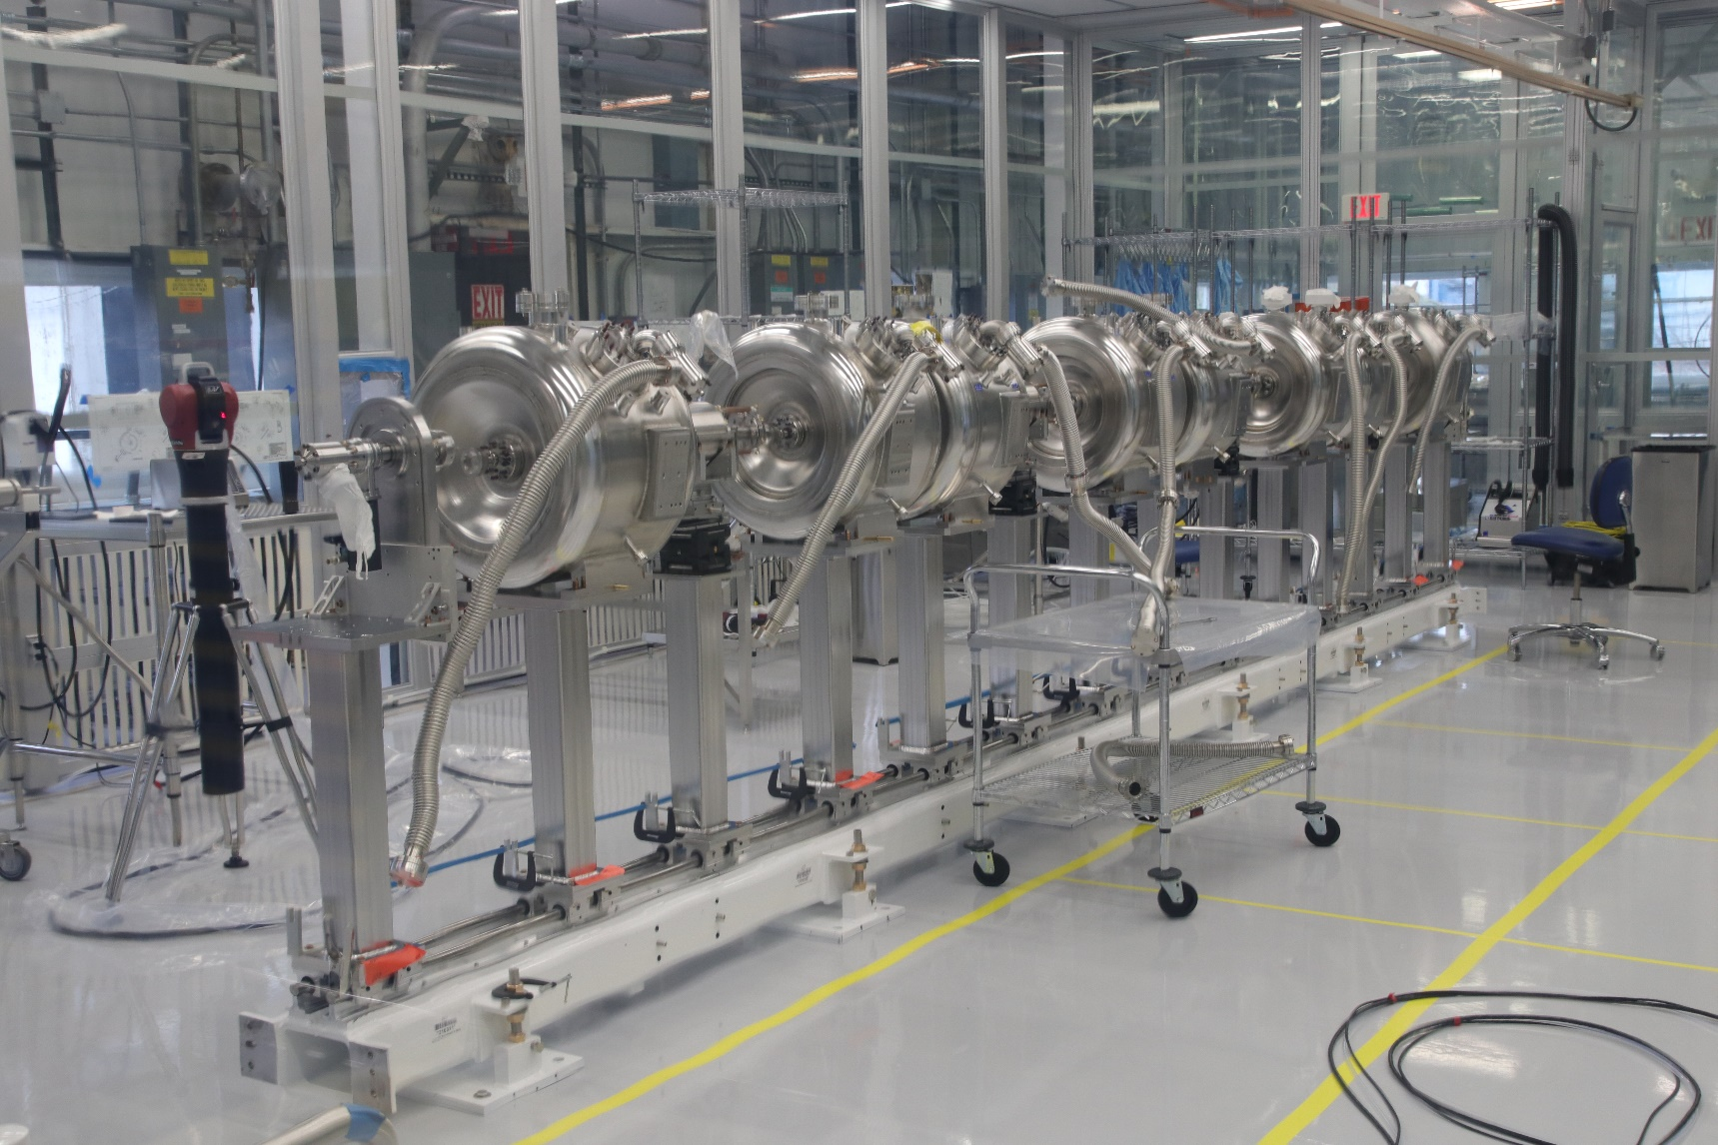
SSR1 cavities string assembly
Charge #2
BPM
IIFC SSR1 cavity
Solenoid
SSR1
Type B
SSR1 Type A
SSR1
Type B
SSR1 Type A
SSR1
Type B
SSR1 Type A
SSR1
Type B
SSR1 Type A
Gate Valve
Coupler
(vacuum-end)
Gate Valve
Currently working on the cavity string assembly in the Lab2 cleanroom
All string assembly components were subject QC inspections
Particle-free procedures were developed and validated by qualifying cavities
Alignment is being performed using laser trackers
Possible design improvements have been identified and collected

Slide 19
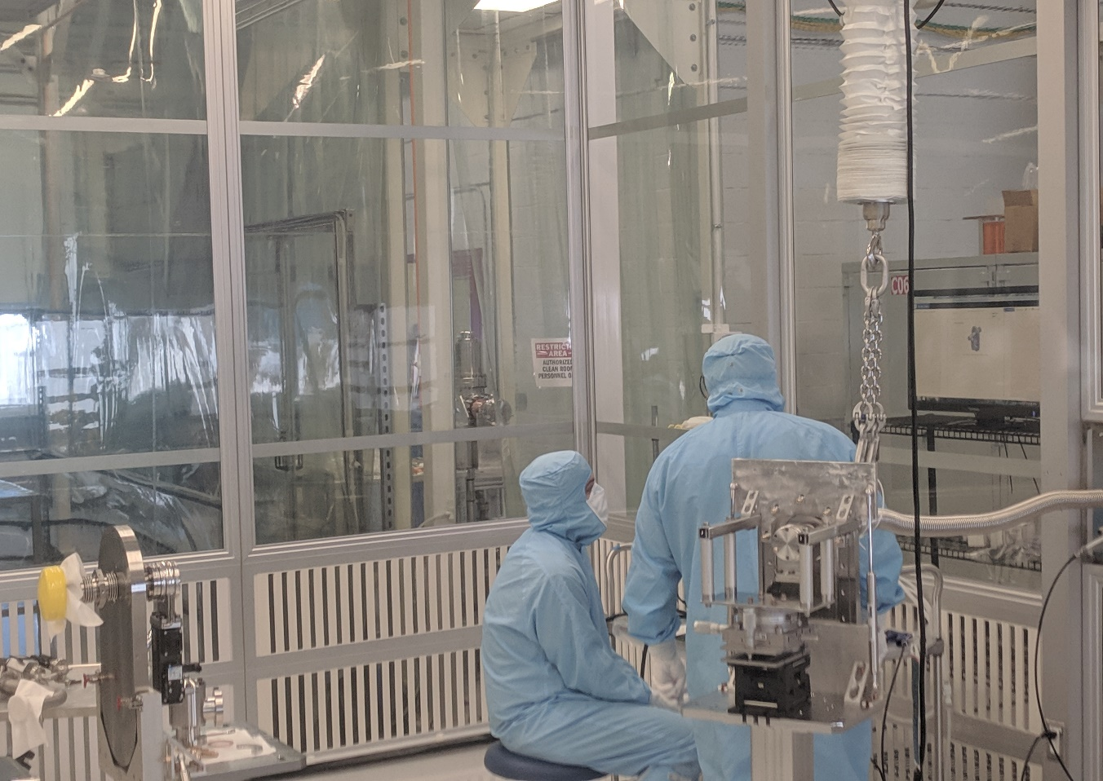
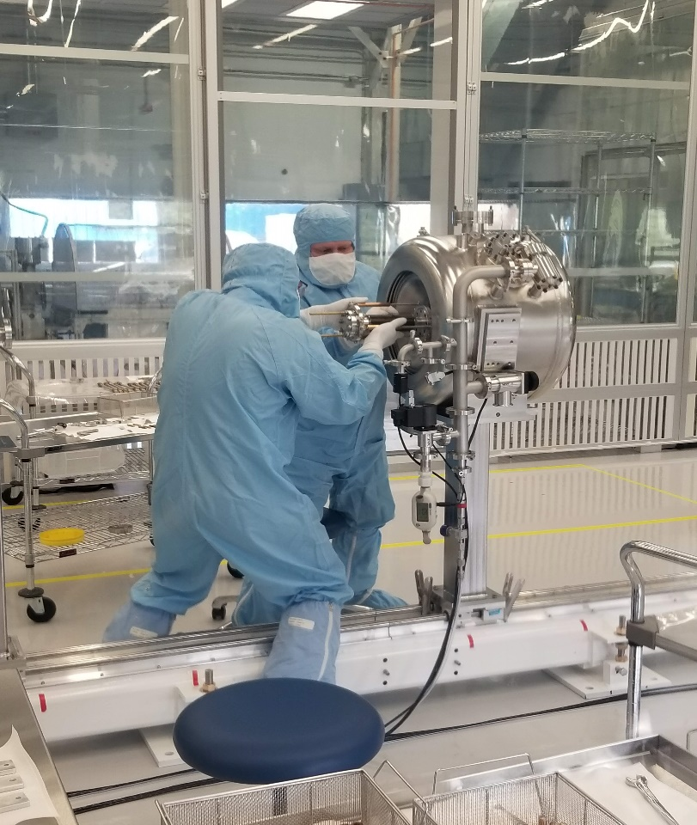
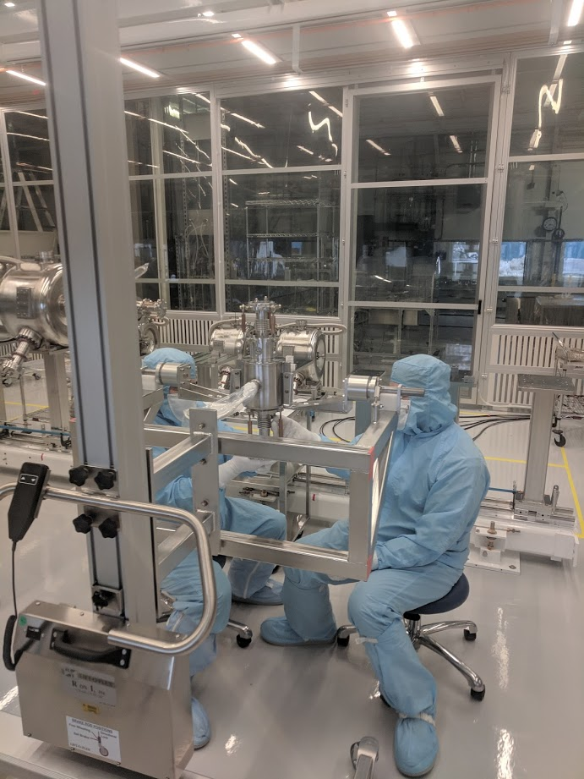
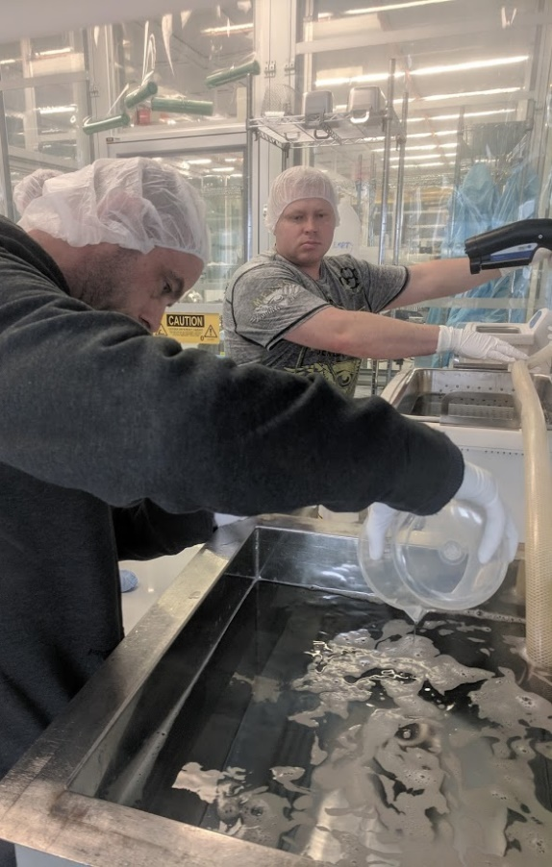
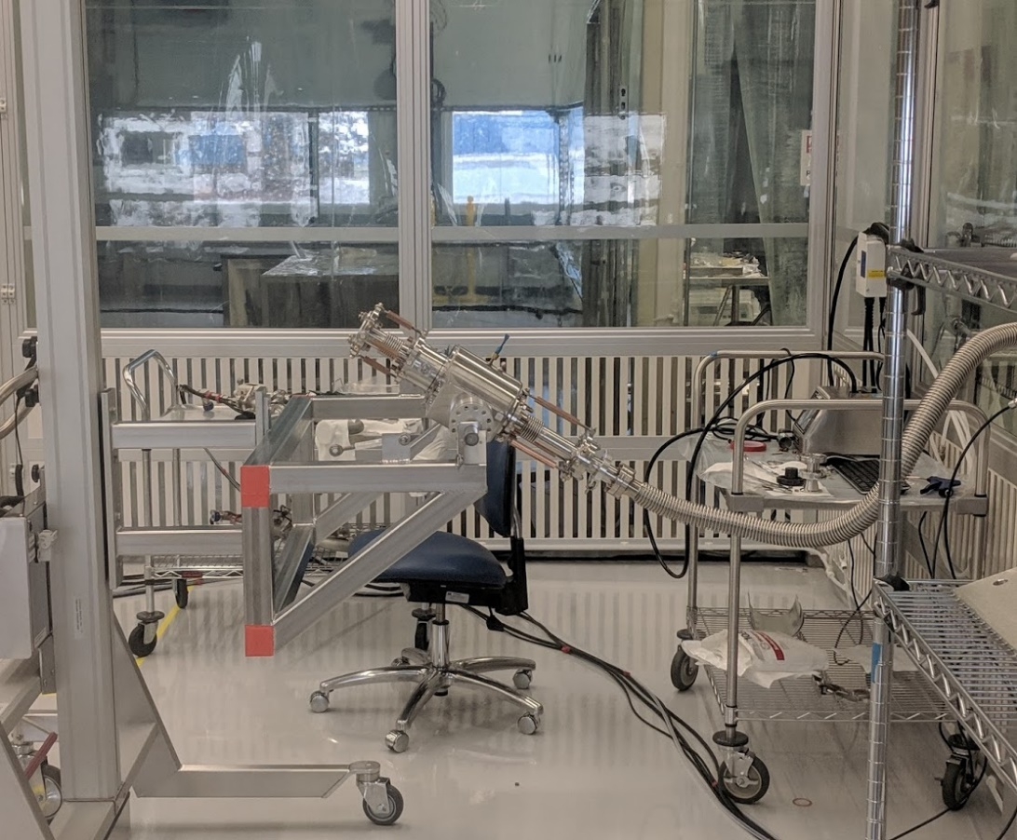
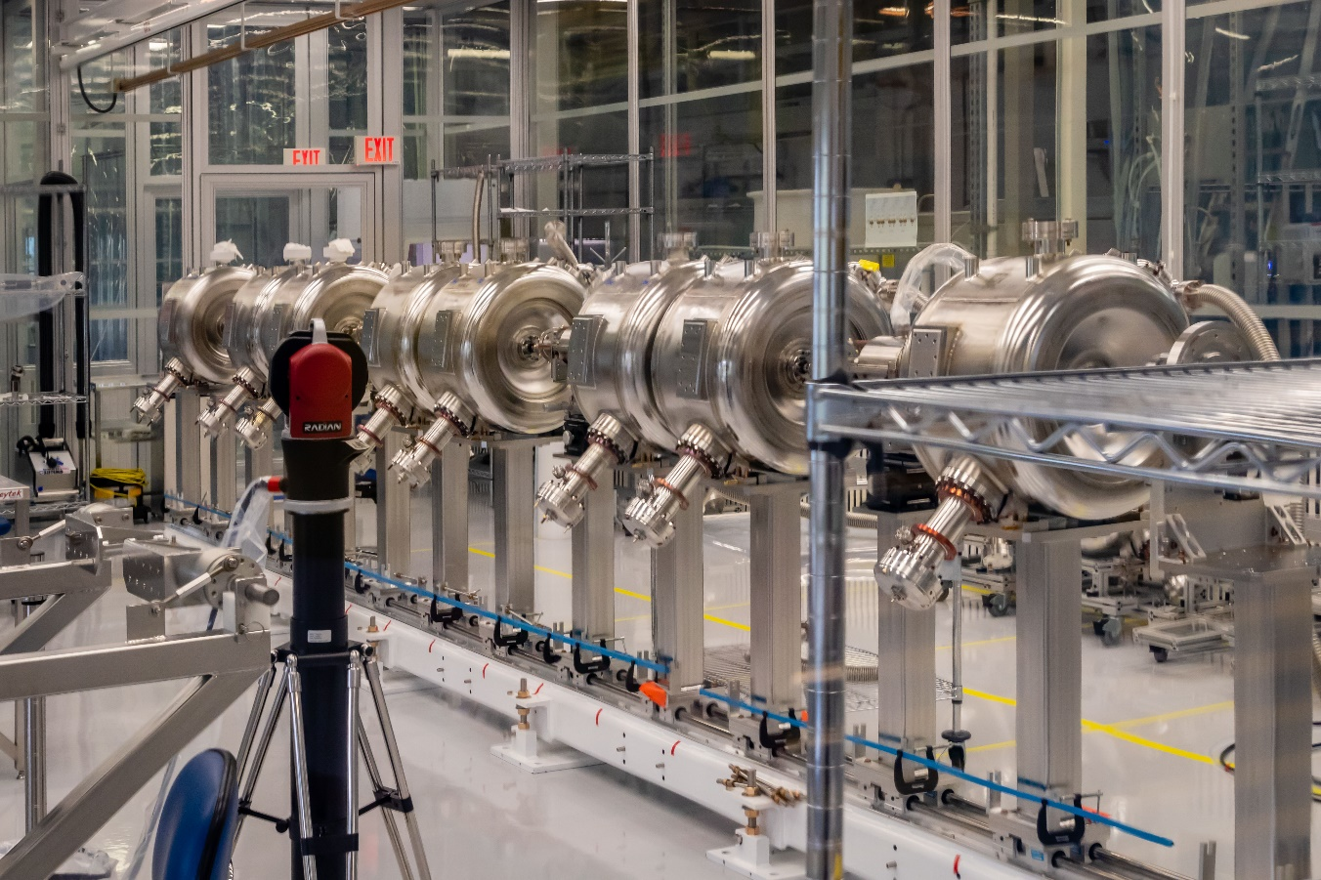
SSR1 cavities string assembly: preparation
Charge #2

Slide 20
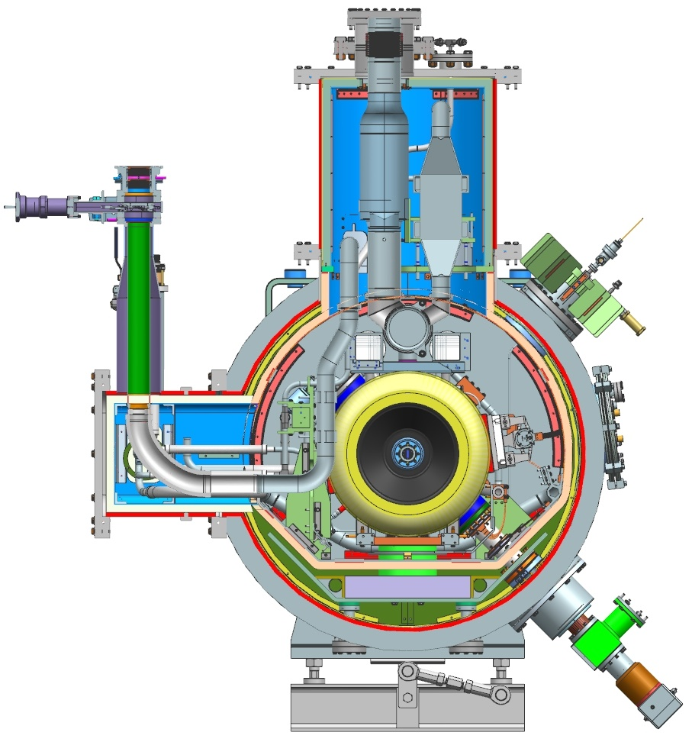
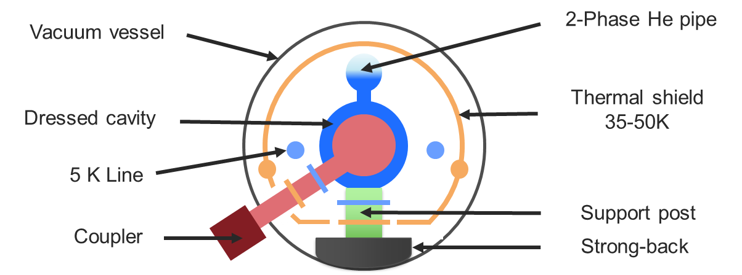
SSR1 Cryomodule
Charge #2
Conceptual layout of PIP-II CMs
SSR1 CM cross section

Slide 21
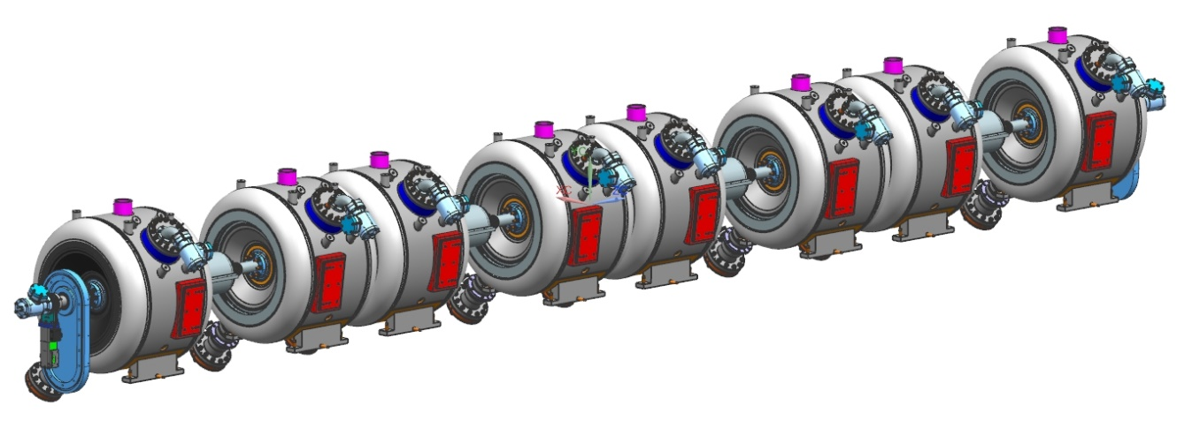
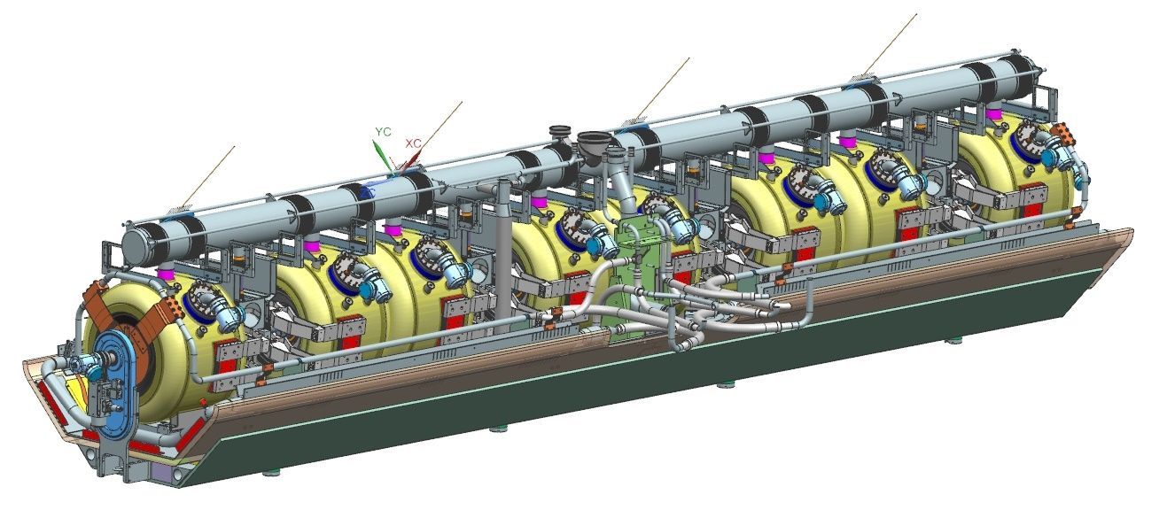
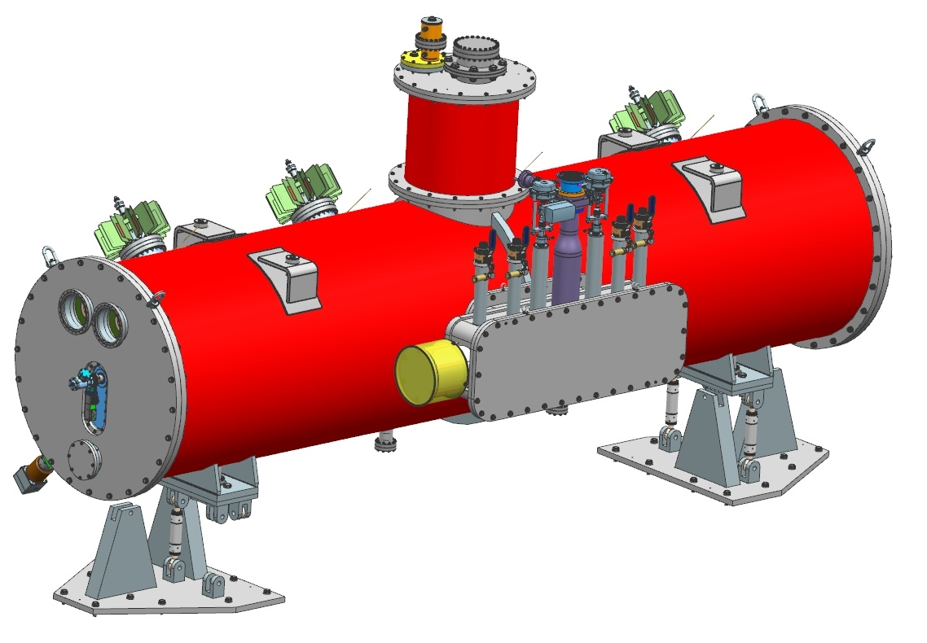
SSR1 Cryomodule: design maturity
Charge #2
  SSR1 Cavity String assembly
    Design: completed
    Procurement: completed
    Assembly is ongoing
      Completion expected by Dec 21, 2018
  SSR1 Coldmass
    Design: completed
    Procurement: ongoing
  SSR1 Top cryomodule assembly
    Design: ready for FDR
    Transportation tooling: in progress
    Procurement: ongoing
    Expected CM completion date
      May 2019
    Testing at PIP2IT

Slide 22
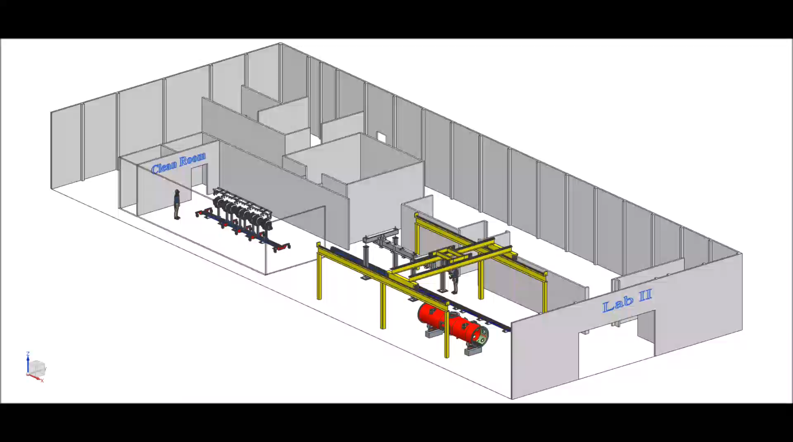
SSR1 CM assembly sequence
Charge #2
  Procedures for the final CM integration are currently being developed

Slide 23
SSR1 CM Documentation
Charge #2
Documents revision controlled in Teamcenter:
  FRS, TRS and ICD
  2D drawings and 3D models
  Reports of design reviews
  P&ID was created and constantly updated
  Piping engineering note: ready for final review (pre-approval)
  Vacuum vessel engineering note: pre-approved
  Procurement specifications

Slide 24
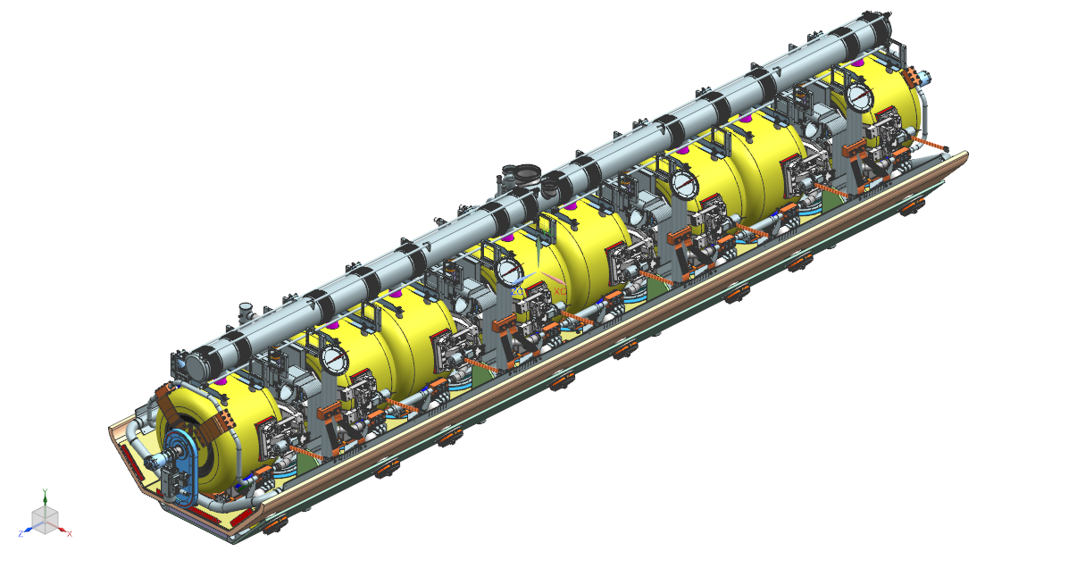
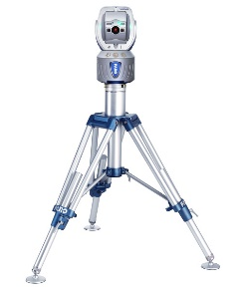
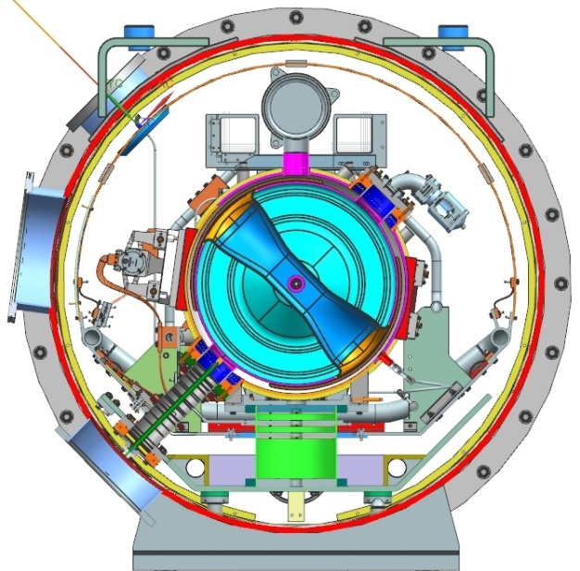
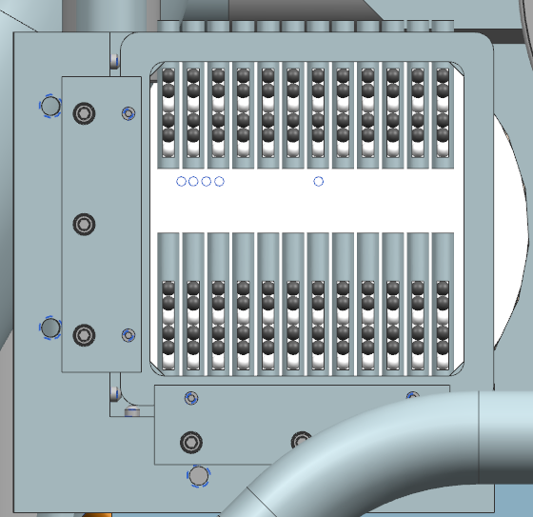
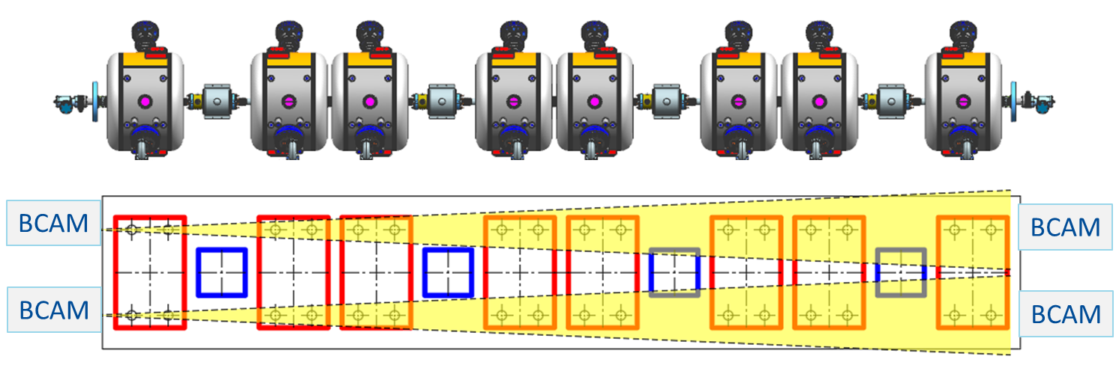
SSR1 cryomodules alignment
Charge #2
Laser trackers will be used for the Final alignment of cavities and solenoids within the PIP-II alignment requirements, taking into account also the shifts due to cooldown.
HBCAM (Brandeis CAMera) will be employed for monitoring the alignment of solenoids and cavities during transportation and cooldown
Targets frame model for the PIP-II cryomodule

Slide 25
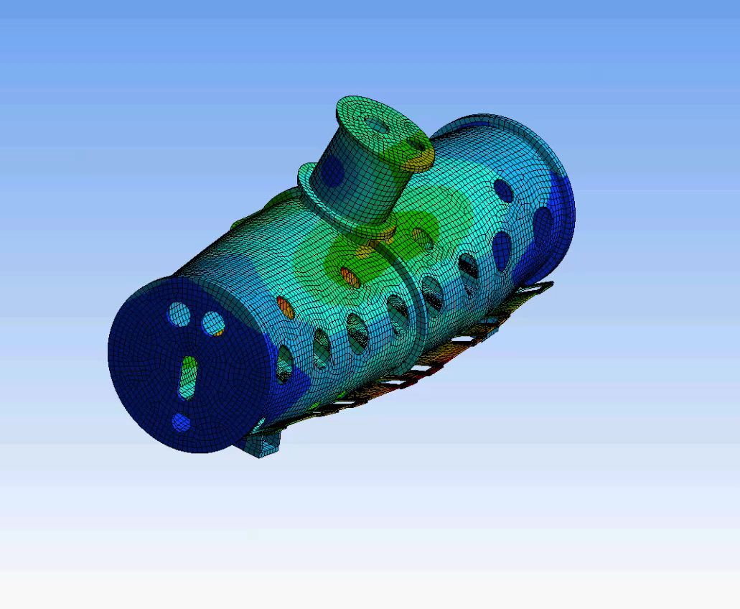
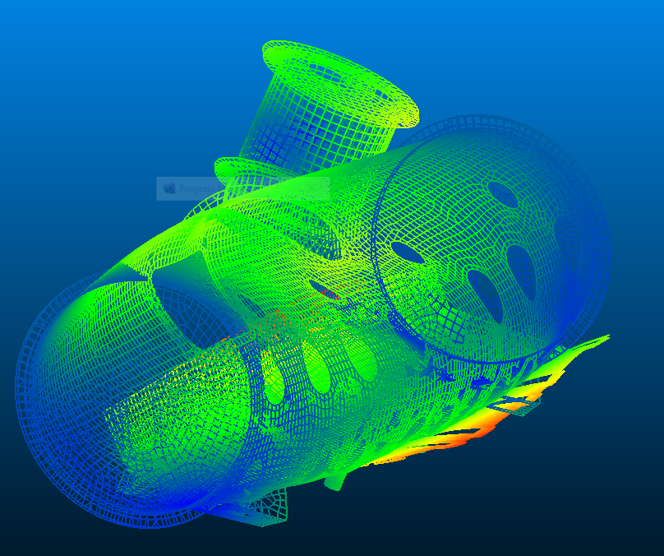
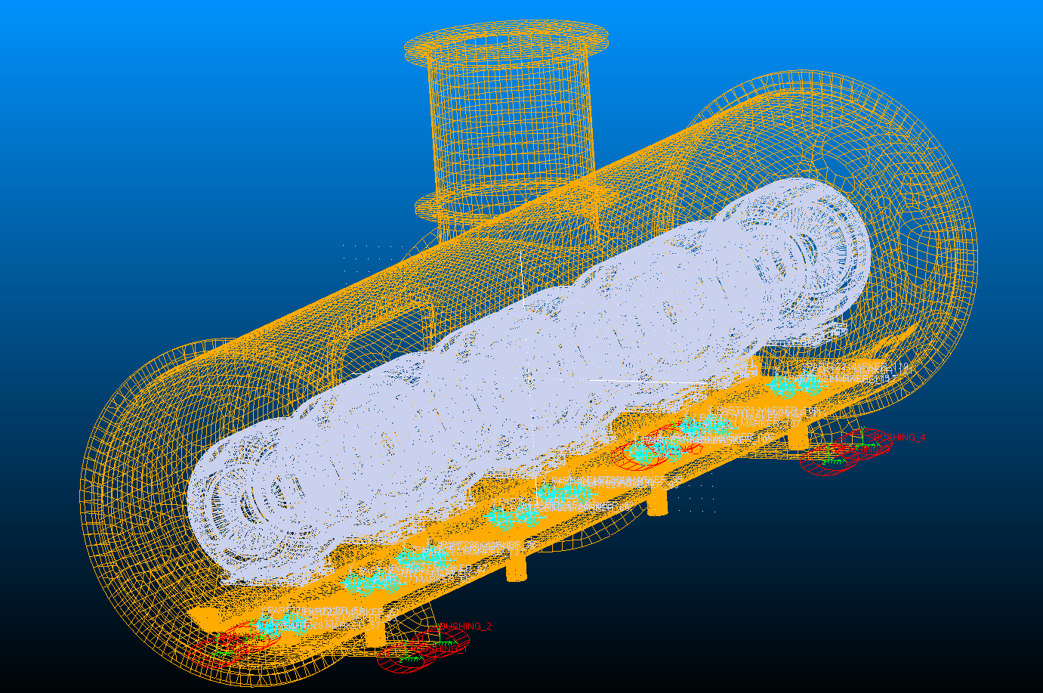
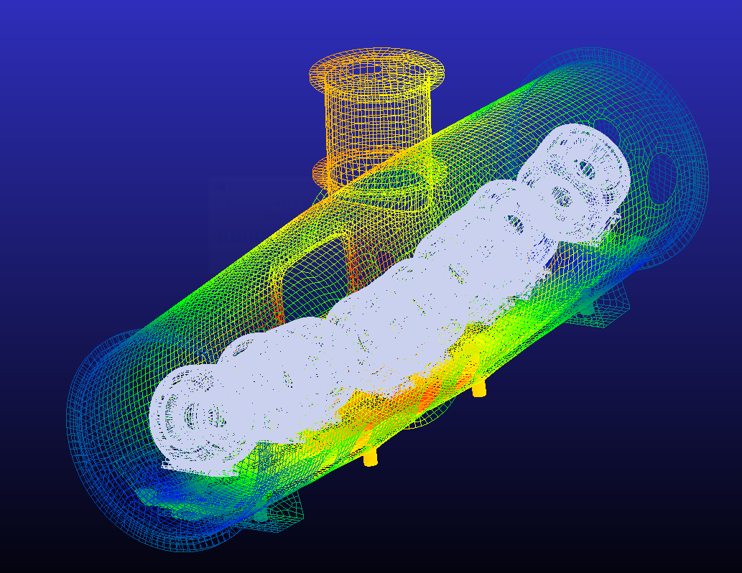
SSR1 CM transportation tooling
Charge #2
Mixed approach: FEM – MultiBody.
Assembly stiffness is computed through FE analysis (small components are simulated as lamped springs/masses) and then imported and combined in multi-body analysis: suspension system optimization, assembly dynamic characterization for transportation tooling desing
FEM: 240 s
MB: 20 s

Slide 26
SSR2 Preliminary design
Charge #2
Cavity
  RF design optimization and structural design is ongoing together with our partners (integrated team)
  PDR is planned in March 2019
Coupler
  RF and structural design is being developed incorporating lessons learned from SSR1 couplers experience
Tuner
  An evaluation to adapt SSR1 tuner design is ongoing
Cryomodule
  A conceptual model of the cryomodule is needed to check interfaces

Slide 27
ESH
Charge #5
Project team is committed to construct PIP-II in a safe, environmentally respectful, and cost efficient manner that meets our stakeholder’s needs
All activities will be in full compliance with Laboratory and DOE standards
    Fermi ES&H Manual
      Pressure vessel compliance (Cavity/CM warm&cold ops)
        All SRF cavities must comply ES&H Manual Chapter 5031.6
        Cryogenic lines must comply ASME B31.3 for Pressure Piping
    Division/Area specific Hazards Analyses and Training
      Cryogenics exposure (Cavity/CM Testing)
      ODH (Cavity/CM Testing)
      Chemical/Acids (Cavity processing at ANL, controlled by ANL)
      Radiation (Cavity/CM testing)
      Material Handling

Slide 28
Quality Management
Charge #6
  Quality control
    Procurement Quality / Supplier Quality are addressed by written procurement specifications and vendor visits
    Incoming inspections are planned for all components (graded approach)
    Acceptance testing are planned for critical sub-assemblies and documented in the Fermilab Vector database
      Operating procedures
      Travelers
    Discrepancy reports and dispositions managed in Vector are used to address corrective actions
  QA Expectations for Partners
    Partners shall have same or equivalent QC plans

Slide 29
Risk Management
Charge #2,7
Risk Rank | Risk ID | Title | Summary
High | RT-121-02-003 | Underestimated resources for design optimization of SSR1 CM (1) | If the SSR1 CM (1) does not meet technical performance requirements during PIP2IT testing, then the module must be removed from the PIP2IT beamline and a repair strategy implemented that may include cold-mass disassembly which will jeopardize PIP2IT testing plans, CM assembly of the HB650 CM(1), and delay the final designs of the SSR2 CM.
 | RT-121-02-003-C | Underestimated resources for design optimization of SSR2 CM (1) | If the SSR2 CM (1) does not meet technical performance requirements during PIP2IT testing, then the module must be removed from the PIP2IT beamline and a repair strategy implemented that may include cold-mass disassembly which will jeopardize PIP2IT testing plans and delay the final designs of the SSR2 CM.
Risk Register

Slide 30
Summary
  FRS and ICD are defined and traceable in Teamcenter
  Proto SSR1 CM
    Results of Integrated tests of SSR1 cavity, coupler and tuner in the Spoke Test Cryostat meet/exceed the requirements
    SSR1 cavity string assembly is currently being assembled in the cleanroom at Lab 2
    Components and sub-assemblies for the final CM integration are in the procurement phase. Detailed assembly procedures and tooling are being developed.
  Proto SSR2 CM
    Cavity design is ongoing
    Lessons learned from SSR1 experience will be applied
  ESH and QA plans are in place
  Risks are understood and tracked in the risk register

Slide 31
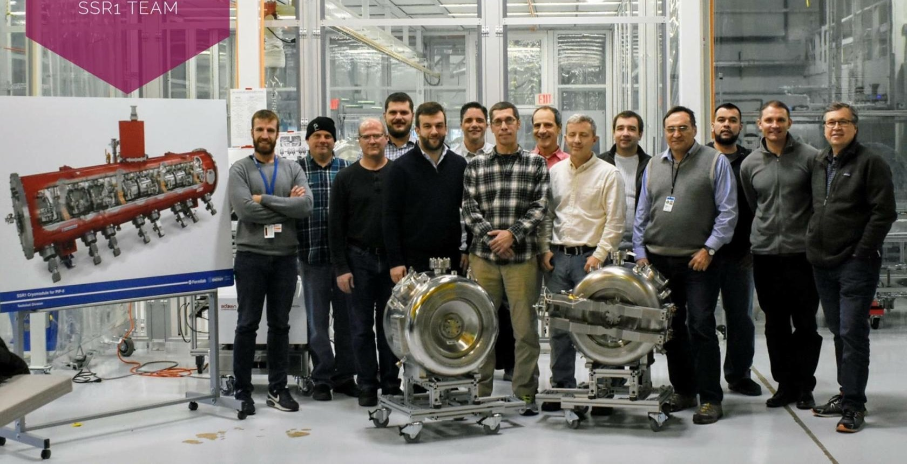
Thank you for your attention
We are on track for CD-2/3a and look forward to your feedback

Slide 32
END

