Slide 1
Interfaces with Other Projects
Breakout Session
Randy Wielgos
PIP-II IPR
4-6 December 2018

Slide 2
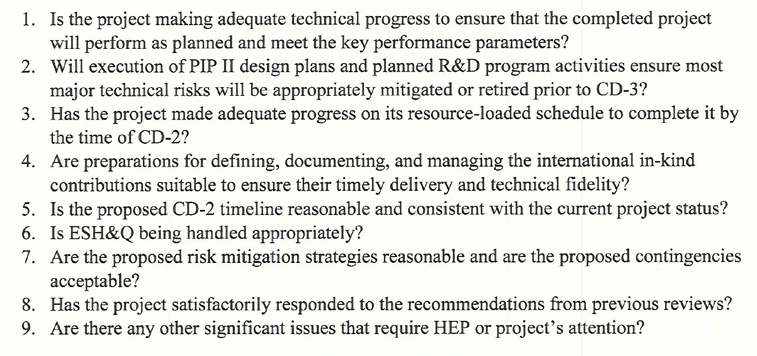
Charge Questions Addressed

Slide 3
Outline
Interfaces
Risks and Mitigations
Summary

Slide 4
About Me:
PIP-II Deputy Manager for Conventional Facilities
Relevant Experience
  Licensed Professional Engineer;
  Project Management Professional (PMP);
  9+ years at Fermilab;
  18+ years utility and infrastructure engineering;
  UUP-SLI Project L3 Manager for High Voltage Infrastructure;
    2018 CD-4
  General Plant Project Manager
    Master Substation Bypass;
    Computer System Upgrades – VoIP;

Slide 5
Functional Requirements Specification [1]
Charge #2
[1] See TeamCenter Document ED0006718

Slide 6
Interfaces
Charge #2
Project Interfaces (Managed through PIP-II processes) [1]
  ED0007697 – Interface Control Document
Fermilab Interfaces
  Infrastructure Connections (Managed through FESS processes)
  General Plant Projects (Managed through FESS processes)
International Interface
  None
FESS is the Facilities Engineering Services Section
[1] See PIP-II Systems Engineering Management Plan at PIP-II-doc-1539

Slide 7
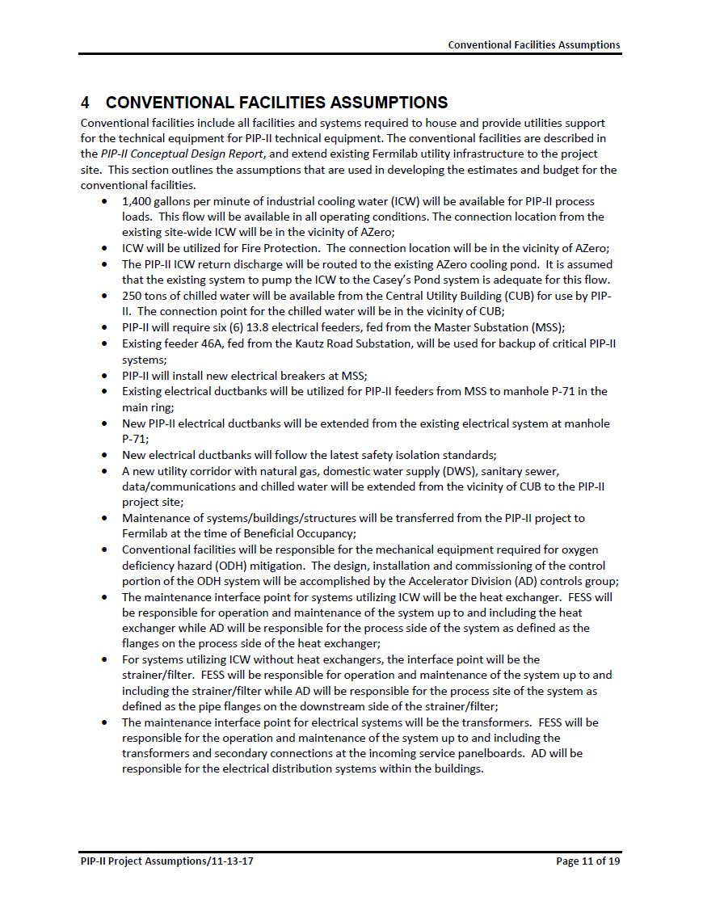
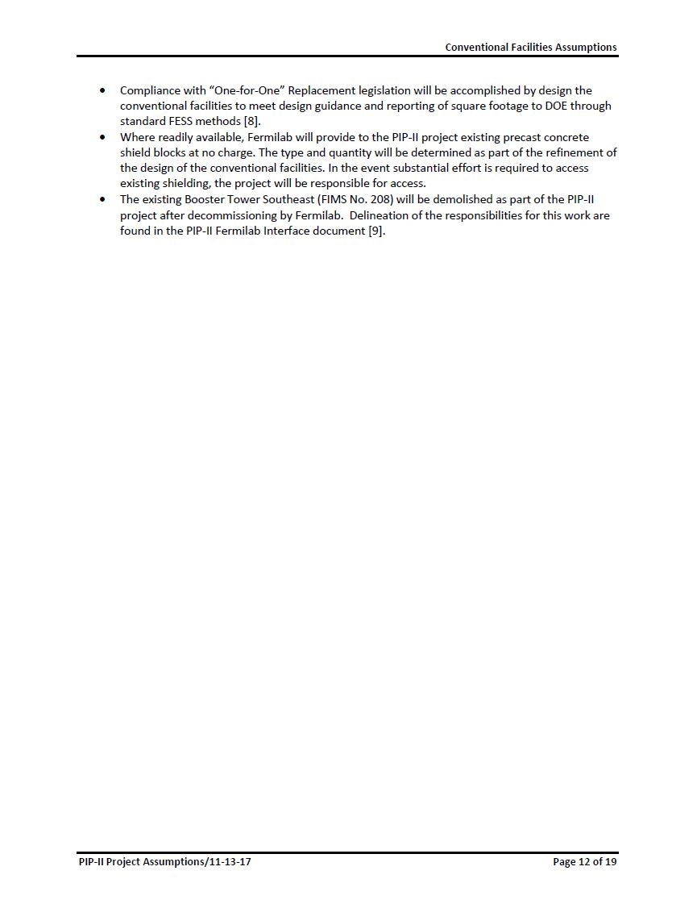
Interfaces
Charge #2
Project Assumptions[1]
[1] See PIP-II Project Assumptions Document at PIP-II-doc-144

Slide 8
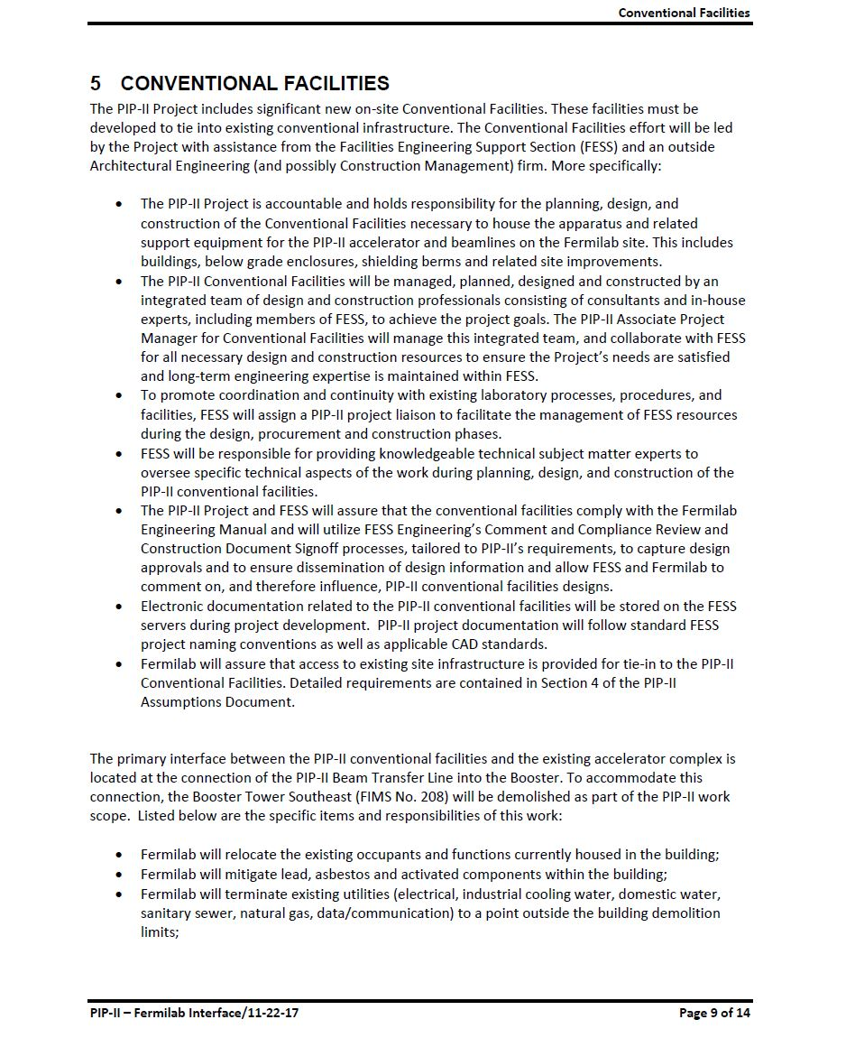
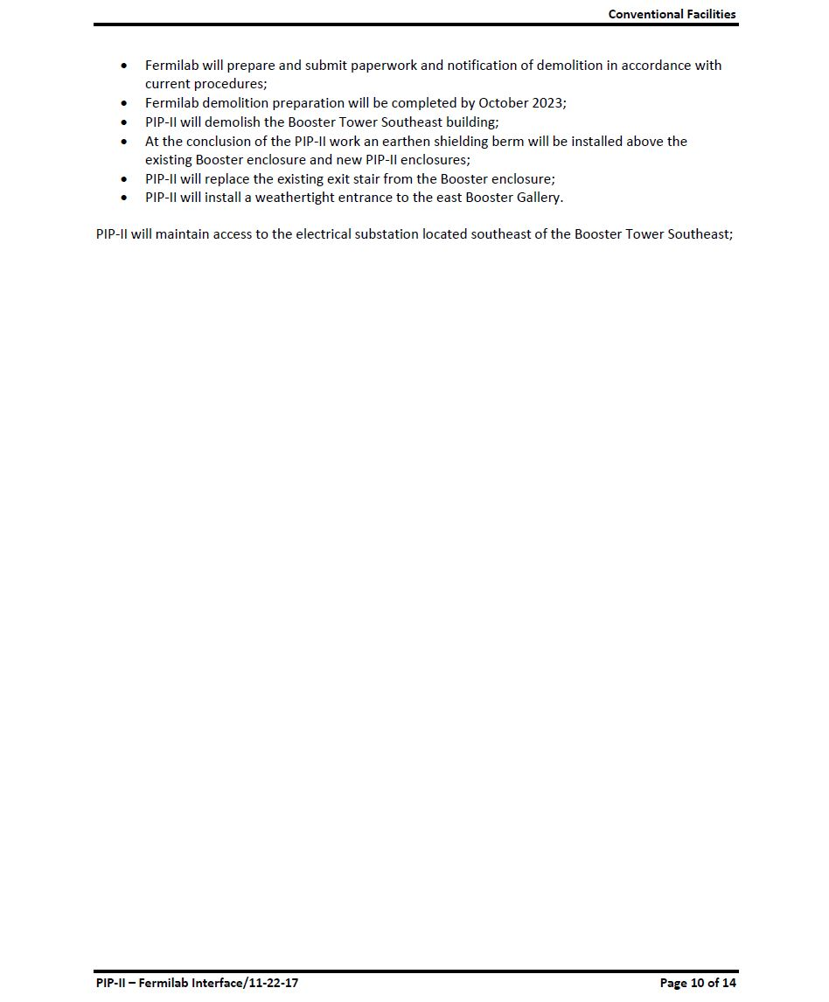
Interfaces
Charge #2
Fermilab- PIP-II Interfaces[1]
[1] See Fermilab - PIP-II Interface Document at PIP-II-doc-528

Slide 9
Preliminary Design and Design Maturity
Charge #2
Opportunity for the Laboratory to Provide Infrastructure Improvements Funding Through HEP
Utility Corridor
  Design Phase (~90% Design)
    Anticipate Complete December 2018;
  Construction Phase
    3Q FY19 – Support the Construction of the Cryo Plant Building
Electrical Feeder Package – Kautz Road Substation
  Design Phase
    1Q FY20
  Construction Phase
    3Q FY20
Electrical Feeder Package – Master Substation
  Design Phase
    1Q FY23
  Construction Phase
    1Q F23

Slide 10
Preliminary Design and Design Maturity
Charge #2
Opportunity for the Laboratory to Provide Infrastructure Improvements Funding Through SLI
CUB Building Expansion
  Design Phase
    1Q FY20;
  Construction Phase
    3Q FY20
Booster Tower Personnel Relocation
  Design Phase
    1Q FY21;
  Construction Phase
    3Q FY21
Booster Tower Demolition Make Ready
  Design Phase
    1Q FY22;
  Construction Phase
    3Q FY22

Slide 11
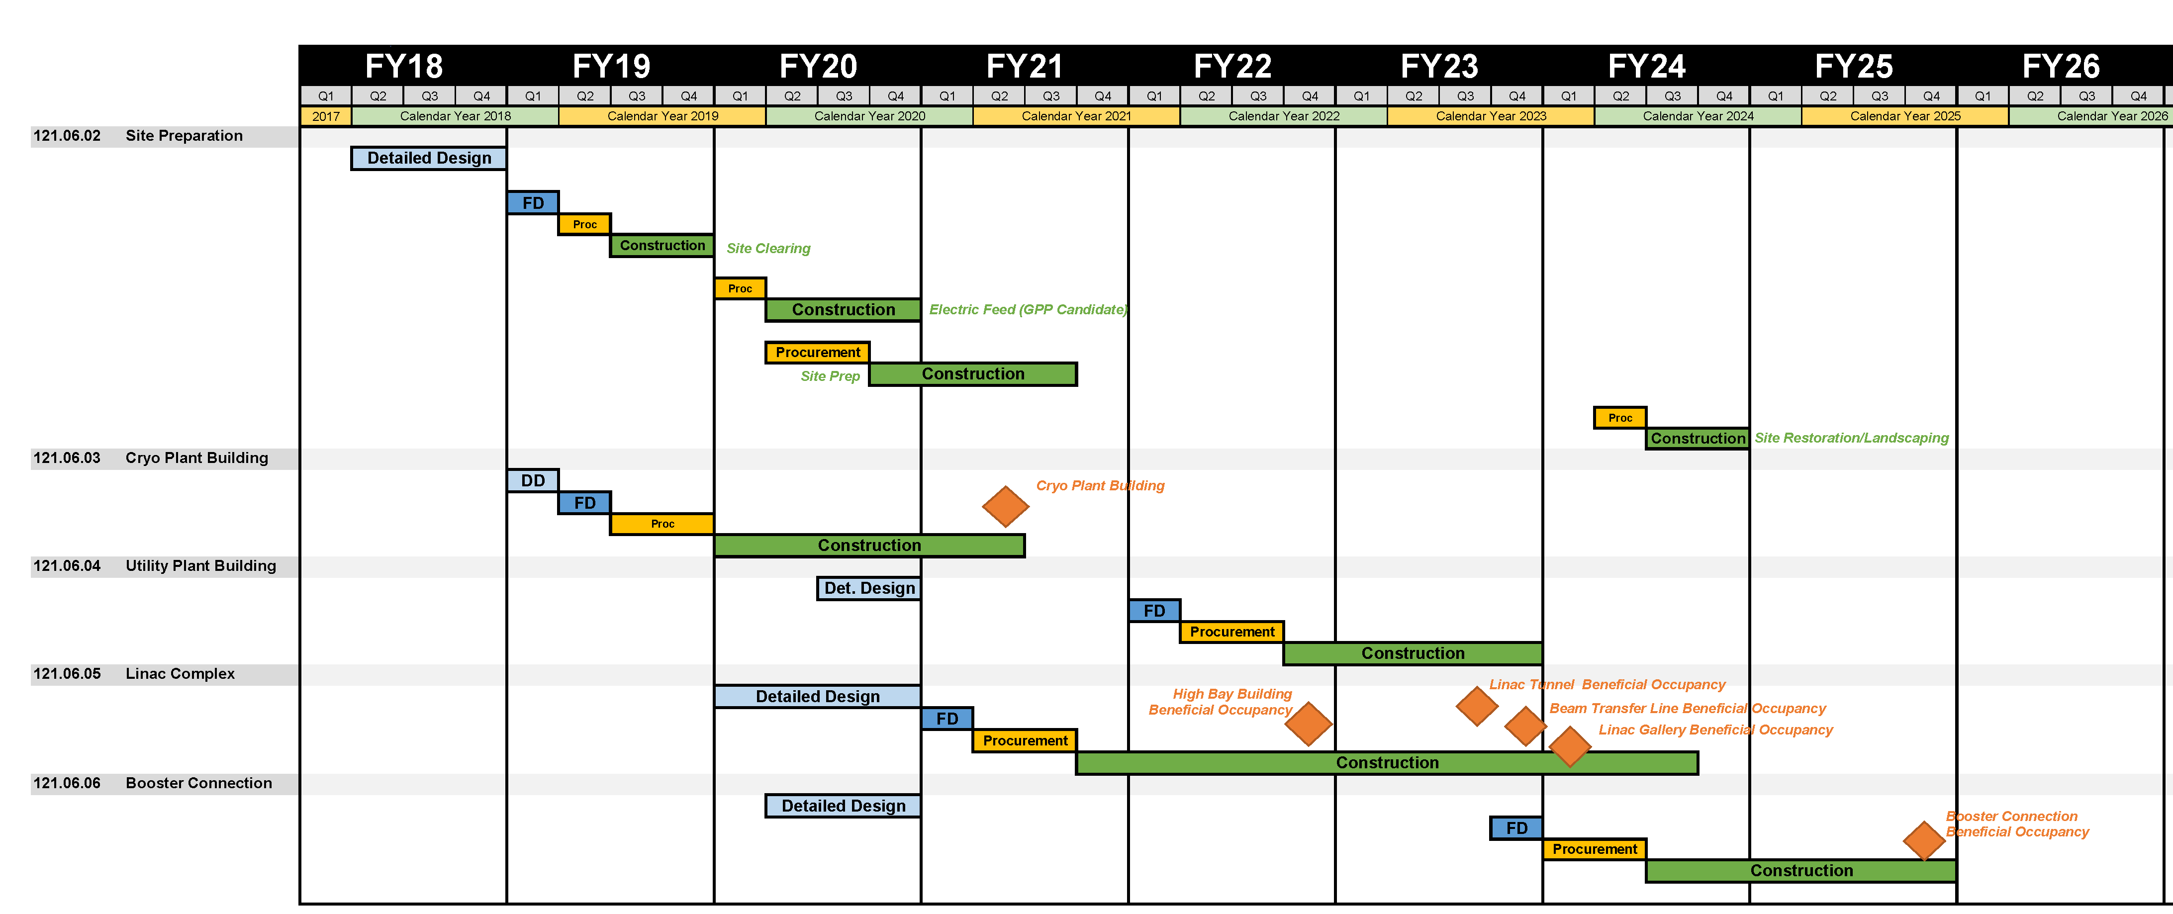
Schedule Detail
Charge #2

Slide 12
Summary
Project/Fermilab interfaces are defined and approved;
Potential Fermilab opportunities are being tracked within the project
Risks are understood and are being managed
Project team is motivated, qualified, and ready to deliver
We look forward to your feedback
Thank you for your attention

Slide 13
END

