Slide 1
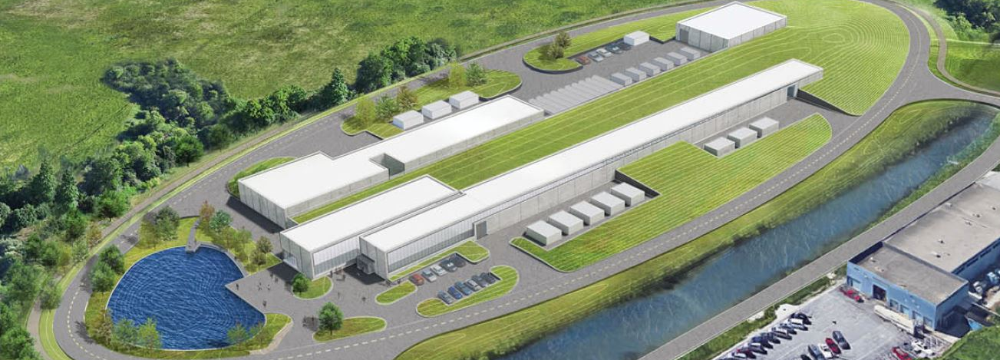
Project Management (WBS 121.01) and CD-2/3a Preparation
Marc Kaducak
PIP-II Independent Project Review
4-6 December 2018

Slide 2
About Me:
Marc Kaducak
  Role: Project Manager
  Relevant Experience:
    Fermilab:
      Head of Fermilab Office of Project Support Services (2014-2018)
      LCLS-II: Fermilab Cost and Schedule Manager (2013-2014)
      PIP-II Project Engineer (2012-2014)
      LBNF: Deputy Manager of Photon Detection System (2010-2012)
      Pierre Auger Observatory – Project Engineer (2001-2009)
    Previous:
      Project Manager for Washington Group International, Exxon-Mobil
  Education:
    Electrical Engineering, Business, University of Chicago Strategic Laboratory Leadership Program, DOE Project Leadership Institute

Slide 3
Review Charge
Is the project making adequate technical progress to ensure that the completed project will perform as planned and meet the key performance parameters?
Will execution of PIP-II design plans and planned R&D program activities ensure most major technical risks will be appropriately mitigated or retired prior to CD-3?
Has the project made adequate progress on its resource-loaded schedule to complete it by the time of CD-2?
Are preparations for defining, documenting, and managing the international in-kind contributions suitable to ensure their timely delivery and technical fidelity?
Is the proposed CD-2 timeline reasonable and consistent with the current project status?
Is ESH&Q being handled appropriately?
Are the proposed risk mitigation strategies reasonable and are the proposed contingencies acceptable?
Has the project satisfactorily responded to the recommendations from previous reviews? See responses to recommendations report from iTrack at:
  https://pip2-docdb.fnal.gov/cgi-bin/private/ShowDocument?docid=2554
Are there any other significant issues that require HEP or project’s attention?

Slide 4
Outline
Project Office Organization and Reporting
Funding Profile and Critical Decision Milestones
Cost and Schedule Development
Summary Schedule and Critical Path
Notable Procurements
Top Risks and Risk Management
CD-2/3a Preparations
Management Breakout Sessions

Slide 5
PIP-II Project Management and Level 2 Systems/Managers
WBS 121.01
ADVISORY COMMITTEES
PIP-II Machine Advisory Committee R. Garoby
PIP-II Project Management Group R. Tschirhart
PIP-II Strategic Project Advisory Committee J. Yeck
FNAL SUPPORT
ACCELERATOR DIV M. Lindgren
TECHNICAL DIV S. Belomestnykh
CFO OFFICE V. Peoples
WDRS K. Van Vreede
CSO OFFICE M. Michels
COO OFFICE K. Gregory
CPO OFFICE R. Tschirhart
PIP-II Project
L. Merminga
PROJECT DIRECTOR
US TECHNICAL COORDINATOR
TECHNICAL DIRECTOR A. Klebaner
PROJECT SCIENTIST E. Pozdeyev
PROJECT MANAGER M. Kaducak
SPECIAL ADVISOR S. Holmes
ENVIRONMENTAL, SAFETY & HEALTH J. Anderson Jr.
DOCUMENT SYSTEM MANAGER T. Langford
EXECUTIVE ADMINISTRATION T. Langford
ADMINISTRATION SUPPORT T. Hamilton
TECHNICAL INTEGRATION
Technical Director - A. Klebaner
PROJECT ENGINEER A. Rowe
DEPUTY PROJ ENGINEER J. Steimel
INTEGRATION COORDINATOR A. Martinez
SRF COORDINATOR J. Holzbauer
QUALITY ASSURANCE MGR J. Adetunji (acting)
Senior Quality Engineer TBD
Quality Engineer (SRF) TBD
PROJECT SCIENTIST
E. Pozdeyev
PROJECT OFFICE
Project Manager - M. Kaducak
Deputy Project Manager – L. Lari
PROJECT CONTROLS MANAGER TBD
Project Controls Specialists J. Randall, M. Bossert, A. Tomori
OPSS Consultant D. Hoffer
FINANCIAL MANAGER C. Jacobsen
PROCUREMENT MANAGER F. Minton
RISK MANAGER L. Taylor (acting)
LOGISTICS MANAGER TBD
INTERNATIONAL COORDINATION
IIFC TECHNICAL COORDINATORS S. Krishnagopal
S.C. Joshi
UK/UKRI TECH. COORD’R P. McIntosh
ITALY/INFN TECH. COORD’R C. Pagani
FRANCE/CEA TECH. COORD’R O. Napoly
FRANCE/IN2P3 TECH. COORD’R D. Longuevergne
WBS 121.01
PROJECT MANAGEMENT
M. Kaducak
System Manager
WBS 121.02
SRF & CRYO SYSTEMS
G. Wu
System Manager
(TBD)
Quality Engineer (SRF)
WBS 121.03
ACCELERATOR SYSTEMS
P. Derwent
System Manager
WBS 121.04
LINAC INSTALLATION & COMMISSIONING
F.G. Garcia
System Manager
WBS 121.05
ACCELERATOR COMPLEX UPGRADES
I. Kourbanis
System Manager
WBS 121.06
CONVENTIONAL FACILITIES
S. Dixon
System Manager

Slide 6
Reporting and Oversight
Fermilab Performance Oversight Group (POG)
Audience is Directorate and DOE Fermi Site Office
Single monthly meeting with updates from all Fermilab projects
Fermilab Project Management Group (PMG)
Audience is host Division Heads, Chief Project Officer, DOE IPT
Precedes the POGs each month
Weekly written briefing to senior FNAL management
DOE Office of Project Assessment (OPA) Reviews
Monthly written report to OHEP, followed by phone briefing
Integrated Project Team (IPT)
  Meets ~3x/month
  General updates and focused meetings on QA, Risk, Business Functions, ESH
DOE
PIP-II Machine Advisory Committee (P2MAC)
PIP-II Strategic Project Advisory Committee (P2SPAC)
External Advisory
Fermilab Internal Reporting

Slide 7
Organization Updated to Focus on Execution
Organization Structure:
  Redefined WBS Level 2, 3 Structure
  Added Technical Integration Office
New personnel to project management team since CD-1 IPR (Dec.2017):
  Lia Merminga – Project Director
  Arkadiy Klebaner – Technical Director
  Eduard Pozdeyev – Project Scientist
  Genfa Wu – SRF/Cryo L2 Manager
  Alex Martinez – Integration Coordinator
  Jeremiah Holzbauer – SRF Coordinator
  John Anderson, Jr. – ESH Manager
  Jemila Adetunji* – QA Manager
  Frank Minton – Procurement Manager
  Marianne Bossert – Project Controls Specialist
  Akinyemi Tomori – Project Controls Specialist
  Lucas Taylor* – Risk Manager
  Traci Langford - Admin
  Marc Kaducak – Project Manager
    *=acting
To be identified/hired:
  Project Controls Manager
  Procurement Administrator
  Logistics Manager

Slide 8
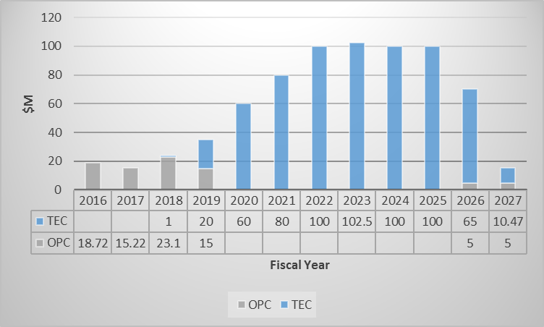
Funding Profile and Milestones
Milestone | Actual or Forecast
CD-0 | 12-Nov-2015 (A)
CD-1 | 23-Jul-2018 (A)
CD-2/3a | Q4FY2019
CD-3b | Q4FY2020
CD-3 | Q4FY2021
CD-4 | Q3FY2027
CD-1 Cost Range -> $653M - $928M.
CD-1 Cost Estimate -> $721M
TPC update is not yet complete.

Slide 9
RLS Development - Summary of Changes since CD-1
Charge # 3
New Organization Structure and Expanded PM Office
New KPPs
PIP2IT converted to a testing facility in 2021
Advanced CryoBldg Beneficial Occupancy to allocate the in-kind Cryoplant
One CryoModule (CM) Prototype added to each CM Family (but HWR)
Expanded scope for In kind Contribution with strong impact on CM production
Added scope to existing machine (e.g. Main Injector upgrade)
Missing CD-1 scope (mainly cabling & connectors)

Slide 10
PIP-II RLS Development Status Overview
Charge # 3
Dark Green: All resource estimates provided by CAMs, included in RLS and checked
Light Green: All resource estimates provided by CAMs and included in RLS- not checked.
Yellow: Resource estimates partially included in RLS. Plan and schedule to be refined.
Red: Resource estimates not included in RLS. Plan and schedule in development.
RLS pdf files posted at:
https://pip2-docdb.fnal.gov/cgi-bin/private/ShowDocument?docid=2513

Slide 11
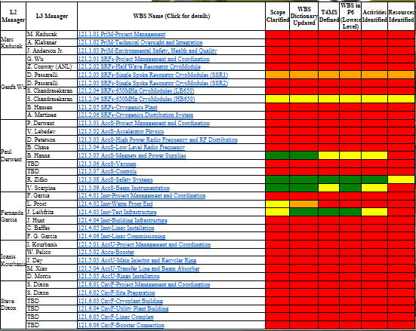

RLS Detailed Status as of 11-May-2018
Charge # 3

Slide 12
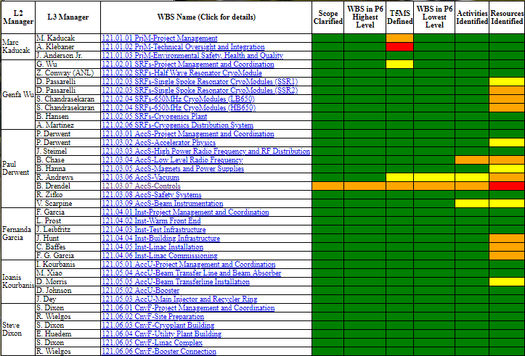
RLS Detailed Status Today
Charge # 3
Extensive efforts with L2/L3/CAMs to develop CD-2 level schedule
Incorporating international partner deliverables and schedules into RLS

Slide 13
Technically Driven Schedule Overview
Charge # 3
CD-1
ESAAB
CD-3a
CD-3b
CD-3
Tier 4 - CD-4
Tier 0 - CD-4
HWR assembly
Proto SSR1
PIP2IT Program
Cryoplant Final Design & Fabrication
Cryoplant Building Construction
SSR1 Production
Proto SSR2
SSR2 Production
Proto LB650
LB650 Production
Proto HB650
HB650 Production
Installation & Commissioning
Linac Complex Construction
FY17
FY18
FY19
FY20
FY21
FY22
FY23
FY24
FY25
FY26
FY27
FY28
FY29
FY 30
PDR Complete
Receipt of largest
single in-kind contribution
Beneficial Occupancy of the Linac Tunnel
Retirement of several high technical risks
CM Prototypes
Design
Assembly & Testing
DOE Activity
DOE and International Partners

Slide 14
Notable FY18 Procurements
Charge # 2
Procurement Description | Cost | PO Awarded | Comments
Site Preparation A/E | $1.55M | 23-Apr-2018 | Task Order on Existing Basic Ordering Agreement
Cryo Building Requirements A/E | $300k | 30-May-2018 | Task Order on Existing Basic Ordering Agreement
HWR Amplifiers | $415k | 25-Sep-2018
HWR | $845k | 24-Sep-2018 | IEWO with Argonne.
Streamlining procurement process through weekly meetings with procurement department
Dedicated procurement manager in place and co-located with project team

Slide 15
Notable FY19 Procurements
Charge # 2
Procurement Description | Cost | PO Awarded | Comments
A/E IDIQ | $17M | 15-Dec-2018 (forecast) | First task order is cryoplant building design (~$700k)
Site Clearing | $1.2M | January 2019 (forecast)
Cryoplant Building Construction | $14M | August 2019 (forecast) | Will require FSO approval
Nb for three(3) HB650 cavities | $320k | Dec 2018 (forecast)
Three(3) HB650 cavities | $560k | Jan 2019 (forecast)
Nb for seven(7) SSR2 cavities | $1M | April 2019 (forecast)
Six(6) SSR2 cavities | $900k | August 2019 (forecast)
Two(2) LB650 cavities | $600k | March 2019 (forecast)

Slide 16
PIP-II Risk Management Plan
Charge # 7
PIP-II follows the standard Fermilab Risk Management Procedure: https://go.usa.gov/xPEm2
Project Director (PD) – together with Project Manager (PM) and Risk Manager (RM):
  Establishes a risk management plan, helps identify and analyze risks, monitors risks, and executes risk response plans throughout the lifecycle of the Project
  PD chairs the RMB will meet ~monthly to address matters of risk
  RMB membership includes the PM, RM, L2s, Deputies, and others as needed (e.g. CAMs, ES&H personnel, technical experts)
Project Director (PD) and Project Manager (PM)
  Assign each risk a Risk Owner – often the SME – to manage the risk
  Manage risk contingency funds subject to the established change control process
  Report on matters of risk to the Project oversight bodies
L2 Managers and Control Account Managers (CAMs): identify risks to their subproject; assess their probabilities and impacts; and develop and execute risk mitigation and response plans. They report on risk-related issues to the RMB.
Risk Manager (RM) is responsible for the Project’s risk processes, tools, training and guidance. The RM maintains the risk register and performs project-wide risk analysis using MC techniques to aggregate cost and schedule impacts for the entire Project.

Slide 17
Risk Workshop – July 12-13, 2018
Charge #2,7
Moderated by Keith Molenaar. Guidance by Lucas Taylor. Database management by Mohammed Elrafih.
Opening session:
  Organization of Workshop, Roles and Responsibilities
  PIP-II Risk Management System
  PIP-II Risk Registry Overview
Four sessions by WBS L2 including:
  Brief summary of the technical scope and critical technology elements. Key assumptions for scope, design, estimate and/or schedule. Key system interfaces.
  Review major existing risks.
  Invitation to identify new risks, particularly from external participants.
Included presentations from BARC/RRCAT, CEA-Saclay, UK-Daresbury

Slide 18
WBS 121.01 Risk Management
Charge #2,7
Project Management Risks
  High Risks: 5
  Medium Risks: 7
  Low Risks: 2
High Risks
RI-ID | Title
RT-121-01-022 | Failure to complete IIFC R&D-related deliverables on schedule
RT-121-01-001 | International partner deliverables have technical issues
RT-121-01-014 | Delay in formalizing international in-kind contributions
RT-121-01-003 | US budget has continuing resolution
RU-121-01-001 | Foreign currency exchange rates are uncertain
Risk Threats (RT) being actively managed and mitigated.

Slide 19
PM Steps to CD-2/3a
Charge # 5
RLS/EVMS
  Complete resource loading
  Align RLS to funding profile and overall cost target
  Integrate with Cobra
  Set preliminary baseline and measure performance against it (EVMS)
    Implement change control process and tool
    Establish monthly statusing process
    Issue work authorization documents (WADs)
  Update and review BOE supporting documentation
Complete update of risk register and perform monte carlo
Finalize assumptions and interface documents with Fermilab organizations
  Transition to Operations
  Special Process Spares
  Utilities tie-ins
  GPPs, AIPs
  Facility availability, especially SRF
Update PMP, PEP, Procurement Management Plan, HAR, QAP
Receive FONSI
Create Configuration Management Plan

Slide 20
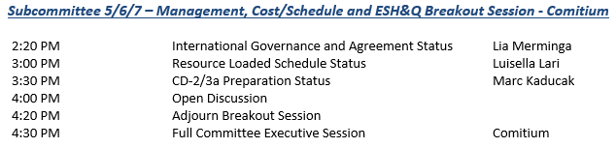
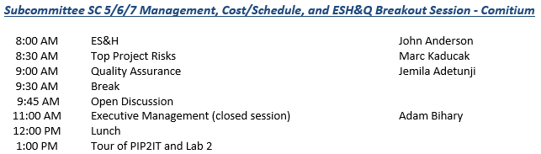
Management Breakout Sessions
Tuesday afternoon
Wednesday

Slide 21
Summary
Progress since CD-1 IPR (Dec.2017)
  Expanded project management office functions and staffing
  Resource Loaded Schedule (RLS) Development
  Increased engagement with procurement department to streamline processes
  Conducted risk workshop including international partners
  Increased communication with IPT
    3-4 meetings/month to discuss business functions, risk, QA, ESH, and other topics.
  Supported CD-1 ESAAB
Outlook
  Highest priority for project management is completion of RLS and final phase of EVMS implementation
  Steps to CD-2/3a are known and being worked intensively. Target is June 2019 IPR.
Thank you for your attention

Slide 22
END

