Slide 1
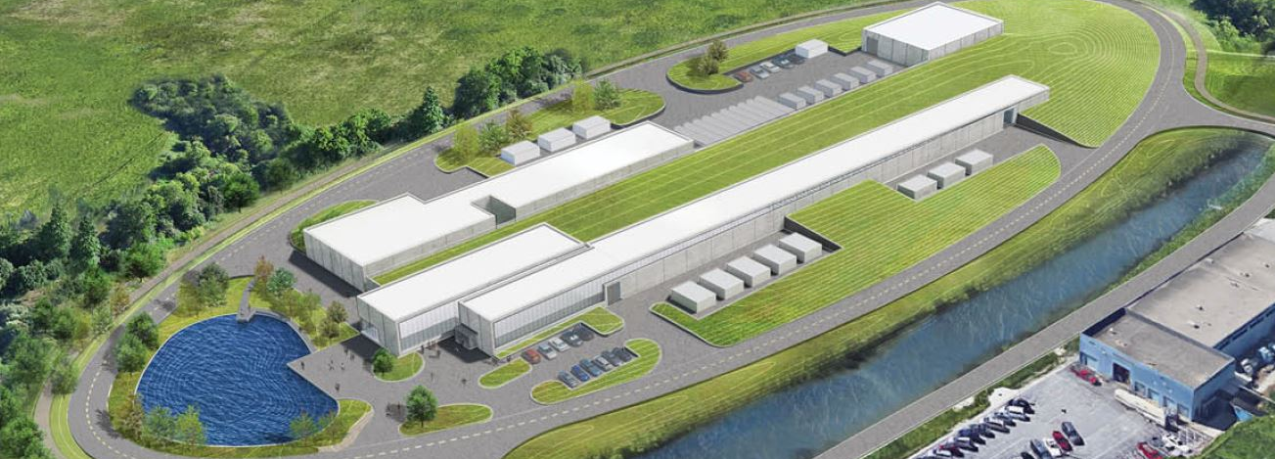
Accelerator Complex Upgrades (121.05)
Ioanis Kourbanis
PIP-II Independent Project Review
4-6 December 2018

Slide 2
Outline
Scope/Deliverables
Requirements
Interfaces
Preliminary Design, Maturity
Design Review Plan
Technical Progress to Date
Organization
Steps to CD-2
ESH&Q
Risks and Mitigations
Responses to CD-1 recommendations
Breakout Session topics
Summary

Slide 3
About Me:
Ioanis Kourbanis
Role in PIP II:
L2 Manager for Accelerator Complex Upgrades.
Relevant experience
Project Manager of two Muon Campus AIPs.
Level 3 Manager and CAM for the Main Injector Upgrades in the ANU NOvA Plan.
Main Injector Department Head.
In charge of machine upgrades to achieve 700 KW operation.

Slide 4
121.05 L2 System Scope
Charge #1
WBS Dictionary Definition: pip2-docdb #599
Labor, materials, travel, and costs associated with the management, design, procurement, fabrication, and installation of and upgrades to the Booster, Recycler, and Main Injector to accommodate increased injection energy, increased intensity and higher repetition rates. Includes the design and installation of the beam line from the superconducting Linac to the Booster and the Beam absorber line and beam dump.

Slide 5
121.05 L3 Systems Scope and Deliverables
Charge #1
WBS Dictionary Definition: pip2-docdb #599
L3 Systems
121.05.02 Transfer Line and Beam Absorber (BTLBA) NEW SCOPE
Beam Absorbers and Collimators
Beam optics and Lattice
121.05.03 Transfer Line Installation (BTLInst) NEW SCOPE
Installation Plan
Magnet stands
121.05.04 Booster (BSTR)
Booster Injection Girder
ORBUMP Magnets
Shorter Gradient Magnets
800 MeV Absorber
New Capacitor Banks for 20 Hz
Power Supplies for 20 Hz operation.

Slide 6
121.05 L3 Systems Scope and Deliverables
Charge #1
WBS Dictionary Definition: pip2-docdb #599
L3 Systems
121.05.05 Main Injector and Recycler Ring (MIRR)
New Recycler RF cavities
Upgraded Main Injector RF Cavities

Slide 7
121.05 L2 System Requirements
Charge #1
Necessary to achieve 2 Objective Key Performance Parameters (2,3).
# | Description of Scope | Threshold KPP | Objective KPP
1 | SRF Linac Beam Energy | 600 MeV | 800 MeV
2 | Linac Beam | Beam delivered to the Beamline Dump | 5.4E12 particles per pulse (H-) at 20 Hz beam delivered to the Beamline Dump
3 | Booster/Recycler/Main Injector upgrades | Booster injection region, Recycler RF upgrades, and Main Injector RF upgrades, hardware installed and tested without beam in respective machines. | Linac beam injected and circulated in the Booster
4 | Cryogenic Infrastructure | Cryogenic plant and associated distribution system are installed and capable to support cavities operation at 2 K | Cryogenic system installed and is capable to support Linac operation in the CW mode

Slide 8
121.05 L3 Functional Requirements Specifications
Charge #1
WBS # | L3 System | TeamCenter ED#
121.05.02 | Beam Transfer line and Beam Absorber | 8140
121.05.03 | Beam transferline Installation | 8080
121.05.04 | Booster (BSTR) | 7865
121.05.05 | MI and RR Ring | 8096

Slide 9
121.05 L3 Interface Control Documents
Charge #1
Project Interfaces (Managed through PIP-II processes)
WBS 121.03 - Accelerator Systems
WBS 121.05 - Linac Installation and Commissioning
WBS 121.06 – Conventional Facilities
WBS # | L3 System | TeamCenter ED#
121.05.02 | Beam Transfer line and Beam Absorber | 7705
121.05.03 | Beam transferline Installation | 7706
121.05.04 | Booster (BSTR) | 7703
121.05.05 | MI and RR Ring | 7704

Slide 10
Preliminary Design and Design Maturity
Charge #1
121.05.02 Beam Transfer Line and Beam Absorber
Lattice design is mature.
Beam Absorber preliminary design completed.
Started preliminary design on beam line collimators.
121.05.03 Beam Transfer line Installation
Preliminary installation plan has been developed.
Magnets stands not designed yet.
121.05.04 Booster
Started preliminary design for ORBUMP magnets
Gradient magnet design has not started.
The preliminary design for the 800 MeV beam absorber has been completed.

Slide 11
Preliminary Design and Design Maturity
Charge #1
121.05.05 Main Injector and Recycler Ring
Ready for Main Injector cavity measurements with two Power Amplifiers.
Have a design of the Recycler Cavity tuner to be tested with the prototype cavity.

Slide 12
Design Review Plan
Charge #2
Review Class | L2 WBS | L3 WBS | Activity ID | Key Design Elements Reviewed / Activity Name | Review Date
Preliminary Design Review | 121.5 | 121.05.05 | MIRR11140 | MIRR_MI_Des: T6 MS - Preliminary Design Review (PDR) | 6-Feb-19
Preliminary Design Review | 121.5 | 121.05.02 | BTLBA11700 | BTLBA_Abs_Des: T6 MS - Preliminary Design Review (PDR) | 9-Jan-19
Preliminary Design Review | 121.5 | 121.05.02 | BTLBA11900 | BTLBA_Transf_Coll_Des: T6 MS - Preliminary Design Review (PDR) | 23-Jan-19
Preliminary Design Review | 121.5 | 121.05.04 | BSTR21450 | BSTR_800MeV_IGMag_ORBUMP_Des: T6 MS - PDR for ORBUMP Magnets | 15-Apr-19
Preliminary Design Review | 121.5 | 121.05.04 | BSTR22030 | BSTR_800MeV_IGMag_FSBD_Des: T6 MS - PDR for Foil System, Beam Dump | 1-May-19
Preliminary Design Review | 121.5 | 121.05.05 | MIRR11250 | MIRR_RR_Des: T6 MS - Preliminary Design Review (PDR) | 6-Jun-19
Preliminary Design Review | 121.5 | 121.05.04 | BSTR21920 | BSTR_800MeV_IGMag_PS_Des: T6 MS - PDR for IG PS | 17-Jun-19
Preliminary Design Review | 121.5 | 121.05.04 | BSTR23170 | BSTR_800MeV_PaintMagSys_Mag_Des: T6 MS - PDR for Painting Magnets | 19-May-20
Preliminary Design Review | 121.5 | 121.05.04 | BSTR21010 | BSTR_800MeV_CFMag_Des: T6 MS - PDR for Combined Function Magnets | 24-Sep-20

Slide 13
T5 Milestones
Charge #5

Slide 14
Progress to date
Charge #1, 2
Finalized the Transfer line lattice.
Magnet specifications finalized.
Instrumentation requirements defined.
3-d model
Completed the preliminary design of the Beam Absorber.
Incorporated lessons learned from the muon campus beam absorber.
Ready for preliminary design review.
Developed a preliminary beam line installation Plan.
SC2-Xiao
SC2-Xiao

Slide 15
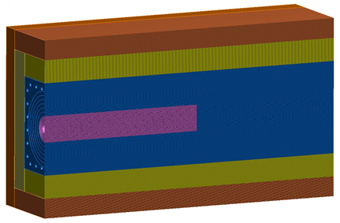
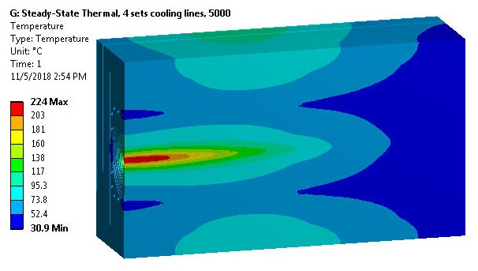
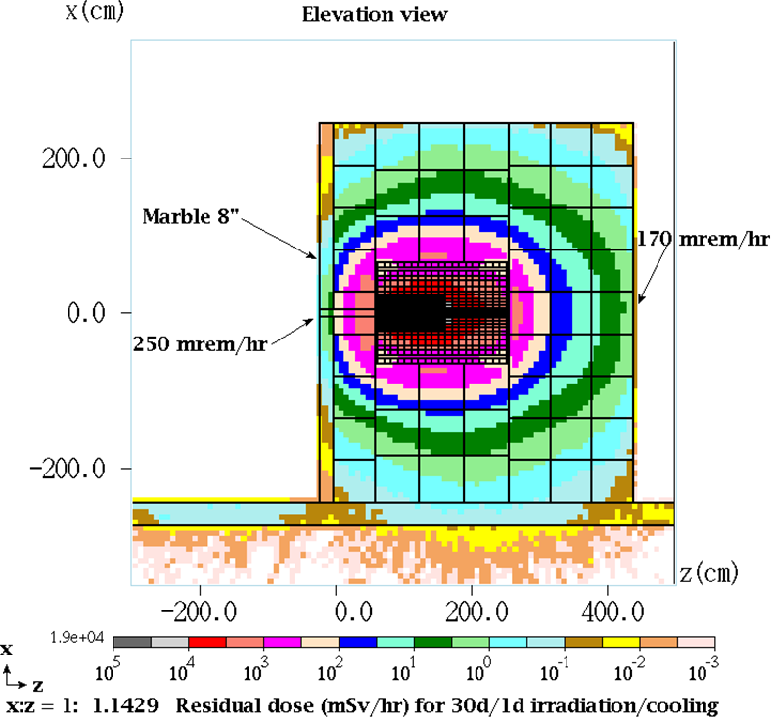
Progress to date (Beam line Absorber)
Charge #1, 2
Graphite core
grade POCO TM
R 8 cm x 1 m
Shrink-fit to aluminum jacket
Concrete shielding
Absorber core Temperatures
Residual Radiation

Slide 16
Progress to date
Charge #1, 2
We have a new Booster Injection Girder design.
Described in PDR.
New stronger ORBUMP magnets.
Shorter Booster Gradient Magnets
Space for An 800 MeV beam absorber.
Verified low level measurements of 2 PA (Power Amplifiers) operation of the MI RF cavity.
Developed a cavity model.
Have a design of the Recycler cavity tuner.
Ordered cooling plates for our prototype tuner.
SC2-Johnson
SC2-Dey
SC2-Dey

Slide 17
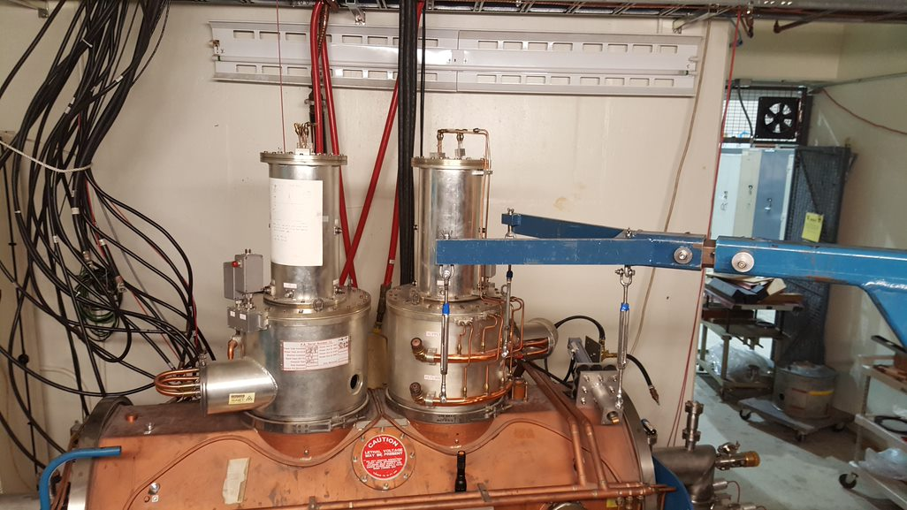
Progress to date (MI RF)
Charge #1, 2
MI Cavity Model with two PAs
MI Cavity with two PAs.

Slide 18
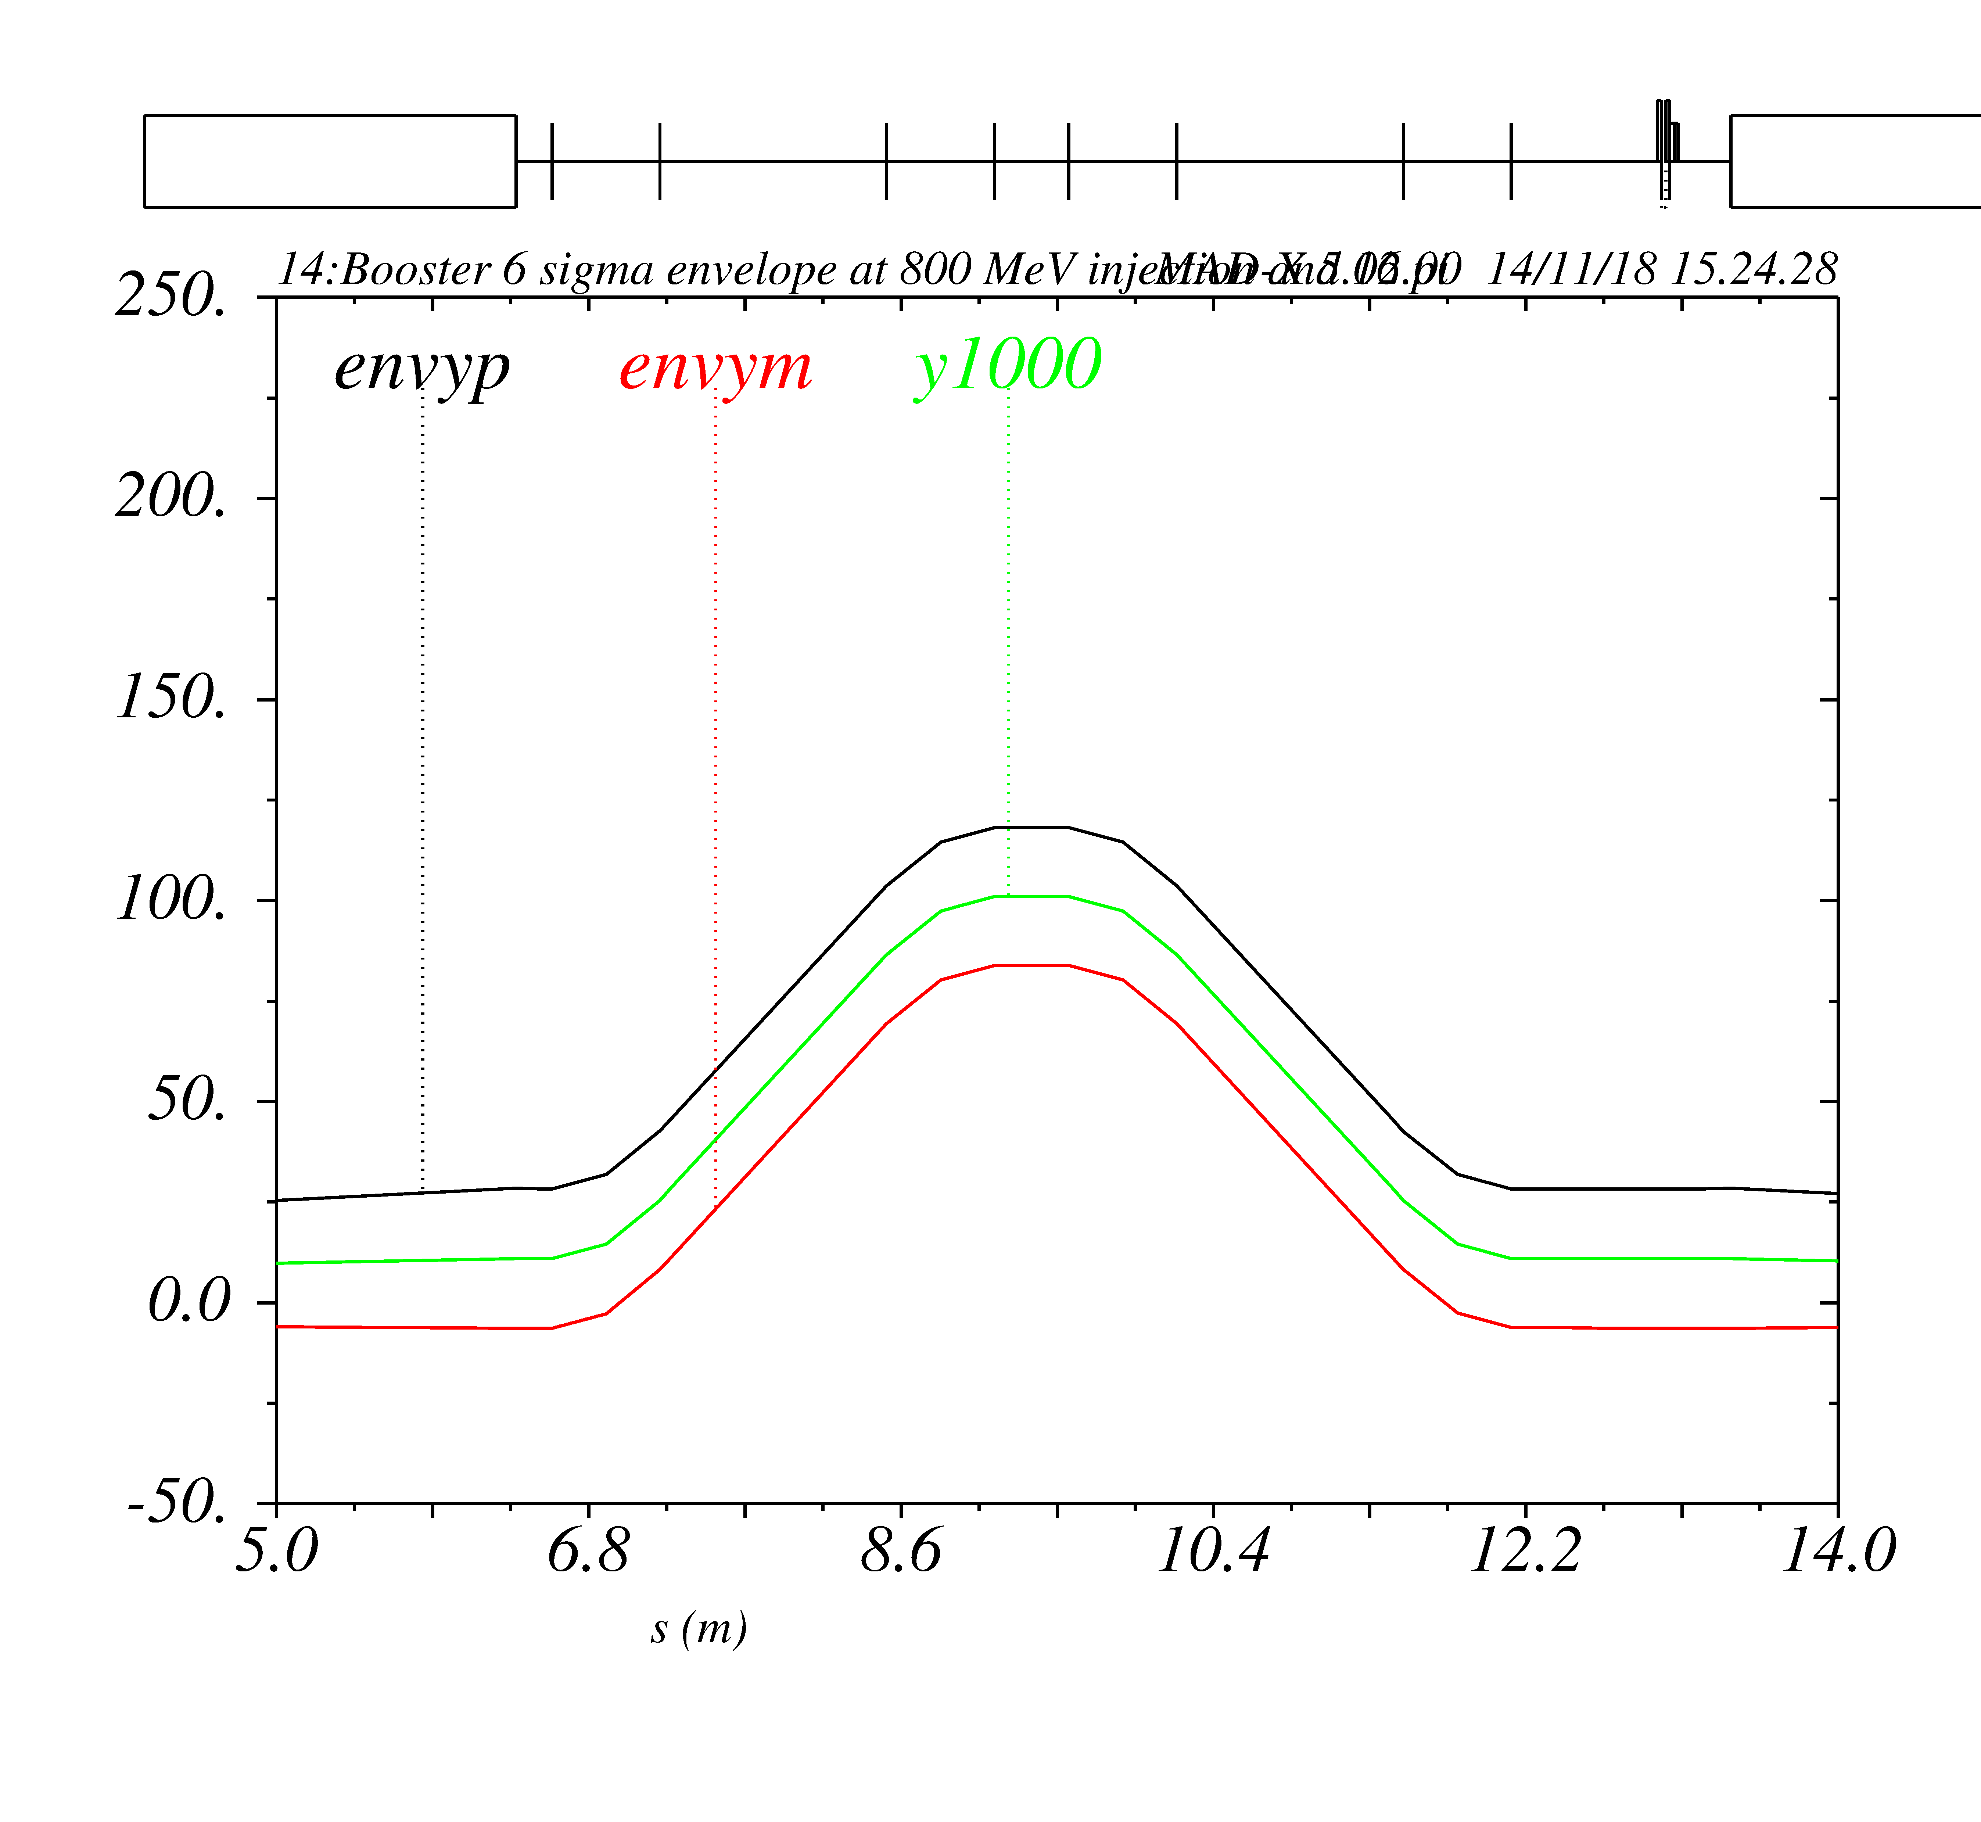
Progress to date (Booster Injection)
Charge #1, 2
New Booster Injection Girder
Key features:
Absorber moved away from
aperture
Opened up ORBUMP aperture
Reduce GM length by ~0.75 m.
Dedicated phase space painting
outside injection straight
Lattice distortion negligible
ORBUMP
ORBUMP
ORBUMP
ORBUMP
detector
H⁻
corrector
H⁻
foil
Gradient
Magnet
ABSORBER
Gradient
Magnet
H⁰
H⁺

Slide 19
Organization
WBS 121.05
ACCELERATOR COMPLEX UPGRADES
I. Kourbanis
System Manager
WBS 121.05.01 Project Management
I. Kourbanis
WBS 121.05.02
Transfer Line/Beam absorber
M. Xiao
WBS 121.05.03
Beam Transfer Line Installation
D. Morris
WBS 121.05.04
Booster
D. Johnson
WBS 121.05.05
MI/RR
J. Dey

Slide 20
Next Steps toward CD-2/3a
Charge #5
Finish the BOEs
Finish the preliminary design of the beam absorber and beam line collimators.
Preliminary design review scheduled.
Finish the preliminary design of the ORBUMP magnets
Preliminary design review scheduled
Drive the spare MI cavity with 2PAs in push pull configuration (test cave) and document its operation.
Preliminary review for MI RF upgrade scheduled in Feb. 2019
Plan of hiring an RF engineer.
Build and test a prototype tuner for the new 53 MHz Recycler cavity. Test tuner with the prototype cavity.
Preliminary design review scheduled in June 2019.

Slide 21
ESH
Charge #6
Personnel Safety and environmental and equipment protection are the highest priorities in the PIP-II Project.
included in all work via Safety By Design Assessment
New absorber in the Booster Injection Girder to minimize activation.
Use of marble in collimators in beam line absorber to minimize radiation exposure.
Specific hazards in HAR DocDB #140 – L3 Breakouts
All activities will be in full compliance with the PIP-II Integrated ESH Management Plan defined in DocDB #141
Laboratory and DOE standards and practices
Fermi ES&H Manual, Radiological Control Manual, etc
Division/Area specific Hazards Analyses and Training

Slide 22
Quality Management
Charge #6
Incorporate quality in our design from the beginning.
Most our deliverables will be made in place
QC Plans
Travelers
Training
Work Controls
Issues Management (Corrective Action/Preventive Actions)
Incorporating lessons learned in the design
We are using lessons learned from the muon campus beam absorber and MiniBoone horn in our design of the Beam dump.
Be sure that the dump can be serviced and replaced
Avoid materials that corrode and lead to fail
We are going to use existing vendors for most purchases
QC Plans
Manufacturing Inspection/Test Plans
Verification of requirements
Vendor visits
Acceptance testing

Slide 23
WBS 121.05 Risk Management
Charge #2,7
Accelerator Complex Upgrades Risks
High Risks: 1
Medium Risks: 0
Low Risks: 0
High Risk
RI-ID | Title
RT-121-05-001 | MI RF upgrade has insufficient power
Risk is the default MI RF Upgrade with 2PAs will not work.
We are working on verifying the 2PA Upgrade option and retiring the risk.

Slide 24
Response to Recommendations
Charge # 8
PIP-II DOE CD-1 Review Recommendation No. | Status: | Closed
 | Date Closed: | 01/31/2018
System | Accelerator Complex Upgrades
Owner | I. Kourbanis
Recommendation | Down Select Injection Girder design before CD-2
Project Response | We have a design for the Booster Injection Girder that is described in PDR and we are working in finalizing the magnet designs.

Slide 25
Response to Recommendations
Charge # 8
PIP-II DOE CD-1 Review Recommendation No. | Status: | Closed
 | Date Closed: | 10/26/2018
System | Accelerator Complex Upgrades
Owner | I. Kourbanis
Recommendation | Review Intensity Limits in Booster, Recycler and Main Injector before CD2.
Project Response | Booster can achieve the PIPII beam intensity, needs to reduce losses. Main Injector needs the RF upgrades to achieve the PIP II intensity. Booster had a high intensity workshop in May 2017.Have developed realistic models for Recycler and Main Injector to study high intensity operation. We are collaborating with CERN and JPARC on high intensity issues.

Slide 26
Breakout Sessions (Wednesday Dec. 5th)
Subcommittee SC 2 Accel. Upgrades, Linac I&C Breakout Session (Hornet’s Nest)
8:00 AM | Beam Commissioning | Fernanda G. Garcia
8:20 AM | Accelerator Complex Upgrades Overview | Ioanis Kourbanis
8:30 AM | Booster | Dave Johnson
9:00 AM | Main Injector, Recycler | Joe Dey
9:30 AM | Break
9:45 AM | Transfer Line, Beam Absorber | Meiqin Xiao
10:15 AM | Open Discussion
12:00 PM | Lunch | Location - TBD

Slide 27
Summary
Our requirements are well defined.
We have made significant progress in critical designs.
We understand our risks and we are on track to retire our major risk early next year.
ESH and QA plans are in place.
Safety By Design Assessment.
Implementing lessons learned in the design.
Project team is motivated, qualified, and ready to deliver.
We are on track for CD-2/3a review in June.

Slide 28
END

