Slide 1
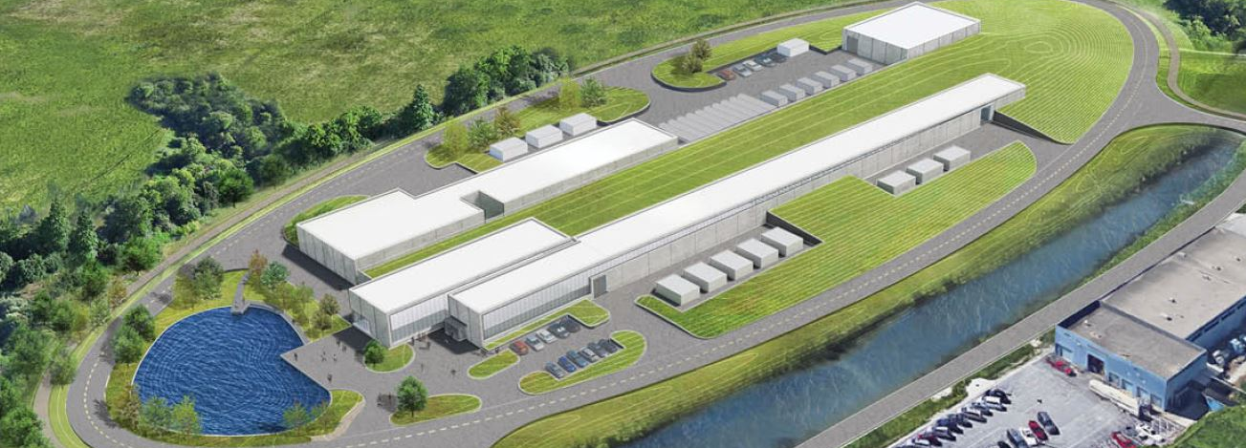
Conventional Facilities (WBS 121.06)
Steve Dixon
PIP-II Independent Project Review
4-6 December 2018

Slide 2
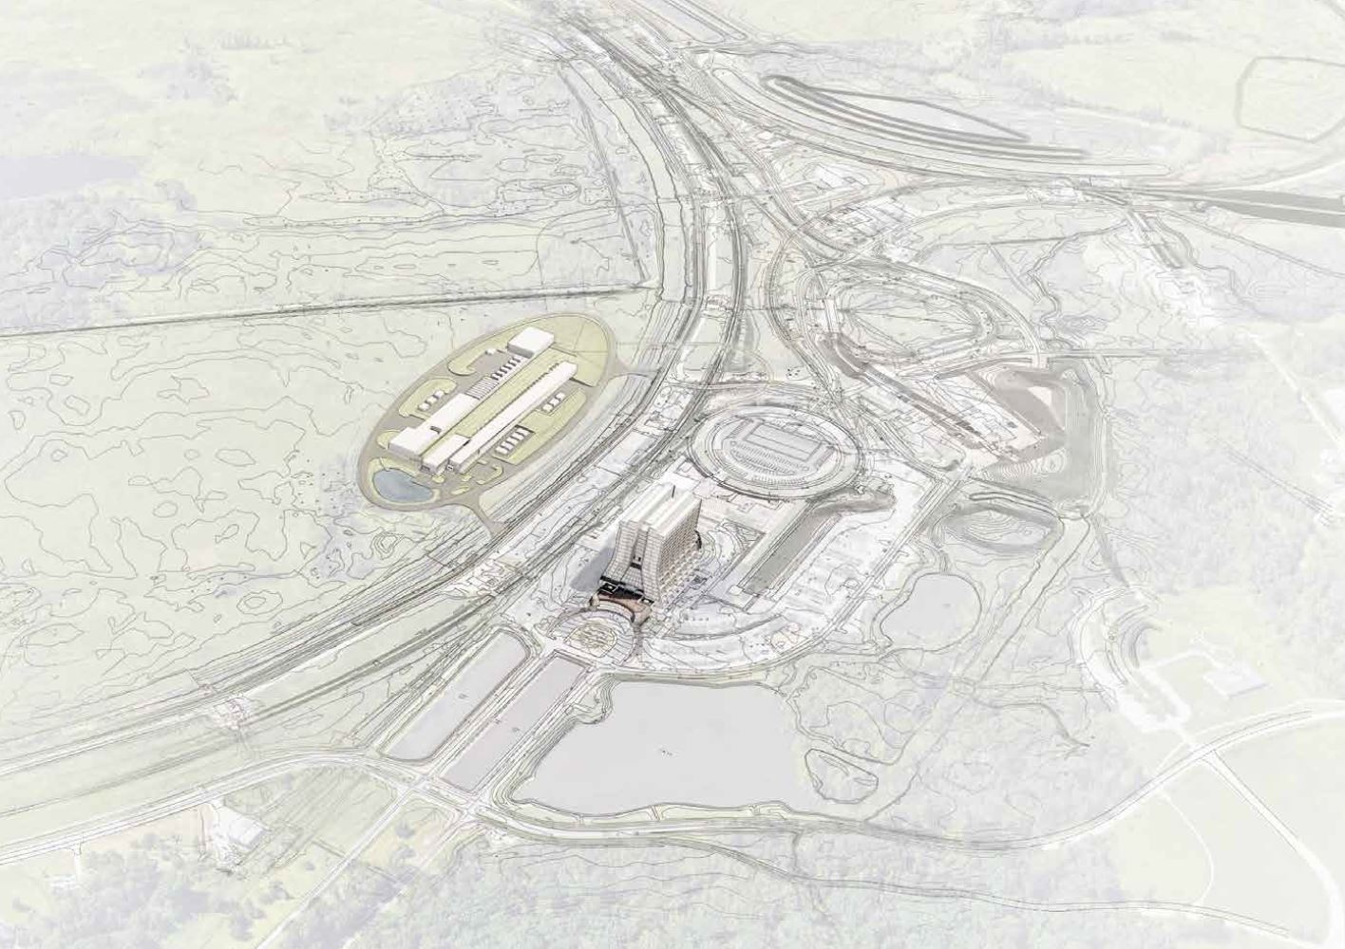
Outline
Scope/Deliverables
Requirements
Interfaces
Preliminary Design
Design Review Plan
Technical Progress to Date
Organization
Steps to CD-2
ESH&Q
Risks and Mitigations
Responses to CD-1 recommendations
Breakout Session topics
Summary

Slide 3
About Me:
PIP-II Level 2 Manager for Conventional Facilities
Relevant Experience
Licensed Architect;
Project Management Professional (PMP);
LEED Accredited Professional;
26+ years at Fermilab;
NOvA Project L2 Manager for Site and Buildings;
2014 CD-4
2015 U.S. DOE Secretary’s Award for Excellence
General Plant Project Manager for 15+ years
Short Baseline Neutrino (SBN) Near Detector Building;
Short Baseline Neutrino (SBN) Far Detector Building;
Experimental Operations Center;

Slide 4
Scope and Deliverables
Charge #1
Conventional Facilities includes the design, procurement and construction of the utilities, roads, structures, enclosures and buildings to support the installation, assembly and operation of the technical components. [1]
WBS
121.06.01 – Project Management and Coordination
121.06.02 – Site Preparation
121.06.03 – Cryogenics Plant Building (23,245 square feet)
121.06.04 – Utility Plant Building (21,275 square feet)
121.06.05 – Linac Complex (88,550 square feet)
121.06.06 – Booster Connection (7,750 square feet)
[1] See WBS Dictionary in PIP-II-doc-599 for complete description

Slide 5
Scope and Deliverables
Charge #1
Conventional Facilities includes the design, procurement and construction of the utilities, roads, structures, enclosures and buildings to support the installation, assembly and operation of the technical components.
WBS
121.06.01 – Project Management and Coordination
121.06.02 – Site Preparation – CD-3A Request
121.06.03 – Cryogenics Plant Building – CD-3A Request
121.06.04 – Utility Plant Building
121.06.05 – Linac Complex – CD-3B Request
121.06.06 – Booster Connection – CD-3B Request

Slide 6
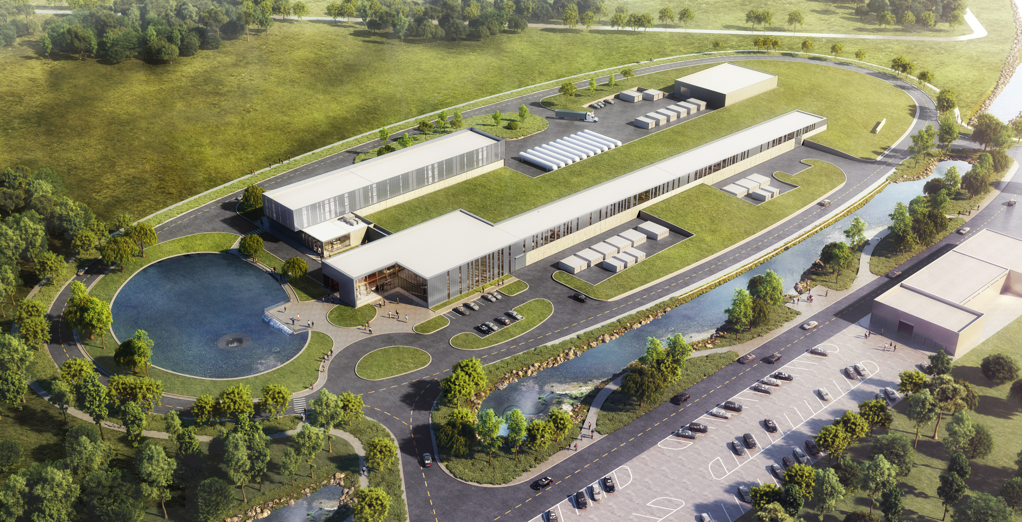
Scope and Deliverables
Utility Plant Building
Cryo Plant Building
Booster
Connection
Linac Complex

Slide 7
Conventional Facilities System Requirements
Charge #1
Conventional Facilities Systems Function and Configuration Document [1]
Facility Scope
Associated conventional facilities including enclosures, equipment galleries, and utilities. The linac enclosure will be constructed with a length to accommodate at least two HB650 cryomodules beyond the nominal compliment required for 800 MeV.
Functional Requirements
The siting of the PIP-II facility will be consistent with future replacement of the existing 8-GeV Booster with either an 8 GeV Rapid Cycling Synchrotron or superconducting pulsed linac.
The siting of the PIP-II facility will be consistent with future upgrades to provide 100 kW beams to the Mu2e hall on the Muon Campus.
The SC Linac will be constructed in a manner that allows installation and commissioning without interruption to ongoing accelerator operations.
Facility Lifetime equal to or greater than 40 years
Safety Requirements
The Project will be built to applicable DOE and FNAL engineering, safety, and radiation standards as outlined in the Fermilab Engineering Manual and Fermilab ES&H Manual.
[1] Conventional Facilities Systems Function and Configuration Document, TeamCenter Document ED0008133
Notes:
Mention that these flow down from Global Requirement Document (TeamCenter ED0008053)

Slide 8
Interfaces
Charge #1
SC4-Dixon
Project Interfaces
Managed through PIP-II processes [1]
ED0007697 – Site Preparation
ED0007698 – Cryogenic Plant Building
ED0007699 – Utility Plant Building
ED0007700 – Linac Complex
ED0007702 – Booster Connection
Conventional Facilities interfaces with all Level 2 subprojects
Fermilab Interfaces
Infrastructure Connections (Managed through FESS processes)
General Plant Projects (Managed through FESS processes)
Accelerator Operations (Managed through AD processes)
International Interface (Managed through WBS 121.02)
Cryogenic plant is Indian partner deliverable
[1] See PIP-II Systems Engineering Management Plan at PIP-II-doc-1539
FESS is Facilities Engineering Services Section

Slide 9
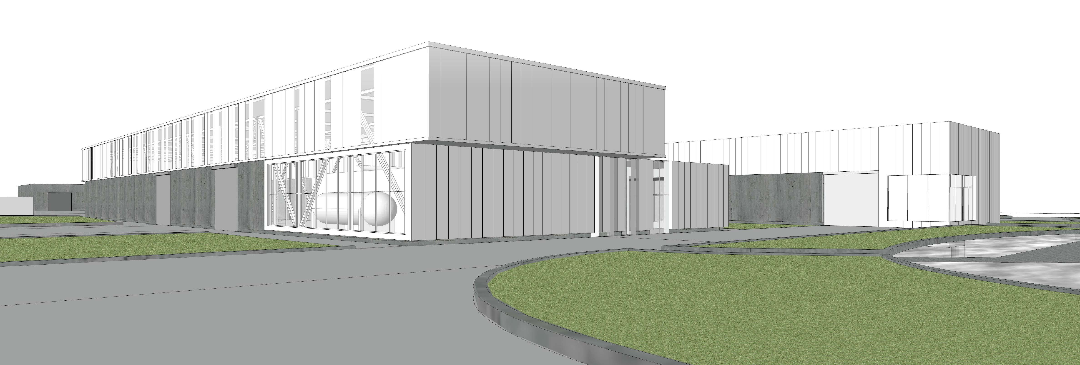
Preliminary Design and Design Maturity
Charge #1
Site Preparation (WBS 121.06.02)
Site Clearing construction package[1]
Site Work construction package[2]
Electrical Feeder construction package[2]
Site Restoration/Landscaping construction package[2]
Final Design Completion scheduled for January 2019
Cryogenics Plant Building (WBS 121.06.03)
Technical Requirements Complete [3]
Final Design Completion scheduled for Q2 FY19
SC4-Wielgos
SC4-Dixon
[1] See TeamCenter ED0008374
[2] See TeamCenter ED0008459
[3] See TeamCenter ED0008373
View Looking Southwest

Slide 10
Preliminary Design and Design Maturity
Charge #1
Conceptual Design Complete:
Utility Plant Building (WBS 121.06.04)
Linac Complex (WBS 121.06.05)
High Bay Building
Linac Tunnel
Linac Gallery
Beam Transfer Line
Booster Connection (WBS 121.06.06)

Slide 11
Design Review Plan
Charge #2
Review Class | L2 WBS | L3 WBS | Activity ID | Key Design Elements Reviewed / Activity Name | Review Date | Teamcenter ED# | Indico Link | Other Review Record Link
Conceptual Design Review | 121.6 |  |  | Conventional Facilities | 19-Sep-16 | ED0005473
Conceptual Design Review | 121.6 |  |  | Value Engineering of CF | 18-Jan-18 |  |  | PIP-II-doc-1377
Requirements Review | 121.6 |  |  | Conventional Facilities | 6-Apr-18 | ED0007517
Preliminary Design Review | 121.6 | 121.6.02 | CFSP10150 | CnvF_SitePrep_Des: T6 MS - PDR for Site Prep | 4-Sep-18 | ED0008236
Final Design Review | 121.6 | 121.6.02 |  | Site Clearing Package | 8-Oct-18 |  |  | FESS CCR Database
Preliminary Design Review | 121.6 | 121.6.03 | CFCB21990 | CnvF_CryoB_Des: T6 MS - PDR for Cryoplant Building | 18-Mar-19
Preliminary Design Review | 121.6 | 121.6.05 | CFLC11700 | CnvF_Cmplx_Des: T6 MS - PDR for Linac Complex | 1-May-20
Preliminary Design Review | 121.6 | 121.6.06 | CFBC21790 | CnvF_ BstrC_Des: T6 MS - PDR for Booster Connection | 1-May-20
Preliminary Design Review | 121.6 | 121.6.04 | CFUB21890 | CnvF_UtilB_Des: T6 MS - PDR for Utility Building | 2-Mar-20

Slide 12
Progress to Date Since CD-1
Charge #1, 2
General Progress Milestones
January 2018 - Value Engineering Workshop with the CF team [1]
April 2018 – Received updated cost/schedule estimate [2]
June 2018
Completed Geotechnical Engineering Investigation [3]
Chartered and held the first meeting of the PIP-II Architectural Advisory Board [4]
July 2018
Received favorable wetland determination for the US ACOE [5]
Developed preliminary shielding strategy for Cryogenics Plant Building with 121.03 (Accelerator Systems)
November 2018 – Preliminary Design Report
December 2018 – Completed the A/E recompete process
[1] See PIP-II-doc-1377
[2] See PIP-II-doc-333
[3] See PIP-II-doc-1533
[4] See PIP-II-doc-1308 and PIP-II-doc-1548
[5] See PIP-II-doc-1630

Slide 13
Progress to Date Since CD-1
Charge #1, 2
Site Preparation – WBS 121.06.02
Design is ~90% Complete (scheduled for completion in January 2019)
Developed a Site Clearing construction package [1]
Received Authorization for Site Clearing package [1]
Cryo Plant Building – WBS 121.06.03
Completed Technical Requirements Design [2]
Completed Water Quality Testing [3]
[1] See TeamCenter ED0008374
[2] See TeamCenter ED0008373
[3] See PIP-II-doc-155

Slide 14
Organization
WBS 121.06
CONVENTIONAL FACILITIES
S. Dixon
System Manager
WBS 121.06.01
Project Management
S. Dixon
WBS 121.06.02
Site Preparation
R. Wielgos
WBS 121.06.03
Cryoplant Building
S. Dixon (Act.)
WBS 121.06.04
Utility Plant Building
E. Huedem
WBS 121.06.05
Linac Complex
S. Dixon
WBS 121.06.06
Booster Connection
R. Wielgos

Slide 15
Next Steps toward CD-2/3A
Charge #5
Site Preparation – WBS 121.06.02 (CD-3A Request)
Complete the Site Clearing construction (FY19)
(Goal: Ready to start construction at the time of the Groundbreaking)
Cryo Plant Building – WBS 121.06.03 (CD-3A Request)
Complete Final Design (anticipated for Q3 FY19);
Initiate Procurement Processes to be ready to start construction (anticipated for Q2 of FY19);
Construction start dependent CD-3A approval and EA FONSI.
CD-2 Activities
Coordination Mock Up of Linac Tunnel (anticipated in FY19);
External Independent Cost Estimate.
EA is Environmental Assessment
FONSI is Finding Of No Significant Impact

Slide 16
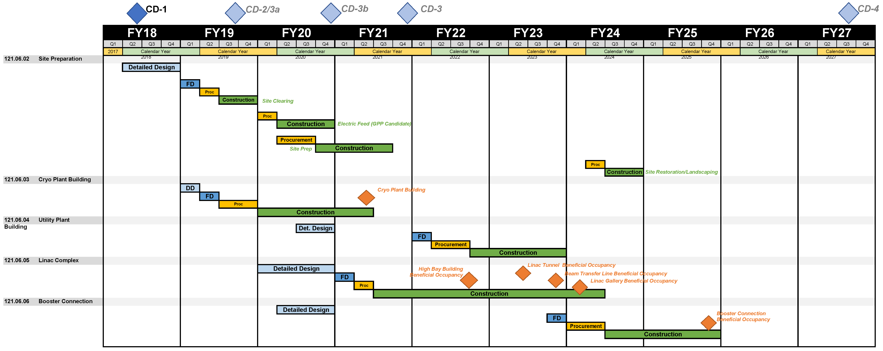
Schedule
Charge #3

Slide 17
Schedule With CD Approval Requests
Charge #3
Prior to CD-2/3A Approved
CD-3A Request
CD-3B Request

Slide 18
T5 Milestones
Charge #5

Slide 19
Environment Safety and Health (ES&H)
Charge #6
Consider and plan for ES&H issues throughout the project life cycle
Conceptual Design Phase
ES&H input includes review of the design, input from Tritium Task Force and Life Safety Analysis [1]
Design Phase
ES&H is considered in A/E selection process;
ES&H is included in design reviews;
Implement Safety by Design process;
Incorporate Hazard Analysis Report hazards in the design process [2]
Procurement/Construction Phase
Include safety performance as part of the subcontractor selection process;
Detail the responsibilities for team members including the Construction Subcontractor and Fermilab Construction Coordinator;
Independent oversight by ESH&Q Section
[1] Life Safety Analysis can be found at PIP-II-doc-120
[2] Hazard Analysis Report can be found at PIP-II-doc-140

Slide 20
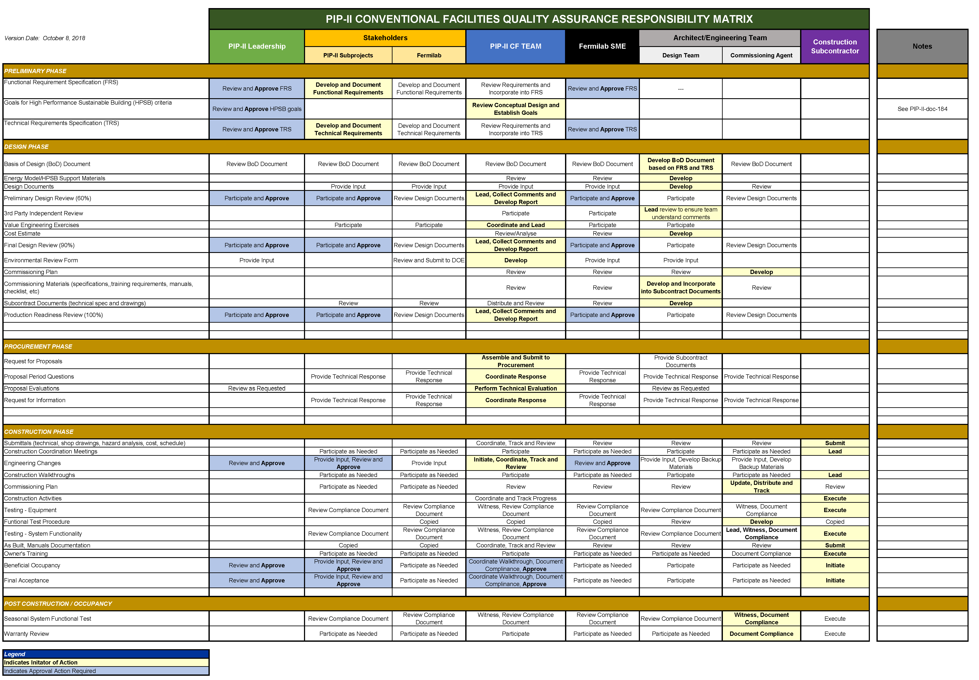
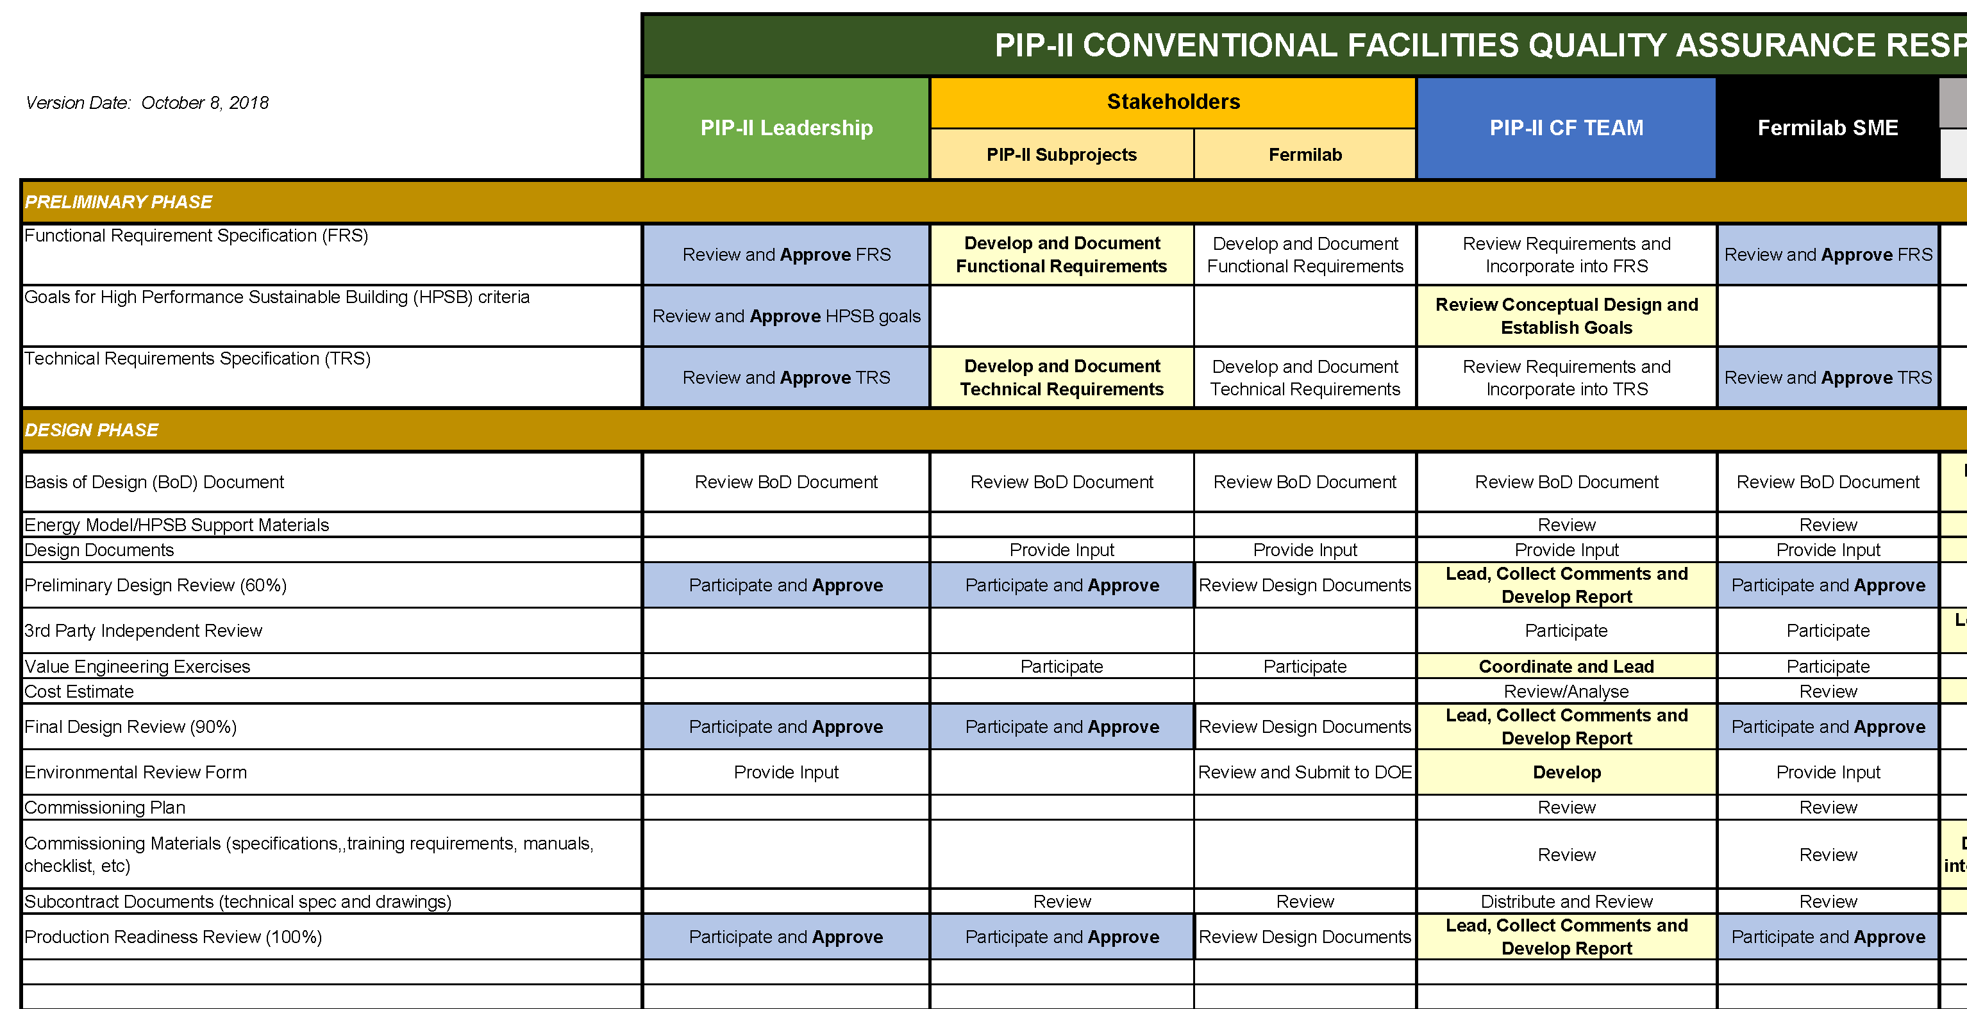
Quality Management
Charge #6
Integrated Team Approach
PIP-II Project Processes [1]
A/E Design Processes *
A/E Commissioning * Processes
FESS Subject Matter Experts
Laboratory Experts
Construction Subcontractor *
SC4-Dixon
(*) Quality requirements are incorporated into consultant selection and subcontract terms and conditions
[1] PIP-II Quality Assurance Plan is at PIP-II-doc-142
See PIP-II-doc-2291 for Quality Assurance Responsibility Matrix

Slide 21
WBS 121.06 Risk Management
Charge #2,7
SC4-Dixon
Conventional Facilities Risks
High Risks: 0
Medium Risks: 13
Low Risks: 30
Top 3 Risks
RI-ID | Title
RT-121-06-001 | Subproject requirements changes impact the Conventional Facilities
RT-121-06-002 | Accelerator shutdown schedule changes
RT-121-06-003 | Construction bids exceed estimates
Note: RT-121-01-006 – Inflation Exceeds Assumption is a Project Management Medium Risk

Slide 22
Response to Recommendations
Charge # 8
SC4-Dixon
Director’s CD-1 Review (October 2017) [1]
2 Recommendations, both closed
DOE CD-1 Review (December 2017) [2]
3 Recommendations, all closed
P2MAC Review (March 2018) [3]
3 Recommendations, all closed
[1] Review ID 47866
[2] Review ID 48107
[3] Review ID 48469

Slide 23
Breakout Sessions
Conventional Facilities In Depth
Schedule, Risks, Interfaces, ESH&Q and Review Recommendations
Site Preparation
Laboratory Interfaces
Cryogenics Plant Building (Joint Session with SRF/Cryo)
Requirements Documentation
SC4-Dixon
SC4-Wielgos
SC4-Wielgos
SC3-Hansen
SC4-Dixon
SC4-Dixon
SC2-Hunt

Slide 24
Summary
Conventional Facilities scope and deliverables are understood and are based on requirements;
Project Processes are in place and functioning;
(Risk Management, ES&H, Quality Management, Reviews)
CD-3A Scope (Site Preparation and Cryo Plant Building) is understood and progressing;
We are on track for CD-2/3A
Thank you for your attention and we look forward to your feedback

Slide 25
END

