Slide 1
121.03.03 AccS – High Power Radio Frequency and RF Distribution (HPRF-RFDist)
Breakout Session: High Power RF and RF Distribution
Jim Steimel
PIP-II IPR
4-6 December 2018

Slide 2
Outline
Scope/Deliverables
  (Including In-Kind Contributions)
Requirements
Interfaces
Preliminary Design, Maturity
Technical Progress to Date
ESH&Q
Risks and Mitigations
Summary

Slide 3
About Me:
Project Role
  Deputy Project Engineer (lead engineer for PIP-II electrical systems)
  Level 3 Manager for PIP-II High Power RF
  IIFC Sub-Project Manager (SPM) for High Power RF
Relevant Experience
  RF systems engineer for Booster ring RF systems
  Designed high bandwidth, beam stability control (damper) systems for Booster, Main Ring, Main Injector, and Tevatron rings
  Instrumentation group leader for Tevatron Department (BPM upgrade)
  Deputy Department Head for HINS program (linear accelerator construction for testing RF concepts)
  Managed construction and commissioning of PIP2IT RFQ
  Extensive knowledge and experience in design and interfacing accelerator RF.

Slide 4
Scope and Deliverables
Charge #2
Scope:
  Amplifiers (122 total)
  Circulators
  RF Distribution
    Coax transmission lines and waveguide
    Connectors, elbows, adapters, etc.
    Directional couplers
    Loads
  Controls & Amplifier Interlocks
    Amplifier reflected power
    Interface to accelerator control network
Deliverables:
  Fermilab provides Circulators, RF distribution and Controls and Interlocks for all systems.
  Fermilab provides amplifiers for warm cavity systems and HWR.
  DAE provides amplifiers for SSR1, SSR2, LB650 and HB650.

Slide 5
Scope and Deliverables
Charge #2
Section | Qty* | Freq (MHz) | Power (kW) | Phase | Source
RFQ | 2 | 162.5 | 75 | R&D | FNAL
Buncher | 4 | 162.5 | 3 | R&D | FNAL
First HWR | 1 | 162.5 | 3 | R&D | FNAL
Other HWR | 7 | 162.5 | 7 | R&D | FNAL
SSR1 | 8 | 325 | 7 | R&D | DAE
SSR1 | 8 | 325 | 7 | Construction | DAE
SSR2 | 5 | 325 | 20 | R&D | DAE
SSR2 | 30 | 325 | 20 | Construction | DAE
LB650 | 8 | 650 | 40 | R&D | DAE
LB650 | 25 | 650 | 40 | Construction | DAE
HB650 | 24 | 650 | 70 | Construction | DAE
Room Temperature Cavities
Supercon-ducting Cavities
DAE Deliverables
*Not including spares

Slide 6
121.03.03 L3 System Requirements
Charge #1
Necessary to achieve 2 Objective Key Performance Parameters
RF Power critical for achieving beam power specifications.
# | Description of Scope | Threshold KPP | Objective KPP
1 | SRF Linac Beam Energy | 600 MeV | 800 MeV
2 | Linac Beam | Beam delivered to the Beamline Dump | 5.4E12 particles per pulse (H-) at 20 Hz beam delivered to the Beamline Dump
3 | Booster/Recycler/Main Injector upgrades | Booster injection region, Recycler RF upgrades, and Main Injector RF upgrades, hardware installed and tested without beam in respective machines. | Linac beam injected and circulated in the Booster
4 | Cryogenic Infrastructure | Cryogenic plant and associated distribution system are installed and capable to support cavities operation at 2 K | Cryogenic system installed and is capable to support Linac operation in the CW mode

Slide 7
WBS L3 System Requirements
Charge #2
This WBS entry covers design, procurement, fabrication, and testing of the linac RF power amplifiers and transmission hardware. It includes development of systems at 162.5 MHz, 325 MHz, and 650 MHz, for both test infrastructure and linac systems.
Functional Requirement Specifications
ED0008023-RF Power Systems FRS
ED0003408-325 MHz SOLID STATE 7kW AMPLIFIER, FRS
ED0003669-325 MHz SOLID STATE 20 kW AMPLIFIER, FRS
ED0003413-650 MHz SOLID STATE 40 kW AMPLIFIER, FRS
ED0003680-650 MHz SOLID STATE 70 kW AMPLIFIER, FRS
FRSs for RF Distribution currently under development.
Technical Requirement Specifications
ED0004290-7 kW RF POWER AMPLIFIER, TRS - SSR1 325 MHz
ED0005489-TRS 40 kW, 650 MHz Solid State RF Power Amplifier System

Slide 8
WBS L3 System Requirements
Charge #2
Power and frequency requirements for SRF amplifiers based on Accel. Physics calculations that assume up to 2mA of beam, and 30% overhead for RF dynamics and power loss.
RF dynamics overhead dictates required linearity and bandwidth of amplifiers, and also circulator power handling capability.
Amplifiers are critical devices in radiation safety system, requiring verifiable shutdown mechanism used by Safety Systems.
Amplifiers shall protect themselves from damage due to overdrive, reflected power, overtemp, or loss of cooling.
The RF system shall provide necessary diagnostics and control to protect cavities from damage due to RF power (part of LLRF-RFPI system).
The amplifiers shall have remote control and diagnostics available to the control system.

Slide 9
Interfaces
Charge #2
Top 4 systems this WBS interfaces to:
WBS 121.03.03
Linac-RF Power
WBS 121.03.04
LLRF
LLRF I/O signals, RF Protection
WBS 121.03.07
Controls
Control of Amplifiers, Communication with PLC
WBS 121.02.02-04
Cavity Input Couplers
Dictate RF Connectors and Transition sections
WBS 121.06 & 121.04.04
Conventional Facilities
Equipment footprints, Cooling Water and HVAC, AC Power

Slide 10
Interfaces
Charge #2
Overall HPRF Interface Control Document (ICD) ED0007688-PIP-II Interface Control Document – High Power Radio Frequency (HPRF)
Technical interface specification documents
  ED0006360 – 650 MHz 40kW RFPA Interface Control Document
  ED0006356 – 325 MHz 7 kW Solid State RFPA Interface Control Document
  Interface to Conventional Facilities contained in Room Data Sheets
Identifier | WBS Level 2 | WBS ID | WBS Name | Space Designation Location | Sub-System | Component | Quantity | Space Type | Heating (F) | Cooling (F) | Humidity (%) | Cooling Type | Heat Load (KW) | Total Heat Load (KW)
DN-015 | 121.3 | 121.3.03 | HPRF | LG-HWR | HWR | Power Amplifiers | 8 | Floor | 40-95F | 82 +/-4 | na | LCW | 15.75 | 126.00
DN-019 | 121.3 | 121.3.03 | HPRF | LG-SSR1 | SSR1 | Power Amplifiers | 16 | Floor | 40-95F | 82 +/-4 | na | LCW | 15.75 | 252.00
DN-023 | 121.3 | 121.3.03 | HPRF | LG-SSR2 | SSR2 | Power Amplifiers | 35 | Floor | 40-95F | 82 +/-4 | na | LCW | 45 | 1575.00
Sample of data from RDS

Slide 11
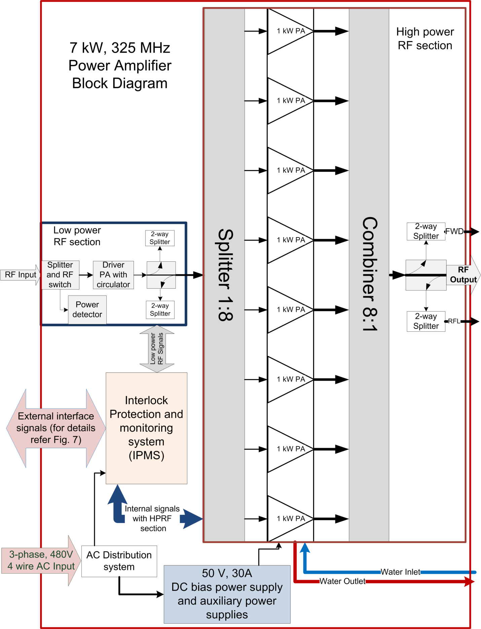
Preliminary Design and Design Maturity
Charge #2
Diagram shows design block diagram from TRS of the 7kW, 325 MHz solid state power amplifier.
This is a common configuration for high power SSPAs, modules with individual high power transistors have their outputs summed for final power specification.
Bandwidth high enough to support microsecond rise times for pulsed operation.
The assumed plan for 20kW units is combining more modules.

Slide 12
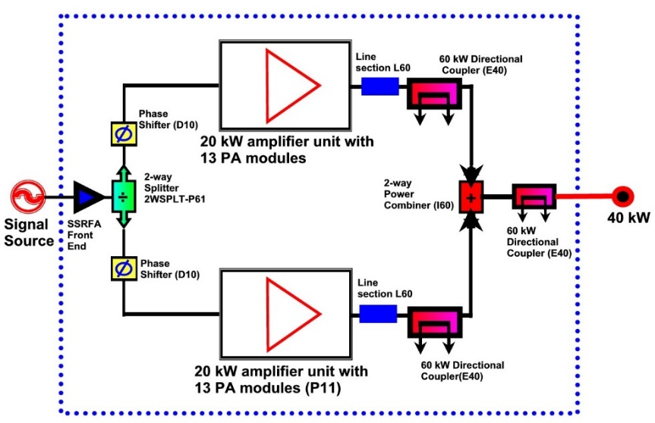
Preliminary Design and Design Maturity
Charge #2
Diagram shows conceptual design block diagram from TRS of the 40 kW, 650 MHz solid state power amplifier.
This configuration combines two, 20kW units that have a similar layout to the 7kW units. In this case, 13 amplifier modules are combined to make 20kW.
The assumed plan for 70kW, 650 MHz is combining four 20kW units. This will take considerable real estate in the gallery.
650 MHz, 40kW RF Power Amplifier
Block Diagram

Slide 13
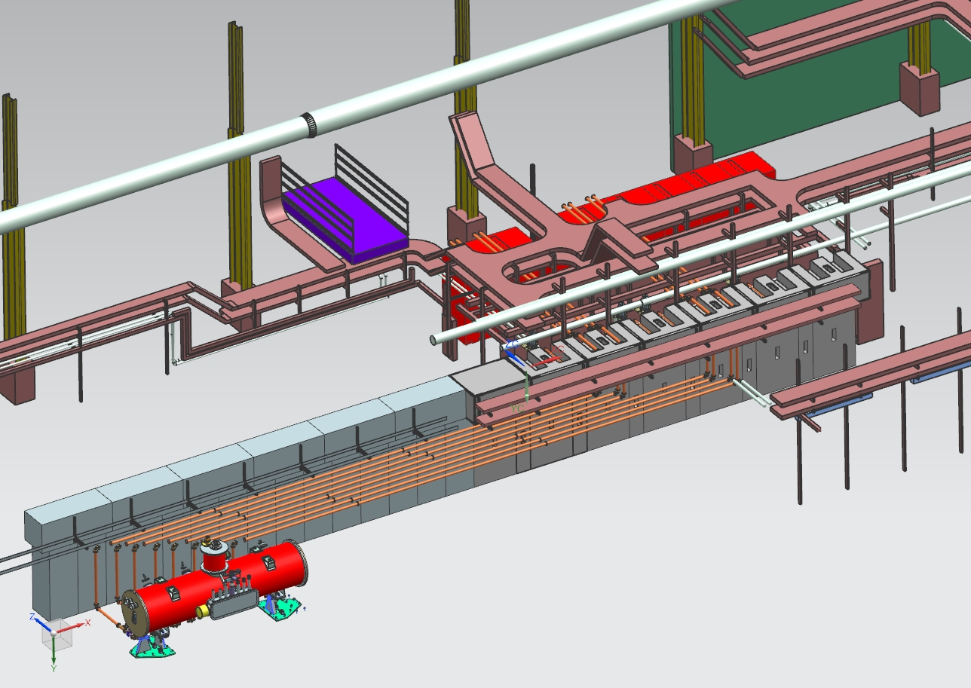
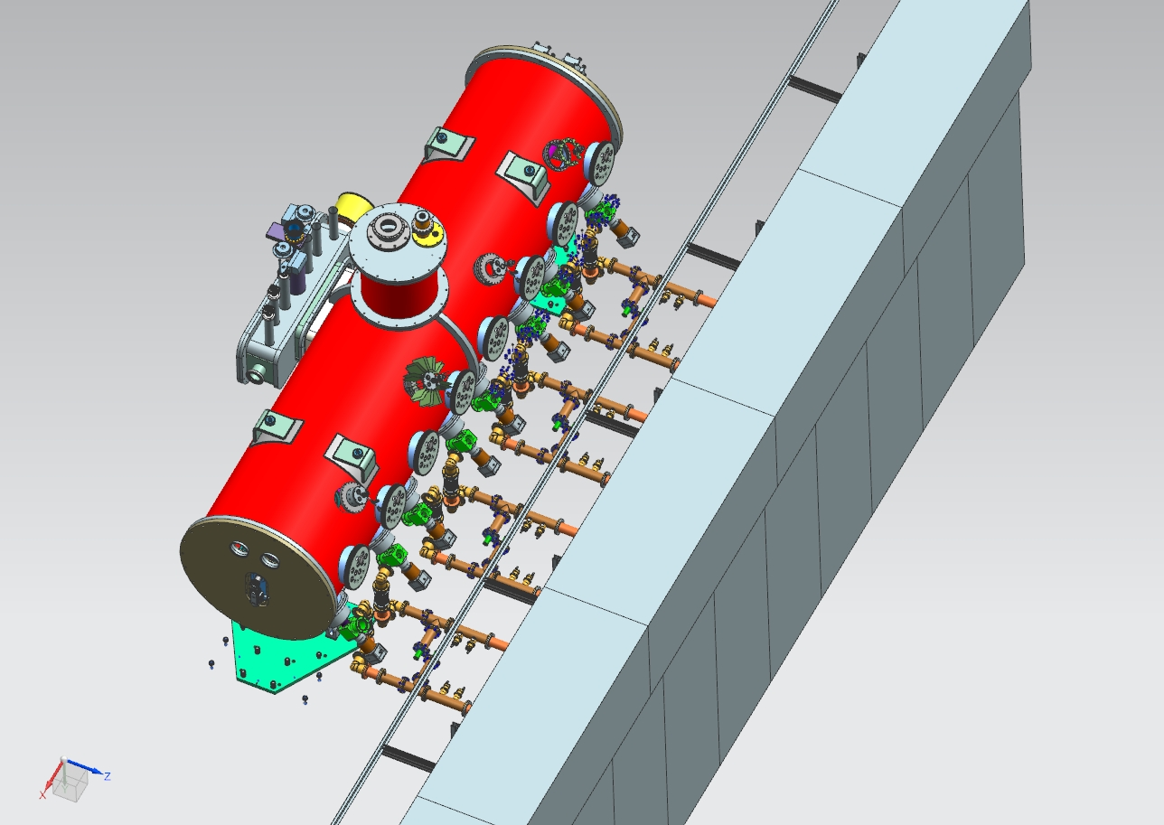
Preliminary Design and Design Maturity
Charge #2
Design of RF distribution for PIP2IT beam line underway.
Pictures below show preliminary solid models of RF distribution for SSR1 cryomodule.

Slide 14
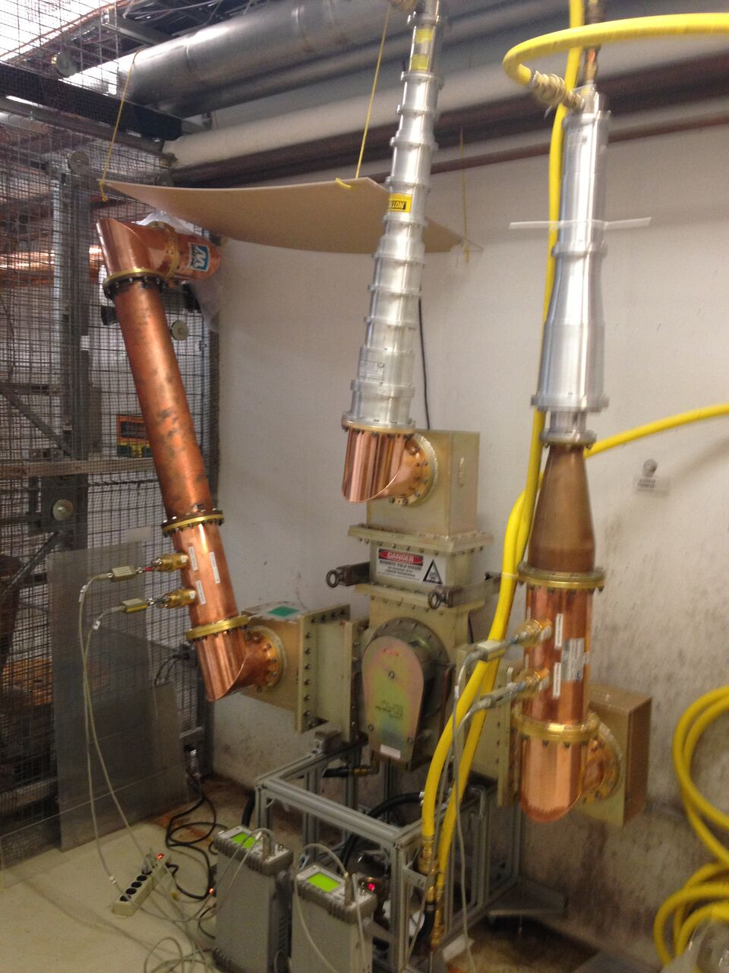
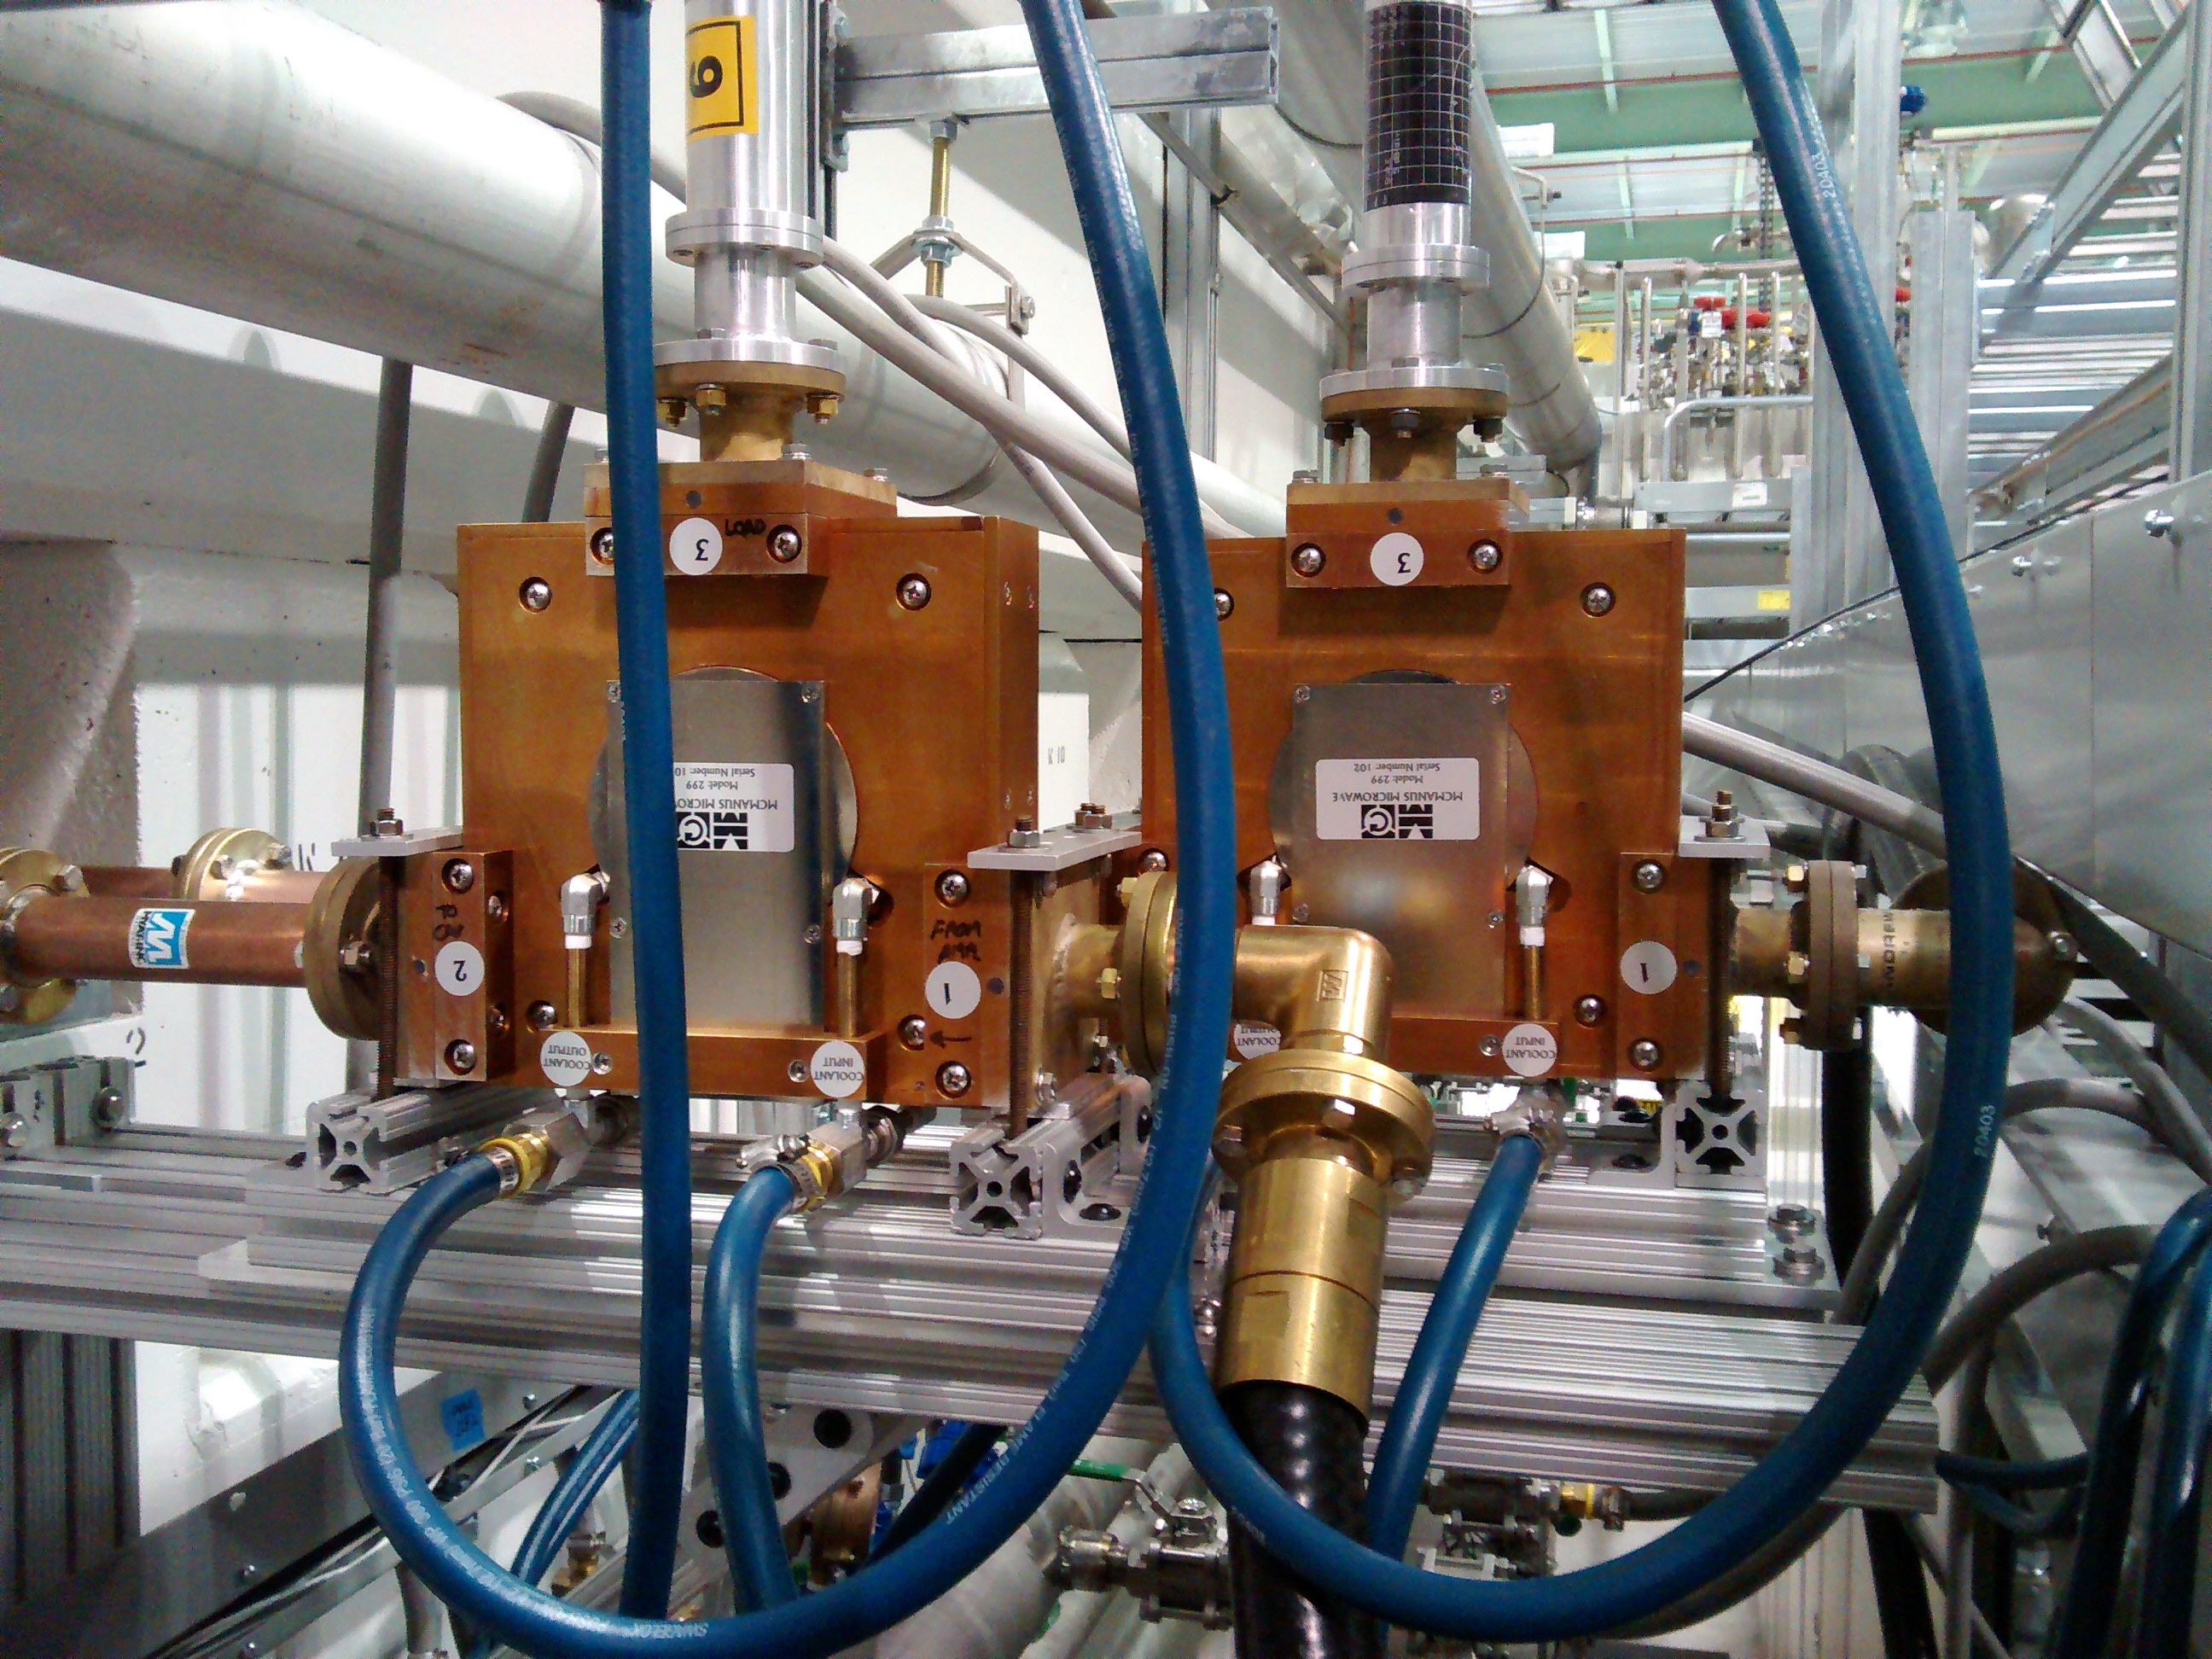
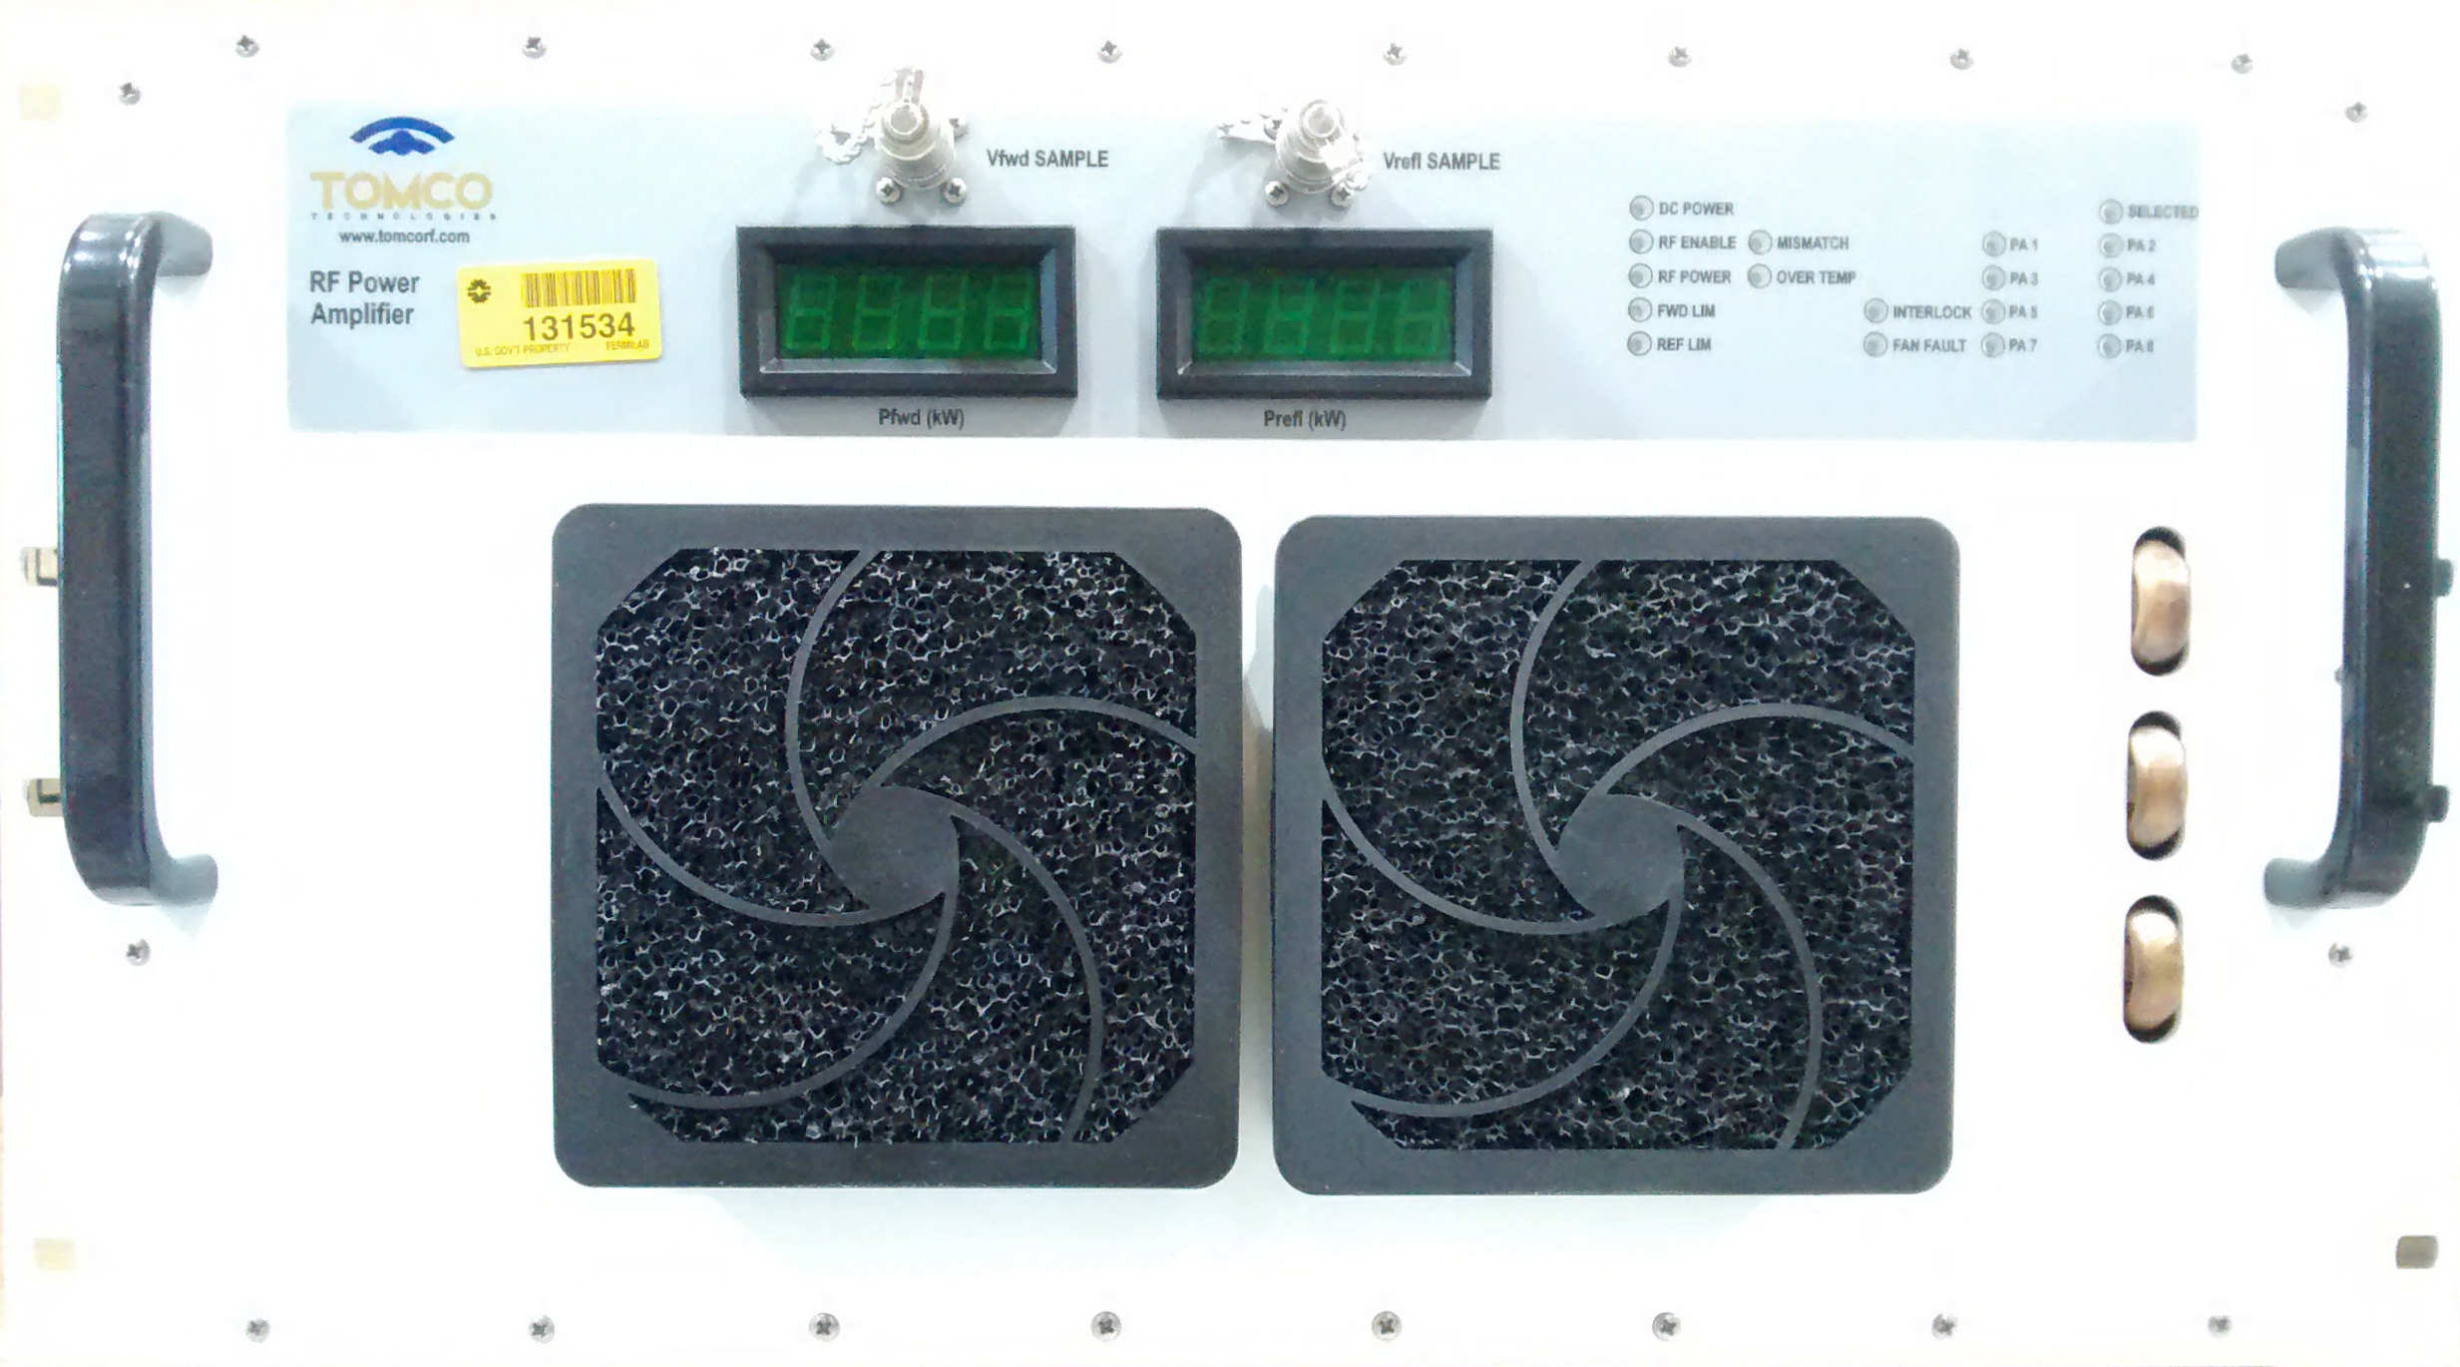
Technical Progress - FNAL
Charge #1
Commissioning of 650 MHz IOT amplifier and RF distribution for 650 MHz coupler tests.
Four McManus 162.5 MHz, 7 kW circulators arrived in May. Two are in use for Buncher 2 and Buncher 3. Remaining 7kW circulators for HWR and SSR1, 325 MHz have been procured.
First 162.5 MHz, 7 kW CW amplifier has arrived. 8 more units procured in FY2018 due early CY19.

Slide 15
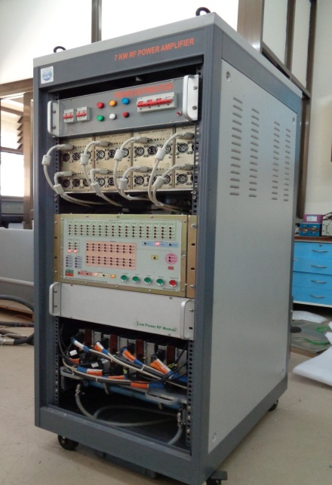
Technical Progress – DAE/BARC
Charge #1
A working, prototype 3kW, 325 MHz amplifier sent to FNAL for evaluation.
A working, prototype 7kW, 325 MHz amplifier completed at BARC.
Order placed with vendor, ECIL, for 9 production units.
FNAL and BARC engineers will experience acceptance testing of 7kW prototype and ECIL first production unit. This is planned for February.
325 MHz, 7 kW Solid State Amplifier at BARC

Slide 16
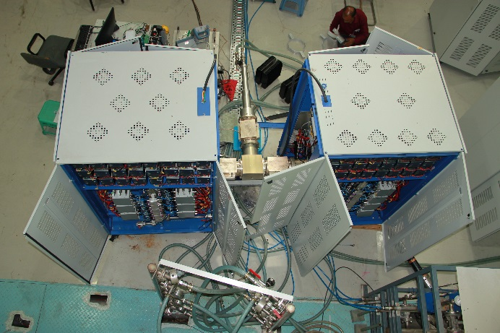
Technical Progress – DAE/RRCAT
Charge #1
A working, prototype 40kW, 650 MHz amplifier completed at RRCAT.
RRCAT contracting ECIL for production versions.
FNAL and RRCAT engineers will experience acceptance testing of 40kW prototype (February) and ECIL first production unit.
650 MHz, 40 kW Amplifier at RRCAT

Slide 17
ESH
Charge #6
All RF Power systems will conform to Fermilab safety standards
  All necessary LOTO procedures will be documented
  All cabling will be in accordance with National Electric Code
  Grounding will be reviewed as systems are installed
  Operational Readiness Clearance (ORC) is required before powering any new amplifier or cavity installation. Areas include
    Electrical safety inspection
    Interlock verifications
    RF leakage checks
    Cavity X-ray measurements
DAE amplifiers will conform as written in TRS to:
  Workmanship: IPC-A-610E
  Standards for PCBs: Lead free, IPC-A-600
  Environmental standards: ROHS Compliant
  EMI/EMC standards: IEC-61204-3; IEC61010-1 (safety rules)
  Vibration standards for transportation only: IEC-61068-27 & 64
PIP-II Preliminary Hazard Analysis Report, Integrated ESH Management Plan and Preliminary Quality Assurance Program (docdb #140, 141 and 142)
PIP-II International Risk Mitigation Strategy (docdb #1201)
Safety is the highest priority and we will coordinate activities with ESH&Q

Slide 18
Quality Management
Charge #6
RF Amplifier collaboration partner QA plan:
  All requirements, preliminary design, and testing plans approved by partners prior to vendor contract.
  Testing categories include water flow, interlocks, remote communication, power output, spectrum, and response. (7kW Testing plan document #’s ED0006507 & ED0006484.)
  Prototypes and first production units testing will be observed by FNAL engineers for compliance prior to continued production.

Slide 19
Quality Management
Charge #6
RF Distribution QA/QC:
  Circulators and waveguide are specified to handle 4x the power capability of power amplifiers.
  All circulators are tested with full reflection CW at the rated power levels of their power amplifiers.
  A number of circulators from different vendors have been tested in the early stages of the project, and we have now have a list of reliable vendors.

Slide 20
Risk: RF Power
Charge #2,7
RT-121-03-002 RF Power Amps Have Technical Issues
  Some on-site modifications may be required to make amplifiers operational and meet specifications.
  We will receive smaller quantities of production amplifiers during R&D phase. We can feedback on design issues for construction phase amplifiers.
RT-121-03-003 High Power Circulator Fails
  This risk is meant to capture possible issues with yield from our circulator vendors.
  A few circulators may fail in testing or early operations.
  They would be returned for warranty, but this risk covers the labor cost of dismantling, preparing for shipping, and re-installing.

Slide 21
Response to Recommendations
Charge # 8
PIP-II DOE CD-1 Review Recommendation No. 3 | Status: | Ongoing
 | Planned Date Closed: | 01/16/2019
System | RF Systems
Owner | James Steimel
Recommendation | Prior to CD-2, specify and document the minimum required MTBF of the RF sources, which may require the SSAs to have redundant power supplies and transistors.
Project Response | A preliminary formula for determining MTBF of the RF amplifiers will be developed. Design and spares strategy will be dependent on overall PIP-II reliability requirements. These requirements are being developed and will flow down to the amplifier requirements.

Slide 22
Response to Recommendations
Charge # 8
PIP-II DOE CD-1 Review Recommendation No. 4 | Status: | Ongoing
 | Planned Date Closed: | 2/15/2019
System | RF Systems
Owner | James Steimel
Recommendation | Prior to CD-2, develop a long term maintenance plan with collaborators and a spares strategy (avoiding obsolesce) for the RF sources.
Project Response | Within the scope of finalizing partner deliverables before CD-2, we will include specifications for spare parts of the RF power amplifiers to insure long term operation.

Slide 23
Next Steps toward CD-2
Charge #5
Start using EVMS with RLS and execute monthly reporting cycle.
Advance Design to Preliminary Stage
  Complete final design reviews for RF distribution of 650 MHz test stands.
  Complete final design reviews for RF distribution in PIP2IT.
  Complete preliminary design review of 40kW, 650 MHz amplifier.
Complete Prototypes necessary to understand performance, cost, & schedule
  325 MHz 7 kW amplifier test at BARC
  325 MHz 7 kW amplifier test at ECIL
  650 MHz 40 kW amplifier test at RRCAT
No 3a scope in this L3 section

Slide 24
Summary
Messages:
  Requirements are defined
  Design is sound and meets the requirements, validated by design reviews
  Risks are understood
  ESH and QA plans are in place
  Project team is motivated, qualified, and ready to deliver
  We are on track for CD-2 and look forward to your feedback
  Thank you for your attention

Slide 25
END

