Slide 1
121.03.05 AccS-MagPS
Magnets and Power Supplies
Bruce Hanna
PIP-II IPR
4-6 December 2018

Slide 2
Outline
Scope/Deliverables
  (Including In-Kind Contributions)
Requirements
Interfaces
Preliminary Design, Maturity
Technical Progress to Date
ESH&Q
Risks and Mitigations
Summary

Slide 3
About Me:
I have been involved in PIP2IT since 2013 and have worked on the LEBT and MEBT as well as on preparations for cryomodule installation and infrastructure at MDB for SRF testing.
I have been involved in the design and testing of the Quench Protection Monitor for the PIP-II Cryogenic magnets as well as in the preliminary design of the warm BTL magnets and power supply systems
Before working on PIP2 I was involved in Tevatron operations. This work required knowledge of cryogenic systems and their diagnosis as well as beam tuning taking care not to induce beam losses that would result in quenches.
  Involved in the technical aspects of the Separator project and the A0 Abort Project
  Project Manager for the Proton Injection Kicker Upgrade
  Project Manager for the Pbar Kicker Upgrade Project

Slide 4
Scope and Deliverables (PIP2IT Power Supply and TI)
Charge #2
PIP2IT:
  Twelve 65 amp switchers
  Sixteen 10 amp switchers
  Sixteen 40 amp switchers
  Eight QPM’s
  Eight Bulk Supply systems
  Eight Crowbar systems
  Sixteen HV power supplies for biasing RF couplers for HWR and SSR1
Test Infrastructure upgrade for SSR2 Testing:
  Fabricate four 80 amp switchers
  Fabricate sixteen 50 amp switchers

Slide 5
Scope and Deliverables (PIP-II Power Supply)
Charge #2
Switcher Modules
  Thirty Seven (37) 80 amp switcher modules for solenoids
  One hundred sixteen (116) 50 amp switchers for SSR1 & 2 correctors
  One hundred thirteen (113) 10 amp switchers for HWR, Warm Unit & BTL correctors
Thirty three (33) QPM systems
Thirty five (35) Bulk supply systems
Forty Four (44) commercially available 1500 watt supplies
  For warm 650 MHz quads
One Hundred sixteen (116) High Voltage power supplies for SRF cavity couplers
Eight (8) commercially available 10000 watt supplies
  Four for BTL individual dipoles and 4 for BTL quad loops
Five (5) 75 kW supply for dipole strings
Two (1) 135 kW supply for 3 way septum and Booster C- magnet
Six (6) 2.4 kW supplies (individual quadrupoles)
Six (6) 3.3 kW supplies (end of line quads)

Slide 6
Scope and Deliverables (Warm Linac Magnets)
Charge #2
India Deliverables for the 650 MHz warm magnets:
    Forty four quadrupole magnets
    Twenty 2-plane Corrector dipole magnets
    Delivery of prototypes is expected in Jan 2020
Since this magnet is similar to the regular BTL quads, the transfer line quadrupoles and dipole correctors may also be in-kind deliverables

Slide 7
Scope and Deliverables (Beam Transfer Line)
Charge #2
Beam Transfer Line Magnets
Device | Quantity
3 Way Septum Magnet | 1
Dipole | 32
Dipole, C-magnet | 1
Dipole, Booster Injection | 2
Dipole, fast switch magnet | 1
Dipole, Beam Dump | 5
V & H dipole corrector | 56
Quad, large aperture F | 1
Quad, large aperture D | 1
Quad, cental line F-D | 49
Quad, Booster Injection | 6

Slide 8
WBS L3 System Requirements
Charge #2
Magnets and specifications from Preliminary Design Report
Style | Qua-ntity | Effect. length [m] | Field integral | Gap or apertu-re (2a) | Good field region | Uniformi-ty, DB/B or DG/G | Opera-ting tem-perature
HWR solenoids | 8 | - | 2 T²m | 33 | - | - | cold
HWR 2-plane dip. corr | 8 | - | ±2.5 mT∙m | 33 | - | - | cold
SSR1 solenoids | 8 | - | 4 T²m | 30 | - | - | cold
SSR1 2-plane dip. corr | 8 | - | ±2.5 mT∙m | 30 | - | - | cold
SSR2 solenoids | 21 | - | 5 T²m | 40 | - | - | cold
SSR2 2-plane dip. corr | 21 | - | ±5.0 mT∙m | 40 | - | - | cold
SC linac quads | 40 | 0.2 | 3 T | 52 mm | Ø24 mm | 0.1% | warm
SC linac 2-plane dip. corr | 20 | ~0.1 | ±10.0 mT∙m | 52 mm | Ø24 mm | 1% | warm
SC linac skew-quads | 4 | ~0.1 | 1 T | 52 mm | Ø24 mm | 0.3% | warm
Transport line regular quads | 49 | 0.2 | 2 T | 52 mm | Ø24 mm | 0.1% | warm
Transport line large bore quads | 2 | 0.4 | 2 T | 80 | 150×10 mm² | 0.1% | warm
End of Booster line quads | 6 | 0.2 | 3T | 52 mm | Ø24 mm | 0.1% | warm
Tr. line one-plane dip. correctors | 56 | ~0.1 | ±10.0 mT∙m | 52 mm | Ø24 mm | 1% | warm
Transport line dipoles | 37 | 2.45 | 0.7 T∙m | 52 mm | Ø24 mm | 0.02% | warm
End of transport line dipoles | 2 | 1.8 | 0.52 T∙m | 52 mm | Ø24 mm | 0.02% | warm
C-dipole of Booster injection | 1 | 1.8 | 0.69 T∙m | 52 mm | Ø24 mm | 0.05% | warm
Fast dipole switch | 1 | 2 | 15 mT∙m | 45 mm | Ø24 mm | 1% | warm
3-way septum magnet | 1 | 2.6 | 0.73 T∙m | 34×34 mm² | Ø30 mm | 0.2% | warm
Beam dump sweep magnet | 1 | 0.5 | 0.05 T∙m | 52 mm | Ø24 mm | 1% | warm

Slide 9
WBS L3 System Requirements
Charge #2
WBS 121.03.05 Linac - Power Supplies
  There are several different systems each with there own requirements
    All cryogenic magnets will require quench protection as well as bipolar switching modules to provide current for both solenoids and correctors
      Solenoids operate up to 75 amps
      Correctors operate up to 50 amps
    Low Beta and High Beta warm Magnets
      Forty Four Quadrupoles operate up to 100 amps
      Forty Correctors operate up to +/- 10 amps
    Beam Lines
      Nine dipole circuits operate up to 500 amps
      Eleven quadrupole circuits operate up to 150 amps
      Fifty six corrector circuits operate up to +/-10 amps
      Three specialty dipoles : fast dipole switch magnet,3 way septum magnet and beam dump sweep magnet
Warm Linac, Beam Transfer Line and Beam Absorber Line Magnets
  Minimize H- stripping due to magnetic bending
    The transfer line elements are designed for 1 GeV which limits the maximum dipole field to 2.8 kG
  Magnets must be designed to provide appropriate focusing and steering as specified in the Preliminary Design Report

Slide 10
Interfaces
Charge #2
BTL Magnet Interfaces :
  Interface with building and installation WBS’s to insure magnet structure and utility needs (such as water cooling) are addressed as well as appropriate cabling is used
    Technical Requirement Specification documents are being developed that incorporate the scope from the Project Interface Control Document:
      Optics requirements
      Alignment requirements and referencing
      Beam Tube requirements
      Rigging requirements
      Stand requirements
      Grounding

Slide 11
Interfaces
Charge #2
Power Supply Interfaces:
  Interface with Controls
    Power supply controls and readback
    Machine Protection
  Installation and building
    AC power requirements
    Cooling requirements
    Adequate space
    Proper grounding
  Interface with High Power RF:
    Coupler HV bias supply requirements and connections
  Interface with Cryomodules:
    Appropriate cable connections
    Appropriate internal cabling for design current
    Appropriate monitoring of critical parameters
  Electrical Safety System
Interfaces identified and being managed
  MagPS has 54 entries in the Project ICD document
  L3 ICD TC document ED0007690

Slide 12
Preliminary Design and Design Maturity
Charge #2
QPM system has been prototyped and tested on a cold SSR1 solenoid at IB1
  A Final Design Review and Procurement Readiness Review has been completed
  Chair Report doc is in TC # ED0008375
Prototyping and testing of the 80 amp DC switcher module is complete
Currently completing design of the new 50 amp DC switcher
  Plan to test a 50 amp prototype in December
Preliminary designs have been completed for all warm magnet systems
  650 MHz warm Quad design from India is in TC doc ED0008430
  Dipole corrector design is waiting on lattice calculations that will affect spacing and fringe fields

Slide 13
Preliminary Design and Design Maturity
Charge #2
All BTL magnet designs are based on previous magnet designs
We have done preliminary designs on all warm BTL magnets
  BTL Dipole design has 24 turns and nominal current of 420 amps
  Regular BTL quads have a maximum current of 150 amps
    Nominal current is less than 100 amps
    This allows the same design to be used for the higher gradient End of Line quads
    Uses direct water cooling; design is robust and reliable
    Large aperture quad design has been completed
      Will need further work to optimize pole tip shape
  Three Way Septum magnet magnetic and mechanical preliminary design has been completed
    This design can also be used for the Booster Injection C-Magnet
  The Fast Switch magnet for moving beam between the BTL abort Line and Booster Injection will be a repurposed Tevatron A0 abort magnet
    Magnet will need some modifications

Slide 14
Preliminary Design and Design Maturity;Dipole
Charge #2
Dipole field from M. Yu showing field strength and coil design

Slide 15
Preliminary Design and Design Maturity;Dipole
Charge #2
Quadrupole coil design from V. Kashikin for direct cooling, 100 amp design

Slide 16
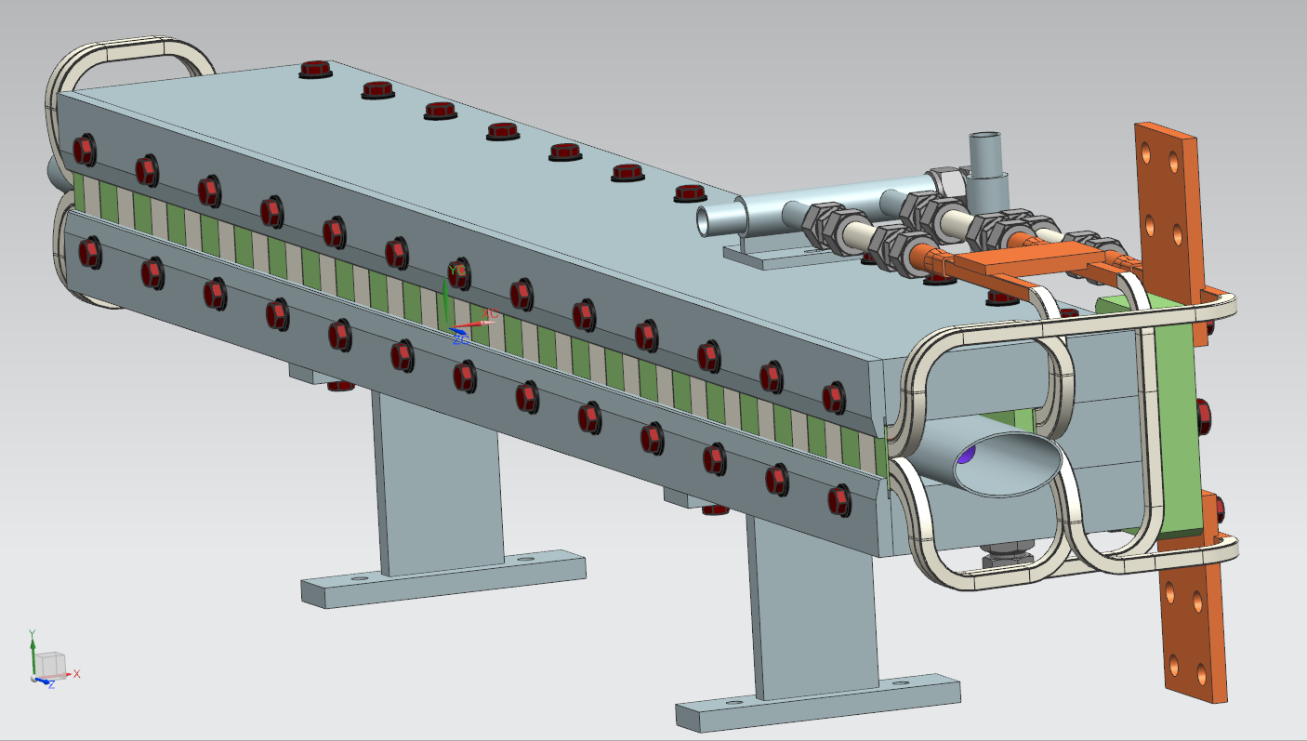
Preliminary Design and Design Maturity;Dipole
Charge #2
Mechanical design for ½ of the 3-way septum magnet from A. Makarov

Slide 17
Preliminary Design and Design Maturity; Switchers
Charge #2
Re-designed filter/choke board thermal scan
Re-designed FET card thermal scan. Maximum FET operating temperature is 150 degrees C

Slide 18
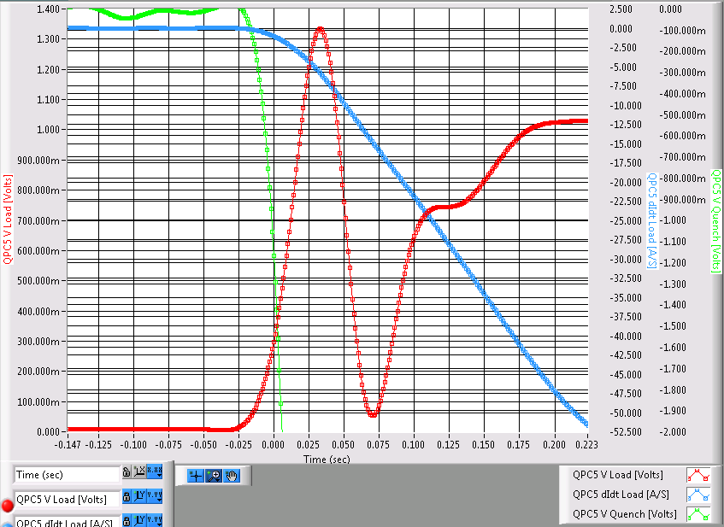
Progress to date( QPM Test w/cold SSR1 solenoid
Charge #1
Plot showing di/dt (blue), voltage across the solenoid (red) and quench voltage (V_measured – LdI/dt; in green). Quench threshold is 1 volt

Slide 19
ESH
Charge #6
Safety by Design (SbD) has been incorporated into all aspects of this WBS
  Safety by Design (SbD) was incorporated into the QPM Final Design Review
EE Support Department and Division ESH practices are documented and all procedures are being followed
  ESHQ-FESHM Fermilab Environment, Safety and Health Manuel
  EE Support Risk Assessment Spread Sheet
  PIP-II Integrated ESH Management Plan (pip2-docdb #141)
Safety is the highest priority and all CD-1 requirements have been met.
ESH for Power Supplies
  All power supply systems will conform to Fermilab electrical standards
    All necessary LOTO procedures will be documented
    All cabling will be in accordance with NEC code
    Grounding will be reviewed as systems are installed
ESH for Beam Transfer Line Magnets
  Communicating and working with magnet vendor

Slide 20
Quality Management
Charge #6
PIP-II Project Quality Assurance Plan (pip2-docdb #142)
Quality Management for Magnets includes:
  Prototype magnets for testing
  Vendor visits to insure magnet production meets our requirements
    This includes visits to any vendor with whom we have no experience to insure they have proper quality control
  All magnets will go through a standard QA assessment at APS-TD (Applied Physics and Superconducting Technology Division):
    Mechanical and electrical tests
    Magnetic measurements
Quality Management for Power Supplies includes:
  Incoming inspections and testing of components and power supplies
    ADDP-EE-2003 Maintenance and Quality Control Guidelines
    ADDP-EE-2004 Quality Control and Maintenance Considerations in Equipment Design
  Vendor visits to insure power supply production meets our requirements
    This includes visits to any vendor with whom we have no experience to insure they have proper quality control
Quality assurance is being incorporated into all aspects of the MagPS WBS

Slide 21
Risk Management
Charge #2,7
Risks associated with magnets:
  Fast Switch Magnet needs to be redesigned (RT121-03-15; Medium Risk)
    We are using an existing A0 Abort magnet. If testing shows this does not work we will need to fabricate a new magnet
      A magnetic preliminary design has been completed for a new magnet
      We have a preliminary design for the pulser and plan on testing the overall system
  Three Way Septum Magnet needs to be redesigned or the production schedule slips (RT-121-03-019; Low Risk)
    Similar magnets for G-2 caused many problems
    Lessons learned have been incorporated into our design
Risks associated with Power Supplies:
  QPM system is inadequate for the higher inductance SSR2 solenoids
    RT121-03-023; Low Risk
    Calculations have been completed that indicate our system will work and that a dump is not needed
      These calculations indicate large voltages can be developed between windings; we must work closely with our International partners to insure adequate insulation is incorporated into these magnets
Risks are understood and are being managed

Slide 22
Summary
Magnet and power supply requirements are defined:
  Project team for PIP2IT power supplies has been assembled and is actively working on the project
  QPM system has been designed, tested and reviewed and PIP2IT QPMs are being built
  New switcher modules have been designed and have either been tested or soon will be
Preliminary designs are sound and meets the requirements.
  These will be validated by design reviews
Risks are understood
ESH and QA plans are in place
Project team is motivated, qualified, and ready to deliver
We are on track for CD-2 and look forward to your feedback
Thank you for your attention

Slide 23
END

