Slide 1
121.04.02 Inst – Warm Front End (WFE)
SC2: Accelerator Complex Upgrades, Linac Install. and Comm.
Lionel Prost
PIP-II IPR
4-6 December 2018

Slide 2
Outline
Scope/Deliverables
Requirements
Interfaces
Design Maturity
Technical Progress to Date
ESH&Q
Risks and Mitigations
Summary

Slide 3
About Me:
Level 3 Manager for the Linac Warm Front End
  Senior Scientist (>15 years experience with accelerator systems)
  Contributed to the Recycler Electron Cooler project at Fermilab
    Highest energy electron cooler in the world
    Beam power ~4MW
IS/LEBT Design
WFE commissioning at PIP2IT

Slide 4

Warm Front End
The Warm Front End (WFE) prepares a H⁻ beam optimized for injection into the Booster and provides capabilities for future Continuous Wave (CW) operation
  A low emittance beam is required to minimize beam loss in the Superconducting Radio Frequency (SRF) linac and at injection into the Booster (KPP #1)
PIP-II Injector Test (PIP2IT): Complete system test that replicates the front end of PIP-II linac through the first Single Spoke Resonator Type 1 (SSR1) cryomodule
Warm Front End
PIP-II Injector Test

Slide 5
WFE WBS Current Deliverables
Charge #2
Included in the PIP2IT program
  Medium Energy Beam Transport (MEBT) kickers (2nd prototypes)
  MEBT absorber
  MEBT scraping systems (2 out of 4)
    2 complete systems already installed at PIP2IT
  MEBT-to-Half-Wave Resonator (HWR) cryomodule transition section
  High Energy Beam Transport (HEBT)
    Including new shielding for the beam dump
Beyond PIP2IT
  MEBT kickers (production)
    New driver electronics
  Ion Source assembly (1) and components to complete the 2nd leg of the Low Energy Beam Transport (LEBT)
    Including power supplies
  MEBT components not included in the PIP2IT beam line
    Additional bunching cavities (2), quadrupole triplets assemblies (3)

Slide 6
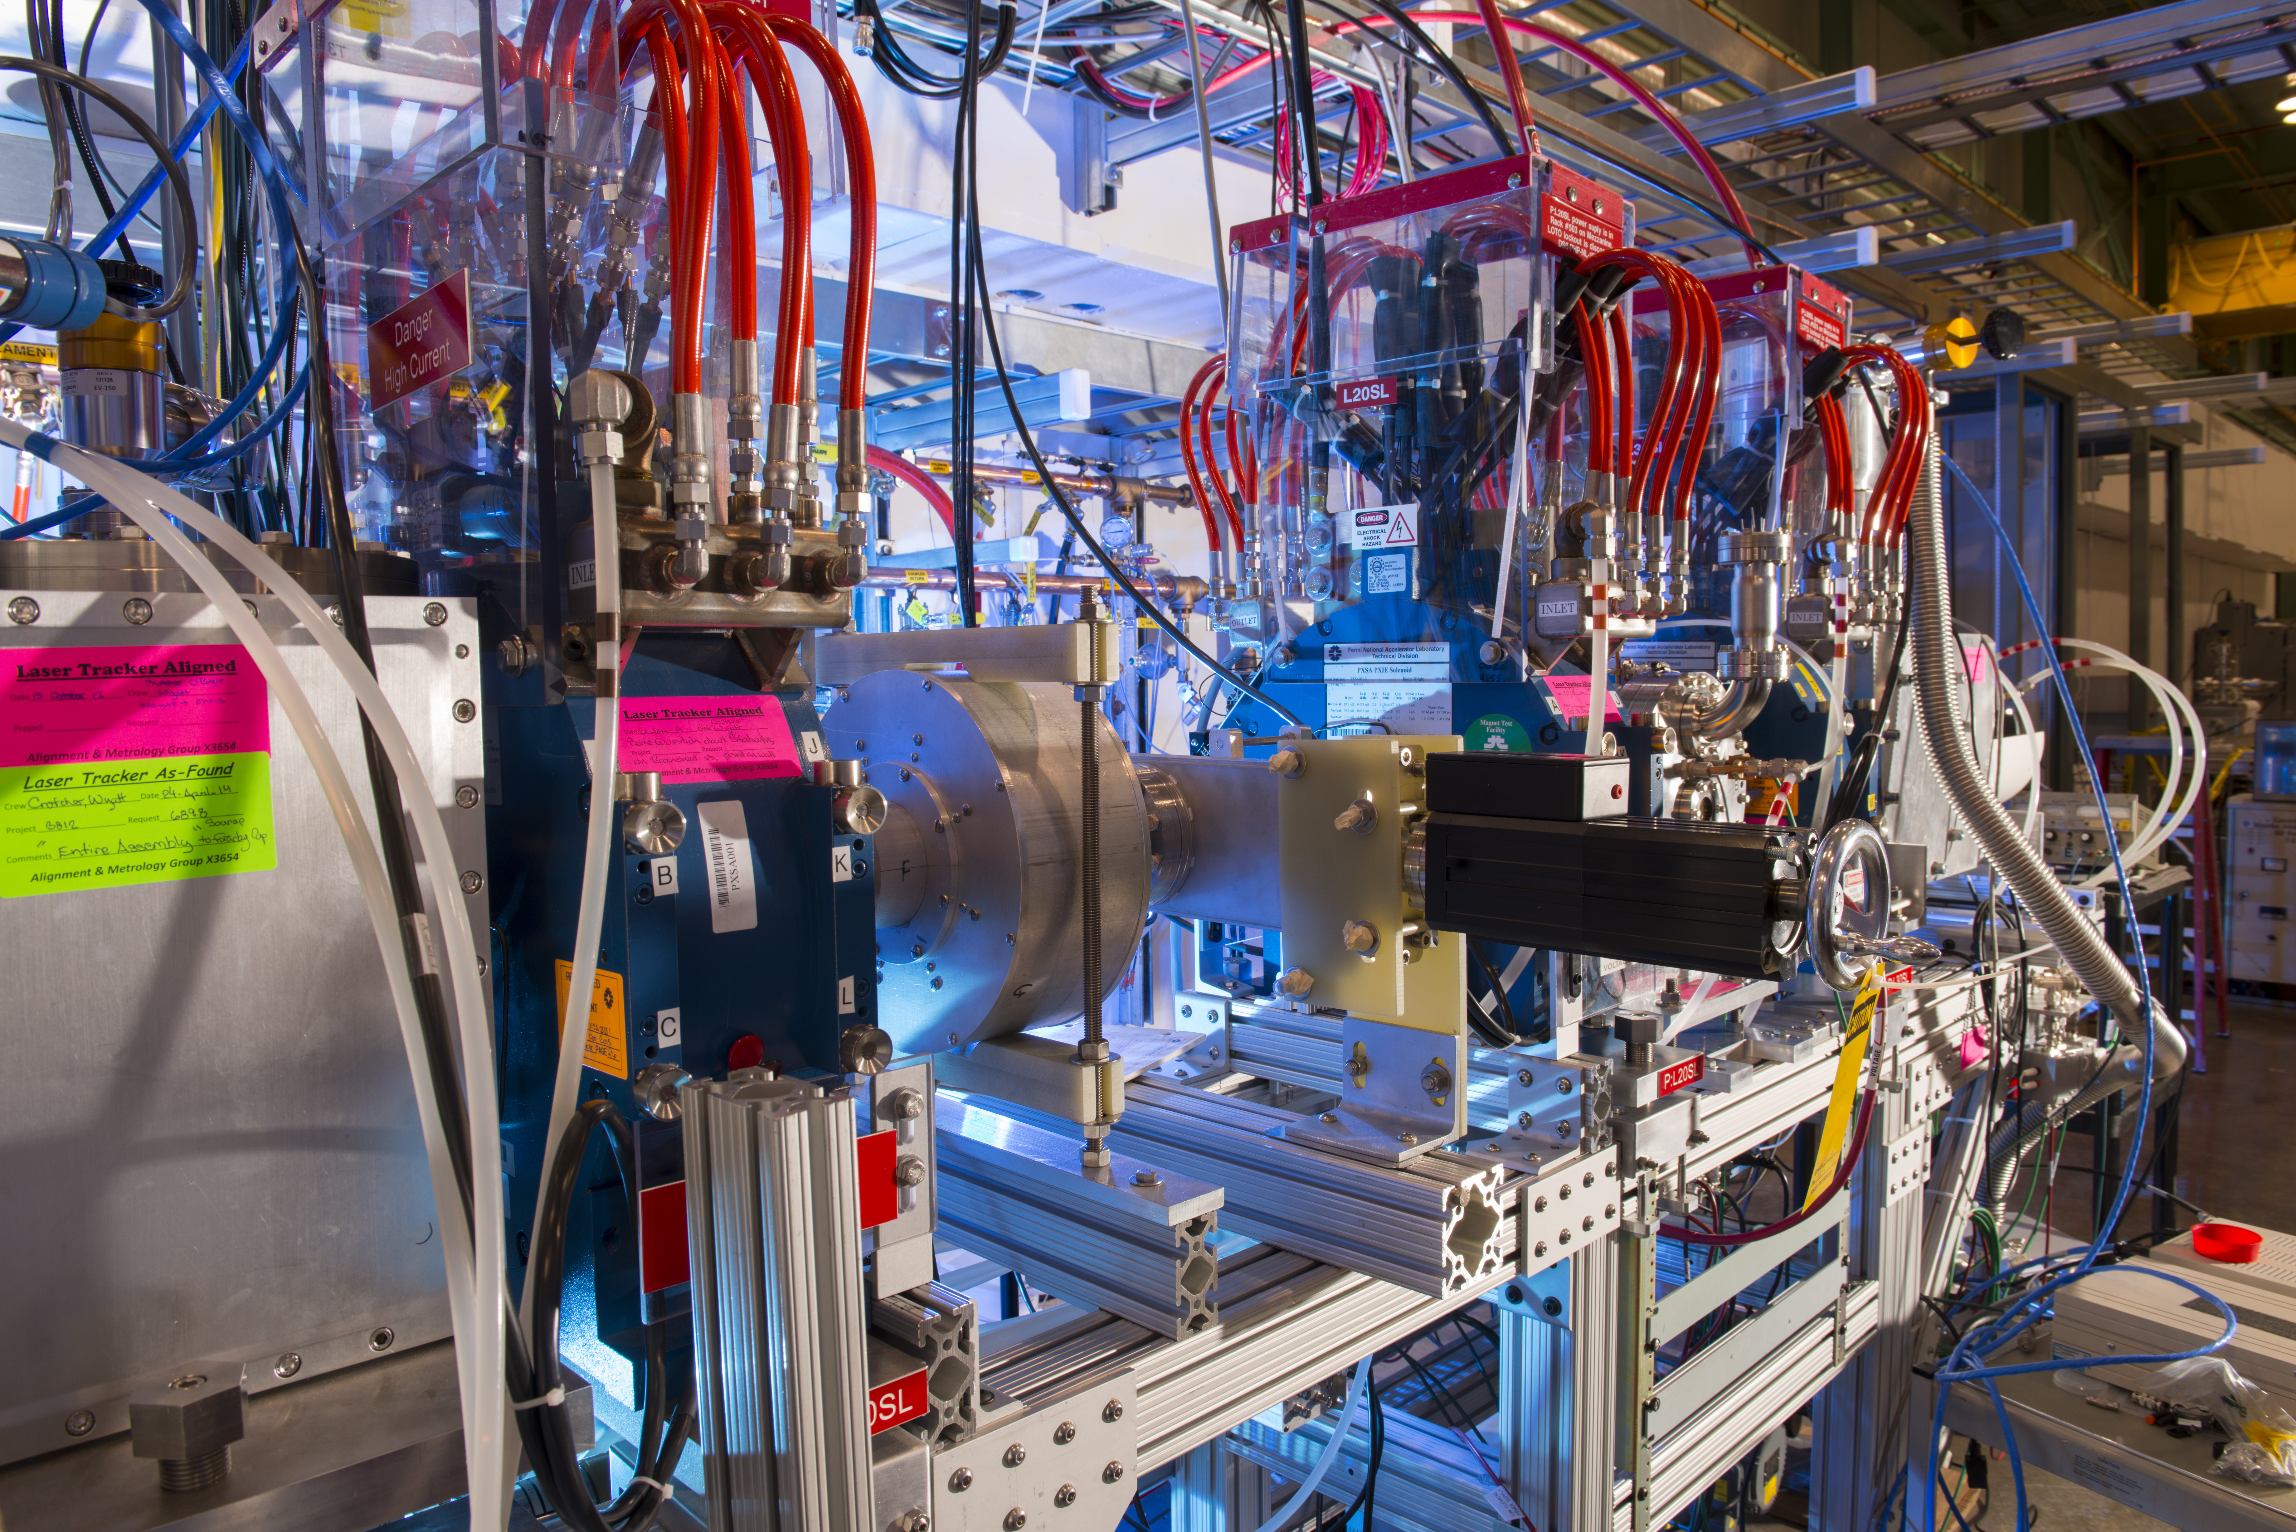
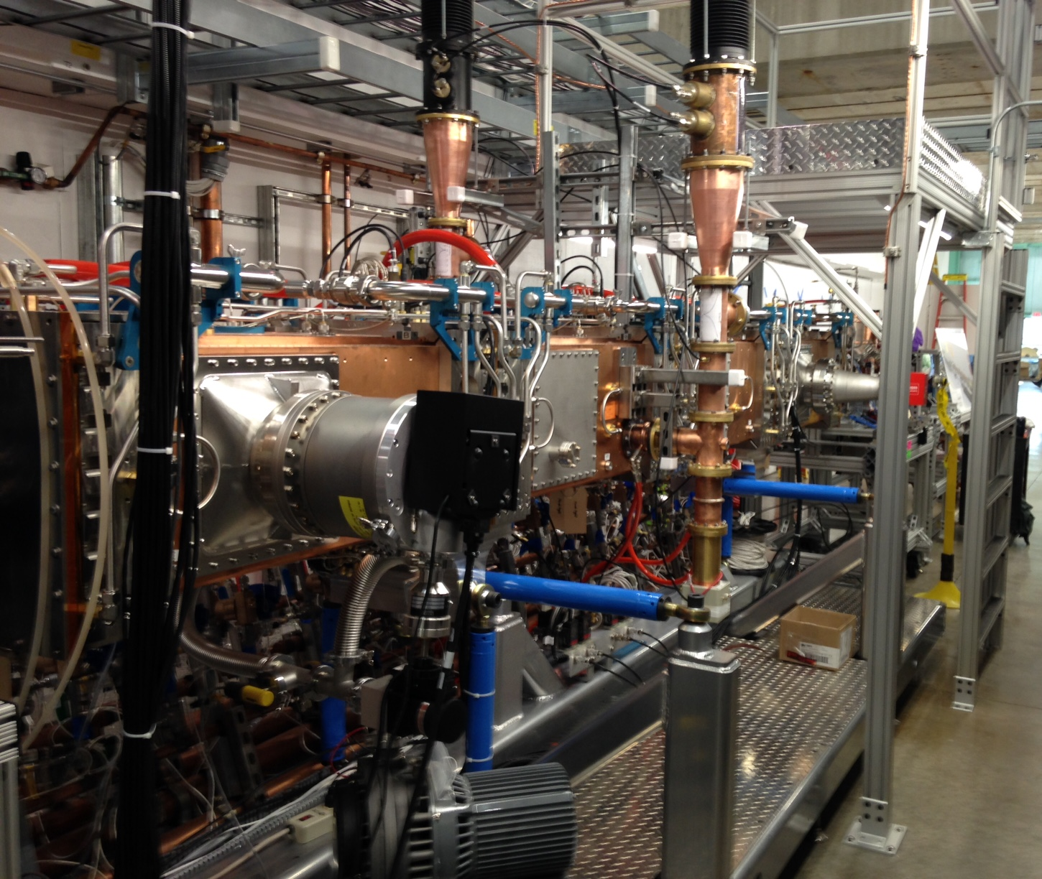
WFE WBS Past Deliverables
Charge #2
A significant fraction of the PIP2IT hardware (already commissioned or to be commissioned) will be used for PIP-II
  Ion source assembly, Radio Frequency Quadrupole (RFQ) (including Power Amplifiers (PA) and water cooling skids), focusing/steering elements (LEBT & MEBT including most power supplies), chopping systems (LEBT & MEBT), scraping systems, most diagnostics, vacuum equipment…
IS & LEBT
RFQ

Slide 7
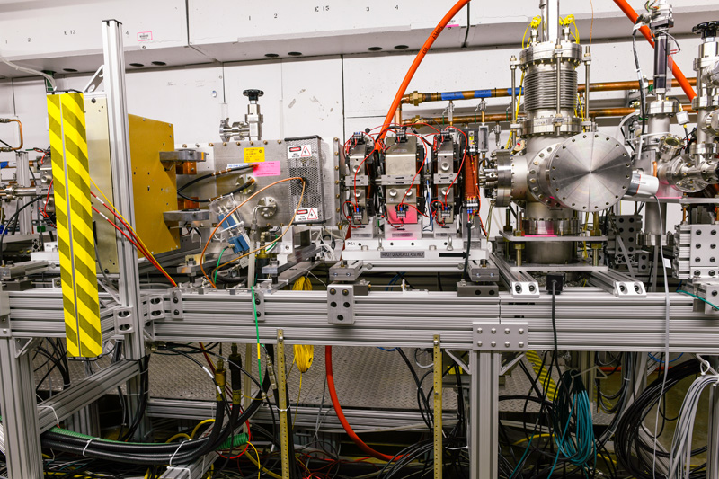
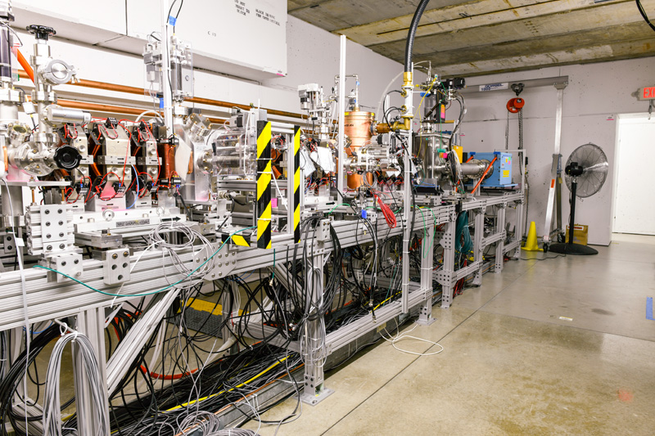
International Partners Deliverables
Charge #2
Bhabha Atomic Research Centre (BARC) has designed the MEBT focusing and steering elements (quadrupole and dipole magnets)
  Installed in PIP2IT beamline
It is assumed that BARC will provide 3 long quadrupoles and 6 short quadrupoles for the PIP-II MEBT
  The details concerning deliverables and schedule will be finalized by CD-2
MEBT
(kicker & prototype absorber)
MEBT

Slide 8
WFE Requirements Have Been Demonstrated
Charge #2
Parameter | Requirement | Units
Particle species | H⁻
Output beam energy (kinetic) | 2.1 | MeV
Bunch repetition rate | 162.5 | MHz
Nominal output beam current (average) | 2 | mA
Nominal charge per bunch (RFQ current) | 30 | pC
Sequence of bunches | Programmable
Beam pulse duration* | 0.55 | ms
Beam pulse repetition rate* | 20 | Hz
Normalized rms beam emittance - Transverse | ≤ 0.3 | mm mrad
Normalized rms beam emittance - Longitudinal | ≤ 0.35 | mm mrad
* For injection into the Booster
Emittance requirements are specified for an ion source beam current (DC) in the range of 2-5 mA

Slide 9
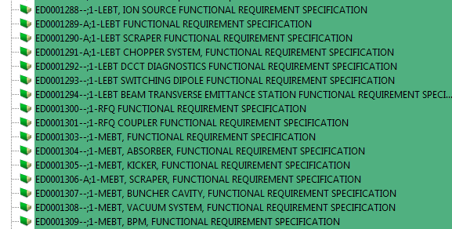
WFE Requirements Are Documented
Charge #2
Requirements are captured in a set of Functional Requirements Specifications (FRS) and, at the sub-systems level, Technical Requirements Specifications (TRS) within our Project Document Database (Teamcenter)
  ED0008004 (WFE FRS)
    ED0001288 (IS FRS)
    ED0001289-A (LEBT FRS)
    ED0001300 (RFQ)
    ED0001303 (MEBT)
Engineering designs
documentation is captured
in Engineering Process
Data Management files (EPDM) within Teamcenter
Partial list from Teamcenter
Also in PIP-II DocDB #2495

Slide 10
WFE Interfaces
…
Charge #2
WBS 121.4.02
WFE
WBS 121.2.03 SSR
WBS 121.2.02 HWR
WBS 121.3.03 HPRF
WBS 121.3.04 LLRF
WBS 121.3.07 Cntrl.
WBS 121.3.08 SS
WBS 121.4.04 Bldg Infr.
WBS 121.6.05 Cmplx
WBS 121.3.06 Vac.
WBS 121.3.09 BI
MEBT/HWR beam line interface
Interface Control Document (ED0007532)
  Unique L3-to-L3 interface IDs
  Cross-checks on-going
…
…
Also in PIP-II DocDB #2495
ID# 3207
ID# 3181
ID# 1787
SSR1/HEBT beam line interface
ID# 1849
ID# 2794
RFQ RF power input connection interface
RFQ RF input connection interface
RFQ RF input coupler air flow interlock interface
RFQ RF input coupler air temperature interlock interface
RFQ RF sensing loop monitor connection interface
ID# 2515
ID# 2750
ID# 2564
ID# 2705
ID# 2659
WFE Critical Devices interface
RFQ RF cavity field connections interface
Bunching cavities RF field cavity connections
Beam pattern generator chopper drive connections
Also identifies “integration” roles
  “Integrator” ≡ Facilitates realization of the interface between the interface’s owner and supplier
WFE timing interface
WFE motion control interface
WFE power supplies control interface
WFE MPS control interface
RFQ vacuum interface
MEBT vacuum interface
LEBT chopping system vacuum interface

Slide 11
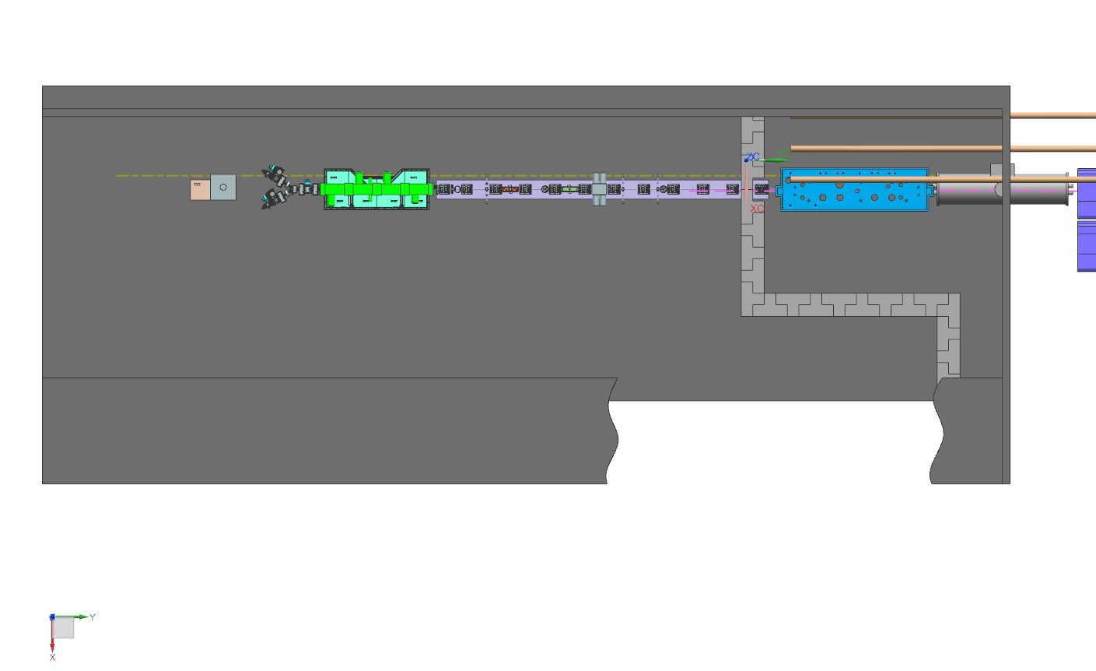
WFE Design Is Mature
Charge #2
Focuses on factors that may determine reliability and uptime
  Two ion sources with switching magnet (30 keV, 15 mA DC)
  2-m long LEBT with partial neutralization transport scheme
    Chopper for creating “macro” pulses
  4.4-m long, 4-vane RFQ, 2.1 MeV, 162.5 MHz CW
  14-m long MEBT with:
    Bunch-by-bunch chopping system; scraping system
    Radiation protection wall
    Differential pumping section after absorber
Ion sources & LEBT
RFQ
MEBT
PIP-II High Bay
PIP-II Linac tunnel

Slide 12
PIP-II WFE Design Development
Charge #2
PIP-II MEBT longer by ~3.5 m than the PIP2IT MEBT
  3 more focusing triplets and one more bunching cavity
    Protection of SRF from absorber vacuum failure (increased distance)
  Free space to accommodate shielding wall from high energy part
    Public viewing (no residual radiation at 2.1 MeV but minimum safety distance when in operation)
PIP-II High Bay
PIP-II Linac Tunnel
PIP2IT
(11/2017)

Slide 13
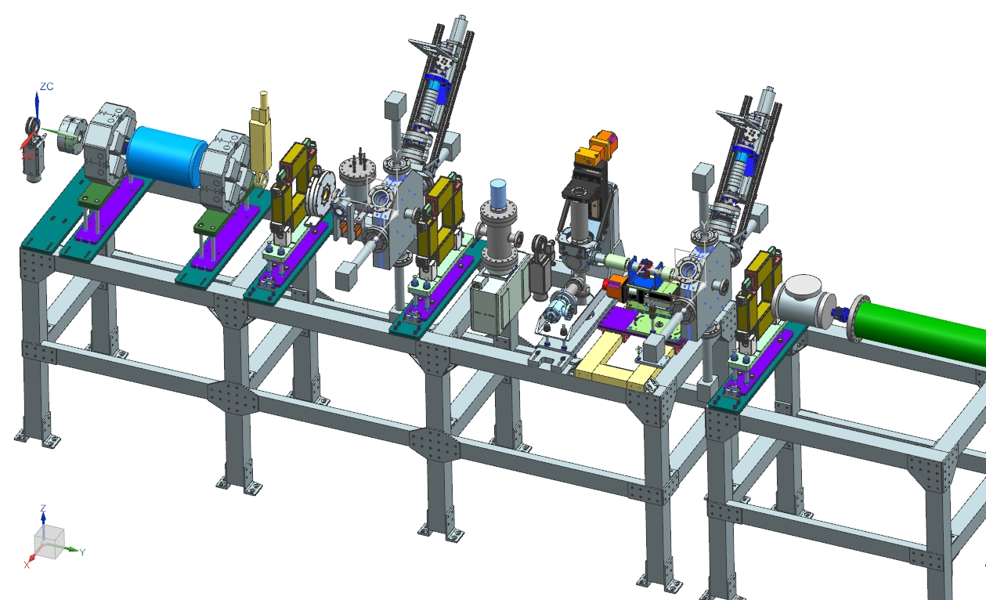
Progress Since CD-1
Charge #1
One ~3-month beam running period at PIP2IT
  Focused on high power operation ⇨ Machine Protection System (MPS) development
  Finalized prototype kickers characterization
  Continued beam optics measurements (transverse and longitudinal)
Then, shifted focus on design effort
  MEBT-HWR transition region
  Kickers Final Design
  Review (FDR) (August 2018)
  High Energy Beam Transport
    Review expected in
    January 2019
Next slides
HEBT 3D model (preliminary) (T. Hamerla, S. Wesseln)

Slide 14
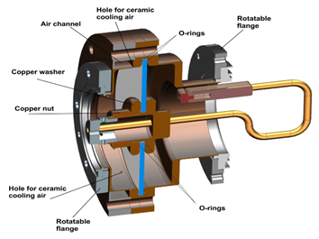
Demonstrated RFQ Reliable CW RF Operation
Charge #1
Increased reliability of couplers at high power
  Replaced brazed RF windows in the couplers by ones sealed with O-rings (S. Kazakov, O. Pronichev)
  Total time of operation in CW: 350 hrs
    No indication of problems
Addressed difficulty to bring the RFQ to
162.50 MHz with CW RF
  Increased nominal resonant frequency by
  ~50 kHz by replacing all 80 plug tuners (J. Steimel, C. Baffes)

Slide 15
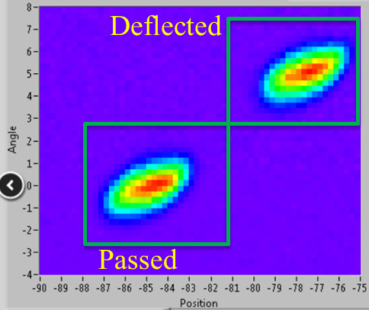
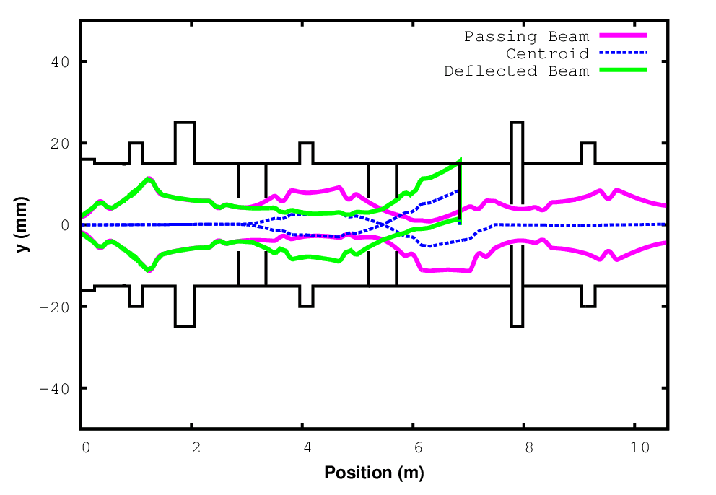
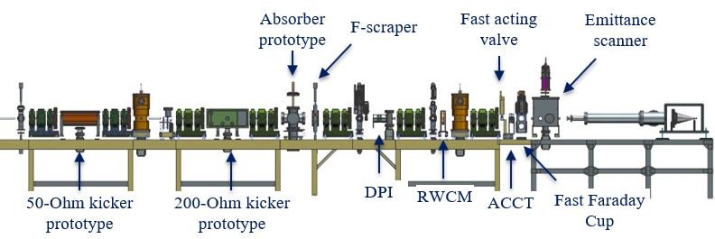
MEBT Chopping System
Charge #1
Two traveling-wave kickers working synchronously followed by a high-power absorber
  Operated successfully
  Kickers do not significantly deteriorate
  the transverse emittance of the beam
5 mA beam collimated to 1.5 mA and deflected by the 200-Ohm kicker
Angle, mrad
F-scraper
Position, mm
50-Ohm Kicker
200-Ohm Kicker
DPI
3σ vertical envelope simulated with Tracewin showing both the passing and the deflected bunches in the configuration with both kickers used in sync. (A. Saini)

Slide 16
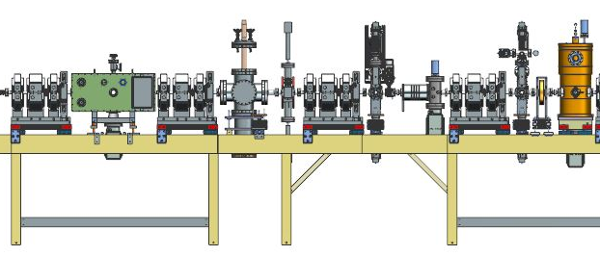
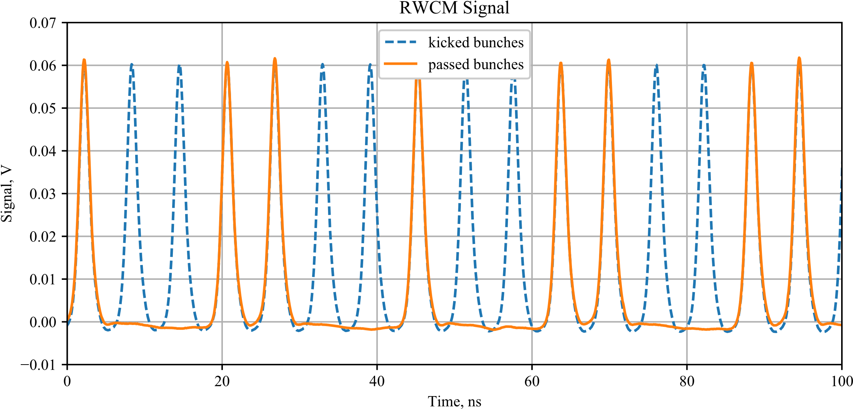
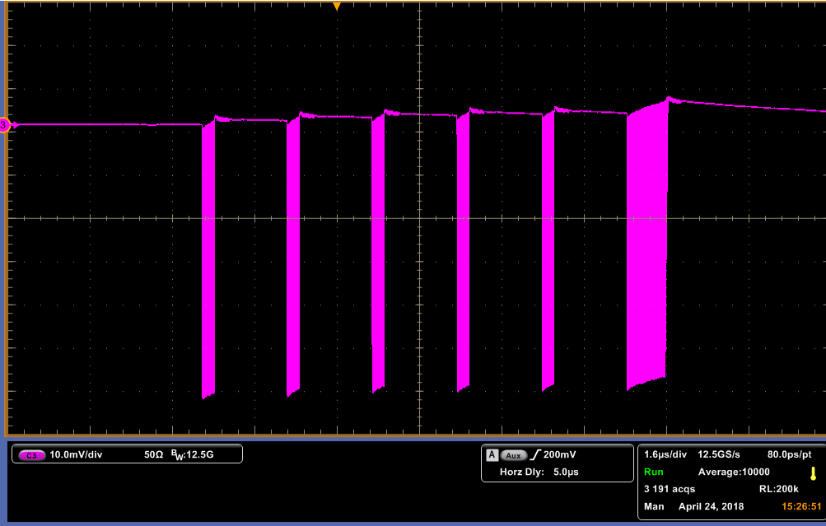
Realized Bunch-by-Bunch Chopping
Charge #1
Arbitrary chopping patterns out of 162.5 MHz bunch trains at 20 Hz (using a single “200-Ohm” kicker)
  Kicked bunches intercepted with a scraper → passing bunches recorded with Resistive Wall Current Monitor (RWCM)
200-Ohm kicker
T. Hamerla
DPI
Kick
Top scraper partially inserted
RWCM
16 μs
Part of the RWCM signal recording the 0.55-ms Booster injection sequence (orange), superimposed over the signal when the kicker is off (blue) (D. Frolov, G. Saewert)
RWCM signal with “μ2e waveform” pattern (i.e. square wave where all bunches are passed for 0.2 μs followed by 1.8 μs with all bunches removed) (D. Frolov, C. Richard)

Slide 17
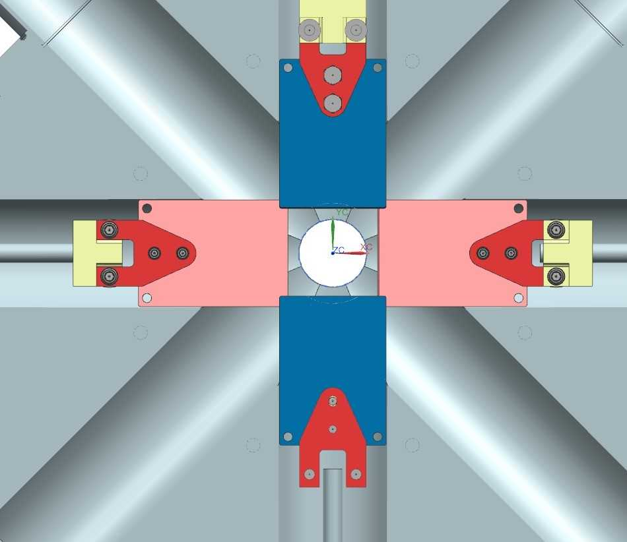
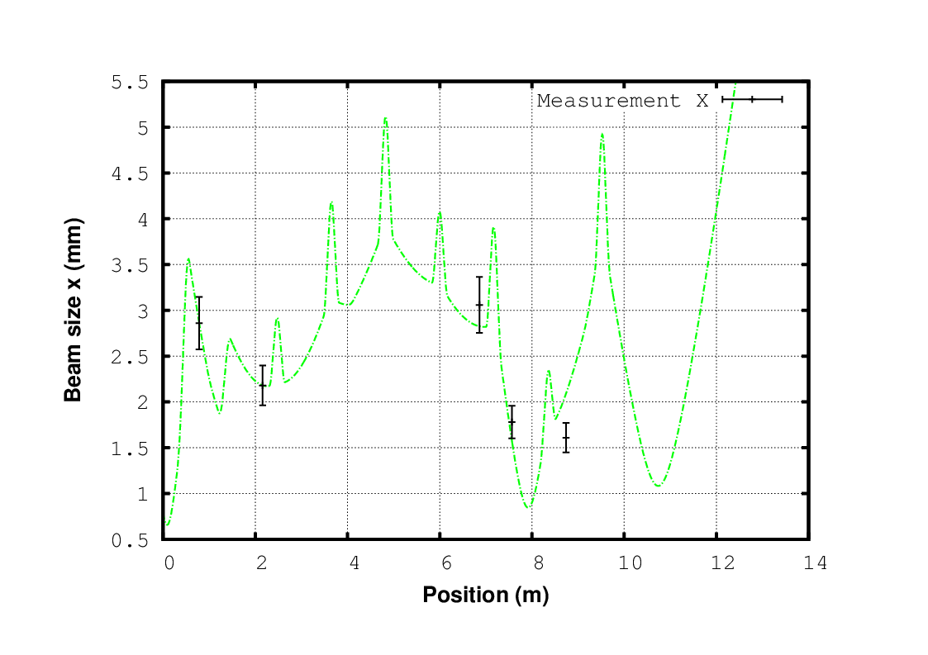
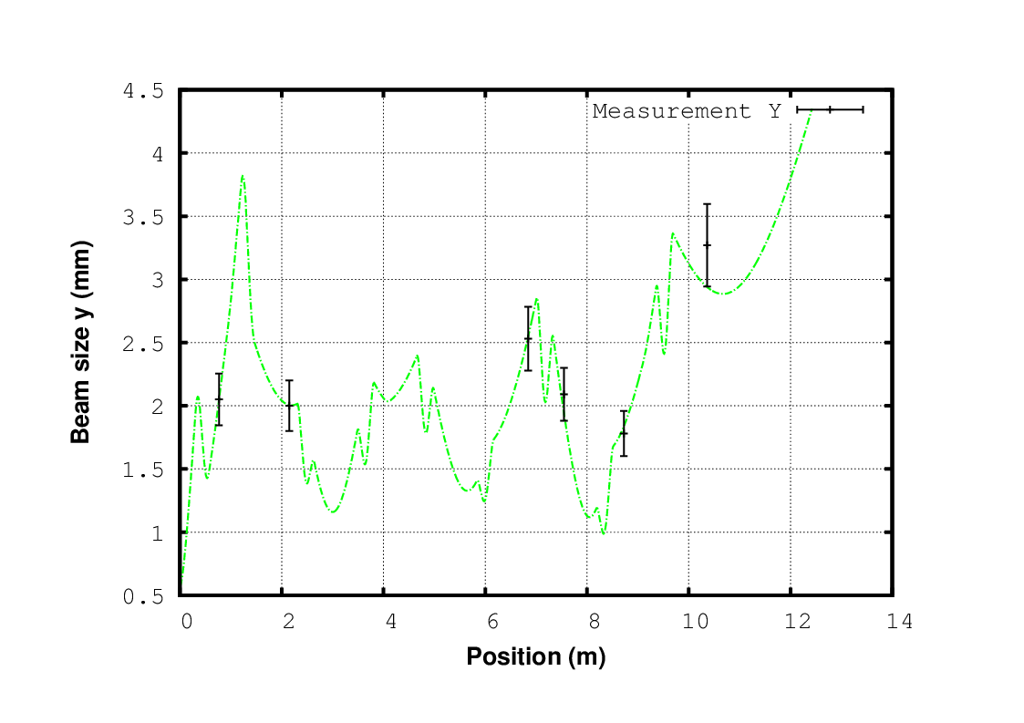
Transverse Optics Have Been Measured
Charge #1
Beam envelope (rms) in the MEBT is understood
and can be predicted to within 10%
  Quadrupole strength calibrations obtained
  from differential trajectory measurements
  Beam sizes measured with scrapers along
  the beamline
Transverse beam size measurements along the MEBT and envelope simulation with TraceWin (light green). Error bars are ±10%. (A. Saini)

Slide 18
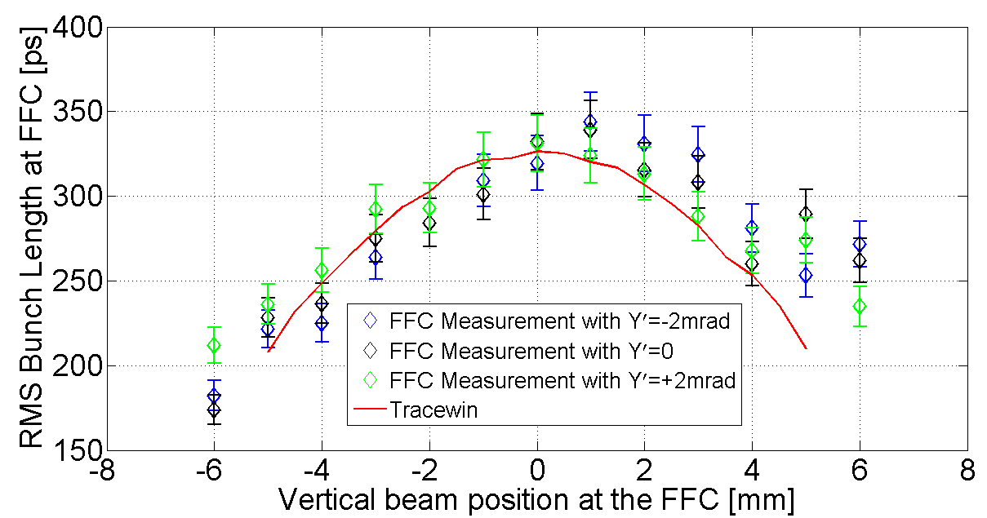
Measured Longitudinal Bunch Parameters
Charge #1
Measured bunch length downstream of 2nd bunching cavity with a Fast Faraday Cup (FFC) designed in-house (D. Sun and A. Shemyakin)
  Revealed transverse-to-longitudinal correlation
    Induced by space charge and predicted in simulations
  Estimated emittance: < 0.3 mm mrad (rms, normalized) from fitting
RMS bunch length across the beam (vertical) at 5 mA and corresponding simulation with TraceWin (red line)
(B. Hanna, J.-P. Carneiro)

Slide 19
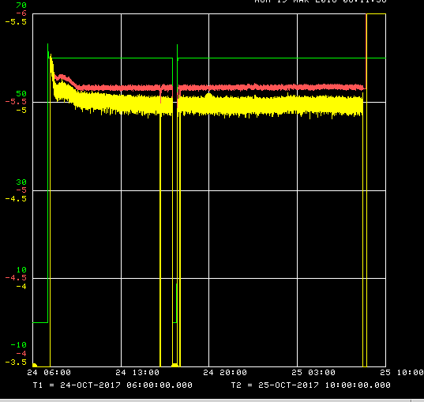
Demonstrated Stable Operation of the Injector
Charge #1
Successfully delivered beam to the dump at nominal parameters (5 mA, 0.55 ms, 20 Hz) with low losses and all aperture restrictions
  “200-Ohm” kicker @ 500 V “Booster
  injection” waveform
  2 interruptions (1 hour total)
    Beam availability ~96%
Multiple-day runs failed at duty
factors > ~10% (too many beam
interruptions)
  False MPS trips; RFQ and bunching
  cavities RF trips; trips induced by kickers’ protection electrodes and DPI (real beam drifts)
  Operated at up to 50% duty factors for tens of minutes
RFQ voltage
DCCT
Dump current
3hr
24 hours
MPS works

Slide 20
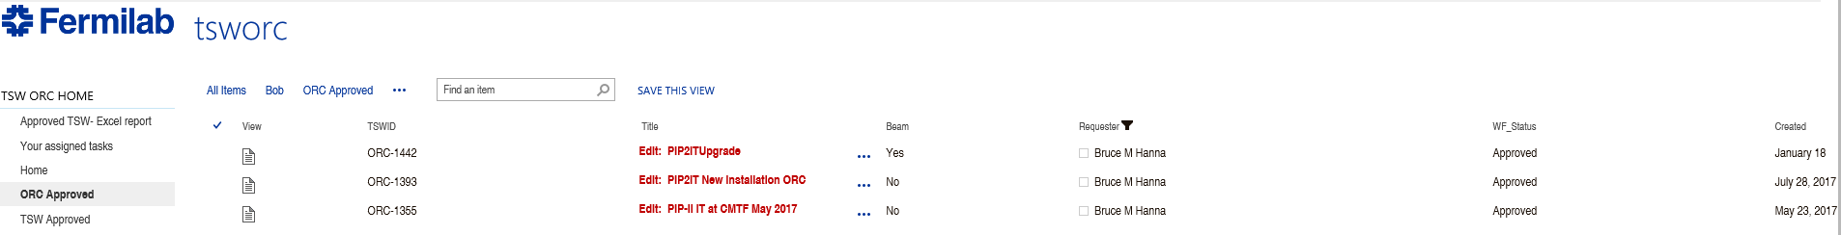
ESH
Charge #6
Project team is committed to construct PIP-II in a safe, environmentally respectful, and cost efficient manner that meets our stakeholder’s needs
  Project Integrated Safety Management Plan (DocDB #141)
  Laboratory and DOE standards and practices
    Fermi Radiological Control Manual, Fermi ES&H Manual
    AD Operation Readiness Clearance (ORC)
      Conducted at PIP2IT for each new configuration
    Radiation surveys are conducted as the beam power increases
Preliminary Hazard Analysis for PIP2IT (DocDB #40)
  Up to 2.1 MeV
ESH&Q Fermipoint screenshot
ORC before last PIP2IT run

Slide 21
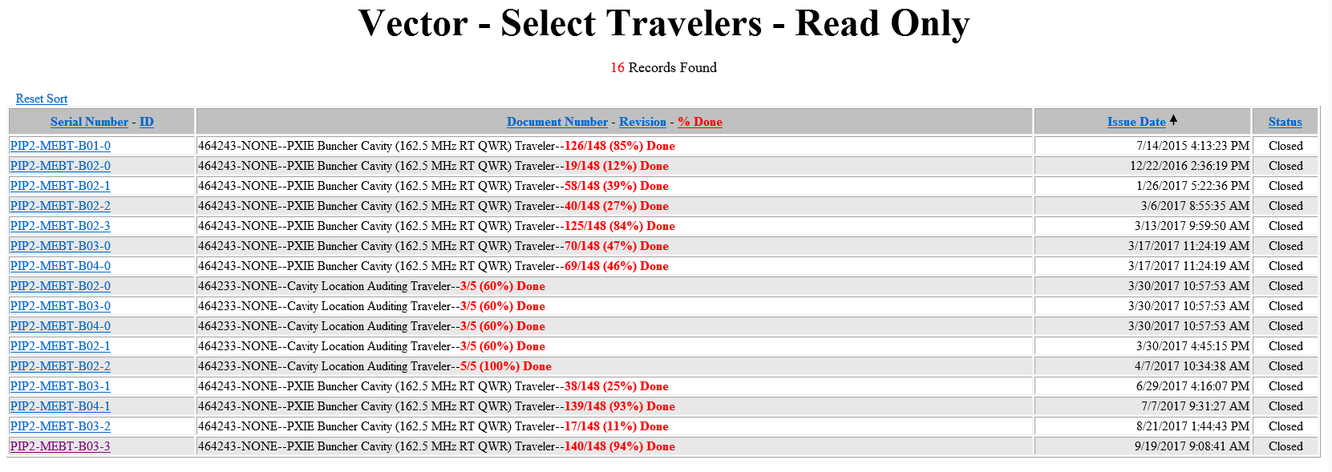
Quality Management
Charge #6
Proceed in accordance with the Project’s Quality Assurance Plan (DocDB #142)
  Communicate and work with vendors and collaborators
    MEBT Bunching cavities from vendor
“Vector” screenshot summarizing all travelers available for the MEBT bunching cavities

Slide 22
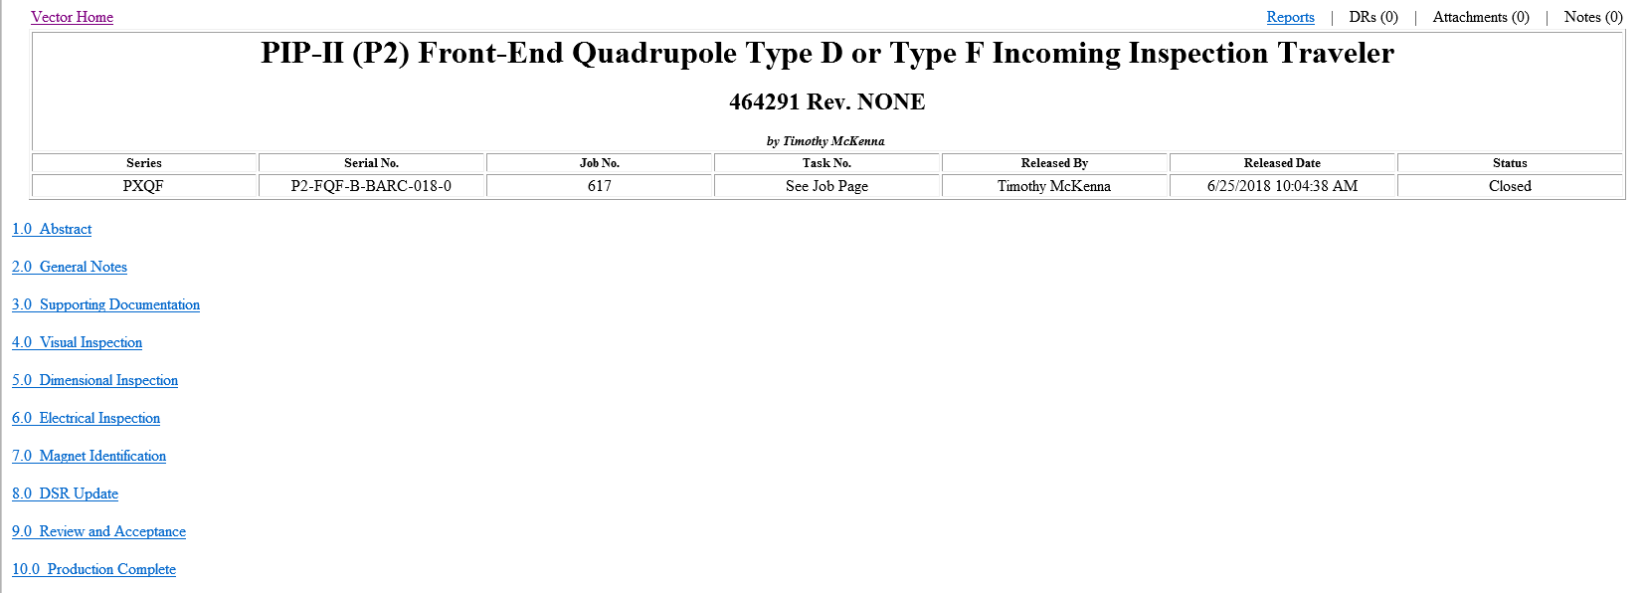
Quality Management (cont’)
Charge #6
Incoming inspection of MEBT magnets delivered by BARC, India
  Qualified their manufacturing process and documentation with extensive measurements of the first prototypes delivered to Fermilab
“Vector” screenshot of the top of the Incoming Inspection Traveler for MEBT magnets from BARC

Slide 23
Risk Management
Charge #2,7
It is one of the purposes of the PIP2IT program to retire risks associated with the WFE
  “MEBT kickers performance is unsatisfactory” (RT-121-04-013)
    Medium risk
      Need to test two kickers of the same type working synchronously
      Possible long-term reliability concerns for the drivers
  “Unable to maintain proper vacuum between MEBT absorber and SRF” (RT-121-04-020)
    Low risk following recent measurements at PIP2IT simulating vacuum failures and measuring the amount of gas propagating down to the location of the first cryomodule (A. Chen)
      Worst case scenario simulated ⇨ monolayer coverage-equivalent of the superconducting surfaces ~40 cm² (negligible)
      Ultimate base pressure without baking nor cleanroom cleaning, 6×10⁻⁹ torr

Slide 24
Summary
The PIP-II Warm Front End design is almost complete and an integrated system has been constructed (i.e. PIP-II Injector Test at the Cryo-Module Test facility)
  Most sub-systems have been fabricated (at least at the prototype level), assembled and tested with beam
    All beam parameter requirements have been met so far
Most of PIP2IT is destined for installation in the PIP-II High-Bay building with minor to no modifications

