Slide 1
WBS121.04.06 – Linac Installation and Commissioning Overview
SC2 Accelerator Complex Upgrades, Linac Install. and Comm.
Fernanda G. Garcia
PIP-II IPR
4-6 December 2018

Slide 2
Outline
Installation and Commissioning
WBS 121.04 overview
Statement about PIP2IT mission
Changes since CD-1
boundaries between CF - Building Infrastructure - Linac Installation
Risks
Final Remarks

Slide 3
WBS 121.04 Overview
Scope of WBS 121.04
WBS 121.04.01 Project Management
WBS 121.04.02 Warm Front-End
normal conducting warm front end, PIP2IT HEBT line
WBS 121.04.03 Test Infrastructure
3 test stands for PIP-II cavities test and cryomodules RF cold test, including cryogenics distribution
WBS 121.04.04 Building Infrastructure
cooling/power/compress gas/racks/cables proc.
WBS 121.04.05 Linac Installation
cable pulls and termination, alignment network, installation machine components, design cryomodule stands, mover and warm units support, logistic
WBS 121.06.06 Beam Commissioning
Beam commissioning plan for PIP2IT and PIP-II, high level applications, temporary diagnostic carts
Completion of WBS 121.04
When PIP-II achieve all 4 key performance parameters
Execution
WBS 12.04 primarily contains DOE funded tasks performed at Fermilab
There are also in-kind contribution towards magnets for the WFE and 650 warm region which means there are joint design efforts and integration for these elements

Slide 4
Installation and Commissioning
WBS 121.04 overview
What’s in this presentation and what you will see in this session
Statement about PIP2IT mission
Changes since CD-1
boundaries between CF - Building Infr. - Linac Installation
Intermediate Milestones (?)
Risks
Final Remarks

Slide 5
PIP-II Injector Test (PIP2IT)
PIP-II Injector Test (PIP2IT)
Now
FY20
30 keV
2.1 MeV
10 MeV
25 MeV
RFQ
MEBT
HWR
SSR1
HEBT
LEBT
40 m, ~25 MeV

Slide 6
Slide from P. Derwent presented at CD-1

Slide 7
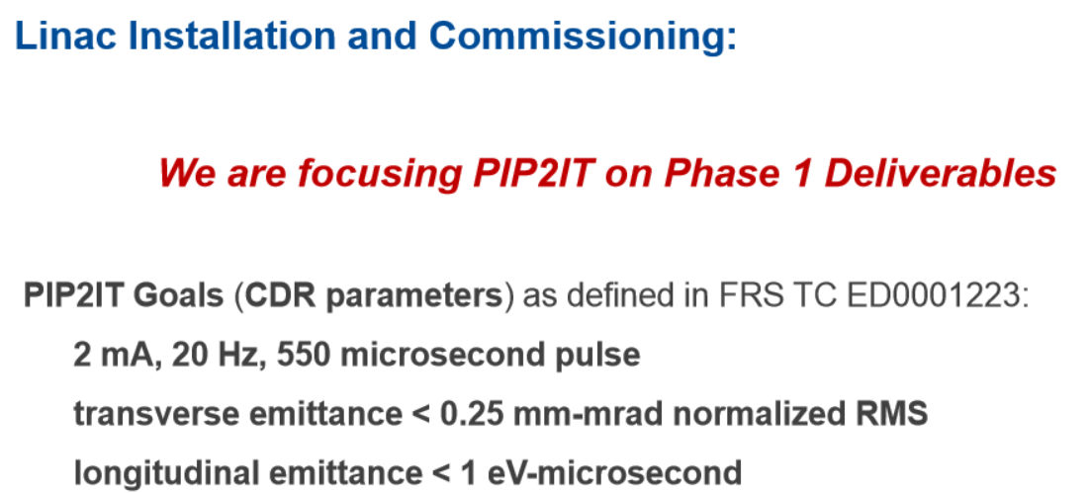
PIP-II Injector Test (PIP2IT)
All Hands Meeting May’2018

Slide 8
PIP-II Injector Test (PIP2IT)
SC2-Prost
Now
FY20
30 keV
2.1 MeV
10 MeV
25 MeV
RFQ
MEBT
HWR
SSR1
HEBT
LEBT
40 m, ~25 MeV
Phase 1: retirement of risks associated with operation of the PIP-II linac in pulsed mode as required for neutrino operations and described in the CDR (1% duty factor). The primary risks to be retired during this period (now-2020) include:
Achievement of required beam characteristics from the ion source through the SSR1 cryomodule
Operated 2 mA, 20 Hz, 550 μsec through MEBT ✓
Demonstration of MEBT chopper operations at a level required for Booster injection
Operated 1 (of 2) prototype kickers with these parameters ✓
Demonstration of the operation of the HWR cryomodule, with beam, in close proximity to the MEBT beam absorber
Demonstration of stable beam acceleration in the protoSSR1 cryomodule, under the full control of prototype RF control systems, including resonance control within the cavities

Slide 9
Installation and Commissioning
WBS 121.04 overview
What’s in this presentation and what you will see in this session
Statement about PIP2IT mission
Changes since CD-1
boundaries between
Conventional Facility
Building Infrastructure
Linac Installation
Risks
Final Remarks

Slide 10
Overview of changes from CD-1
Organization
Significant modified from CD-1 to provide more effective structure for managing
The 121.04 WBS was created as a result of the new structure
Split Installation and General System Services into 3 pieces
121.04.05 Linac Installation
121.04.06 Beam Commissioning
121.04.04 Building Infrastructure
Scope of work was re-distributed accordingly among the L3 levels
Reflected on the Interfaces and Requirement documents

Slide 11
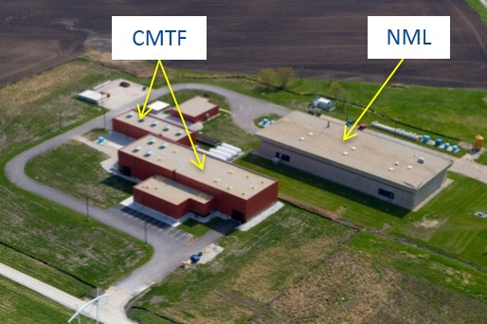
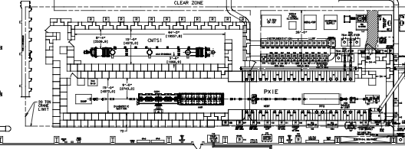
Changes since CD-1
Warm Front End
Scope unchanged
SC2-Prost
Test Infrastructure
Scope inherited/added
Added PIP2IT cave setup to test PIP-II 650 cryomodules in conjunction with SSR
Added Horizontal Test Stand -2 (HTS-2) at Meson Detector Building (MDB)
Inherited cryogenic distribution line scope for PIP2IT from SRFCRYO
Scope removed
Modifications to CMTS1 to test PIP-II 650 cryomodules
SC2-Leibfritz
PIP2IT Test Cave
SSR 325MHz Test Stand
HWR/650 MHz Test Stand

Slide 12
Changes since CD-1
Building Infrastructure
New WBS L3 structure since CD-1
Scope inherited/added
Inherited general system services scope from Installation
Close collaboration with conventional facility
Added cables and connectors procurement
SC2-Hunt
Linac Installation
Scope changed since CD-1
Scope removed:
beam transfer lines installation move to Rings Installation under Accelerator Upgrades
Scope inherited/added:
Added design and build of the warm unit structures
Added cryomodules ready for installation transportation from storage area to the PIP-II complex
SC2-Baffes

Slide 13
Changes since CD-1
Beam Commissioning
New WBS L3 structure since CD-1
Scope inherited/added
Added PIP2IT beam commissioning
Inherited High Level Applications development
Added Accelerator Readiness Review (ARR)
SC2-Garcia

Slide 14
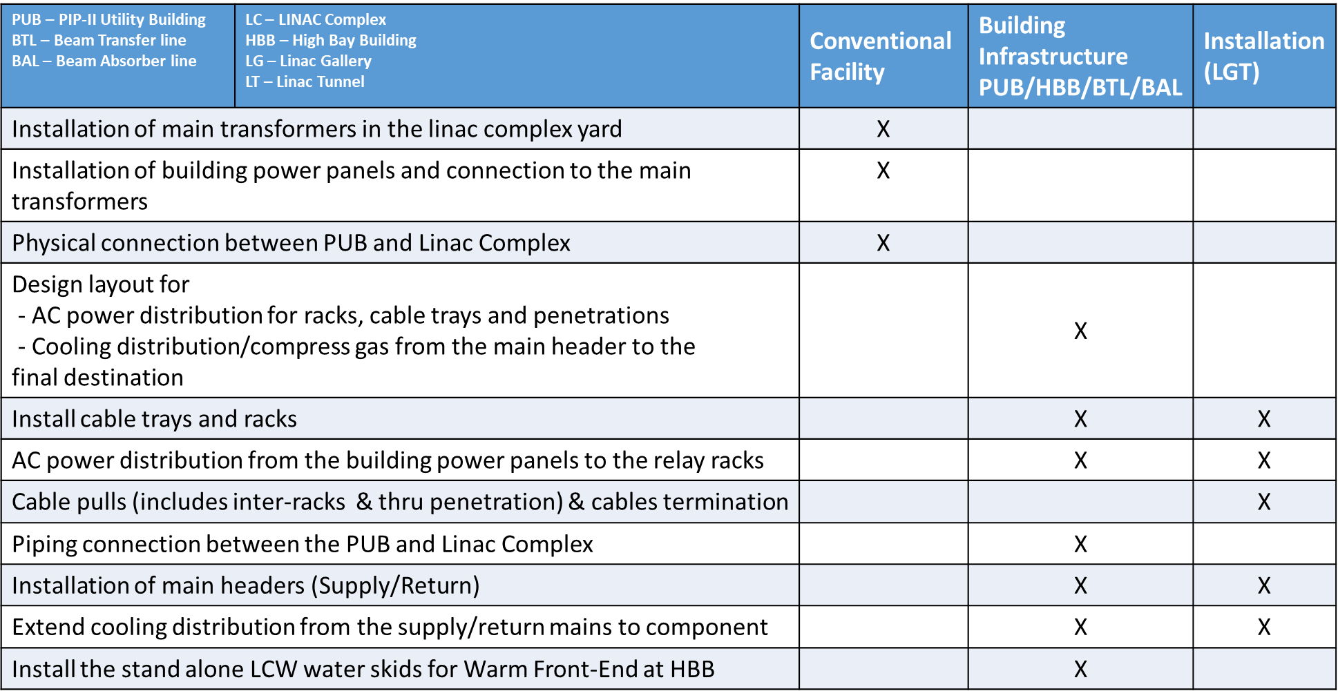
Boundaries between Conventional Facility / Building Infrastructure / Installation

Slide 15
Installation and Commissioning
WBS 121.04 overview
What’s in this presentation and what you will see in this session
Statement about PIP2IT mission
Changes since CD-1
boundaries between CF - Building Infr. - Linac Installation
Risks
Final Remarks

Slide 16
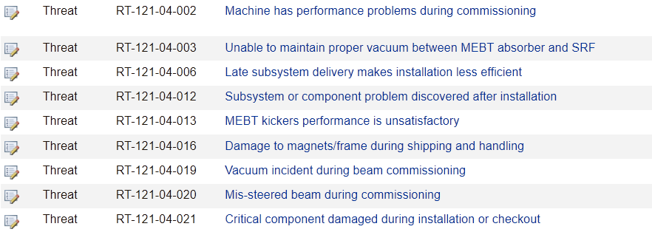
Risk Management (121.04)
Charge #2,7
Linac Installation and Commissioning Risks
High Risk: 0
Medium Risk: 5
Low Risk: 4
Details during individual sub-systems presentations
Link to Risk Register: https://fermipoint.fnal.gov/organization/ocoo/ippm/Lists/Risk%20Register/all-risks.aspx

Slide 17
Final Remarks
Since the previous IPR considerable work has been conducted in preparation for CD-2/3A
Management
New WBS structure implemented and scope adjusted accordingly
Build up staff
Ongoing work on developing a comprehensive resource loading schedule
All functional requirements and interfaces were revised
currently under review – next step approval process
Risks were revised
Next presentations more details on all fronts
requirements, interfaces, technical status and detailed risks
Let’s start!

