Slide 1
CD-2/3a Preparation Status
Marc Kaducak
PIP-II Independent Project Review
4-6 December 2018

Slide 2
Project Management Progress since Feb. 2018
Expanded project management office functions and staffing
Co-located project management team
Resource Loaded Schedule Development
  Extensive efforts with L2/L3/CAMs to develop CD-2 level schedule
  Incorporated international partner deliverables and schedules into RLS
  Updated BOE format and instructions
Increased engagement with procurement department
International partners contributed to risk workshop (July 2018)
Supported CD-1 ESAAB

Slide 3
CD-2 Requirements (DOE O 413.3b)
CD-2 Deliverable | Status | Planned Completion Date for CD-2 | Comments
Approve an updated Acquisition Strategy, if there are any major changes to the acquisition approach | Current version prepared for CD-1 July 2018. | N/A | FPD advises that AS does not need to be updated for CD-2.
Approve updated Project Execution Plan | Current version prepared for CD-1 July 2018. | Submit April 2019. Complete with signatures for ESAAB (August 2019) | Update KPPs, cost/schedule estimates, funding profile, tailoring strategy, international agreements, risks
Establish a Performance Baseline | Plan to establish internal baseline Feb.2019 | Final baseline officially established at CD-2 | This is probably our biggest management hurdle to CD-2.

Slide 4
CD-2 Requirements (DOE O 413.3b)
CD-2 Deliverable | Status | Planned Completion Date for CD-2 | Comments
Develop a Project Management Plan, if applicable | Draft version posted | Signed version for CD-2 IPR
Perform a Performance Baseline External Independent Review (EIR) or an Independent Project Review (IPR) |  | June 2019
Complete a Preliminary and/or Final Design | First version of Preliminary Design Report prepared. | Design maturity commensurate with CD-2 June 2019 | Will be reviewed by P2MAC March 2019.
Employ an Earned Value Management System compliant with EIA-748C | FRA has compliant EVMS, maintained by OPSS | Implement EVMS statusing and reporting 01-Feb-2019 | Requires completion of internal baseline before implementing EVMS on PIP-II.

Slide 5
CD-2 Requirements (DOE O 413.3b)
CD-2 Deliverable | Status | Planned Completion Date for CD-2 | Comments
For projects with a TPC ≥ $100M, the PMRC will review and analyze the CD and make recommendations to the ESAAB, CE, or PME, as applicable |  | July 2019
Conduct a Project Definition Rating Index Analysis, as appropriate, for projects with a TPC ≥ $100M. |  | N/A | Advised that SC does not use PDRI.

Slide 6
CD-2 Requirements (DOE O 413.3b)
CD-2 Deliverable | Status | Planned Completion Date for CD-2 | Comments
Issue the final Environmental Impact Statement or Environmental Assessment and Finding of No Significant Impact, | Public comments close 15-Nov-2018. No significant comments yet, just encouragement to proceed. | On schedule to receive FONSI Dec. 2018.
For Major System Projects, or first-of-a-kind engineering endeavors, conduct a Technology Readiness Assessment and develop a Technology Maturation Plan, as appropriate |  | N/A | Investigated TRA, but OHEP suggested using alternate means of representing design maturity

Slide 7
CD-2 Requirements (DOE O 413.3b)
CD-2 Deliverable | Status | Planned Completion Date for CD-2 | Comments
Prepare a Hazard Analysis Report | Draft posted | Feb.2019 | No known issues.
Determine that the Quality Assurance Program is acceptable and continues to apply. | Draft posted | Mar. 2019 | Primary challenge is addressing international partner aspects.

Slide 8
Other Typical Expectations for CD-2
CD-2 Deliverable | Status | Planned Completion Date for CD-2 | Comments
Risk Monte Carlo Analysis | Updating risk register now | March 2019. Priority is RLS/EVMS. | Need updated risk register, RLS before performing monte carlo
Updated BOEs including recent quotes for large procurements | Updating now. Detailed instructions provided to CAMs. | Feb.2019
Assumptions Document | Updating now. | Jan.2019 | Several details to work out between project and other Fermilab organizations.
Scope Contingency Identified | Revised KPPs. Identifying associated scope contingency now. | Feb.2019 | First priority is completing baseline RLS.

Slide 9
Other Typical Expectations for CD-2
CD-2 Deliverable | Status | Planned Completion Date for CD-2 | Comments
Configuration Management Plan | Just started. Have several examples. | Jan.2019 | Primary challenge is addressing international partner aspects.
Procurement Management Plan | CD-1 version exists. Will be updated by new procurement manager. | Feb.2019 | No known issues with concepts, but list of notable procurements will require an update.

Slide 10
PIP-II Specific Requirements for CD-2
CD-2 Deliverable | Status | Planned Completion Date for CD-2 | Comments
International Agreement Plan | Draft exists. | January 2019 (6 months prior to ESAAB)
Project Planning Documents (PPDs) | In preparation now | Signed versions for ESAAB (August.2019)

Slide 11
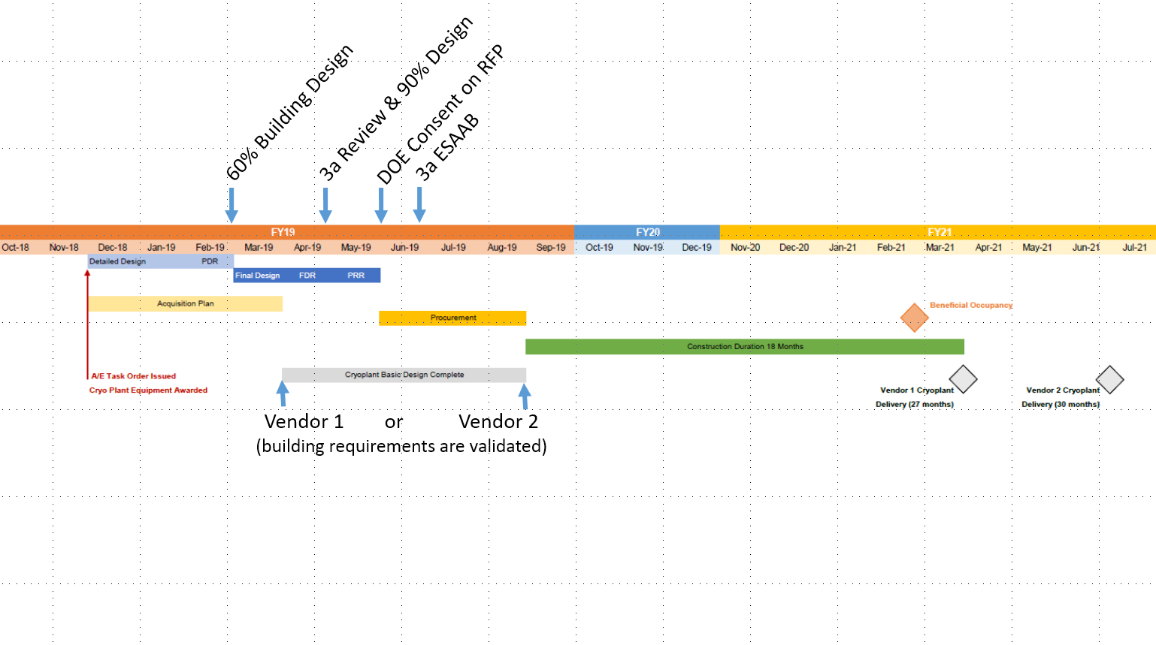
Cryoplant Building Schedule
Charge #2
Cryo Plant Building and Site Preparation Design Complete
Schedule and Cost Known
From 18OCT18 Integrated Project Team Meeting

Slide 12
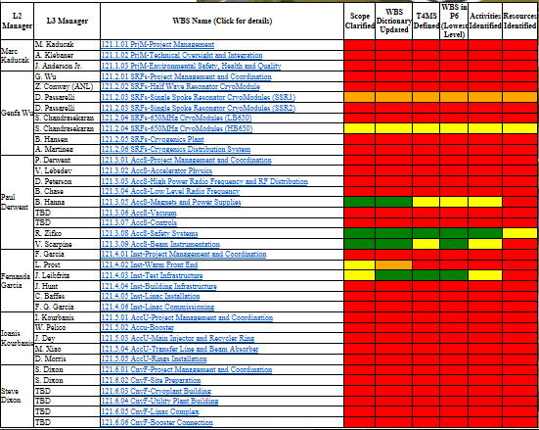

RLS Detailed Status as of 11-May-2018
Charge # 3

Slide 13
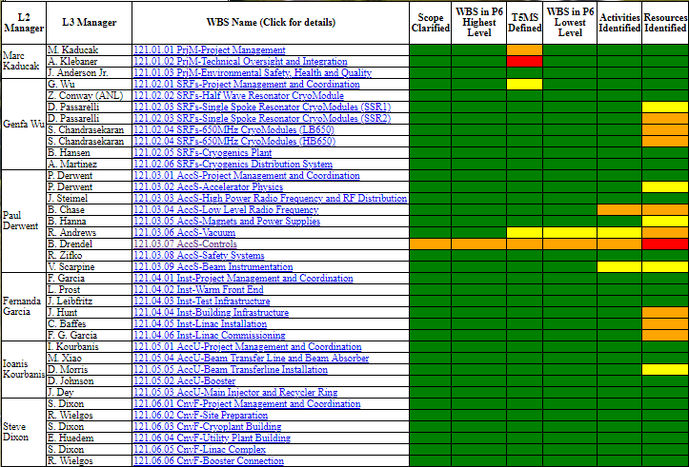
RLS Detailed Status Today
Charge # 3
Extensive efforts with L2/L3/CAMs to develop CD-2 level schedule
Incorporating international partner deliverables and schedules into RLS

Slide 14
CD-2 Preparation Schedule
Next campaign

Slide 15
Summary
Tremendous momentum and progress on RLS development
We understand the steps required to achieve CD-2/3a
  Next major PM efforts are:
    Resource loading remainder of RLS
    Aligning with funding profile
    Updating BOEs
    Implementing formal change control, EVMS monthly statusing and reporting
Much work to do, but on track for June 2019 CD-2/3a ESAAB
Thank you for your attention

Slide 16
END

