Slide 1
WBS121.04.06 – Beam Commissioning
SC2 Accelerator Complex Upgrades, Linac Install. and Comm.
Fernanda G. Garcia
PIP-II IPR
4-6 December 2018

Slide 2
Outline
Scope/Deliverables
Requirements
Interfaces
Preliminary Design, Maturity
Technical Progress to Date
ESH&Q
Risks and Mitigations
Summary

Slide 3
Many thanks to the Beam Commissioning team
A. Shemyakin , L. Prost, A. Saini
for their valuable discussion and contributions to this talk

Slide 4
About Me:
Role
L2 manager for Installation and Commissioning
L3 manager for Beam Commissioning
Relevant Experience
Scientist – 22 years of experience at the lab
14 years in Accelerator Division
10 years Linac Group Leader
PIP Deputy Project Manager
PIP L2 manager for Linac Upgrade
PIP L3 manager for Linac 200 MHz RF Power Upgrade
L2 manager for SBN-FD (ICARUS) Installation and Integration (2015-2018)
Head of 400 MeV Transfer Line (2004-2008)
Designed new injection scheme lattice into Booster
Leadership role during installation and commissioning phase

Slide 5
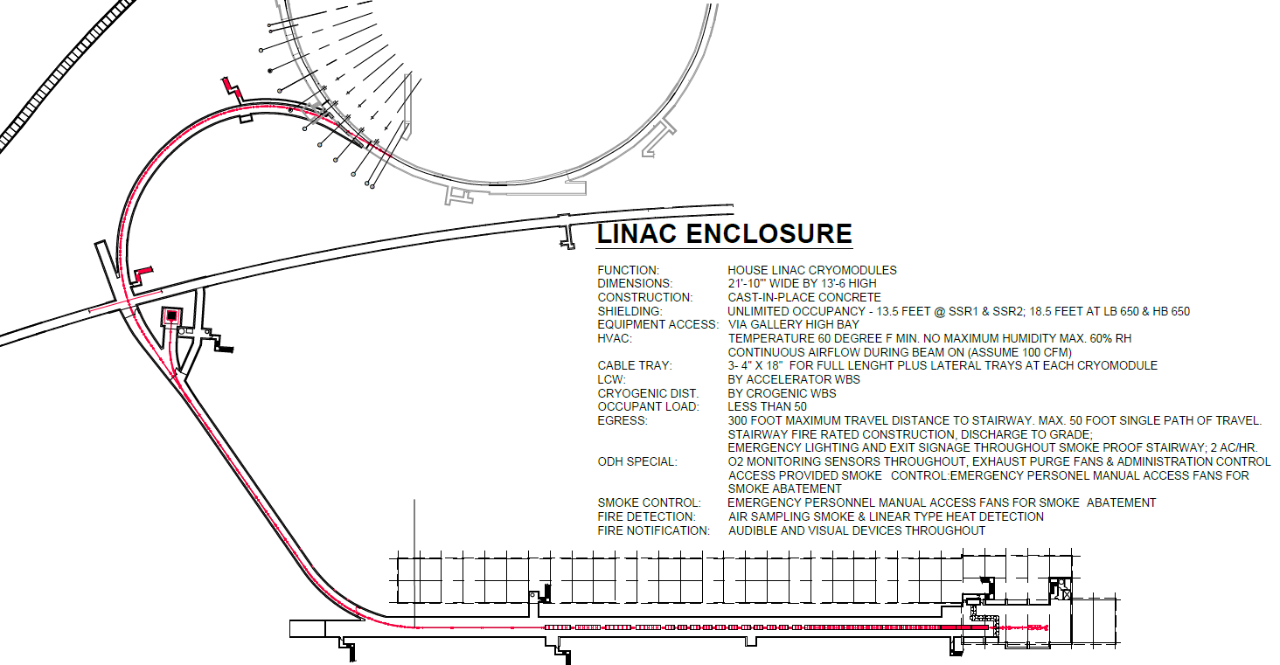
Scope and Deliverables
Charge #2
WBS Dictionary pip2-docdb#599
The PIP-II Beam Commissioning WBS scope includes the work related with
Beam commissioning of the accelerator sections (Warm Front End (WFE), Super-Conducting Linac (SCL), Beam Transfer Line (BTL)/Beam Absorber Line (BAL)), including beam commissioning of booster
Ensure readiness of plans/procedures for commissioning preparation and commissioning
Ensure readiness of tools
Establish teams
Organize, execute, analyze beam commissioning data
Deliverable is a machine achieving objective KPP’s that is handed off to operations
booster
WFE
main absorber / BAL
does not require
program shutdown
BTL
SCL linac
WFE

Slide 6
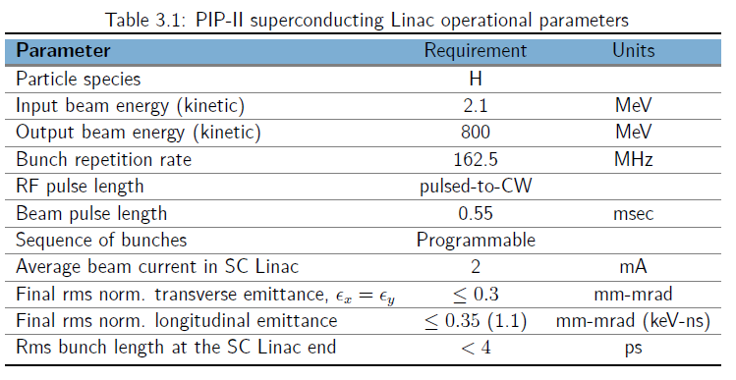
PIP-II Beam Parameters
Charge #2
Requirements for future injection into the Booster:
0.55 ms x 20 Hz at 5 mA from the Radio Frequency Quadrupole (RFQ)
Medium Energy Beam Transport (MEBT) chopping system removes ~half of all bunches to create a non-periodic pattern optimized for filling the Booster RF buckets.

Slide 7
Beam Commissioning Requirements
Charge #2
pip2-docdb#2495
FRS: ED0008026,
Beam commissioning plan
Complete suite of procedures, documentation and schedule for beam measurements
High Level Applications
Provide list of applications needs during beam commissioning to Controls
Support development and test of applications
Beam commissioning shifts
Setup tools to document results and findings during shifts
Collaborate with Accelerator Physics lattice group
Perform and communicate optics results to AP lattice group
Optimize accelerator performance based on simulation results
Shielding Validation
Support shielding validation effort

Slide 8
Interfaces
Charge #2
The nature of interfaces of this WBS is organization and scheduling
Therefore, does not fit in the normal structure of an Interface document
Interfacing with mostly all Accelerator Systems WBS as far as coordination and schedule of beam commissioning period
Accelerator Physics
Beam dynamics and simulation
Instrumentation
LLRF
Controls
High level applications
and interfacing within the 121.04 WBS
Linac Installation
Schedule coordination
Documentation handoff
Hardware checkout

Slide 9
Preliminary Design and Design Maturity
Charge #2
Developing a phased commissioning strategy
At a conceptual level
Based on beam commissioning experience at similar machines
SNS had 7 stages interleaved with installation activities,
“… Although having many beam commissioning stages complicated planning and installation activities, the benefit was well worth this complication.”
No reviews in this WBS have taken place, yet
J. Galambos, HB2006

Slide 10
Parameters Affecting the Commissioning Strategy
Charge #2
PIP-II superconducting section starts at 2.1 MeV
Low energy compared to SNS (185 MeV) and ESS (90 MeV)
SNS/ESS normal conducting section use insertable devices
Large phase advance through low-energy SRF
~10π to 185 MeV and ~4π to 800 MeV
Similar to SNS/ESS for the same energies
No insertable devices in SC linac (2.1 – 800 MeV)
Diagnostics: beam position monitors, laser wires, current monitors

Slide 11
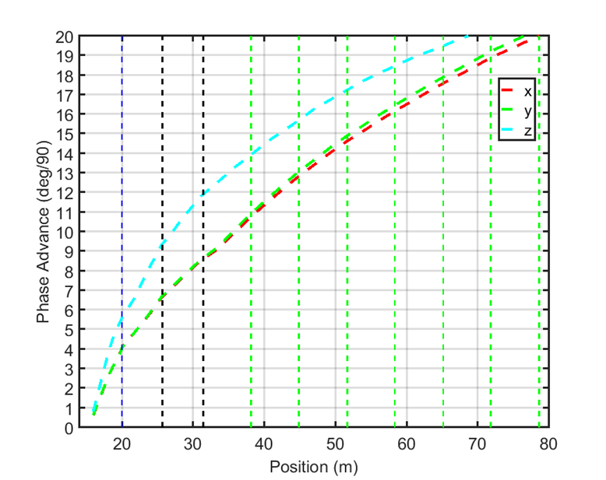
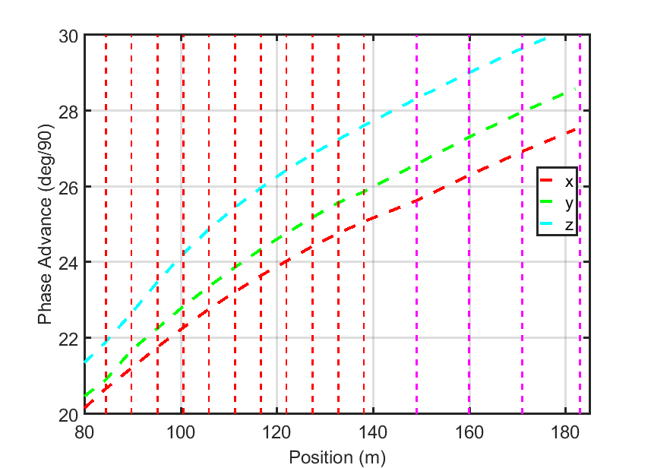
PIP-II Phase Advance Through the SCL
HWR SSR1 SSR2 LB650 HB650
(A. Saini). Red arrows – LWs, green rectangles – ACCT

Slide 12
Progress to Date
Charge #1
Organization
Bi-weekly commissioning meetings started in Q1FY19
Frequency will be adjusted as needed throughout commissioning
Tasks to perform
PIP2IT beam is the precursor for PIP-II beam commissioning plan
WFE prepares the beam with the proper characteristics
Goal: accelerate beam through the HWR and protoSSR1
gain experience accelerating proton beam through superconducting cavities
understand the beam loss at frequency transition (longitudinal tails)
develop/optimize LLRF resonance control loops algorithms
test the MPS compatibility with SRF tolerance
Apply lessons learned post PIP2IT to further develop PIP-II commissioning
Review beam commissioning experience
Review the tools/applications/simulations/monitoring required for the commissioning phase

Slide 13
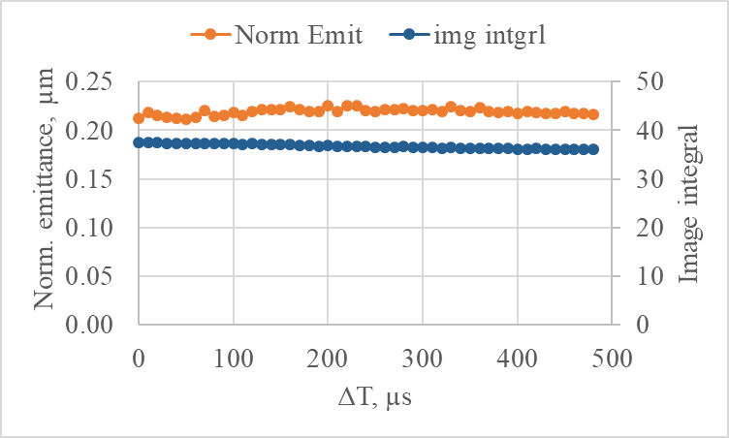
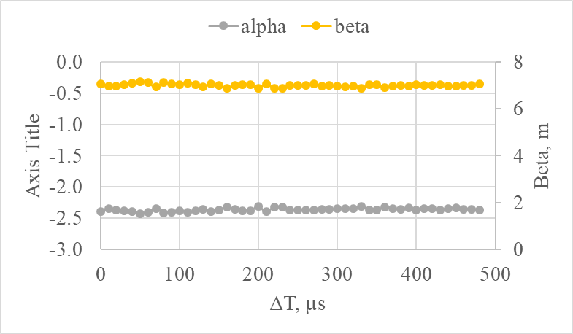
Preparation for PIP-II Commissioning at PIP2IT
Charge #1
LEBT scheme provides constant beam properties throughout the pulse
Beam parameters at 10 µs and at the end of a 0.55 ms pulse are the same to within several %
Variation of beam parameters through 0.5 ms pulse. Left – normalized vertical emittance and image integral (proportional to the beam current). Right – Twiss parameters.
First beam thru superconducting linac will be at low intensity, short pulse length (10 µs ) and low repetition rate “diagnostic mode”

Slide 14
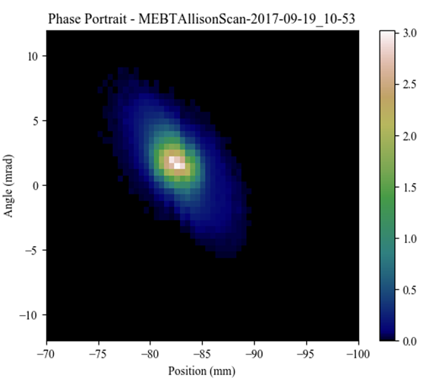
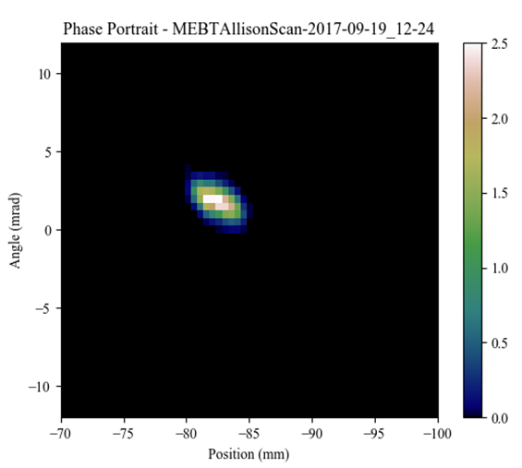
Preparation for PIP-II Commissioning at PIP2IT
Charge #1
Initially, the beam to be accelerated thru the superconducting region will be scraped in the MEBT with two set of scrapers
4 plates in each, ~90º phase advance
“low-emittance beam” mode
Phase portrait of the nominal 5 mA beam. $ε_{V_rms_n}=0.2 μm$
5 mA beam is scraped vertically to 1.5 mA. $ε_{V_rms_n}=0.04 μm$

Slide 15
Phased Commissioning
Charge #2
Beam commissioning at PIP-II foreseen to occur in series with installation activities
Phased commissioning approach
Warm Front End (WFE) (2.1 MeV)
Superconducting Linac – Phase 1 & 2
Beam transmitted to the straight ahead dump
Beam transmitted to the main absorber (BAL)
Beam transmitted to the Booster injection region (BTL)

Slide 16
Phases in the WFE & Superconducting Linac
Charge #1
booster
WFE (0.030 - 2.1 MeV)
Goal:
recover WFE beam parameters obtained
at PIP2IT and set up the machine for
SCL beam commissioning
Configuration:
Ion Source (IS), Low Energy Beam Transport (LEBT), RFQ, and MEBT
Beam mode:
up to full power to the MEBT absorber
Superconducting section (2.1 – 800 MeV)
Goal:
instrumentation commissioning, RF synchronization, pass beam through the superconducting section, measure rms beam properties, beam transmission
Configuration: two commissioning break-points
Phase 1 (~ 35 MeV – end of SSR1)
Phase 2 (~185 MeV – end of SSR2)
temporary diagnostic line with a low-power beam stop for each
Beam mode:
low-emittance mode with low duty factor
WFE
main absorber / BAL
SCL linac
WFE

Slide 17
Phases for Transfer Lines
Charge #1
Beam to the straight ahead dump and main absorber
Goal:
measure transverse optics of the
transfer line; demonstrate long beam
pulses operation, achieve KPP#1&2
Configuration:
all cryomodules and warm units
installed and checked out,
upstream hardware fully operational including LLRF beam-loading compensation
transfer line up to main absorber installed and checked out
Beam mode: diagnostic mode, capability for long beam pulses
Beam to Booster Injection
Goal:
transport beam to the booster injection region and inject into the ring, achieve KPP#3
Configuration: last portion of the booster transfer line
equipment installed and checked out
Booster injection region installed and checked out
Beam mode:
diagnostic mode, establish circulating beam in the Booster
Booster
WFE
main absorber / BAL
SCL linac
WFE
Straight-ahead dump

Slide 18
ESH
Charge #6
Beam commissioning activities will follow the Fermilab and PIP-II safety standards and practices
PIP-II Integrated Safety Management Plan pip2-docdb #141
Laboratory and DOE standards and practices
Prior to beginning beam commissioning, an Accelerator Readiness Review is required
Requirements established in DOE O 420.2C, “Implementation Guide for Safety of Accelerator Facilities”
Beam commissioning is planned as a staged approach which will result on a staged Accelerator Readiness Review
Plan will be worked out with Fermi Site Office and appropriate documented
Fermi Radiological Control Manual, Fermi ES&H Manual
Planning Phase
Implement Safety by Design process
Incorporate Project Hazard Analysis Report (PHAR) in the planning process
Hazards include:
Radiation Hazards:
Residual radioactivity after beam operations
Radiation dose rates in excess outside the enclosure
Radiation safety is a significant part of the PIP-II Project – within L3 Accel. Phys. WBS

Slide 19
Quality Management
Charge #6
Quality Assurance and Control
PIP-II Project Quality Assurance Plan pip2-docdb #142
Create the details QC plan of the beam commissioning phase
Documentation
Daily savings
Develop machine operation procedures and documentation
Apply lessons learned from similar accelerators
From SNS, significant testing and operational experience led to better understanding of the systems
Transition to operations
Involve Accelerator Division Operation Department (AD/Ops) at earliest opportunity
Possibly during commissioning at a limited scope
Collaborate with AD/Ops to integrate with accelerator complex standards
LOTO procedures, monitoring tools and programs, saves, e-log,
Provide support during transition

Slide 20
WBS 121.04.06 Risk Management
Charge #2,7
Beam Commissioning Risks
High Risk: 0
Medium Risk: 2
Low Risk: 1
RT-121-04-002 Machine has performance problems during commissioning
Mitigation: This is a technical risk with a high impact to schedule & cost
PIP2IT will enable a variety of system-level tests to be performed on many critical systems providing opportunity for the majority of the issues to be identified and addressed before the accelerator components are installed in PIP-II tunnel
Perform cold RF-cryomodule test on all cryomodules
Verification of RF power systems before and after installation
First version of machine protection system is functional and has been tested at PIP2IT. Further development is needed to meet all requirements. However, is inevitable that problems will be discovered during commissioning

Slide 21
WBS 121.04.06 Risk Management
Charge #2,7
Beam Commissioning Risks
High Risk: 0
Medium Risk: 2
Low Risk: 1
RT-121-04-019 Vacuum incident during beam commissioning
Mitigation: This is a technical risk with a high impact to schedule & cost
The design of the MEBT takes in to account vacuum management techniques to protect the superconducting section of the machine. Furthermore, the final MEBT for PIP-II will be longer to increase the separation between the absorber and the first cryomodule
System is installed at the PIP2IT - awaiting beam tests in FY20

Slide 22
Summary
Requirements and interfaces are identified
Conceptual beam commissioning plan is in place
PIP2IT has been and will be an important part of PIP-II
WFE beam parameters already demonstrated
Superconducting beam running period will refine the PIP-II beam commissioning plan
Risks are identified and mitigation in place
Initial assessment of hazards analysis
Thank you for your attention

Slide 23
END

