Slide 1
Top Project Risks
Charge #2,7
Marc Kaducak
PIP-II Independent Project Review
4-6 December 2018

Slide 2
Review Charge
Is the project making adequate technical progress to ensure that the completed project will perform as planned and meet the key performance parameters?
Will execution of PIP-II design plans and planned R&D program activities ensure most major technical risks will be appropriately mitigated or retired prior to CD-3?
Has the project made adequate progress on its resource-loaded schedule to complete it by the time of CD-2?
Are preparations for defining, documenting, and managing the international in-kind contributions suitable to ensure their timely delivery and technical fidelity?
Is the proposed CD-2 timeline reasonable and consistent with the current project status?
Is ESH&Q being handled appropriately?
Are the proposed risk mitigation strategies reasonable and are the proposed contingencies acceptable?
Has the project satisfactorily responded to the recommendations from previous reviews?
Are there any other significant issues that require HEP or project’s attention?

Slide 3
Risk Management at Fermilab
Enterprise risk management (ERM) addresses major, cross-cutting risks that may jeopardize the high-level objectives of Fermilab.
Operations risk management addresses risks to accelerator, experiments and facilities operations, and business processes (ES&H, finance, legal, HR, IT, etc.)
Project risk management addresses technical, cost and schedule risks to DOE 413.3b projects and other major projects.
-All above risk types reside in a common database.
-Risks can be transferred from one type to another.

Slide 4
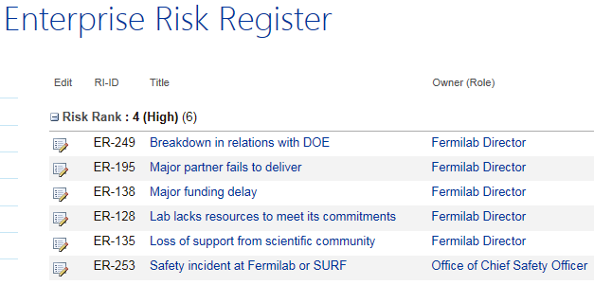
Example Enterprise High Risks

Slide 5
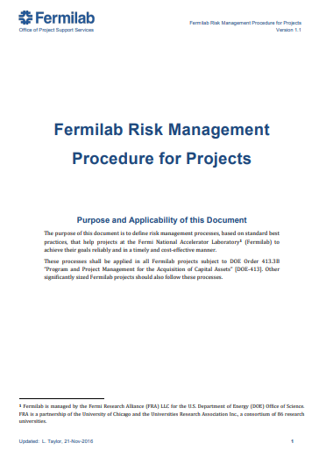
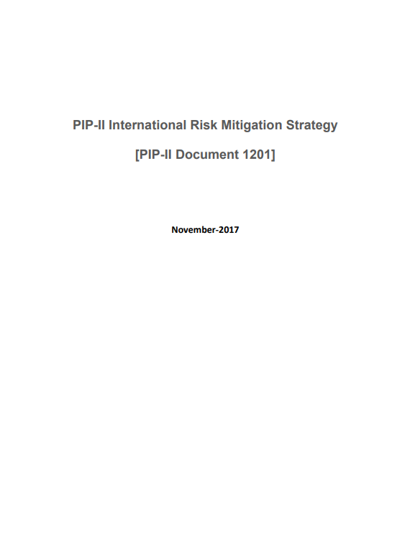
Relevant Risk Documents

Slide 6
PIP-II Risk Management Plan
PIP-II follows the standard Fermilab Risk Management Procedure: https://go.usa.gov/xPEm2
Project Director (PD) – together with Project Manager (PM) and Risk Manager (RM):
Establishes a risk management plan, helps identify and analyze risks, monitors risks, and executes risk response plans throughout the lifecycle of the Project
PD chairs the RMB will meet ~monthly to address matters of risk
RMB membership includes the PM, RM, L2s, Deputies, and others as needed (e.g. CAMs, ES&H personnel, technical experts)
Project Director (PD) and Project Manager (PM)
Assign each risk a Risk Owner – often the SME – to manage the risk
Manage risk contingency funds subject to the established change control process
Report on matters of risk to the Project oversight bodies
L2 Managers and Control Account Managers (CAMs): identify risks to their subproject; assess their probabilities and impacts; and develop and execute risk mitigation and response plans. They report on risk-related issues to the RMB.
Risk Manager (RM) is responsible for the Project’s risk processes, tools, training and guidance. The RM maintains the risk register and performs project-wide risk analysis using MC techniques to aggregate cost and schedule impacts for the entire Project.
Slide from Lucas Taylor

Slide 7
Risk in the Cost Estimating Process
Estimating Guidance
Vendor Information
Prior Experience
Standard Costs
Escalation
Indirect rates
Labor rates
External Constraints
Technical Challenges
Economic Factors
Vendors
External Constraints
Cost
Estimation
Elucidate Scope
Estimate M&S $
Estimate Labor Hrs
Schedule
Development
Define Activities
Build Logic
Load Resources
Risk
Assessment
Identify Risks
Estimate P & Impacts
Develop Mitigations
Contingency
Analysis
Model Risk Events
Adjust Plans
Calc. Contingency
BoEs by WBS
Supporting Material
Cost Book & Drivers
Schedule
Milestones
Critical Path and float
Risk Register
General Uncertainties
Standing Army Costs
Cost and Contingency
Finish Dates
Schedule Float
Tools: Oracle Primavera P6 (RLS)
Primavera Risk Analysis
Deltek Cobra (costs/EVMS)
Slide from Lucas Taylor

Slide 8
Risk Workshop – July 12-13, 2018
Moderated by Keith Molenaar. Guidance by Lucas Taylor. Database management by Mohammed Elrafih.
Opening session:
Organization of Workshop, Roles and Responsibilities
PIP-II Risk Management System
PIP-II Risk Registry Overview
Four sessions by WBS:
Conventional Facilities WBS 121.06
Accelerator Systems, Commissioning/Install, Upgrades (combined WBS 121.03,.04,.05)
SRF Cryo WBS 121.02
Project Management WBS 121.01
Each WBS session included:
Brief summary of the technical scope and critical technology elements. Key assumptions for scope, design, estimate and/or schedule. Key system interfaces.
Review major existing risks.
Invitation to identify new risks, particularly from external participants.
Review existing risk handling strategies, quantify effectiveness of mitigation actions, and capture any new risk handling strategies.
Included presentations from BARC/RRCAT, CEA-Saclay, Daresbury

Slide 9
PIP-II Risk Register – covers broad spectrum of risks
2 risks
5 risks
9 risks
15 risks
1 risk
2 risks
3 risks
6 risks
8 risks
12 risks
1 risks
4 risks
8 risks
3 risks
8 risks
6 risks
38 risks
3 risks

Slide 10
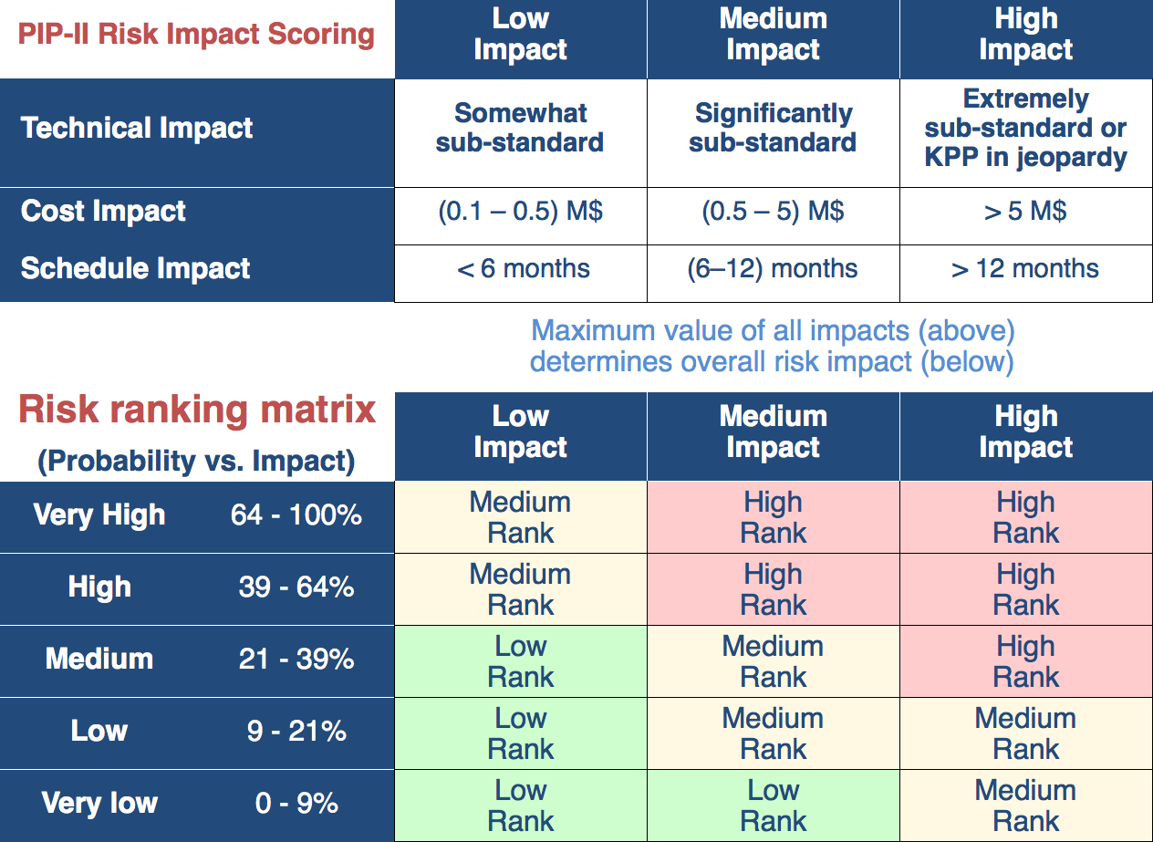
Risk Ranking Matrix

Slide 11
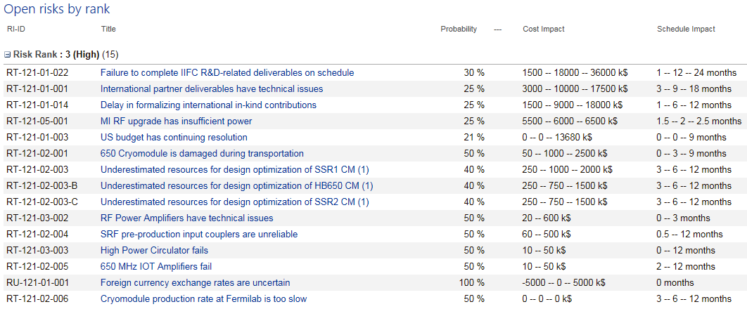
High Rank Risks (across all WBS L2s)
International Risk Mitigation Plan has been developed. See L. Merminga breakout presentation.

Slide 12
Project Management Risks
ID | RT-121-01-022
Title | Failure to complete IIFC R&D-related deliverables on schedule
Description | ​If Fermilab fails to complete the IIFC R&D-related deliverables on schedule then the construction deliverable agreement will be delayed or could be at risk of being cancelled. Potential triggers for this risk include delay in completion of the HB650 prototype and delay in resolution of export control and/or intellectual property issues. The mostly likely delay appears to be HB650, which will be challenging to complete in 2020.
Mitigation | ​Expediting procurements of HB650 cavities, converting PIP2IT cave to a test stand earlier than initially planned, assembling cryomodule during anticipated gap between LCLS-II and LCLS-II HE. Working with Department of Commerce on export control issues. Pursuing extension of IIFC R&D phase by one year.

Slide 13
Project Management Risks
ID | RT-121-01-001
Title | International partner deliverables have technical issues
Description | ​​If international in-kind contributions do not meet U.S. safety and manufacturing standards or if such contributions do not adhere to Fermilab requirements, then the fabricated parts or systems may have to be repaired or replaced, jeopardizing the Project's cost, schedule and technical goals.
Mitigation | ​​Technical Integration team to assure all requirements and specifications for international contributions conform with U.S. safety standards and PIP-II requirements. Fermilab will retain expertise, facilities, and capability to repair and/or replace in-kind deliverables.

Slide 14
Project Management Risks
ID | RT-121-01-014
Title | Delay in formalizing international in-kind contributions
Description | ​If international commitments to the PIP-II Project are not formalized in a timely manner (formal plan submitted six months in advance of scheduled DOE CD-2/CD-3A and PPDs and SOIs submitted to CD-2/CD-3A reviewers), then the DOE may not baseline the Project and/or provide authorization for long lead item procurements as scheduled, jeopardizing the ability the Project to achieve cost and schedule goals.
Mitigation | Close coordination between Fermilab, DOE, and International Partners to agree on governance, agreement document framework, and scope and schedule of deliverables. Governance structure defined at each level of stakeholder (INC, P2LDC, P2PEB).

Slide 15
Project Management Risks
ID | RT-121-01-003
Title | US budget has continuing resolution
Description | ​​Project Plans for 3 months of CR every FY. If the CR continues for longer than 3 months then the projects ability to award major procurements will be impacted jeopardizing the schedule.
Mitigation | We are planning for 3 months delay in budget approval by avoiding awards of major procurements in the first quarter of each FY.

Slide 16
SRF Risks
ID | RT-121-02-001
Title | 650 Cryomodule is damaged during transportation
Description | ​​​If the 650 CMs are damaged during overseas transportation, then the cryomodule(s) must be repaired which jeopardizes 650 CM testing at CMTS and subsequent LINAC installation and commissioning.
Mitigation | Incorporate lessons learned from LCLS-II and 3.9GHz shipment to DESY. Include transportation requirements in the design and create ease of access to observe sensitive areas of the cryomodule. Added transportation tests with prototype cryomodules, which will be performed before production starts. Perform additional transportation analyses/calculations. Explore insurance options.

Slide 17
SRF Risks
ID | RT-121-02-003/B/C
Title | Underestimated resources for design optimization of SSR1 CM (1)/HB650 CM(1)/SSR2 CM(1)
Description | ​​​​If the SSR1 CM (1)/HB650 CM(1)/SSR2 CM(1)does not meet technical performance requirements during testing, then the module must be removed from the test stand and a repair strategy implemented that may include cold-mass disassembly which will jeopardize subsequent testing and CM assembly plans, and final designs.
Mitigation | Critical device testing is implemented in the project plan. ​All cavities, RF couplers, and tuners will be tested at high power at STC prior to string assembly. Prototype designs will be subject to design reviews.

Slide 18
Accelerator Complex Upgrade Risk
ID | RT-121-05-001
Title | MI RF upgrade has insufficient power
Description | ​​​​​If the default option of using two PAs per RF Station in MI will not have enough RF Power it will result in reduced bunch intensity in MI jeopardizing the 1.2MW goal.
Mitigation | ​Backup option being developed. Baseline option expected to be validated in FY19.

Slide 19
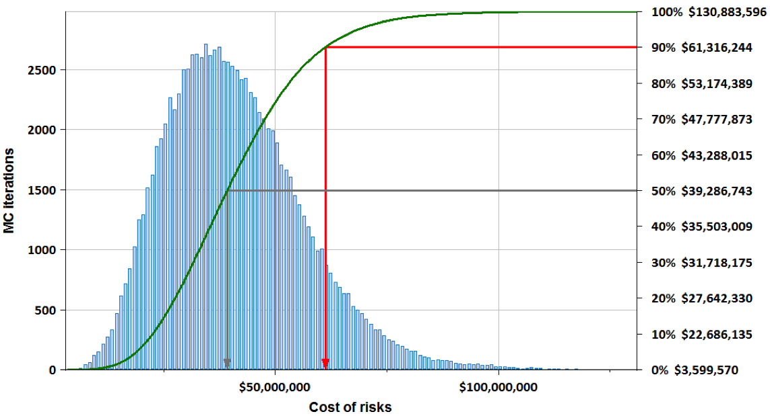
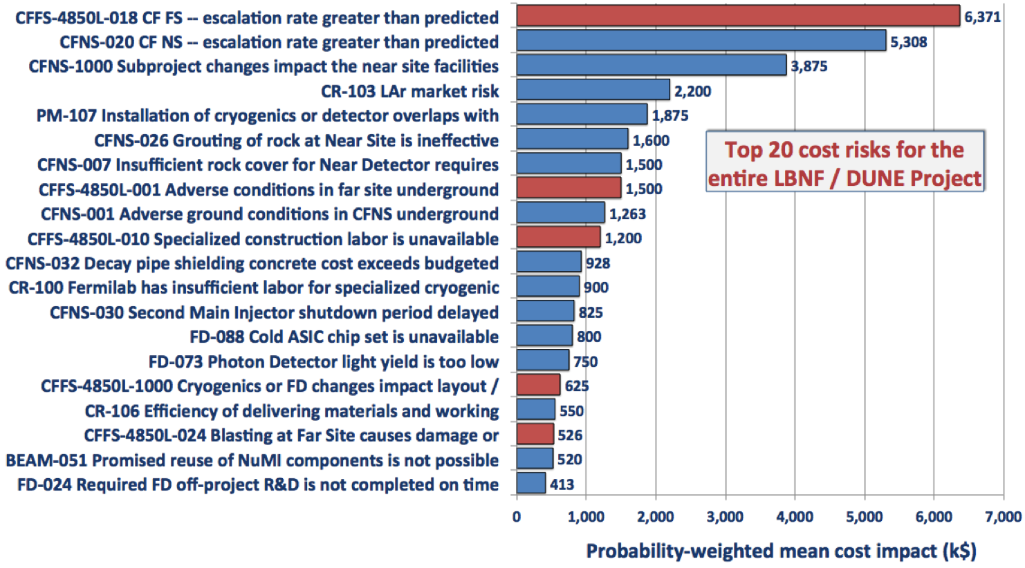
Are the proposed contingencies acceptable?
Prior to CD-2, will use Primavera Risk Analysis MC to model risks in RLS to determine cost and schedule contingency
P6 RLS
Activities
Schedule logic
Milestones
Fully burdened costs
Activity-level uncertainties
Risk Register
Risk description, owner,…
Risk probability
Impact: tech, cost, schedule
Standing army, escal’n burn
Mitigation &response plans
For each iteration of risk MC:
Risks do / don’t happen according to estimated probability
If risk happens, choose cost and schedule impacts from p.d.f. (usually a triangle function)
Update RLS (costs and delays)
Re-compute entire schedule
Determine cost and finish dates
PRA Risk Model
Full resource-loaded schedule
Uncertain costs and durations
Probabilistic risk events
Cost & schedule impact PDFs
Correlations and burn rates
Probability
Mean
Min
Max
Impact
Likely
(point estimate)
Cost and schedule probability distributions
Cost and schedule drivers

Slide 20
Summary
PIP-II is using Fermilab’s established project risk management system
The PIP-II project plan is informed by its risks
The high risks are understood and are being mitigated
Completion of risk analysis process is on track for June 2019 CD-2/3a ESAAB
Thank you for your attention

Slide 21
END

