Slide 1
Cryogenics Plant Building (WBS 121.06.03)
Breakout Session
Steve Dixon
PIP-II IPR
4-6 December 2018

Slide 2
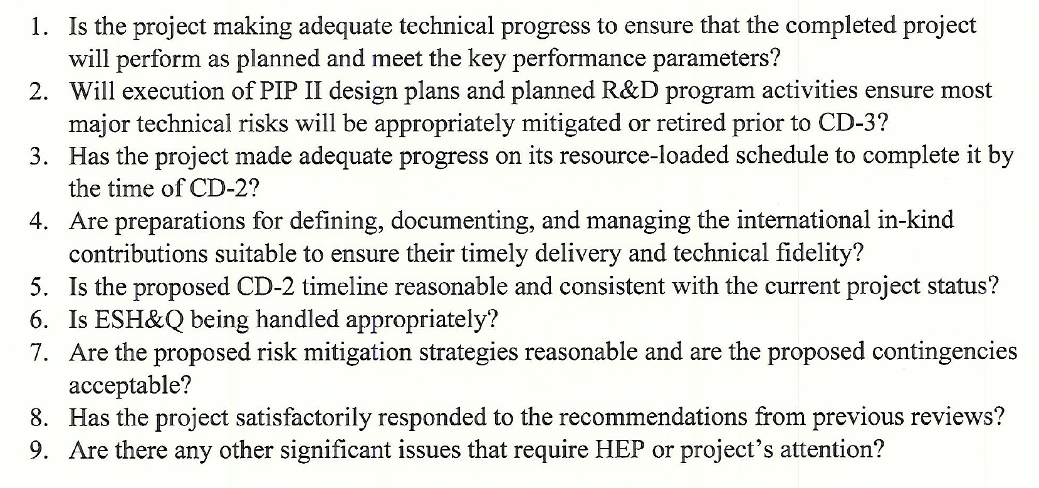
Charge Questions Addressed

Slide 3
Outline
Scope/Deliverables
Requirements
Interfaces
Preliminary Design, Maturity
Technical Progress to Date
ESH&Q
Risks and Mitigations
Summary

Slide 4
About Me:
PIP-II Level 2 Manager for Conventional Facilities
Relevant Experience
Licensed Architect;
Project Management Professional (PMP);
LEED Accredited Professional;
26+ years at Fermilab;
NOvA Project L2 Manager for Site and Buildings;
2014 CD-4
2015 U.S. DOE Secretary’s Award for Excellence
General Plant Project Manager for 15+ years
Short Baseline Neutrino (SBN) Near Detector Building;
Short Baseline Neutrino (SBN) Far Detector Building;
Experimental Operations Center;

Slide 5
Scope and Deliverables [1]
Charge #2
WBS 121.06.03.01 – Project Management and Coordination
Project management for the Cryoplant Building including the oversight and coordination of the technical effort, project planning and scheduling, cost estimating, risk and contingency analysis, and reporting. Includes travel costs for management, technical coordination, and vendor visits.
WBS 121.06.03.02 – Detailed and Final Design
Services needed for the design of the Cryo Plant Building work scope. It describes the labor resources, materials and services, including architectural/engineering services, necessary for planning, oversight and engineering and design.
WBS 121.06.03.03 – Construction on Site
Procurement and management for all contracted labor, materials, tools, equipment, and services needed for the construction of the Cryo Plant Building work scope. It describes the labor resources, materials and services necessary organization, planning, oversight and engineering, design, inspection and administration (EDIA) of the construction work on the Fermilab site.
[1] Definitions from WBS Dictionary, PIP-II-doc-599

Slide 6
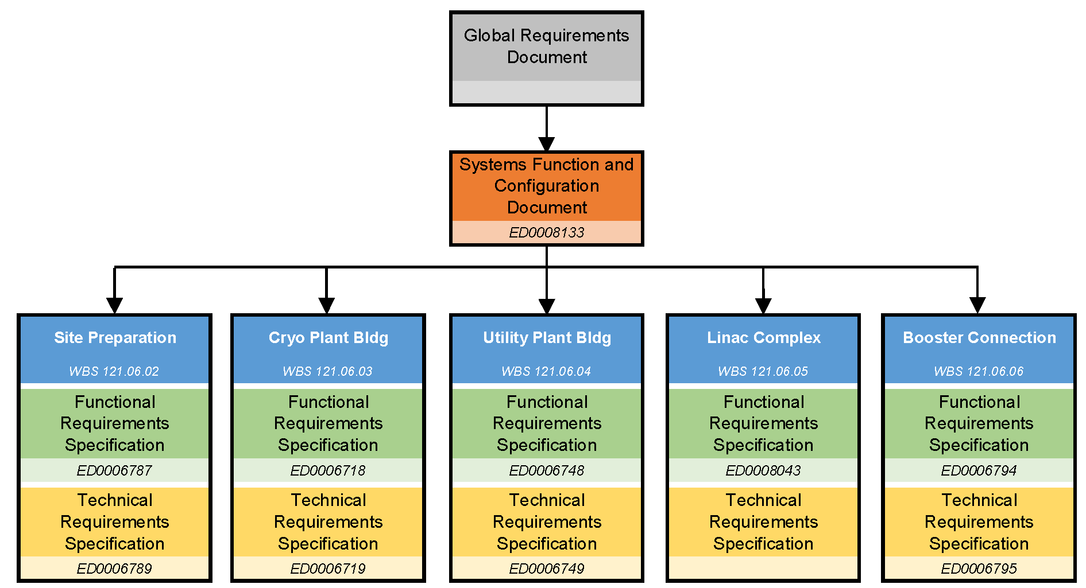
WBS L3 System Requirements
Charge #2

Slide 7
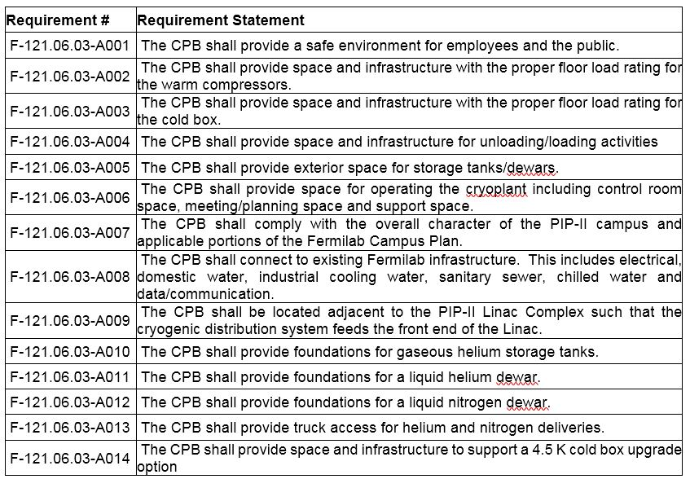
Functional Requirements Specification [1]
Charge #2
[1] See TeamCenter Document ED0006718

Slide 8
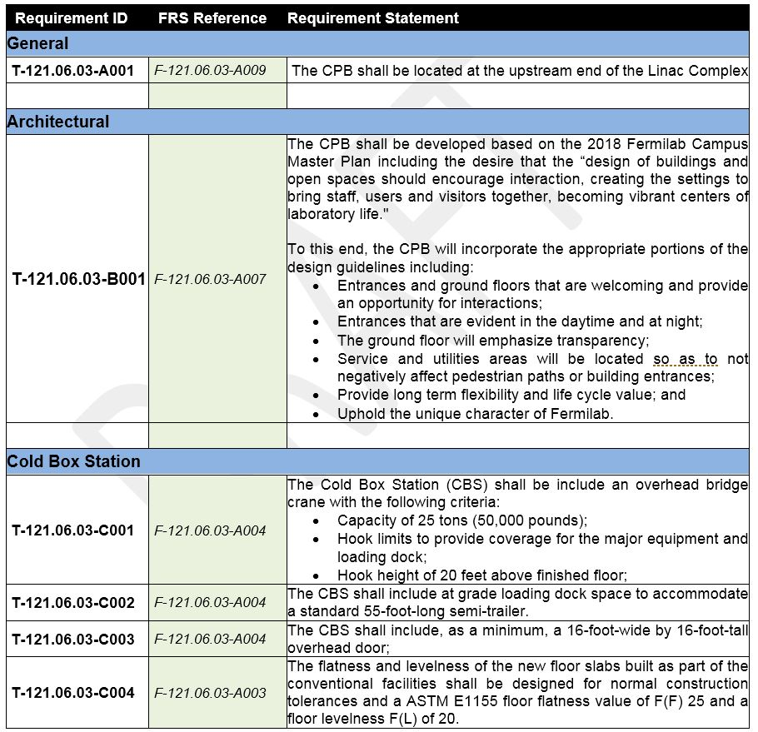
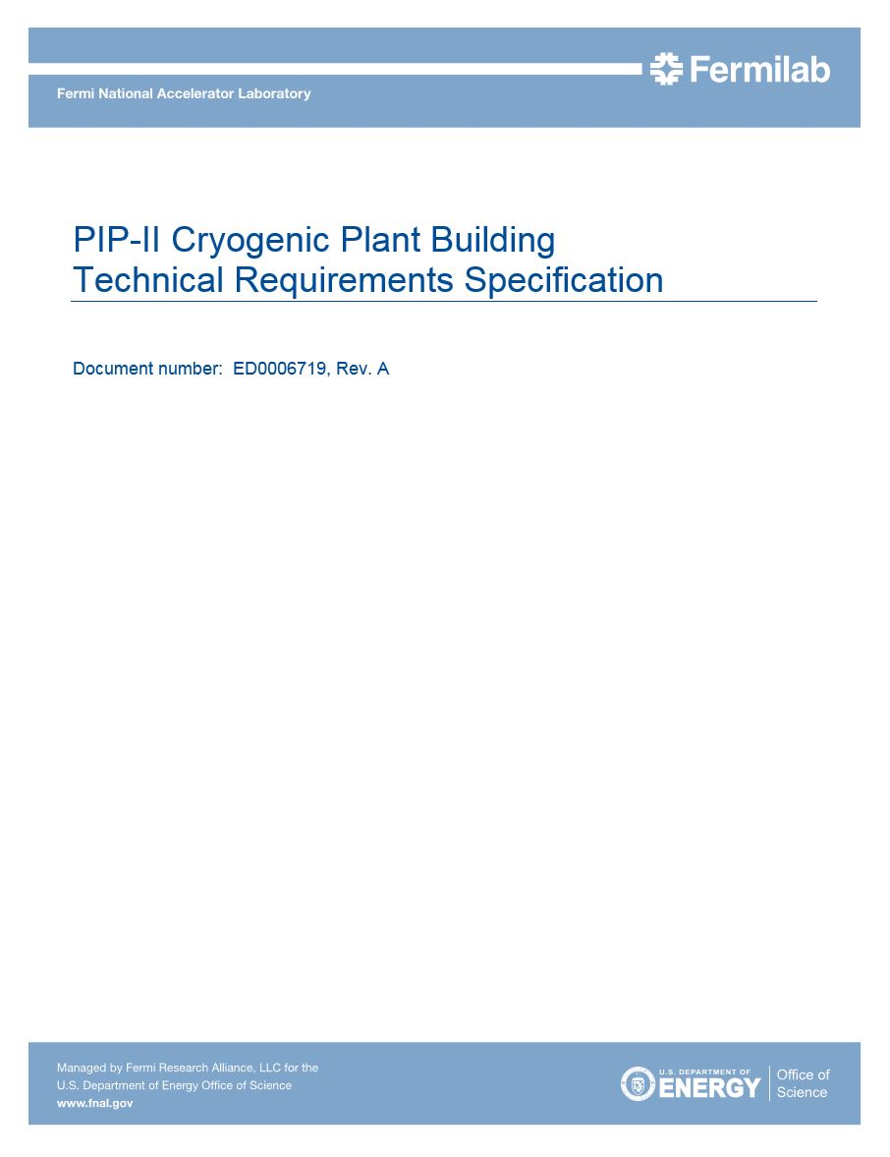
Technical Requirements Specification [1]
Charge #2
[1] See TeamCenter Document ED0006719

Slide 9
Interfaces
Charge #2
Project Interfaces (Managed through PIP-II processes) [1]
ED0007698 – Interface Control Document
WBS 121.02 - SRF & Cryo Systems
WBS 121.02.05 – Cryo Plant (B. Hansen)
WBS 121.02.06 – Cryogenic Distribution (A. Dalesandro)
Fermilab Interfaces
Infrastructure Connections (Managed through FESS processes)
General Plant Projects (Managed through FESS processes)
International Interface (Managed through WBS 121.02)
Cryogenic plant is Indian partner deliverable
FESS is the Facilities Engineering Services Section
[1] See PIP-II Systems Engineering Management Plan at PIP-II-doc-1539

Slide 10
Preliminary Design and Design Maturity
Charge #2
Technical Requirements Phase
Started in May 2018;
Completed in September 2018;
Detailed/Final Design
Goal is to start in December 2018
Complete in May 2019
Dependent on architect/engineer award;
Goal: 90% Design Maturity by CD-3A Review

Slide 11
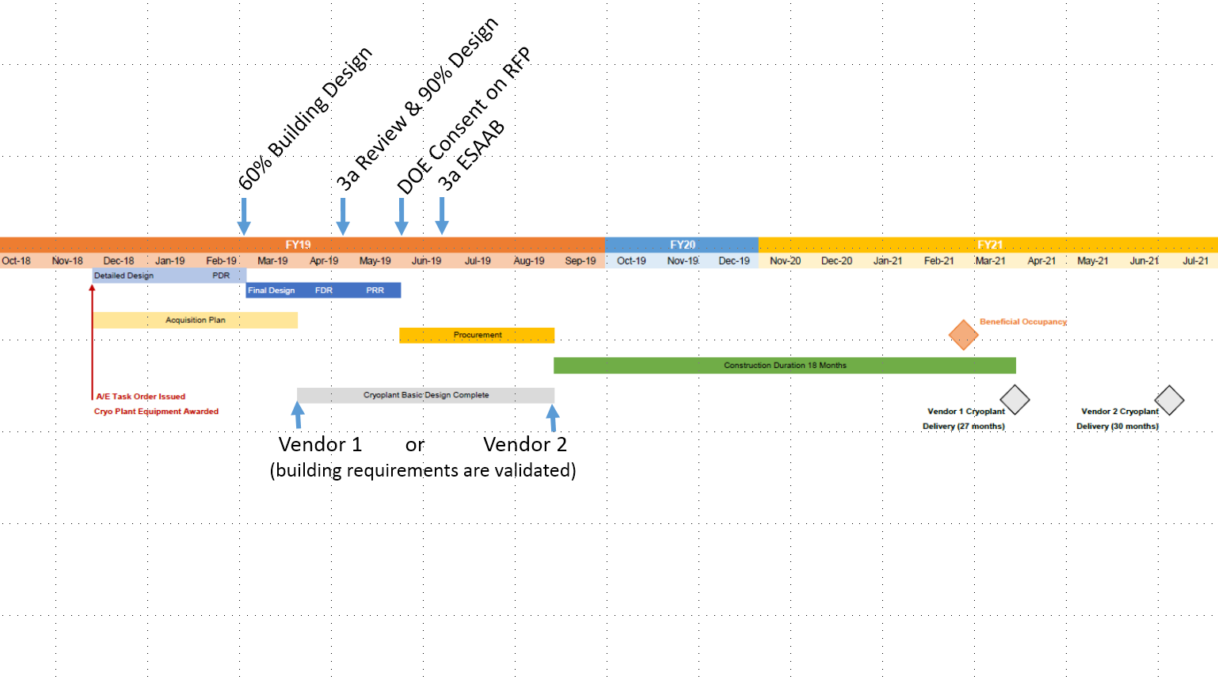
Schedule Detail
Charge #2
Cryo Plant Building and Site Preparation Design Complete
Schedule and Cost Known
From 18OCT18 Integrated Project Team Meeting

Slide 12
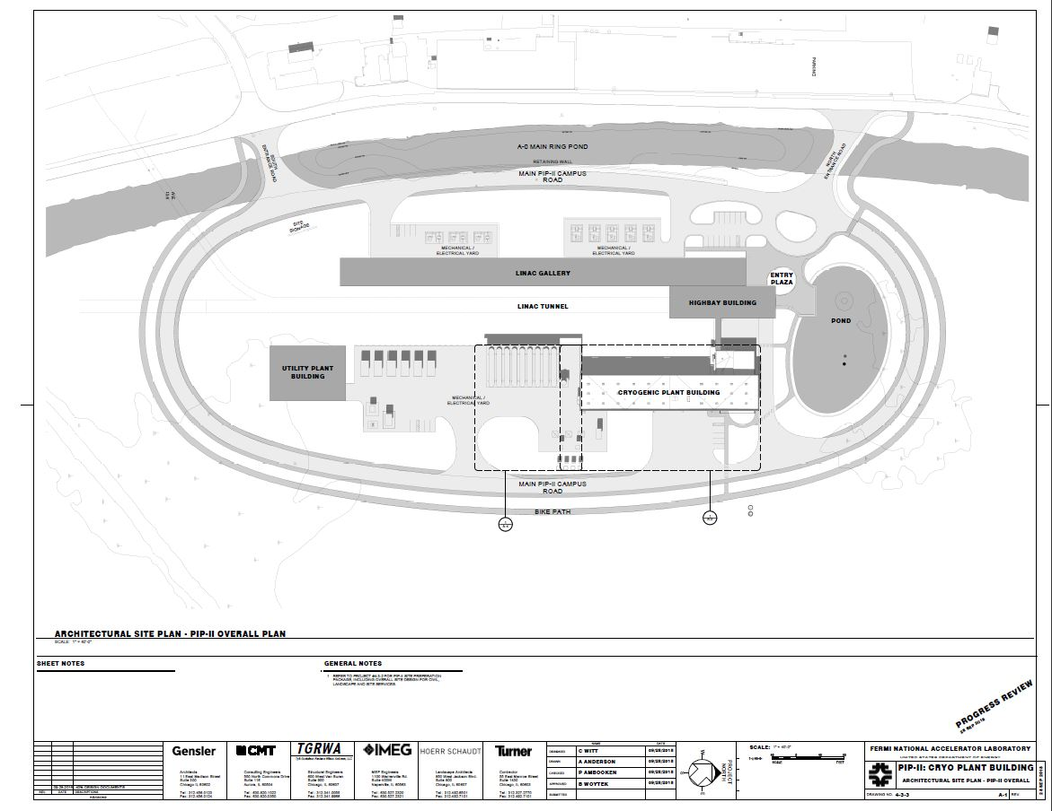
Progress to Date
Charge #1
Developed preliminary shielding strategy with 121.03 (Accelerator Systems)
Requirement and Specification Review [1]
Industrial Cooling Water Quality Testing Complete [2]
Technical Requirements Phase (40% Design) [3]
[1] See TeamCenter ED0008588
[2] See PIP-II-doc-155
[3] See TeamCenter ED0008373
From TeamCenter Document ED0008373

Slide 13
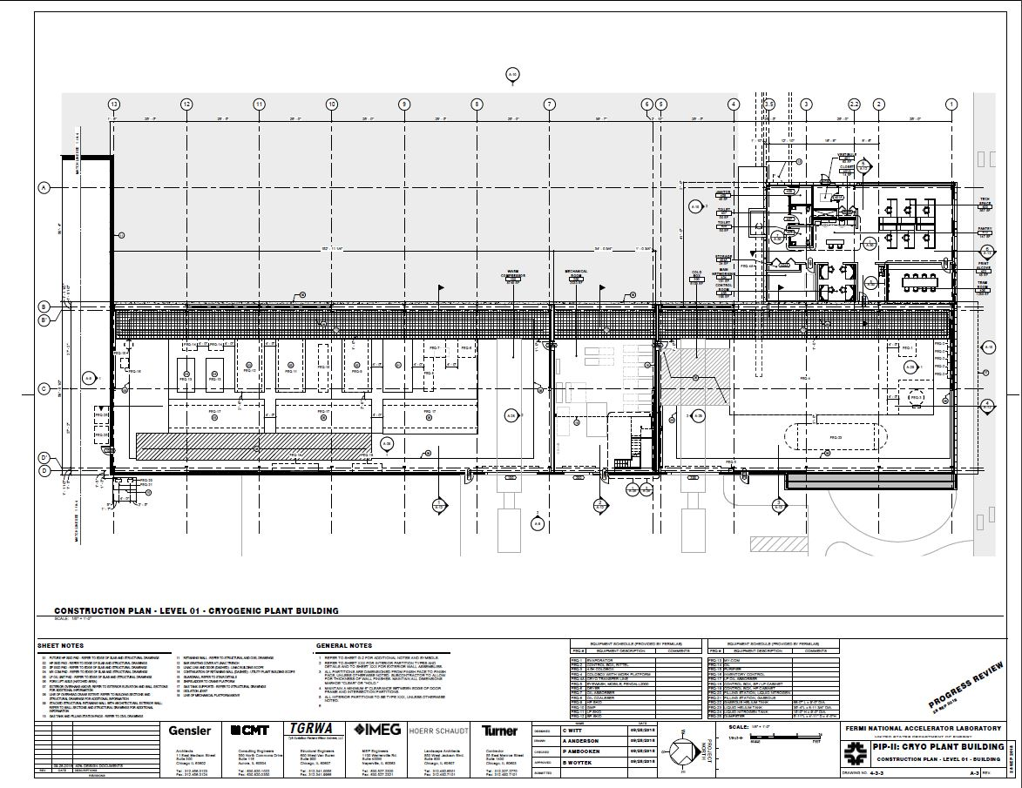
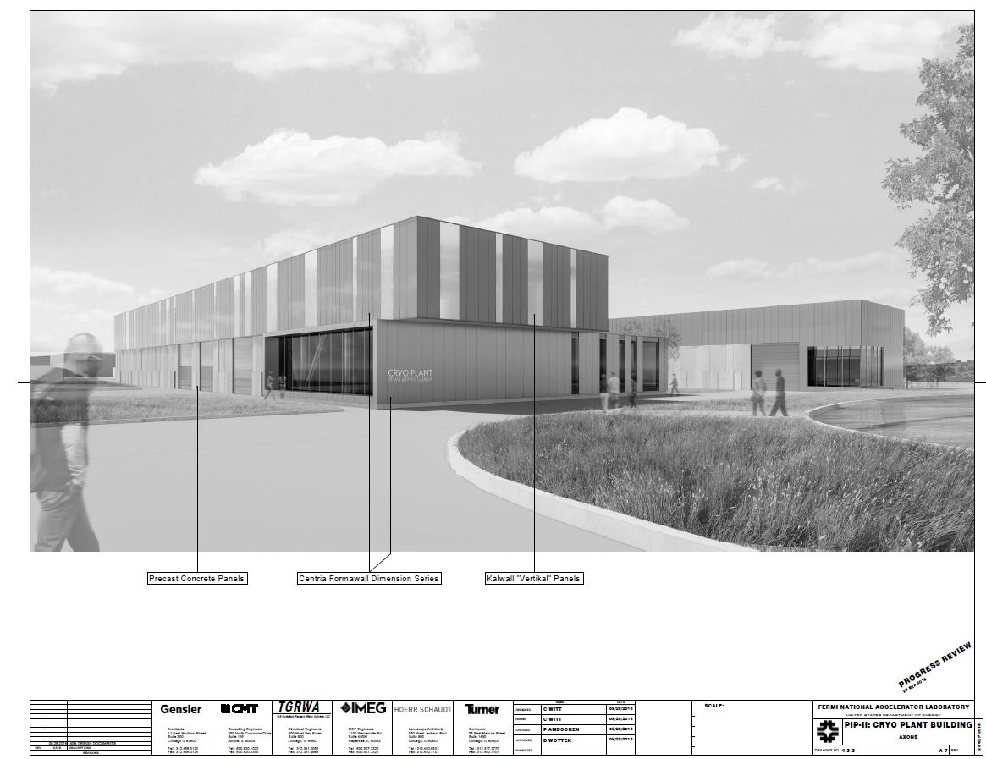
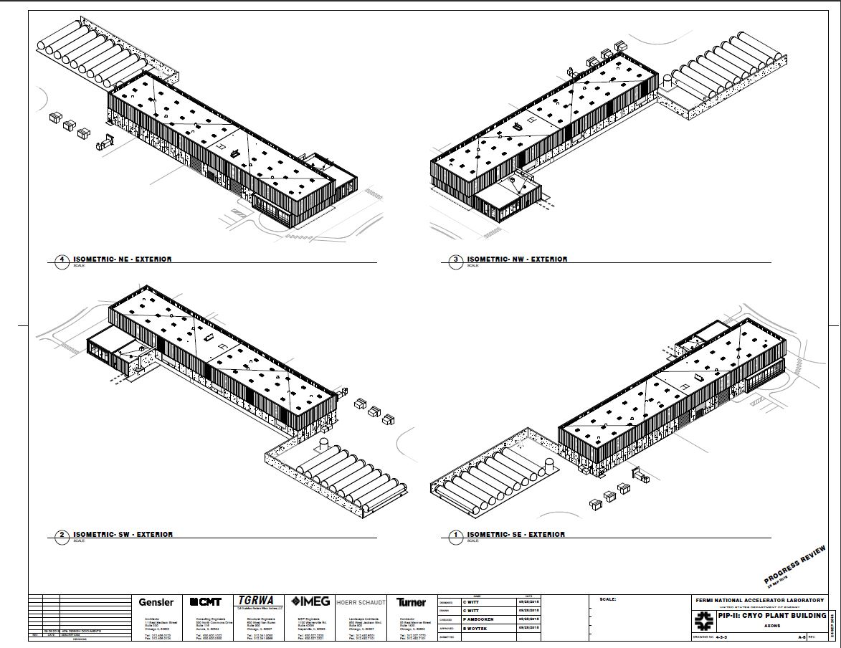
Progress to Date
Charge #1
From TeamCenter Document ED0008373

Slide 14
Environment Safety and Health (ES&H)
Charge #6
Design Phase Incorporates:
Architect/Engineer selection included ES&H considerations;
Life Safety Assessment requirements; [1]
Safety By Design process;
Input from Tritium Task Force;
Input from Hazard Analysis Report (HAR) hazards [2]
[1] Life Safety Analysis can be found at PIP-II-doc-120
[2] Hazard Analysis Report can be found at PIP-II-doc-140

Slide 15
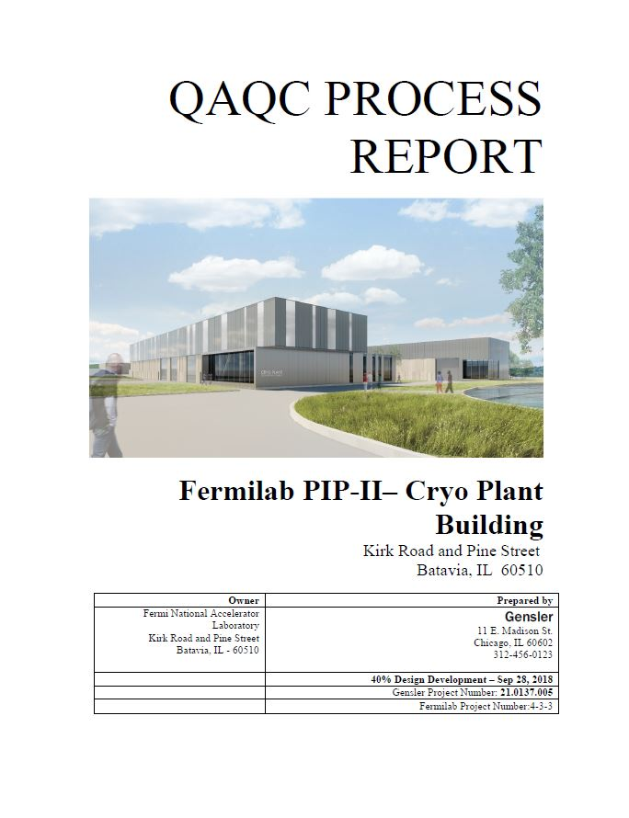
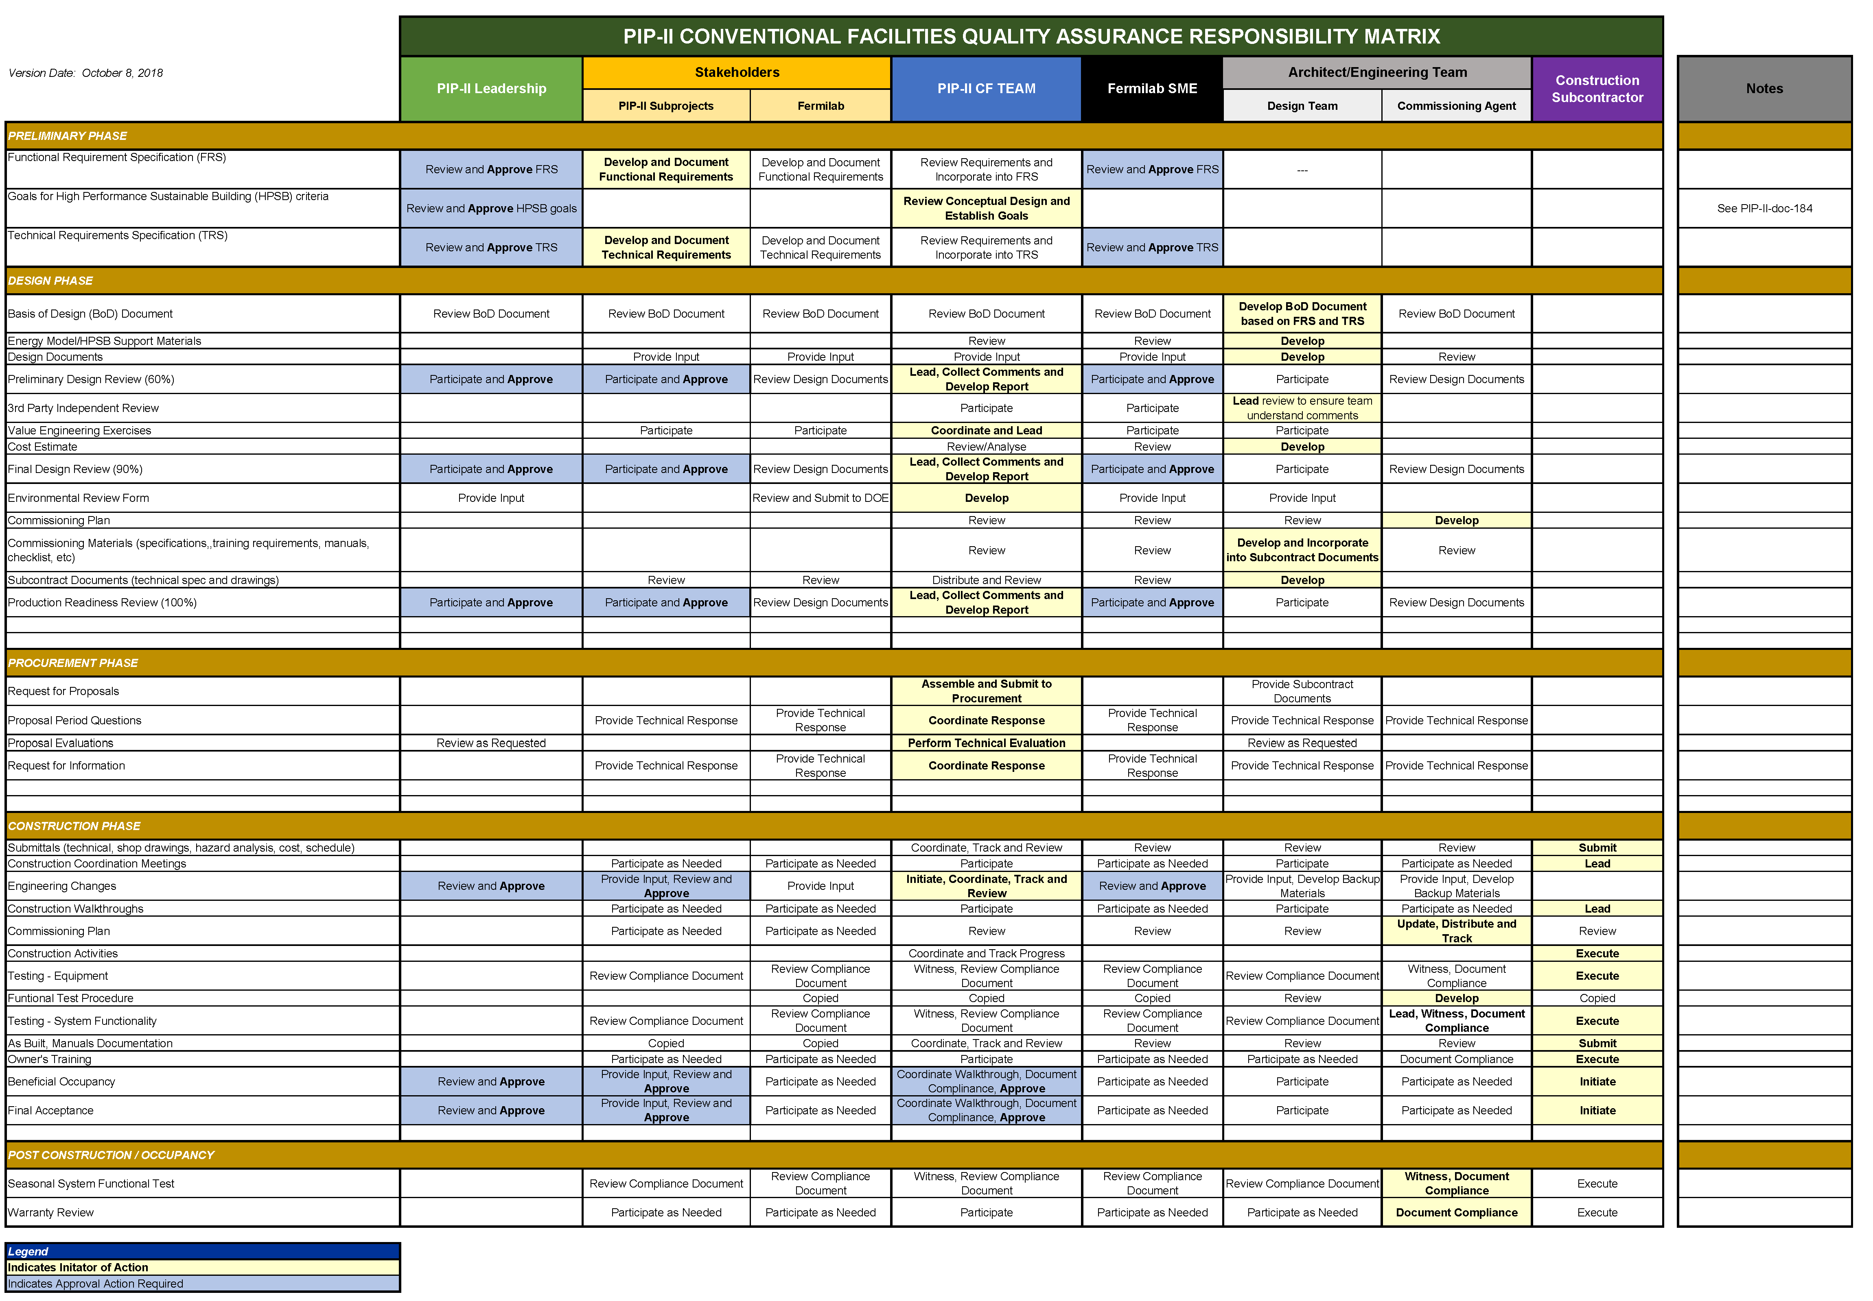
Quality Management
Charge #6
Process to date include:
Requirement and Specification Review (PIP-II process)
Comment and Compliance Review (FESS/E process)
QAQC Process Report (A/E process)

Slide 16
Risk Management
Charge #2,7
Cryogenic Plant Building Related Risks
RT-121-06-001 – Subproject Requirement Change
RT-121-06-003 – Construction Bids Exceed Estimates
RT-121-06-005 – Cryoplant Design Requirements
RT-121-06-008 – Cryoplant Cooling Water
RT-121-06-039 – Cryogenic Plant Building BO Delayed

Slide 17
Steps to CD-3A (Cryogenics Plant Building)
Complete the Construction Package
Design complete;
Specifications complete;
Updated cost/schedule estimate
Anticipated for May 2019
Favorable EA FONSI
Anticipated in December 2018;
Procurement Process
Advanced Acquisition Plan (start in January 2019)
Subcontractor Outreach Program
EA is Environmental Assessment
FONSI is Finding Of No Significant Impact

Slide 18
Summary
Cryogenics Plant Building is a CD-3A request;
Good progress on the design since CD-1;
Design of the Cryogenic Plant Building is based on the requirements from two potential cryogenics plant vendors;
On track for a CD-3A Review in Q3 FY19;
On track to achieving the goal of having the building and supporting infrastructure ready in advance of cryogenic equipment arrival;
Thanks for your time.

Slide 19
END

